Slide 1



Electro-excitation Form Factors of the Proton
Adnan Bashir
Department of Integrated Sciences
University of Huelva, Huelva, Spain
Institute of Physics and Mathematics
University of Michoacán, Morelia, Michoacán, Mexico
Southeast Asian Workshop on Nuclear and Hadron Physics Yogyakarta, Indonesia, August 19-21, 2025

Slide 2
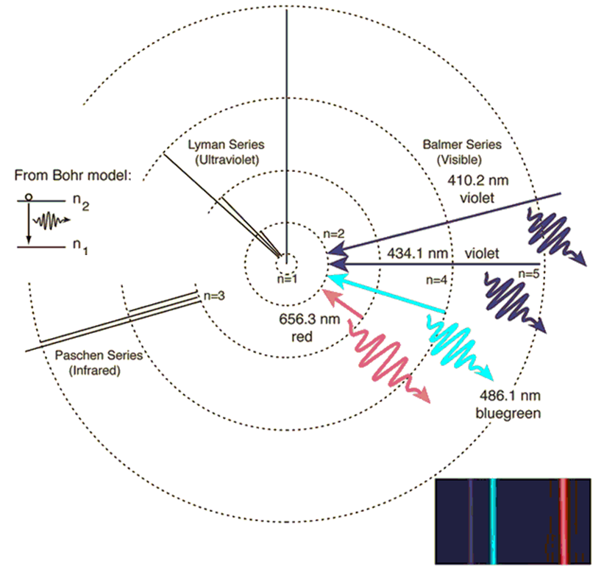
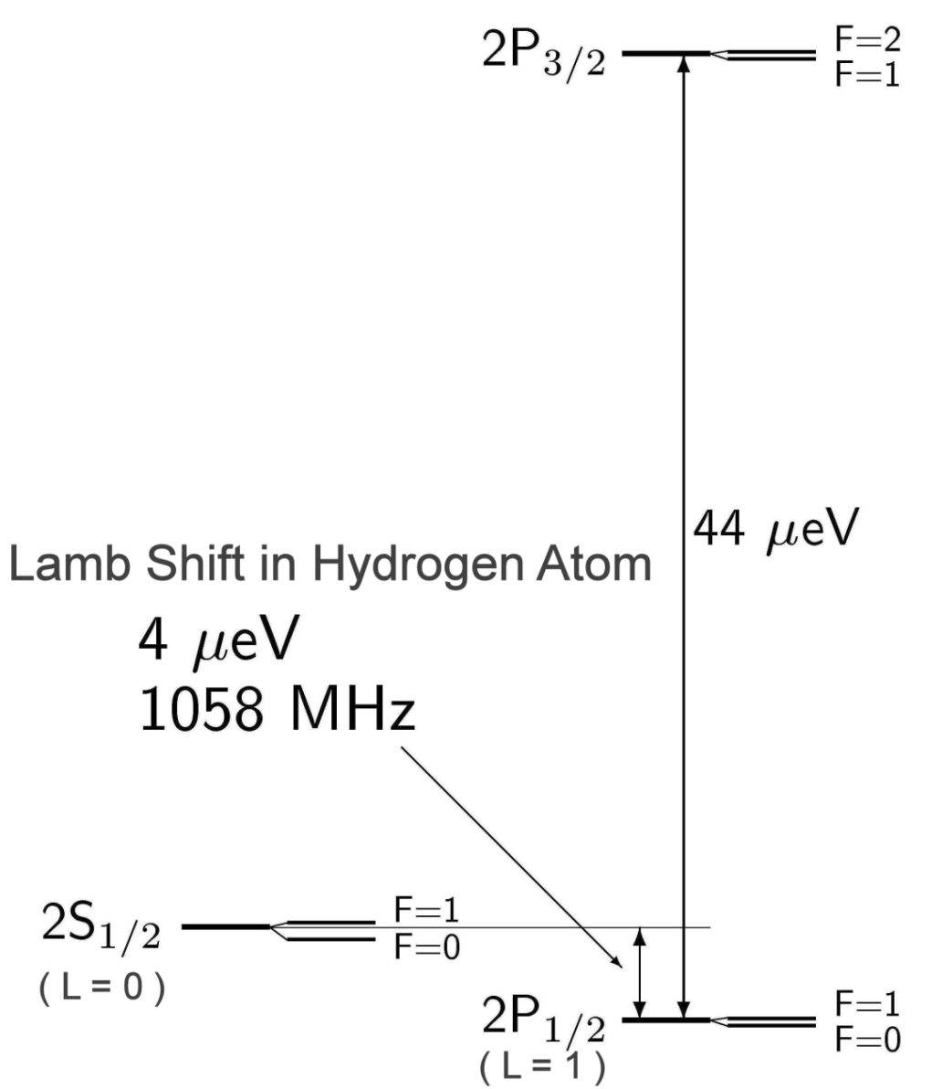
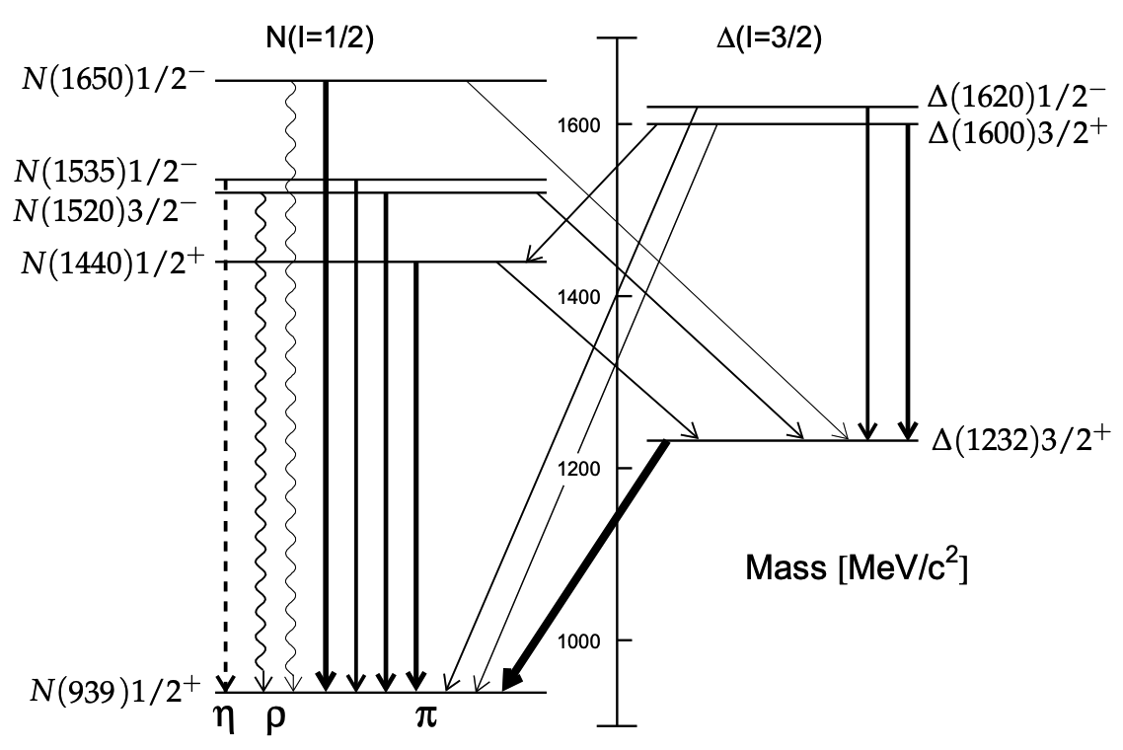
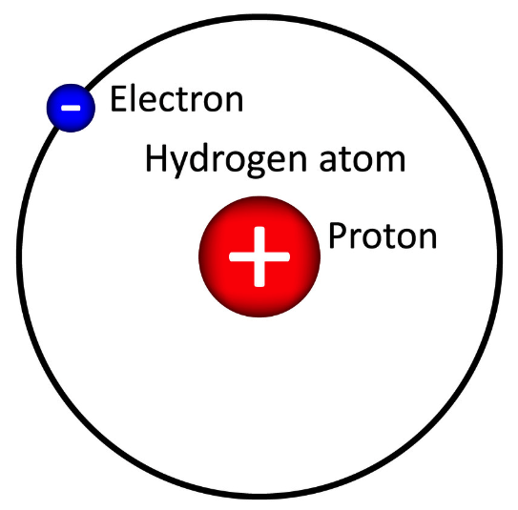
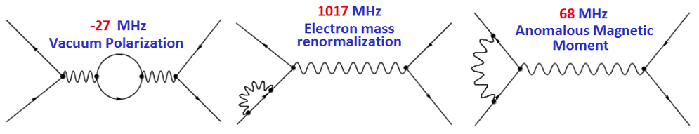
Bound states in QED and QCD
Dyson: If you don’t understand the Hydrogen
atom you don’t understand anything (QED).
N: simplest 3-body bound state in QCD
If you don’t understand the nucleon you don’t understand anything (QCD).
Renormalized QED
Confinement and emergent mass

Slide 3
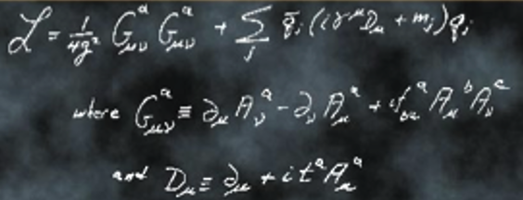

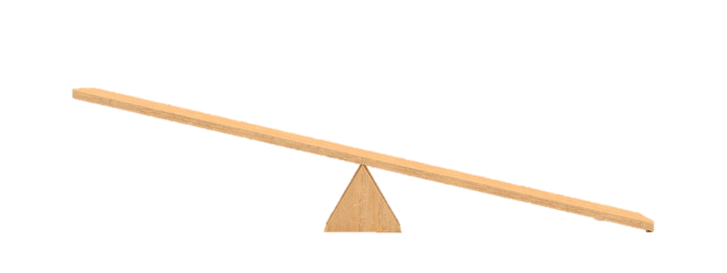




QCD: Emergent Phenomena
QCD is characterized by two emergent phenomena:
confinement and emergent hadron mass (EHM).
Quarks and gluons do not reach detectors.
Formation of color-singlet bound states: “Hadrons”
mesons, baryons, tetraquarks, molecules
Emergence of hadron masses (EHM) from QCD dynamics
$\sim 2\%$ of $M_{p}$
$\sim 98\%$ of $M_{p}$ strong QCD
$m_{u,d}≈5−10$ MeV
$M_{p,n}≈940$ MeV

Slide 4
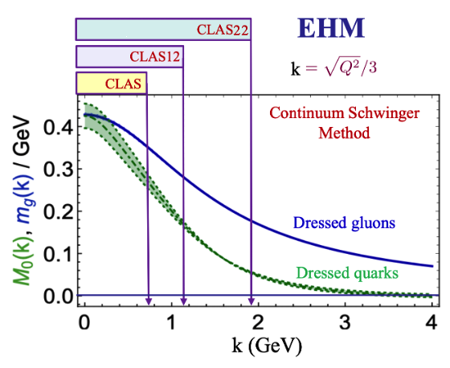
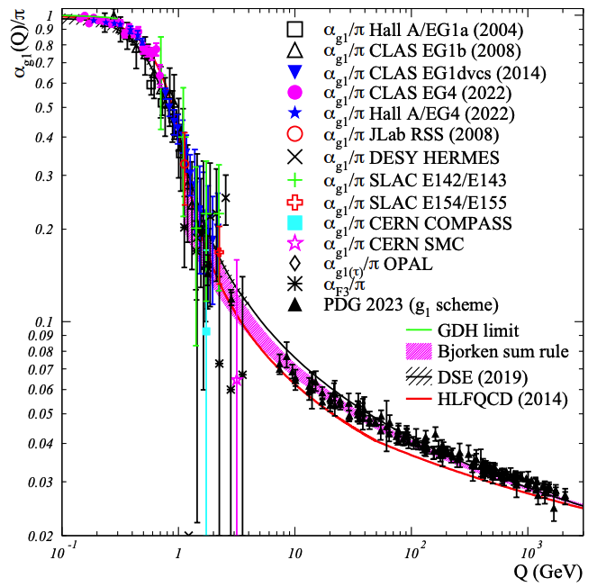
QCD: Facts and Challenges
Origins of confinement and emergence of hadron mass can be traced back to the infrared
behavior of the Green functions involving quarks and gluons.
These emergent phenomena of QCD, non-existent in perturbation theory are naturally linked to the infrared enhancement of the strong running coupling.
The effects of confinement and the pattern of emergent quark and hadron mass are traceable in the experimental program of CLAS experiments.

Slide 5
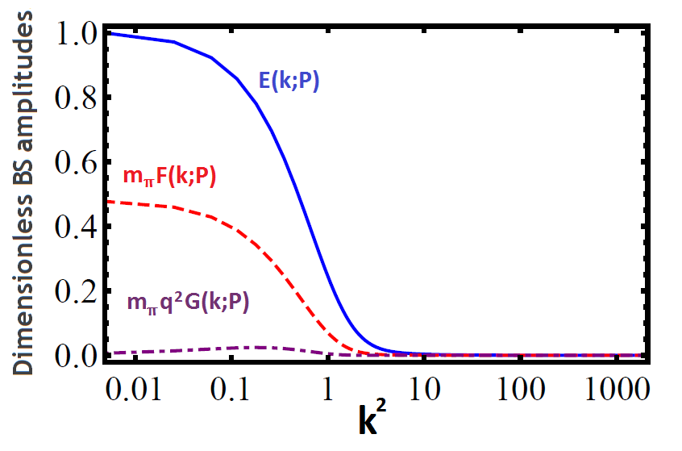
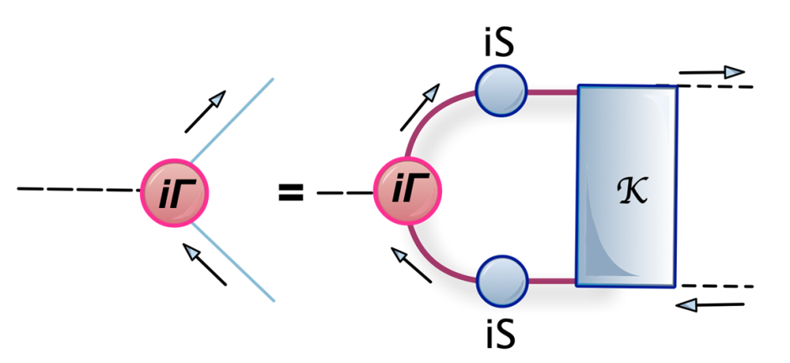
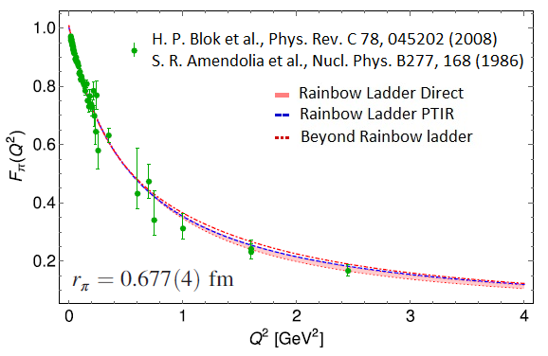
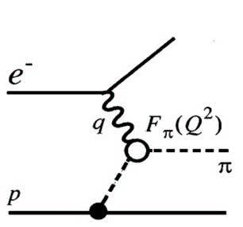
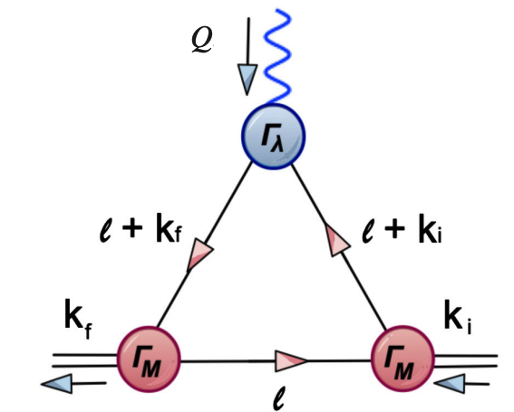
Bethe-Salpeter Amplitude
The momentum dependence of the quark mass function is traceable in the momentum evolution of pion Bethe-Salpeter Amplitudes and electromagnetic form factor.
Pion Form Factor
Muon AMM: e-Print: 2505.21476 [hep-ph]
Muon AMM: There is no tension between the SM and
experiment at the current level of precision.
A. Miramontes, AB, K. Raya, P. Roig,
Phys. Rev. D 105 (2022) 7, 074013

Slide 6
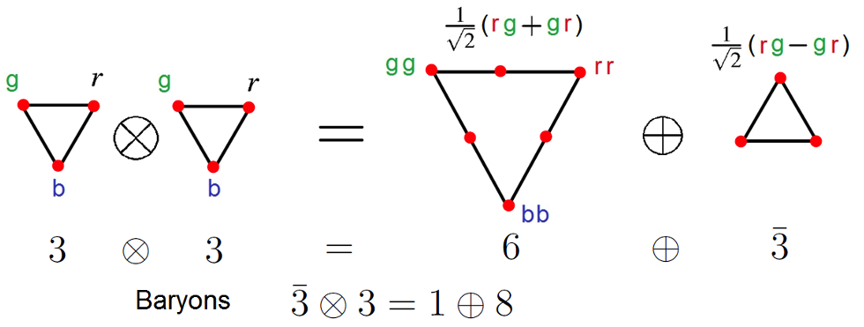
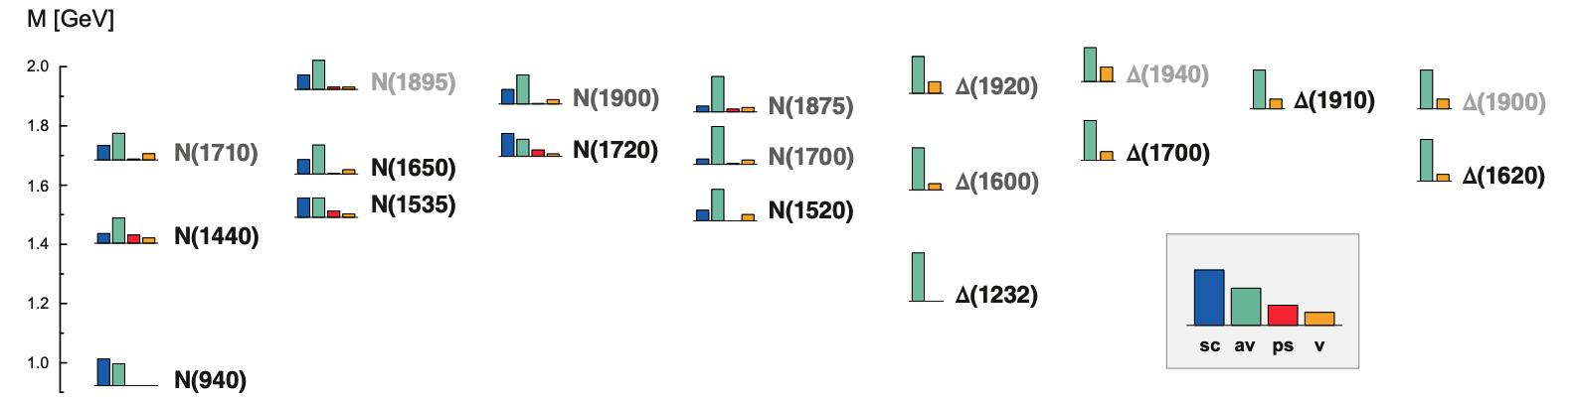
From Mesons to Diquarks
Scalar [ud]₀⁺ diquark is generated
dynamically along with the pion and the axial vector {ud}₁+ diquark in
Correspondence with the ρ-meson
through Bethe-Salpeter equation.
Sizes and masses are bounded by
that of analogous mesonic system.
M. Yu, Barbanov et. al., Prog. Part. Nucl. Phys. 116 (2021) 103835

Slide 7
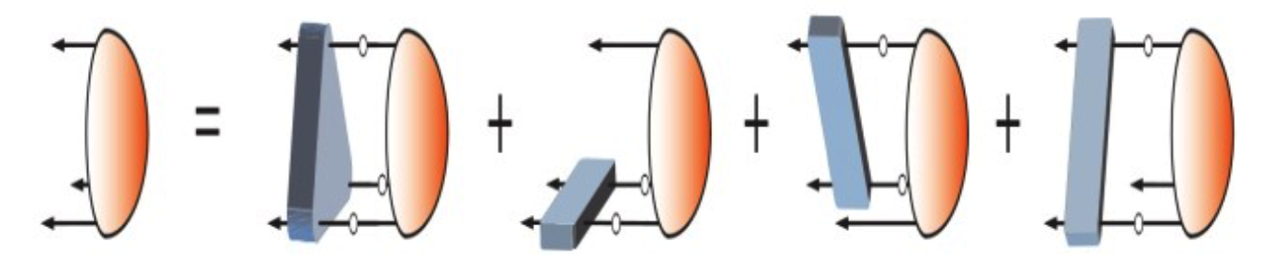
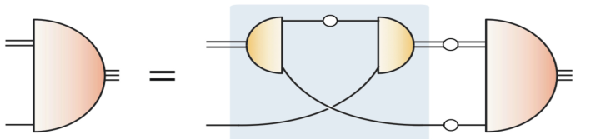
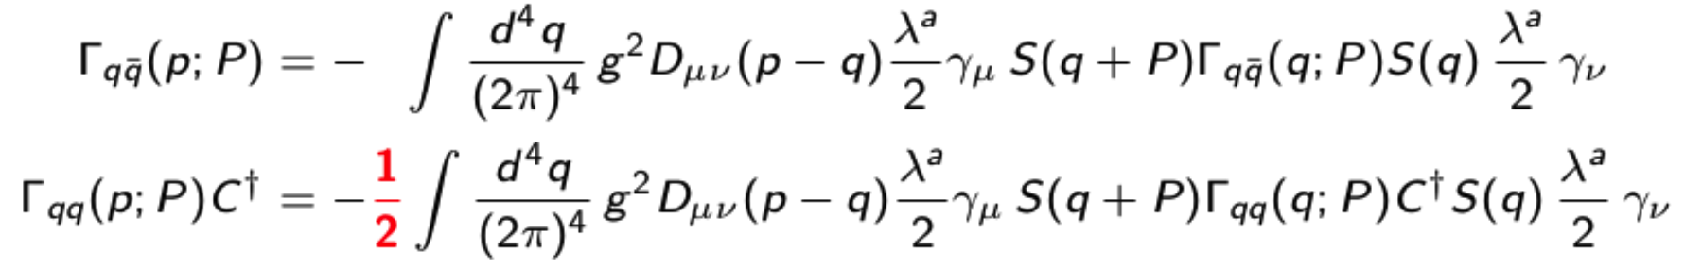
From Diquarks to Baryons
Faddeev equation for a
baryon:
G. Eichmann, Phys. Rev. D 84 (2011) 014014; G. Eichmann et. Al. Prog. Part. Nucl. Phys. 91 (2016) 1-100
The quark-diquark picture of baryon reproduces
results within 5% of the 3-body problem:
Dynamical quark-diquark picture
Less tightly bound:

Slide 8
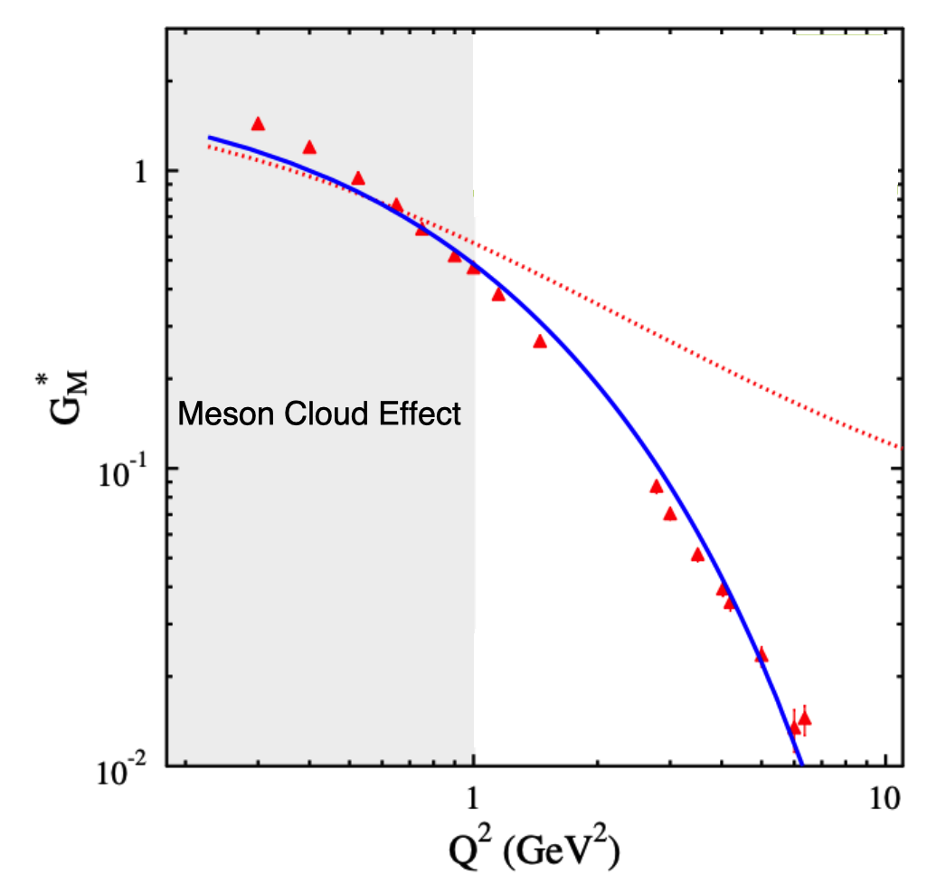
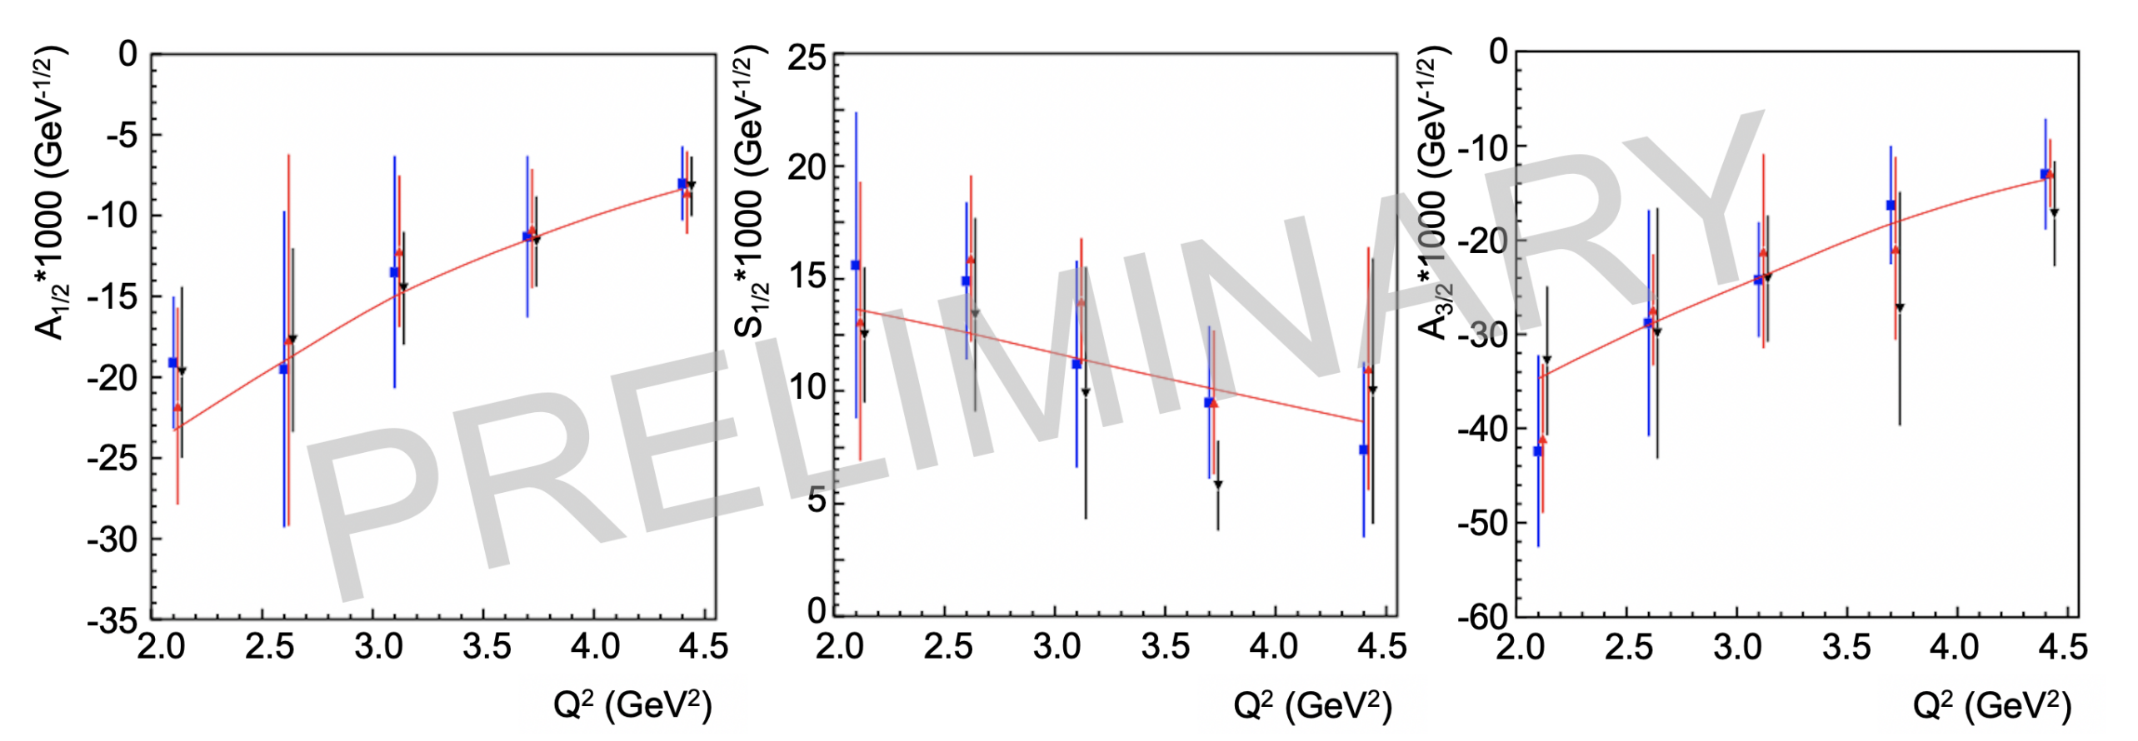
N→∆(1232), ∆(1600) Transition Form Factors
The CSM results reported for N → ∆(1232) and N → ∆(1600) are
compatible with experiment where meson cloud effect does not
contaminate the Q² evolution:
N → ∆(1232)
J. Segovia, C. Chen, C.D. Roberts, S. Wan Phys. Rev. C88 (2013) 032201(R)
J. Segovia et. al., Few-Body Syst. 55 (2014) 1-33
J. Segovia, et. al., Few-Body Syst. 55 (2014)
I. Aznauryan et al., Phys. Rev. C 80, 055203 (2009)
N → ∆(1600):
Ya Lu et al., Phys. Rev. D 100, 034001 (2019)
CLAS results on ∆(1600)3/2+
electrocouplings confirmed
the CSM prediction based
on QCD kindred calculation.
D.S. Carman, R.W. Gothe, V.I. Mokeev, C.D. Roberts, Particles 6 (2023) 1, 416-439.

Slide 9
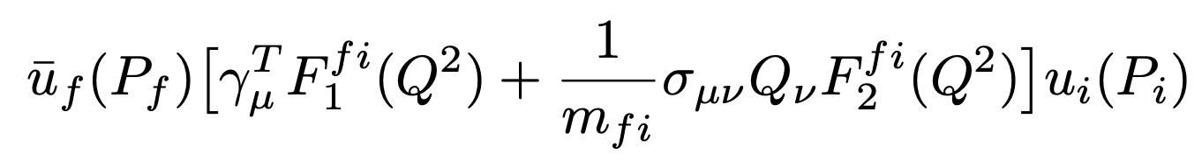
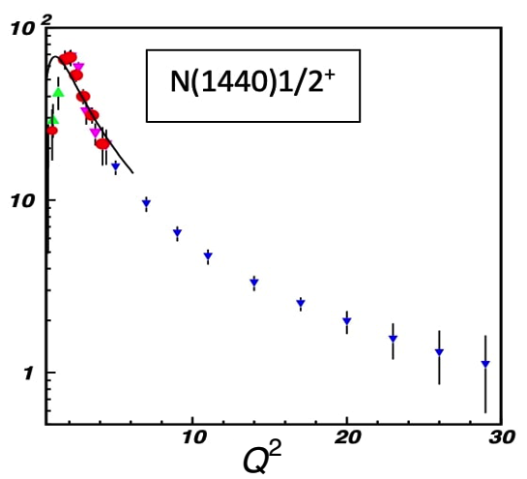
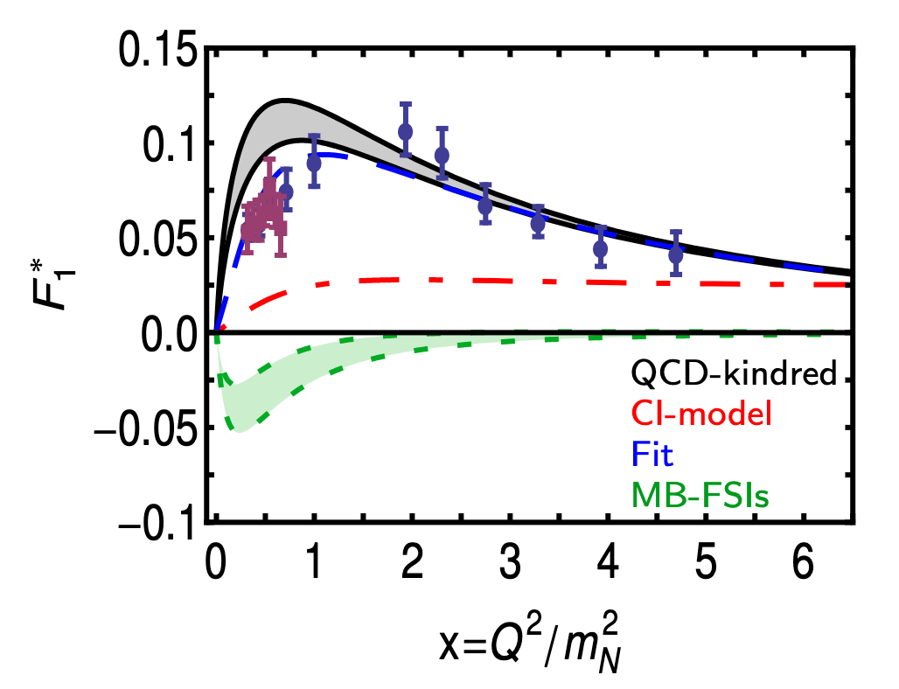
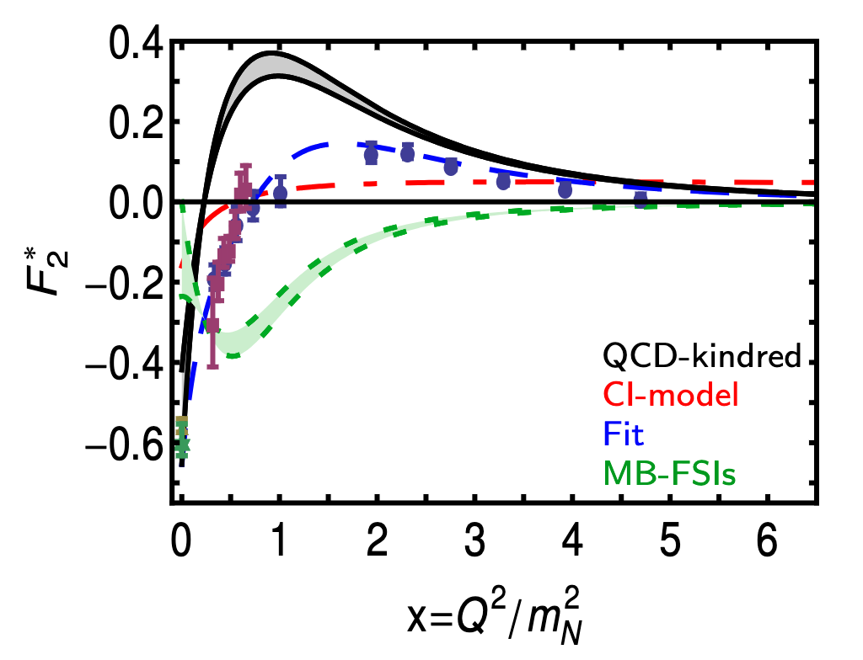
N → N*(1440) Transition Form Factors
Dirac and Pauli transition form factors:
I. Aznauryan et al., Phys. Rev. C 80, 055203 (2009)
V. I. Mokeev et al., Phys. Rev. C 86, 035203 (2012)
V. I. Mokeev et al., Phys. Rev. C 93, 025206 (2016)
It agrees quantitatively in magnitude & qualitatively
in trend with the data above x ≿ 2.
C. Chen et. al. Phys. Rev. D97 (2018) 3, 034016
J. Segovia, et. al., Phys. Rev. Lett. 115 (2015) 17, 171801
JLab 22 GeV Projections
Courtesy V. Mokeev

Slide 10
Truncating Schwinger-Dyson Equations:
Sophisticated Truncations
Numerically Demanding
“QCD Predictions”
QCD Green Functions
Mesons – Static, FFs, PDAs, PDFs
Schwinger-Dyson Equations
Most Observables
Mesons, Baryons
Moderate Simplicity
QCD-like Predictions
Contact Interaction
QCD-Inspired & Data Driven
Algebraic Models
Simple Implementation
Insightful - Mindful
LFWFs, GPDs, TMDs,
PDFs, FFs, Mesons, Baryons

Slide 11
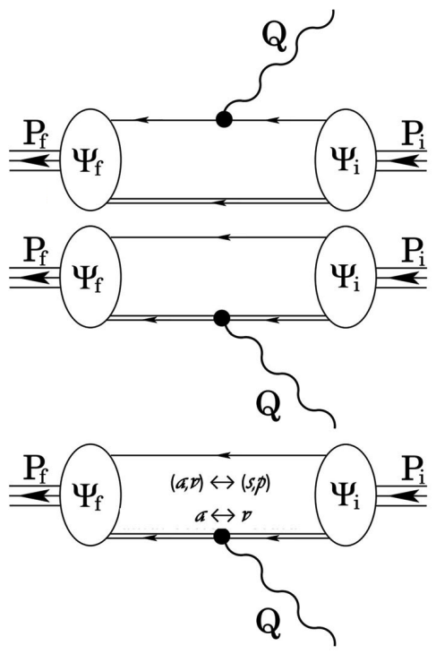
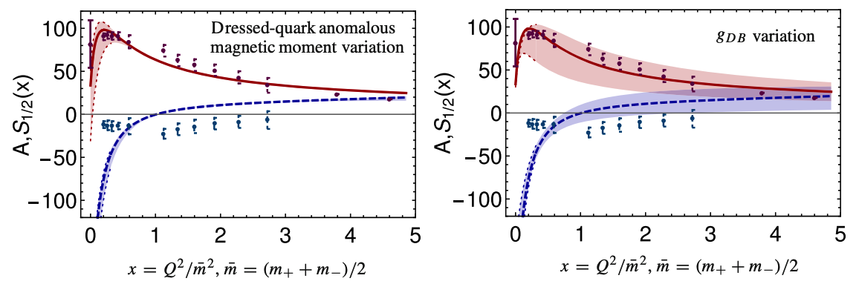
Contact Interaction: N➔N*(1535)
Spin ½ initial and final states but with opposite parity.
I. Aznauryan et al., Phys. Rev. C 80, 055203 (2009)
K. Raya, L.X. Gutiérrez, AB, L. Chang, Z-F. Cui, Y. Lu, C.D. Roberts, J. Segovia, Eur. Phys. J. A 57 (2021) 9, 266

Slide 12
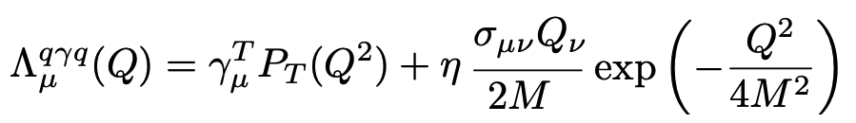
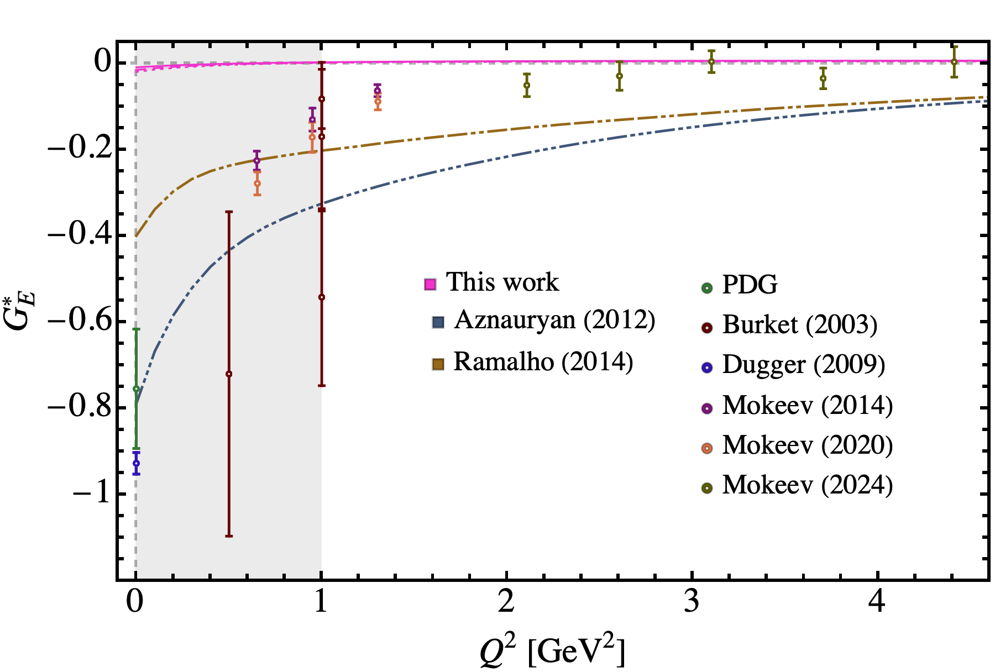
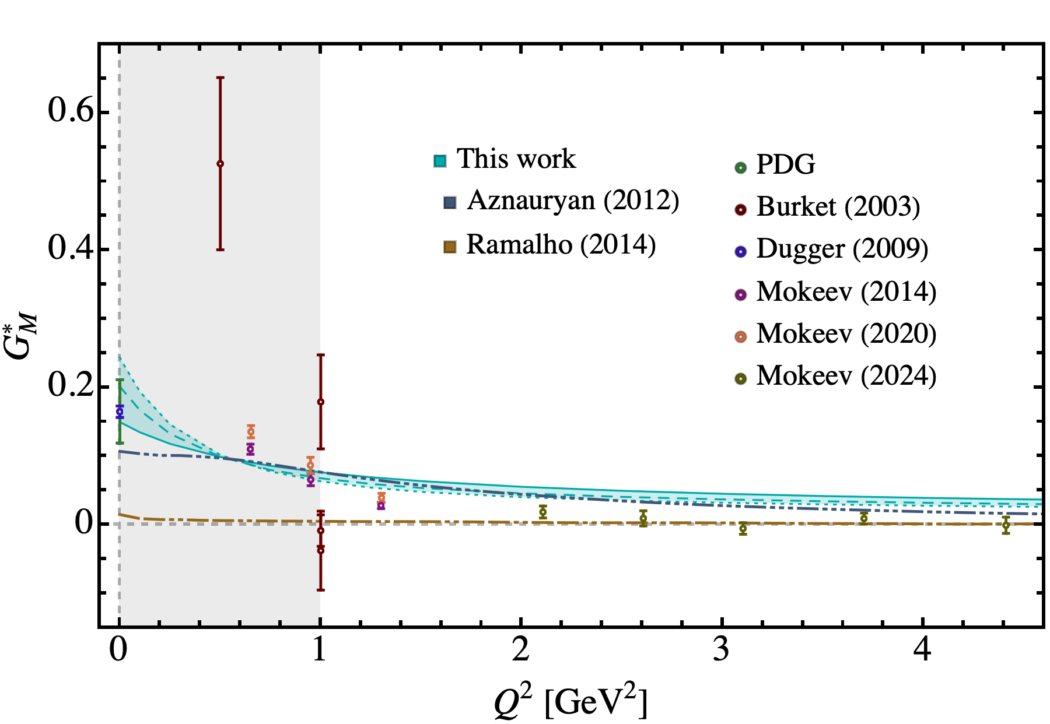
N(940)➔∆(1700)3/2⁻ Transition Form Factors
The Δ(1700) and N(1520) states in the CI are characterized by a single Faddeev amplitude, associated with the 1⁺ diquark.
Anomalous magnetic moment:
.
L. Albino, G. Paredes, K. Raya, AB, J. Segovia, e-Print: 2502.06206 [hep-ph] - PhD Thesis: Gustavo Paredes

Slide 13
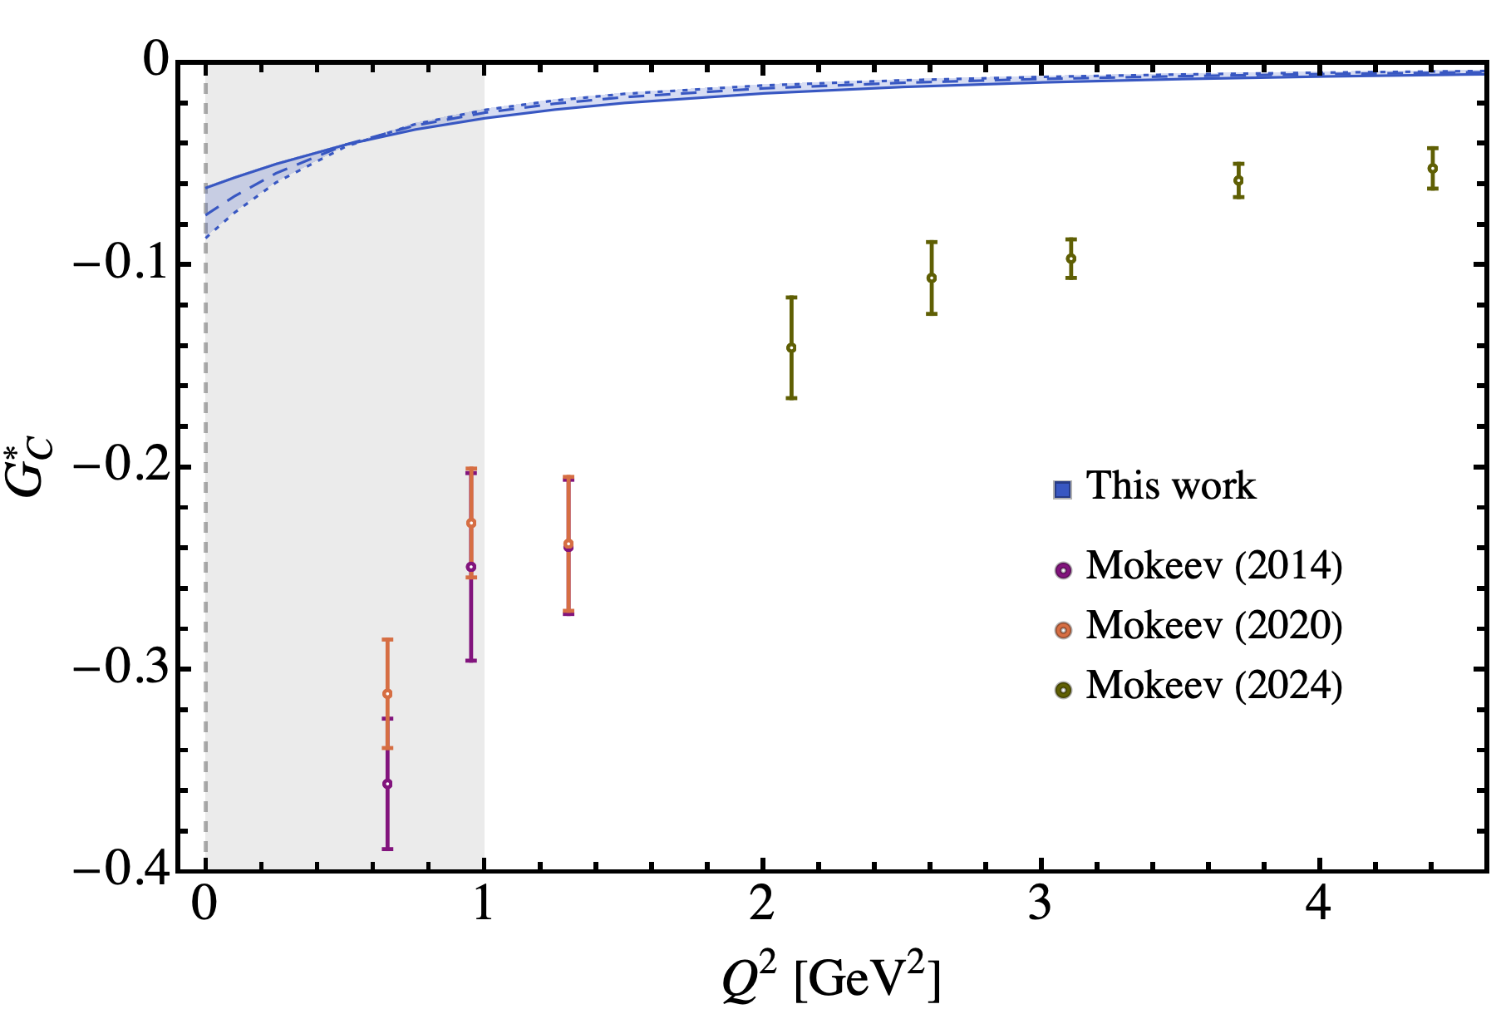
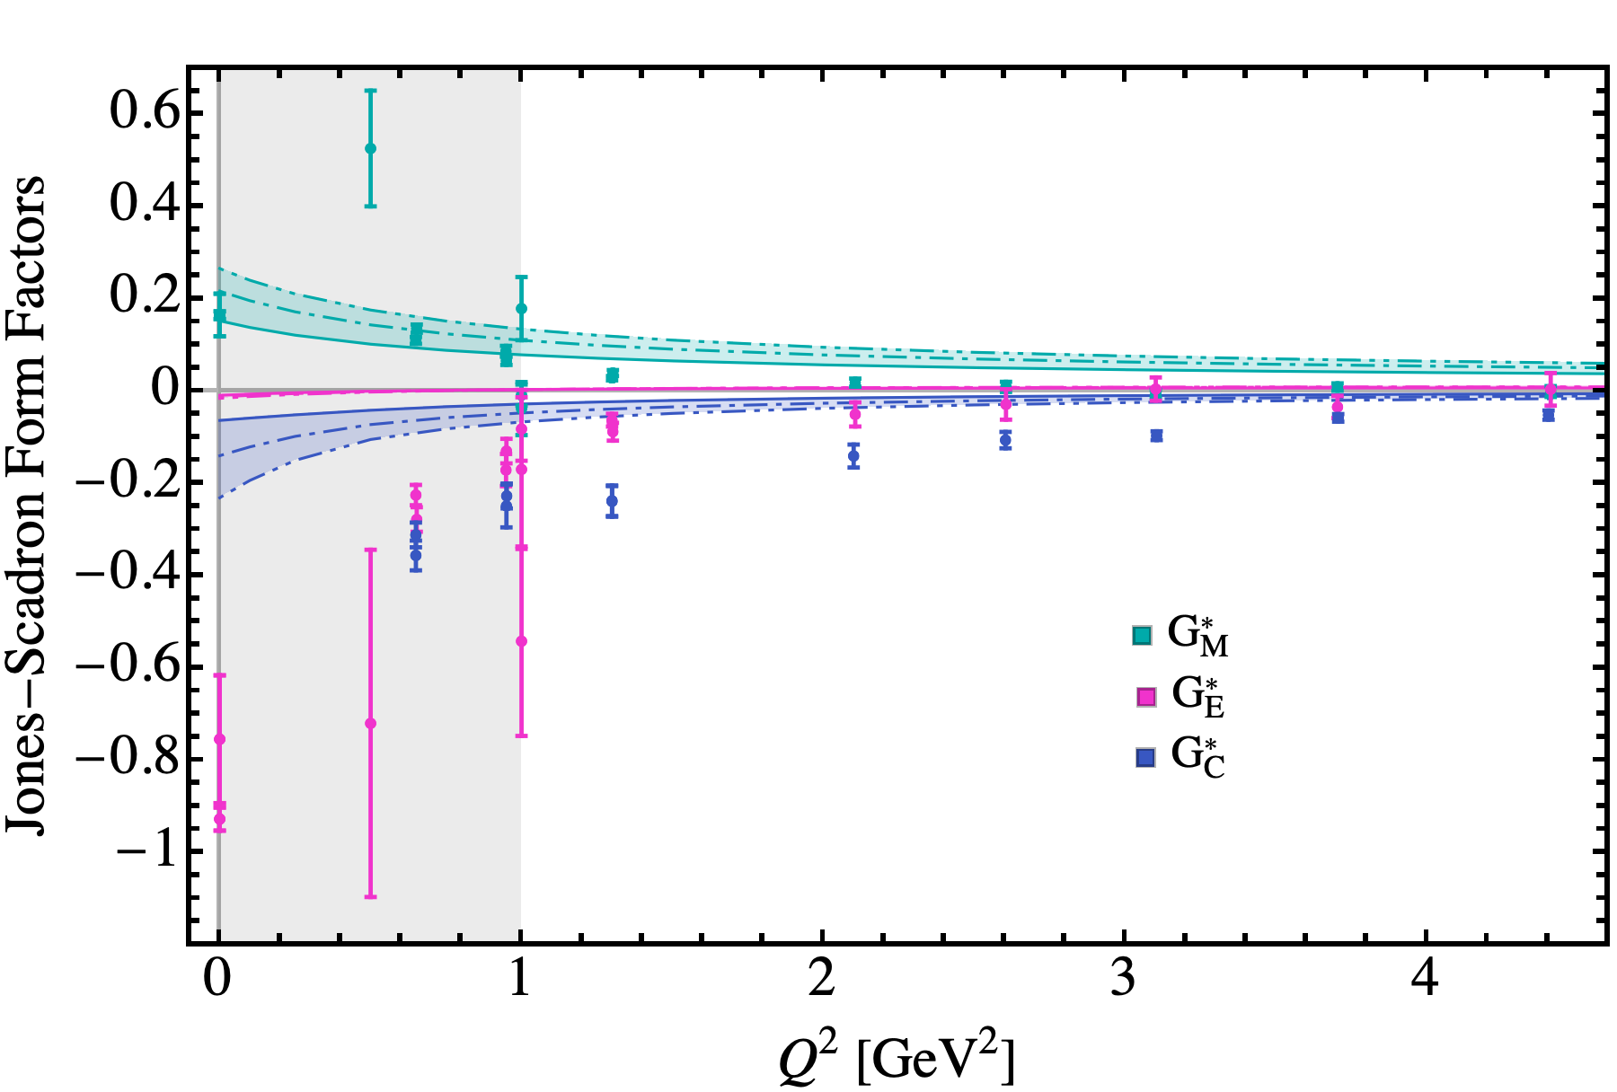
N(940)➔∆(1700)3/2⁻ Transition Form Factors
Anomalous magnetic moment:
The N(940)➔Δ(1700) transition form factors as a varying Δ mass:
.
L. Albino, G. Paredes, K. Raya, AB, J. Segovia, e-Print: 2502.06206 [hep-ph] - PhD Thesis: Gustavo Paredes

Slide 14
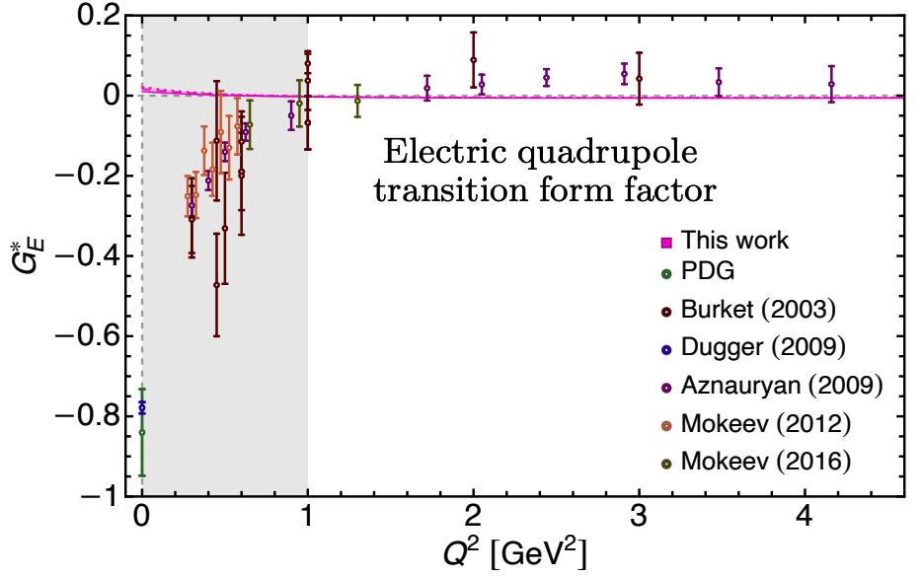
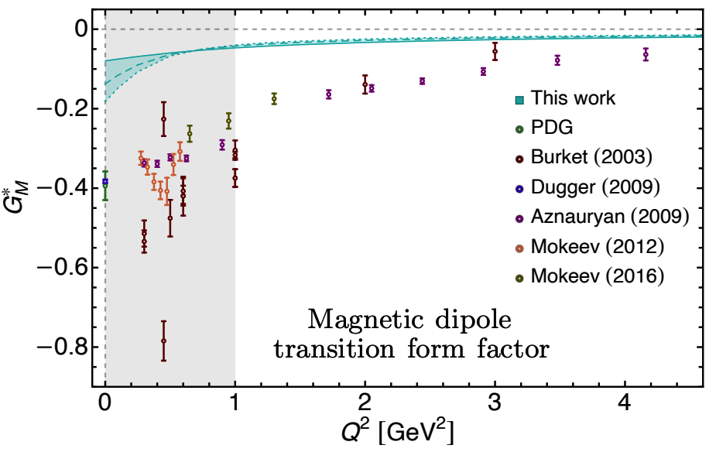
N➔N*(1520) Transition Form Factors
The N(940) ➔ N(1520) transition form factors
Anomalous magnetic moment:
L. Albino, G. Paredes, K. Raya, AB, J. Segovia, e-Print: 2504.01770 [hep-ph] - PhD Thesis: Gustavo Paredes

Slide 15
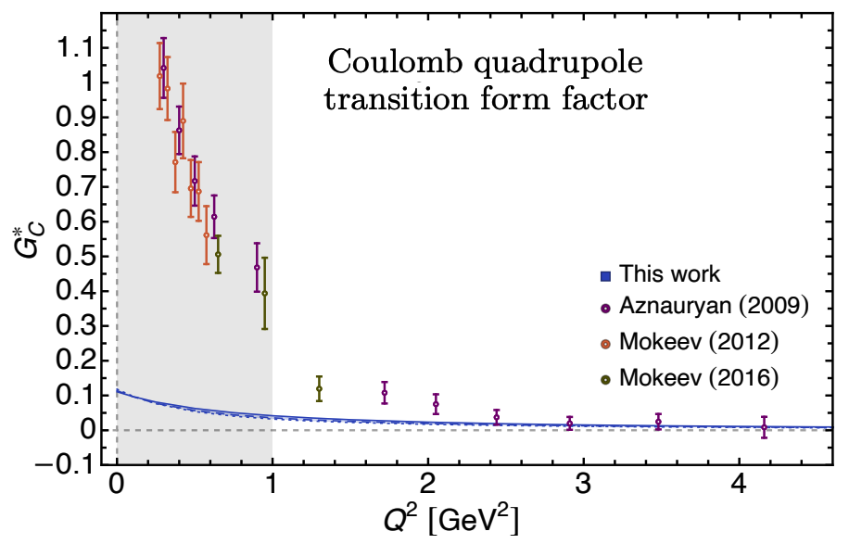
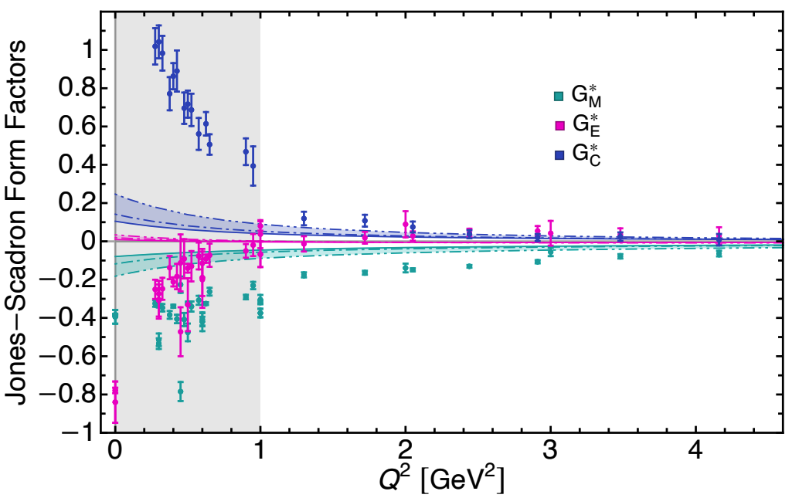
N(940)➔N*(1520) Transition Form Factors
Anomalous magnetic moment:
The N(940)➔N*(1520) transition form factors as a function of N* mass:
.
L. Albino, G. Paredes, K. Raya, AB, J. Segovia, e-Print: 2504.01770 [hep-ph] - PhD Thesis: Gustavo Paredes

Slide 16
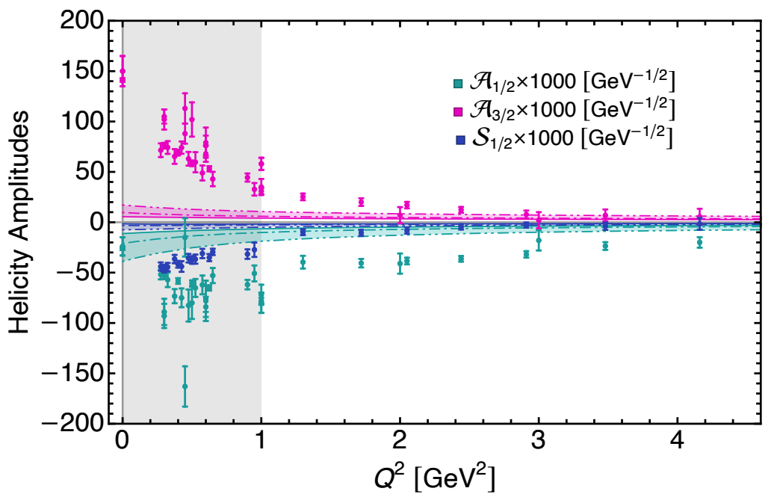
N(940)➔N*(1520) Transition Form Factors
Transition form factors
Helicity amplitudes
L. Albino, G. Paredes, K. Raya, AB, J. Segovia, e-Print: 2504.01770 [hep-ph]
PhD Thesis: Gustavo Paredes

Slide 17
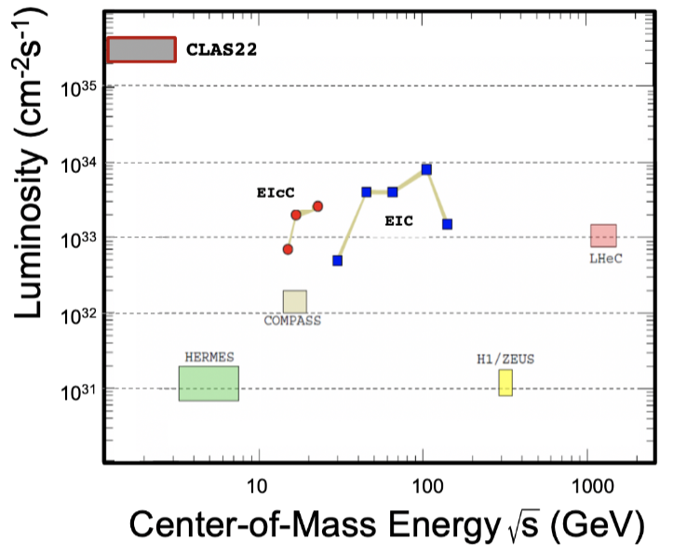
JLAB CLAS22: Promise and Opportunities
Simulations of 𝜋N, KY, and 𝜋⁺𝜋⁻p electroproduction with CEBAF@22 GeV show that
𝛾_{v}pN* electrocouplings can be determined up to Q² ~ 30 GeV² for 𝓛 ~ 2 - 5 ⨉ 10³⁵ cm⁻²s⁻¹
Courtesy V. Mokeev
The high luminosity frontier provides JLab a special advantage in comparison with EIC or EIcC.
It offers a unique opportunity to study Nature’s simplest
3-body bound state and its electrocouplings with its resonances in a large domain of momentum transfer.
CLAS22 can hopefully map out the working of QCD from its non-perturbative behavior at low Q² to its asymptotic regime
where perturbative QCD can provide predictions, charting
out the pattern of emergent hadron mass.
Strong Interaction Physics at the Luminosity Frontier with 22 GeV Electrons at Jefferson Lab
A. Accardi et al., Eur. Phys. J. A 60 (2024) 9, 173

Slide 18
Summary and Outlook
The interplay of QCD akin truncations of Schwinger-Dyson equations, QCD-based algebraic model based upon these studies and the insights from the Contact Interaction
shed important light on the internal structure of mesons and baryons.
Results for the pion Bethe-Salpeter amplitudes and electromagnetic form factor allow us to compute corresponding quantities for the diquarks.
Schwinger-Dyson equations have also been of substantial success in the studies of baryons such as the transition form factors of nucleon to its excited states in a quark-diquark picture which is a hallmark of CLAS, CLAS12 and CLAS22 programs at JLab and hold the promise not just to understand the ground state nucleon but its excited states in one unified framework.

