Slide 1
Geometry of Non-Unitary Evolutions in Open Quantum Systems
Ezra Acalapati¹, Giuseppe Policastro¹, Kausik Ghosh²
¹Laboratoire de Physique de l’Ecole Normale Supérieure, ENS, Université PSL, CNRS, Sorbonne Université, Universit´e de Paris, F-75005 Paris, France.
²Department of Mathematics, King’s College London, Strand, London, WC2R 2LS, United Kingdom.

Slide 2
Non-unitary process (Lindblad Master Equation)
They form
Quantum Dynamical Semigroup
We propose it can be modelled using
Finslerian Geometry
Which is related by applying
Pontryagin’s Maximum Principle

Slide 3
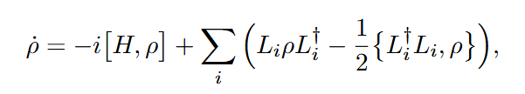


Lindbladian Evolution and Kraus Operation
Lindblad Master Equation
Loss of Invertibility! -> non-symmetric metric
Nonnegative

Slide 4
Open Quantum Systems in Nuclear and Hadron Physics
Quark-Gluon Plasma and Heavy Quarkonia
  Heavy Quark Open-System Framework (Akamatsu, Prog.Part.Nucl.Phys. 123 (2022) 103932)
  Spin Dynamics and Polarization (Yang and Yao Phys.Rev.D 110 (2024) 7, 074037)
Bound-State Formation in Heavy-Ion Collisions (Rais, van Hees & Greiner in prep)
Lindblad Formalism for Unstable Particle Decay (Bertlmann et al, Phys.Rev.A 73 (2006) 054101)
Lindbladian Dynamics in Nuclear Reactions and Scattering (Diaz-Torres, Phys.Rev.C 81 (2010) 041603)

Slide 5


Finslerian Geometry
Finsler metric
Some important properties:
Positive
Homogeneous of order one wrt
Relaxes the symmetric and invertible properties
Riemannian Geometry

Slide 6
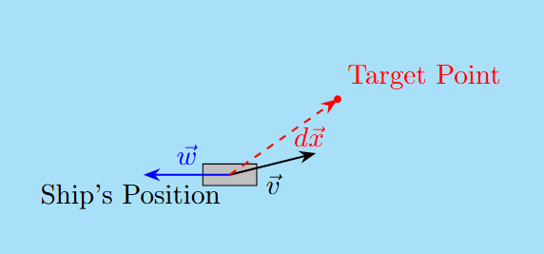

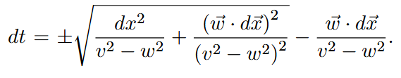
Example: Zermelo’s Navigation Problem - Randers Metric
Kropina Metric
Randers Metric
When v = w

Slide 7

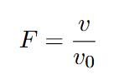
Pontryagin’s Maximum Principle (PMP) / Optimal Control Theory
Controls (⍵, γ)
Hamiltonian
Cost function (e.g. time, distance, etc)
Velocities
Finsler Metric
Control equations (Linbladian equations)
Minimising the Hamiltonian
Optimal Solutions

Slide 8
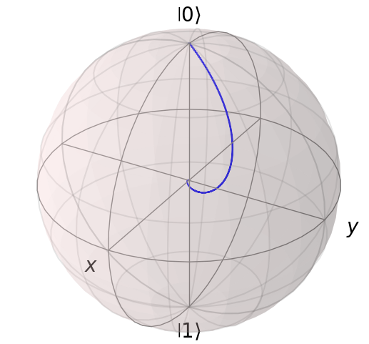

Case Study: Time-Optimal Depolarising Process with 1D Rotation
dr (radial change)
Cost function to optimise
Visualisation of a depolarising process with 1D rotation

Slide 9
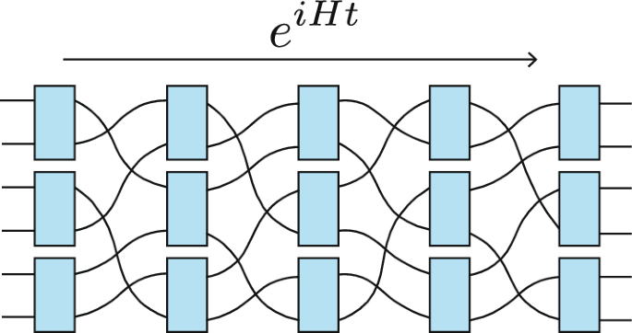
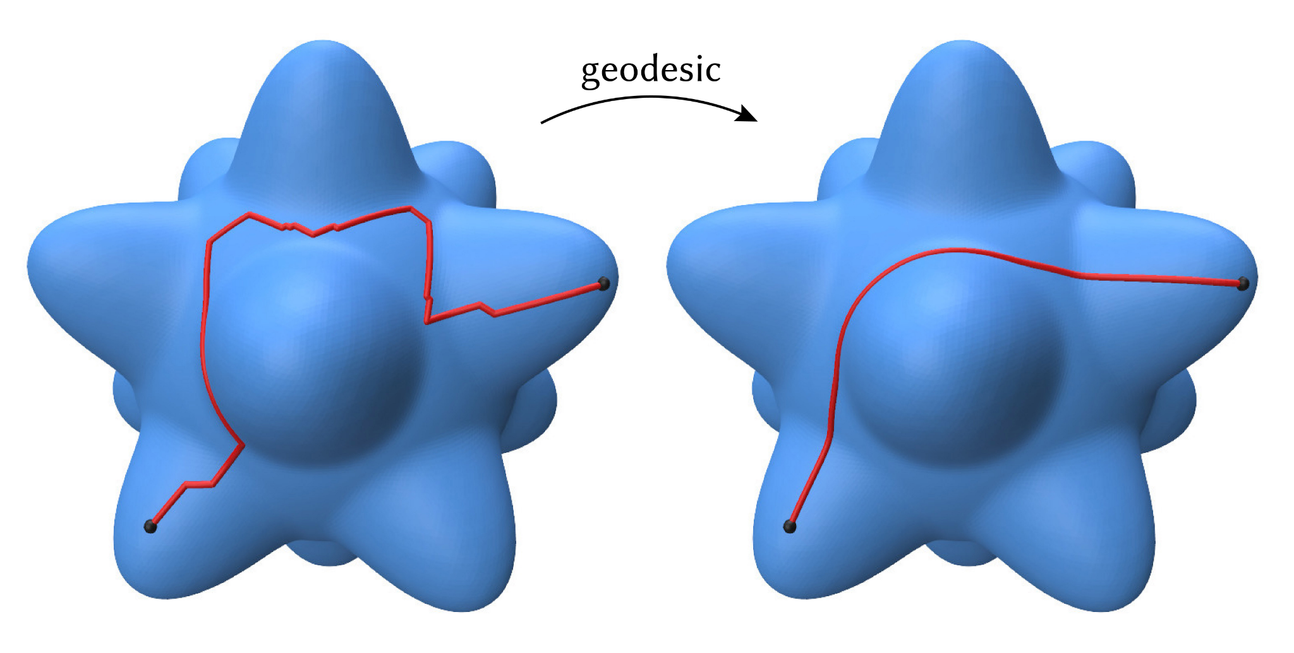
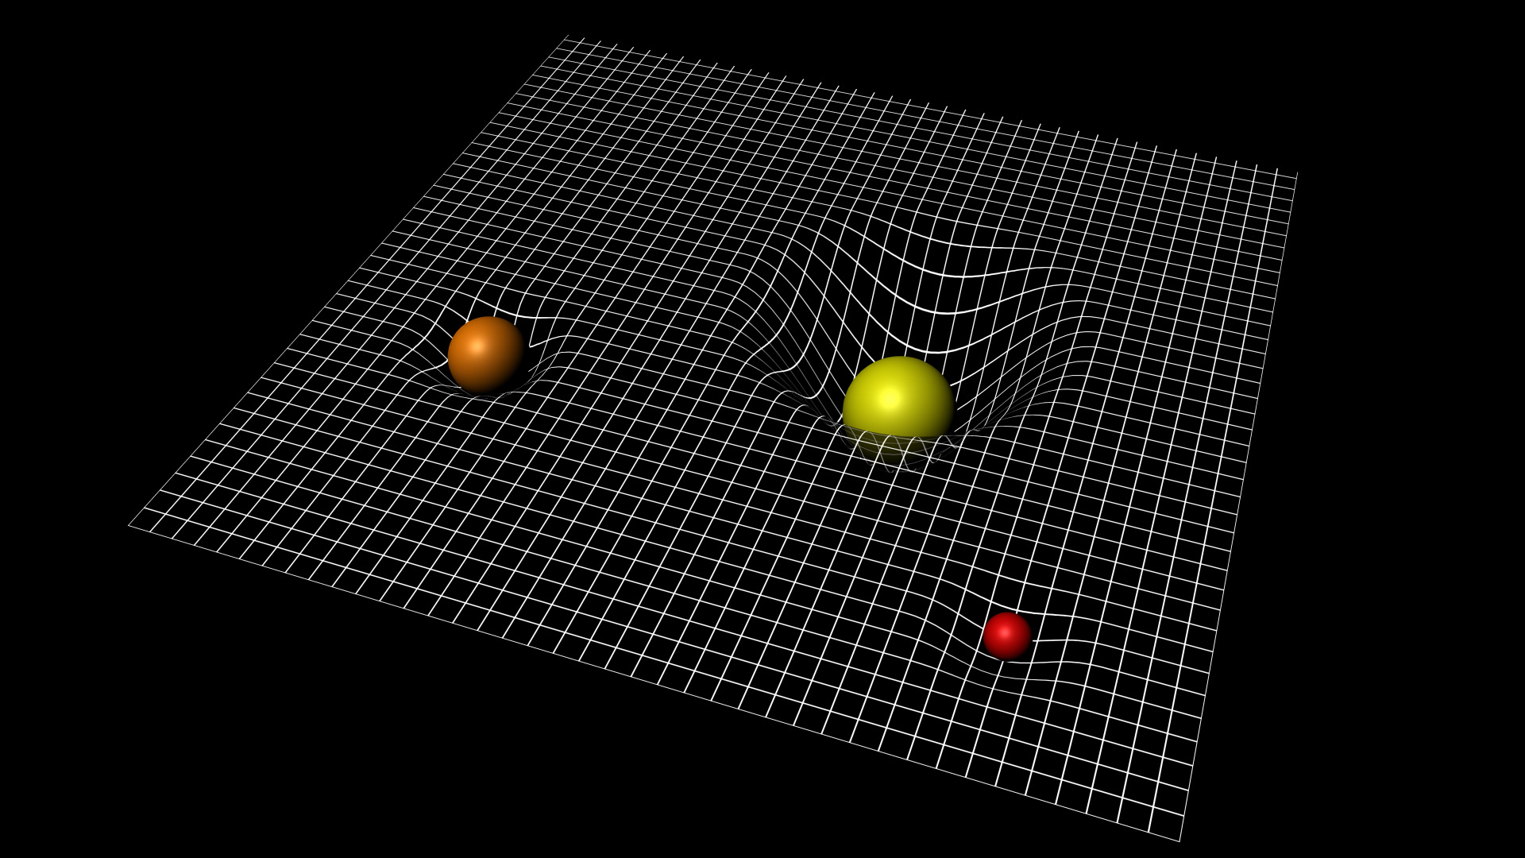
Advantages of Geometric Complexity
Geodesics <-> Optimal Solutions
Circuit Complexity
From Geodesics
Physics from Geometrical Properties

Slide 10
THANK YOU

Slide 11
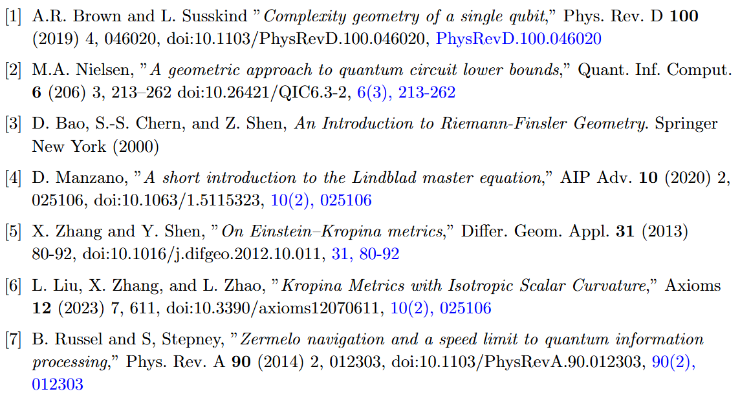
References

Slide 12
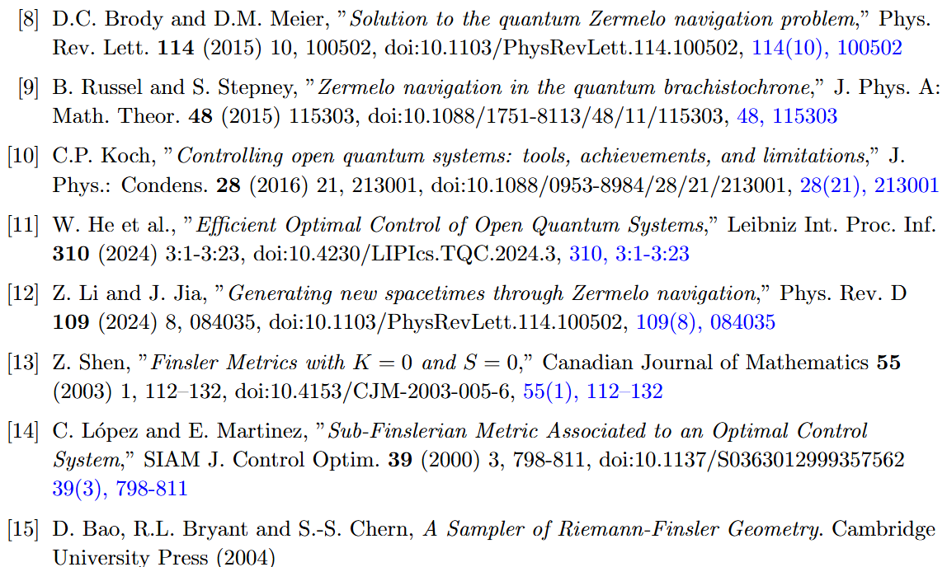
References

Slide 13
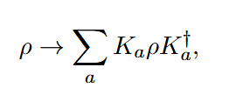
Lindbladian Evolution and Kraus Operation
Lindblad Master Equation
Kraus Operation
Loss of Invertibility! -> non-symmetric metric
Nonnegative

Slide 14
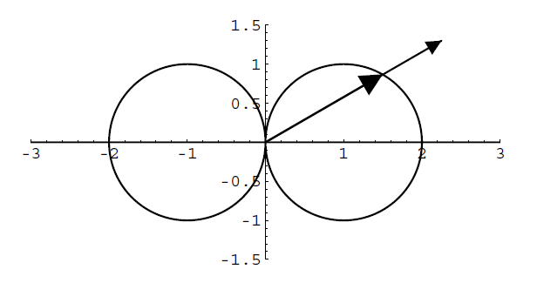

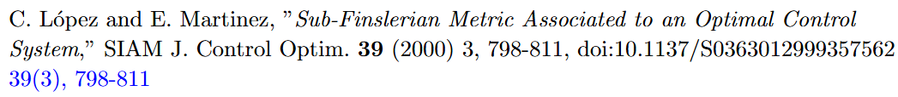
Sub-Finslerian Geometry from PMP
Tangent Space/ Velocity Space
Finsler Metric
Indicatrix/ optimal solution

Slide 15
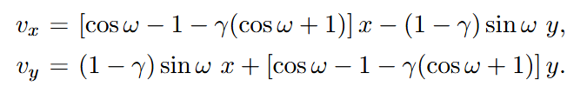
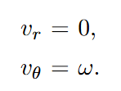
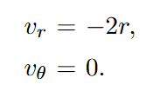
Optimal Solutions for the Depolarising Process with Rotation
Control Equations (Krauss Operation)
Optimal Solution #1: Pure Rotation
Optimal Solution #2: Pure Dissipation

Slide 16
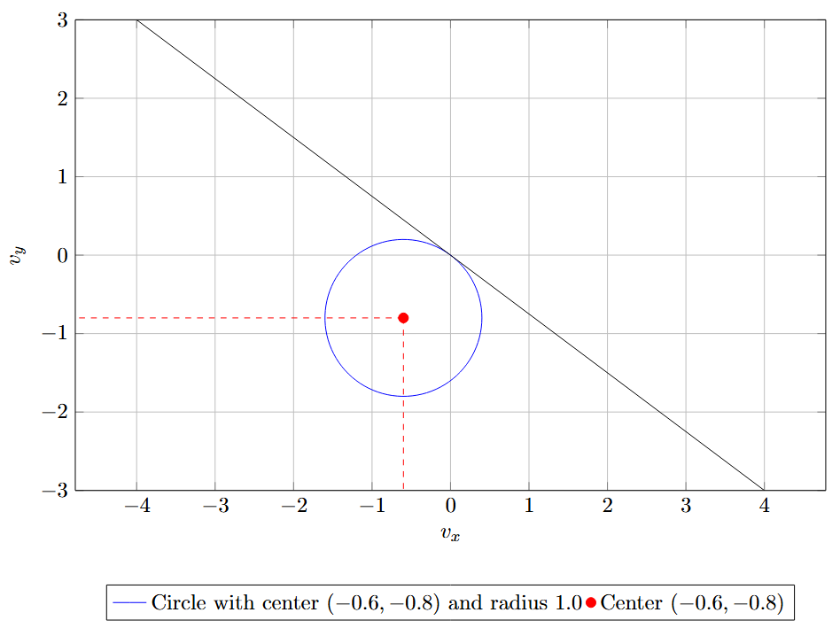
Finslerian Metric for the Depolarising Process
Cost function to optimise

Slide 17
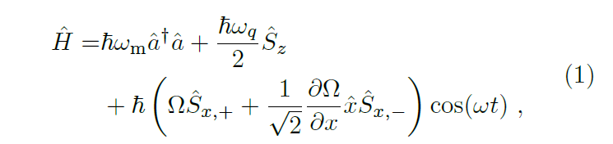
Next Steps
Extend to two more special cases (Amplitude Damping and L_i = g_i \sigma_i)
Connection to circuit complexity (In Nielsen (2016), it relates the geodesic of an upper-bounded Finsler metric with the circuit complexity)
Curvatures of the Finsler metrics we have found.
Real-world application of non-unitary controls (Environmental Cooling for Trapped-Ion Quantum Computers)

