Slide 1


Probing the Spectroscopy and Electromagnetic Structure of Heavy Mesons within the Light-Front Quark Model
Muhammad Ridwan
Young Researcher Session
Southeast Asian Workshop on Nuclear and Hadron Physics 2025
Universitas Gadjah Mada
Tuesday, 19th August 2025

Slide 2
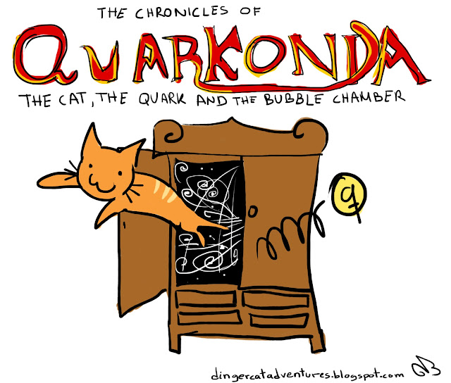
Outline
Backgrounds
Light-Front Quark Model
Result
Summary

Slide 3
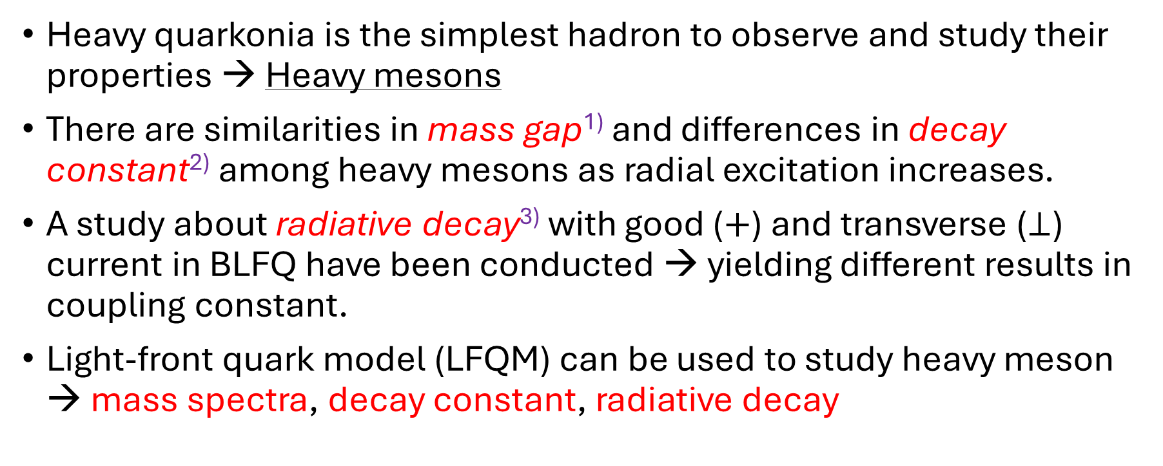
Backgrounds
Heavy quarkonia is the simplest hadron to observe and study their properties → Heavy mesons
There are similarities in mass gap¹⁾ and differences in decay constant²⁾ among heavy mesons as radial excitation increases.
A study about radiative decay³⁾ with good ($+$) and transverse ($⊥$) current in BLFQ have been conducted → yielding different results in coupling constant.
Light-front quark model (LFQM) can be used to study heavy meson → mass spectra, decay constant, radiative decay
1): (Shah et al., 1985; Arifi et al., 2022), 2): (Ke et al., 2010; Arifi et al., 2022), 3): (Li et al., 2018)

Slide 4


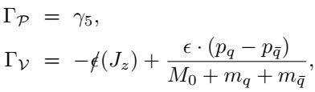
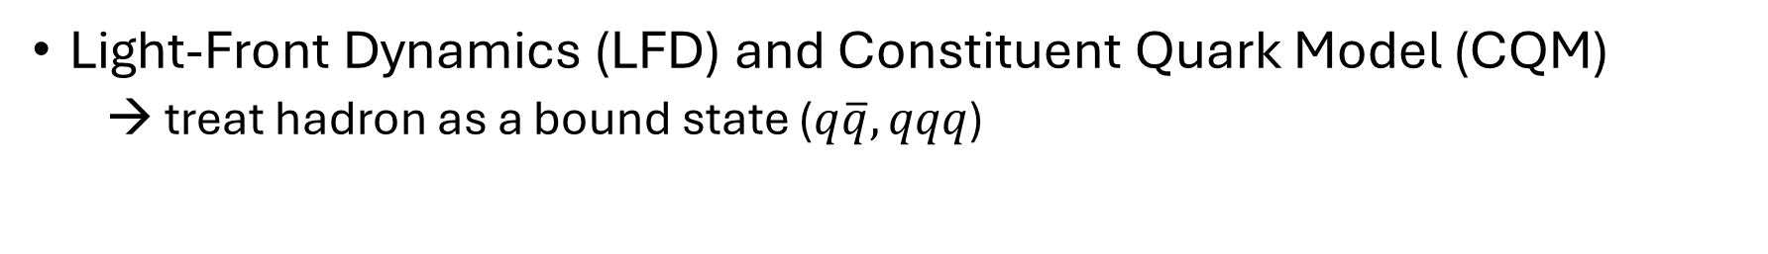
Light-Front Quark Model
Light-Front Dynamics (LFD) and Constituent Quark Model (CQM)
→ treat hadron as a bound state ($q\overline{q},qqq$)
The light-front wave function (LFWF)
(the trial wave function)
→ Radial WF:
→ Spin-orbit WF:
(pseudoscalar)
Operator
(vector)
→ Lorentz invariant variable $x_{i}= p_{i}^{+}/P^{+}$

Slide 5




We define the QCD-motivated effective Hamiltonian
where
→
The effective potential

Slide 6

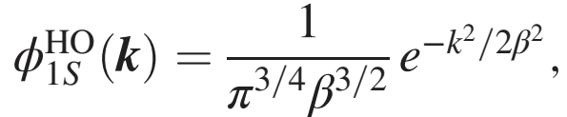





Determining the parameter
Variational principle
Trial wave function → Gaussian (H.O Basis)
Defining the mixing state (1S – 3S)
Assuming some interactions
Screened pot., Coulomb, Hyperfine
Variational analysis → mass spectra on 1S ^{[4]}
Treat pertubatively, i.e., neglecting Hyp. term
determine 10 parameters
[4] Ridwan et al., ITM Web Conf. (2024), 01016

Slide 7
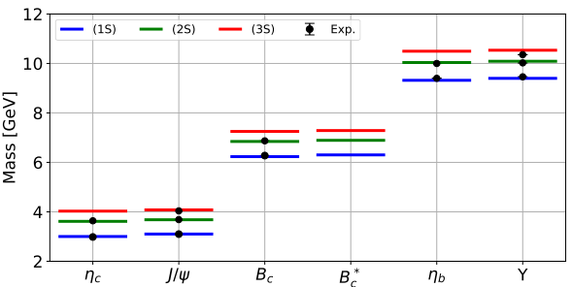


Result
Mass Spectra
→ All heavy mesons are in good agreement with experimental data, except $Υ(3S)$.

Slide 8
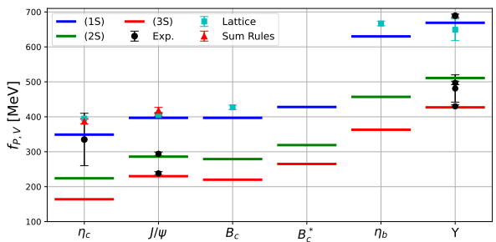


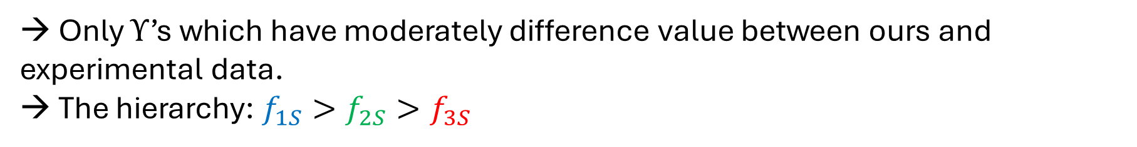
Decay Constant
Pseudoscalar
Vector
Explicit form
→ Only $Υ$’s which have moderately difference value between ours and experimental data.
→ The hierarchy: $f_{1S}>f_{2S}>f_{3S}$

Slide 9

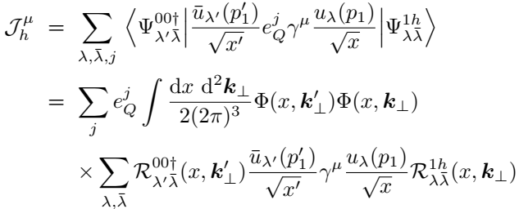

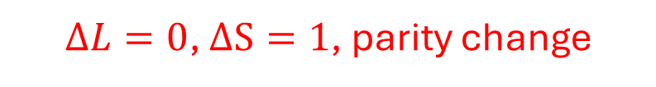
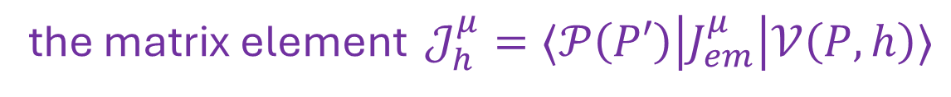
M1 Radiative Transition
$ΔL=0$, $ΔS=1$, parity change
The transition form factor (TFF) $F_{𝒱𝒫}(q^{2})$ is defined by
the matrix element $𝒥_{h}^{μ}=⟨𝒫\left(P′\right)\left|J_{em}^{μ}\right|𝒱\left(P,h\right)⟩$
the tensor term
→ Good ($μ=+$) and transverse ($μ= ⊥$) current are used to explore the TFF

Slide 10
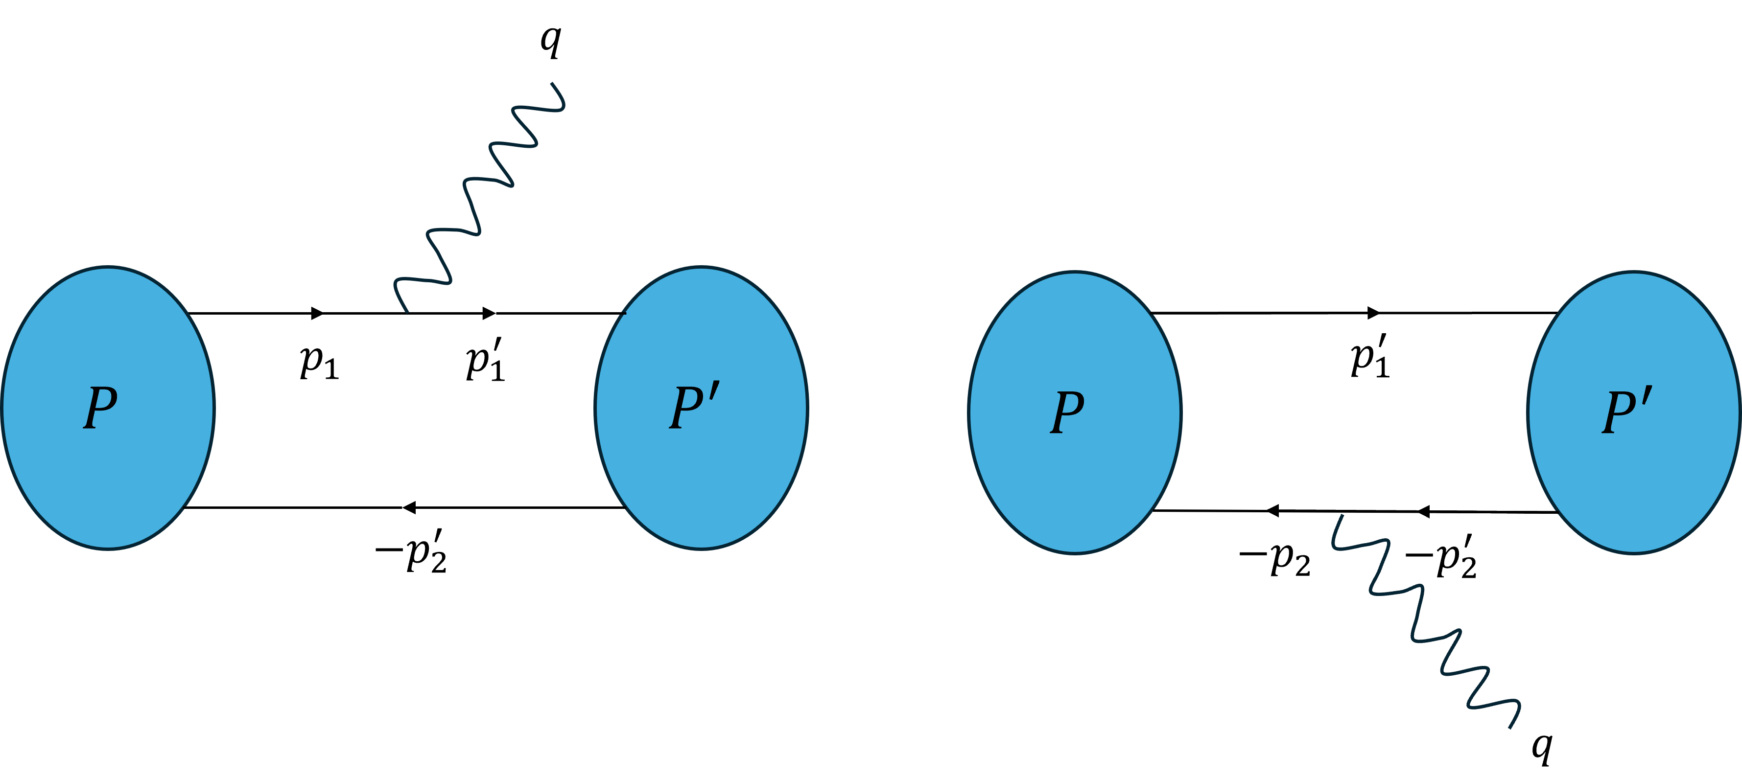




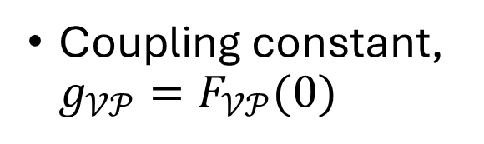
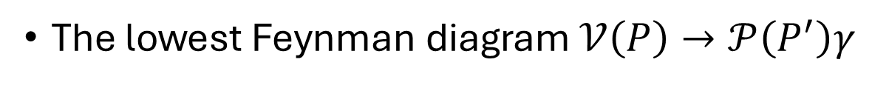
The lowest Feynman diagram $𝒱\left(P\right)→𝒫\left(P^{′}\right)γ$
Coupling constant, ${g_{𝒱𝒫}=F}_{𝒱𝒫}(0)$
Decay width
where
quark
anti-quark
Branching ratio
where $I_{h}^{μ}(m_{1},m_{2},Q^{2})$ is the one-loop integral
operator

Slide 11
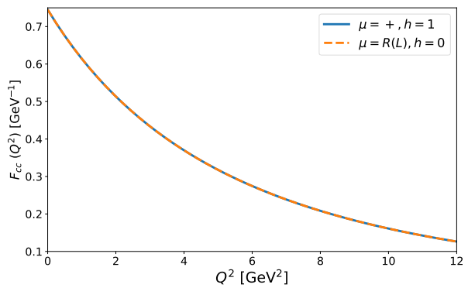
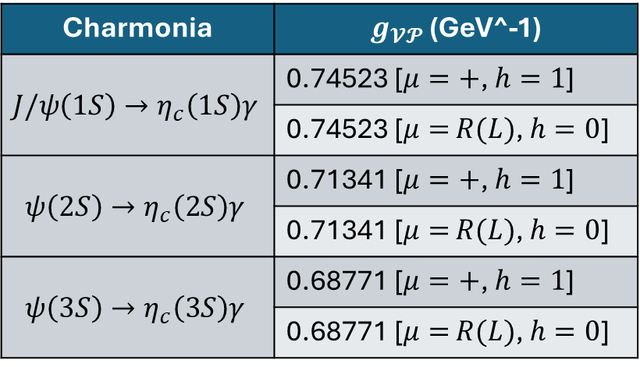

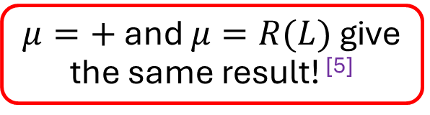
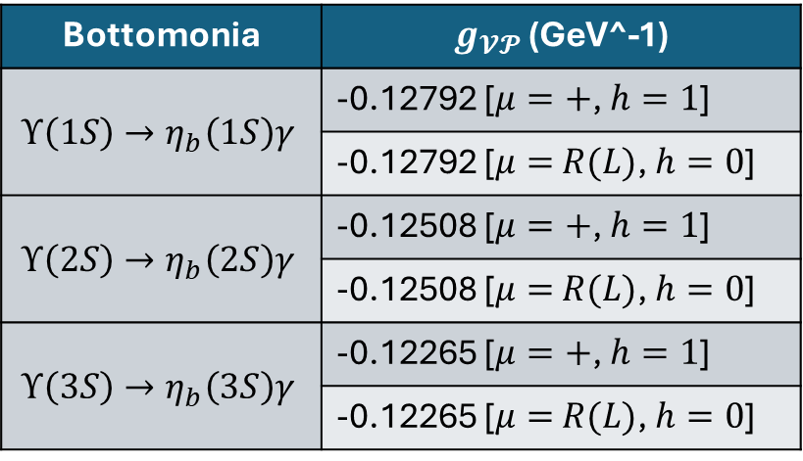
Coupling constant ($g_{𝒱𝒫}$): good vs transverse
Charmonia | $g_{𝓥𝓟}$ (GeV^-1)
$$J/ψ\left(1S\right)→η_{c}\left(1S\right)γ$$ | 0.74523 [$μ=+$, $h=1$]
 | 0.74523 [$μ=$ $R(L)$, $h=0$]
$$ψ\left(2S\right)→η_{c}\left(2S\right)γ$$ | 0.71341 [$μ=+$, $h=1$]
 | 0.71341 [$μ=$ $R(L)$, $h=0$]
$$ψ\left(3S\right)→η_{c}\left(3S\right)γ$$ | 0.68771 [$μ=+$, $h=1$]
 | 0.68771 [$μ=$ $R(L)$, $h=0$]
Bottomonia | $g_{𝓥𝓟}$ (GeV^-1)
$$Υ\left(1S\right)→η_{b}\left(1S\right)γ$$ | -0.12792 [$μ=+$, $h=1$]
 | -0.12792 [$μ=$ $R(L)$, $h=0$]
$$Υ\left(2S\right)→η_{b}\left(2S\right)γ$$ | -0.12508 [$μ=+$, $h=1$]
 | -0.12508 [$μ=$ $R(L)$, $h=0$]
$$Υ\left(3S\right)→η_{b}\left(3S\right)γ$$ | -0.12265 [$μ=+$, $h=1$]
 | -0.12265 [$μ=$ $R(L)$, $h=0$]
$$J/ψ\left(1S\right)→η_{c}\left(1S\right)γ$$
$μ=+$ and $μ=R(L)$ give the same result! ^{[5]}
[5] Ridwan et al., PRD (2025), 01016

Slide 12
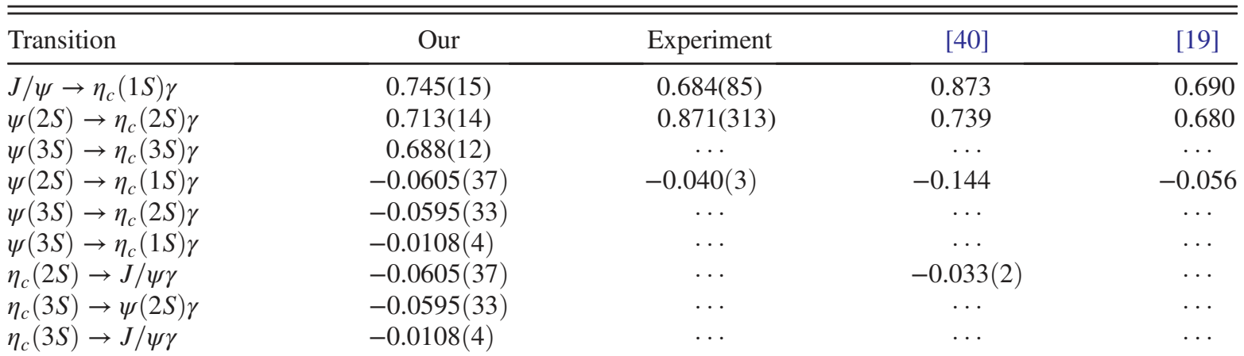
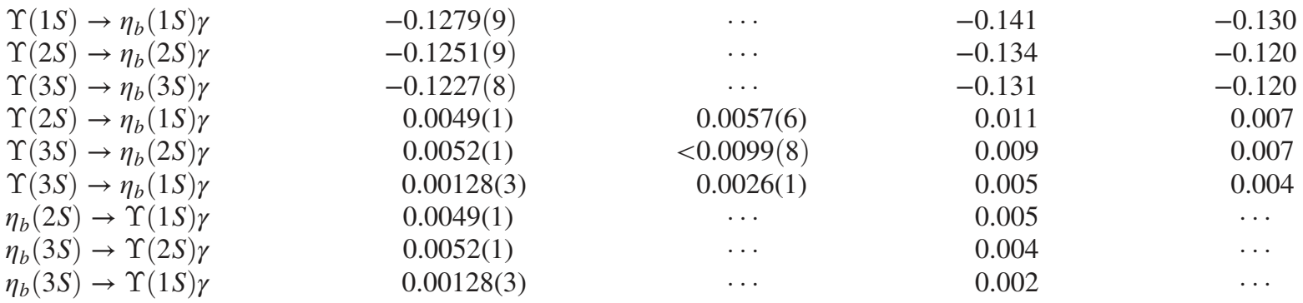
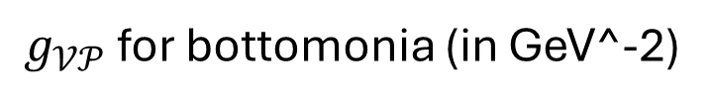
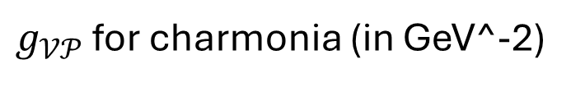
$g_{𝒱𝒫}$ for charmonia (in GeV^-2)
$g_{𝒱𝒫}$for bottomonia (in GeV^-2)
[40] Li et al., PRD 98 (2024), 034024; [19] Godfrey & Isgur, PRD 32 (1985), 189

Slide 13
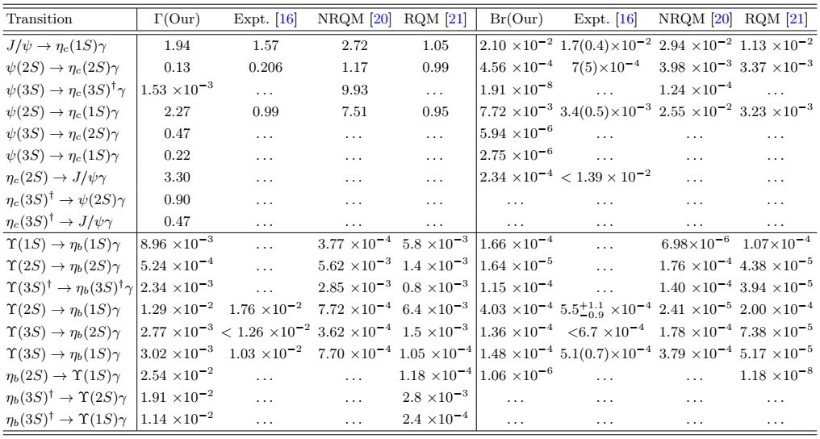
$Γ$ and Br in $cc$ and $bb$

Slide 14
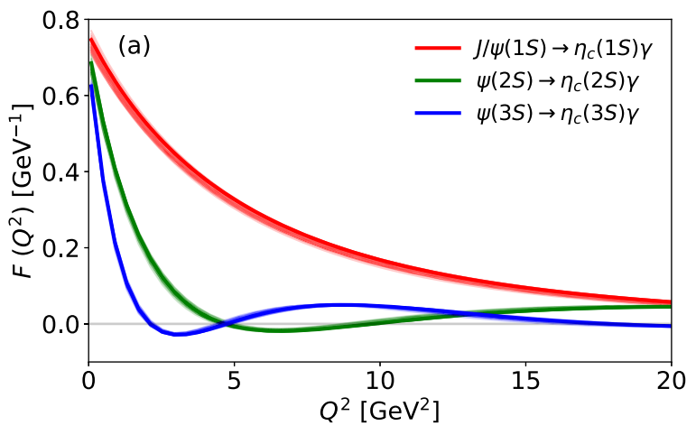
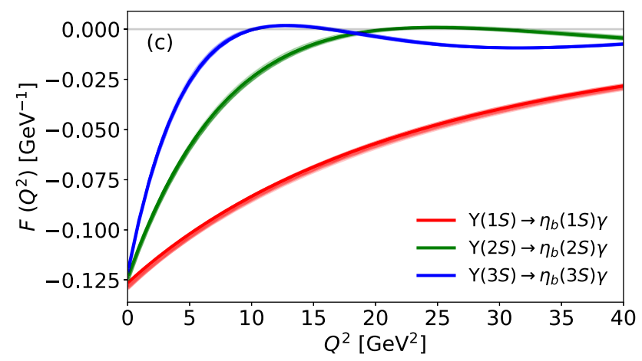

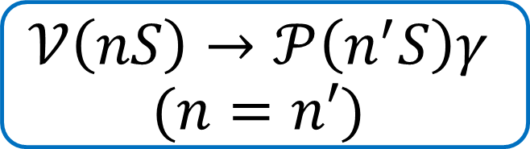

$$c\overline{c}$$
$$𝒱\left(nS\right)→𝒫\left(n^{′}S\right)γ$$
$$(n=n′)$$
the allowed transition due to the overlap of the initial and final wave function.
$$b\overline{b}$$
Notes:
Such a various curves are characterized by the radial wave function used in one-loop integral

Slide 15
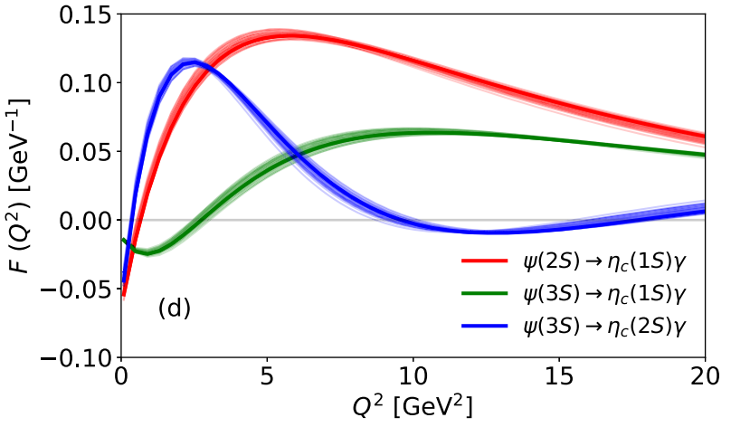
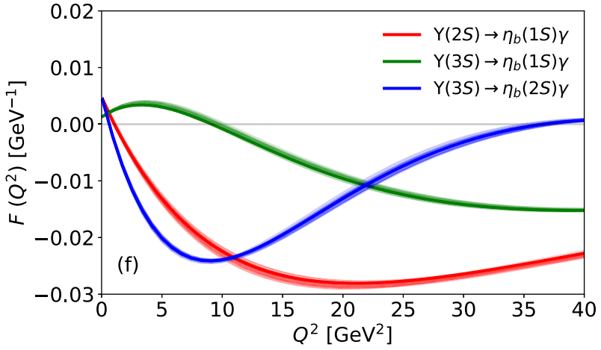


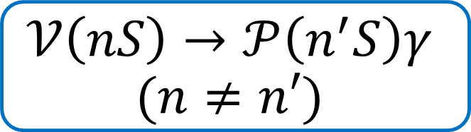
$$c\overline{c}$$
$$𝒱\left(nS\right)→𝒫\left(n^{′}S\right)γ$$
$$(n≠n′)$$
the hindered transition due to the orthogonality of the wave functions.
$$b\overline{b}$$

Slide 16

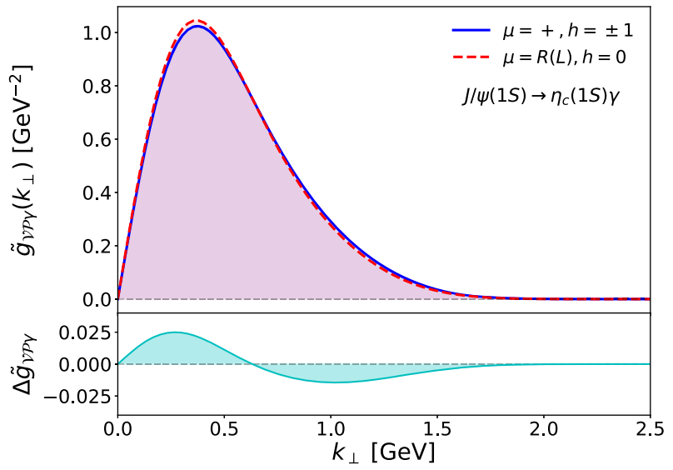
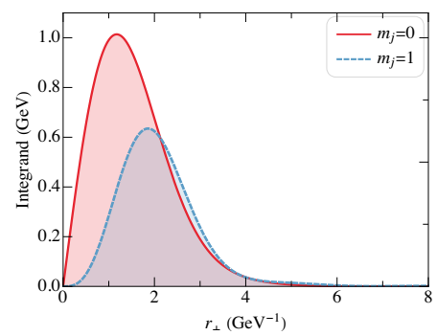
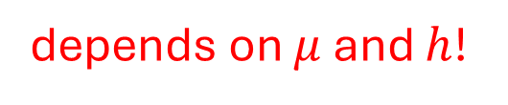
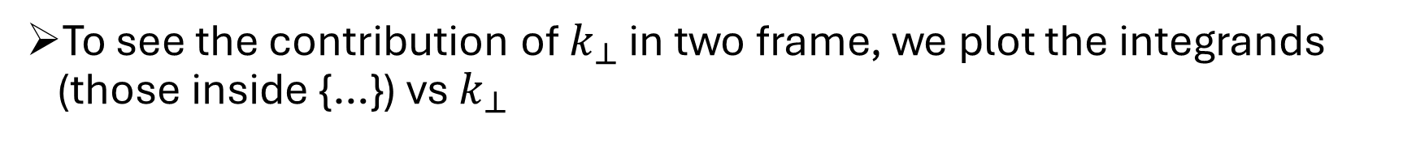
To see the contribution of $k_{⊥}$ in two frame, we plot the integrands (those inside {…}) vs $k_{⊥}$
depends on $μ$ and $h$!
→ expect different curve
However….
transverse
VS
good
Ours
Ref. [1]
[1] Li et al., PRD 98 (2018), 034024

Slide 17
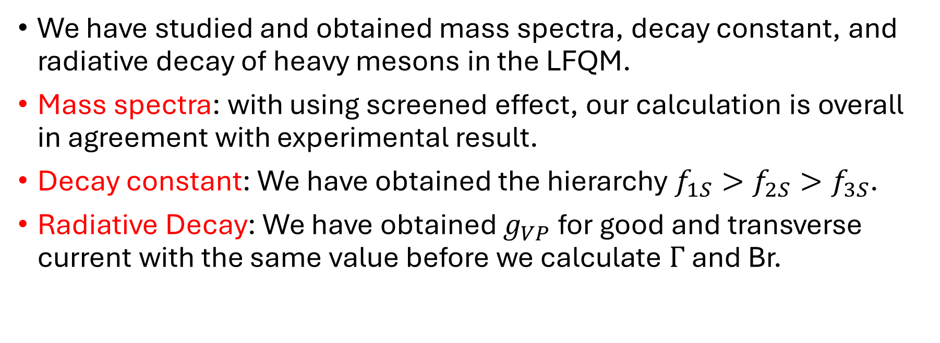
Summary
We have studied and obtained mass spectra, decay constant, and radiative decay of heavy mesons in the LFQM.
Mass spectra: with using screened effect, our calculation is overall in agreement with experimental result.
Decay constant: We have obtained the hierarchy $f_{1S}>f_{2S}>f_{3S}$.
Radiative Decay: We have obtained $g_{VP}$ for good and transverse current with the same value before we calculate $Γ$ and Br.

Slide 18

Thank You For Your Attention!

Slide 21
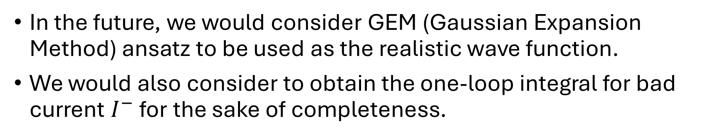
Outlook
In the future, we would consider GEM (Gaussian Expansion Method) ansatz to be used as the realistic wave function.
We would also consider to obtain the one-loop integral for bad current $I^{−}$ for the sake of completeness.
62

Slide 22
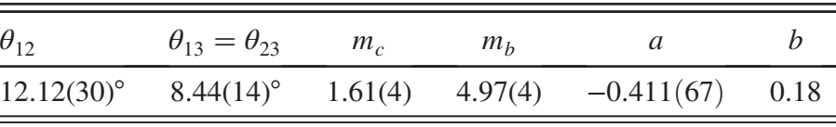
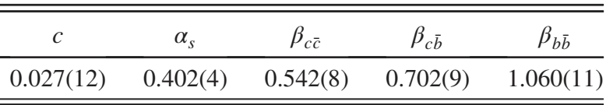
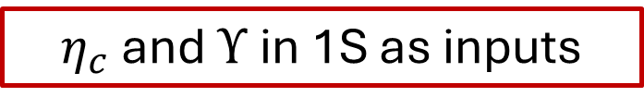
$η_{c}$ and $Υ$ in 1S as inputs
Fixed parameters
11 parameters are obtained
Notes:
Input for 1S: \eta_c = 2984 MeV, \upsilon = 9399 MeV

Slide 23
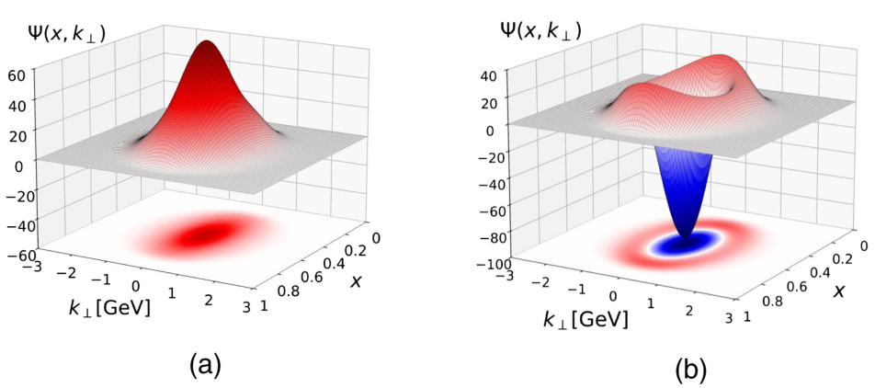

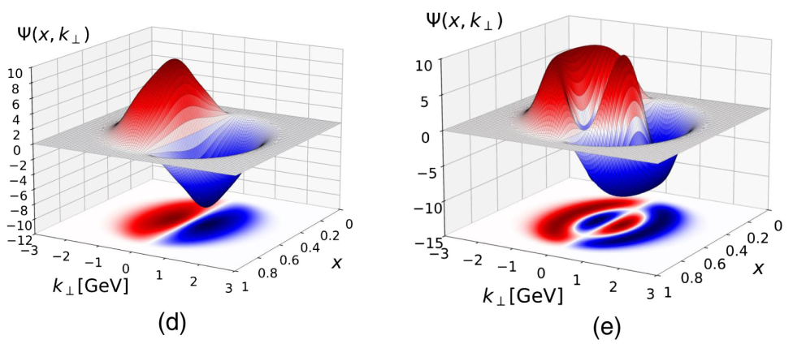

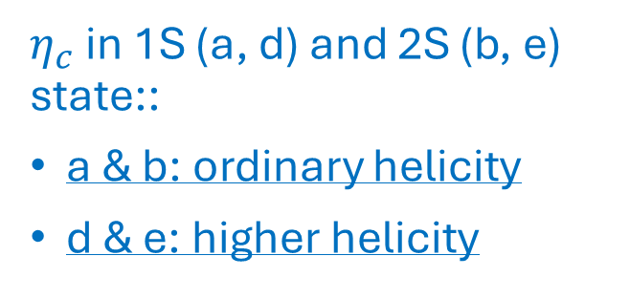
Wave function in the mixing state (1S – 3S)
$η_{c}$ in 1S (a, d) and 2S (b, e) state::
a & b: ordinary helicity
d & e: higher helicity
35

Slide 24
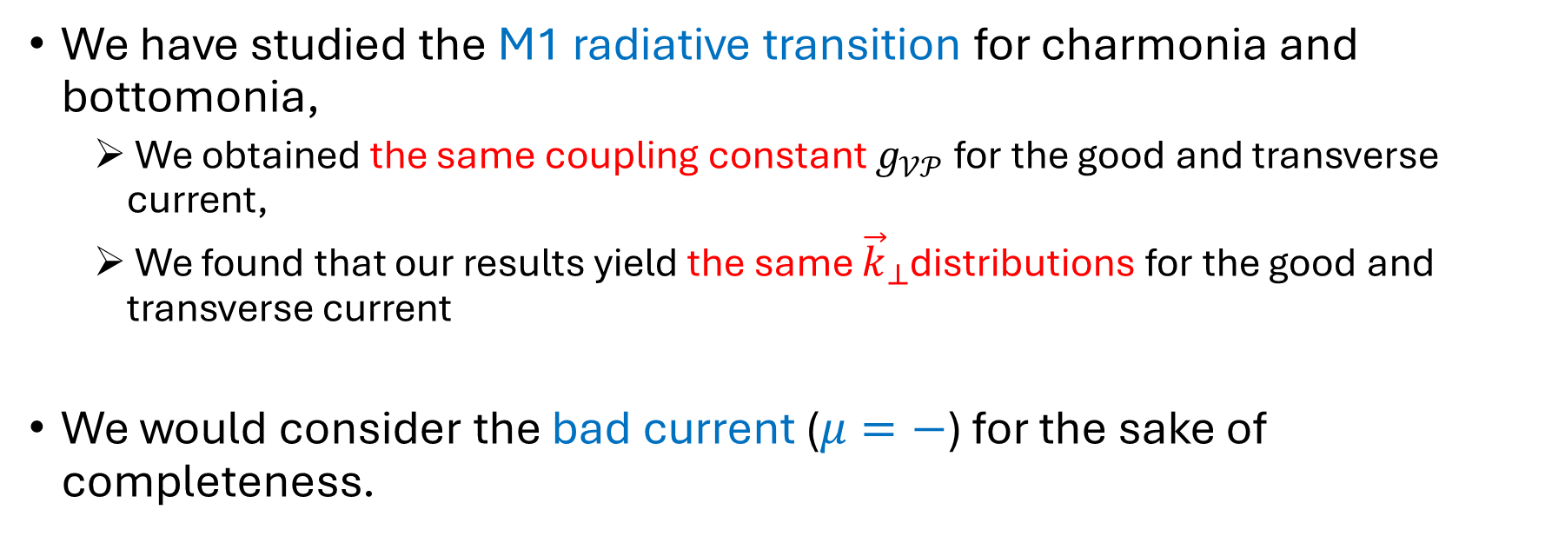
Summary and Outlook
We have studied the M1 radiative transition for charmonia and bottomonia,
We obtained the same coupling constant $g_{𝒱𝒫}$ for the good and transverse current,
We found that our results yield the same ${\vec{k}}_{⊥}$distributions for the good and transverse current
We would consider the bad current ($μ=−$) for the sake of completeness.
46

