Slide 1
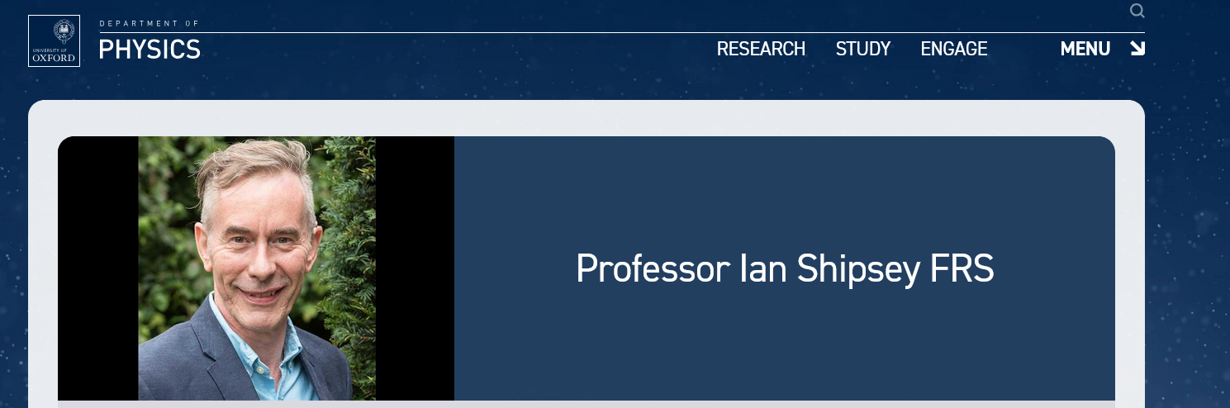
Impact on Oxford Physics
Sonia Contera
29/03/2025

Slide 2
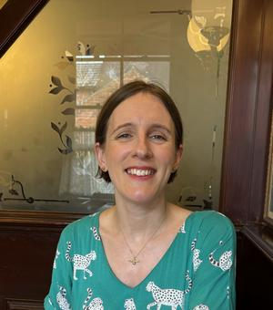
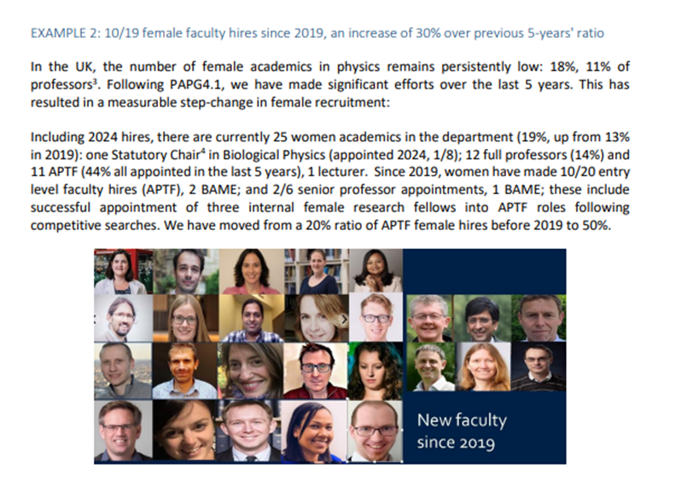
ATTRACTING THE BEST TO OXFORD PHYSICS
Two massive hires were Shivaji Sondhi and Nynke Dekker. Both of these would never have happened without Ian’s drive to secure funding – from philanthropy and the Leverhulme Trust for Shivaji, from the University’s SRF for Nynke
His commitment to the REF environment statement in REF2021 meant we were one of only 3 Physics departments in the country to receive 100% 4* for environment. (fond memories now of late nights on zoom discussing this but also what he and Daniela had cooked on the aga for dinner and sometimes interrupted by Daniela bringing in dessert 😊)
He was committed to development and increasing donations
He was also very good at saying thank you and giving people credit (to our team it always felt like we were very appreciated).

Slide 3
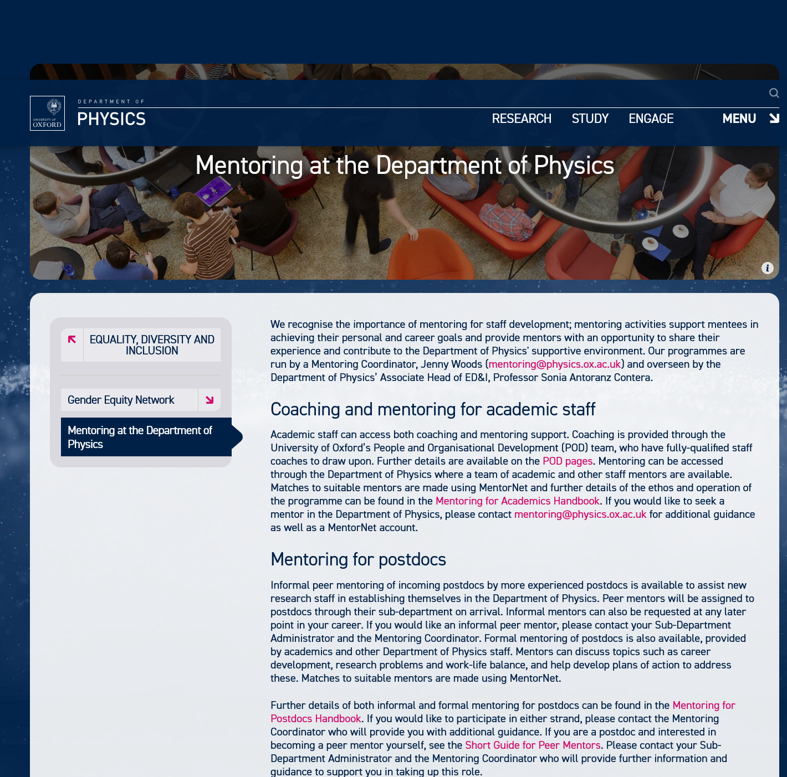
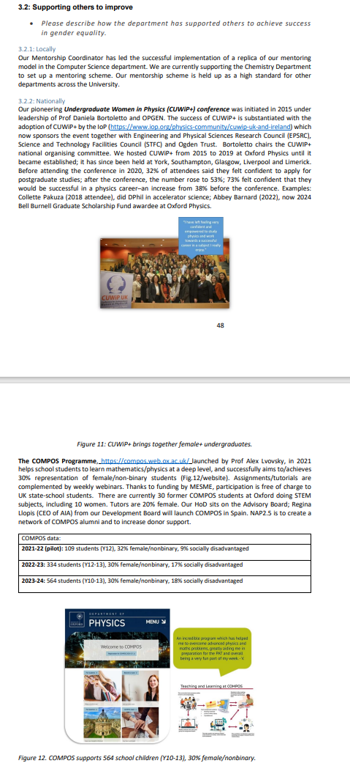
MENTORSHIP
OUTREACH
ACCESS

Slide 4
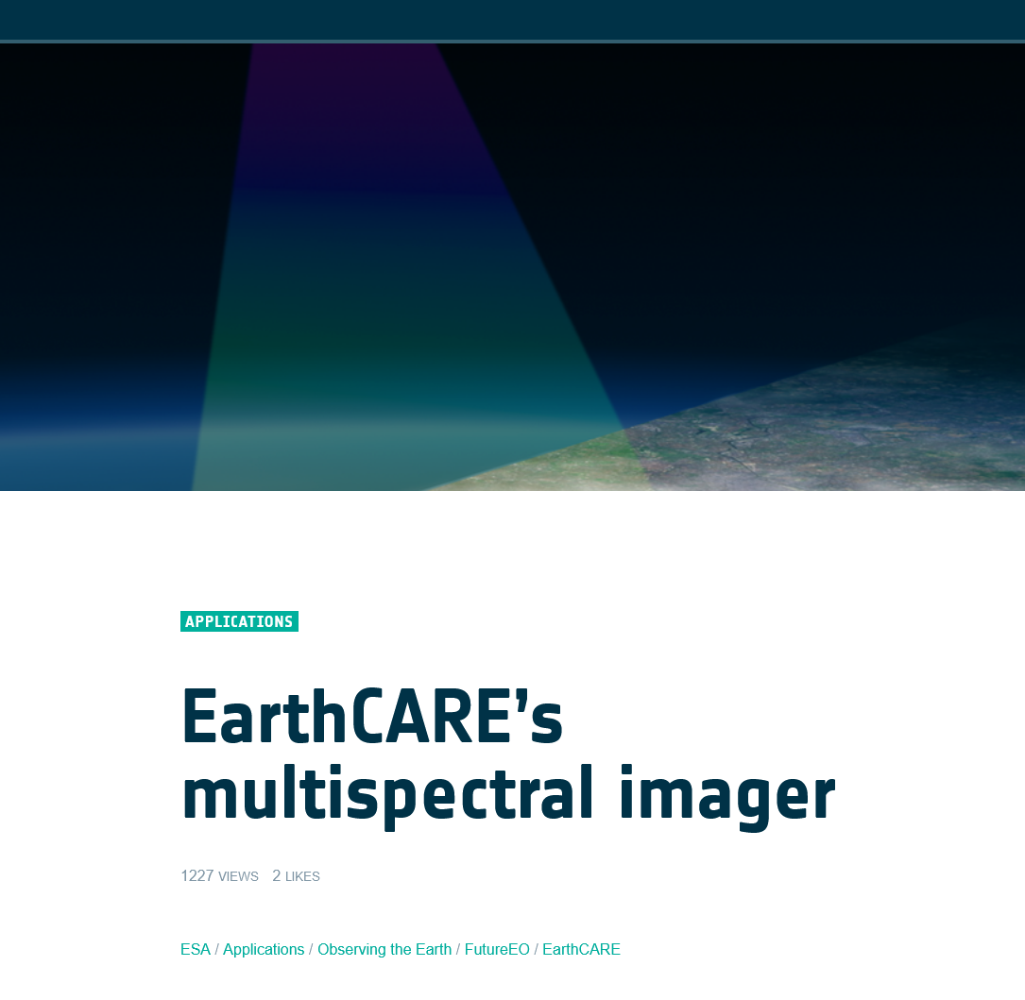
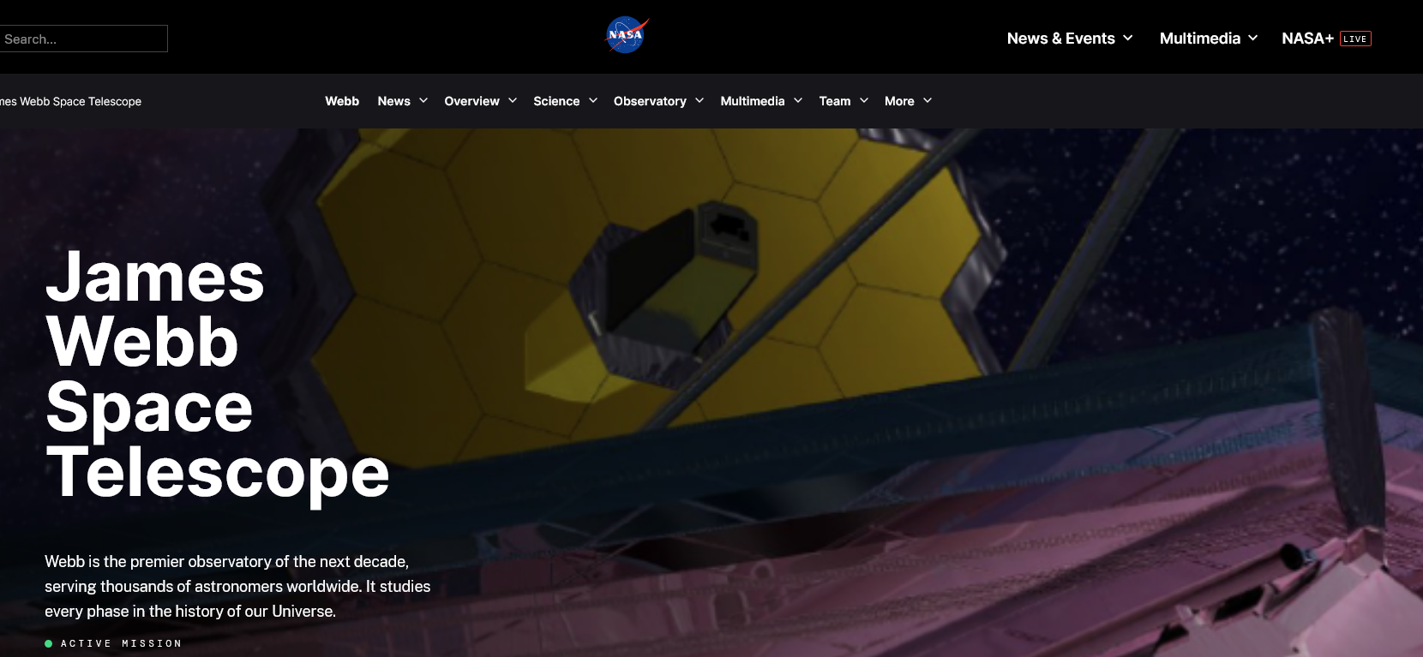
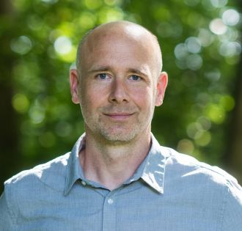
He was fully supportive of our strong aspirations in climate, space, and planets, with APTF appointments in each area. He took candidate negotiations extremely seriously and worked tirelessly until he secured appointments.
He fully supported AOPP’s move to integrate the Infrared Multilayer Laboratory from Reading into the department, which has been a great success, providing a wide range of high-spec filters for many space missions, including the European Space Agency’s Planet EarthCARE Multi-Spectral Imager (MSI) and the NASA/ESA James Webb Space Telescope (JWST) Mid-Infrared Instrument (MIRI).
  He was particularly supportive of our strong EDI aspirations in AOPP and helped us to translate some of our initiatives into Physics-wide initiatives, e.g. the mentoring scheme.
And maybe most importantly, Ian’s unmatched enthusiasm and curiosity for fundamental science were contagious and a true inspiration for all.

Slide 5
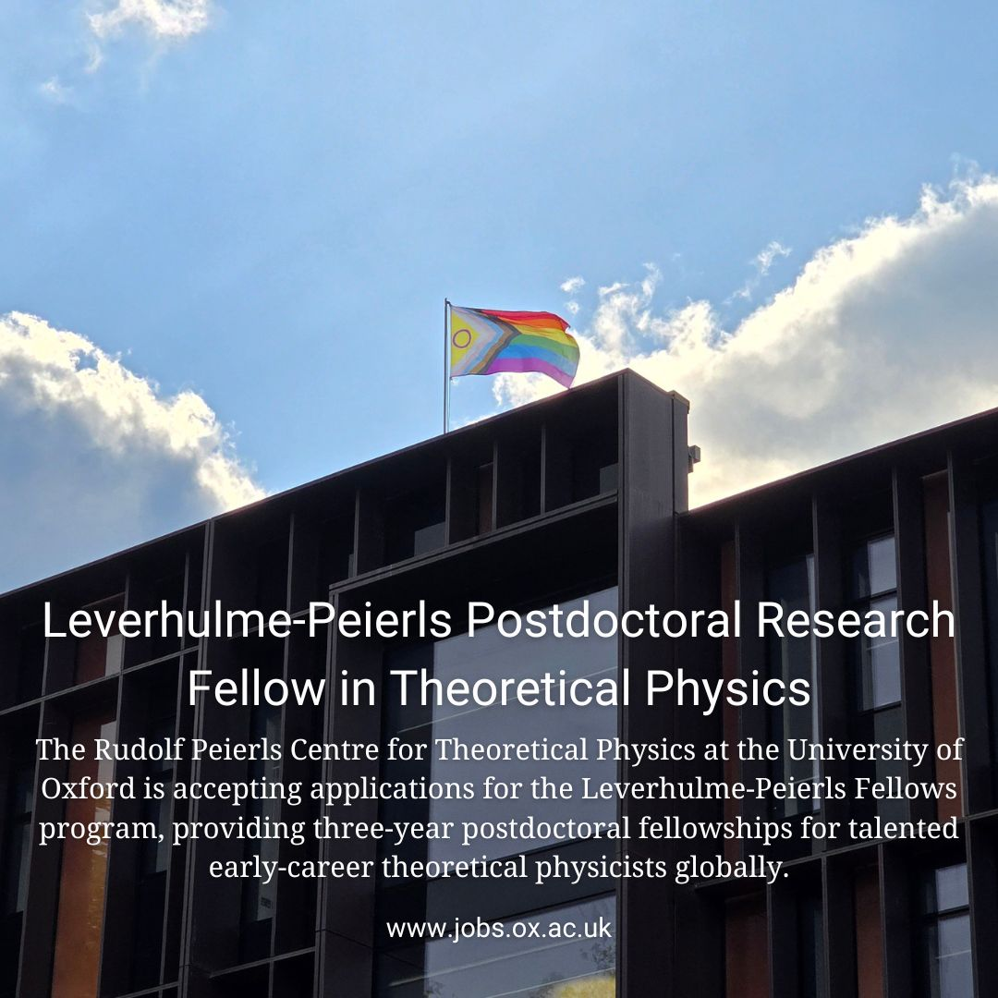
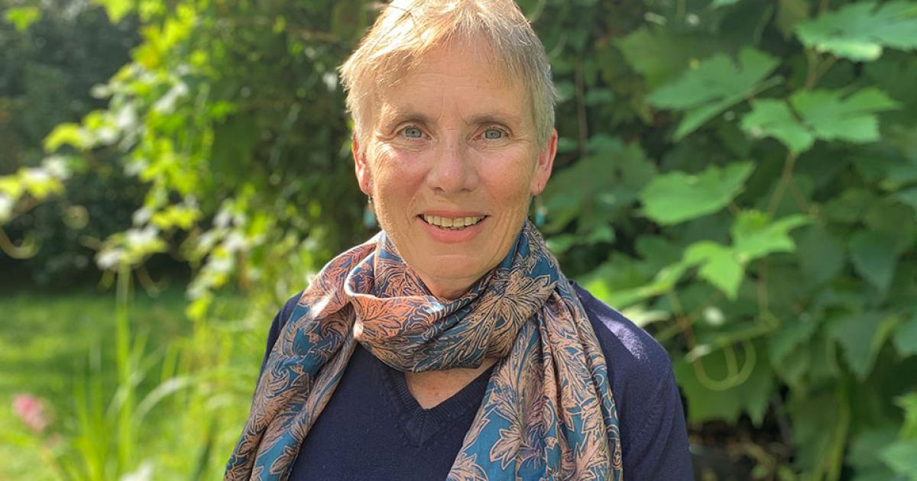
Facilitating the Leverhulme funding that got Shivaji here and has funded the Leverhulme-Peierls Fellows (~3 outstanding post-docs each year).
He was very supportive of getting the theoretical bio APTF and astro-particle APTFs through the Division and then encouraging the best candidates to come to Oxford.
On a personal level, he was behind asking me to apply for an ERC which I would never have thought of doing otherwise. Presumably he encouraged other people in the same way.

Slide 6
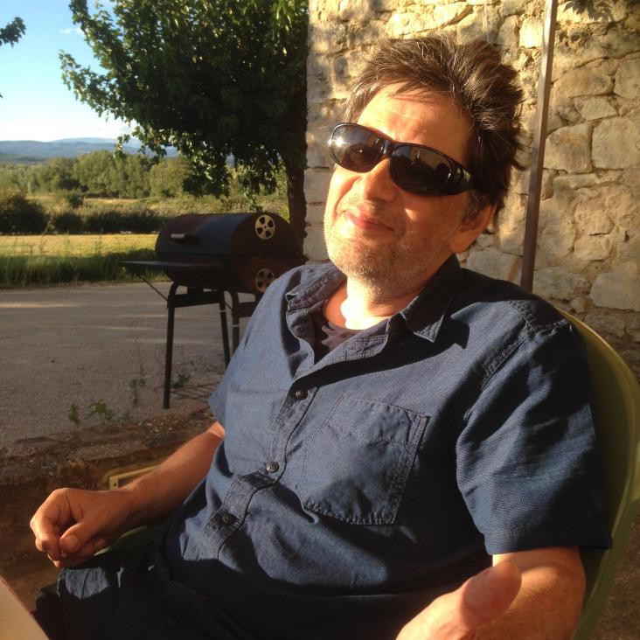
Ian has been extremely supportive and skilled in dealing with a number of difficult issues, involving individuals not to be named, that I was involved in. His personal skills, good judgement and charisma made the difference. More generally, and in relation to any number of smaller issues, I have always felt that Ian was a HoD firmly on the side of academia. This has been greatly appreciated, in TP and I am sure elsewhere.

Slide 7
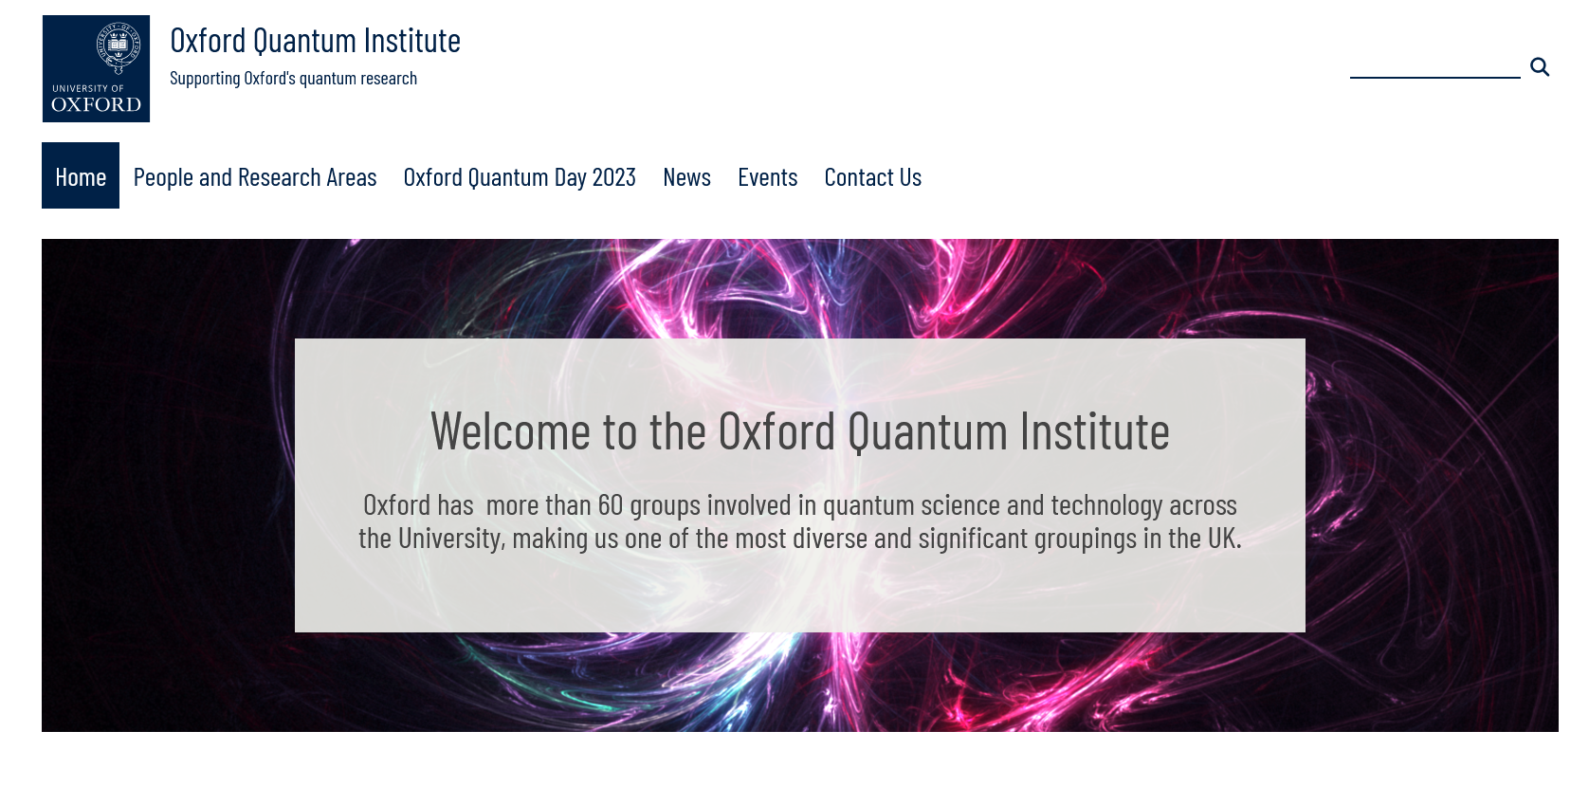
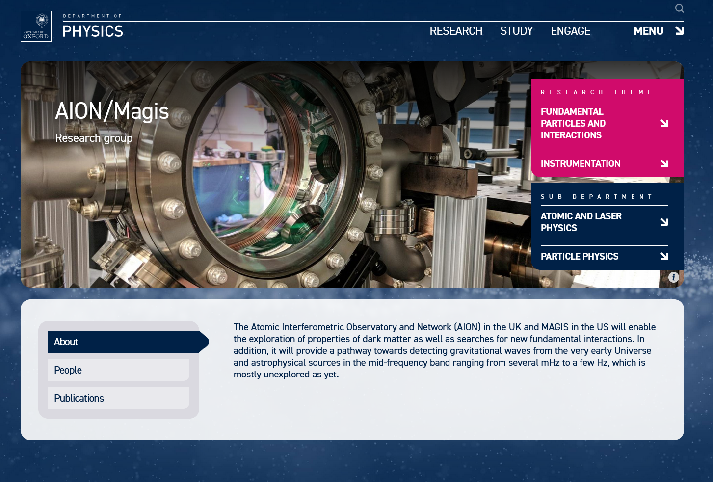
• the negotiations for the Hooke Professorship were very protracted, in part because of the pandemic. Ian was very helpful in ensuring that there was at least some progress during the first search.
• It is expected that the Director of the OQI will be announced very soon, and I’m fully expecting it to be a high-profile appointment. Ian played a significant role in ensuring that the OQI will be based in Physics, and I expect also that he did a lot to attract the incoming Director.
• Ian was very helpful with the appointments of Andrew Daley and Sam Vinko. Ian was always keen to meet and talk to the shortlisted candidates, and I think that this helped us recruit the best possible candidates.
• Quantum technologies for fundamental physics programme, which Ian & others lobbied UKRI to set up. One project in this programme that benefitted ALP (in particular Chris Foot’s group) was the AION (Atom Interferometric Observatory and Network,) project to construct atom interferometers to detect gravitational waves, dark matter etc.

Slide 8
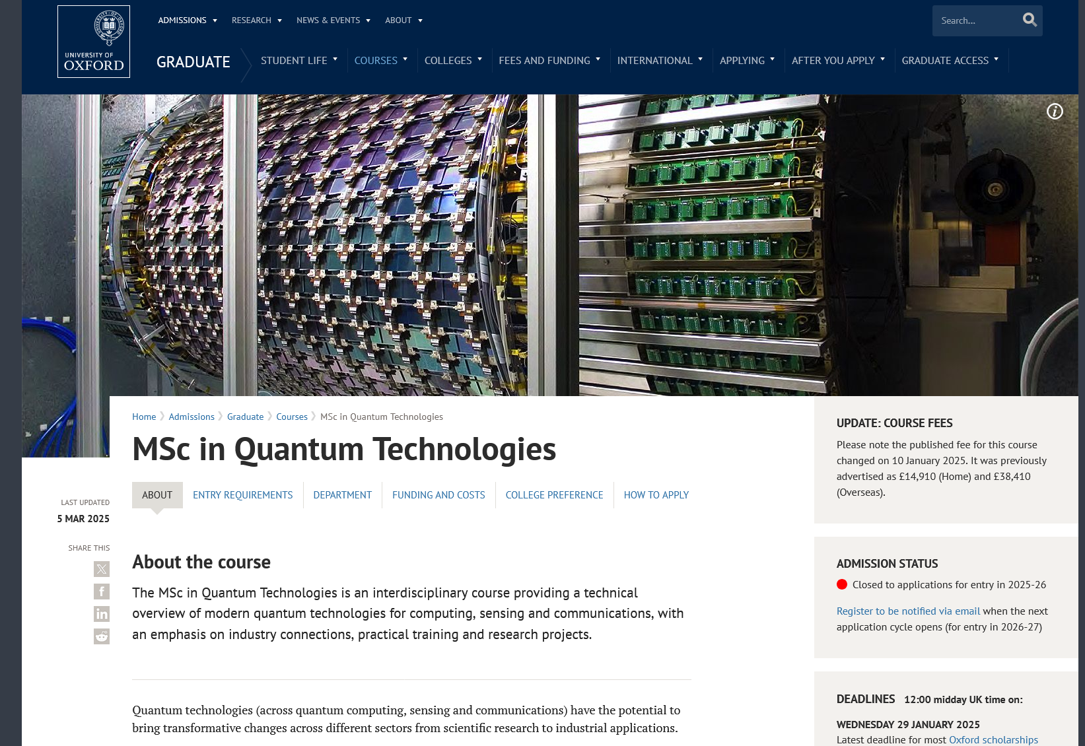
Supportive and instrumental in bringing the Master course in Quantum Technologies into life.
Instrumental in setting up an external panel for the review of the Oxford Physics department

Slide 9
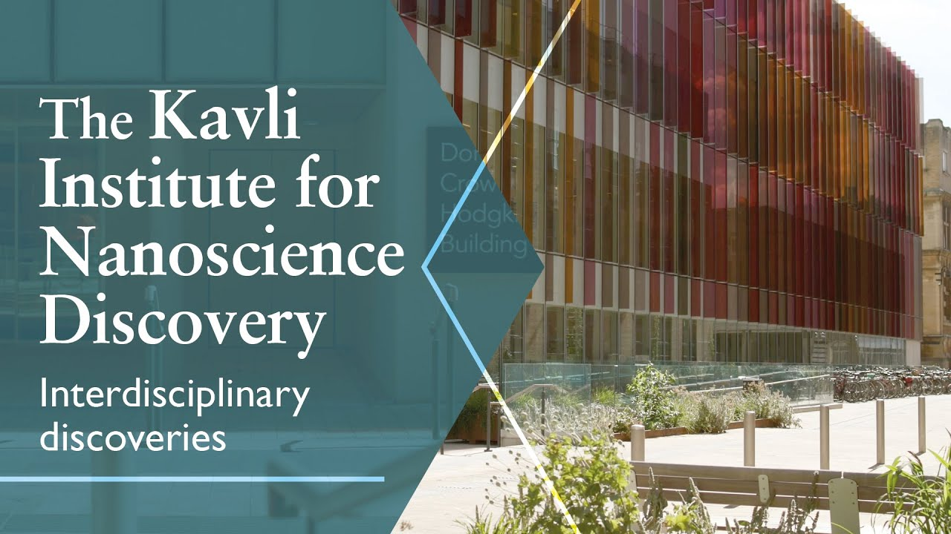
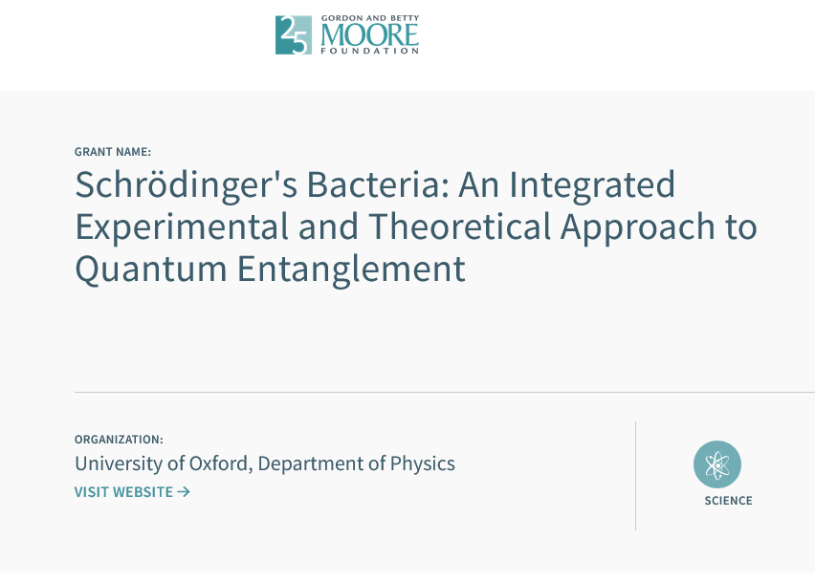
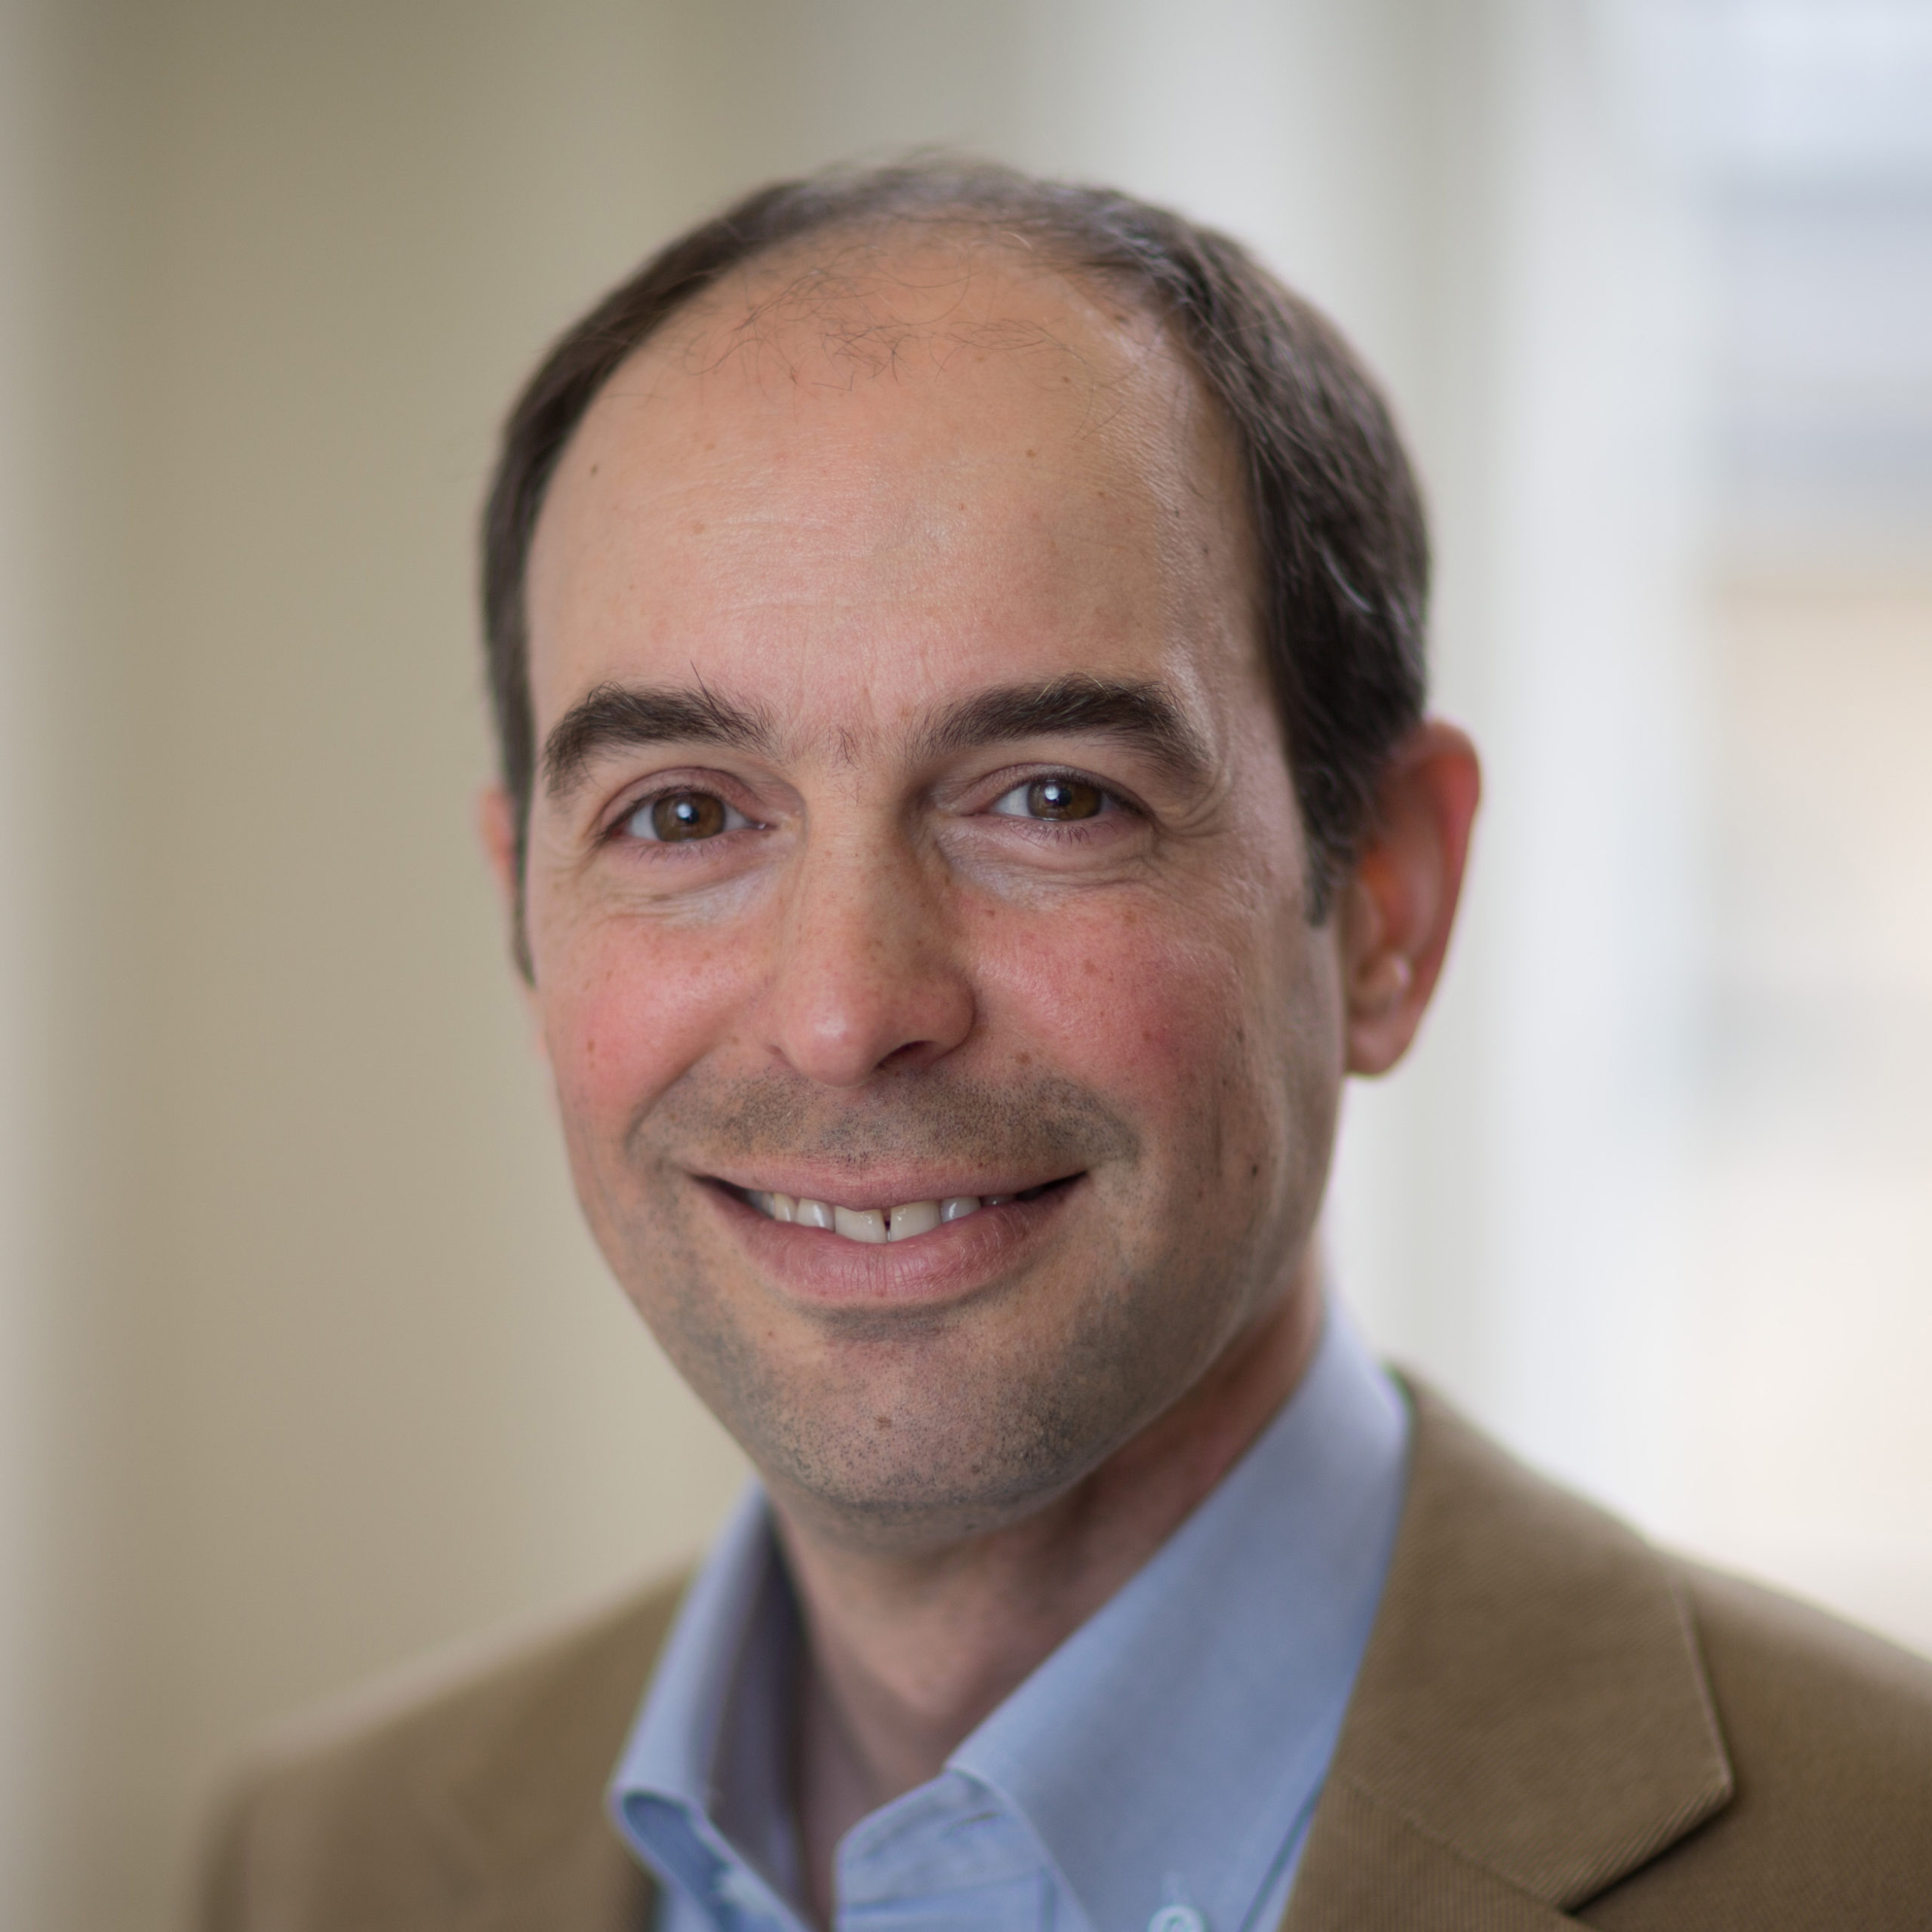
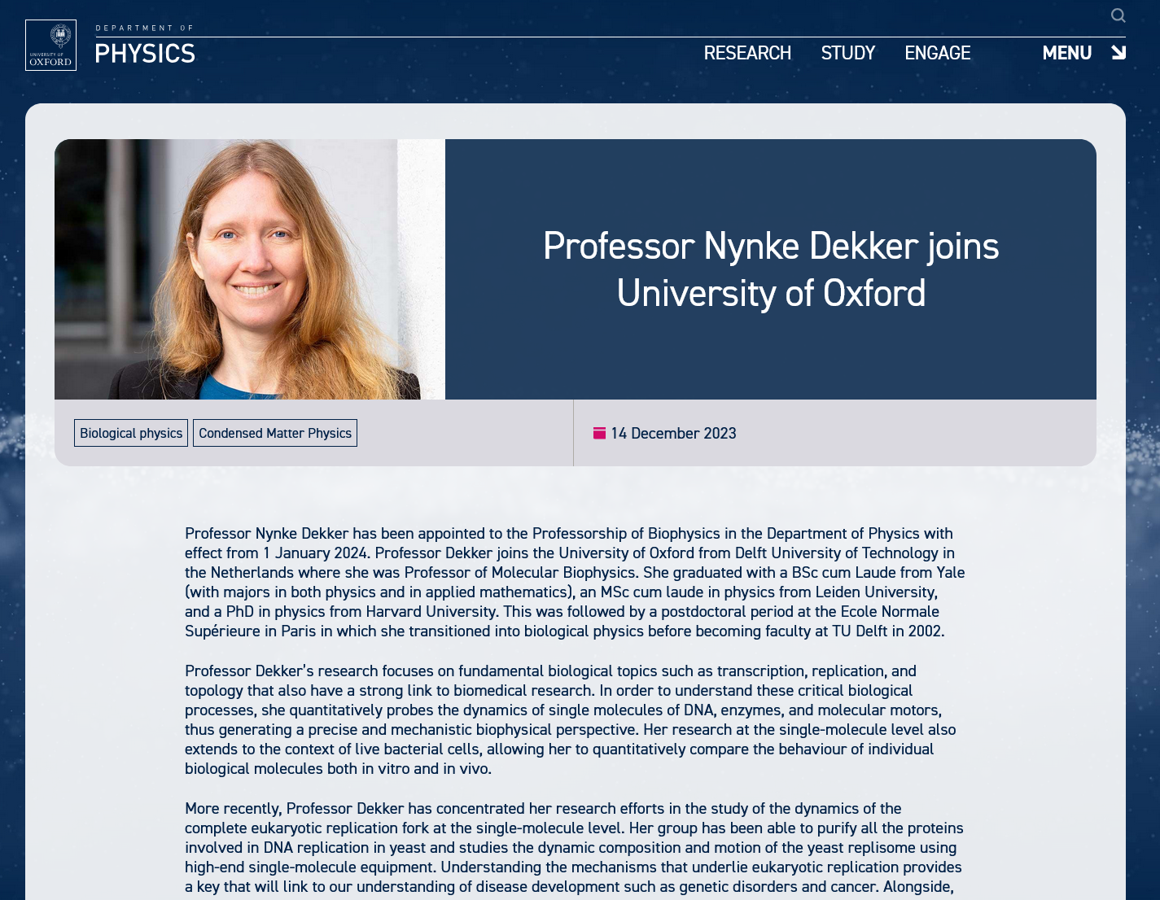
Ian supported Seamus's relationships with the Moore Foundation and the Royal Society, which have both been hugely to the benefit of the department and CMP.
And he was very proactive in APTF appointments, meeting all shortlisted candidates and batting hard for startup commitments from the division.
I hope you will mention Ian's visceral commitment to a positive working environment for everyone, and also his unique perspective on inclusion.

Slide 10
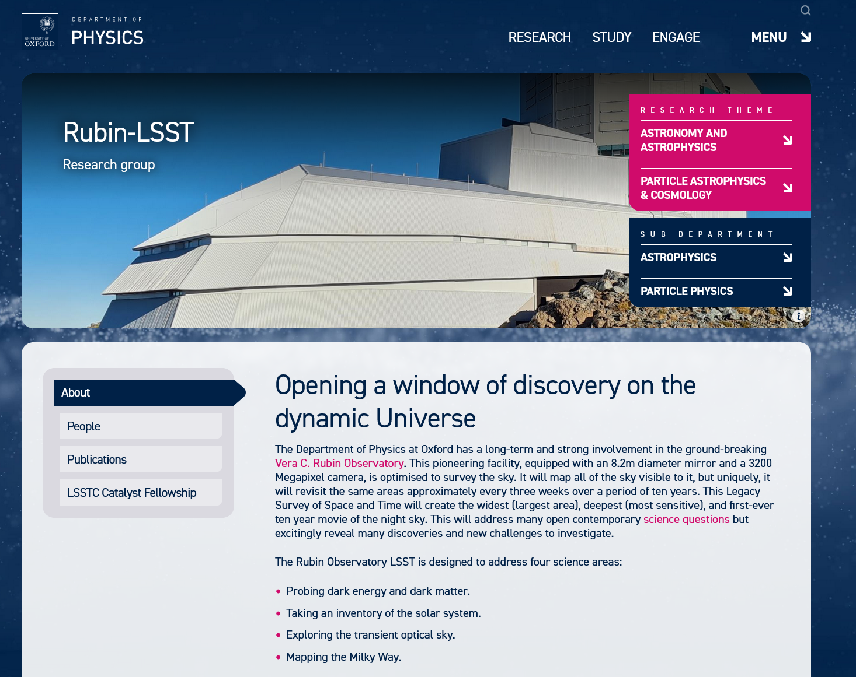
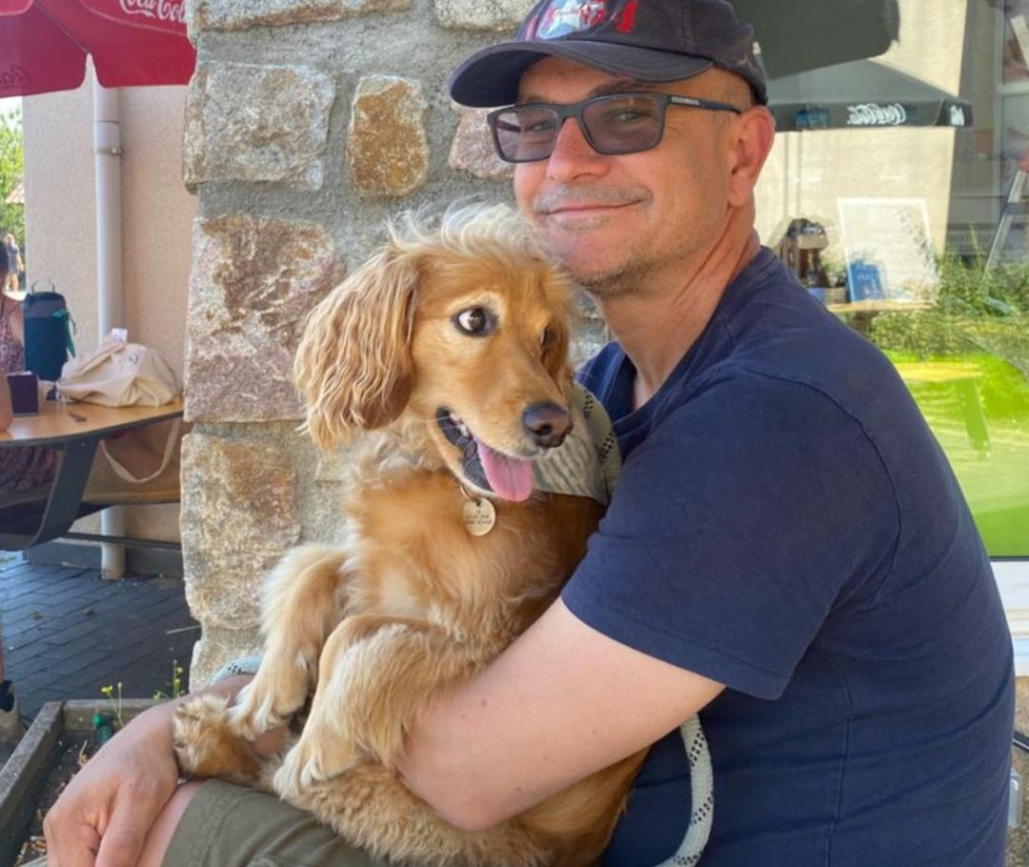
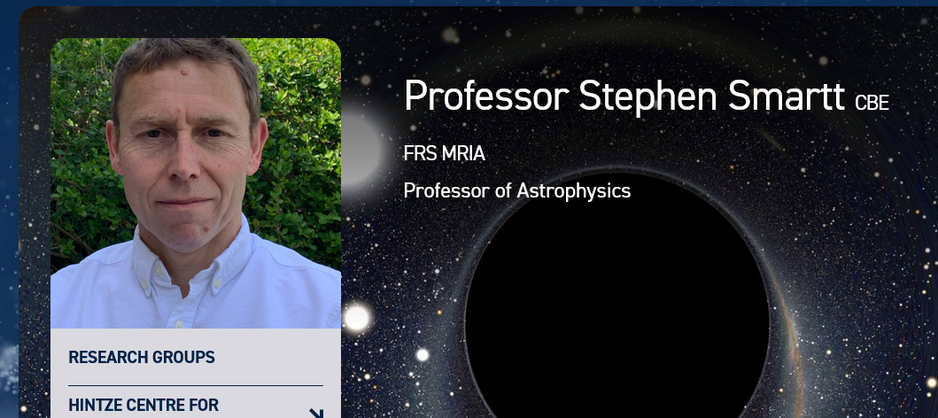
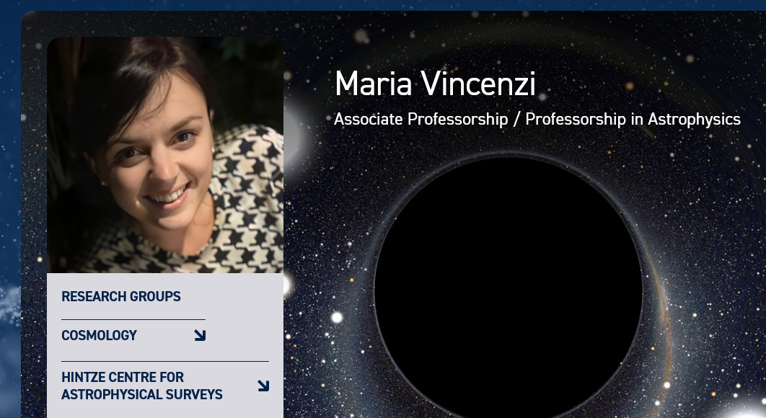
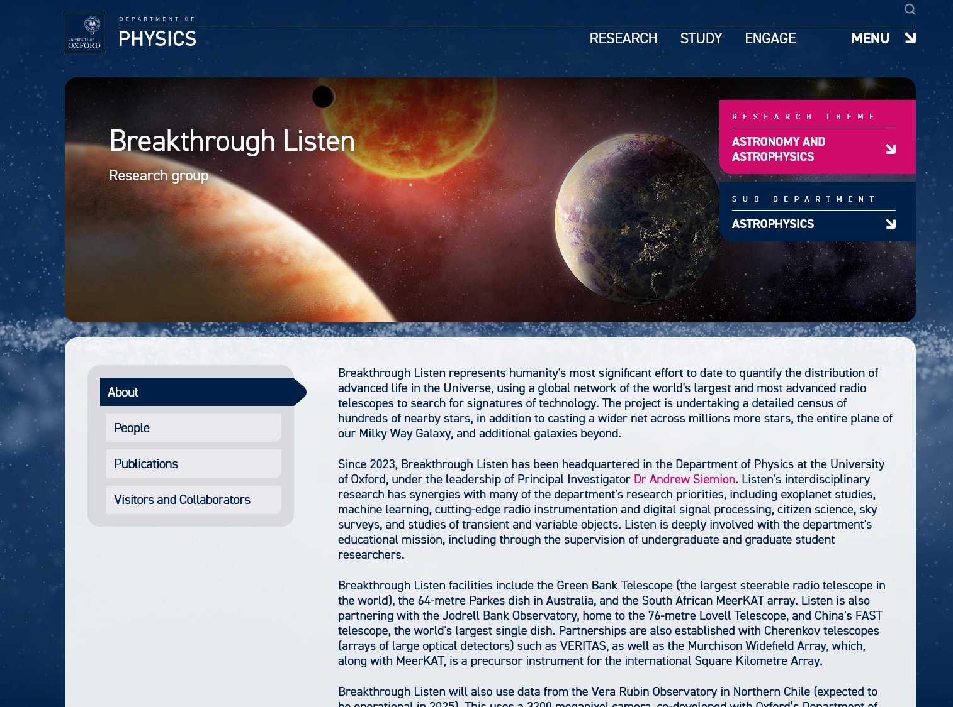
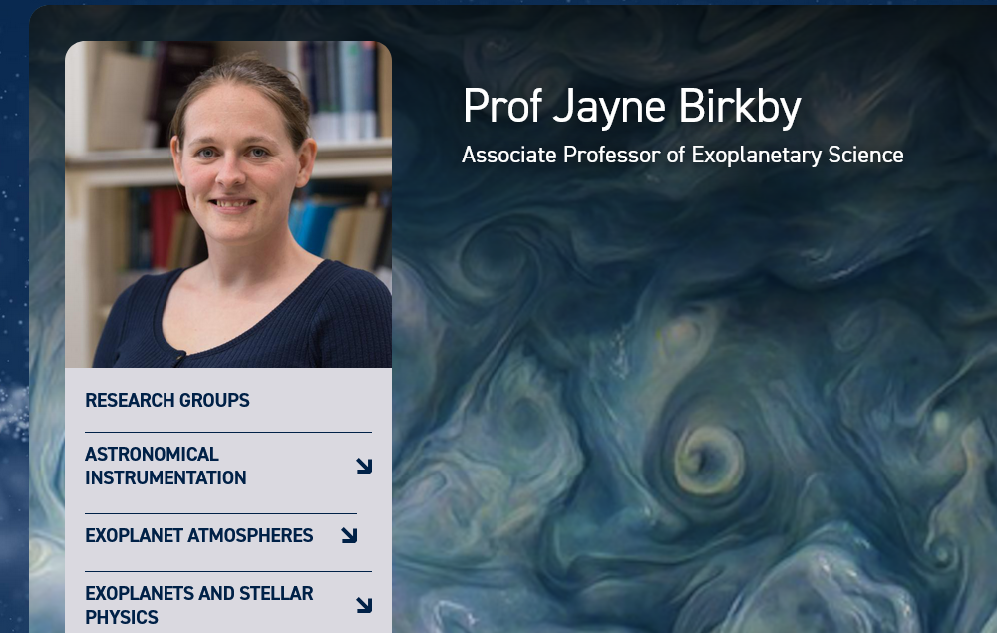
Ian was a major player in Oxford’s involvement in LSST / Rubin (a very powerful new survey telescope due to start operations next year or so), a very strong aspect which he brought with him when he arrived (his group made some detectors, and of course we harvest the astronomy).
Ian and I spent a _long_ time (many meetings and many dinners) working together to bring Breakthrough Listen to Oxford.
Similarly, we worked together a lot on the Wetton chair (which Stephen Smartt got) and Ian strongly supported our hires of Jayne Birkby and Maria Vincenzi to Assoc Professor posts.

Slide 11
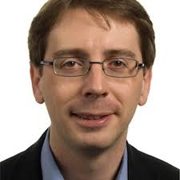
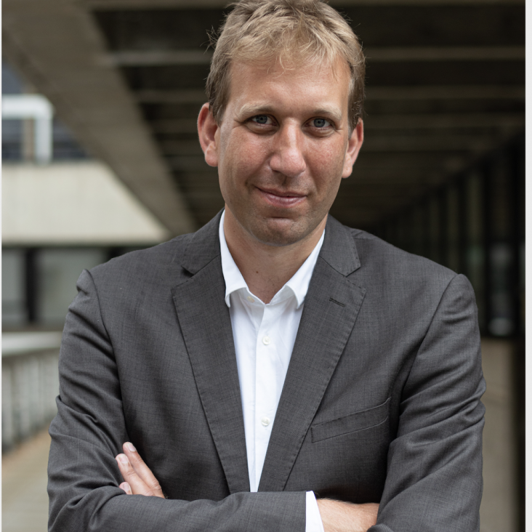
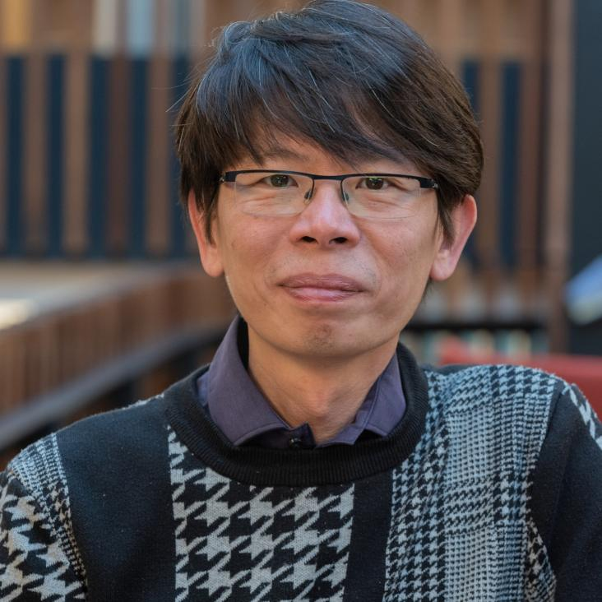
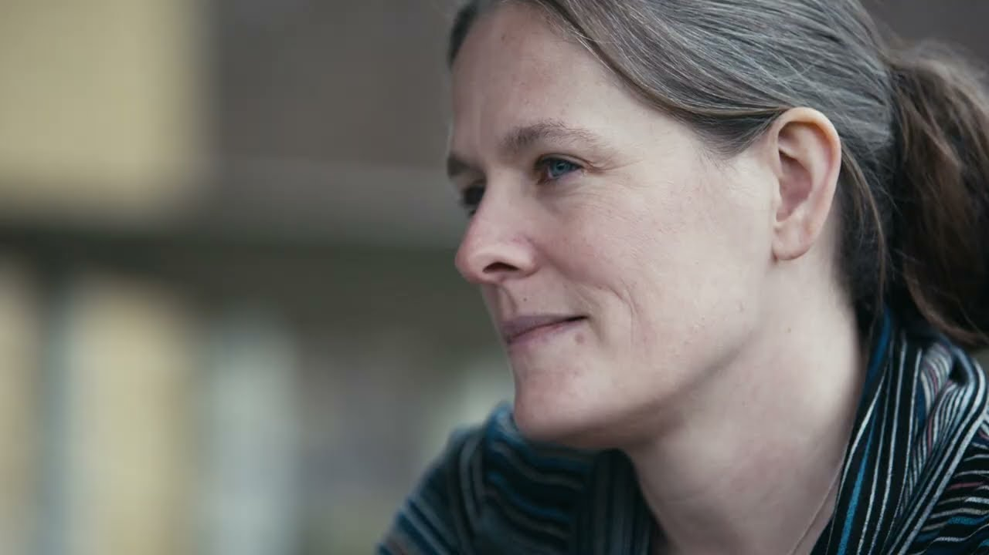
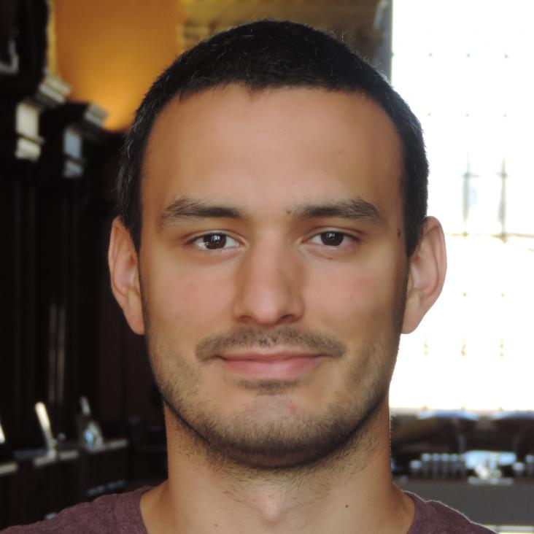
Andy Bunker
Ian was very supportive when I got my ERC, enabling me to concentrate on research after the James Webb Space Telescope launch.
Chris Lintott
Ian’s major contribution to astrophysics was, of course, his work on the camera for what is now the Vera Rubin Observatory. He was involved in the project in the US, being instrumental in bringing the Department of Energy on board as a major funder, and using expertise in particle physics instrumentation for this project. Early in his time in Oxford, there was a meeting set up for those of us in astro interested in the project to chat to this new particle physics chair - Ian’s delight on turning up (late) and seeing the BIPAC seminar room crammed with people eager to work with him was palpable, and infectious. Through the more than a decade long process of construction, Ian was key to making sure that the UK - and Oxford - played a strong role, helping secure STFC funding for operations and gearing up research ready to take advantage of the data this massive sky survey will shortly start producing. The magnificent camera he helped design - the largest ever built for astronomy - is now at the telescope, and we’ll think of him when the first photons hit it.
Boon Kok Tan
Ian certainly help to facilitate my contract situation.
Jayne Birkby
I was a hire during Ian’s HoD tenure. I remember his deep enthusiasm, attention, and care about the grander/long-term research plans I was proposing and his unwavering support even at that early stage.
David Alonso
he played a significant role in Oxford getting involved in LSST early on.
He facilitated the joint PhD positions with IPMU
Much lower-level, but he was a lot of help preparing for my ERF, which wasn't even with Oxford.

Slide 12

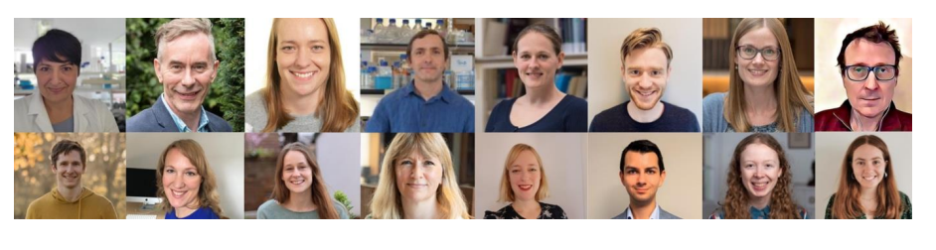

Oxford Physics
Athena Swan submission 2024

