Slide 1
Early Days of the PHENIX Experiment and the Journey of RHIC Discoveries
W.A. Zajc Physics Department
Columbia University, New York, NY
Thanks to all my PHENIX Collaborators and other colleagues at RHIC
This work was supported by the United States Department of Energy Grant DOE-FG02-86ER-40281
Notes:
Mar-99 Private Hulk
Time to physics
Youngest
Pub history from vigdor
QGP cites
Praveen?
T-shirt plot
Luminosity from Roser
Chair?

Slide 2
Overview
The emphasis will be on truly early days
More history than science
Mostly pictures
It’s all about PHENIX … ☺

Slide 3
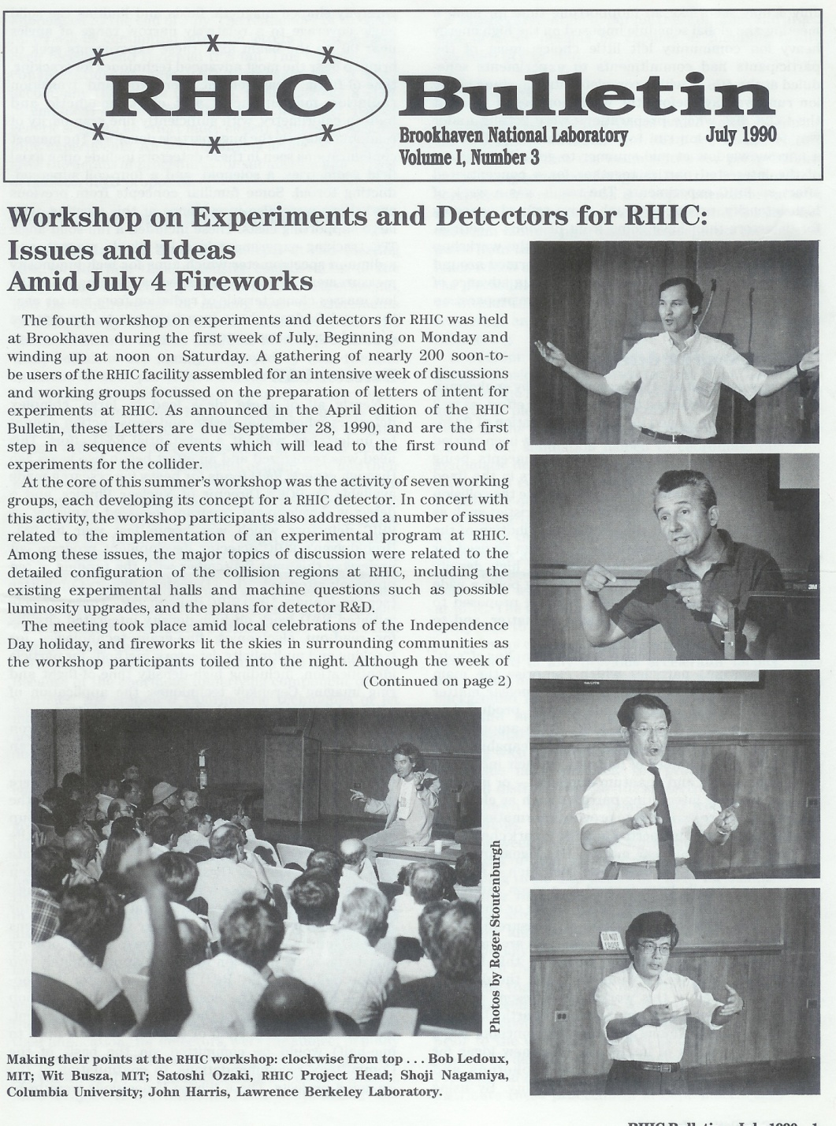
In the beginning …
1990: Workshop over July 4th holiday at BNL
Converged (?) to 7 working groups on various detector proposals

Slide 4
In the beginning …
1990: Workshop over July 4th holiday at BNL
Converged (?) to 7 working groups on various detector proposals

Slide 5
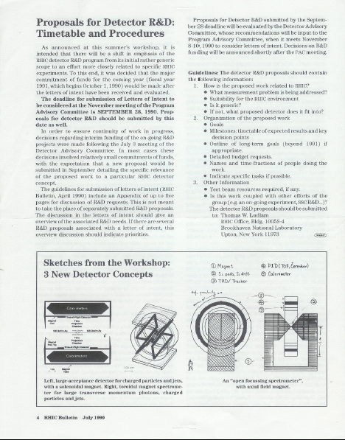
Our Collective DNA

Slide 6
Our Collective DNA

Slide 7
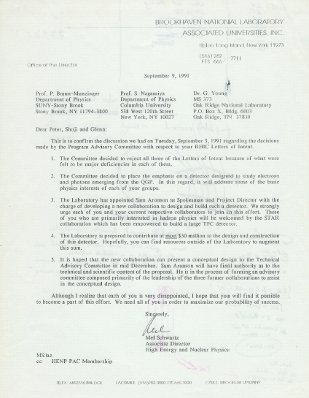
1991 Labor Day Massacre
RIP:
Dimuon
TALES/SPARC
OASIS
Née
RE2
“RHIC Experiment 2”

Slide 8

1991 Labor Day Massacre
“reject all three Letters of Intent because of what were felt to be major deficiencies in each of them.”
“The Committee decided to place the emphasis on a detector designed to measure electrons and photons emerging from the QGP.”
“The Laboratory has appointed Sam Aronson as Spokesman and Project Director.”
“Those of you who are primarily interested in hadron physics will be welcomed by the STAR Collaboration which has been empowered to build a large TPC detector.”
“The Laboratory is prepared to contributed at most $30 million to the design and construction of this detector.

Slide 9
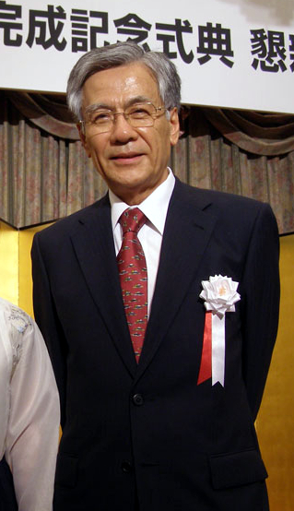
A Long Interregnum…
Dominated by the struggles you can easily imagine that follow from forced marriage of three major experiments…
Most significant event: Profoundly wise decision by Sam Aronson to separate Project Director and Spokesperson ➔ Shoji Nagamiya
先生
大
Notes:
大先生

Slide 10
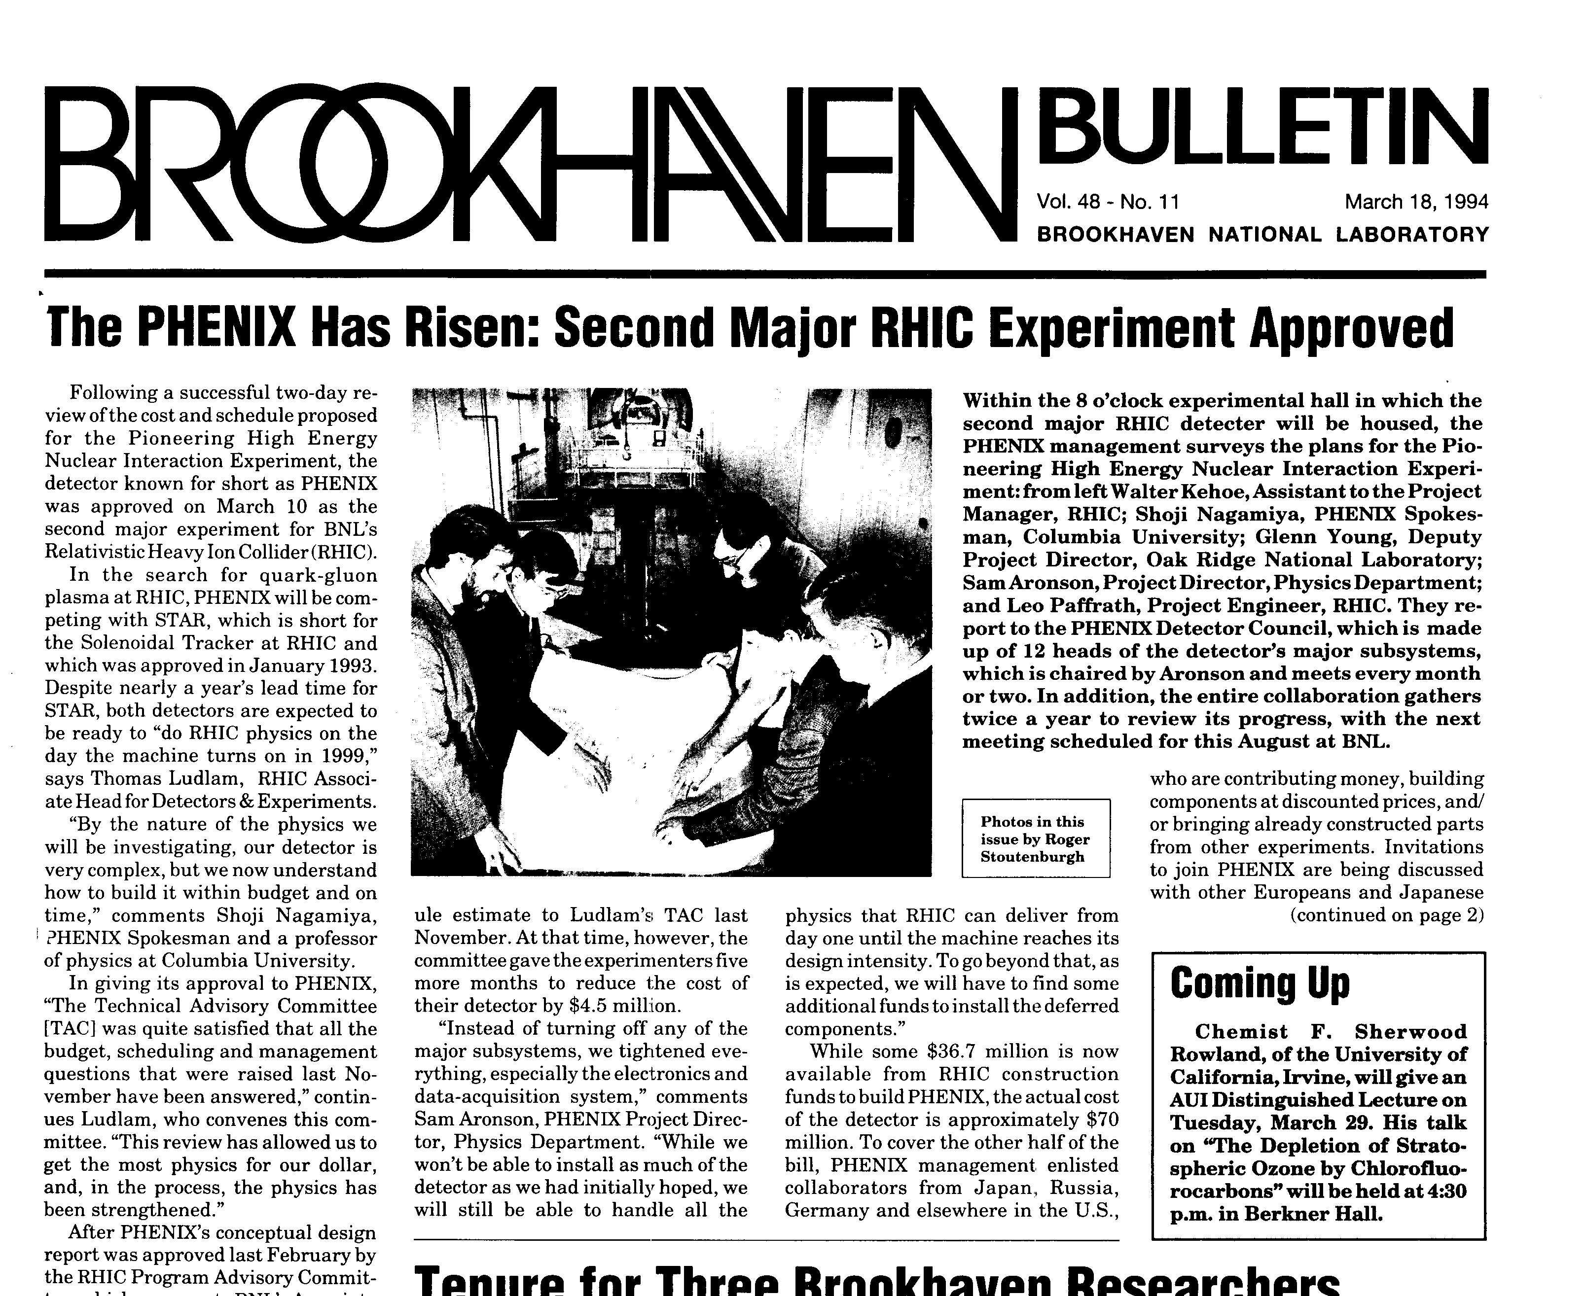
PHENIX Is Born
PHENIX: 10-Mar-94 (STAR: Jan-93)
Despite nearly (sic) a year’s lead time for STAR, both detectors are expected to be ready to “do RHIC physics on the day the machine turns on in 1999”.
(To reduce costs) “Instead of turning off any of the major subsystems, we tightened everything, especially the electronics and data acquisition system”.

Slide 11
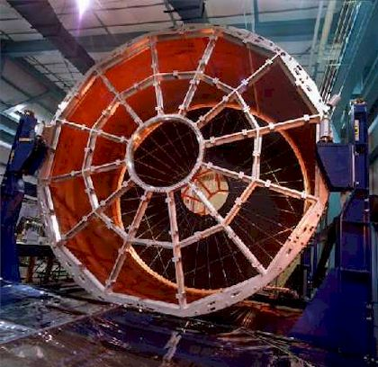
STAR TPC circa 1997

Slide 12
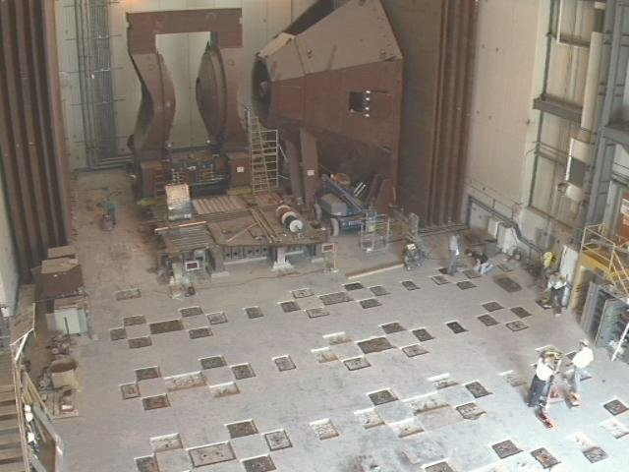
PHENIX 25-Jun-97

Slide 13
Question
How do you overcome a 1+ year head-start by a better organized and more coherent effort ??
First step: Know your competition.

Slide 14

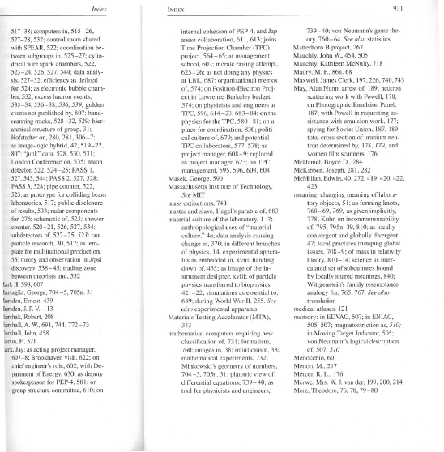
1997: Insider Knowledge Published …

Slide 15
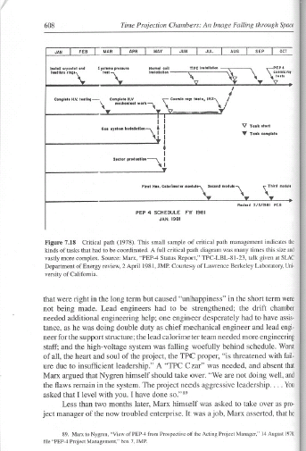
A Worked Example
Jay Marx was the Project Manager on the first (~1978) large TPC
Jay and John got this, allowing them to defer sub-systems while preserving TPC physics
Key difference from PHENIX:
The design of PHENIX required this, making Day-1 readiness very challenging
“the heart and soul of the project, the TPC proper”
(To reduce costs) “Instead of turning off any of the major subsystems, we tightened everything…”

Slide 16

Doing Triage
Mar-97, Costa Mesa workshop: Abandon all tracking, just measure neutral mesons in calorimeter??
No !
Jul-98: Ames meeting – too much experiment left at the end of the money…

Slide 17
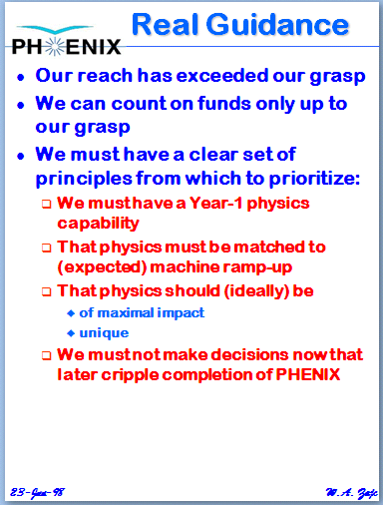
Doing Triage
Mar-97, Costa Mesa workshop: Abandon all tracking, just measure neutral mesons in calorimeter??
No !
Jul-98: Ames meeting – too much experiment left at the end of the money…

Slide 18
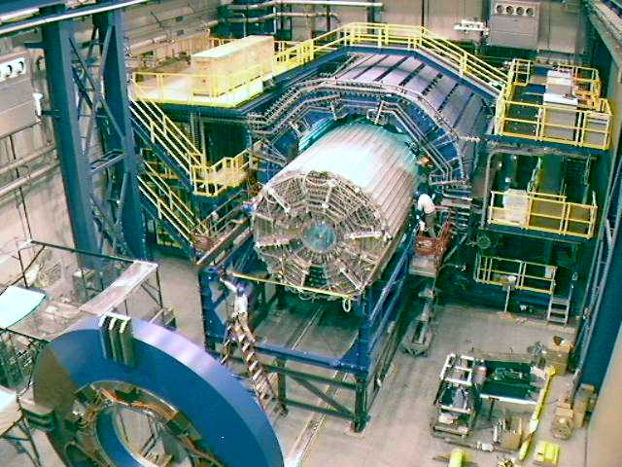
STAR Circa Nov-98

Slide 19
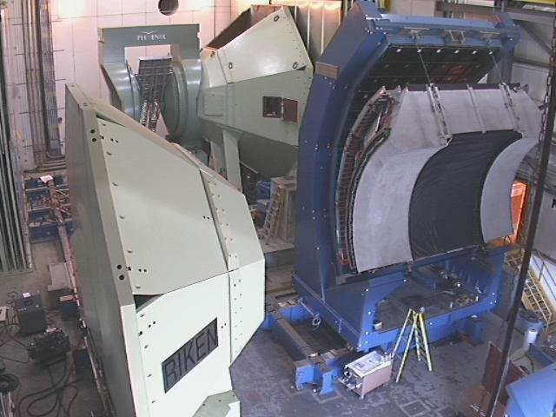
PHENIX Nov-98
Some assembly required ….

Slide 20
STAR Circa Nov-98

Slide 21
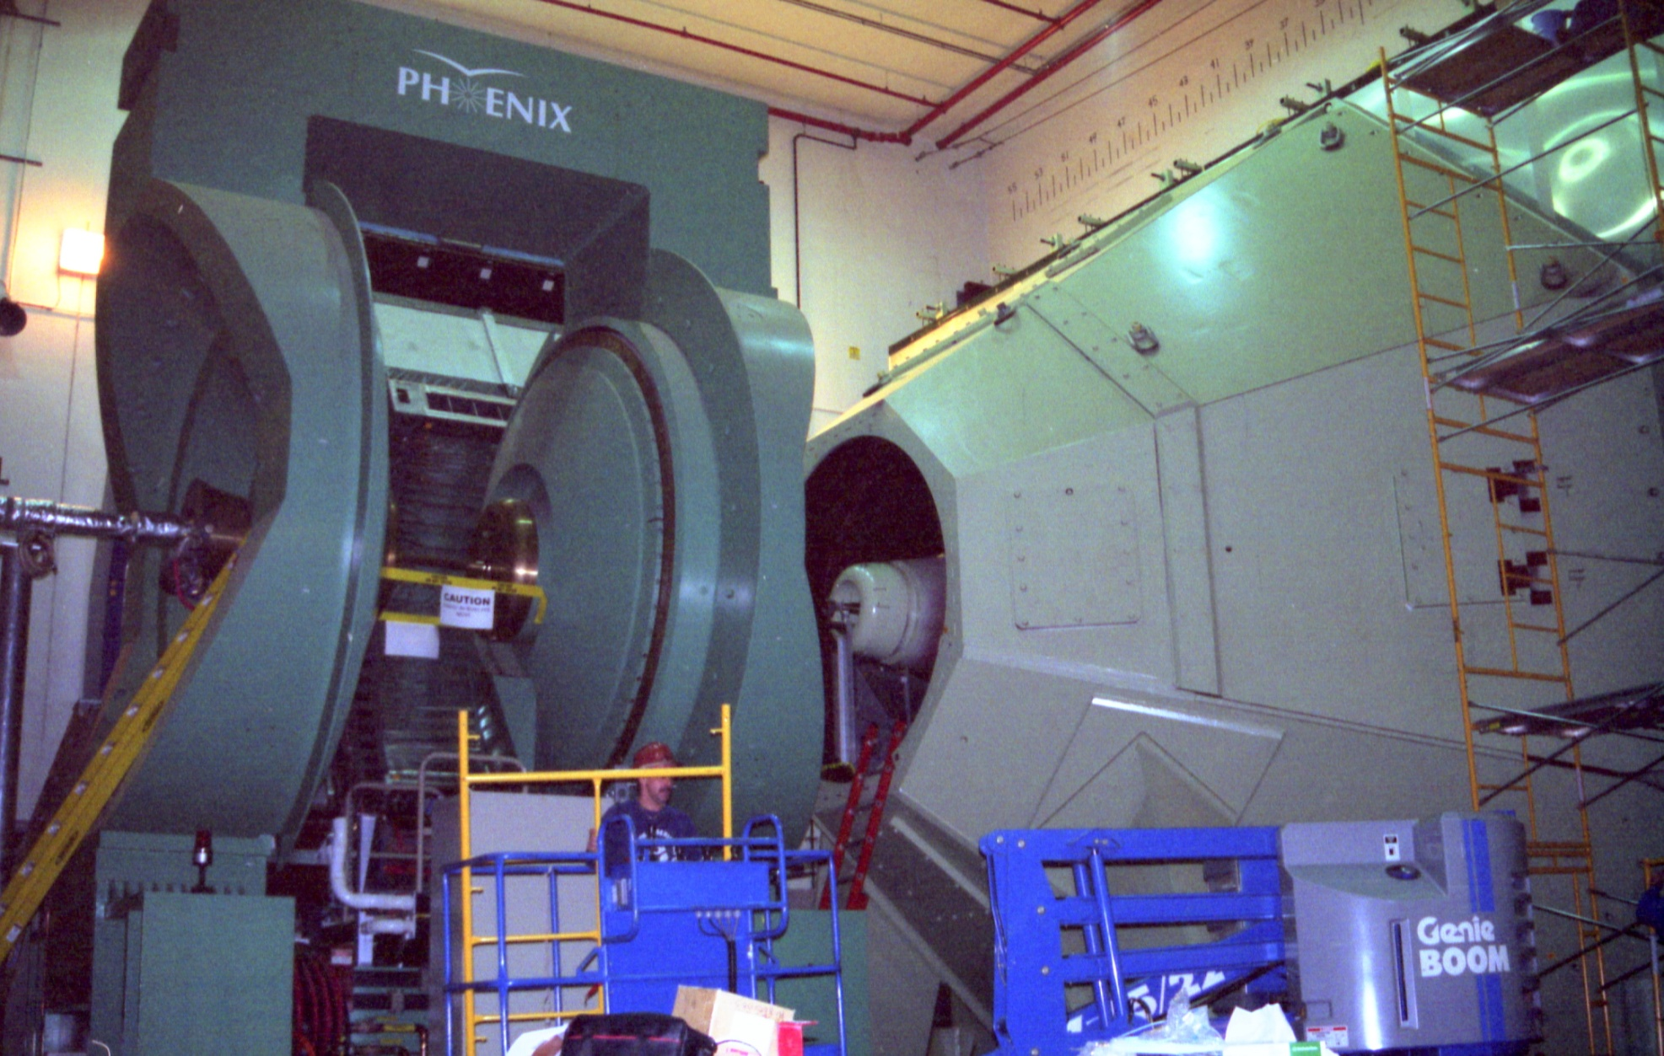
PHENIX Minimalism
The PHENIX version of stairs

Slide 22
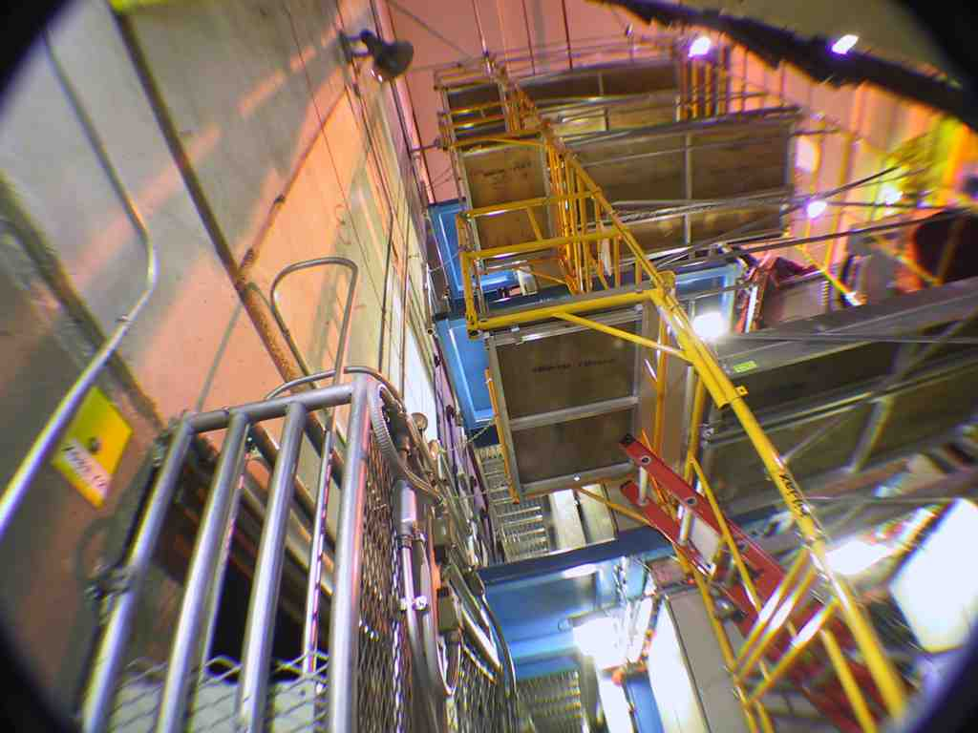
Stairs Are For Sissies

Slide 23
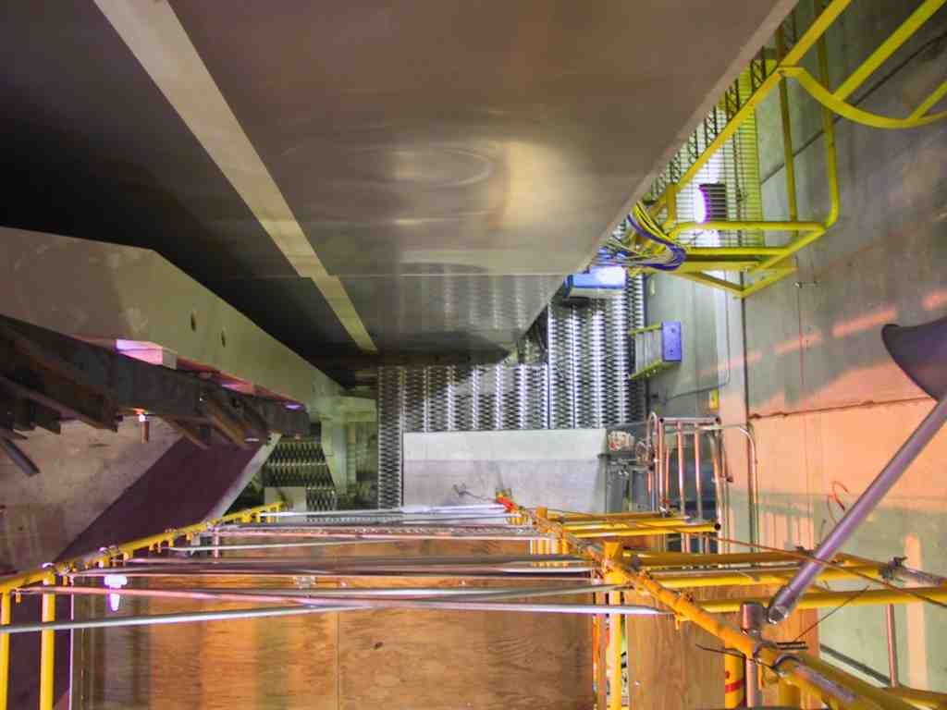
Umm, Maybe I’m a Sissy…

Slide 24
Imitation is the Sincerest Form of…
Reports in from the field (1997): “ ‘Relentless encouragement’ is a good catch phrase. It's what xxxx xxxxxx tells me is the stunning difference between STAR and PHENIX management.”

Slide 25
Building Morale
Thursday, December 10th , 1998: 1st Annual PHENIX Holiday Party
Held at Brookhaven Center
Institute goofy “PHENIX-ian Awards”
Notes:
---------------------------------------------------------------------------
Winners of 1998 PHENIXian Awards
Special Award (not previously announced):
Donna Earley and Patricia Meehan - Most excellent party organizers
Dedication Awards
Bill McGahern - Comes to work earliest
Gabor David - Leave's work latest
Vince Cianciolo - Most likely to work nights/weekends
Appearance Awards
Craig Woody - Has the neatest desk
Bob Hoade - Looks best in a hard hat
Hiroyuki Sako - Looks best sitting at a computer terminal
Fitness Awards
Emil & Erik Gustafsson - Healthiest eater
Sebastian White - Eats the most junk food
Wlodek Guryn - Exercises the most
Congeniality Awards (a.k.a. girl/boy scout awards)
Richard Hogue - Most helpful
Kazu Kurita - Most friendly
Naohito Saito - Most courteous
Sergei Belikov - Most cheerful
Vicki Greene - Most thrifty
General Awards
Mike Tannenbaum - Travels the farthest to Work
Jeff Mitchell - Most newly in love
Glenn Young - Shows the most transparencies during a talk

Slide 26
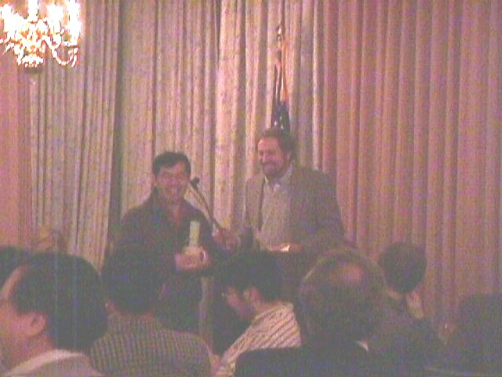
Most Friendly

Slide 27
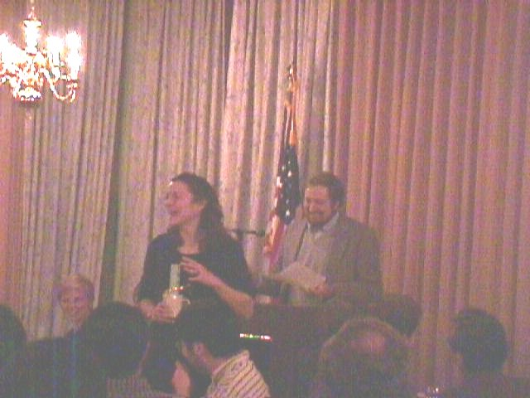
Most Thrifty

Slide 28
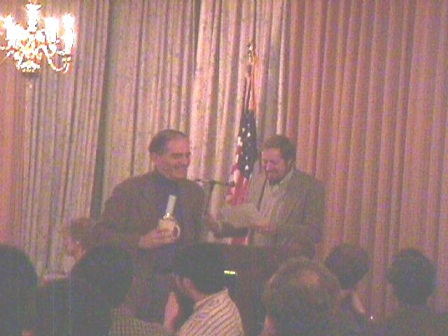
Travels Farthest to Work

Slide 29
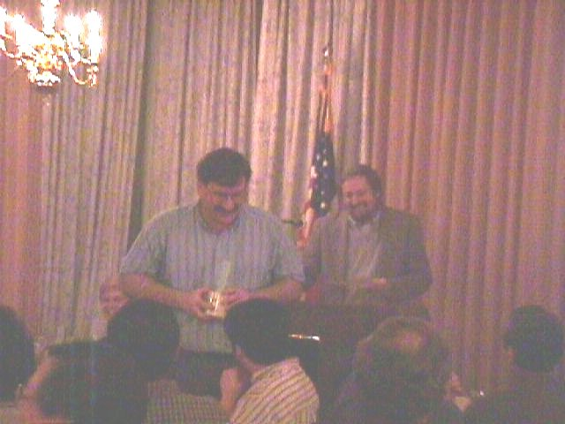
Shows Most Transparencies in a Talk

Slide 30

Request for Remarks from BNL Management

Slide 31
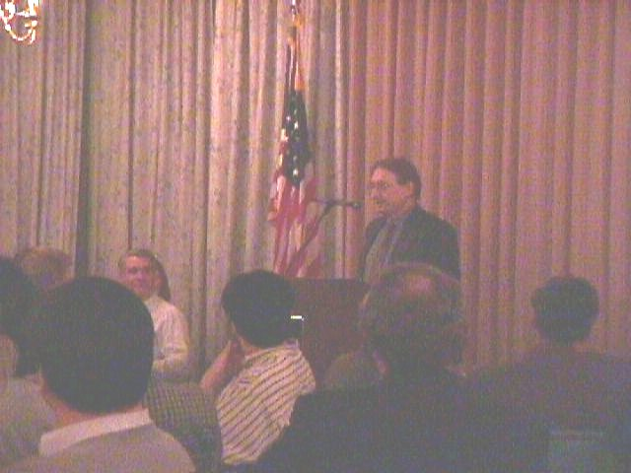

Management Morale Building
disparaging remarks on PHENIX management…

Slide 32
Management Morale Building
Everybody knows PHENIX has problems and won’t be ready on Day-1, but not to worry, I suppose eventually you’ll make it work…

Slide 33
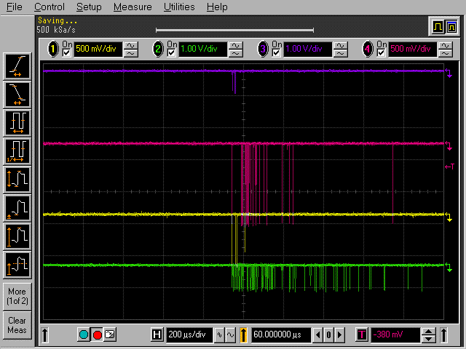
1999: RHIC Turn-On
RHIC broadcast messages
for: Jul 3 00:10:55 1999
Updated 22:50 Friday July 2nd, 1999
BLUE RING COMMISSIONING CONTINUES
2250: Beam restored to sector 10. PHENIX corroborated the first shot of beam with coincident events in scintillators and ZDC!
BBN
TrigN*TrigS
BBN*BBS
ZDCN*ZDCS
Jul-99: Successful engineering run of RHIC Blue Ring, parts of PHENIX
Oct-99: Suggestions of 2-4 week RHIC Schedule delays
Nov-99: “The timing of Quark Matter 2000 was predicated on the end of the first RHIC physics run and the availability of local conference facilities. The realities of bringing on-line a new generation of machines and world-class detectors suggests that we revisit this schedule.”

Slide 34
1999: A Strange Morale Booster
Several month RHIC schedule delay
(Mechanically unstable vacuum pipe support inside cryostat for short corrector magnet…)
18-Oct-99: (Public) “The recently announced delay of the RHIC schedule provides us with an opportunity to make ready a significant fraction of the Baseline detector for the very start of RHIC operations.”
(Private): “should be a call to arms to come and help in this last ditch effort to even the playing field with the other experiments!”

Slide 35
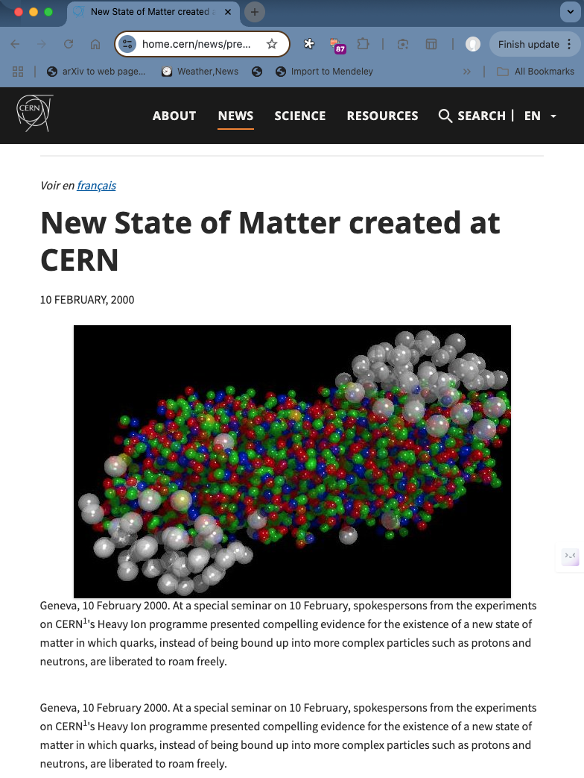
2000 CERN Press Release
“Good” news (from the RHIC perspective): It did not directly claim discovery of the quark-gluon plasma.
Bad news:
Was not linked to publication of peer-reviewed findings.
Nonetheless stated
“the experiments on CERN's Heavy Ion programme presented compelling evidence for the existence of a new state of matter in which quarks, instead of being bound up into more complex particles such as protons and neutrons, are liberated to roam freely.”

Slide 36

First RHIC Phase Transition

Slide 37

First RHIC Phase Transition
1
1

Slide 38


Slide 39

PHENIX Data Debut at QM01

Slide 40
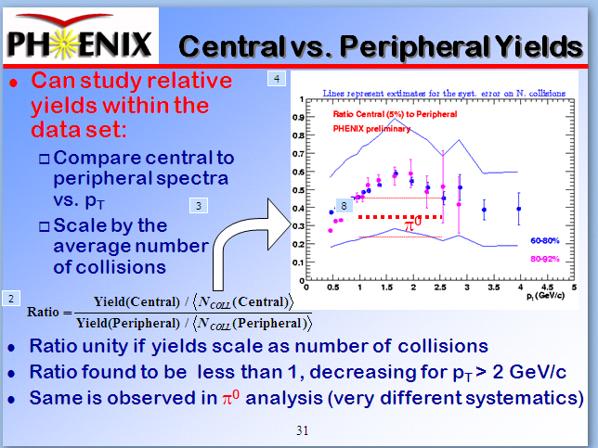
QM01: 1st Jet Quenching Result

Slide 41
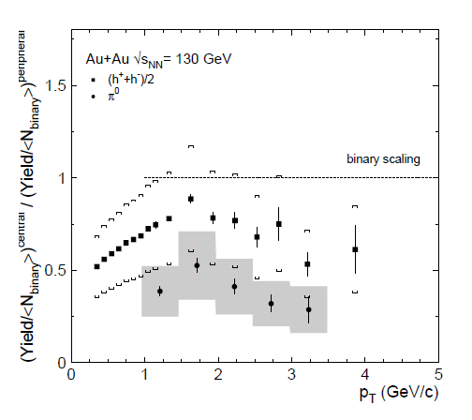
First Jet Quenching Paper
Suppression of hadrons with large transverse momentum in central Au+Au collisions at s(NN)**(1/2) = 130-GeV. (K. Adcox et al.). Sep 2001. 6pp. Phys.Rev.Lett.88:022301,2002. e-Print: nucl-ex/0109003
1282 citations

Slide 42
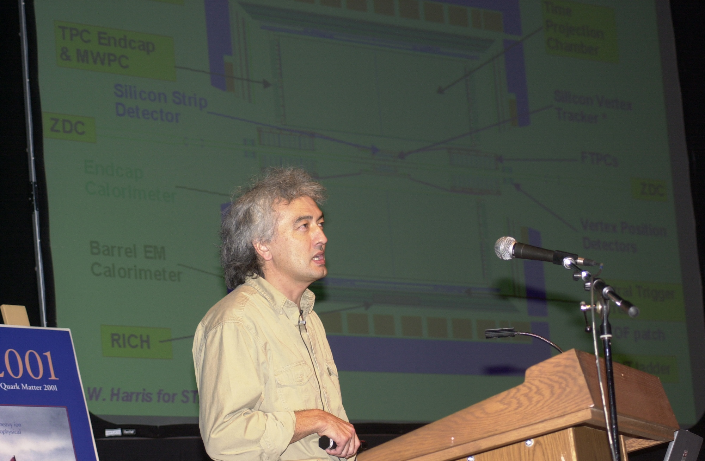
John at QM01

Slide 43
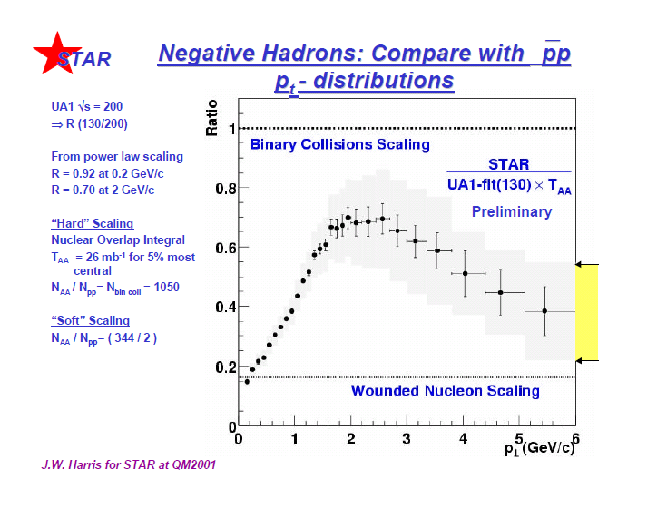
QM01: STAR Results on Quenching

Slide 44
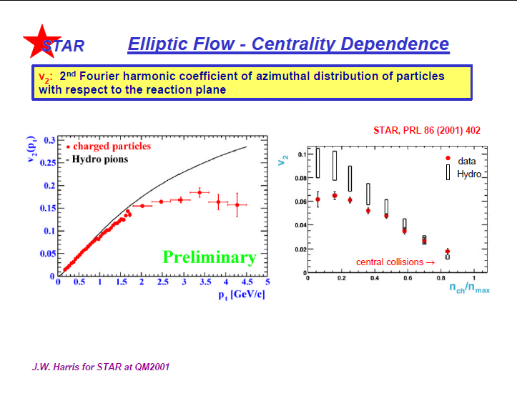
QM01: First Elliptic Flow Results

Slide 45
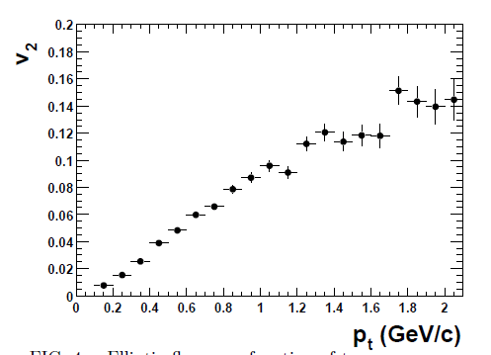
First Elliptic Flow Paper
Elliptic flow in Au + Au collisions at (S(NN))**(1/2) = 130 GeV. (K.H. Ackermann et al.). Phys.Rev.Lett.86:402-407,2001. e-Print: nucl-ex/0009011
906 Citations

Slide 46
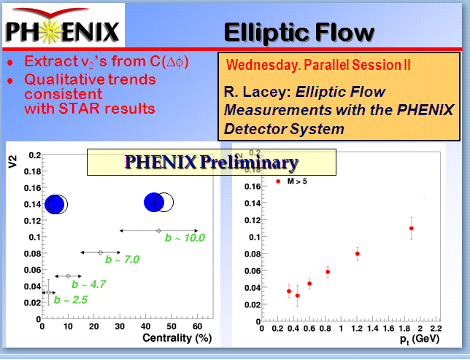
QM01: PHENIX Results on Flow

Slide 47
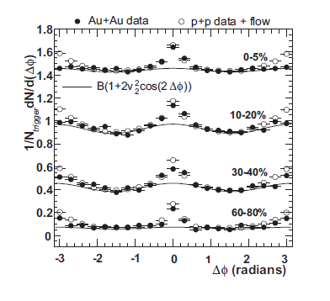
STAR Doing PHENIX Physics
Disappearance of back-to-back high p(T) hadron correlations in central Au+Au collisions at s(NN)**(1/2) = 200-GeV. (C. Adler et al.). Oct 2002. 6pp. Phys.Rev.Lett.90:082302,2003. e-Print: nucl-ex/0210033
959 Citations

Slide 48
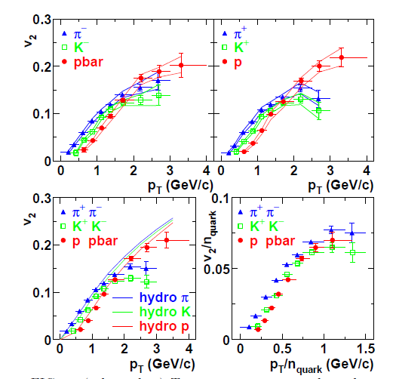
PHENIX doing STAR Physics
Elliptic flow of identified hadrons in Au+Au collisions at s(NN)**(1/2) = 200-GeV. (Stephen Scott Adler et al.). Phys.Rev.Lett.91:182301,2003. e-Print: nucl-ex/0305013
922 citations
HA !
“Those of you who are primarily interested in hadron physics will be welcomed by the STAR Collaboration which has been empowered to build a large TPC detector.”

Slide 49

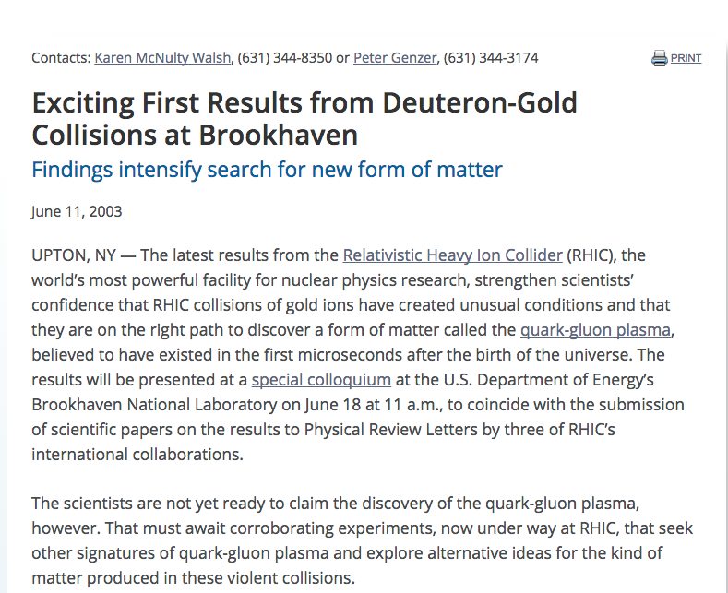
Critical in situ Control Measurement
2000 – first collisions
2001 – major results from all 4 collaborations
2002 – first full-energy Au+Au run
2003 – d+Au control run

Slide 50
Critical in situ Control Measurement
2000 – first collisions
2001 – major results from all 4 collaborations
2002 – first full-energy Au+Au run
2003 – d+Au control run

Slide 51

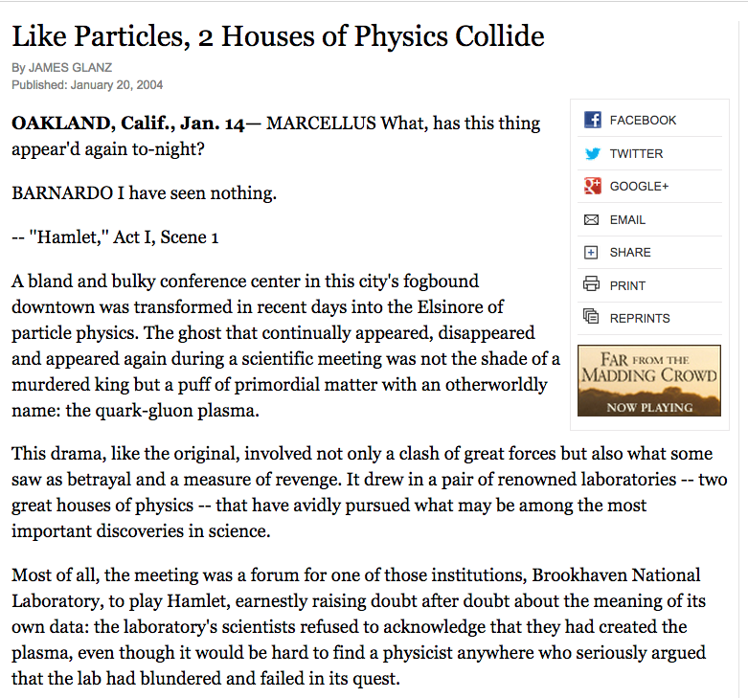
The “Crisis”
Jan-24: 97 RHIC publications but . . .
New York Times article by Jim Glanz emphasized “reluctance” to announce QGP discovery.
This was enormously polarizing . . .

Slide 52
From That Article
…the (previous) CERN announcement ''added more confusion than light to the story’’ (RHIC scientist)
Those words were like daggers . . . “They (BNL) were just starting a half-billion-dollar operation and we (CERN) are saying: ‘Bye-bye. We have stolen your child’ ” (Senior CERN scientist)
To announce a discovery now, Dr. Xyyyyyy said, ‘'the very same people who were very critical have to eat their words.’’
''It's no mystery to me why they haven't announced it,’’ Dr. Mueller said. ''I think the lab has been appropriately cautious.''

Slide 53
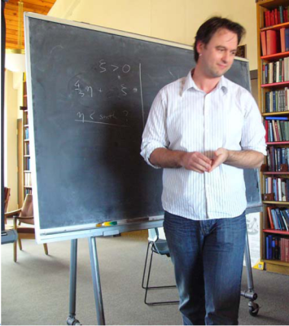
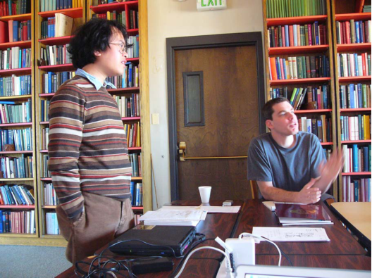
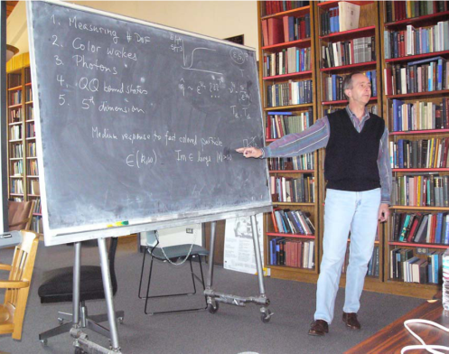
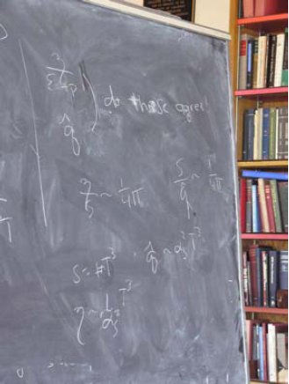
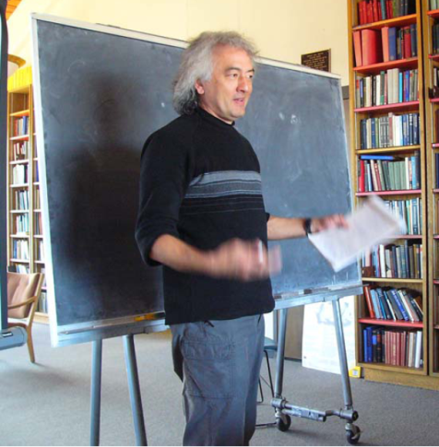
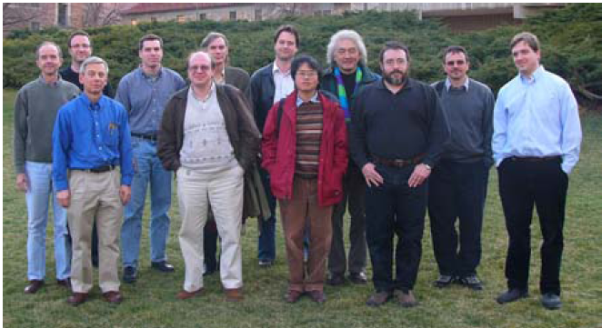
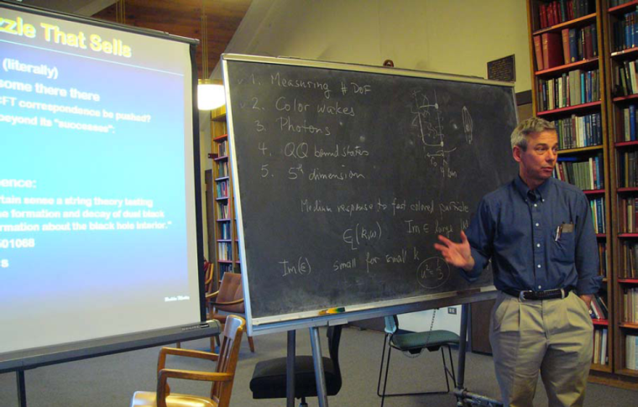
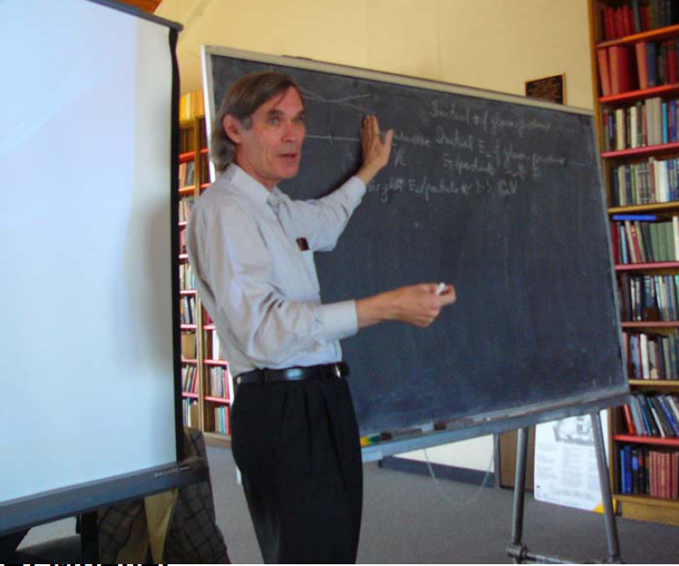
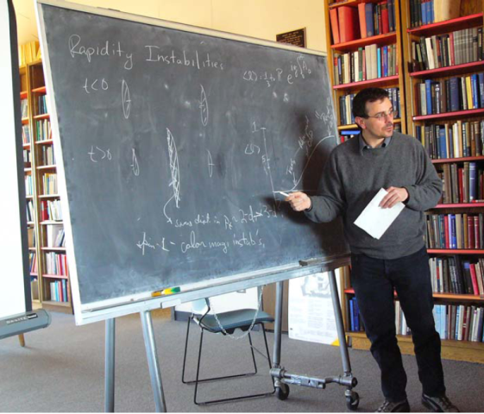
Boulder Workshop Mar-05

Slide 54
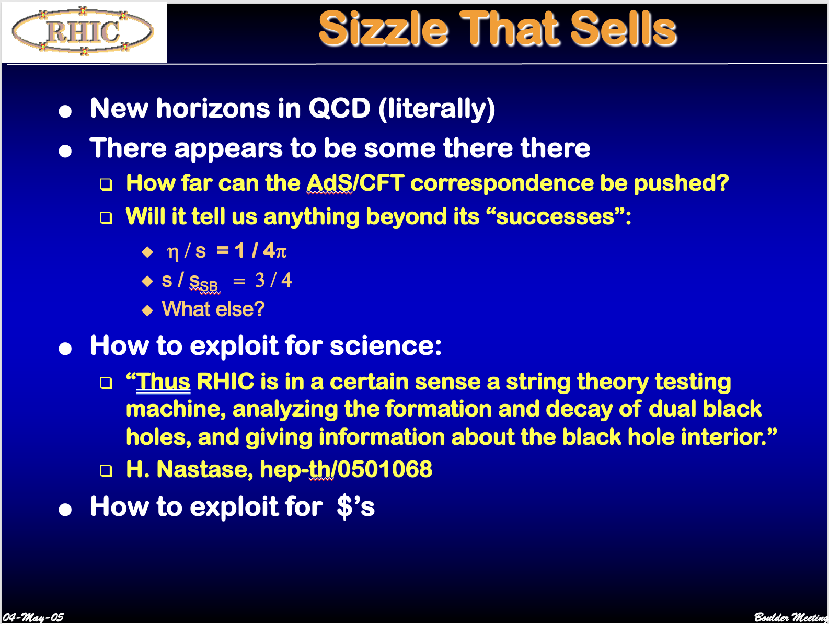
Boulder Workshop Mar-05

Slide 55
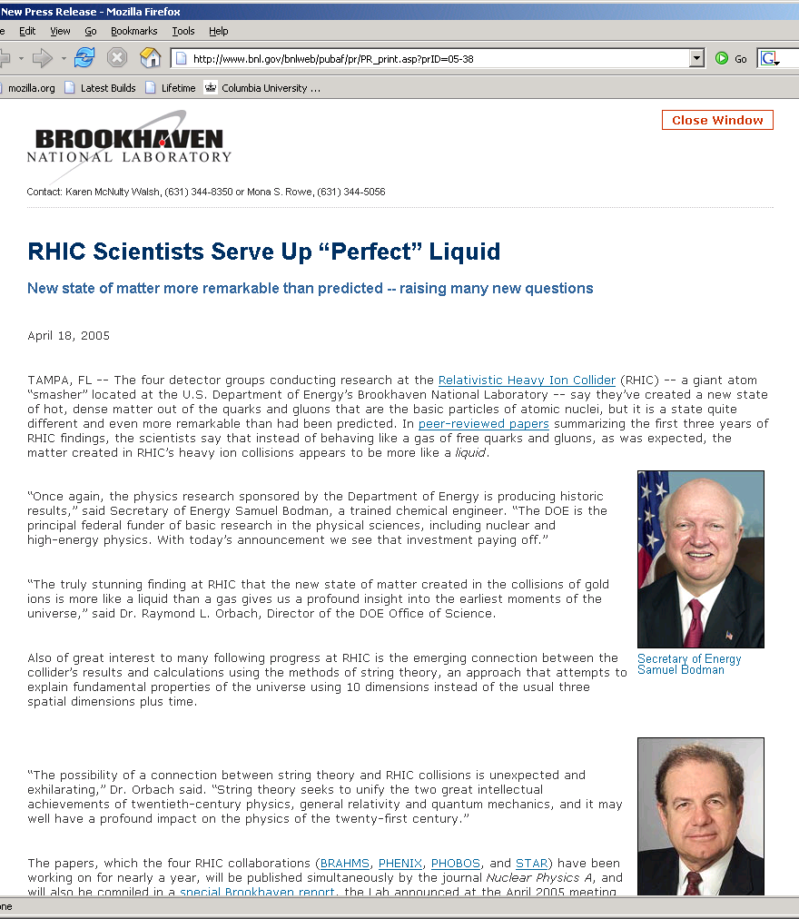

RHIC Success !!

Slide 56
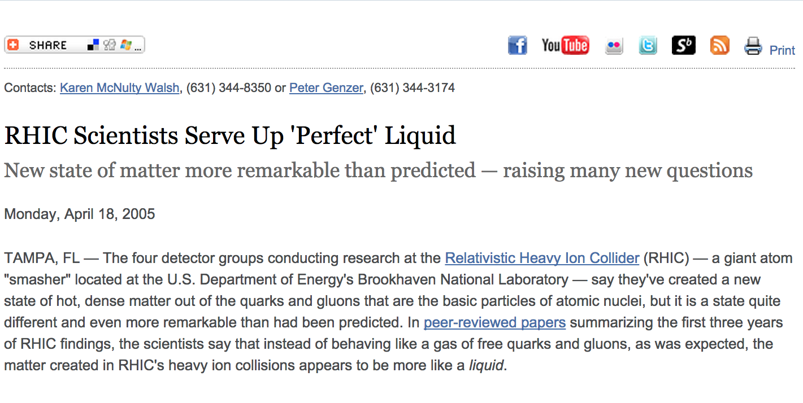
RHIC Scientists Serve Up ‘Perfect’ Liquid

Slide 57
2000 CERN Press Release
“Good” news (from the RHIC perspective): It did not directly claim discovery of the quark-gluon plasma.
Bad news:
Was not linked to publication of peer-reviewed findings.
Nonetheless stated
“the experiments on CERN's Heavy Ion programme presented compelling evidence for the existence of a new state of matter in which quarks, instead of being bound up into more complex particles such as protons and neutrons, are liberated to roam freely.”

Slide 58
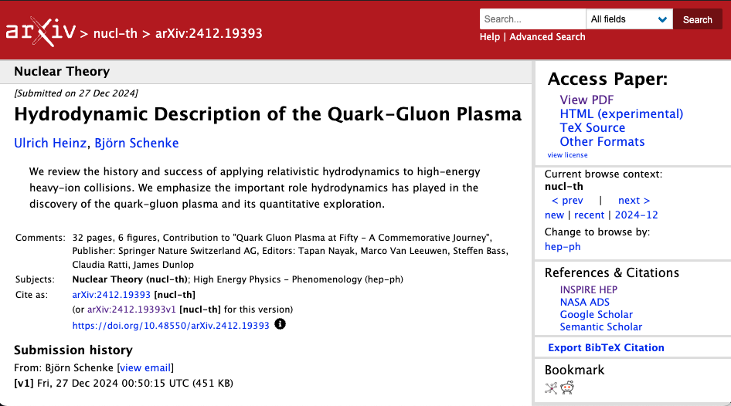
Current Perspective
“Good” news (from the RHIC perspective): It did not directly claim discovery of the quark-gluon plasma.
Bad news:
Was not linked to publication of peer-reviewed findings.
Nonetheless stated
“the experiments on CERN's Heavy Ion programme presented compelling evidence for the existence of a new state of matter in which quarks, instead of being bound up into more complex particles such as protons and neutrons, are liberated to roam freely.”
“Good” news (from the RHIC perspective): It did not directly claim discovery of the quark-gluon plasma.
Bad news:
Was not linked to publication of peer-reviewed findings.
Nonetheless stated
“the experiments on CERN's Heavy Ion programme presented compelling evidence for the existence of a new state of matter in which quarks, instead of being bound up into more complex particles such as protons and neutrons, are liberated to roam freely.”
An assessment of the insights gained from the heavy-ion program at the CERN SPS during the 1980s and 1990s [48] concluded that compelling evidence for the creation of “a new form of matter” had been found but stopped short of claiming unambiguous discovery of the quark-gluon plasma, nor did it comment on its perfectly liquid collective dynamical properties. The latter became only obvious after theory had progressed to a quantitative understanding of the bulk of the very comprehensive and precise experimental data collected at RHIC.

Slide 59
RHIC Discoveries in Perspective
RHIC’s data produced a paradigm shift in our understanding of the quark-gluon plasma.
Nothing could be further from the truth than the old model of QGP as a state where quarks “are liberated to roam freely”.
Rather, asymptotic freedom is relevant only asymptotically (!)
Instead – the quark-gluon plasma is the most strongly-coupled liquid ever produced, quantified in the very low value of η/s .
This will be (is) the textbook legacy of RHIC.

Slide 60
Back-up Material
W.A. Zajc Physics Department
Columbia University, New York, NY
Thanks to all my PHENIX Collaborators and other colleagues at RHIC
This work was supported by the United States Department of Energy Grant DOE-FG02-86ER-40281
Notes:
Mar-99 Private Hulk
Time to physics
Youngest
Pub history from vigdor
QGP cites
Praveen?
T-shirt plot
Luminosity from Roser
Chair?

Slide 61

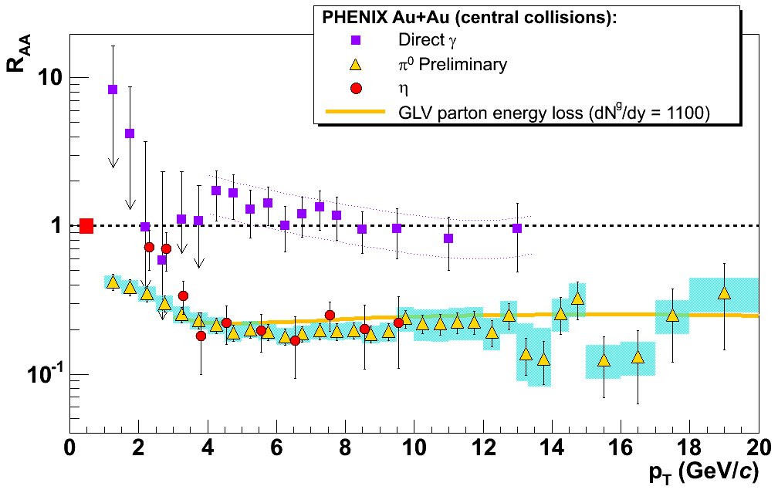
Critical in situ Control Measurements
No suppression in d+Au collisions
Primordial rate of hard scatterings as per QCD:
Verified in yield of open charm production
Verified in direct photon production
Perturbative primordial yields in Au+Au collisions absorbed in strongly-coupled dense, opaque medium
~ 100 x normal nuclear density ε ~ 100 ε₀

Slide 62
Also – an Intensified Search for Improved Theory
The measures of hydrodynamics flow at RHIC were in qualitative agreement with ideal relativistic hydrodynamics.
Ideal → no dissipation → zero viscosity
But in 2003-4 a new bound appeared from the AdS/CFT (Anti-de Sitter Space/Conformal Field Theory) correspondence in string theory (!):
A Viscosity Bound Conjecture, P. Kovtun, D.T. Son, A.O. Starinets, hep-th/0405231
In retrospect – anticipated in a 1985 argument using the uncertainty principle: Dissipative Phenomena in Quark-Gluon Plasmas, P. Danielewicz, M. Gyulassy, Phys.Rev. D31, 53,1985.

Slide 63
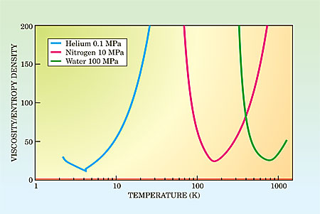
Is The Bound Respected ?
All ordinary fluids exceed the KSS bound by factors of 10-1000.
“A Viscosity Bound Conjecture”, P. Kovtun, D.T. Son, A.O. Starinets, hep-th/0405231
4π x KSS bound is at unity on this scale.
Various guess-timates strongly suggested the value of η/s in the QGP formed at RHIC fell below the observed minimum for all known fluids (!)
4π x

Slide 64
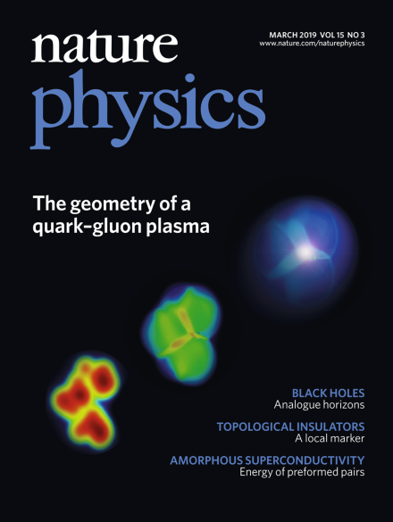

The Game Was Afoot !
Theory community embarked on a decade long effort to
Develop truly relativistic viscous hydrodynamics
Control all aspects of modeling to provide reliable error estimation
In the meantime, RHIC discoveries continued unabated:
Flow signatures simplified at quark level
Extend v₂ to v₃, v₄, . . .
Systematic exploration of flow in small systems
Heavy quarks (charm) participate in the “bulk” flow
Direct photon production consistent with QGP
Extraordinary vorticity of the collision state

Slide 65
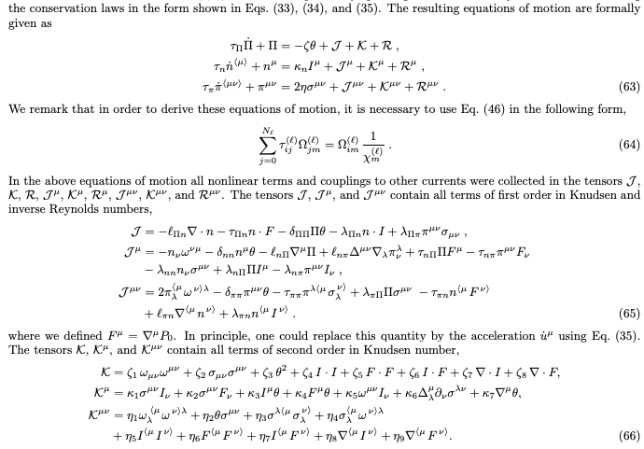
The Game Was Afoot !
Theory community embarked on a decade long effort to
Develop truly relativistic viscous hydrodynamics – a hard problem!
Derivation of transient relativistic fluid dynamics from the Boltzmann equation, G. Denicol et al., Phys.Rev. D85 114047, (2012). https://inspirehep.net/literature/1089847

Slide 66

The Game Was Afoot !
Theory community embarked on a decade long effort to
Develop truly relativistic viscous hydrodynamics
Control all aspects of modeling to provide reliable error estimation
A multi-scale problem
Benefited from the development of multi-parameter Bayesian estimation in cosmology
Error estimates on η/s now available conditioned on ~20 parameter “marginalization”

Slide 67


Reliable Parameter Estimation
Most recent results indicate
Longitudinal Dynamics of Large and Small Systems from a 3D Bayesian Calibration of RHIC Top-energy Collision Data, JETSCAPE Collaboration, A. Mankolli et al., https://arxiv.org/abs/2601.17234

Slide 68

With Fully Marginalized Errors
Note also that this analysis also estimates the temperature dependence of η/s .

Slide 69
Is The Bound Respected ?
All ordinary fluids exceed the KSS bound by factors of 10-1000
“A Viscosity Bound Conjecture”, P. Kovtun, D.T. Son, A.O. Starinets, hep-th/0405231
4π x KSS bound is at unity on this scale.
RHIC QGP is at (1-2) x unity on this scale
- but at a temperature ~ 10¹⁰ times higher !
4π x

Slide 70

RHIC’s Final Day – 9 am, February 6th , 2026

Slide 71
RIP RHIC
RHIC has indeed fulfilled its destiny.
The results from the world’s most versatile collider have revolutionized our understanding of non-perturbative QCD and the quark-gluon plasma.
But RHIC will not Rest In Peace, but instead . . .
Will form the basis for the Electron-Ion Collider

Slide 72
Causality in the White Paper Process
12-Feb-04: Discussion Sam Aronson, Tim Hallman, WZ “RHIC Science Retreat”
20-Feb-04: Tim Hallman, WZ discuss possible “white papers”
25-Feb-04: Spokesperson’s meeting, WZ charged to draft a process
27-Feb-04: Experiments invited to contribute ~15-page paper to RBRC Series
29-Feb-04: Draft process for White Papers’s distributed to other spokespersons + Sam Aronson
02-Mar-04: Spokespersons discuss politely declining publication in RBRC Series
Unrealistic time scale (April 5)
Interference with existing White Paper process
Would replicate rather than address CERN announcement
04-Mar-04: Draft response circulated (7 AM); revised draft (3 PM)
(Extraordinary period of work, writing, negotiations)
04-Oct-04: PHENIX WP posted to archive, other experiments to follow
( Another extraordinary period consolidating understanding strong coupling ←→ η / s…)
18-Apr-05: Perfect liquid announcement

Slide 73

Addressing the nature of QGP discovery
From the PHENIX “White Paper”
nucl-ex/0410003
(1958 citations)
Q: What is the most relevant “experimentally observed property”?
A. Viscosity (suitably normalized)

Slide 74

PHENIX (well, me) Bragging at QM01

Slide 75

QM01: A Failed Zajc Prediction

Slide 76

(Minimal) AdS / CFT
Graviton with 5-momentum k in bulk satisfies k•k = 0 → described by 4 numbers
Those 4 numbers describe virtual gauge quanta on 4-d boundary
( Adopted from S. Brodsky figure )

Slide 77
18-Feb-00
QUARK MATTER POSTPONEMENT We would like to announce that the next Quark Matter conference has been postponed from its original dates of July 17-22, 2000 to January 15-20, 2001 due to the interference of the original date with the extension of the first RHIC running period.

Slide 78


Slide 79



Slide 80
26-Jul-02: BNL Institutional Plan site visit: Undersecretary, Director of Office of Science unconvinced RHIC had done anything interesting
RHIC Program Review by the Nuclear Physics Division of the U.S. Department of Energy
Brookhaven National Laboratory, July 31 – August 2, 2002
Will you guarantee RHIC-I will discover QGP ?

Slide 81
18-Oct-99: (Public) “The recently announced delay of the RHIC schedule provides us with an opportunity to make ready a significant fraction of the Baseline detector for the very start of RHIC operations. This is a wonderful chance for us to begin RHIC physics with both the East and West arms, with the obvious tremendous gain in our early physics potential. Obviously, it behooves us to do all that is possible to ensure the success of this new plan… By staying on track to complete the East Arm assembly by early December, we can be in position to do physics with both central arms as soon as there are collisions in RHIC. With your continued efforts, this can and will be accomplished.”
(Private) “should be a call to arms to come and help in this last ditch effort to even the playing field with the other experiments!”

