Slide 1


Production of Light Nuclei and Hypernuclei in Heavy-Ion Collisions
Guannan Xie (Yue-Hang Leung)
University of Chinese Academy of Sciences (University of Heidelberg)
2026/03/26
The 22nd International Conference on Strangeness in Quark Matter, UCLA

Slide 2
Contents
Introduction
Experimental Facilities
(Hyper)Nuclei yields
  Stable nuclei
  Hypernuclei
    Aside: Charge symmetry breaking
  Unstable nuclei
Correlation functions
Flow
Summary and Outlook

Slide 3
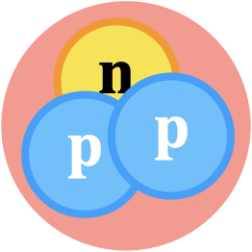
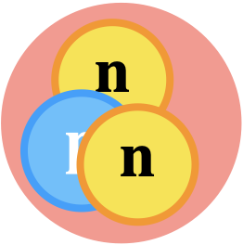
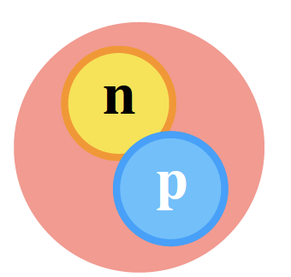
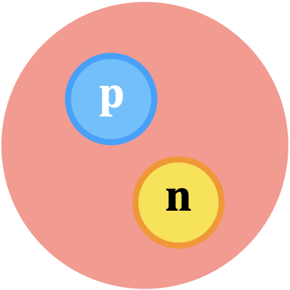
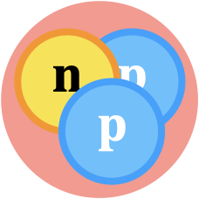

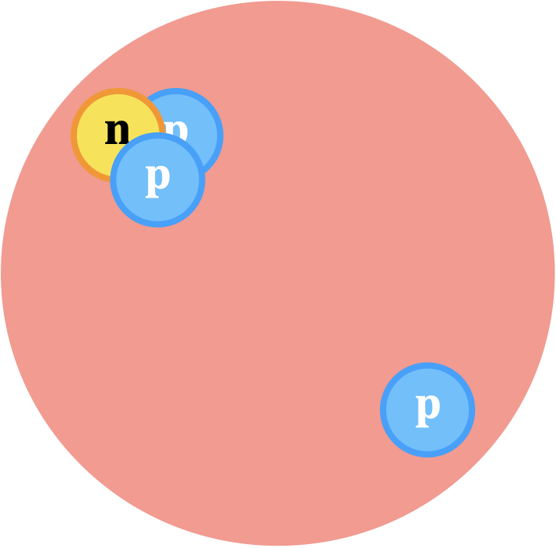
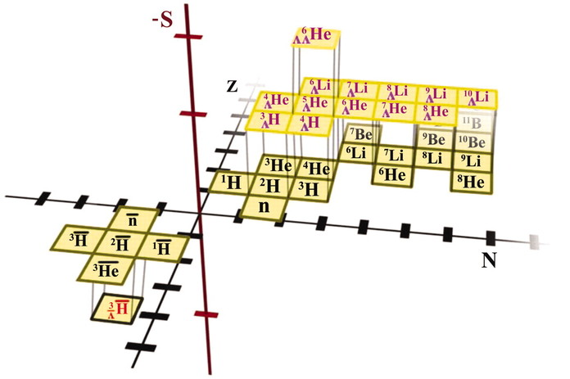
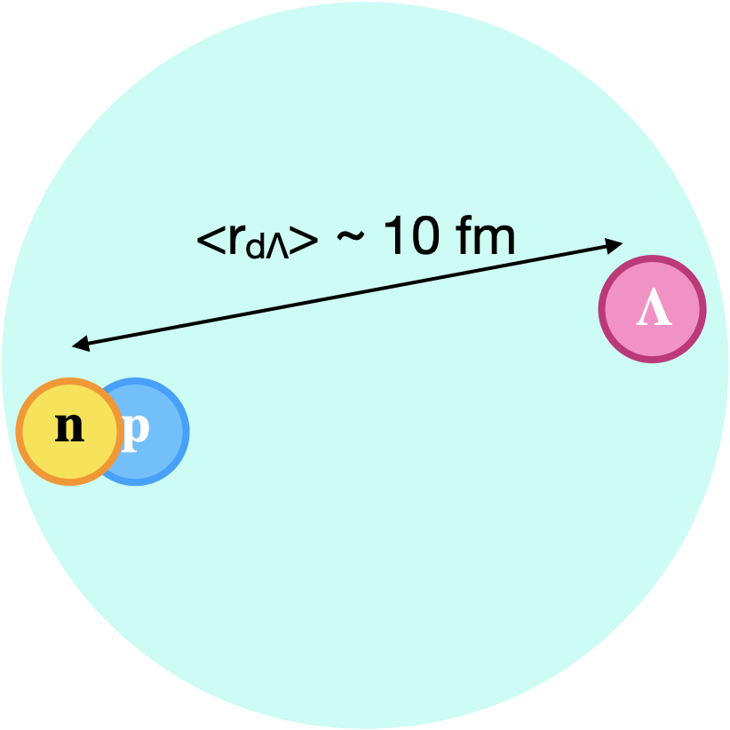
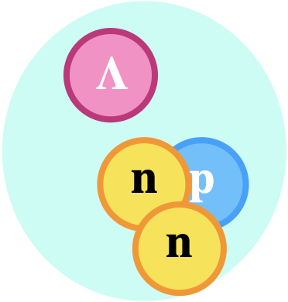
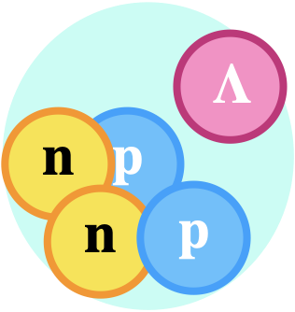
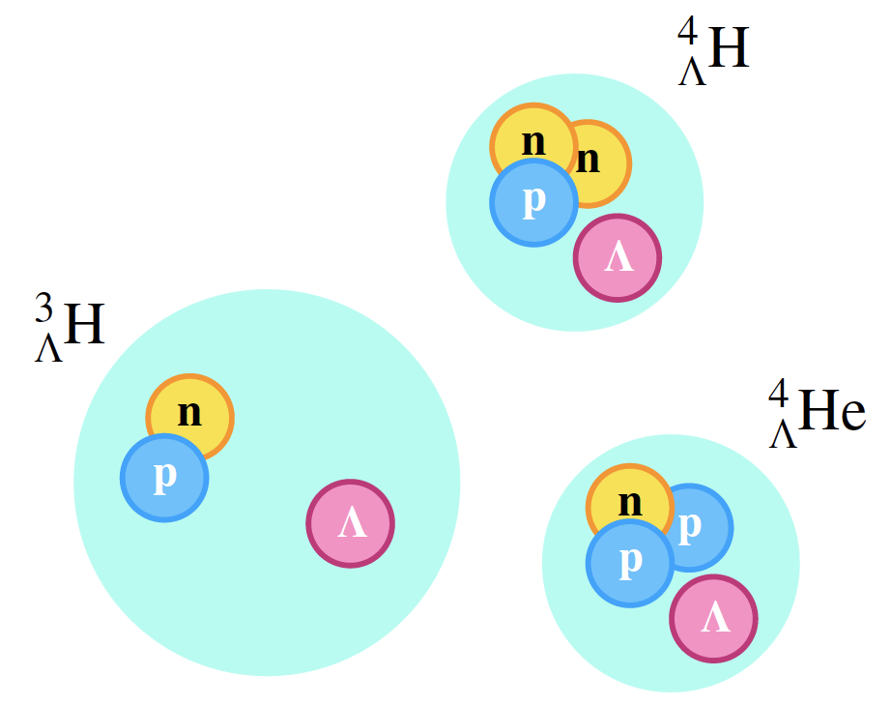







Light Nuclei & Hypernuclei (What)
Hypernuclei are nuclei containing at least one hyperon
$$d$$
$${}_{}^{3}{He}$$
$${}_{}^{4}{He}$$
$${}_{}^{4}{Li}$$
Light (hyper)nuclei show strong structural diversity
B_{Λ}∼O(0.1MeV)
Figure not to scale
$${}_{Λ}^{3}H$$
$${}_{Λ}^{4}H$$
$${}_{Λ}^{5}{He}$$
Add a=5
Figure from Science 328 (2010) 58-62

Slide 4
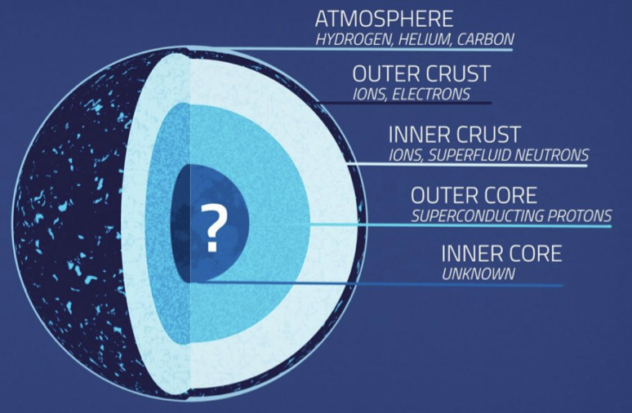
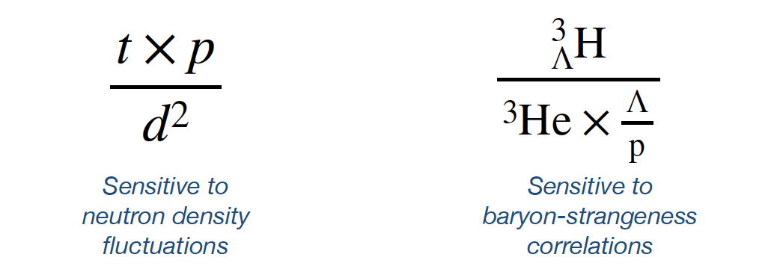
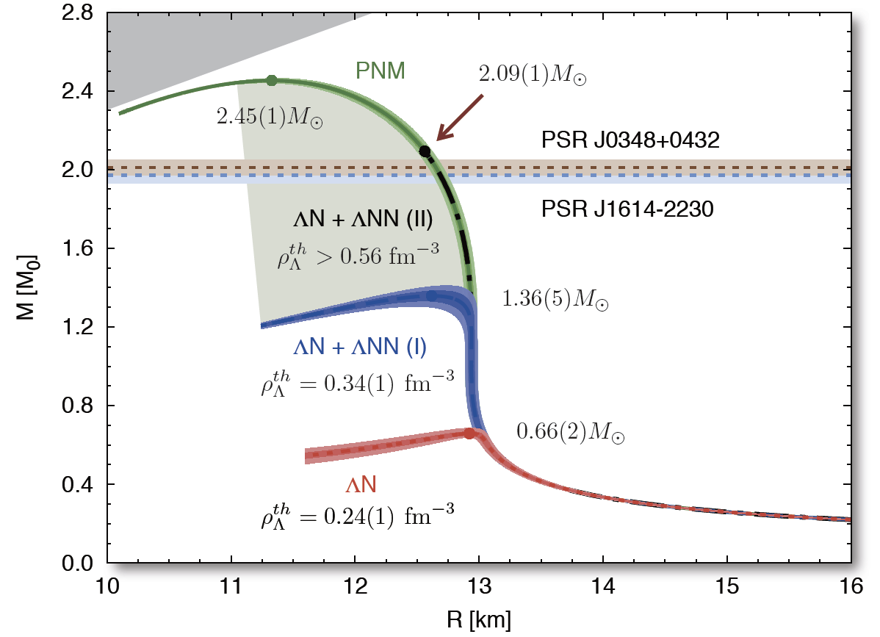
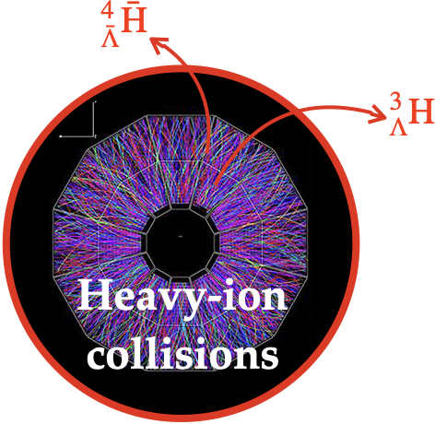

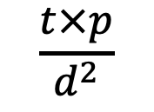
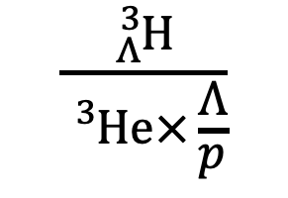
Light Nuclei & Hypernuclei (Why)
1. What can (hyper)nuclei production in heavy-ion collisions tell us about the QCD phase diagram and the nuclear equation-of-state?
S. Zhang et al., Phys. Lett. B 684 (2010) 224
K. Sun et al., Phys. Lett. B 781 (2018) 499
Sensitive to critical fluctuations and the onset of deconfinement
$$\frac{t×p}{d^{2}}$$
$$\frac{{}_{Λ}^{3}H}{{}_{}^{3}{He×\frac{Λ}{p}}}$$
2. What is the role of hyperon-nucleon (Y-N, Y-N-N) and hyperon-hyperon (Y-Y) interaction in the equation-of-state of high baryon density matter?
EoS governs the structure of neutron stars
Hyperon Puzzle: difficulty to reconcile the measured masses of neutron stars with the presence of hyperons in their interiors
?
D Lonardoni et al., Phys. Rev. Lett. 114, 092301 (2015)

Slide 5
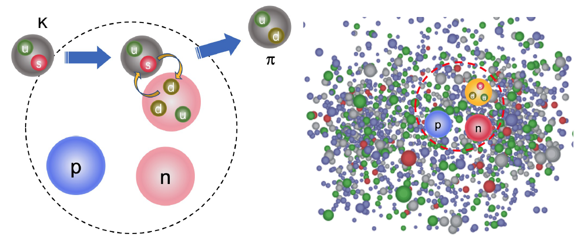
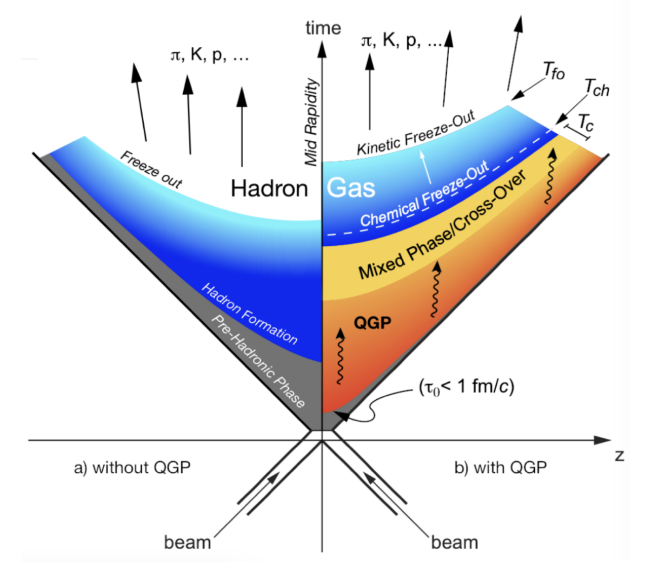
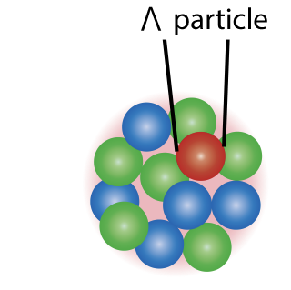


Light Nuclei & Hypernuclei (How)
1. When and how are (hyper)nuclei formed?
$${}_{Λ}^{A}H$$
$${}_{Λ}^{A}H$$
Fig. from Yifei Zhang
Observables related to nuclei production: p_{T} spectra, yields, flow, correlation functions
Need a solid understanding of the production mechanisms before we can use them to probe the Y-N interaction
The process of light nuclei & hypernuclei formation in violent heavy-ion collisions is not well understood

Slide 6
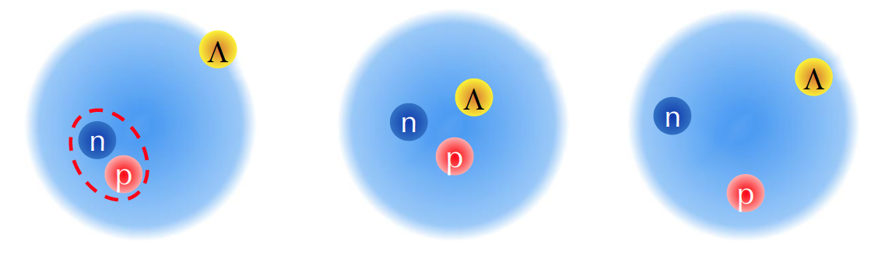
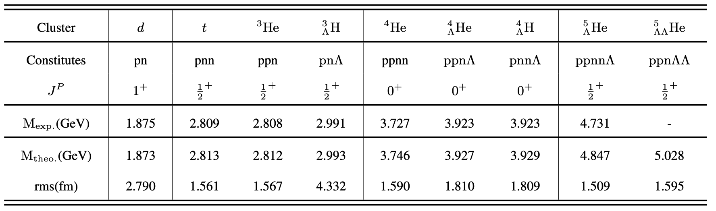


Light Nuclei & Hypernuclei (How)
2. Is the production yield of (hyper)nuclei sensitive to their internal structure?
Observables related to hypernuclear structure: Binding energy, lifetime, … (yield?)
Compare production yields of (hyper)nuclei with large and small radii, e.g.:
$1. {}_{Λ}^{3}H$ vs ${}_{}^{3}{He}$
Jiaxing Zhao, 24/03 afternoon
$2. {}_{}^{4}{Li}$ vs ${}_{}^{4}{He}$
Jiaxing Zhao et al., Phys.Rev.C 112 (2025) 6, 064902
Compare H3L and He3!
Compare He4 and Li4

Slide 7
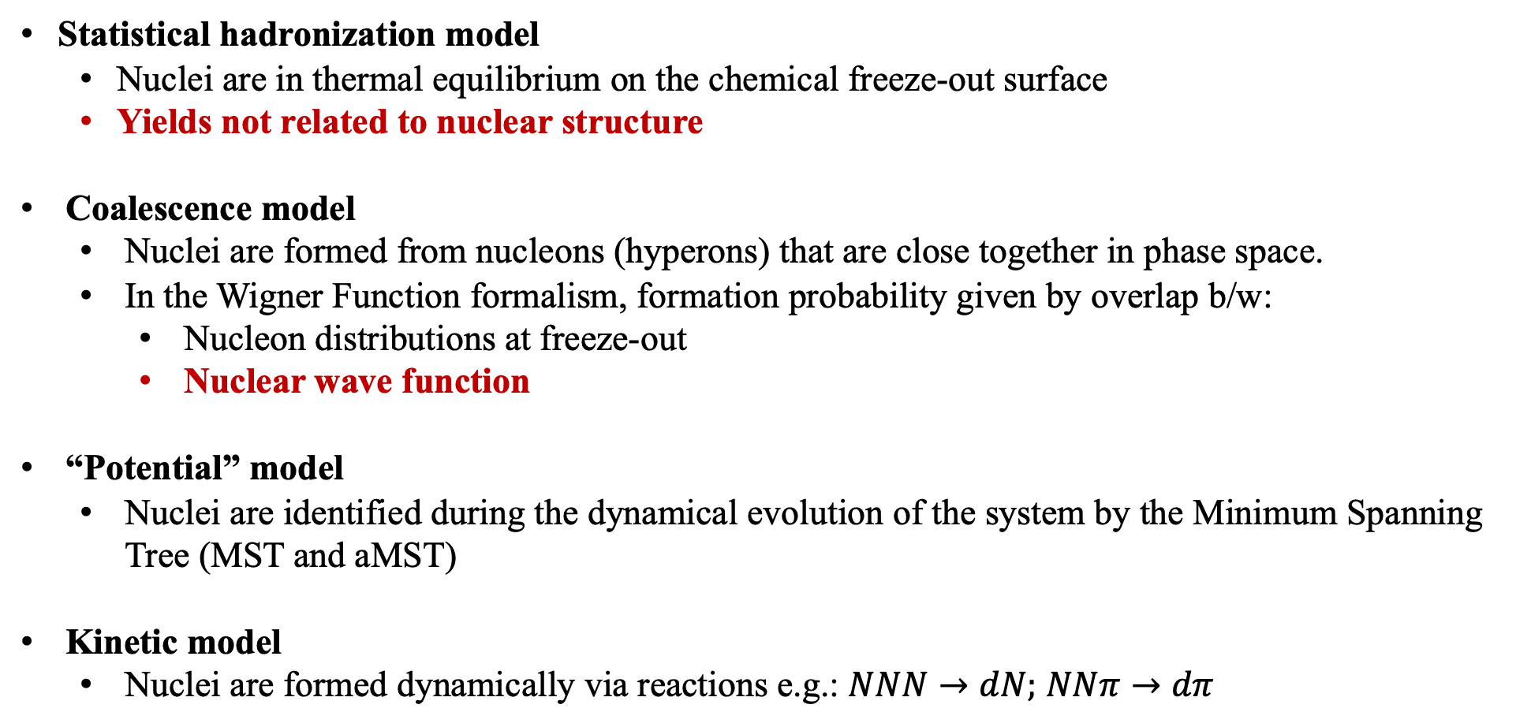
Clusterization mechanism
Jiaxing Zhao, 24/03 afternoon
Statistical hadronization model
  Nuclei are in thermal equilibrium on the chemical freeze-out surface
  Yields not related to nuclear structure
Coalescence model
  Nuclei are formed from nucleons (hyperons) that are close together in phase space.
  In the Wigner Function formalism, formation probability given by overlap b/w:
    Nucleon distributions at freeze-out
    Nuclear wave function
“Potential” model
  Nuclei are identified during the dynamical evolution of the system by the Minimum Spanning Tree (MST and aMST)
Kinetic model
  Nuclei are formed dynamically via reactions e.g.: $NNN→dN;$ $NNπ→dπ$
A. Andronic, et al. Phys.Lett.B 697 (2011) 203-207
J. Steinheimer, et al. Phys.Lett.B 714 (2012) 85-91
J. I. Kapusta Phys.Rev.C 21 (1980) 1301
R. Scheibl and U. Heinz, Phys. Rev. C 59, 1585 (1999)
K. Sun and C. Ko, Phys. Rev. C 103, 064909 (2021)
F. Bellini, et al. Phys. Rev. C 103, 014907 (2021)
J. Aichelin, Phys. Rept. 202, 233 (1991)
J. Aichelin, et al, Phys. Rev. C 101, 044905 (2020) (PHQMD)
D. Oliinychenko, et al. Phys.Lett.B 714 (2012) 85-91 (SMASH)
G. Coci et al. Phys. Rev. C 108, 014902 (2023) (PHQMD)

Slide 8
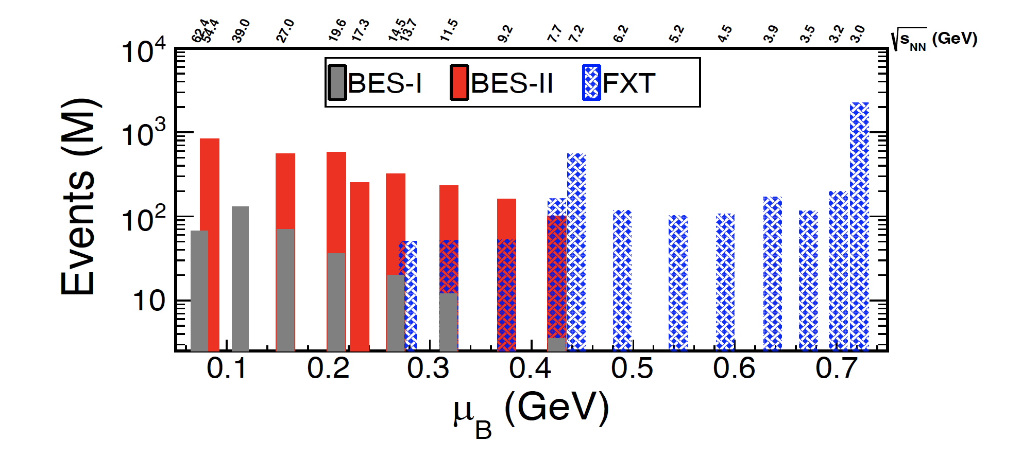
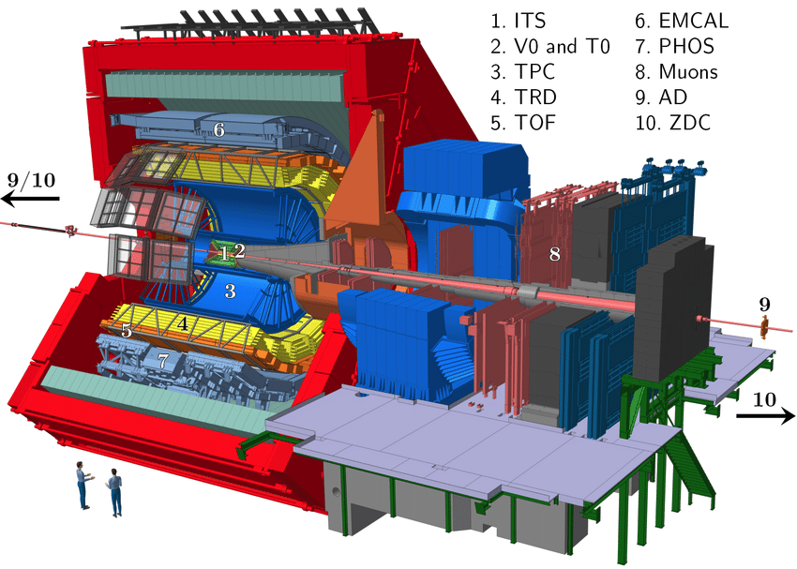
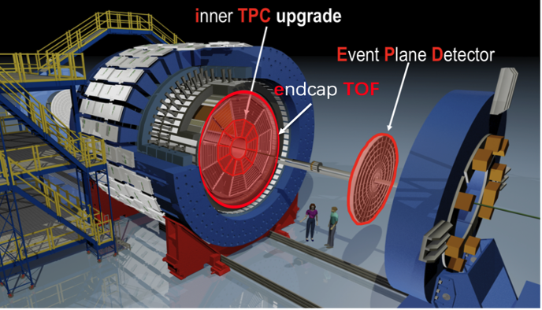
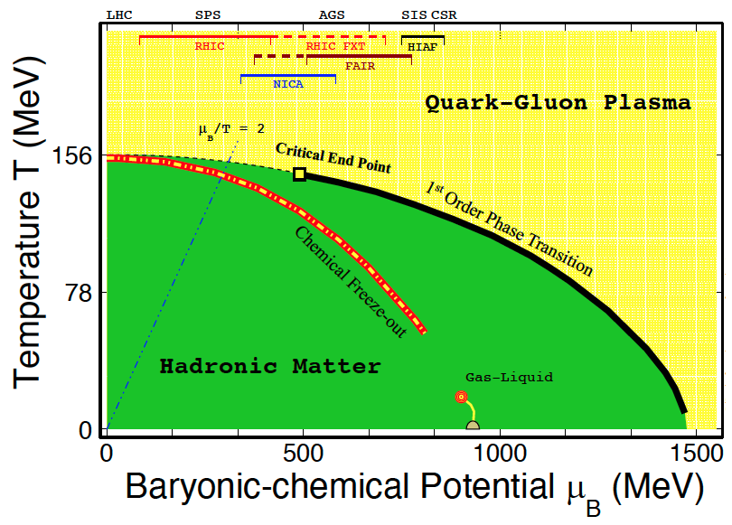
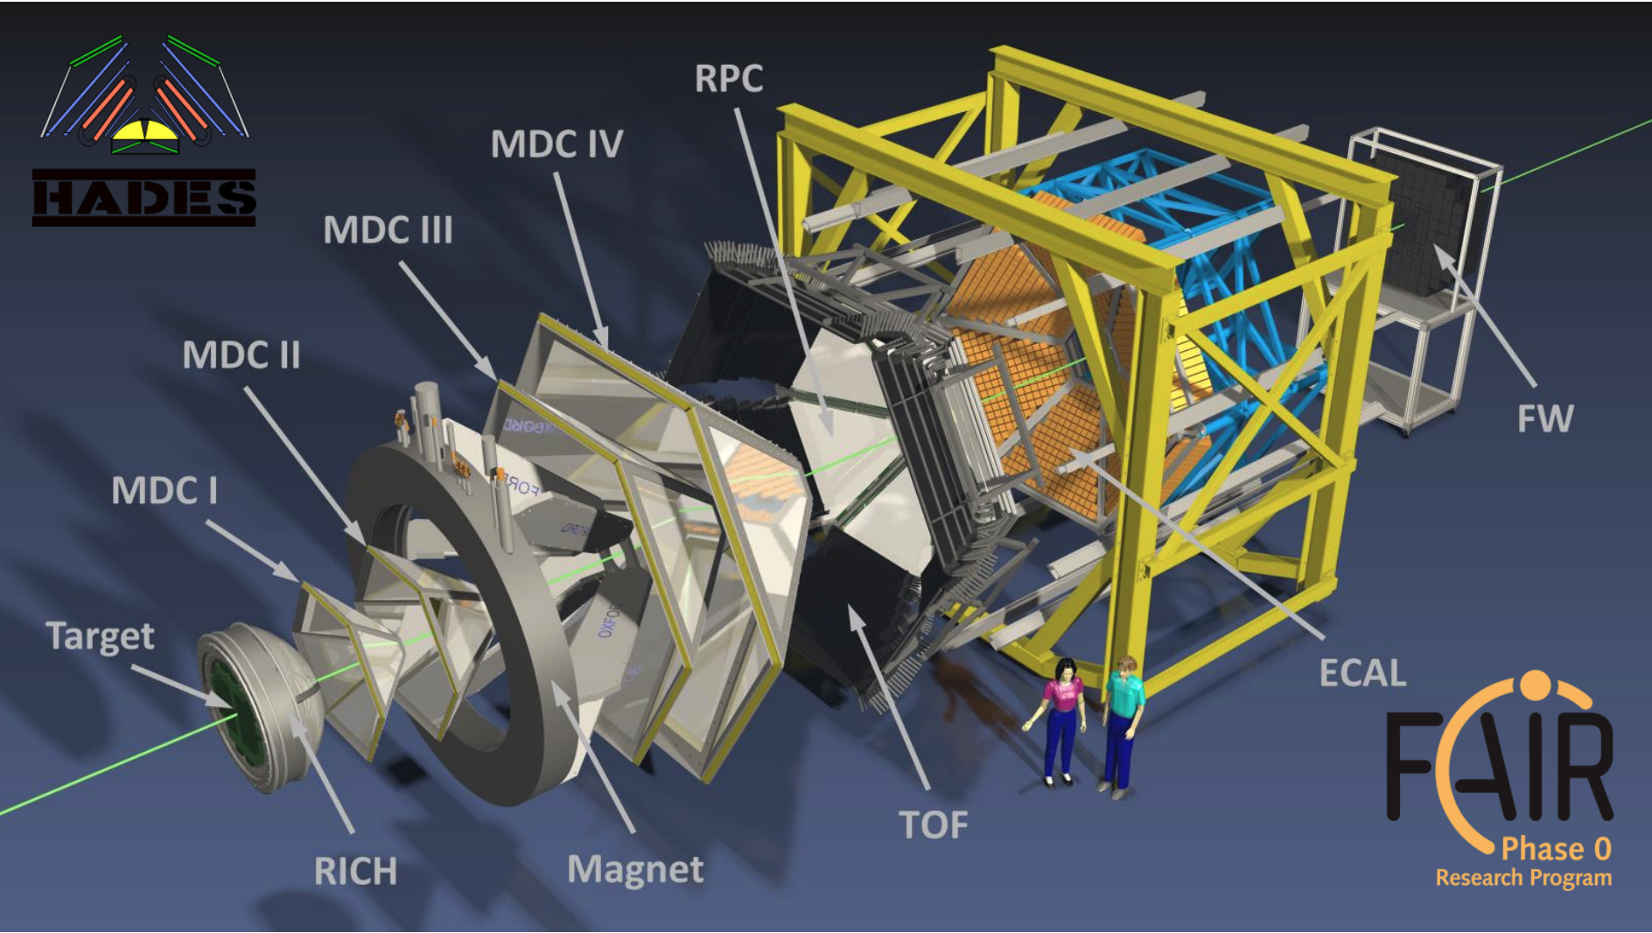
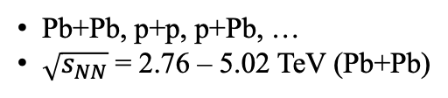
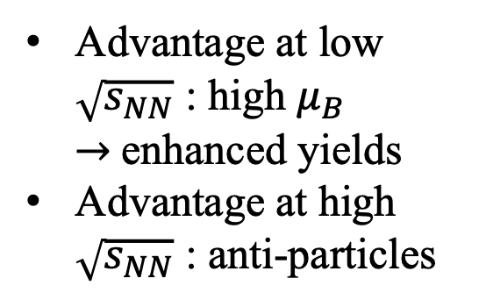
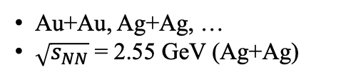
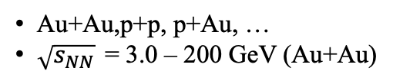
Experimental Facilities
Why in heavy-ion collisions (HIC)?
RHIC BES-II, $3<\sqrt{s_{NN}}<200 GeV$
STAR RHIC, BNL
ALICE LHC, CERN
Au+Au,p+p, p+Au, …
$\sqrt{s_{NN}}$ = 3.0 – 200 GeV (Au+Au)
Pb+Pb, p+p, p+Pb, …
$\sqrt{s_{NN}}$ = 2.76 – 5.02 TeV (Pb+Pb)
HADES SIS18, GSI
Advantage at low $\sqrt{s_{NN}}$ : high $μ_{B}→$enhanced yields
Advantage at high $\sqrt{s_{NN}}$ : anti-particles
Au+Au, Ag+Ag, …
$\sqrt{s_{NN}}$ = 2.55 GeV (Ag+Ag)
RHIC/BES-II, $3<\sqrt{s_{NN}}<200 GeV;760>μ_{B}>25 MeV;$

Slide 9
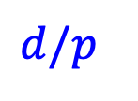
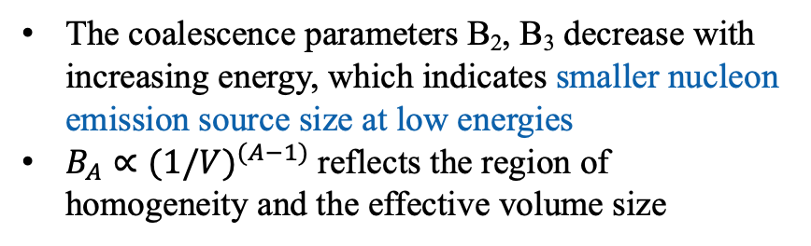
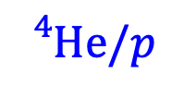
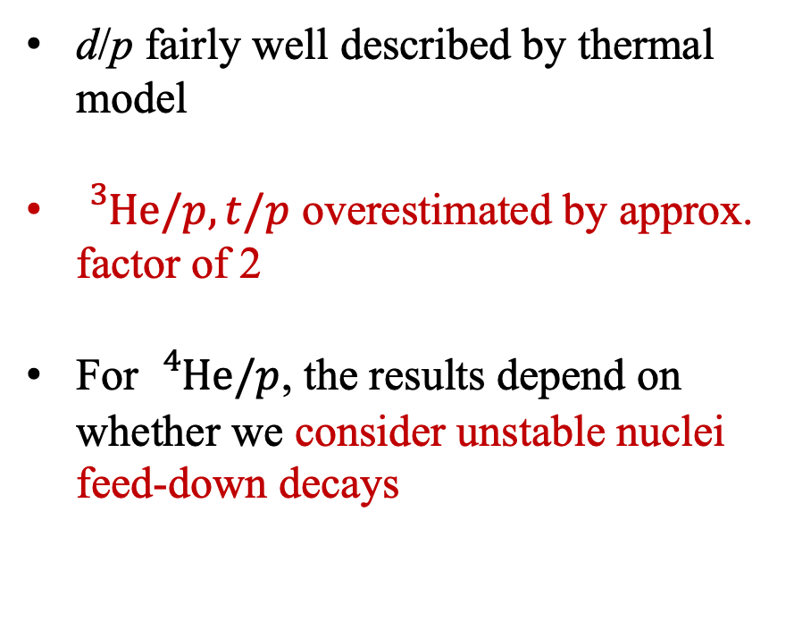

Nuclei Yield Ratios from RHIC-BES
RHS can consider lhc
Y. Jin, STAR, QM2025
Thermal-FIST: V. Vovchenko, Comput. Phys. Commun. 244, 295 (2019)
d/p fairly well described by thermal model
${}_{}^{3}{He/p}, t/p$ overestimated by approx. factor of 2
For ${}_{}^{4}{He/p}$, the results depend on whether we consider unstable nuclei feed-down decays
$$d/p$$
$${}_{}^{4}{He/p}$$
$${}_{}^{3}{He/p}, t/p$$
The coalescence parameters B₂, B₃ decrease with increasing energy, which indicates smaller nucleon emission source size at low energies
$B_{A}∝{(1/V)}^{(A−1)}$reflects the region of homogeneity and the effective volume size
Notes:
Dynamic, $π t ← →π n n p ,$ arXiv:2207.12532

Slide 10
Compound Ratio ($tp/d^{2})$
STAR, Phys. Rev. Lett. 130 (2023) 202301
K. Sun et al., Phys. Lett. B 781 (2018) 499
Data follows a common decreasing trend
Thermal model predicts an increasing trend and is inconsistent with data
Compound ratio can be described by coalescence calculations
Notes:
In central collisions, non-monotonic behavior around 19.6 and 27 GeV observed with a combined significance of 4.1σ (2.3, 3.4 σ respectively)

Slide 11
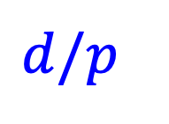
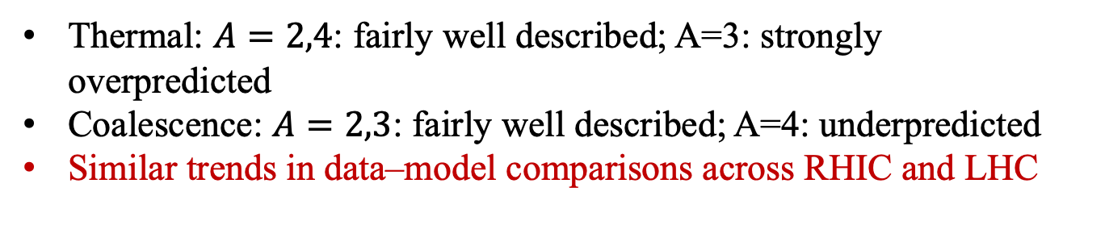
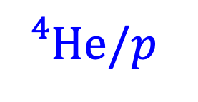
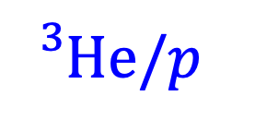
Nuclei Ratios from LHC
RHS can consider lhc
ALICE, Phys. Lett. B 858 (2024) 138943
$$d/p$$
$${}_{}^{3}{He/p}$$
$${}_{}^{4}{He/p}$$
Thermal: $A=2,4$: fairly well described; A=3: strongly overpredicted
Coalescence: $A=2,3$: fairly well described; A=4: underpredicted
Similar trends in data–model comparisons across RHIC and LHC
For nuclei with A < 4, coalescence models provide a good description, while thermal models do not consistently describe all species
The coalescence parameters B₂, B₃ decrease with increasing energy, which indicates smaller nucleon emission source size at low energies
$B_{A}∝{(1/V)}^{(A−1)}$reflects the region of homogeneity and the effective volume size
A=2,4: fairly well described; A=3 nuclei: strongly overpredicted
Notes:
Dynamic, $π t ← →π n n p ,$ arXiv:2207.12532

Slide 12
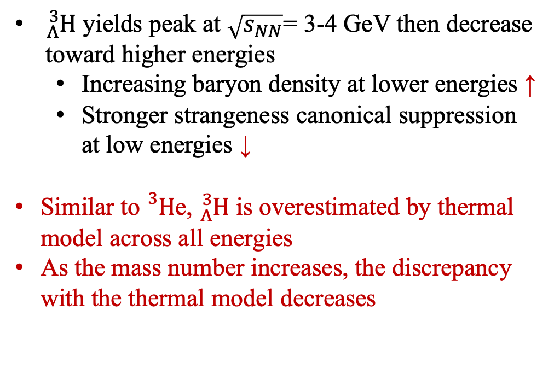
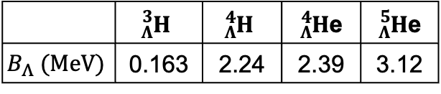
Hypernuclei Excitation Functions in Au+Au collisions
${}_{Λ}^{3}H$ yields peak at $\sqrt{s_{NN}}$= 3-4 GeV then decrease toward higher energies
  Increasing baryon density at lower energies ↑
  Stronger strangeness canonical suppression at low energies ↓
Similar to${}_{}^{3}H$e, ${}_{Λ}^{3}H$ is overestimated by thermal model across all energies
As the mass number increases, the discrepancy with the thermal model decreases
 | $${}_{Λ}^{3}H$$ | $${}_{Λ}^{4}H$$ | ${}_{Λ}^{4}H$e | ${}_{Λ}^{5}H$e
$$B_{Λ} (MeV)$$ | 0.163 | 2.24 | 2.39 | 3.12
May indicate larger survival probability for more tightly bound hypernuclei
Need dynamical models coupling formation and dissociation of (hyper)nuclei
STAR, Phys. Rev. Lett 128, 202301 (2022)
Low energies 3-5 GeV optimal range search for $ΛΛ$-hypernuclei

Slide 13
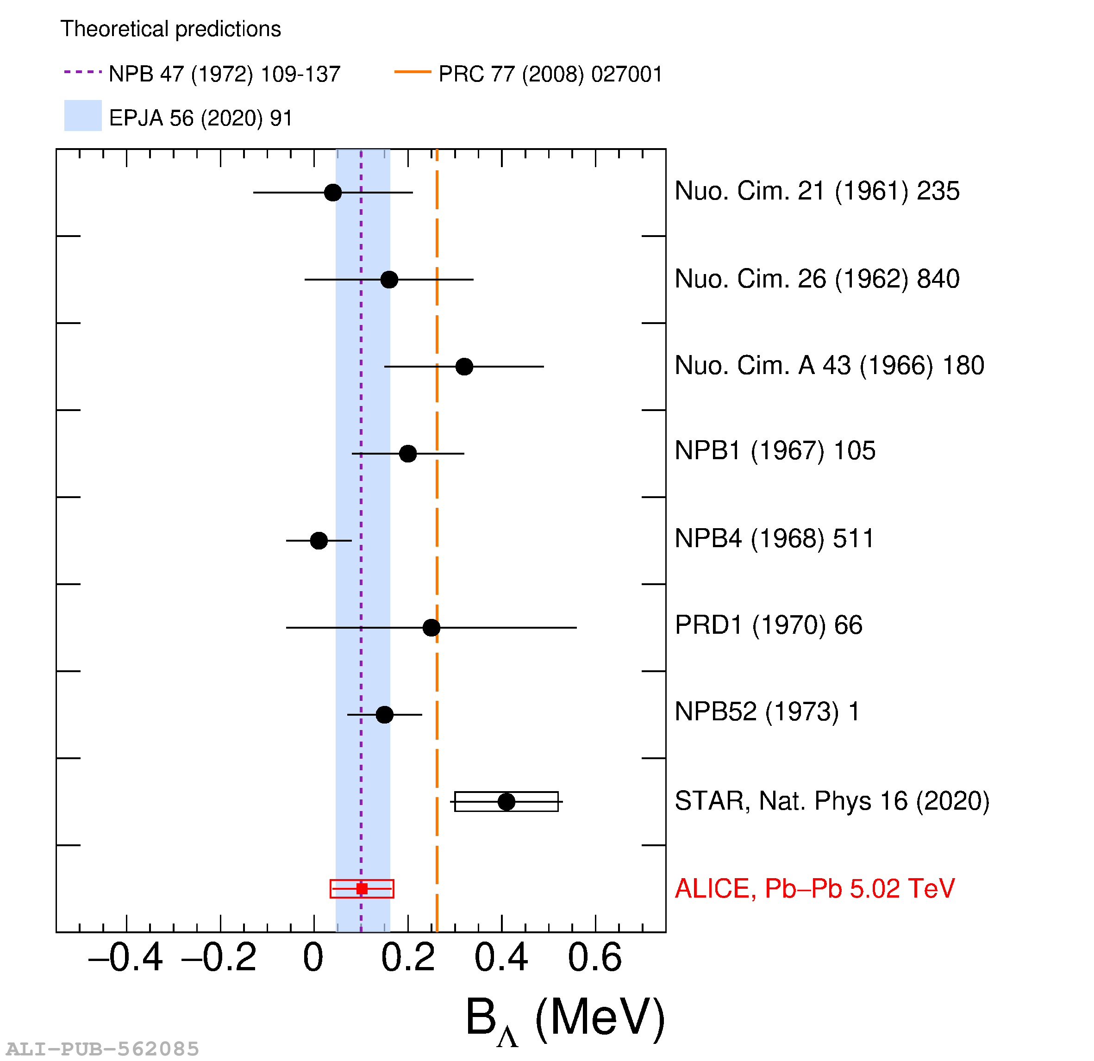
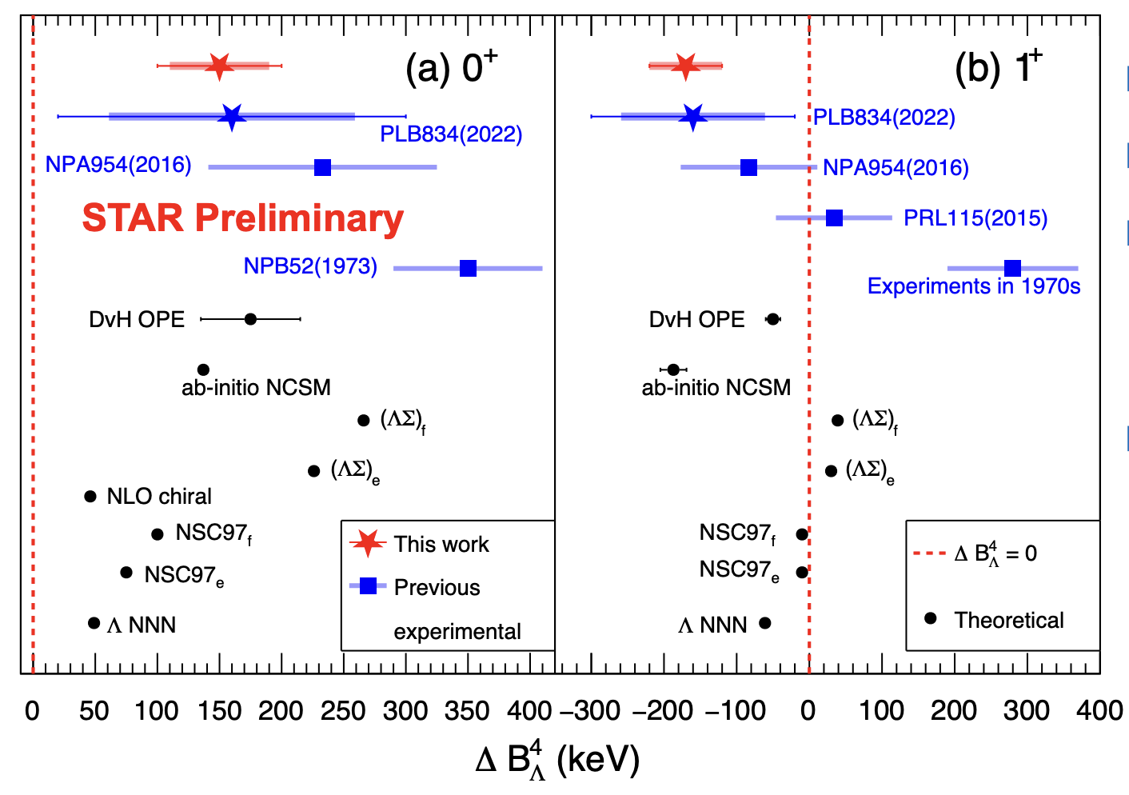
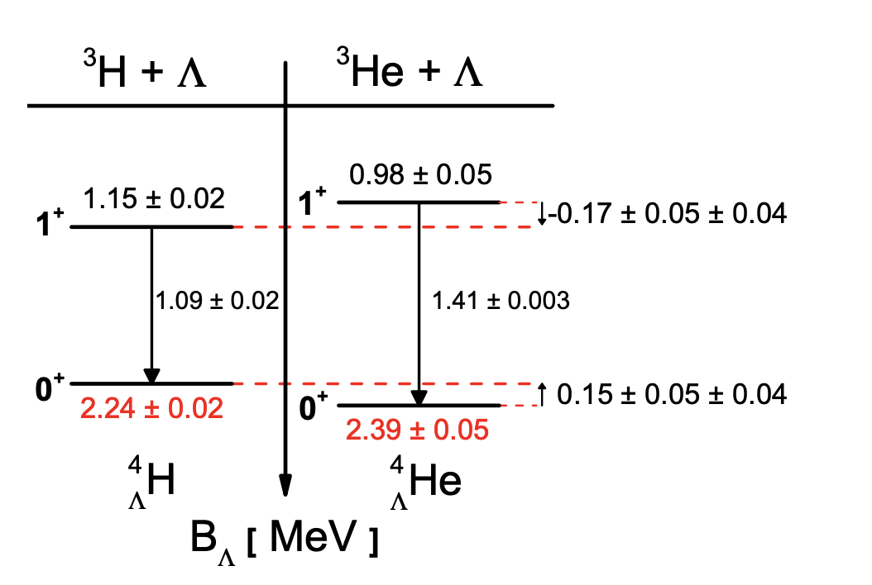
Aside: Charge Symmetry Breaking in A = 4 hypernuclei
Tianhao Shao, 24/03 afternoon
Precise constraints on YN and YNN interactions
Precise measurement of ${}_{Λ}^{4}H$and ${}_{Λ}^{4}He ground state binding energies$
Charge Symmetry Breaking is comparable in magnitude but opposite in sign for ground and excited states
Consistent with ab-initio no-core shell model calculation

Slide 14
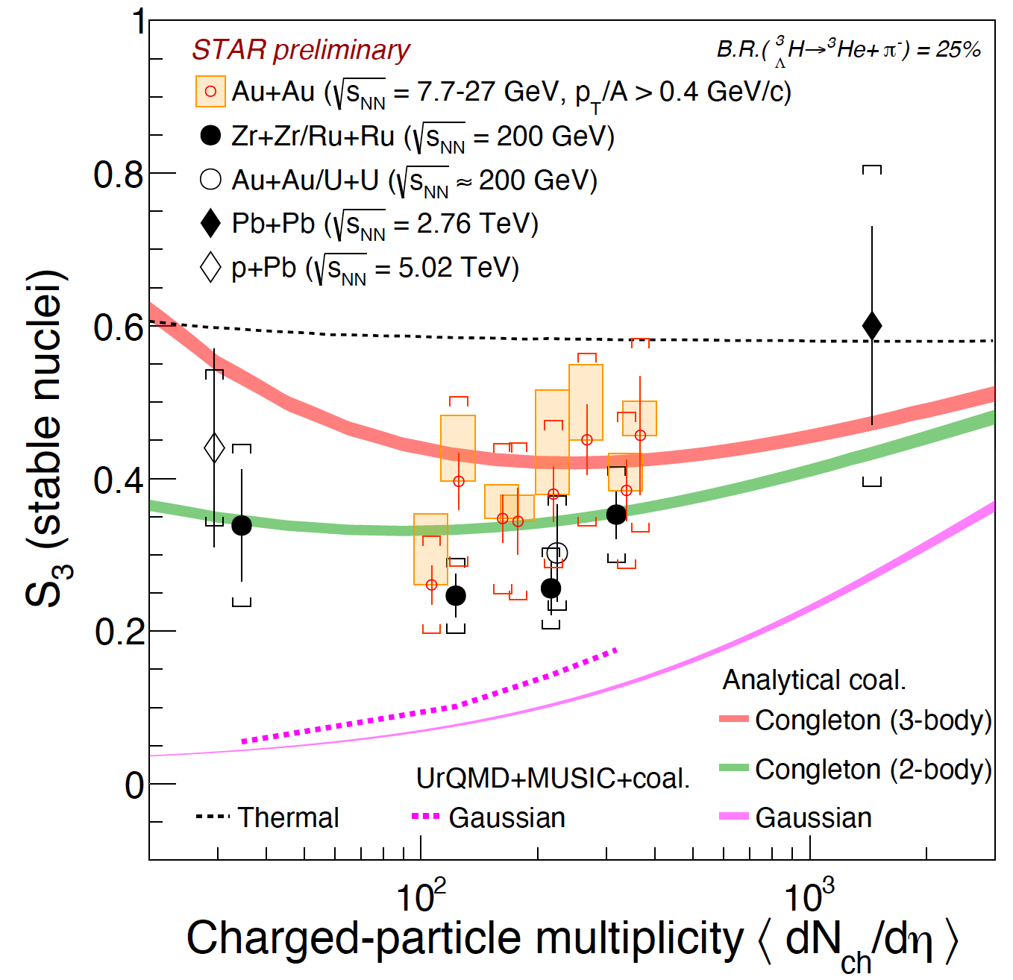
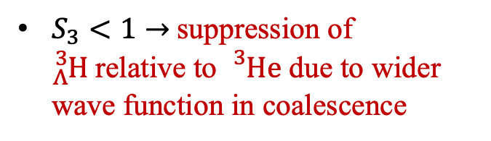
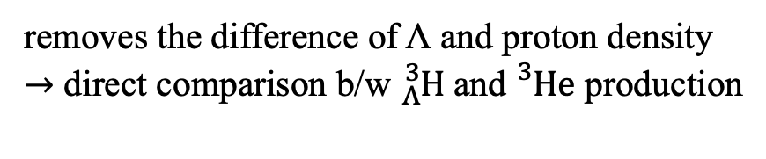
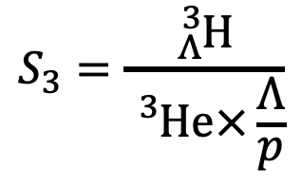
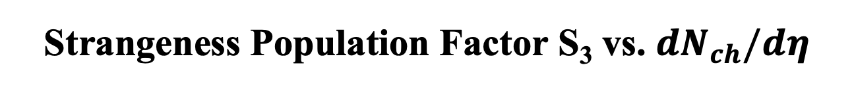

Strangeness Population Factor S₃ vs. $dN_{ch}/dη$
$$S_{3}=\frac{{}_{Λ}^{3}H}{{}_{}^{3}{He×\frac{Λ}{p}}}$$
removes the difference of Λ and proton density $→$ direct comparison b/w ${}_{Λ}^{3}H$and${}_{}^{3}{He}$ production
 | $${}_{Λ}^{3}H$$ | $${}_{}^{3}{He}$$
Mass (GeV) | 2.991 | 2.809
rms (fm) | 4.332 | 1.567
$S_{3}<1$ $→$suppression of ${}_{Λ}^{3}H$relative to ${}_{}^{3}{He}$ due to wider wave function in coalescence
Coalescence using Gaussian wave function underestimates the data
Coalescence using Congleton wave function describes across different energies/systems
F. Bellini et al., Phys. Rev. C 103 (2021) 1, 014907
YHL et al., Phys.Rev.C 113 (2026) 3, 034912
K. Sun et al., PLB 820(2021)136571
V .Vovchenko et al., Phys. Let. B 809 (2020) 135746
ALICE, Phys. Rev. Lett. 128 (2022) 252003
ALICE, Phys. Lett. B 754 (2016) 360
Increasing trend of S₃ originally proposed as a signature of onset of deconfinement

Slide 15



Strangeness Population Factor S₃ vs. $dN_{ch}/dη$
$$S_{3}=\frac{{}_{Λ}^{3}H}{{}_{}^{3}{He×\frac{Λ}{p}}}$$
removes the difference of Λ and nucleon density $→$ direct comparison b/w ${}_{Λ}^{3}H$and${}_{}^{3}{He}$ production
ALICE, QM2025
Similar observations in p+p collisions at 13.6 TeV
$S_{3}$ provides access to the short distance behavior of the ${}_{Λ}^{3}H$wave function
F. Bellini et al., Phys. Rev. C 103 (2021) 1, 014907
YHL et al., Phys.Rev.C 113 (2026) 3, 034912
K. Sun et al., PLB 820(2021)136571
V .Vovchenko et al., Phys. Let. B 809 (2020) 135746
ALICE, Phys. Rev. Lett. 128 (2022) 252003
ALICE, Phys. Lett. B 754 (2016) 360
Increasing trend of S₃ originally proposed as a signature of onset of deconfinement

Slide 16

${}_{ }^{4}{Li }\&{}_{ }^{5}{Li}$yields in $\sqrt{s_{NN}}$ = 3 GeV Au+Au collisions
Chenlu Hu, Junlin Wu, 24/03 afternoon
Fig. from STAR preliminary + STAR, Phys. Rev. C 110 (2024) 54911
 | $${}_{}^{4}{Li}$$ | $${}_{}^{4}{He}$$
Mass (GeV) | 3.749 | 3.727
rms (fm) | ? | 1.590
Yield of ${}_{ }^{4}{Li /\text{(2}\text{J}\text{+1)}}$ is significantly lower than that of ${}_{ }^{4}{He }$
Thermal model overestimates ${}_{ }^{4}{Li }$yield
Thermal model (including unstable nuclei feed-down) overestimates ${}_{ }^{4}{He }$yield

Slide 17





Search for ${}_{ }^{4}{\overline{Li} }$ in Pb+Pb collisions at 5.36 TeV
Giorgio Lucia, 24/03 afternoon
Significance: 2.1$σ$
Search for ${}_{ }^{4}{\overline{Li} }$in Pb+Pb at $\sqrt{s_{NN}}$ = 5.36 TeV
Upper limit on ${}_{ }^{4}{\overline{Li}}$yield obtained, significantly below SHM prediction
  ${}_{ }^{4}{Li}$suppressed relative to ${}_{ }^{4}{He}$, possibly reflecting its resonant nature and extended spatial structure

Slide 18





Studying deuteron production via femtoscopy
RHS can consider lhc
Luca Barioglio, 24/03 afternoon
The correlation function of π-d can provide information about deuteron production
Aim: to distinguish between two scenarios
  Prompt production
  Coalescence (occurs after resonance decay)
For bound nuclei with A < 4, coalescence models provide a good description, whereas thermal models do not
The coalescence parameters B₂, B₃ decrease with increasing energy, which indicates smaller nucleon emission source size at low energies
$B_{A}∝{(1/V)}^{(A−1)}$reflects the region of homogeneity and the effective volume size
ALICE, Nature 648 (2025) 8093, 306-311
Large fraction of deuteron formed via coalescence following the strong decay of short-lived resonances
A=2,4: fairly well described; A=3 nuclei: strongly overpredicted
Notes:
Dynamic, $π t ← →π n n p ,$ arXiv:2207.12532

Slide 19


Nuclei and hypernuclei Flow
Luca Barioglio, 24/03 afternoon
  Nuclei and hypernuclei $dv_{1}/dy$ follows mass number scaling up to $A=5$in $\sqrt{s_{NN}}=3$ GeV Au+Au collisions
  ${}_{}^{3}{\overline{He} }$ $v_{2}$ in $\sqrt{s_{NN}}=5.36$ TeV Pb+Pb collisions, consistent with hydrodynamic models paired with coalescence
STAR, Phys. Rev. Lett. 130 (2023) 212301, QM2025
ALICE, arXiv:2603.19398
  Nuclei flow measurements support the coalescence picture

Slide 20

Summary
Data suggest that (hyper)nuclei yields are sensitive to their internal structure, and models that neglect this cannot consistently describe all observables
  (Hyper)nuclei with larger spatial extent (${}_{Λ}^{3}H,{}_{}^{4}{Li})$suppressed w.r.t. those with smaller (${}_{}^{3}He,{}_{}^{4}{He})$
  ${}_{Λ}^{3}H$ production is sensitive to its internal wave function.
    Gaussian ansatz fail, while more realistic (Congleton-type) wave functions describe data
Data for bound nuclei with $A<4$ consistent with coalescence during late stage of collision
  Coherent description of yield ratios, flow, and correlation observables across datasets
  Correlation function indicates majority of deuterons produced after resonance decay
  Thermal model works reasonably well for A=4–5 non-resonant (hyper)nuclei
    May be due to stronger binding and larger survival probability in the hot medium

Slide 21







Future Prospects
CBM@FAIR
HIAF
NA60+/DICE
NICA
Double-Λ hypernuclei (YY): ${}_{ΛΛ}^{A}H$?
  Constrain ΛΛ interaction
Heavier single-Λ hypernuclei
  Further explore CSB, in-medium ΛN, etc.
Hypernuclei polarization, etc.
Y. Zhou, EMMI workshop 2025

Slide 22


Thank you for your attention!

Slide 23
Backup slides follow

Slide 24






Unstable and Resonant Light Nuclei (${}_{ }^{4}{Li }\&{}_{ }^{5}{Li}$)
$$p+{}_{ }^{4}{He}$$
Chenlu Hu, Junlin Wu, 24/03 afternoon
${}_{ }^{4}{Li }\left({{}_{ }^{3}P}_{2}\right)→p+{}_{ }^{3}{He}$ ($τ\sim$30 fm/c)
${}_{ }^{5}{Li }({{}_{ }^{ }P}_{3/2})→p+{}_{ }^{4}{He}$ ($τ\sim$120fm/c)
Femtoscopic correlations provide a unique bridge between heavy-ion collisions and low-energy nuclear scattering
Novel method: Partial-wave + phase-shift data + LL model enables the extraction of near-threshold resonances, ${}_{ }^{4}{Li }\&{}_{ }^{5}{Li}$

Slide 25









Hypernuclei Reconstruction
$${}_{Λ}^{3}H$$
$${}_{\overline{Λ}}^{4}{\overline{H}}$$
$${}_{\overline{Λ}}^{4}{\overline{He}}$$
$${}_{Λ}^{5}He$$
New QM25
$${}_{Λ}^{4}H$$
${}_{Λ}^{3}H→{}_{}^{3}{He} π^{−} {}_{\overline{Λ}}^{4}{\overline{H}}→{}_{}^{4}{\overline{He}} π^{+}$ ${}_{\overline{Λ}}^{4}{\overline{He}}→{}_{}^{3}{\overline{He}} \overline{p}{ π}^{+} {}_{Λ}^{5}{He}→{}_{}^{4}{He} p π^{−}$
Various hypernuclei reconstructed using 2- and 3-body mesonic decay channels
STAR, Nature 632 (2024) 8027
ALICE, Phys. Rev. Lett. 134 (2025) 16, 162301
Discovery of ${}_{\overline{Λ}}^{4}{\overline{H}}$(STAR, 2024) and ${}_{\overline{Λ}}^{4}{\overline{He}}$(ALICE, 2025)
Observation of the heaviest hypernucleus in heavy-ion collisions to date, ${}_{Λ}^{5}He$
Y. Zhou, STAR, QM2025

Slide 26




Data-Driven Semi-Analytical Coalescence Model (YHL et al., Phys.Rev.C 113 (2026) 3, 034912
Define $B_{3}$ as ratio of hypernuclei yields to the product of constituent yields:
p and Λ yields from data
In the Wigner-function coalescence formalism (ignoring momentum dependence of the nucleon source):
F. Bellini et al., Phys. Rev. C 103 (2021) 014907
nuclei wave function
nucleon source
Assume an isotropic Gaussian nucleon source:
$R_{inv}$is estimated using deuteron data
No free parameters for once ${}_{Λ}^{3}H$wave function is specified

Slide 27





The Hypertriton Wave Function
${}_{Λ}^{3}H\text{: }\text{loosely} \text{bound} \text{hypernuclei}$
Gaussian:
F. Bellini et al., Phys. Rev. C 103 (2021) 014907
Congleton:
2-body model of ${}_{Λ}^{3}H\text{:}$
J. Congleton, J.Phys.G 18 (1992)339-357
3-body effective field theory:
F. Hildenbrand, H.-W. Hammer, Phys. Rev. C 100(2019)034002
${}_{Λ}^{3}H$wave function is an active field of research
Jiaxing Zhao et al., Phys.Rev.C 112 (2025) 6, 064902
Z. Zhang et al., Phys.Lett.B 874 (2026) 140285

Slide 28
Nuclei yields in BES
Coalescence gives a reasonable description of $A<4$nuclei data
V. Vovchenko, et al, Comput. Phys. Commun. 244 (2019) 295
YHL et al., Phys.Rev.C 113 (2026) 3, 034912
STAR, Phys. Rev. Lett. 130 (2023) 202301

Slide 29
Hypernuclei yields in BES
V. Vovchenko, et al, Comput. Phys. Commun. 244 (2019) 295
YHL et al., Phys.Rev.C 113 (2026) 3, 034912
Coalescence gives a reasonable description of $A<4$hypernuclei data

Slide 30



Compound Ratio ($tp/d^{2})$ vs. $\sqrt{s_{NN}}$
STAR, Phys. Rev. Lett. 130 (2023) 202301
K. Sun et al., Phys. Lett. B 781 (2018) 499
Yield ratios have been suggested to be sensitive to neutron density fluctuations
$$\frac{t×p}{d^{2}}=g(1+∆n)$$
∆𝑛: Neutron Density Fluctuation
Compound ratio can be described by coalescence calculations
Enhancements around 19.6/27 GeV w.r.t. baseline observed, but they decrease with decreasing p_{T} acceptance
Analyses with STAR BES-II (with extended low p_{T} coverage) is in progress.
Notes:
In central collisions, non-monotonic behavior around 19.6 and 27 GeV observed with a combined significance of 4.1σ (2.3, 3.4 σ respectively)

