Slide 1
Tracking/Timing L2
Report from the US HFCC Strategy Meeting
Zoomlandia Nov 12, 2025

Slide 2
Main messages from strategic meeting
Ask for input to the European Strategy Process
  Can we say more in favor of the FCC (CERN’s default plan?)
  Can we say something about Linear Collider at CERN?
  Many people felt that going beyond the P5 report would not be appropriate
Our request numbers for FCC are very high
  Total at about $1.5M but Srini only has maybe $1M but for the entire set of L2
  Our request were particularly high
  Need to work on priorities
  Can we identify cross cutting effort with for example computing/software/analysis and AIM?
Workshop at SLAC December 19/20 need more people to register

Slide 3
Specific Requests for Support: Solid State and Timing
Effort | Detector systems | Institutions | Requested Support
Development of MAPS sensors | Vertex, Outer Tracker, Si Wrapper, Calorimeters | Caltech, BNL, Brown, FNAL, SLAC, UOregon | $300k (SLAC) $300k (FNAL)
Development of LGAD | Si Wrapper | BNL, FNAL, SLAC UCSC | $70k, 0.5FTE PD (UCSC) $70k, 0.5 FTE PD (BNL)
Testing and Characterization | Vertex, Outer Tracker, Si Wrapper, Calorimeters | Caltech, Brandeis, Brown, FNAL, SLAC, Stony Brook, MIT | $70k, 0.5 FTE PD (FNAL) $70k, 0.5 FTE PD (SLAC) $27.5, 0.25 FTE grad (MIT) $40k 0.25 FTE RS (MIT) $27.5k, 0.25 FTE grad (Brown)
Simulation efforts | Overall Detector Optimization | Brown, FNAL, MIT, SLAC | $27.5k, 0.25 FTE grad (SLAC) $27.5k, 0.25 FTE grad (Brown) $27.5k, 0.25 FTE grad (MIT) $40k, 0.25 FTE RS (MIT)
Tracker readout with the smart on-chip data processing | Tracker simulations, AI/ML training, and circuit design | ANL | $50-$100k (ANL)
Total $1,147.5k - $1.197.5k
1RS = $160k; 1 PD = $140k; 1 grad = $110k
Srini: maybe we can stretch to have 1M for all L2 areas.

Slide 4
$ | Building a prototype chamber with 25 straws, new electronics and dN/dX studies using cosmic ray and test beams at Fermilab (summer 2025) and CERN | $60K | $25k for building a prototype chamber, $10k for frontend electronics/waveform readout, $5k for test beam, $20k for student support
Duke University | Bundling straws for strength, string a few straws and check operations | $6.5K | $3.3k for material/machining, $3.2k for undergraduate student
Tufts University | Cosmic ray and test beam studies, straw tracker optimization | $47K | 0.5 FTE (graduate student)
UT Austin | Detector and layout optimizations (DELPHES simulation, stereo angle, w/ and w/o silicon wrapper, dN/dX) | $30K | 1 semester (graduate student)
BNL | Simulation (analytic + e-field), monte carlo reconstruction for TB, validate dN/dX during TB with small prototypes Wire R&D from different manufacturers | $30K | Support student for simulation studies
SLAC | Momentum resolution studies, DCH cell geometry optimization | $0K
U of Kansas + others | TPC feasibility studies | $0K
Total $173.5k
Srini: maybe we can stretch to have 1M for all L2 areas.

Slide 5
Low Mass Supports Funding Requests
Institute | Request | Remarks
ANL | $0k | Novel TIMs, high thermal conductivity
Cornell | $10k | Radiation hard interface materials, UG support
Florida | $5k | Thermal interface material, UG support, material characterization as “service”
FNAL | $30k | Low mass supports + vertex detector, 0.25 FTE junior person / tech
Hawaii | $5k | Experience / synergies w Belle II upgrade, readout
LBNL | $0k | Vertex detector
Purdue | $55k | $30k S&E, $25k 0.2 FTE technician. Existing Blue Sky on CF wire chamber and integrated composites, the ask here is for $45k in equipment - see remark. Material characterization as “service”.
Yale | $5k | Wire chamber / readout
Total | $110k
Interest in CF based gaseous detector:
Purdue (Jung)
Hawaii (Vahsen) and Yale (Prakhar)
Interest in composite mechanics:
Cornell (radiation hard interface materials)
Florida Institute of Technology (thermal interface materials)
Purdue (advanced composite structures, integrated detector support systems, simulations)
LBNL, Fermilab, ANL (multiple people)
→ Unique leadership opportunity, no CF coating facility (world’s only is Russian: non-accessible)
→ Establish Facility in US:
Re-commission sputtering/coating available via Purdue Nuclear value of > 50k$
Discussion with INFN Bari, potential for ~50k$ contribution if adequate funding from US side - unique opportunity!

Slide 6
US Areas of Interest in Tracking and Timing
Solid State Tracking: MAPS for vertexing and for tracking, integration and test
Timing: TOF wrapper layer using LGAD or other fast timing technology
Gas: Straw tracker
Gas: Open volume drift chamber (DCH)
PID using dE/dx or dN/dx
  Basic studies of performance and comparisons
  Design of appropriate FE electronics
  Interface with TOF?
Mechanics: low mass support structure for vertex and global support, timing layers, CF components for drift chambers, including CF wires
General considerations of how to design systems for low systematic uncertainties (at the Z pole)
  Acceptance and efficiency monitoring
  Calibration and survey
  Flavor tagging

Slide 7
Areas of Existing US Expertise and Synergy
Considerable technical overlap with EIC (EPIC) detector
  A number of people in the US HF community are already also engaged with EIC and growing
  Early tests and proof of concept, fabrication processes
  EIC mechanics overlap with multiple US HF/EIC institutions for both tracking and TOF
Leading institutions on the development of the Si-LGAD technology and electronics, and also in the design and fabrication of the new timing layers for LHC. New efforts on SiC-LGADs and alternatives
Strong IC design teams at national laboratories and universities with growing involvement in MAPS developments
ATLAS and CMS silicon trackers fabrication and integration
Strong multi-institutional teams already on straw tubes and gas tracking going back to ATLAS tracker and muon system
Leading institutions on low mass support and cooling with many contributions to the LHC (and earlier) experiments and the heavy ion collider program

Slide 8
Specific Areas for Solid State Tracking
MAPS R&D at SLAC: For FY25, propose to advance the design, simulation and integration of critical MAPS components for next-generation detectors. Key deliverables include high-performance low-power TDC enabling sub-ns timing resolution, thorough trade-off studies addressing power, timing resolution and calibration, and innovative research into wafer stacking and scaled CMOS processes (below 65 nm) to achieve breakthrough improvements in vertex detector granularity. The team will also conduct detailed characterization of the SLAC-designed NAPA-p2 prototype.
MAPS R&D at FNAL: FY25 program will drive progress toward the next prototype submission. Specific objectives include TCAD simulations for sensor optimization and development of crucial IC elements for wafer-scale MAPS designs, such as shunt LDO components for stitched wafer-scale sensors and advanced serializers capable of 1.2 GB/sec transmission speeds. Additional innovations under development include TDC timing performance improvements and chip-to-chip transmission solutions for the outer vertex detector.
MAPS R&D at BNL, Brandeis, Brown, Caltech, MIT, Oregon, Stony Brook: support for MAPS through physics studies to optimize design requirements.

Slide 9
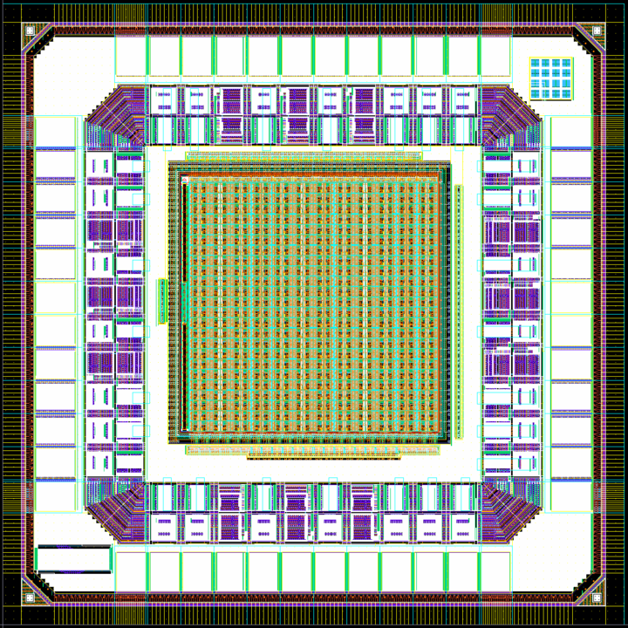
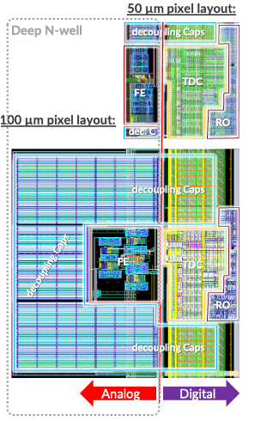
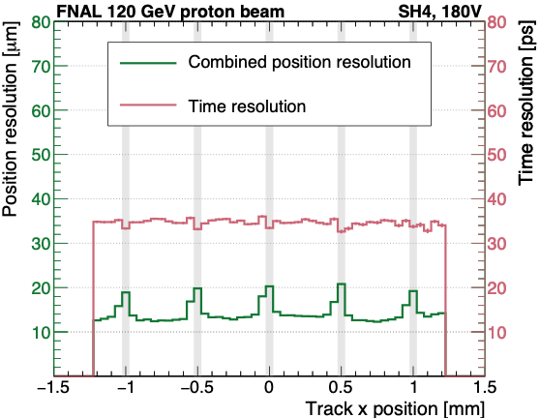
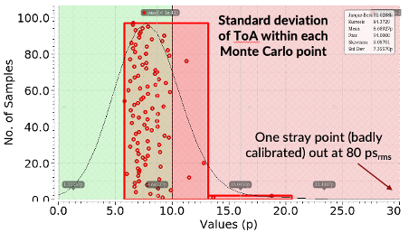
SS and Timing: ongoing efforts and interests
Development of Monolithic Active Pixel Sensors
  Partnership with Skywater Technologies​ 90nm, optimize the process towards HEP sensors
    Goal: US manufactured sensor capability for HEP experiments​
  Prototypes with TJ 65nm as part of a CERN WP1.2 collaboration (ALICE)
    Goal: use state of the art CMOS process to achieve low power consumption and aim for O(nsec) timing
Developments of 3D-integrated sensors
  Partnership with TJ 65nm and TSMC 28nm to utilize state-of-the-art technologies for HEP
    Goal: development of 3D-integrated, low-mass and low-power trackers
Fast timing R&D leveraging HL-LHC expertise
  Continued development of sub-10ps low power TDCs in 28nm
  Fast on-chip processing to reduce data transmission needs
  Post-processed LGAD for foundry CMOS using microwave annealing
Interest in ramping up our simulation efforts to evaluate BIB effects and tracking and timing detector requirements needs.
Picture of Napa-p2 from WP1.2 shared submission
Layout of the MPW submission for the 3D-integrated project
Sensors with uniform 10-15 μm and 30-35 ps resolution across surface
Expected performance of the 3D-integrated devices
<number>

Slide 10
Specific Areas for Timing
There is substantial ongoing work which is supported through generic R&D and/or the LHC upgrades efforts
BNL: Strip and Pixel LGAD sensor R&D, LGAD in MAPS
FNAL, SLAC: Strip and Pixel LGAD sensor and readout electronics R&D, LGAD in MAPS and 3D-integrated LGADs
UCSC: Strip and Pixel LGAD sensor R&D
LBNL: working on SiC-LGAD, ongoing support already in place

Slide 11
Solid State Testing and Characterization Activities
Collaborative efforts are the key in the development of Silicon systems (for Vertex, Tracker or Silicon wrapper)
  Numerous institutions with strong history in testing/characterization, construction and integration have expressed interest to participate
    BNL, Brandeis, Brown, Caltech, FNAL, MIT, Oregon, SLAC, Stony Brook
Deliverables:
  Simulation of Beam-Induced Backgrounds to define requirements for tracking systems and MDI
  Perform detailed testing and characterization studies of the prototypes

Slide 12
Specific Requests for Support: Solid State and Timing
Effort | Detector systems | Institutions | Requested Support
Development of MAPS sensors | Vertex, Outer Tracker, Si Wrapper, Calorimeters | Caltech, BNL, Brown, FNAL, SLAC, UOregon | $300k (SLAC) $300k (FNAL)
Development of LGAD | Si Wrapper | BNL, FNAL, SLAC UCSC | $70k, 0.5FTE PD (UCSC) $70k, 0.5 FTE PD (BNL)
Testing and Characterization | Vertex, Outer Tracker, Si Wrapper, Calorimeters | Caltech, Brandeis, Brown, FNAL, SLAC, Stony Brook, MIT | $70k, 0.5 FTE PD (FNAL) $70k, 0.5 FTE PD (SLAC) $27.5, 0.25 FTE grad (MIT) $40k 0.25 FTE RS (MIT) $27.5k, 0.25 FTE grad (Brown)
Simulation efforts | Overall Detector Optimization | Brown, FNAL, MIT, SLAC | $27.5k, 0.25 FTE grad (SLAC) $27.5k, 0.25 FTE grad (Brown) $27.5k, 0.25 FTE grad (MIT) $40k, 0.25 FTE RS (MIT)
Tracker readout with the smart on-chip data processing | Tracker simulations, AI/ML training, and circuit design | ANL | $50-$100k (ANL)
Total $1,147.5k - $1.197.5k
1RS = $160k; 1 PD = $140k; 1 grad = $110k
Srini: maybe we can stretch to have 1M for all L2 areas.

Slide 13
General Aspects for Gaseous Tracking
Michigan, BNL, Duke, UT Austin, Tufts, UMass, Harvard, MSU, UCI, SLAC
Challenges
  DCH: ~350k wires, wire assembly, mechanical structure (10 tons of total load on each end plate), O(100µm) single hit resolution, dN/dX
  Straw: thin-wall straw production, wire assembly, mechanical support of 4-5 m straws, O(100µm) single hit resolution, dN/dX
  TPC: ion backflow, occupancy/hit density, number of readout channels, dE/dX resolution
Develop reliable simulations
Electric field design with FEM techniques
Garfield and Garfield++ microscopic analysis
Monte Carlo techniques for reconstruction and digitization
Wire R&D from different manufacturers
Build a prototype chamber
Study performance and establish dN/dX in CR and test beam campaigns
Study electronics and readout architecture

Slide 14
Specific Areas for Straw Tubes
Detector geometry and layout optimization studies using GEANT: occupancy, straw length, radius, stereo angles, resolution etc
Straw assembly: end plugs, end plates, assembly procedure, wire material, wire tension, gas leakage etc
Mechanical support: end plate, straw holding, precision etc
Gas mixture studies: Garfield simulation, primary and secondary clusters etc
Prototype chamber: build a prototype chamber with ~25 straws
dN/dx: new front end electronics to provide enough gain to detect single electron peaks and record the whole waveform for dE/dX and dN/dX studies
Cosmic ray and test beam studies using the prototype chamber

Slide 15
Specific Areas for Drift Chamber (some common to Straw)
Develop reliable simulation
  Electric field design with FEM techniques
  Garfield and Garfield++ microscopic analysis
Monte Carlo techniques for reconstruction and digitization
Wire R&D from different manufacturers
Study performance and establish dN/dX in test beam campaigns
Study electronics and readout architecture

Slide 16
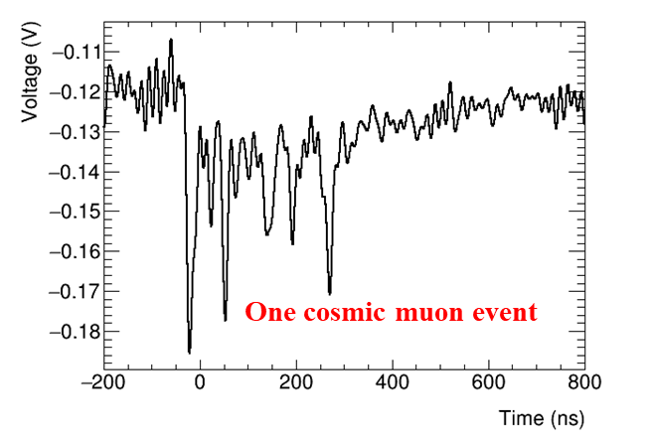
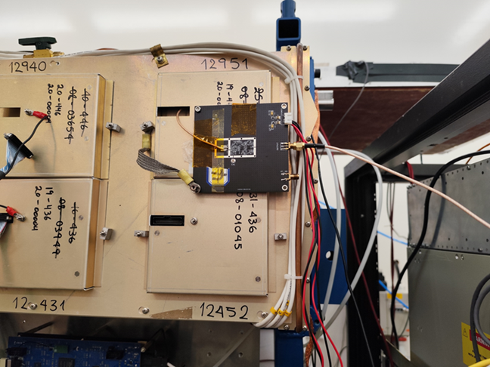
PID using dE/dx and dN/dx
dE/dX resolution: σ = 0.4 n^{-0.46} (tp)^{-0.32}→ ~4.5%
dN/dX resolution: σ = N_{clusters}^{-0.5}→ ~2.3%
Need to detect single electron peaks and perform clustering → signal amplification, waveform recording, and peak-finding and clustering algorithms
  modify the ATLAS HGTD amplification board to amplify raw signals
  use CAEN waveform digitizers to read out multiple channels
  algorithms will be developed offline and implemented inside FPGAs later
Perform cosmic ray studies in the lab and test beam studies at Fermilab (scheduled for summer 2025) and CERN
HGTD amplification board mounted on an ATLAS MDT chamber

Slide 17
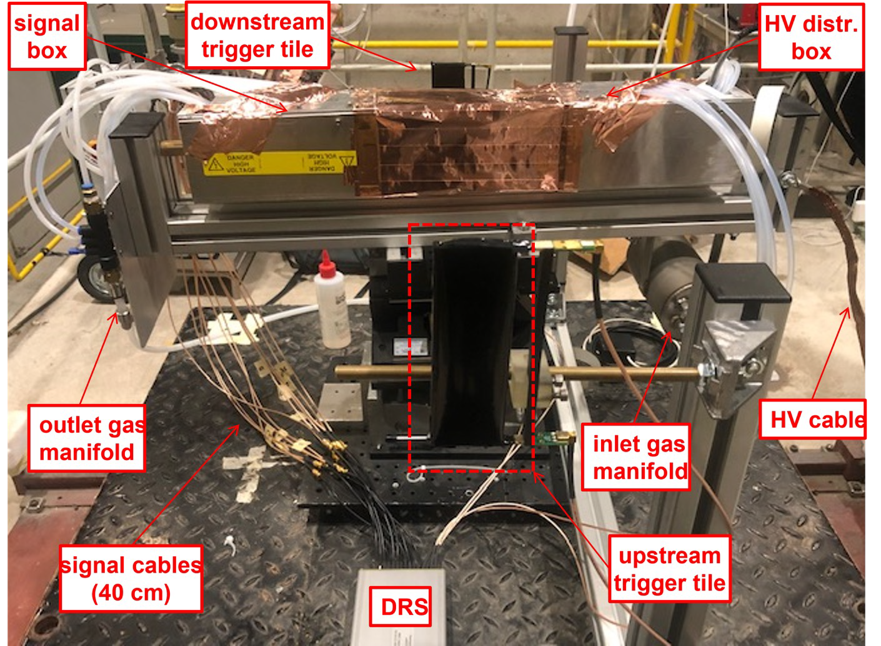
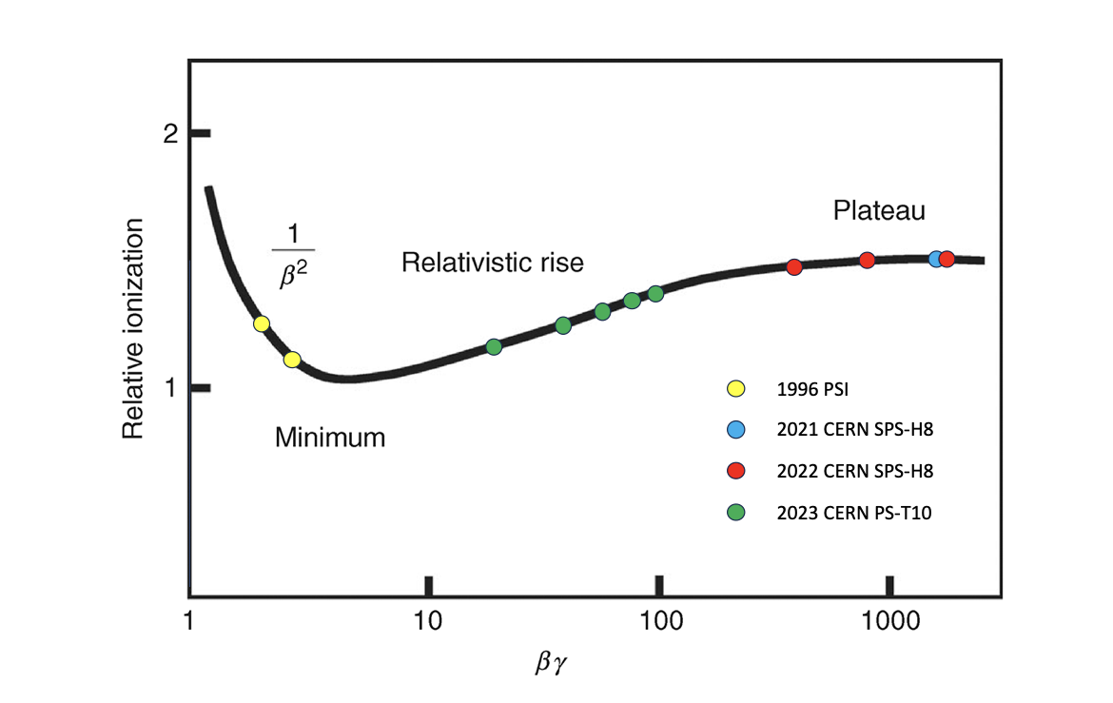
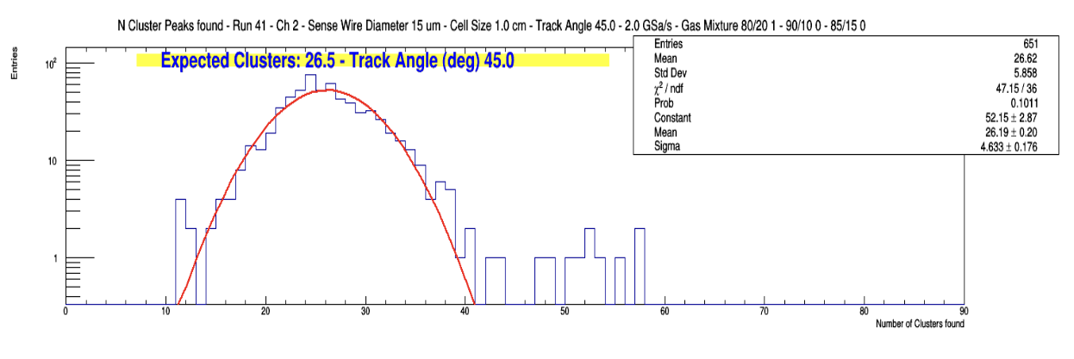
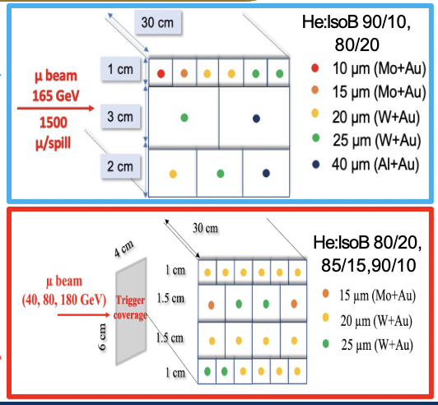
Promise of PID using dE/dx and dN/dx (DCH) based on Studies ongoing in Europe
Several test beams to experimentally assess and optimize the performance of the cluster counting/timing techniques covering big range of βγ range
Several algorithms under testing
  Derivative Algorithm (DERIV)
  Running Template Algorithm (RTA)
  Long short-term memory (LSTM) (Recurrent Neural Network - RNN) for peak finding & Dynamic Graph Convolutional neural networks (DGCNN) to identify electrons in the same primary cluster

Slide 18
$ | Building a prototype chamber with 25 straws, new electronics and dN/dX studies using cosmic ray and test beams at Fermilab (summer 2025) and CERN | $60K | $25k for building a prototype chamber, $10k for frontend electronics/waveform readout, $5k for test beam, $20k for student support
Duke University | Bundling straws for strength, string a few straws and check operations | $6.5K | $3.3k for material/machining, $3.2k for undergraduate student
Tufts University | Cosmic ray and test beam studies, straw tracker optimization | $47K | 0.5 FTE (graduate student)
UT Austin | Detector and layout optimizations (DELPHES simulation, stereo angle, w/ and w/o silicon wrapper, dN/dX) | $30K | 1 semester (graduate student)
BNL | Simulation (analytic + e-field), monte carlo reconstruction for TB, validate dN/dX during TB with small prototypes Wire R&D from different manufacturers | $30K | Support student for simulation studies
SLAC | Momentum resolution studies, DCH cell geometry optimization | $0K
U of Kansas + others | TPC feasibility studies | $0K
Total $173.5k
Srini: maybe we can stretch to have 1M for all L2 areas.

Slide 19
Areas for Low Mass Supports
Institutes: Purdue, Hawaii, Yale, FNAL, Cornell, Florida, ANL, LBNL
CF components for gas tracking - wires, support
CF components for the calorimeter
Support structures for silicon tracking
Highly integrated development and fabrication cycle: CAD→FEA→tooling design→manufacturing→validation→(FEA loop back)
Integration of support and services/cooling in fabrication
Multi-functional structures
Strong support and contacts with industry in the USA - SBIR/STTR,
Expertise and training of engineers, techs, students

Slide 20
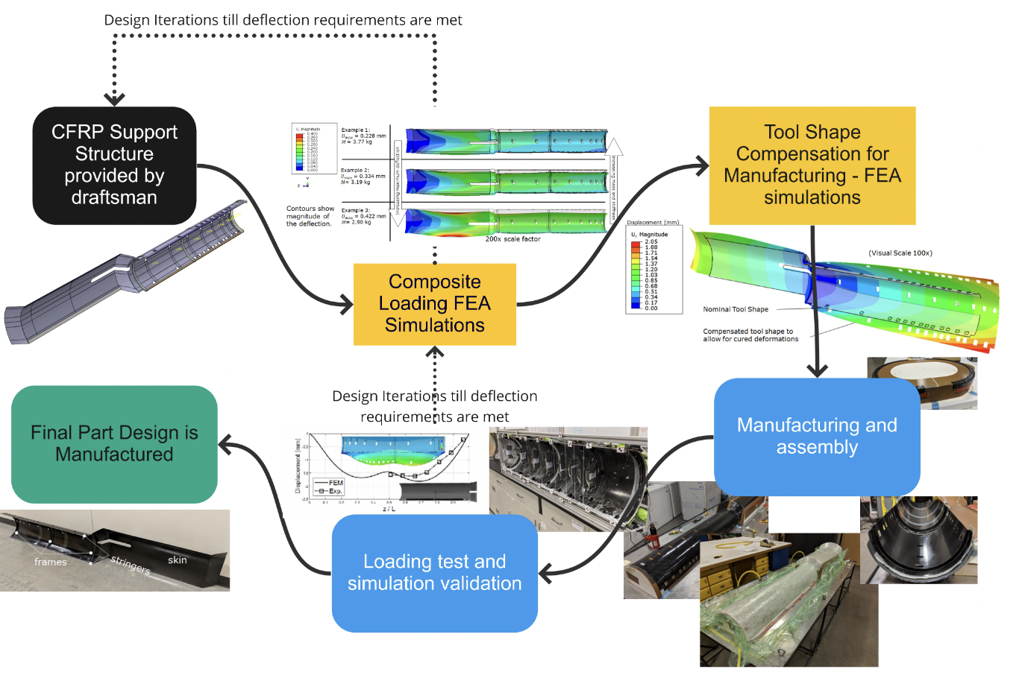

Slide 21
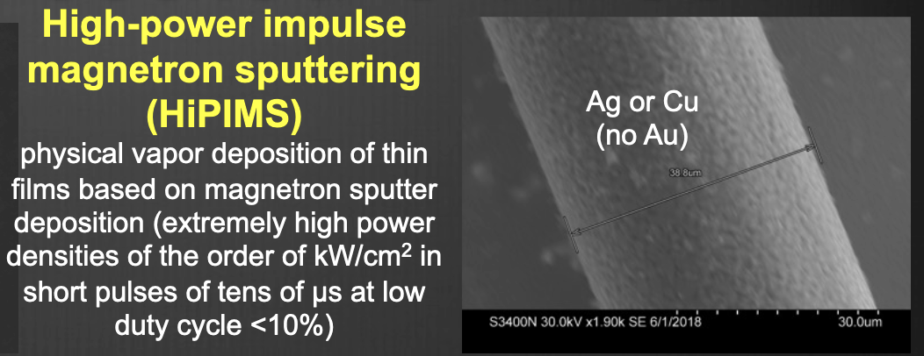

Slide 22
Low Mass Supports Funding Requests
Institute | Request | Remarks
ANL | $0k | Novel TIMs, high thermal conductivity
Cornell | $10k | Radiation hard interface materials, UG support
Florida | $5k | Thermal interface material, UG support, material characterization as “service”
FNAL | $30k | Low mass supports + vertex detector, 0.25 FTE junior person / tech
Hawaii | $5k | Experience / synergies w Belle II upgrade, readout
LBNL | $0k | Vertex detector
Purdue | $55k | $30k S&E, $25k 0.2 FTE technician. Existing Blue Sky on CF wire chamber and integrated composites, the ask here is for $45k in equipment - see remark. Material characterization as “service”.
Yale | $5k | Wire chamber / readout
Total | $110k
Interest in CF based gaseous detector:
Purdue (Jung)
Hawaii (Vahsen) and Yale (Prakhar)
Interest in composite mechanics:
Cornell (radiation hard interface materials)
Florida Institute of Technology (thermal interface materials)
Purdue (advanced composite structures, integrated detector support systems, simulations)
LBNL, Fermilab, ANL (multiple people)
→ Unique leadership opportunity, no CF coating facility (world’s only is Russian: non-accessible)
→ Establish Facility in US:
Re-commission sputtering/coating available via Purdue Nuclear value of > 50k$
Discussion with INFN Bari, potential for ~50k$ contribution if adequate funding from US side - unique opportunity!

