Slide 1

Topological Landau Theory
Joseph Maciejko
University of Alberta
Theory Canada 17
June 7, 2025

Slide 2

Canon Sun
(Alberta)
C. Sun & JM, arXiv:2412.15103
(PRL, in press)

Slide 3
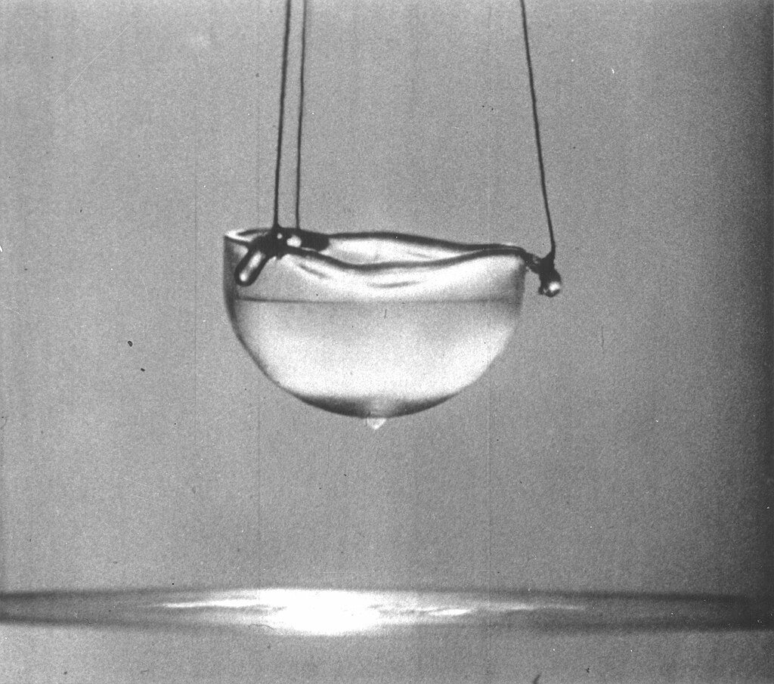
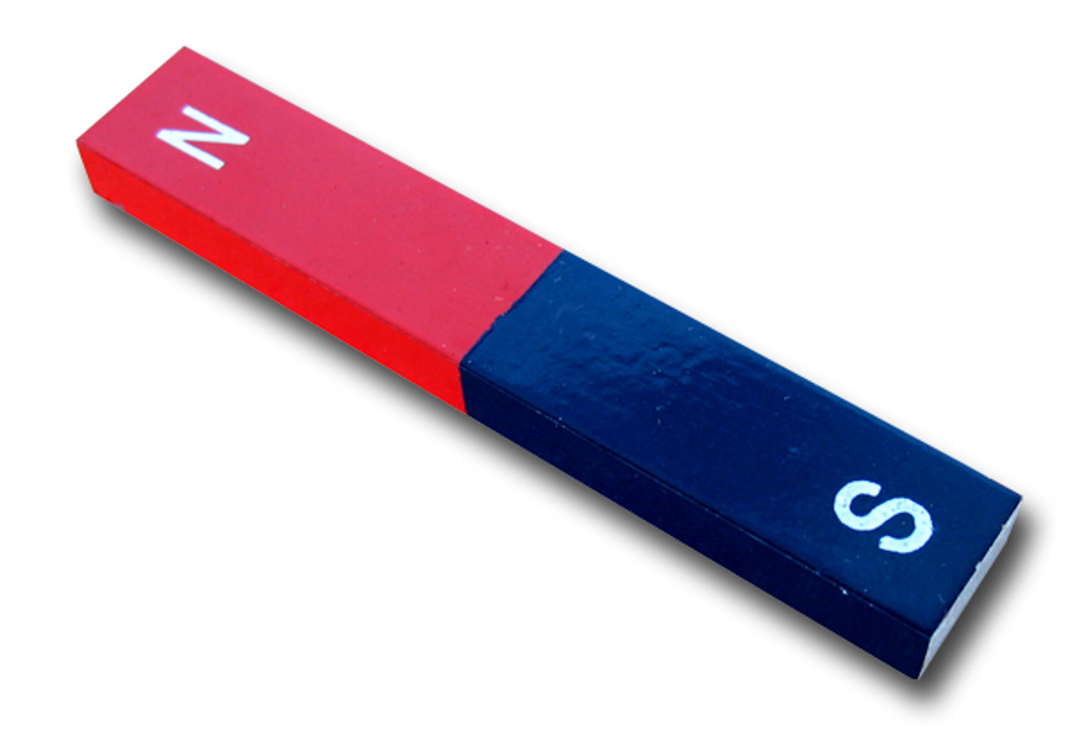
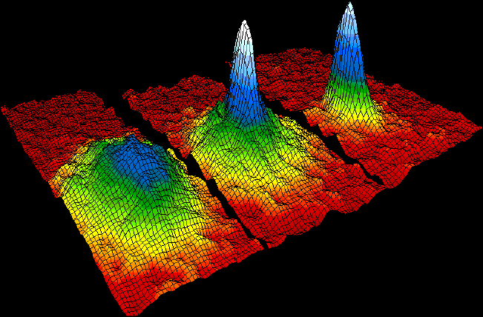
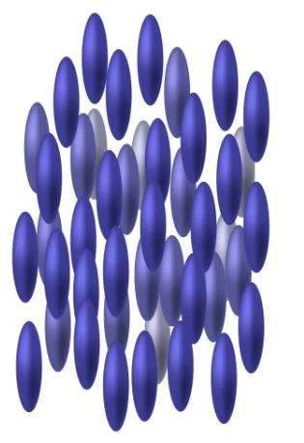

Phases of matter
Ferromagnet
Bose-Einstein condensate
Superfluid
Superconductor
Liquid crystal
and more…

Slide 4
Landau theory
Framework to understand phase transitions
Also used to understand the phases themselves
General—applies to a wide variety of systems
Phenomenological—no need for microscopic theory

Slide 5
Overview
Landau theory
  Ising ferromagnet
  Superconductor
Topological Landau theory
  Berry phase in quantum mechanics
  Berry phase in statistical mechanics
Microscopic model
  Topology of the superconducting order parameter (≠ topological superconductivity!)
  Measurement of Berry phase in Josephson junctions

Slide 6
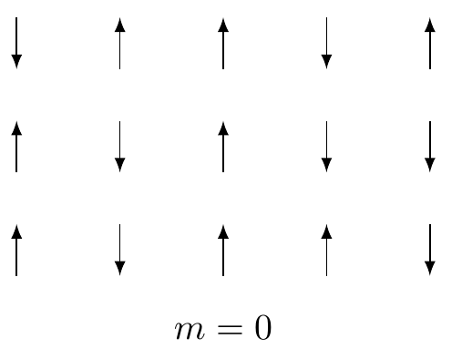
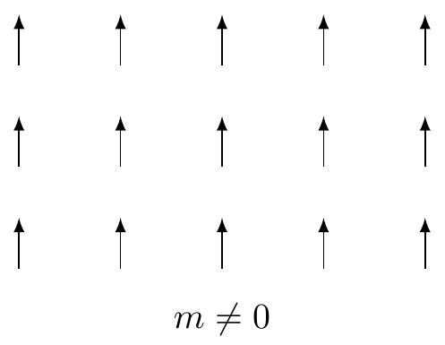
Ising ferromagnet
Paramagnet
Ferromagnet

Slide 7
Landau free energy
Free energy depends on order parameter (magnetization)
Order parameter is small near continuous phase transition
=> expand free energy as power series in
Free energy must be compatible with symmetry

Slide 8
Spontaneous symmetry breaking
Free energy:
Paramagnet
Ferromagnet

Slide 9
General prescription
Identify order parameter
  Magnetization
Construct free energy
  Free energy must be invariant under symmetry operations
  Spin flip
Minimize free energy
  Quadratic coefficient determines critical temperature

Slide 10
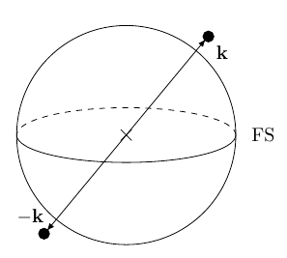
Superconductivity
Phenomenology
Zero resistivity
Meissner effect (flux expulsion)
Cooper pair
Electrons pair to form a Cooper pair
Cooper pairs condense

Slide 11
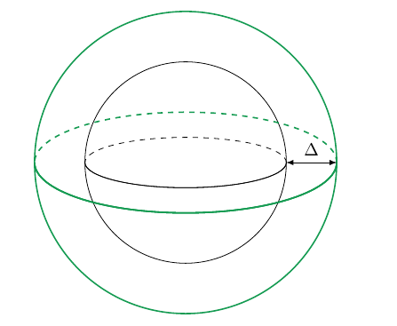
Order parameter
Pair amplitude
Gap function
Free energy should be invariant under a change of phase

Slide 12
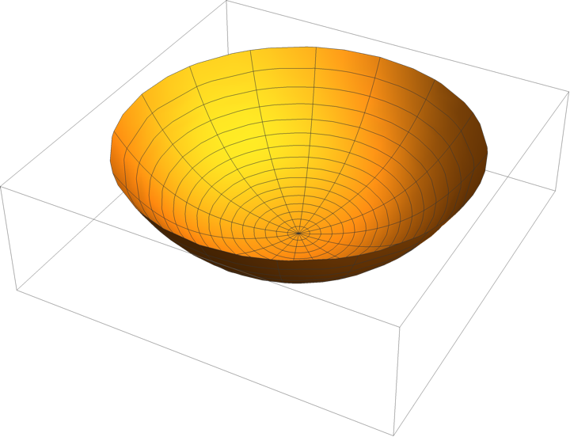
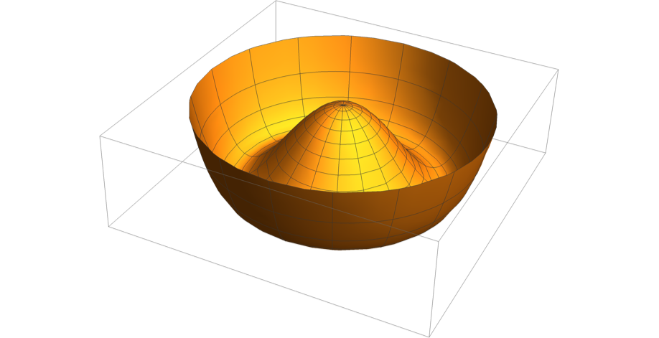
Spontaneous symmetry breaking
Free energy:
Metal
Superconductor

Slide 13
Gauge symmetry
Wavefunction
Complex function
Wavefunctions that differ by a phase correspond to the same quantum state
Gap function
Complex function
Gap functions that differ by a phase correspond to the same thermodynamic ground state
Notes:
Unlike a ferromagnet, there is no gauge-invariant observable that can distinguish two degenerate SC ground states with a different phase. Only phase differences can be measured, e.g. through the Josephson effect. So it is better to think of the U(1) symmetry as a gauge symmetry (even if there is no gauge field present), like in quantum mechanics.

Slide 14
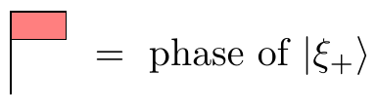
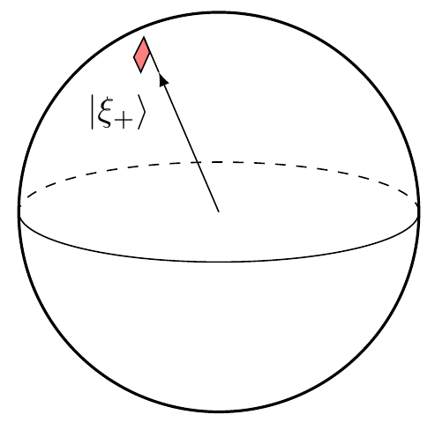
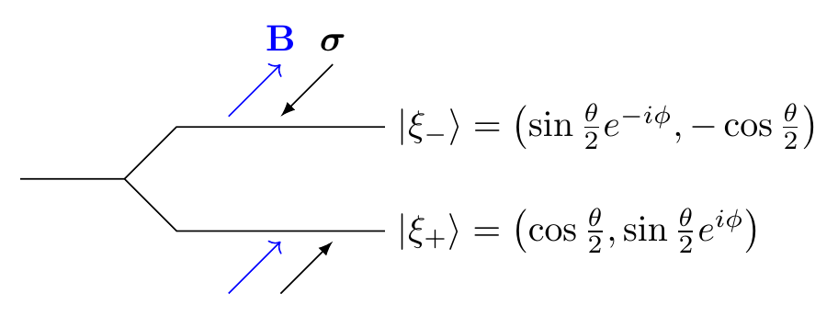
Berry phase in QM
Spin-1/2 in a magnetic field
Hamiltonian
Spectrum
Bloch sphere

Slide 15
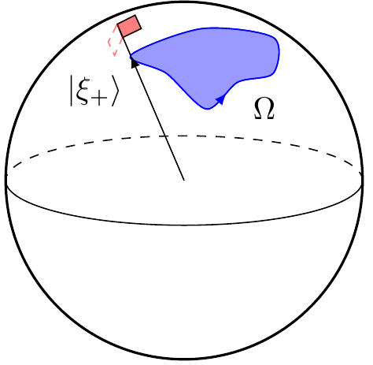
Berry phase in QM
Adiabatic theorem
If the parameters of the Hamiltonian are varied slowly, then the system will remain in the same eigenstate.
Returning to the initial parameters brings the system back to its starting state, up to a phase
Bloch sphere

Slide 16
Berry phase
Quantum mechanics
Statistical mechanics
?
Notes:
Can the superconducting order parameter acquire a Berry phase under adiabatic evolution of thermodynamic parameters?
Can this Berry phase be observed?

Slide 17
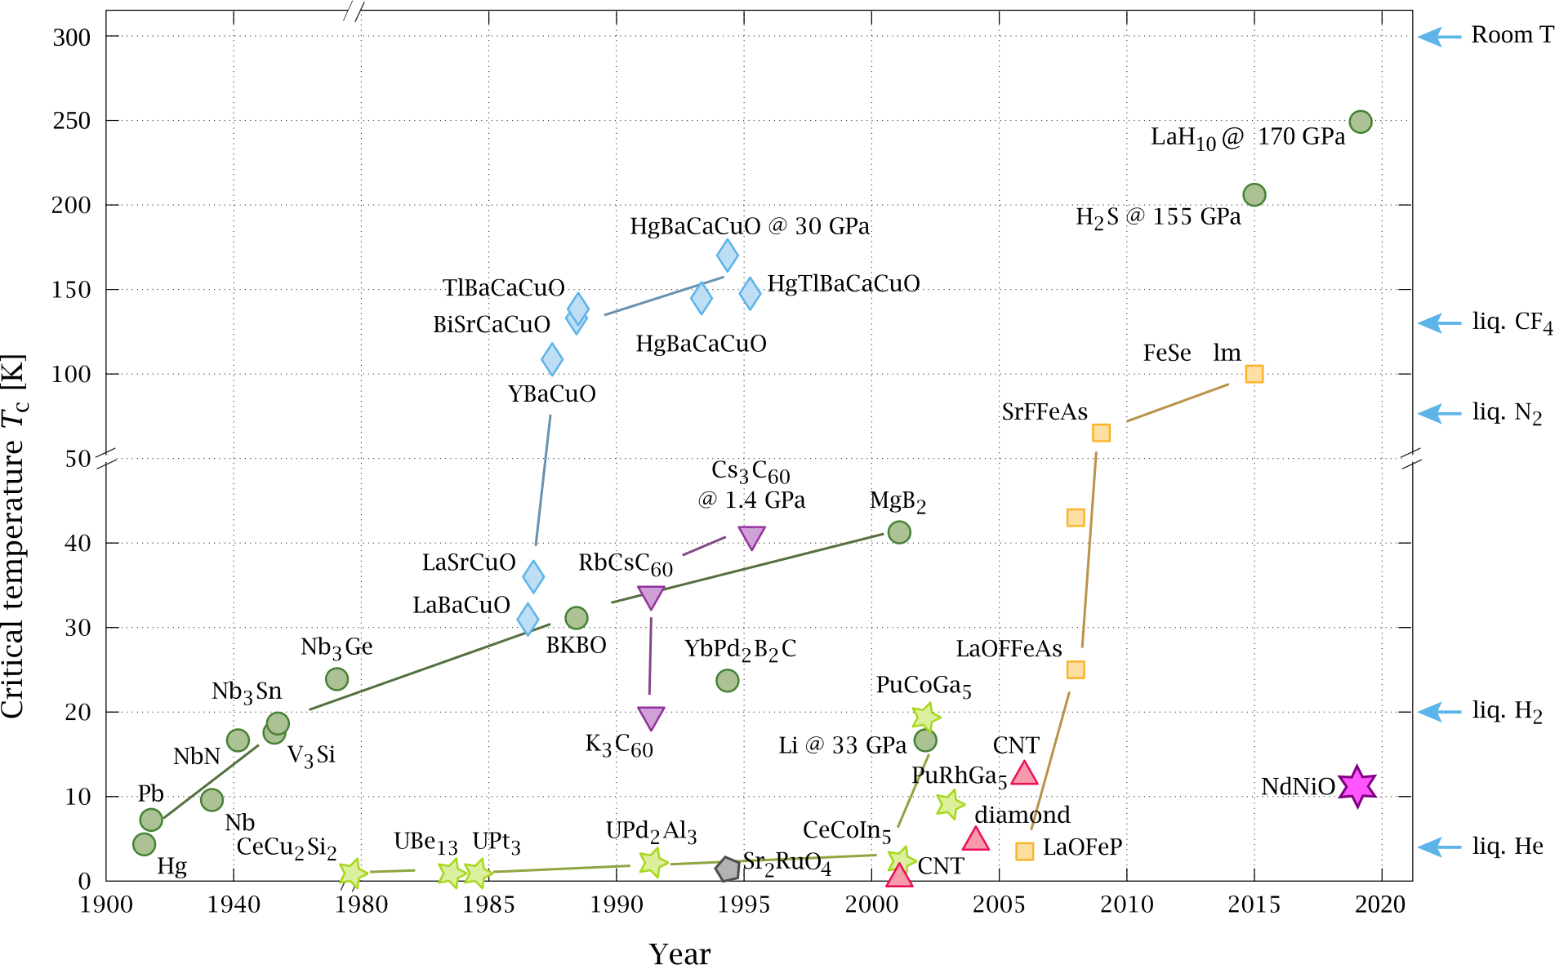
Cuprate superconductors
Order parameter:

Slide 18
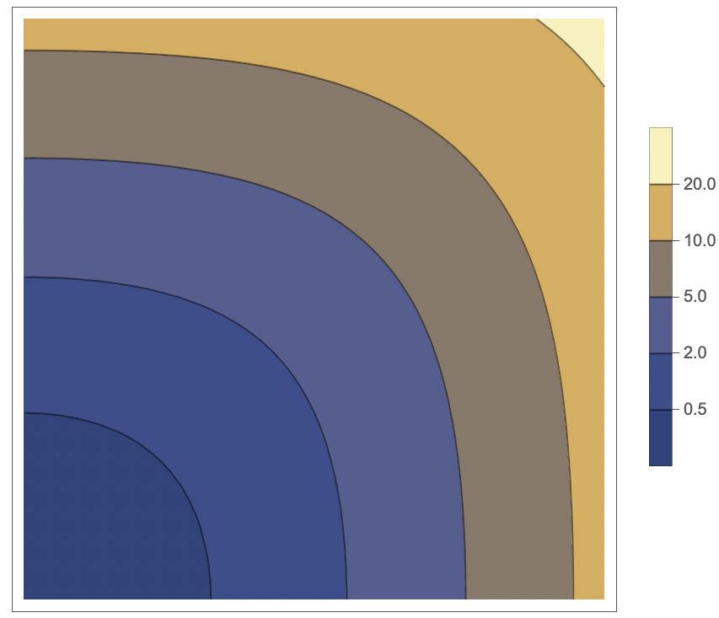
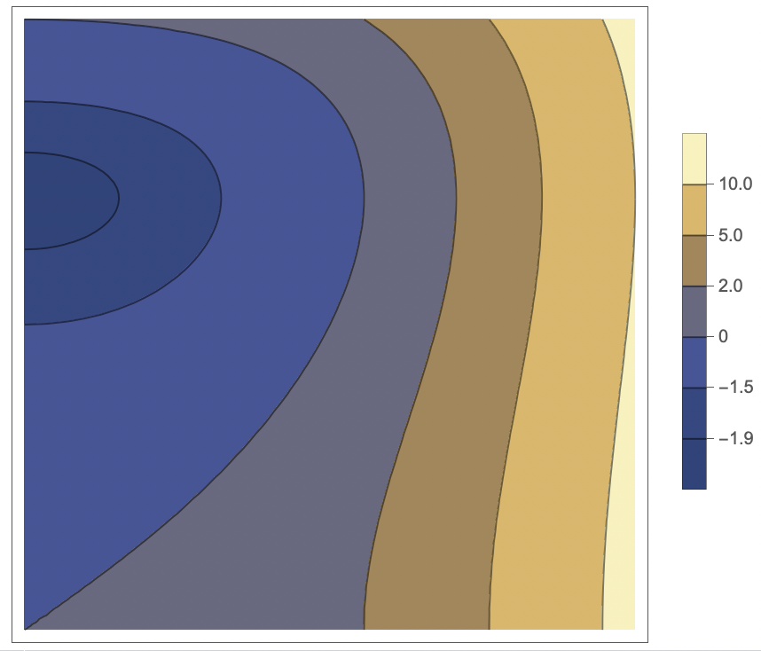
Competition between phases
Order parameter
Quadratic term
Quadratic term determines:
Critical temperature
The order parameter
Can we have a term?

Slide 19
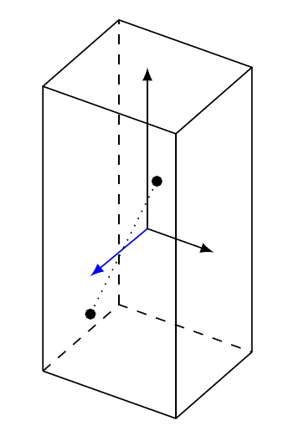
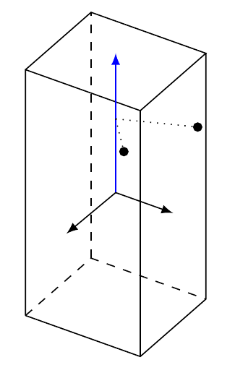
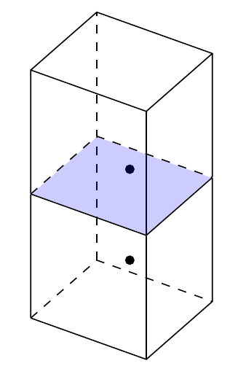
D_{4h} point group
C₄ rotation about z-axis
Mirror parallel to x-y plane
C₂ rotation about x-axis
Notes:
Tetragonal point group

Slide 20
Symmetry of order parameter
Order parameter
 | C₄ rotation z-axis | x-y mirror | C₂ rotation x-axis
not invariant under C₄ rotation about z-axis

Slide 21
Symmetry of order parameter
Order parameter
 | C₄ rotation z-axis | x-y mirror | C₂ rotation x-axis
invariant under all symmetry operations!
Notes:
“extended s-wave”

Slide 22
Matrix quadratic term
Order parameter
with
Orthonormal basis functions that transform the same way under symmetry operations
Quadratic term
Most general term compatible with symmetry
where is a Hermitian matrix
“s-wave”
“extended
s-wave”

Slide 23
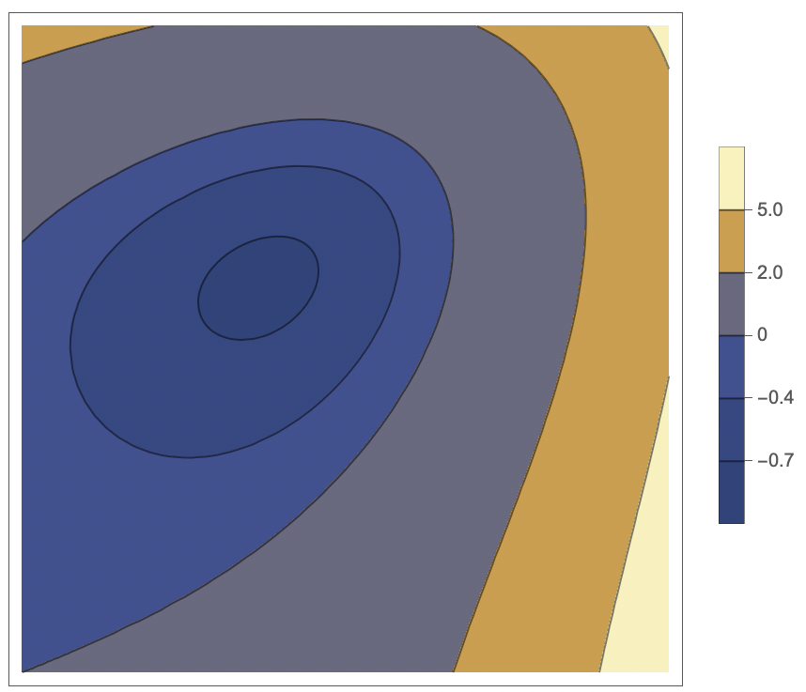
Berry phase of order parameter
Free energy
Critical temperature = temperature when smallest eigenvalue changes sign
Order parameter = eigenvector of smallest eigenvalue
The matrix depends on microscopic parameters
  Order parameter changes as parameters are varied
  Berry phase

Slide 24
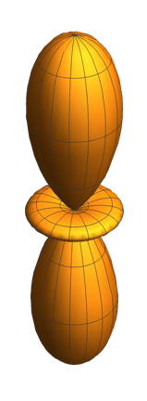
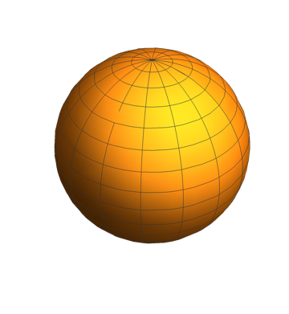
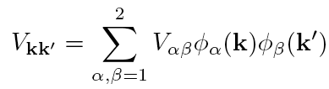
Model Hamiltonian
Free Hamiltonian
Interaction Hamiltonian
Scattering matrix element
D_{4h} orbitals

Slide 25
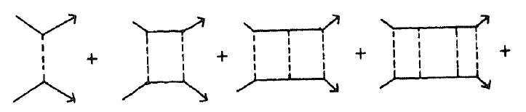
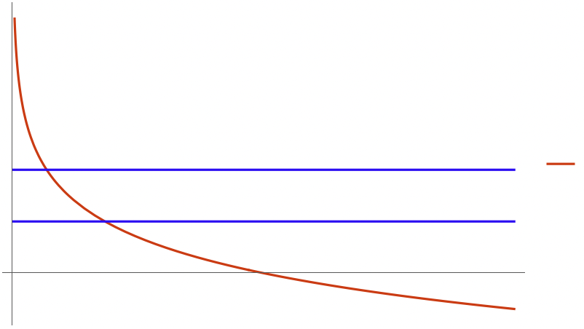
Free energy
…
Quadratic term
where
Logarithmic divergence as
There is a phase transition at sufficiently low temperature
Order parameter eigenvector of with largest eigenvalue
T_{c}
Notes:
- Logarithmic divergence in Cooper (particle-particle) channel
- Which is the eigenvector of A with the *smallest* eigenvalue (the one that condenses)

Slide 26
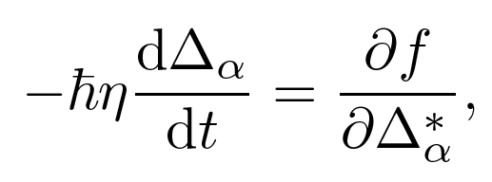

Adiabatic order parameter dynamics
Time-dependent Ginzburg-Landau equation
Vary interaction parameters in “slowly”, on characteristic time scale
Slightly below T_{c}, critical (non-critical) eigenvector relaxes on time scale ( ) with
Provided , order parameter stays in the “instantaneous ground state” but acquires Berry phase :
Landau & Khalatnikov 1954
Gor’kov & Eliashberg 1968
Berry connection

Slide 27
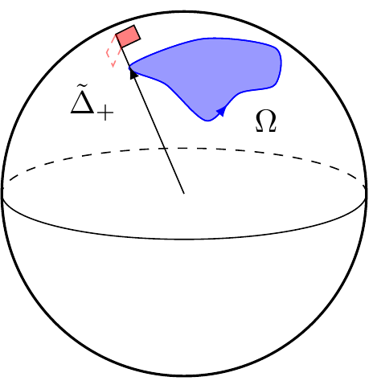
Thermodynamic 3D Weyl point
Most general scattering matrix element
(time-reversal symmetry breaking)
Eigenvalues
Eigenvectors
U(1) Berry phase
“monopole bundle”

Slide 28
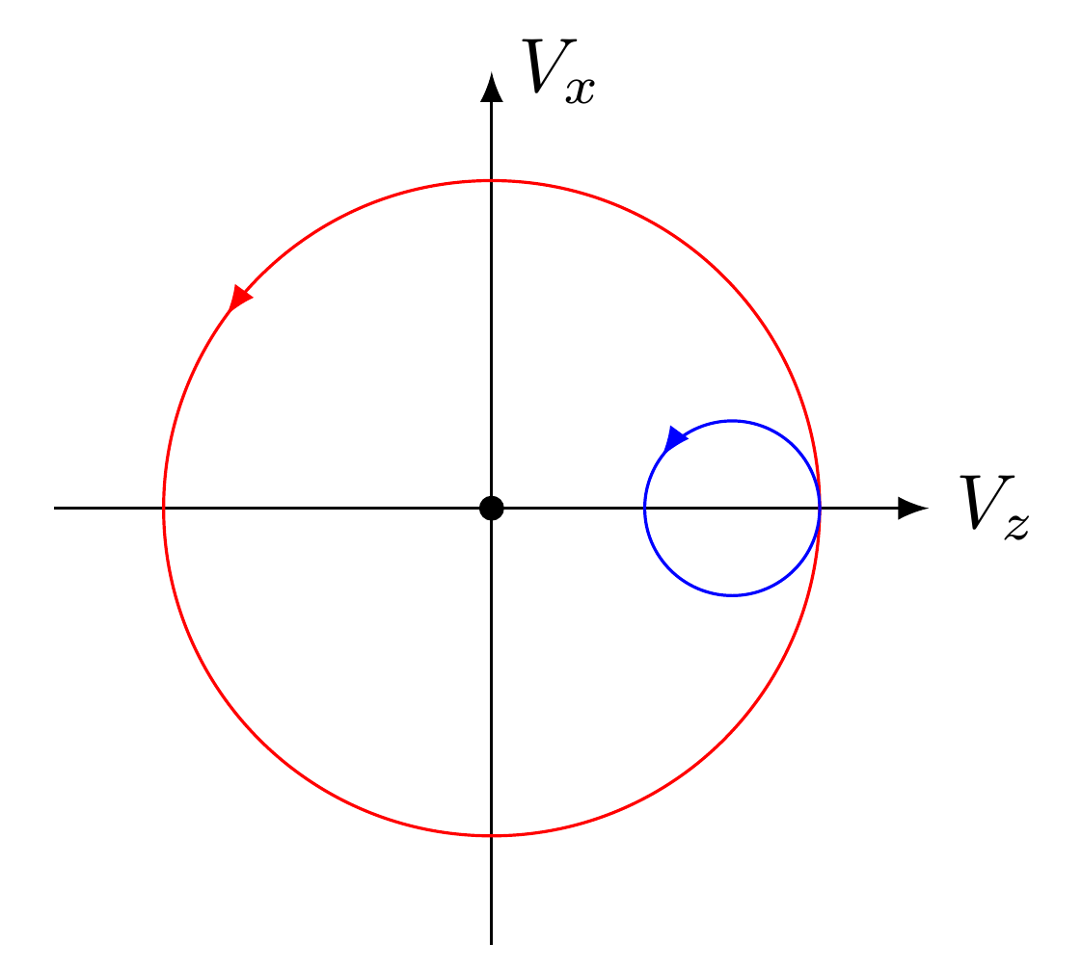
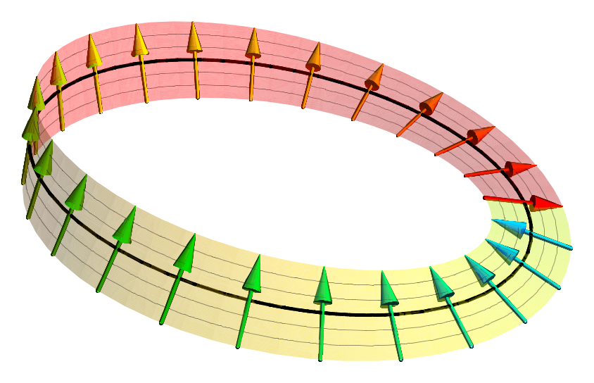
Thermodynamic 2D Dirac point
Most general time-reversal symmetric scattering matrix element
Eigenvalues
Eigenvectors
Z₂ Berry phase
“Möbius bundle”
Notes:
The usual pi Berry phase of a 2D Dirac cone, like in graphene or the surface of 3D topological insulators

Slide 29
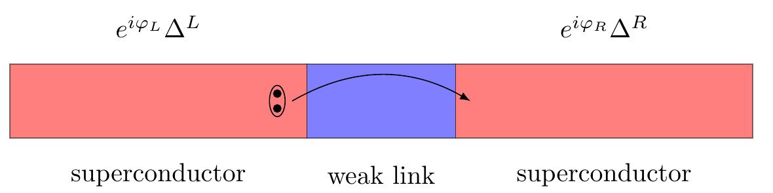
Josephson effect
Cooper pairs tunneling through a weak link leads to a current

Slide 30
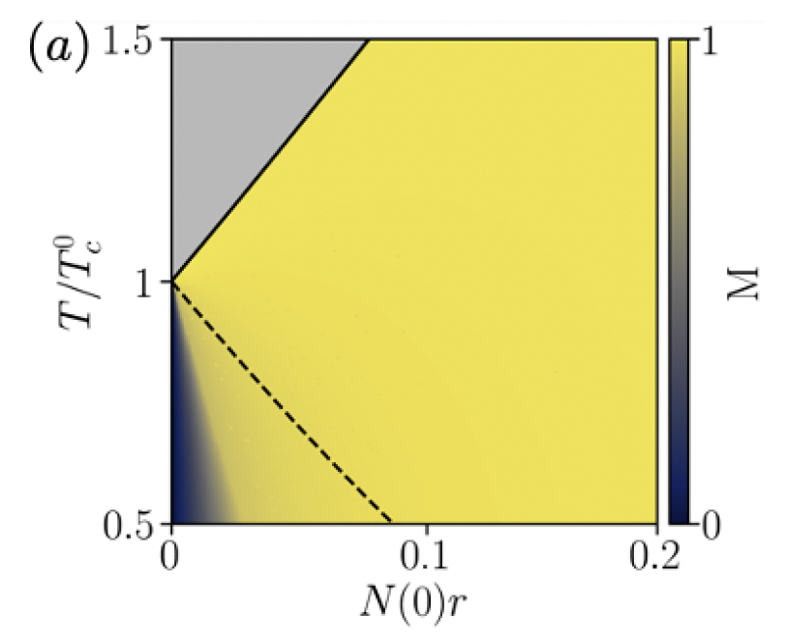
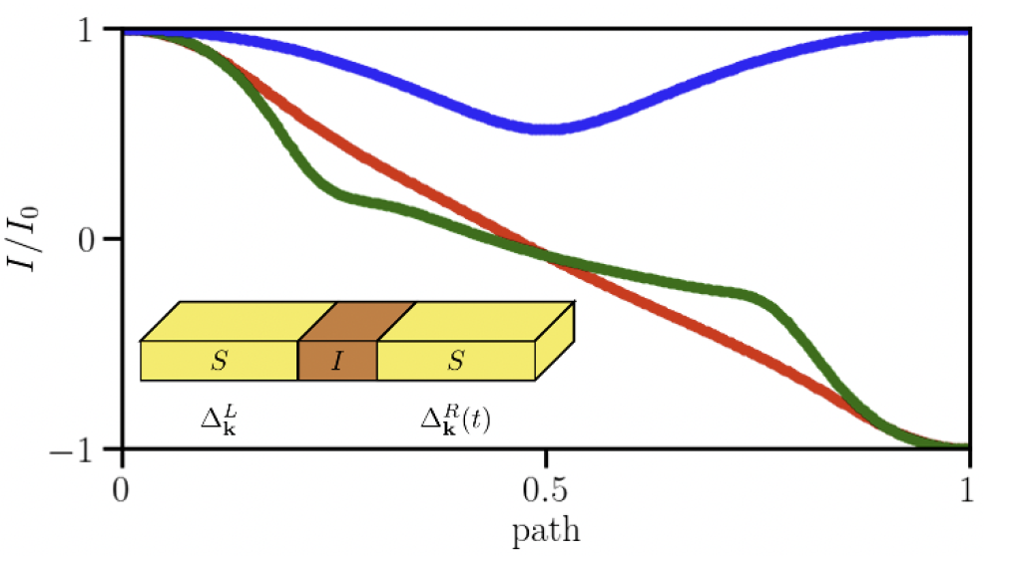
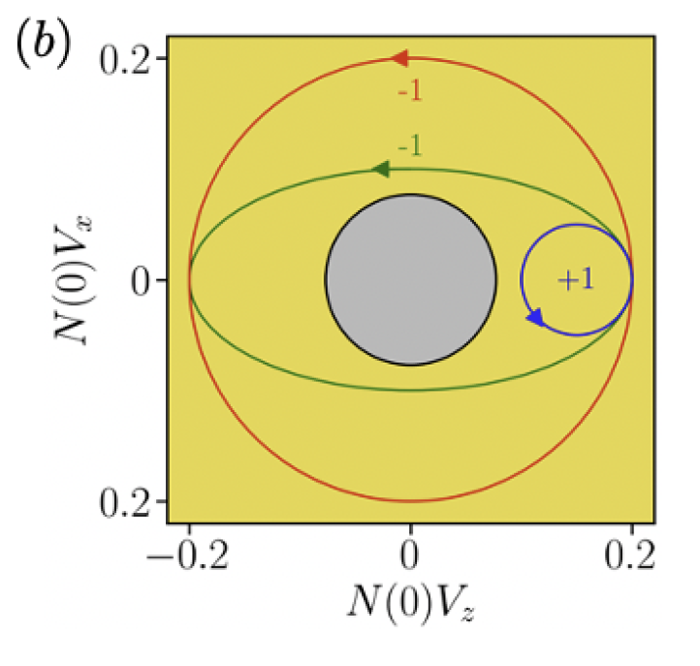
Topological Josephson effect
N
Josephson current changes sign due to π Berry phase of Dirac cone
“thermodynamic Dirac cone”
SC
N
Berry phase at fixed T
SC
vary interactions adiabatically
Notes:
Color gradient measures the squared overlap between eigenvector of quadratic term in Landau theory (Delta_+) and order parameter obtained from full numerical solution of BCS equations; agrees well near T_c

Slide 31
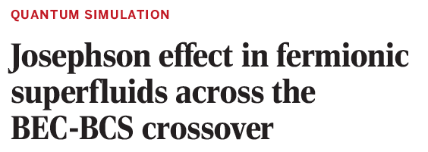
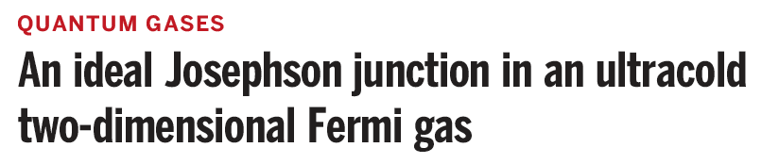
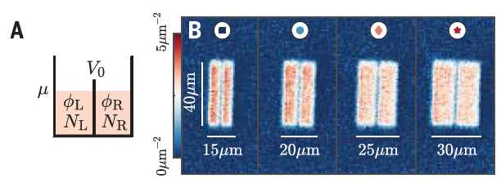
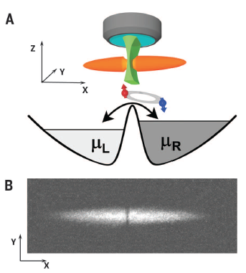
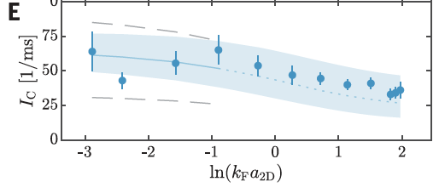
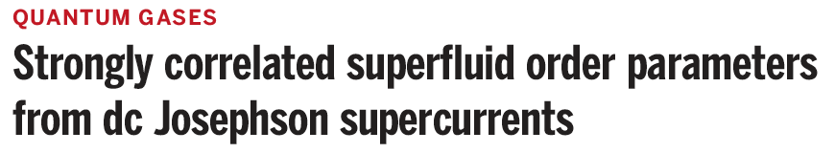
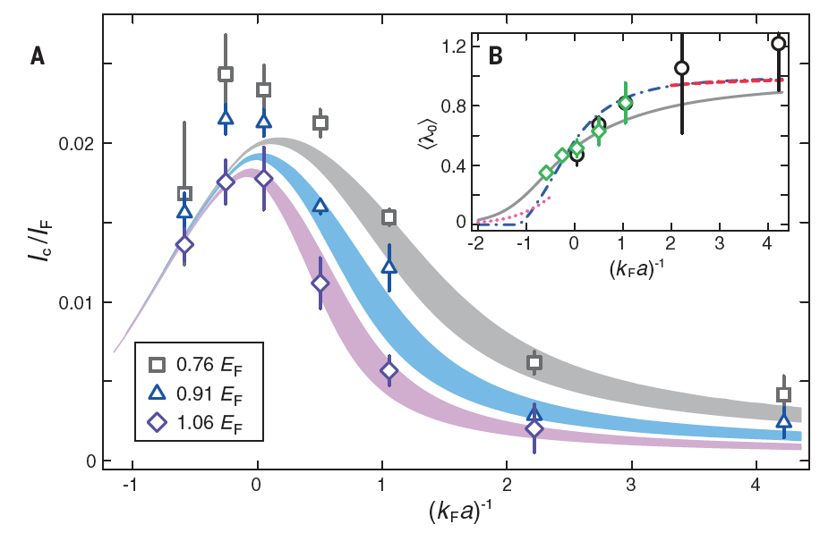
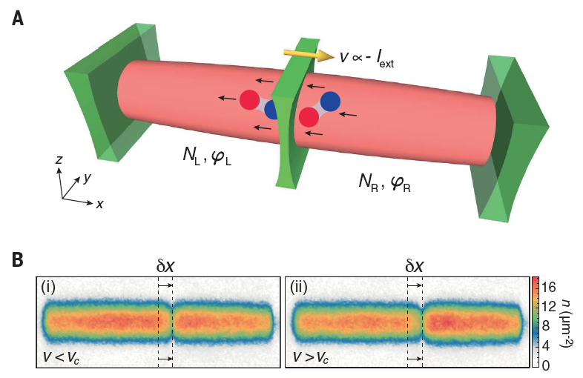
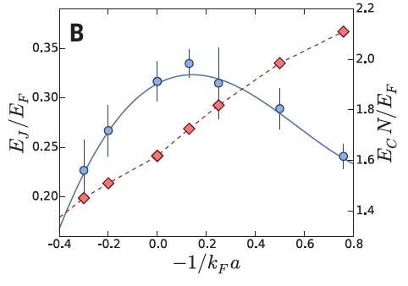
Tunable atomic junctions?
a = scattering length (Feshbach resonance)
Luick et al., Science 369, 89 (2020)
Valtolina et al., Science 350, 1505 (2015)
⁶Li
Kwon et al., Science 369, 84 (2020)
Notes:
<lambda_0> is the condensate fraction

Slide 32
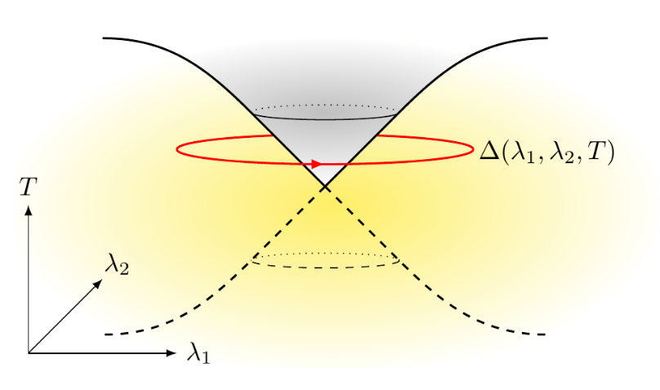

Summary
”Hidden” topology in Landau theory
Berry phase of order parameter from thermodynamic analogs of Weyl & Dirac points
Realization in microscopic model of superconductor/superfluid with two “competing” order parameters
Berry phase can be measured in a Josephson junction
Potential realization in ultracold atomic Josephson junctions (?)
C. Sun and JM, arXiv:2412.15103
Notes:
Parallels with topological band theory:
quadratic term in Landau theory ~ Bloch Hamiltonian
Order parameter ~ Bloch state
Interaction parameters ~ momentum space
Critical eigenvector ~ “occupied” Bloch state

Slide 33
Some formal aspects
Symmetry group
e.g.
Order parameter
Order parameter lives in some Hilbert space
e.g.
Hilbert space can be decomposed into invariant subspaces:
labels the irrep
labels the multiplicity
Order parameter can be expanded as
labels vector within irrep
e.g. and are different functions that belong to the same irrep
Quadratic term
Most general quadratic term compatible with symmetry

Slide 34
Parallels with topological band theory
Quadratic term
Hermitian matrix
Depends on parameters
  Microscopic, e.g. interaction strength
  Macroscopic, e.g. temperature
Phase transition happens when eigenvalue crosses zero
Eigenvector below zero = relevant order parameter
Bloch Hamiltonian
Hermitian matrix
Depends on parameters
Metal-insulator transition when eigenvalue crosses zero
Eigenvector below zero = filled Bloch state

