Slide 1


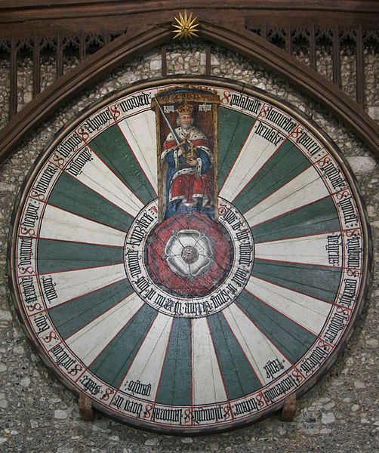



Quasi-Dirac Neutrinos
Bhupal Dev
Round Table on New Avenues in Particle Cosmology
Winchester, UK
May 21, 2025

Slide 2
Neutrinos: The Least Known Sector of the SM

Slide 3
Nature of Neutrino Mass
Majorana or Dirac?
From A. de Gouvea
Why is it a difficult question?
Because the Majorana nature is suppressed by the tiny neutrino mass itself.
Two ways around:
Find non-relativistic neutrinos.
Find a process that violates L.
Both are difficult.

Slide 4
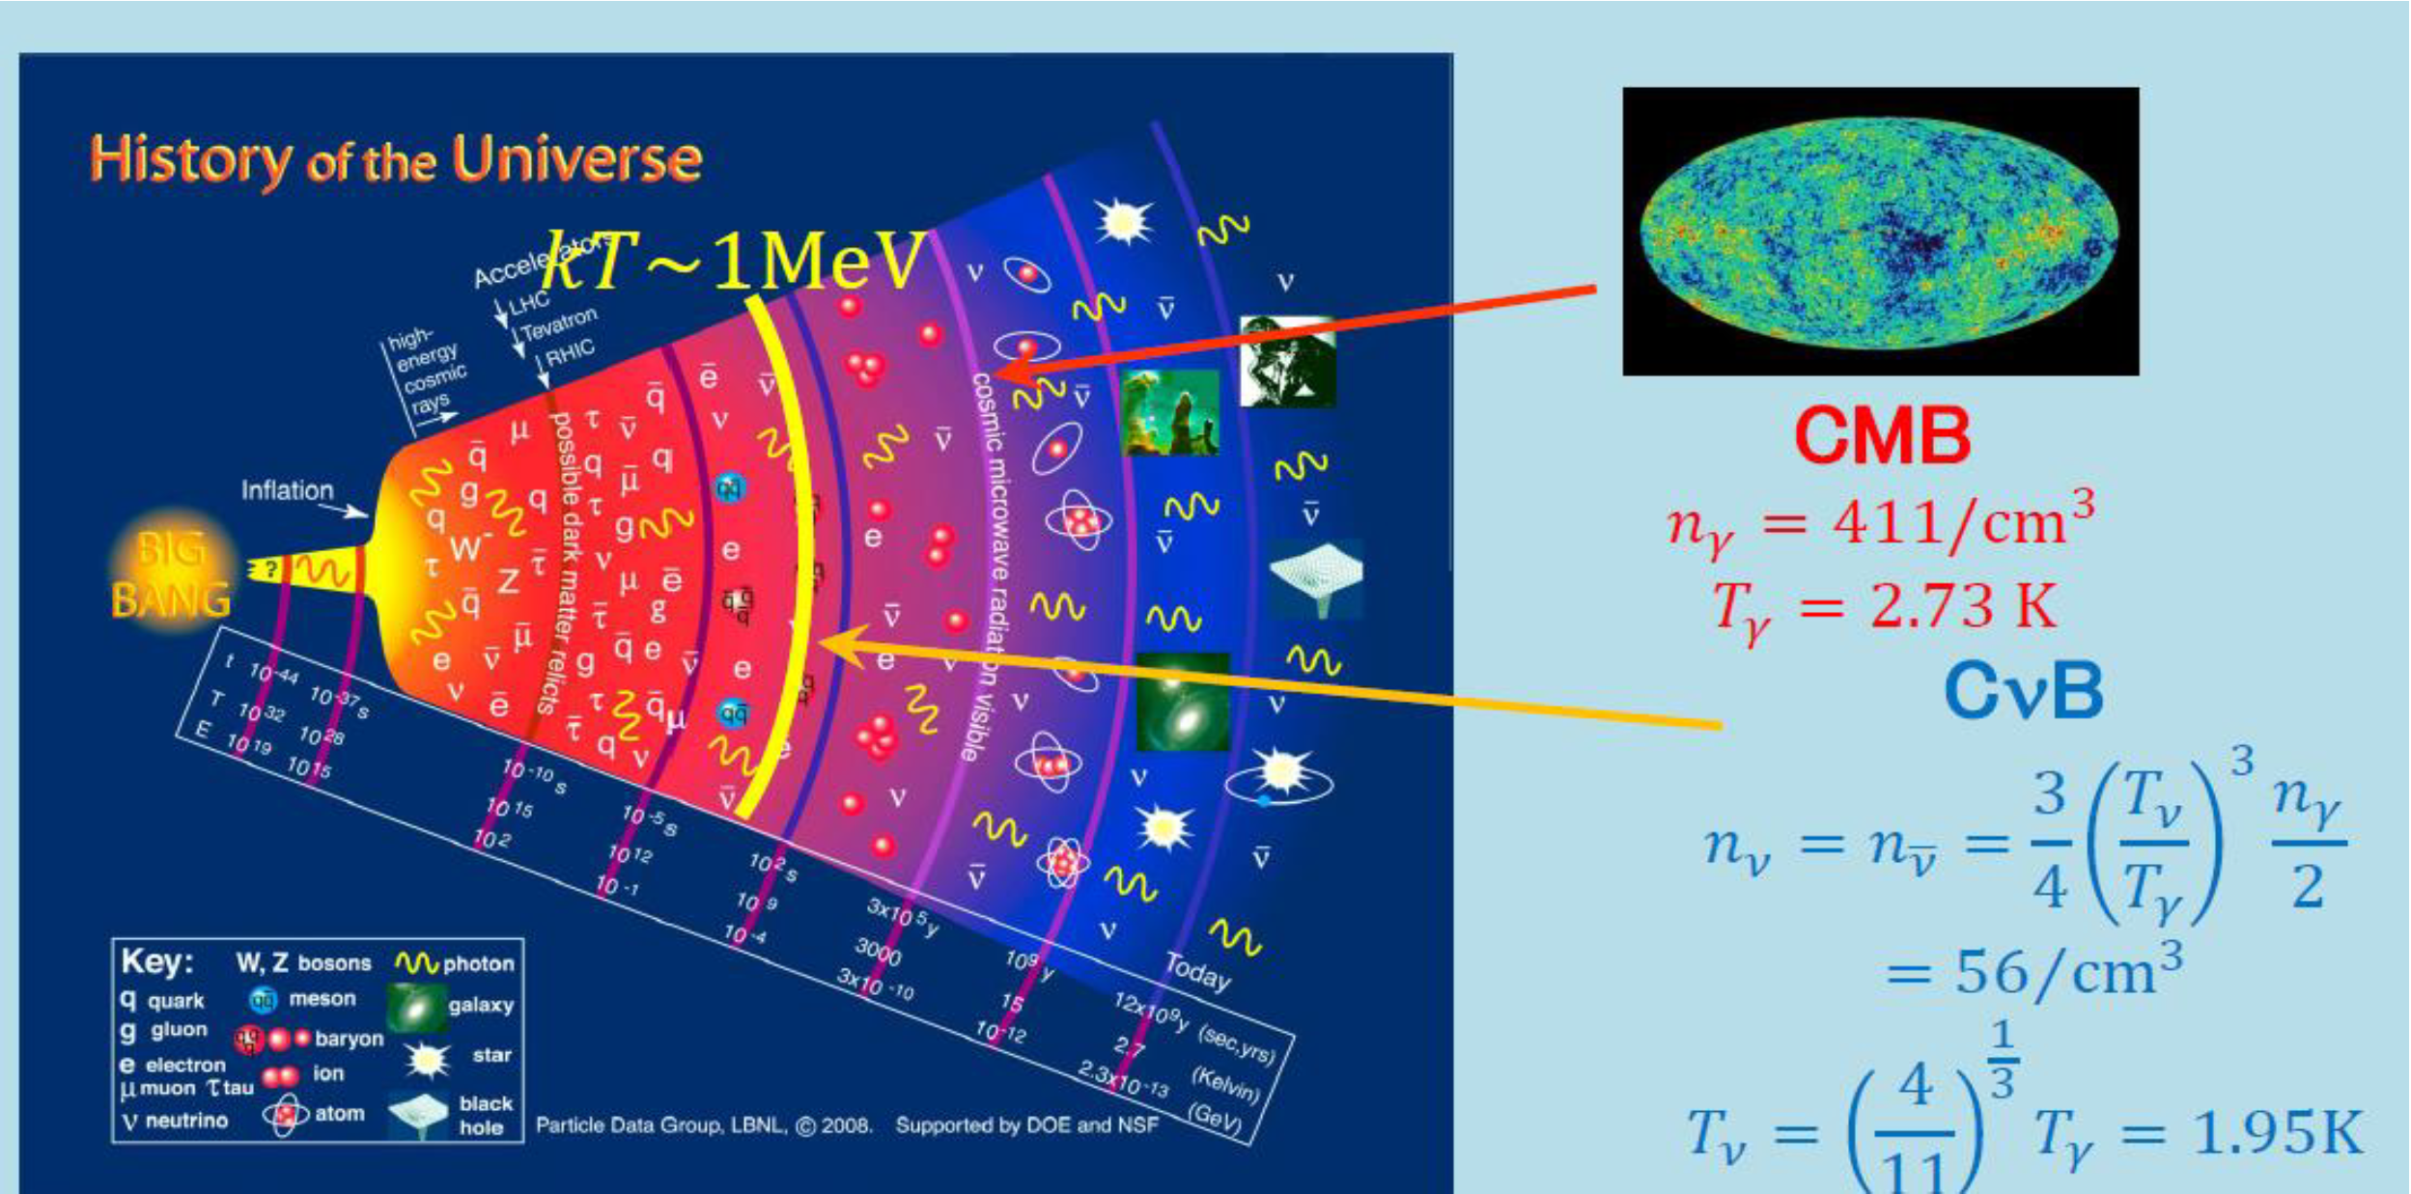


Non-relativistic Neutrinos
Long, Lunardini, Sabancilar, 1405.7654;
PTOLEMY, 1902.05508

Slide 5
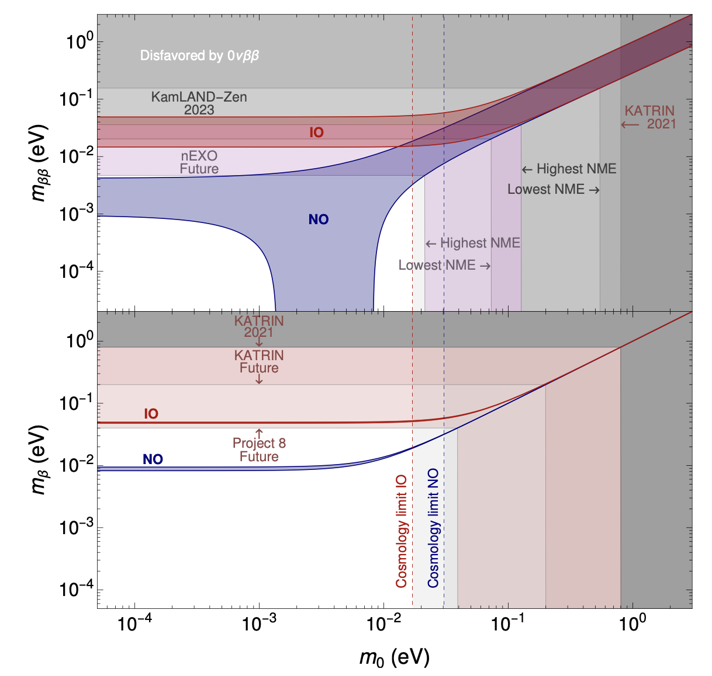
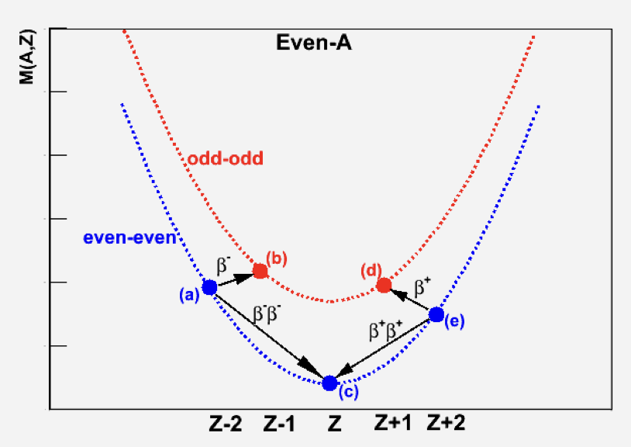
Neutrinoless Double Beta Decay
Goeppert-Mayer
(1935)
2310.20681
Racah (1937); Furry (1939); Schechter, Valle (1982)

Slide 6
Guidance from Theory

Slide 7
Dirac, Majorana or Quasi-Dirac?

Slide 8


How to Probe Quasi-Dirac Neutrinos (QDinos)
Active-sterile oscillations suppressed, unless
$$δm^{2}\frac{L}{E}∼1$$
Need astrophysical baselines
(for maximal mixing)
Barbieri, Dolgov (PLB 1990);
de Gouvea, Huang, Jenkins, 0906.1611;
Ansarifard, Farzan, 2211.09105

Slide 9
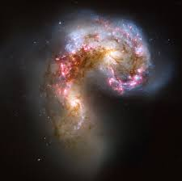
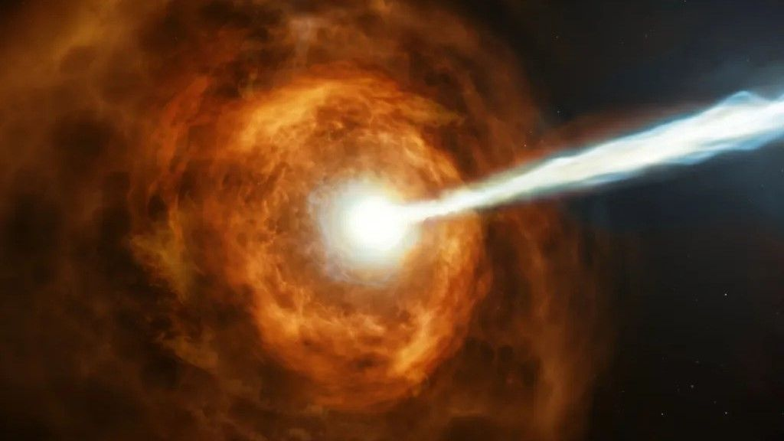
High-Energy Astrophysical Neutrinos
Multi-messenger connection

Slide 10



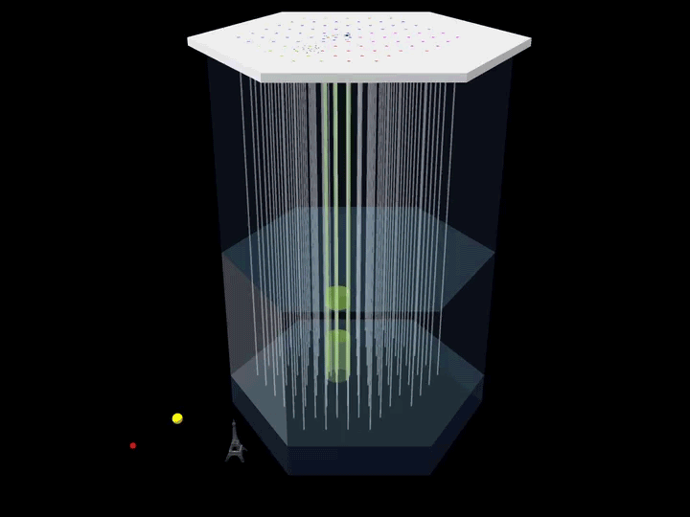
High-Energy Neutrino Signal at IceCube
CC Muon track
Tau double-bang
EM/Hadronic showers
Throughgoing muons, huge statistics
Showers: Good energy resolution, but poor angular resolution.
Tracks: Good angular resolution, but poor energy resolution.

Slide 11
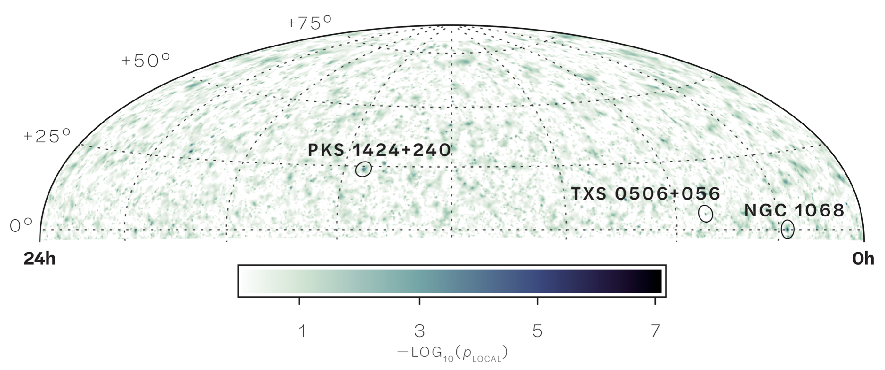
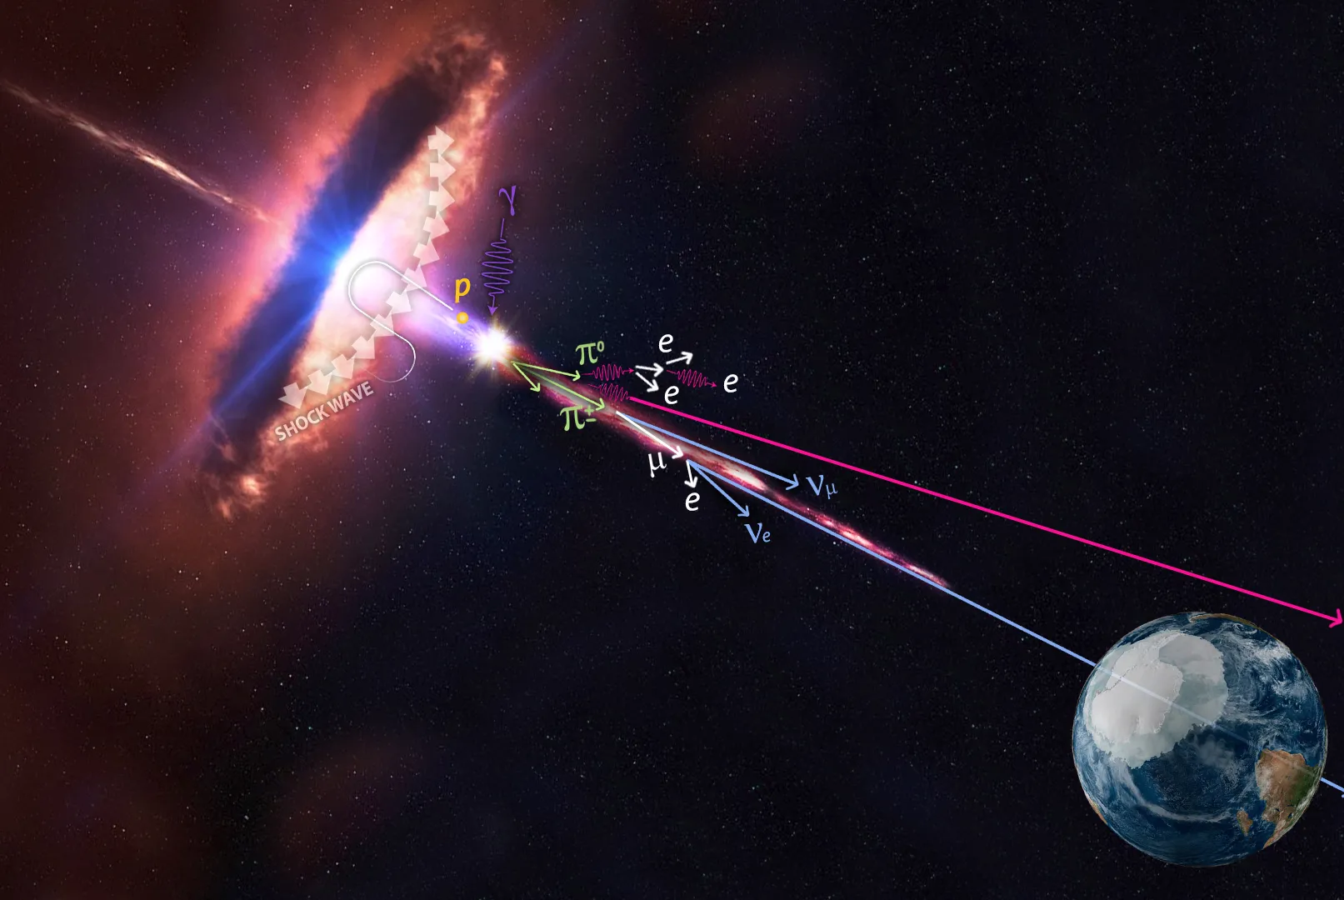
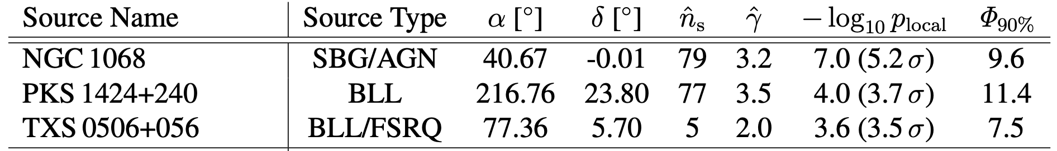
Point Source Identification
IceCube Collaboration, 2211.09972 (Science);
1807.08794 (Science).

Slide 12
Probing QDino Oscillations using Point Sources
Carloni, Martinez-Soler, Arguelles, Babu, BD, 2212.00737

Slide 13
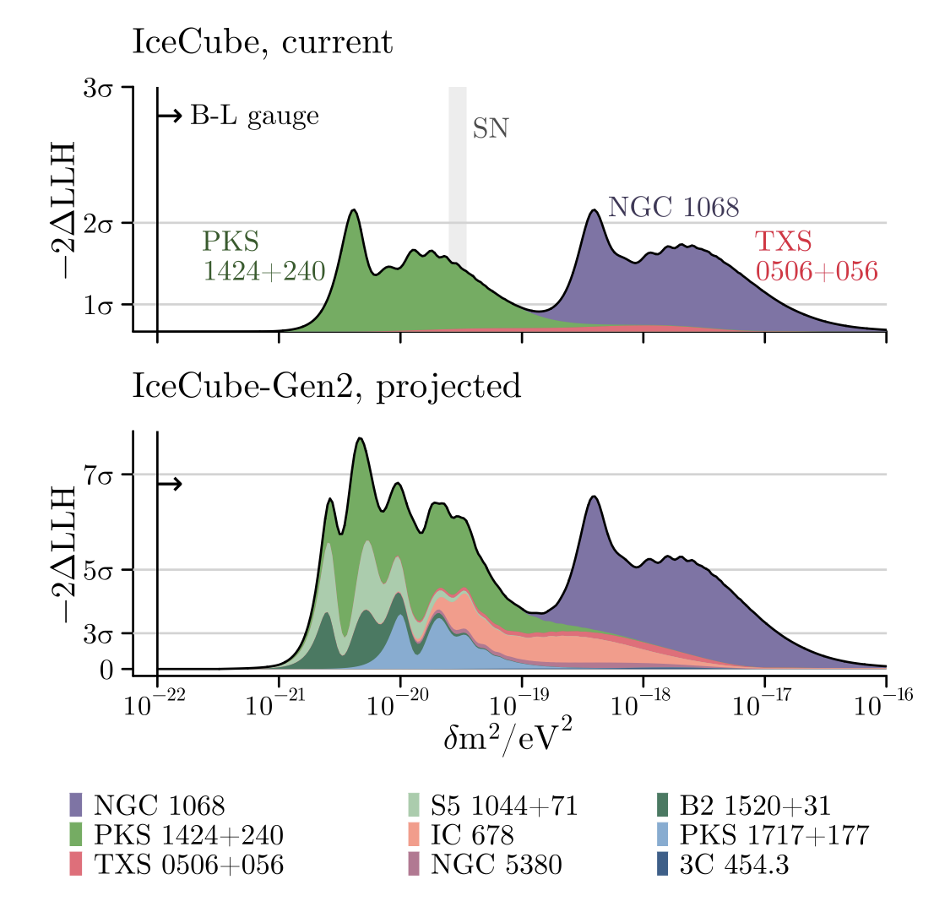
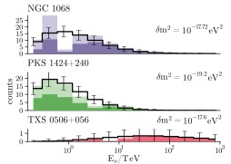
First IceCube Constraints on QDinos
5
Carloni, Martinez-Soler, Arguelles, Babu, BD, 2212.00737

Slide 14
Hint of QDinos in IceCube All-Sky Data
Carloni, Porto, Arguelles, BD, Jana, 2503.19960

Slide 15
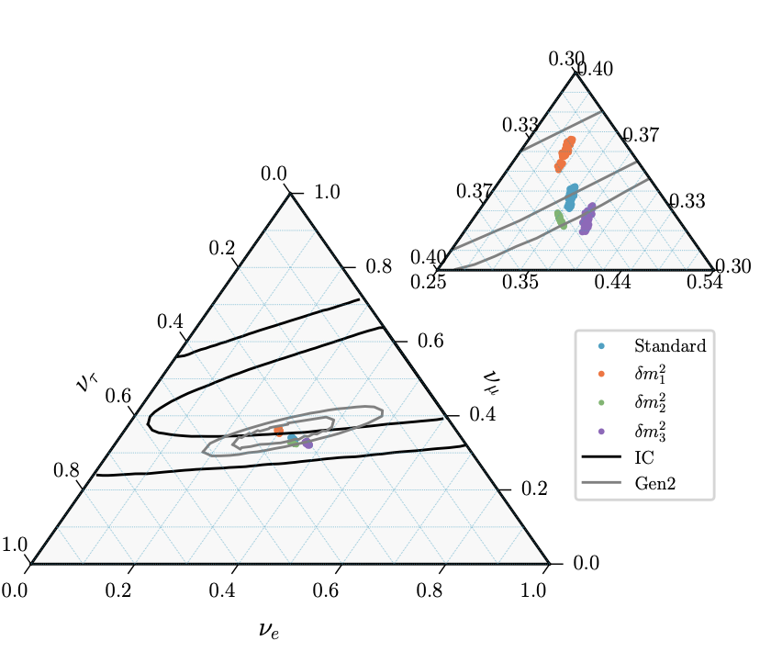
Flavor Triangle Analysis
(eV)
BD, Machado, Martinez-Soler,2406.18507;
See also Fong, Porto, 2406.15566
BD, Dutta, Martinez-Soler, Verma (in preparation)

Slide 16
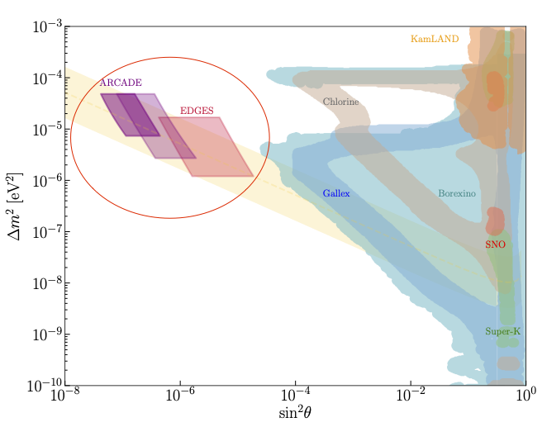
Case of Non-Maximal Mixing
BD, Di Bari, Martinez-Soler, Roshan (preliminary)

Slide 17
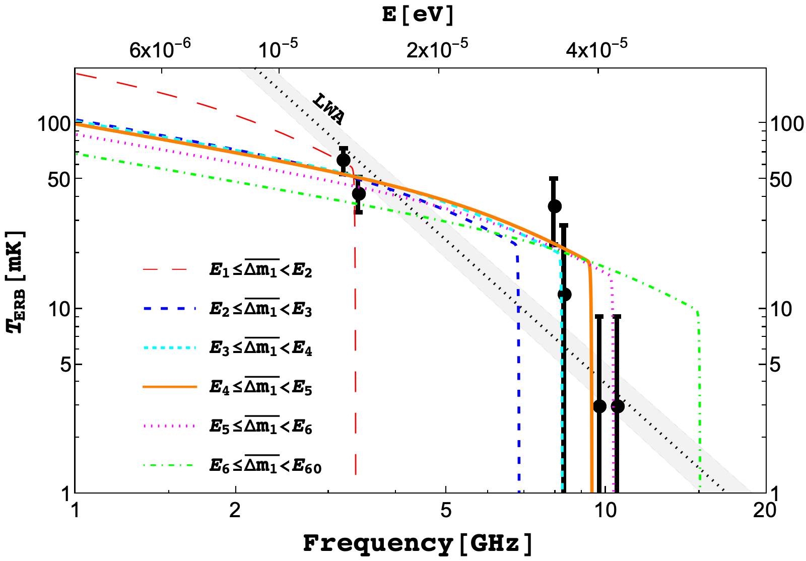
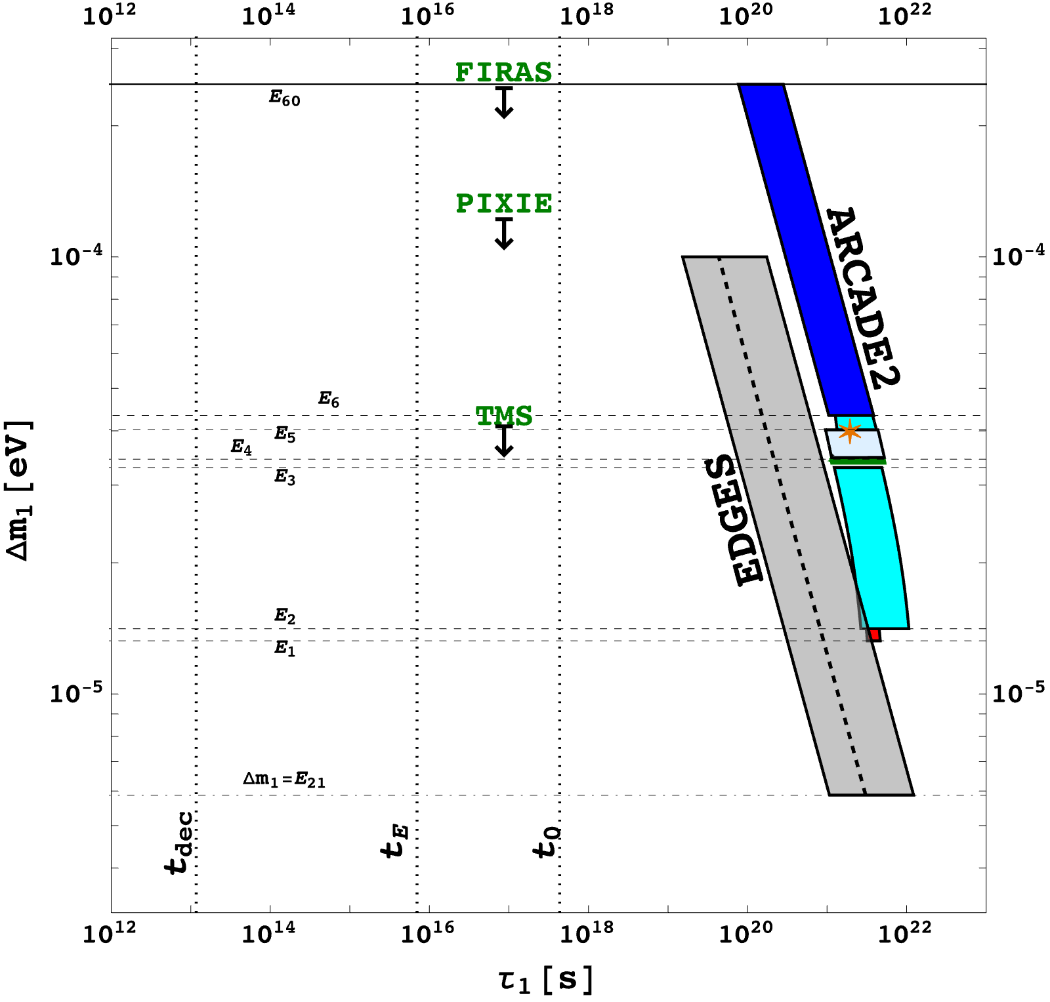
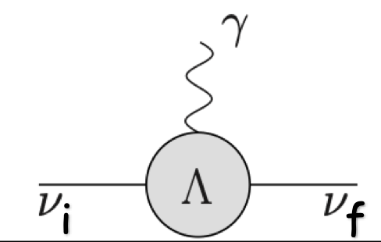
Fitting ARCADE2 & EDGES Anomalies with QDino
Unstable relic neutrino solution.
Stringent constraints from neutrino magnetic moment.
Ongoing model building work.
BD, Di Bari, Martinez-Soler, Roshan, 2312.03082
Chianese, Di Bari, Farrag, Samanta, 1805.11717

Slide 18
Conclusions
Nature of neutrino mass is an open question of fundamental importance.
We studied the possibility of quasi-Dirac neutrinos (QDinos).
Novel experimental signatures in astrophysical neutrino data.
Unstable QDino can address the excess radio background.
Testable in near future.

