Slide 1




Semiclassics
at the Cusp
Jesse Woods
Based on arxiv:2604:15422 in collaboration with J. Bersini, D. Orlando, and S. Reffert.

Slide 2
Outline
Motivation For
Non-local Observables
Semiclassical Methods
Results and Directions
Jesse Woods, U. Bern
Semiclassics at the Cusp

Slide 3
Upshot
Large charge works for extended operators
in gauge theory
Jesse Woods, U. Bern
Semiclassics at the Cusp

Slide 4
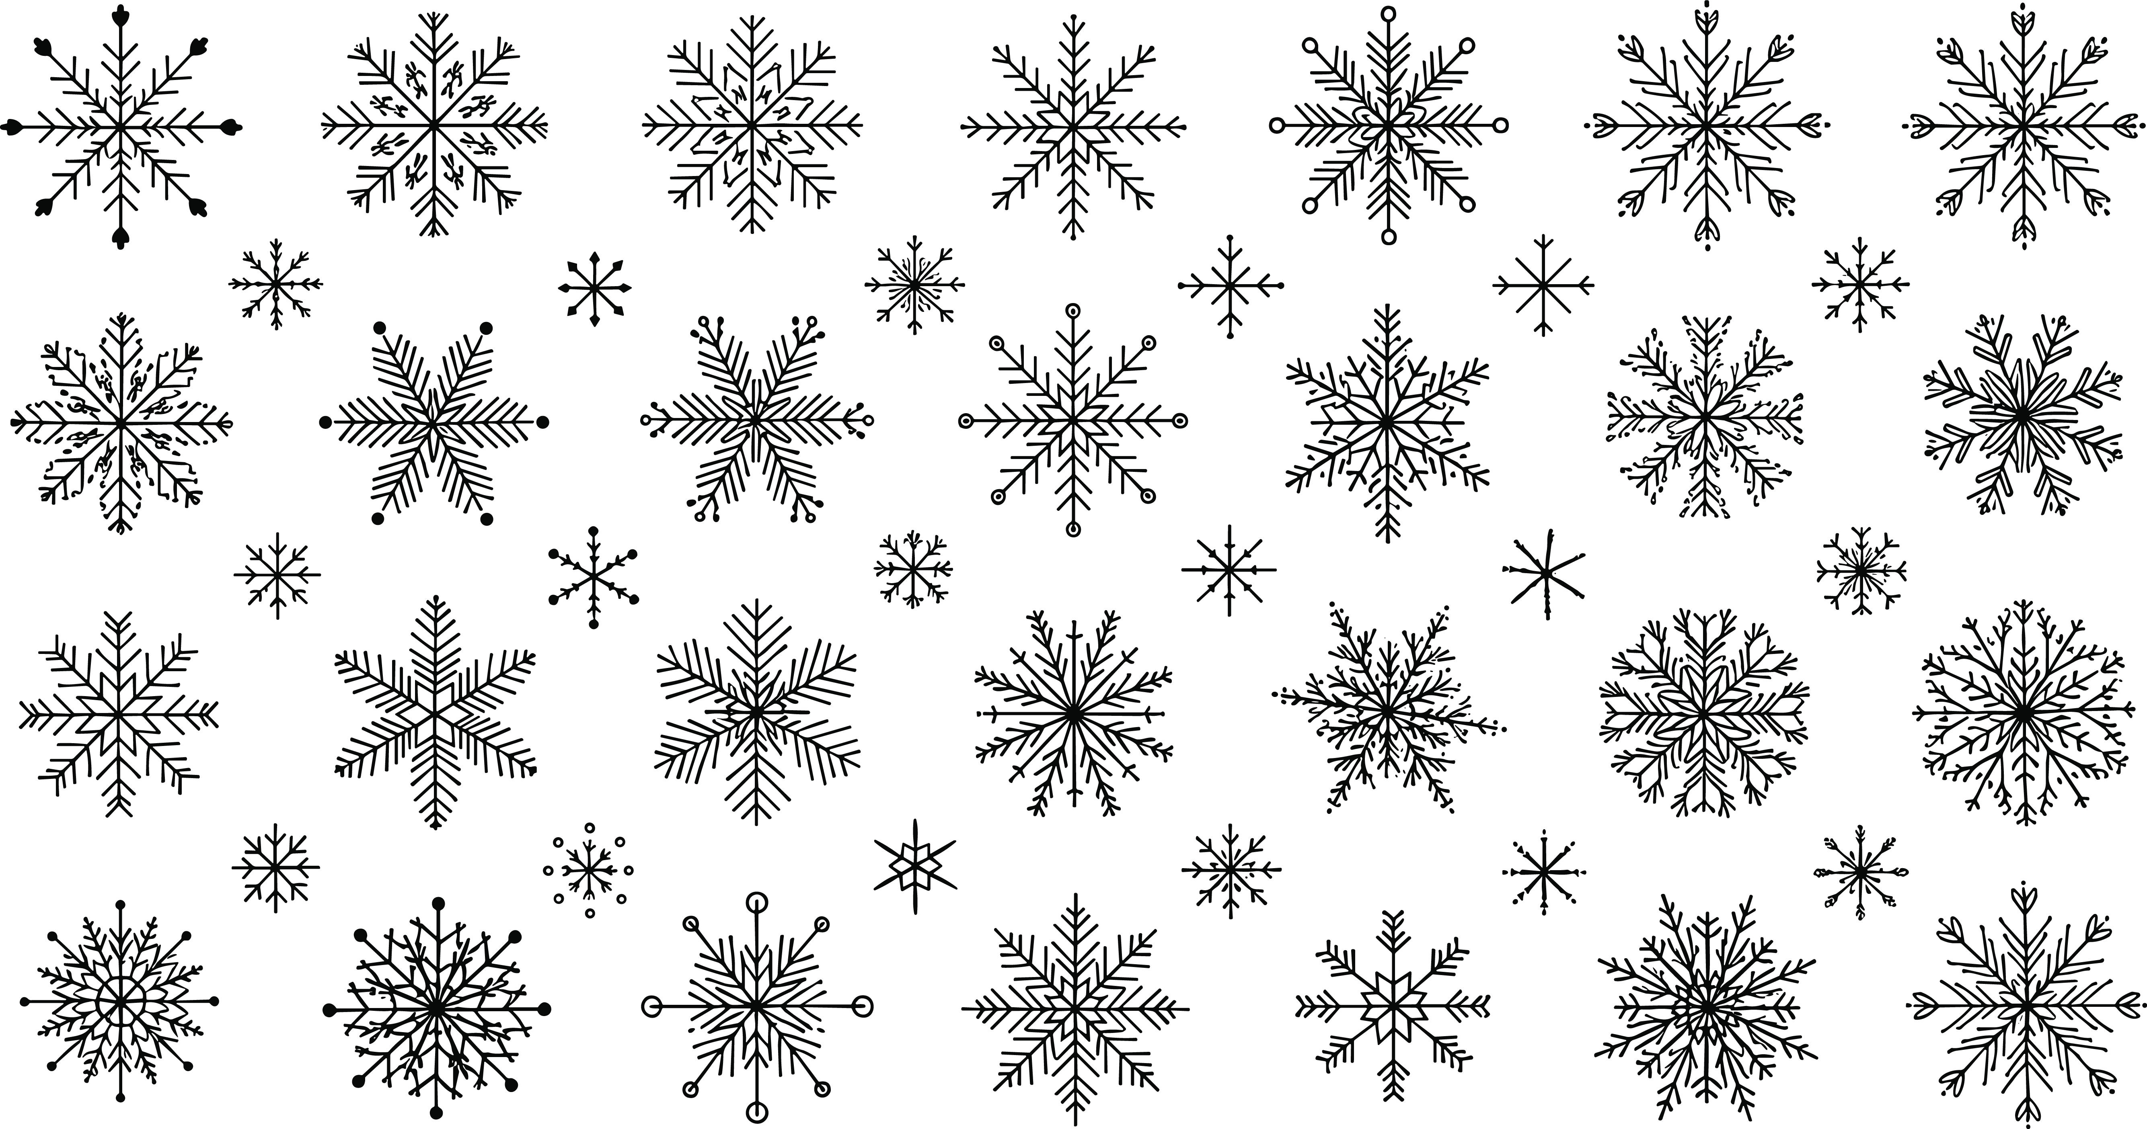
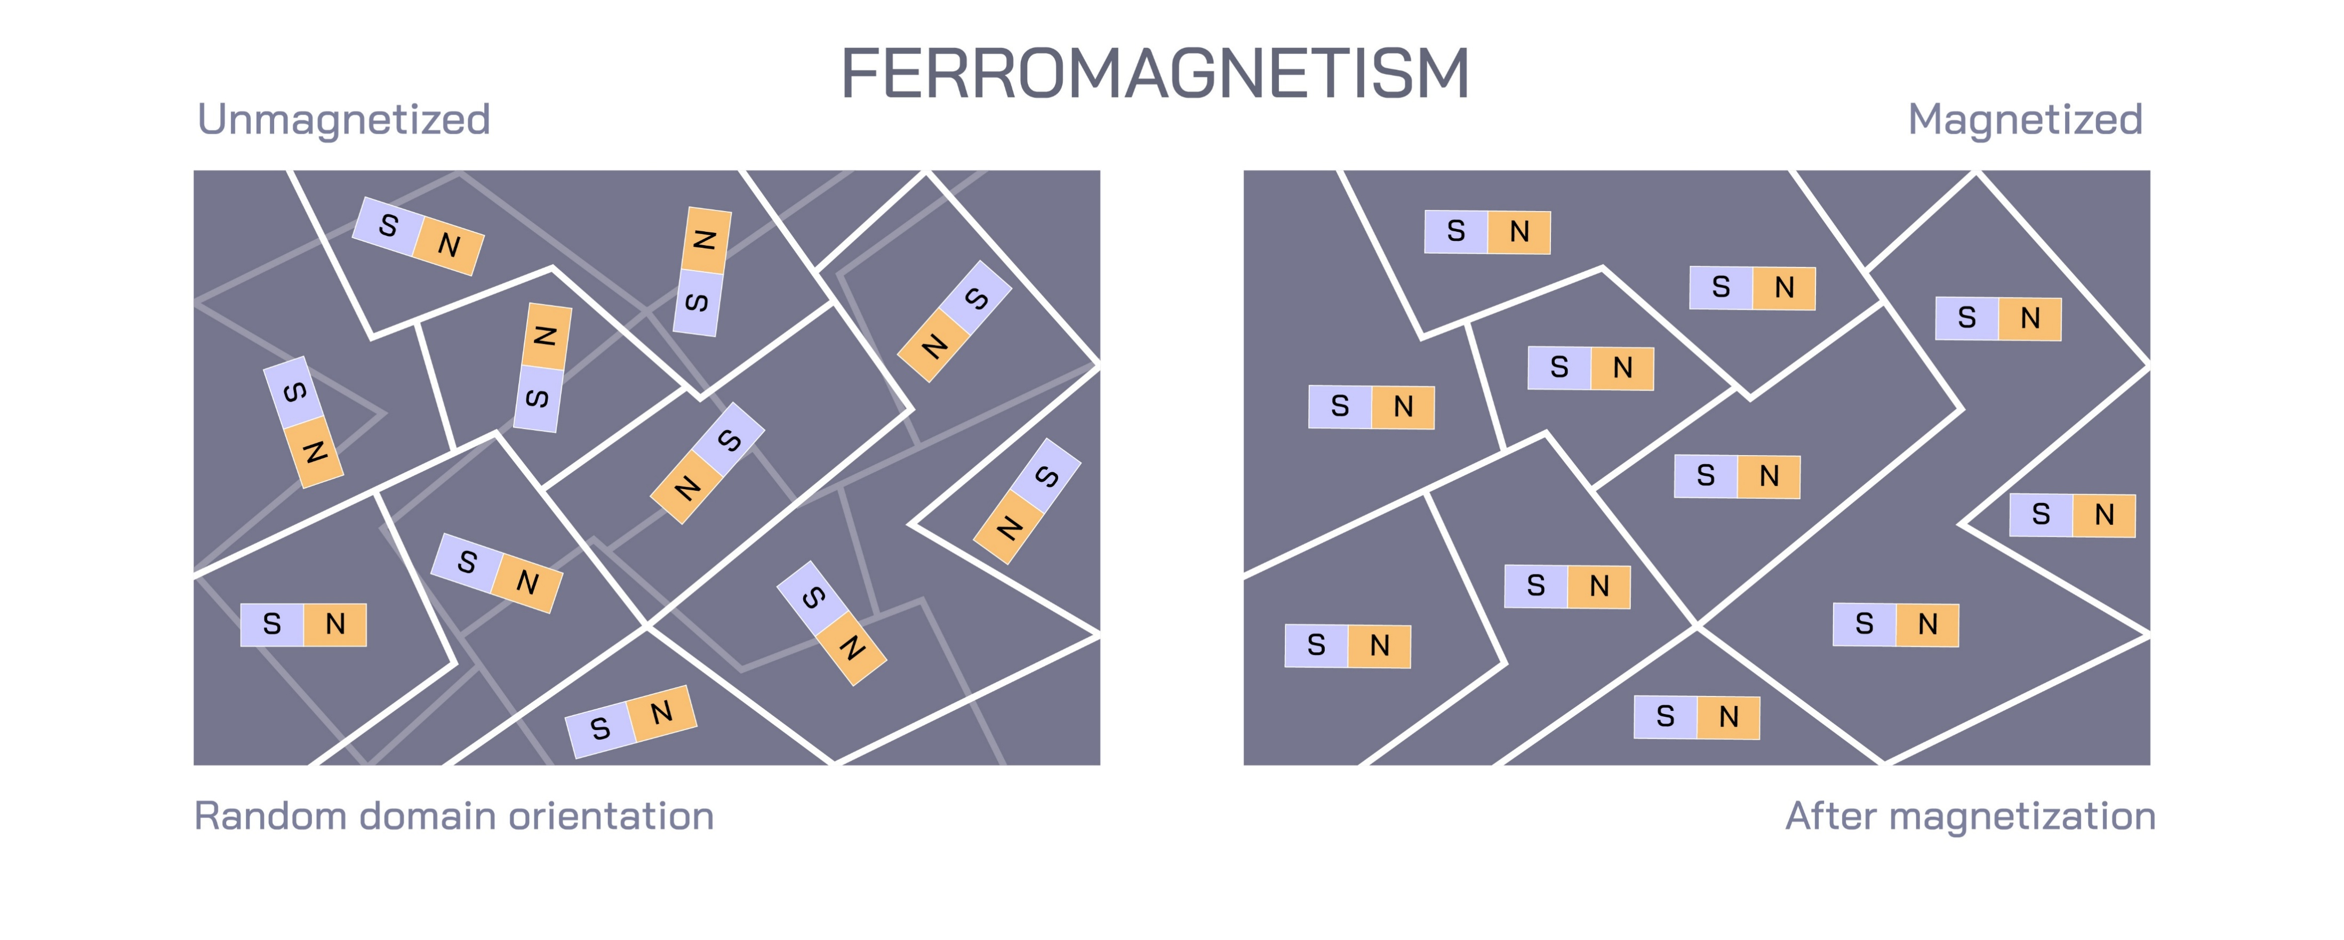
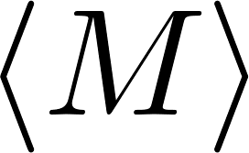

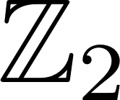
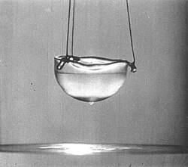
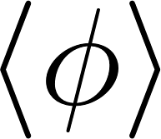
Order Parameter
Landau Paradigm:
  Phases of matter are classified by the symmetries they break
Favoured direction
No favoured direction
Symmetry-broken phase
Symmetric phase
Superfluid phase
U(1) symmetry
  Conserved charge: particle number
Jesse Woods, U. Bern
Semiclassics at the Cusp

Slide 5
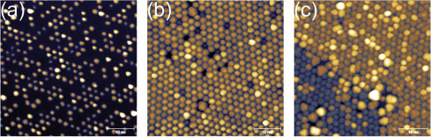
Long range order
How strongly do correlations persist over long distances?
Single-layer graphene sheets with long range order, Vesselli et al. (2017).
Anomalous dimension:
deviation from classical scaling dimension
Jesse Woods, U. Bern
Semiclassics at the Cusp

Slide 6
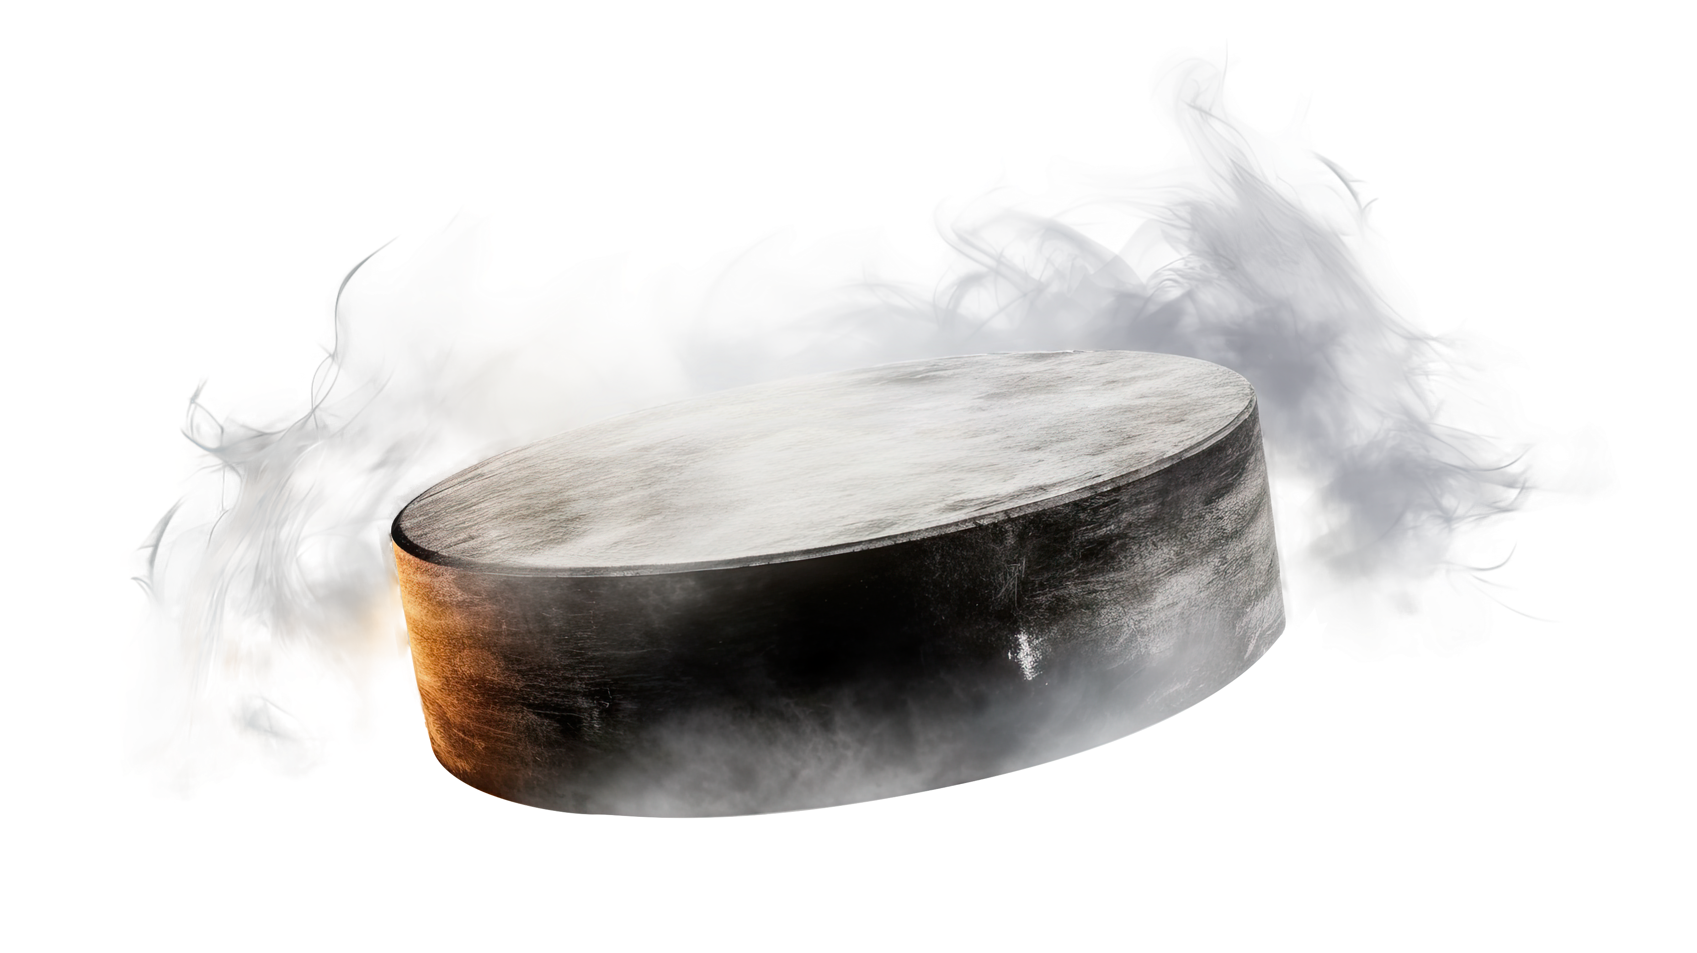
Problem:
In superconductors, we expect the symmetry to be gauged

Slide 7
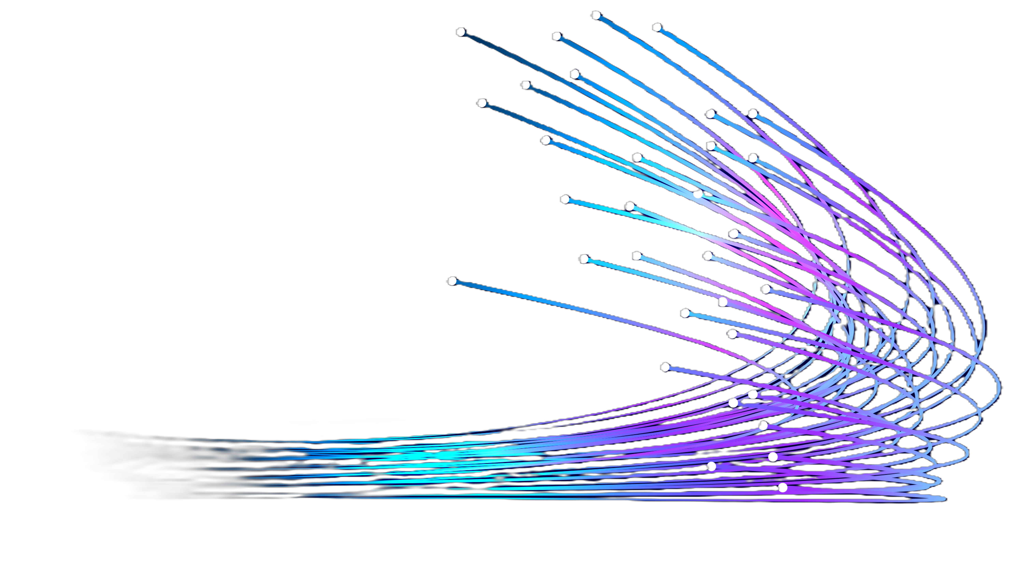
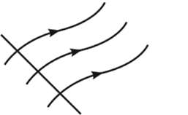
Even the humble 2-pt function is not gauge invariant
Elitzur’s Theorem:
Jesse Woods, U. Bern
Semiclassics at the Cusp

Slide 8
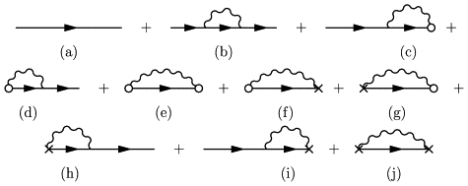
Even if we insist, the result explicitly depends on the choice of gauge
Feynmann diagram arguments say there is dependence only at 1-loop
Jesse Woods, U. Bern
Semiclassics at the Cusp

Slide 9
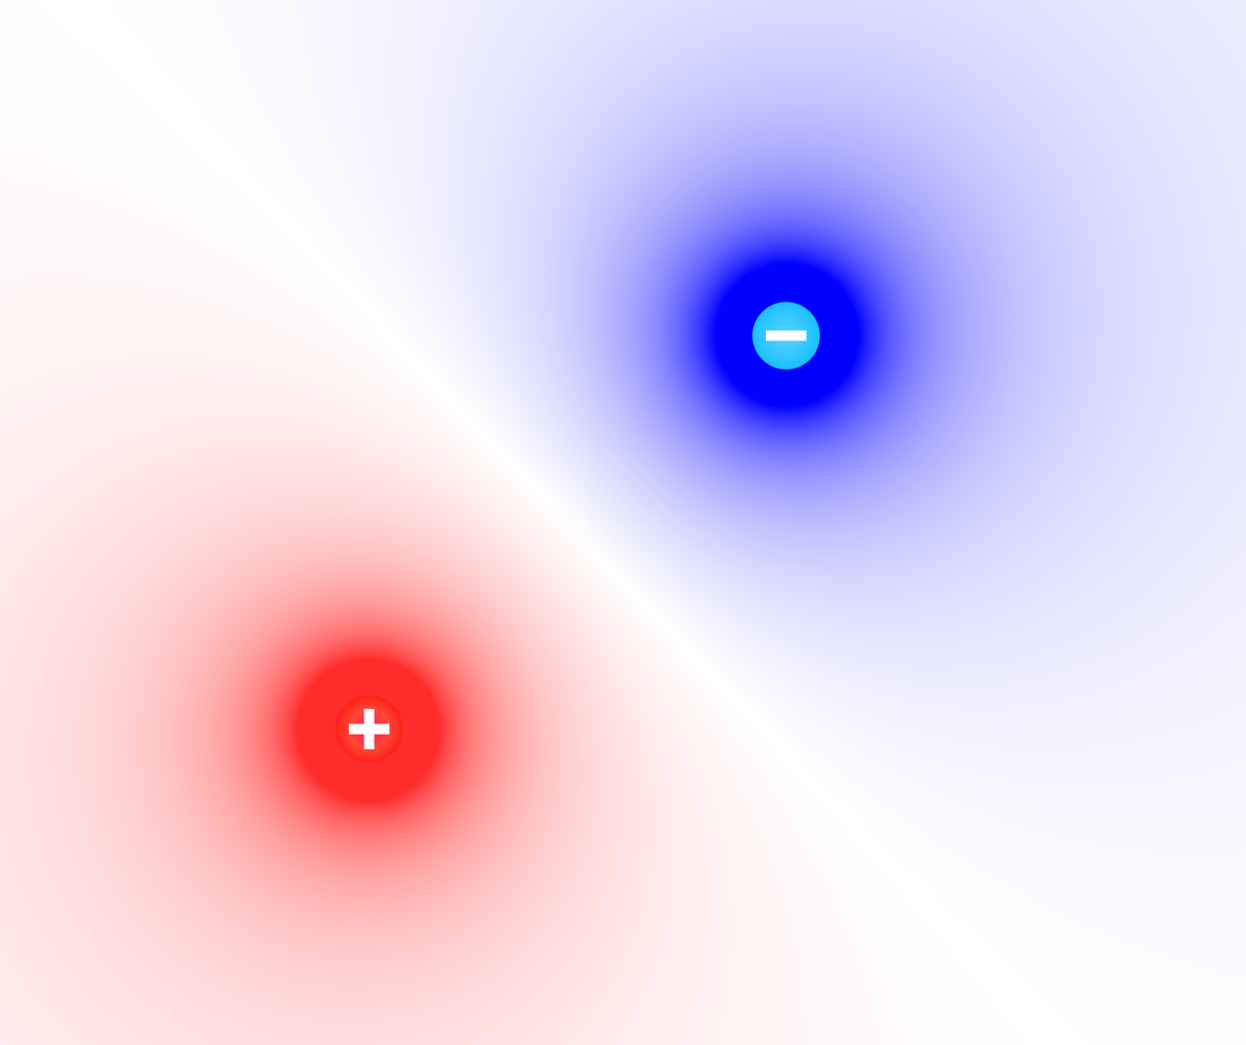
Dirac’s Solution:
Dress the fields with some nonlocal functional of the gauge field
Jesse Woods, U. Bern
Semiclassics at the Cusp

Slide 10
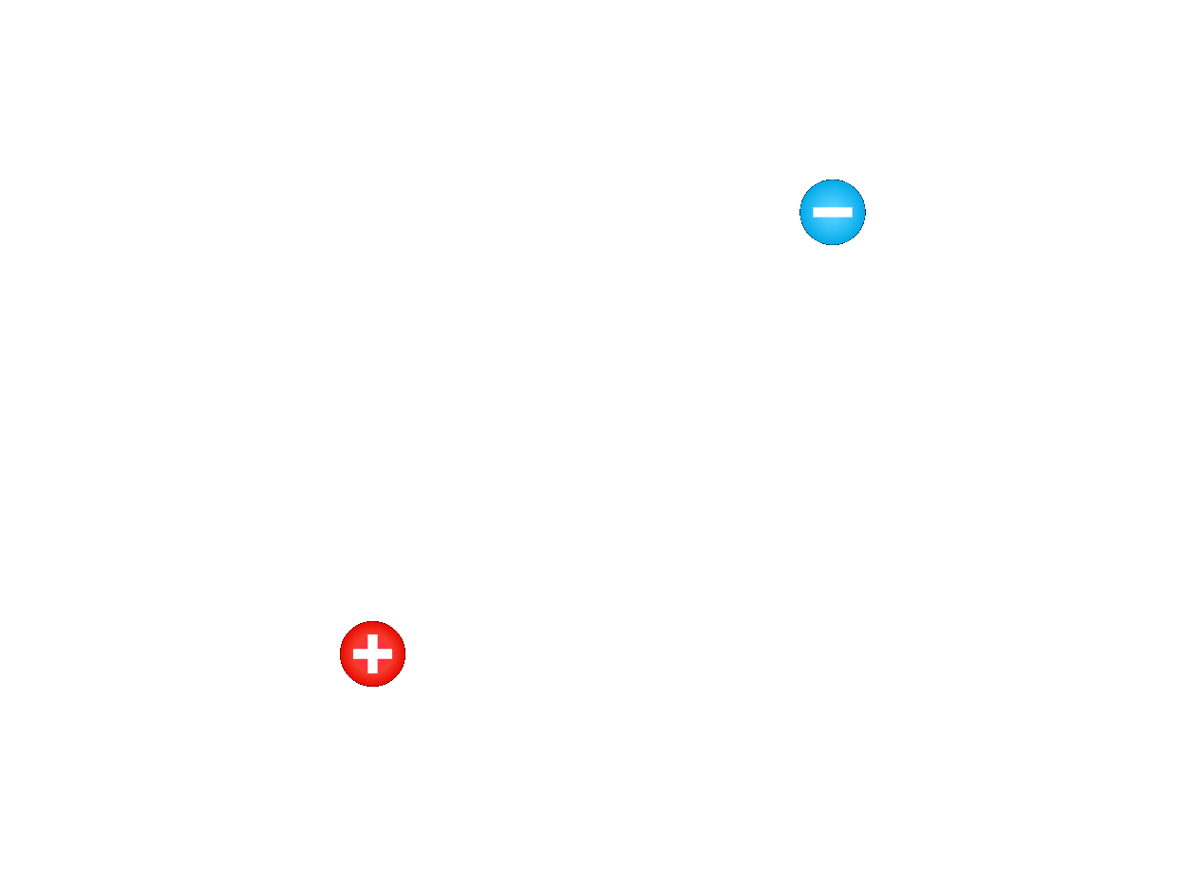
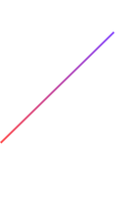
Two interesting cases of dressings:
Dirac dressing (Coulomb field)
Mandelstam-Schwinger dressing (Wilson line)
Jesse Woods, U. Bern
Semiclassics at the Cusp

Slide 11
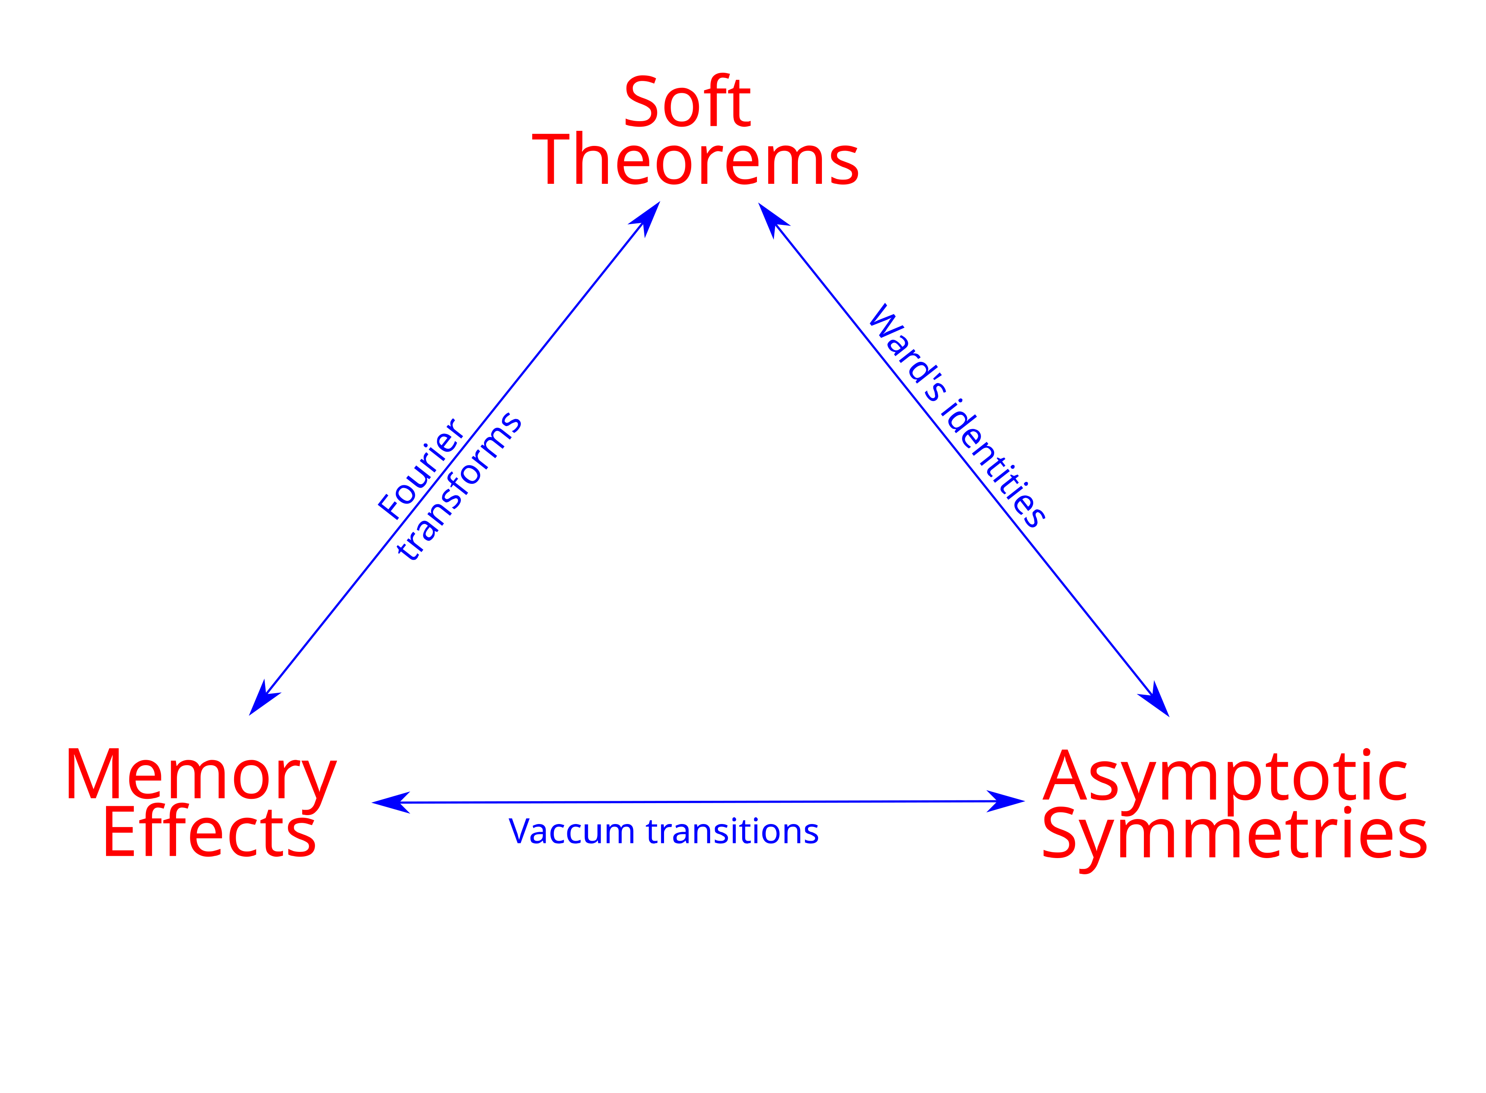
Gauge-invariant
Highly symmetric
Interesting links to asymptotic symmetries and memory effect
Jesse Woods, U. Bern
Semiclassics at the Cusp

Slide 12
Literature Claim:
Dressing corresponds to a gauge choice.
[Kleinert, Schakel (2003)]
Jesse Woods, U. Bern
Semiclassics at the Cusp

Slide 13

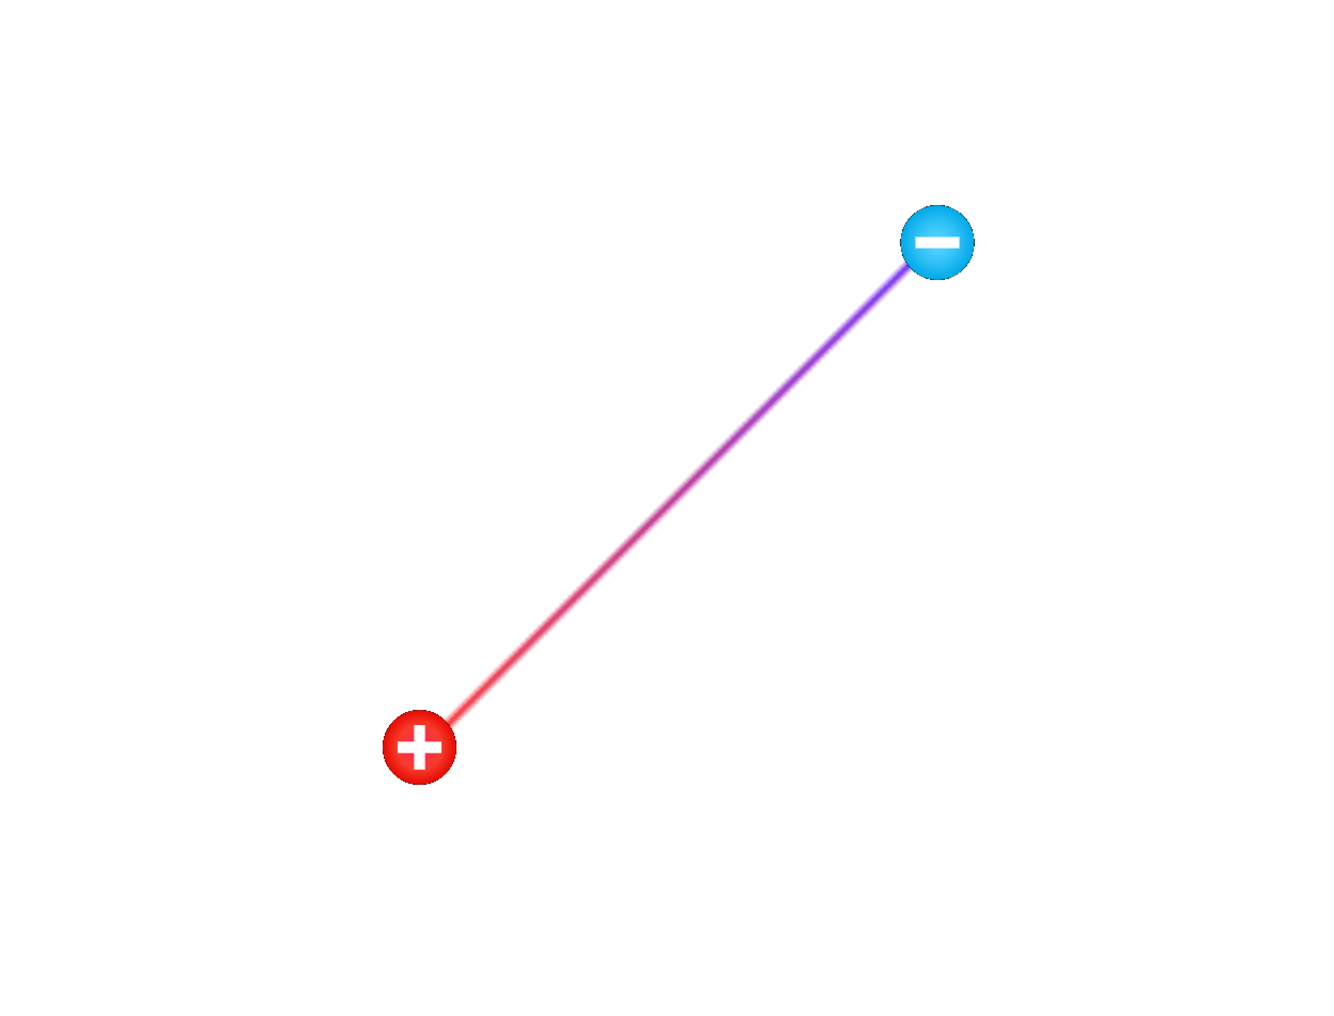
Beyond dressings
Lines are objects in their own right
Jesse Woods, U. Bern
Semiclassics at the Cusp

Slide 14




General picture:
“Cusp” with defect-changing operator
Jesse Woods, U. Bern
Semiclassics at the Cusp

Slide 15
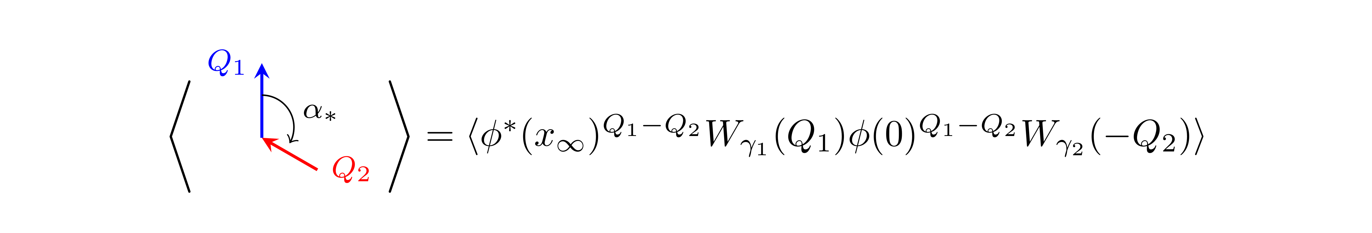
Jesse Woods, U. Bern
Semiclassics at the Cusp

Slide 16

Cusp anomalous dimension
Natural observable is the coefficient that describes the divergence
What does this tell us?
Jesse Woods, U. Bern
Semiclassics at the Cusp

Slide 17
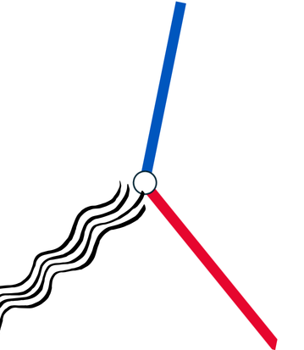
Bremsstrahlung
Change of velocity -> radiation emitted
Jesse Woods, U. Bern
Semiclassics at the Cusp

Slide 18
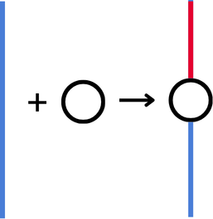
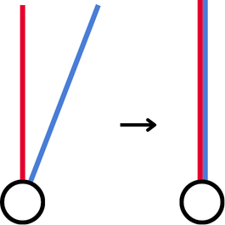
Defects
Information about defect-changing operators (impurities)
Encodes the self-fusion behaviour of the line
Jesse Woods, U. Bern
Semiclassics at the Cusp

Slide 19
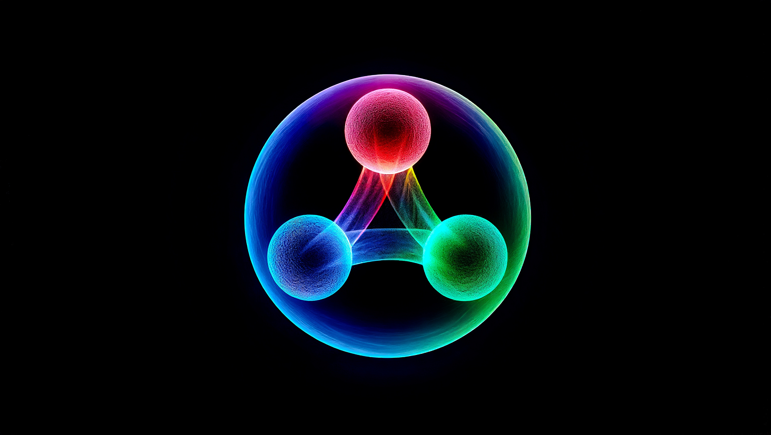
Problem
Interesting systems are strongly coupled

Slide 20

Solution
Semiclassical methods

Slide 21
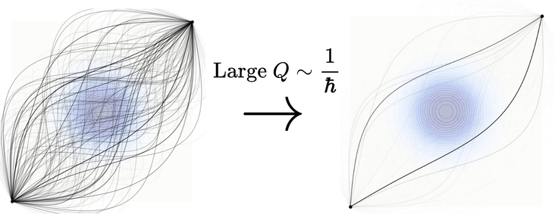
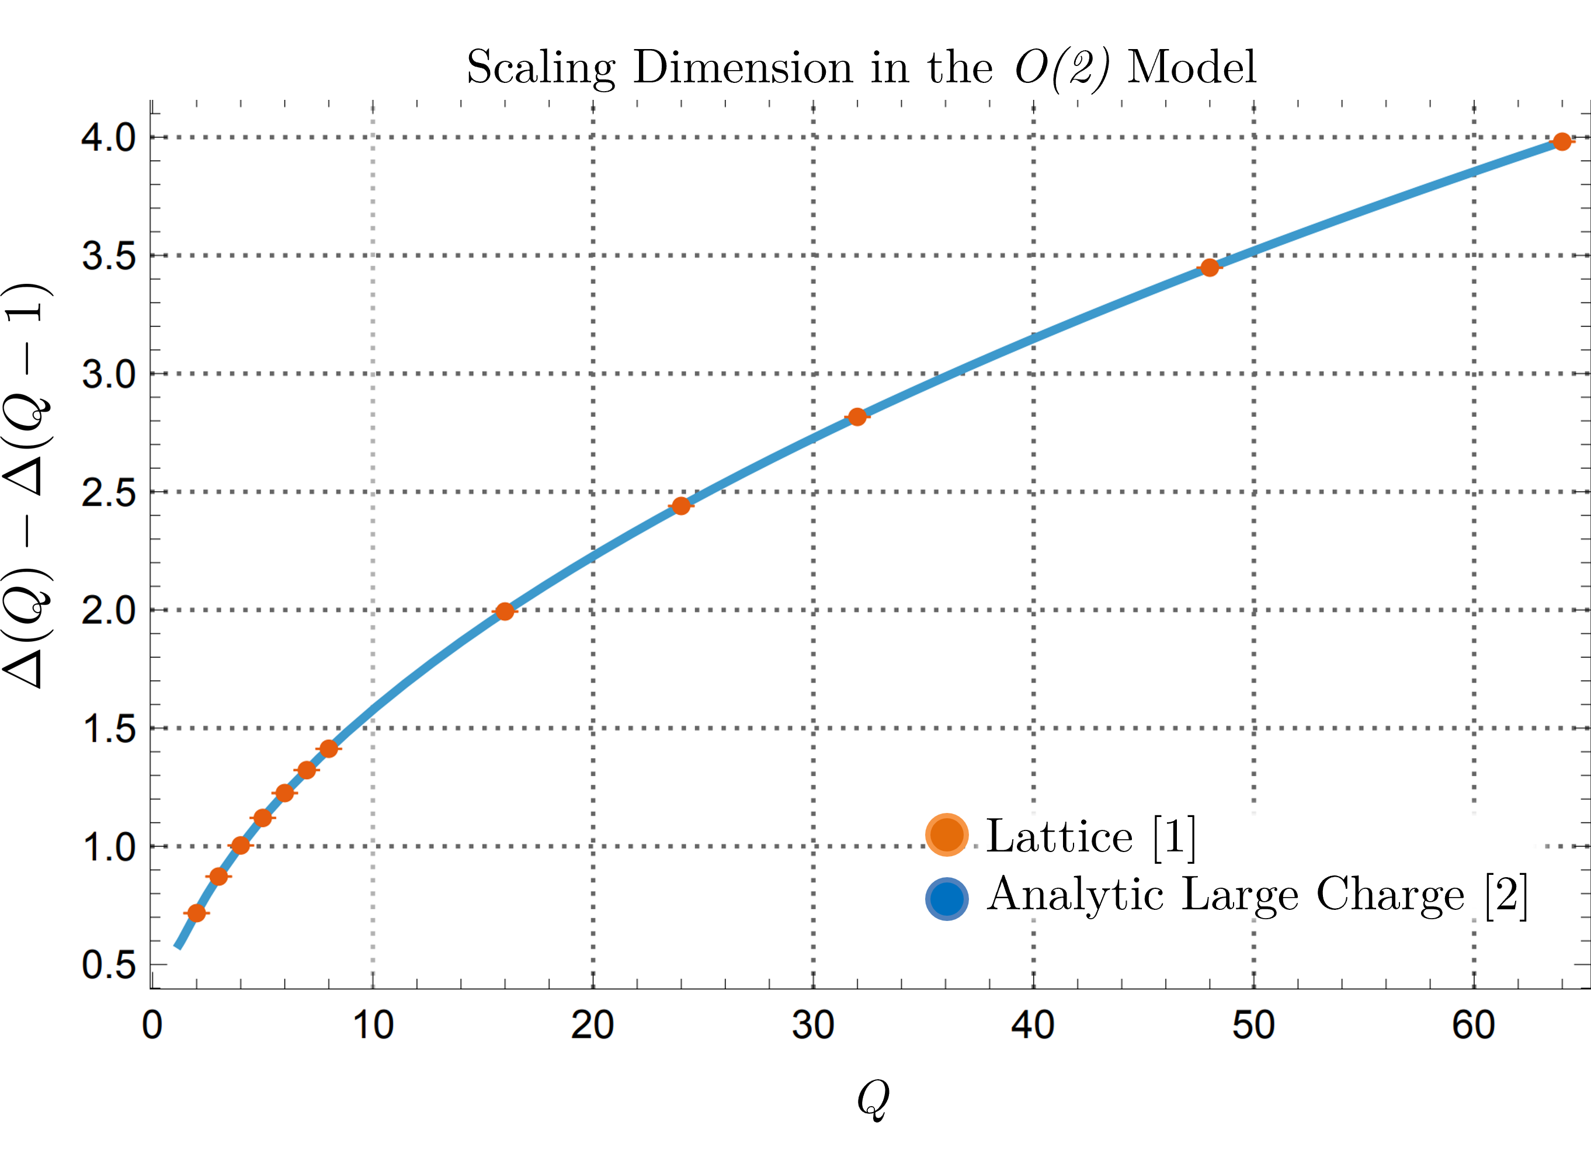
Semiclassical Methods
Idea: introduce a large parameter x to localise the path integral
Restrict to a sector of large quantum number: spin, charge, etc
Works very well…
Q
[1] Hasenbusch, M. (2026). [2] Banerjee, D., Chandrasekharan, S., & Orlando, D. (2018).
Jesse Woods, U. Bern
Semiclassics at the Cusp

Slide 22

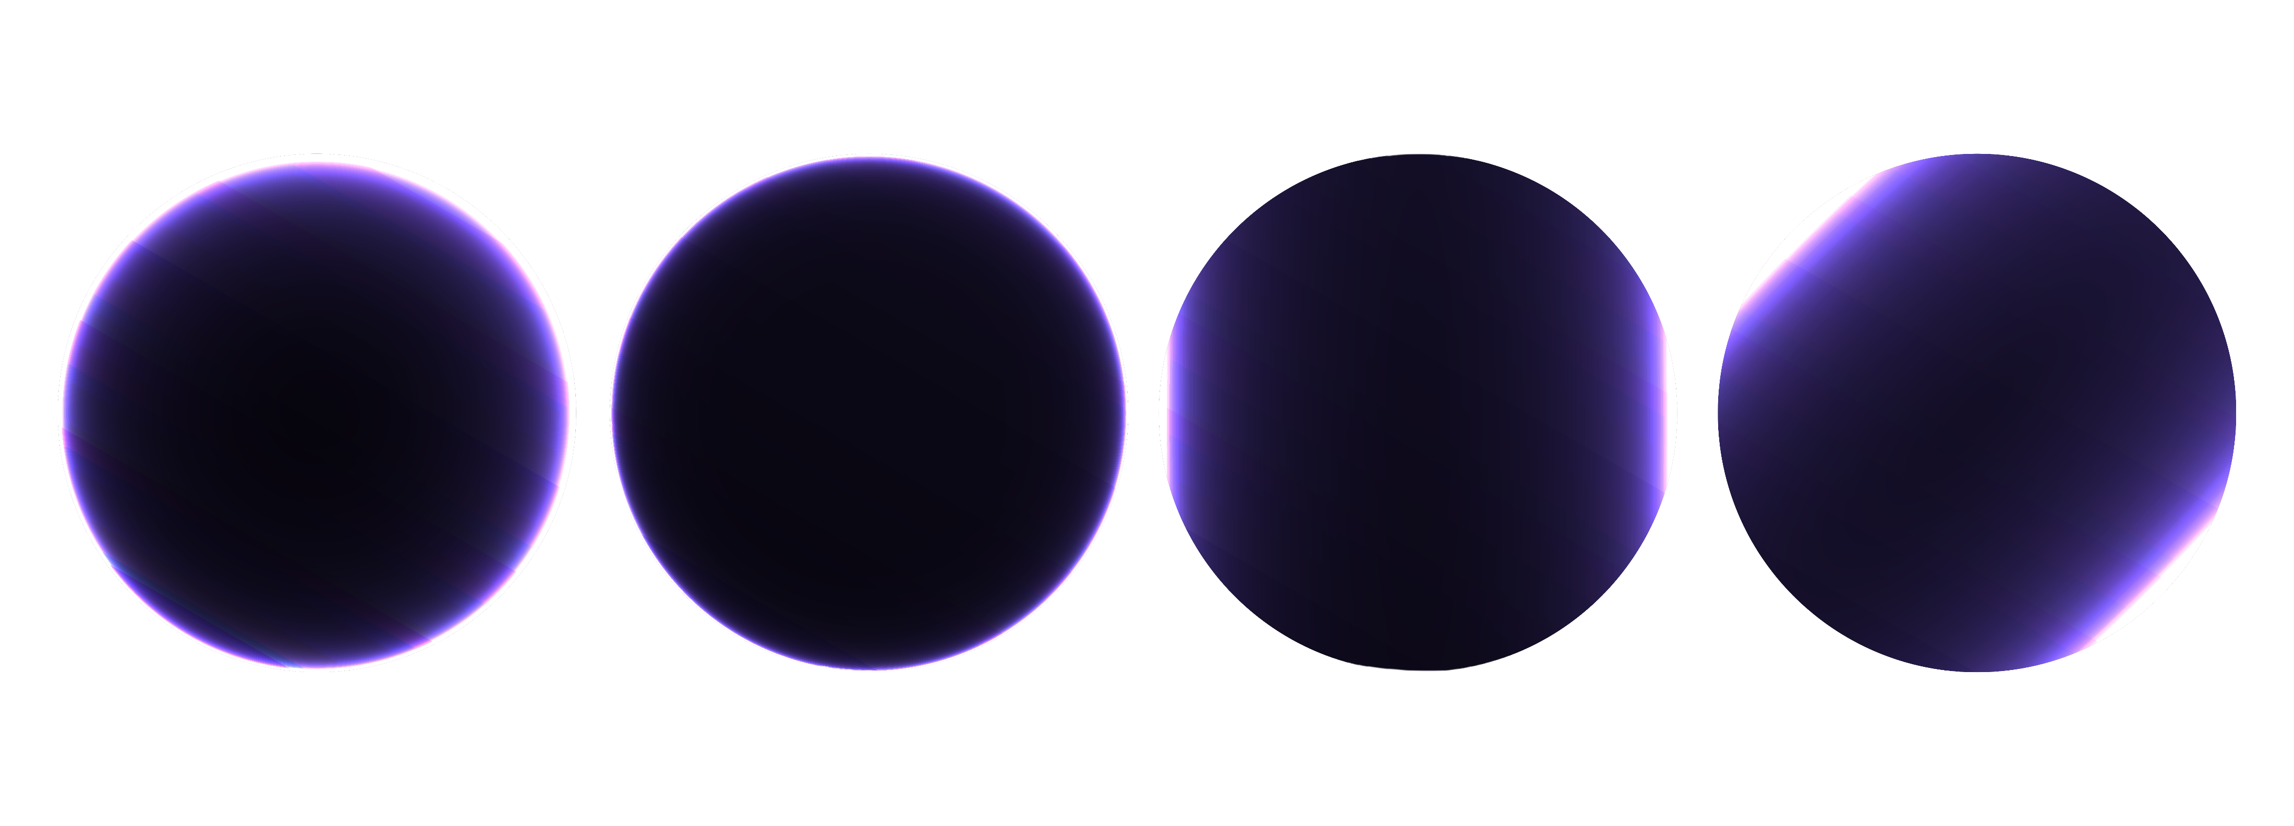
What about in Gauge Theory?
Quantum numbers for global symmetries
Gauge invariance?
EFT picture: SSB vs Higgs Mechanism?
Jesse Woods, U. Bern
Semiclassics at the Cusp

Slide 23
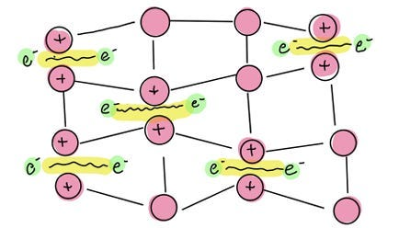

Abelian Higgs model
Superconductivity
λ controls superconductor rigidity and Cooper pair repulsion
Jesse Woods, U. Bern
Semiclassics at the Cusp

Slide 24
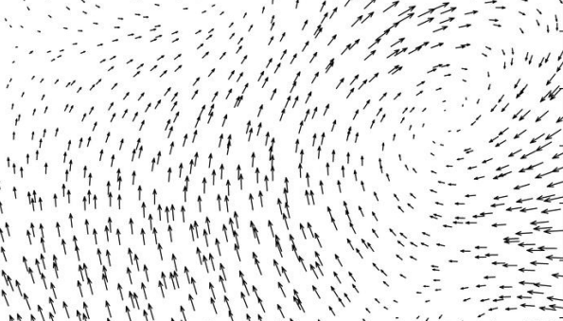

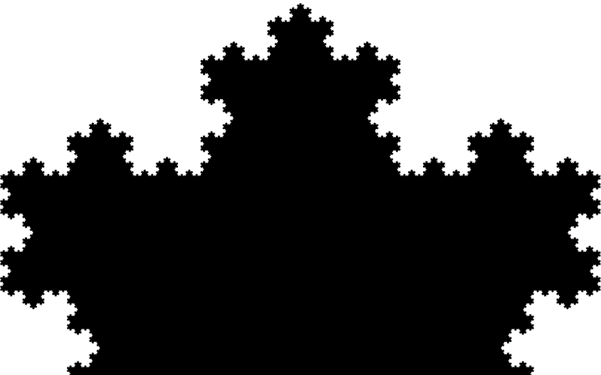
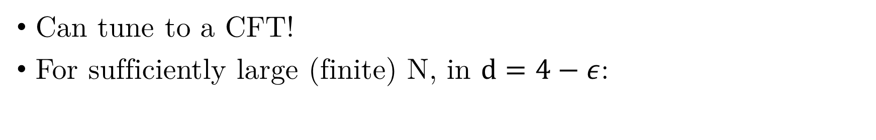
Abelian Higgs model
Can tune to a CFT!
For sufficiently large (finite) N, in $d=4−ε$:
Jesse Woods, U. Bern
Semiclassics at the Cusp

Slide 25
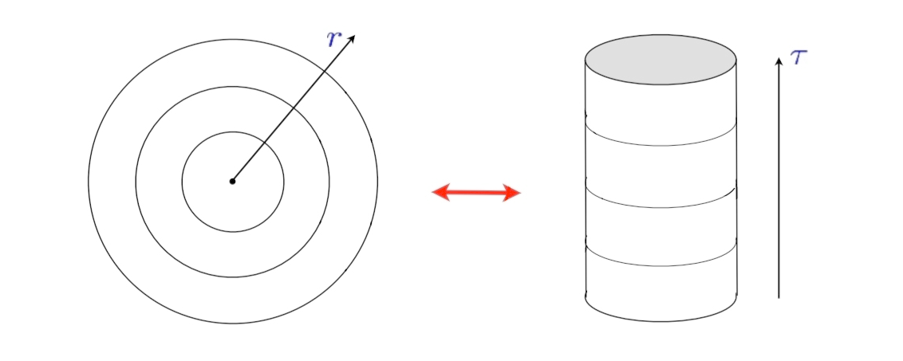
State Operator Correspondence
Jesse Woods, U. Bern
Semiclassics at the Cusp

Slide 26
Semiclassical limit:
We take
And the limit
Jesse Woods, U. Bern
Semiclassics at the Cusp

Slide 27

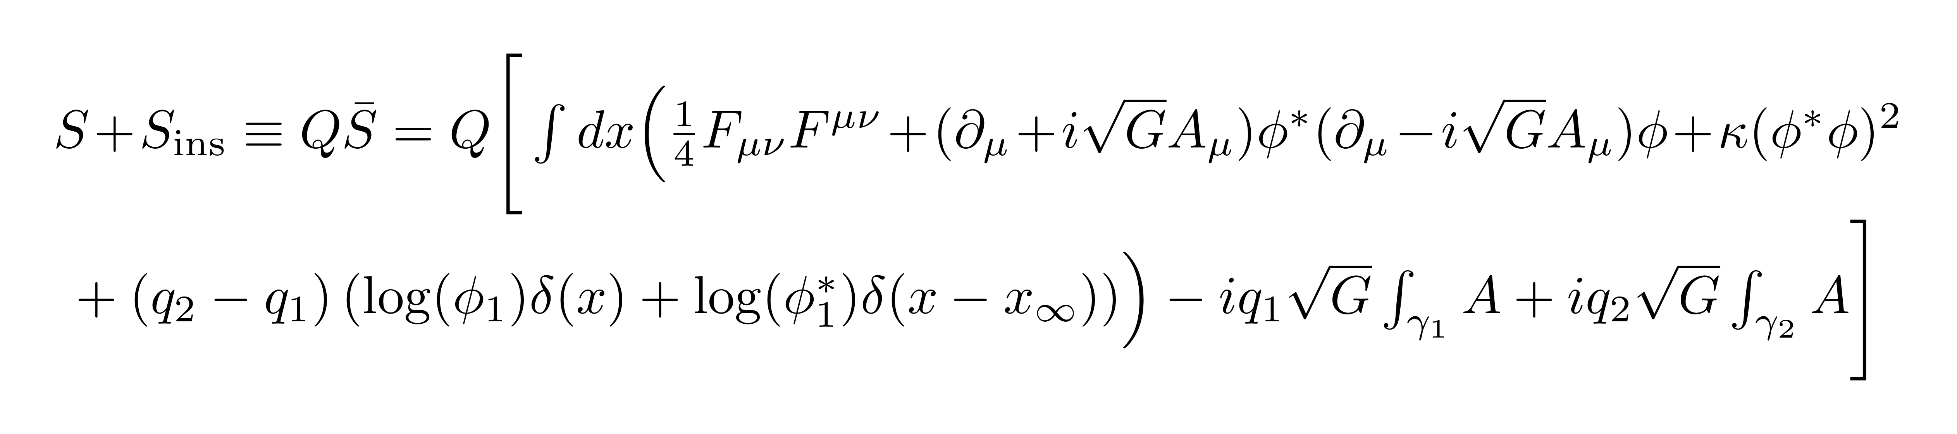
Abelian Higgs model
Write the insertions as a term in the action
Rescaling fields gives the total action
Controlled by semiclassics!
Jesse Woods, U. Bern
Semiclassics at the Cusp

Slide 28
Semiclassical limit exists!
Can compute quantities via large charge
Jesse Woods, U. Bern
Semiclassics at the Cusp

Slide 29
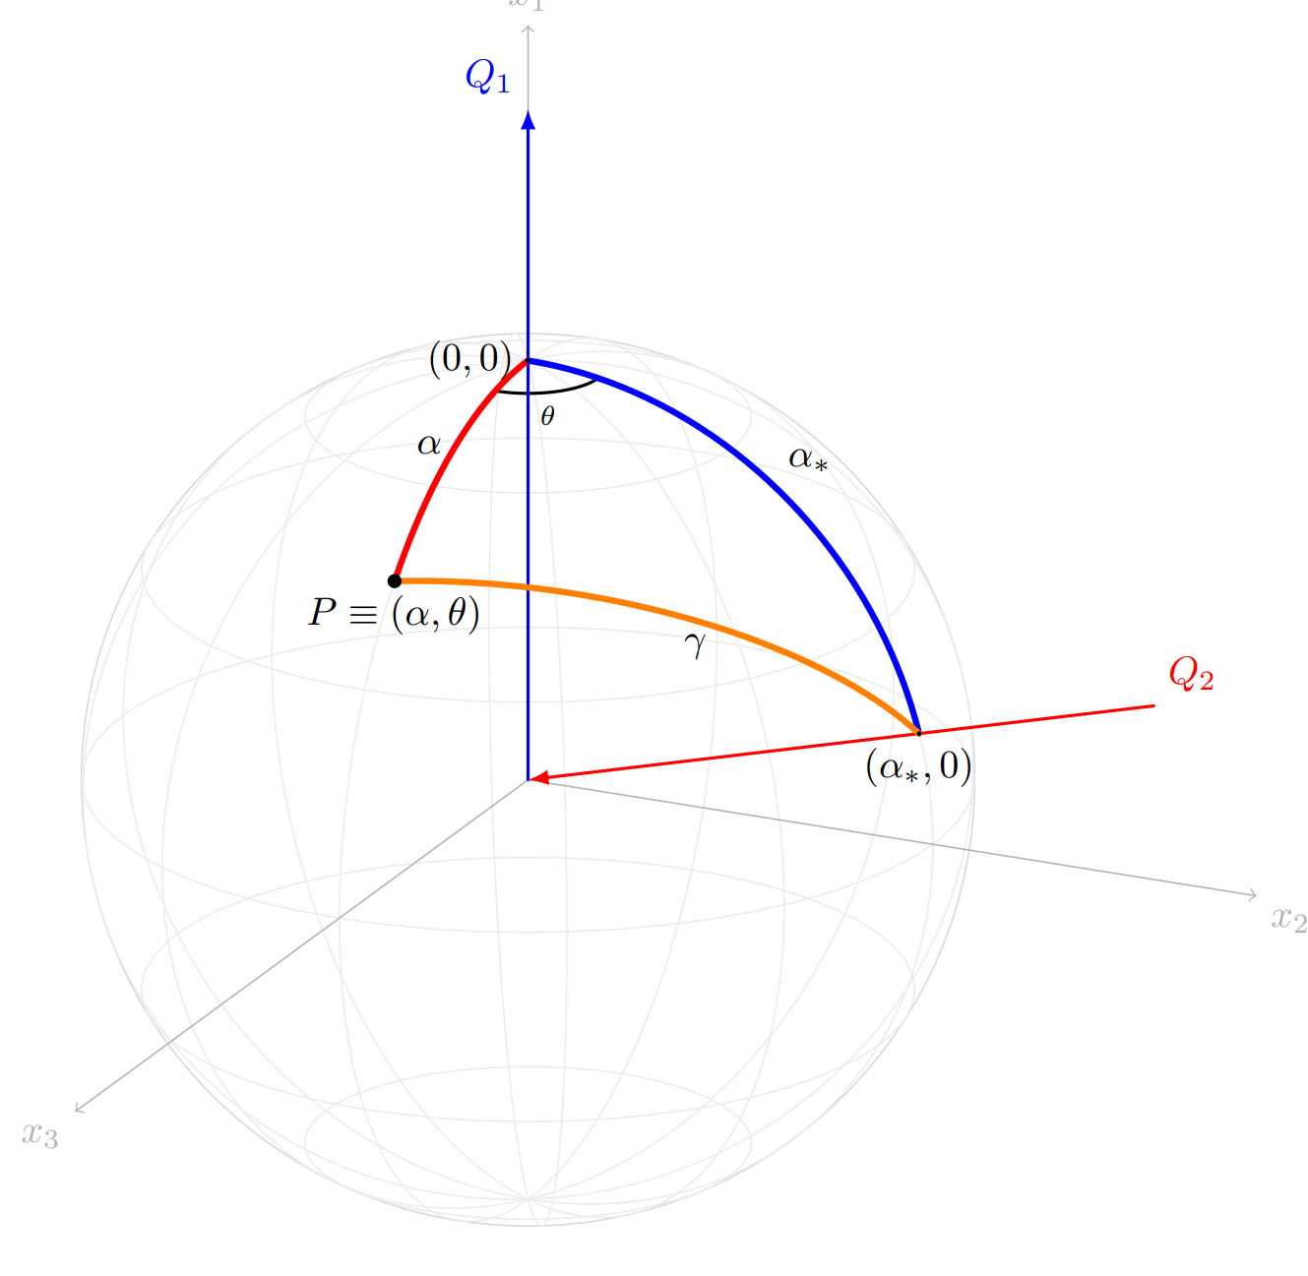


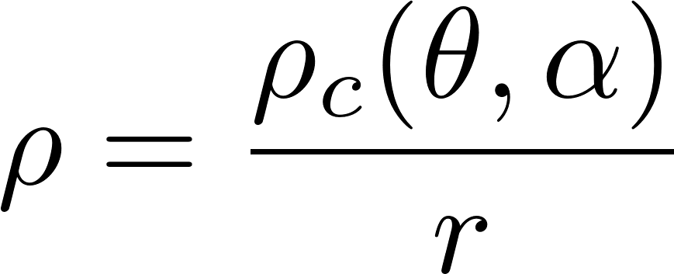
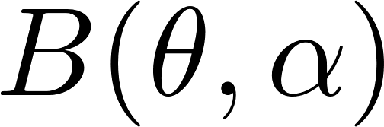
Degrees of Freedom
Manifestly gauge invariant
Jesse Woods, U. Bern
Semiclassics at the Cusp

Slide 30

Saddle Point Equations
Matter
Maxwell
Gauss
Jesse Woods, U. Bern
Semiclassics at the Cusp

Slide 31
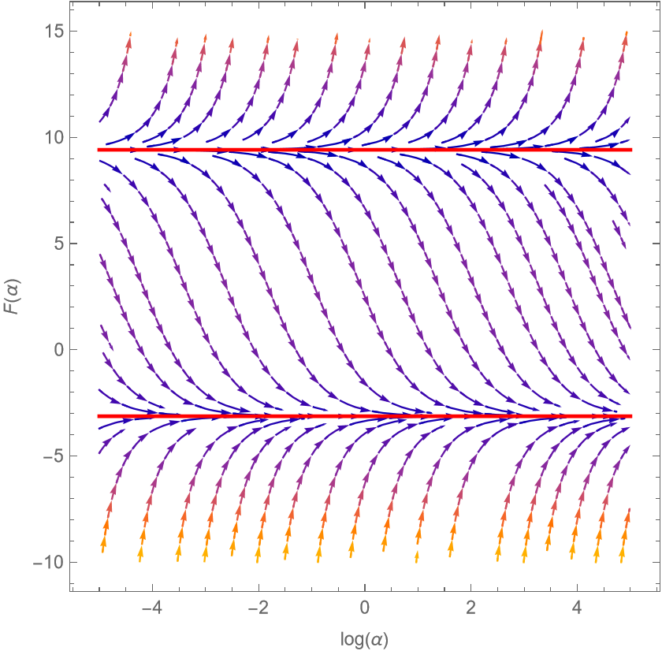
Boundary Conditions?
If we treat the line as a genuine defect, potential non-trivial boundary conditions
See also [Aharony, Cuomo, Komargodski, Mezei, Raviv-Moshe (2023)]
Jesse Woods, U. Bern
Semiclassics at the Cusp

Slide 32
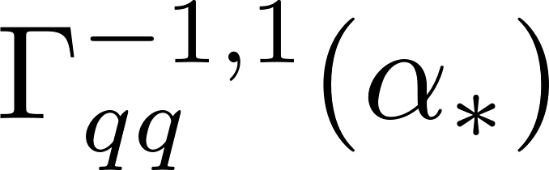

Trivial Defect-Change ($Q_{1}=Q_{2}$)
Can actually solve exactly
Jesse Woods, U. Bern
Semiclassics at the Cusp

Slide 33
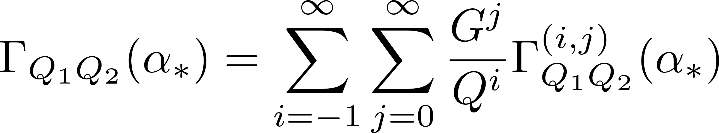
Perturbation theory in G
Jesse Woods, U. Bern
Semiclassics at the Cusp

Slide 34



Leading Order Solution
Reproduces the result of the ungauged model [Badel, Cuomo, Monin, Rattazzi (2019)], and the Dirac dressed case [Antipin, Bednyakov, Bersini, Panopoulos, Pikelner (2022)]
Resummation of perturbation theory in $κ$!
Jesse Woods, U. Bern
Semiclassics at the Cusp

Slide 35

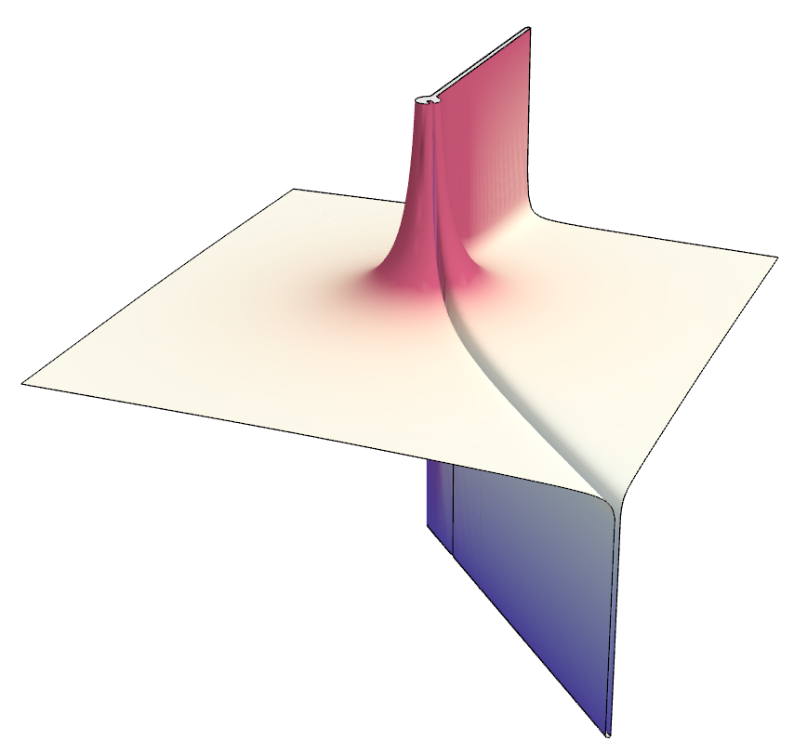

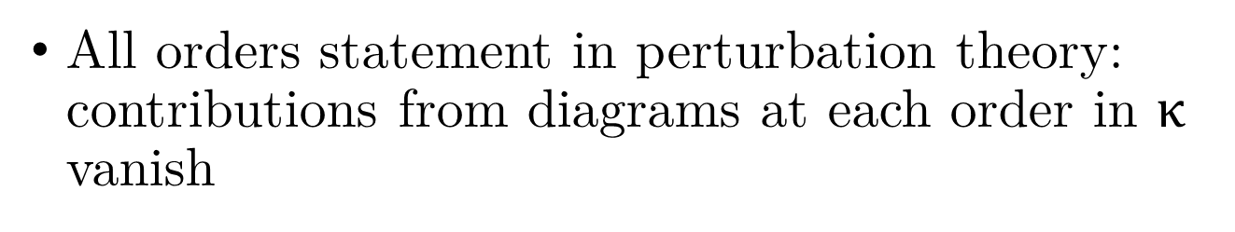
Next-to-Leading Order Solution
Independent of $κ$!
All orders statement in perturbation theory: contributions from diagrams at each order in $κ$ vanish
Jesse Woods, U. Bern
Semiclassics at the Cusp

Slide 36
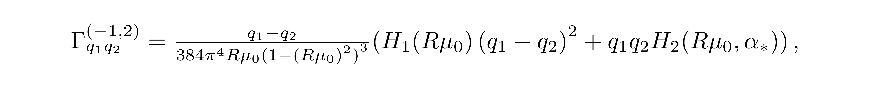
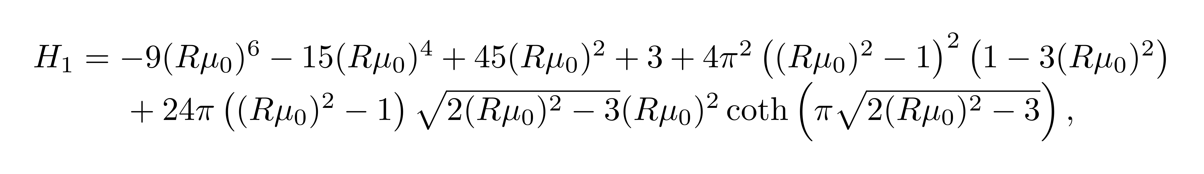
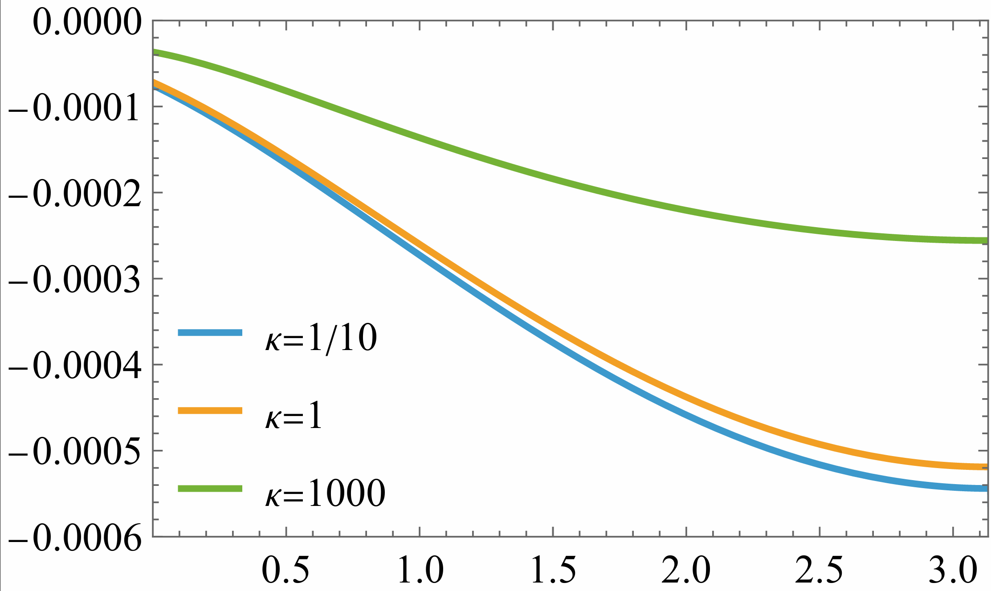
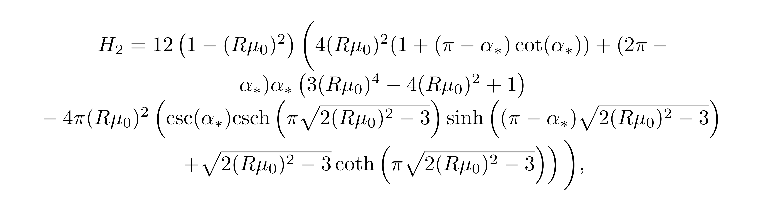
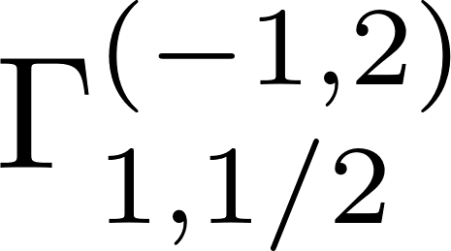
Next-to-Next-to-Leading Order Solution
Non-trivial… and non-zero
Jesse Woods, U. Bern
Semiclassics at the Cusp

Slide 37
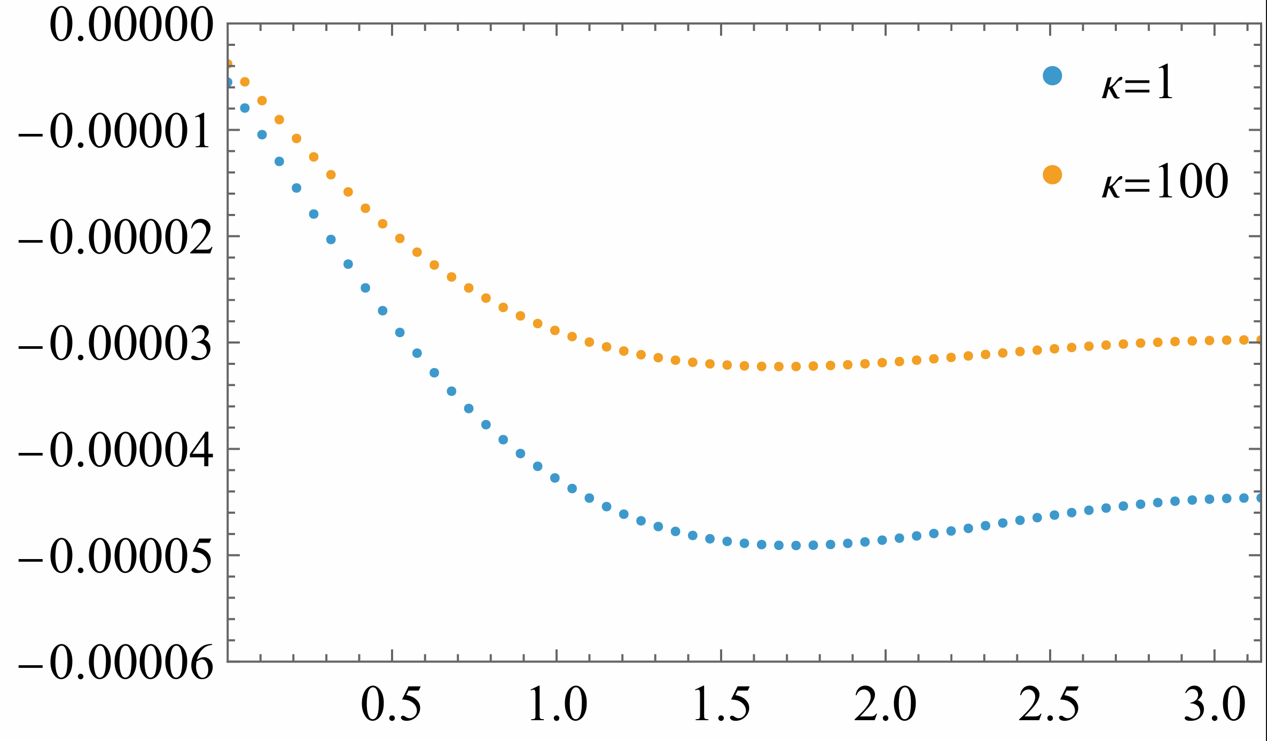
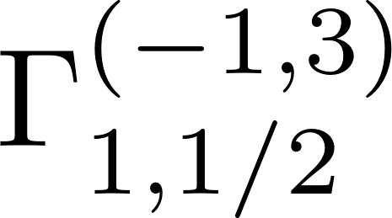
NNNLO Numerics
Energy integral too hard to evaluate analytically
Jesse Woods, U. Bern
Semiclassics at the Cusp

Slide 38
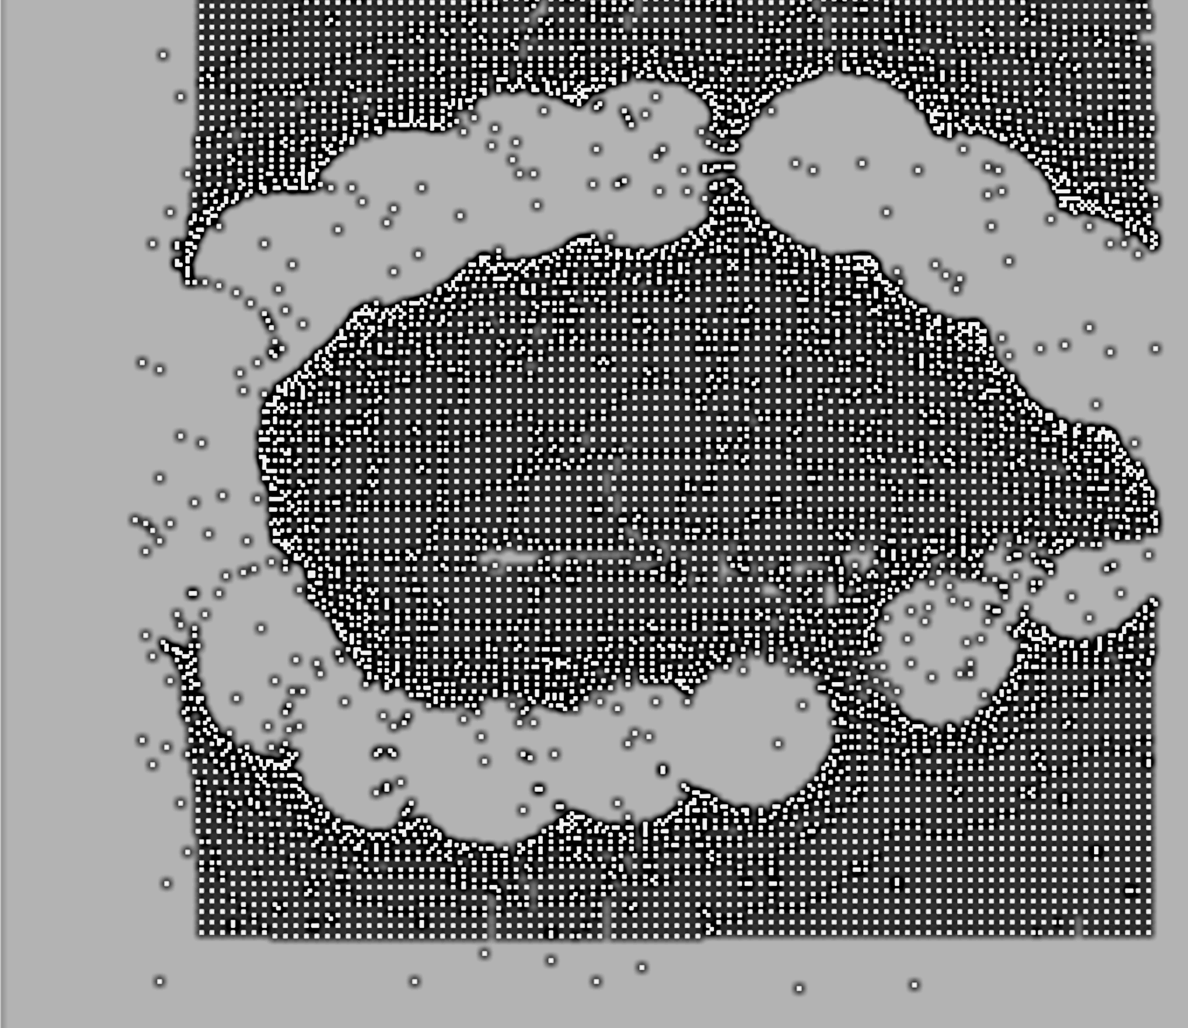
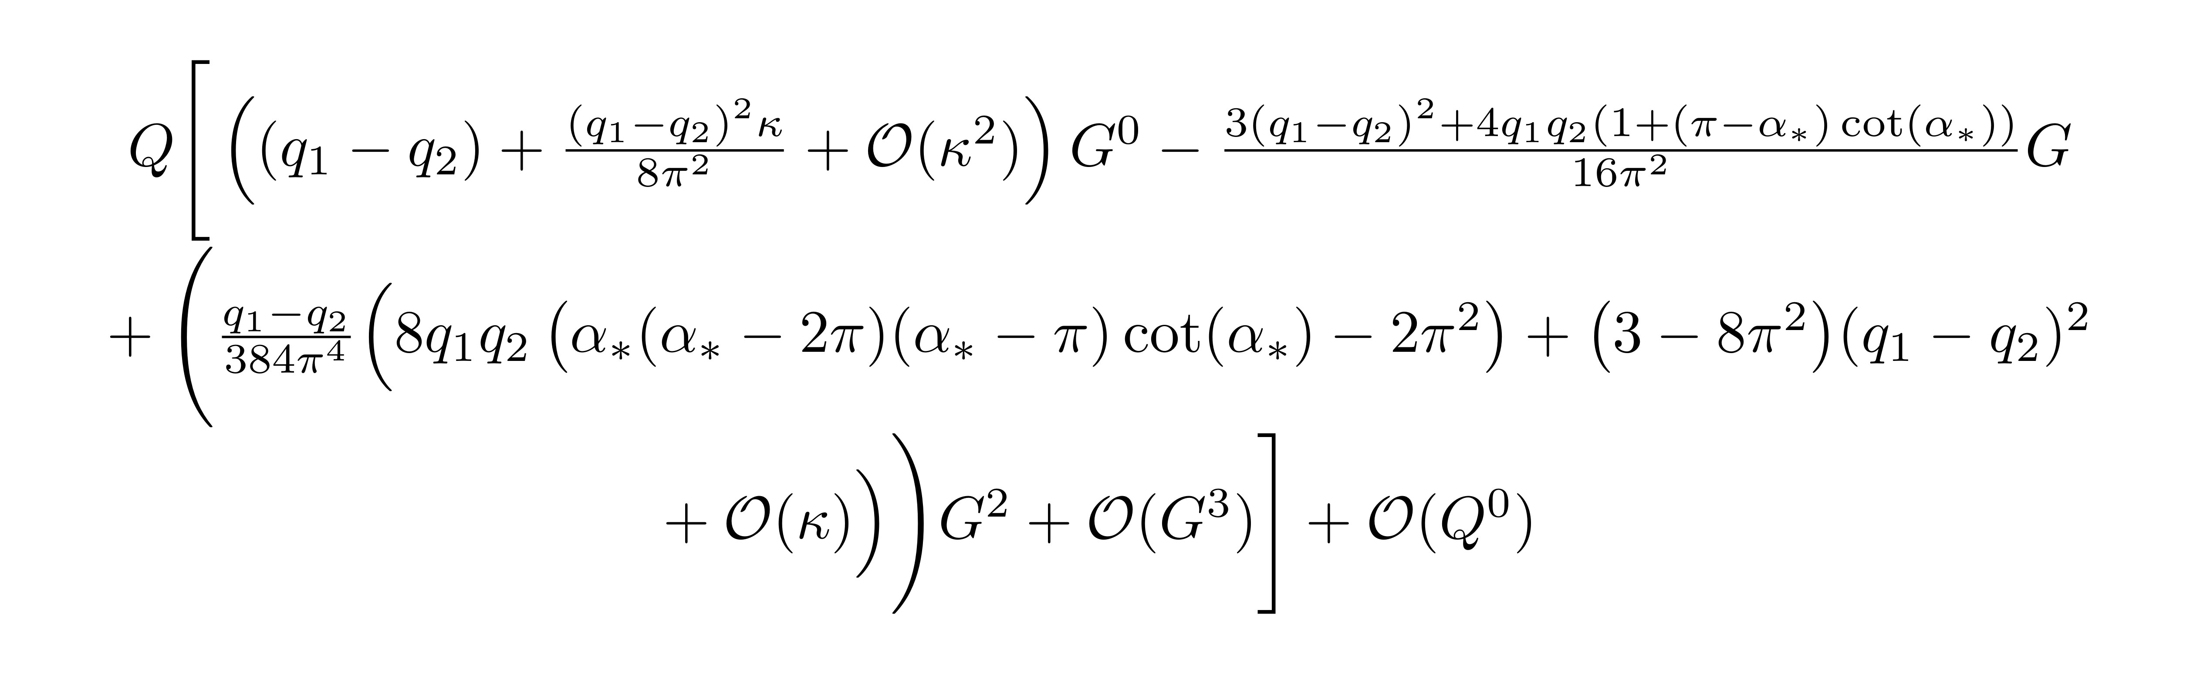

Order Q Expansion ($κ≪1$)
Reproduces perturbative Feynman diagram expansion at each order
Jesse Woods, U. Bern
Semiclassics at the Cusp

Slide 39

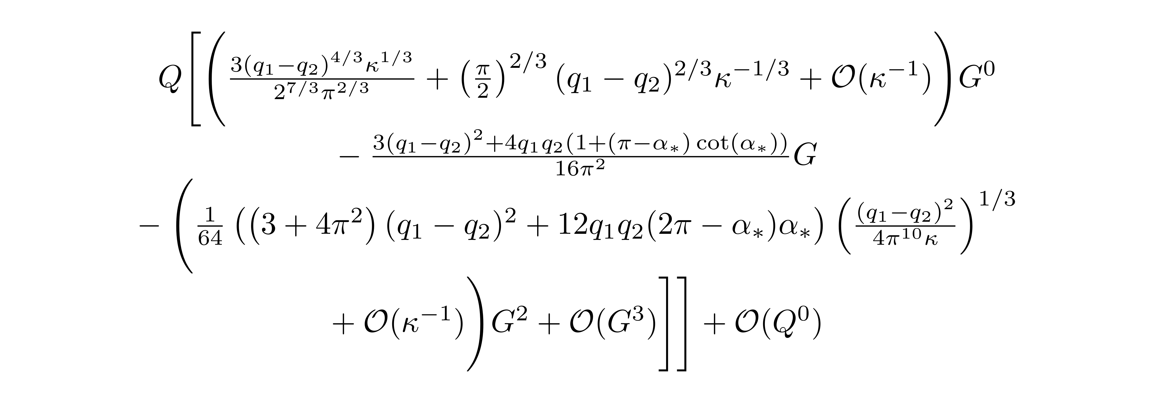

Order Q Expansion ($κ≫1$)
Characteristic large-charge scaling behaviour
New results beyond perturbation theory!
Full formula interpolates between both regimes
Jesse Woods, U. Bern
Semiclassics at the Cusp

Slide 40
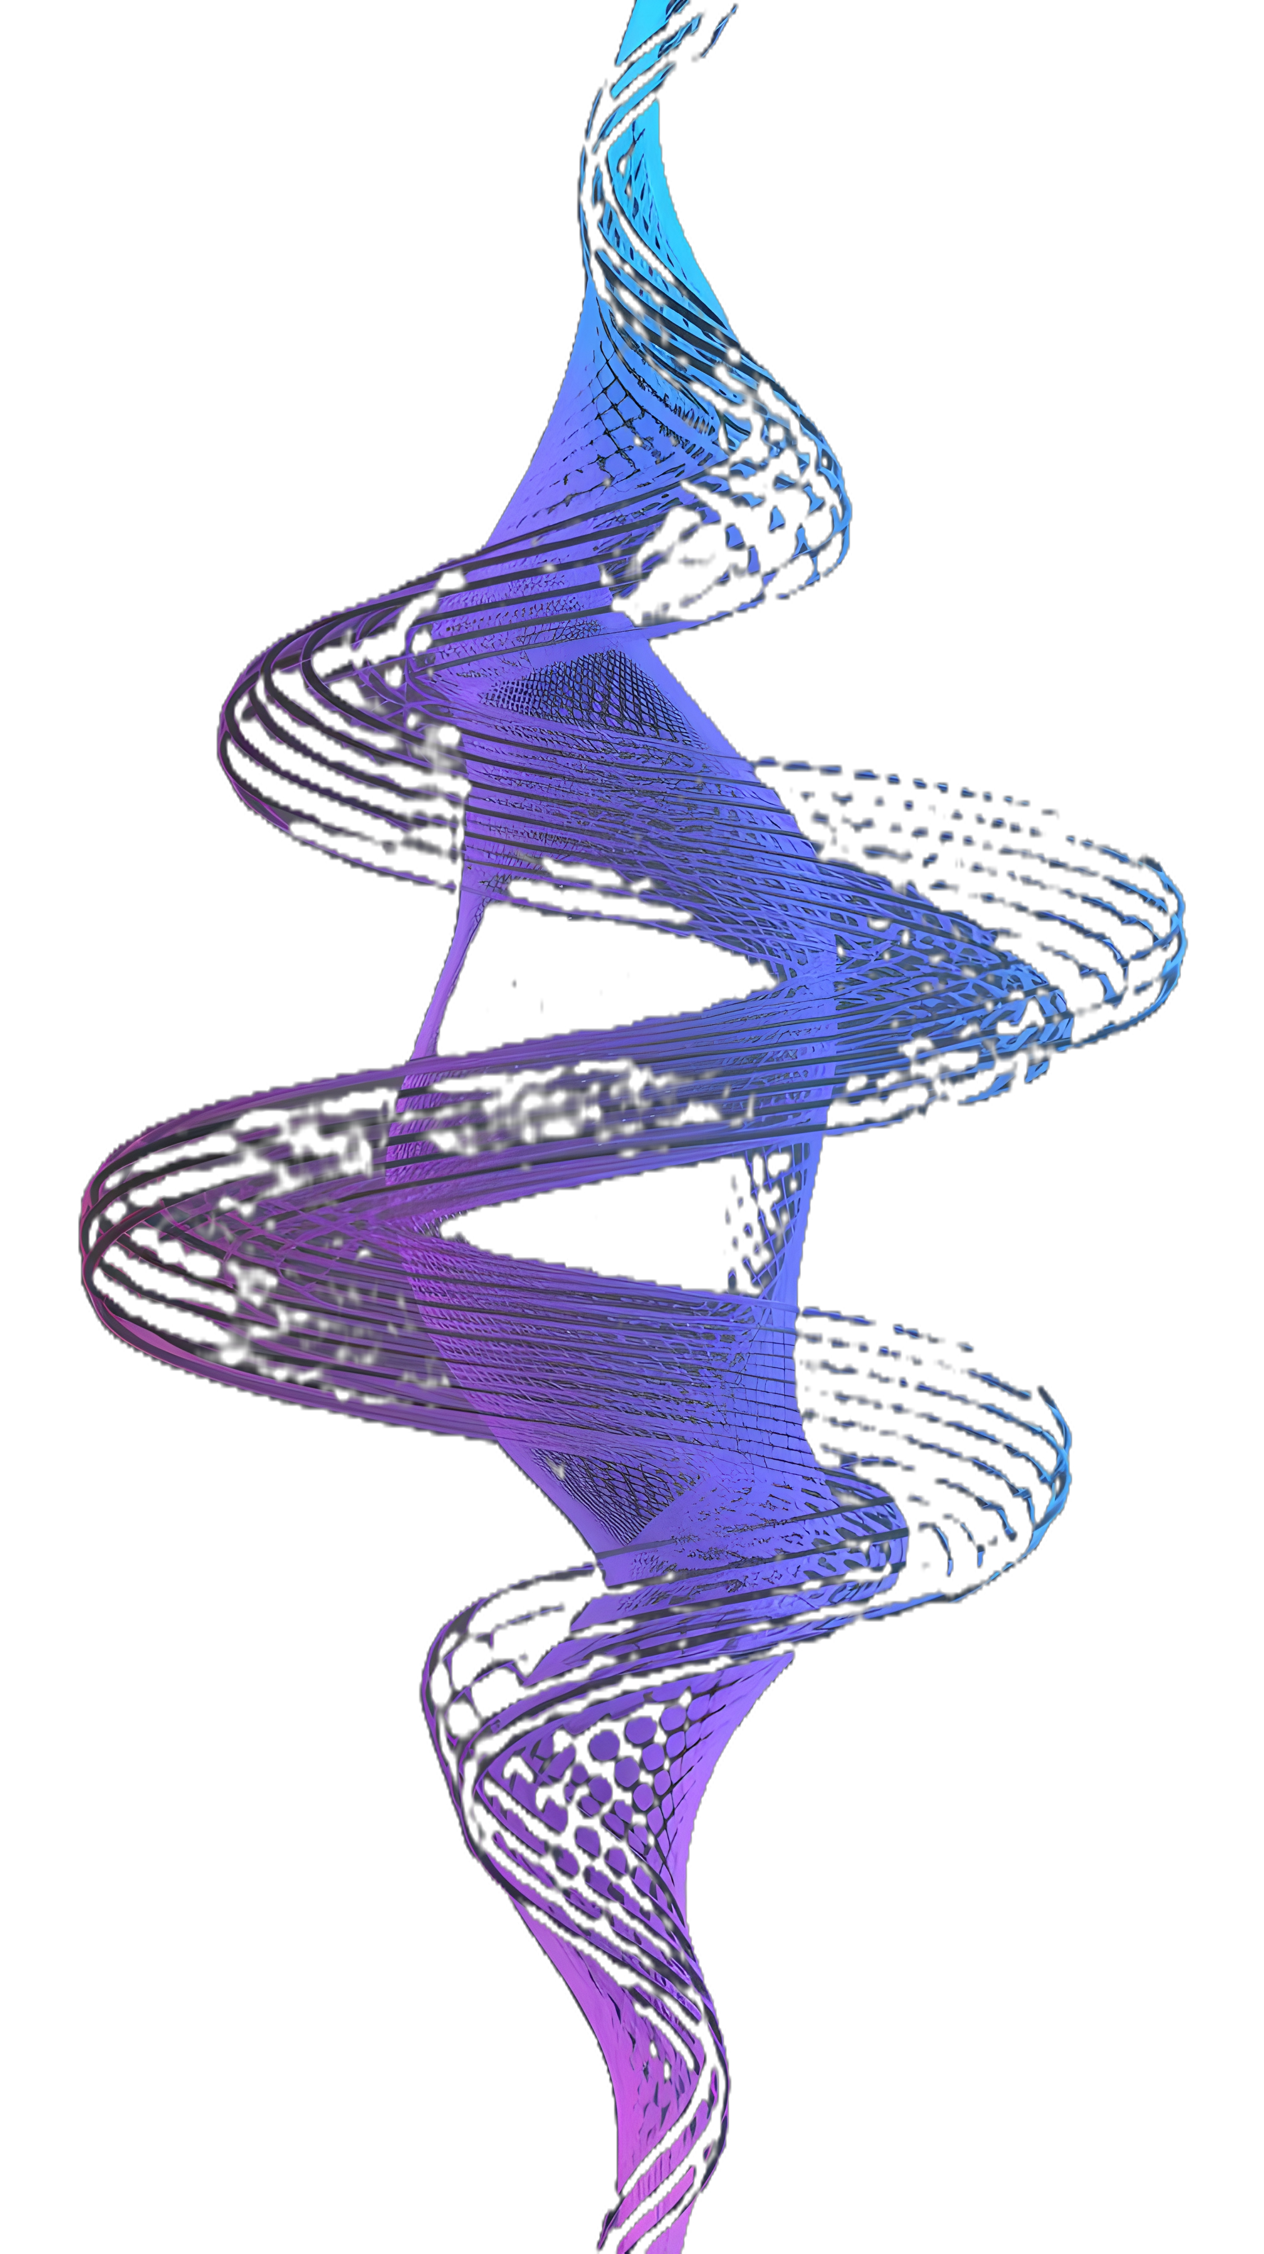
Fluctuations
Want $𝒪(Q^{0})$ contributions to the anomalous dimension
Obtained from spectrum of fluctuations around classical solution
Jesse Woods, U. Bern
Semiclassics at the Cusp

Slide 41
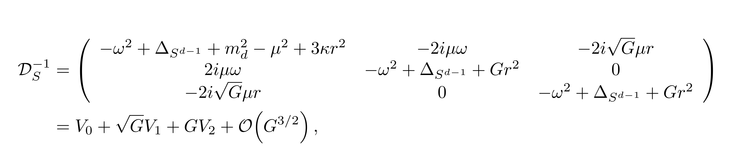

Dispersion Relations
Need eigenvalues of each block of inverse propagator matrix, eg:
Function of position-dependant fields. Use matrix element pert. Theory:
Jesse Woods, U. Bern
Semiclassics at the Cusp

Slide 42



Mass Spectrum
Expectation: line breaks $SO\left(d,1\right)×\frac{SU\left(N\right)}{ℤ_{N}}→SO\left(d−2\right)×𝒟×\frac{SU\left(N−1\right)}{ℤ_{N−1}}$
No Type-I Goldstone (Higgs), S- and gauge field massive
Jesse Woods, U. Bern
Semiclassics at the Cusp

Slide 43

Contribution to Anom. Dim.
Complicated but known
Reproduces usual LO fluctuations
Can sum eigenvalues for NLO corrections
Jesse Woods, U. Bern
Semiclassics at the Cusp

Slide 44

Contribution to Anom. Dim.
Each order is again a resummation of perturbation theory in $κ$
Jesse Woods, U. Bern
Semiclassics at the Cusp

Slide 45

Observables

Slide 46


Observables: Defect Changing Operator
$β$ related to displacement operator:
Jesse Woods, U. Bern
Semiclassics at the Cusp

Slide 47

Defect Changing Operator: Small Limit
Jesse Woods, U. Bern
Semiclassics at the Cusp

Slide 48

Defect Changing Operator: Large Limit
Jesse Woods, U. Bern
Semiclassics at the Cusp

Slide 49


Observables: Defect Fusion
Casimir energy is independent of $κ$!
Jesse Woods, U. Bern
Semiclassics at the Cusp

Slide 50

Observables: Order Parameter
Dirac dressing differs from MS dressing at all loops, not just 1-loop
Jesse Woods, U. Bern
Semiclassics at the Cusp

Slide 51

To summarise:
Large charge works in gauge theory
Semiclassical expansion in Q
Elucidation of SC order parameter
Gauge redundancy $⇒$ no I-Goldstone
Non-perturbative results
Jesse Woods, U. Bern
Semiclassics at the Cusp

Slide 52

Further directions
Large G regime
Nonabelian lines
Supersymmetric Extensions
Junctions
Multiple defect changes
Jesse Woods, U. Bern
Semiclassics at the Cusp

Slide 53
Thankyou!
Jesse Woods, U. Bern
Semiclassics at the Cusp

Slide 54
Backups, Old Slides
Jesse Woods, U. Bern
Semiclassics at the Cusp

