Slide 1



What we talk about when we talk about gluon saturation
Peter Jacobs
Lawrence Berkeley National Laboratory
UC Berkeley
In collaboration with:
  Raymond Ehlers, LBNL/UCB
  Andreas van Hameren, Krakow
  Florian Jonas, LBNL/UCB
  Krzysztof Kutak, Krakow
  Farid Salazar, Temple
  Bjoern Schenke, BNL/SBU
SURGE Collaboration Meeting
UCLA, June 25 2025

Slide 2
Is this the correct description of the low-x structure of matter?
How do we test it experimentally?
→
QCD phenomena evolve only logarithmically in x and Q²
  → experimental study of non-linear QCD evolution requires “logarithmically broad” coverage in (x,Q²)
Universality: correct theoretical description must self-consistently describe measurements of multiple observables at low (x,Q²) in multiple collision systems
Multi-messenger program: combine measurements from e-A DIS and diffractive interactions at EIC, with forward p-A collisions at RHIC and LHC

Slide 3
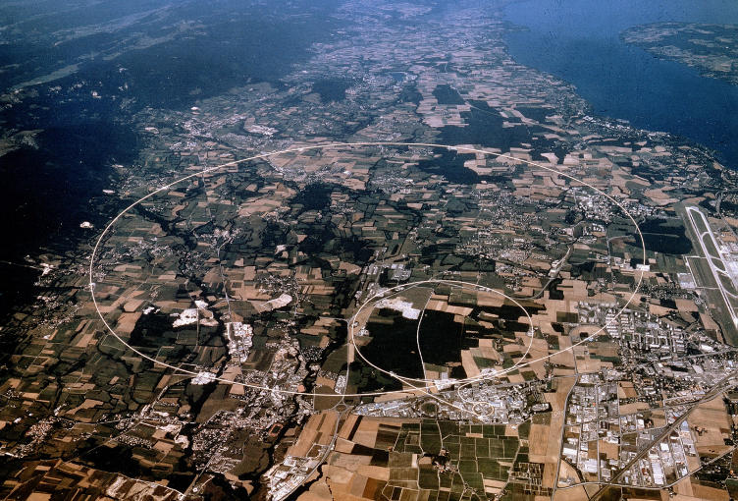
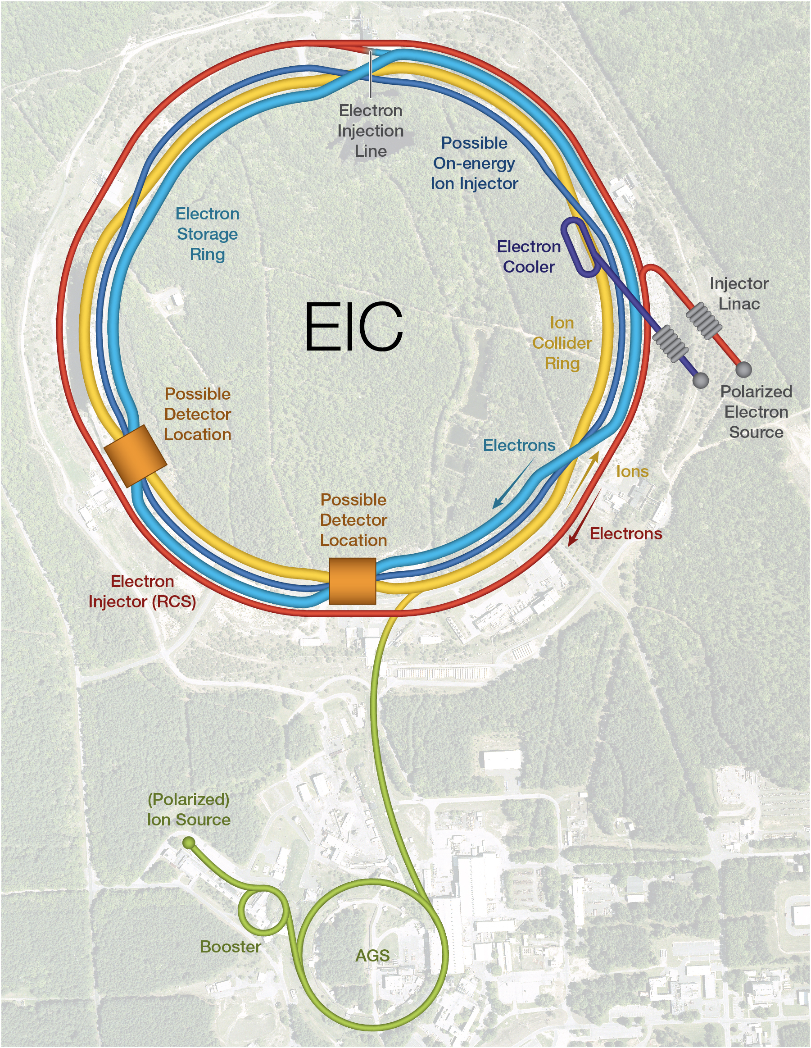

Complementary for low-x physics?

Slide 4
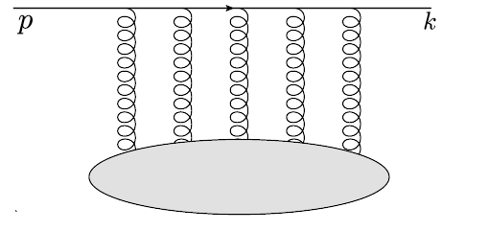



Theoretical interpretability: dipole formalism
Forward p+A:
Inclusive π⁰, jet, direct γ
γ+jet
balanced di-jet,…
e+A DIS
Interaction cross section
Structure Functions F₂, F_{L}
Multiple processes in e-A DIS and forward p-A are described theoretically by the same dipole-medium forward scattering amplitude T_{LO} → calculable beyond LO
Compare e-A DIS and forward p-A: universality
Dipoles in DIS:
Gribov, Sov. Phys. JETP 30 (1970) 709-717
Bjorken and Kogut, Phys. Rev. D 8 (1973) 1341
Frankfurt and Strikman, Phys. Rept. 160 (1988) 235
A. H. Mueller, Nucl. Phys. B 335 (1990) 115
Nikolaev and Zakharov, Z. Phys.C 49 (1991) 607
Dipoles in particle production:
Kopeliovich, Tarasov and Schafer, Phys. Rev. C 59 (1999) 1609
Gelis and Jalilian-Marian, Phys. Rev. D66 (2002) 014021
Kovchegov and A. H. Mueller, Nucl. Phys. B 529 (1998) 451
Kopeliovich, Raufeisen and Tarasov, Phys. Lett. B 503 (2001) 91

Slide 5
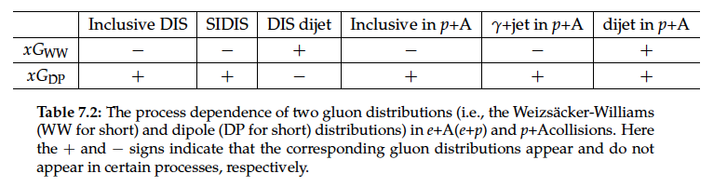
EIC Yellow Report: e+A DIS vs forward p+A
Nucl. Phys. A1026 (2022) 122447
Dominguez, Xiao and Yuan 1009.2141
Dominguez, Marquet, Xiao and Yuan 1101.0715
Sect. 7.5.4: Low-x gluons and factorization in eA (ep) vs pA and AA
“…pA collisions can serve as a gateway to the EIC as far as saturation physics is concerned, and it also plays an important and complementary role in the study of these two fundamental gluon distributions (Weiszacker-Williams and Dipole)…The small-x factorization in DIS and pA collisions is expected to hold at higher order [1228], since the higher-order corrections do not generate genuine new correlators in the large Nc limit.”
quadrupole
dipole

Slide 6
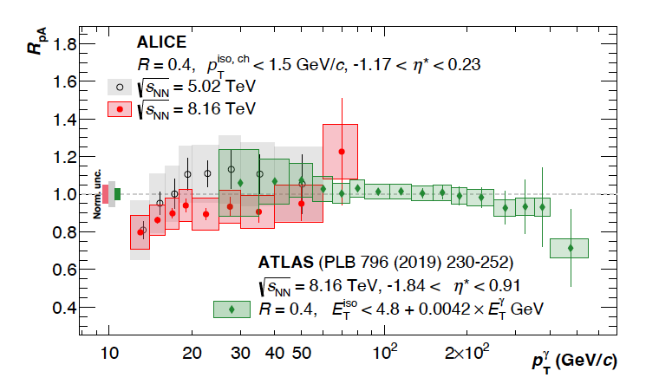

ALICE: prompt photon production in p+Pb
ALICE arXiv:2502.18054
~2$σ$ suppression for $x$~3 $×$10⁻³

Slide 7
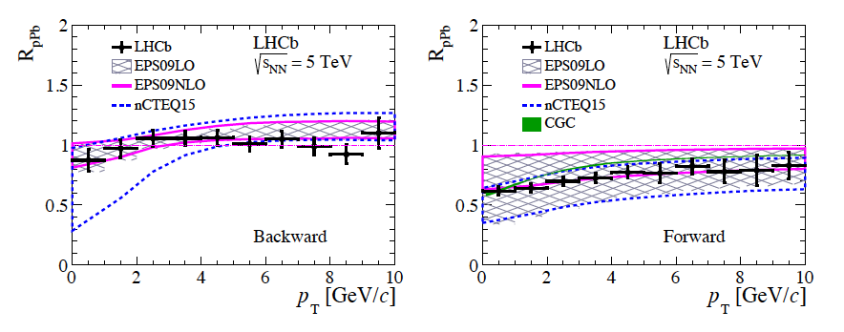
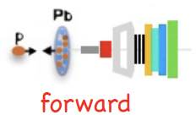
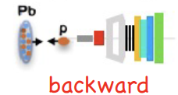
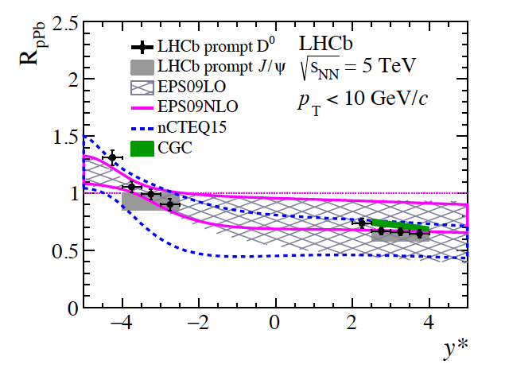
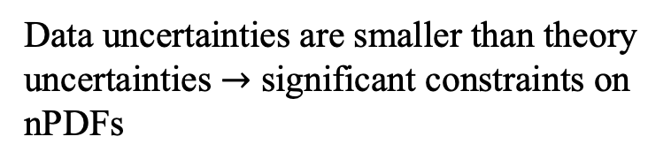
LHCb: D⁰ production in p+Pb
R_{pPb}: yield ratio p+Pb/pp
JHEP 10 (2017) 090
arXiv:1707.02750
Data uncertainties are smaller than theory uncertainties $→$ significant constraints on nPDFs

Slide 8
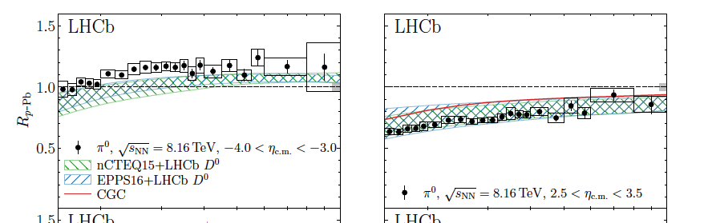
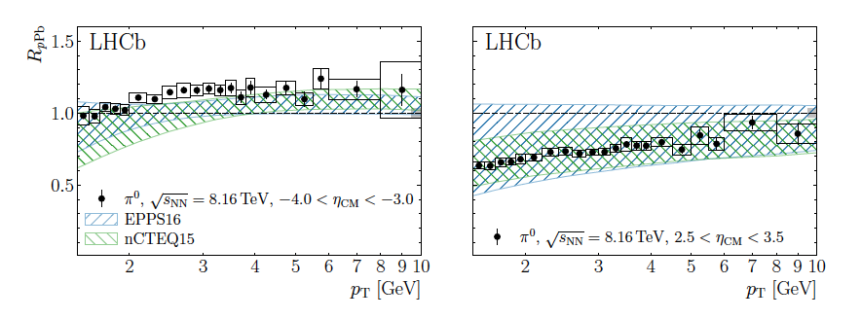
nPDFs: impact of LHCb D⁰ data
PRL 131 (2023) 042302
arXiv:2204.10608
Compare nPDFs to LHCb π⁰ data with and without reweighting by LHCb D⁰ data
Reweighting with LHCb D⁰ data
Low-x: marked reduction in systematic uncertainties
Without LHCb D⁰ data

Slide 9
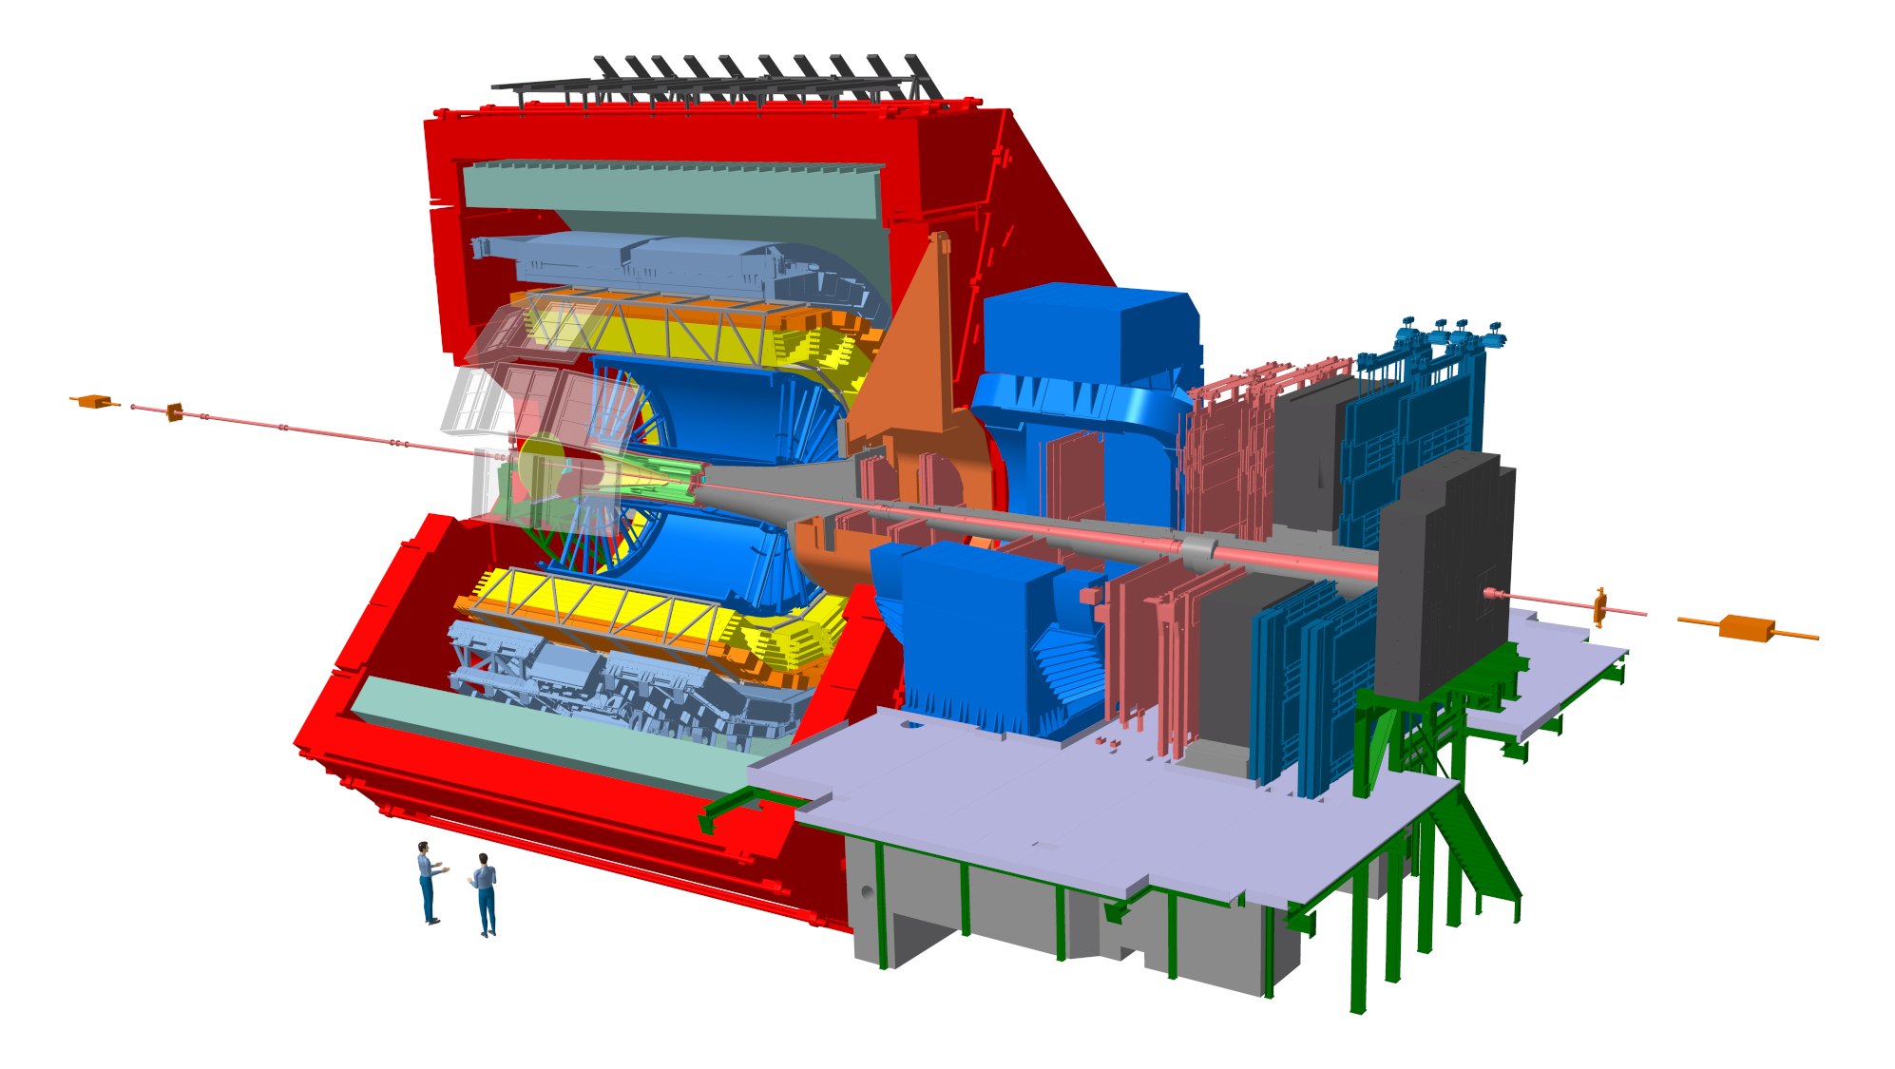
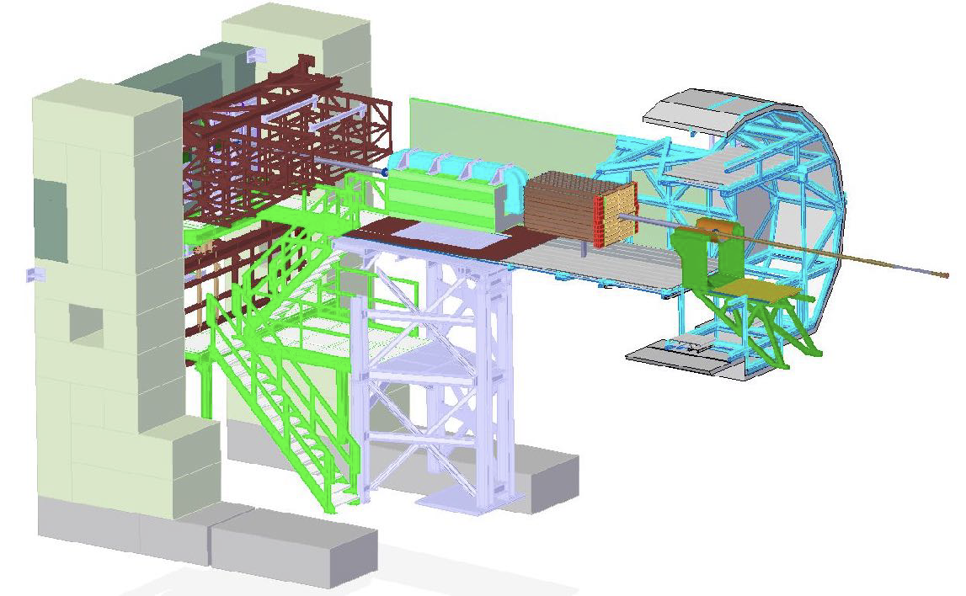
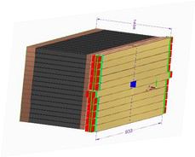
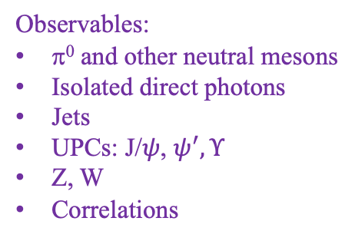
The ALICE Forward Calorimeter (FoCal) upgrade
Letter of Intent: CERN-LHCC-2020-009
Physics Program: ALICE-PUBLIC-2023-001
https://inspirehep.net/literature/2661418
Physics Performance: ALICE-PUBLIC-2023-004
Technical Design Report: ALICE-TDR-022
CERN-LHCC-2024-004
FoCal-E: high granularity Si-W sampling calo
FoCal-H: conventional metal-scintillator sampling calo
FoCal
(not to scale)
3.4<η<5.8
Main physics goal: study universal structure of matter at low-x
Flagship measurement: isolated direct photons for p_{T}>~2 GeV/c at very forward η
Observables:
π⁰ and other neutral mesons
Isolated direct photons
Jets
UPCs: J/$ψ$, $ψ^{′}, Υ$
Z, W
Correlations
  Installation: LHC Long Shutdown 3 Operation: LHC Run 4 (start 2029)

Slide 10
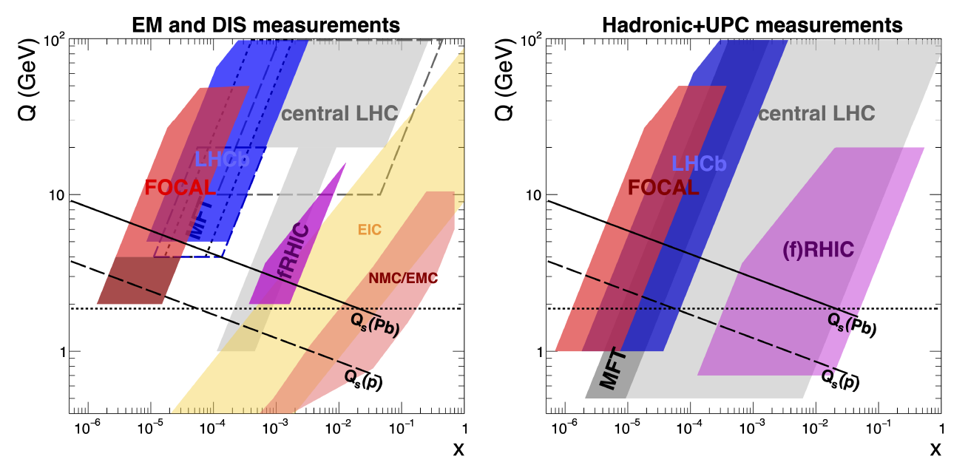
LHC Run 4 kinematic coverage
EM in hadronic collisions: direct γ, DY

Slide 11
Big-picture question: how can we best discriminate non-linear from linear QCD evolution?
Fast-forward ~10 years: lots of beautiful new data
ep, eA: F₂, F_{L}, diffractive,…
pA from EIC+forward RHIC/LHC: photons, di-jets, UPCs,…
How will we use these vast and heterogenous datasets optimally to search for non-linear evolution and quantify its effects?

Slide 12
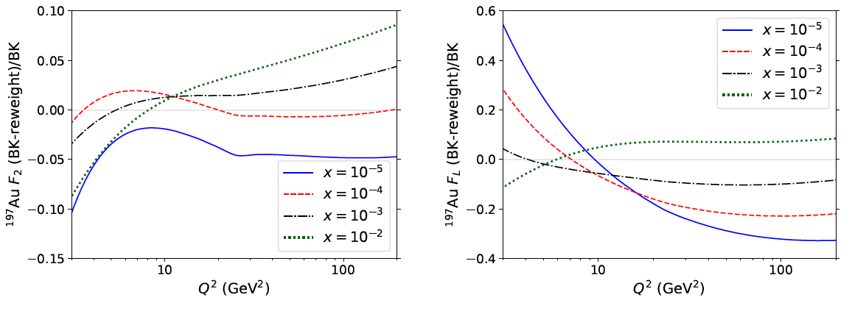
Non-linearity via DIS structure fns
Armesto et al.
PRD 105 (2022) 11, 114017
arXiv:2203.05846
Example: what is the sensitivity of DIS Structure Functions for discriminating linear and non-linear evolution?
Toy model:
Compute F₂ and F_{L} in EIC and LHeC kinematics; no exp. uncert
Both collinear factorization and CGC (non-linear) approaches
Match at x~10⁻² and Q²~10 Q_{s}²
Evolve away from matching region and compare
Relative difference of nonlinear and linear evolution
¹⁹⁷Au F₂
¹⁹⁷Au F_{L}
EIC
EIC
EIC: F₂ difference ~few percent; F_{L} difference ~10% $→$challenging

Slide 13
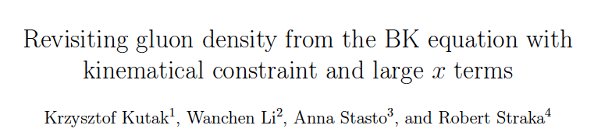
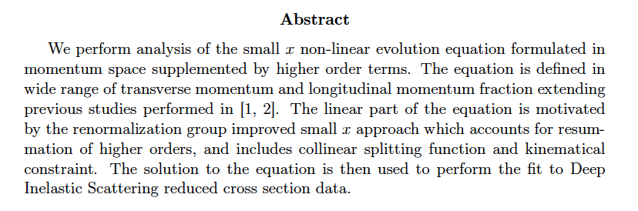
Phys.Rev.D 111 (2025) 11, 116021
arXiv:2502.15465

Slide 14
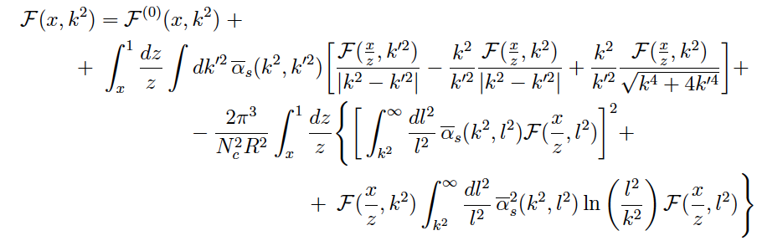

Evolution of unintegrated gluon density: BK equation
Phys.Rev.D 111 (2025) 11, 116021
arXiv:2502.15465
Evolution in x at transverse momentum k
starting distribution
Linear
evolution
Non-linear evolution
Ansatz for starting distribution (Golec-Biernat/Wuesthoff)
Fit parameters
Fit to HERA reduced x-section data data

Slide 15
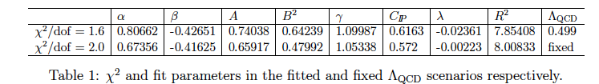
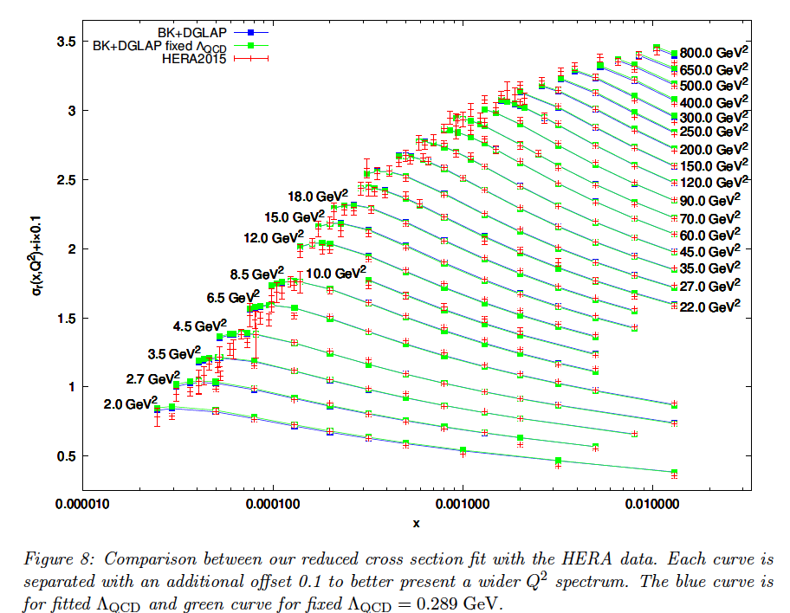
BK evolution fit to HERA data
arXiv:2502.15465
Computationally intensive
F2 calculation: each point in (x,Q²) takes about 1 s.
Full calculation: 3 days on GPU GeForce Titan Z.
Good fit to data
consistent description over vast kinematic range
How to define uncertainty?

Slide 16
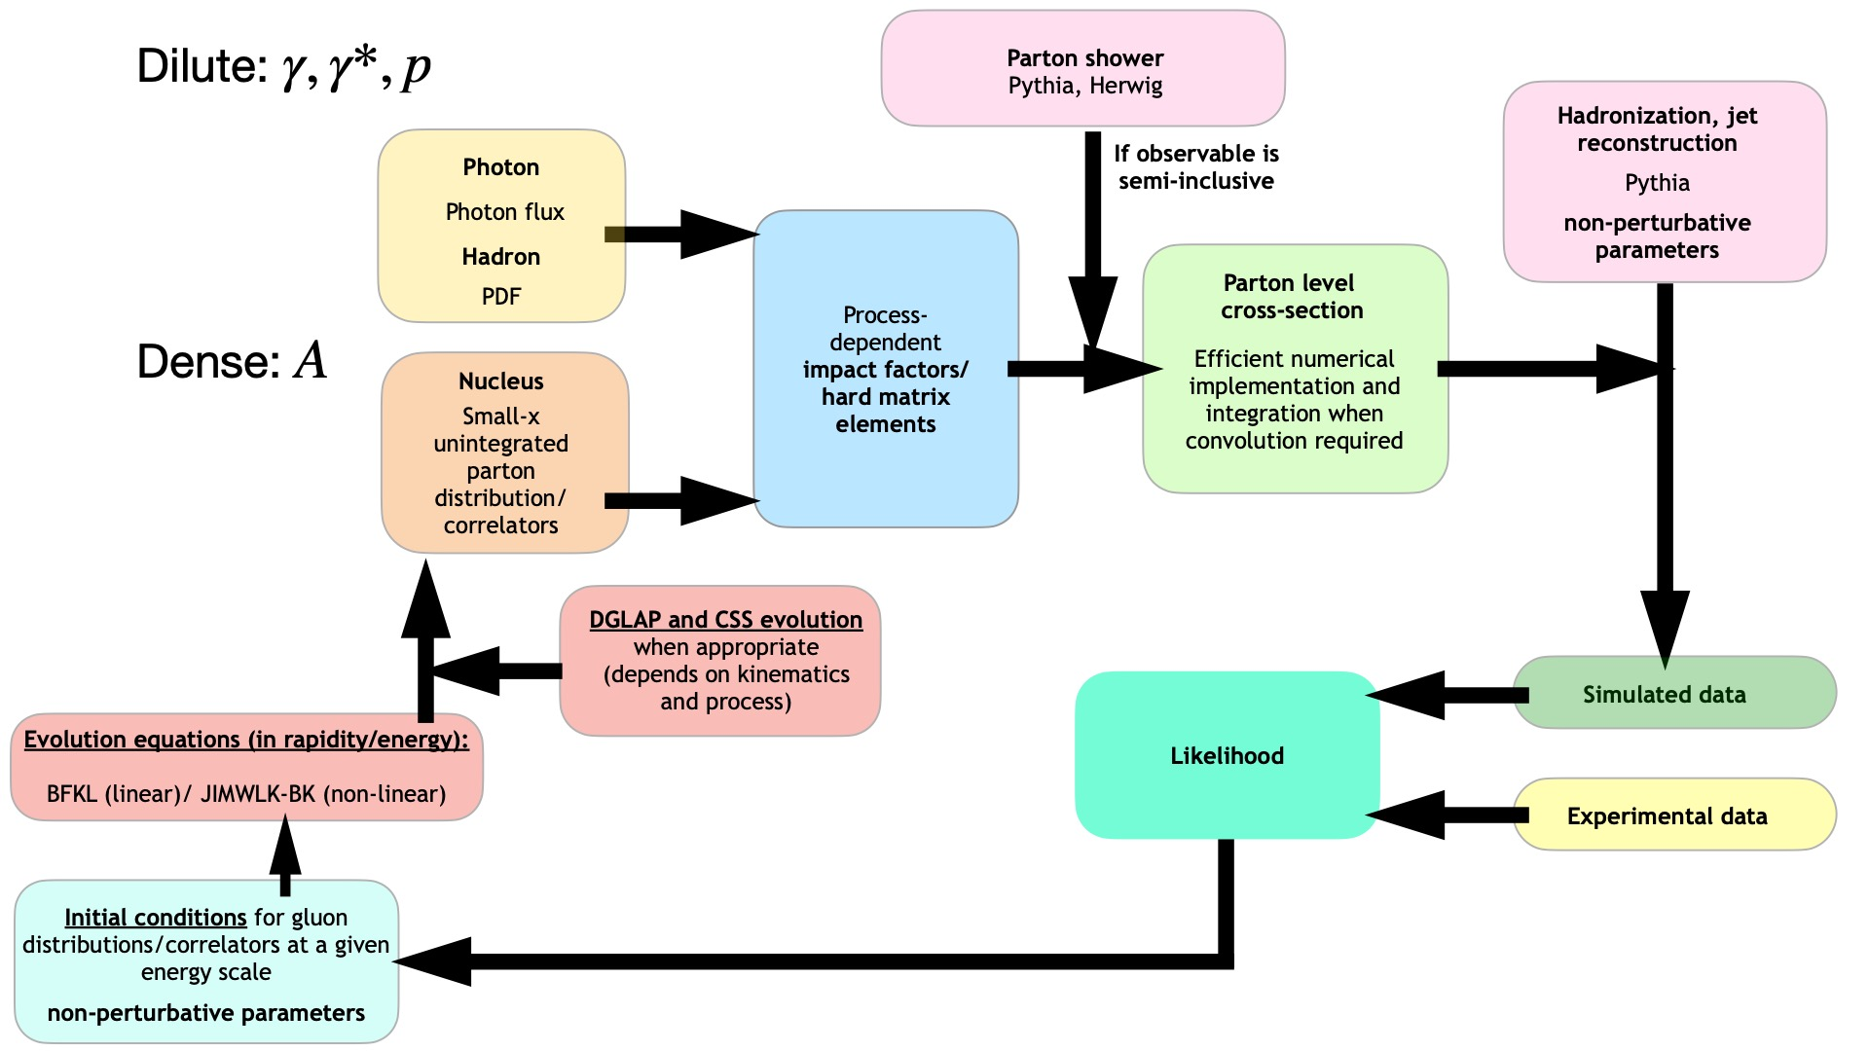
(First draft of) Saturation Workflow
Work in progress: focus at the moment just on content, not layout

Slide 17
(First draft of) Saturation Workflow
Goals:
Theory: exploratory studies
Exp: model tension; parameter constraints
Th/Exp uncertainties
AI/ML tools
Bayesian Inference
quadrupole/JIMWLK
dipole/BK

Slide 18
Backup

Slide 19
LHC Run 4 coverage by experiment
FoCal upgrade

Slide 20
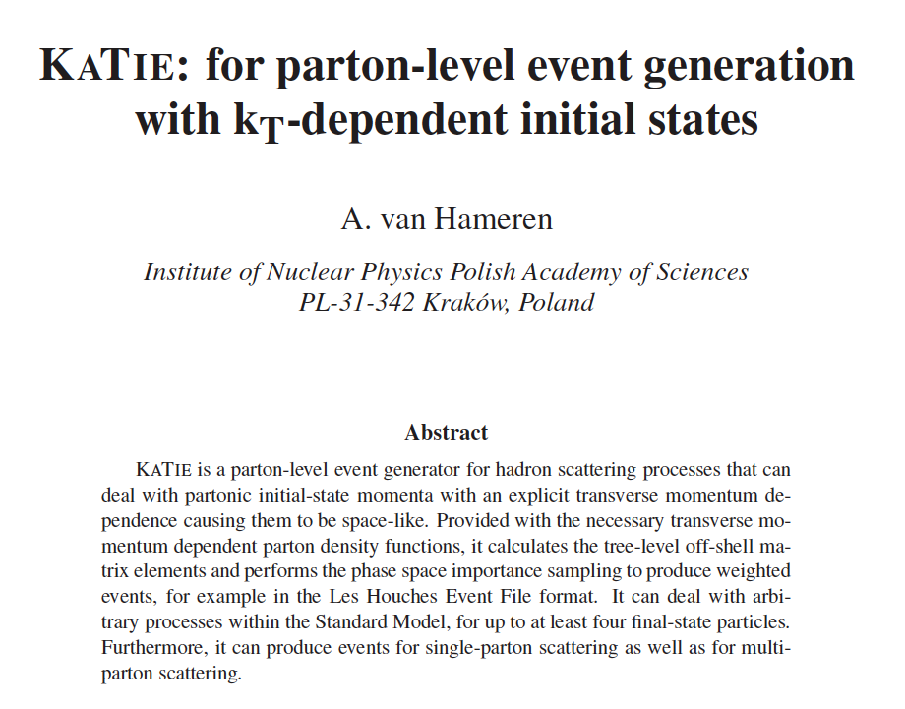
arXiv:1611.00680

Slide 21
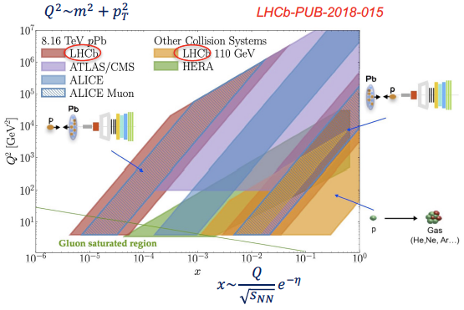
LHC Run 2/3 measurements at low x

Slide 22
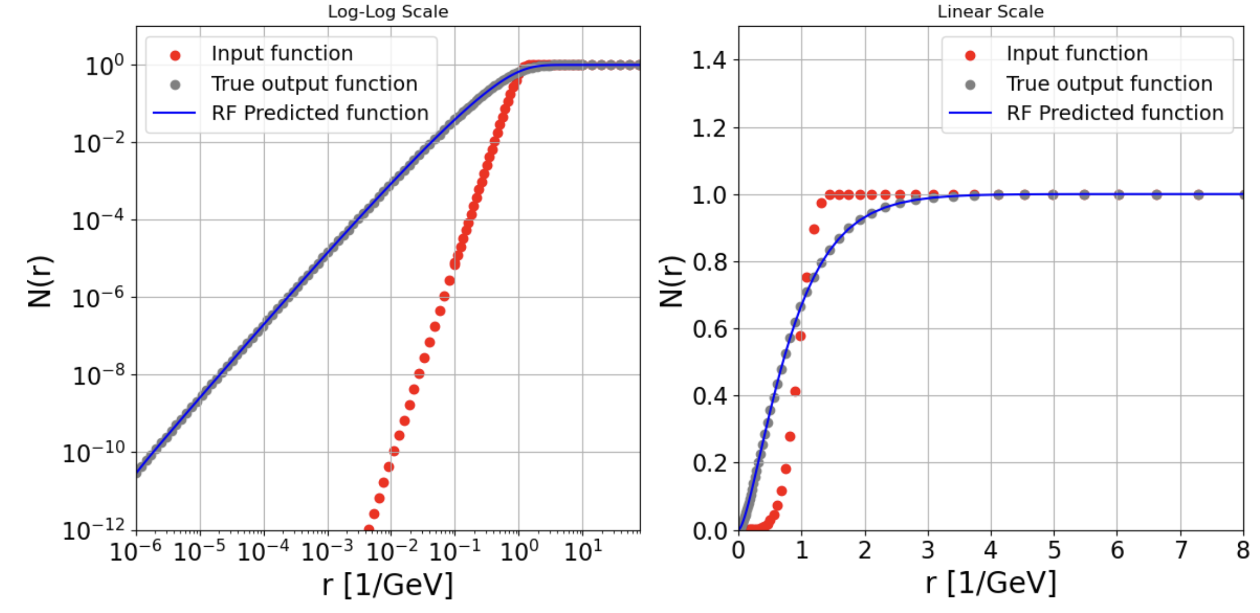
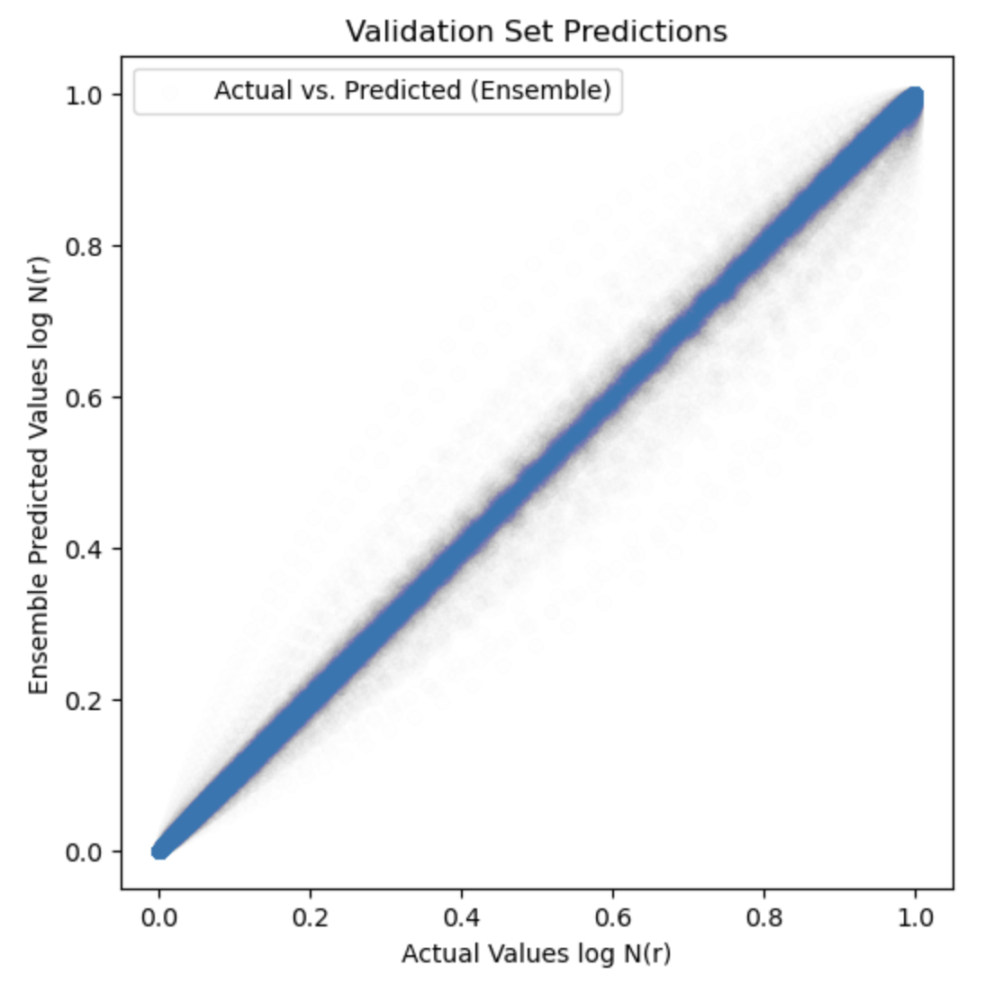

BK evolution of dipole amplitude: acceleration using Machine Learning
Bjoern Schenke
Data: dipole N(x₀,r) → BK-evolved amplitudes N(x,r)
formulated as fn of dipole size r; previous slides utilize k_{T}
currently leading-log BK; NLL to be implemented
Train ML model (Random Forest) to predict evolved dipole amplitude → fast x-evolution
Performance of ML vs. full evolution calculation
$$x={10}^{−2}→{10}^{−6}$$

Slide 23
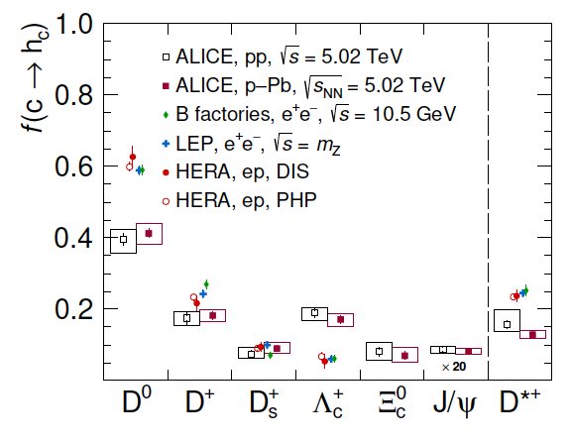
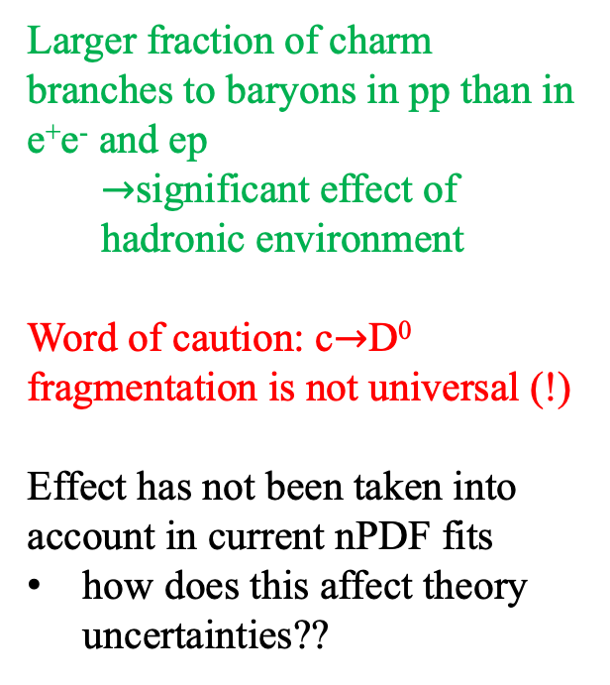
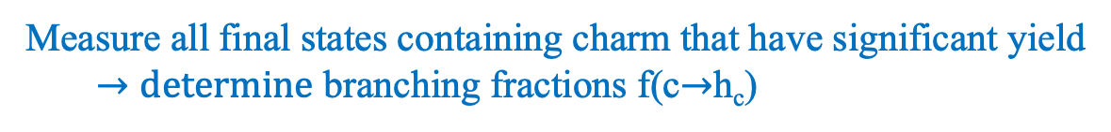
ALICE: charm fragmentation in p+p collisions
Eur.Phys.J.C 84 (2024) 12, 1286
Measure all final states containing charm that have significant yield
  $→determine$ branching fractions f(c$→$h_{c})
Larger fraction of charm branches to baryons in pp than in e⁺e⁻ and ep
  $→$significant effect of hadronic environment
Word of caution: c$→$D⁰ fragmentation is not universal (!)
Effect has not been taken into account in current nPDF fits
how does this affect theory uncertainties??

Slide 24
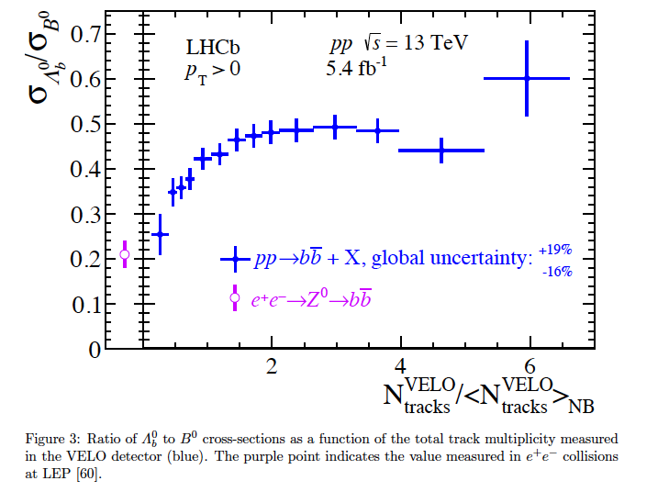
LHCb: beauty fragmentation in pp
Phys.Rev.Lett. 132 (2024) 8, 081901
Ratio of beauty baryon/meson yield vs Event Activity
Same picture in the beauty sector: relative branching into baryons vs. mesons depends on the hadronic environment!

Slide 25
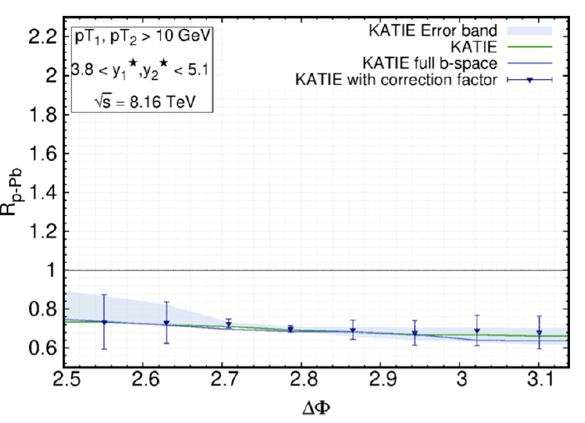
Katie calculation: Forward di-jets in FoCal acceptance
Al-Mashad et al., arXiv:2210.06613
Balanced di-jet acoplanarity
KaTie
Improved TMD (iTMD) framework
Sudakov resummation
NP effects: jet showering, hadronization (PYTHIA)
characteristic theory uncertainty

Slide 26
Rigorous connection of data and models:
Bayes’s Theorem
For a given model, what parameters are most compatible with experimental data?
Bayesian Inference: combine knowledge of theory and experiment to constrain parameters
Likelihood
Prior knowledge of model parameters
Posterior: probability density of parameters giving best description of the data
Likelihood incorporates covariance of data uncertainties, theory uncertainties

Slide 27
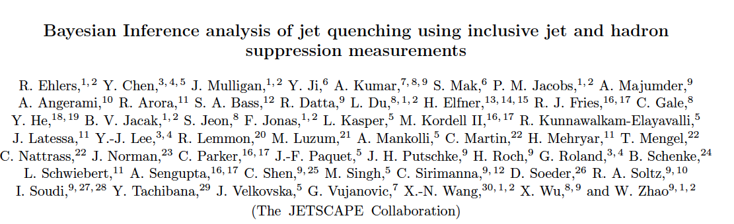
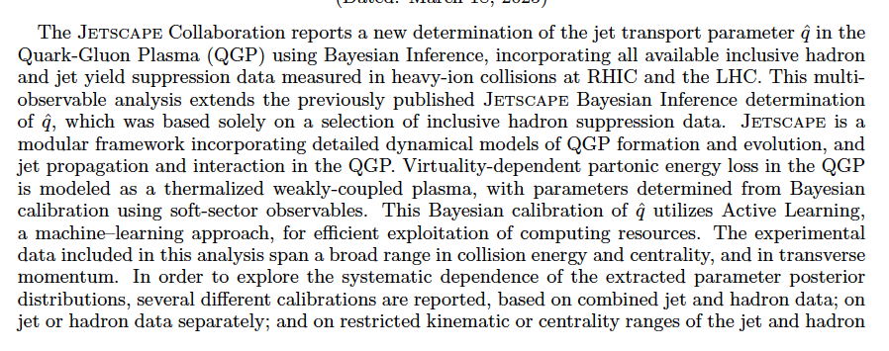
Phys.Rev.C 111 (2025) 5, 054913
arXiv:2408.08247

Slide 28
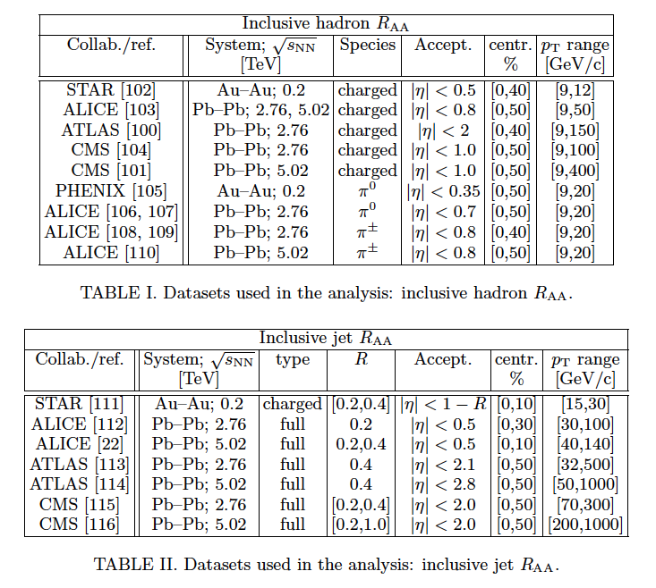

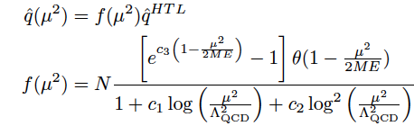
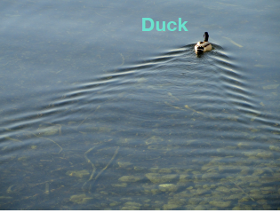
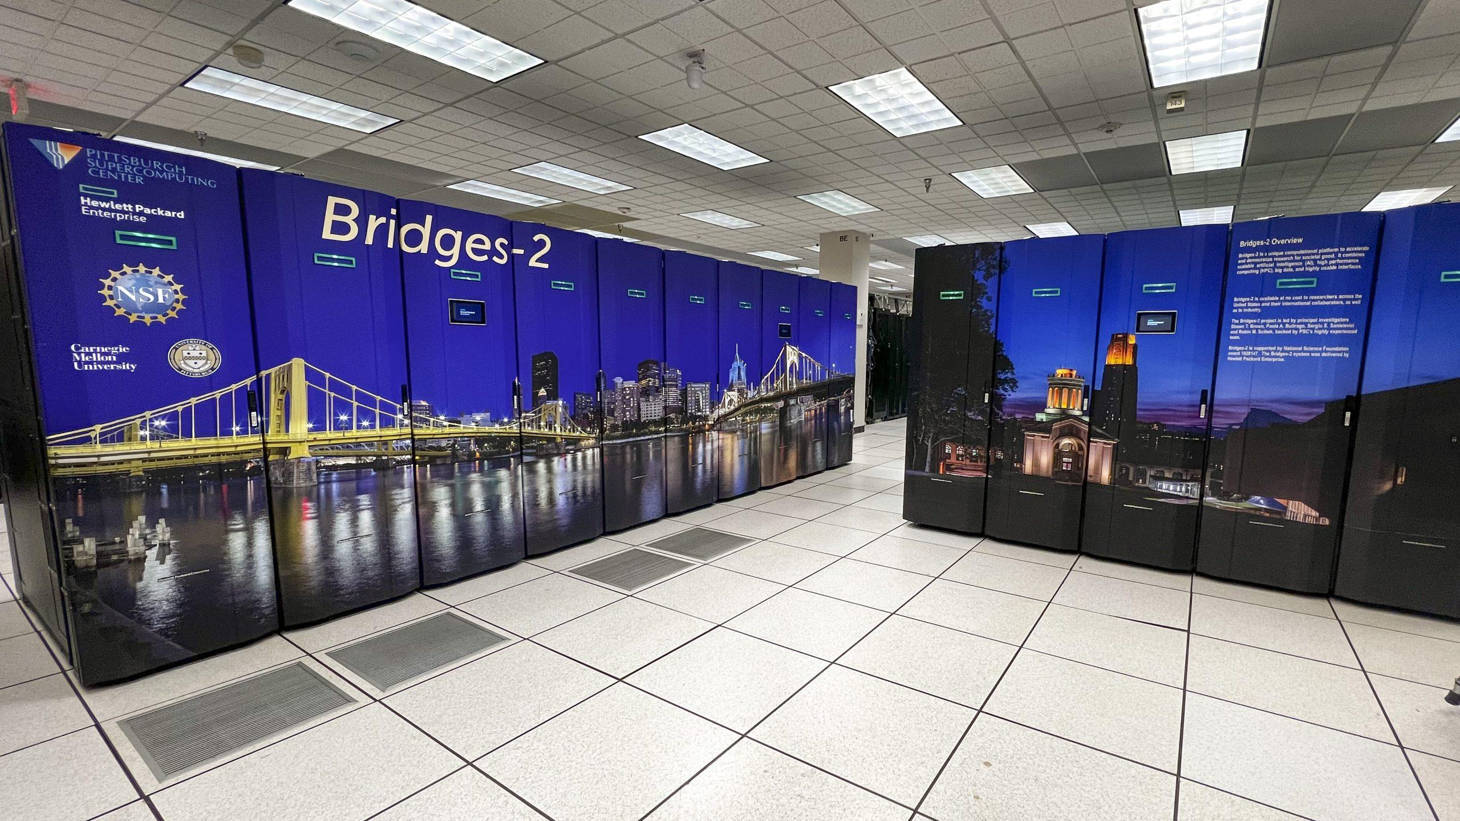
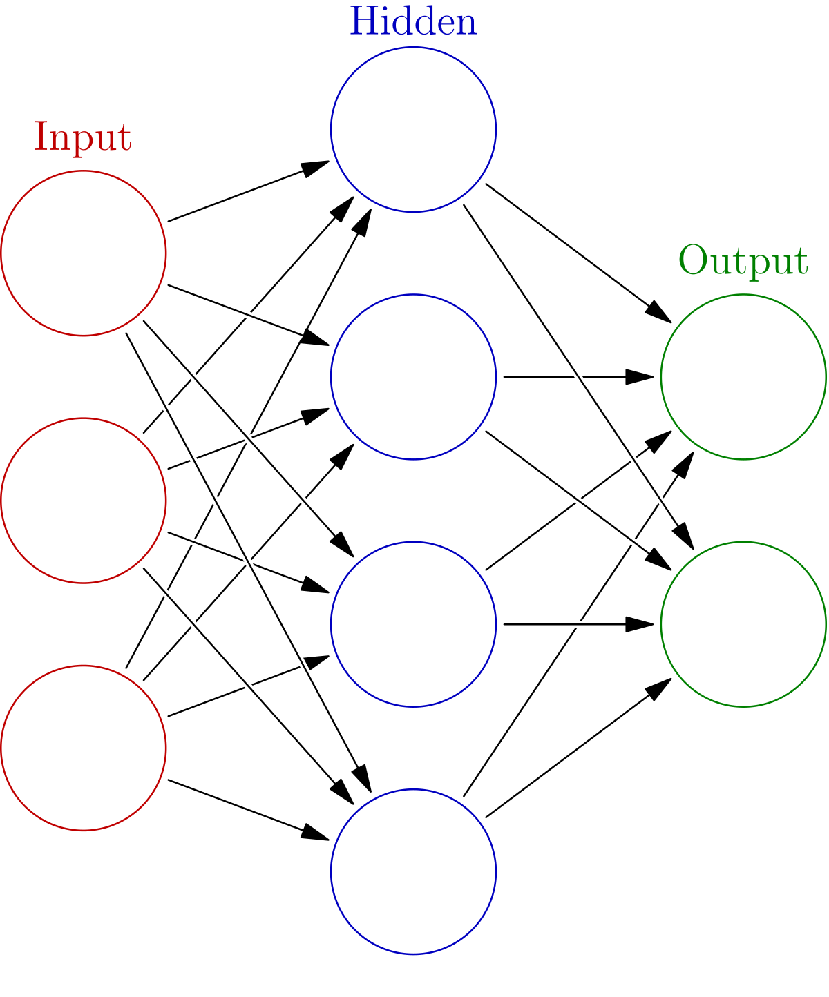

Ingredients
Comprehensive dataset
Virtuality-dependent $\hat{q}$
Hydrodynamics (QGP)
Massive computing
~5M HPC core hours
AI/ML: Active Learning

Slide 29
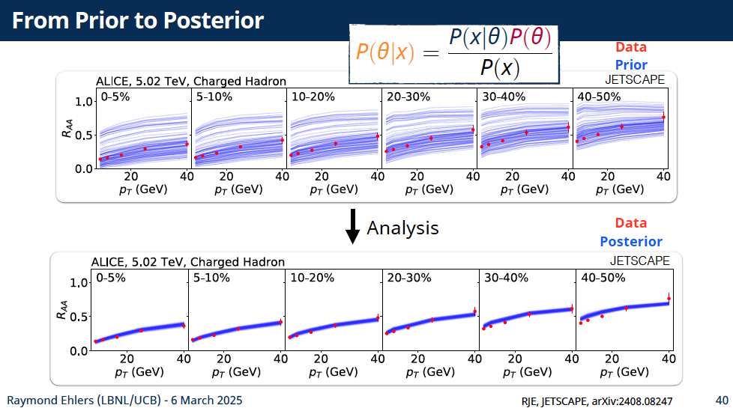

Slide 30
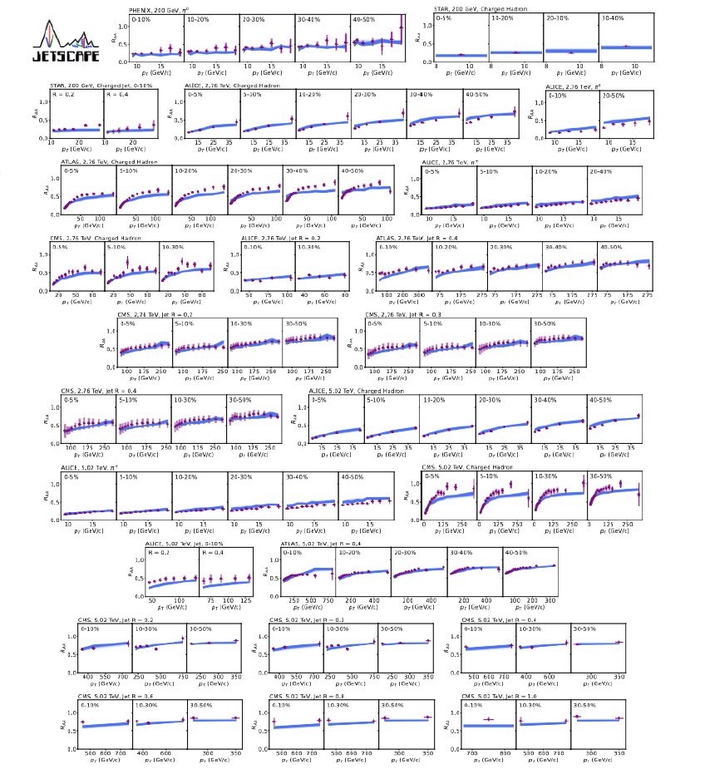
Comprehensive fit
Overall reasonable agreement, some tension

Slide 31
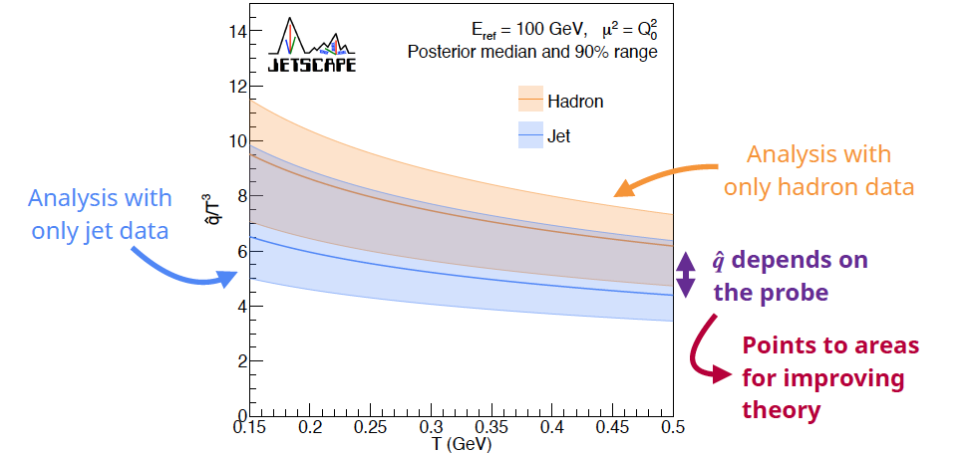
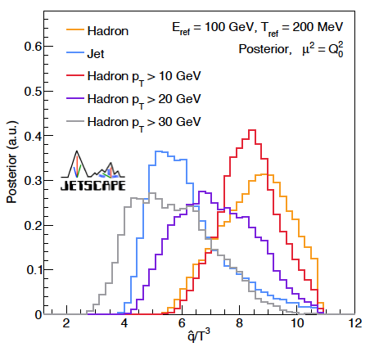
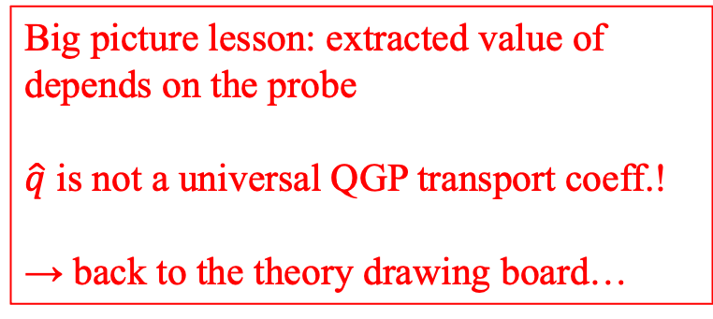
Big picture lesson: extracted value of depends on the probe
$\hat{q}$ is not a universal QGP transport coeff.!
→ back to the theory drawing board…

