Slide 1

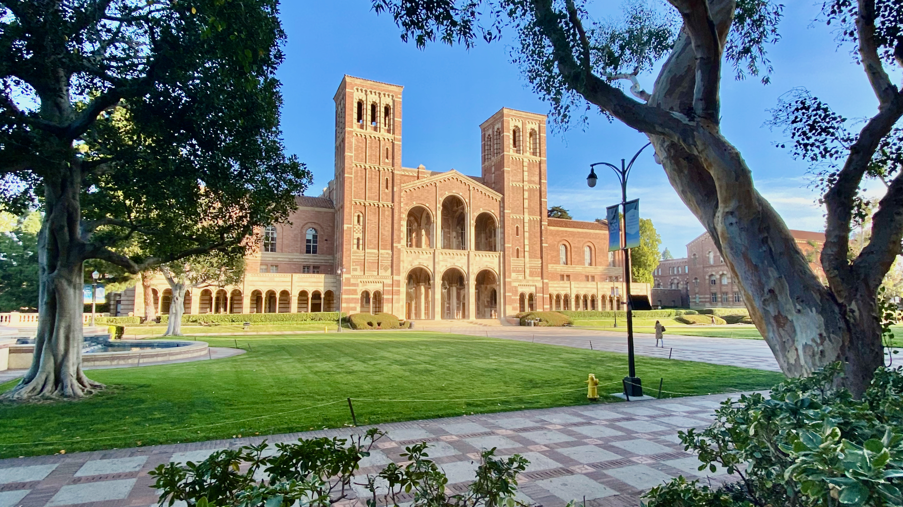
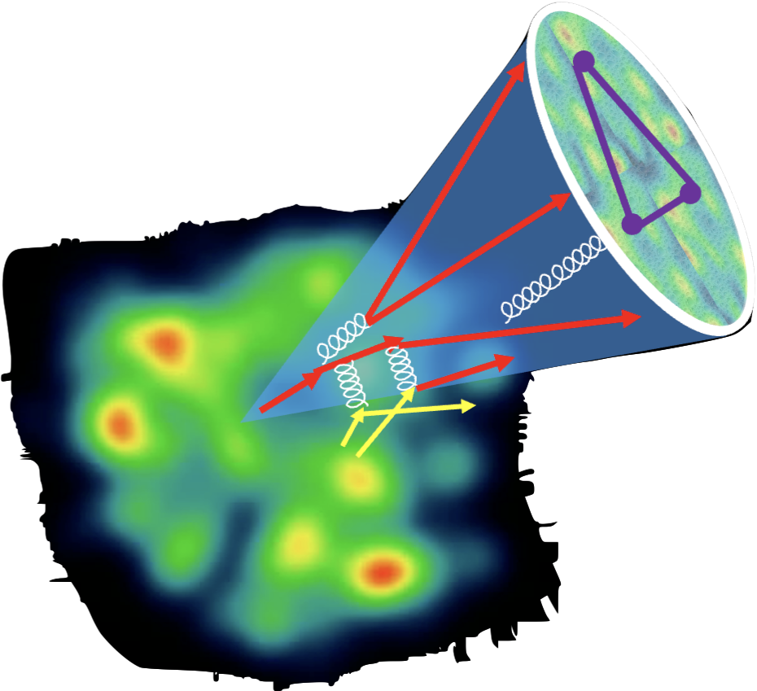
SURGE Collaboration meeting
UCLA, June 22-24, 2025
Modification of EEC in cold and hot QCD medium
Xin-Nian Wang
Central China Normal University
In collaboration with Y. He, W. Ke, I. Moult and Z. Yang, W. Zhao

Slide 2
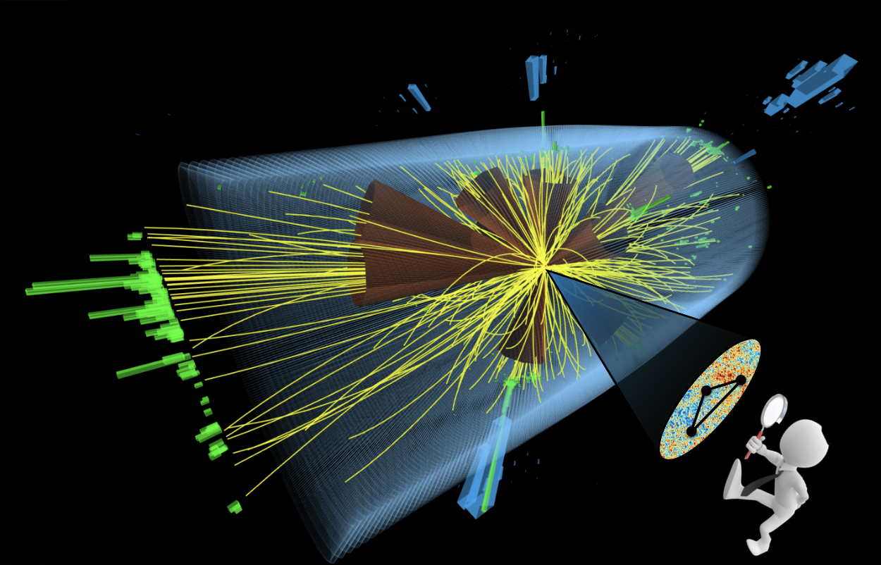
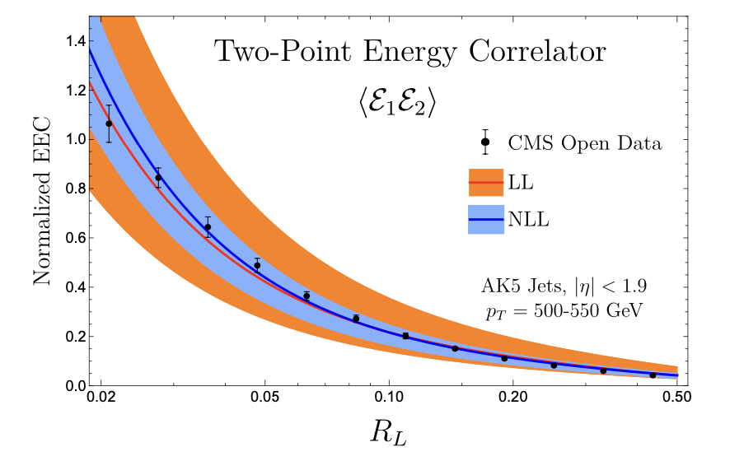
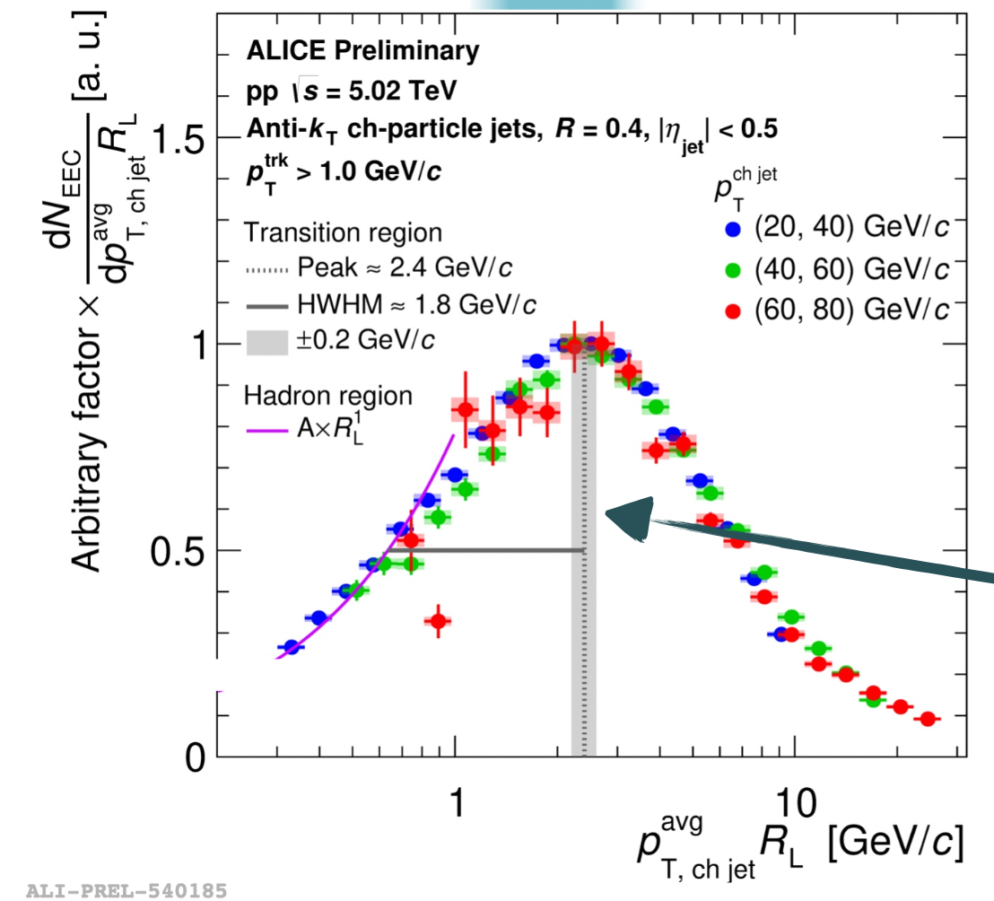
Energy-energy correlator (EEC)
A new jet substructure observable:
Moult, et al
Fan, QM23
Notes:
\frac{d\Sigma^{(n)}}{d\theta}=\frac{1}{\sigma}\sum_{i\neq j}\int d \vec n_{i,j} \frac{d\sigma_{ij}}{d\vec n_{i,j}} \frac{E_i^n E_j^n}{Q^{2n}} \delta(\vec n_1\cdot \vec n_2 -\cos\theta)

Slide 3
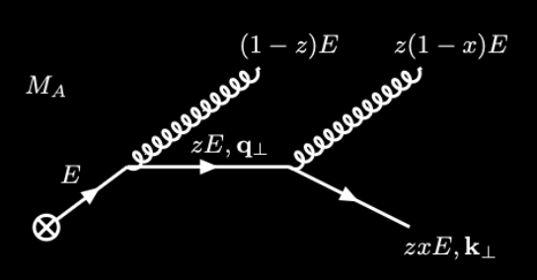
Jet EEC in Vacuum
LO emission:
Leading Log evolution:
….
Uncorrelated emission at small angle
Different EEC for quarks and gluons
Notes:
\frac{d\Sigma_q^{\rm vac}}{d\theta} \approx \frac{\alpha_s}{2\pi} C_F
\int_0^1 dz~ z(1-z) P_{qg}(z) \int_{\mu_0^2}^{Q^2} \frac{d{\bf \ell}_\perp^2}{\ell_\perp^2} \delta \left(\theta - \frac{\ell_\perp}{z(1-z)E}\right)
\approx \frac{\alpha_s}{2\pi}\frac{C_F}{2\theta} \left(3-\frac{2\mu_0}{E\theta}\right)\sqrt{1-\frac{4\mu_0}{E\theta}}
\frac{\partial \Sigma_q}{\partial \ln \mu^2} = \frac{\alpha_s(\mu^2)}{2\pi}\left[\gamma_{qq}(3)\Sigma_q +\cdots\right]
\frac{\partial }{\partial t}
\begin{bmatrix}
\Sigma_q\\
\Sigma_g\\
\end{bmatrix}
=
\begin{bmatrix}
\gamma_{qq}(3) & \gamma_{gq}(3) \\
2N_f\gamma_{qg}(3) & \gamma_{gg}(3)
\end{bmatrix}
\begin{bmatrix}
\Sigma_q\\
\Sigma_g
\end{bmatrix}

Slide 4
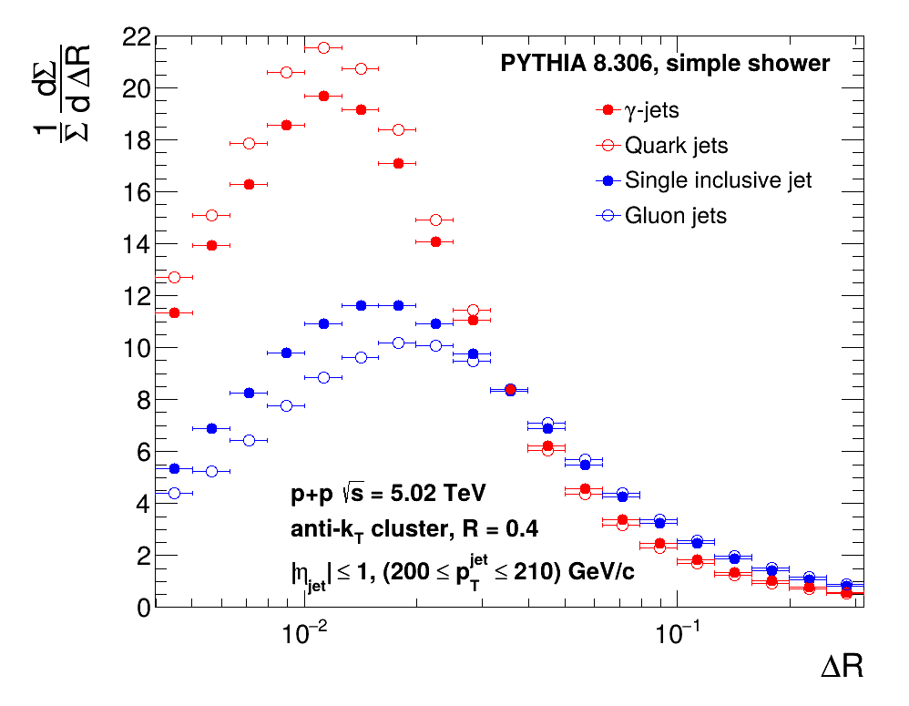
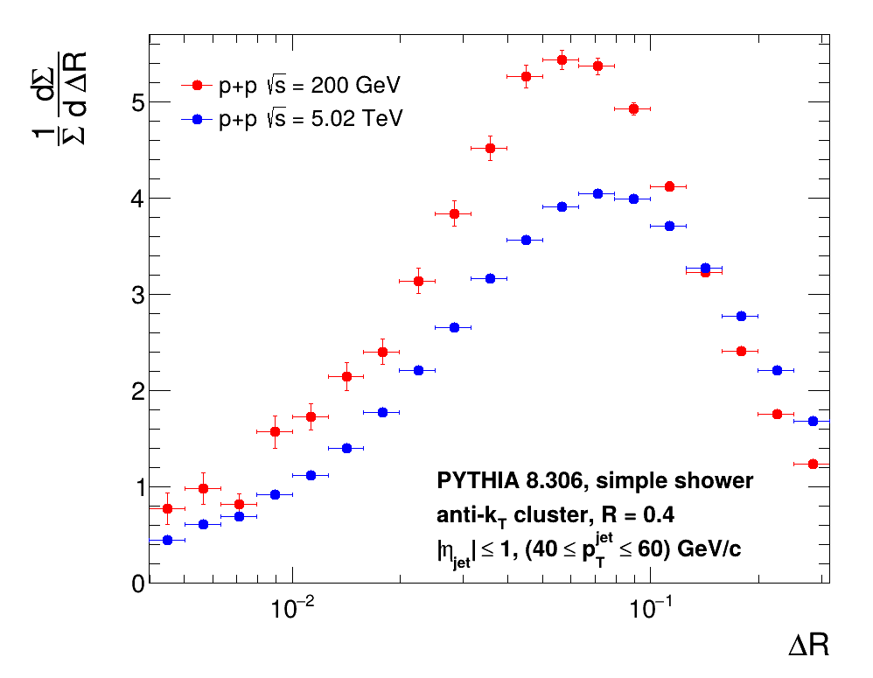
Consequences of flavor dependence of EEC
γ-jets vs.
Single inclusive
jets
-dependence
of EEC
p_{T} – dependence of single inclusive jet EEC
L. Apolinari, Z. Yang, et al, 2502.11406

Slide 5
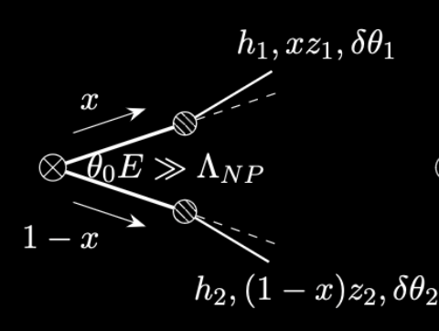
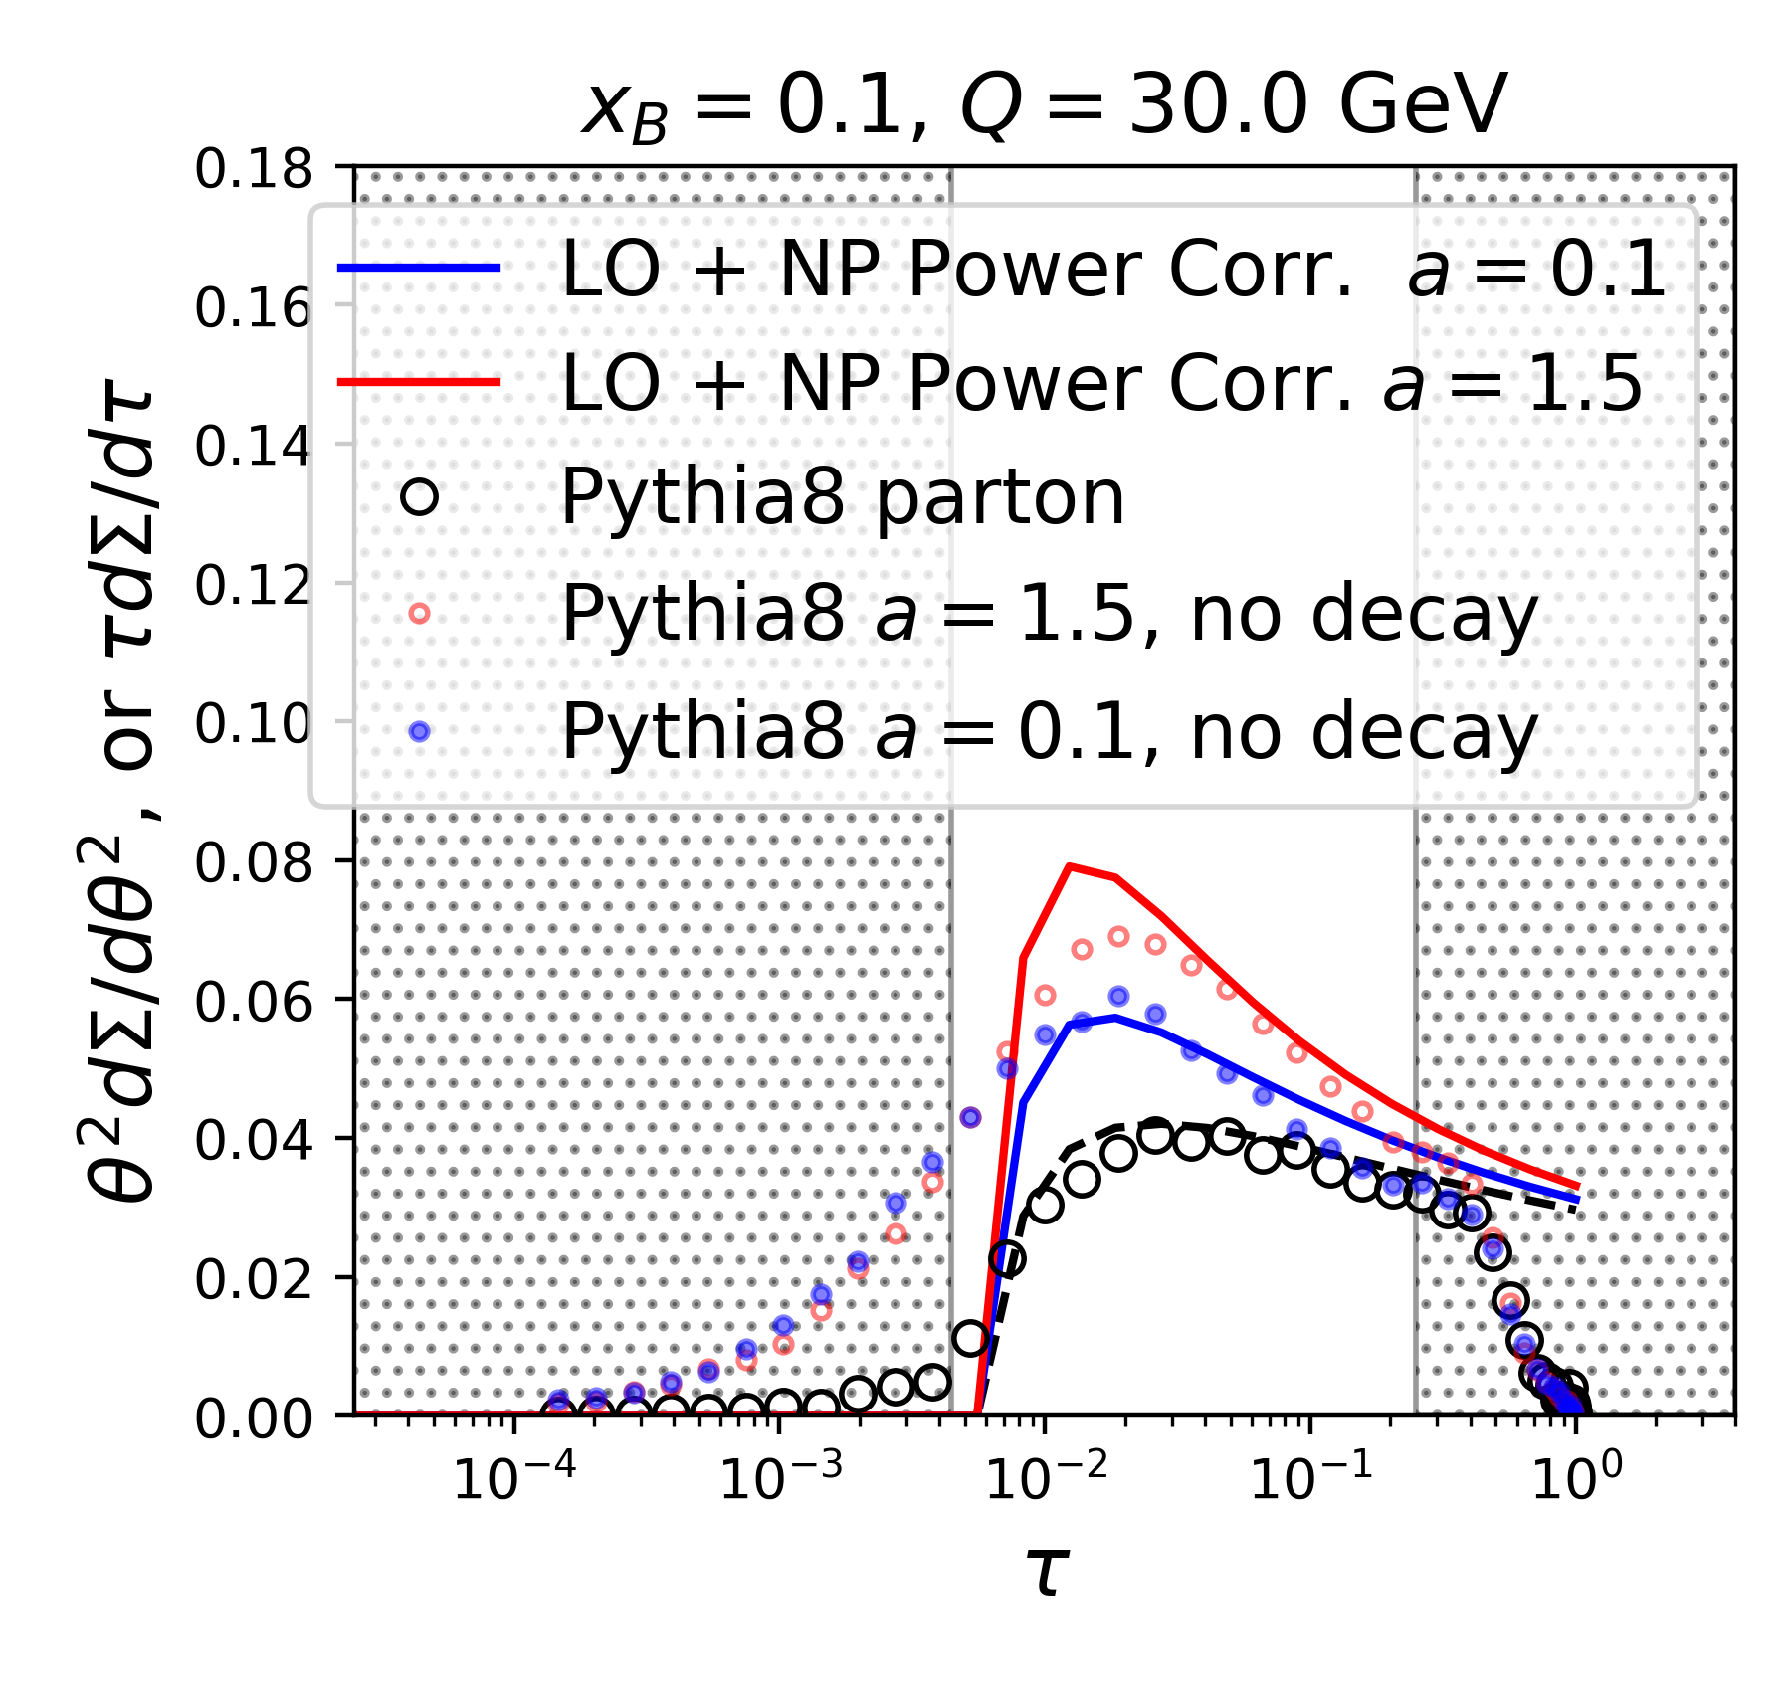
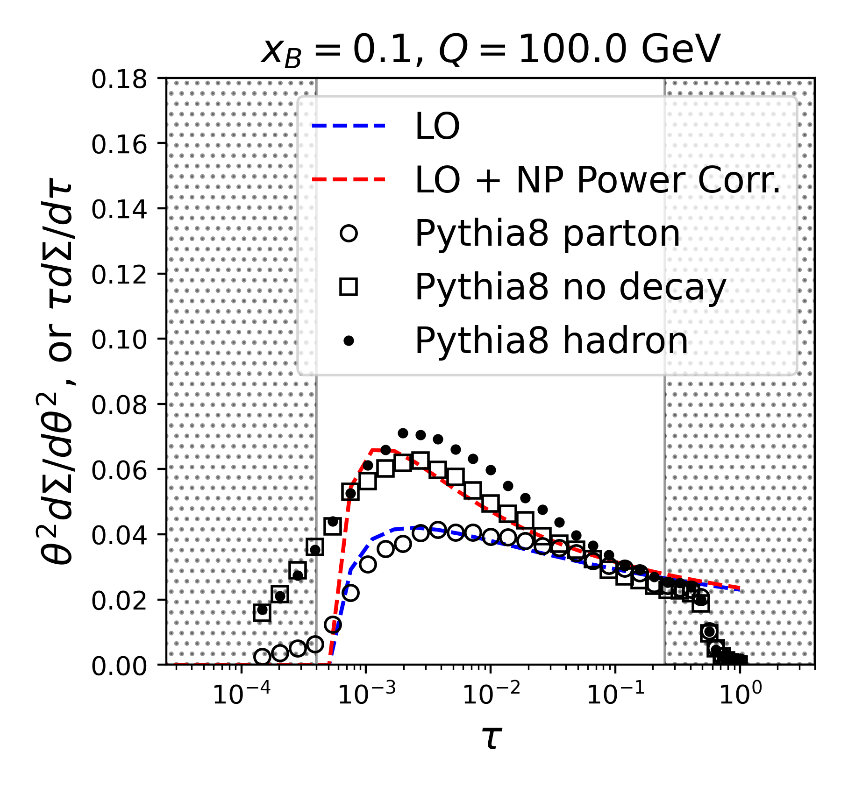
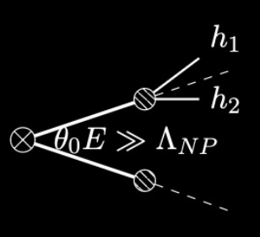
Effects of hadronization: TMD Fragmentation
Power corrections at large angle
Y. Ke, XNW and W. Zhao in preparation
Random correlation at small angle
EEC should be sensitive to momentum broadening in medium
Notes:
f_{h/i}(z_h,{\bf k})= f_{h/i}(z_h) \frac{e^{-{\bf k}^2/2\sigma^2}}{2\pi \sigma^2 }
f_{h/i}(z_h) \propto \frac{(1-z)^a z^b}{z}
\frac{dN}{d\theta^2} &=& \frac{\alpha_s(\mu^2) C_F}{2\pi}\frac{3}{4}\left\{ 1 + \left[\frac{2\sigma^2}{\theta^2 E^2}\right]^{\frac{1}{2}} \frac{(1+a)\sqrt{\pi}}{3} \left[\log^2\frac{\mu^2}{\theta^2E^2} + \mathcal{O}(\log\frac{\mu^2}{\theta^2E^2})\right] \right\}

Slide 6
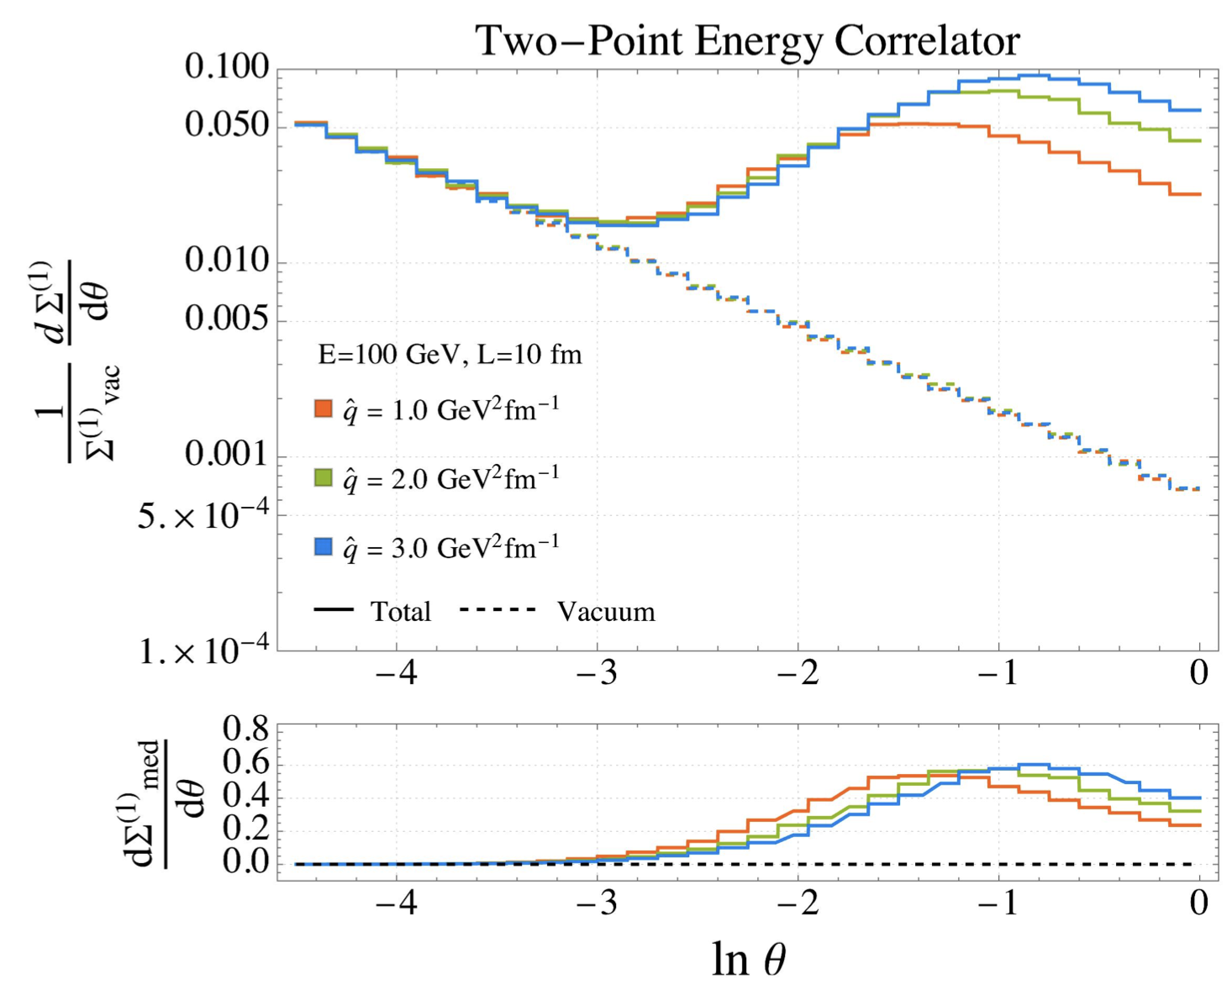
Resolving QGP scales with EEC
Andres, et al , PRL 130 (2023) 26, 262301 (2209.11236)

Slide 7
Resolving QGP scales with EEC
Can EEC resolve the induced gluon emission in EIC and heavy-ion collisions?
Can EEC resolve momentum broadening of leading partons and recoil partons (medium response)?
Can EEC resolve the angular scale of in-medium parton collisions in EIC and heavy-ion collisions

Slide 8
Gluon spectrum from single emission in GHT
Generalized HT induced emission in a QCD brick medium:
g(2)
a
l
a(1)
k
Notes:
\frac{dN_{g}^{a({\rm GHT})}}{dz d\ell^2_\perp}
= \frac{C_AC_2(R)}{N_c^2-1} \frac{\alpha_s}{2\pi} P_{ag}^{(0)}(z)
\int dy \rho_A(y) \int_0^{Q^2} d^2{\bf k}_\perp \frac{\alpha_s \phi_{g}(x_g, {\bf k}_\perp^2)}{k_\perp^2} \frac{2{\bf k}_\perp \cdot {\bf \ell}}{\ell_\perp^2({\bf \ell}_\perp-{\bf k}_\perp)^2}
\left[1-\cos\frac{y}{\tau_f}\right]
\tau_f =\frac{2z(1-z)E}{(\bf \ell_\perp-\bf k_\perp)^2}
\ell_\perp \ll zE, |\bf k_\perp-\bf \ell_\perp| \ll (1-z)E
\theta_{12}^2\approx 4\frac{(\bf \ell_\perp- z\bf k_\perp)^2}{z^2(1-z)^2E^2} \approx 4\frac{(\bf \ell_\perp- \bf k_\perp)^2}{z^2(1-z)^2E^2}
\int_0^{2\pi} d\phi \frac{\bf k_\perp\cdot\bf \ell_\perp+\bf k_\perp^2}{(\bf \ell+\bf k_\perp)^2}=2\pi \Theta(k_\perp^2-\ell_\perp^2)
\bf \ell_\perp -\bf k_\perp \rightarrow \bf \ell_\perp
\theta_{12} \approx \frac{2 \ell_\perp}{z(1-z)E}
\frac{d\Sigma^{\rm med}_q}{d\theta} =\frac{{L}^{5/2} \hat{q}}{\pi\sqrt{E}} \frac{8\alpha_\mathrm{s} C_A}{(\sqrt{EL}\theta)^3}
\int dz \frac{P_{qg}(z)}{z(1-z)} \left[1-\frac{\sin ELz(1-z)\theta^2/8}{ELz(1-z)\theta^2/8}\right]
\frac{d\Sigma^{\rm med}_q}{d\theta} \approx
\frac{ L^{2} \hat{q}}{2 E} \frac{\alpha_\mathrm{s} C_A}{\theta}, \theta> \sqrt{8\pi/EL}
\frac{d\Sigma^{\rm med}_q}{d\theta} \approx \frac{L^3 \hat{q} \alpha_\mathrm{s} C_A \theta}{64\pi}, \theta < \sqrt{8\pi/EL}
\hat q_R= \int d^2k_\perp \frac{\alpha_s C_2(R)}{N_c^2-1} \rho_A \phi(x_g, \vec{k}_{\perp}) =\frac{\pi C_2(R)}{N_c^2-1} \rho_A K\ln(1+\frac{Q^2}{x_B Q_s^2}).

Slide 9
EEC from single emission in e+Pb
l
k
GHT induced emission in e+Pb
Y. Ke, XNW and W. Zhao in preparation
Notes:
\frac{d\Sigma^{\rm med}_q}{d\theta} \approx
\frac{ L^{2} \hat{q}}{2 E} \frac{\alpha_\mathrm{s} C_A}{\theta}, \theta> \sqrt{8\pi/EL}
\frac{d\Sigma^{\rm med}_q}{d\theta} \approx \frac{L^3 \hat{q} \alpha_\mathrm{s} C_A \theta}{64\pi}, \theta < \sqrt{8\pi/EL}

Slide 10

eHIJING: electron Heavy Ion Jet Interaction Generator
DIS
Gluon saturation
initial TMD PDF
Multiple scattering
in parton propagation
Fragmentation &
Hadronization
Hadron
propagation
TMD high-twist
TMD
in nuclei
Pythia for γ*+N → jet shower processes
Simple model for saturation in gluon TMD distribution
Elastic scattering with TMD distr.
Induced gluon emission
Multi-scale evolution for multiple gluon emission
  Q², Q_{s}², μ₀²
String hadronization
Ke, Zhang, Xing and XNW, Phys. Rev. D 110, 034001 (2024)
Notes:
\alpha_s \phi_g(x_g, k_\perp^2, Q^2) = \frac{(1-x_g)^p x_g^\lambda}{q_\perp^2 + Q_s^2},
\frac{dN_g}{dz dl_\perp^2}
=\frac{P_{qq}^0(z)}{l_\perp^2} \left\{1 + \tilde{T}_A
\int_0^L dt^+ \int \frac{d^2k_\perp}{\pi} \frac{\alpha_s \phi_{g}(x_g, k_\perp^2)}{k_\perp^2} \frac{2\vec k_\perp\cdot \vec l_\perp}{(\vec l_\perp-\vec k_\perp)^2}
\left[1-\cos\frac{t^+}{\tau_f}\right]\right\}

Slide 11
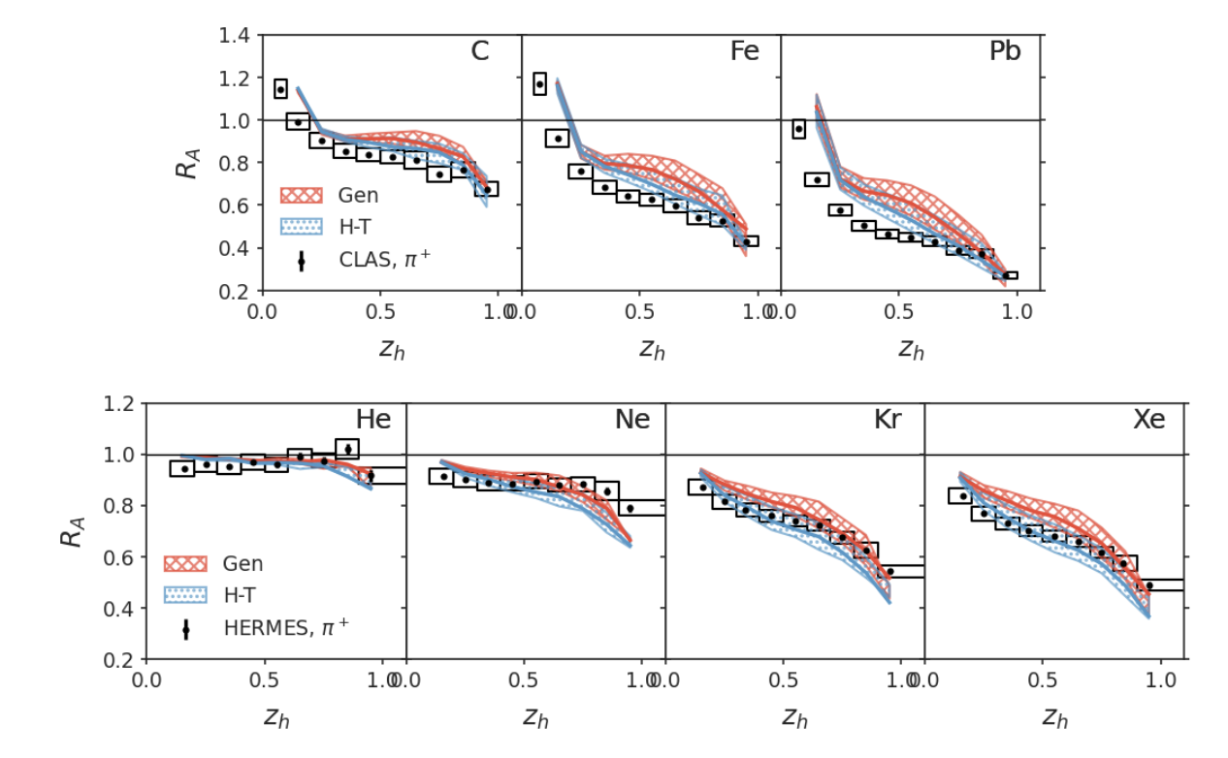
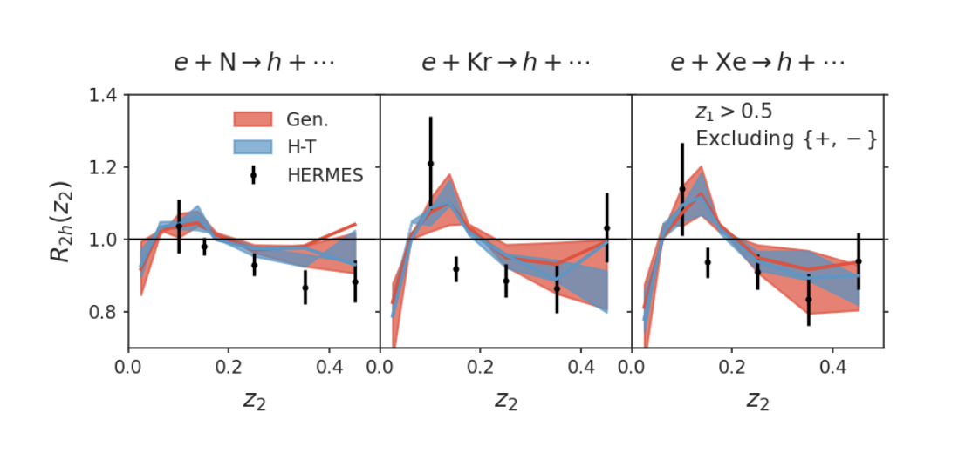
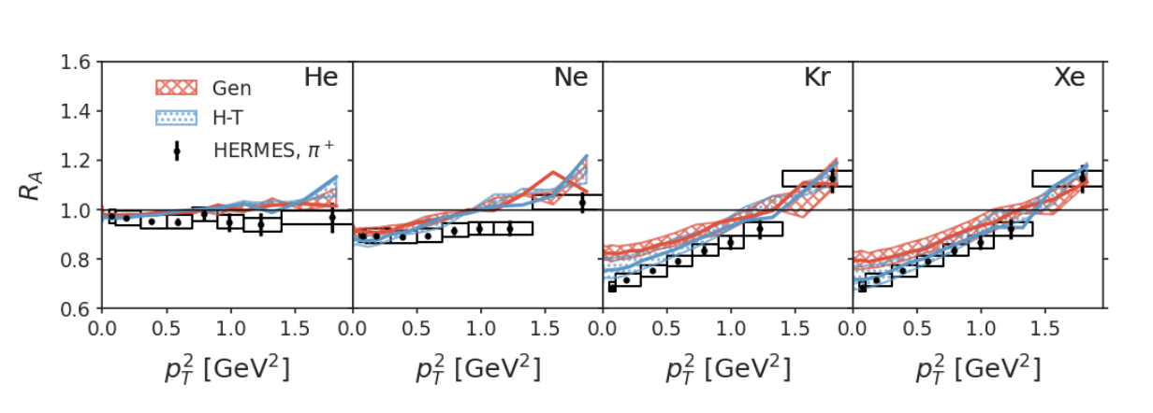
Modification of single and dihadron spectra in EIC
Leading hadron spectra
di-hadron spectra
Leading hadron spectra
Ke, Zhang, Xing and XNW, Phys. Rev. D 110, 034001 (2024)

Slide 12
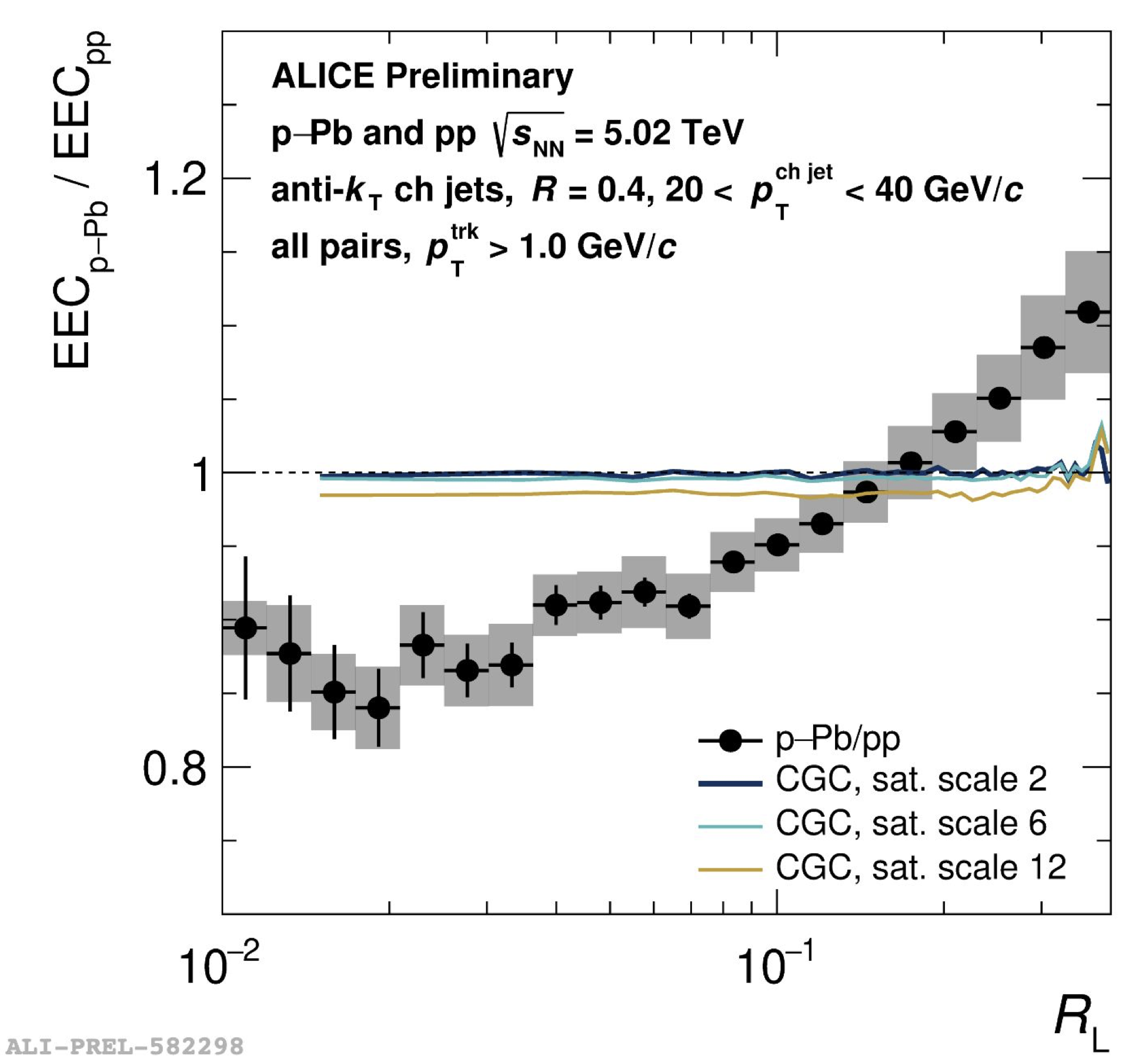
Medium modification of ECC in EIC
Modification mainly caused by momentum broadening
e+A
p + Pb
Y. Ke, XNW and W. Zhao in preparation
Nambrath for ALICE at HP2024

Slide 13
EEC from single emission in QGP
l
k
HT induced emission in a QGP brick:
Yang, He, Moult & XNW, PRL 132 (2024) 1, 011901
Notes:
\frac{d\Sigma^{\rm med}_q}{d\theta} \approx
\frac{ L^{2} \hat{q}}{2 E} \frac{\alpha_\mathrm{s} C_A}{\theta}, \theta> \sqrt{8\pi/EL}
\frac{d\Sigma^{\rm med}_q}{d\theta} \approx \frac{L^3 \hat{q} \alpha_\mathrm{s} C_A \theta}{64\pi}, \theta < \sqrt{8\pi/EL}

Slide 14
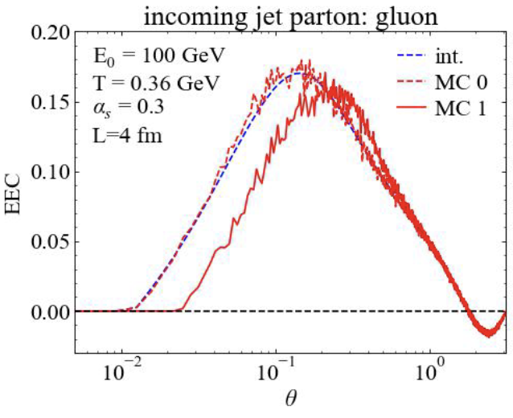
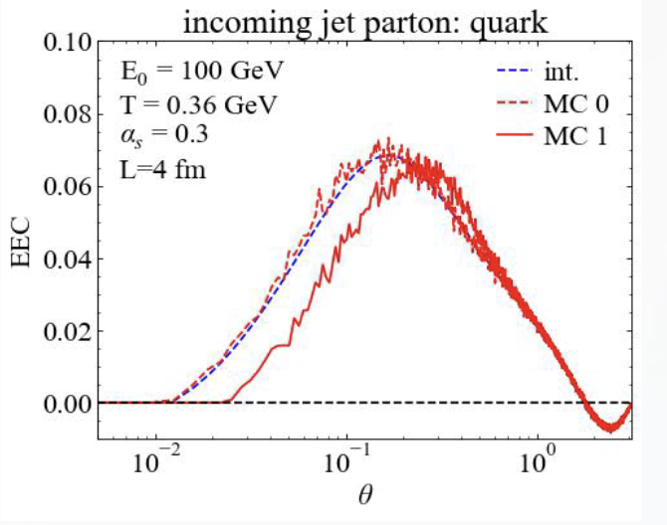
Contributions from medium response
2→ 2 elastic collisions:
1(a)
2(c)
k
Both recoil and
back-reaction (“negative partons”)
3 (d)
(b)
2→ 3 inelastic collisions:
l
θ₁₃
θ₂₃
θ₁₃
k
θ₂₃
Notes:
\frac{d\Sigma^{\rm med}_a}{d\theta}\hspace{-6pt} = \hspace{-6pt}\int dx \sum_{b,(cd)} \int \prod_{i=b,c,d}d[p_i] \times \left[\int d\vec n_{c,d}\delta(\vec n_c\cdot \vec n_d -\cos\theta)E_d f_b(1\pm f_c)(1\pm f_d)\right.\\
\left. - {\color{red} \int d\vec n_{c,b}\delta(\vec n_c\cdot \vec n_b -\cos\theta) E_b f_c(1\pm f_a)(1\pm f_b)}\right] \frac{E_c}{E_a^2}\\
\times \frac{\gamma_b}{2E_a} (2\pi)^4\delta^4(p_a+p_b-p_c-p_d) \left|\mathcal{M}_{ab\rightarrow cd}\right|^2,

Slide 15
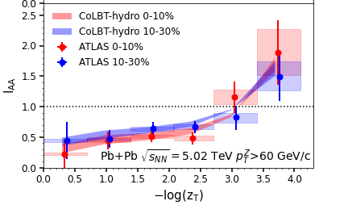
Modification of jets and medium response
r
CoLBT
e-Print: 2101.05422
Notes:
In order to Simultaneous description of hadron and jet RAA need to include jet-induced medium response

Slide 16
EEC of single parton in a QGP brick
Single parton with multiple scattering in a brick in LBT
Debye mass:
We vary only K in sampling the transverse momentum transfer of 2→2 and kinematic limit of gluon bremsstrahlung. We however keep qhat and 2→2 rate unchanged.
Medium response
(recoil + ”negative” partons)
Is (more) important
Yang, He, Moult & XNW, PRL 132 (2024) 1, 011901
Notes:
\mu_D^2=\frac{3}{2} K g^2 T^2

Slide 17
EEC of γ-jets in Pb+Pb Collisions
CoLBT simulations:
Enhancement at large angles by soft hadrons from radiated gluons and medium response, sensitive to pT cuts
EEC by energetic hadrons from leading shower partons at small angles are suppressed, not affected by pT cuts
Yang, He, Moult & XNW, PRL 132 (2024) 1, 011901

Slide 18
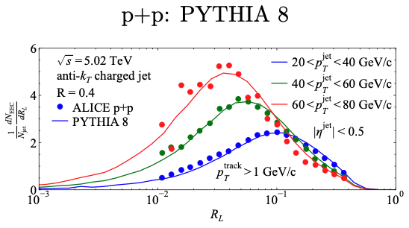
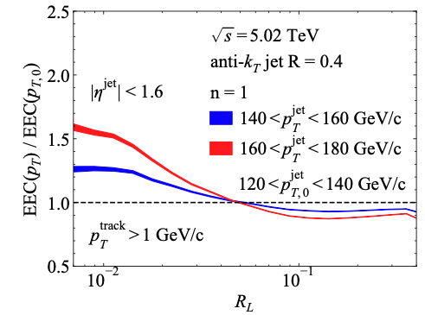
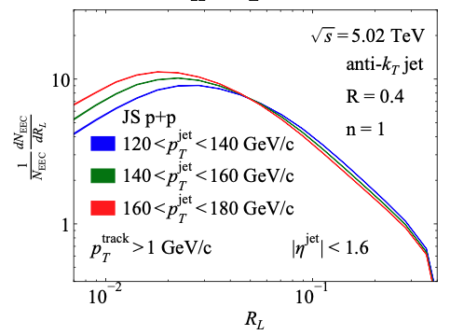
EEC of Single inclusive jets
If 120 GeV jets come from vacuum fragmentation of jets with energy loss from initial 140 or 160 GeV

Slide 19
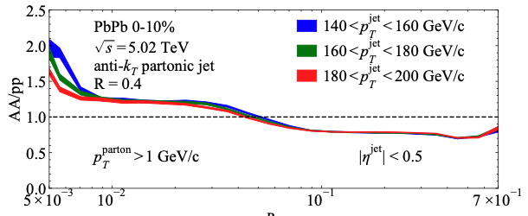
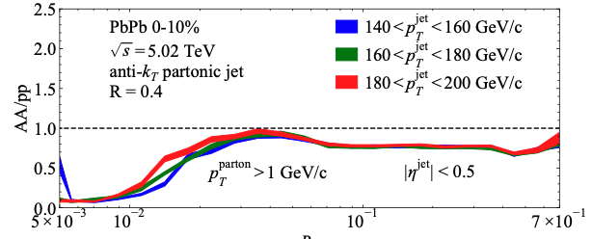
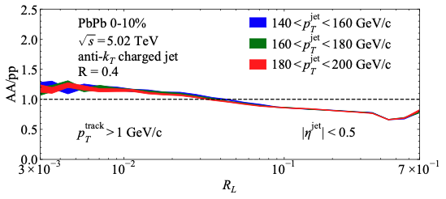
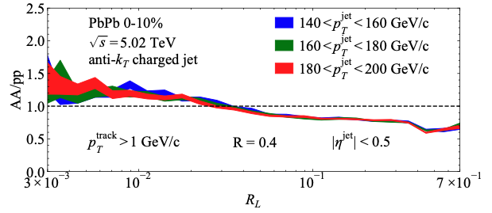
Enhancement due to jets with reduced energy?
With jet splitting outside medium
No jet splitting outside medium
partons
hadrons
Preliminary JETSCAPE
Preliminary JETSCAPE
Effect of hadronization dominates at small angle !

Slide 20
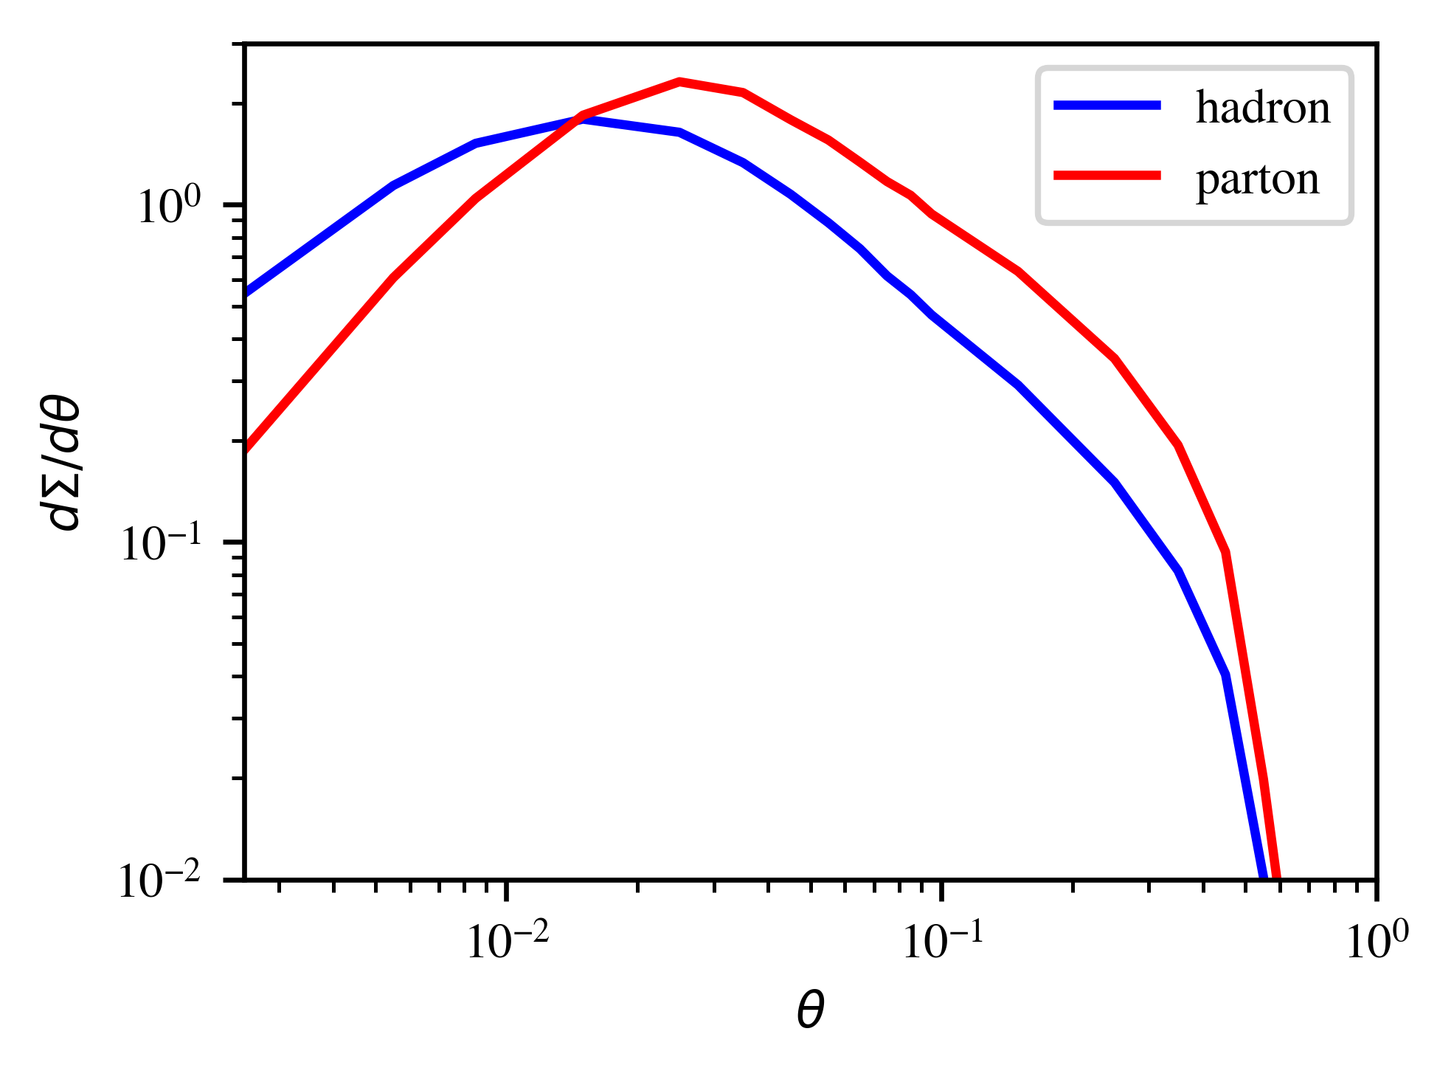
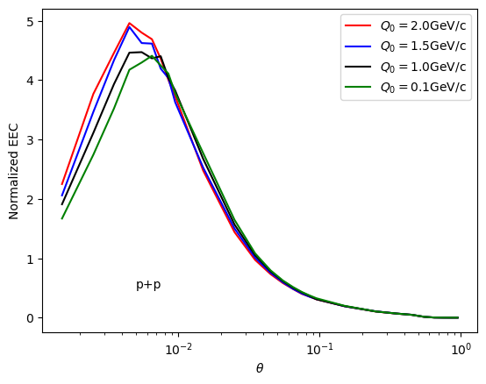
Effects of hadronization
Parton EEC at small angle due to random correlation
Hadron EEC sensitive to hadronization
Pythia γ-jet
p_{T}^{γ}>100 GeV/c
p_{T}^{jet}> 50 GeV/c, R=0.5
JETSCAPE: increase of the hadronization scale Q₀

Slide 21
Single jet EEC from CoLBT
Increased virtuality scale in medium leads to enhancement of EEC at small angle
Medium response leads to enhancement at large angle R_{L}>0.3

Slide 22
Summary
Medium modification of EEC in EIC by pt broadening
Medium-response dominates enhancement of EEC at large angles in heavy-ion collisions which is sensitive to interaction scale in medium
Increased parton scale in medium leads to enhancement of EEC at small anglee

Slide 24
EEC of a jet shower in a QGP brick
A jet shower in a brick in LBT
Initial γ-jet configurations generated from Pythia8
Energy loss and momentum
broadening lead to suppression
at small angles
Radiated gluon and medium response dominate at large angles
Yang, He, Moult & XNW, PRL 132 (2024) 1, 011901

Slide 25
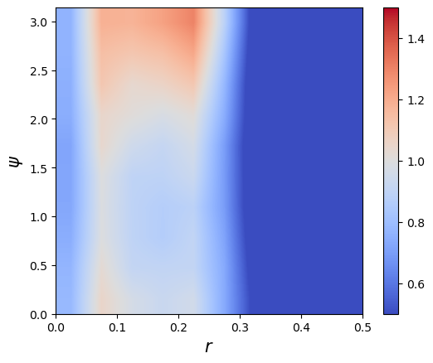
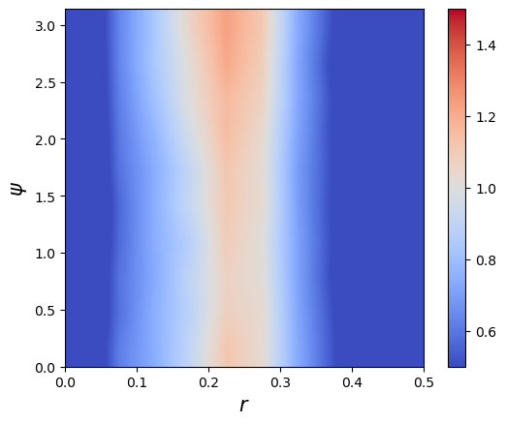
Seeing Mach-cone through 3p Azimuthal Correlation
p+p (γ+jet) p_{T}>40 GeV/c
0-10%Pb+Pb (γ+jet)
ψ
r
)
Back-to-back correlation due to momentum conservation of parton splitting
Azimuthal uniform correlation due to medium-response: Mach-cone – sound velocity?
r=(r1+r2)/2

Slide 26
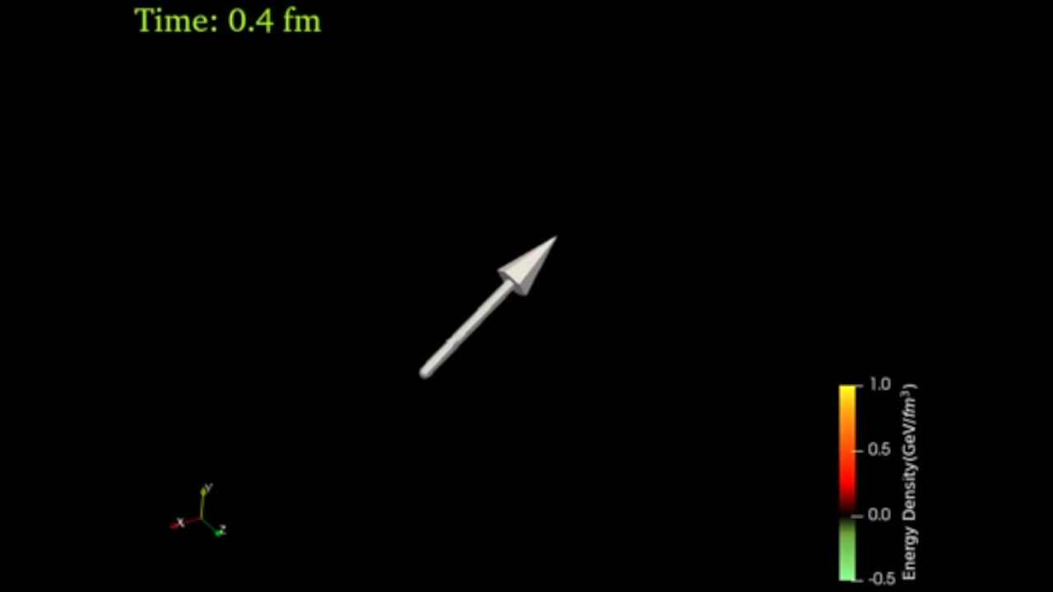
LBT & CoLBT: Jet-induced medium response
x
y
η_{s}
Energy transverse distribution of medium response in a static medium
3D energy density distribution of the medium response induced by a γ-jet in a 0-10% Pb+Pb event
Notes:
f_i(p_i)=\frac{1}{e^{p_i\cdot u/T}\pm 1} (i=2,4)
f_i(p)=(2\pi)^3\delta^3(\vec p_i-\vec p_0)\delta^3(\vec x-\vec x_0-t\vec v_i) [i=1,3]
\frac{dN_g}{dzd^2k_\perp dt}=\frac{2\alpha_s N_c}{\pi k_\perp^4} P(z)
(\hat p\cdot u) \hat q \sin^2(\frac{t-t_0}{2\tau_f})

Slide 27
Linear Boltzmann Transport model
LBT: Linear Boltzmann Transport
Induced radiation
jet parton
pQCD elastic and radiative processes (high-twist)
Transport of medium recoil partons ( and back-reaction)
CLVisc 3+1D hydro bulk evolution
Back-reaction
(particle hole)
recoil parton
He, Luo, Zhu & XNW, PRC 91 (2015) 054908
Notes:
f_i(p_i)=\frac{1}{e^{p_i\cdot u/T}\pm 1} (i=2,4)
f_i(p)=(2\pi)^3\delta^3(\vec p_i-\vec p_0)\delta^3(\vec x-\vec x_0-t\vec v_i) [i=1,3]
\frac{dN_g}{dzd^2k_\perp dt}=\frac{2\alpha_s N_c}{\pi k_\perp^4} P(z)
(\hat p\cdot u) \hat q \sin^2(\frac{t-t_0}{2\tau_f})
p_1\cdot \partial f_1=-\int dp_2dp_3dp_4(f_1f_2-f_3f_4)|M_{12 \rightarrow 34}|^2(2\pi)^4\delta^4(\sum_i p_i) + {\rm inelastic}
\frac{dN_g}{dzd^2k_\perp dt} \approx \frac{2C_A\alpha_s}{\pi k_\perp^4}P(z) \hat q (\hat p\cdot u) \sin^2\frac{k_\perp^2 (t-t_0)}{4z(1-z)E}

Slide 28
CoLBT-hydro
(Coupled Linear Boltzmann Transport hydro)
Concurrent and coupled evolution of bulk medium and jet showers
LBT for energetic partons (jet shower and recoil)
Hydrodynamic model for bulk and soft partons: CLVisc
Parton coalescence (thermal-shower)+ jet fragmentation
Hadron cascade using UrQMD
Chen, Cao, Luo, Pang & XNW, PLB777(2018)86
Notes:
\partial_\mu T^{\mu\nu}(x) = j^\nu (x)
\delta f(p,x) \ll f(p,x)
j^\nu(x) = \sum_i p^\nu_i \delta^{(4)}(x-x_i) \theta(p^0_{cut}-p\cdot u)
j^\nu(x) = \sum_a\int \frac{d^3p}{(2\pi)^3}\frac{p^\nu}{p^0}f_a(p)\theta(p\cdot u - p^0_{cut})
p\cdot \partial f(p) =- C(p) \;\;\; p\cdot u > p_{cut}^0

Slide 29
EEC of dijets
Leading jet
subleading jet
EEC_{leading} – EEC_{subleading} : robust measure of medium modification free of background

Slide 30
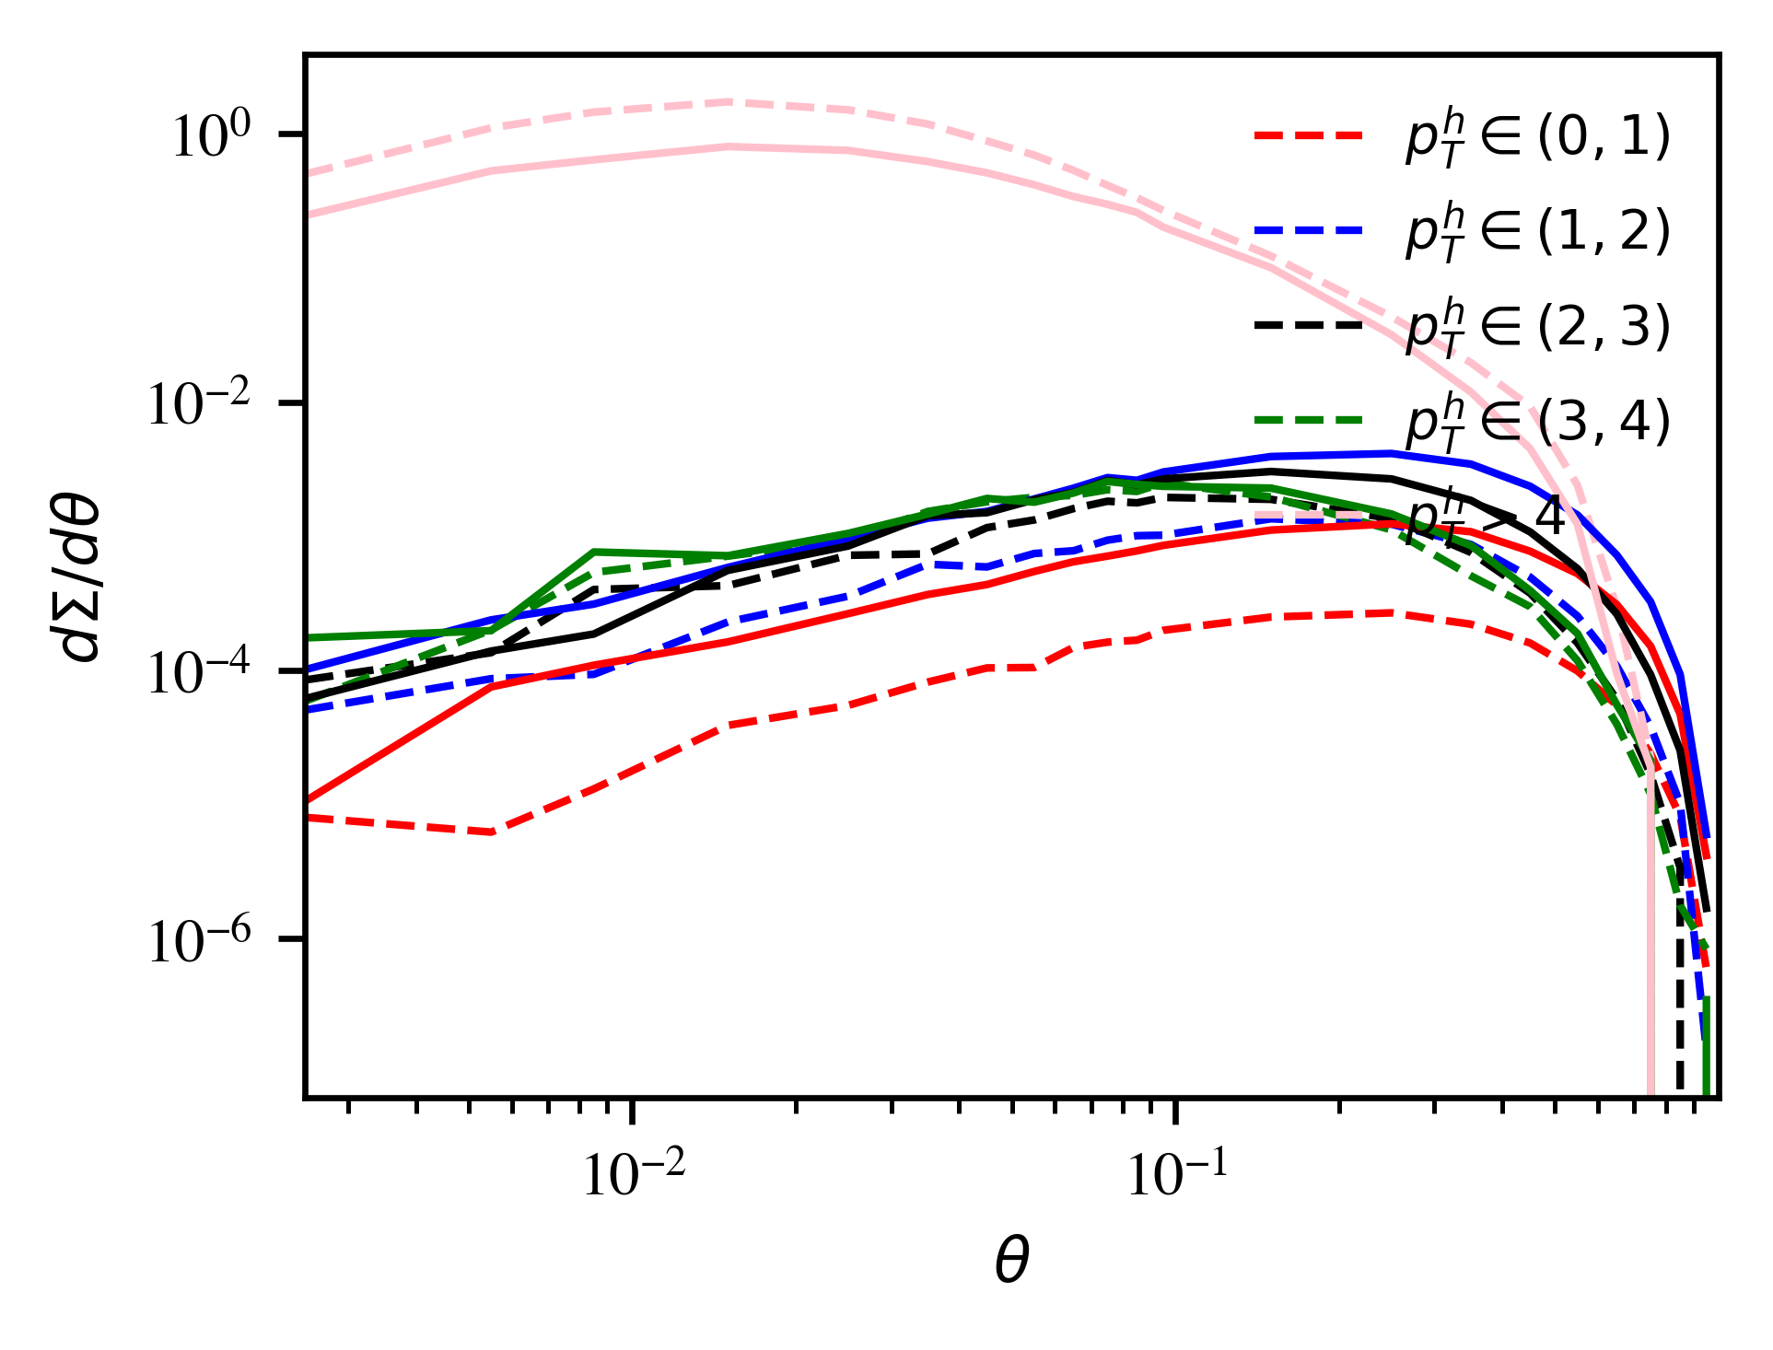
pT dependence of EEC

Slide 31
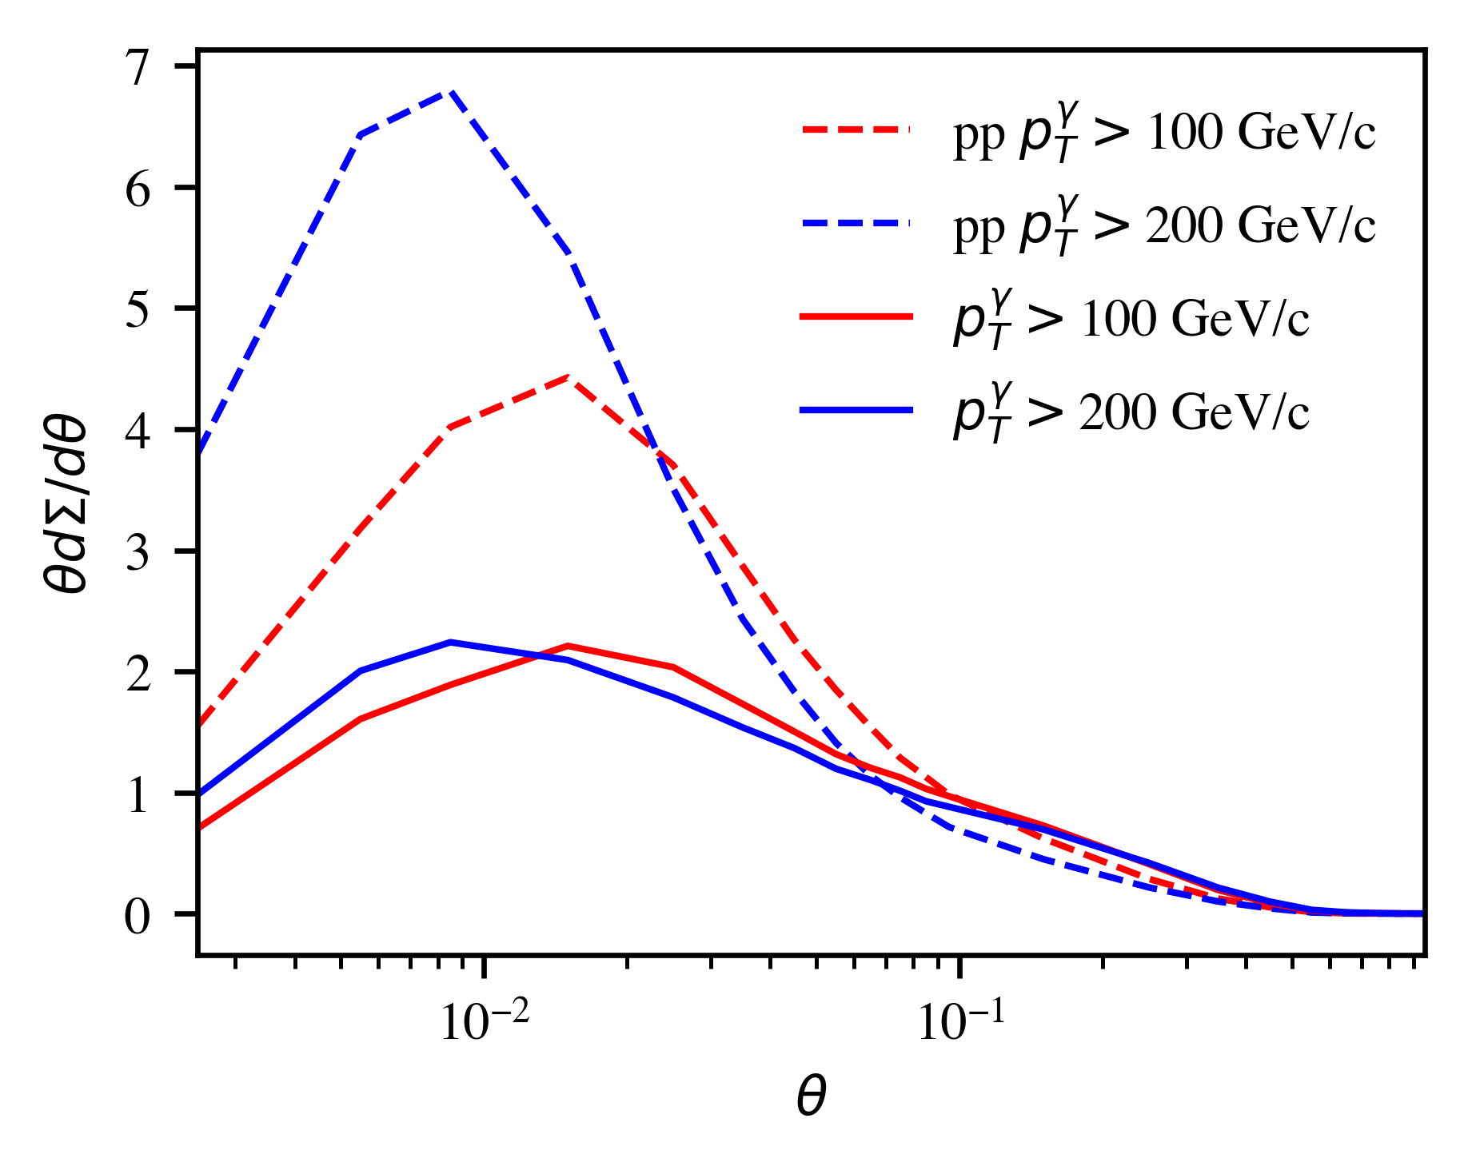
γ energy dependence

Slide 32
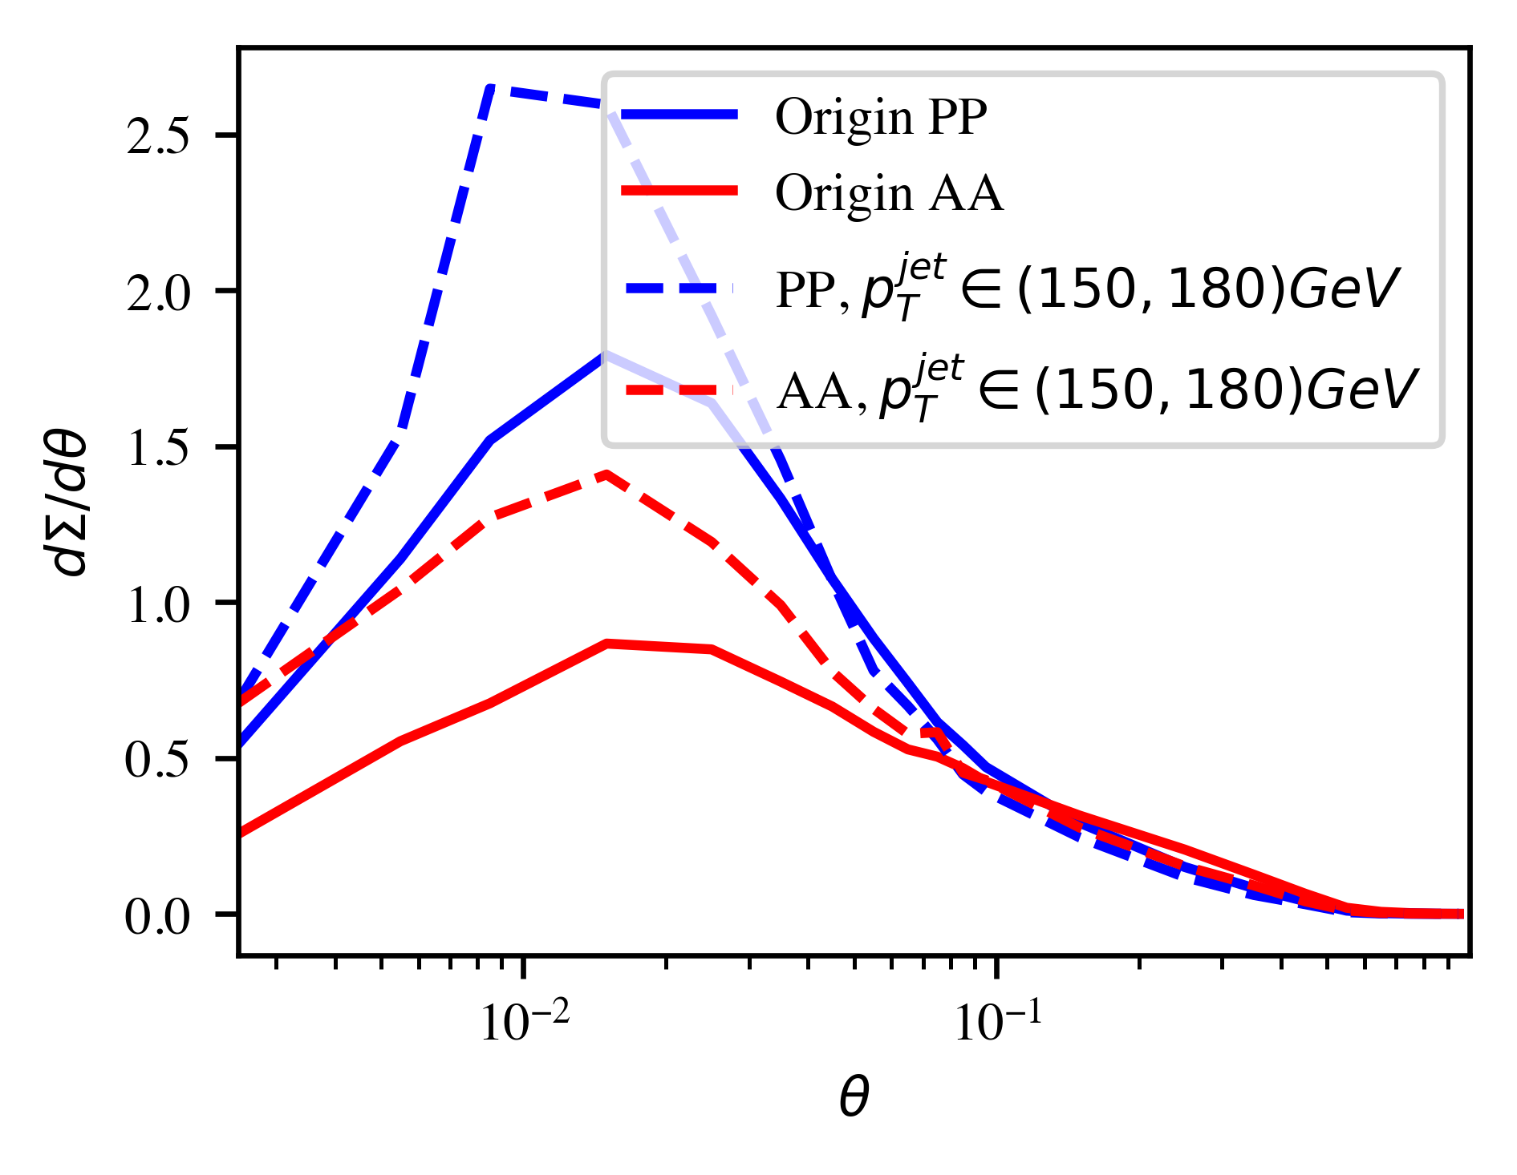
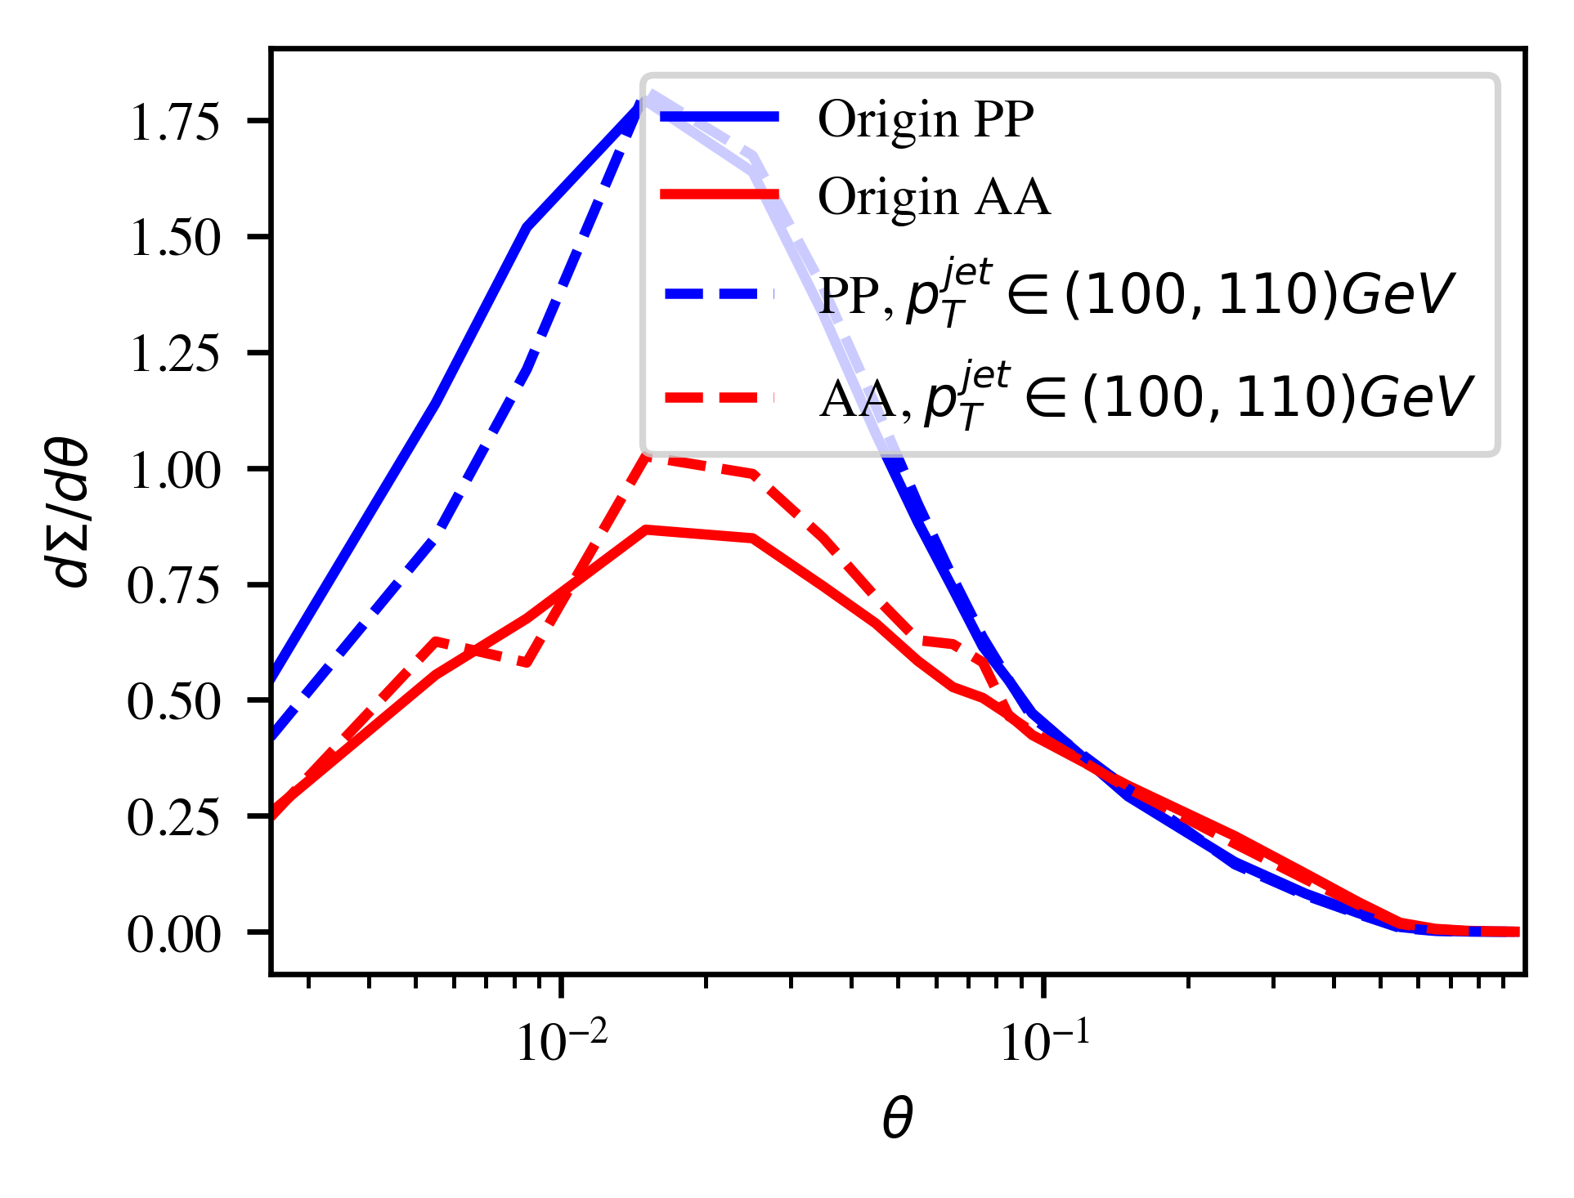
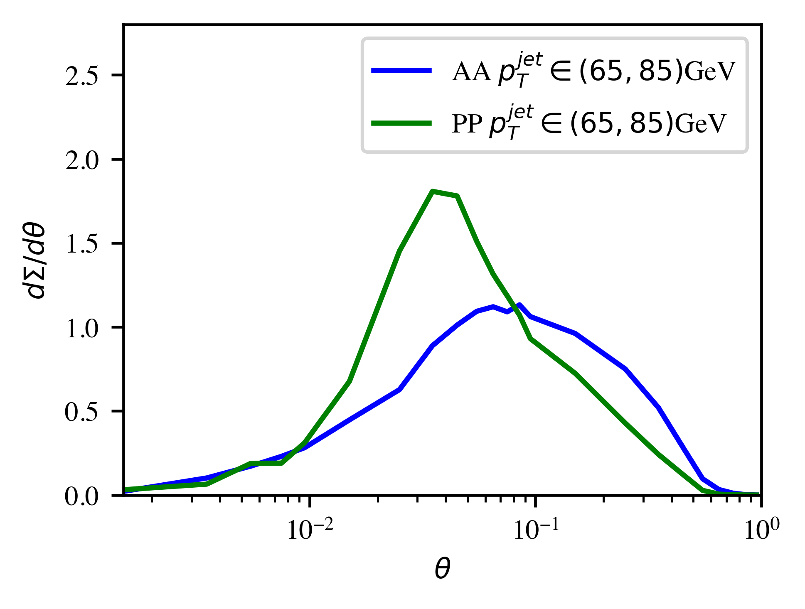
Jet energy dependence

Slide 33
MPI subtraction in Z-hadron correlation
Medium modification of MPI: low pT enhancement and high pT suppression
No correlation with Z/γ-jet
Jet
MPI
Mixed event subtraction

Slide 34
Sensitivity to EoS and shear viscosity
eosq: first order
s95p: rapid crossover from LQCD
Larger effective c_{s} in eosq → :
larger Mach cone angle → shallower DF valley
Stronger radial flow → smaller soft MPI
Competition of:
η/s increase transverse flow → suppression of soft MPI and DF valley
Negative shear correction of longitudinal pressure → impede longitudinal expansion → increase MPI and DF valley

Slide 35
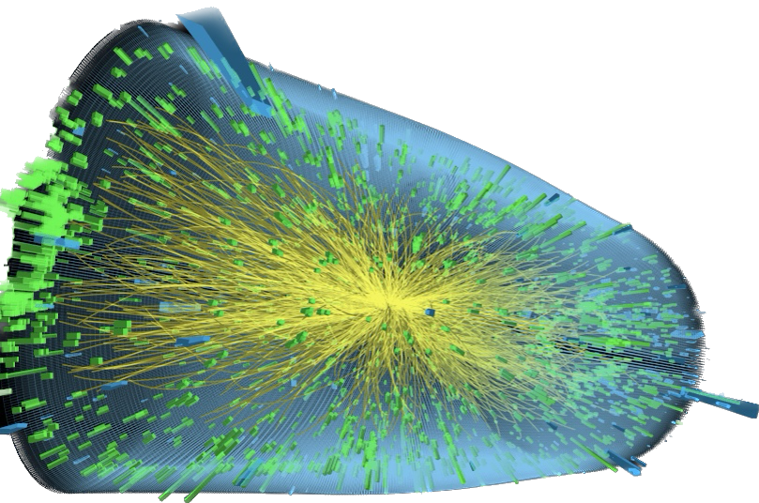
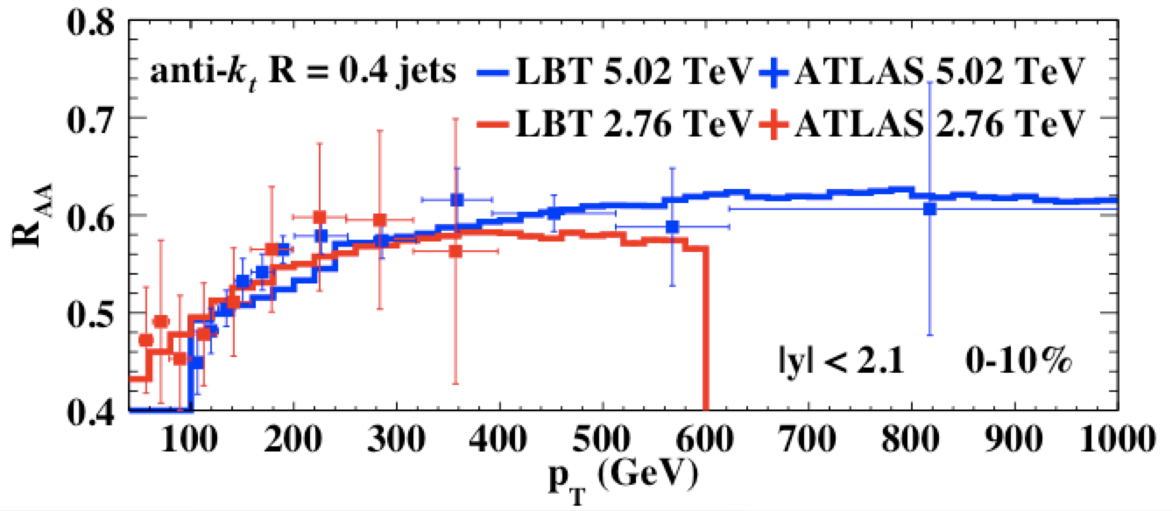
Jet suppression and medium response at LHC
Z-jet
Single inclusive jets
γ-jet
He, Cao, Chen, Luo, Pang & XNW 1809.02525
Zhang, Luo, XNW, Zhang, arXiv:1804.11041
Luo, Cao, He & XNW, arXiv:1803.06785

Slide 36
Gluon spectrum from single emission in GHT
Generalized HT induced emission in a QGP brick:
g(2)
For small angle emission:
a
l
a(1)
k
Change of variable
Notes:
\frac{dN_{g}^{a({\rm GHT})}}{dz d\ell^2_\perp}
= \frac{C_AC_2(R)}{N_c^2-1} \frac{\alpha_s}{2\pi} P_{ag}^{(0)}(z)
\int dy \rho_A(y) \int_0^{Q^2} d^2{\bf k}_\perp \frac{\alpha_s \phi_{g}(x_g, {\bf k}_\perp^2)}{k_\perp^2} \frac{2{\bf k}_\perp \cdot {\bf \ell}}{\ell_\perp^2({\bf \ell}_\perp-{\bf k}_\perp)^2}
\left[1-\cos\frac{y}{\tau_f}\right]
\tau_f =\frac{2z(1-z)E}{(\bf \ell_\perp-\bf k_\perp)^2}
\ell_\perp \ll zE, |\bf k_\perp-\bf \ell_\perp| \ll (1-z)E
\theta_{12}^2\approx 4\frac{(\bf \ell_\perp- z\bf k_\perp)^2}{z^2(1-z)^2E^2} \approx 4\frac{(\bf \ell_\perp- \bf k_\perp)^2}{z^2(1-z)^2E^2}
\int_0^{2\pi} d\phi \frac{\bf k_\perp\cdot\bf \ell_\perp+\bf k_\perp^2}{(\bf \ell+\bf k_\perp)^2}=2\pi \Theta(k_\perp^2-\ell_\perp^2)
\bf \ell_\perp -\bf k_\perp \rightarrow \bf \ell_\perp
\theta_{12} \approx \frac{2 \ell_\perp}{z(1-z)E}
\frac{d\Sigma^{\rm med}_q}{d\theta} =\frac{{L}^{5/2} \hat{q}}{\pi\sqrt{E}} \frac{8\alpha_\mathrm{s} C_A}{(\sqrt{EL}\theta)^3}
\int dz \frac{P_{qg}(z)}{z(1-z)} \left[1-\frac{\sin ELz(1-z)\theta^2/8}{ELz(1-z)\theta^2/8}\right]
\frac{d\Sigma^{\rm med}_q}{d\theta} \approx
\frac{ L^{2} \hat{q}}{2 E} \frac{\alpha_\mathrm{s} C_A}{\theta}, \theta> \sqrt{8\pi/EL}
\frac{d\Sigma^{\rm med}_q}{d\theta} \approx \frac{L^3 \hat{q} \alpha_\mathrm{s} C_A \theta}{64\pi}, \theta < \sqrt{8\pi/EL}

Slide 37
Jet EEC in Vacuum
LO emission in vacuum:
Leading Log evolution:
….
Non-leading log power corrections
Uncorrelated emission at small angle
Notes:
\frac{d\Sigma_q^{\rm vac}}{d\theta} \approx \frac{\alpha_s}{2\pi} C_F
\int_0^1 dz~ z(1-z) P_{qg}(z) \int_{\mu_0^2}^{Q^2} \frac{d{\bf \ell}_\perp^2}{\ell_\perp^2} \delta \left(\theta - \frac{\ell_\perp}{z(1-z)E}\right)
\approx \frac{\alpha_s}{2\pi}\frac{C_F}{2\theta} \left(3-\frac{2\mu_0}{E\theta}\right)\sqrt{1-\frac{4\mu_0}{E\theta}}
\frac{\partial \Sigma_q}{\partial \ln \mu^2} = \frac{\alpha_s(\mu^2)}{2\pi}\left[\gamma_{qq}(3)\Sigma_q +\cdots\right]

Slide 38
EEC in generalized high-twist
With a (GW) static potential model
For large angles
Recover HT results:
Notes:
\hat q=\int dk_\perp^2 \phi(0, k_\perp) \approx \rho \frac{C_2(R)C_2(T)}{N_c^2-1} 4\pi \alpha_s^2 \ln\frac{s^*}{4\mu_D^2}
\frac{d\Sigma^{\rm med}_q}{d\theta} =\frac{{L}^{5/2} }{\pi\sqrt{E}} \frac{\hat{q}}{\ln\frac{s^*}{4\mu_D^2}}\frac{8\alpha_\mathrm{s} C_A}{\theta\sqrt{EL}}
\int dz \frac{z(1-z)P_{qg}(z)}{z^2(1-z)^2\theta^2EL+4\mu_D^2} \left[1-\frac{\sin ELz(1-z)\theta^2/8}{ELz(1-z)\theta^2/8}\right]
\frac{d\Sigma^{\rm med}_q}{d\theta} =\frac{{L}^{5/2} \hat{q}_{HT}}{\pi\sqrt{E}} \frac{8\alpha_\mathrm{s} C_A}{(\sqrt{EL}\theta)^3}
\int dz \frac{P_{qg}(z)}{z(1-z)} \left[1-\frac{\sin ELz(1-z)\theta^2/8}{ELz(1-z)\theta^2/8}\right]

