Slide 1



Overview:
Spin Working Group
Matthew D. Sievert
SURGE 2025
Collaboration Meeting
6/23/2025
M. Sievert
Overview: Spin Working Group
1 / 18

Slide 2
The Proton Spin Budget
Jaffe-Manohar Spin Sum Rule:
Jaffe and Manohar, Nucl. Phys. B337 509 (1990)
Quark Polarization:
Nonlocal generalization of the axial vector current $j_{5}^{μ}=\overline{ψ} γ^{μ}γ^{5}ψ$
Gluon Polarization:
Circular azimuthal correlation of gluon field strengths
M. Sievert
Overview: Spin Working Group
2 / 18

Slide 3
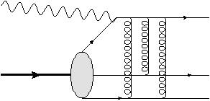
Spin at Large x and Small x
At large x, DIS is dominated by a “Knockout” process
  Polarized and unpolarized scattering occur
  at the same order in large-x kinematics
c.f) Large x: “Knockout” DIS
At small x, the leading channel is a “dipole” process
  The leading-power S-matrix is spin-independent
  Spin at small x is a sub-eikonal degree of freedom
Small x: “Dipole” DIS
Spin at small x selects on sub-eikonal dynamics with access to different quantum numbers
  Spin observables are sensitive to novel small-x physics
M. Sievert
Overview: Spin Working Group
3 / 18

Slide 4
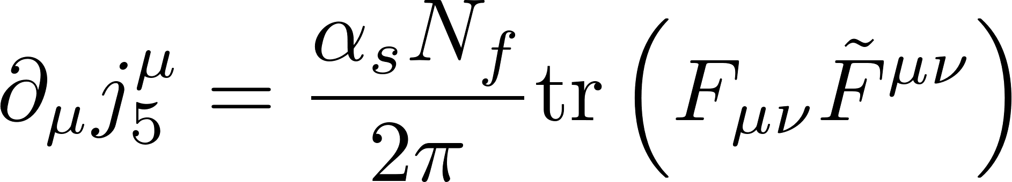
The Roots of Spin are Chiral
Helicity shares an intimate connection with the axial vector current
Jaffe and Manohar, Nucl. Phys. B337 509 (1990)
The total quark helicity leads to a local matrix element of the axial vector current.
Opens the door to nonperturbative contributions from the axial anomaly
A. Tarasov, R. Venugopalan,
Phys. Rev. D100 (2019), D102 (2020), D105 (2022)
M. Sievert
Overview: Spin Working Group
4 / 18

Slide 5
The S-Channel Picture of Spin at Small x
…
Spin-dependent branching
Kovchegov, Pitonyak, M.D.S.,
JHEP 1601 (2016), Phys. Rev. D95 (2017)
Also G. Chirilli, JHEP 1901 (2019)
Generalize the “s-channel” picture of a small-x parton cascade to include spin.
Operators (generalized Wilson lines) describe the S-matrix of polarized partons
Spin information is transmitted to small x by spin-dependent branching
M. Sievert
Overview: Spin Working Group
5 / 18

Slide 6
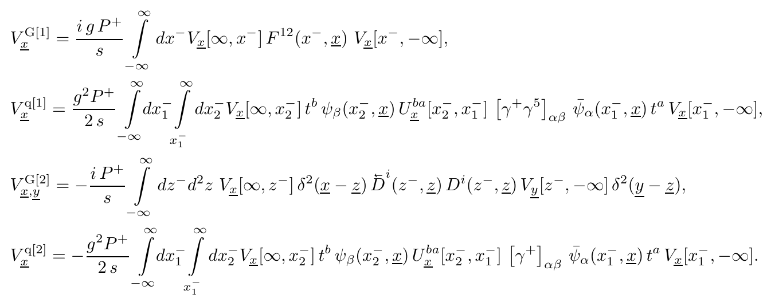
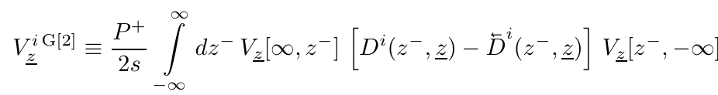
Building Blocks: Polarized + Sub-Eikonal Wilson Lines
Polarized Sub-Eikonal
Unpolarized
Sub-Eikonal
M. Sievert
Overview: Spin Working Group
6 / 18

Slide 7


Beyond Color Transparency and Into the UV
Ladder emissions from the unpolarized Wilson line possess color transparency at short distances
Cancels when $\underline{x_{2}}→\underline{x_{0}}$
But for ladder emissions from the polarized Wilson line, color transparency is violated by spin
Does NOT cancel when $\underline{x_{2}}→\underline{x_{1}}$
M. Sievert
Overview: Spin Working Group
7 / 18

Slide 8
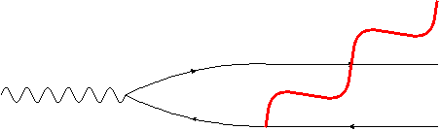
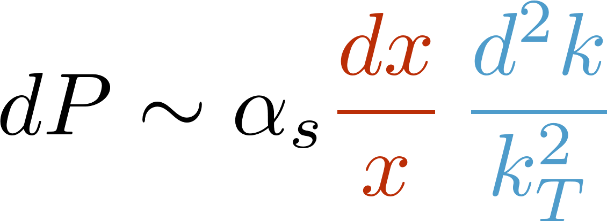

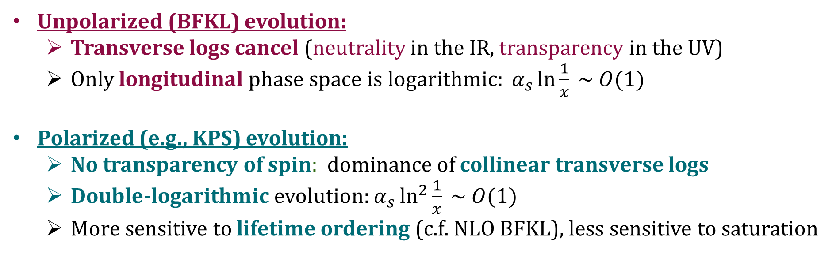
Double-Logarithmic Evolution at Small x
Longitudinal + transverse logarithmic phase space
Long wavelength/IR
Short wavelength/UV
Unpolarized (BFKL) evolution:
  Transverse logs cancel (neutrality in the IR, transparency in the UV)
  Only longitudinal phase space is logarithmic: $α_{s}\ln{\frac{1}{x}} \sim O(1)$
Polarized (e.g., KPS) evolution:
  No transparency of spin: dominance of collinear transverse logs
  Double-logarithmic evolution: $α_{s}\ln^{2}{\frac{1}{x}} \sim O(1)$
  More sensitive to lifetime ordering (c.f. NLO BFKL), less sensitive to saturation
M. Sievert
Overview: Spin Working Group
8 / 18

Slide 9
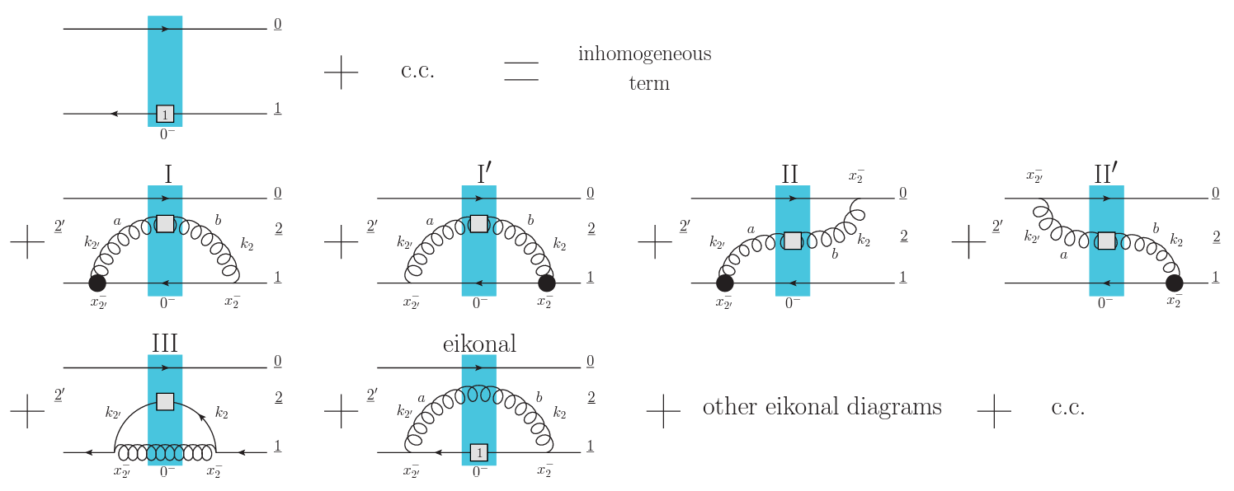
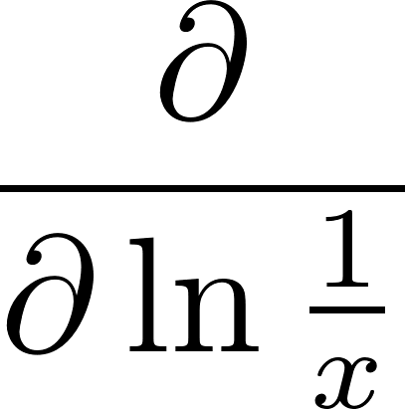


Small-x Helicity Evolution (KPS-CTT)
Includes recoil: KPS-CTT
No recoil: KPS
Spin-dependent
Wilson line
Spin-dependent
splitting vertex
Large Nc: Gluon dipoles only
Large Nc+Nf: Quark + Gluon dipoles
M. Sievert
Overview: Spin Working Group
9 / 18

Slide 10
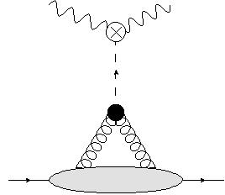
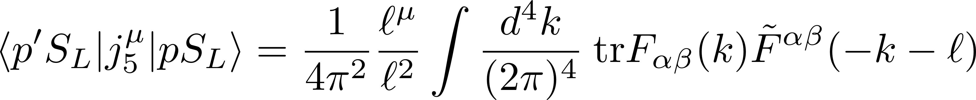
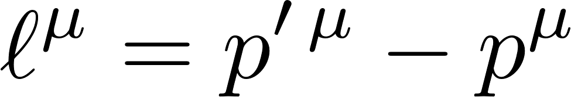
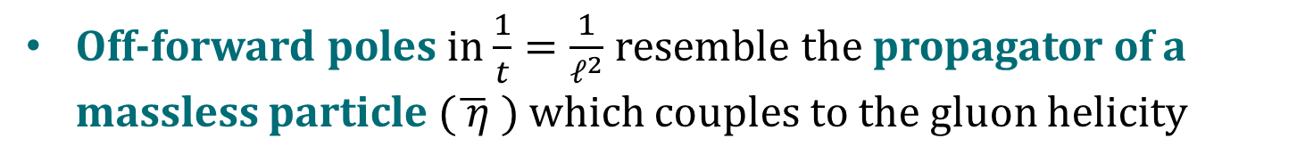
Helicity; Chirality; Anomaly
Proton helicity also couples directly to the axial anomaly
G. Shore and G. Veneziano, Phys. Lett B244 75 (1990);
Nucl. Phys. B381 23 (1992); Nucl. Phys. B516 333 (1998)
S. Bhattacharya, Y. Hatta, W. Vogelsang,
Phys. Rev. D107 (2023), arxiv: 2305.09431
Off-forward poles in $\frac{1}{t}=\frac{1}{ℓ^{2}}$ resemble the propagator of a massless particle $(\overline{ η} )$ which couples to the gluon helicity
A. Tarasov, R. Venugopalan, D102 (2020) 11
The regulation of this exotic pole (not naively captured within collinear factorization) determines the anomaly contribution to the proton spin.
M. Sievert
Overview: Spin Working Group
10 / 18

Slide 11
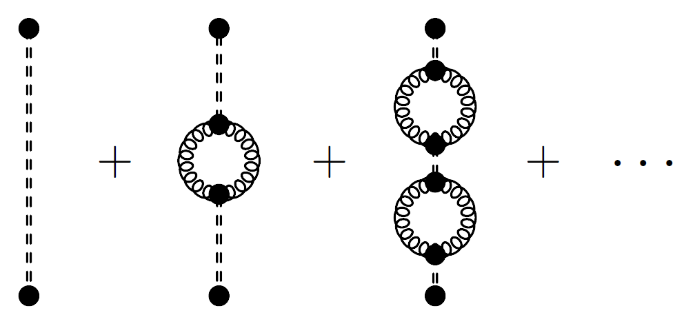
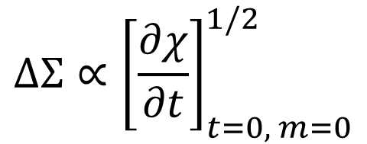
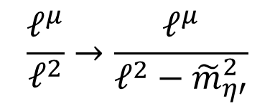
A Topological Interpretation of the Proton Spin
J. Wess, B. Zumino, Phys. Lett. B37 1 (1971) 95
The coupling of the axial charge density to the “primordial isosinglet $\overline{η}$” is described by a Wess-Zumino-Witten term in the effective action.
Resumming the 1PI bubbles of the QCD topological susceptibility regulates the
$\frac{1}{t}$ divergence with the $η′$ mass and connects the proton spin to QCD topology
$$ΔΣ∝{\left[\frac{∂χ}{∂t}\right]}_{t=0, m=0}^{1/2}$$
$$\frac{ℓ^{μ}}{ℓ^{2}}→\frac{ℓ^{μ}}{ℓ^{2}−{\tilde{m}}_{η′}^{2}}$$
A. Tarasov, R. Venugopalan, D105 (2022) 1
M. Sievert
Overview: Spin Working Group
11 / 18

Slide 12
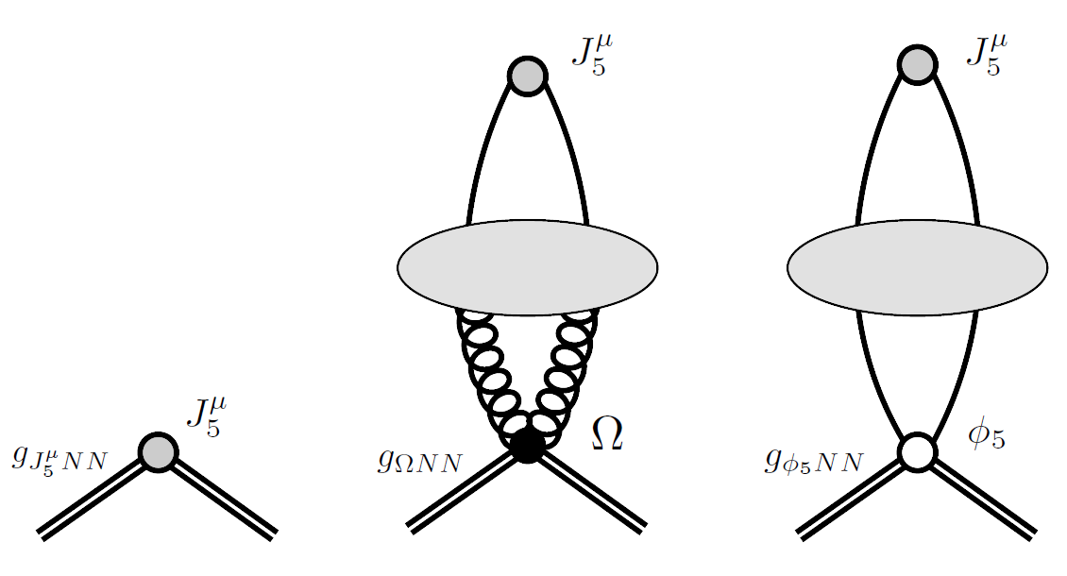
Beyond the Chiral Limit
New calculation revisits the previous anomaly calculations and includes explicit masses (away from the chiral limit).
A. Tarasov, R. Venugopalan, D111 (2025) 7
Introduces new couplings (e.g. to the pseudosalar $φ_{5}$) but does not qualitatively change the conclusions.
Interpretation of nonlinear / saturation effects in the proton spin as evidence of topological sphaleron physics.
M. Sievert
Overview: Spin Working Group
12 / 18

Slide 13
Spin Working Group: Timeline and Objectives
 | Future | Y2 | Y1
CTT Recoil Operator Correction |  |  | X
Large Nc+Nf Evolution |  |  | X
Running Coupling |  |  | X
hMV Initial Conditions |  |  | X
Include Polarized SIDIS Data |  |  | X
Nonlinear Saturation Corrections |  |  | X
Anomaly Theory Development |  | X | X X
Include Polarized pp Data |  | X
Orbital Angular Momentum |  | X
S-Channel Th’y → Global Analysis | X
Anomaly Th’y → Global Analysis | X
M. Sievert
Overview: Spin Working Group
13 / 18

Slide 14
Progress Relative to the Proposal
Year 1:
  Update the helicity dependent MV model (Kovchegov)
  Implement new developments and begin inclusion of SIDIS and polarized p+p collisions data into small-x helicity fits at large-Nc&Nf (Kovchegov, Pitonyak, Sievert)
  Include running coupling corrections into large-Nc & Nf helicity evolution phenomenology (Kovchegov, Pitonyak, Sievert)
  Begin determination of axial anomaly contribution to g1 and SIDIS (Venugopalan, Hatta)
Year 2:
  Finalize inclusion of SIDIS and polarized p+p collision data into small-x helicity fits at large-Nc&Nf with running coupling, interfacing it with the hMV model (Kovchegov, Pitonyak, Sievert)
  Finalize determination of axial anomaly contribution to g1, g2 and SIDIS (Venugopalan, Hatta)
M. Sievert
Overview: Spin Working Group
14 / 18

Slide 15
Recent Progress: Polarized Gluon Production in pA
+…
Moving beyond deep inelastic scattering, a first calculation of the gluon channel in polarized pA scattering has been performed.
Y. Kovchegov, M. Li, JHEP 5 (2024) 177
Result expressed in a symmetric form for use even for symmetric collisions like polarized pp scattering.
M. Sievert
Overview: Spin Working Group
15 / 18

Slide 16
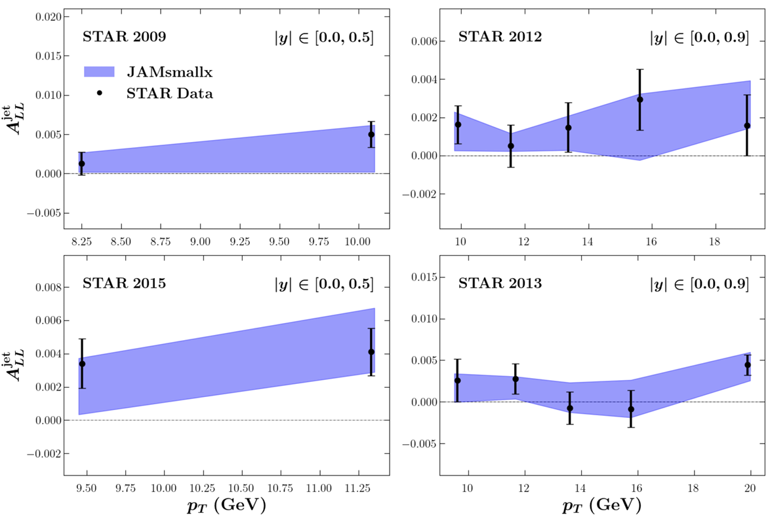
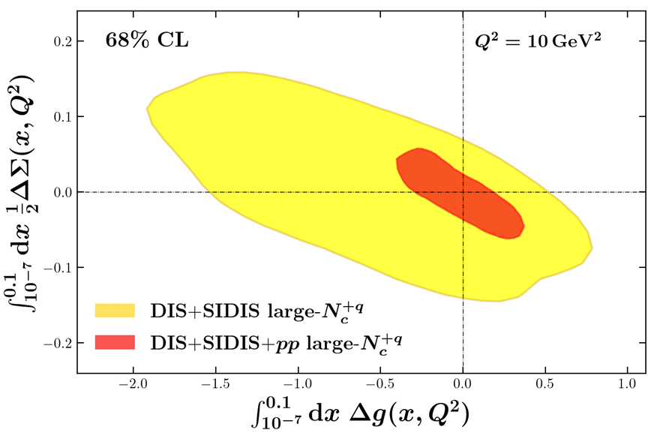
Recent Progress: Polarized pp Data and the Proton Spin
D. Adamiak et al., arXiv: 2503.21006
Utilizing this gluon channel to perform a large-Nc (only) analysis including polarized pp data successfully constrains the polarized gluon contribution
Not the final analysis (only gluon channel so far), but shows the constraining power.
M. Sievert
Overview: Spin Working Group
16 / 18

Slide 17
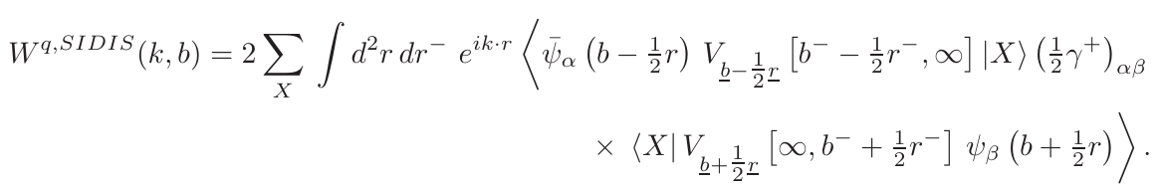


Recent Progress: Refined Treatment of OAM
Orbital angular momentum (OAM) depends not just on the dipole amplitudes,
but on the their impact-parameter weighted moments
With the latest polarized Wilson lines, the small-x asymptotics of OAM are in agreement with previous literature.
Y. Kovchegov, B. Manley,
Phys. Rev. D111 (2025) 5
R. Boussarie, Y. Hatta, F. Yuan,
Phys. Lett. B797 (2019)
M. Sievert
Overview: Spin Working Group
17 / 18

Slide 18
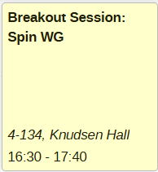

Spin WG Talks at this Collaboration Meeting
11:35 – 12:00
M. Sievert
Overview: Spin Working Group
18 / 18

