Slide 1
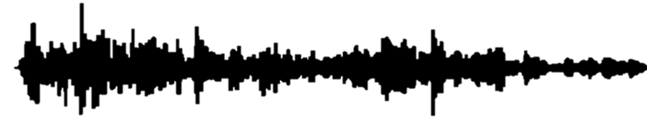
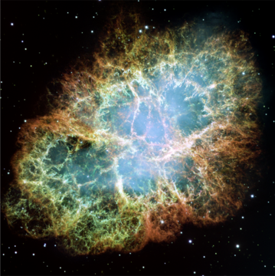



Challenges in the observation of gravitational waves from the collapse of massive stars
Pablo Cerdá-Durán
BH, NS, & GW @ Black Sea - Varna

Slide 2
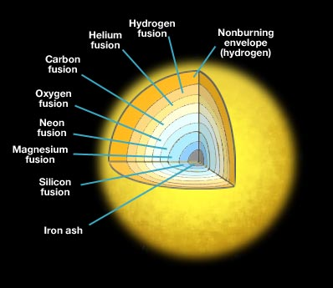
Collapse of massive stars
Massive star : at birth M_{ZAMS} ~ 10-100 M☉
About 1 every million stars is massive
Develop a core of non-burning iron (iron core)
Massive cores (M>M_{Chandrasekhar}) collapse
(core collapse)

Slide 3
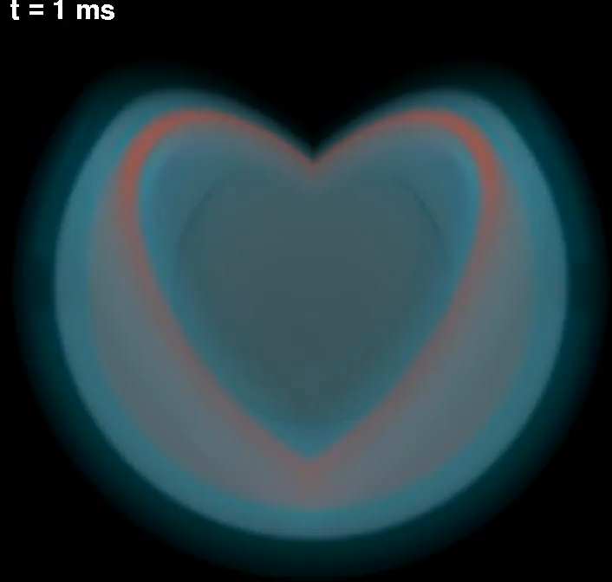
~100 km
Iron core
Hammer et al 2010
3D simulation
15.5 M☉ progenitor
color= entropy
Blue surface=shock front

Slide 4
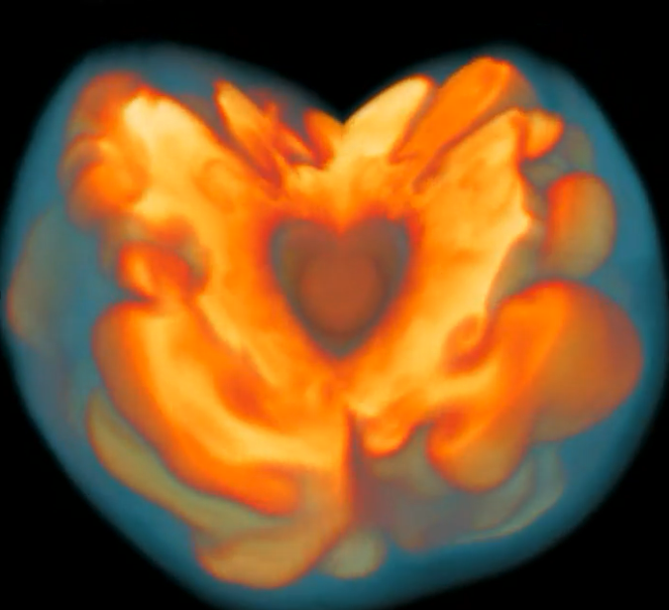
~100 km
Neutrinos
Collapsing star
~10-30 km
PNS
Stalled accretion shock
PNS = Proto-neutron star

Slide 5
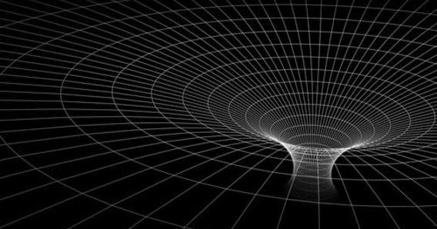
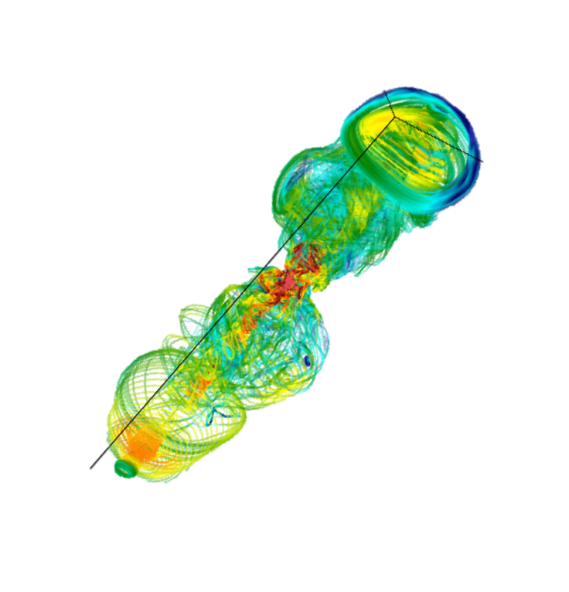
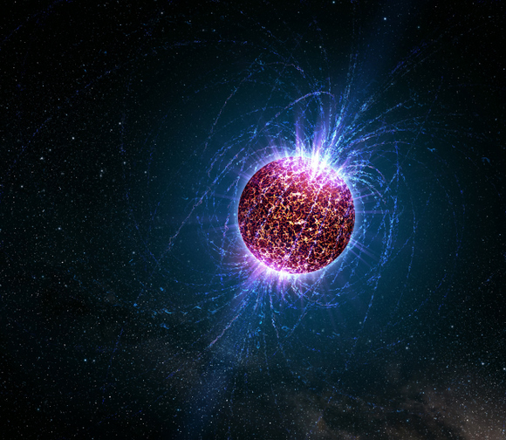
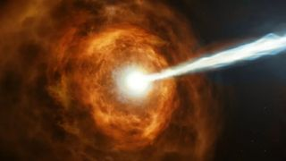
Neutrino driven supernovae
  Rate: ~2/century @ Milky Way
  Remnant: NS (~1.2-2 M ☉)
Progenitor mass
Metallicity
Core rotation
Black hole formation
Rate: ~3-4/1 000 yr @ Milky Way (15-20%)
Remnant: BH (~10-50 M ☉ ?)
Magneto-rotational explosion
Rate: <2/10 000 yr @ Milky Way (<1%)
Remnant: NS or BH
Supernovae producing magnetar
Rate: <2/1 000 yr @ Milky Way (~10%?)
Remnant: magnetar
Long GRB
Rate: <1/10 000 yr @ Milky Way (<1%)
Remnant: BH?

Slide 6
Development of instabilities
PNS core convection
Hot-bubble convection
SASI
GWs
Non-spherical perturbations of the
proto-neutron star
GW emission

Slide 7
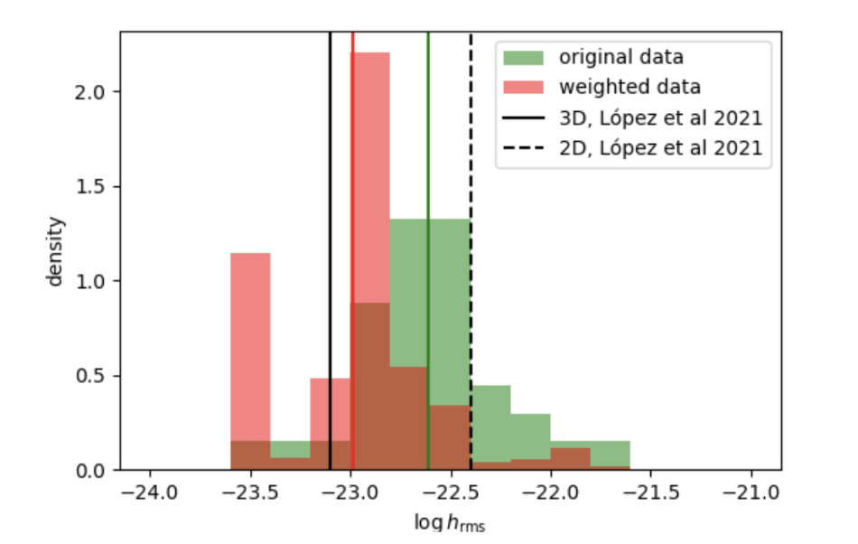
Highly stochastic
(one progenitor – multiple realizations)
Matched filtering not possible
Strain amplitude @ 10 kpc
Slow rotation: ~10⁻²³
Fast rotation: ≲10⁻²¹
Torres-Forné et al 2019
CD in 2025

Slide 8
Excitation of PNS oscillation modes (p, g, f, SASI)
Torres-Forné et al 2019

Slide 9
Can we detect GW from core collapse events?

Slide 10
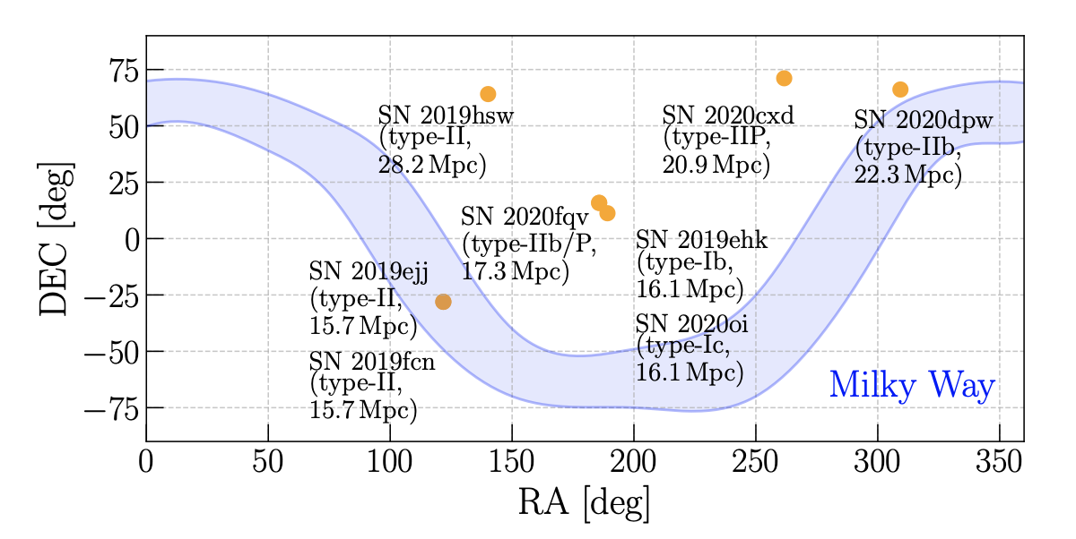
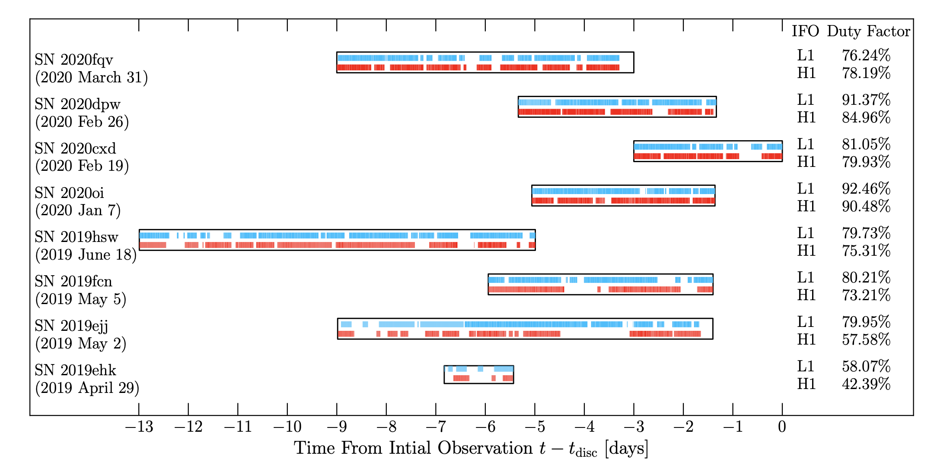
LVK searches
Sky localization of SNe during O3
On source windows for SNe during O3
arXiv:2305.16146
Unmodelled search algorithms (excess power): cWB
Searches (O1, O2, O3):
  Targeted (SN within 30 Mpc)
  All-sky
No detection (not expected)
Closest SN: 6.7 Mpc (during O2)
Horizon distance:
  ~10 kpc (neutrino-driven)
  ~100 kpc (magnetorotational)

Slide 11
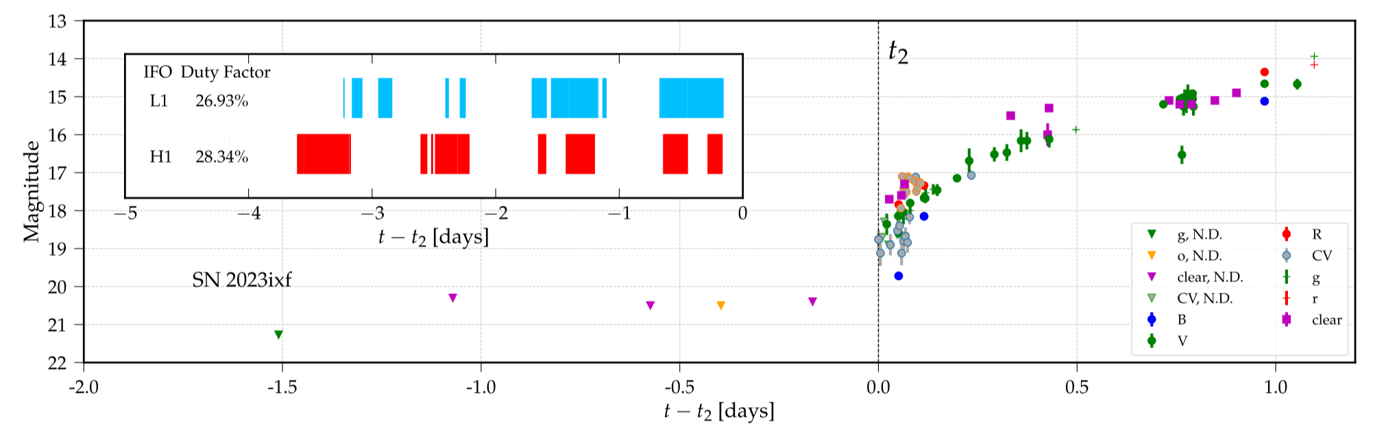
LVK searches
SN2023ixf at M101 (6.7 Mpc)
15th engineering run
arXiv:2305.16146
Abac et al 2025

Slide 12
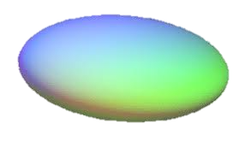
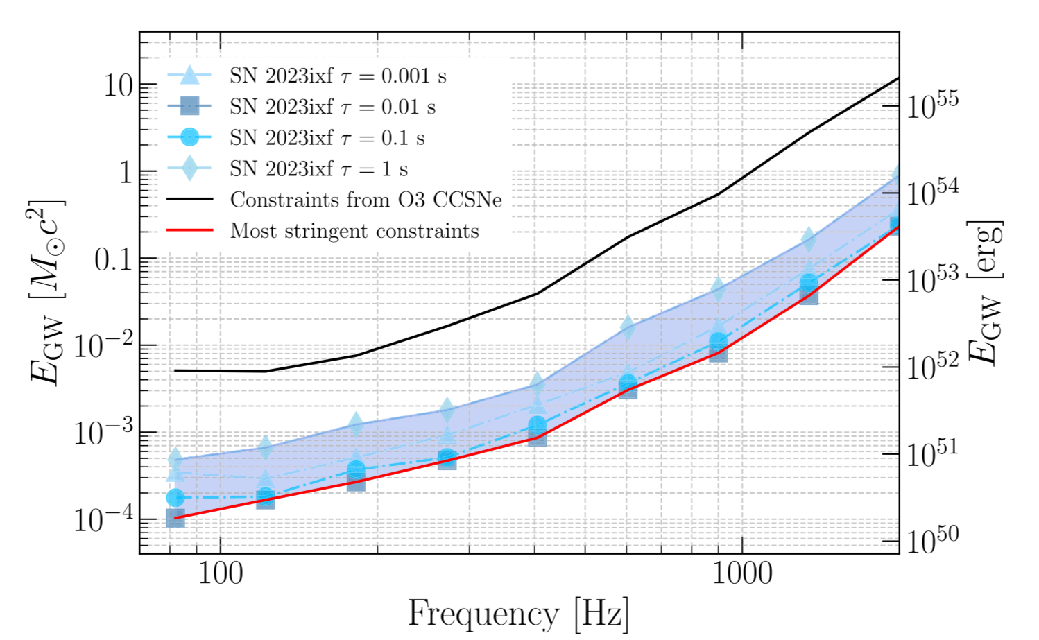
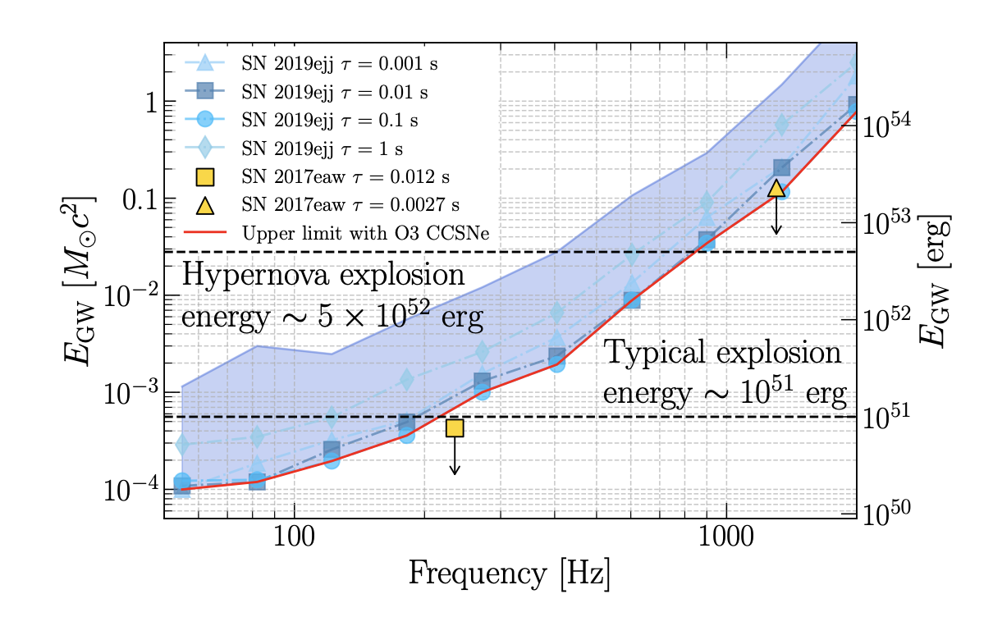
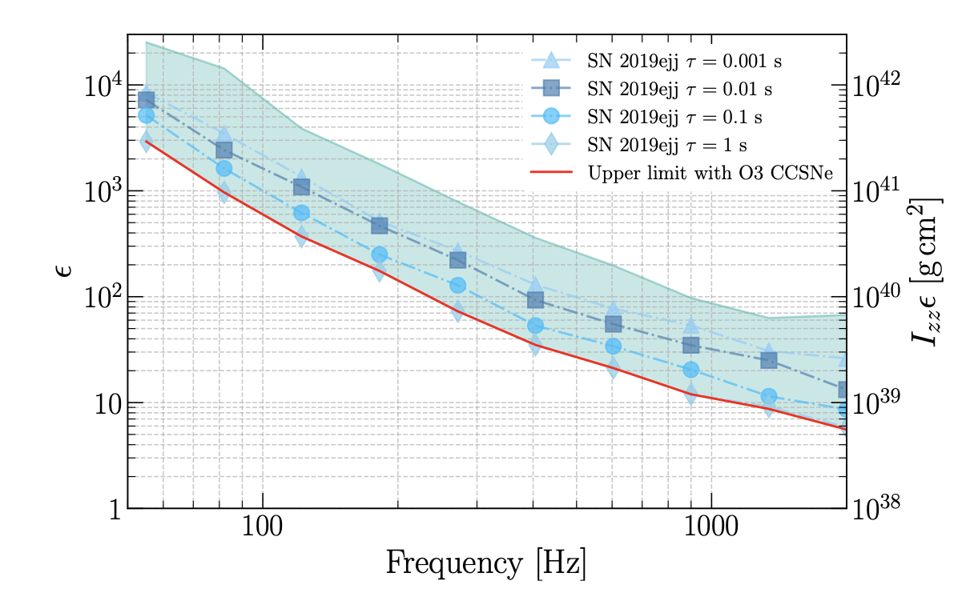
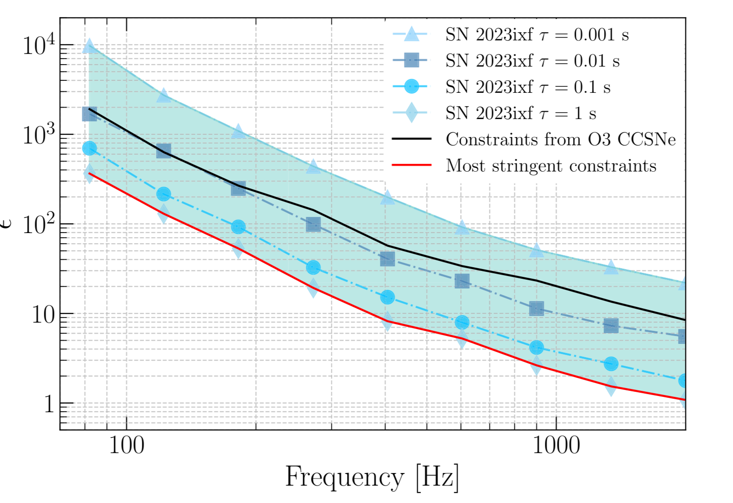
LVK searches
Constraints for bar mode instabilities in the proto-neutron star
Abac et al 2025
Constraint on the GW energy emitted
Constraint on the ellipticity
arXiv:2305.16146
SN2023ixf

Slide 13
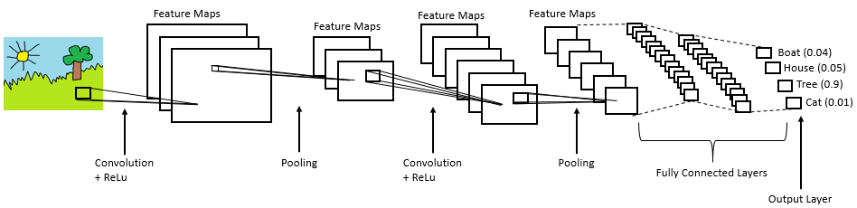
Detection using machine learning
Complex
input data (e.g. an image)
Machine learning algorithm (e.g. CNN)
Complex
Non-linear
Parametric
Simple output data (e.g. a class)
Example of a typical convolutional neural network (CNN)

Slide 14
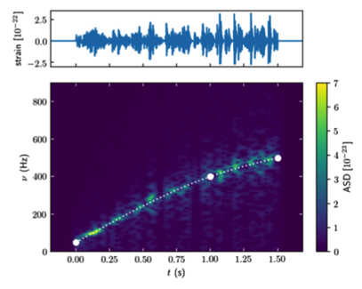
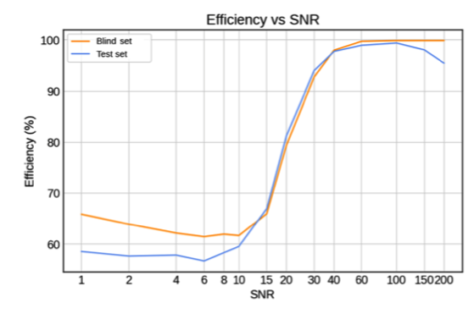
Detection using machine learning
Phenomenological templates (ccphen v3):
  Parametric
  Stochastic
  Mimic CCSNe waveforms
Training:
  no limitation in number of templates
  (~9000 waveforms in López et al 2020)
  Exploration of the parameter space homogeneously
López et al 2020
Detection at SNR~15-20
CNN’s can recognize signals from numerical simulations

Slide 15
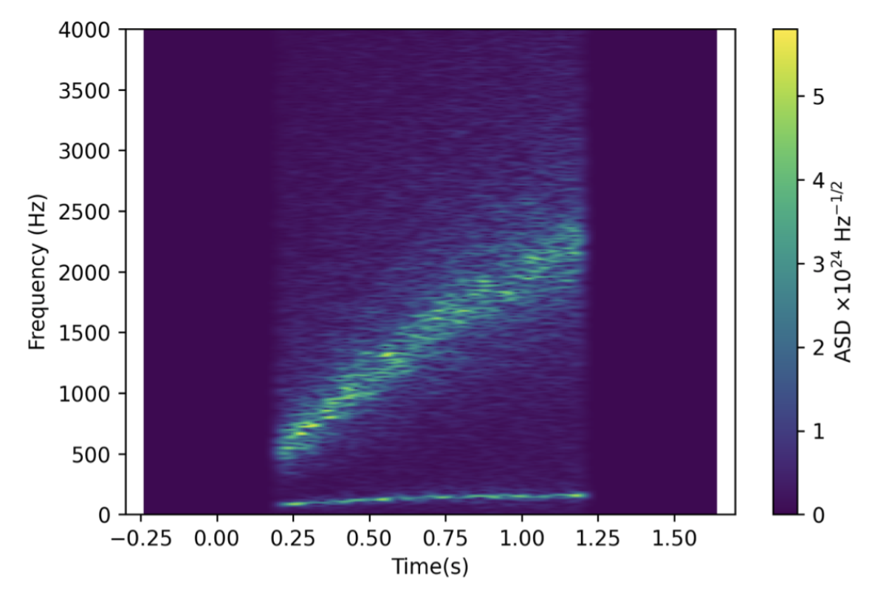
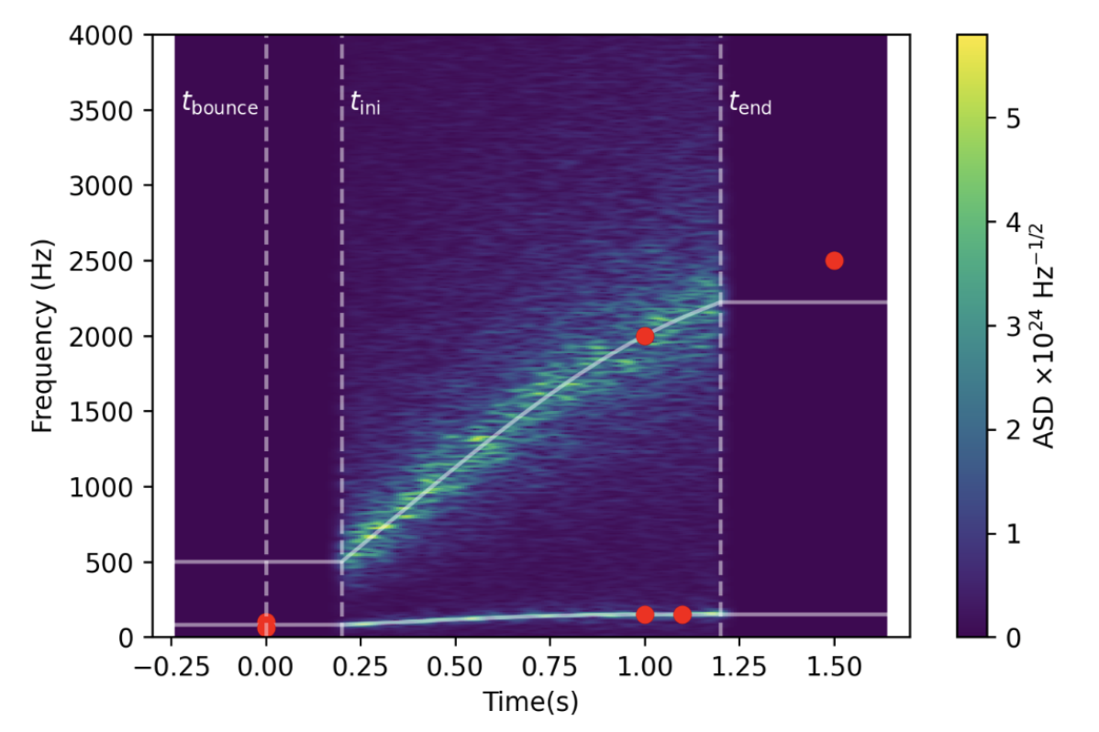
New phenomenological templates
ccphen v4
Non-rotating progenitors (rotation work in progress)
SASI + g-modes
Polarization
Fast: ~4-15 ms per waveform
CD et al 2025

Slide 16
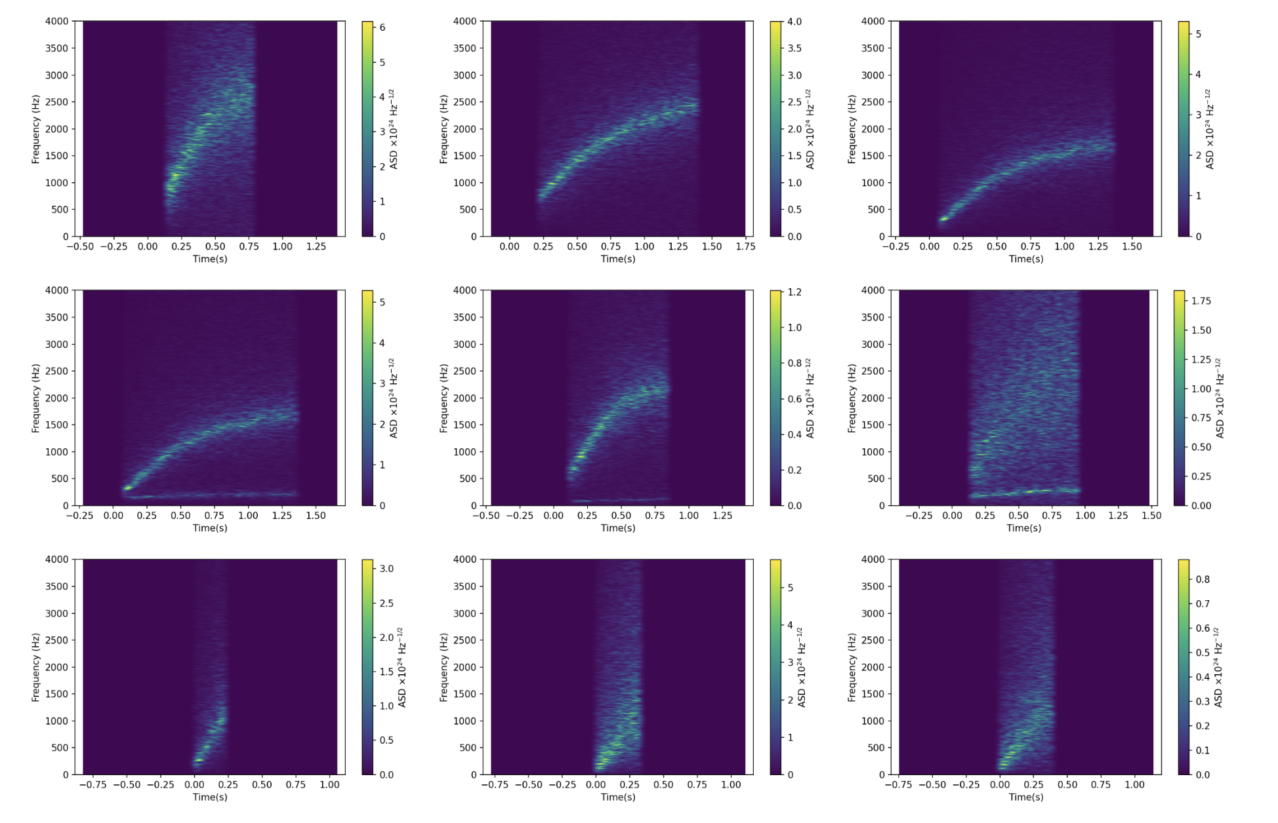
CD et al 2025

Slide 17
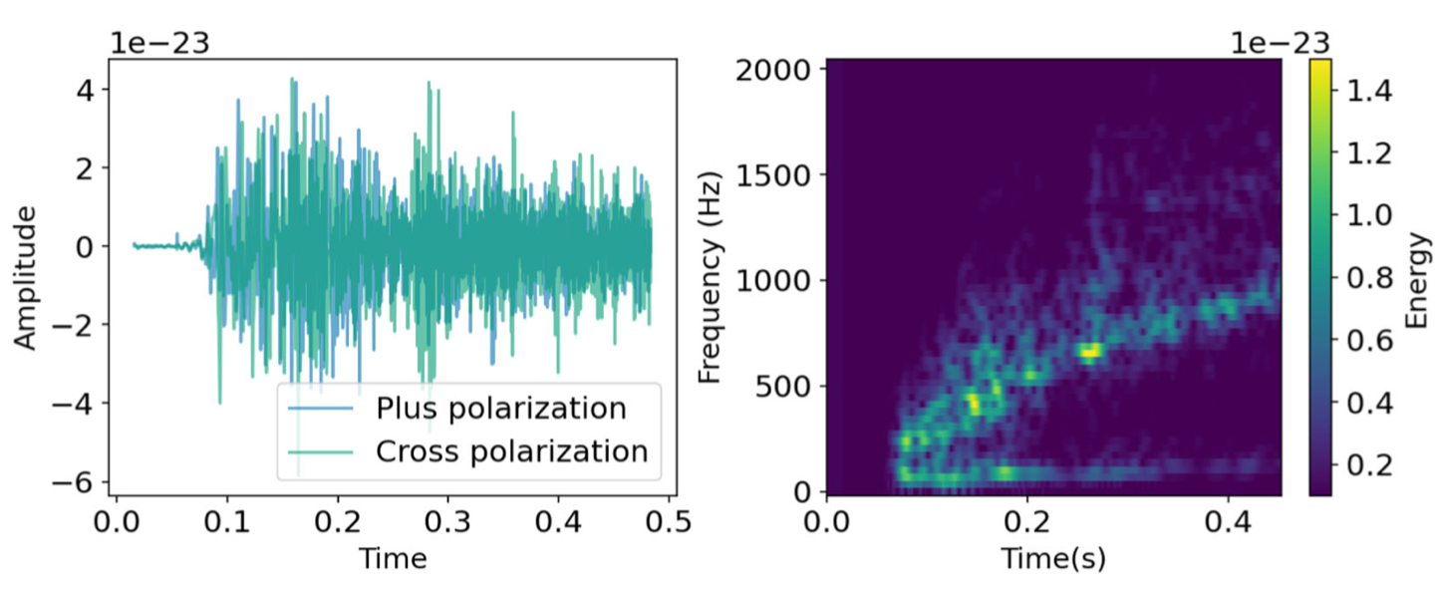
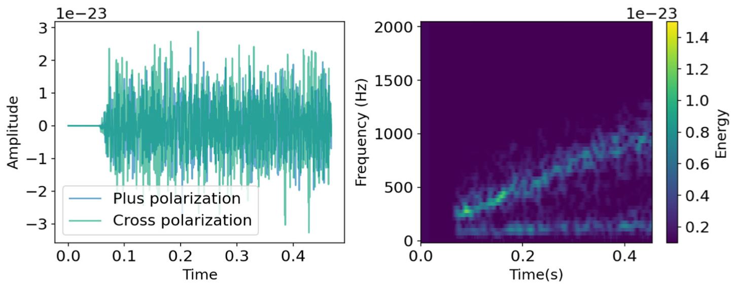
Numerical simulation
Model mesa20_v_LR
(O’Connor & Couch 2018)
ccphen v4
Best fit (MSE spectrograms ~ 0.16)
CD et al 2025

Slide 18
What can we learn from a core-collapse detection?

Slide 19
PNS asteroseismology
₃

Slide 20
PNS asteroseismology
₃
Dominant mode
(g or f mode?)
core g-mode
SASI-mode
GREAT (GR Eigenvalue Analysis Tool)
(Torres-Forné et al 2008, 2009)
Publicly available!
(https://www.uv.es/cerdupa/codes/GREAT)
Calculation of eigenmodes from simulations
Linear perturbation of spherical background

Slide 21
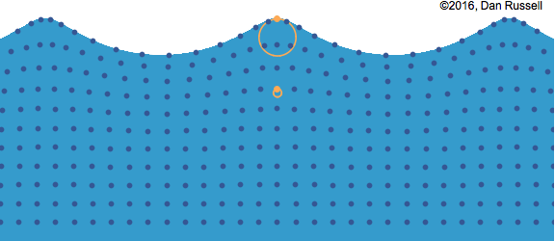
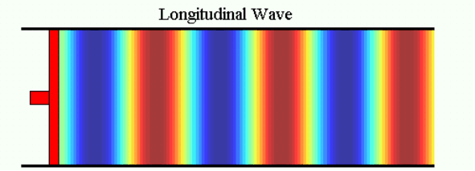
g and p-modes
Gravity (buoyancy) waves vs pressure waves
Transverse waves
Longitudinal waves
g-modes
p-modes

Slide 22
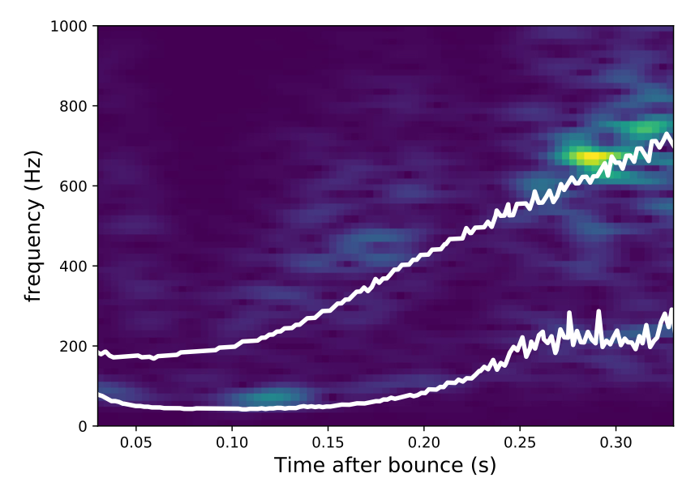
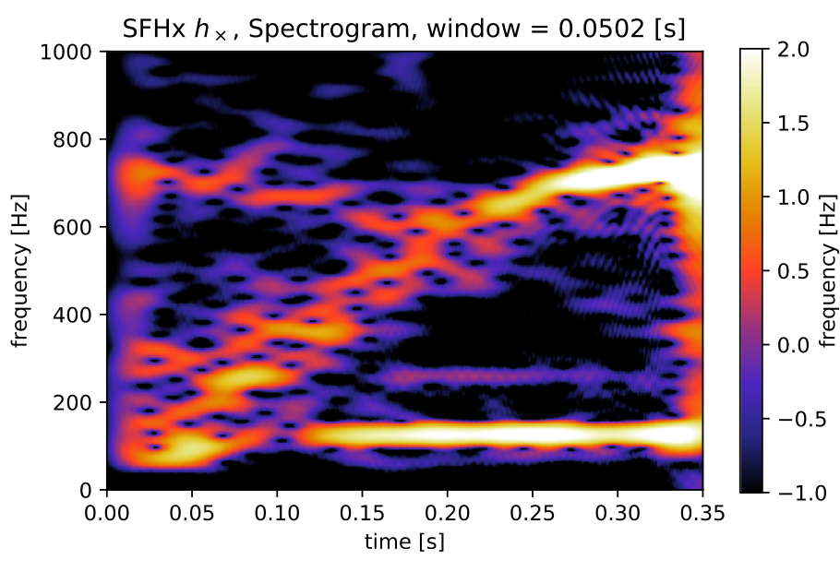
PNS asteroseismology- SASI
Powell et al 2021
Kawahara et al 2018
(Kuroda et al 2016 simulation)

Slide 23
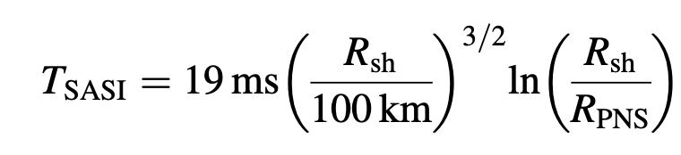
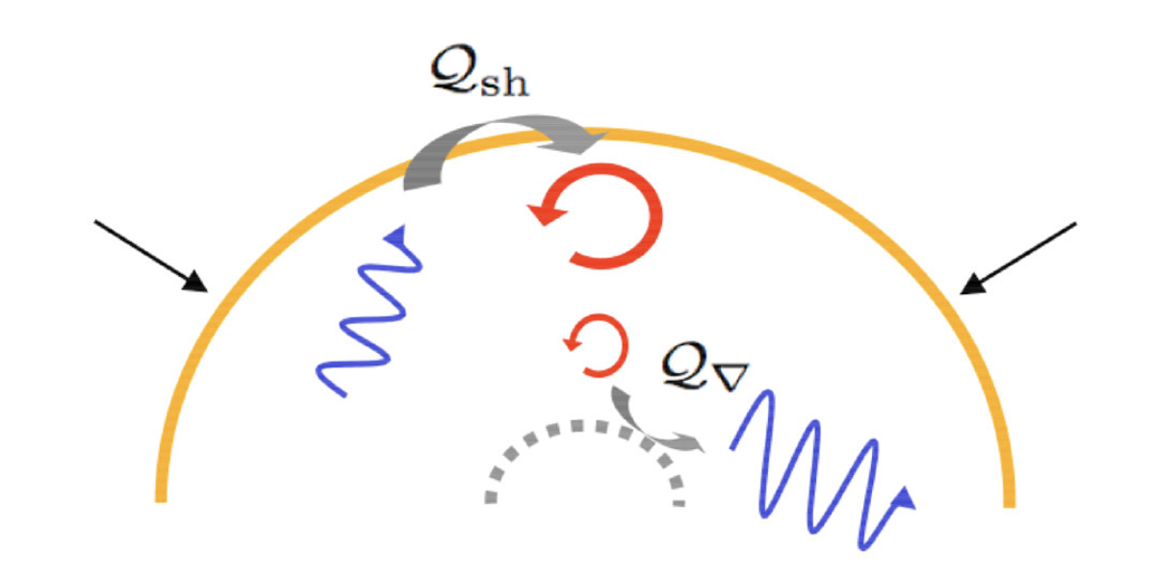
Standing Shock Accretion Instability (SASI)
Unstable advection-acoustic cycle (Bondin et al 2003, Foglizzo et al 2006)
Oscillating low-l modes (l=1, 2)
For l=1 (sloshing modes):
Guilet & Foglizzo 2012
SASI does not appear generically. Appropriate conditions are necessary.

Slide 24
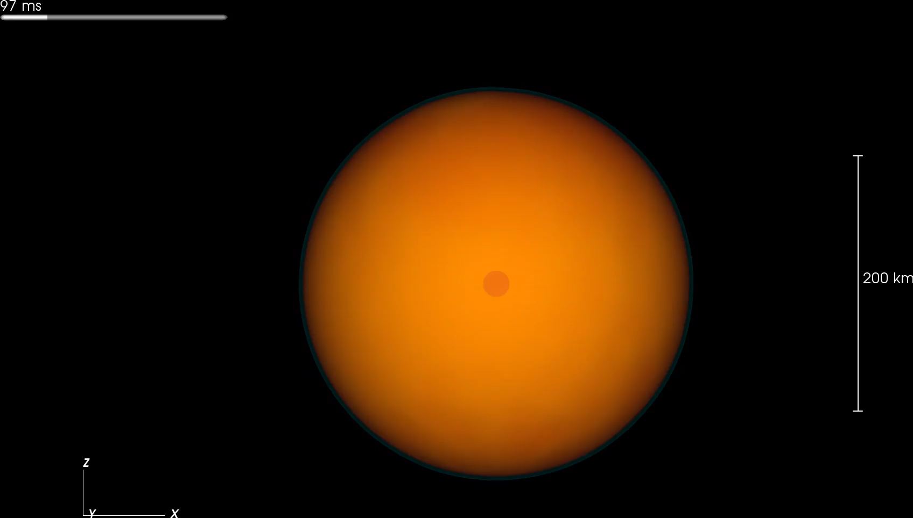
Hanke et al 2013
3D simulation
27 M☉ progenitor
color= entropy
Blue surface=shock front

Slide 25
Standing Shock Accretion Instability (SASI)
Unstable advection-acoustic cycle (Bondin et al 2003, Foglizzo et al 2006)
Oscillating low-l modes (l=1, 2)
For l=1 (sloshing modes):
Computation of SASI modes: linear perturbations of a background with an accretion flow
Dimitra Tseneklidou’s talk tomorrow afternoon
Guilet & Foglizzo 2012
SASI does not appear generically. Appropriate conditions are necessary.

Slide 26
Dominant mode
₃
Dominant mode
(g or f mode?)
core g-mode
SASI-mode

Slide 27
Dominant mode
26 1D simulations
2 codes (Alcar-Aenus and CoCoNuT)
6 EOS (LS220, Gshen-NL3, Hshen, SFHo, BHB-Λ, Hshen-Λ)
8 progenitors (11.2 – 75 M☉)
Torres-Forné et al 2019
g-modes scale with PNS surface gravity
No dependence on EOS
Dominant mode

Slide 28
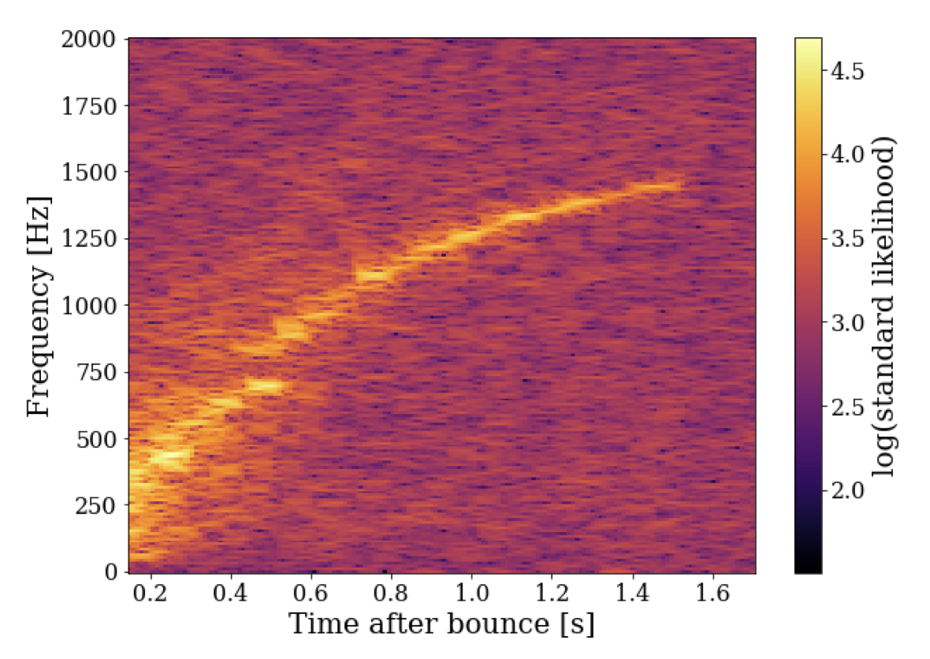
Injections:
Simulations: 10 x 2D & 3D
Code: Aenus-Alcar
Progenitors: 11.2-40 M☉
EOS: LS220, Gshen, SFHo
Noise:
Detector network 2nd gen (HL, HLV, HLVK, HLVKA..) and 3rd gen (ET, CE)
Simulated noise
Observational scenario
Neutrino trigger (time of bounce within ~10 ms)
EM observation → accurate sky localization
Spectrograms:
Dominant polarization frame (similar to X-pipeline)
Time shifted data
Dominant mode
Bruel et al 2023
LVK network, source at 5 kpc

Slide 29
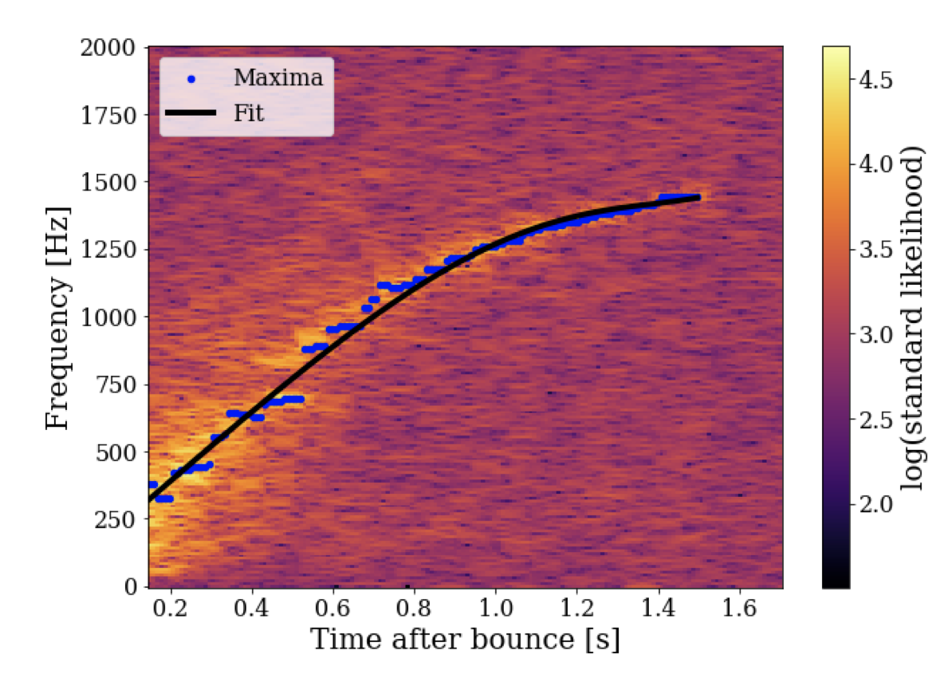
Dominant mode
Bruel et al 2023
Tracking algorithm:
Maximum identification
Polynomial fit (LASSO regression)
Time-frequency tracking of the main ridge
f(t)
LVK network, source at 5 kpc

Slide 30
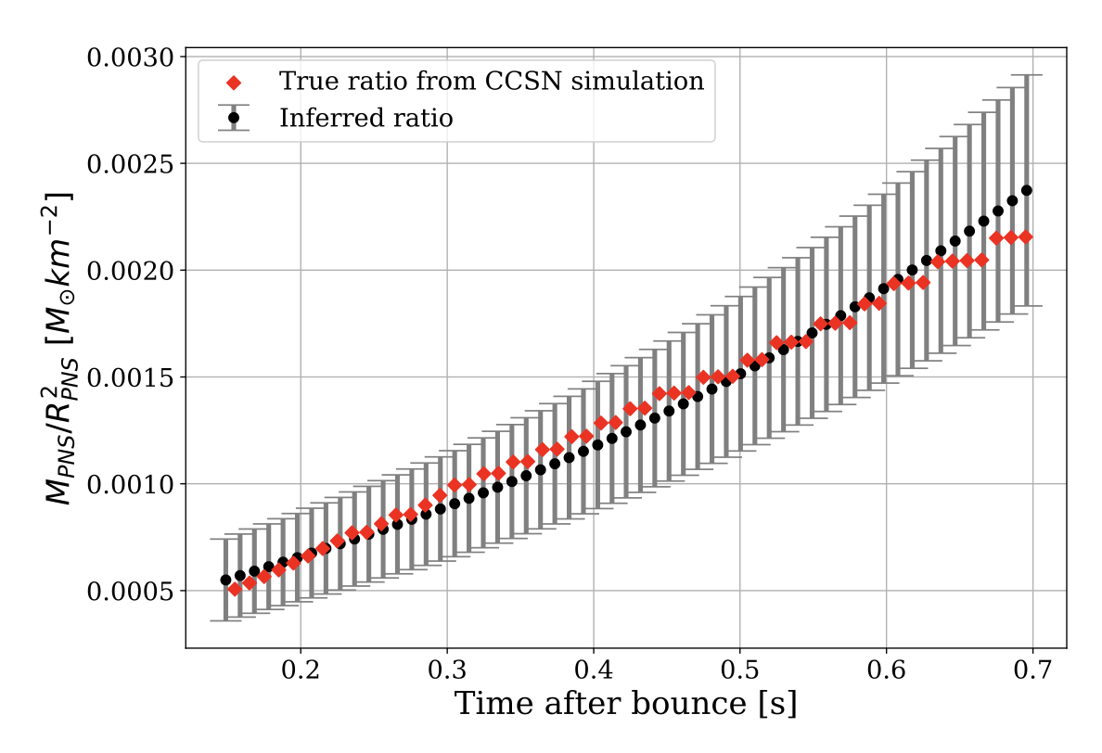
Dominant mode
Bruel et al 2023
95% confidence interval
HLVKA network, source at 5 kpc

Slide 31
Core g-modes
₃
Dominant mode
(g or f mode?)
core g-mode
SASI-mode

Slide 32
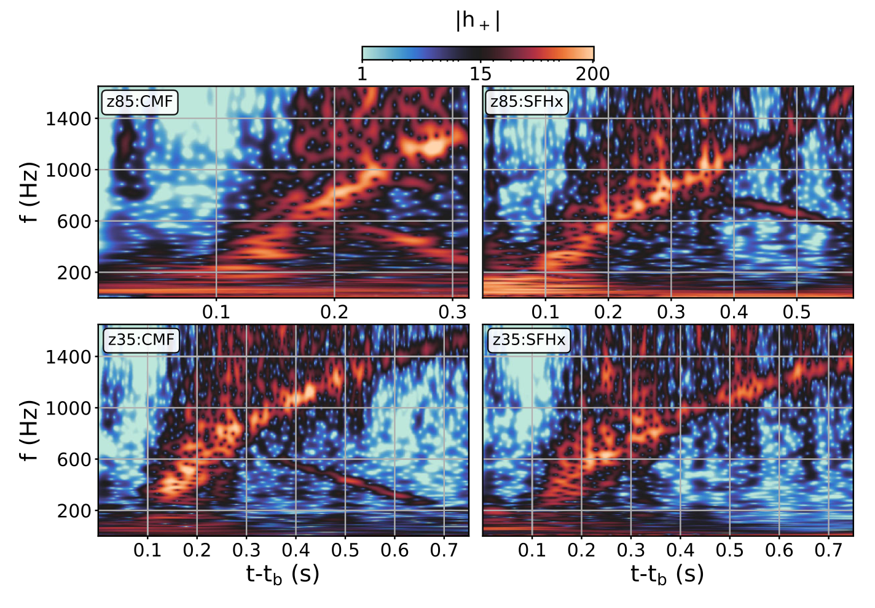
Core g-modes
Core g-mode frequency depends on the EOS
Jakobus et al 2023

Slide 33
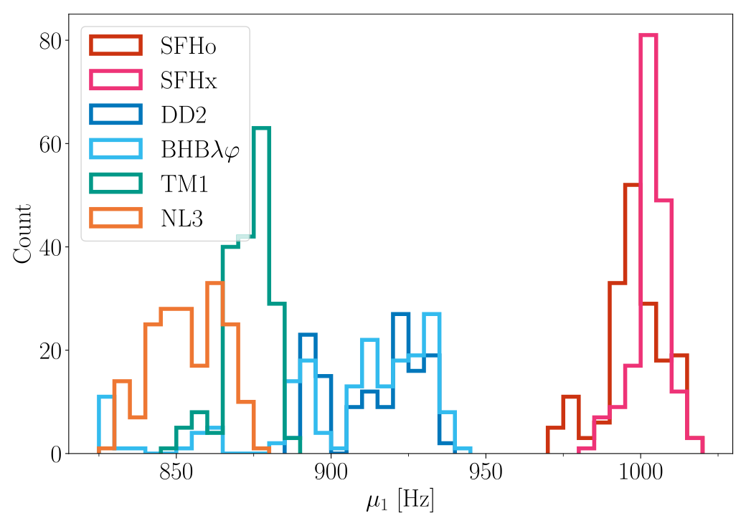
Core g-modes
Core g-mode frequency depends on the EOS
1D simulations with AGILE-IDSA
174 progenitors: 10.8 and 40 M☉ (solar, subsolar and zero metallicity)
6 EOS
Number of simulations
Core g-mode frequency at 0.4 s
Wolfe et al 2023

Slide 34
Colclusions
A nearby supernova would give us a unique opportunity to learn about …
  … explosion mechanism
  … EOS at high densities and temperatures
  … rotation
There is still a lot of work to do …
  … eigenmode calculation: SASI, rotation …
  … eigenmode classification
  … inference from other features (GW gap, secondary g-modes, SASI, bar-mode)
  … phenomenological templates including rotation

