Slide 1
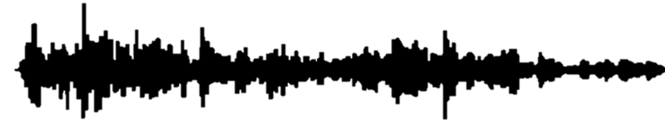
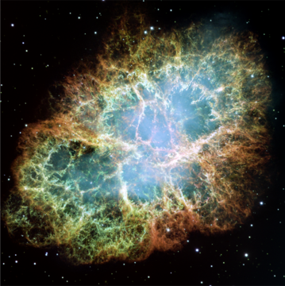
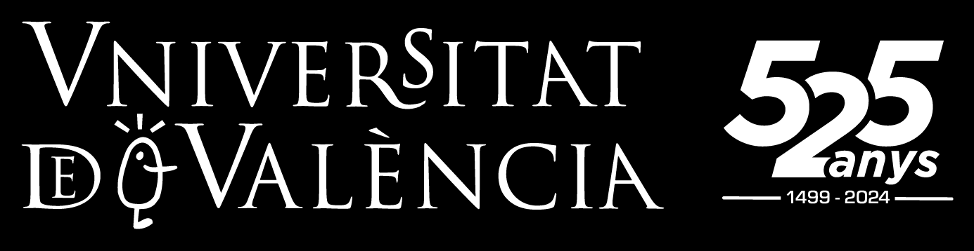


Challenges in the observation of gravitational waves from the collapse of massive stars
Pablo Cerdá-Durán
BH, NS, & GW @ Black Sea - Varna

Slide 2
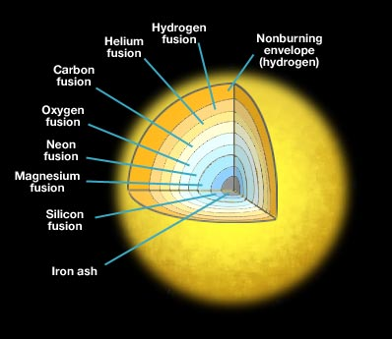
Collapse of massive stars
Massive star : at birth M_{ZAMS} ~ 10-100 M☉
About 1 every million stars is massive
Develop a core of non-burning iron (iron core)
Massive cores (M>M_{Chandrasekhar}) collapse
(core collapse)

Slide 3
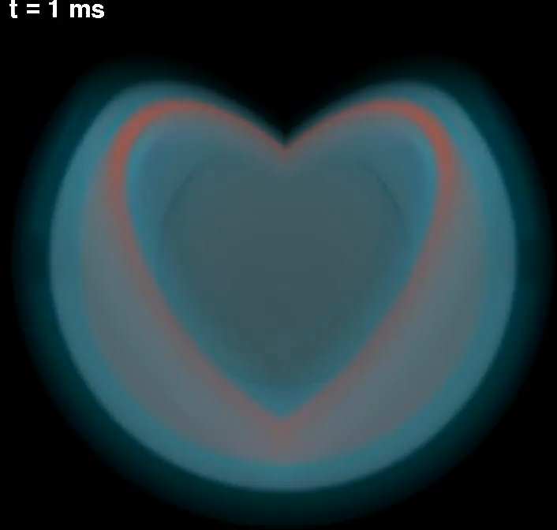
~100 km
Iron core
Hammer et al 2010
3D simulation
15.5 M☉ progenitor
color= entropy
Blue surface=shock front

Slide 4
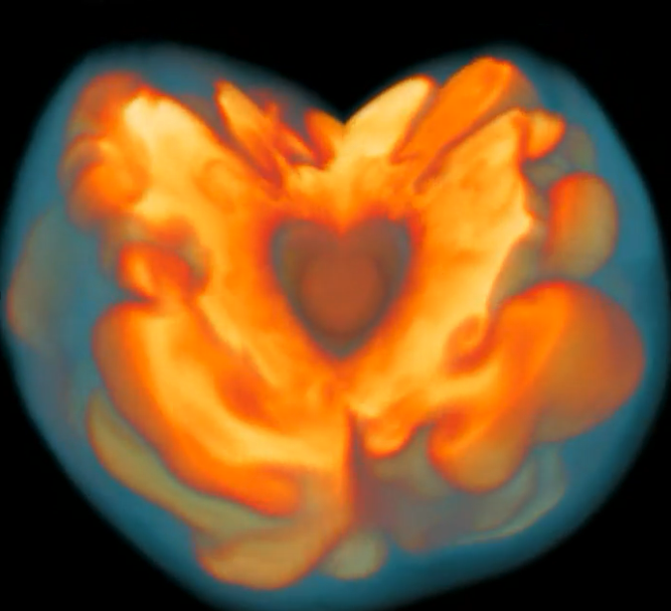
~100 km
Neutrinos
Collapsing star
~10-30 km
PNS
Stalled accretion shock
PNS = Proto-neutron star

Slide 5
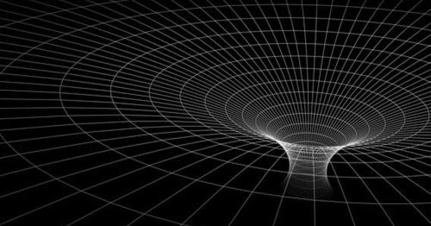
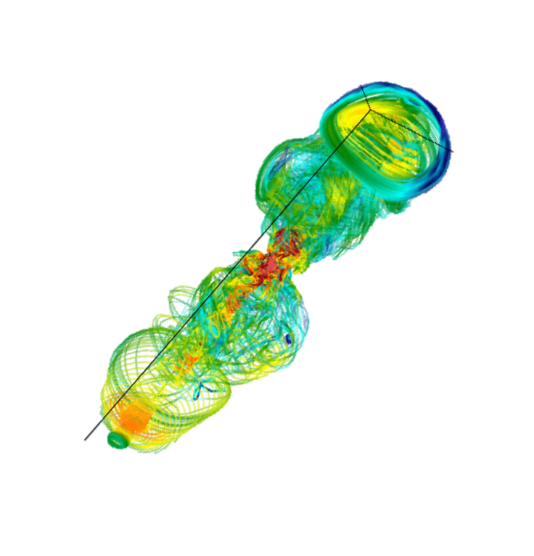
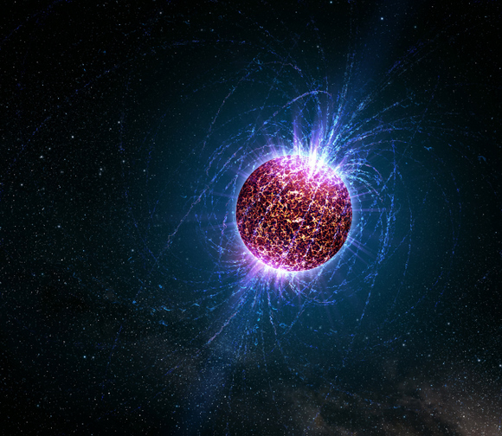
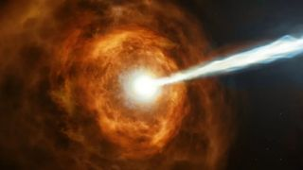
Neutrino driven supernovae
  Rate: ~2/century @ Milky Way
  Remnant: NS (~1.2-2 M ☉)
Progenitor mass
Metallicity
Core rotation
Black hole formation
Rate: ~3-4/1 000 yr @ Milky Way (15-20%)
Remnant: BH (~10-50 M ☉ ?)
Magneto-rotational explosion
Rate: <2/10 000 yr @ Milky Way (<1%)
Remnant: NS or BH
Supernovae producing magnetar
Rate: <2/1 000 yr @ Milky Way (~10%?)
Remnant: magnetar
Long GRB
Rate: <1/10 000 yr @ Milky Way (<1%)
Remnant: BH?

Slide 6
Development of instabilities
PNS core convection
Hot-bubble convection
SASI
GWs
Non-spherical perturbations of the
proto-neutron star
GW emission

Slide 7
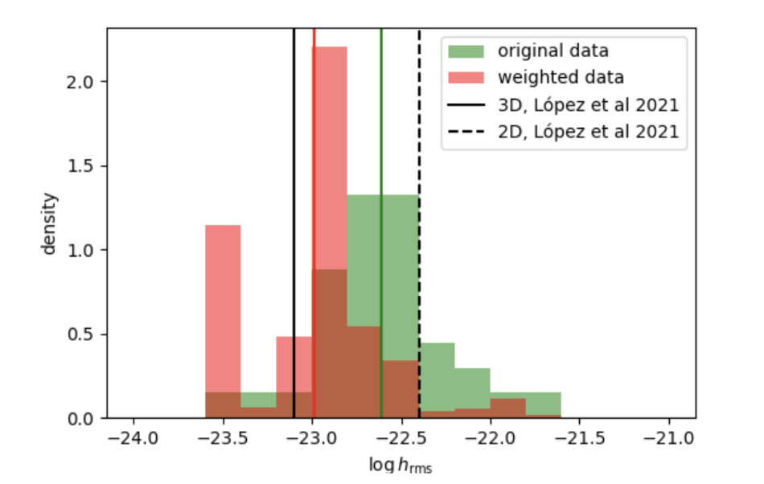
Highly stochastic
(one progenitor – multiple realizations)
Matched filtering not possible
Strain amplitude @ 10 kpc
Slow rotation: ~10⁻²³
Fast rotation: ≲10⁻²¹
Torres-Forné et al 2019
CD in prep

Slide 8
Excitation of PNS oscillation modes (p, g, f, SASI)
Torres-Forné et al 2019

Slide 9
Can we detect GW from core collapse events?

Slide 10
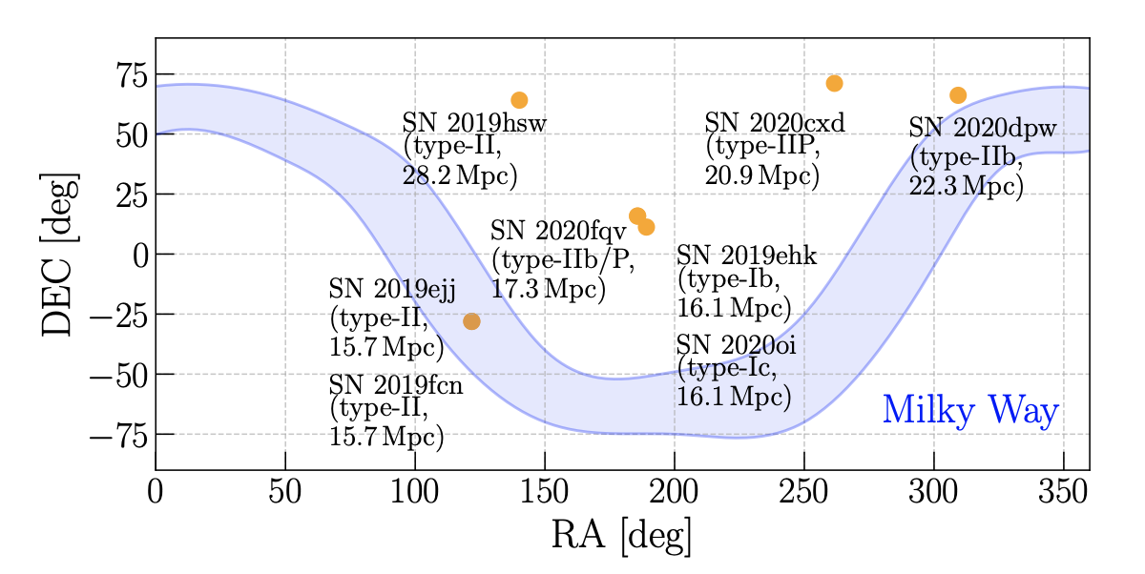
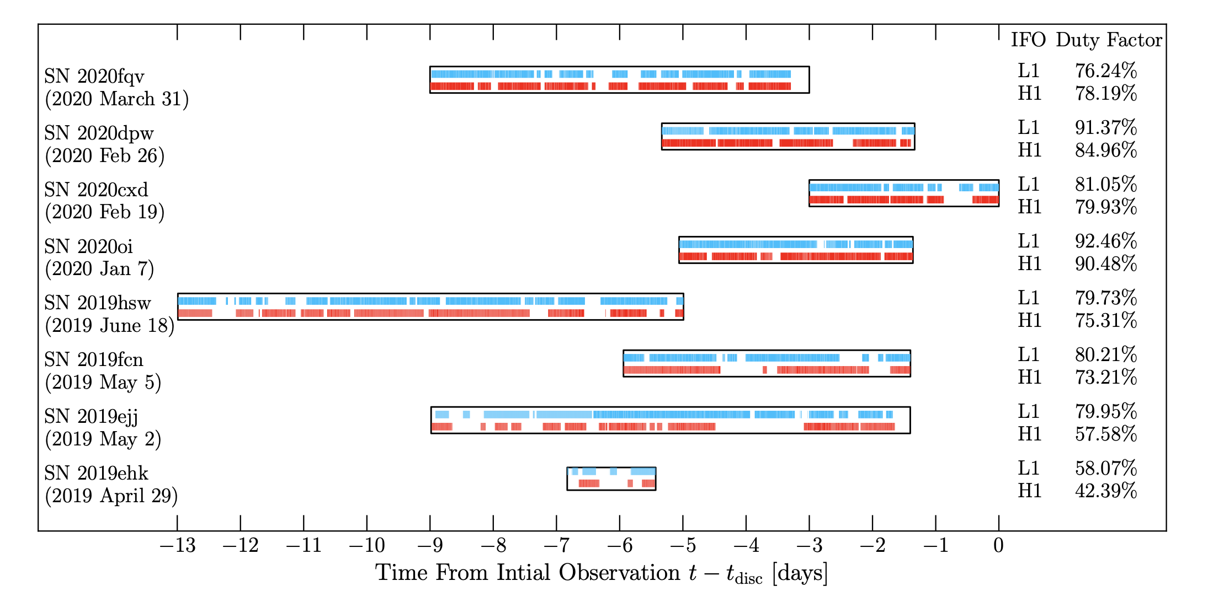
LVK searches
Sky localization of SNe during O3
On source windows for SNe during O3
arXiv:2305.16146
Unmodelled search algorithms (excess power): cWB
Searches (O1, O2, O3):
  Targeted (SN within 30 Mpc)
  All-sky
No detection (not expected)
Closest SN: 6.7 Mpc (during O2)
Horizon distance:
  ~10 kpc (neutrino-driven)
  ~100 kpc (magnetorotational)

Slide 11
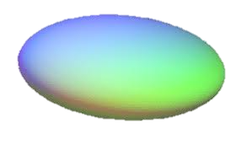
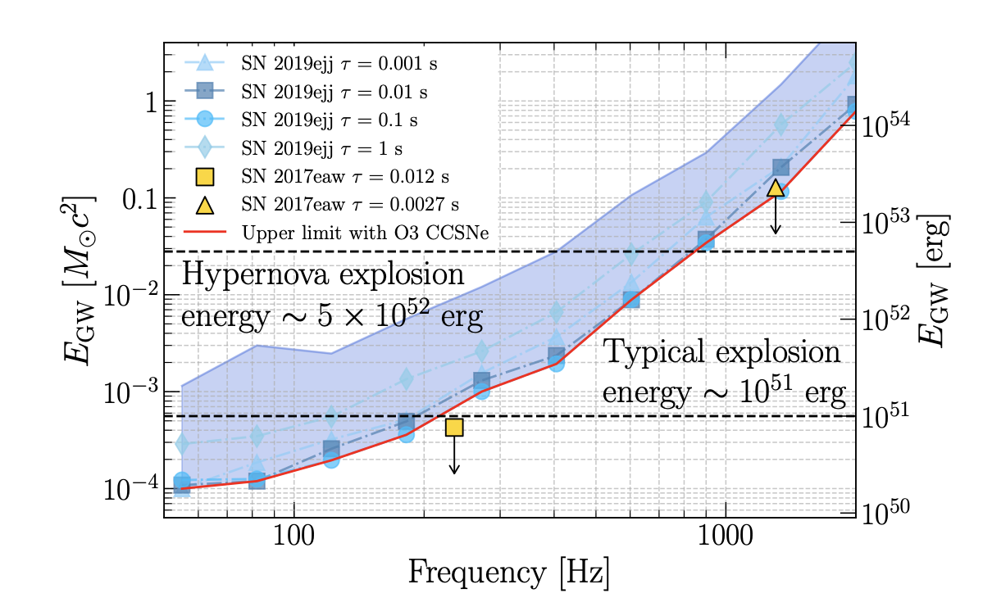
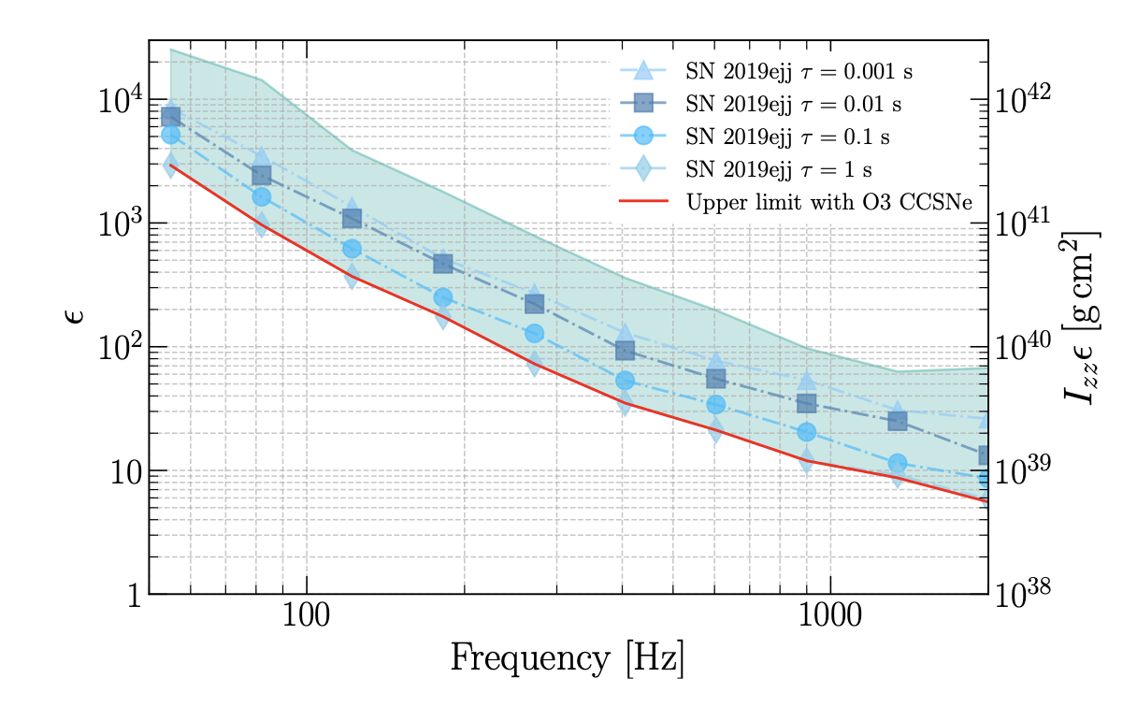
LVK searches
Constraints for bar mode instabilities in the proto-neutron star
Constraint on the GW energy emitted
Constraint on the ellipticity
arXiv:2305.16146

Slide 12
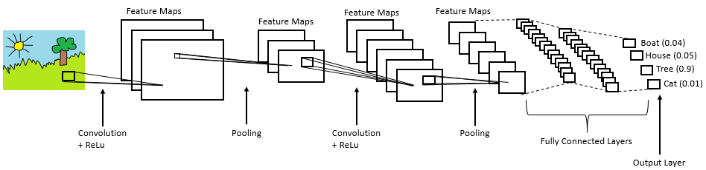
Detection using machine learning
Complex
input data (e.g. an image)
Machine learning algorithm (e.g. CNN)
Complex
Non-linear
Parametric
Simple output data (e.g. a class)
Example of a typical convolutional neural network (CNN)

Slide 13
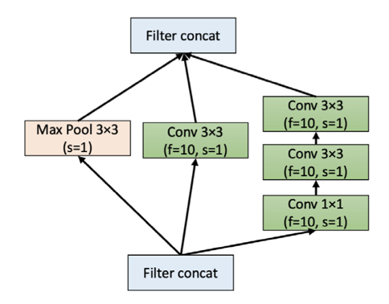
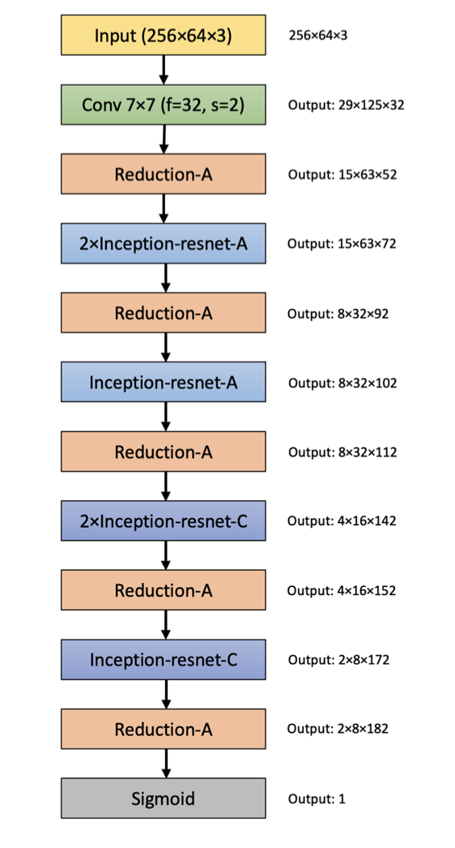
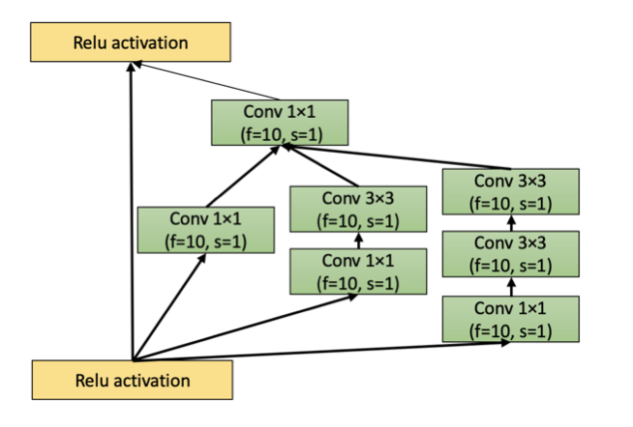
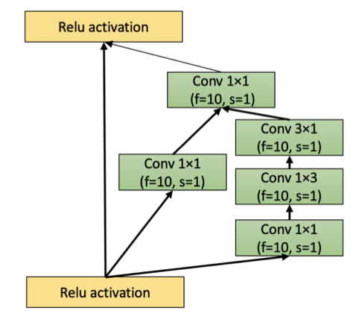
Detection using machine learning
Mini Inception-Resnet CNN
(~100 000 parameters)
Training with spectrograms

Slide 14
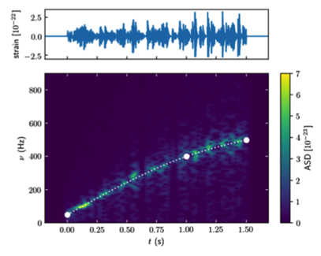
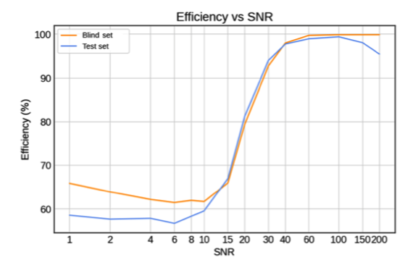
Detection using machine learning
Phenomenological templates (ccphen v3):
  Parametric
  Stochastic
  Mimic CCSNe waveforms
Training:
  no limitation in number of templates
  (~9000 waveforms in López et al 2020)
  Exploration of the parameter space homogeneously
López et al 2020
Detection at SNR~15-20
CNN’s can recognize signals from numerical simulations

Slide 15
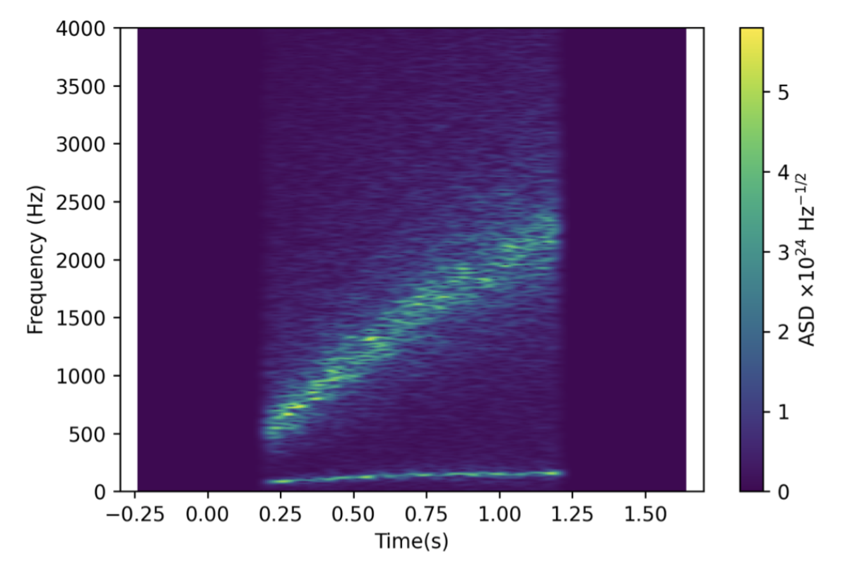
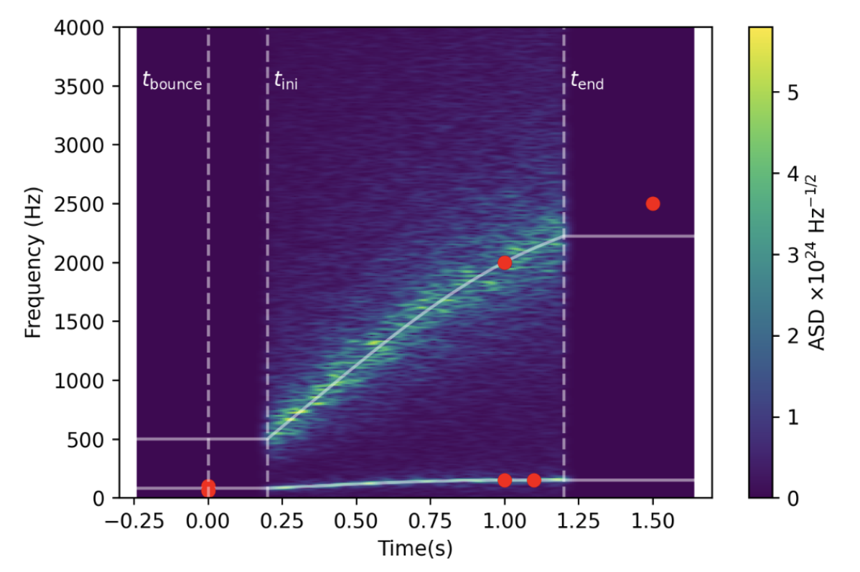
New phenomenological templates
ccphen v4
Non-rotating progenitors (rotation work in progress)
SASI + g-modes
Polarization
Fast: ~4-15 ms per waveform
CD et al 2025

Slide 16
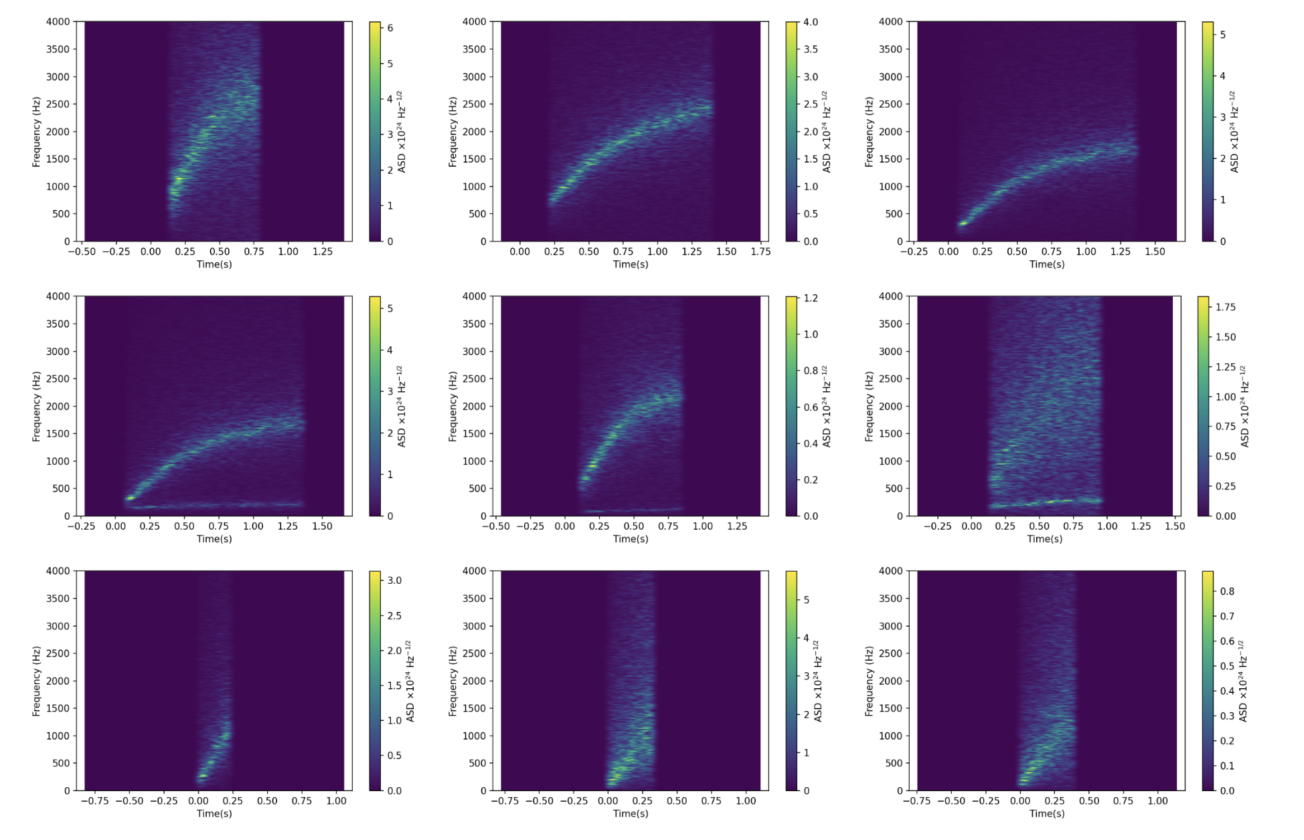
CD et al 2025

Slide 17
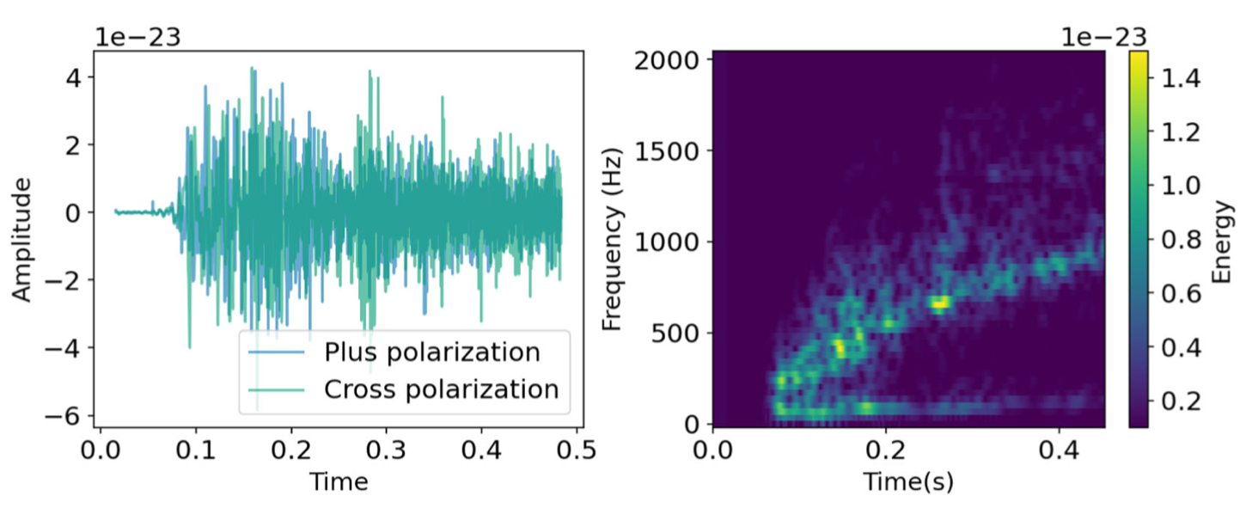
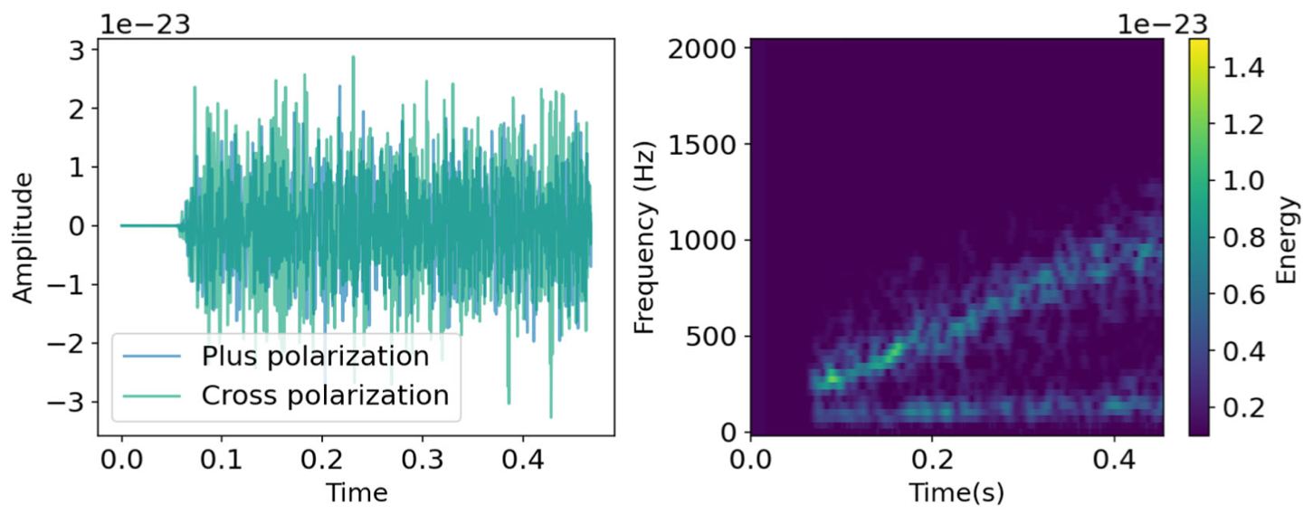
Numerical simulation
Model mesa20_v_LR
(O’Connor & Couch 2018)
ccphen v4
Best fit (MSE spectrograms ~ 0.16)
CD et al 2025

Slide 18
What can we learn from a core-collapse detection?

Slide 19
Proto-neutron star asteroseismology

Slide 20
PNS asteroseismology
₃
Dominant mode
(g or f mode?)
core g-mode
SASI-mode
GREAT (GR Eigenvalue Analysis Tool)
(Torres-Forné et al 2008, 2009)
Publicly available!
(https://www.uv.es/cerdupa/codes/GREAT)
Calculation of eigenmodes from simulations
Linear perturbation of spherical background

Slide 21
PNS asteroseismology (dominant mode)
26 1D simulations
2 codes (Alcar-Aenus and CoCoNuT)
6 EOS (LS220, Gshen-NL3, Hshen, SFHo, BHB-Λ, Hshen-Λ)
8 progenitors (11.2 – 75 M☉)
Torres-Forné et al 2019
g-modes scale with PNS surface gravity
No dependence on EOS
Dominant mode

Slide 22
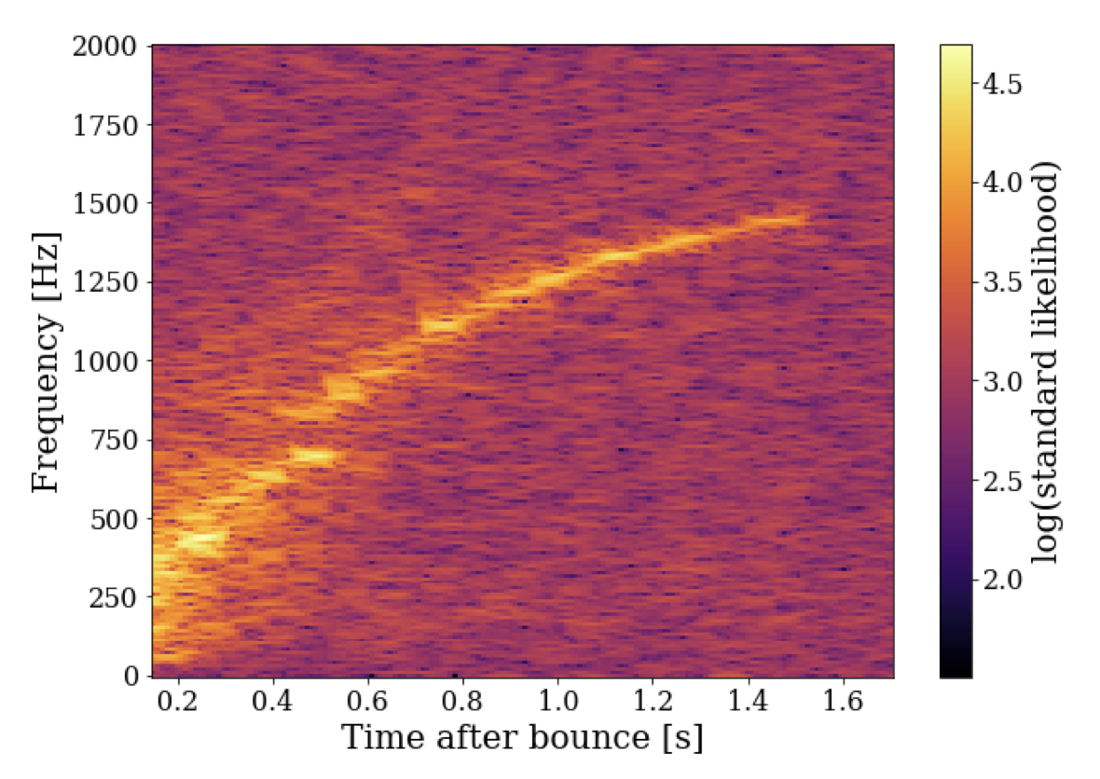
Injections:
Simulations: 10 x 2D & 3D
Code: Aenus-Alcar
Progenitors: 11.2-40 M☉
EOS: LS220, Gshen, SFHo
Noise:
Detector network 2nd gen (HL, HLV, HLVK, HLVKA..) and 3rd gen (ET, CE)
Simulated noise
Observational scenario
Neutrino trigger (time of bounce within ~10 ms)
EM observation → accurate sky localization
Spectrograms:
Dominant polarization frame (similar to X-pipeline)
Time shifted data
PNS asteroseismology
(dominant mode)
Bruel et al 2023
LVK network, source at 5 kpc

Slide 23
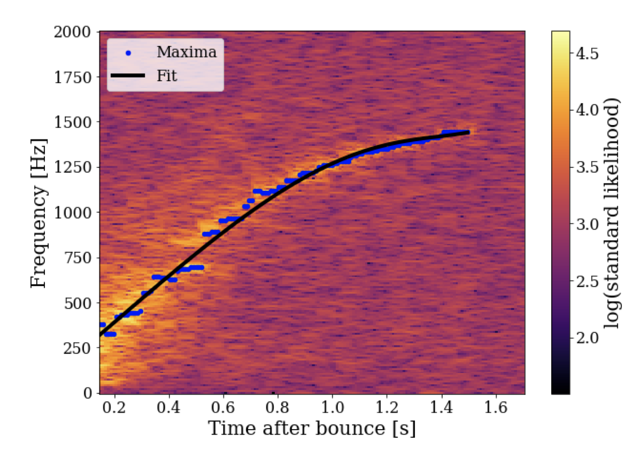
PNS asteroseismology (dominant mode)
Bruel et al 2023
Tracking algorithm:
Maximum identification
Polynomial fit (LASSO regression)
Time-frequency tracking of the main ridge
f(t)
LVK network, source at 5 kpc

Slide 24
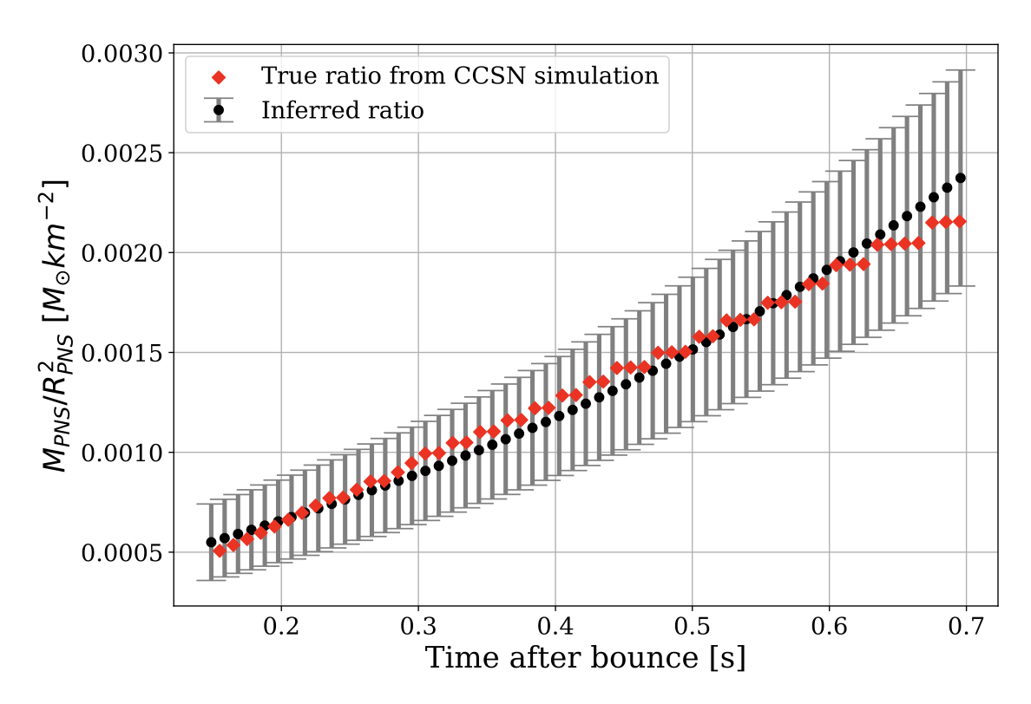
PNS asteroseismology (dominant mode)
Bruel et al 2023
95% confidence interval
HLVKA network, source at 5 kpc

Slide 25
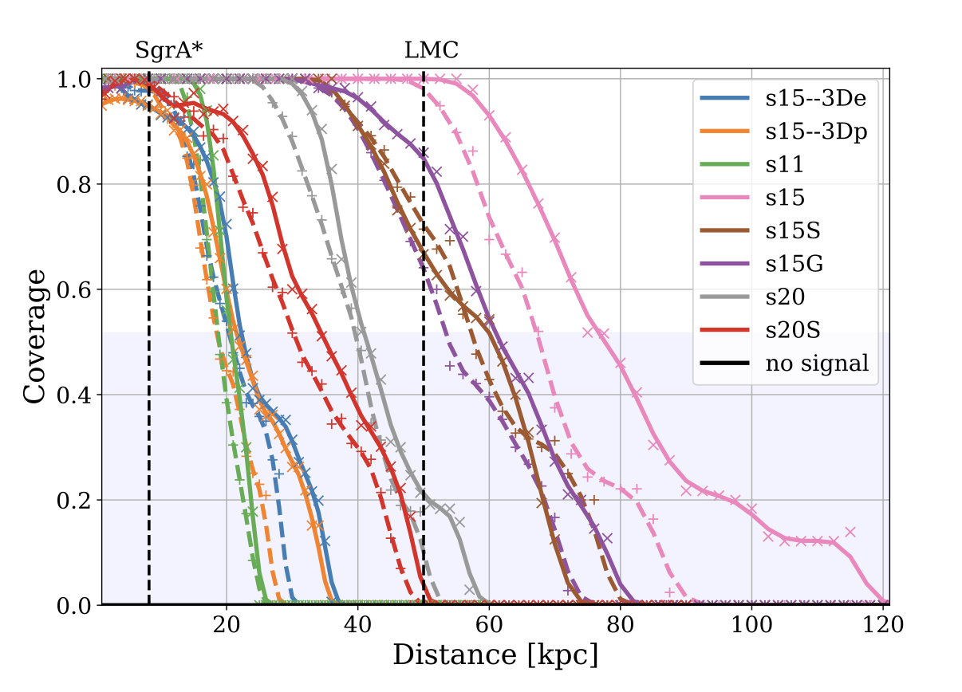
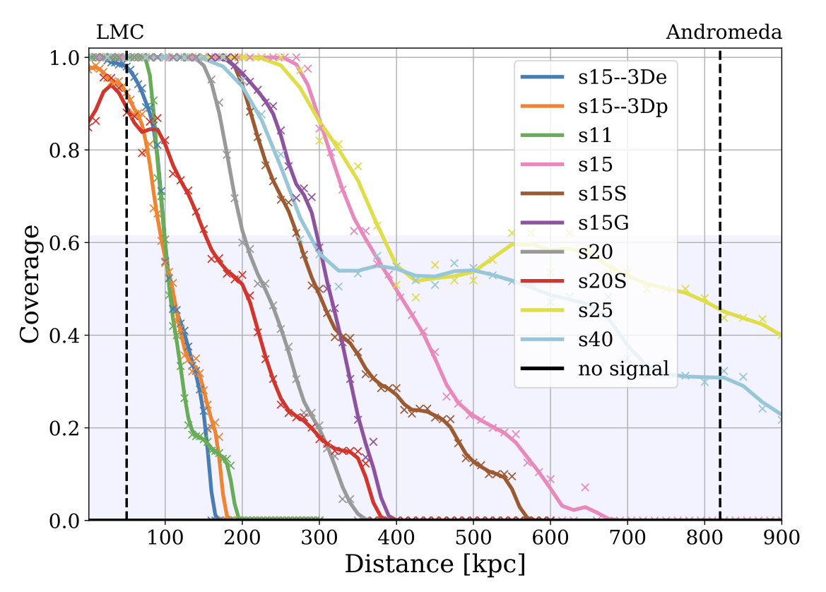
PNS asteroseismology (dominant mode)
Coverage (fraction of the real surface gravity inside the 95% interval of the inferred values)
2nd gen. detectors: galactic SN 3rd gen. detectors: a few 100 kpc
HLVKA and HL network (solid and dashed lines)
ET+2CE network

Slide 26
PNS asteroseismology (core g-mode)
₃
Dominant mode
(g or f mode?)
core g-mode
SASI-mode

Slide 27
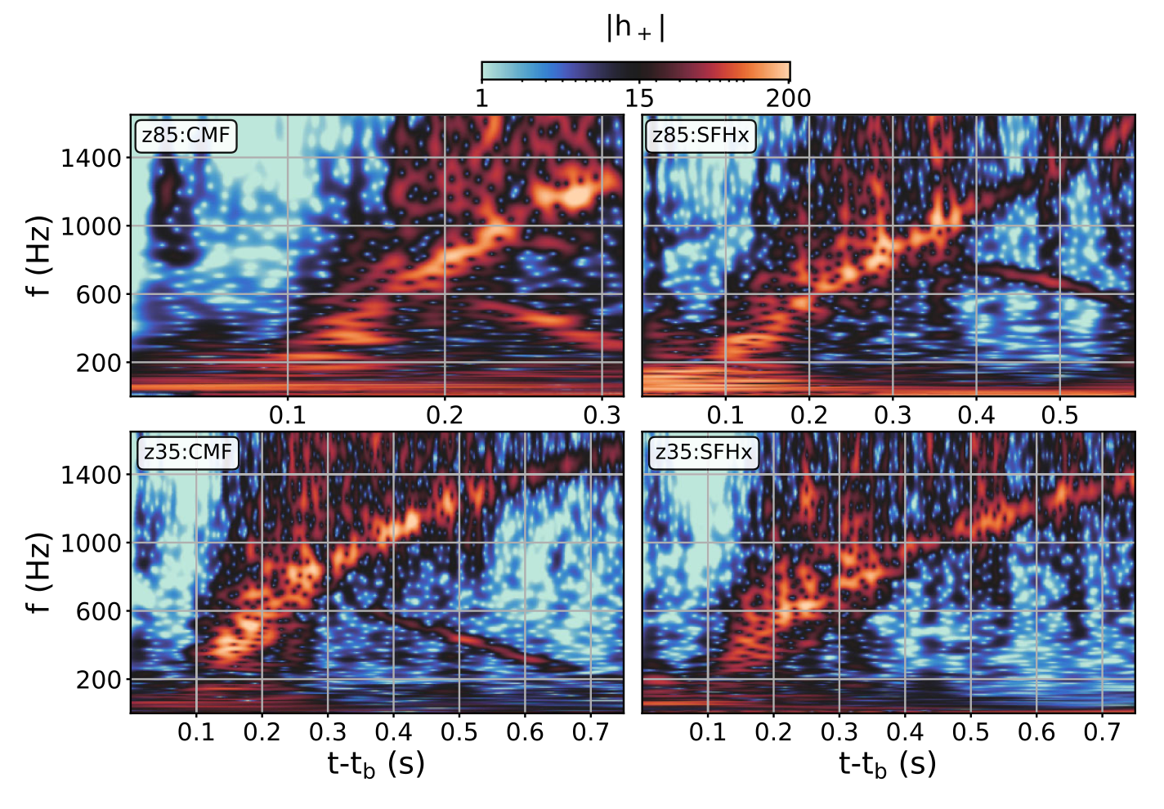
PNS asteroseismology (core g-mode)
Core g-mode frequency depends on the EOS
Jakobus et al 2023

Slide 28
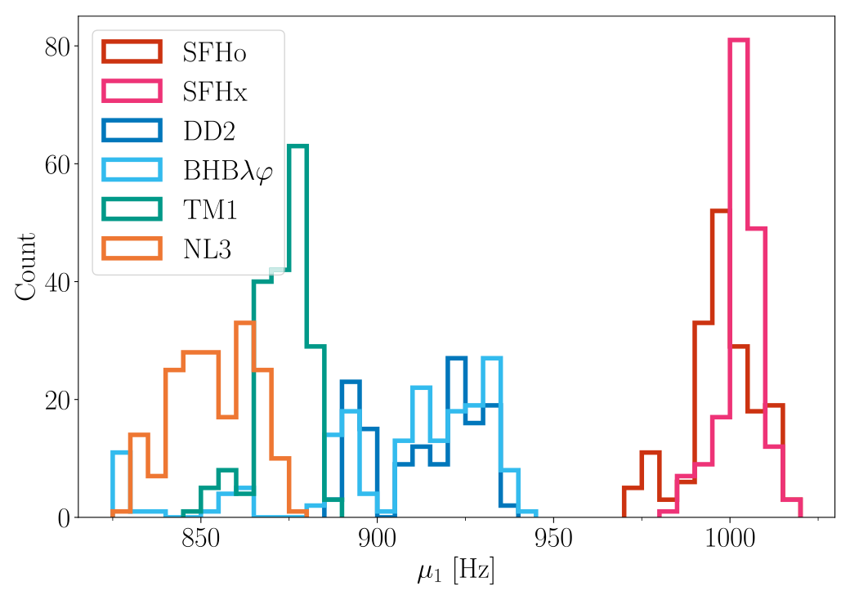
PNS asteroseismology (core g-mode)
Core g-mode frequency depends on the EOS
1D simulations with AGILE-IDSA
174 progenitors: 10.8 and 40 M☉ (solar, subsolar and zero metallicity)
6 EOS
Number of simulations
Core g-mode frequency at 0.4 s
Wolfe et al 2023

Slide 29
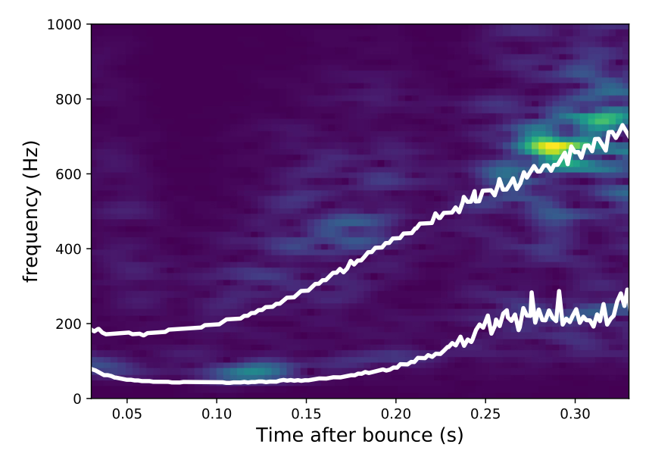
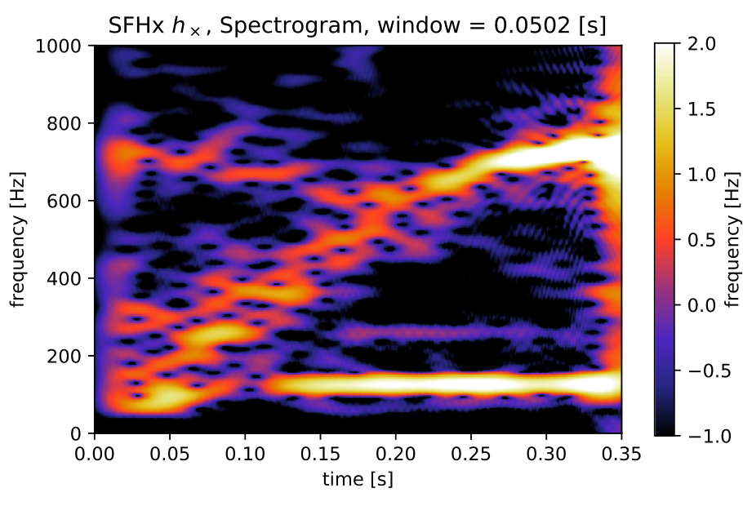
PNS asteroseismology (SASI)
Powell et al 2021
Kawahara et al 2018
(Kuroda et al 2016 simulation)

Slide 30
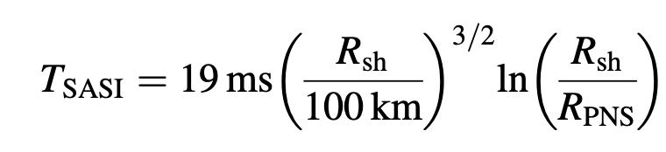
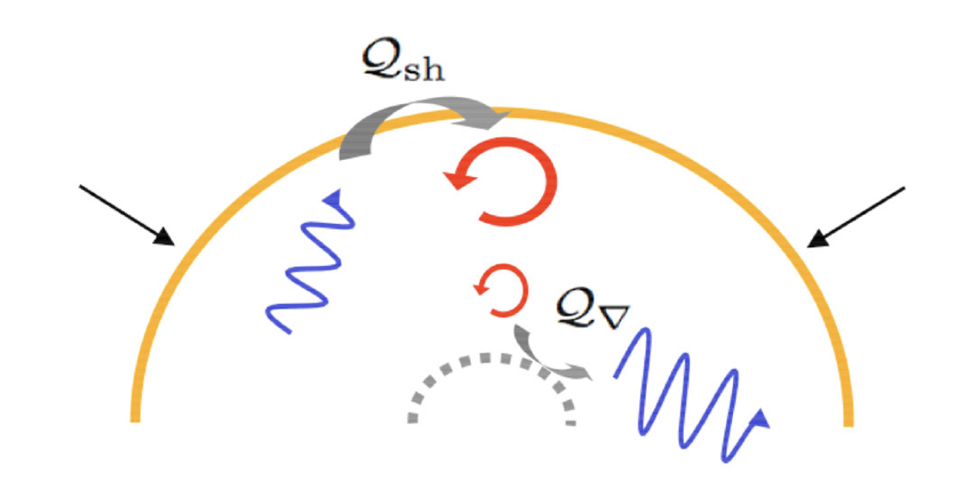
Standing Shock Accretion Instability (SASI)
Unstable advection-acoustic cycle (Bondin et al 2003, Foglizzo et al 2006)
Oscillating low-l modes (l=1, 2)
For l=1 (sloshing modes):
Guilet & Foglizzo 2012
SASI does not appear generically. Appropriate conditions are necessary.

Slide 31
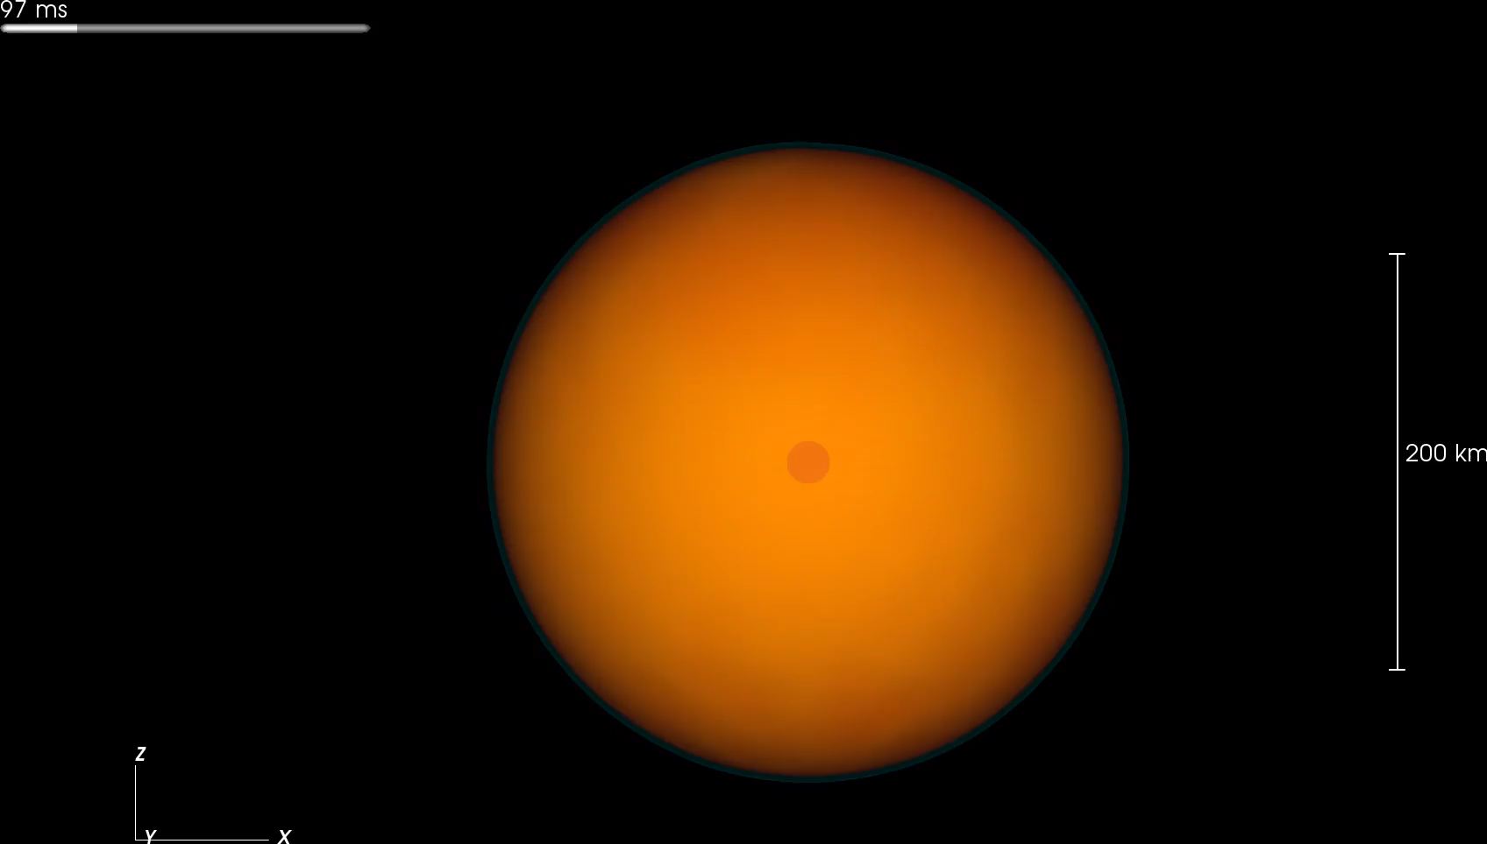
Hanke et al 2013
3D simulation
27 M☉ progenitor
color= entropy
Blue surface=shock front

Slide 32
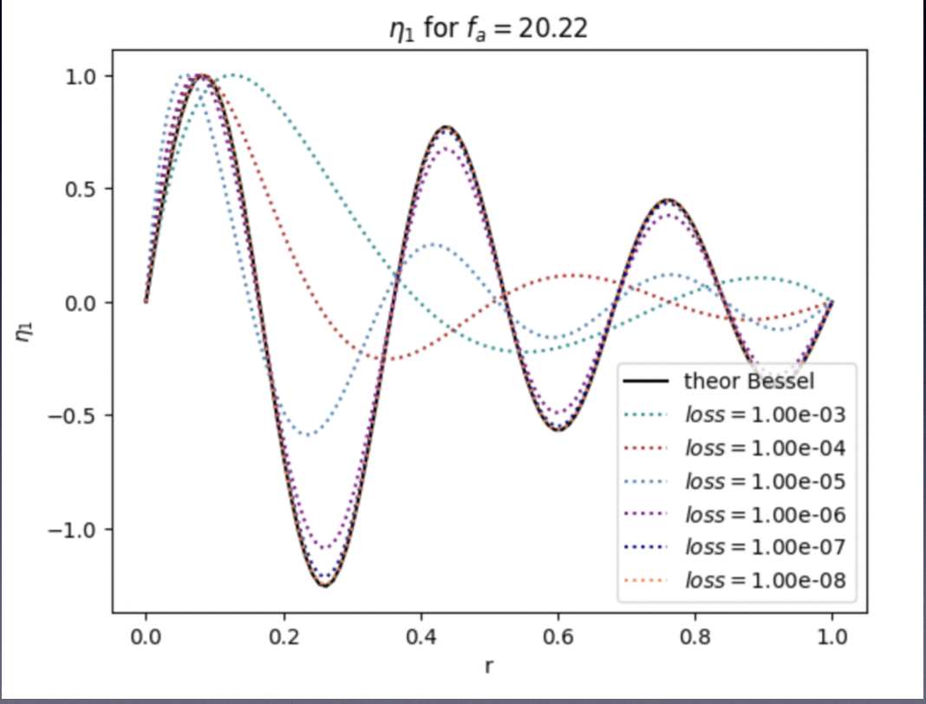
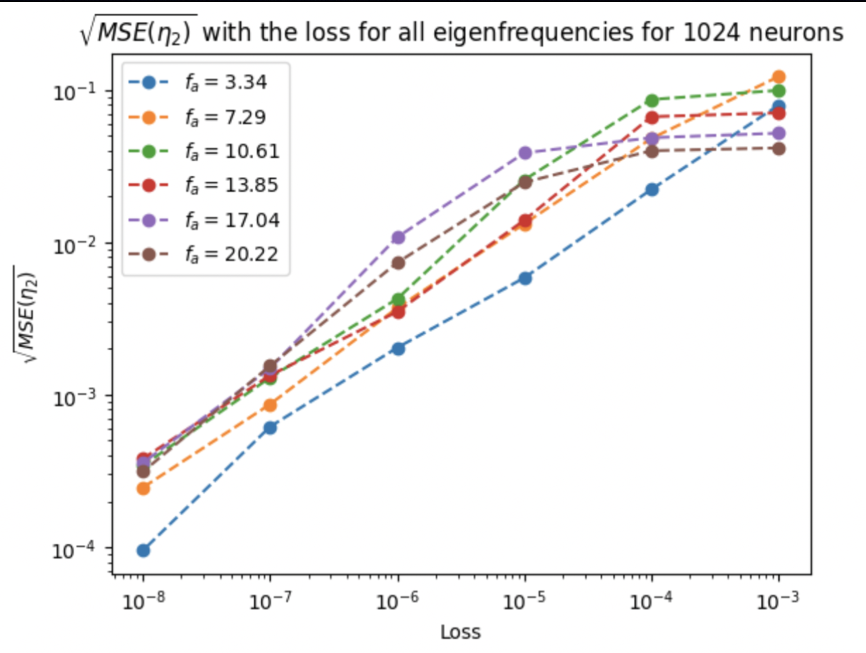
PNS asteroseismology – Future (I)
Improved eigenmode calculation:
Physically Informed Neural Networks (PINNs)
Spectral methods
Calculations in more complex situations
Complex boundary conditions (accretion shock)
PNS accretion (advection terms → SASI)
Rotation (2D problem)
PINNs: Convergence of the solution by decreasing the training loss
(Test case with analytic solution)
Tseneklidou et al (in prep.)
Eigenfunction (radial part)
Mean square error

Slide 33
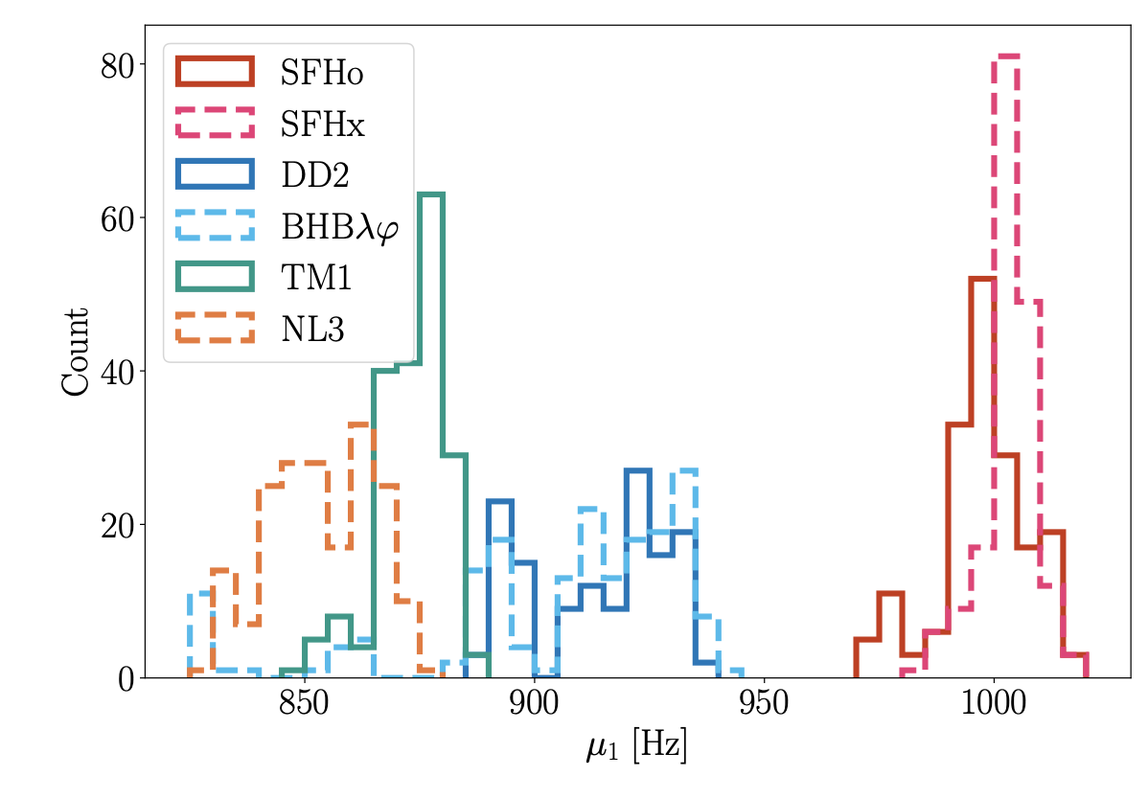
PNS asteroseismology – Future (II)
Bruel et al 2023
Wolfe et al 2023
Gap frequency depends on the EOS
(statistics for 1000 simulations for different EOS and progenitors)
GW emission gap (avoided crossing?)

Slide 34
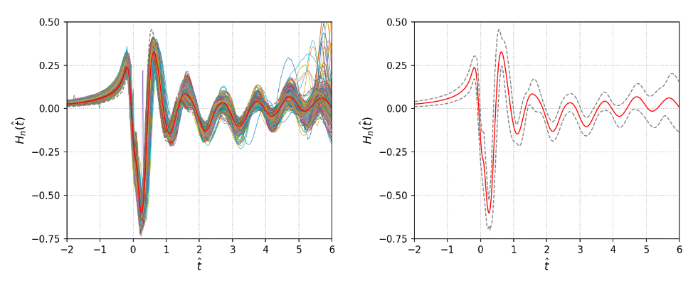
Fast rotating progenitors: bounce signal

Slide 35
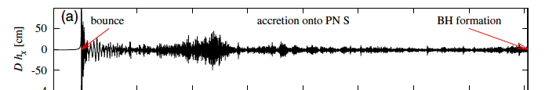
Fast rotating progenitors – bounce signal
Duration: 0.2 - 1 s
Frequencies: 50 - 3000 Hz
Highly stochastic → no templates possible
g/f-modes, SASI
Cerdá-Durán et al 2017
Bounce signal
Duration: ~10 ms
Frequency: 600 – 900 Hz
Quadrupolar deformation induced by rotation
Only in fast rotating progenitors
Signal similar for all models
Richers et al 2017

Slide 36
Fast rotating progenitors – bounce signal
Richers et al 2017
Fast rotation
Extreme rotation
Fast rotation
Extreme rotation
Kinetic rotational to potential energy ratio (measure of rotation)
Central density

Slide 37

Fast rotating progenitors – bounce signal
Template generated from 402 waveforms from Richers et al 2017
2-σ interval
Master template
Pastor-Marcos et al 2024

Slide 38
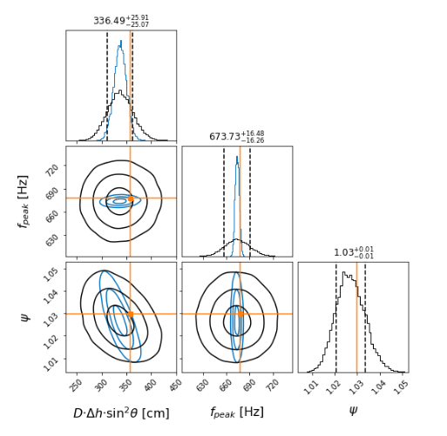

Fast rotating progenitors – bounce signal
Pastor-Marcos et al 2024
Bayesian inference with
SETUP
3 detectors network (HLV)
Gaussian colored noise
Design sensitivities
Sources of error:
Detector noise
Uncertainties in the template

Slide 39
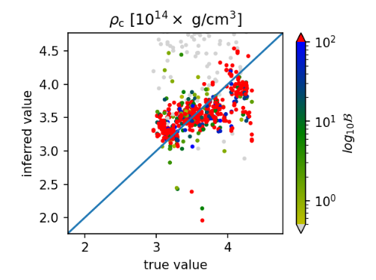
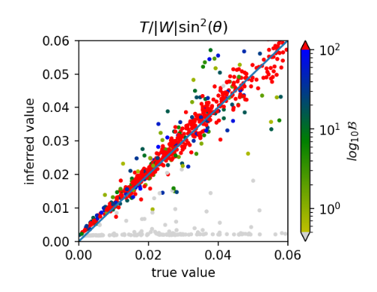
Fast rotating progenitors – bounce signal
Pastor-Marcos et al 2024
We can infer the rotation rate but is degenerated with the inclination angle.
Accuracy better than 10% for more than 50% of the detectable signals

Slide 40
Colclusions
A nearby supernova would give us a unique opportunity to learn about …
  … explosion mechanism
  … EOS at high densities and temperatures
  … rotation
There is still a lot of work to do …
  … eigenmode calculation: SASI, rotation …
  … eigenmode classification
  … inference from other features (GW gap, secondary g-modes, SASI, bar-mode)
  … phenomenological templates

