Slide 1
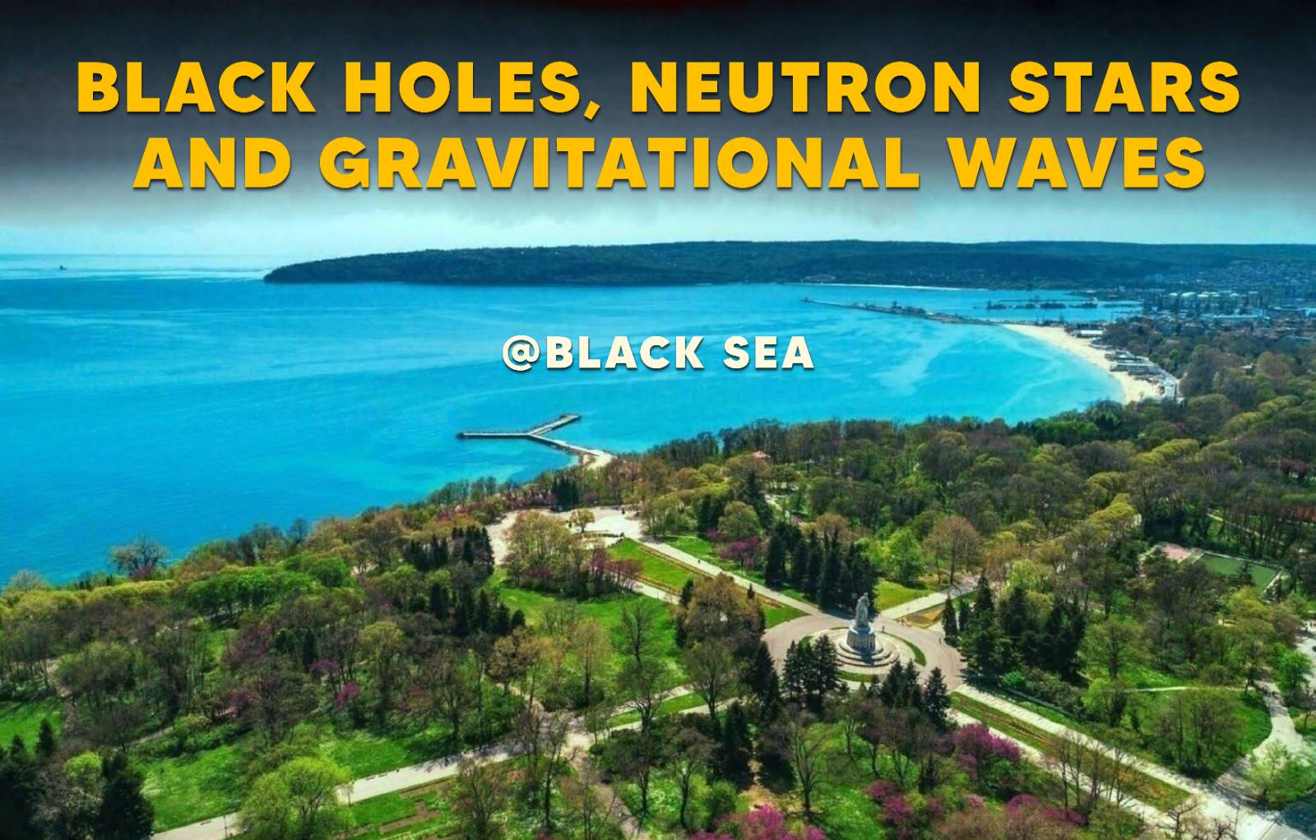

Sparse-dictionary learning for GW reconstruction: applications
Jun 16 – 20, 2025
Varna, Bulgaria
Alejandro Torres Forné
Miquel Llorens-Monteagudo, Charles Badger, Rahul Srinivasan, Katarina Martinovic, Ainara Sainz-Pérez
Astrid Lamberts, Marie-Anne Bizouard, Toni Font, Mairi Sakellariadou

Slide 2
Outline
Motivation
Mathematical framework
Applications
  Denoising of GW from LIGO/Virgo data.
  Classification:
    CCSN explosion mechanism.
    BNS postmerger EoS extraction.
  Rapid detection of BBH mergers.
  Glitch mitigation.
  Application to LISA sources:
    BBH in the presence of galactic noise.
    Extreme-mass-ratio inspirals

Slide 3
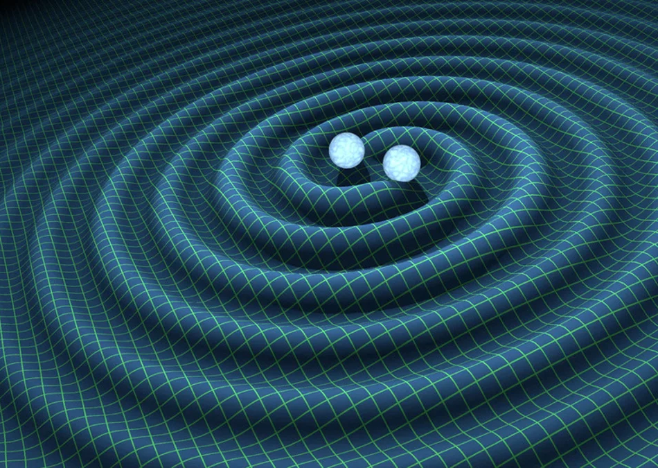
Detecting BBHs in LVK
Over 90 Binary Black Hole (BBH) have been confidently detected in LVK using traditional matched-filter methods.
The number of detected events will increase significantly in the near future.
New techniques to speed-up the detection and analysis are required.
Machine Learning methods are being explored to accelerate search times and improve result accuracy.
We explore the prospects of signal reconstruction and classification using the dictionary learning approach.

Slide 4
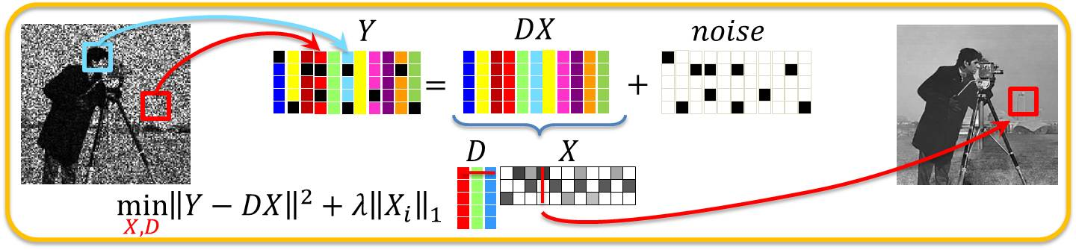

Methods - Dictionary Learning
CSIRO Research
Add the constraint to assure sparsity:

Slide 5
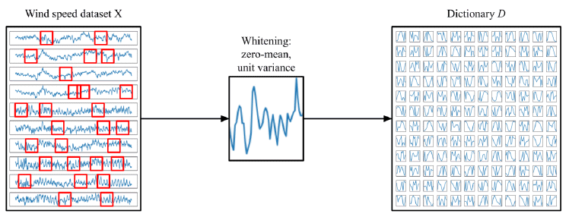

Methods - Dictionary Learning
Noise-free templates
signal patches:
We use block-coordinate descend method.
  Solve and each iteratively.

Slide 6
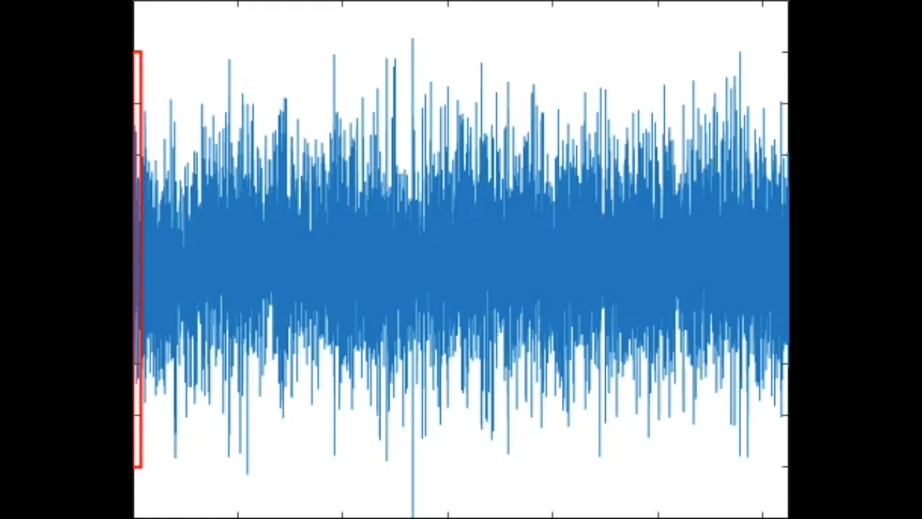

Reconstruction process
Noisy signal
Denoised signal

Slide 7
Applications of SDL
Denoising of GW signals from LIGO/Virgo.
Rapid detection BBH mergers.
Reconstruct and mitigate glitches from GW data.
Classification tasks:
    CCSN explosion mechanism.
    BNS postmerger EoS classification
Application to LISA target sources:
  BBH in the presence of galactic noise.
  Extreme-mass-ratio inspirals.

Slide 8
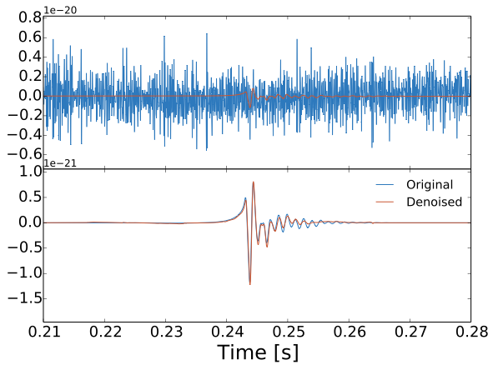
Reconstruction of GW in LIGO/Virgo
GW150914
CCSN
Torres-Forné A, Marquina A., Font J.A. and Ibañez J.M. Physical Review D, 94, 1 ,(2017)

Slide 9
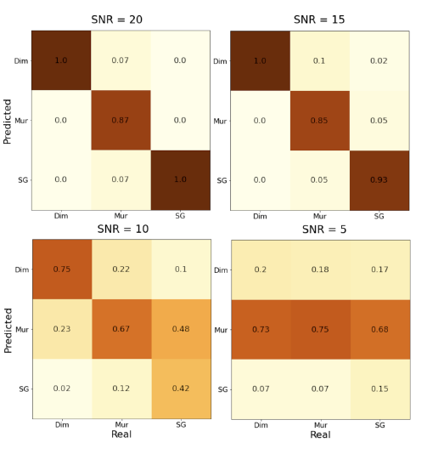
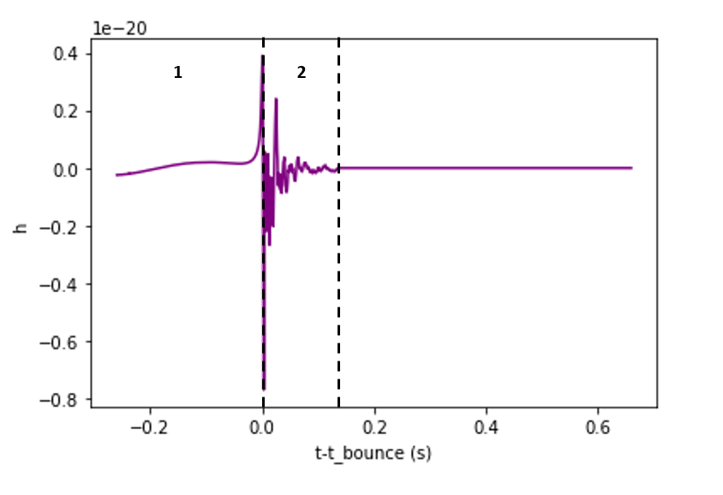
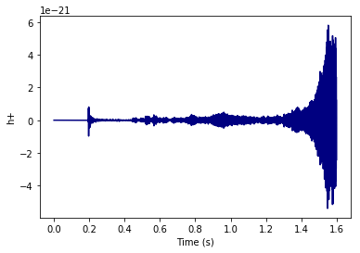
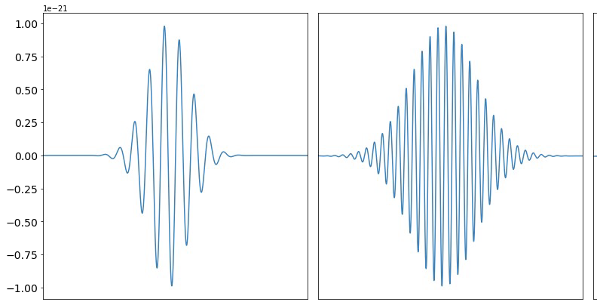
CCSN mechanism extraction – Gaussian noise
* Logue J., Ott C. D., Heng I. S., Kalmus P., Scargill J. H. C., 2012, Phys. Rev. D, 86, 044023
We try to reproduce the analysis done in Logue* + 2012
The idea is to determine the main mechanism of emission of GW.
  Magnetorotational mechanism.
  Neutrino mechanism.
  Glitch model (non physic).
We use signal from three CCSN catalogs embedded in Gaussian noise.
Use non-trained dictionaries to determine to which dictionary belongs a random signal.
Magnetorotational
Neutrino
Glitch
Dimmelmaier + 2008
Murphy + 2009
Saiz-Pérez, A ; Torres-Forné, A; Font, José A MNRAS, Volume 512, Issue 3 (2022).

Slide 10
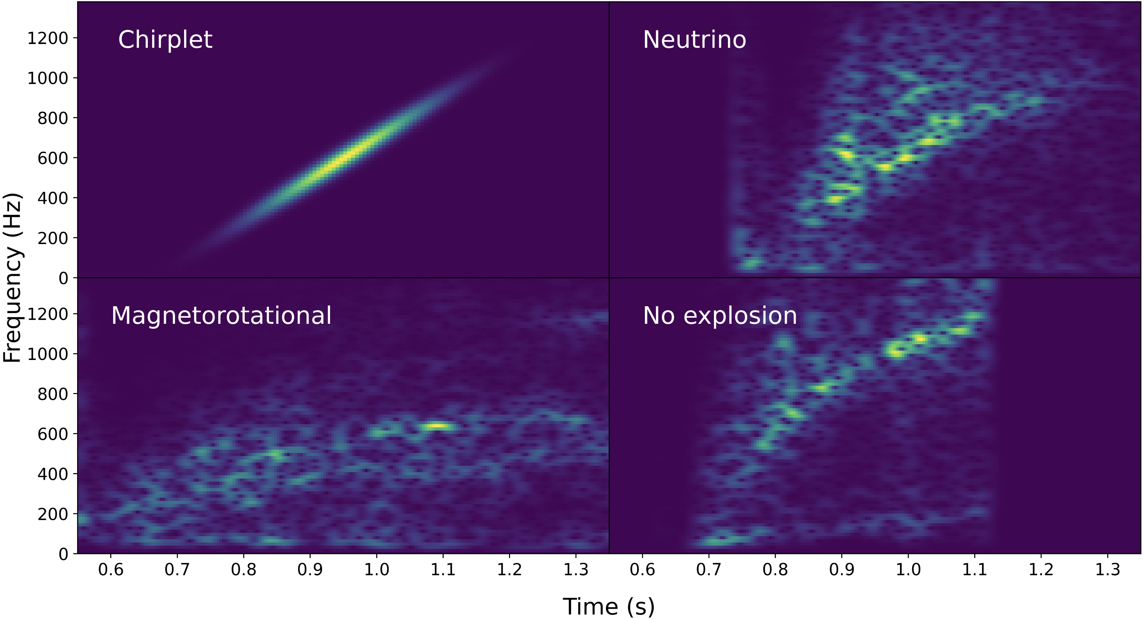
CCSN mechanism extraction – real noise
New 3D long-duration magneto-rotational core-collapse supernova waveforms that cover the full explosion phase, injected into noise for the Advanced LIGO, Einstein Telescope and NEMO gravitational-wave detectors.
3 methods:
Supernova Mechanism Evidence Extractor (SMEE)
SDL
Deep Learning
Powell J., Iess A., Llorens-Monteagudo M. et al. Physical Review D, Volume 109, Issue 6 (2024)

Slide 11
CCSN mechanism extraction – real noise
All methods are able to reject all the chirplets.
SMEE and SDL show similar overall results.
CNN cannot distinguish between neutrino driven and no-explosión.
Powell J., Iess A., Llorens-Monteagudo M. et al. Physical Review D, Volume 109, Issue 6 (2024)

Slide 12
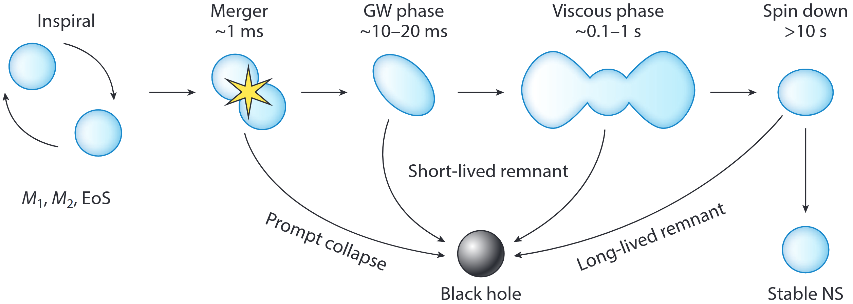
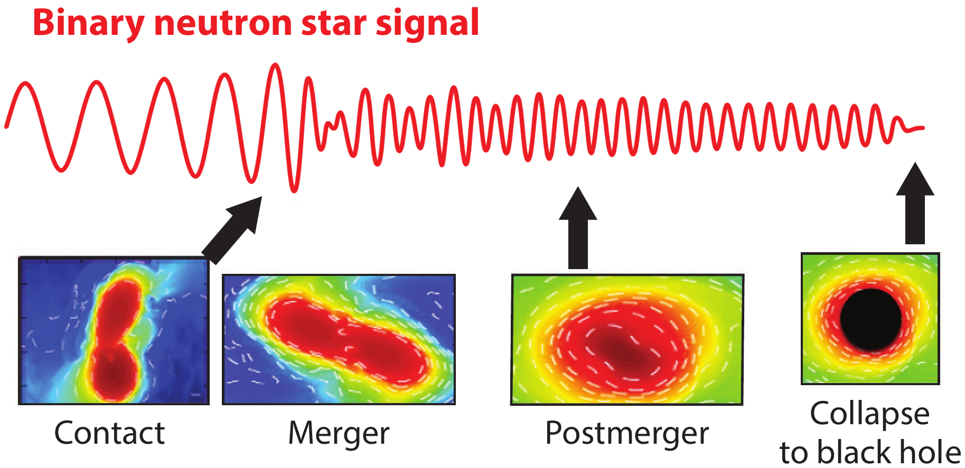
GWs from Binary Neutron Star mergers
EOS+Dynamics
M_{c}, q, χ_{eff}, Λ_{c}
Inspiral and merger produce strong GWs.
Post-merger: fainter, contains rich EOS features, within 1 – 4 kHz.
Expected to be observable with next-generation detectors.
Goal: Discriminate between EOS from the postmerger GW
BNS evolution diagram from Radice et al. (2020, left), GW stages diagram from Lattimer et al. (2021, right)

Slide 13
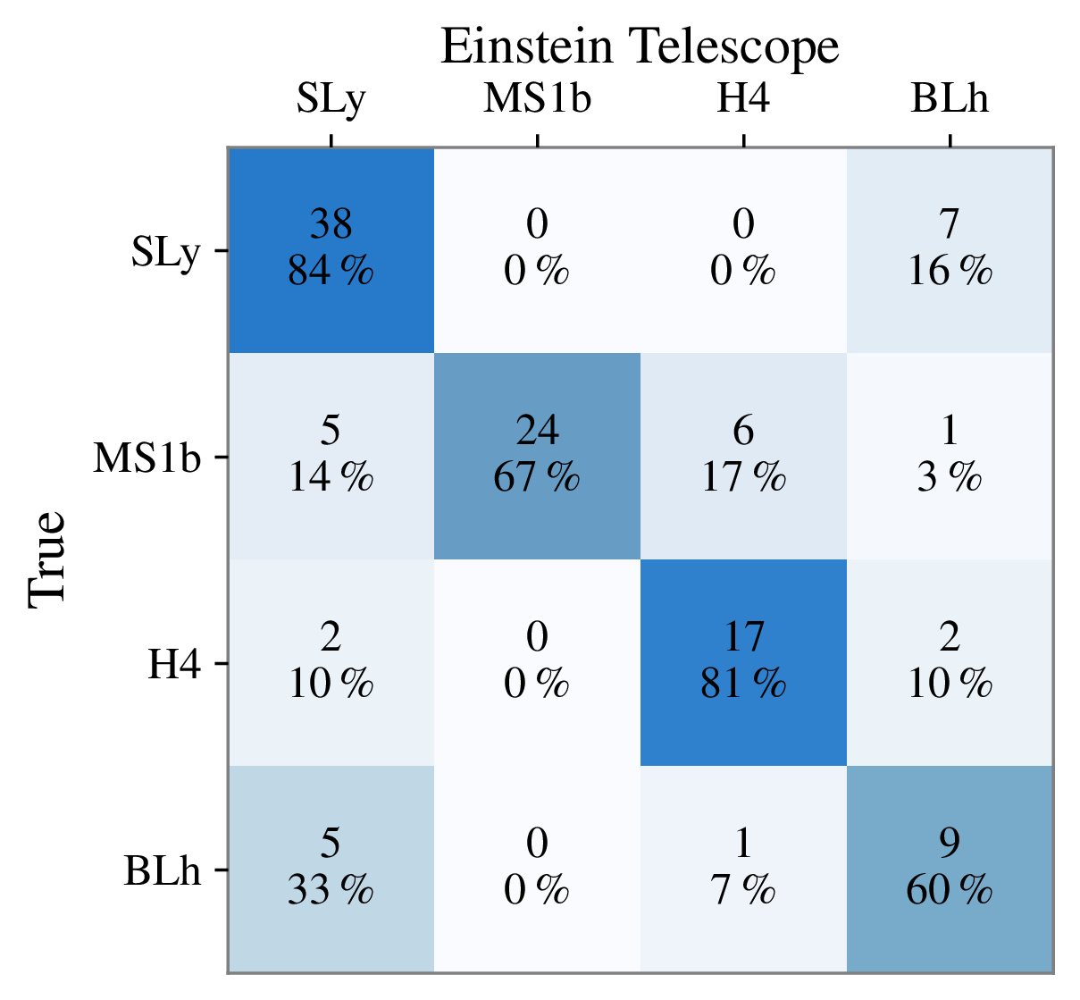
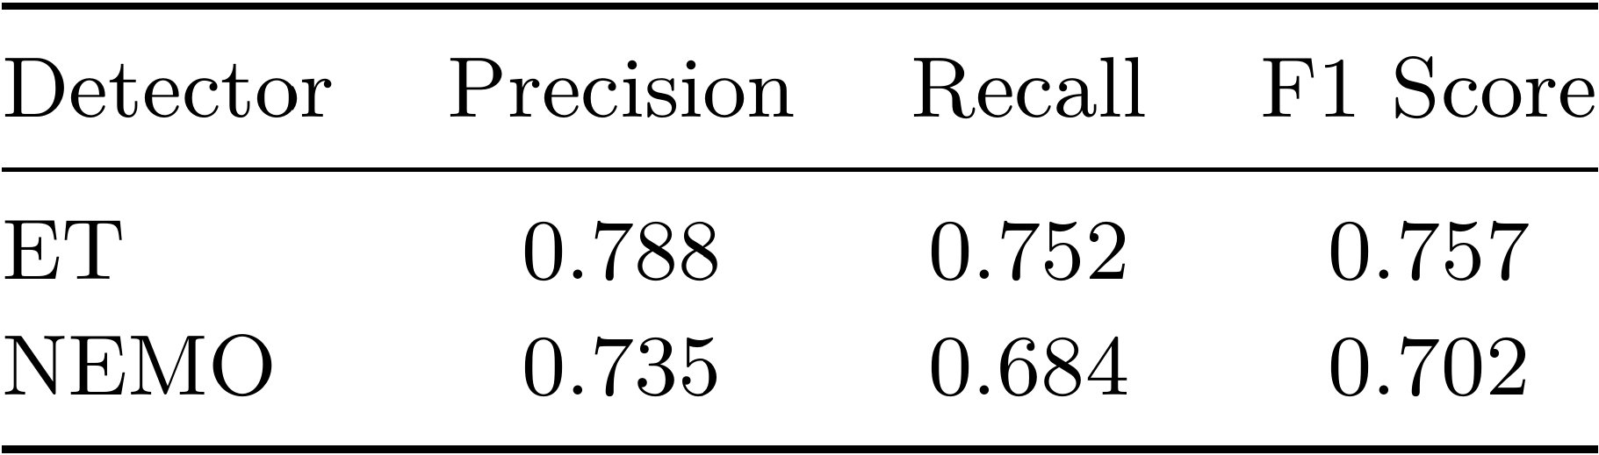
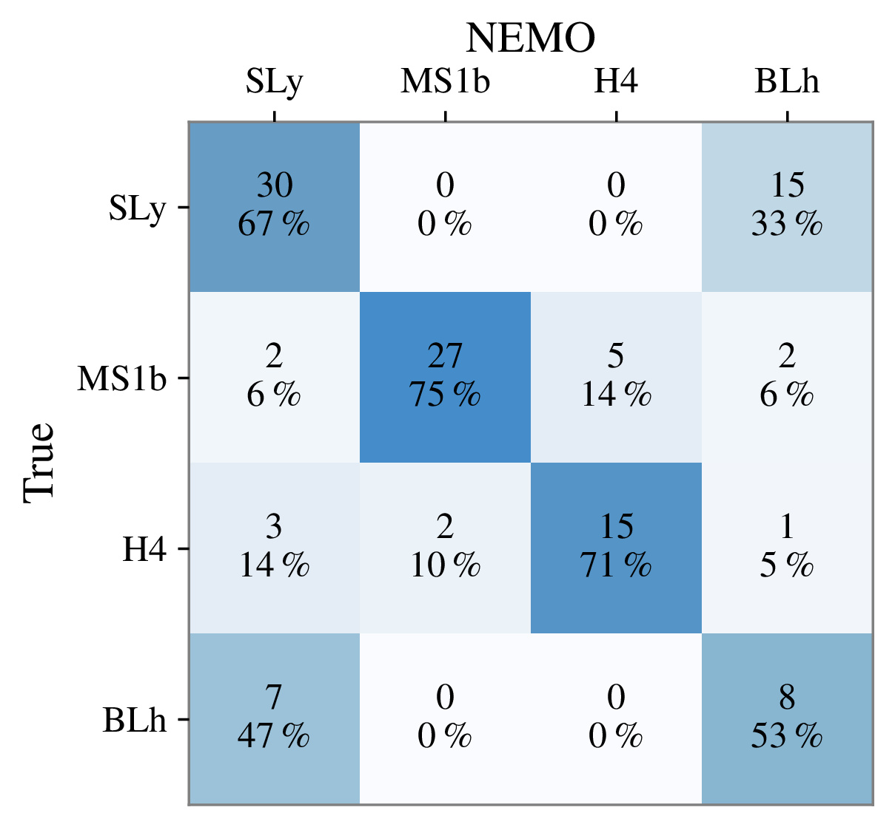
BNS postmerger classification
Confusion matrices
Performance metrics at SNR = 5
Precision → moderate reliability in positives.
Recall → more difficult to identify relevant signals in NEMO.
We can discriminate between EOS!
SLy-BLh confusion from class-specific features where detectors lose sensitivity.
Llorens-Monteagudo M. , Torres-Forné A & Font J. A. (in preparation)

Slide 14
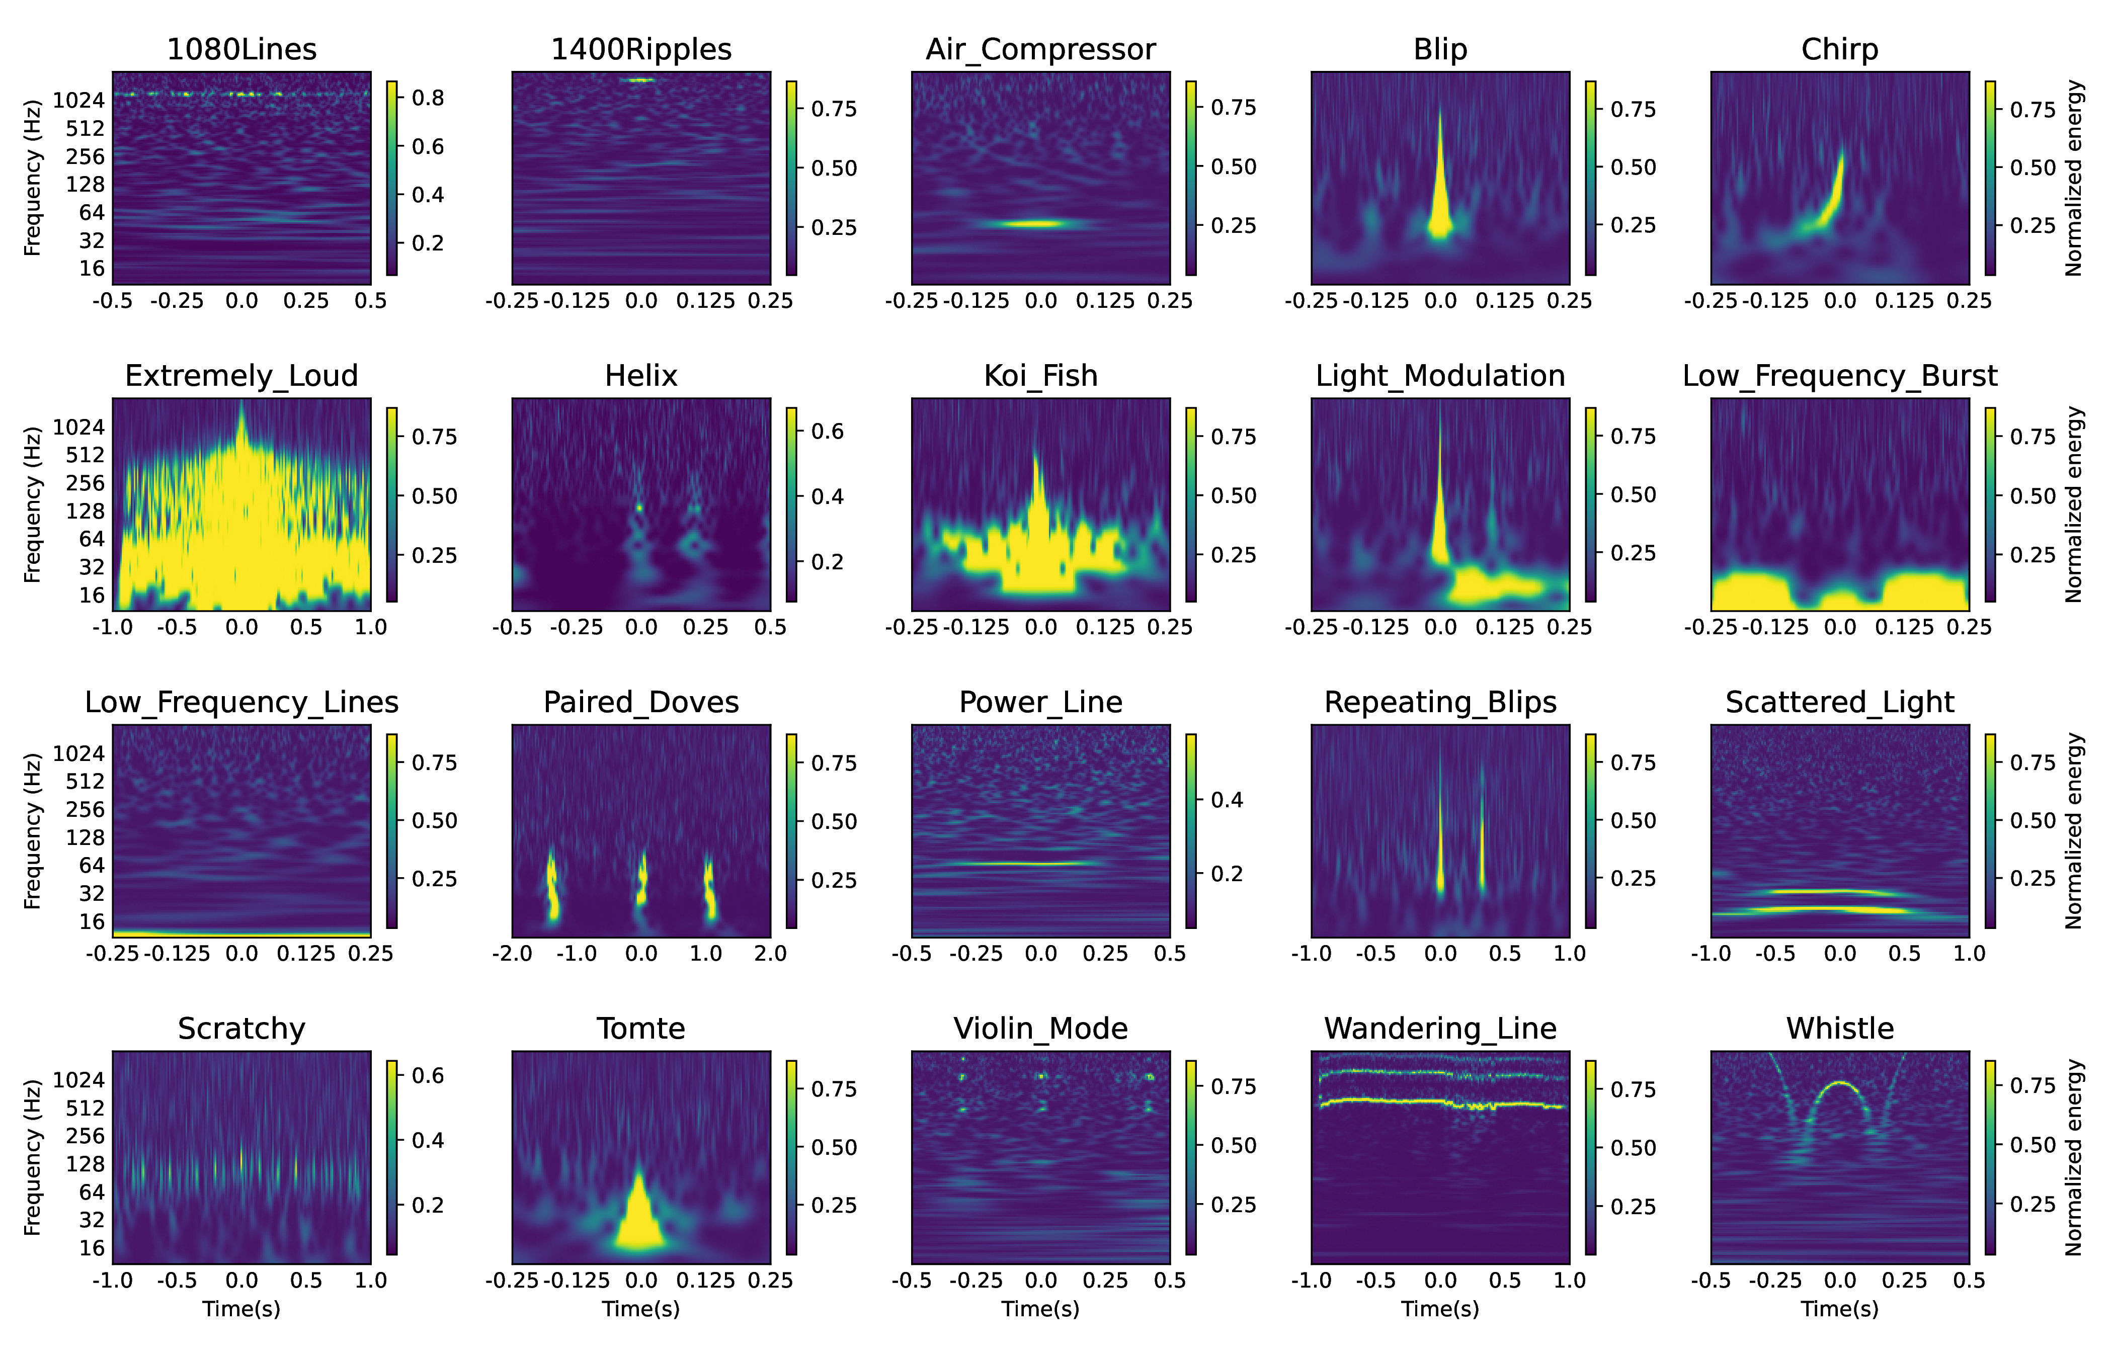
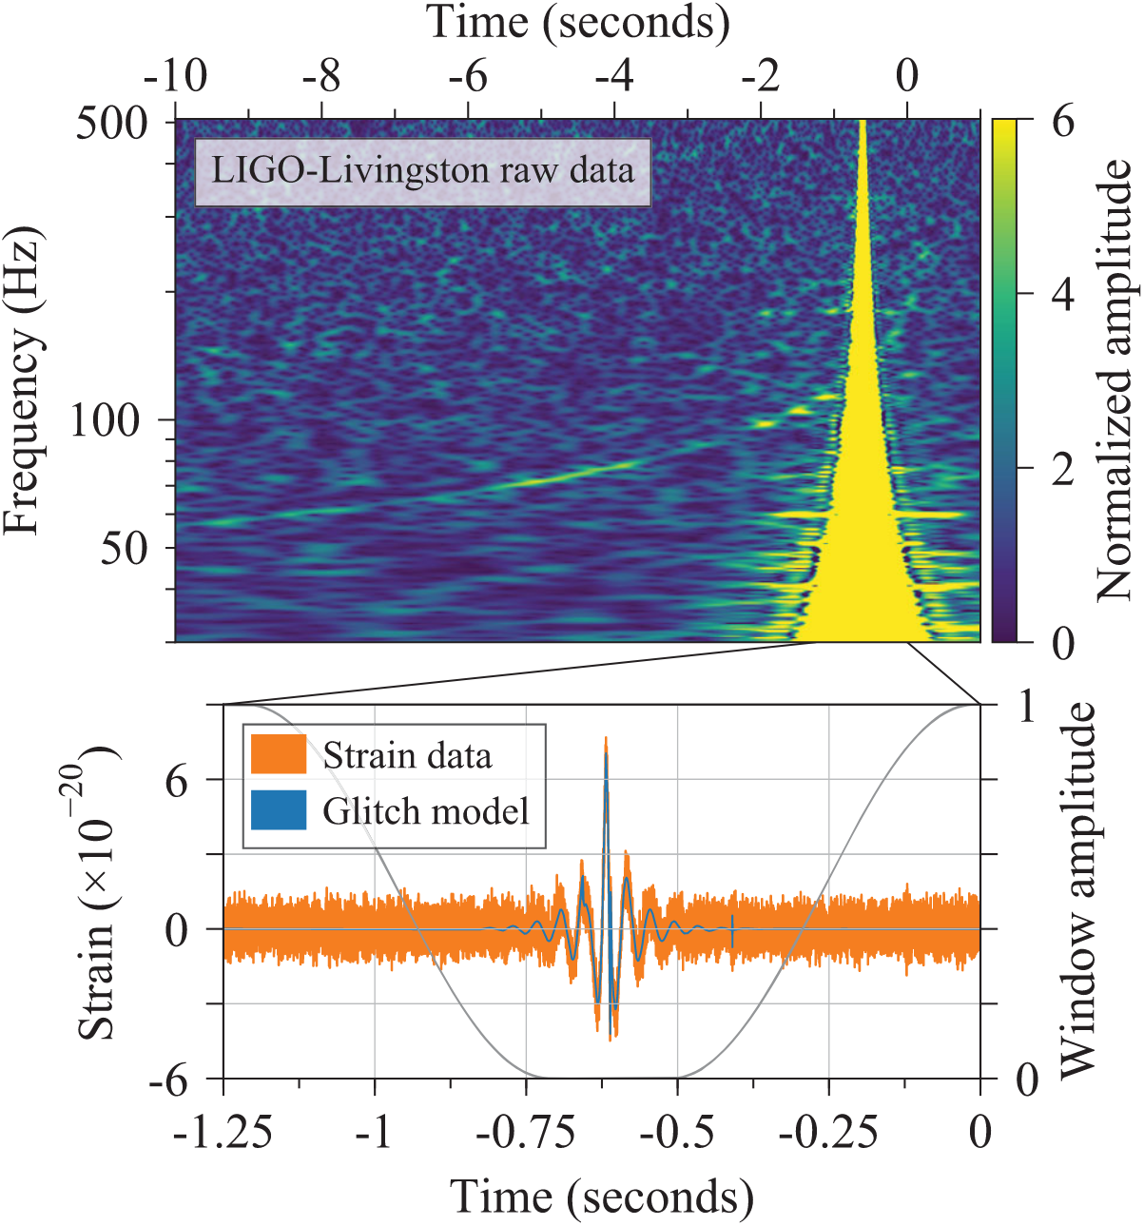
Glitches in LVK data
In all GW detectors
High diversity
Numerous origins
Can mimic GWs

Slide 15
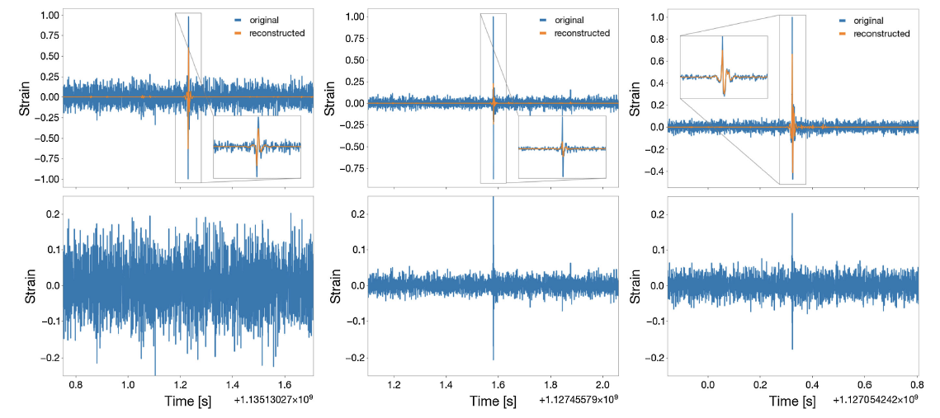
Glitch mitigation
Torres-Forné, A., Cuoco E., Marquina A. and Font J.A. Physical Review D, Volume 102, 2020

Slide 16
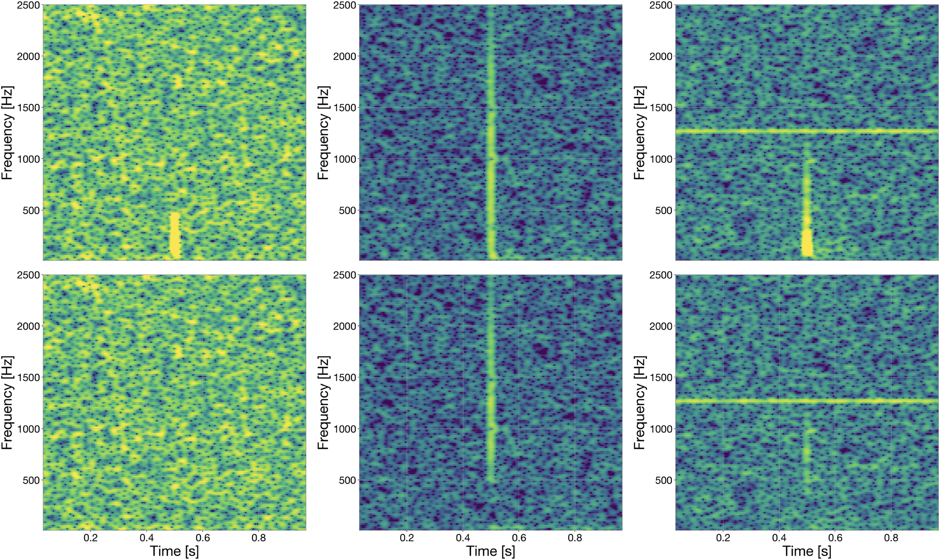
Blip denoising
Torres-Forné, A., Cuoco E., Marquina A. and Font J.A. Physical Review D, Volume 102, 2020

Slide 17
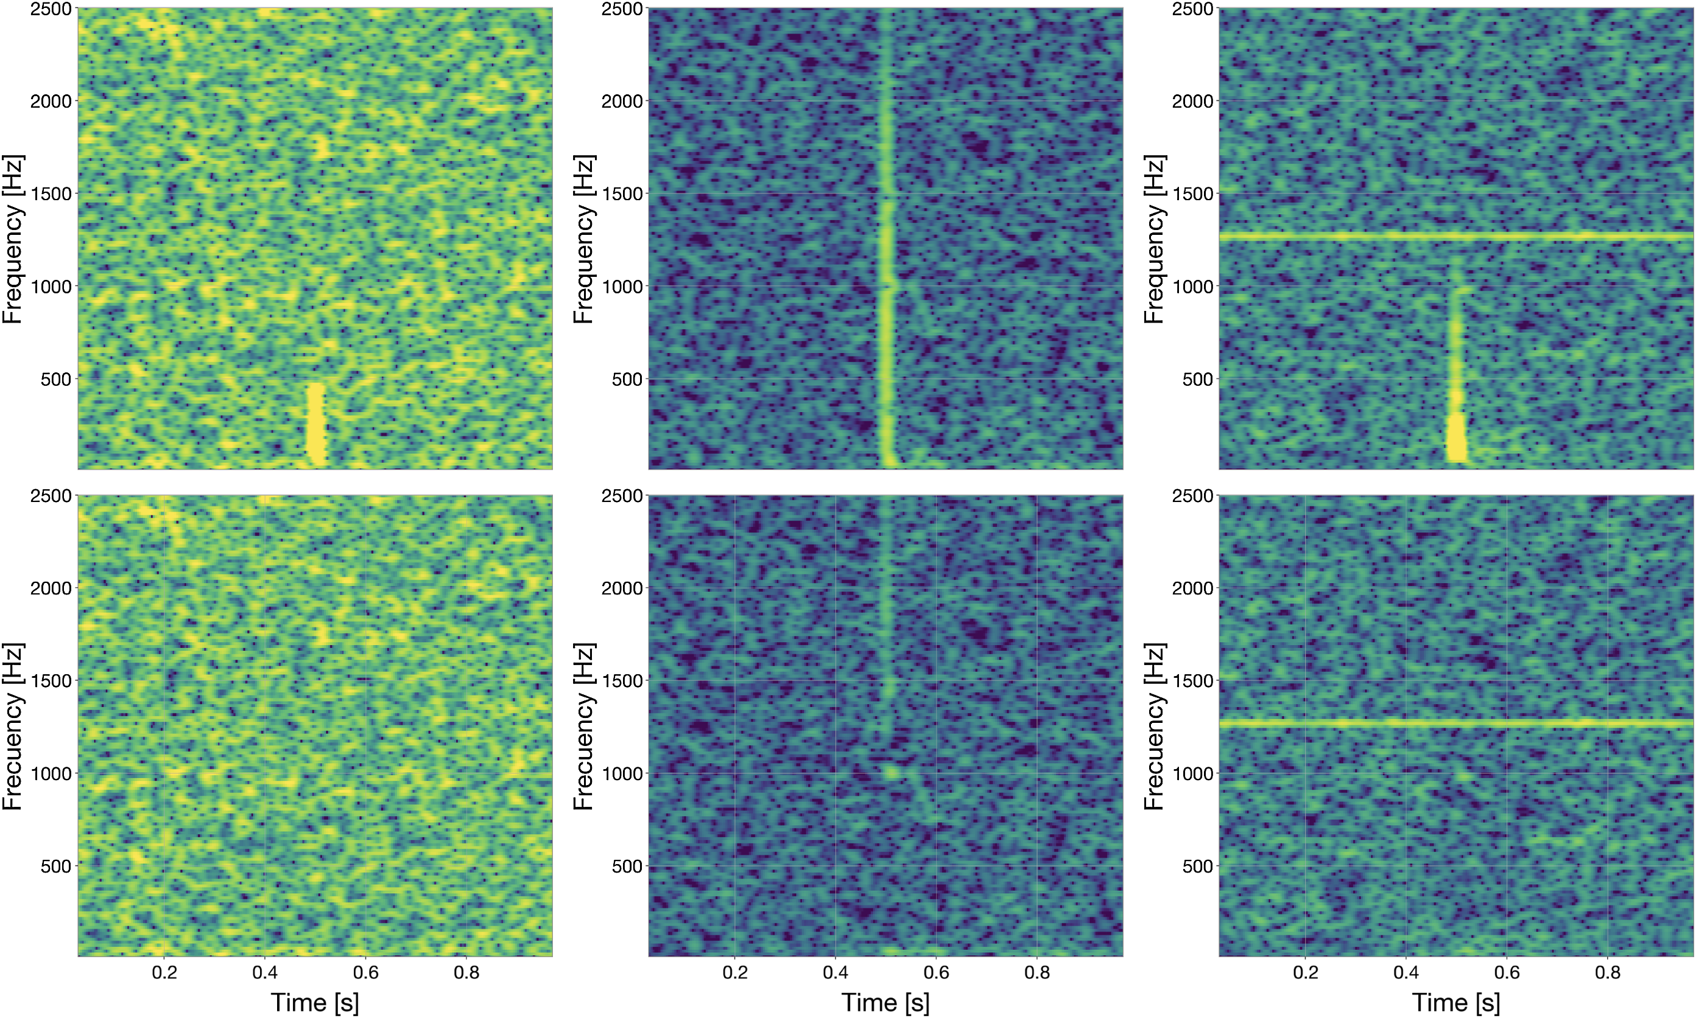
Blip denoising
Torres-Forné, A., Cuoco E., Marquina A. and Font J.A. Physical Review D, Volume 102, 2020

Slide 18
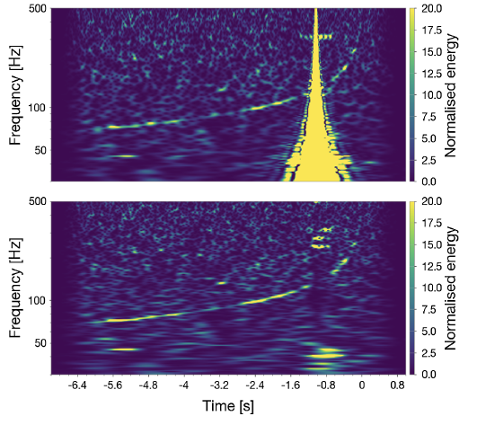
GW170817 – Livingston data
Torres-Forné A., Cuoco E., Marquina A. and Font J.A. Physical Review D, Volume 102, 2020

Slide 19
GW170817 – Livingston data
Torres-Forné, A., Cuoco E., Marquina A. and Font J.A. Physical Review D, Volume 102, 2020

Slide 20
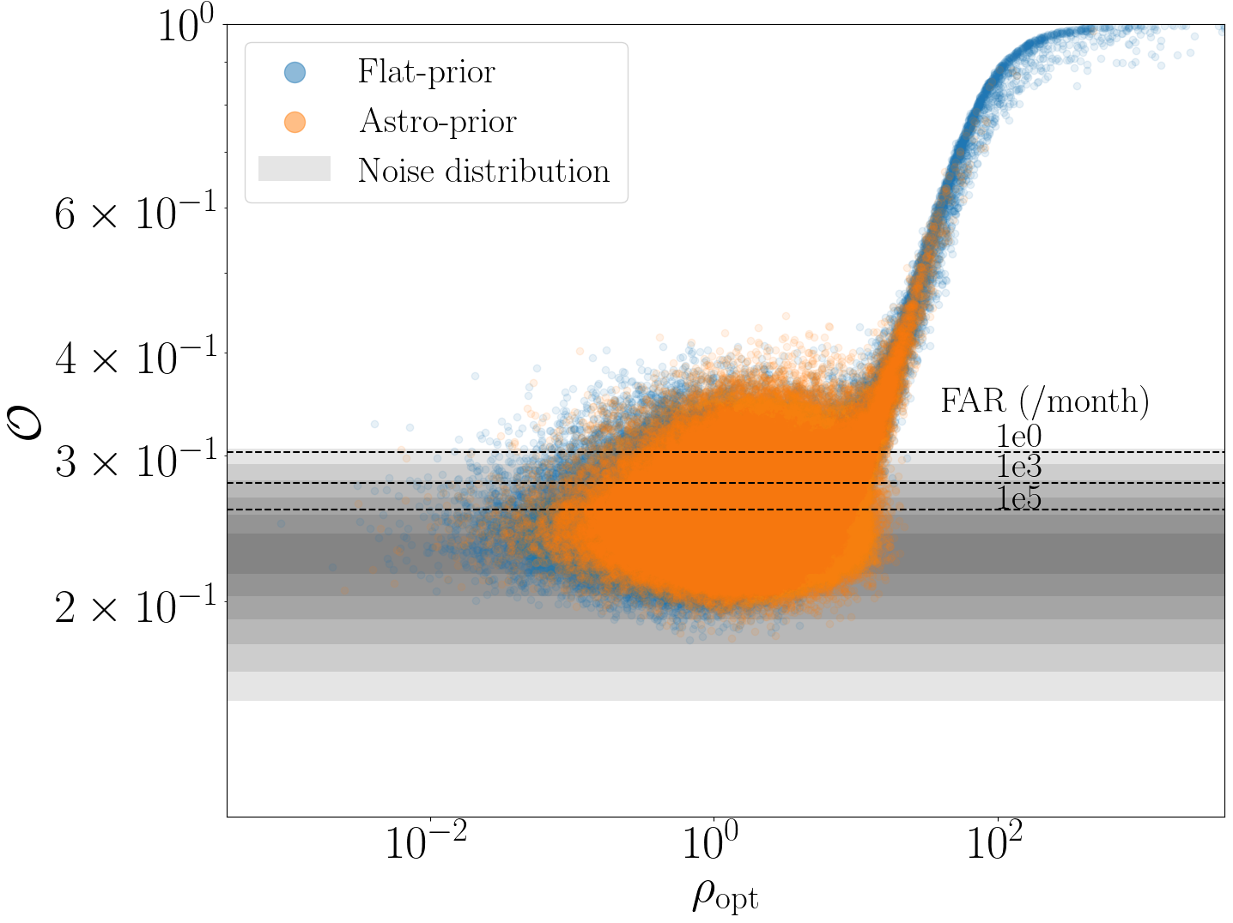
Towards a SDL pipeline for BBH detection
Two suites of 150,000 BBH injections overlaid with A+ detector noise
Flat-prior population
Astrophysical population Isolated field binaries, simulated using a binary population synthesis code (COSMIC) and assuming a star formation model.
[Srinivasan, R., et al. 2023, MNRAS, 524(1), pp.60-75.].
Badger C., Srinivasan R., Torres-Forné A., Lamberts A., Bizouard M. A., Font J. A., Sakellariadou M. Physical Review D, Volume 111, 2025

Slide 21
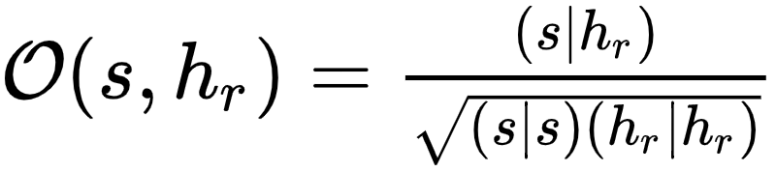
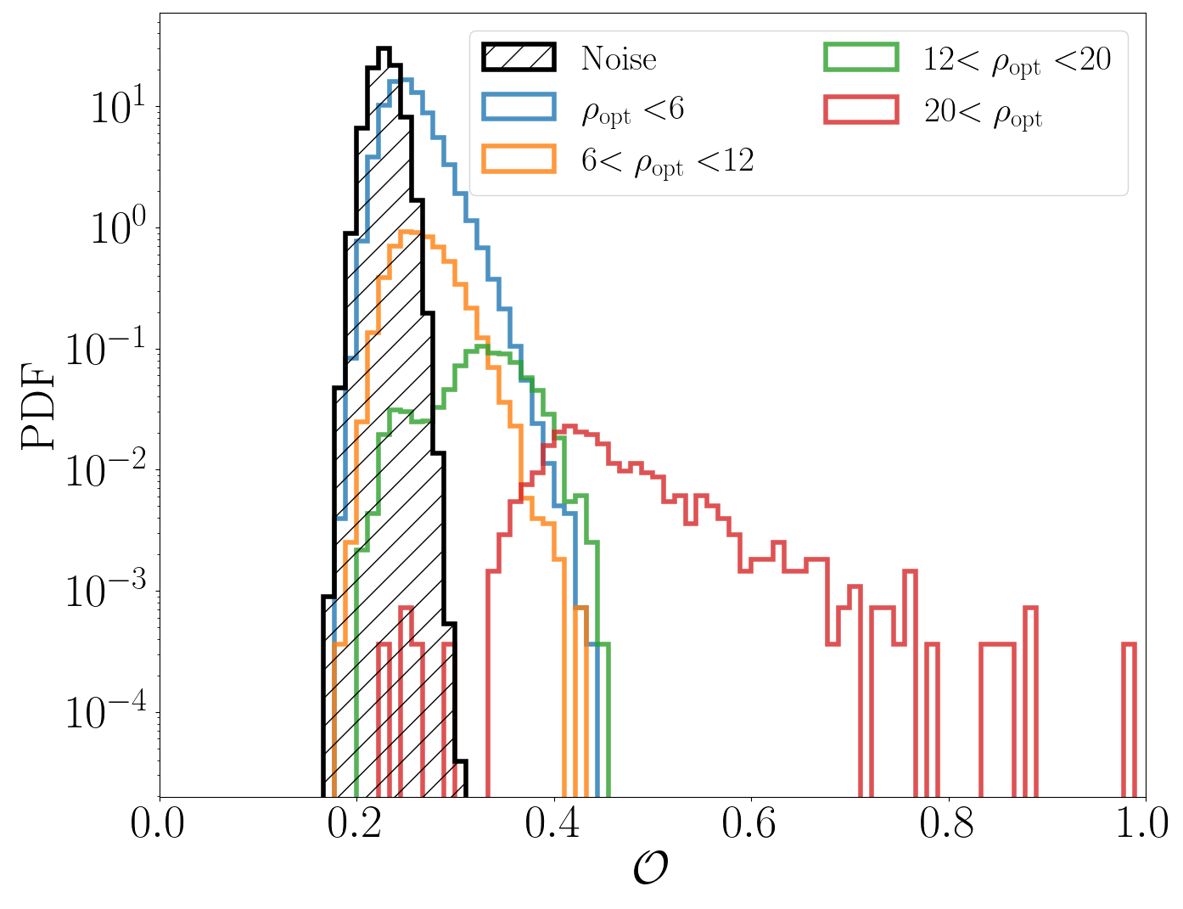
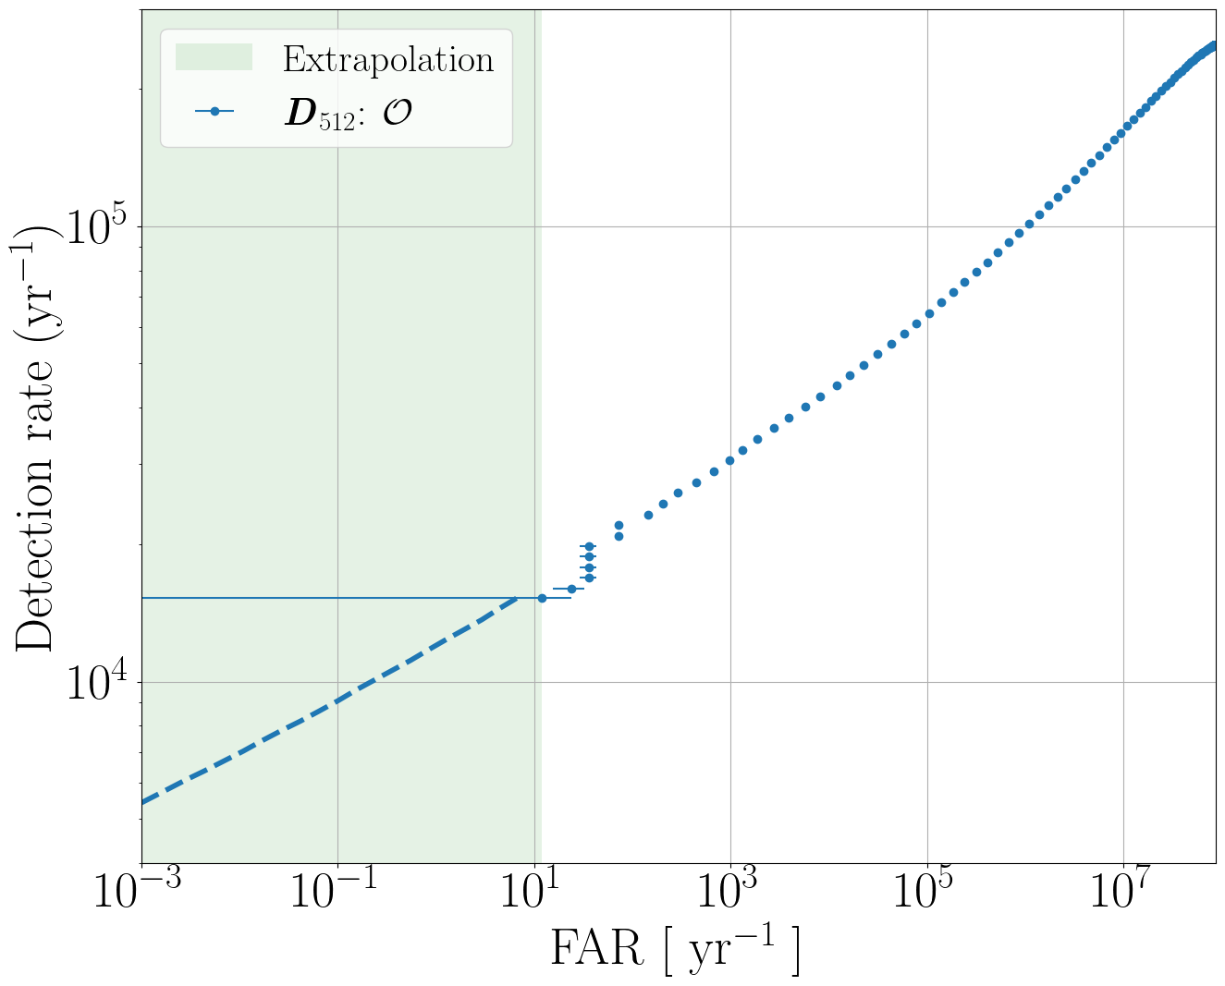
Towards a SDL pipeline for BBH detection
Our detection metric (overlap) distribution
ROC curve
Badger C., Srinivasan R., Torres-Forné A., Lamberts A., Bizouard M. A., Font J. A., Sakellariadou M. Physical Review D, Volume 111, 2025

Slide 22
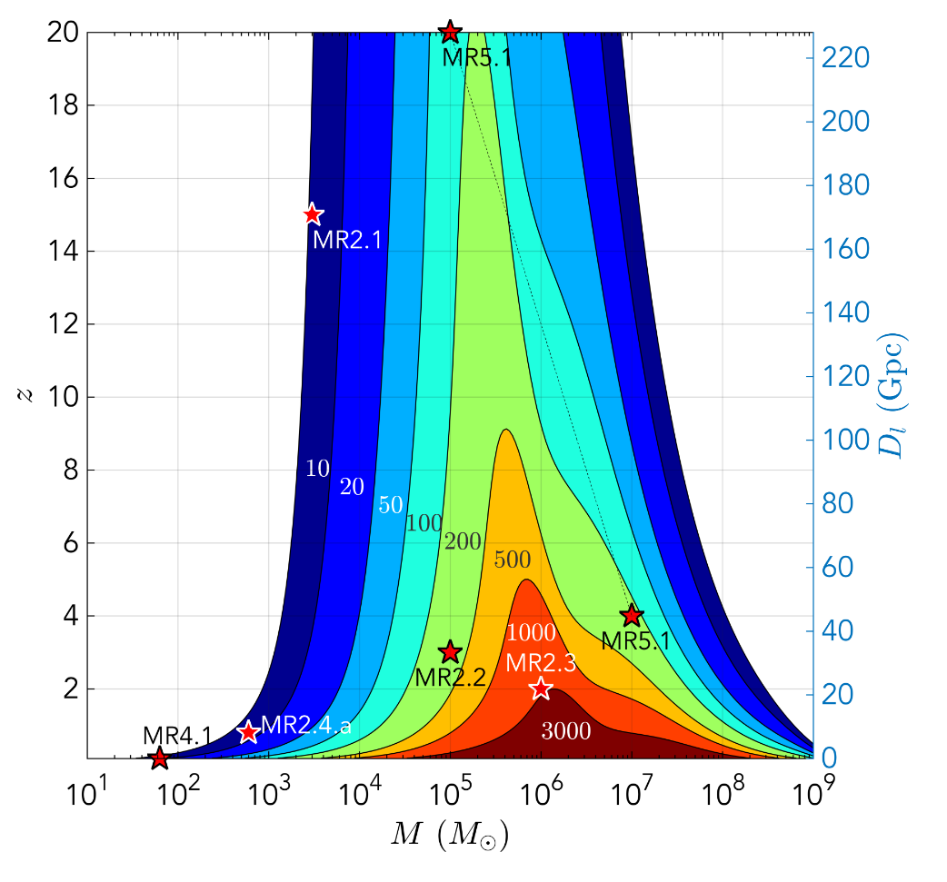
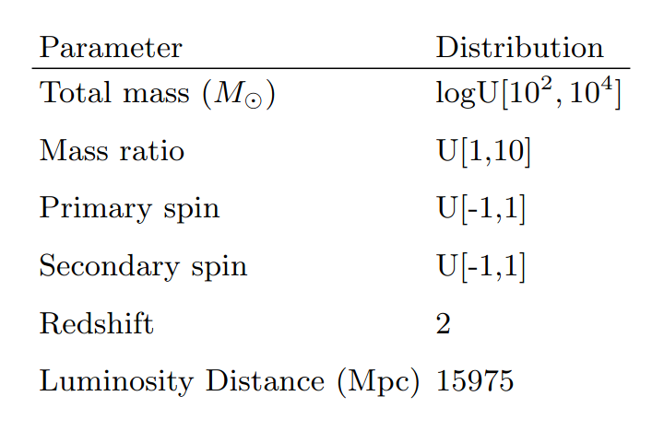
Detecting BBH in the Presence of Galactic Noise with LISA
We use the IMRPhenomD approximant¹
to model waveforms of massive black hole binary mergers detectable by LISA.
SNR of binaries with constant mass ratio = 5.
Badger C., Martinovic K., Torres-Forné A., Sakellariadou M., and Font J.A. Physical Review Letters 130, 091401 (2023)

Slide 23
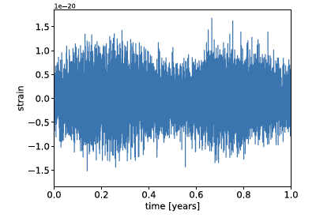
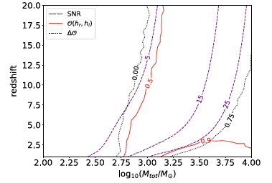
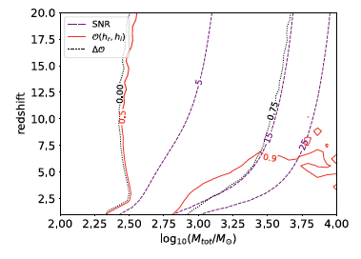
Detecting BBH in the Presence of Galactic Noise with LISA
Our method proves extremely successful for binaries with total mass greater than ∼3 x 10³ M up to redshift 3 in conservative scenarios, and up to redshift 7.5 in optimistic scenarios.
Strong
Weak
Badger C., Martinovic K., Torres-Forné A., Sakellariadou M., and Font J.A. Physical Review Letters 130, 091401 (2023)

Slide 24
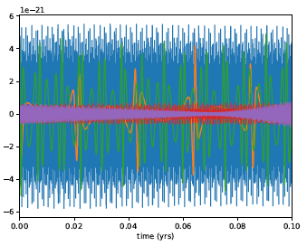
EMRI Dataset Characteristics
Modeled using AAK (Augmented Analytic Kludge) models with 14 parameters.
Dataset: 2000 one-year waveforms with 5-second cadence (dt=5s).
Black hole mass (MBH) between 10^{5.4} and 10⁷ M⊙.
Eccentricities ranging from 0 to 0.7.
Waveforms rescaled for different luminosity distances.
Badger C., Font J.A., Sakellariadou M., and A. Torres-Forné Physical Review D, Volume 110, Issue 6, (2025)

Slide 25
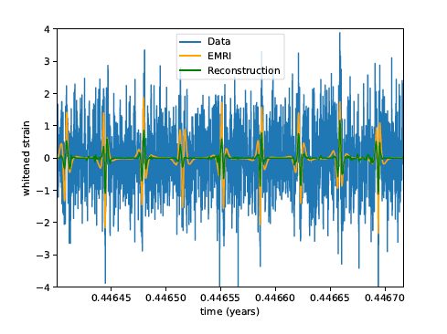
Reconstruction Accuracy of EMRI Waveforms
False Alarm Rate (FAR):
  Estimated using 2000 one-year LISA noise simulations.
  For EMRIs with BH masses ≈ 10⁵.⁴ M☉, eccentricity < 0.3, and distance < 0.03 Gpc, FAR < 0.001 yr⁻¹.
  Systems with larger BH masses (∼10⁶ M☉) showed FAR > 0.1 yr⁻¹ due to lower SNR.
SNR and Detection Confidence:
  EMRIs with high SNRs (e.g., lower-eccentricity and nearby systems) yield mismatches < 0.1.
  Even high-eccentricity systems achieved good reconstructions due to strong waveform features.
Observation Time Impact:
  Longer observations increase accuracy and reduce FAR.
  Half-year of data yields FAR < 0.002 yr⁻¹ with 95% confidence.
  One-year observation of nearby systems (< 0.01 Gpc) achieves mismatches < 0.25.
Short-Time Reconstruction:
  Accurate waveform reconstruction possible in short windows (~2.8 hours) within a full-year signal.
  Minimum mismatch of 0.06 achieved at peak signal amplitude.
Badger C., Font J.A., Sakellariadou M., and A. Torres-Forné Physical Review D, Volume 110, Issue 6, (2025)

Slide 26
Conclusions
  CCSN explosion mechanism inference
    Able to tell apart magnetorotational mechanisms from neutrino-driven and no explosion.
    Optimized for LIGO, but promising results for ET and NEMO.
  BNS postmerger EOS classification
    Effective down to SNR 5 in both ET and NEMO.
    Consistent association of unknown EOS with a broadly physically similar EOS of the training set.
  Glitch mitigation
    Effective to remove glitches keeping the background unaltered.
    Need to extend to all classes of glitches.
  Fast detection of BBH
    In A+ sensitivity, most BBHs with SNR > 12 can be detected with FAR < 1/mo.
    10⁴ yr ⁻¹ with FAR <1/month, estimate 5000 events with FAR<1/Myr
  Detection of BBH in LISA
    In A+ sensitivity, most BBHs with SNR > 12 can be detected with FAR < 1/mo.
    10⁴ yr ⁻¹ with FAR <1/month, estimate 5000 events with FAR<1/Myr
  Reconstruction and detection of EMRI
    EMRIs with masses around 10⁵.⁴ M☉, low eccentricity (< 0.3), and distances < 0.03 Gpc can be reliably detected with FAR < 0.001 yr⁻¹.

Slide 27
Thank you for attention!

