Slide 1




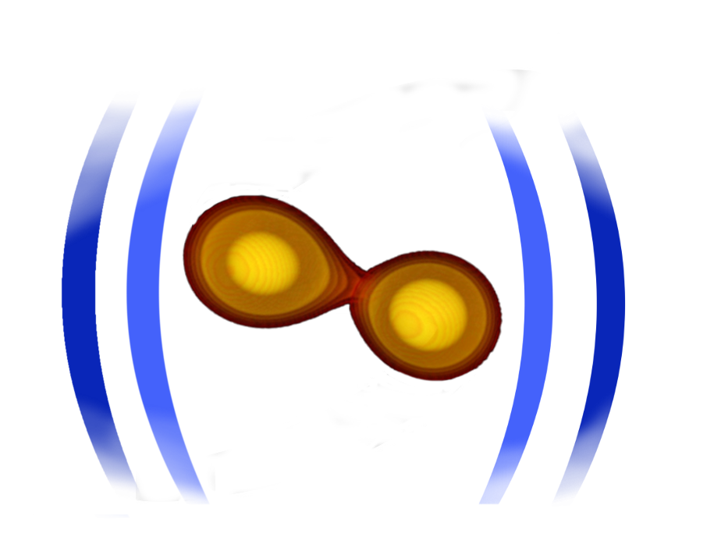






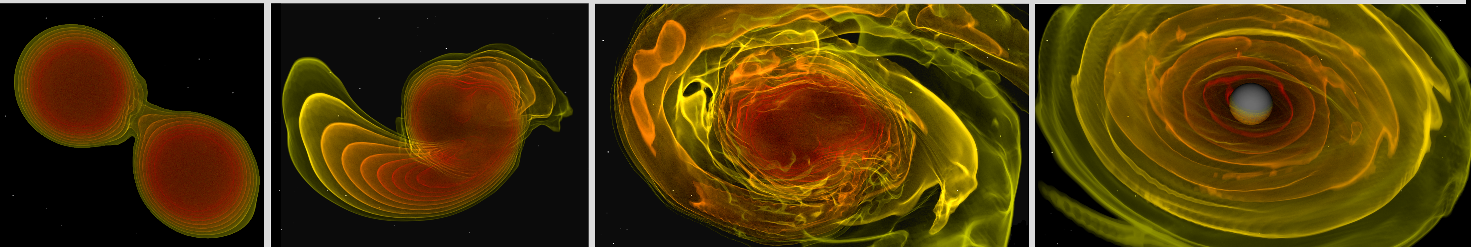
Simulating and Interpreting the Multimessenger Picture of Neutron Star Mergers
Tim Dietrich
University of Potsdam
Max Planck Institute for Gravitational Physics
18th of June 2025
Notes:
1

Slide 2
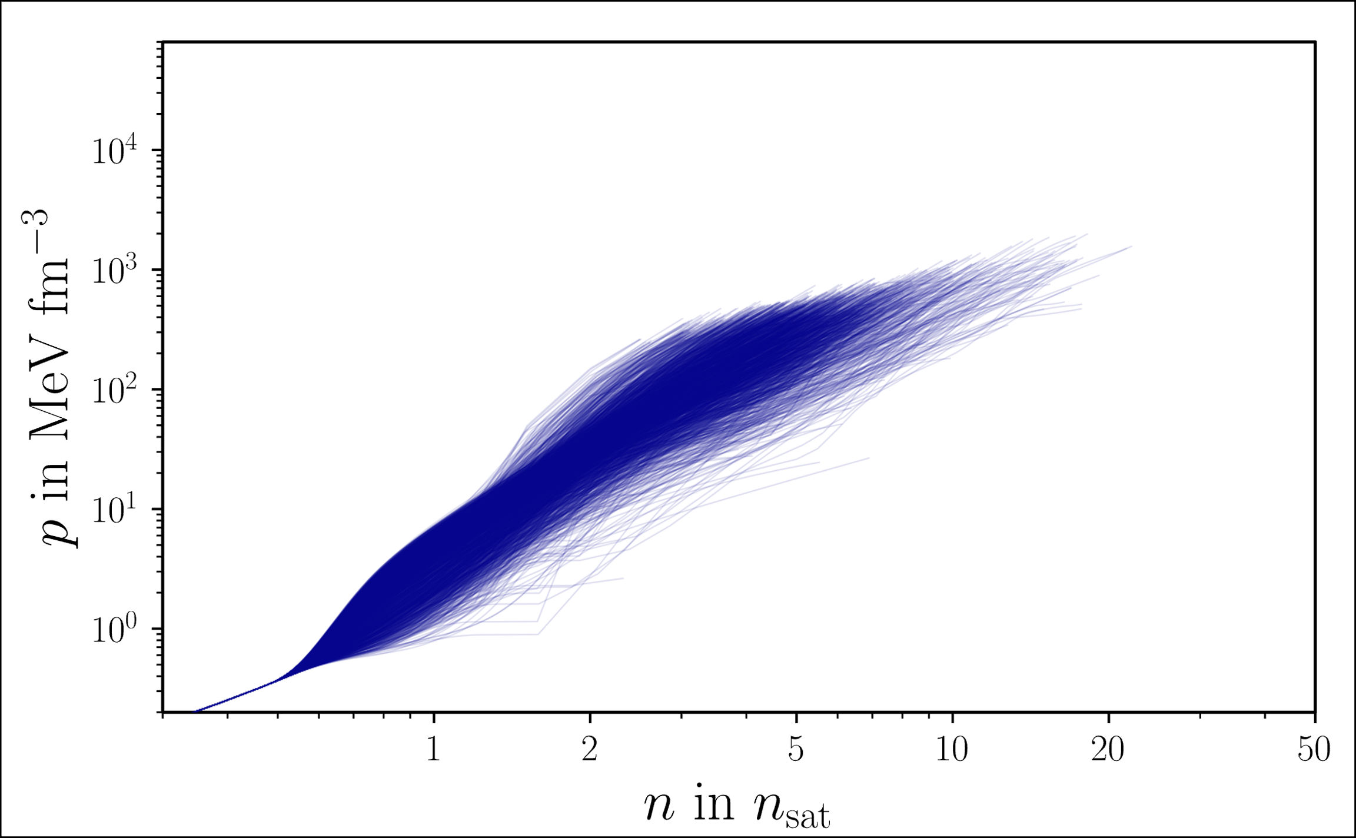
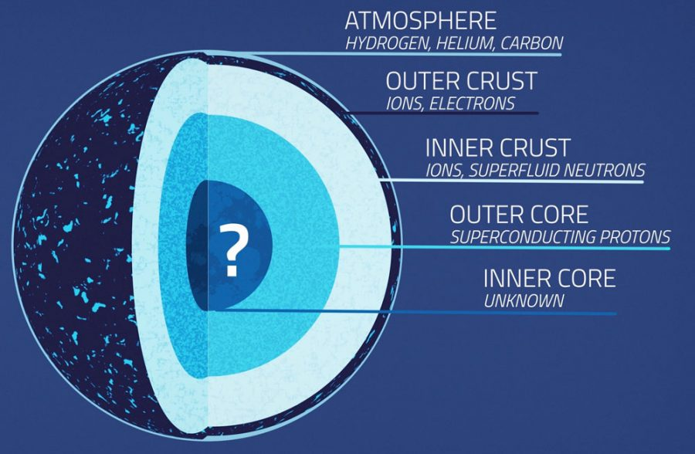
Neutron stars… our astrophysical laboratory
- collapsed core of massive star
- smallest and densest known class of stellar compact objects
- typical size of 12 kilometer and masses between one and two solar masses
Equation of state computed with the metamodel (cf. talk by Anthea Fantina)
The equation of state inside the stars cores are unknown, but the global properties allow us to draw some reasonable conclusions.
NASA

Slide 3
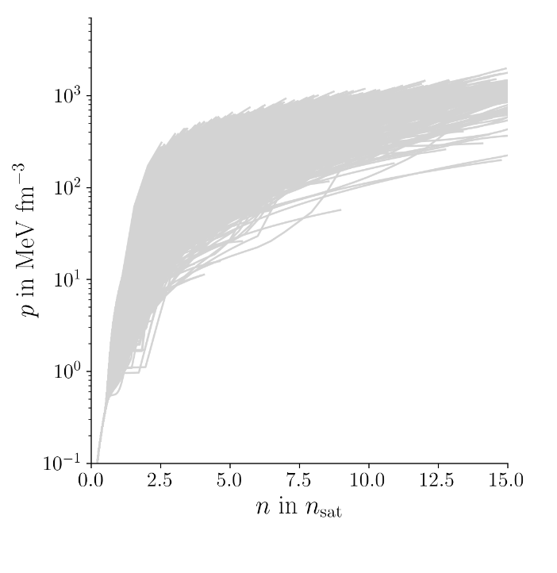
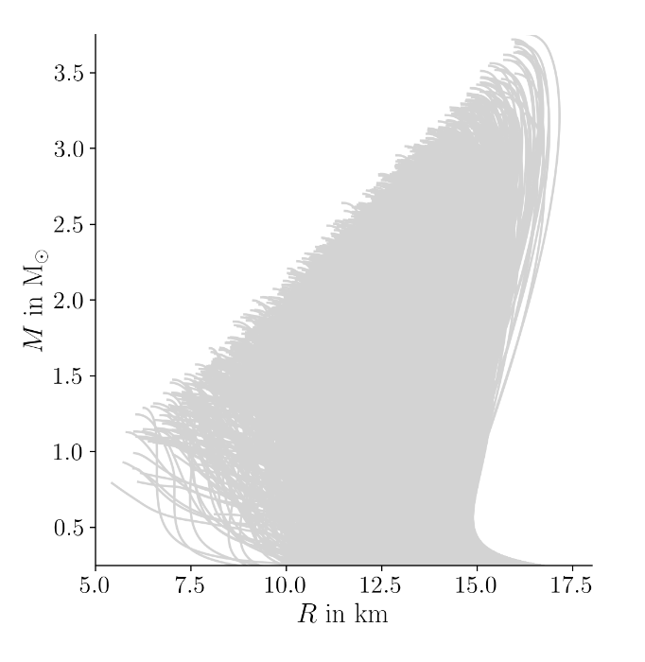
Input from a variety of sources
Koehn et al. 2024, PRX 15 (2025) 2, 021014
Work done by H. Koehn, H. Rose et al.

Slide 4
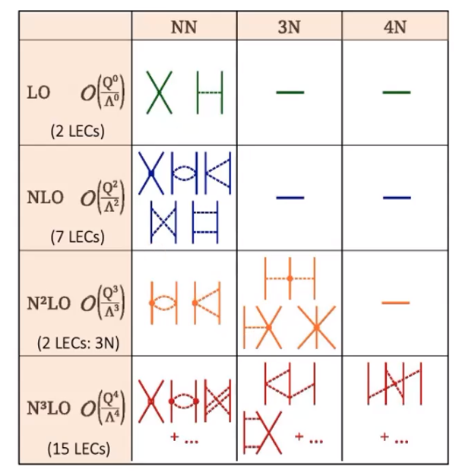
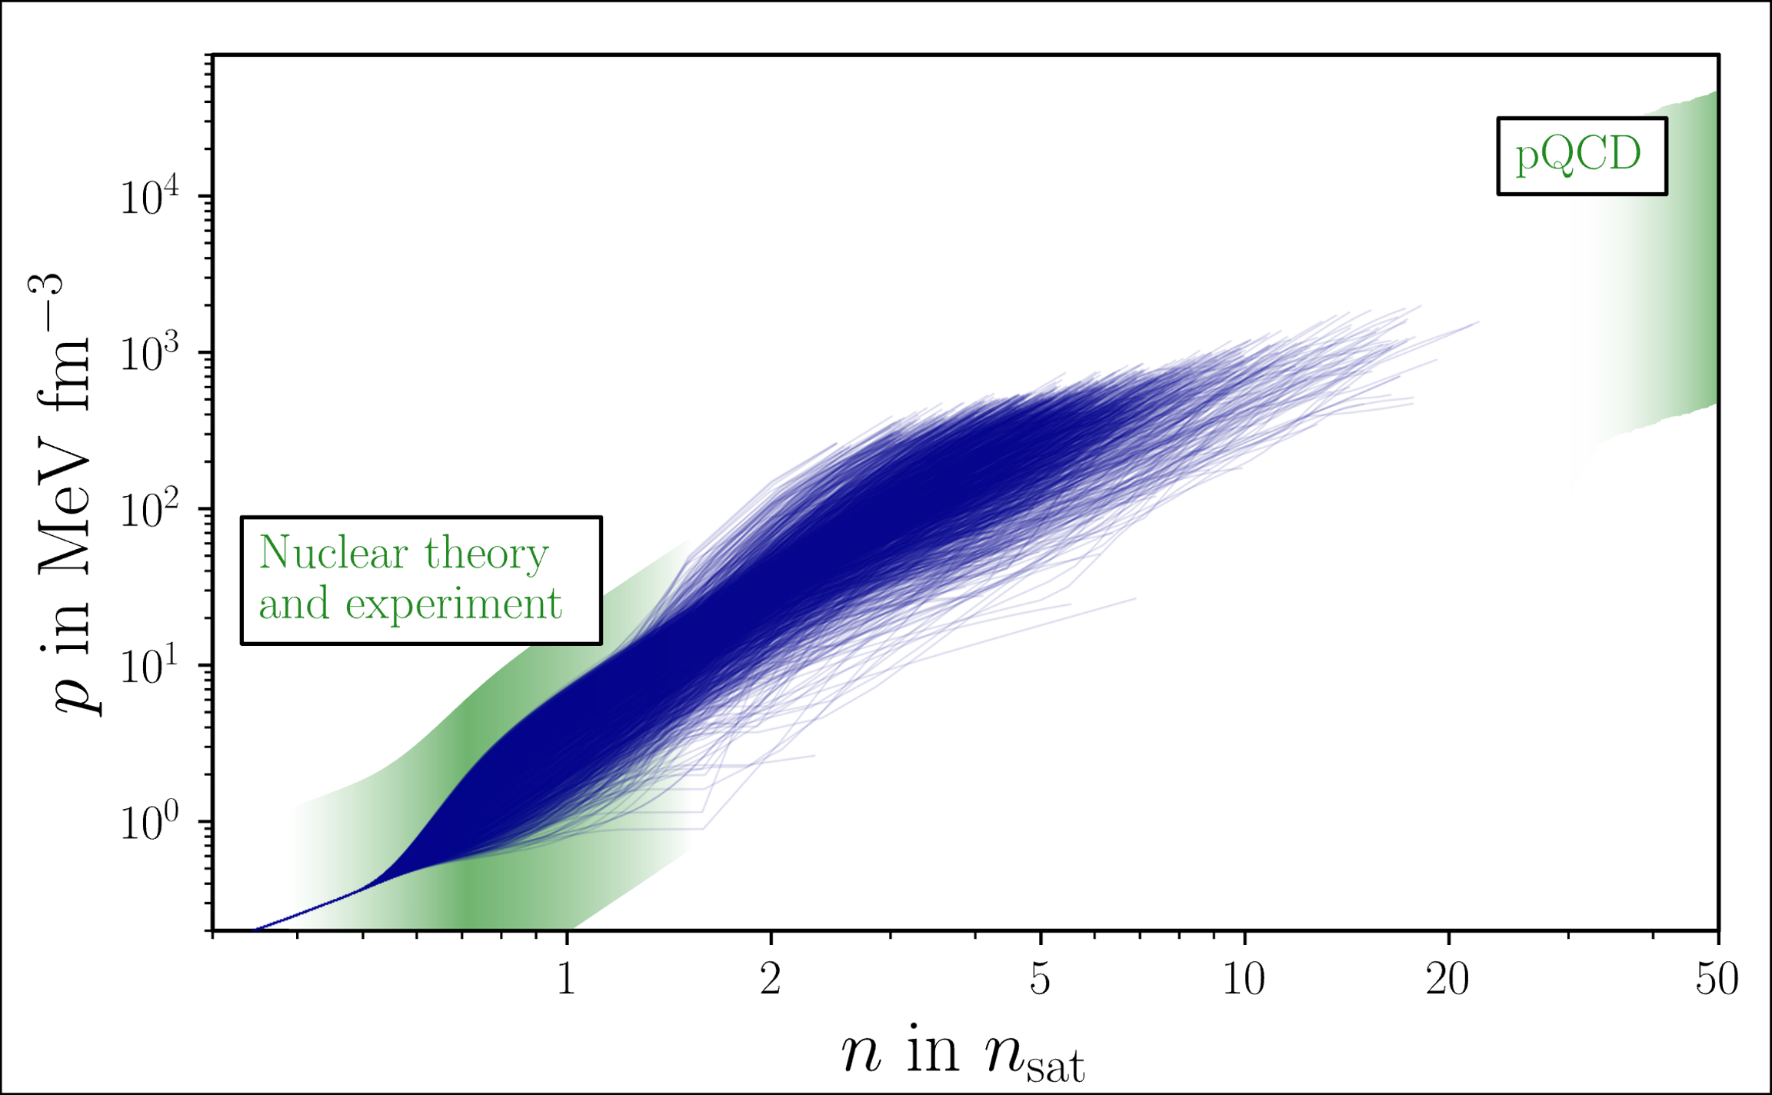
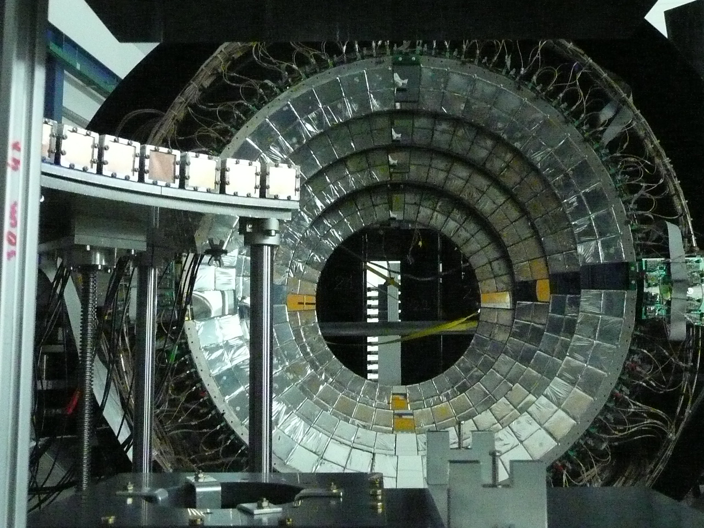
Input from a variety of sources
Nuclear Physics
Koehn et al. 2024, PRX 15 (2025) 2, 021014
Koehn et al. 2024, 2402.04172
Chiral EFT
pQCD
PREX-II/ CREX
Pb dipole measurement
Heavy Ion Collisions
…
Work done by H. Koehn, H. Rose et al.

Slide 5
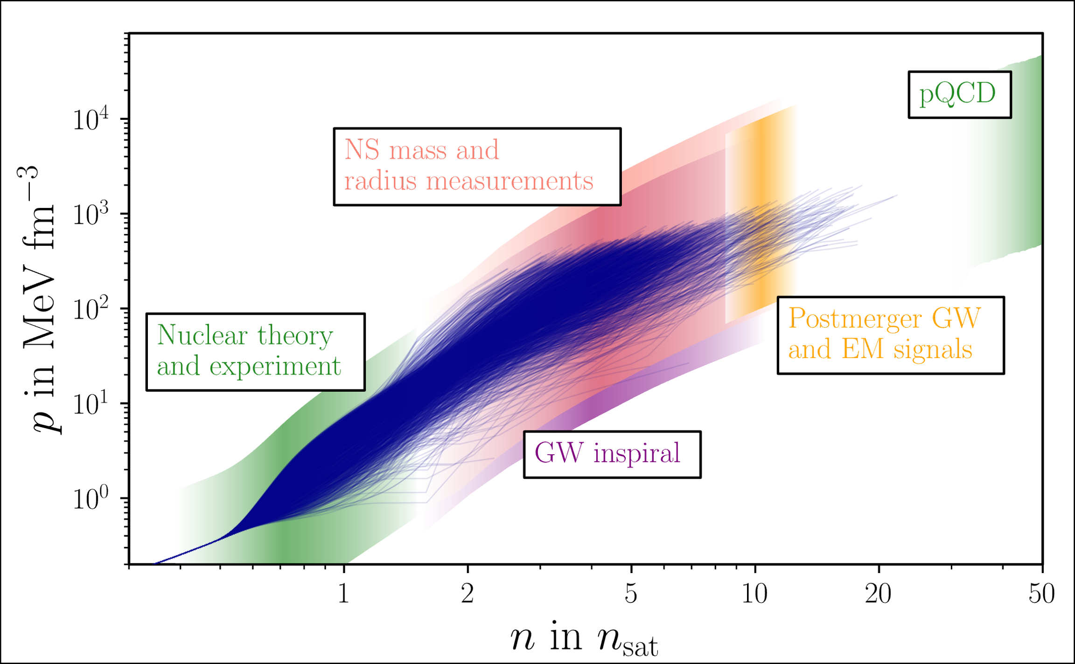
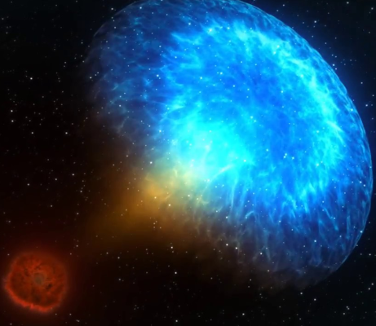
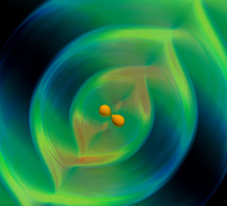
Input from a variety of sources
Nuclear Physics
Koehn et al. 2024, PRX 15 (2025) 2, 021014
Chiral EFT
pQCD
PREX-II/ CREX
Pb dipole measurement
Heavy Ion Collisions
…
Astrophysics
Heavy pulsars
NICER
HESS object
qLMXBs
Thermo-nuclear accretion
bursts
GW170817
+ AT2017gfo
+ GRB170817A
GW190425
GRB211211A
Post-merger constraints from GW170817
Work done by H. Koehn, H. Rose et al.

Slide 6
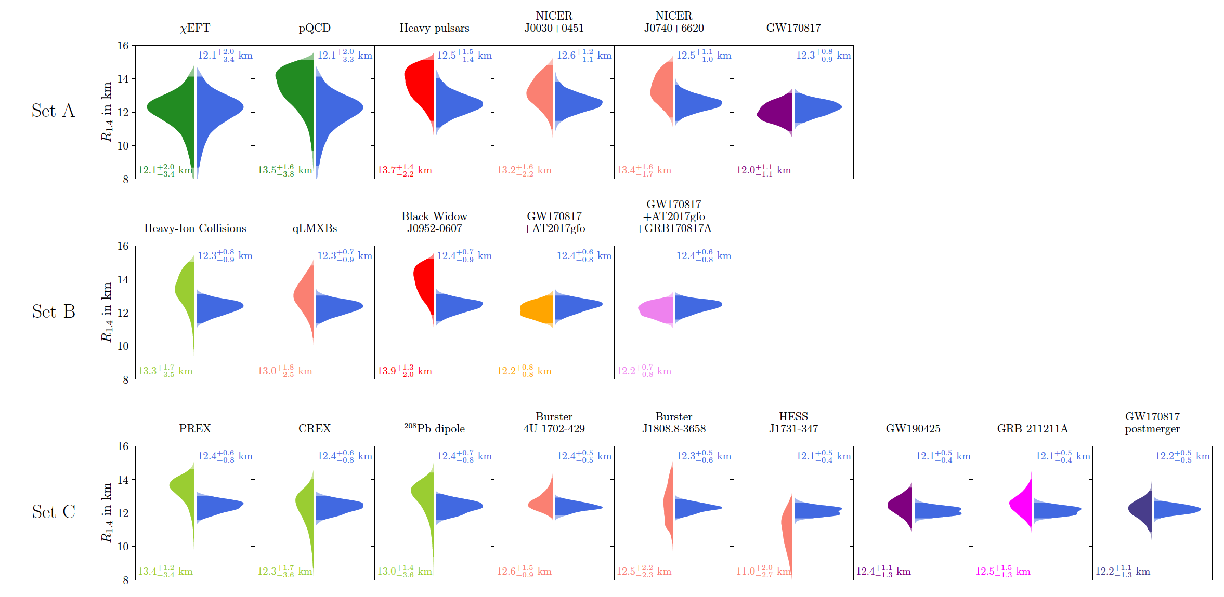
Input from a variety of sources
Nuclear Physics
Koehn et al. 2024, PRX 15 (2025) 2, 021014
Chiral EFT
pQCD
PREX-II/ CREX
Pb dipole measurement
Heavy Ion Collisions
…
Astrophysics
Heavy pulsars
NICER
HESS object
qLMXBs
Thermo-nuclear accretion
bursts
GW170817
+ AT2017gfo
+ GRB170817A
GW190425
GRB211211A
Post-merger constraints from GW170817
Work done by H. Koehn, H. Rose et al.

Slide 7

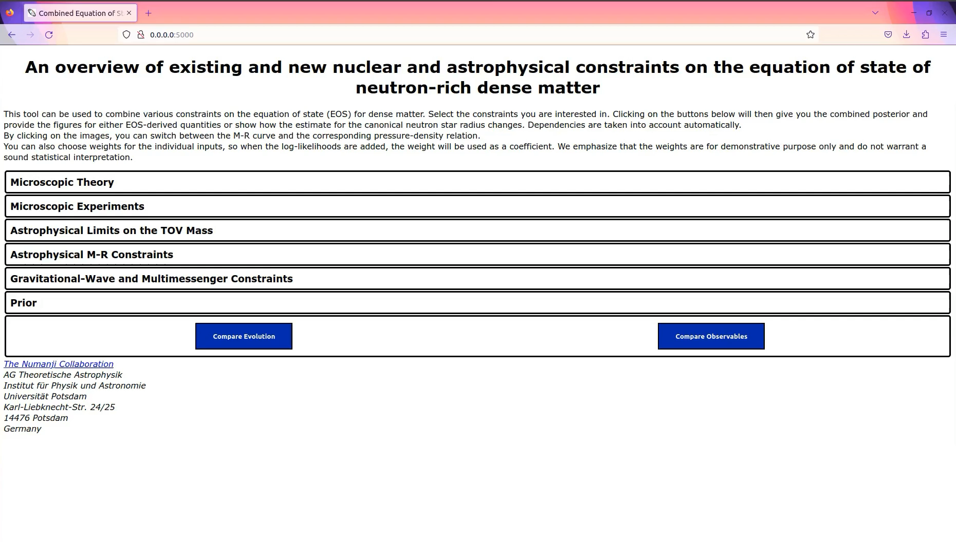
Input from a variety of sources
Nuclear Physics
Koehn et al. 2024, PRX 15 (2025) 2, 021014
Chiral EFT
pQCD
PREX-II/ CREX
Pb dipole measurement
Heavy Ion Collisions
…
Astrophysics
Heavy pulsars
NICER
HESS object
qLMXBs
Thermo-nuclear accretion
bursts
GW170817
+ AT2017gfo
+ GRB170817A
GW190425
GRB211211A
Post-merger constraints from GW170817

Slide 8
Input from a variety of sources
Nuclear Physics
Koehn et al. 2024, PRX 15 (2025) 2, 021014
Chiral EFT
pQCD
PREX-II/ CREX
Pb dipole measurement
Heavy Ion Collisions
…
Astrophysics
Heavy pulsars
NICER
HESS object
qLMXBs
Thermo-nuclear accretion
bursts
GW170817
+ AT2017gfo
+ GRB170817A
GW190425
GRB211211A
Post-merger constraints from GW170817

Slide 9

The Binary Neutron Star Merger Simulation
gravitational wave emission

Slide 10
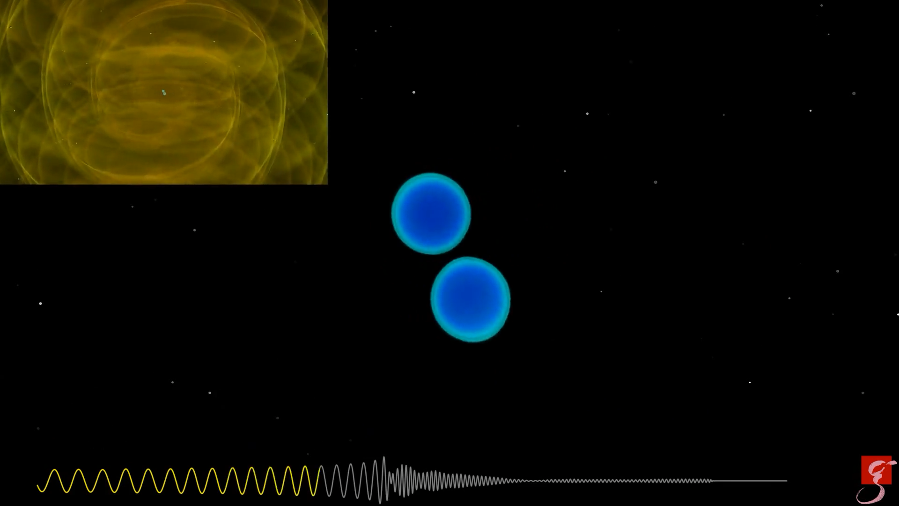
The Binary Neutron Star Merger Simulation
gravitational wave emission
deformation before merger, ejection of material, heavy element production

Slide 11
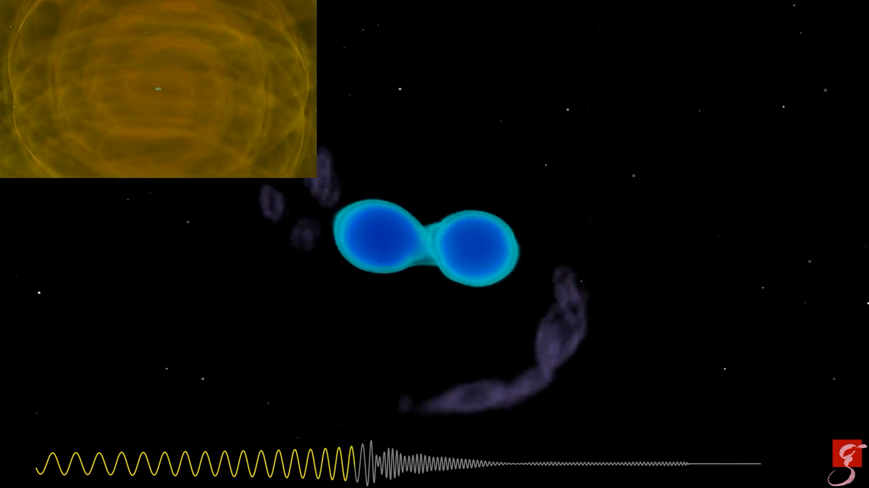
The Binary Neutron Star Merger Simulation
gravitational wave emission
deformation before merger, ejection of material, heavy element production
black hole formation
70 milliseconds

Slide 12
Theoretical Framework:
well-posedness of PDEs
advantageous properties
Computational Methods:
HPC facilities
parallelizable code
numerical techniques
Input Physics:
Microphyics (EOS, Neutrinos)
Magnetic fields
Turbulences
Parameter space
cf. talks by Shibata, Bernuzzi, …

Slide 13
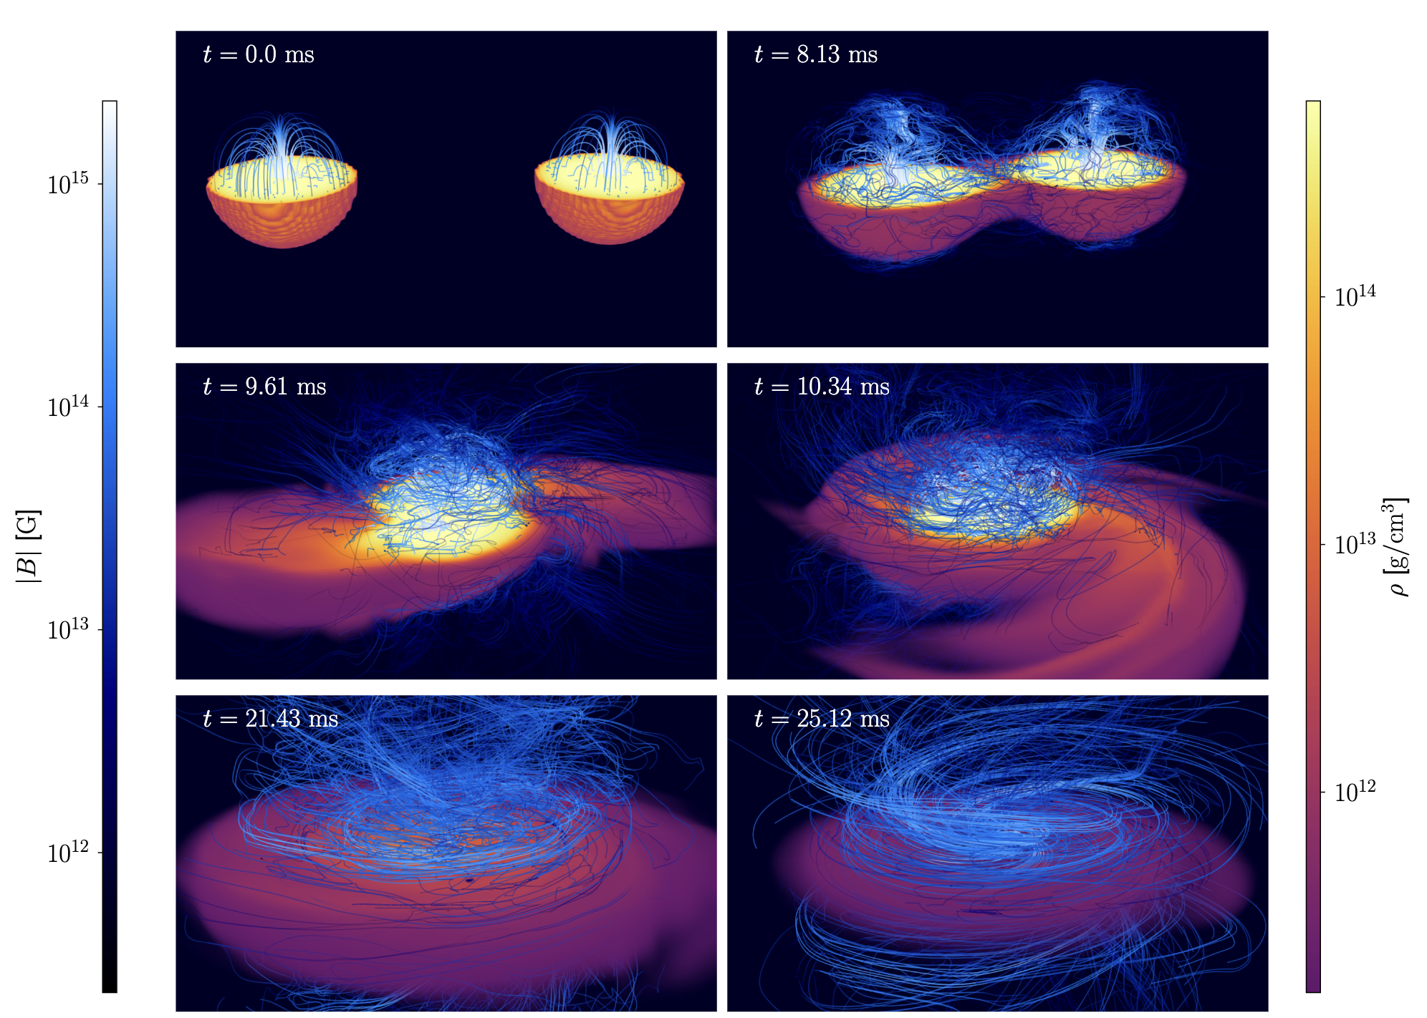
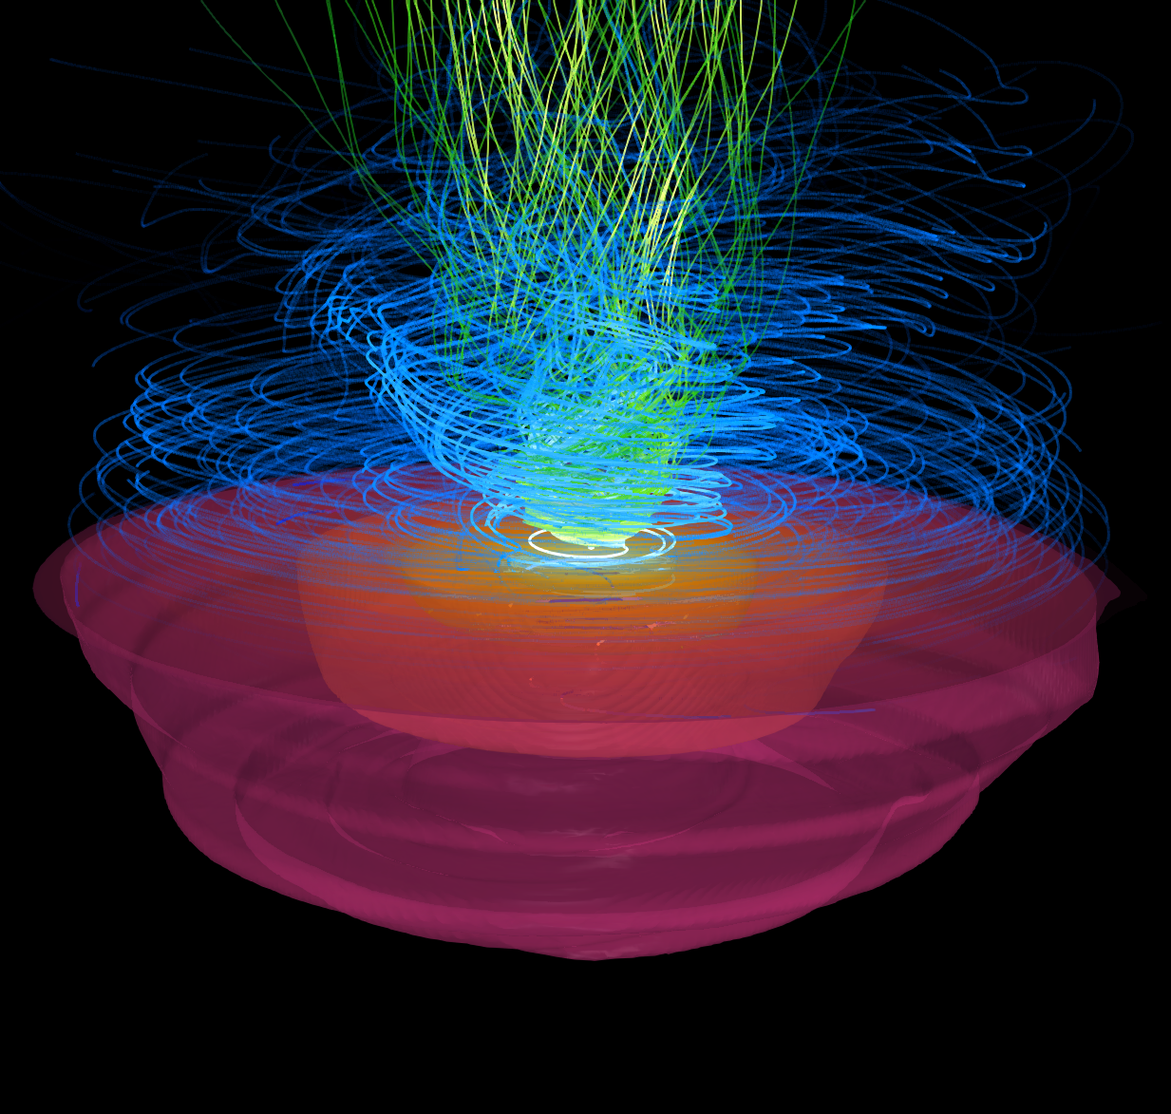
Theoretical Framework:
well-posedness of PDEs
advantageous properties
Computational Methods:
HPC facilities
parallelizable code
numerical techniques
Input Physics:
Microphyics (EOS, Neutrinos)
Magnetic fields
Turbulences
Parameter space
Modelling of magnetic fields and resolving small scale turbulences
Neuweiler et al.,
PRD 110 (2024) 8, 084046
cf. talk by Palenzuela

Slide 14
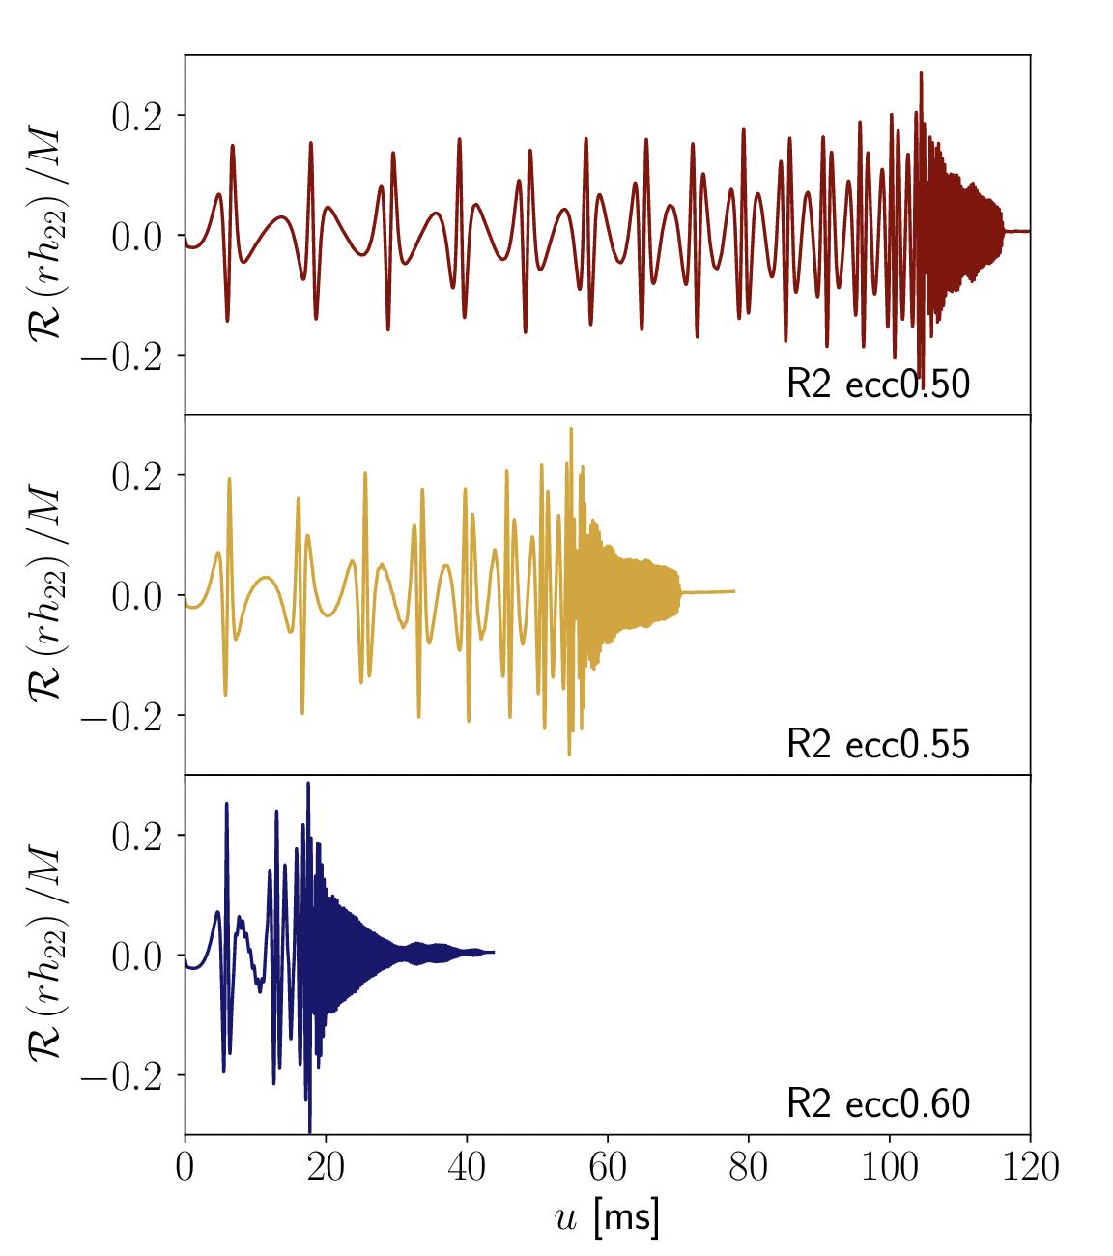
Theoretical Framework:
well-posedness of PDEs
advantageous properties
Computational Methods:
HPC facilities
parallelizable code
numerical techniques
Input Physics:
Microphyics (EOS, Neutrinos)
Magnetic fields
Turbulences
Parameter space
Neuweiler et al., arXiv: 2504.10228
Work done by A. Neuweiler

Slide 15
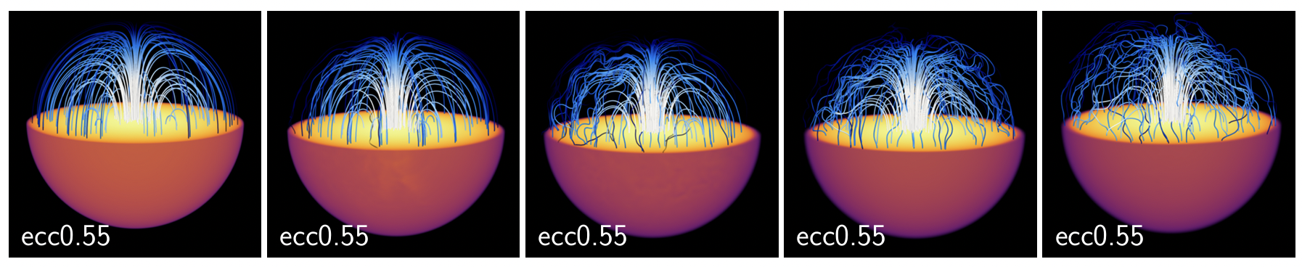
Theoretical Framework:
well-posedness of PDEs
advantageous properties
Computational Methods:
HPC facilities
parallelizable code
numerical techniques
Input Physics:
Microphyics (EOS, Neutrinos)
Magnetic fields
Turbulences
Parameter space
Neuweiler et al., arXiv: 2504.10228
Work done by A. Neuweiler

Slide 16
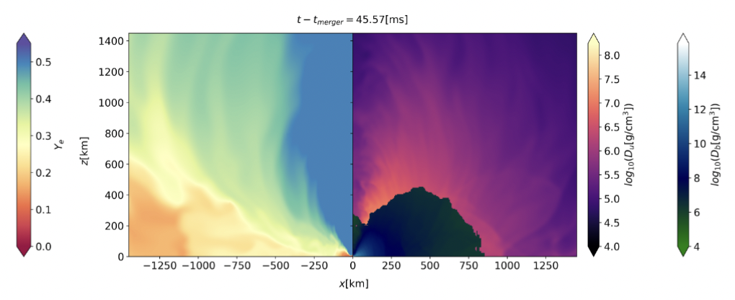
Theoretical Framework:
well-posedness of PDEs
advantageous properties
Schianchi et al., PRD 109 (2024) 4, 044012
Computational Methods:
HPC facilities
parallelizable code
numerical techniques
Emission of neutrinos incorporating general relativistic radiation hydrodynamics schemes
Input Physics:
Microphyics (EOS, Neutrinos)
Magnetic fields
Turbulences
Parameter space
Work done by F. Schianchi, and H. Gieg, et al.

Slide 17
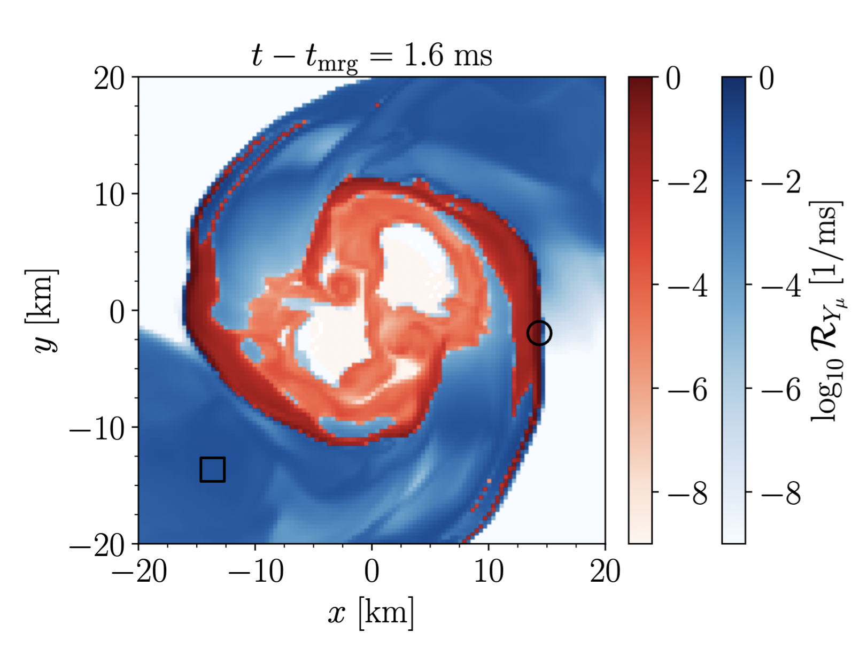
muonization
Theoretical Framework:
well-posedness of PDEs
advantageous properties
demuonization
Computational Methods:
HPC facilities
parallelizable code
numerical techniques
Inclusion of muonic neutrinos –
Gieg et al., arXiv: 2409.04420
Input Physics:
Microphyics (EOS, Neutrinos)
Magnetic fields
Turbulences
Parameter space
Work done by H. Gieg, et al.

Slide 18
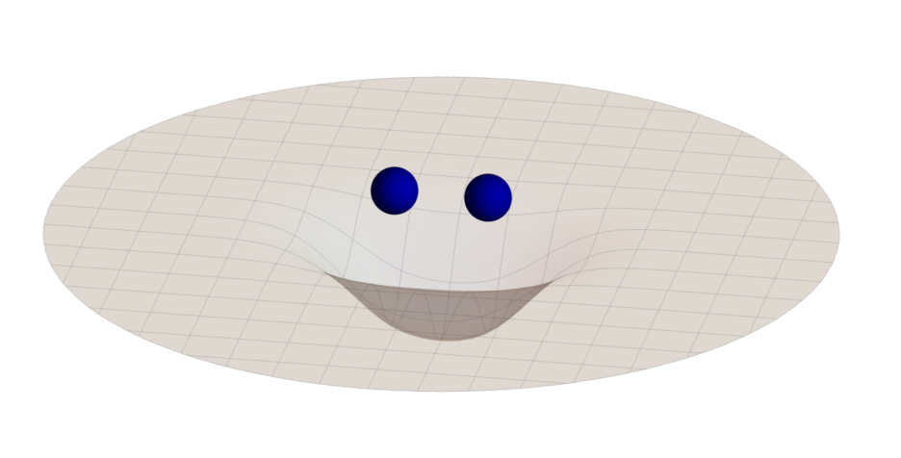
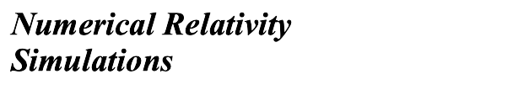
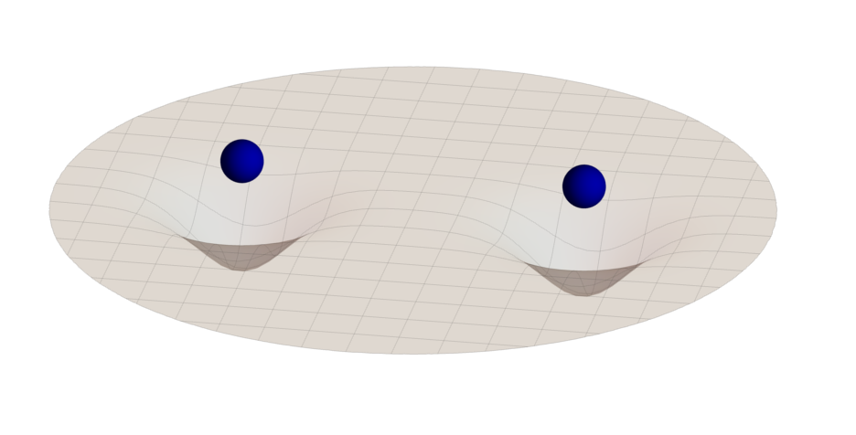

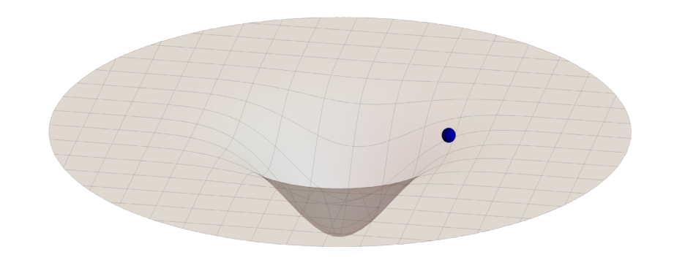


Inspiral waveforms
Various models
cf. talks by Husa, Hinderer, …

Slide 19
Inspiral waveforms
Various models
since 2017 ongoing development to model tidal contributions
Models:
NRTidal (2017/2018)
→ used for GW170817 and GW190425
NRTidalv2 (2019)
NRTidalv3 (2024)
…. soon NRTidalv3 including
higher modes
cf. talks by Husa, Hinderer, …

Slide 20
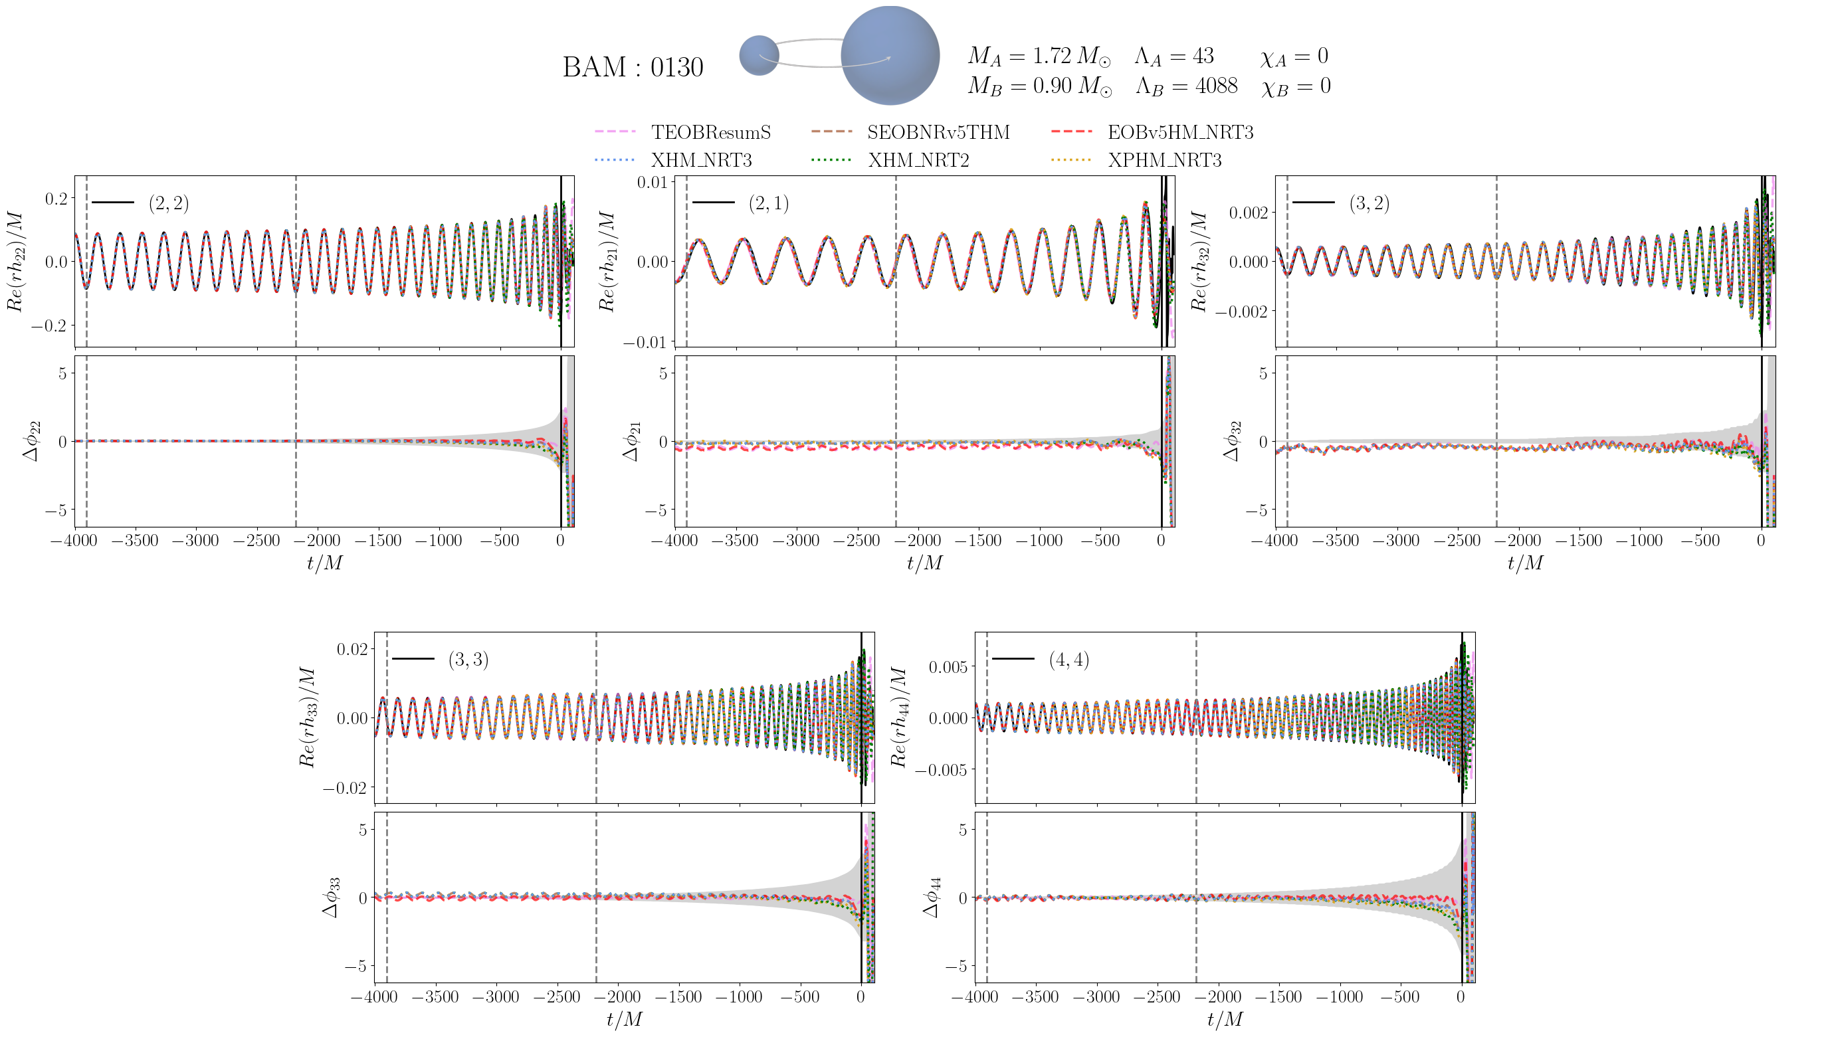
New inspiral models:
IMRPhenomXPHM_NRTidalv3 and SEOBNRv5_ROM_NRTidalv3
cf. talks by Husa, Hinderer, Bernuzzi…
Work done by A. Abac, et al.

Slide 21
Inspiral waveforms
Various models
Work done N.Kunert, et al.
N.Kunert et al., PRD105 (2022) 6, L061301

Slide 22
Inspiral waveforms
Various models
Work done N.Kunert, et al.
N.Kunert et al., PRD105 (2022) 6, L061301

Slide 23
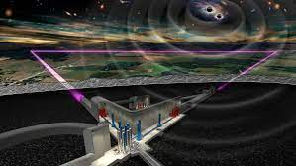

Inspiral waveforms
Various models
Note: Kunert et al., PRD 110 (2024) 4, 4 shows that Hubble
constant measurements show less waveform modelling bias.
Einstein Telescope
N.Kunert et al., PRD105 (2022) 6, L061301

Slide 24
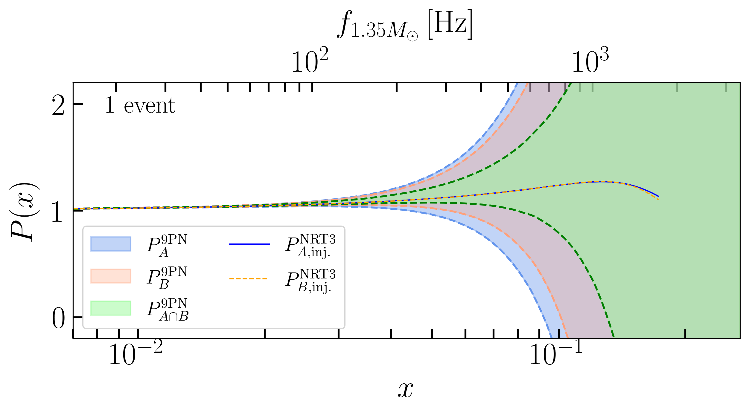
Waveform Model Development through observations
Abac. et al PRL 134 (2025) 21, 211401
Work done by A. Abac, et al.

Slide 25
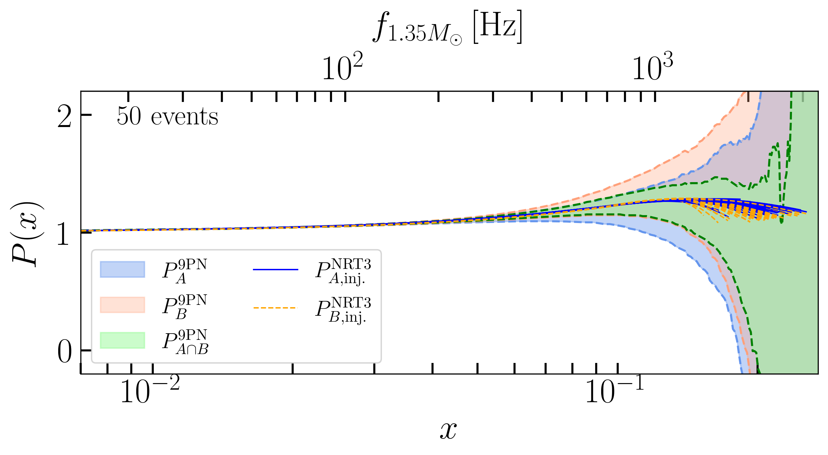
Waveform Model Development through observations
Abac. et al PRL 134 (2025) 21, 211401
Work done by A. Abac, et al.

Slide 26
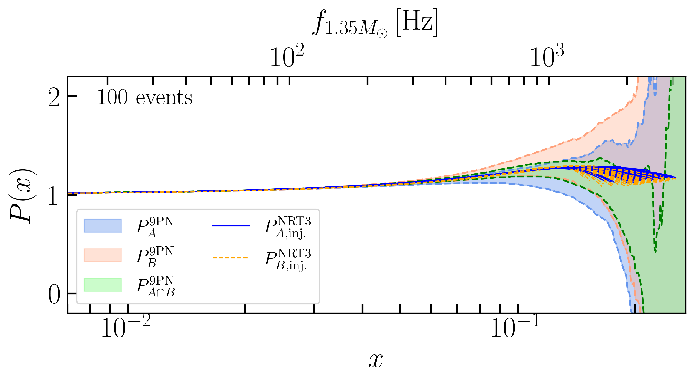
Waveform Model Development through observations
Abac. et al PRL 134 (2025) 21, 211401
Work done by A. Abac, et al.

Slide 27

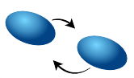
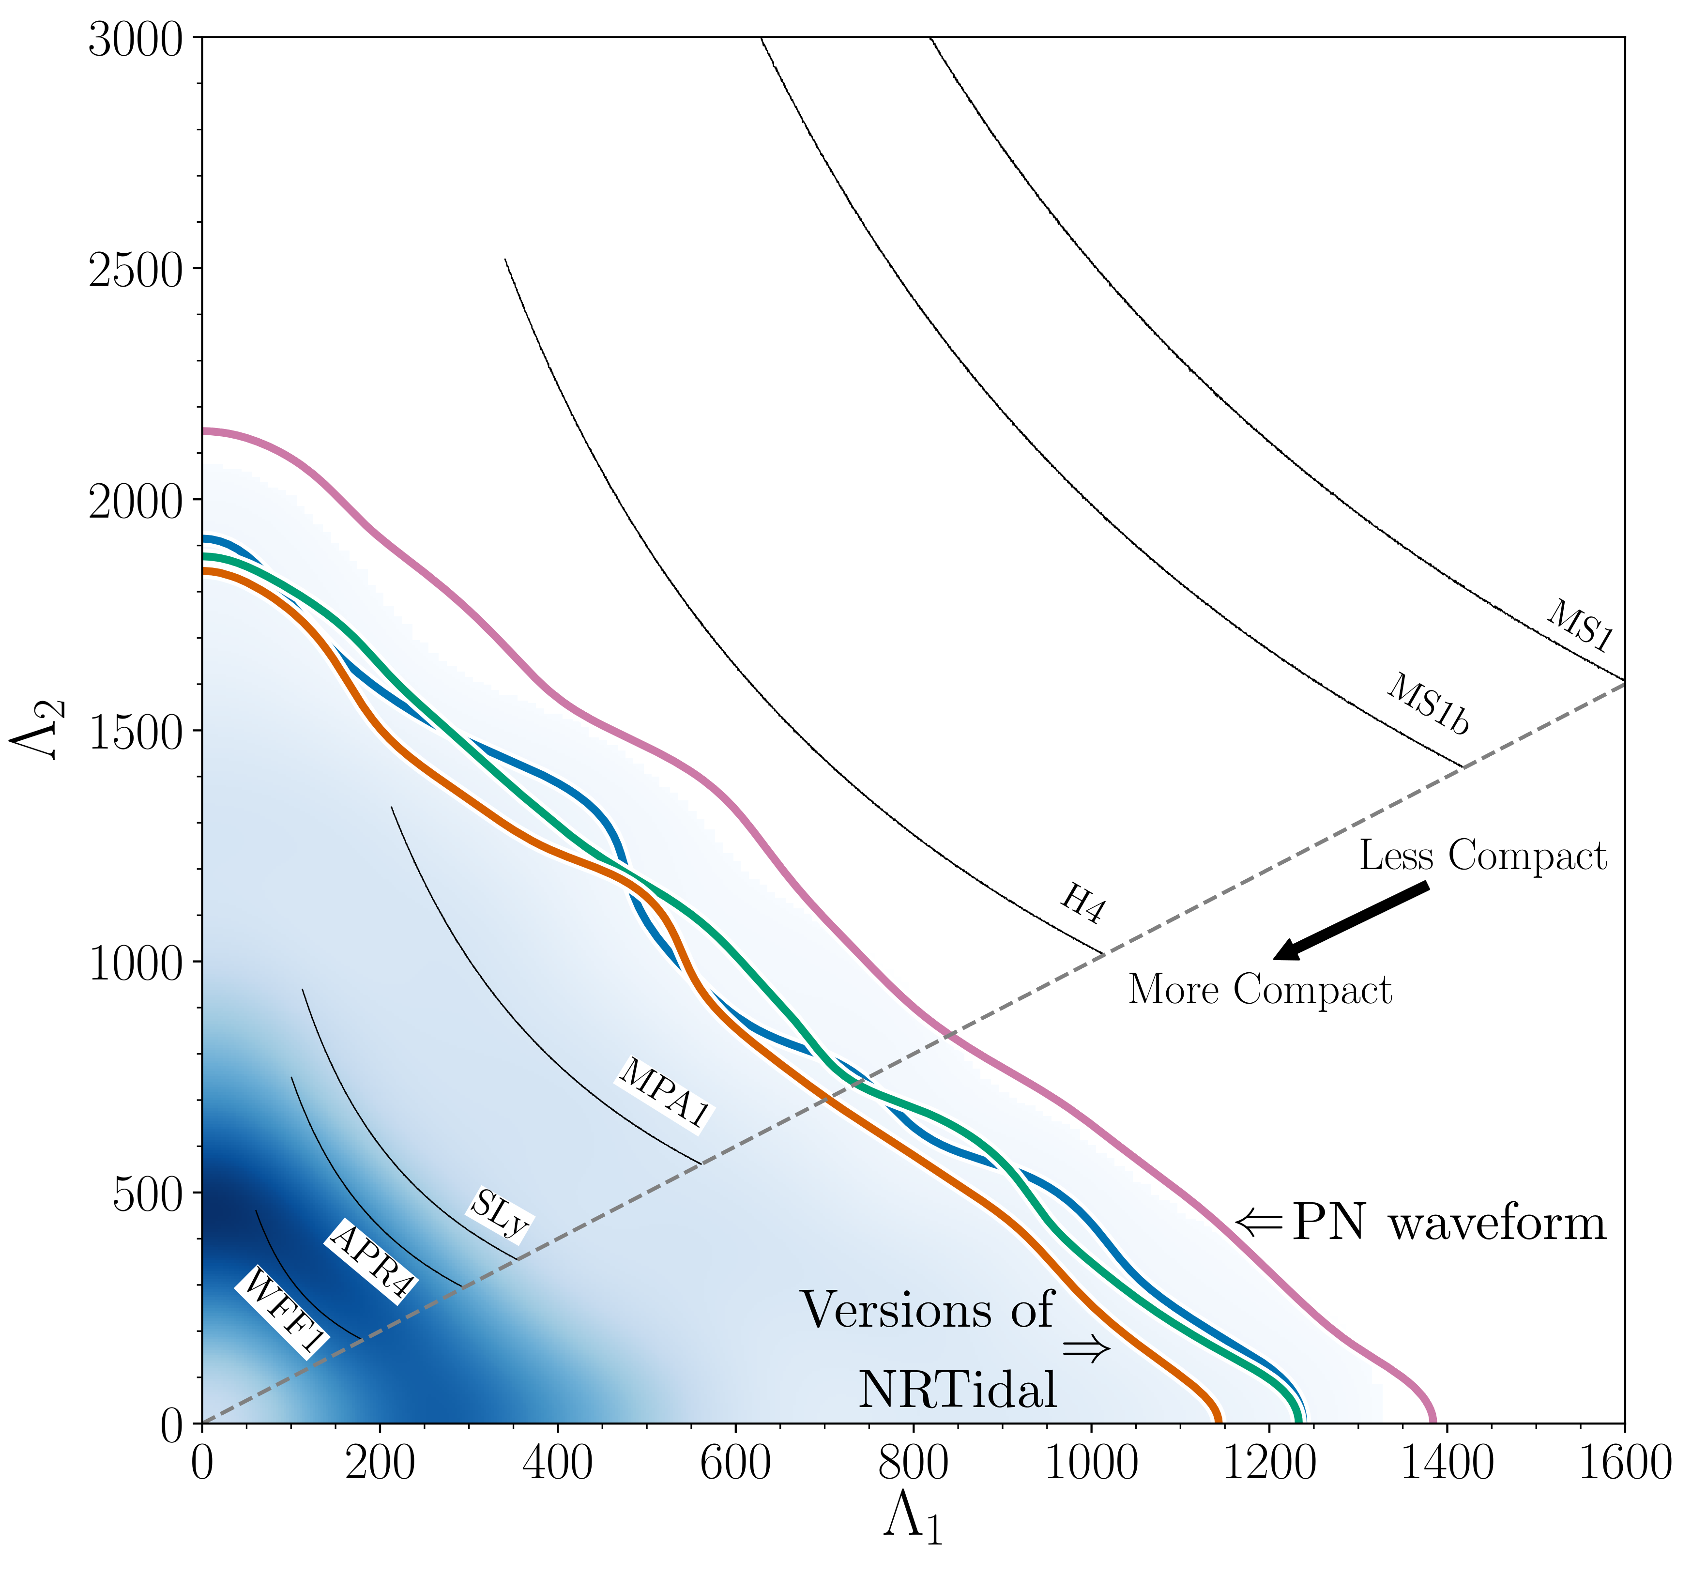


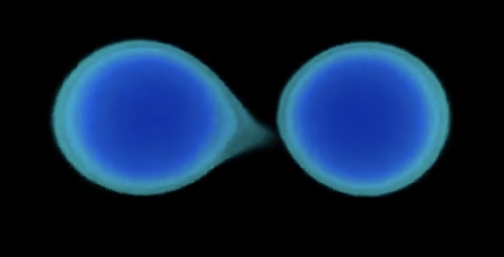
Gravitational Wave Analysis
c
GW170817
determines tidal deformability
→ no assumption about the
type of the compact object
Phys.Rev. X9 (2019) 011001

Slide 28
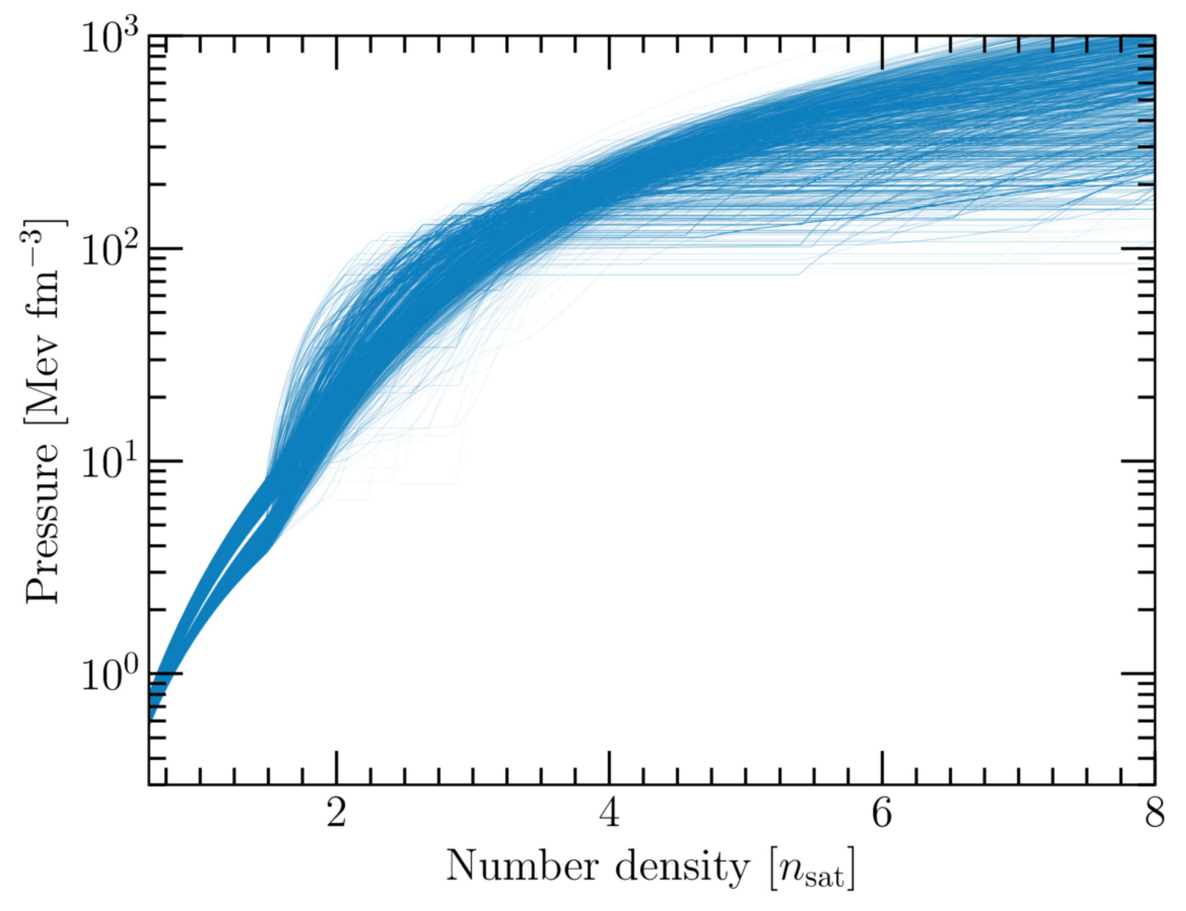
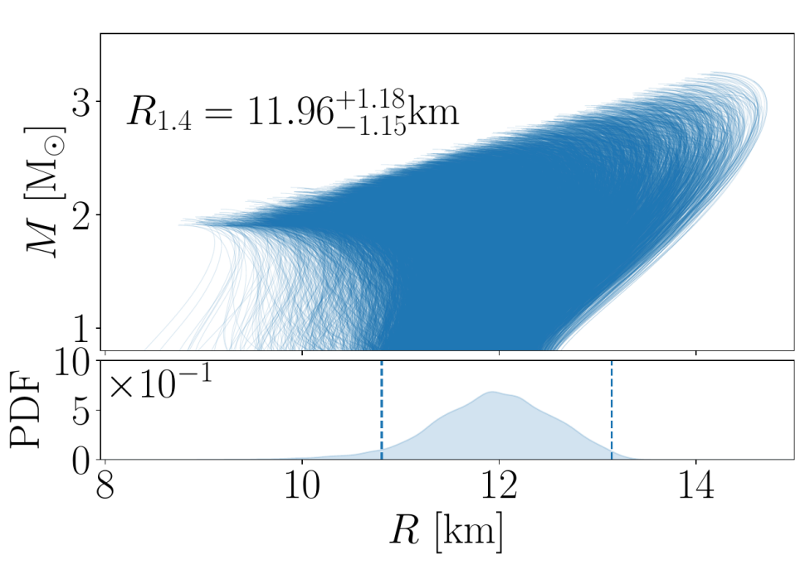
Gravitational Wave Analysis
c
GW170817
Assumption: The merging objects were neutron stars
determines tidal deformability
nuclear-physics computations
→ no assumption about the
type of the compact object
Phys.Rev. X9 (2019) 011001

Slide 29
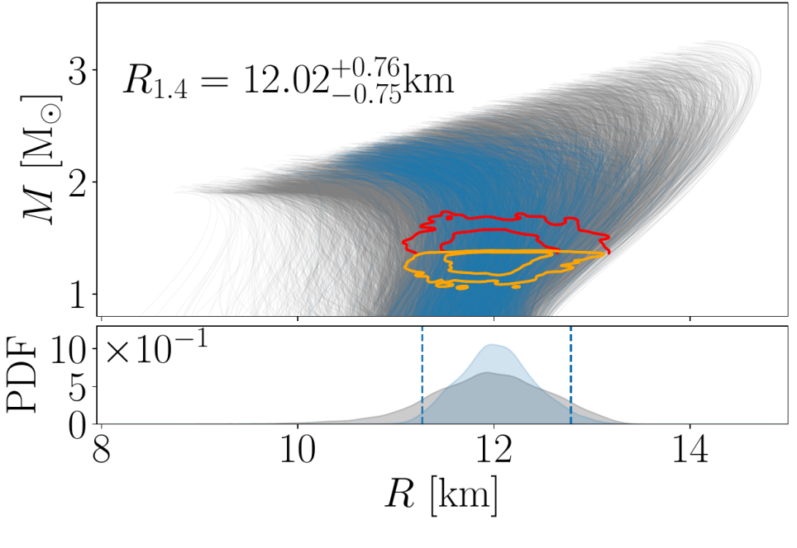
Gravitational Wave Analysis
c
GW170817
determines tidal deformability
Assumption: The merging objects were neutron stars
TD et al. Science, Vol. 370, Issue 6523, pp. 1450-1453

Slide 30
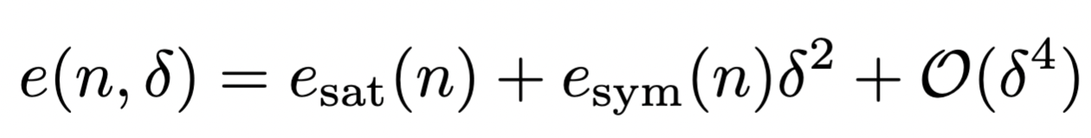
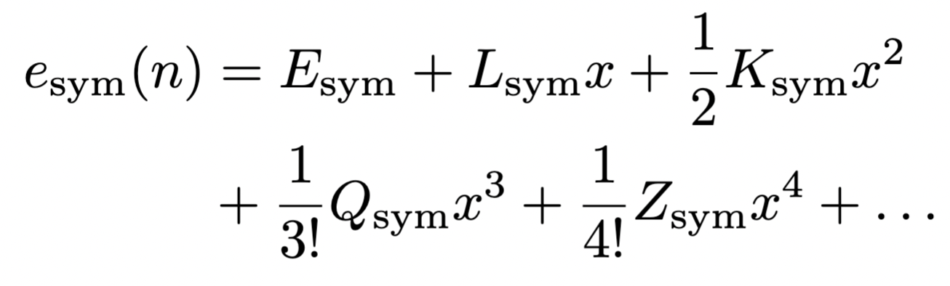
Gravitational Wave Analysis
c
GW170817
Direct constraints on
nuclear-physics parameters
determines tidal deformability
Work done by H. Rose
Assumption: The merging objects were neutron stars
TD et al. Science, Vol. 370, Issue 6523, pp. 1450-1453

Slide 31

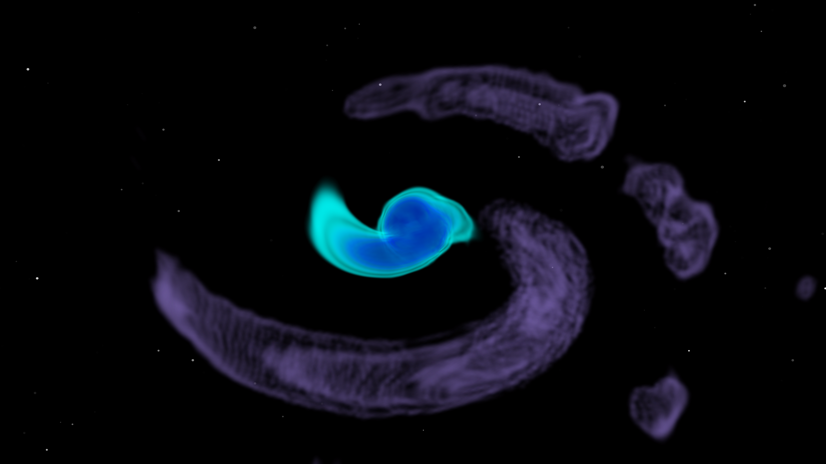
EM Signals – Kilonova
- neutron rich ejecta produce heavy r-process elements
- pseudo-black body radiation from r-process elements
- mergers are major sites for the formation of heavy elements
Notes:
31

Slide 32
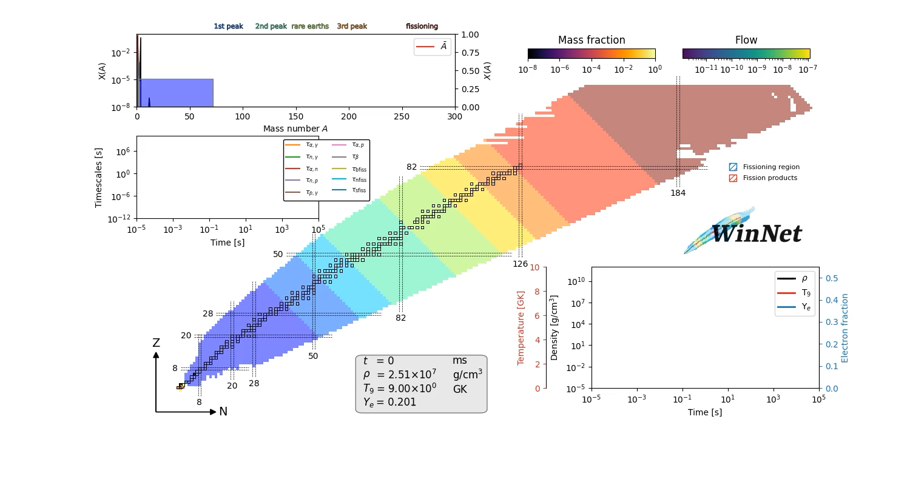
EM Signals – Kilonova
- neutron rich ejecta produce heavy r-process elements
- pseudo-black body radiation from r-process elements
- mergers are major sites for the formation of heavy elements
Notes:
32

Slide 33
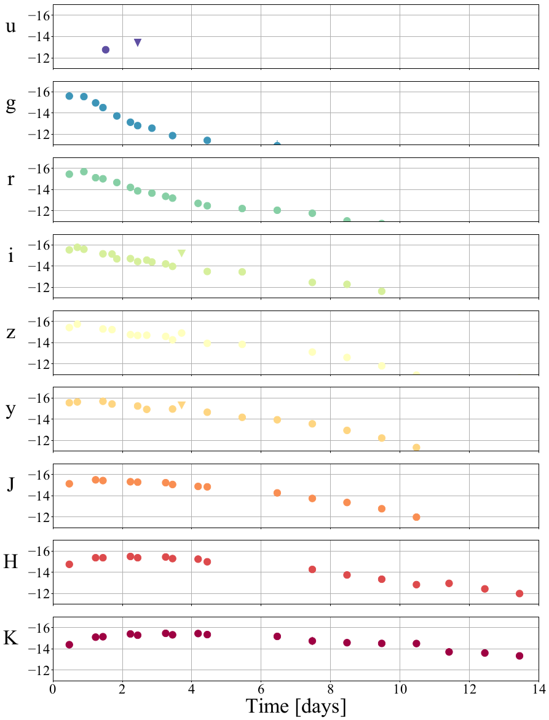
Photometric lightcurves
Notes:
33

Slide 34
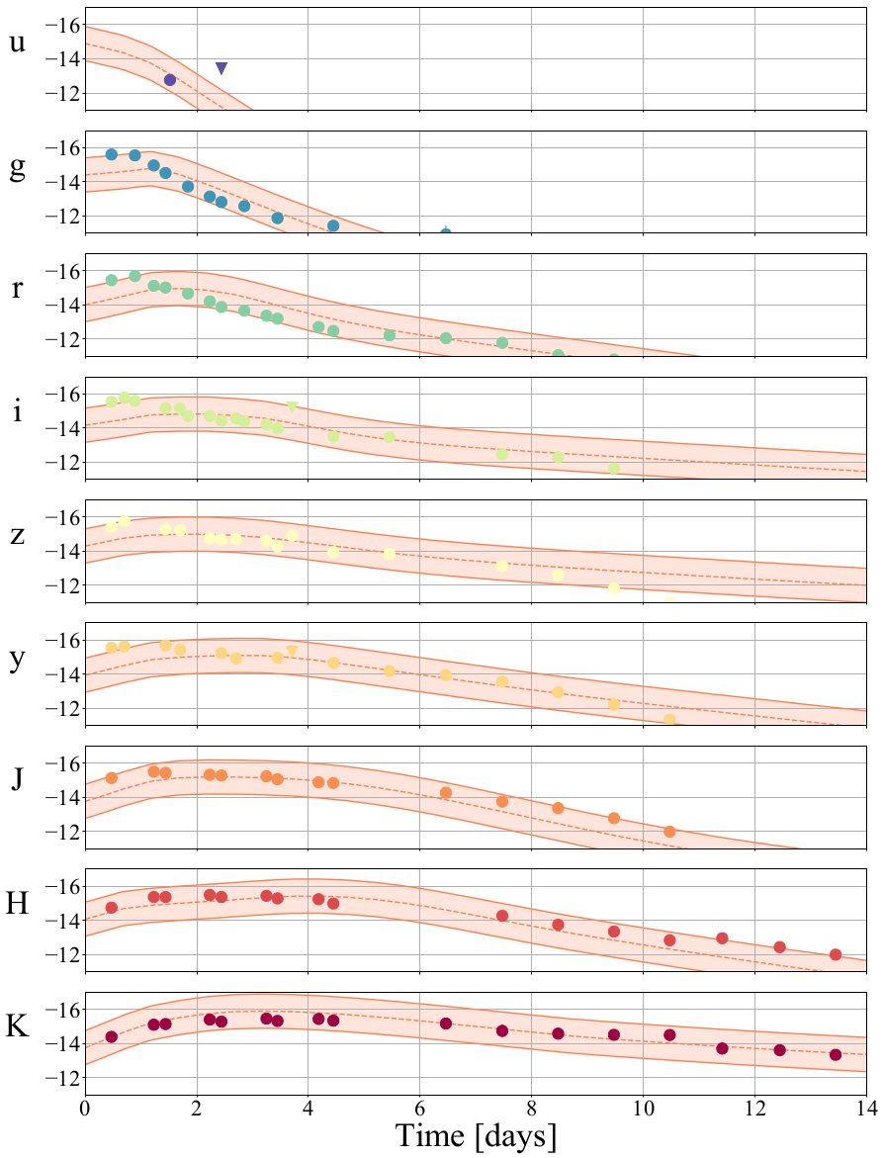
Photometric lightcurves
Notes:
34

Slide 35
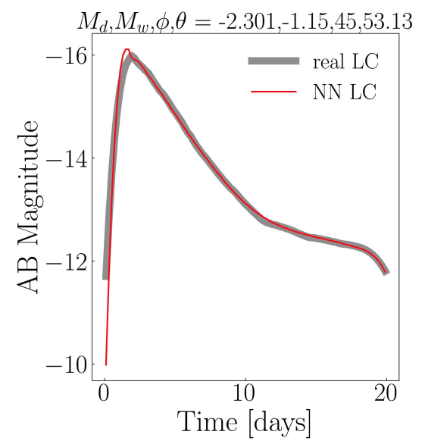
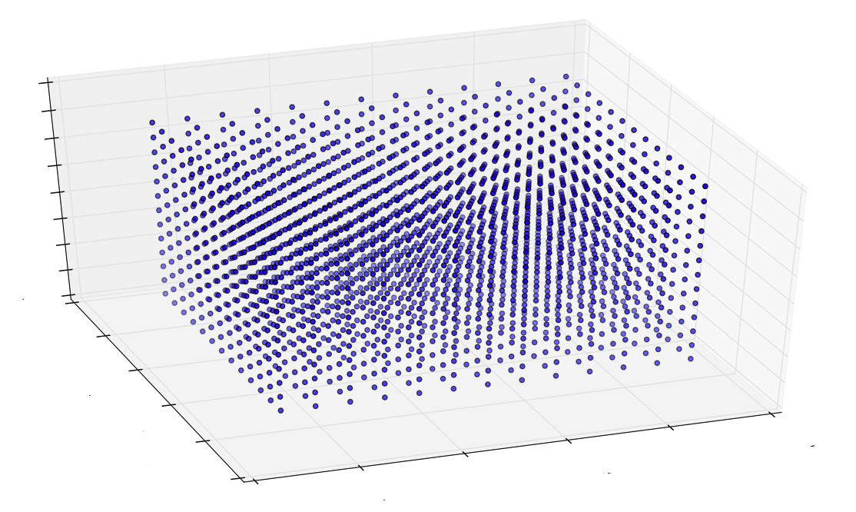
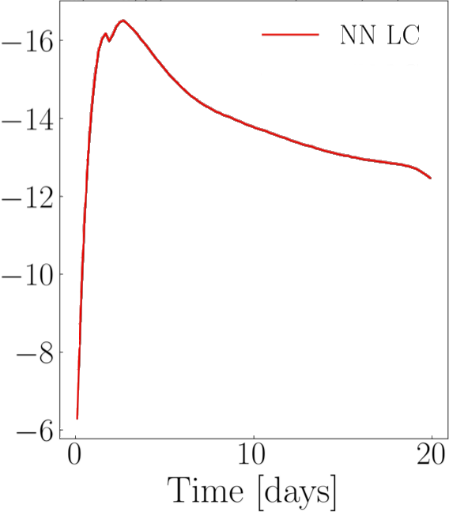
Photometric lightcurves
1.) compute lightcurves for a set (grid) of ejecta properties with a radiative transfer code
2.) interpolate within this grid through Gaussian Process Regression or a Neural Network
Ejecta Parameters
Ejecta Parameters
Ejecta Parameters
Notes:
35

Slide 36
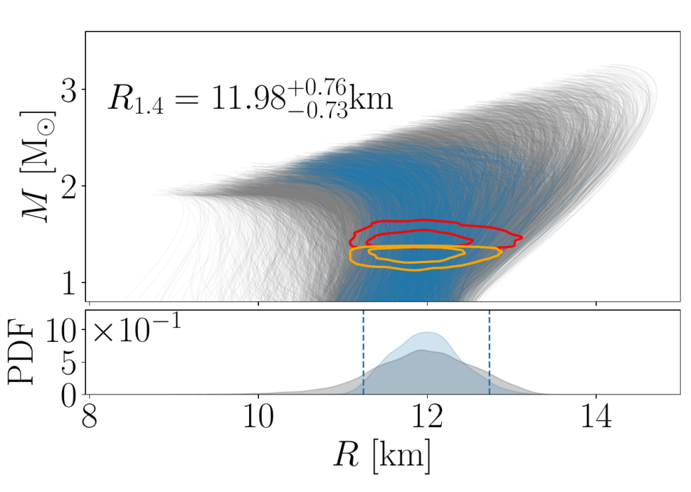
Photometric lightcurves
1.) compute lightcurves for a set (grid) of ejecta properties with a radiative transfer code
2.) interpolate within this grid through Gaussian Process Regression or a Neural Network
3.) link ejecta properties through numerical-relativity predictions to the binary properties
Notes:
36

Slide 37
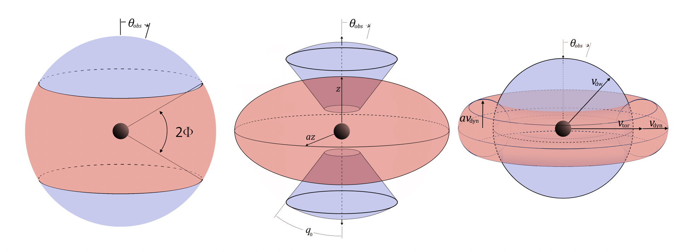
Uncertainties
1.) Knowledge about the outflowing material (mass, velocity, geometry, composition)
2.) Heating rates depend on the formed elements and ejecta properties
3.) Incomplete knowledge about opacities for complicated elements
e.g., Heinzel et al., MNRAS. 502 (2021) 2, 3057-3065
Cross-code comparisons for
numerous geometries and assumptions → estimate on the modelling uncertainty
Notes:
37

Slide 38
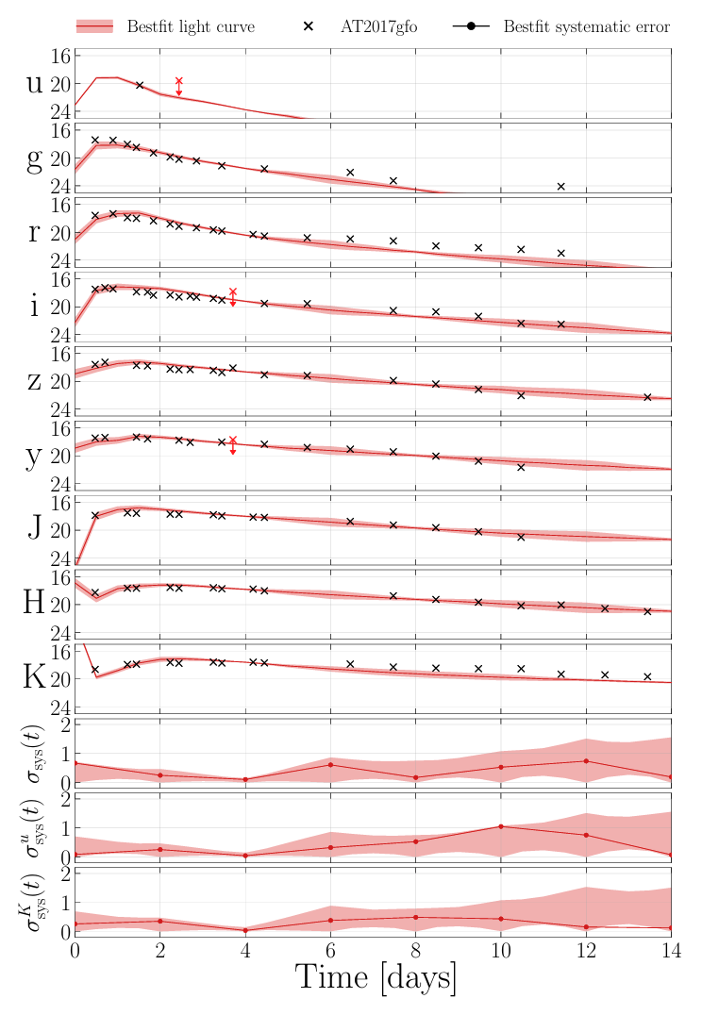
Uncertainties
1.) Knowledge about the outflowing material (mass, velocity, geometry, composition)
2.) Heating rates depend on the formed elements and ejecta properties
3.) Incomplete knowledge about opacities for complicated elements
Data-driven approach to determine uncertainties
Jhawar et al., PRD 111 (2025), 4, 043046
Notes:
38

Slide 39
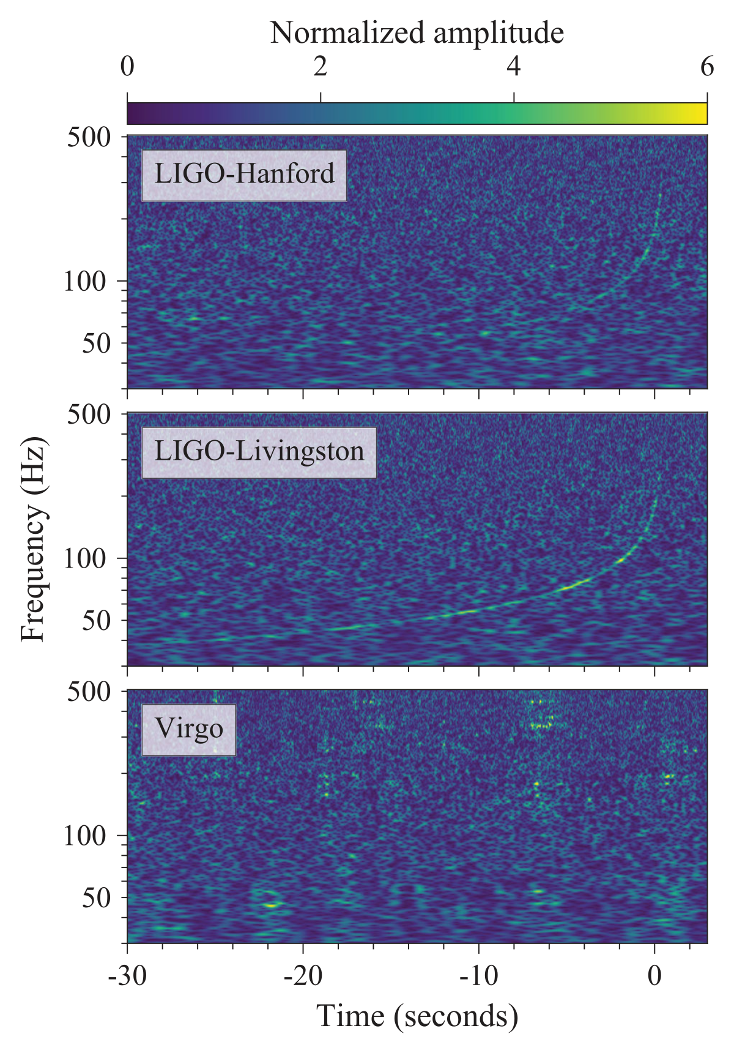

NMMA: Steps towards a nuclear-physics and multi-messenger astrophysics framework
- simultaneous analysis of GW, kilonova, and GRB afterglow while sampling nuclear physics parameters
- HPC facilities needed or GPU-acceleration required

Slide 40


NMMA: Main Contributions by
University of Potsdam and
Max Planck Institute for Gravitational Physics
computational astrophysics
gravitational-wave modelling
multi-messenger data analysis
University of Minnesota
- optical and near-infrared observations
- multi-messenger analysis
Observations
Observatory of la Côte d'Azur
- optical and near-infrared observations
- multi-messenger analysis
Utrecht University
- gravitational-wave data analysis
- multi-messenger data analysis
University of Ferrara
- modelling of electromagnetic signals
Theory
Los Alamos National Lab
- nuclear physics

Slide 41



https://github.com/nuclear-multimessenger-astronomy
Pang et al., Nat. Comm. 14 (2023) 1, 8352
Work done by H. Rose, H. Koehn, A. Puecher, et al.

Slide 42

https://github.com/nuclear-multimessenger-astronomy
Pang et al., Nat. Comm. 14 (2023) 1, 8352

Slide 43

Nuclear Physics and Multi-messenger Astrophysics

Slide 44
Nuclear Physics and Multi-messenger Astrophysics

Slide 45


PyBlastAfterglow
Nuclear Physics and Multi-messenger Astrophysics
https://github.com/vsevolodnedora/PyBlastAfterglowMag
modular publicly available code including
forward and reverse shock
lateral spreading and lateral structure
radiation losses, synchrotron emission, self-absorption, synchrotron self-Compton
realistic electron distributions, …
Work done by V. Nedora
Nedora et al., MNRAS 538 (2025),Nedora et al., MNRAS 524 (2023)
Nedora et al., MNRAS 520 (2023), Nedora et al., MNRAS 506 (2021)

Slide 46
Nuclear Physics and Multi-messenger Astrophysics

Slide 47

Nuclear Physics and Multi-messenger Astrophysics
Gravitational Wave
TD et al. Science, Vol. 370, Issue 6523, pp. 1450-1453

Slide 48
Nuclear Physics and Multi-messenger Astrophysics
Gravitational Wave
TD et al. Science, Vol. 370, Issue 6523, pp. 1450-1453
Radio Counterpart

Slide 49
Nuclear Physics and Multi-messenger Astrophysics
Gravitational Wave
Kilonova
TD et al. Science, Vol. 370, Issue 6523, pp. 1450-1453
Radio Counterpart

Slide 50
Nuclear Physics and Multi-messenger Astrophysics
Gravitational Wave
Kilonova
TD et al. Science, Vol. 370, Issue 6523, pp. 1450-1453
Radio Counterpart

Slide 51

Summary
Modelling:
Numerical Relativity
Radiative Transfer Simulations
….
Data Analysis:
Bayesian Inference
Model Selection/Hypothesis testing
….
and Links
NMMA
PyBlastAfterglow
Multi-messenger Constraints
https://github.com/nuclear-multimessenger-astronomy
https://github.com/vsevolodnedora/PyBlastAfterglowMag
https://multi-messenger.physik.uni-potsdam.de/eos_constraints

