Slide 1
Distinguishing Flavor Model Predictions for Neutrino Observables
Henry Truelson
Particle Physics on the Plains 2025
Nov. 16th, 2025
University of Kansas

Slide 2
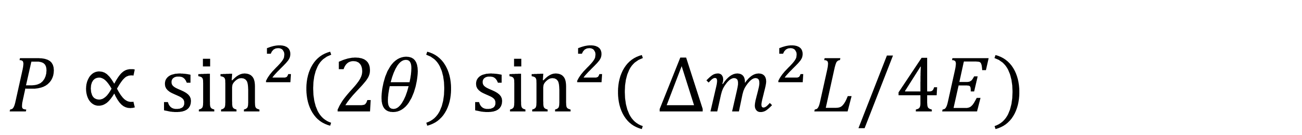
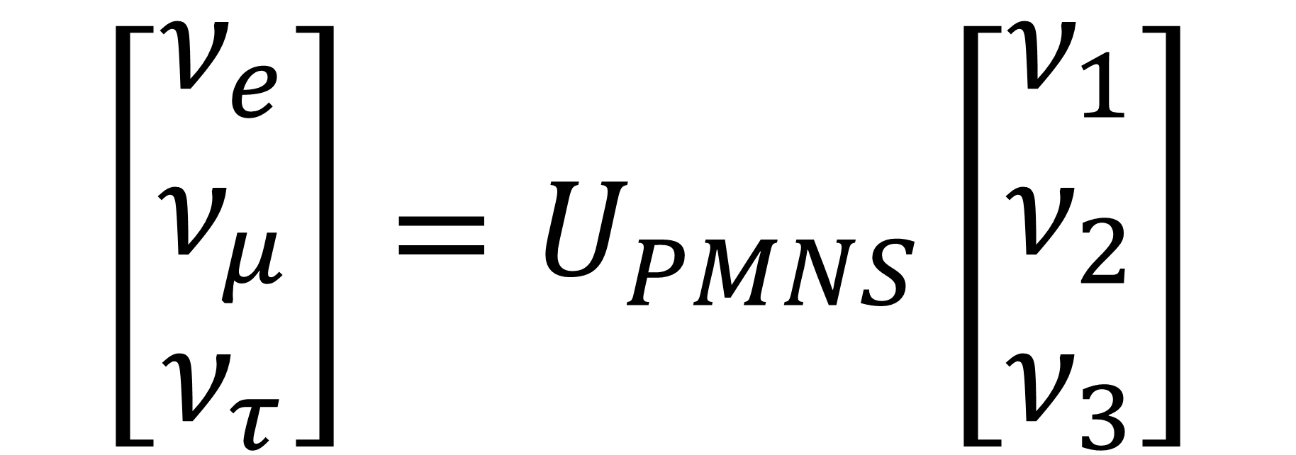
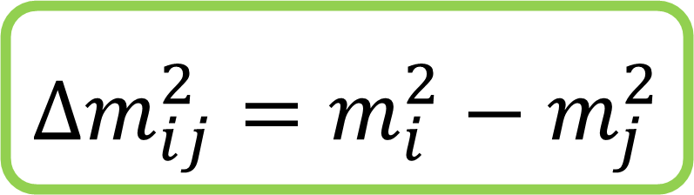
Neutrino Oscillations:
$$Δm_{ij}^{2}=m_{i}^{2}−m_{j}^{2}$$
Neutrinos can change their flavor:
$P∝\sin^{2}\left(2θ\right)\sin^{2}({Δm^{2}L/4E)}$
This is governed by the PMNS mixing matrix:
$$\left[\begin{matrix}ν_{e} \\ ν_{μ} \\ ν_{τ}\end{matrix}\right]=U_{PMNS}\left[\begin{matrix}ν_{1} \\ ν_{2} \\ ν_{3}\end{matrix}\right]$$
H. Truelson – CSU:
“Distinguishing Flavor Model Predictions”

Slide 3
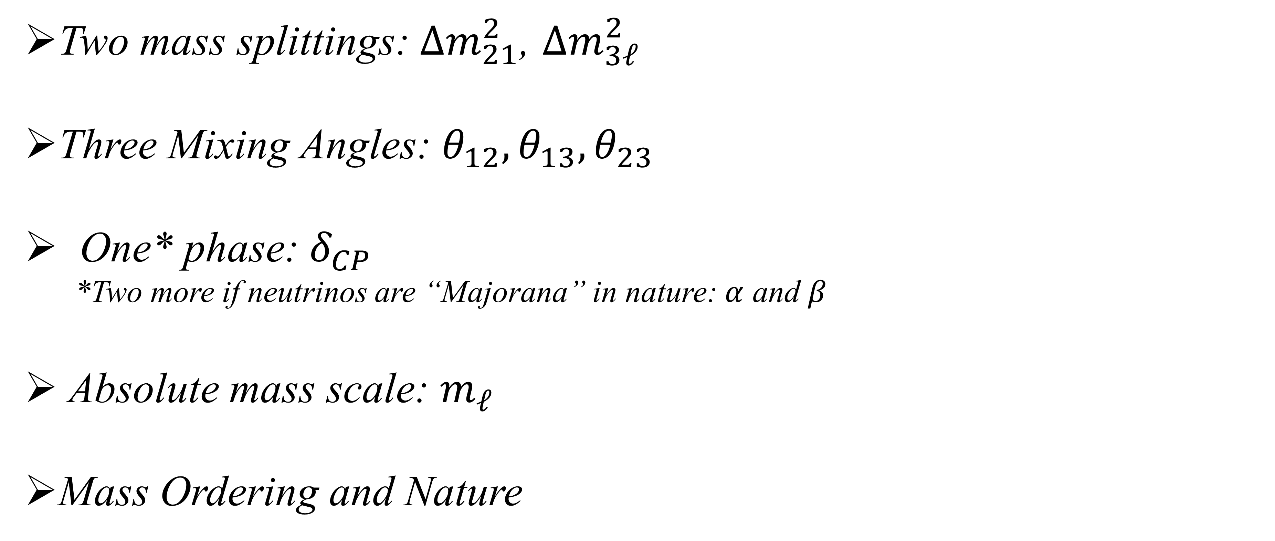
Oscillation Parameters:
Two mass splittings: $Δm_{21}^{2}$, $Δm_{3ℓ}^{2}$
Three Mixing Angles: $θ_{12}, θ_{13}, θ_{23}$
One* phase: $δ_{CP}$
*Two more if neutrinos are “Majorana” in nature: $α$ and $β$
Absolute mass scale: $m_{ℓ}$
Mass Ordering and Nature
Precisely measured
Better measurements coming
Mostly unconstrained
H. Truelson – CSU:
“Distinguishing Flavor Model Predictions”

Slide 4
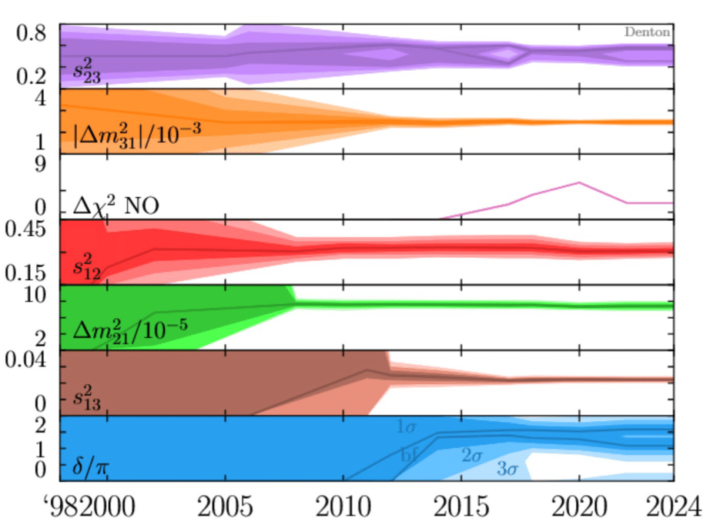

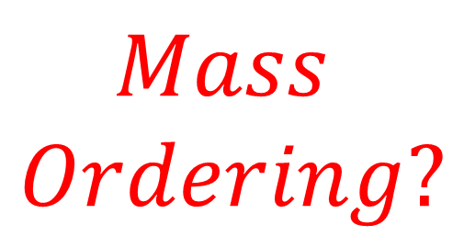
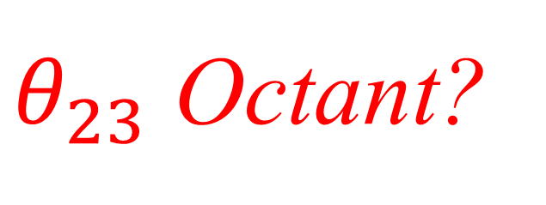
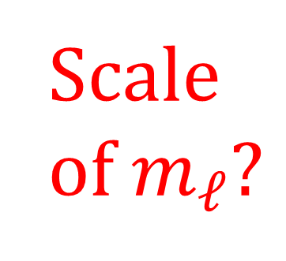
Neutrino Physics: Where are we?
$θ_{23}$ Octant?
$$Mass$$
$$Ordering?$$
Scale of $m_{ℓ}?$
$$δ_{CP}?$$
H. Truelson – CSU:
“Distinguishing Flavor Model Predictions”
[1] From Peter Denton, updated from Snowmass arxiv:2212.00809

Slide 5
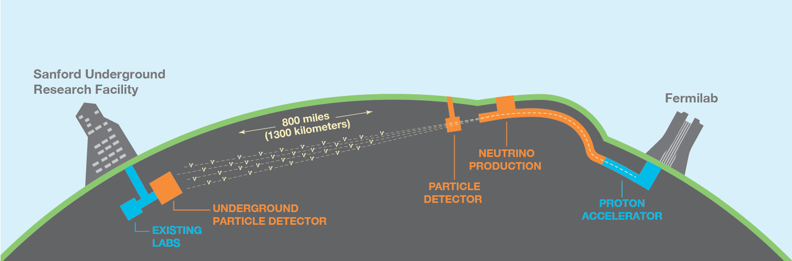
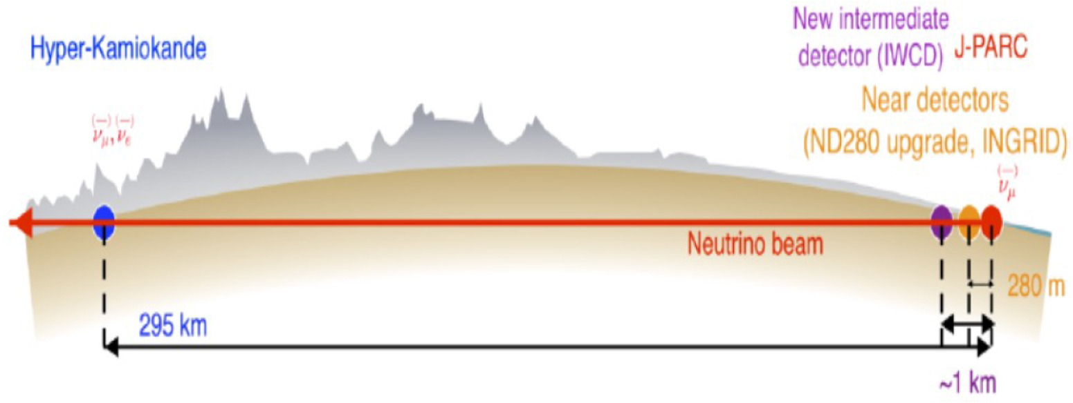
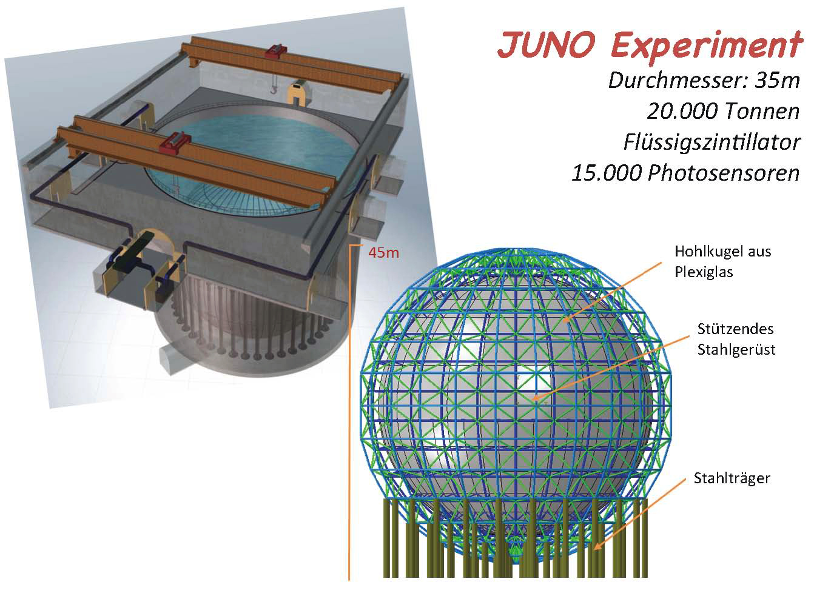
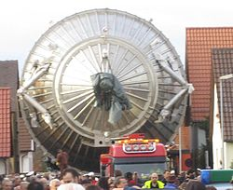
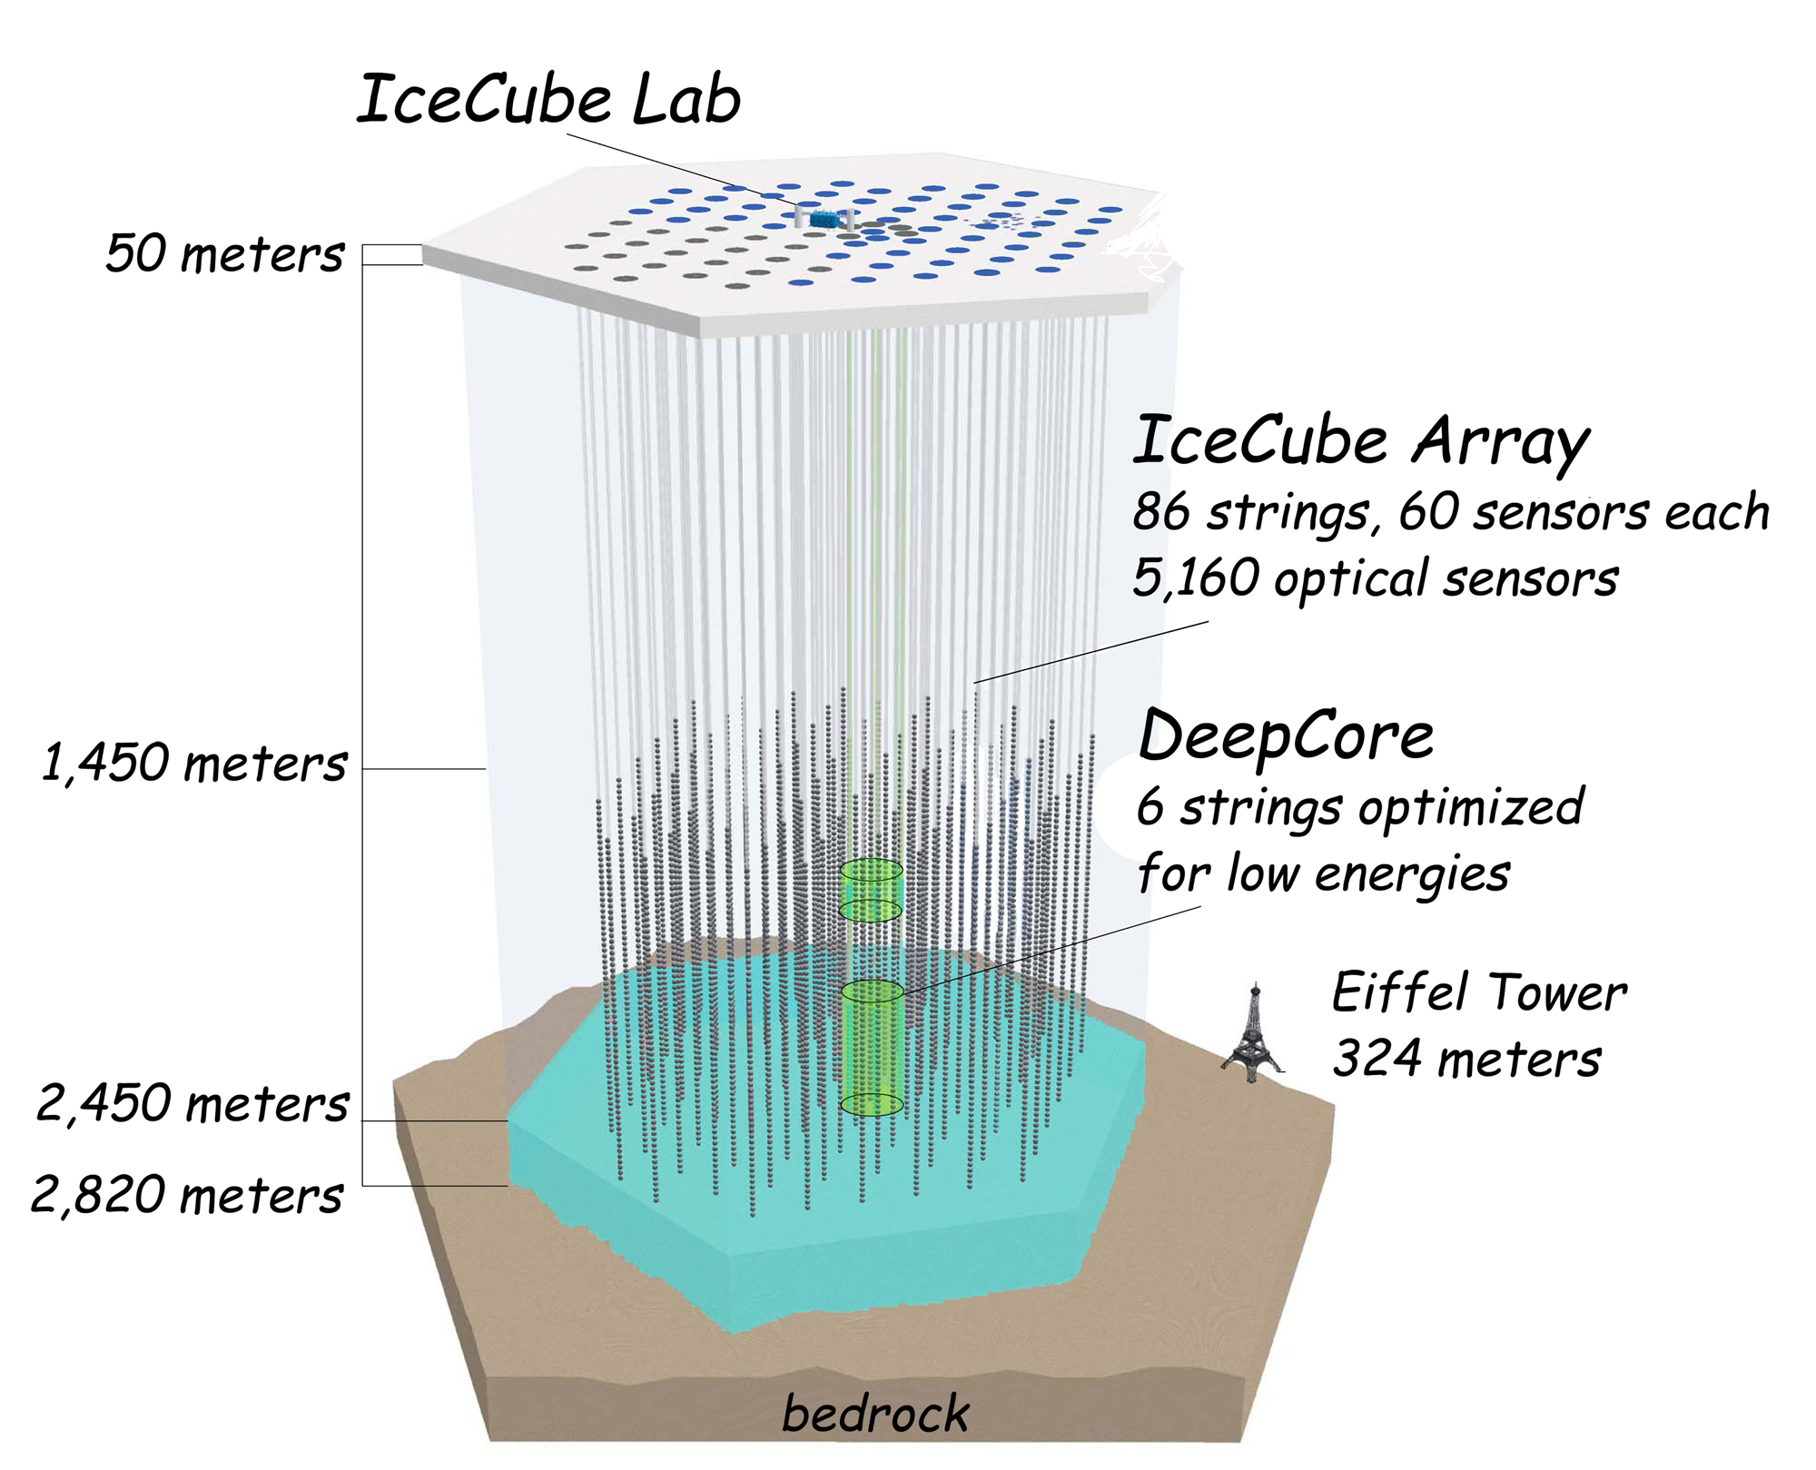
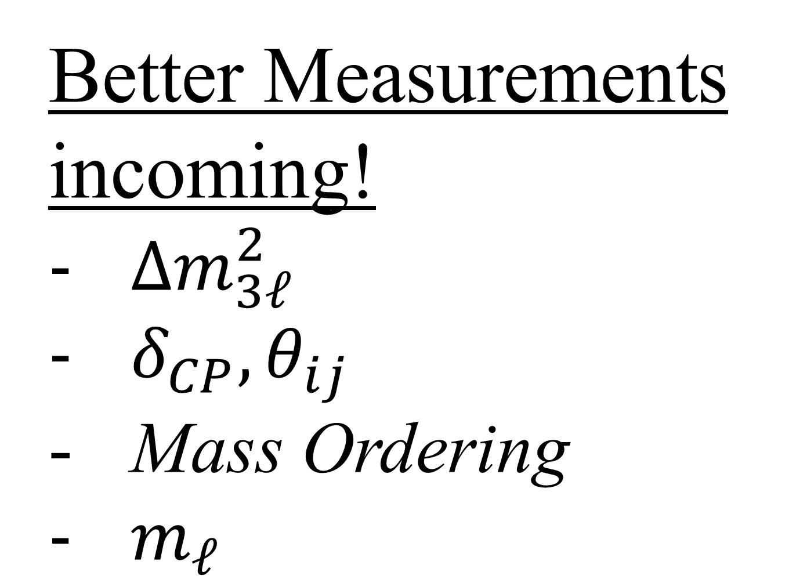
Upcoming/Ongoing Precision Experiments:
Better Measurements incoming!
$Δm_{3ℓ}^{2}$
$δ_{CP}, θ_{ij}$
Mass Ordering
$m_{ℓ}$
And more!
H. Truelson – CSU:
“Distinguishing Flavor Model Predictions”
& Cosmology!

Slide 6
What can theorists do with these measurements?
Flavor Models
H. Truelson – CSU:
“Distinguishing Flavor Model Predictions”
6

Slide 7
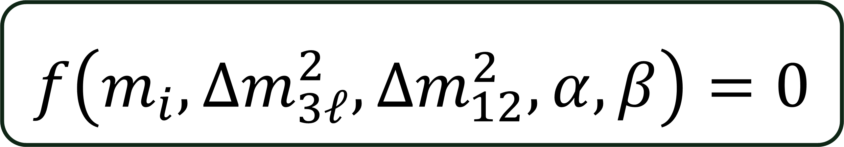
Sum Rules
By inducing some modular “flavor” symmetry into the lepton sector, we can reduce the number of free parameters.
This takes the form of a sum rule:
$$f\left(m_{i},Δm_{3ℓ}^{2},Δm_{12}^{2},α, β\right)=0$$
H. Truelson – CSU:
“Distinguishing Flavor Model Predictions”

Slide 8
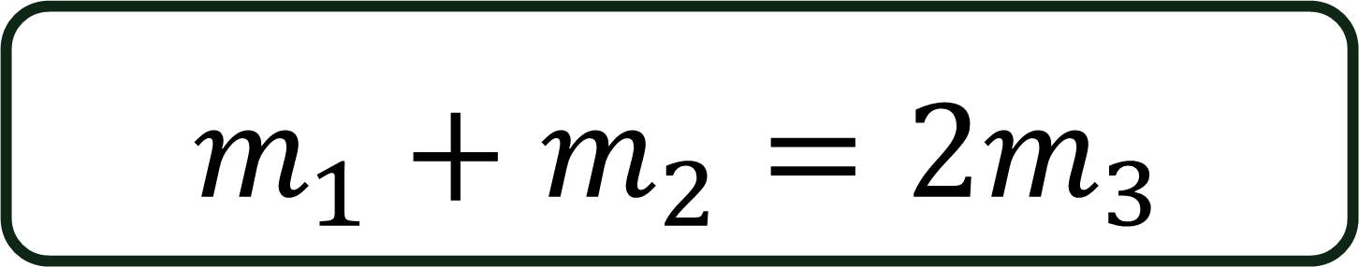
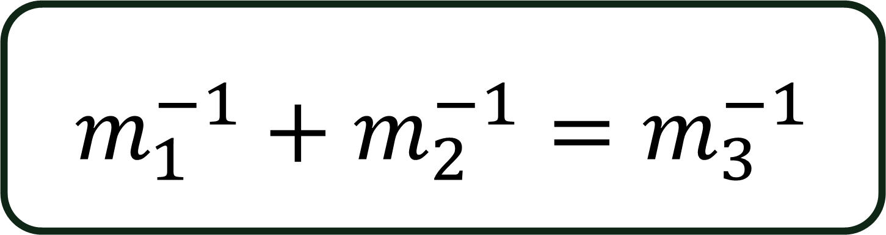
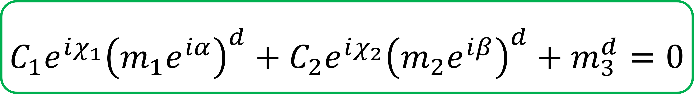
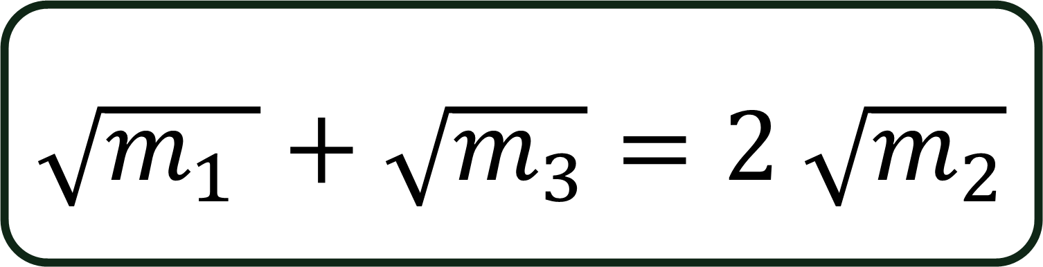
Examples:
$$m_{1}^{−1}+m_{2}^{−1}=m_{3}^{−1}$$
$$\sqrt{m_{1} }+\sqrt{m_{3}}=2 \sqrt{m_{2}}$$
$$m_{1}+m_{2}=2m_{3}$$
$$C_{1}e^{iχ_{1}}{\left(m_{1}e^{iα}\right)}^{d}+C_{2}e^{iχ_{2}}{\left(m_{2}e^{iβ}\right)}^{d}+m_{3}^{d}=0$$
H. Truelson – CSU:
“Distinguishing Flavor Model Predictions”

Slide 9
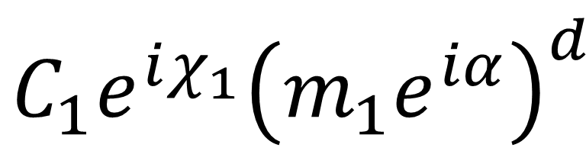
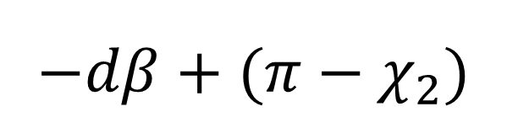
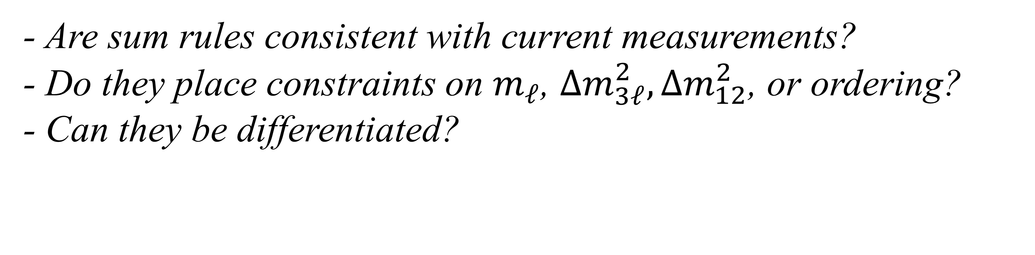
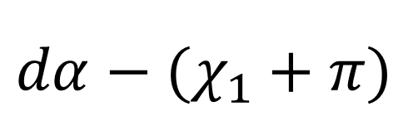


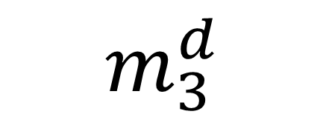
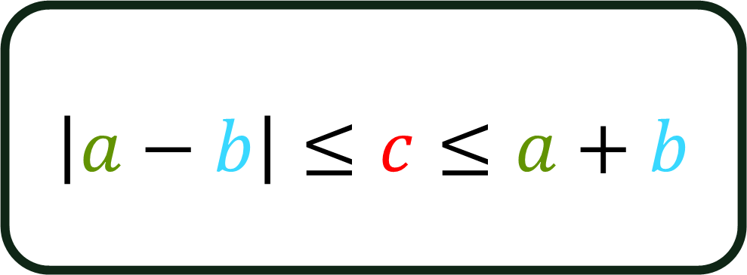
$$C_{2}e^{iχ_{2}}{\left(m_{2}e^{iβ}\right)}^{d}$$
$$C_{1}e^{iχ_{1}}{\left(m_{1}e^{iα}\right)}^{d}$$
$$−dβ+({π−χ}_{2})$$
$$dα−(χ_{1}+π)$$
$$m_{3}^{d}$$
$$⇒$$
$$\left|a−b\right|≤c≤a+b$$
$$⇐$$
- Are sum rules consistent with current measurements?
- Do they place constraints on $m_{ℓ}$, $Δm_{3ℓ}^{2},Δm_{12}^{2}$, or ordering?
- Can they be differentiated?
Ongoing work with Julia Gehrlein and Peter Denton
H. Truelson – CSU:
“Distinguishing Flavor Model Predictions”

Slide 10
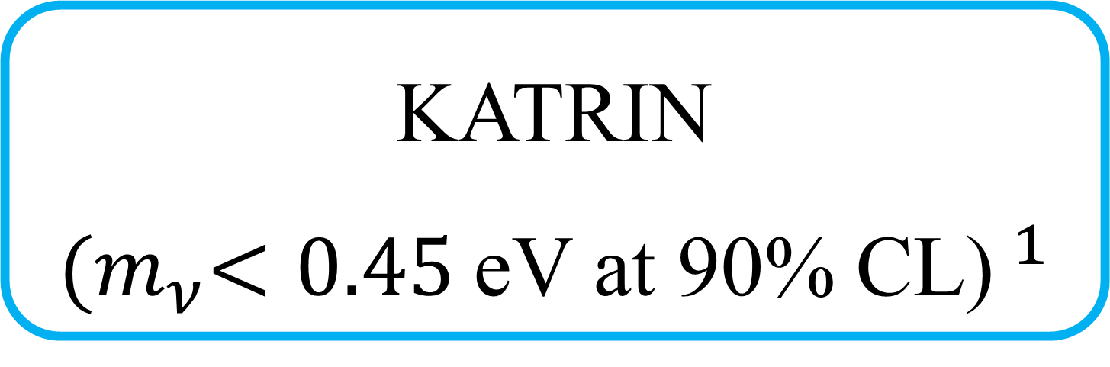
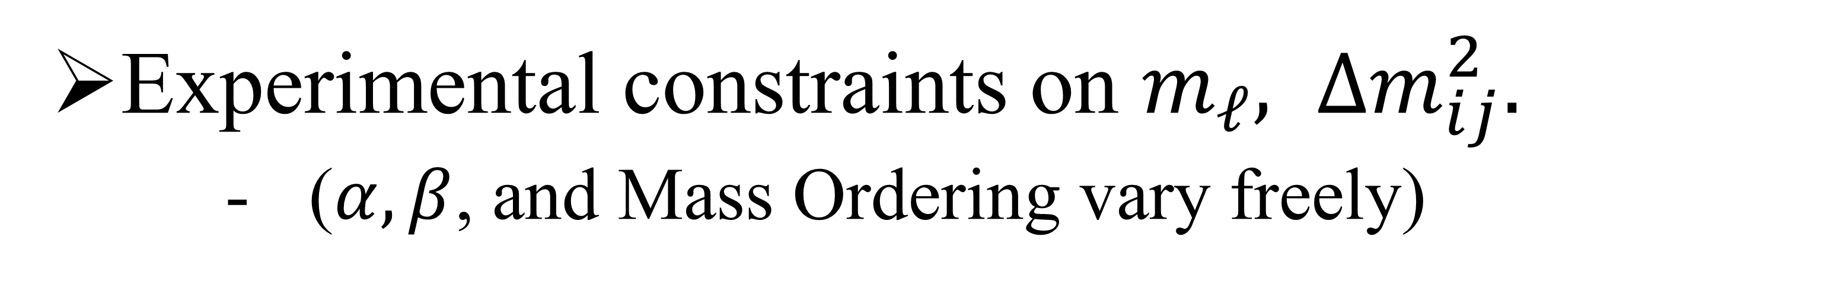
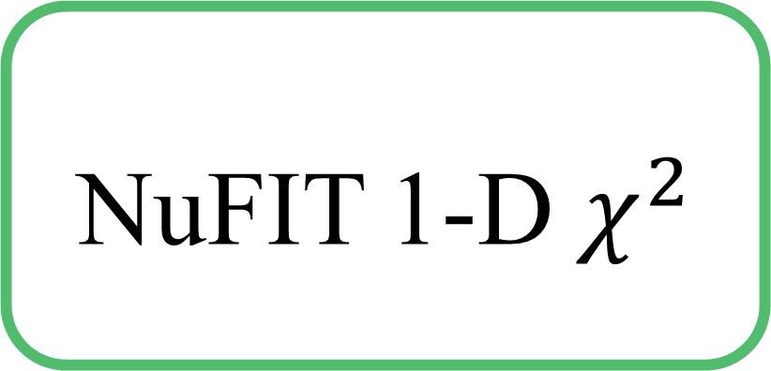
Approach:
KATRIN
${(m}_{ν}<0.45$eV at 90% CL)$^{1}$
NuFIT 1-D $χ^{2}$
Experimental constraints on $m_{ℓ}, Δm_{ij}^{2}.$
($α, β$, and Mass Ordering vary freely)
Find range of $m_{ℓ}$ where the sum rule can be satisfied.
H. Truelson – CSU:
“Distinguishing Flavor Model Predictions”
[1] Direct neutrino-mass measurement based on 259 days of KATRIN data, KATRIN Collaboration. Arxiv: 2406.13516

Slide 11
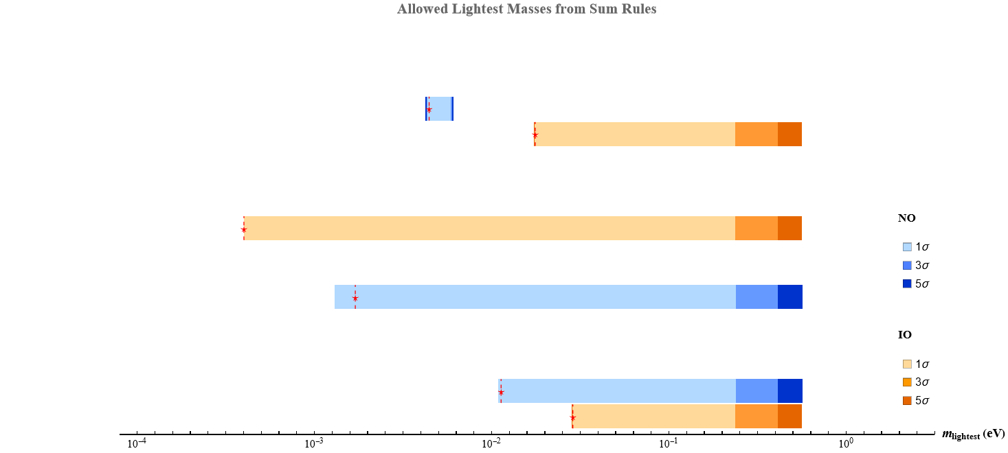
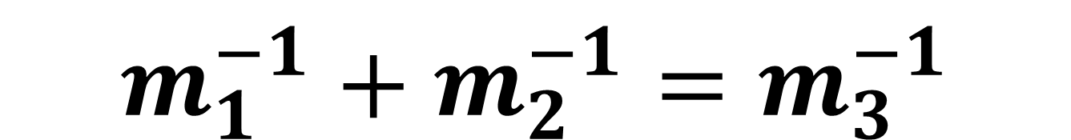
Sum Rules:
$$m_{1}^{−1}+m_{2}^{−1}=m_{3}^{−1}$$
H. Truelson – CSU:
“Distinguishing Flavor Model Predictions”

Slide 12



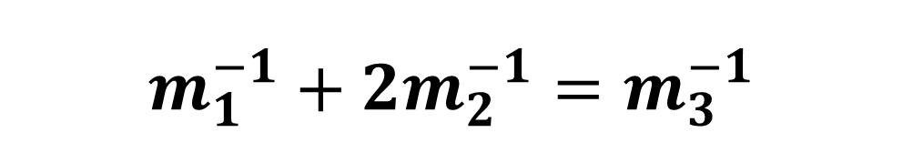
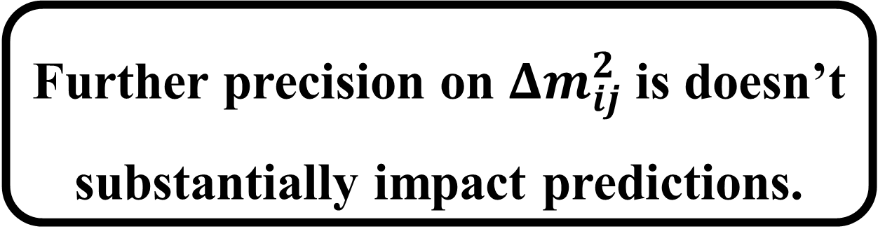


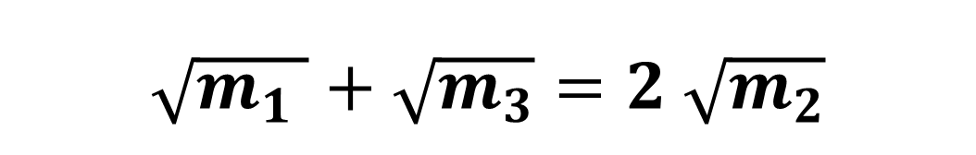

Sum Rules:
Further precision on $Δm_{ij}^{2}$ is doesn’t substantially impact predictions.
$$m_{1}^{−1}+2m_{2}^{−1}=m_{3}^{−1}$$
$$1.$$
$$m_{1}+m_{2}=2m_{3}$$
$$2.$$
$$3.$$
$$\sqrt{m_{1} }+\sqrt{m_{3}}=2 \sqrt{m_{2}}$$
$$m_{1}^{−1}+m_{2}^{−1}=m_{3}^{−1}$$
$$4.$$
H. Truelson – CSU:
“Distinguishing Flavor Model Predictions”

Slide 13
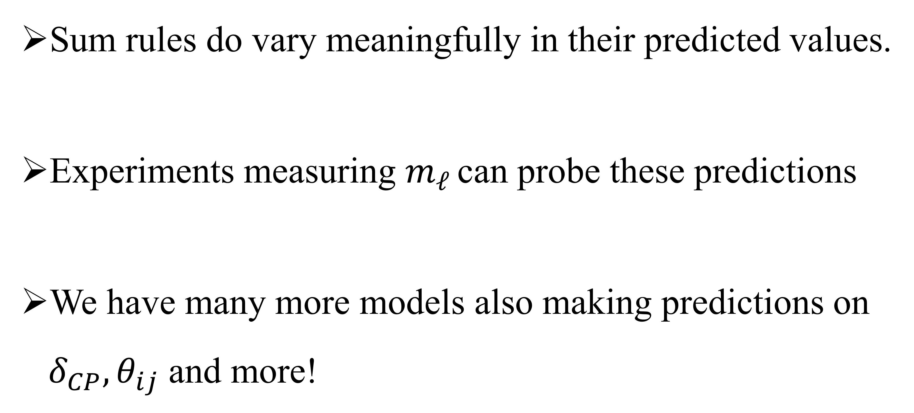
Conclusions:
Sum rules do vary meaningfully in their predicted values.
Experiments measuring $m_{ℓ}$ can probe these predictions
We have many more models also making predictions on $δ_{CP}, θ_{ij}$ and more!
H. Truelson – CSU:
“Distinguishing Flavor Model Predictions”

