Slide 1

Shedding Light on the KM3NeT event: A Dark Matter Effect
Ankur Verma
Email: ankur.verma@usd.edu
Postdoctoral Researcher,
Department of Physics
arXiv : 2505.22754
In collaboration with
Bhupal Dev, Bhaskar Dutta, Aparajitha Karthikeyan, Writasree Maitra, Louis Strigari
Particle Physics on the Plains 2025
Notes:
Hi everyone
My name is Ankur Verma and I am a postdoc at University of South Dakota. I will be talking on the ‘Dark’ Matter Effect as a Solution to the KM3-230213A Puzzle.

Slide 2
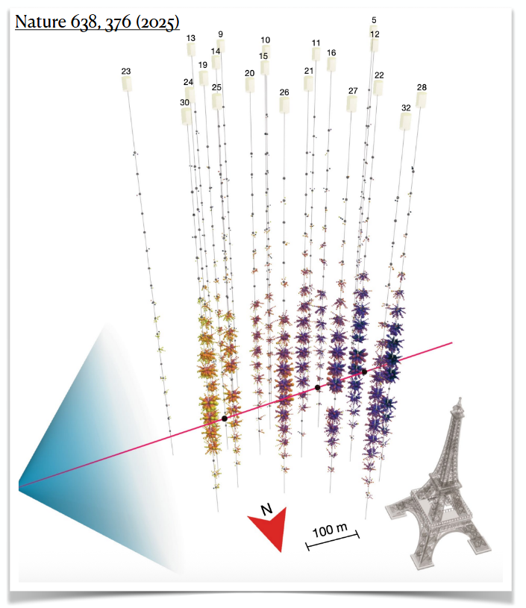
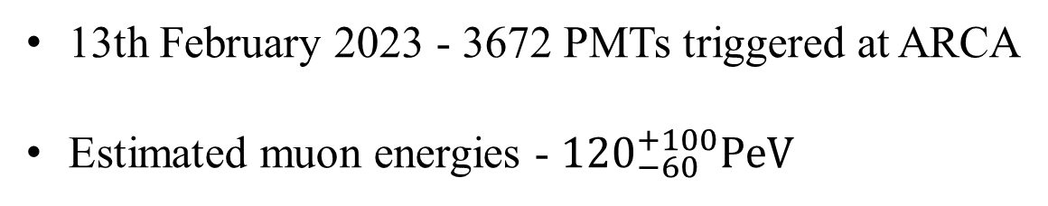
The Event at KM3NeT
13th February 2023 - 3672 PMTs triggered at ARCA
Estimated muon energies - ${120}_{−60}^{+100}PeV$
Highest energy muon observed ever!
Notes:
The KM3NeT collaboration has recently reported the detection of an ultra-high-energy throughgoing muon event with energy 120+110 −60 PeV.
This lit up almost almost a third of the detector triggering 3672PMTs at ARCA.
This is the highest energy event ever detected by a neutrino telescope, surpassing the previous record set by IceCube [2] by almost an order of magnitude.

Slide 3
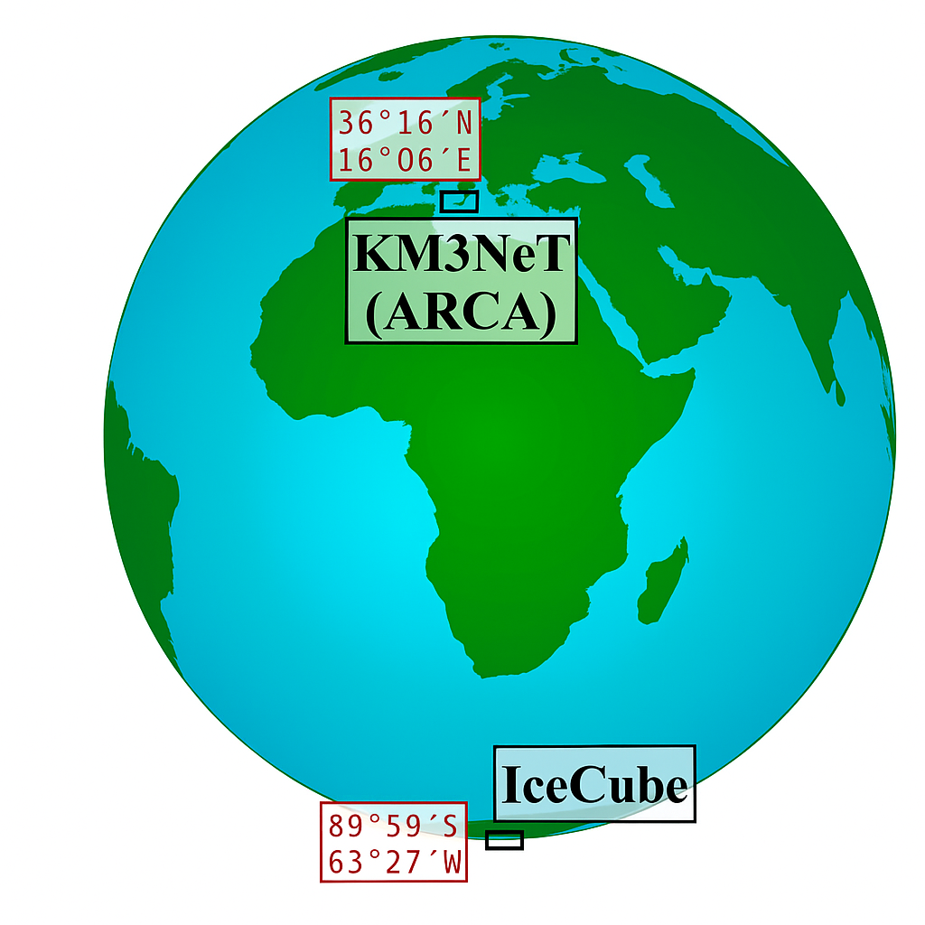
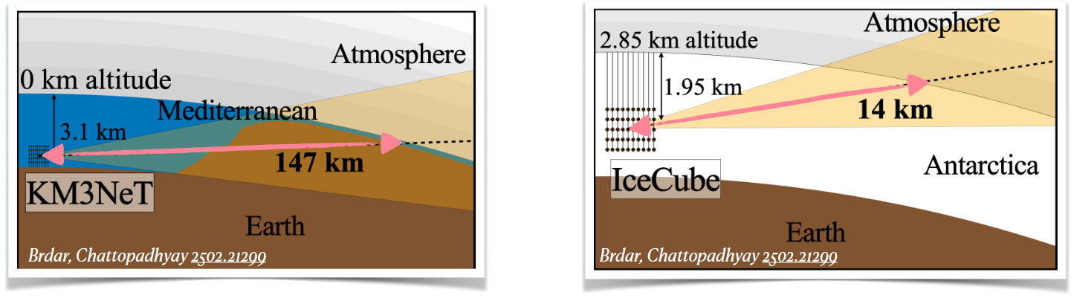
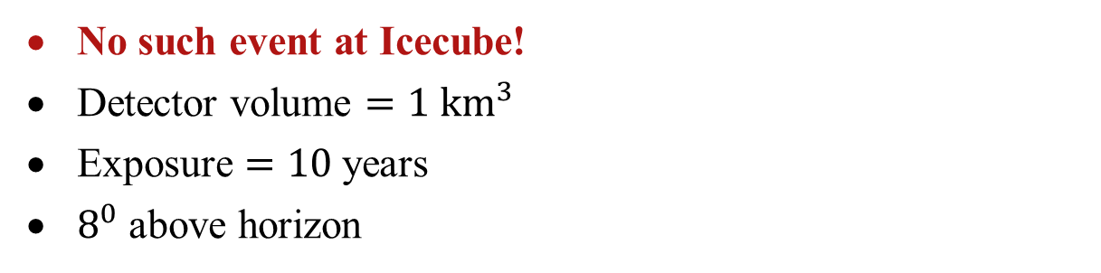
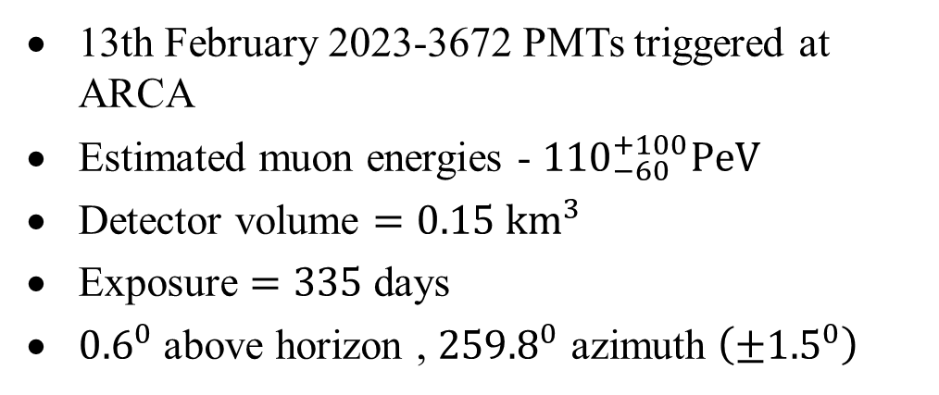
The Event at KM3NeT
13th February 2023-3672 PMTs triggered at ARCA
Estimated muon energies - ${110}_{−60}^{+100}PeV$
Detector volume $=0.15{ km}^{3}$
Exposure $=335$ days
${0.6}^{0}$ above horizon , ${259.8}^{0}$ azimuth $\left(±{1.5}^{0}\right)$
No such event at Icecube!
Detector volume $=1{ km}^{3}$
Exposure $=10$ years
$8^{0}$ above horizon
In equatorial coordinates, RA=94.3⁰, dec.=-7.8⁰ (far from GC).
Notes:
The excellent angular resolution for muon tracks enabled KM3NeT to reconstruct the direction of the event to be near-horizontal, originating 0.6◦ above the horizon at an azimuth of 259.8◦ with an uncertainty of 1.5◦ at 68% confidence level (CL).
In equatorial coordinates (J2000), this event points to the Southern hemisphere with right ascension (RA) of 94.3◦ and declination angle (dec.) of −7.8◦.
IceCube has been running with a much larger effective area for a much longer time, and yet it has not reported neutrinos above 10 PeV.
IceCube with much larger effective area times exposure has not found any such events. The event is located about 8◦ above the horizon for IceCube; in this direction, IceCube has the maximum effective area.
Two major issues make this event rather unusual: (i) Why did this event evade detection at IceCube, which has 10 times more exposure and about 20 times larger effective area [3] than the current KM3NeT?
What kind of cosmic accelerators can produce such a high-energy particle? Given the enormous energy of the event, the source is most likely extragalactic.
will encounter much less Earth overburden (about 14 km) compared to KM3NeT (about 147 km). We further realize that the 1.50 uncertainty in the source location results in potentially larger overburden distances for KM3NeT (59 − 418 km) than for IceCube (12 − 17 km). Therefore, the DM flux from the blazar has a larger probability to upscatter inside Earth’s crust and produce muon events at KM3NeT than at IceCube.

Slide 4
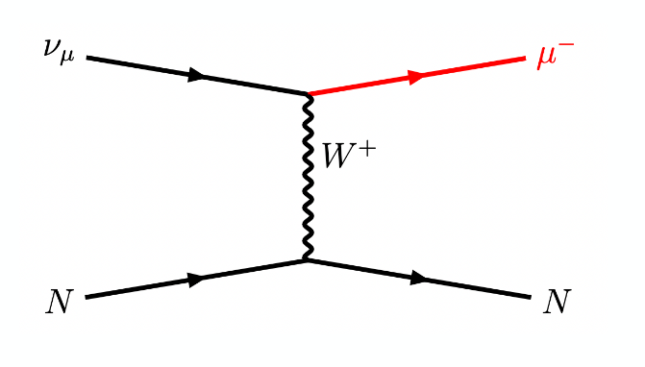
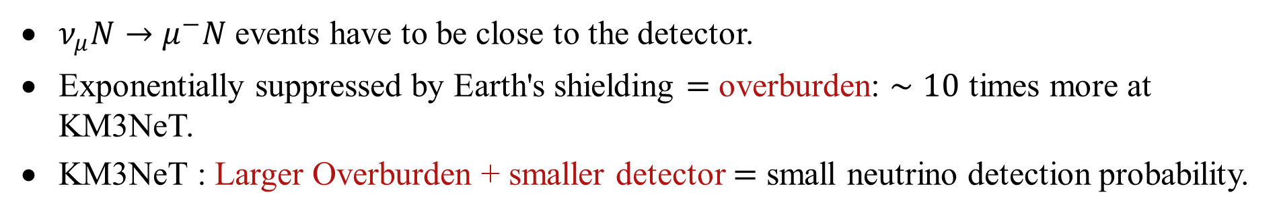
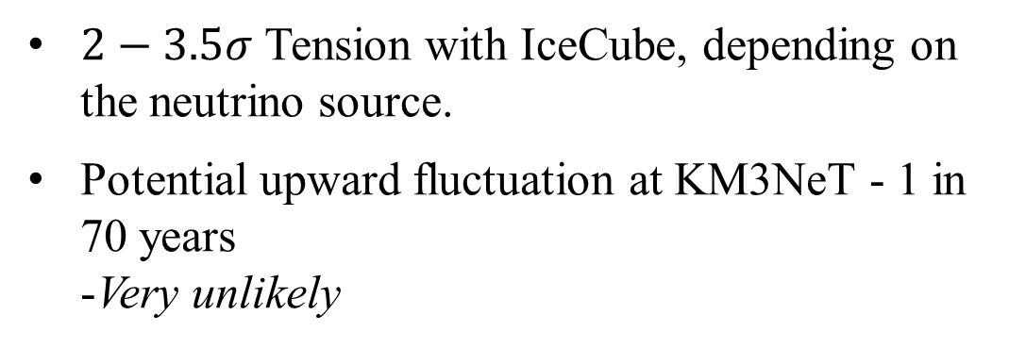
SM Neutrinos?
$2−3.5σ$ Tension with IceCube, depending on the neutrino source.
Potential upward fluctuation at KM3NeT - 1 in 70 years -Very unlikely
$ν_{μ}N→μ^{−}N$ events have to be close to the detector.
Exponentially suppressed by Earth's shielding $=$ overburden: $∼10$ times more at KM3NeT.
KM3NeT : Larger Overburden + smaller detector $=$ small neutrino detection probability.
Notes:
Since this is a throughgoing muon, the parent particle, assumed to be a neutrino in the KM3NeT analysis, must carry even higher energy, estimated to be in the range of 110–790 PeV with a median energy of 220 PeV.
To beat IceCube’s advantage of exposure time, a transient point source explanation [6] seems more plausible than a diffuse cosmogenic [7] or galactic [8] source.
Taking a typical redshift of z ≈ 1 for these sources, the estimated source luminosity for the blazar jet from the inferred neutrino luminosity to explain the event is Lp ≃ 1050 erg/s [6], orders of magnitude larger than a typical blazar luminosity of 1045 erg/s without beaming. Even with a beaming factor of 103, the blazar needs to be flaring for O(100) years to meet the required neutrino flux, thus putting the standard interpretation again in tension with IceCube.
The cosmic neutrino energy spectrum measured up to now falls steeply with energy.

Slide 5
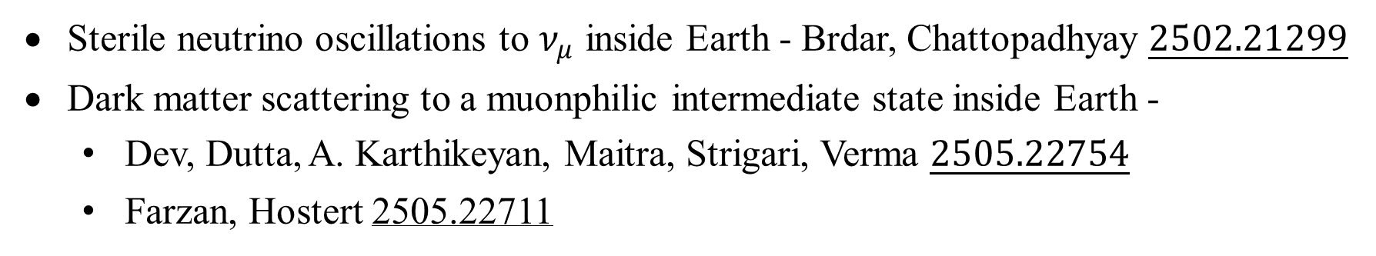

New Physics?
Larger Overburden $→$ Enhancement???
Use Earth matter effect to address the tension:
Sterile neutrino oscillations to $ν_{μ}$ inside Earth - Brdar, Chattopadhyay $\underline{2502.21299}$
Dark matter scattering to a muonphilic intermediate state inside Earth -
Dev, Dutta, A. Karthikeyan, Maitra, Strigari, Verma $\underline{2505.22754}$
Farzan, Hostert 2505.22711
Notes:
We propose a novel solution to this conundrum in terms of dark matter (DM) scattering in the Earth’s crust. We show that intermediate dark-sector particles that decay into muons are copiously produced when high-energy (∼ 100 PeV) DM propagates through a sufficient amount of Earth overburden.
we consider a transient source of boosted DM that scatters in the Earth matter – dubbed as the ‘dark’ matter effect.
due to an enhanced cross section and effective area for the DM scattering, compared to the neutrino scattering solution, we can afford to explain the KM3NeT event with a smaller flaring period for a given source luminosity, thus alleviating the tension with IceCube.
Neutrino Matter Effect
Dark Matter Effect

Slide 6
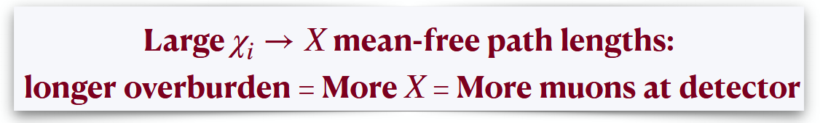
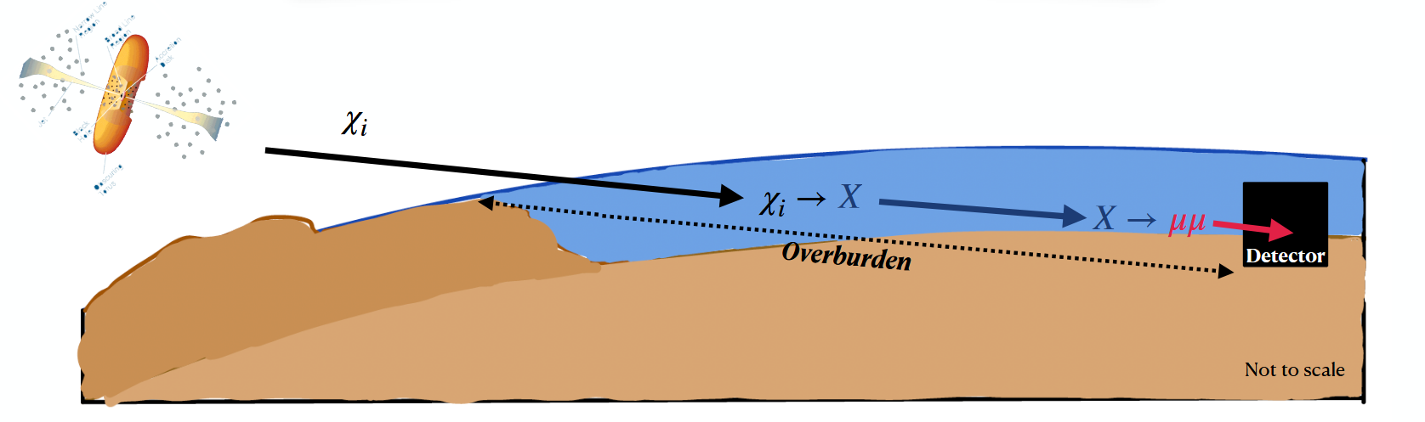
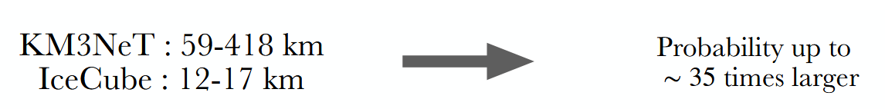
“Dark” Matter effect - our solution
Notes:
The crux of our solution is that when sufficiently energetic DM enters the Earth, it can efficiently upscatter to produce an intermediate dark sector particle, transferring almost all its energy to it, which subsequently decays into muons after traversing some overburden distance.
From the sky map in the direction of KM3-230213A [1], we find that the Earth overburden traveled by DM arising from blazars in the 1.5◦ uncertainty region around KM3-230213A is between 59 km and 418 km. The corresponding range of overburden to reach IceCube is between 12 km and 17 km. Since the overburden distance at KM3NeT can be ∼ 35 times than at IceCube, KM3NeT is more sensitive to the DM parameter space that has scattering and decay mean free path lengths (MFPLs) that are of O(100 km).
two examples of weakly coupled long-lived dark sector scenarios that satisfy all existing constraints.
We find that the DM solution is more favored than the SM neutrino solution, even if we assume the same DM and neutrino luminosities, due to different effective areas. For larger overburdens, the effective area of DM is enhanced by upscattering into intermediate particles χ2/Z′. However, the effective area for the SM neutrino is smaller due to the requirement that the neutrinos must scatter close to the detector, because the resulting high-energy muon from the charged-current process loses energy rapidly as it traverses matter, and having a higher-energy neutrino to compensate for this will come with a smaller flux.

Slide 7
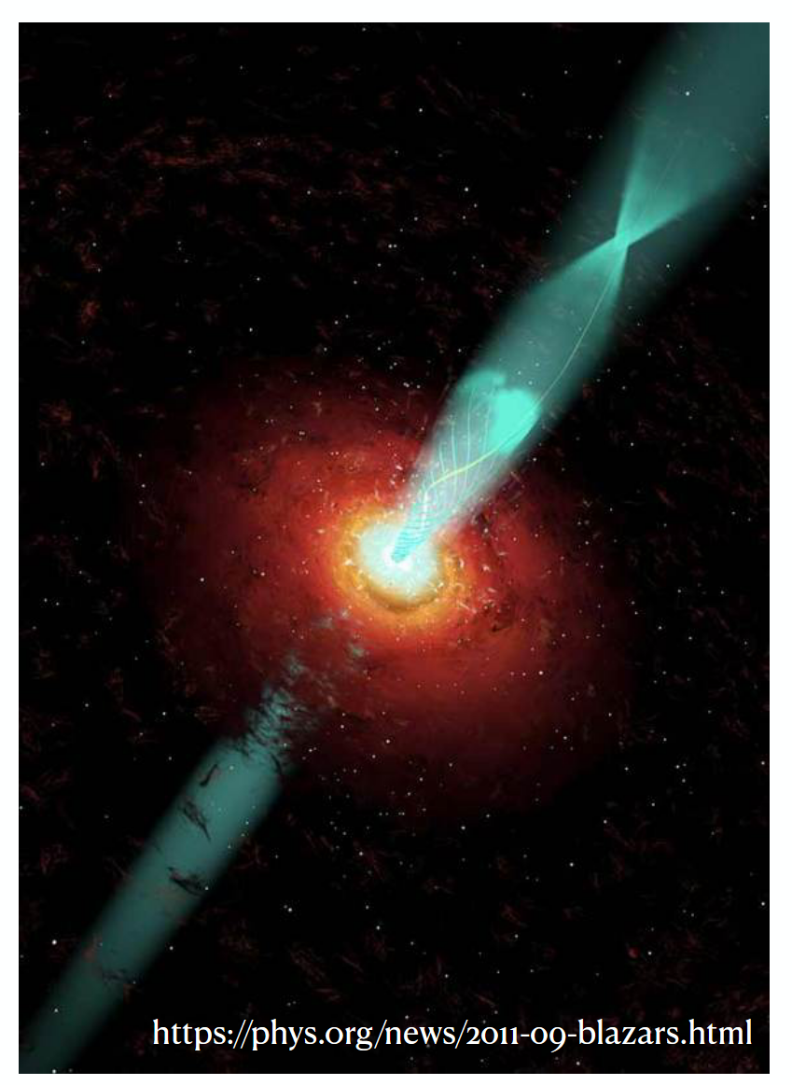
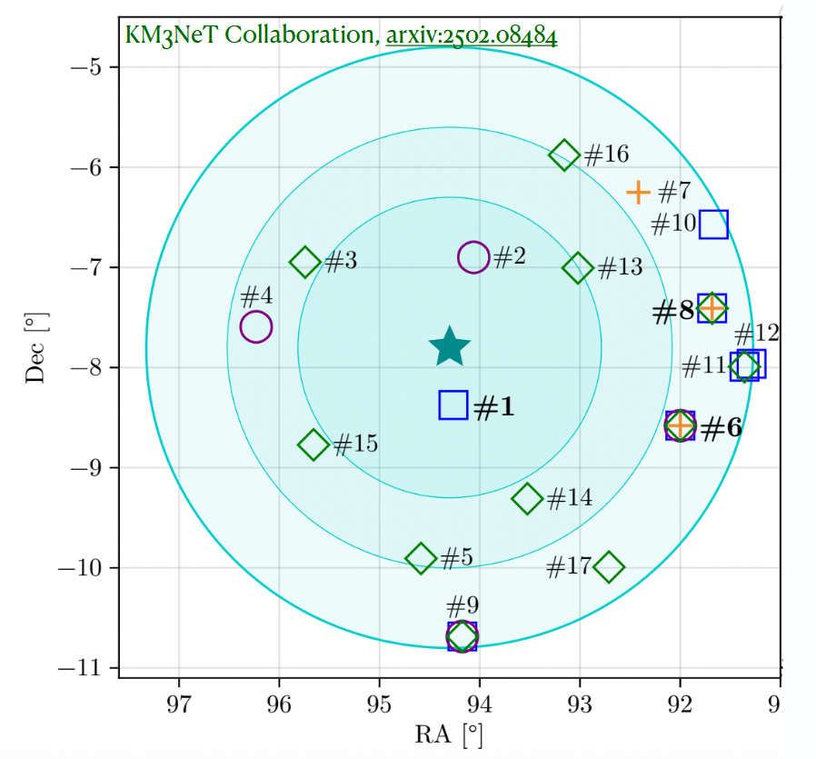
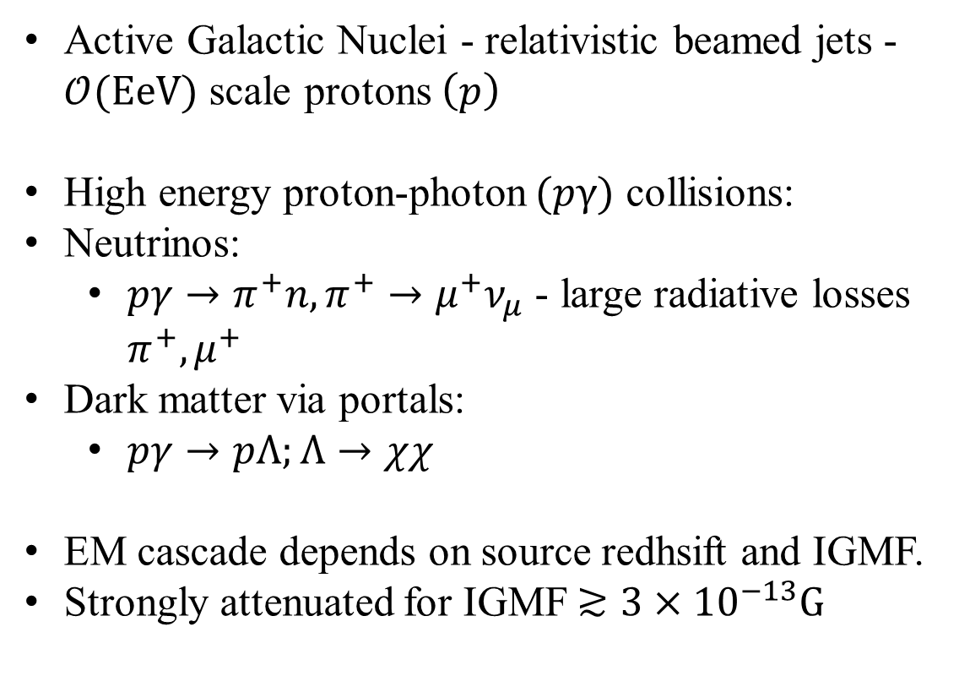
Blazar Sources
Active Galactic Nuclei - relativistic beamed jets -$𝒪(EeV)$ scale protons $\left(p\right)$
High energy proton-photon $(pγ)$ collisions:
Neutrinos:
$pγ→π^{+}n,π^{+}→μ^{+}ν_{μ}$ - large radiative losses $π^{+},μ^{+}$
Dark matter via portals:
$pγ→pΛ;Λ→χχ$
EM cascade depends on source redhsift and IGMF.
Strongly attenuated for IGMF$≳3×{10}^{−13}G$
Fang, Halzen, Hooper, arxiv:2502.09545
Crnogorčevića, Blanco, Linden, arxiv:2503.16606
Notes:
Blazars are a special type of active galactic nucleus (AGN)
High-energy protons accelerated in the jet interact both with the jet’s internal radiation field and with any thermal photon population, initiating photohadronic (pγ) processes.
The same interactions responsible for DM scattering in Earth also source the boosted DM flux from a high-luminosity blazar.
the same interactions responsible for DM scattering on Earth could also produce the DM and boost it to O(100) PeV energy via pγ processes in a cosmic-ray accelerator environment, like blazars.1 The highly boosted DM in our case is assumed to come from a extragalactic transient point source in the Southern sky, most likely a flaring blazar
KM3NeT has identified 17 blazars within 3◦ of the KM3-230213A location in the sky through their multiwavelength properties
However, for a transient point source like a flaring blazar, the actual exposure depends on the flaring time. Here we assume that the high-luminosity blazar responsible for the KM3230213A event was actively flaring for 2 years including the KM3NeT observation window, so TIC ∼ 2 yrs.

Slide 8
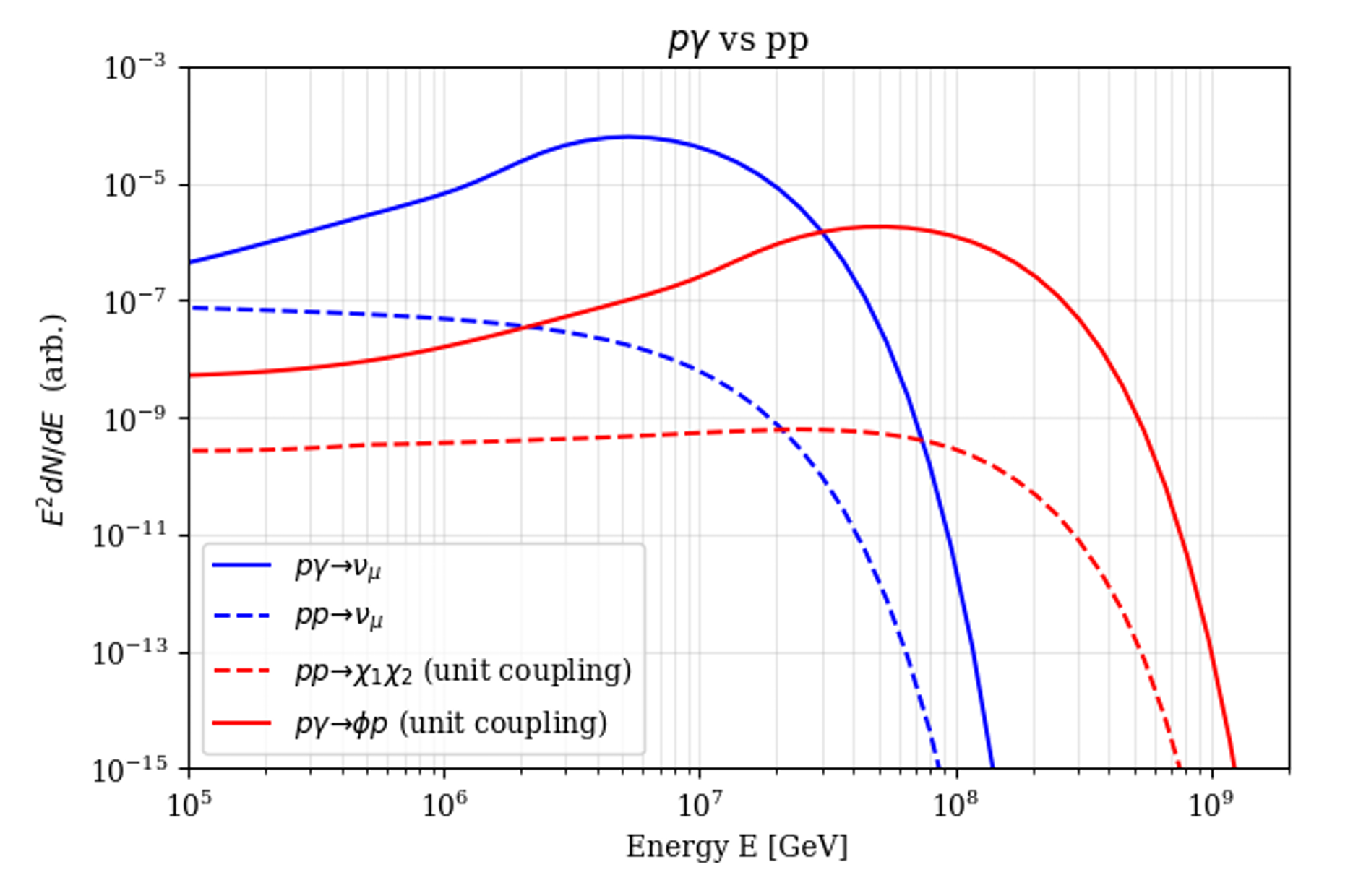
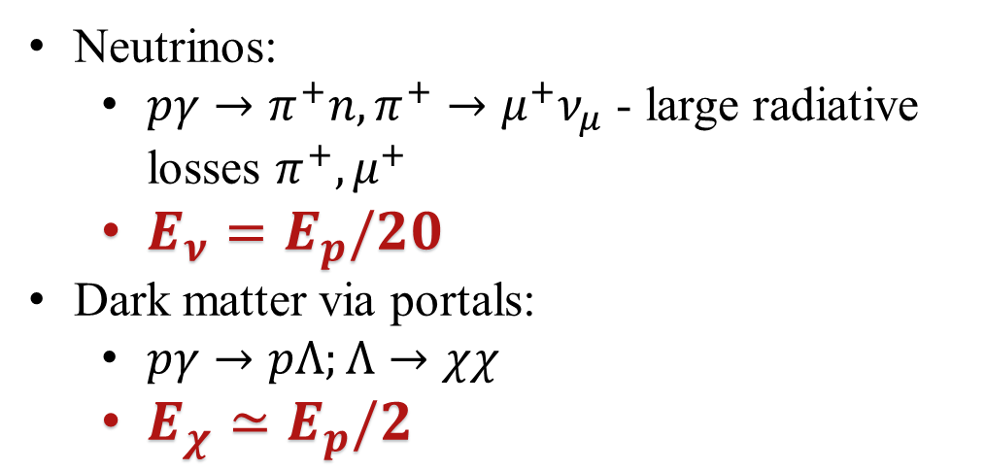
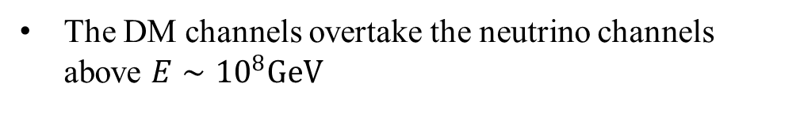
Blazar Sources
Neutrinos:
$pγ→π^{+}n,π^{+}→μ^{+}ν_{μ}$ - large radiative losses $π^{+},μ^{+}$
$E_{ν}=E_{p}/20$
Dark matter via portals:
$pγ→pΛ;Λ→χχ$
$E_{χ}≃E_{p}/2$
The DM channels overtake the neutrino channels above $E∼{10}^{8}GeV$
Notes:
Figure 5 shows the comoving E2dN/dE spectra for neutrinos and DM obtained with the benchmark parameters above. At energies E > 100 PeV, the DM flux from either pγ or pp production could significantly exceed the accompanying neutrino flux. This is because the assumed DM production channels deposit a larger fraction of the proton energy, than photopion neutrino production, amplifying the high-energy yield. In addition, unlike charged pions and muons there are no radiative losses since the neutral DM pair does not suffer synchrotron cooling. So its spectrum inherits the full high-energy power-law tail of the parent protons. This justifies why the DM explanation proposed here is only relevant at the highest energies, while the “lower” energy events observed by IceCube can still be the neutrino-induced events.
We determine the flux from a blazar with an intrinsic “DM” luminosity Lχ (in units of erg/s), located at a luminosity distance dL ≈ 7 Gpc from Earth, corresponding to a source redshift z ≈ 1. The DM flux from the blazar is boosted into a narrow cone in the direction towards the Earth, resulting in an enhanced flux relative to an isotropic source model.
fbeam ≈ 103 when the emission is concentrated within 4◦ around the jet direction
the blazar luminosities required for our solution to work are consistent with the observed luminosity distributions of a large population of blazars

Slide 9
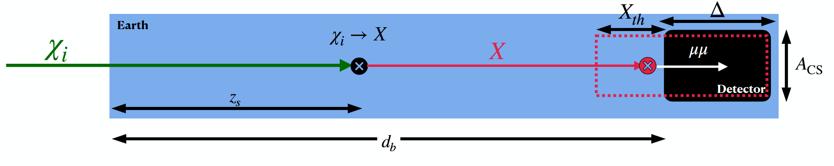
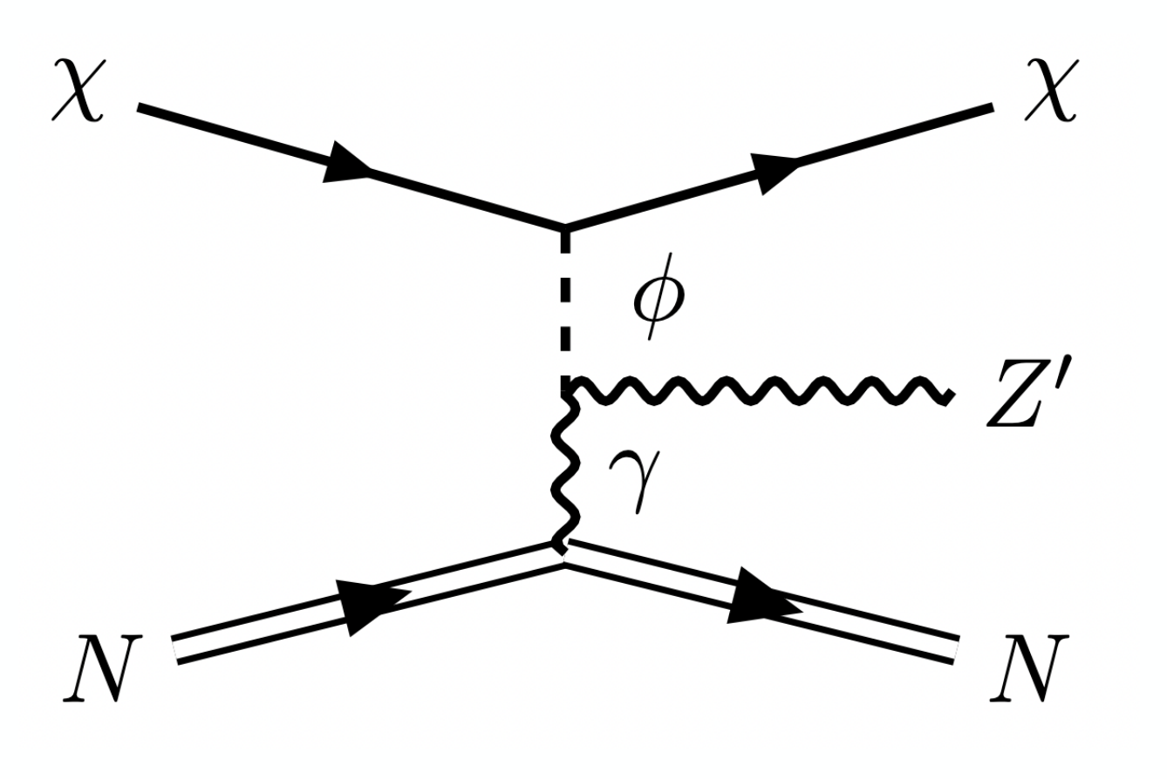
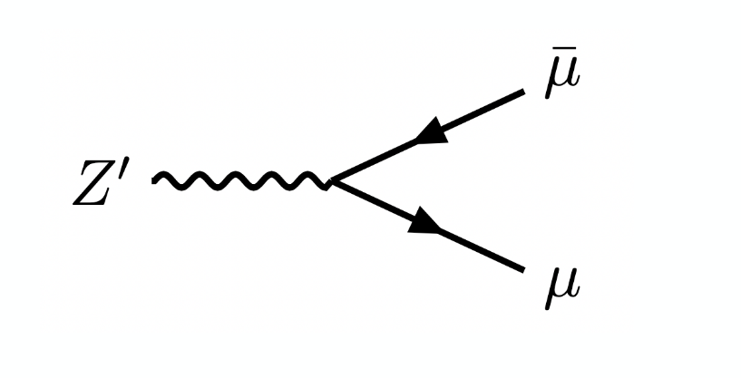
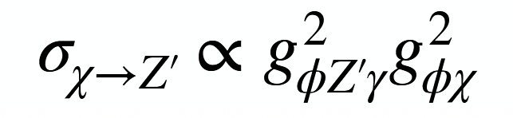
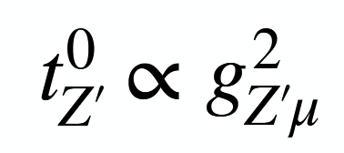
Dark Matter Effect
Single Scattering
Example :
Notes:
2 → 3 DM scattering via a scalar mediator, χN → χN Z′, followed by Z′ → μ+μ− single-component DM χ with mass mχ that couples to a new scalar φ with mass mφ, which interacts with the SM sector through an effective vertex involving a Z′ and the SM photon.
gφZ′γ is an effective dimension-5 interaction that can be realized at loop-level in a ultraviolet-complete theory, e.g. via a 3rd-generation SM fermion loop coupled to the SM Higgs mixed with a singlet scalar.

Slide 10
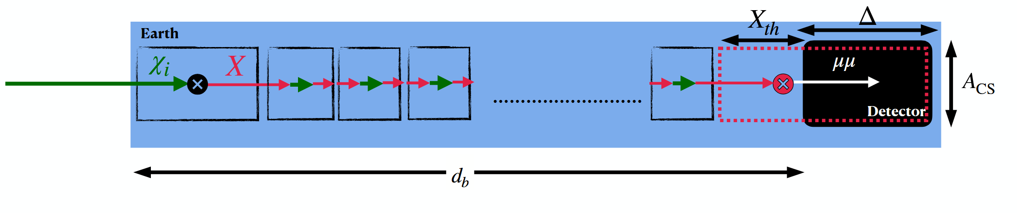
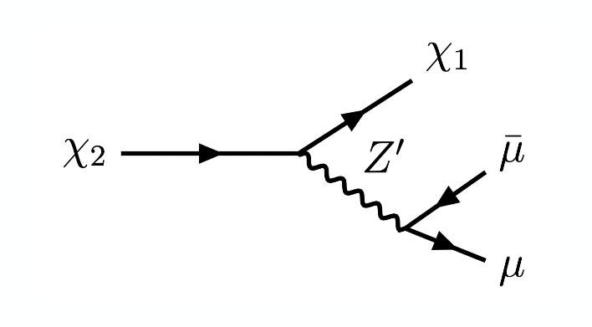
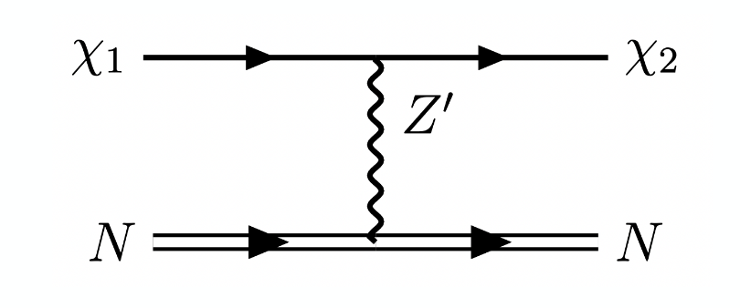
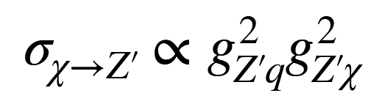
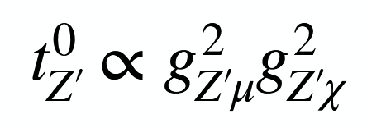
Dark Matter Effect
Multiple Scattering
Example :
$2→2 \text{up}\text{−}\text{scattering} \text{of} \text{an} \text{inelastic} \text{DM}$ via a vector mediator:
Notes:
involves a two-component inelastic DM (χ1, χ2) with masses mχ1,χ2 that couples to a vector boson Z′ with mass mZ′.
gχ, gZ′f (f = q, μ) denote the coupling strengths of Z′ with the DM and with the SM fermions. the Z′ must couple to the first-generation quarks (u, d) and to the muon
followed by the de-excitation of the heavier state χ2 → χ1μ+μ
it is more feasible for inelastic DM to undergo multiple scattering than the single-component DM

Slide 11
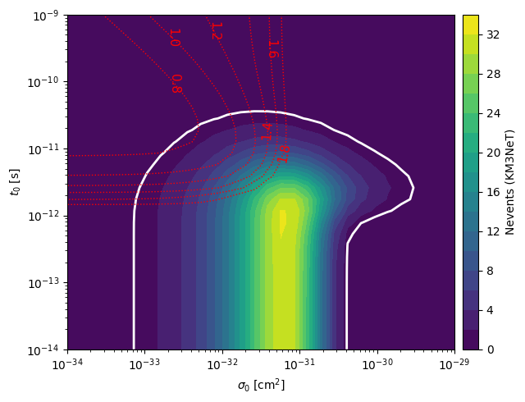
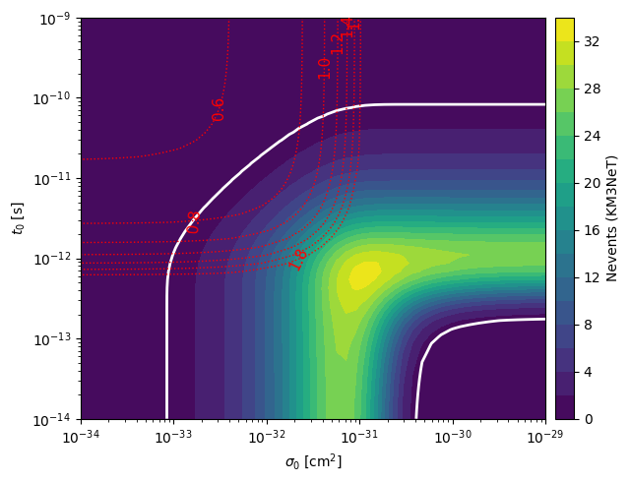





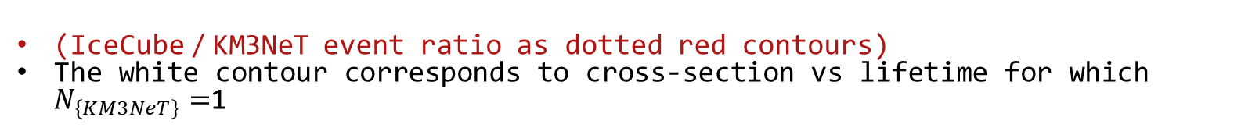

$$\text{Preferred} \text{Cross} \text{sections} \text{vs} \text{lifetimes}$$
(IceCube / KM3NeT event ratio as dotted red contours)
The white contour corresponds to cross-section vs lifetime for which $N_{\left\{KM3NeT\right\}}=$1
Note: these plots are for illustration only and don’t take into account the angular uncertainties and no. of PMT hits prior.
Single
scattering
Multiple
scattering
$$\begin{aligned}&L_{χ}=0.1×f_{\text{b}\text{eam} }×{10}^{48}erg/s; \\ &f_{\text{beam} }={10}^{3}\end{aligned}$$

Slide 12
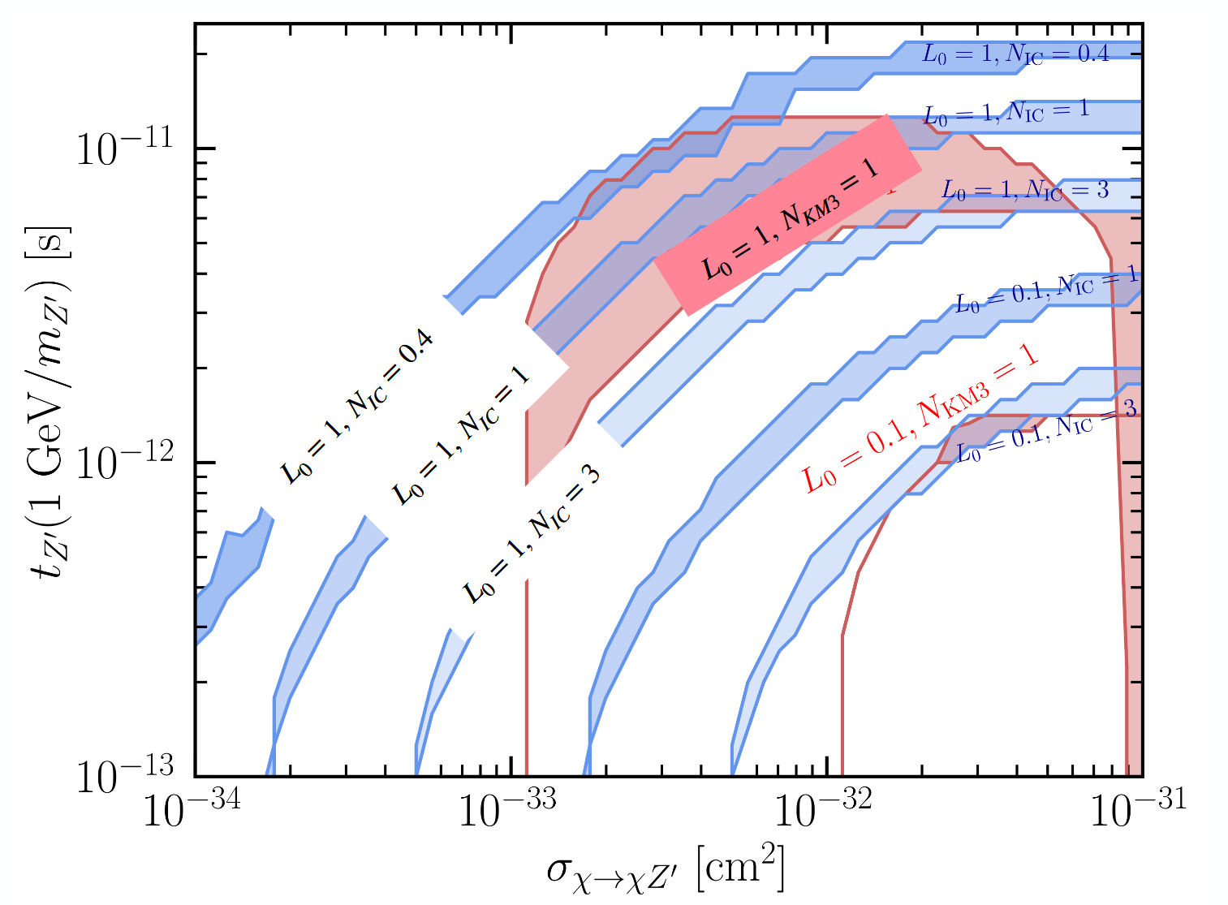
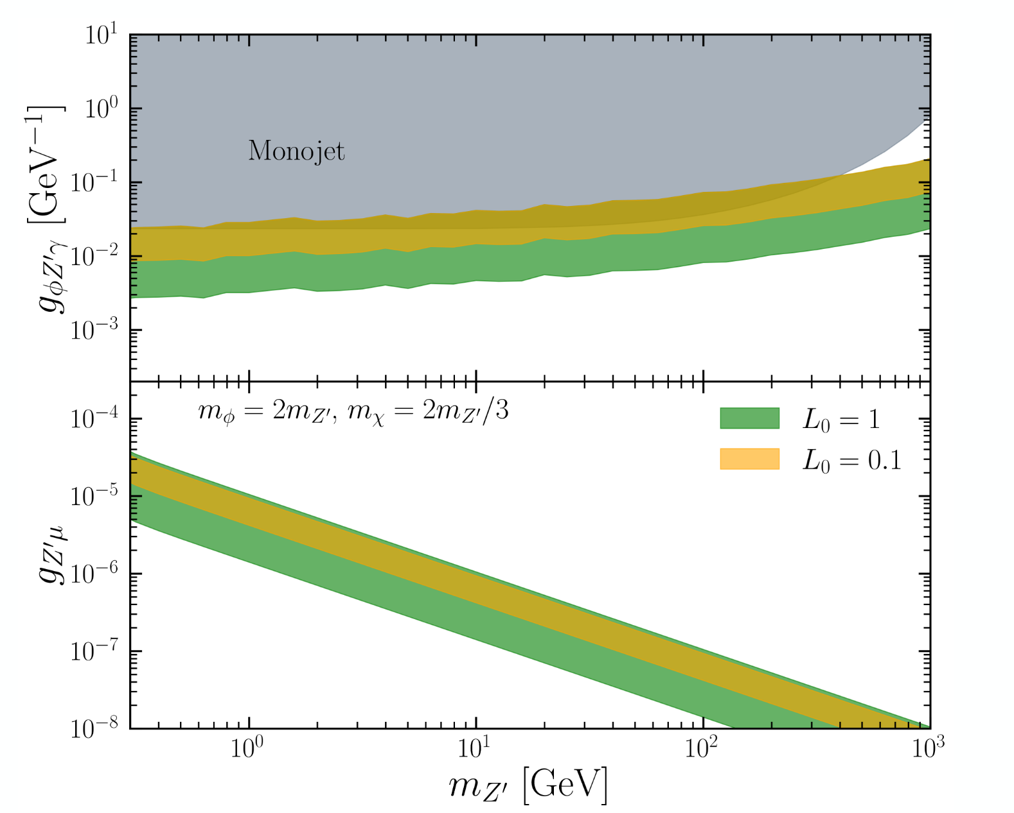
2 → 3 DM scattering scenario
Bands correspond to overburden ranges
Notes:
Figure 2 shows the iso-event contours for KM3NeT, and the corresponding predictions at IceCube, in the space of cross section (χi → X) and lifetime (X → μ+μ−) for various blazar luminosities. The peach bands correspond to those that give rise to one event at KM3NeT. The blue bands show the parameters that correspond to a particular number of events at IceCube.
For example, when Lχ = 1047 erg/s, we find that along the range of parameters that give rise to one event at KM3NeT (corresponding to the uncertainty in the overburden), the number of events at IceCube can vary between 0.3 and 3.
Thus, there exists some viable parameter space which explains the non-observation of this event at IceCube
One of the salient features in these sensitivites is that the lifetime required for a single event increases as a function of cross section. This is due to the fact that the mean-free path length for scattering is inversely proportional to the cross section. Therefore, the decrease in mean-free path length with an increase in cross section is compensated by increasing the lifetime, or the mean decay length.
Another feature we observe is that for larger DM luminosities, the required cross section to produce can be lessened. Since the overburden faced by KM3NeT is larger than IceCube, this allows for more events at KM3NeT for characteristically larger MFPL.
In the elastic DM model, we assume that mφ = 2mZ′ , mχ = 2mZ′ /3, and gχ = 2.5. Under these assumptions, Fig. 3b shows the required couplings gφZ′γ and gZ′μ as a function of mZ′ that satisfy the required cross sections and lifetimes. Since the scalar φ decays invisibly once produced and Z′ is not allowed kinematically to decay into a single photon, we find that monophoton searches at DELPHI and BaBar do not apply here. However, the monojet cross section bound from ATLAS [61] for pT > 200 GeV is translated into a constraint on gφZ′γ.

Slide 13
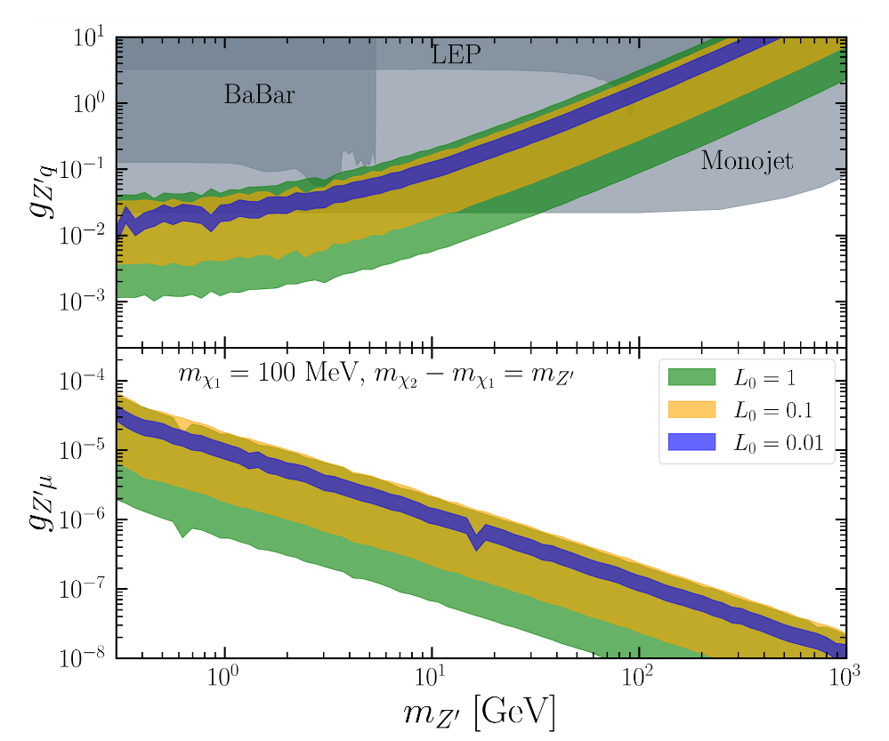
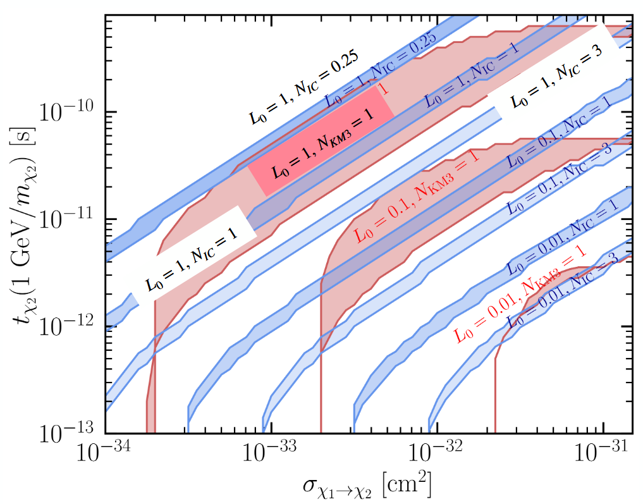
Inelastic DM scenario
Bands correspond to overburden ranges
Notes:
it is more feasible for inelastic DM to undergo multiple scattering than the single-component DM, (when mχ2 − mχ1 = mZ′ ), we find that the sensitivity of KM3NeT is much larger in the inelastic DM scenario
we show the range of masses and couplings for both inelastic and elastic DM scenarios that give rise to the cross sections and lifetimes required for one event at KM3NeT. We depict our sensitivities for 300 MeV < mZ′ < 1 TeV where the requirements for forward decay (from intermediate particle) and forward scattering (from intial DM) impose the lower and higher limit on mZ′ , respectively.
show the limits for gZ′q and gZ′μ as a function of mZ′ .
The direct constraints on gZ′μ come from the charged kaon [56] and pion [57] decay, as well as from (g − 2)μ [58]. However, for heavy mediators, mZ′ > 300 MeV, these bounds appear only for gZ′μ > 10−3. Since the lifetimes require couplings much less than 10−3, these bounds are not relevant for our study.
For gZ′q, however, we find that constraints from monophoton searches at BaBar [59] exclude gZ′q ≳ 10−1 for mZ′ ≲ 10 GeV, and the Z boson decay width rule out gZ′q. Here, we assume that the mixing between Z′ − γ is ∼ e/(4π2). For heavier Z′, monojet searches at LHC [60] rule out gZ′q ≳ 10−2. ≳ 2 for mZ′ ≲ 80 GeV.
Here, we assume that the mixing between Z′ − γ is ∼ e/(4π2). For heavier Z′, monojet searches at LHC [60] rule out gZ′q ≳ 10−2.

Slide 14
Conclusions
The KM3NeT event is the highest energy (non-CR) event ever recorded.
Tension with IceCube non-observation.
Potential solution using blazar produced DM scattering in Earth.
Larger overburden facilitates DM scattering – new muonphilic particles. Neutrinos are attenuated whereas DM scattering is enhanced
In both the DM model scenarios discussed, there exists parameter space that can account for this event while remaining consistent with Ice Cube
Notes:
DM scattering within the Earth leads to highly collimated μ+μ− final states, either from the decay of a heavier DM component or a long-lived mediator.
Also possible to explain the ANITA-IV anomalous events with comparable chord lengths as the KM3NeT event within our DM model parameter spaces, without conflicting with IceCube and Pierre Auger non-observations, by considering different blazar sources located along the direction of the events.

Slide 15
Backup

Slide 16
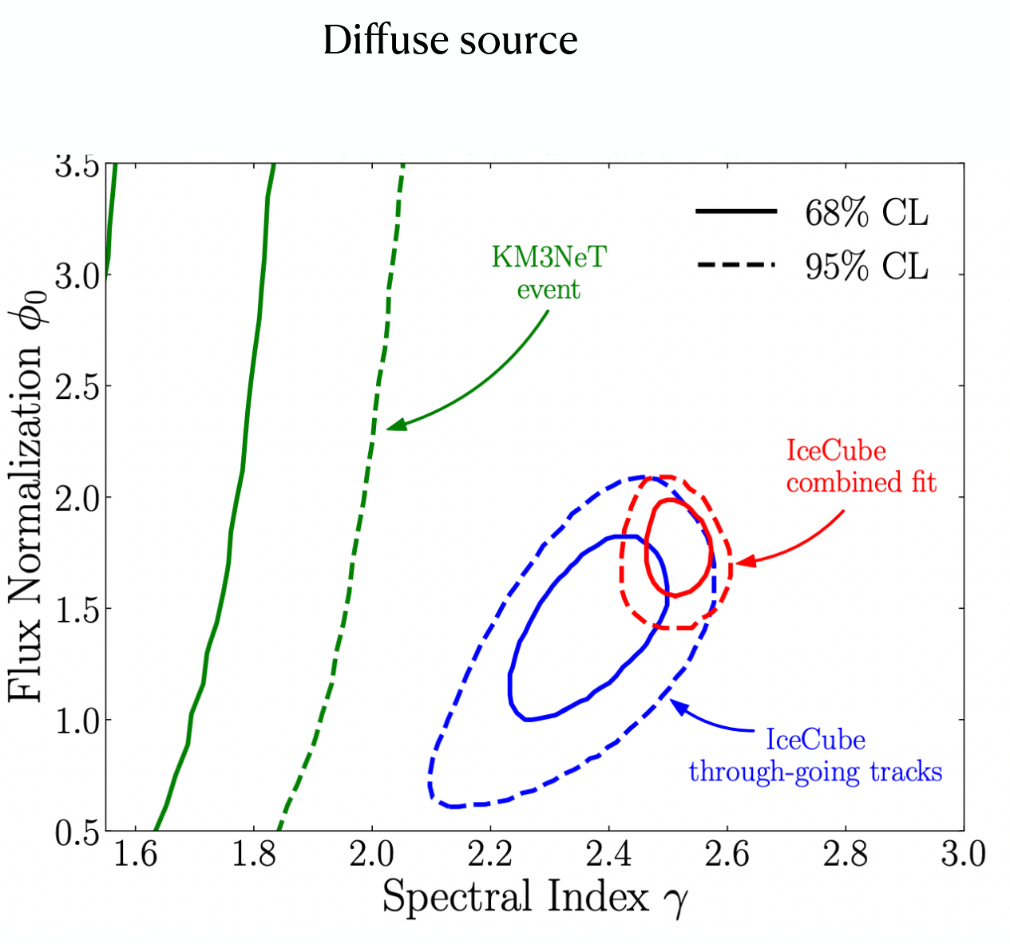
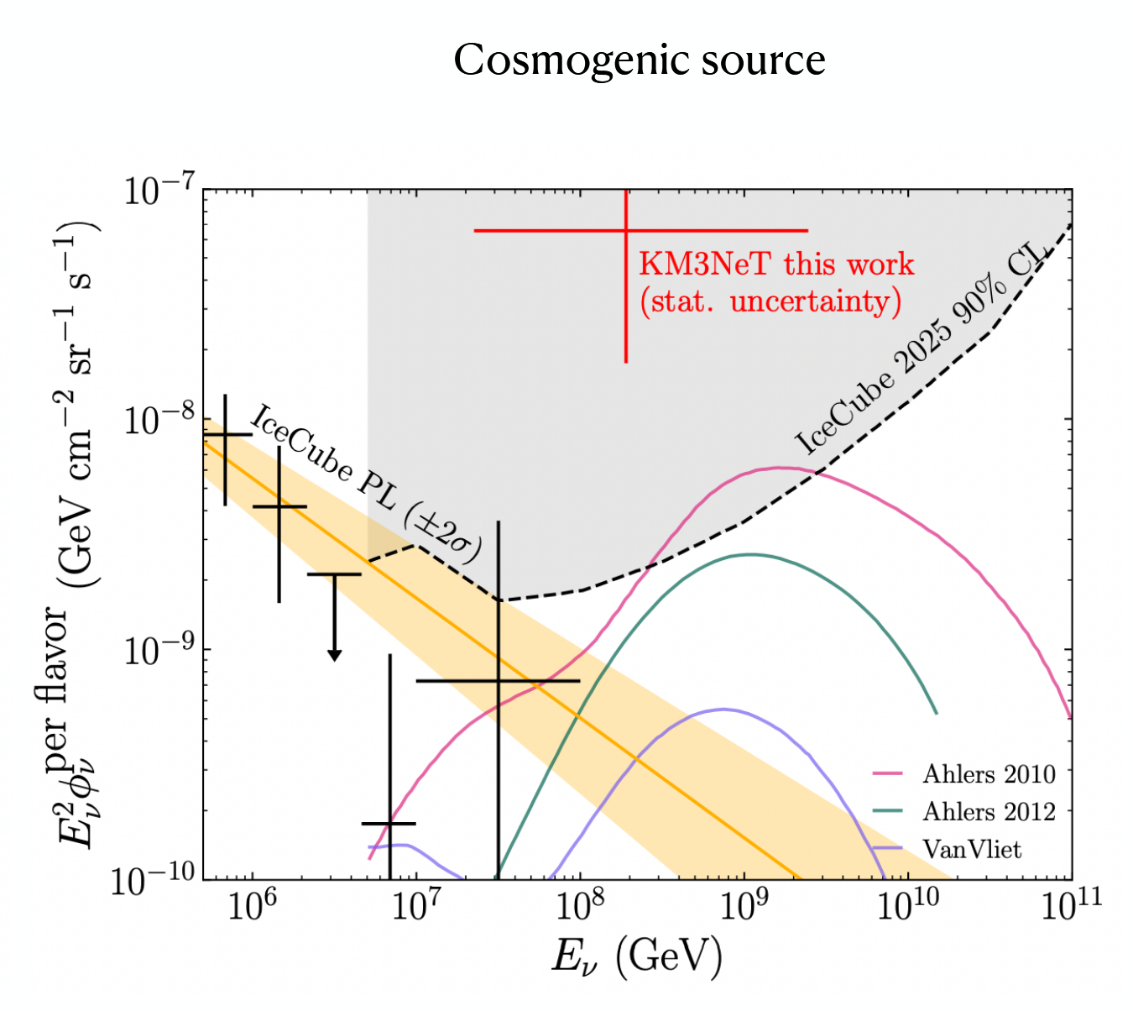
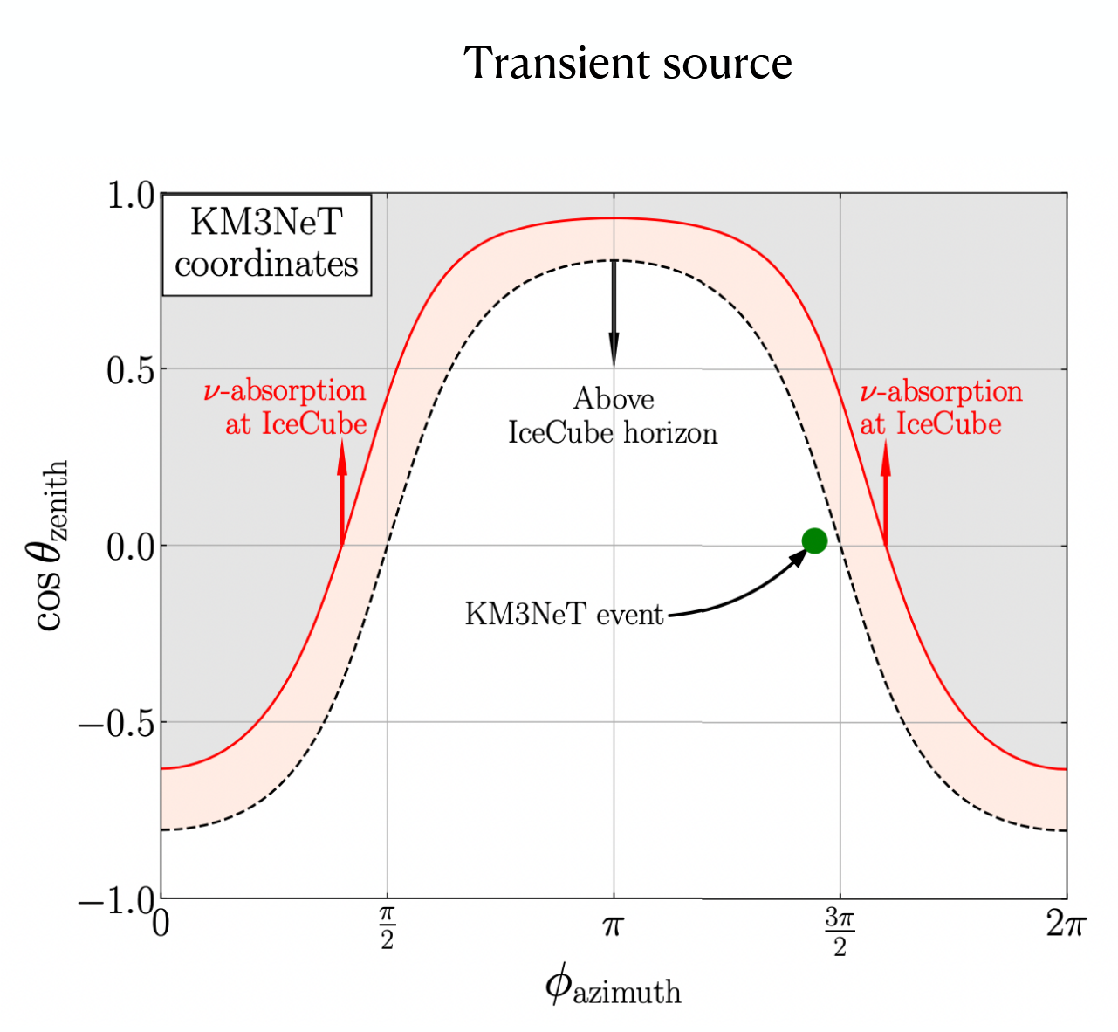
SM Neutrino solution
SM Neutrino solution
arxiv:2502.04508
Li, Machado, Naredo-Tuero, Schwemberger
Notes:
DM scattering within the Earth leads to highly collimated μ+μ− final states, either from the decay of a heavier DM component or a long-lived mediator.

Slide 17
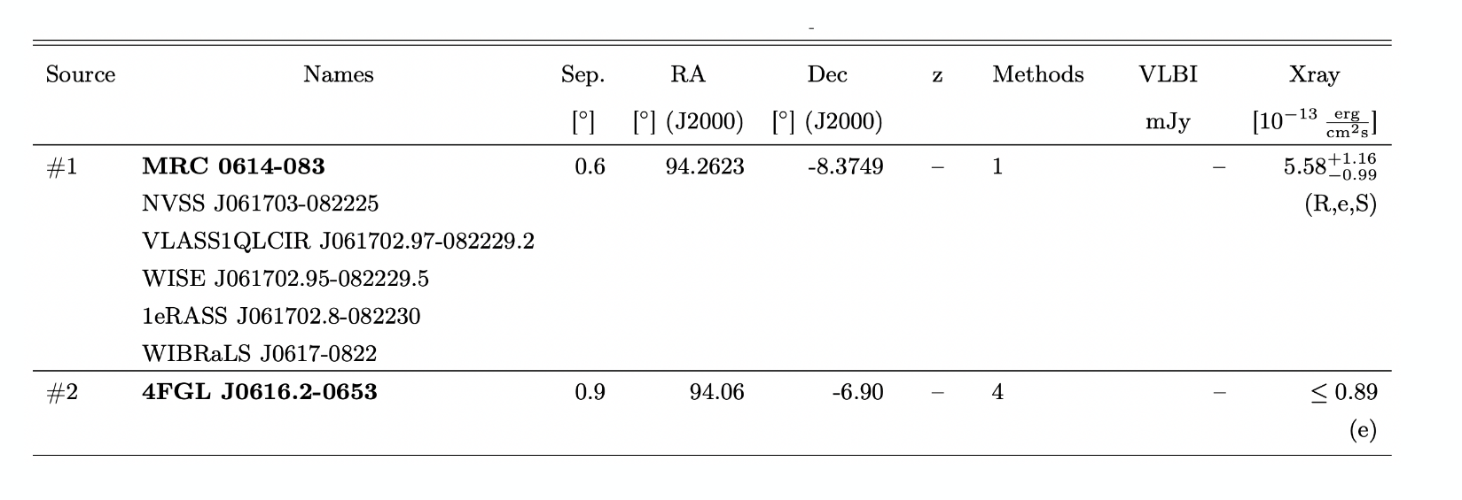
Blazar Sources - FSRQ
Notes:
DM scattering within the Earth leads to highly collimated μ+μ− final states, either from the decay of a heavier DM component or a long-lived mediator.

Slide 18
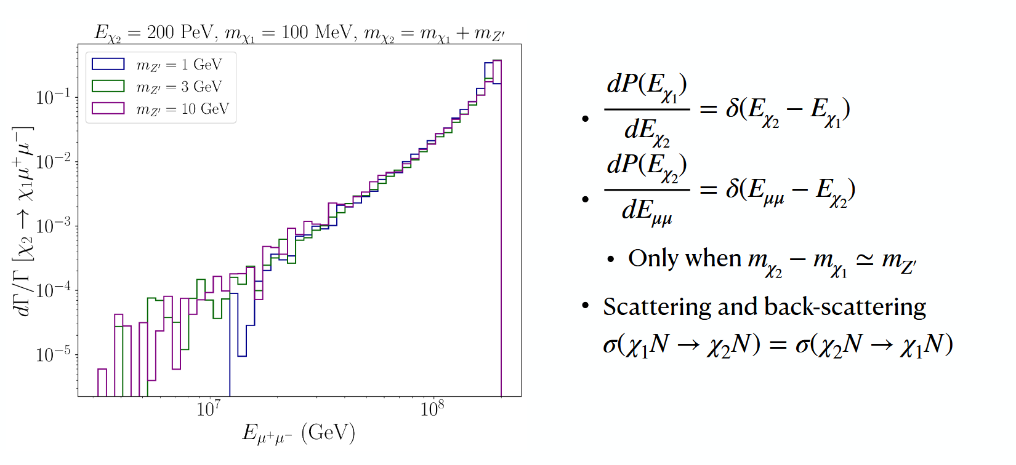
$$\text{Inelastic} 2→2$$
Notes:
DM scattering within the Earth leads to highly collimated μ+μ− final states, either from the decay of a heavier DM component or a long-lived mediator.

Slide 19
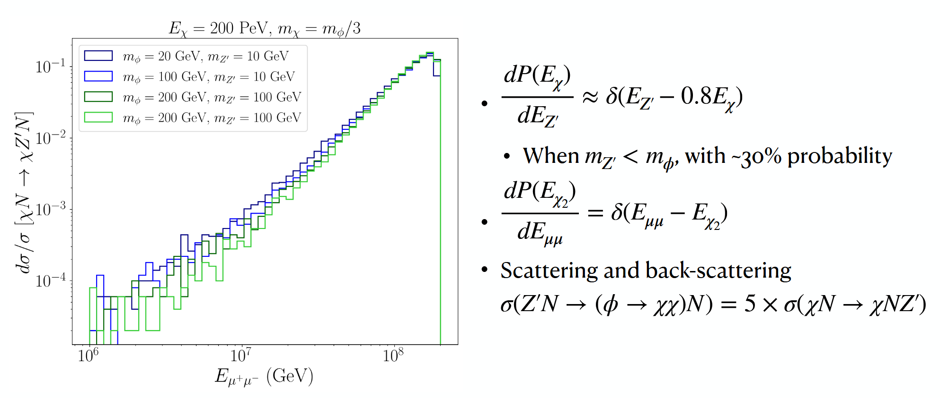
$$\text{E}\text{lastic} 2→3$$
Notes:
DM scattering within the Earth leads to highly collimated μ+μ− final states, either from the decay of a heavier DM component or a long-lived mediator.

Slide 20
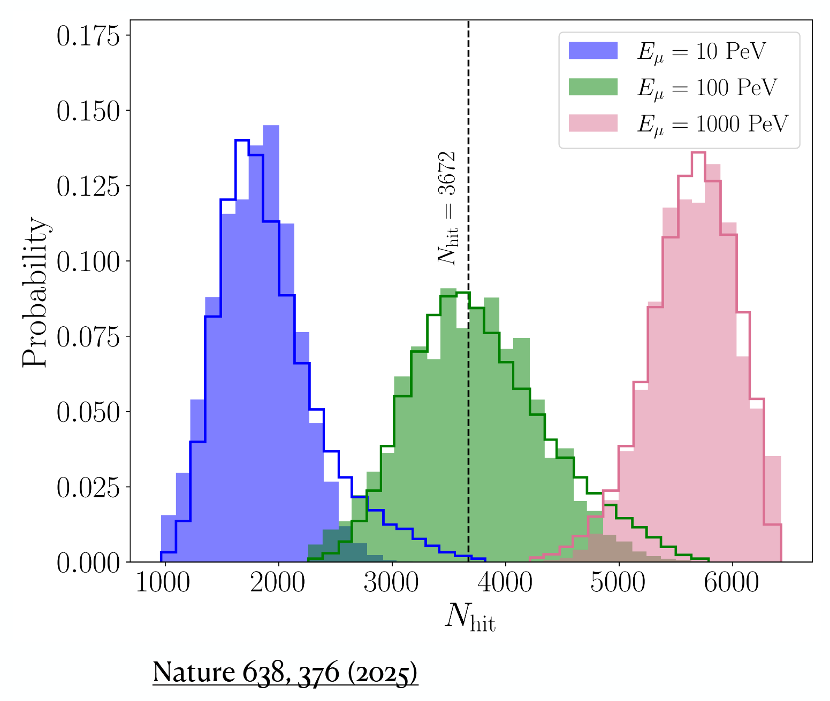
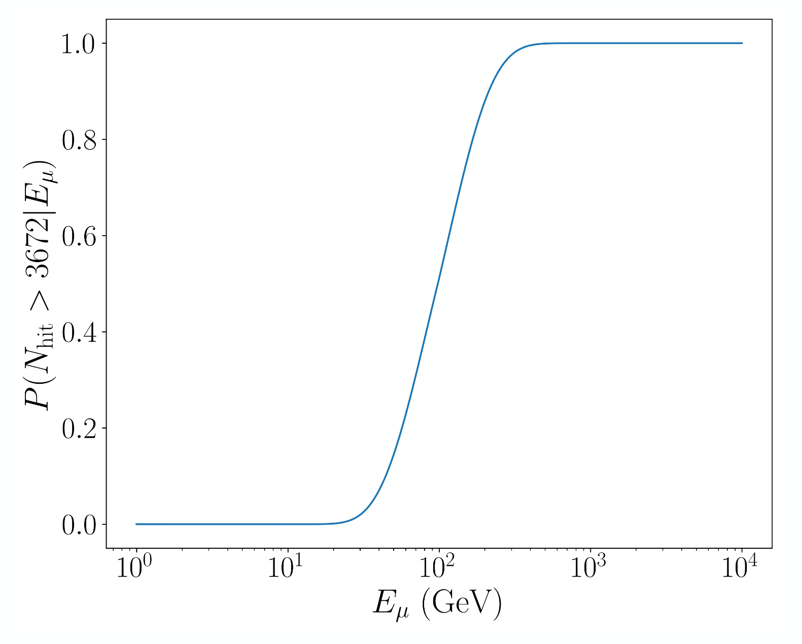

$$\text{DM} \text{Effective} \text{area} \text{with} \text{prior}$$
Prior included to calculate the probability that the muon produced at/entering the detector triggers $≥3672$ PMTs
Notes:
DM scattering within the Earth leads to highly collimated μ+μ− final states, either from the decay of a heavier DM component or a long-lived mediator.

Slide 21
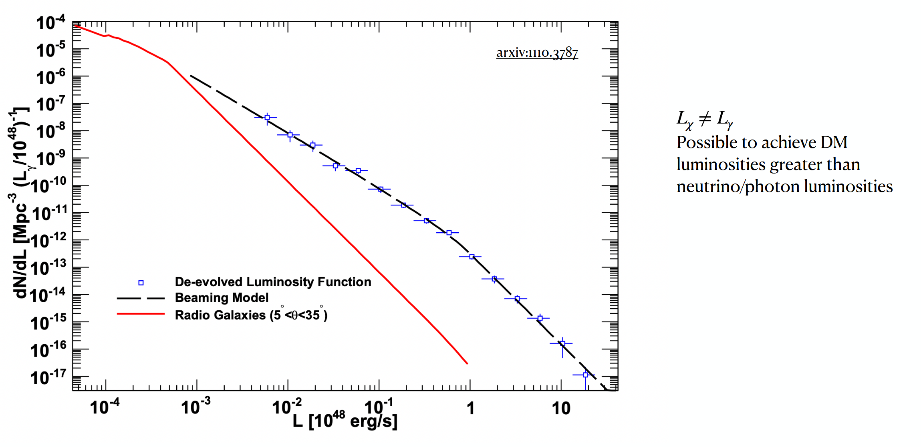
$$\text{Blazar} \text{Luminosity} \text{distributions}$$
Notes:
DM scattering within the Earth leads to highly collimated μ+μ− final states, either from the decay of a heavier DM component or a long-lived mediator.

Slide 22
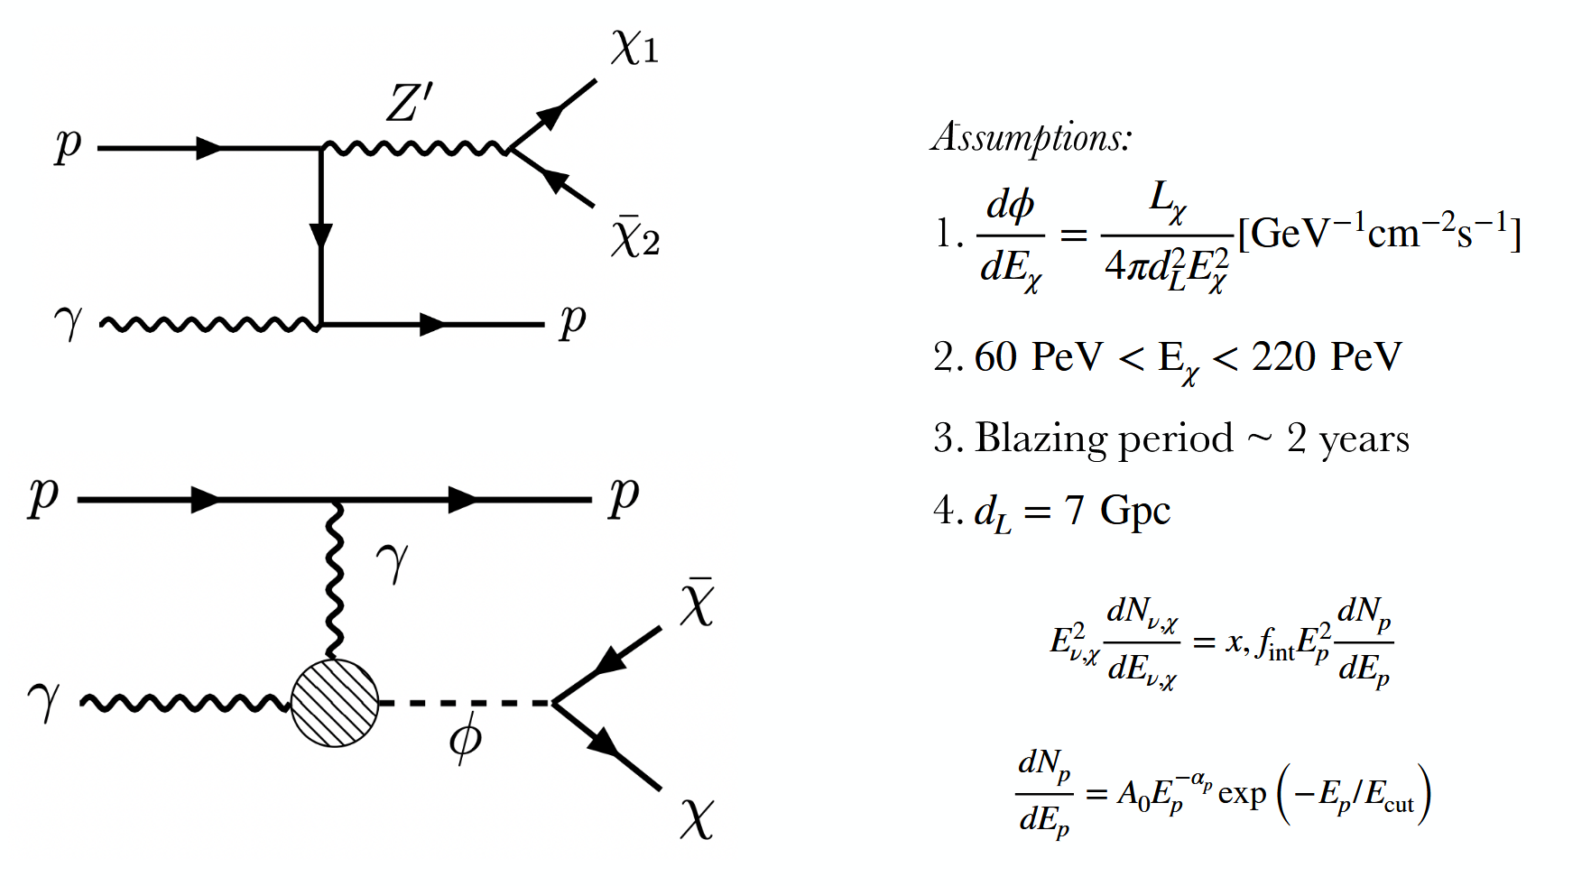
$$\text{DM} \text{production} \text{at} \text{Blazars}$$
Notes:
DM scattering within the Earth leads to highly collimated μ+μ− final states, either from the decay of a heavier DM component or a long-lived mediator.

Slide 23
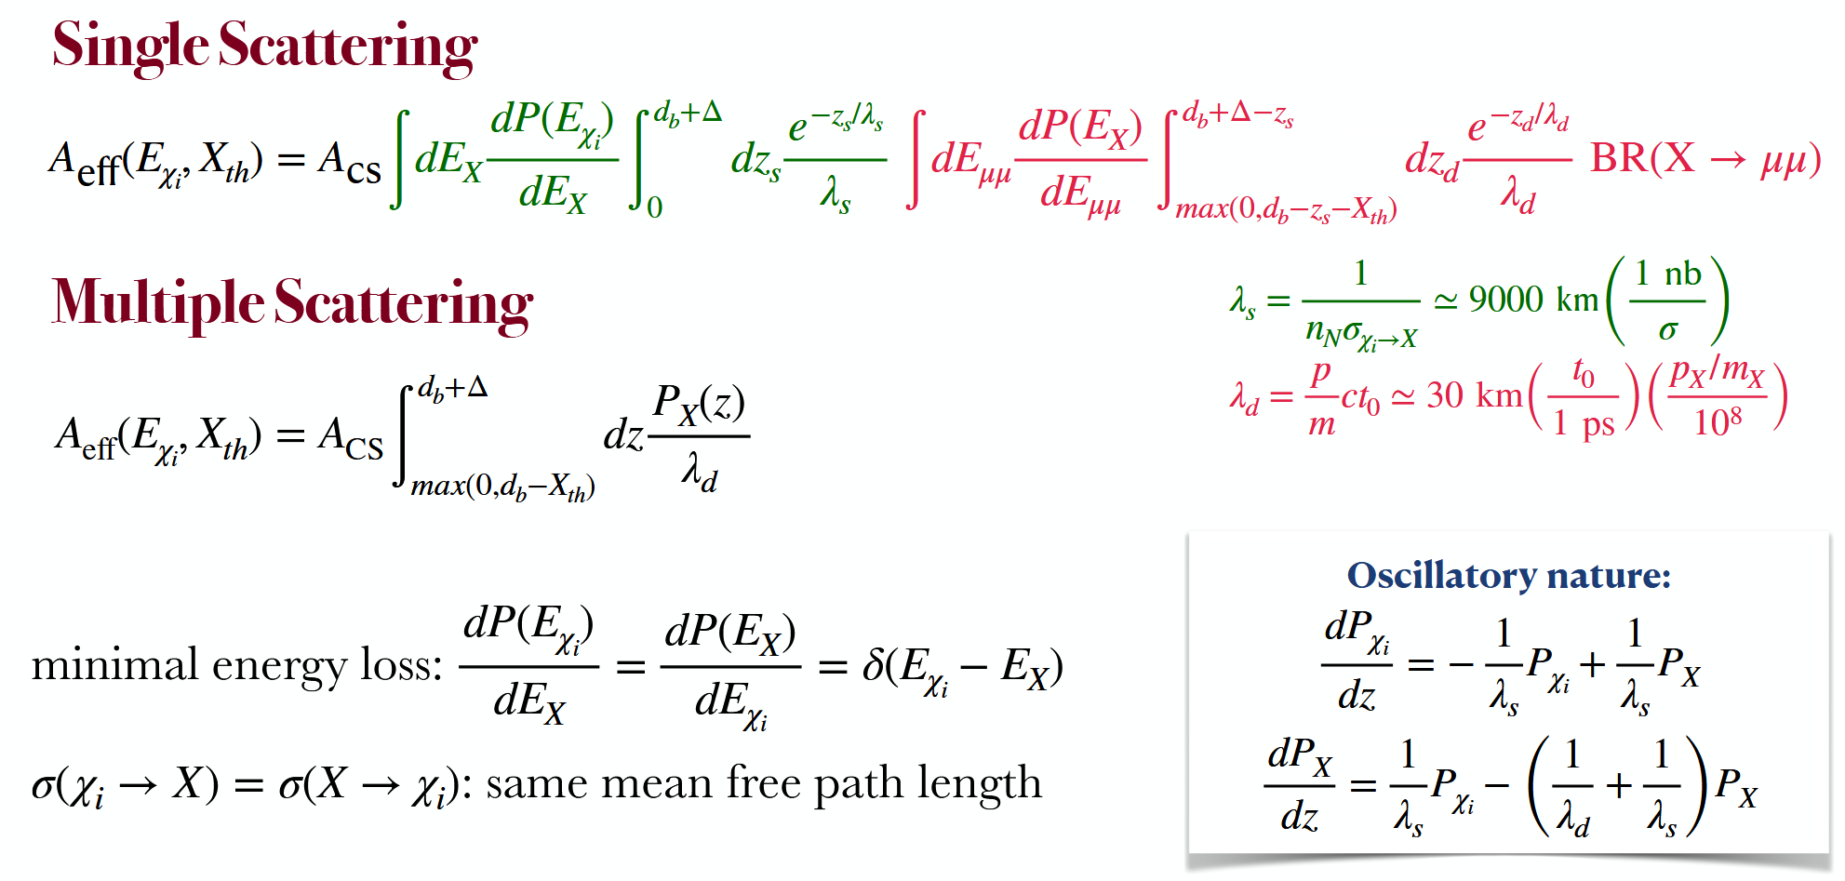
$$\text{DM} \text{Effective} \text{area}$$
Notes:
DM scattering within the Earth leads to highly collimated μ+μ− final states, either from the decay of a heavier DM component or a long-lived mediator.

Slide 24
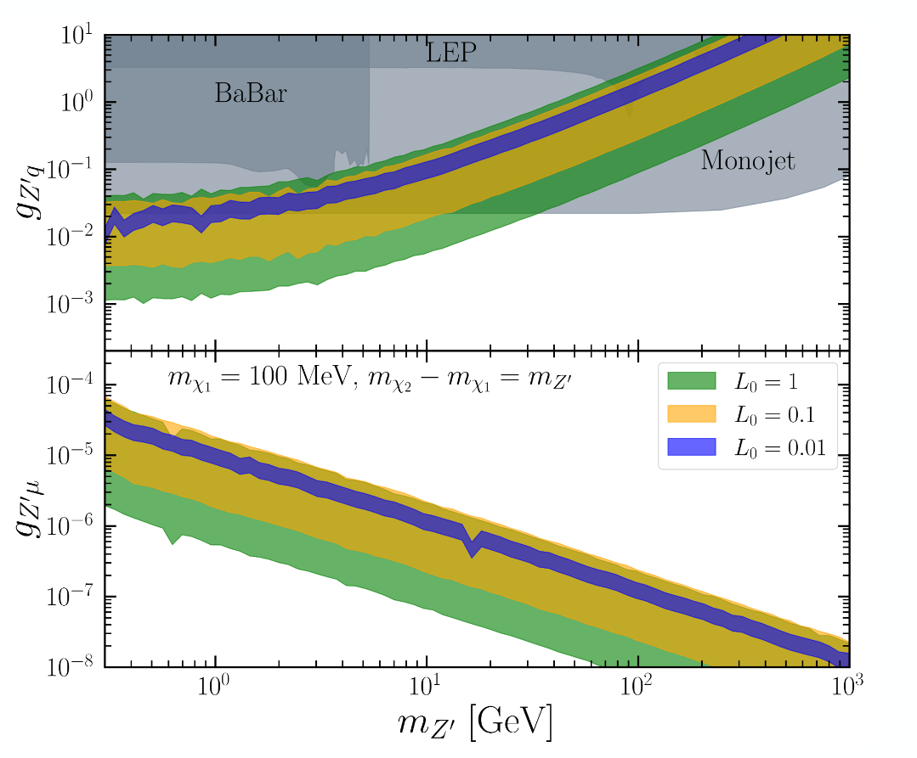
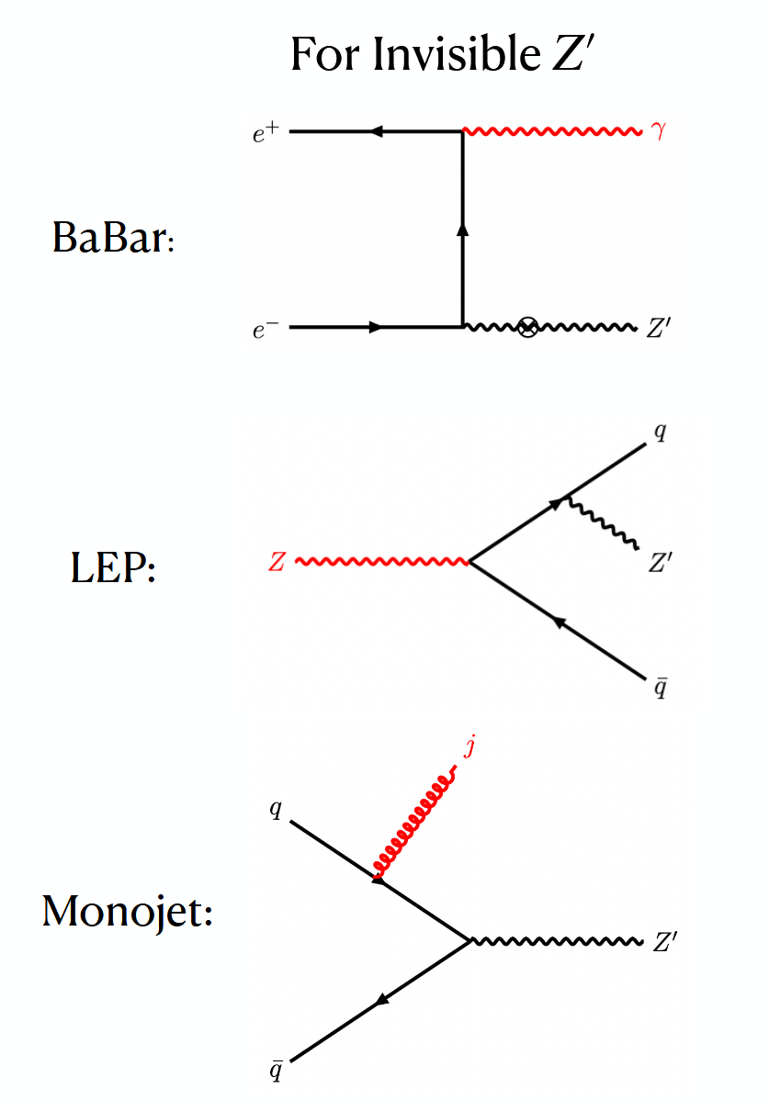
Preferred regions - Inelastic DM
Notes:
DM scattering within the Earth leads to highly collimated μ+μ− final states, either from the decay of a heavier DM component or a long-lived mediator.

Slide 25
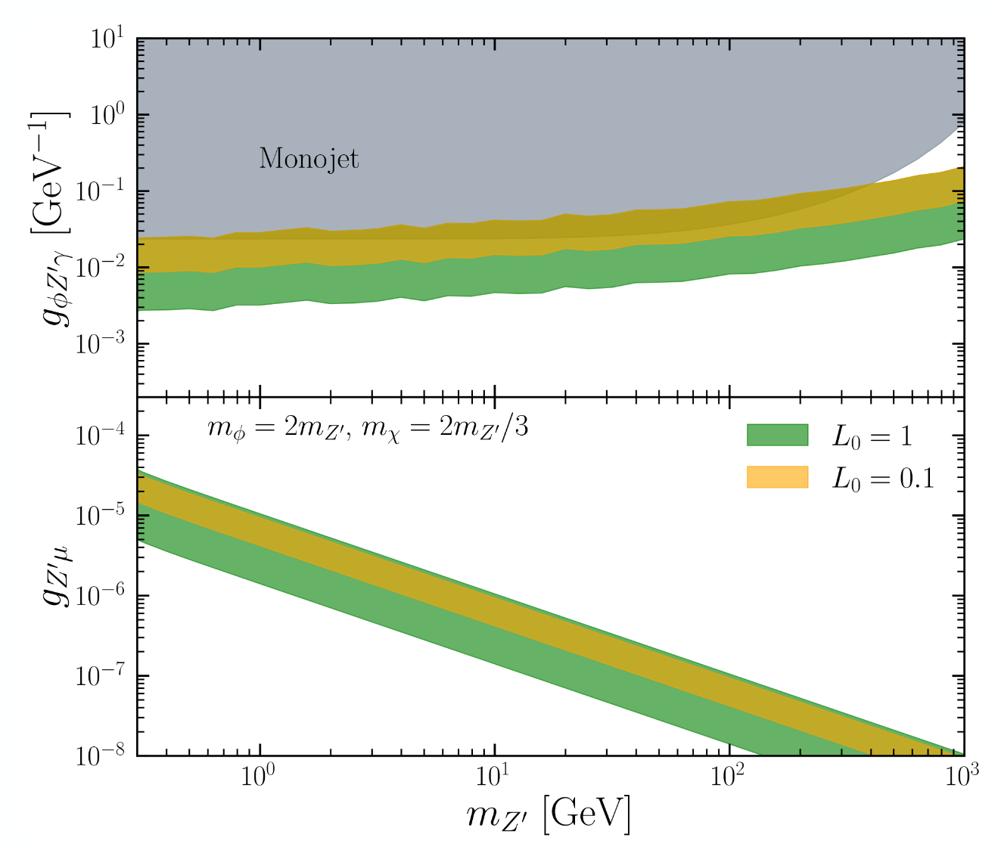

Preferred regions - Elastic DM
Notes:
DM scattering within the Earth leads to highly collimated μ+μ− final states, either from the decay of a heavier DM component or a long-lived mediator.

