Slide 1


The Atom Interferometry and Observational Network (AION)
AION-10 Planning
Dr. Kimberly Tkalčec
ket36@cam.ac.uk
30th January 2025

Slide 2
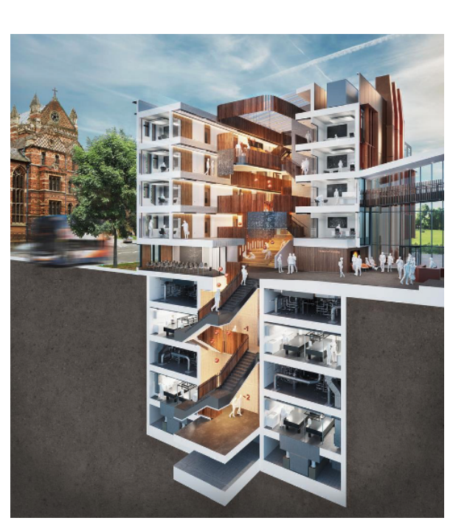
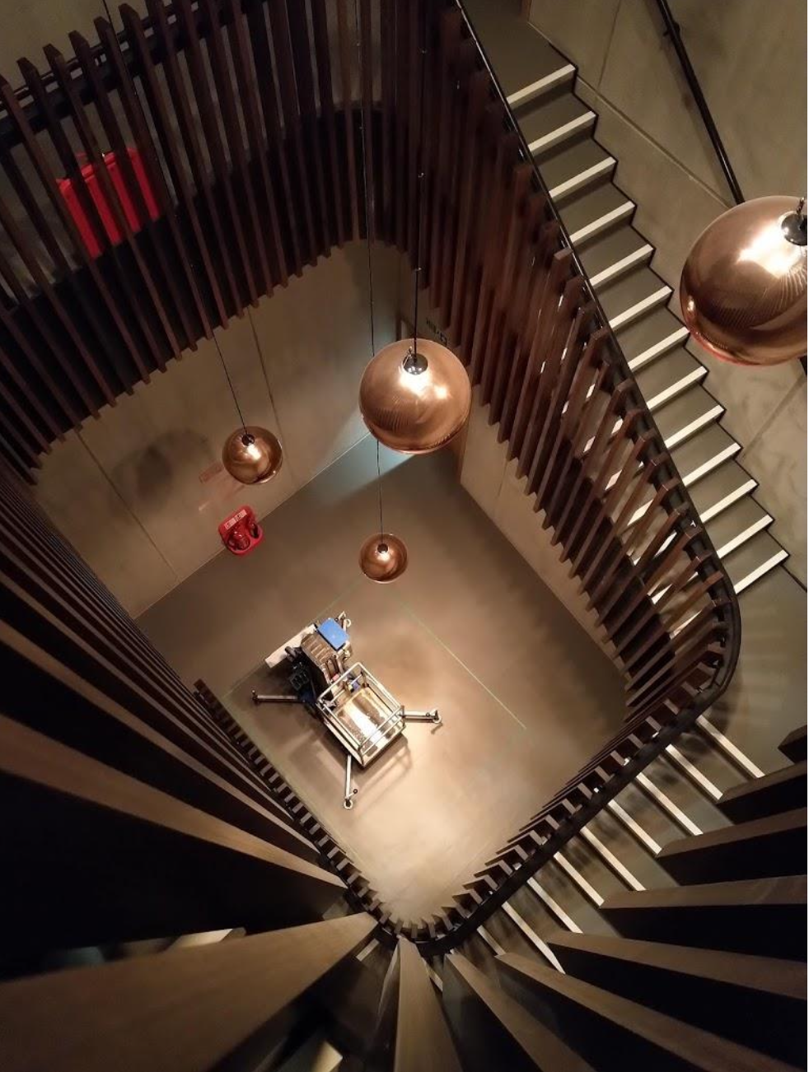
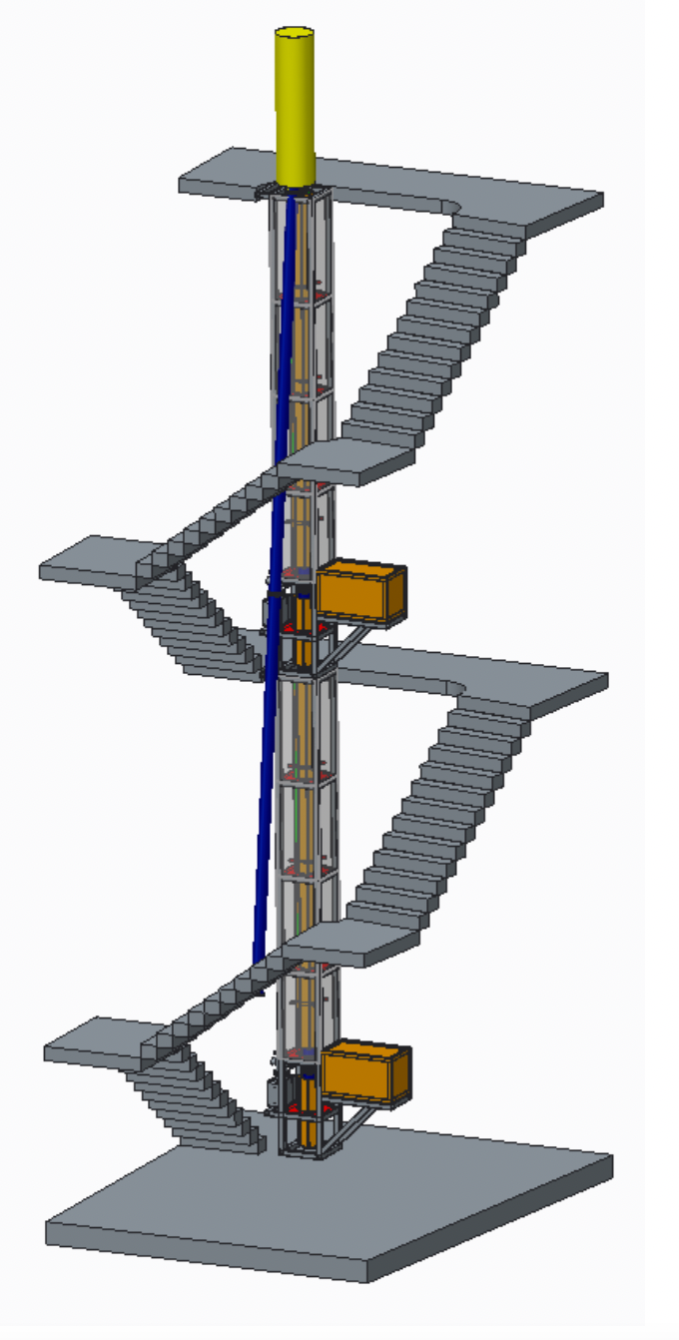
AION-10 Plans
Oxford Physics Department
Beecroft Building
https://www.hawkinsbrown.com/projects/beecroft-building-university-of-oxford

Slide 3
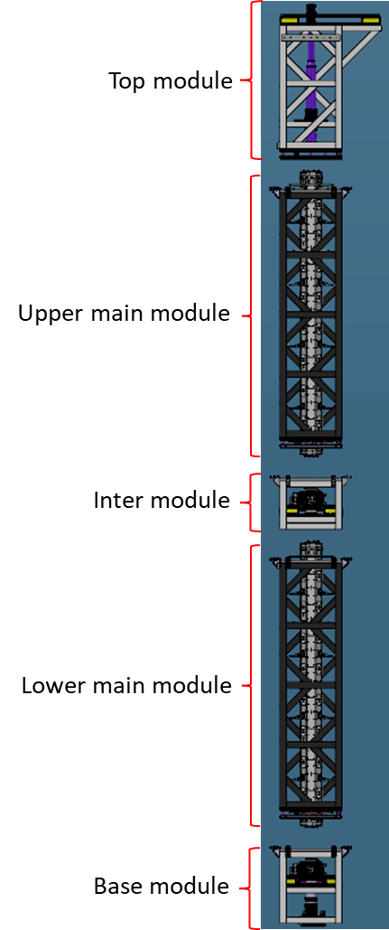
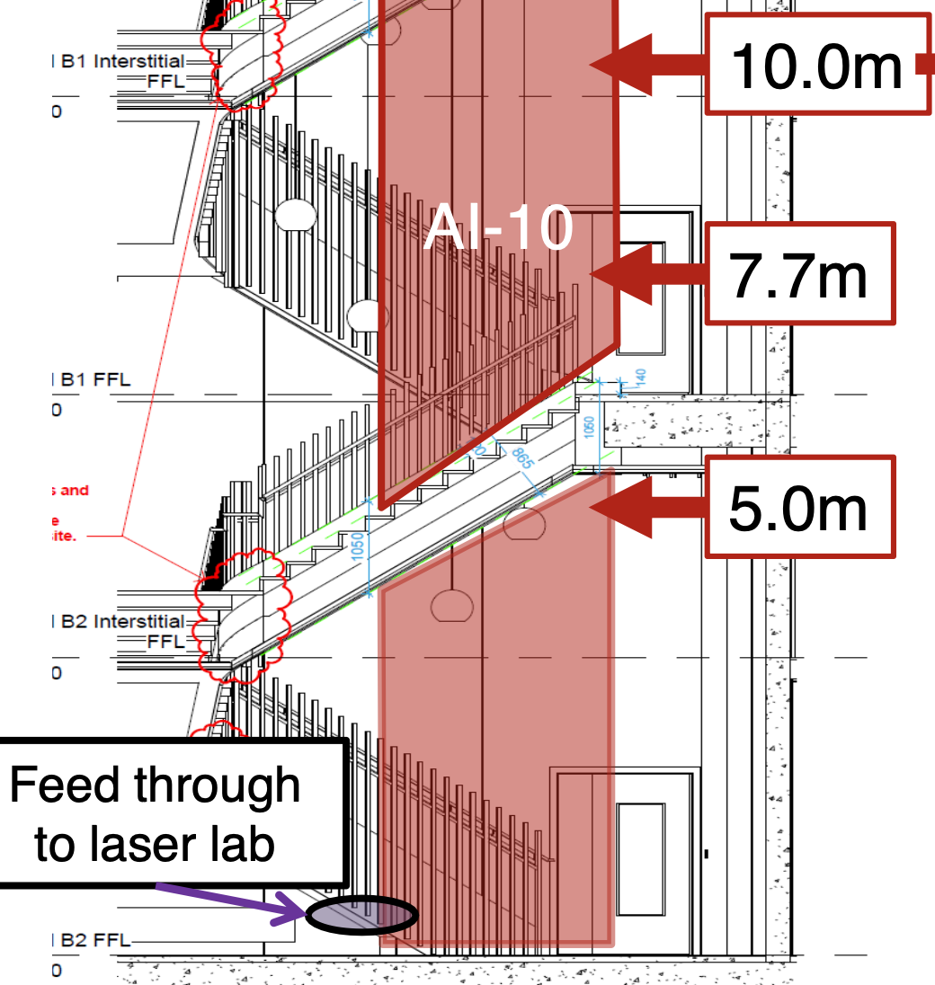
AION-10 Plans: Modules
The modules encased in their aluminium support frames
space for attachments such as cold atom sources as well as stability support
The modules will be lifted into the building and lowered into place using a dedicated crane system.

Slide 4
AION-10 Plans: Modules
Top Module:
2 m long
Houses telescope and ion pumps
Telescope

Slide 5
AION-10 Plans: Modules
Upper/Lower main module:
Each 4.6 m long
Module houses vacuum pipe and the magnetic shields.
Levelling mechanism is present to correct any skewness.

Slide 6
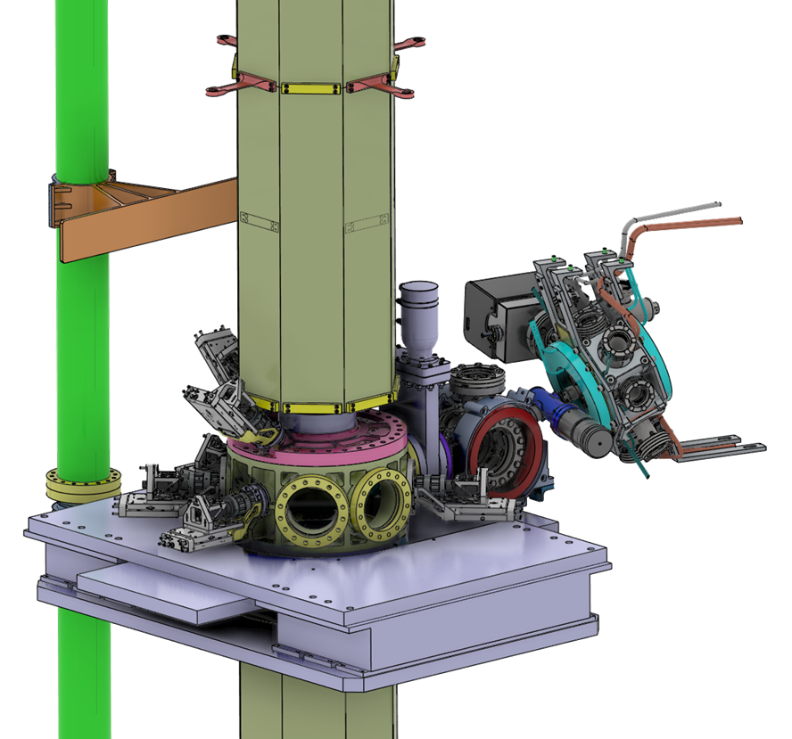
AION-10 Plans: Modules
Inter module:
  Bespoke support structure around the interconnect chamber for the optical elements.
2D MOT
3D MOT
Interconnect chamber
Active Vibration Isolation Platforms for camera stability

Slide 7
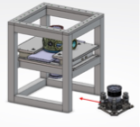
AION-10 Plans: Stability Requirements
Base Module:
Inter Module
(Interconnect chamber
Attached to Cold Atom Source)
BR Mirror
Passive Vibration Isolation Platform at base of tower

Slide 8
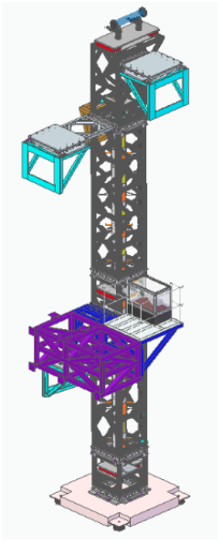
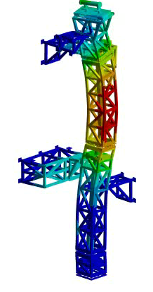
AION-10 Structure
Structural Stability
Support Structure: Connection Points on Walls and Ground
Modal frequency analysis
Evaluation of stability of lenses and camera
→ Translational RMS (Root mean square) or End-To-End values of response points

Slide 9
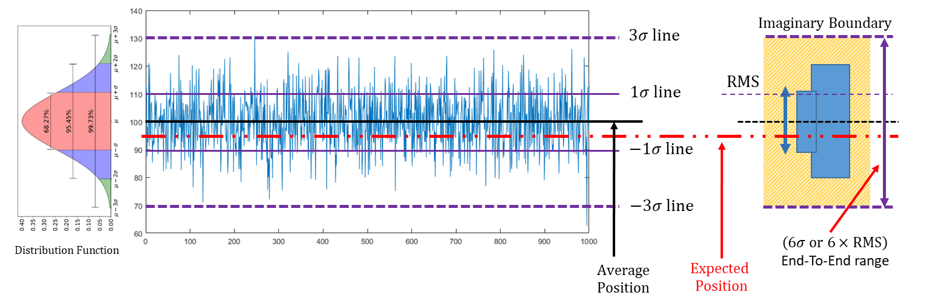
AION-10 Structure
Example: Translational motion of camera
Stability requirement: The two camera assemblies are ∼ 5 m apart and must be fixed within 100 nm relative to each other during measurements.

Slide 10
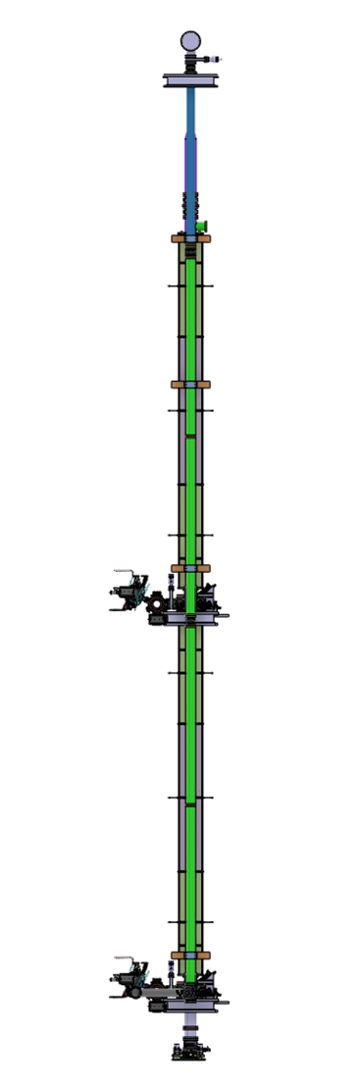
AION-10 Configuration
Gradiometer Configuration:
Two atom interferometers along a baseline
for differential measurements
Laser beam
Intrinsic laser phase noise then becomes common mode
if one interferometry laser beam used for the entire vertical baseline.
That requires single-photon transitions between the laser pulses and the atoms
Differential readout
atom
cloud
Baseline L
atom
cloud

Slide 11
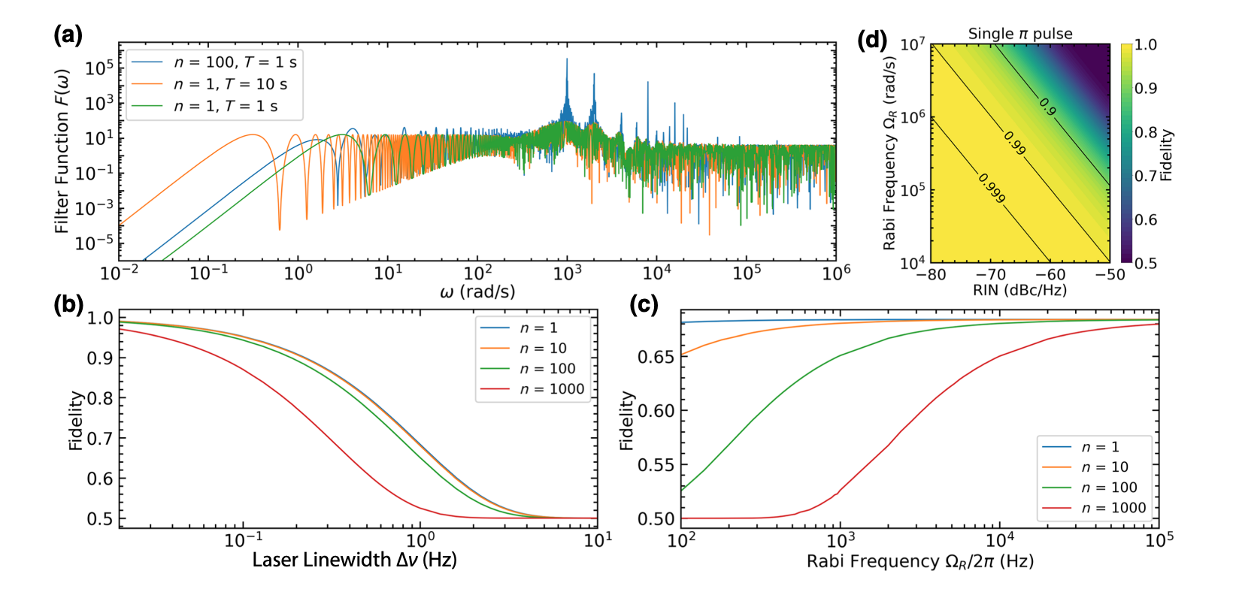
Large Momentum Transfer (LMT)
Increasing AI sensitivity with π pulses
Required beam power levels calculated:
For clock interferometry @ 698 nm
AION 100 m (beam waist ~1cm) → ~10² W
AION 1km (beam waist ~3 cm) → ~10³ W
(assuming pulse length of ~1 us (LMT : 10^4),
Rabi Frequ.> 10kHz, Laser Linewidth stabilised to 1 Hz )
Example
Strontium clock transition @698 nm
for pulse separation = 1us,
pulse length = 1 s
PRX QUANTUM 3, 030348 (2022)

Slide 12
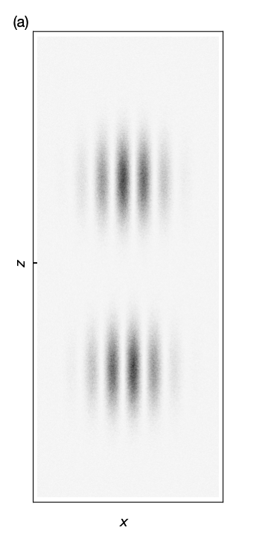
AI Readout – Phase Noise
AI Readout:
To achieve high fringe visibility, phase noises in the interference pattern must be minimised.
Phase noise in the readout arise from laser-induced phase shifts:
  Inhomogeneous intensity distribution
Uniform intensity distribution on lengthscale of atom cloud
→ Telescope designed to maximise beam size
  Laser wavefront aberrations
𝛑/2
𝛑
Simulation
M. Abe et al, Quantum Sci. Technol. 6 044003 (2021)
𝛑/2
atom cloud

Slide 13
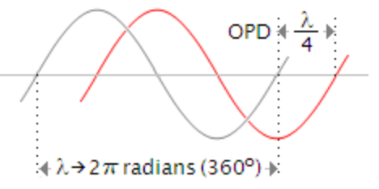
AI Readout – Phase Noise
Laser Wavefront Aberrations:
Δφ = Δφ_{curv}+ Δφ_{surf}+ Δφ_{mech} + Δφ_{scatt}
Optical Path Difference (OPD)
Phase shift of a wavefront curvature
Wavefront aberration results in OPD across the beam.

Slide 14
AI Readout – Phase Noise
Laser Wavefront Aberrations:
Δφ = Δφ_{curv}+ Δφ_{surf}+ Δφ_{mech} + Δφ_{scatt}
Optical Path Difference (OPD)
Phase shift of a wavefront curvature
Wavefront aberration results in OPD across the beam.
Beam Delivery to AI pipe:
Vacuum pressure calculation:
OPD due to refractive index (n>1) –
Refractive indices as a function of air pressure calculated
(Theory in Appl. Opt. 35, 1566-1573 (1996))
pressure p = 10⁻⁵ mbar → Phase shift dphi = 0.038 mrad
(n(p) = 1+2.6745*10⁻¹², T = 20 deg C, path length = 10 m, lambda = 698 nm)

Slide 15
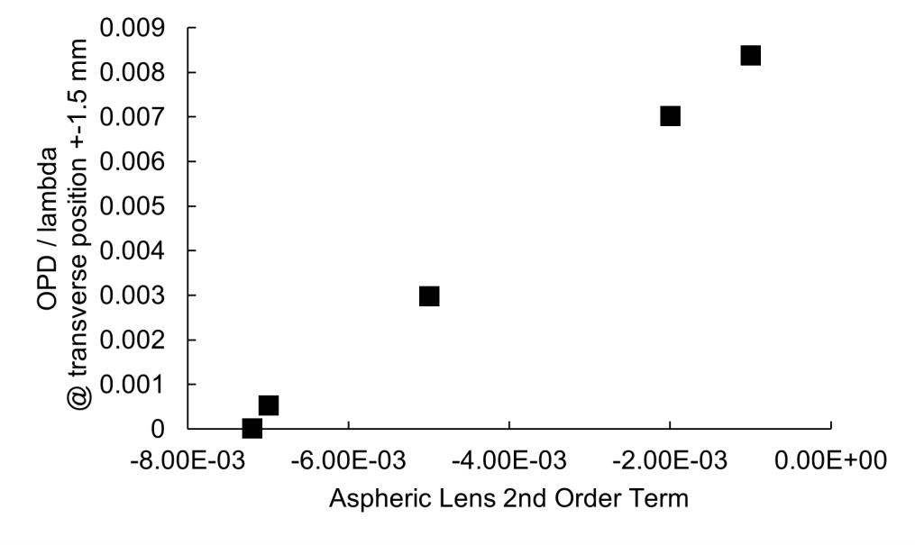
AI Readout – Phase Noise
Laser Wavefront Aberrations:
Δφ = Δφ_{curv}+ Δφ_{surf}+ Δφ_{mech} + Δφ_{scatt}
Optical Path Difference (OPD)
Phase shift of a wavefront curvature
→ Analysis in telescope design
Wavefront aberration results in OPD across the beam.

Slide 16
AI Readout – Phase Noise
Laser Wavefront Aberrations:
Δφ = Δφ_{curv}+ Δφ_{surf}+ Δφ_{mech} + Δφ_{scatt}
Optical Path Difference (OPD)
Phase shift of a wavefront curvature
→ Analysis in telescope design
Wavefront aberration results in OPD across the beam.
Including aspheric first lens could cancel out the OPD around the optical axis

Slide 17

AI Readout – Phase Noise
Laser Wavefront Aberrations:
Δφ = Δφ_{curv}+ Δφ_{surf}+ Δφ_{mech} + Δφ_{scatt}
Phase shift of imperfect optical surfaces
→ feasibility studies on surface tolerances
Δz
OPD Requirement ~ Δz < 1/1000 λ

Slide 18
AI Readout – Phase Noise
Laser Wavefront Aberrations:
Δφ = Δφ_{curv}+ Δφ_{surf}+ Δφ_{mech} + Δφ_{scatt}
Beam pointing angle < 35 nrad!
(Assuming 1% fluctuation in
horizontal phase gradient)
Phase shift due to
mechanical instabilities
Optical path difference between clouds
Beam Pointing instabilities
Laser wavefront curvature
Phase shear
L
L
x
δL

Slide 19
AI Readout – Phase Noise
Laser Wavefront Aberrations:
Δφ = Δφ_{curv}+ Δφ_{surf}+ Δφ_{mech} + Δφ_{scatt}
Phase shift of a scatterer
Motivation:
What dust size can we tolerate?
What are cleanliness requirements?
Numerical analysis of dust particle size:
Fourier propagation of a beam propagating through a dust particle.

Slide 20
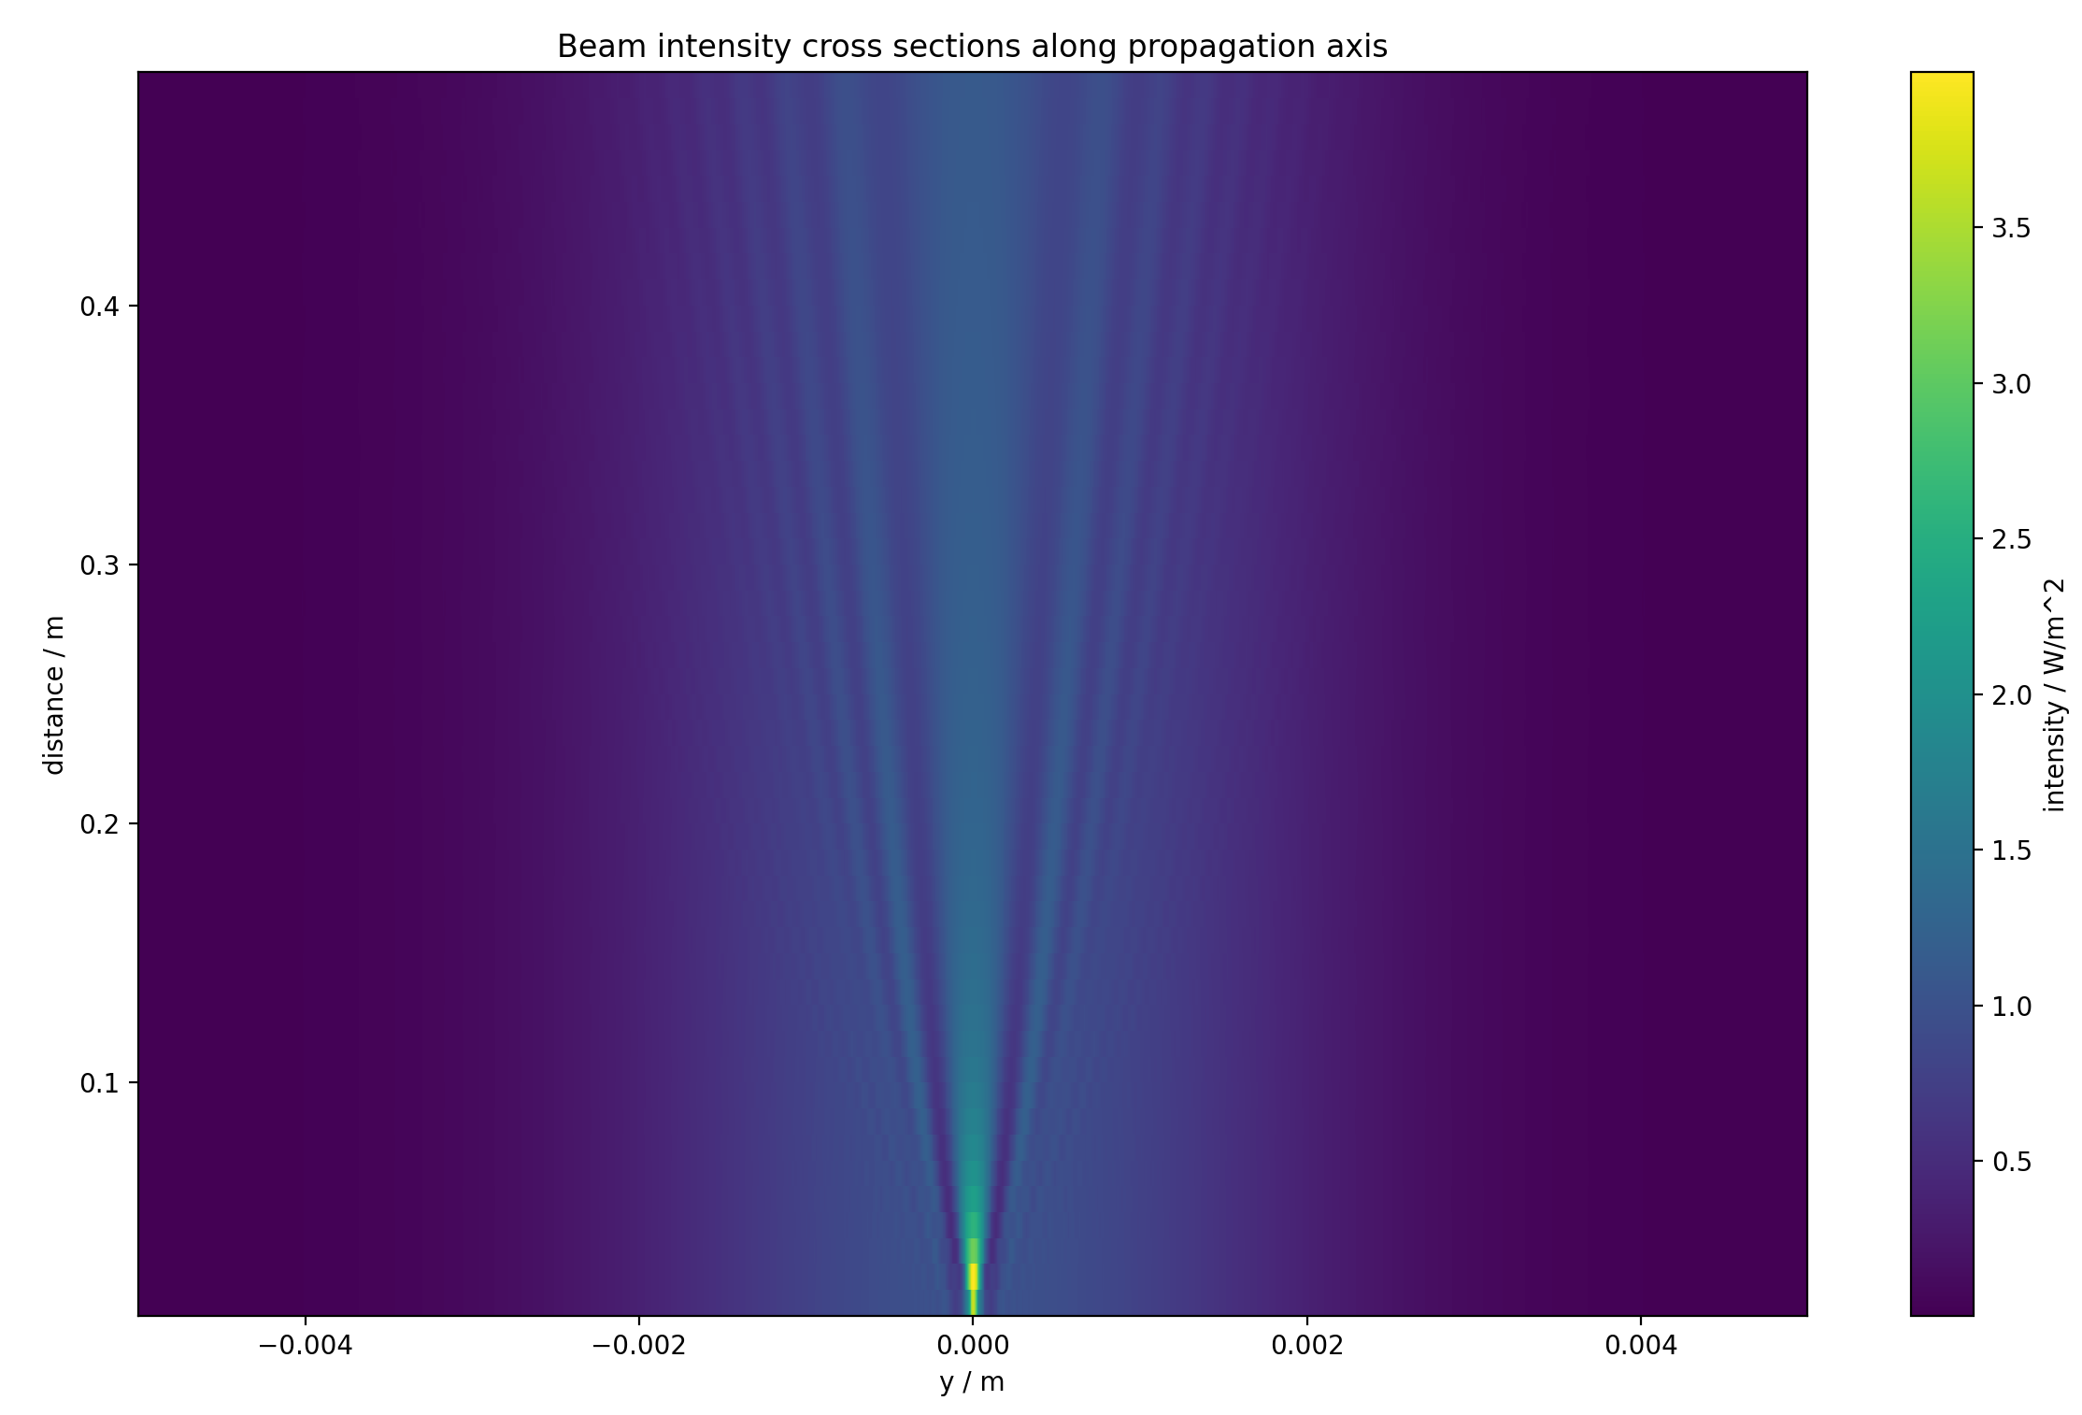
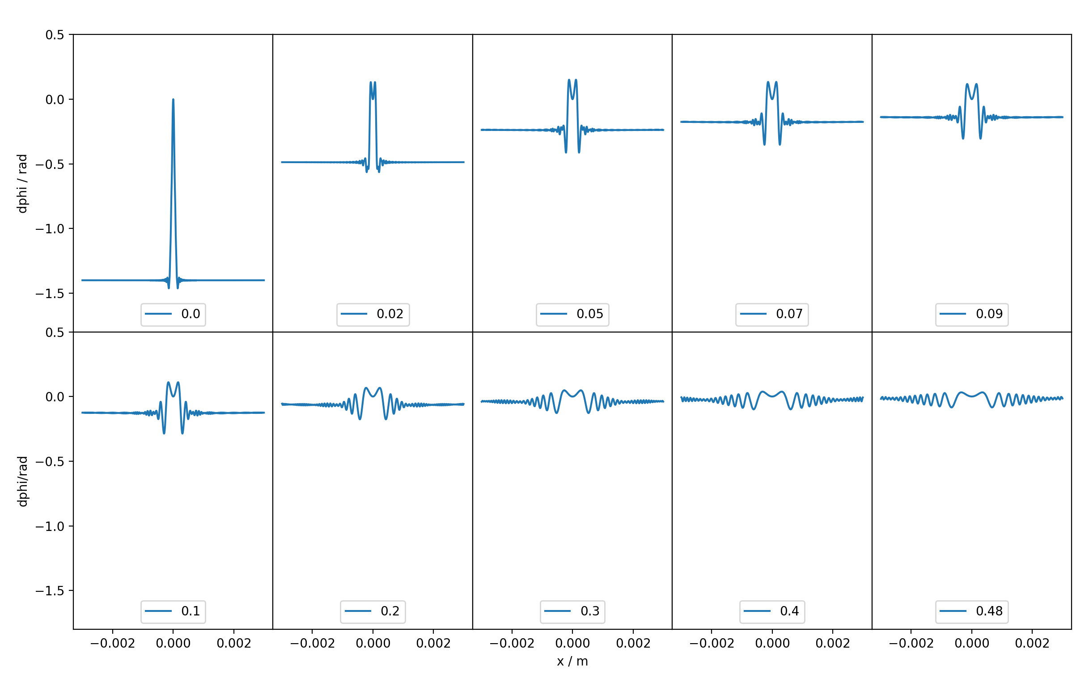
AI Readout – Phase Noise
Laser Wavefront Aberrations:
What dust size can we tolerate?
Δφ = Δφ_{curv}+ Δφ_{surf}+ Δφ_{mech} + Δφ_{scatt}
Phase shift of a scatterer
Dust particle size: 200 um
Aberrations still >> 0.5 mrad after 0.5 m propagation

Slide 21
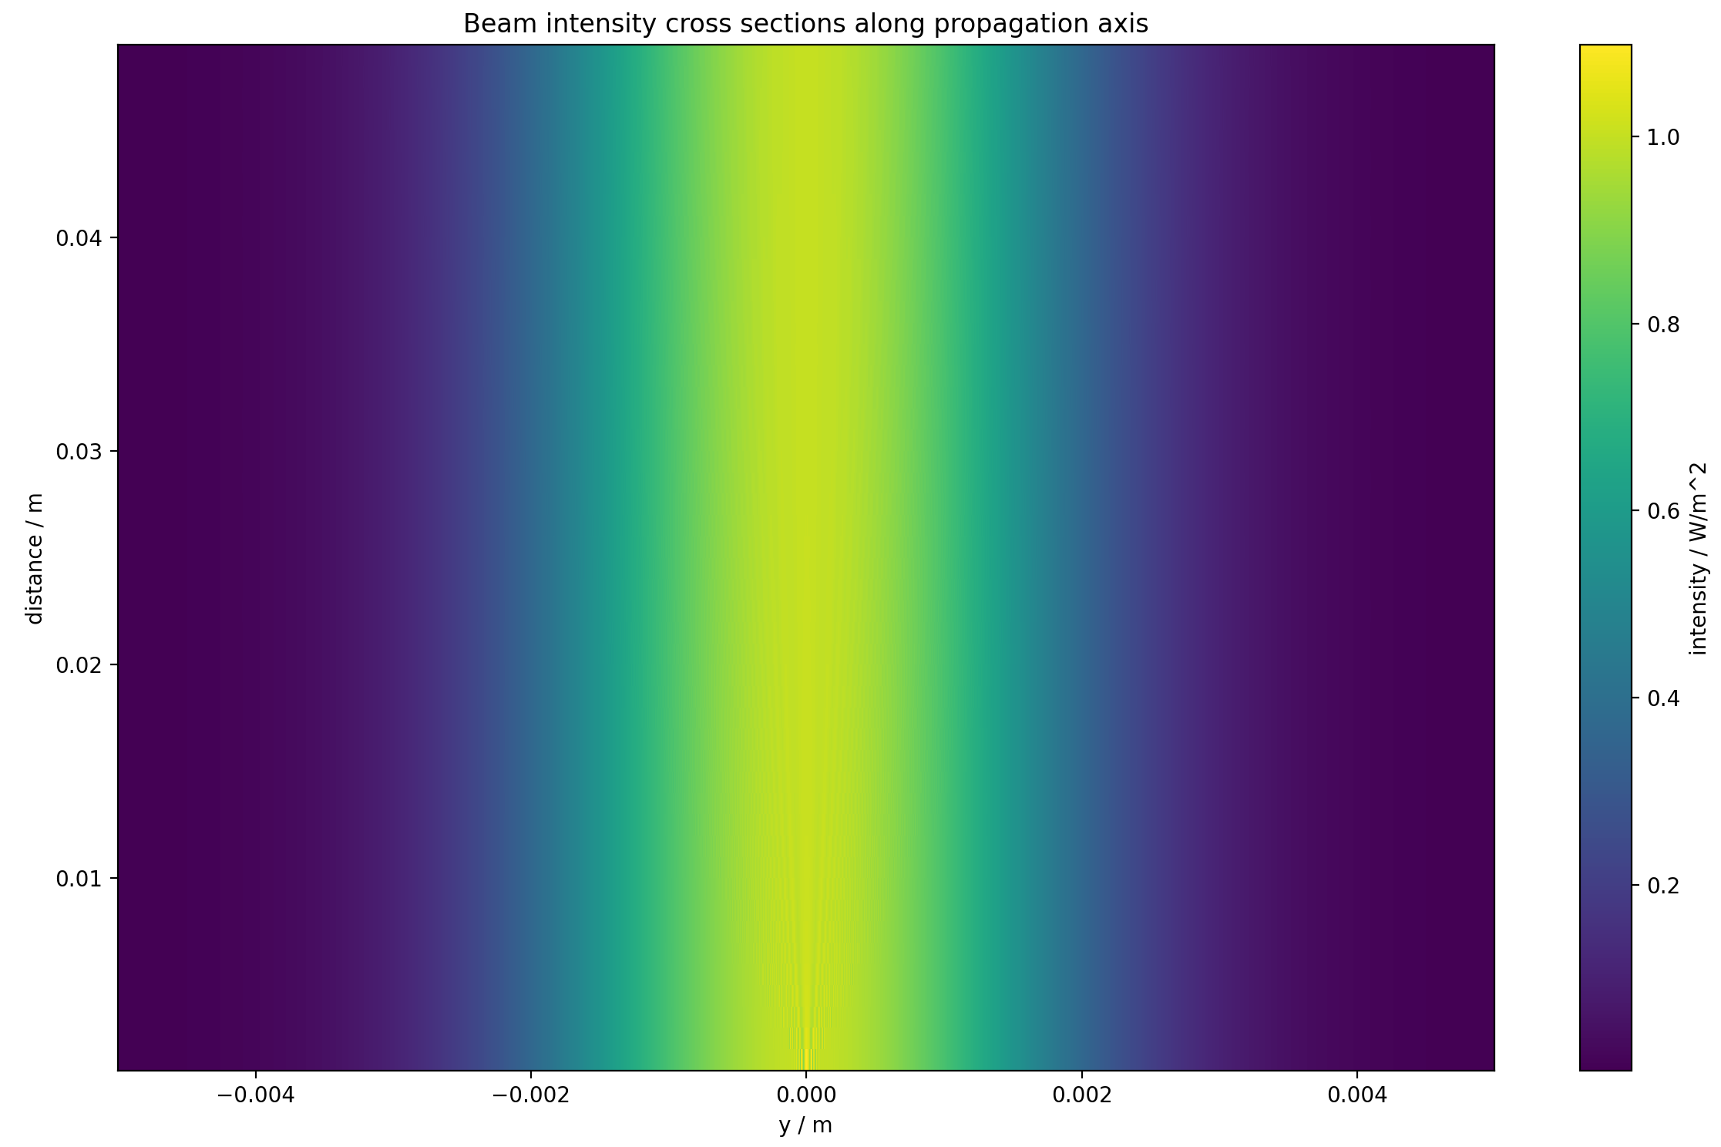
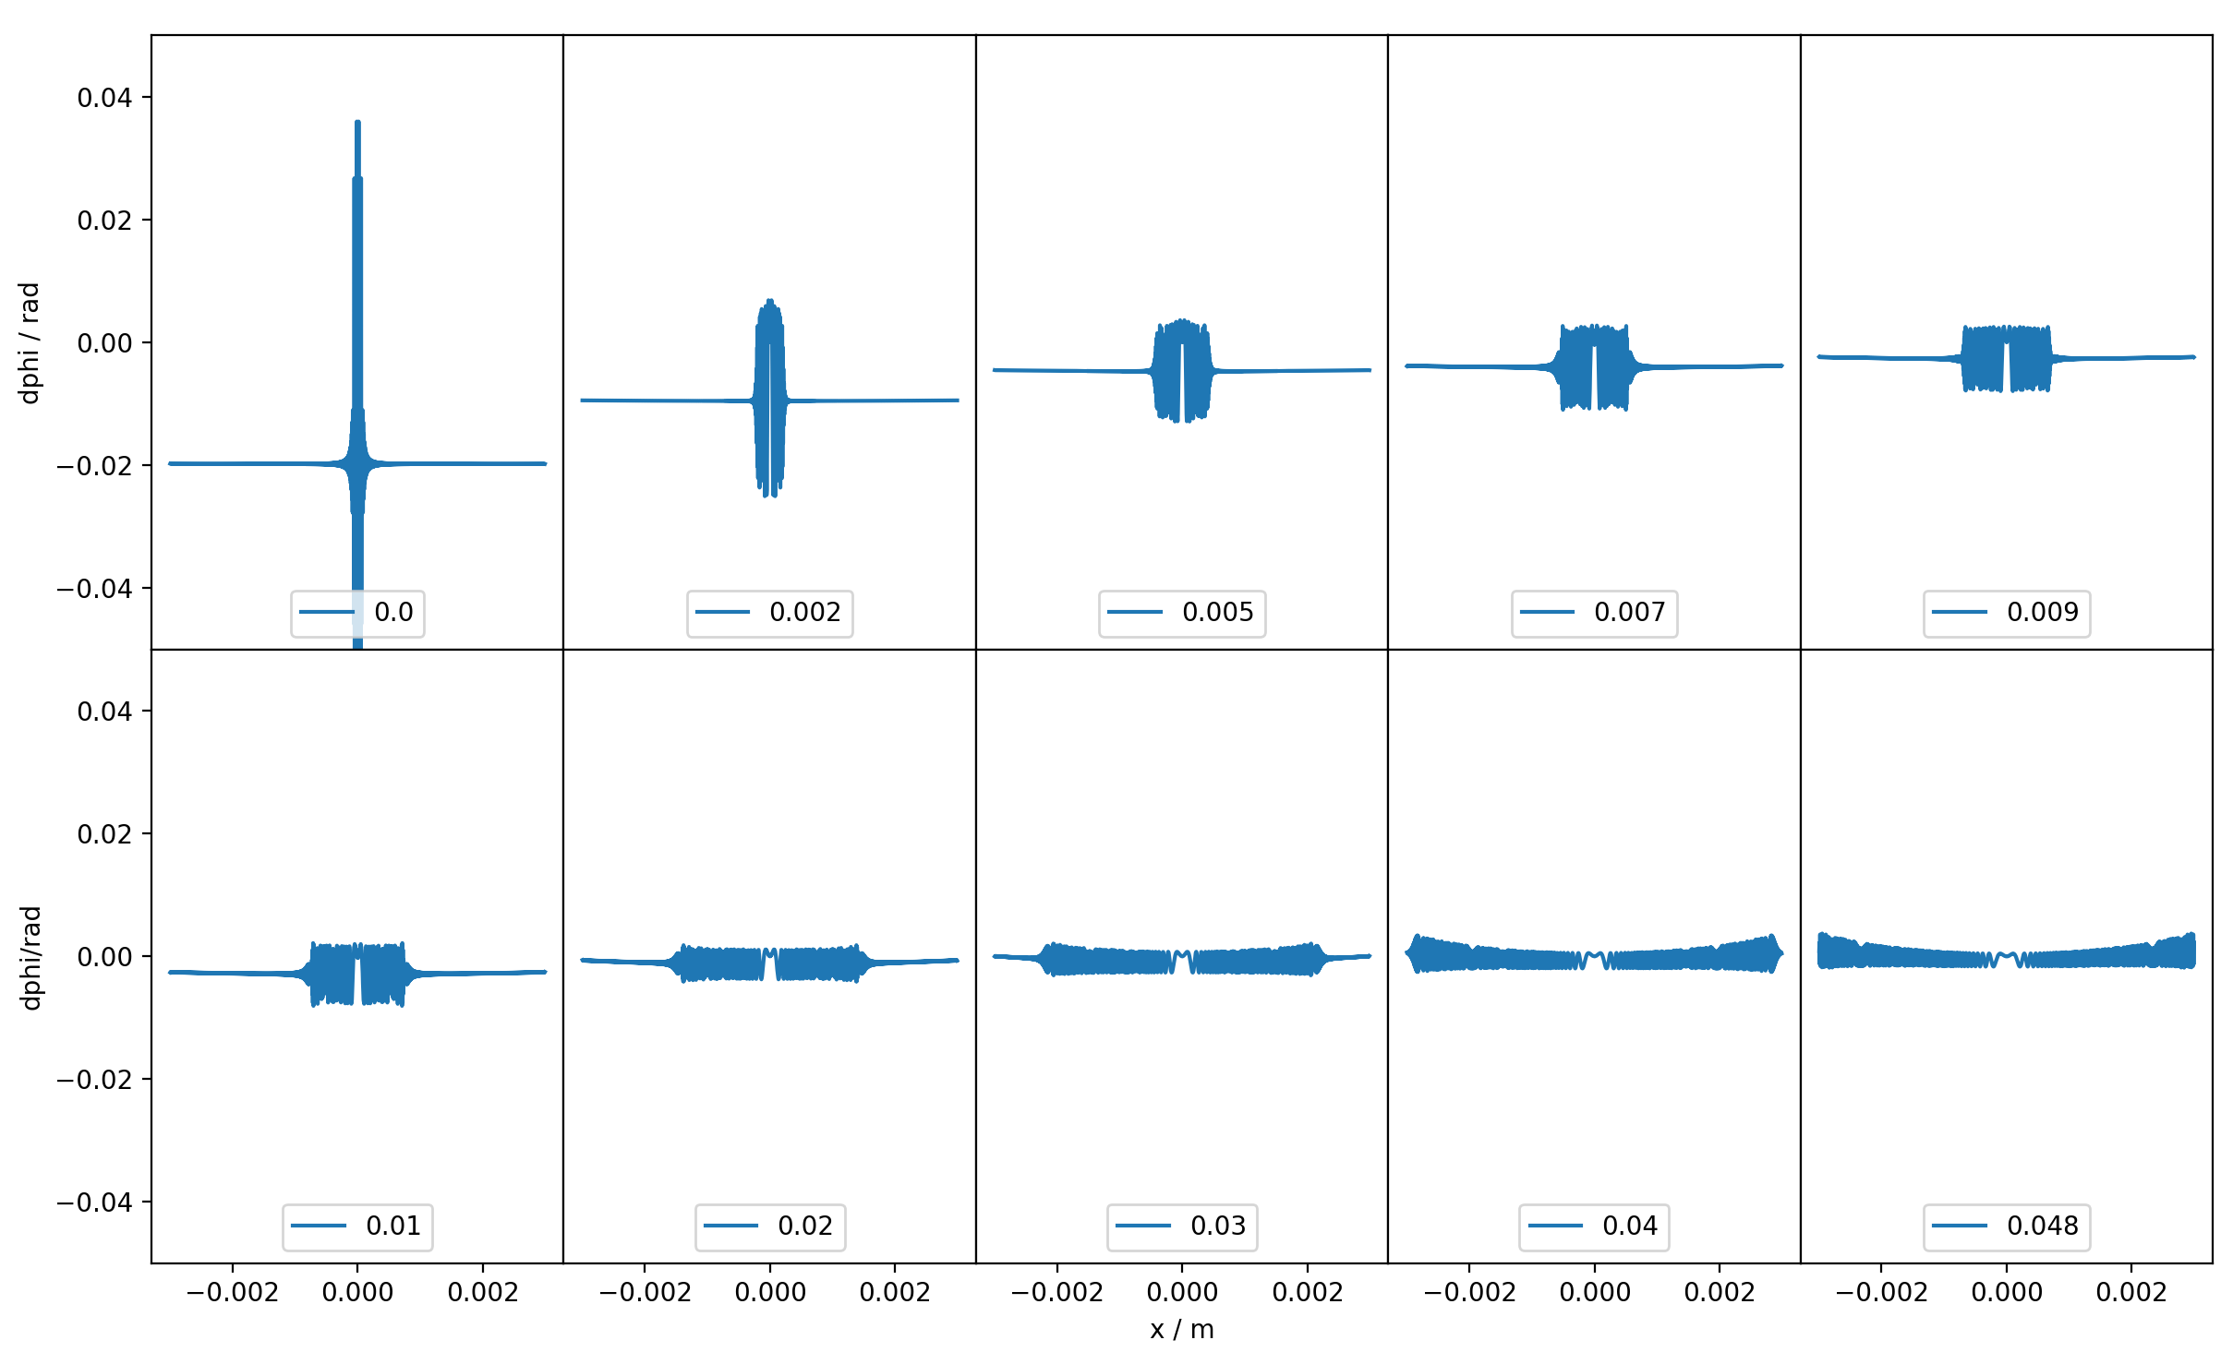
AI Readout – Phase Noise
Laser Wavefront Aberrations:
What dust size can we tolerate?
Δφ = Δφ_{curv}+ Δφ_{surf}+ Δφ_{mech} + Δφ_{scatt}
Dust particle size: 10 um
Phase shift of a scatterer
Aberrations <5 mrad for distances >0.03 m

Slide 22
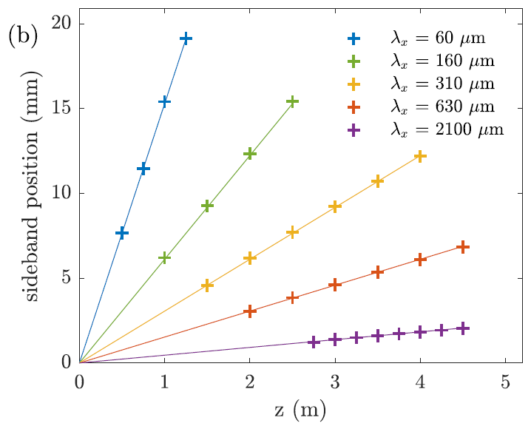
AION 10 - Beam Cleaning
M2
M1
Galilean Telescope
Simulation:
→ Removing transverse wavevectors
Lens 1
Lens 2
Atom
cloud 1
Atom
cloud 2
BR Mirror
Bottom figure: Abe et al 2021 Qu. Sci. Technol. 6 044003

Slide 23
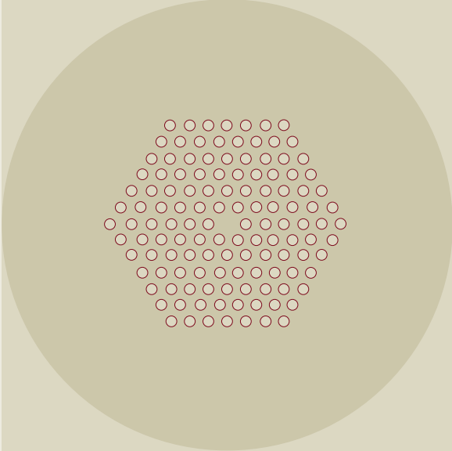
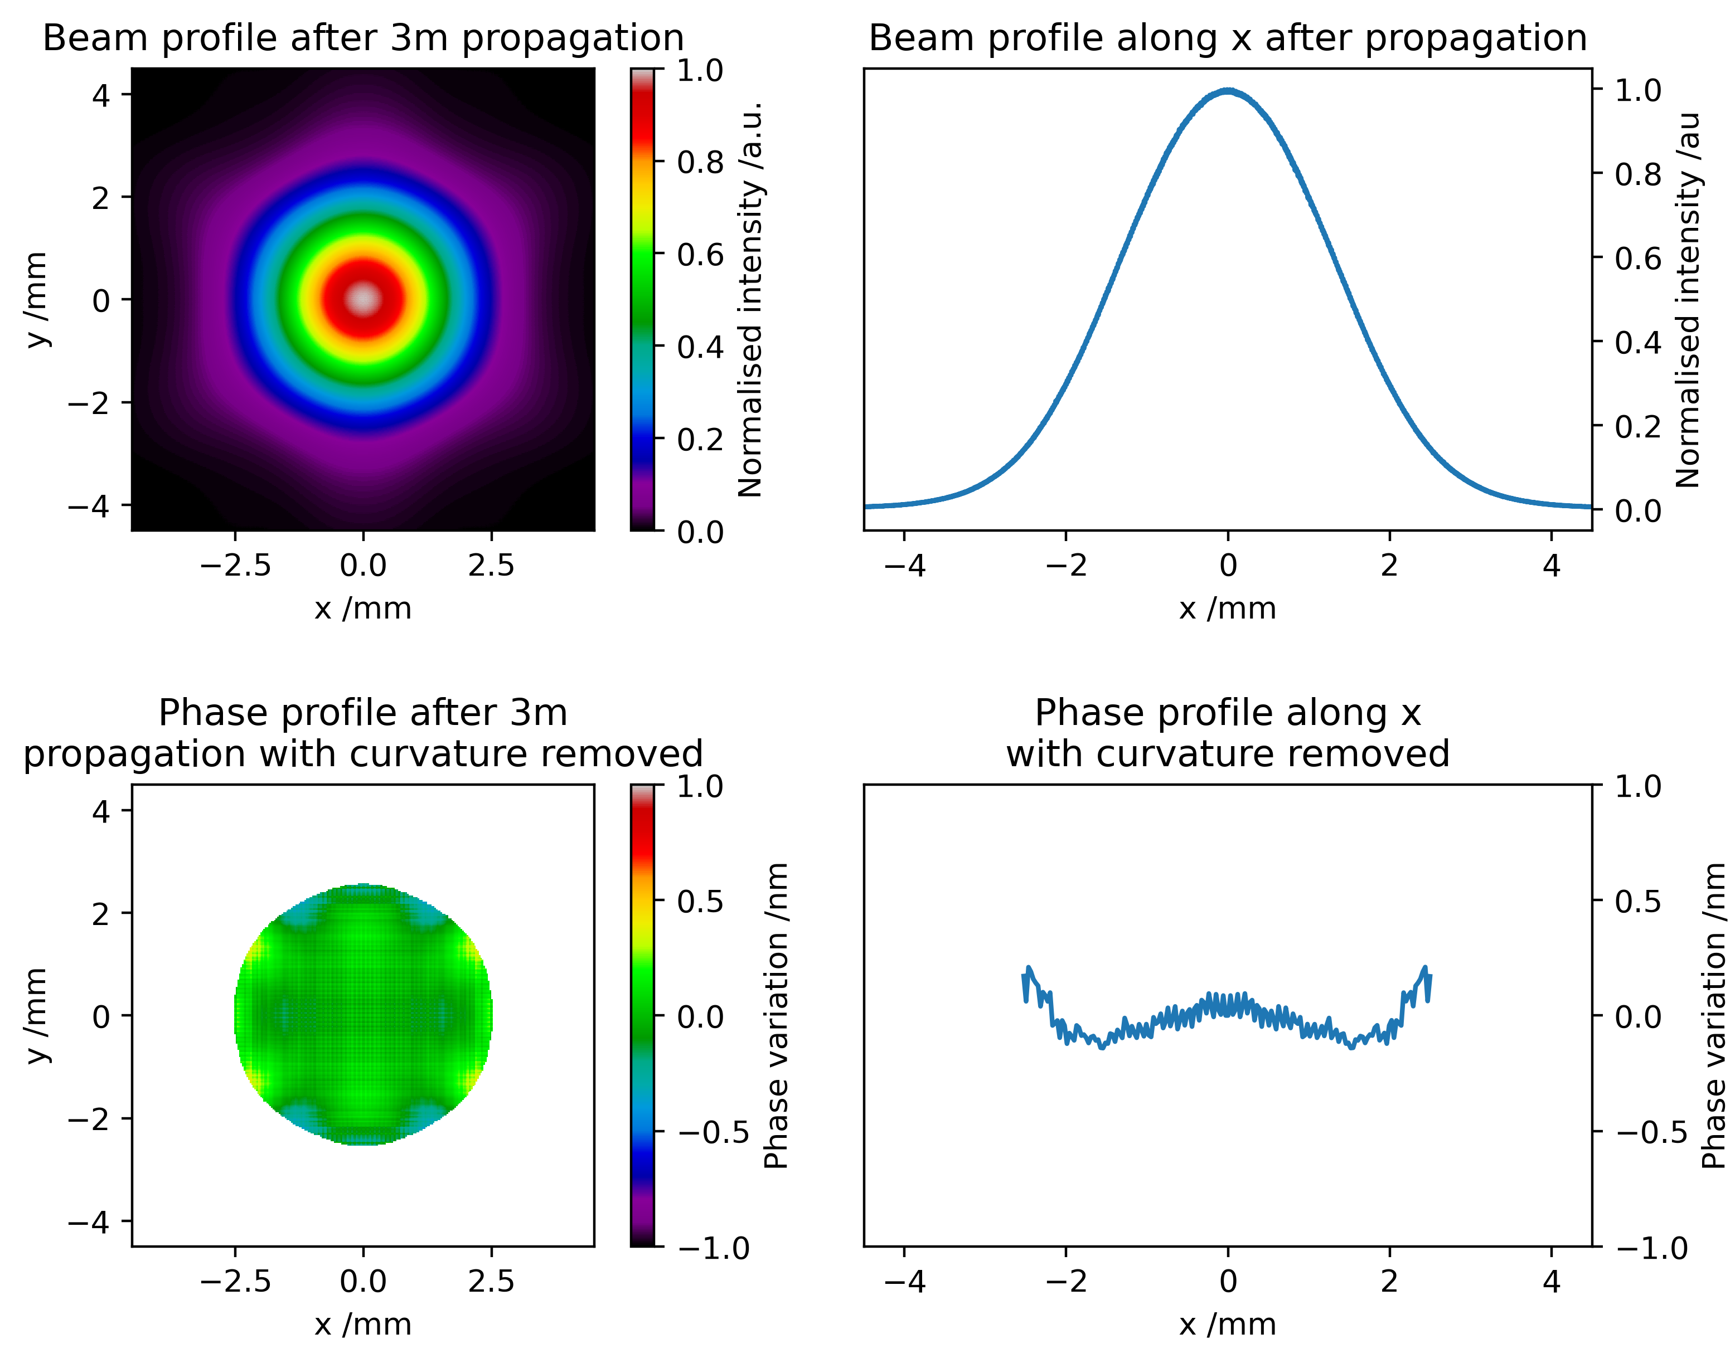
AION 10 - Beam Cleaning
M2
M1
Option: Coupling via Large Mode Area Photonic Crystal Fibre (PCF)
Large Mode Area Photonic Crystal Fibre (PCF)
Lens 1
Lens 2
Beam simulation
at 3.3 m after PCF:
Atom
cloud 1
Atom
cloud 2
BR Mirror

Slide 24
AION 10 - Beam Cleaning
M2
M1
Option: Coupling via Large Mode Area Photonic Crystal Fibre (PCF)
Large Mode Area Photonic Crystal Fibre (PCF)
Lens 1
Lens 2
Beam simulation
at 3.3 m after PCF:
Atom
cloud 1
Stimulated Brillouin Scattering does not limit the PCF input power level up to ~3.5 Watts
(test: 698 nm laser of ~100 kHz linewidth).
Future tests with higher power and narrower linewidth.
Atom
cloud 2
BR Mirror

