Slide 1

Preparing atoms for interferometry: cooling, transport and atom-optics
Dr Tiffany Harte
05/01/29, Cambridge AION workshop

Slide 2
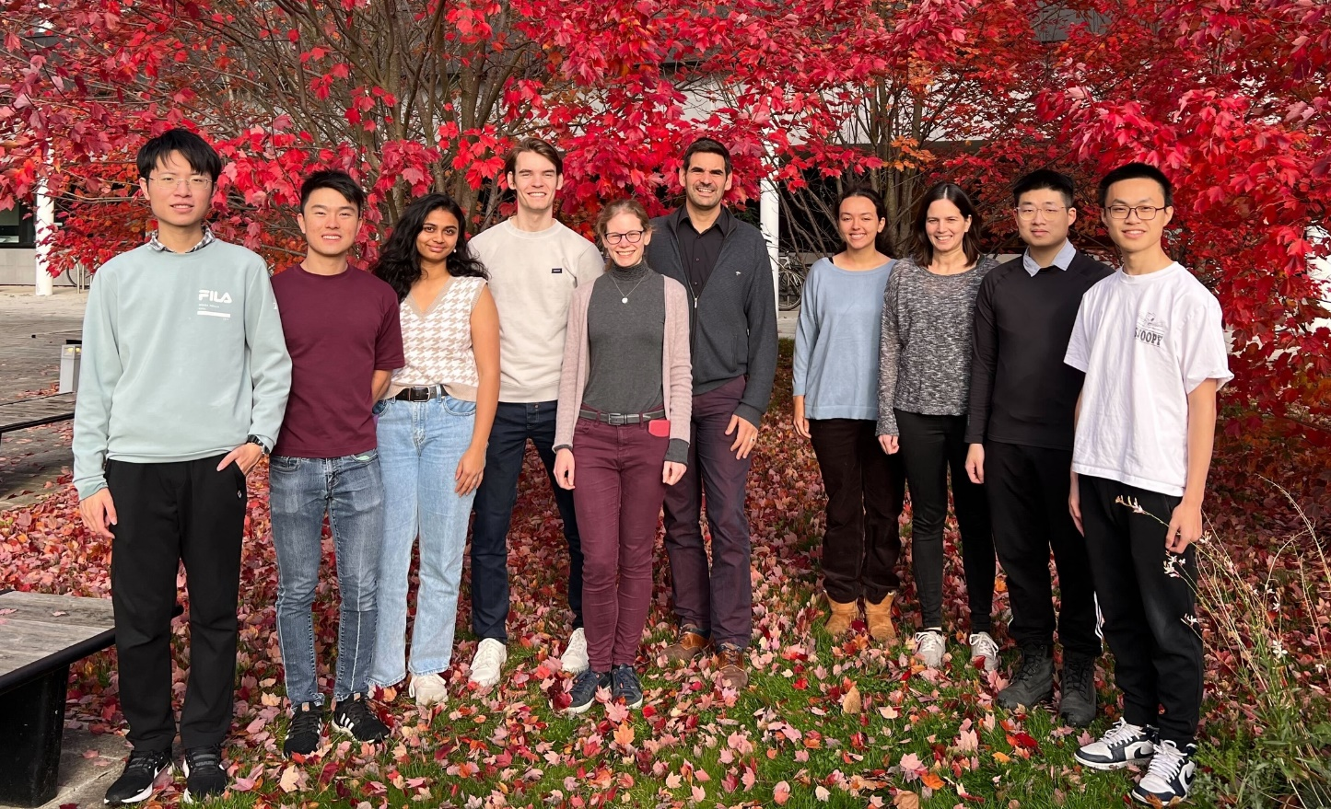
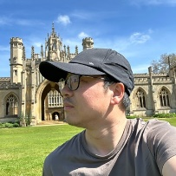
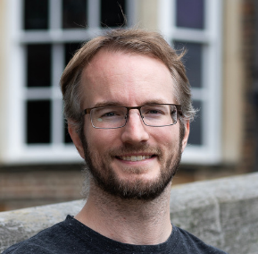



Cambridge Strontium team (AION and optical tweezers)
Experiment
Theory and simulations (AION)
Jeremiah Mitchell
Shengnan Zhang
Noam Mouelle
Chen
Lu
Michael Hsu
Julian Scheper
Ulrich Schneider
(MBQD PI)
Kimberly Tkalčec
Lichi
Fang (UG, graduated)
Benjamin
Millward
Jiajun Chen
Bhavana Panchumarthi
(graduated)
Tiffany Harte
Mariame Karzazi
Yijun Tang
Notes:
Sr team – AION and tweezers

Slide 3
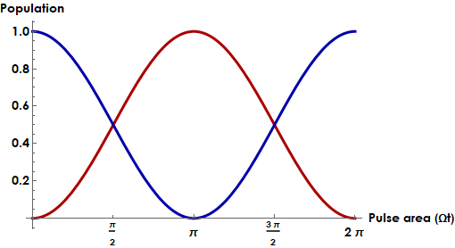
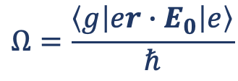
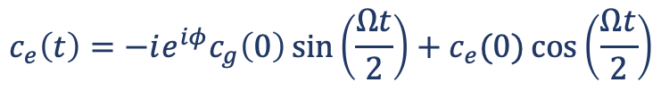

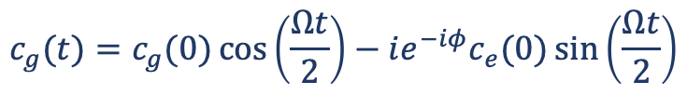

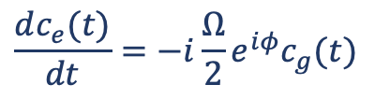
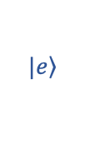
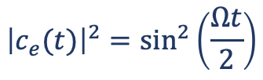
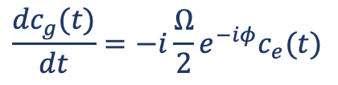
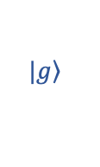
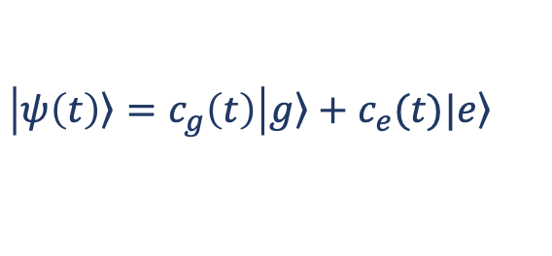
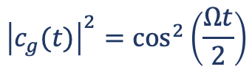
Atom-light interactions
Substitute into Schrödinger equation and ignore rapidly-oscillating terms.
$$|\left.e\right\rangle$$
$$\frac{dc_{g}(t)}{dt}=−i\frac{Ω}{2}e^{−iφ}c_{e}(t)$$
$$\frac{dc_{e}(t)}{dt}=−i\frac{Ω}{2}e^{iφ}c_{g}(t)$$
$$ω_{0}$$
$$|\left.g\right\rangle$$
$$c_{g}(t)=c_{g}(0)\cos\left(\frac{Ωt}{2}\right)−ie^{−iφ}c_{e}(0)\sin\left(\frac{Ωt}{2}\right)$$
$$c_{e}\left(t\right)={−ie^{iφ}c}_{g}\left(0\right)\sin\left(\frac{Ωt}{2}\right)+c_{e}(0)\cos\left(\frac{Ωt}{2}\right)$$
$$H_{int}=er∙E_{0}\cos{(φ−ω_{0}t)}$$
$$Ω=\frac{\left\langle g | er∙E_{0} | e\right\rangle }{ℏ}$$
$${\left|c_{g}(t)\right|}^{2}=\cos^{2}\left(\frac{Ωt}{2}\right)$$
$${\left|c_{e}(t)\right|}^{2}=\sin^{2}\left(\frac{Ωt}{2}\right)$$
$$\left|\left.ψ\left(t\right)\right\rangle =c_{g}\left(t\right)\right|\left.g\right\rangle +c_{e}(t)|\left.e\right\rangle$$
Following C.J. Foot, Atomic Physics

Slide 4

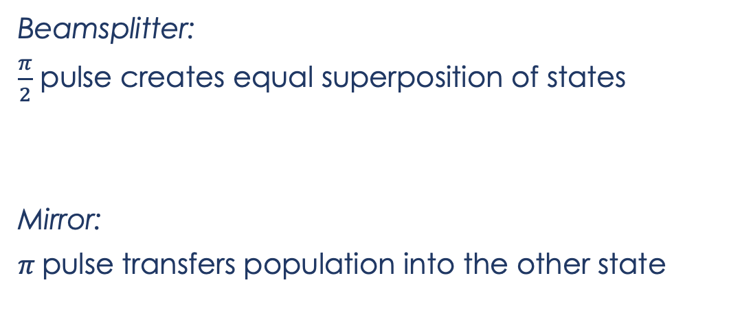
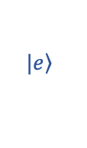
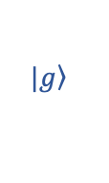


Atom-light interactions
$$|\left.e\right\rangle$$
$$ω_{0}$$
$$|\left.g\right\rangle$$
Beamsplitter:
$\frac{π}{2}$ pulse creates equal superposition of states
Mirror:
$π$pulse transfers population into the other state
$$\left.|g\right\rangle → \frac{1}{\sqrt{2}}\left(\left.|g\right\rangle −ie^{iφ}\left.|e\right\rangle \right)$$
$$\left.|g\right\rangle →−ie^{iφ}\left.|e\right\rangle$$
Recent atom-optics implementation using time-varying potentials: Phys. Rev. Lett. 129, 183202 (2022)

Slide 5

Optical interferometry
Mach-Zehnder interferometer:
$$∆φ$$

Slide 6
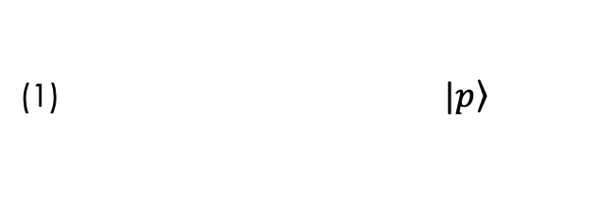

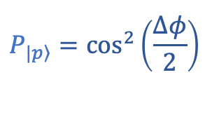
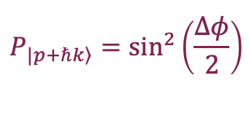
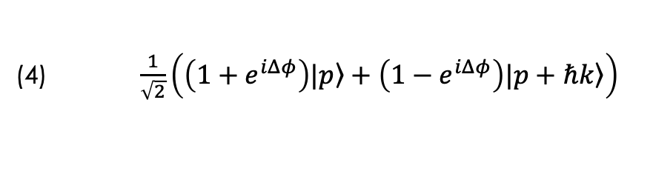

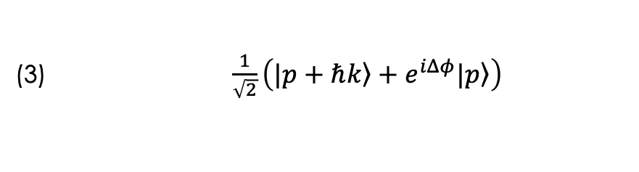

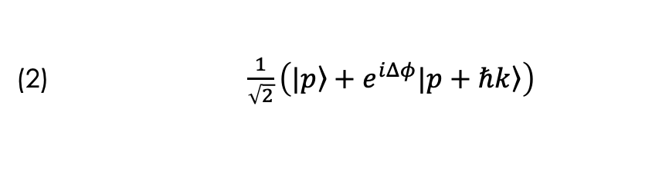
Atom interferometry
(1) $|\left.p\right\rangle$
(2) $\frac{1}{\sqrt{2}}\left(|\left.p\right\rangle +e^{iΔφ}|\left.p+ℏk\right\rangle \right)$
e.g. Mach-Zehnder interferometer:
(3) $\frac{1}{\sqrt{2}}\left(|\left.p+ℏk\right\rangle +e^{iΔφ}|\left.p\right\rangle \right)$
(1)
(2)
(3)
(4)
(4) $\frac{1}{\sqrt{2}}\left(\left(1+e^{iΔφ}\right)|\left.p\right\rangle +\left(1−e^{iΔφ}\right)|\left.p+ℏk\right\rangle \right)$
$$P_{|\left.p\right\rangle }=\cos^{2}\left(\frac{∆φ}{2}\right)$$
$$P_{\left.|p+ℏk\right\rangle }=\sin^{2}\left(\frac{∆φ}{2}\right)$$
${∆φ}_{total} ={∆φ}_{propagation}$ + ${∆φ}_{separation}$+ ${∆φ}_{laser}$
$$\frac{π}{2}$$
$$π$$
$$\frac{π}{2}$$
Time
Note: other interferometer configurations e.g. Ramsey-Bordé can cancel/enhance different phase terms
Useful references:
arXiv:0806.3261 (2008)
Quantum Sci. Technol. 6, 044003 (2021)

Slide 7
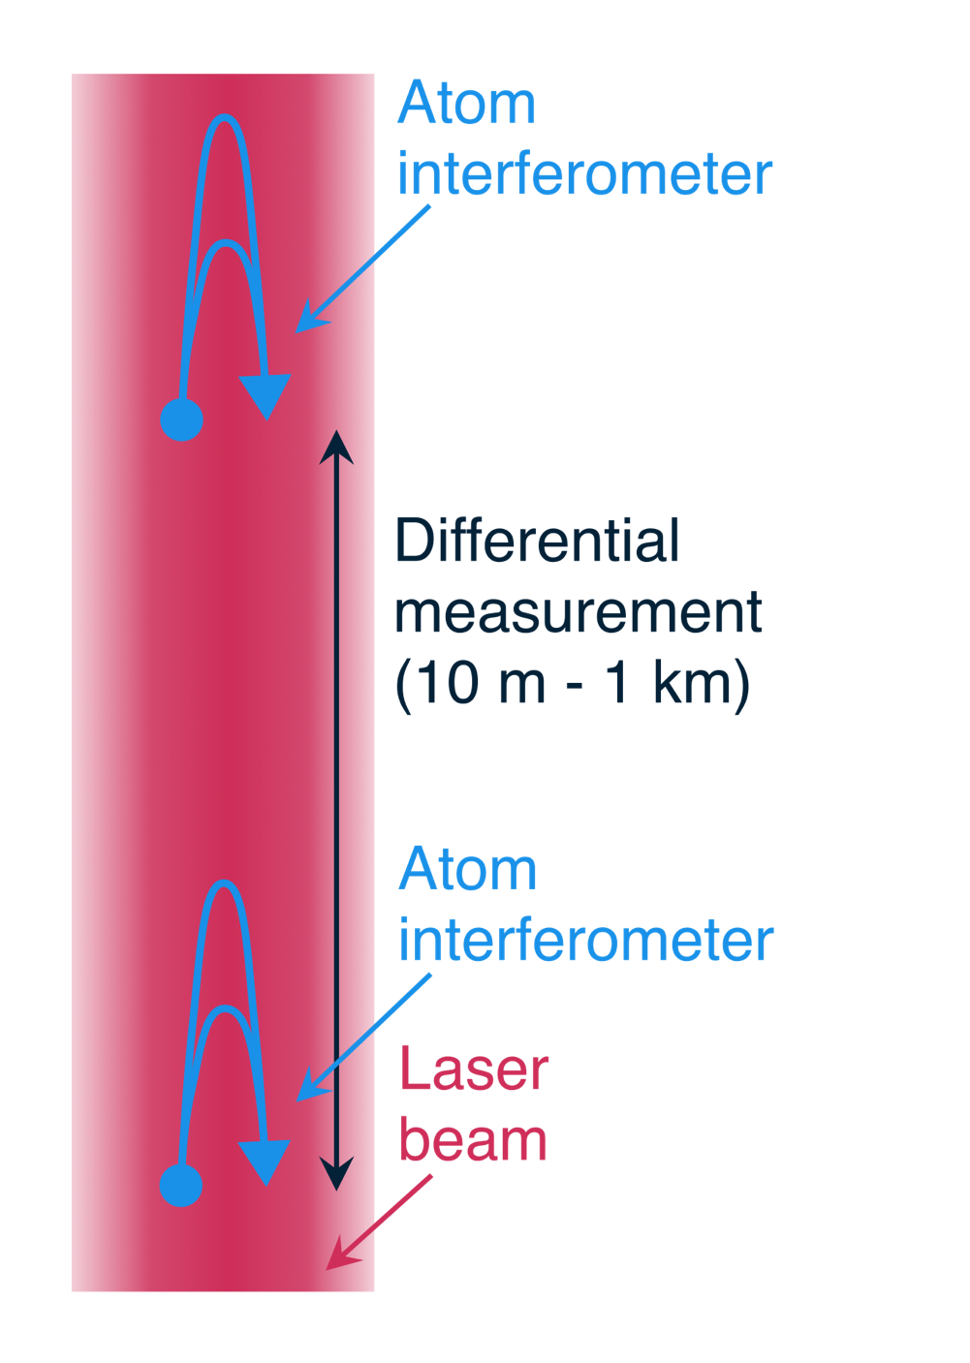
Long-baseline atom interferometry
Single or multiple atom interferometers separated by baseline (horizontal or vertical), addressed by common laser
  Analysis of multi-gradiometer configuration: Phys. Rev. D 107, 055002 (2023)
Differential measurement: fluctuations in relative phase between interferometers
Sensitivity scales with baseline length
Other interferometry configurations also hold great promise for fundamental physics studies – e.g. cavity interferometry in the Müller group Berkeley (Phys. Rev. Lett. 114, 100405 (2015))

Slide 8
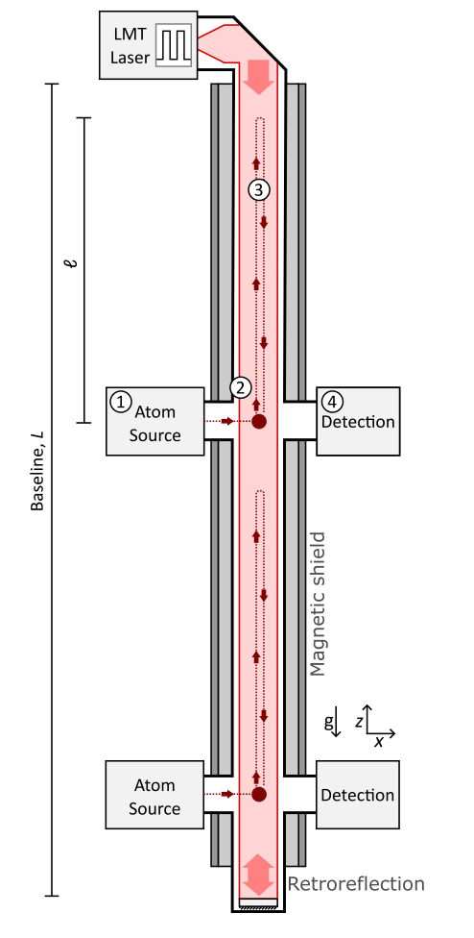

The atom interferometer observatory and network (AION)
Journal of Cosmology and Astroparticle Physics 5, 011 (2020)
Strontium-87 (fermionic)
  Clock transition
  Single-photon interferometry* [1,2]
Differential measurement (long baseline)
Cold clouds with large atom number, delivered with a fast repetition rate
Large momentum transfer
Quantum enhancements: squeezing
Detector network for fundamental physics
Noise modelling, systematics analsysis, and signal verification [3]
5s6s ³S₁
5s6s ³S₁
707 nm
5s5p ¹P₁
679 nm
461 nm
2π x 30 MHz
J=2
689 nm
2π x 7.5 kHz
J=1
5s5p ³P_{J}
J=0
698 nm
mHz
5s² ¹S₀
[1] P. Graham et al. PRL 110 171102 (2013)
[2] L. Hu et al. PRL 119, 263601 (2017)
[3] J. Mitchell et al. J. Inst. 17, 01 (2022)
* Recent 3-photon excitation of ⁸⁸Sr clock transition: S. Carman et al, arXiv:2406.07902 (2024)

Slide 9

The atom interferometer observatory and network
Journal of Cosmology and Astroparticle Physics 5, 011 (2020)
Strontium-87 (fermionic)
  Clock transition
  Single-photon interferometry* [1,2]
Differential measurement: fluctuations in relative phase between AIs
Sensitivity scales with baseline length
Detector network for fundamental physics
5s6s ³S₁
5s5p ¹P₁
461 nm
30 MHz
J=2
689 nm
7.5 kHz
J=1
J=0
5s5p ³P_{J}
698 nm
mHz
5s² ¹S₀
[1] P. Graham et al. PRL 110 171102 (2013)
[2] L. Hu et al. PRL 119, 263601 (2017)
* Recent 3-photon excitation of ⁸⁸Sr clock transition: arXiv:2406.07902 (S. Carman et al, Stanford)
Notes:
Mention long term prospects!! Mention here the global landscape.

Slide 10
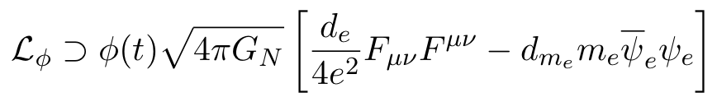


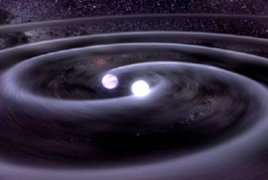
Detection goals
Ultralight (wavelike) dark matter [2-4]
10⁻²² - 10⁻⁷ eV
Decihertz gravitational waves [1]
Photon coupling
Electron mass coupling
Equivalence principle tests
Gradiometer (accelerometer) comparison between different states or species [5,6]
Fine-structure constant measurements
Earth science and seismology
Turning noise into signal: gravity fluctuations and gradients [7]
Probing dark energy models
[1] P.W. Graham et al. PRL 110, 171102 (2013).
[2] Y. V. Stadnik and V. V. Flambaum, PRL 114 161301 (2015).
[3] A. Arvanitaki et al. Phys. Rev. D 91 015015 (2015).
[4] L. Badurina, et al. Phys. Rev. D 107, 055002 (2023).
[5] G. Rosi et al. Nat. Commun. 8, 15529 (2017).
[6] P. Asenbaum et al. PRL 125, 191101 (2020).
[7] J. Mitchell et al., J. Inst., 17, 01 (2022).
Notes:
(ultralight spin 0)

Slide 11
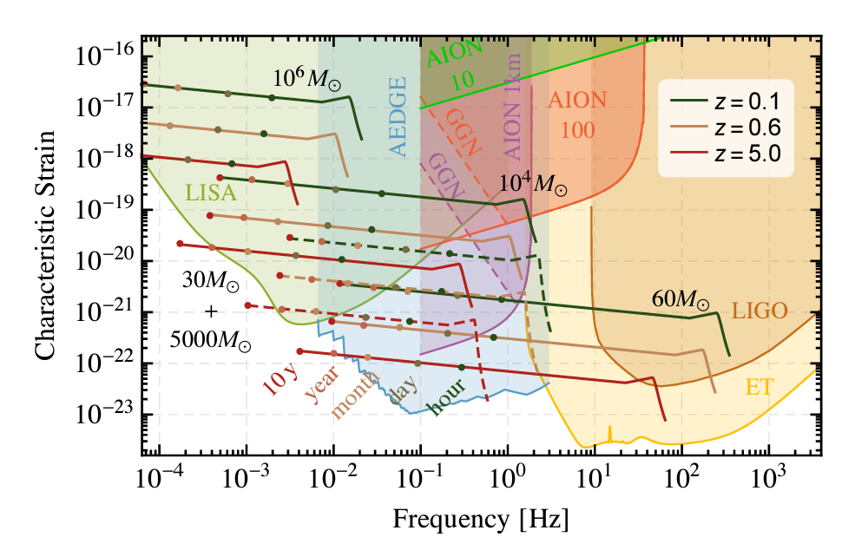
Gravitational wave detection bands
deci-Hz range
(Future) sensitivity to [1]:
“seed black holes” (merger/accretion to form supermassive black holes
Orbital eccentricities of stellar-mass black holes
Type 1A supernovae origins (white dwarf merger vs accretion)
Tests of relativity
[1] Stephen Fairhurst, TVLBAI workshop https://indico.cern.ch/event/1369392/
J. Cosmol. Astropart. Phys. 5, 011 (2020)
(Similar sensitivities for other atom interferometer detectors)

Slide 12
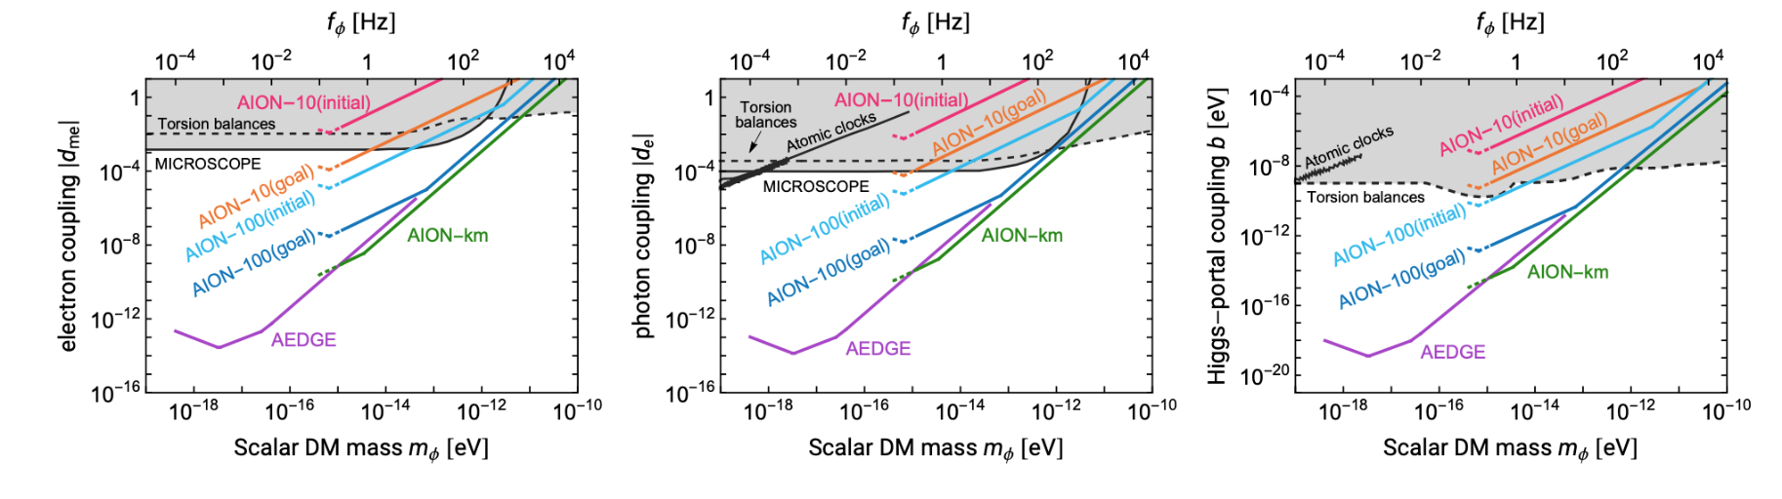
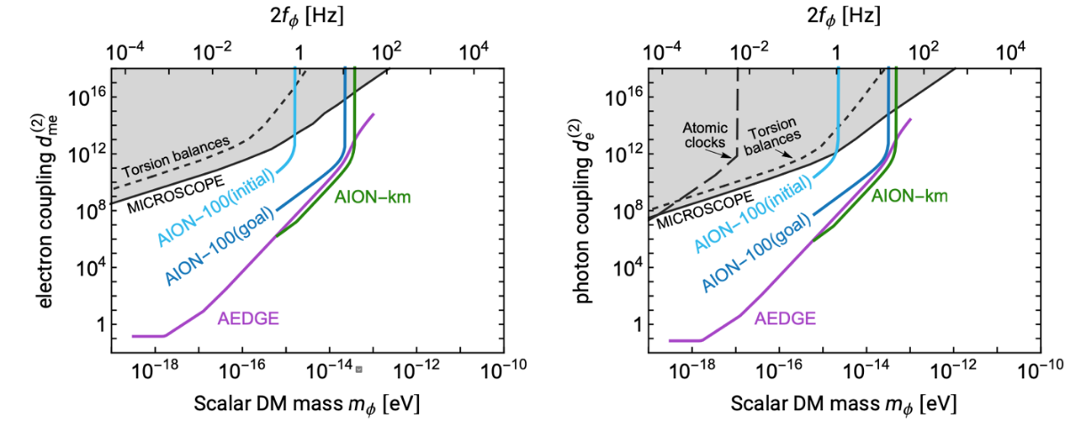
Fundamental physics searches
Gravitational waves
Ultra-light dark matter (linear coupling)
Ultra-light dark matter (quadratic coupling)
Journal of Cosmology and Astroparticle Physics 5, 011 (2020)

Slide 13
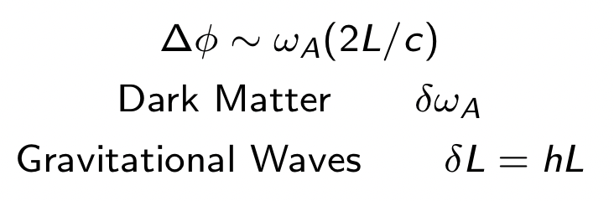
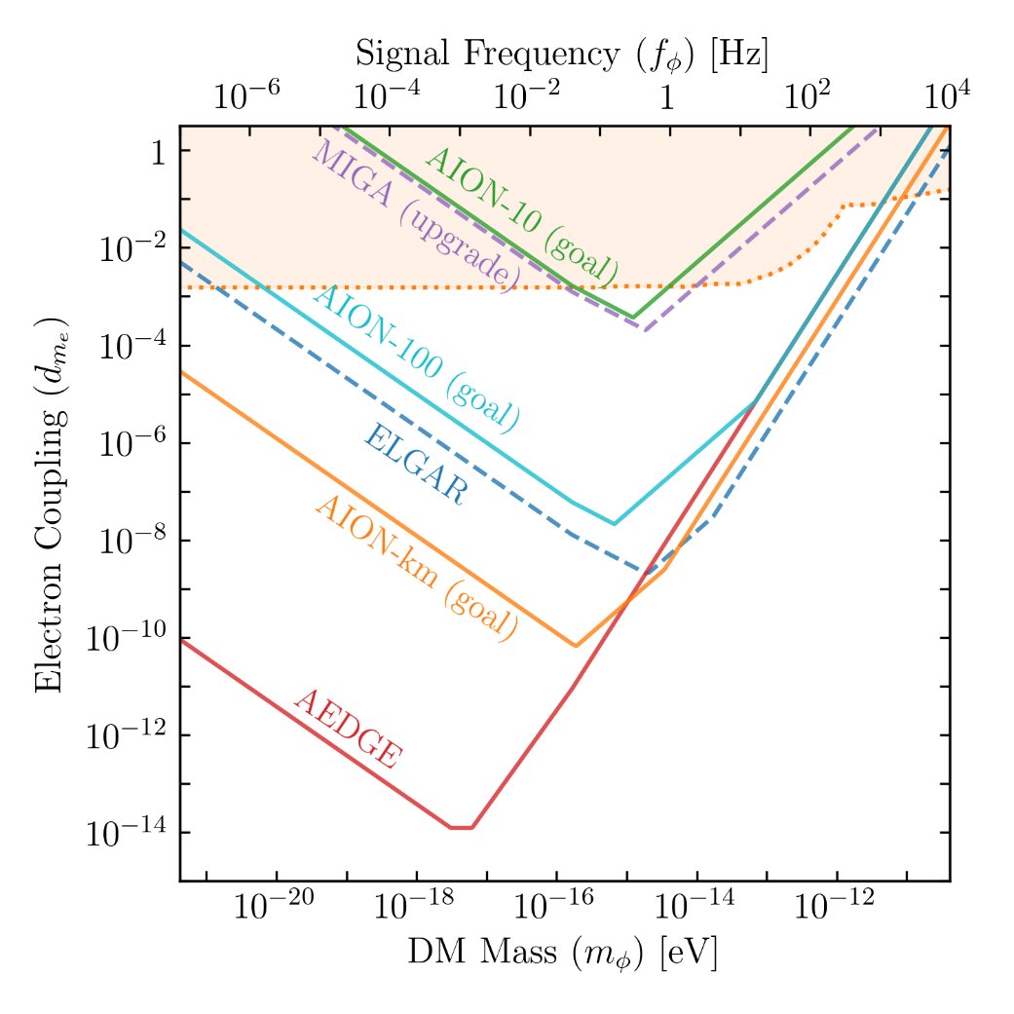
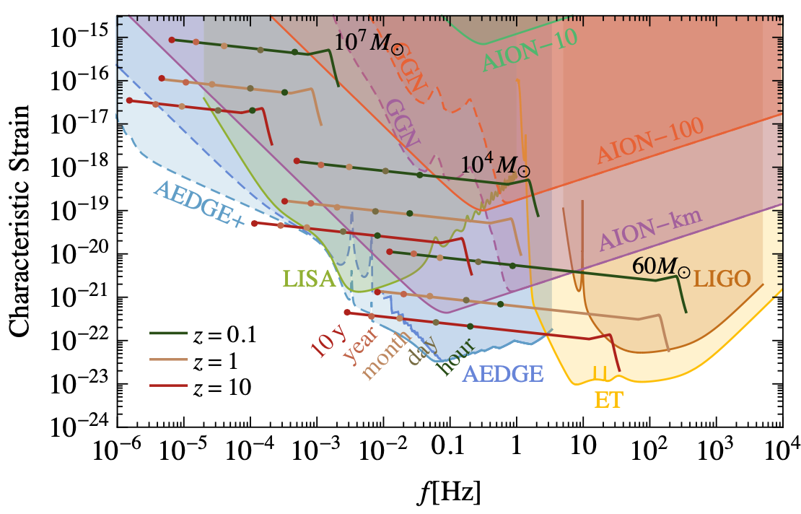
Fundamental physics searches
Ultralight dark matter searches
Gravitational wave searches
Single-baseline detector
L. Badurina et al., AION: An Atom Interferometer Observatory and Network, JCAP 05 (2020) 011, [arXiv:1911.11755]

Slide 14
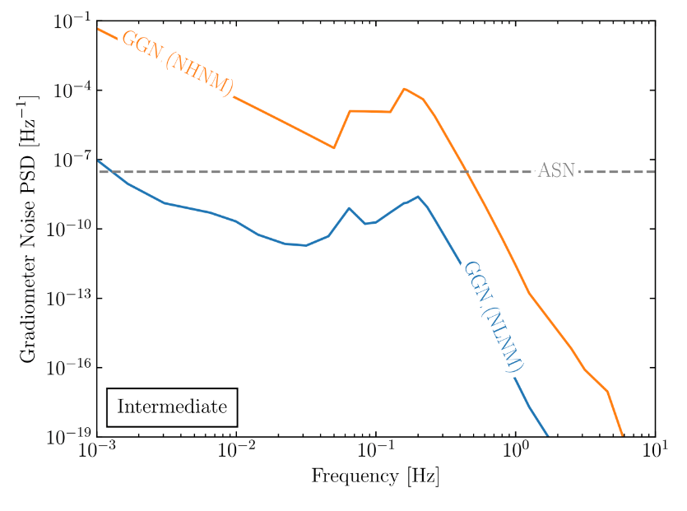
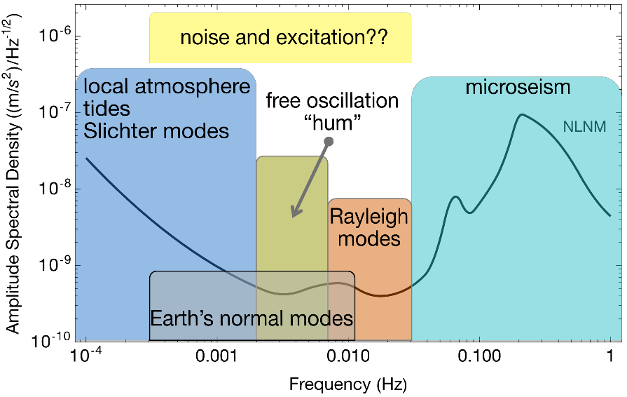
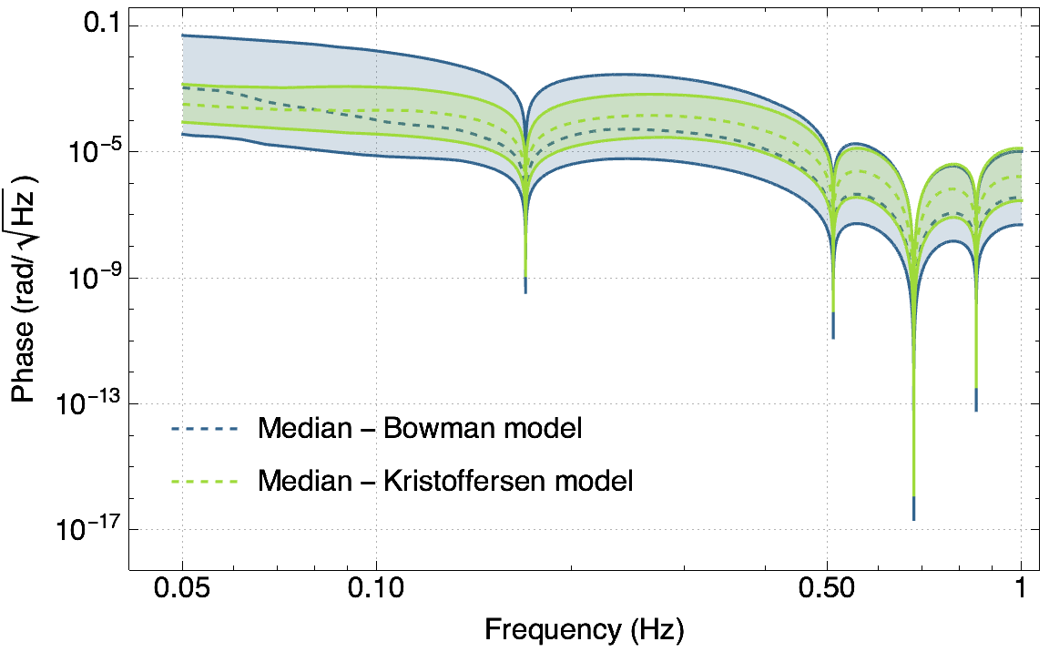

Earth Science: Background and Signals
Rayleigh seismic waves source gravitational fluctuations
Terrestrial backgrounds cause gravity gradient noise limiting fundamental physics searches
AION can use gravitational signal channel to answer open questions in Earth science
  Earth’s free oscillation and normal modes
  Low-frequency Earth dynamics
Seismic Frequency Spectrum
Atmospheric infrasound and temperature gradient noise
Preliminary!
Mitchell et al., J. Inst., vol. 17, 01, 2022.
Badurina, et al. Phys. Rev. D 107, 055002

Slide 15
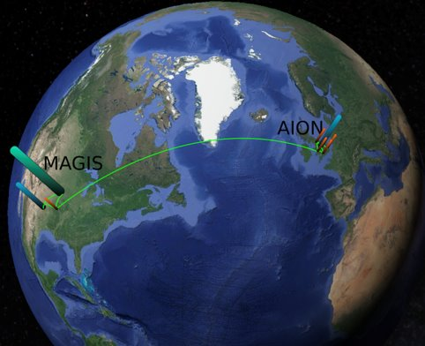
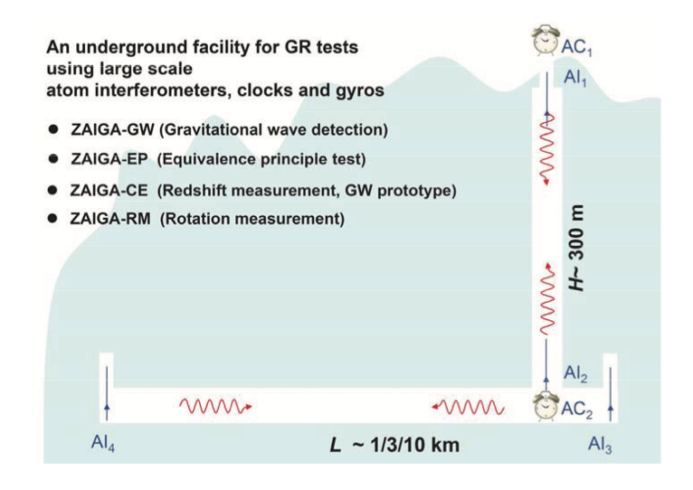
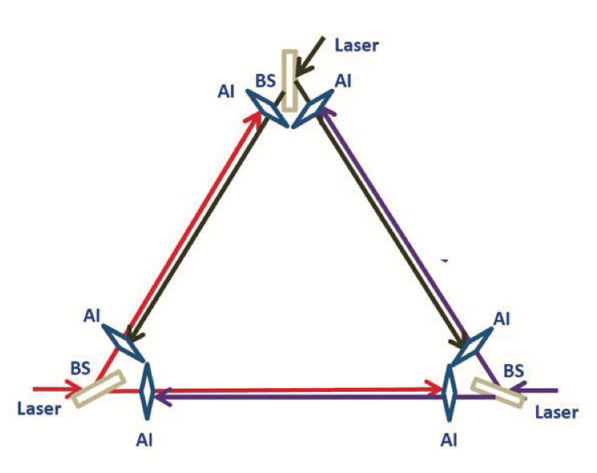
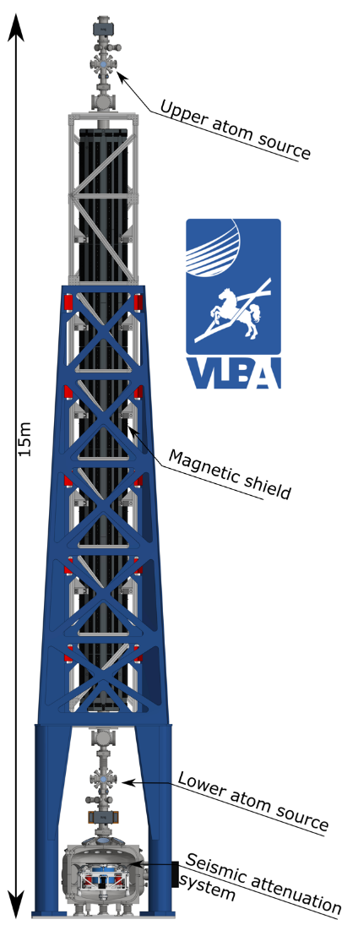
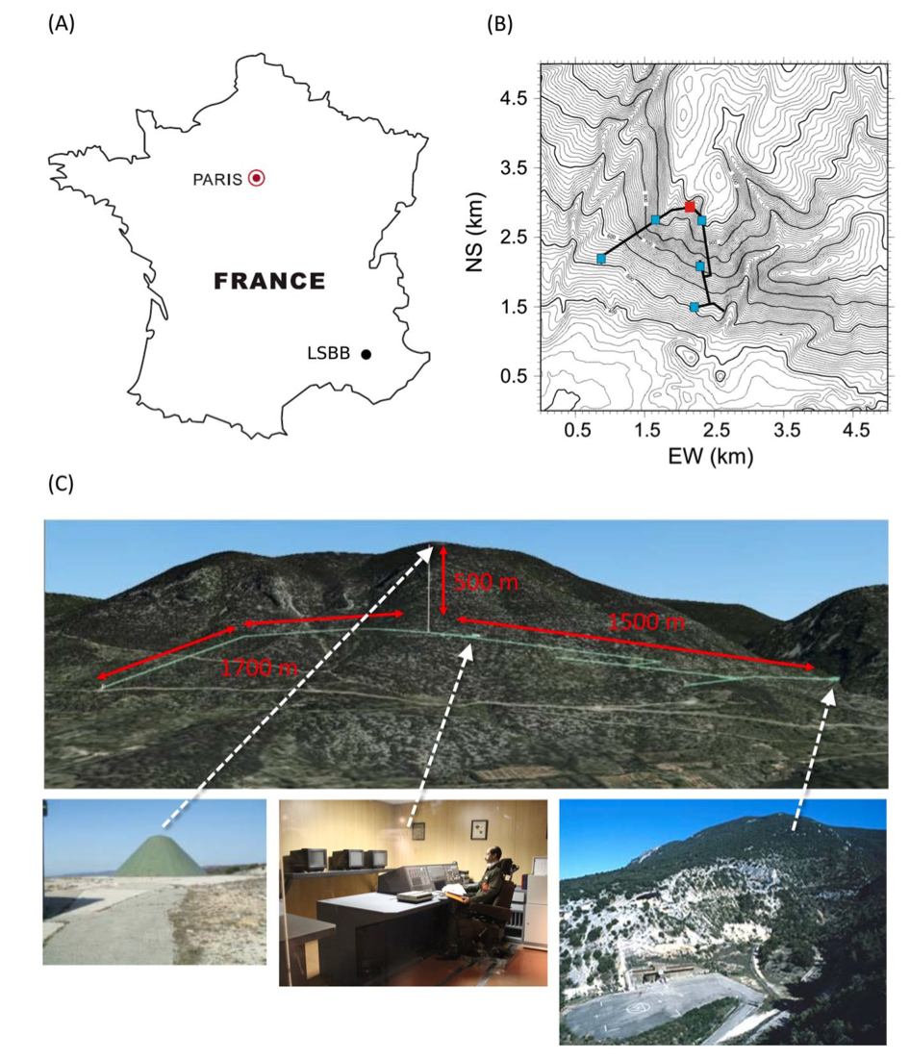
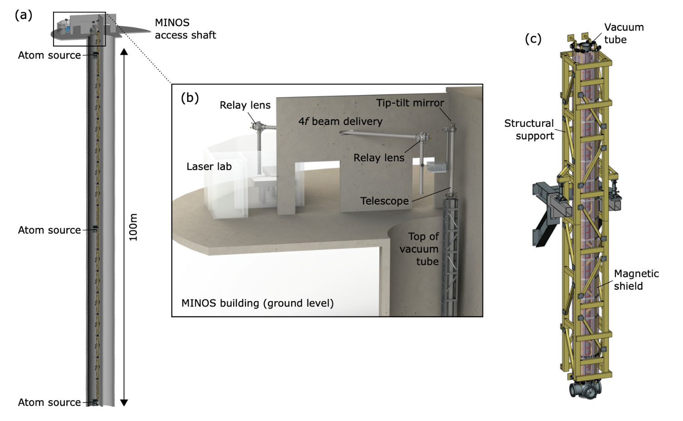
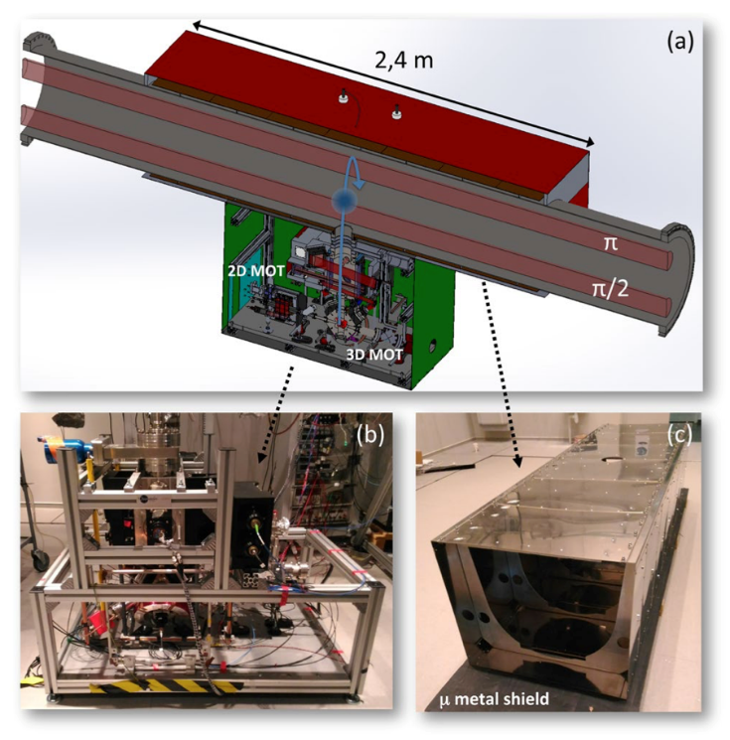
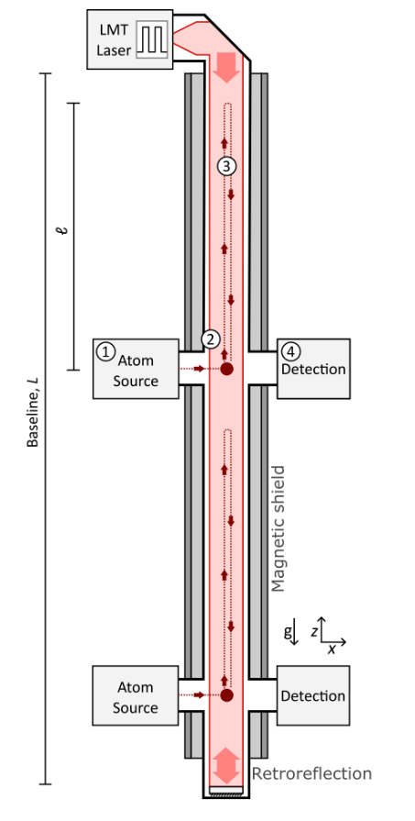
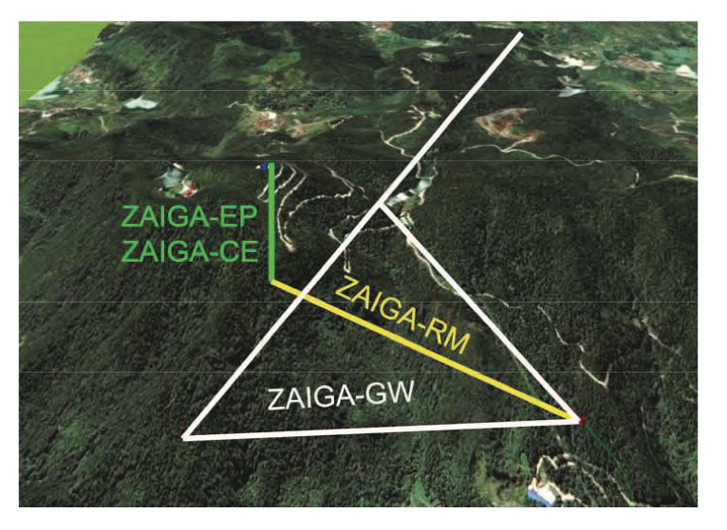
Long-baseline atom interferometers
MIGA and ELGAR
ZAIGA (China)
M.-S. Zhan et al. Int. J. Mod. Phys. D 29 1940005 (2020).
VLBAI
AION (UK)
L. Badurina et al. J. Cosmol. Astropart. Physics 5, 011 (2020)
J. Hartwig et al. New J. Phys. 17 035011 (2015)
MAGIS-100 (US)
M. Abe et al, Quantum Sci. Technol. 6 044003 (2021)
B. Canuel et al. Sci. Rep. 8 14064 (2018)
Notes:
MENTION THESE ARE OFTEN WITH MULTIPLE CLOUDS

Slide 16

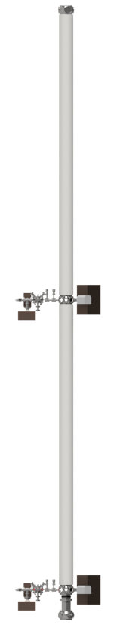
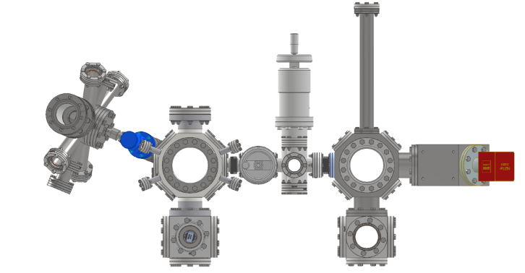
The AION consortium
Cambridge: transport, launching, cooling atoms for AION, DAQ/analysis for MAGIS, systematics analysis, modelling
University of Birmingham: LMT pulse sequences, Sr technology transfer
King’s + Imperial Colleges: Theory, phenomenology
Project executed in national partnership with UK National Quantum Technology Hub in Sensors and Timing, Birmingham, UK,
and international partnership with The MAGIS Collaboration
and The Fermi National Laboratory, US
Cambridge, Imperial, B’ham: modelling system parameters
10m
Imperial: (clock) laser stabilisation, squeezing
7 UK institutions
5 ultracold strontium labs
Design and deploy increasing-baseline atom interferometers 10m -> 100m -> 1km
Technology development and network with MAGIS-100 for large-scale science goals
Rutherford-Appleton Lab (STFC): Vacuum + support structure. Design AION-100
Liverpool: in-vacuum optics for MAGIS + AION
Oxford: site, cold-atom source, laser lab, construction for AION, camera system design for MAGIS
Notes:
Planning detector network, currently prototyping

Slide 17
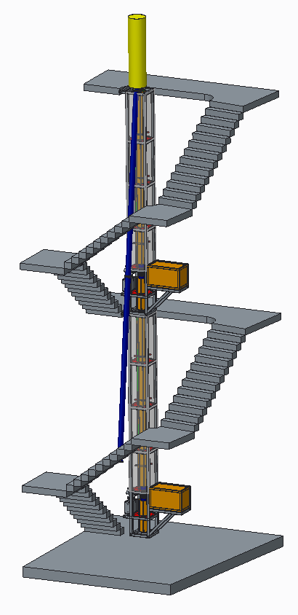
The AION consortium
14.7m
7 UK institutions
5 ultracold strontium labs [1]
Design and deploy increasing-baseline atom interferometers 10m -> 100m -> 1km
Technology development and network with MAGIS-100 for large-scale science goals
Ground level
AI-10
10.0m
7.7m
5.0m
Project executed in national partnership with UK National Quantum Technology Hub in Sensors and Timing, Birmingham, UK,
and international partnership with The MAGIS Collaboration and The Fermi National Laboratory, US
Planned AION-10 detector (University of Oxford)
[1] AVS Quantum Sci. 6, 014409 (2024)
Notes:
Planning detector network, currently prototyping

Slide 18


The AION detector
  Dark matter: $δω_{A}$
  Gravitational waves: $δL$
  Differential measurement (long baseline)
  Single photon transition
  Cold clouds
  Fast repetition rate
  Large momentum transfer
  Squeezing
  Launch
  Detection/imaging

Slide 19


Progressive Expansion of Quantum Detectors
Stage Expansion of Detector Length**
Stage 1: 2024 to 2027
10 m detector protype to be built in Oxford, focus fundamental science and R&D
10–20 m AION “spin-off” from Oxford design & experience at Boulby focus Earth Science applications.
Stage 2: 2028 to 2035
(Multi-)100 m detector: Site options are Boulby or Daresbury (UK), possibly also at CERN (France/Switzerland).
Stage 3: 2035 onwards
Km-scale detector: Site options are Boulby and other international sites
AVS Quantum Science (Vol. 6, Issue 2)
https://doi.org/10.1116/5.0185291
** Sensitivity scales with length of detector

Slide 20

AION R&D platform
Atom source
Oven, laser cooling, optical dipole trap and transport
Interferometry chamber
Tabletop technology demonstrator

Slide 21





Laser cooling of strontium
Magneto-Optical Trapping
Pre-cooling from oven: 2D blue MOT
mK: 3D blue MOT
µK: 3D red MOT
5s6s ³S₁
5s6s ³S₁
707 nm
5s5p ¹P₁
679 nm
461 nm
2π x 30 MHz
J=2
689 nm
2π x 7.5 kHz
J=1
5s5p ³P_{J}
J=0
698 nm
mHz
5s² ¹S₀
3D blue MOT
1 mm

Slide 22
AION Cambridge R&D
Transport, cooling and atom-optics
Preparing ultracold strontium for interferometry
Large atom number (target 10⁶ atoms)
Lowest possible temperature (near-term target 100 nK, long-term 10s nK)
High repetition rate (rapid delivery, sequence interleaving, semi-continuous atom sources)
Optimisation for atom cloud kinematics and shot-to-shot reliability
Atom interferometry simulation pipeline
Simulations of atom dynamics* to inform and understand experimental sequence
Interferometry simulations: systematics and science case
Atom source
Oven, laser cooling, optical dipole trap and transport
Interferometry chamber
Tabletop technology demonstrator
* X. Chen et al. arXiv:2105.06447
https://github.com/TeamAtomECS/AtomECS

Slide 23
AION Cambridge R&D
Transport, cooling and atom-optics
Preparing ultracold strontium for interferometry
Large atom number (target 10⁶ atoms)
Lowest possible temperature (near-term target 100 nK, long-term 10s nK)
High repetition rate (rapid delivery, sequence interleaving, semi-continuous atom sources)
Optimisation for atom cloud kinematics and shot-to-shot reliability
Atom interferometry simulation pipeline
Simulations of atom dynamics* to inform and understand experimental sequence
Interferometry simulations: systematics and science case
Future (networked) detectors
Interferometry beam delivery and engineering
Long-baseline site characterisation and systematics
International networking (with MAGIS-100)
Membership of MAGIS-100: technology development, analysis pipeline
* X. Chen et al. arXiv:2105.06447
https://github.com/TeamAtomECS/AtomECS

Slide 24



Transport, cooling and atom-optics
Preparation of ultracold strontium for interferometry
Large atom number
Lowest possible temperature
High repetition rate

Slide 25
Transport, cooling and atom-optics
Preparation of ultracold strontium for interferometry
Large atom number
Lowest possible temperature
High repetition rate
Transport
Optical transport of ultracold atoms over 50 cm
Maximise efficiency, minimise heating
Cloud splitting and launch (AION-0.5)
Cooling
Evaporative cooling
Delta-kick/decompression cooling (target 20 nK before launch)
Long-term (AION-100) target tens pK
Atom Optics
Shaping/focussing cloud to optimise interferometry
Imaging
Optimised imaging/readout of cloud after interferometry sequence

Slide 26
Laser cooling of strontium
5s5p ¹P₁
461 nm
30 MHz
J=2
689 nm
7.5 kHz
J=1
J=0
5s5p ³P_{J}
698 nm
mHz
5s² ¹S₀
Notes:
Last time – installing last optics for 3d mot
Parameter searches etc
Saw first convincing signals in July – for us a big optimisation was 2d fields. Interesting fluorescence signals prior to seeing mot - seemed to be loading directly into magnetic trap
Summer of optimising parameters, pulling fields down, finding thresholds to reduce laser powers, oven temps etc. Challenge – stability, air conditioning. Mariame.

Slide 27



Dipole trap simulations: AtomECS
Goal: inform and understand dipole trap loading, optical transport and cooling
In progress: parameter optimisation for optical dipole trap and optical transport
Developing python wrapper: PyAtomECS
X. Chen et al. arXiv:2105.06447
https://github.com/TeamAtomECS/AtomECS
Notes:
Mention bug fixes and new reliability
Should collaborate and share!

Slide 28

Optical dipole trap
Optimising loading efficiency:
  Red MOT into XODT
  XODT into transport beam
Control over size, ellipticity and focus position of both beams
Simulations:
  Optical potentials
  Atom kinematics
x
z
Notes:
Different optimum parameters for each stage
Simplest scheme for the flexibility needed
Optical calculations to inform atomecs

Slide 29
Optical dipole trap
Optimising loading efficiency:
  Red MOT into XODT
  XODT into transport beam
Control over size, ellipticity and focus position of both beams
Simulations:
  Optical potentials
  Atom kinematics
Notes:
Different optimum parameters for each stage
Simplest scheme for the flexibility needed
Optical calculations to inform atomecs

Slide 30


Optical dipole trap
Simulation parameters:
Beam powers 15 W
Transport beam waist 50 µm (circular)
Diagonal beam waist 150 µm (circular)

Slide 31



Optical transport
Dipole trap stability:
  Laser power
  Focus position
  Beam pointing
Dynamic trap parameters
  Power
  Dimensions
Optimised acceleration profiles (ongoing)
Simulation parameters:
Initial atom cloud at 20 µK
Transport beam waist 50 µm (circular)
Acceleration profile: minimum jerk

Slide 32



Intersection with wider quantum technologies
Quantum information
New strontium hybrid optical lattice/tweezer experiment
Single-site addressing and readout for quantum memories
Quantum simulation
MBQD optical lattice experiments (rubidium and potassium): optical quasicrystal and kagome lattice
Quantum advantage in quantitative quantum simulators
New EPSRC programme grant
(Cambridge Co-Is: Harte, Schneider, Hadzibabic, Cooper)
One Cambridge work package: intersection of quantum sensing and quantum simulation - quantum sensors based on many-body effects and exploring feedback pathways
Kagome quantum gas microscope apparatus
Studying the Kagome lattice flat band

Slide 33
Summary
Parallel technology development and iterative design across institutions
Cambridge technology focus: transport, cooling and atom-optics to meet detector sensitivity goals
Intersection of ultracold quantum technologies: scope for exploration and mutual technology transfer
Technology goals growing with science case
Contact: th558@cam.ac.uk

