Slide 1
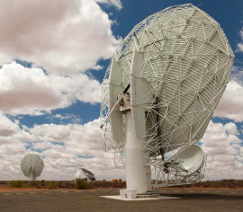
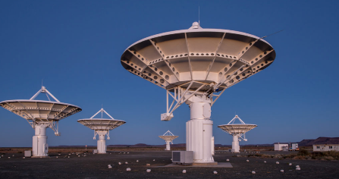
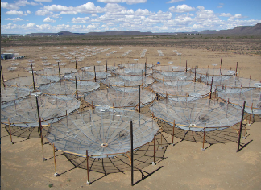
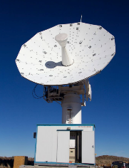
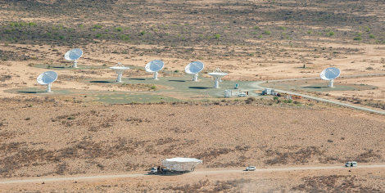
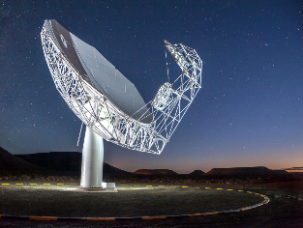
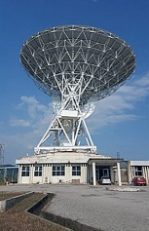

SKA Steerco
Project Cash Update
MTEF 2024/25
20 JANUARY 2025
www.sarao.ac.za

Slide 2
SKAO Payment Schedule MTEF 2024/25 to 2026/27
RSA Observatory Funding Commitments:
  Cash contributions over the next 2.5 years (105,7m Euro) – indexation based on actual Inflationary adjustments can change this. Exchange rate risk to be mitigated by FEC contracts, we reviewing options based on engagements with bankers.
  Payments for 2024/25 = R451m (29 Nov 2024) Actual Payment
  Payments for 2025/26 = R786m (May 2025 and Nov 2025) aligned to MTEF
  Payments for 2026/27 = R868m (May 2026 and Nov 2026) aligned to MTEF

Slide 3
SARAO Cash Requirements Projected 2024/25 & 2025/26

Slide 4
Funding Requirements - MTEF 2025 - 2031
Long term funding requirements informed by
  SKA construction profile and cash flow requirements, including additional funding
  BFI Fuding and Expenses included
  Commencement of stable SKA operations in 2029/2030
  SARAO capital and operational expenditure
  MeerKAT integration estimated in 2028

