Slide 1





Precision optical spectroscopy of exotic nuclei
Daniel Bettaney
Nuclear Physics Group, The University of Manchester

Slide 2
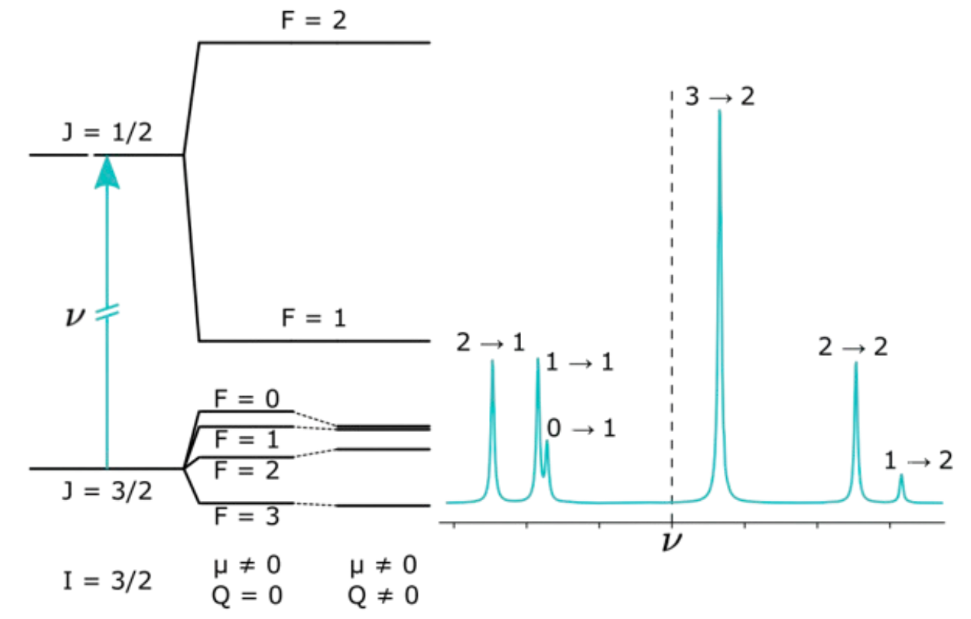
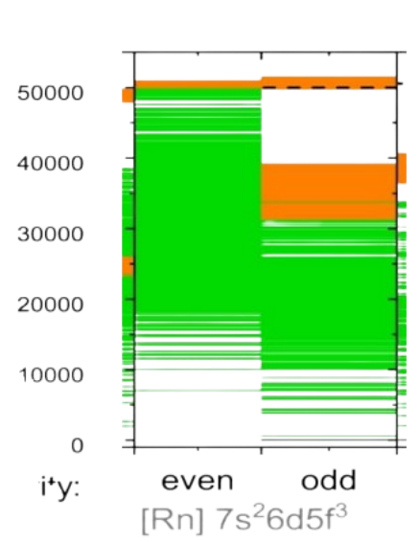

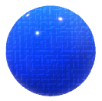


Nuclear properties using the atomic fingerprint
Uranium atom
${ 10}^{−7}$effect
Isotope shift
Hyperfine structure
Model independent extraction of…
Photon detector
$$δ⟨r^{2}⟩$$
μ
Q
I
Eur. Phys. J. A (2024) 60:20

Slide 3
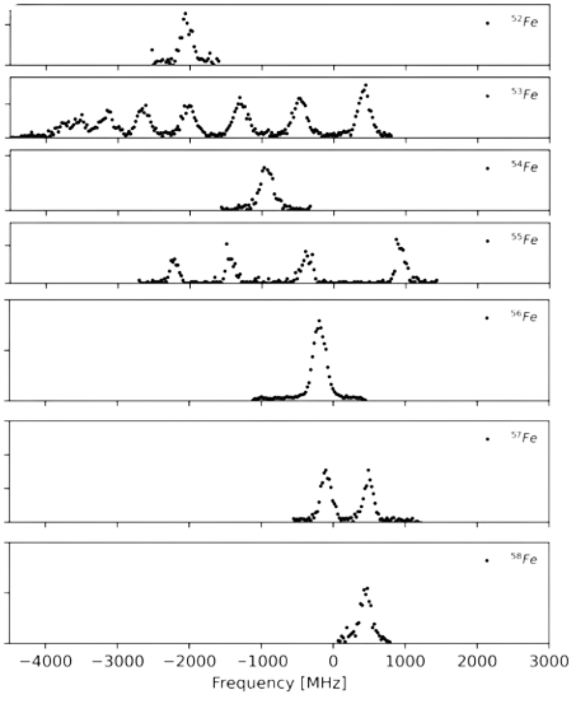
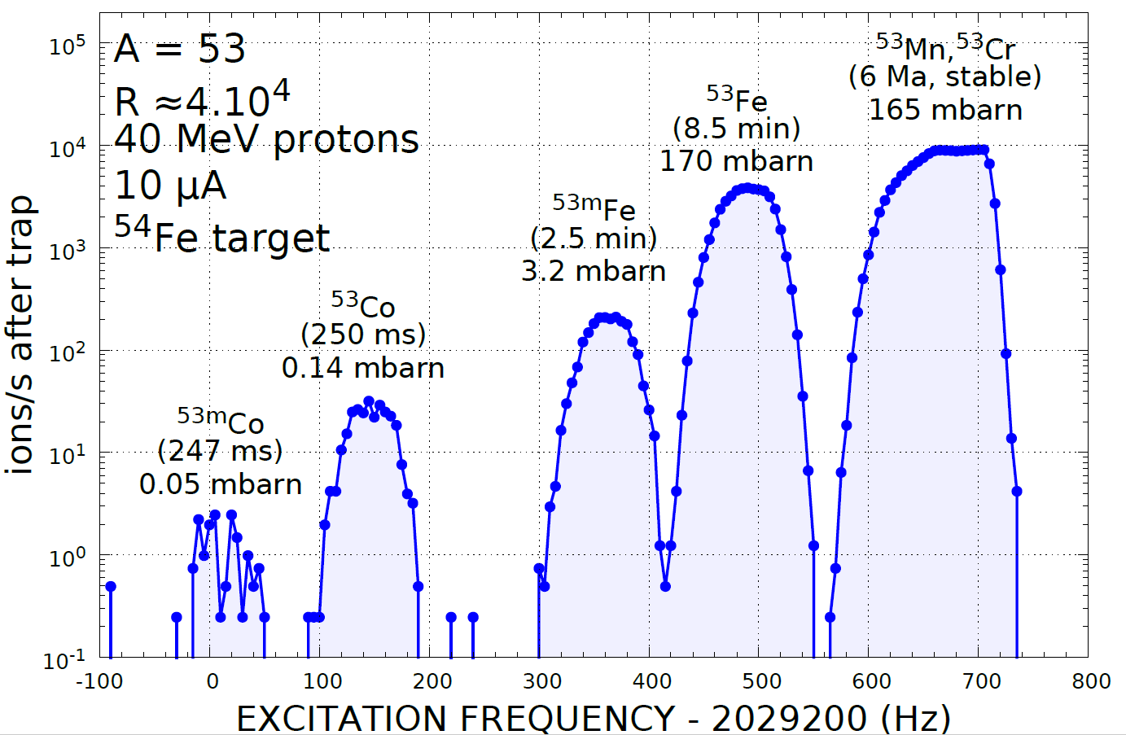


Is a higher sensitivity method needed?
1700 ions $s^{−1}$
140 ions $s^{−1}$
1 Photon per 1000 ions

Slide 4
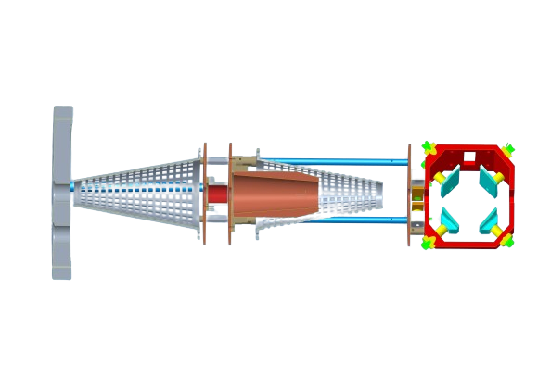
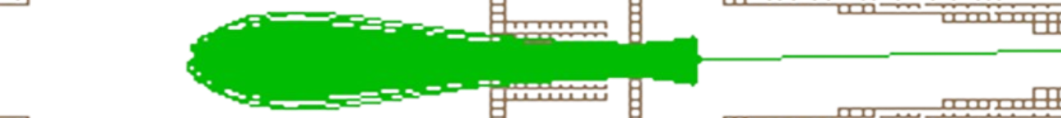


To progress…
Avoid optical detection (ε ~ 1 %)
Long interaction region
Optical pumping region
Charge exchange
Ion beam
Atoms
Deflector
Excited state
Ions
Metastable state
# Atoms
Ground state

Slide 5
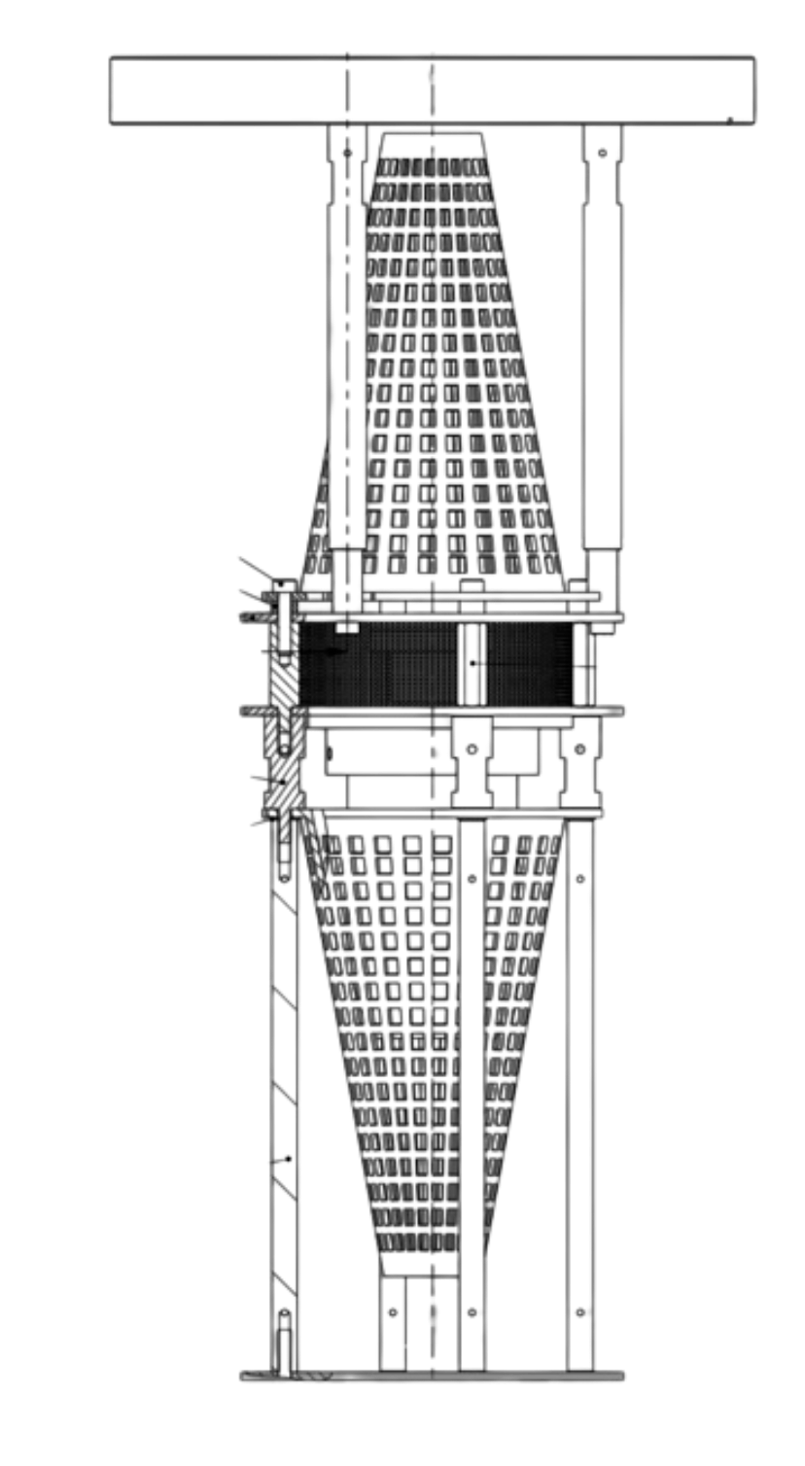
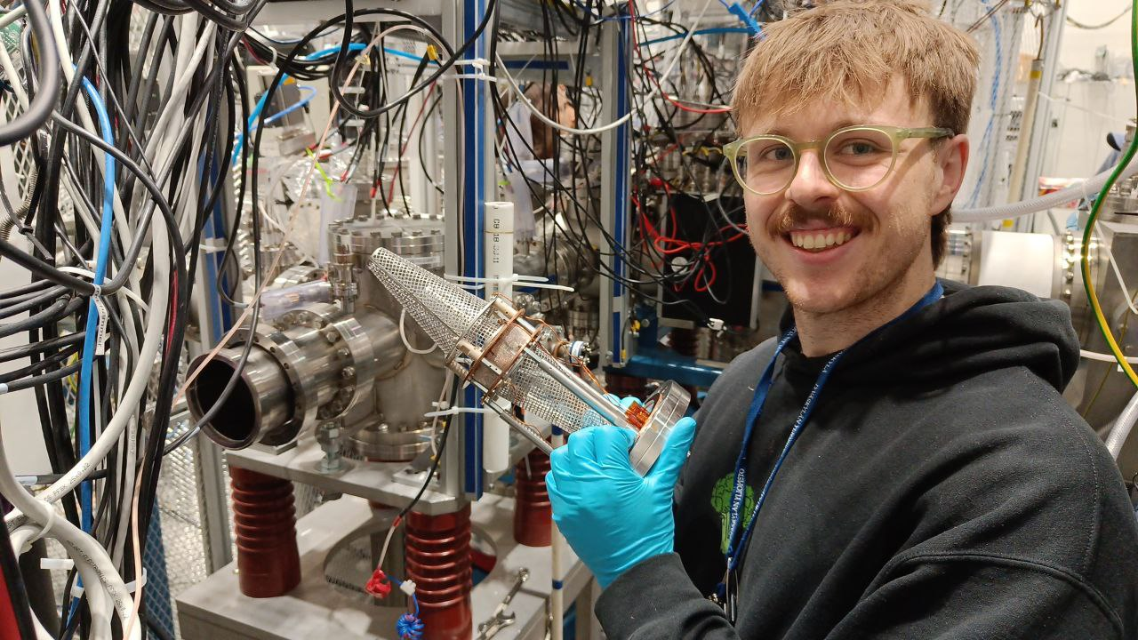
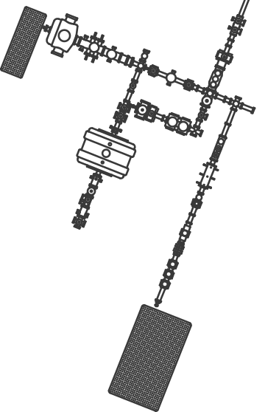
Present status
Trapping times exceeding 100 ms @ IGISOL
Manchester ConeTrap to be commissioned @ IGISOL, proposal accepted for on-line commissioning

Slide 6
Thank you!
Collaborators:
University of Manchester :
Paul Campbell
Zixu Shen
University of Jyväskylä:
Saikumar Chinthakayala
Tommi Eronen
Zhuang Ge
Sonja Kujanpää
Luis Miguel Motilla
Iain Moore
Andrea Raggio
Mikael Reponen
KU Leuven :
Ruben De Groote
Ági Koszorús
Stefanos Pelonis
University of Liverpool:
Bradley Cheal
Jack Hughes

