Slide 1
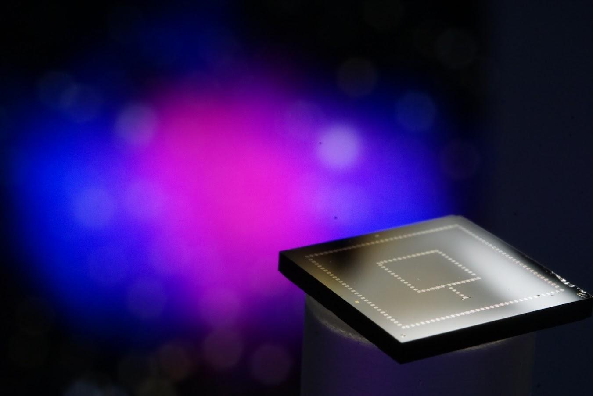

Solving the Fundamental Challenges of meV-GeV Dark Matter Searches with Calorimeters
Matt Pyle
UC Berkeley
University of Michigan
25/05/04

Slide 2
Light Mass DM Direct Detection
Design Drivers

Slide 3
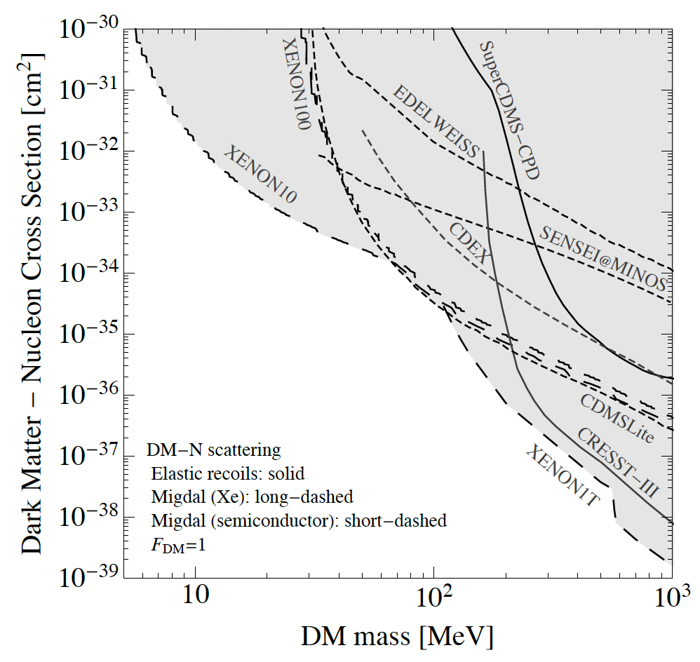
Light Mass DM: Nuclear Recoil Direct Detection Constraints
?
There are basically no Direct Detection constraints. Why?
Typical Neutrino cross section
2203.08297

Slide 4
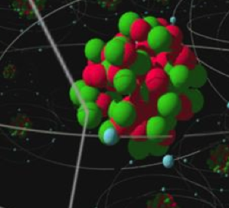
Kinematics: 2 Body Elastic Nuclear Scattering
DM
When M_{n}>> M_{DM}
Transfer of DM kinetic energy to nucleus is really inefficient for elastic 2 Body Scatters when M_{n} >> M_{DM}

Slide 5
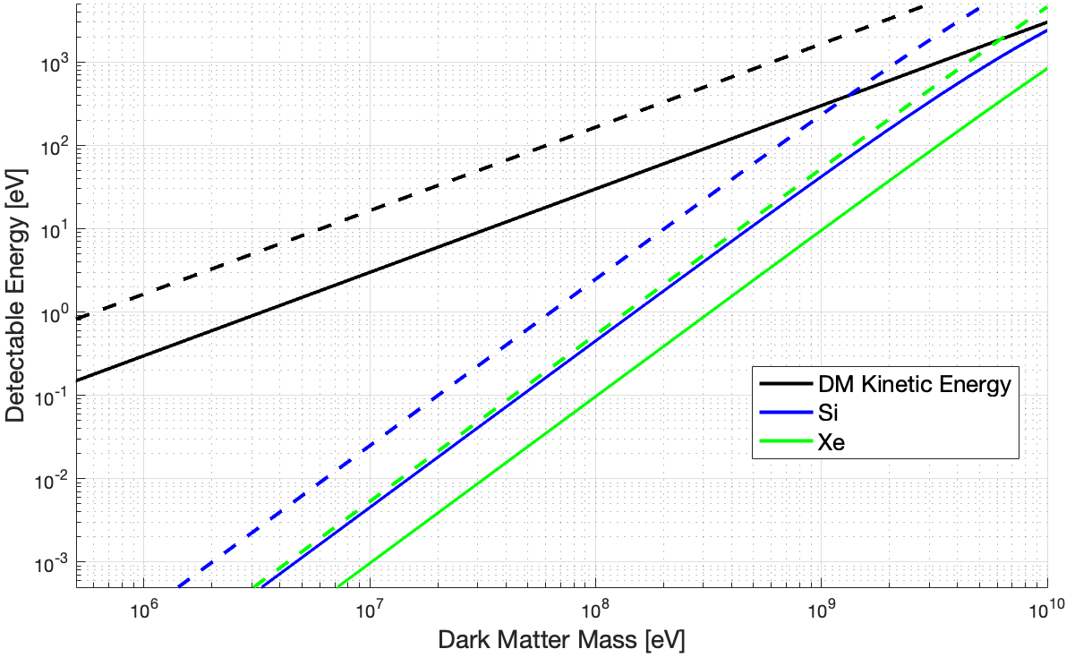
Light Mass Dark Matter: Elastic Nuclear Scattering
<v> -
V_{esc} --
1 meV
Design Driver #1: Energy Sensitivity

Slide 6
It’s not quite this daunting …

Slide 7
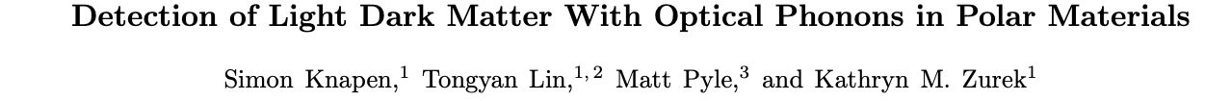
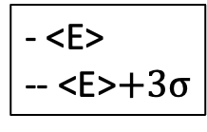
DM- Coherent Vibrational Interactions
For DM interactions with small momentum and energy transfers, we need to start thinking about DM interactions producing coherent crystal excitations!
Scalar Nuclear Interaction: Detectable Energy [eV]
- <E>
-- <E>$+3σ$
Coherent Vibrational Excitations in Si
1712.06598, 2205.02250

Slide 8
Light Mass DM: Detector Design Driver #1: Energy Sensitivity
1. Energy Sensitivity
Typical Neutrino cross section
2203.08297

Slide 9
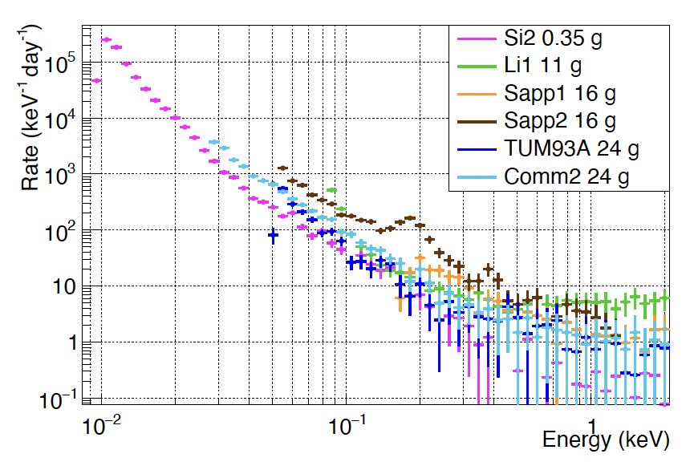
Mysterious Low Energy Excess
CRESSTIII Background Studies
CRESST III
2207.09375
Si 0.35g
LiAlO₂ 11g
Al₂O₃ 16g
Al₂O₃ 16g
CaWO₄ 24g
CaWO₄ 24g
?
Expected Radiogenic Backgrounds
Seen in all calorimeter experiments to varying degree

Slide 10
Light Mass DM: Detector Design Drivers
1. Energy Sensitivity
2. Detector
Backgrounds
Typical Neutrino cross section
2203.08297

Slide 11
Superconducting Athermal Phonon Detectors
2410.16510: you can read today … a bit out of date☺
Most plots shown are coming from our newest athermal phonon pixel detector paper. Going up on arXiv next week!

Slide 12
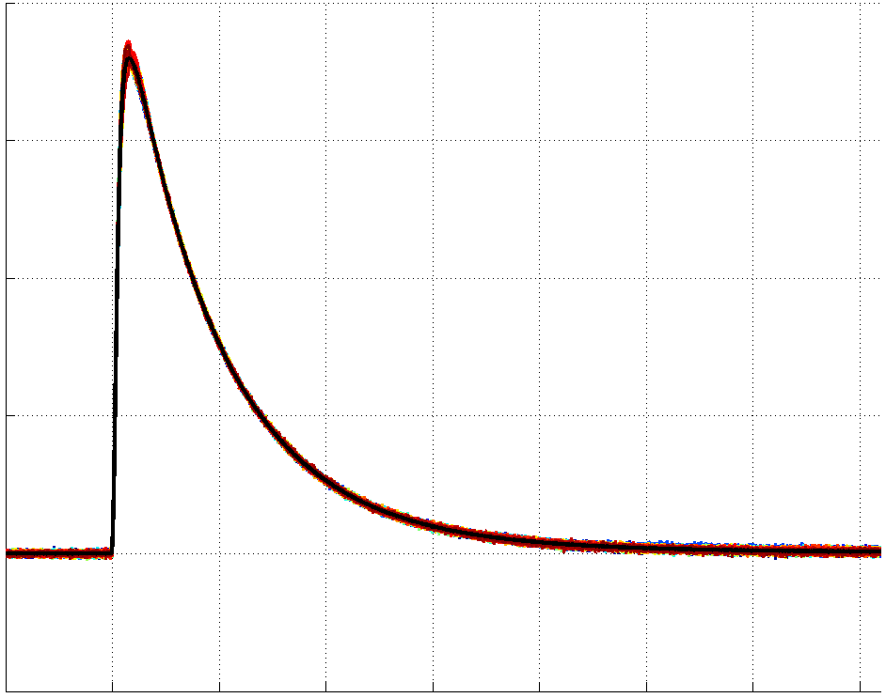
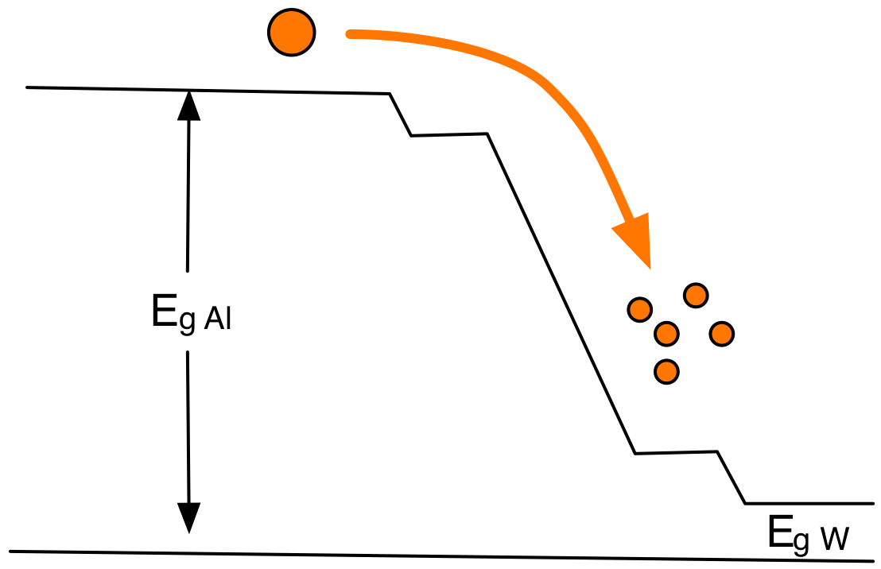
Athermal Phonon Detectors
TES (W or IrPt)
Athermal Phonon
Collection Fins (Al)
Substrate (Si,Ge,GaAs,SiO₂,Al₂O₃)
R
T
1 cm
1 cm

Slide 13
Measured Phonon Collection Efficiency
1cm²x1mm Silicon 1% coverage
Phonon detectors optimized for maximum phonon collection / energy sensitivity
Single Photon Sensitivity!
Easy to Calibrate with IR/Optical Photons

Slide 14
Unexplained Low Energy Excess (LEE) Background(s)

Slide 15
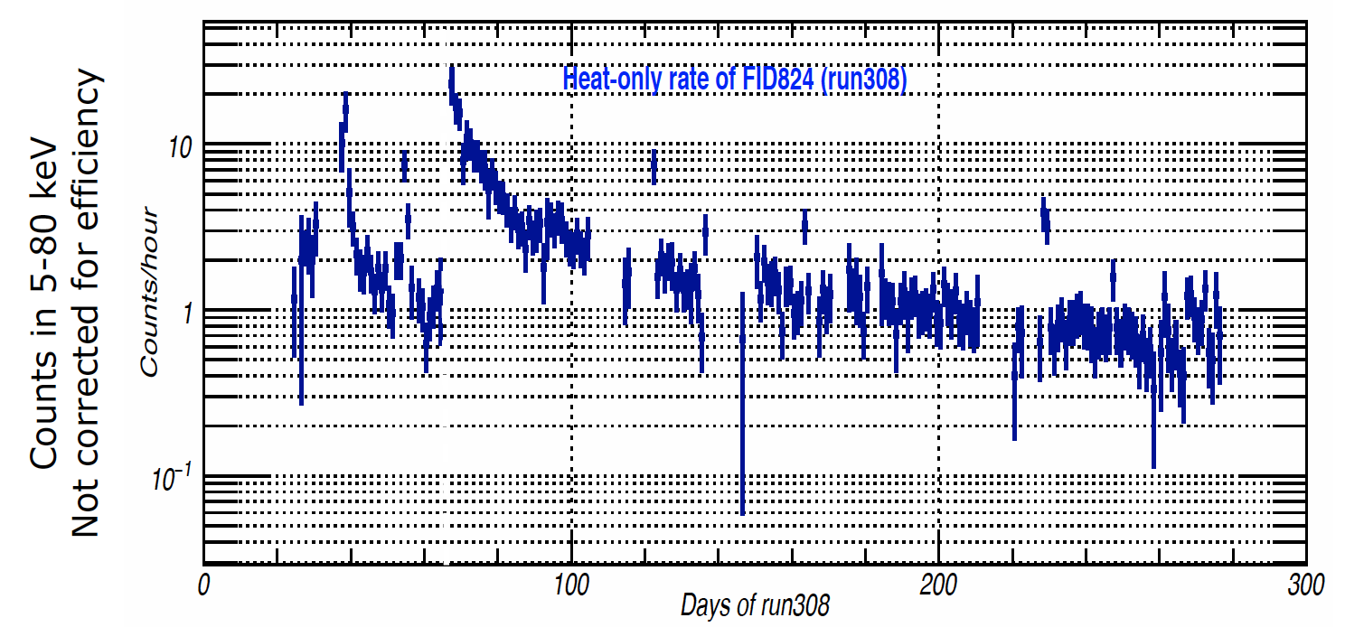
1. Variation with time since cooldown
EDELWEISS/RICOCHET
Ge, epoxy, Au
Warm up to 11K and 19K due to fridge issues
E. Queguiner
Thesis
Rate partially reset with thermal cycling
2 distinctive decay time constants

Slide 16
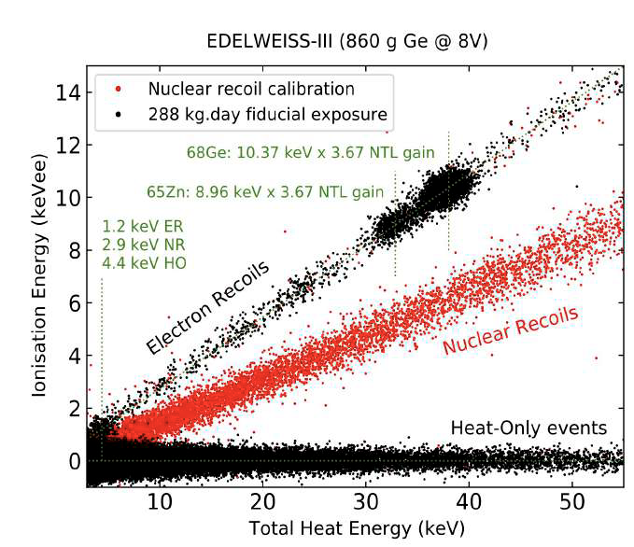
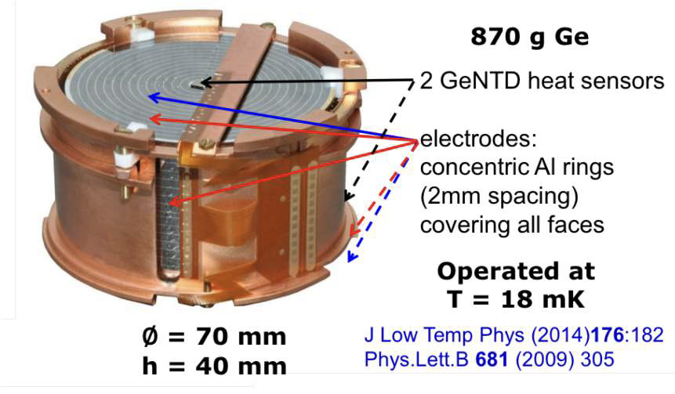
2) Low Energy Excess is Non-Ionizing
Ge, NTD,
epoxy, Au
EDELWEISS interleaved detectors measure both phonons (NTD) and ionization production
Large no ionization background of unknown origin out to pretty high energies
From J. Gascon /EDELWEISS

Slide 17
Low Energy Excess Fact Summary
 | SPICE/CDMS | EDELWEISS | CRESST
1) Variation with time since cooldown (and/or time since fabrication) | Yes | Yes | Yes
2) Non-Ionizing | Yes | Yes
3) Same above /below ground | In 10-80eV range | mostly
These facts are incredibly restrictive!

Slide 18
Stress Relaxation?
Detector
Detector
Detector under stress due to thermal contraction,manufacturing, etc.
Detector relaxes releasing phonon energy
arXiv:physics/0504151

Slide 19
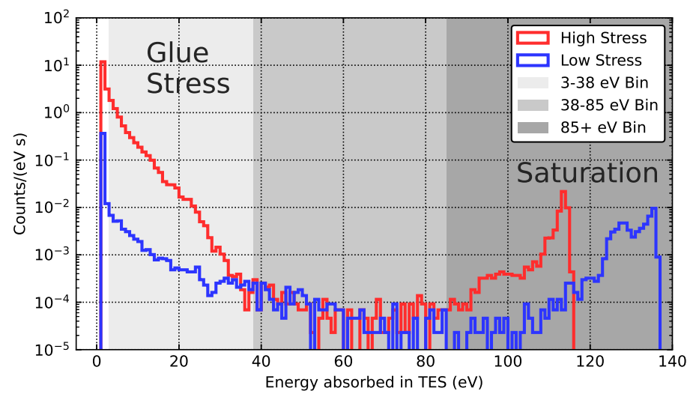
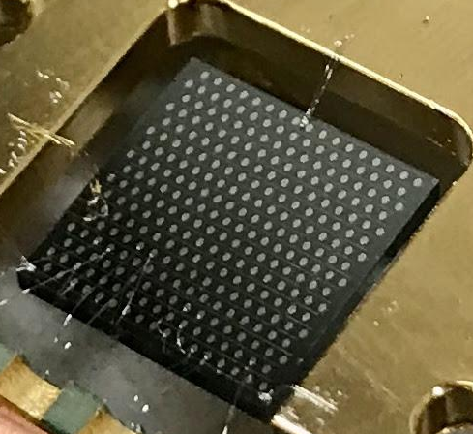
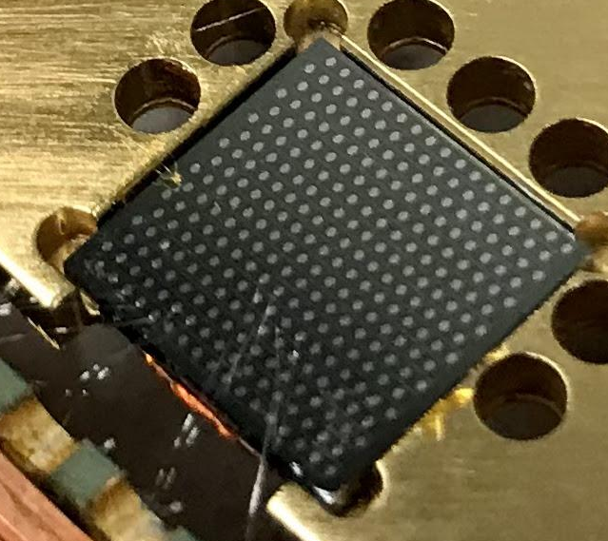
Stress Related Relaxation:
1st Low Energy Evidence
2208.02790
Hanging (low stress)
2 orders of magnitude difference in rate between high stress (glued) and low stress (hanging) device
Glued Down with GE varnish
(High Stress)
GE varnish (and rubber cement) significantly increase <38eV backgrounds

Slide 20
Mitigation for Stress Relaxation Events:
GET RID OF ALL STRESS
Support Structure
Sensor Films
Crystal Surface Relaxation
Bulk dislocation(s) relaxation

Slide 21
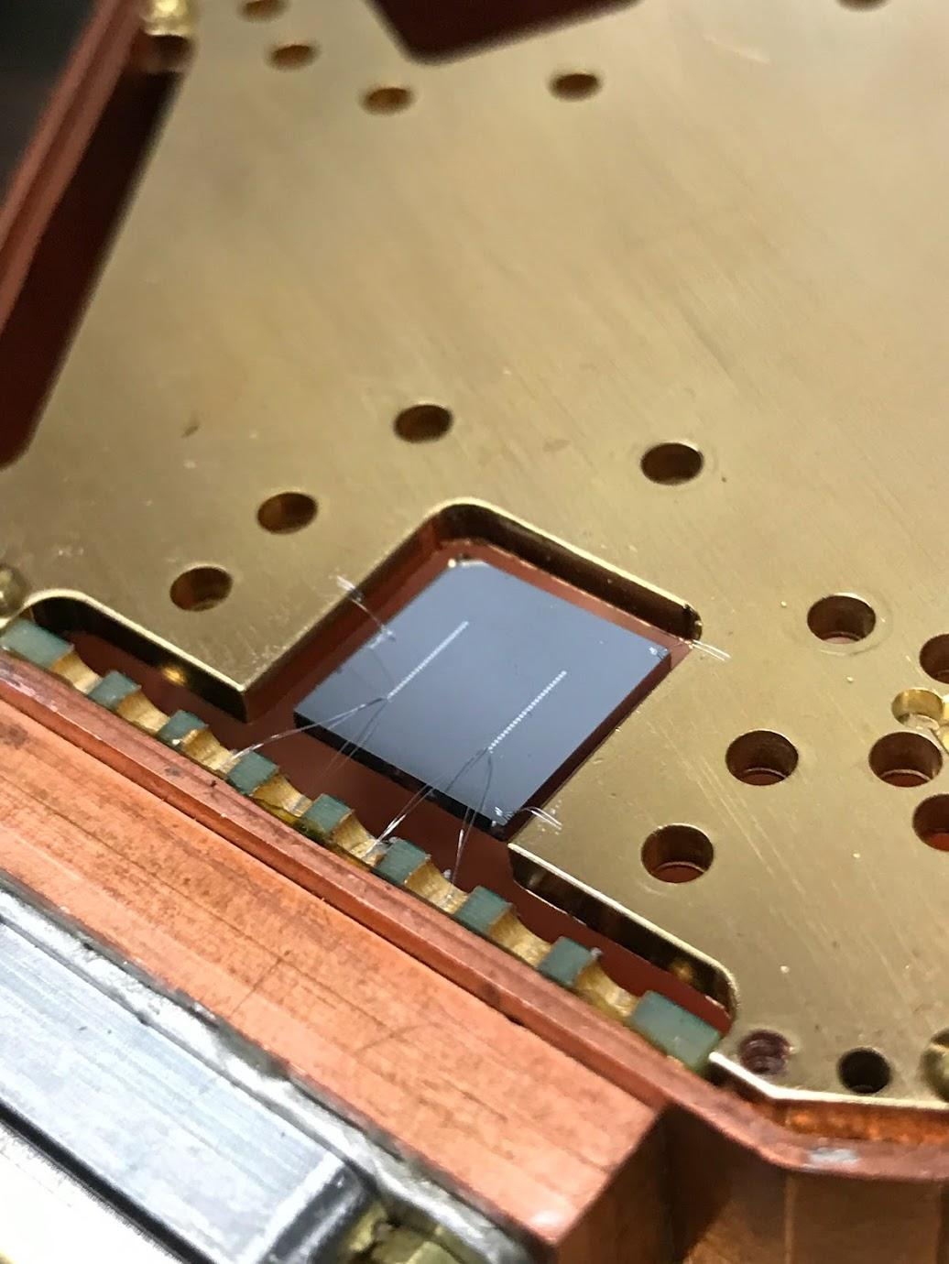
Understanding Relaxation Events: 2 Channel Devices
1% 2 Channel Device
We see both shared and single channel relaxation events

Slide 22
Single Events in Photon Calibration too
Calibration photons have single and shared events too!
Shared = substrate absorption
Singles = Al fin absorption
1 Al fin photon + 3 substrate photons

Slide 23
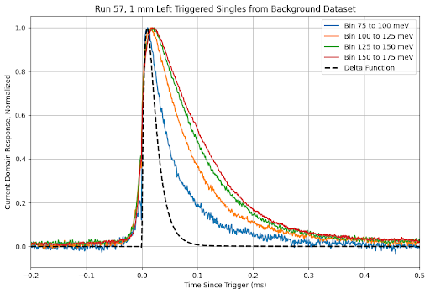
Single Relaxation Event Pulse Shape
LEE single pulse shapes and Al fin calibrations photons have pulse shapes consistent with a dirac delta energy pulse that saturates a single phonon sensor in the channel
As LEE energy drops, pulse shape looks more like a dirac-delta energy deposition (known from dIdV)
Single LEE background source is Al film relaxation!

Slide 24
Source Shared LEE Relaxation?
Substrate Volume?
Dicing Saw Sidewall Surface?
Polished z face?
Wirebond support interface?
Test hypotheses with different substrate geometries

Slide 25
Shared LEE Rates
76mm diameter x1mm thick
First Evidence that LEE seems to scale largely with substrate mass/volume not surface area …

Slide 26
Tension with CRESST Measurements?
CRESSTIII Background Studies
2207.09375
Si 0.35g
LiAlO₂ 11g
Al₂O₃ 16g
Al₂O₃ 16g
CaWO₄ 24g
CaWO₄ 24g

Slide 27
Energy Sensitivity

Slide 28
Current Performance: Sensitivity
On Day 12, Phonon baseline energy resolution is 259meV_{rms}
  World leading by x4
Sensitivity continues to improve pretty rapidly with time cold. @40days, we expect 180meV_{rms} !

Slide 29
Measured Noise
Excess nominated splits into 2 pieces:
- Correlated noise whose pulse shape -> shot noise from substrate phonon events
- Uncorrelated white power noise -> shot noise from localized sensor events

Slide 30
Light Mass DM LEE Design Driver
LEE Mitigation
Typical Neutrino cross section
2203.08297

Slide 31
Low Energy Excess Discrimination

Slide 32
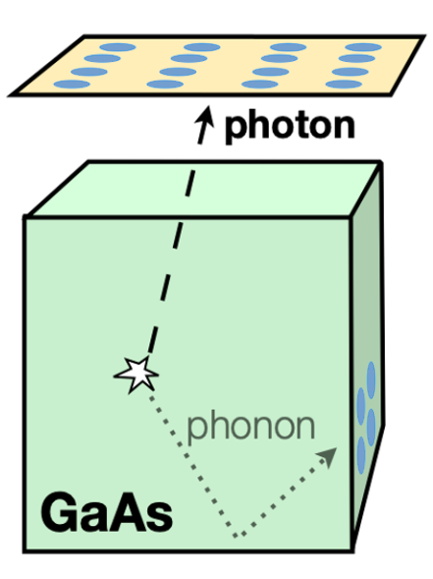
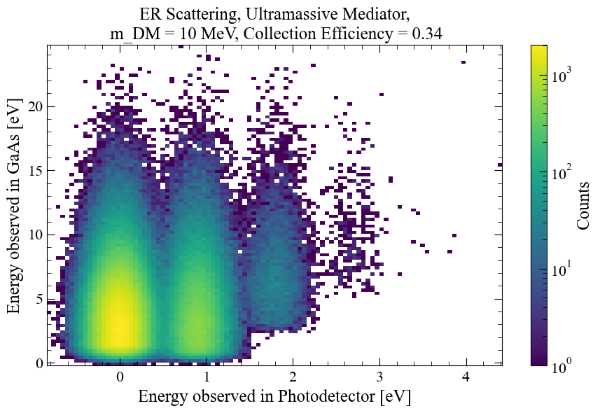
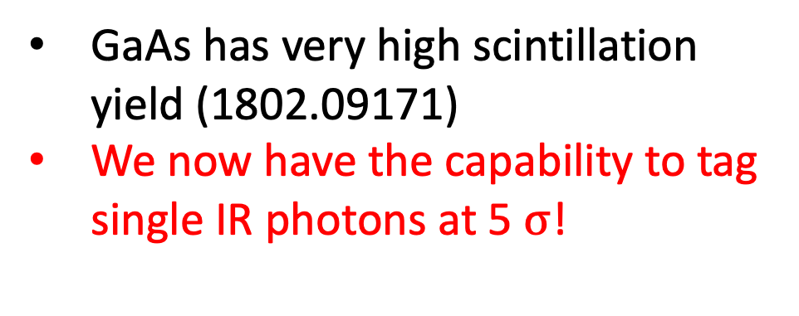
GaAs
GaAs has very high scintillation yield (1802.09171)
We now have the capability to tag single IR photons at 5 $σ$!
ER DM and NR DM interactions can be distinguished from non-ionizing LEE Backgrounds!

Slide 33
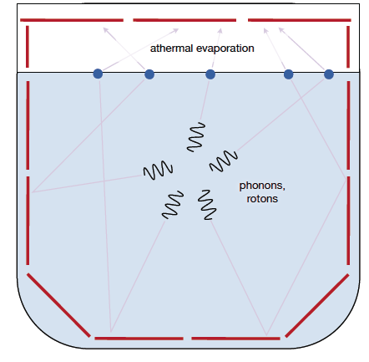
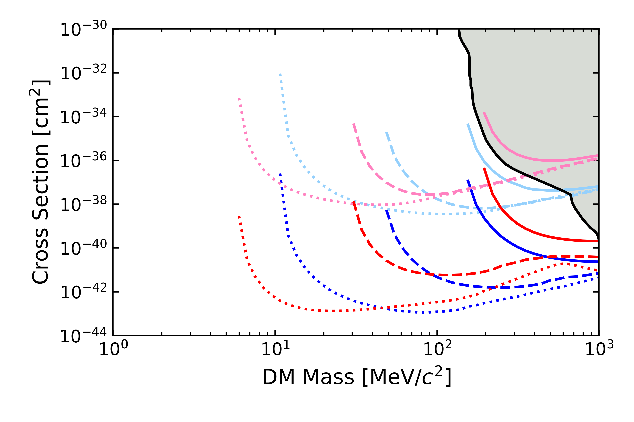
Superfluid Helium: it’s a liquid … no stress microfractures
Multiple Pixel Coincidence for He DM events discriminates DM from pixel microfractures
Pulse Shape Discrimination: Helium is slow!
Al₂O₃
He
Surface
Required
Goal
Stretch
Goal
Underground

Slide 34
Light Mass DM LEE Design Driver
LEE Mitigation
Huge Progress
Discrimination
GaAs Single IR Sensitivity
Typical Neutrino cross section
2203.08297

Slide 35
Backup

Slide 36
The TES Challenge: Environmental Noise
Lowering T_{c} and decreasing V_{tes,} doesn’t just increase sensitivity to DM, it drastically increases sensitivity to all environmental power sources
To increase your sensitivity by x10, you need to decrease your susceptibility to environmental DC backgrounds by x100!

Slide 37
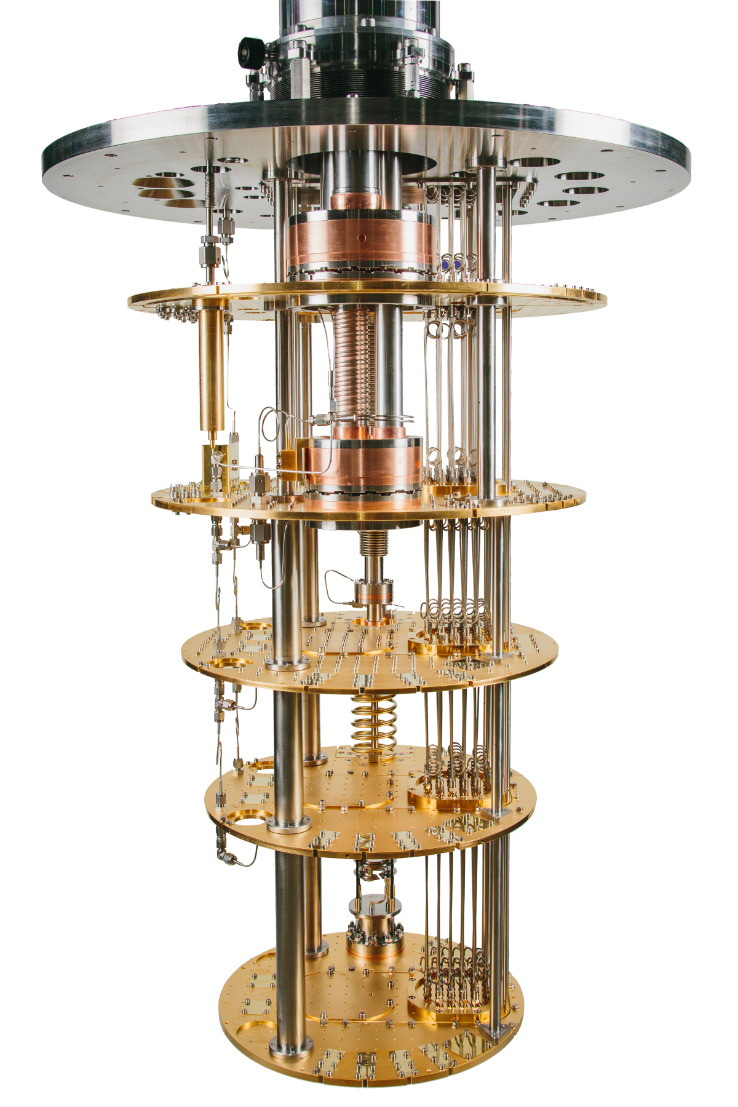
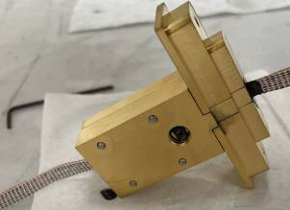
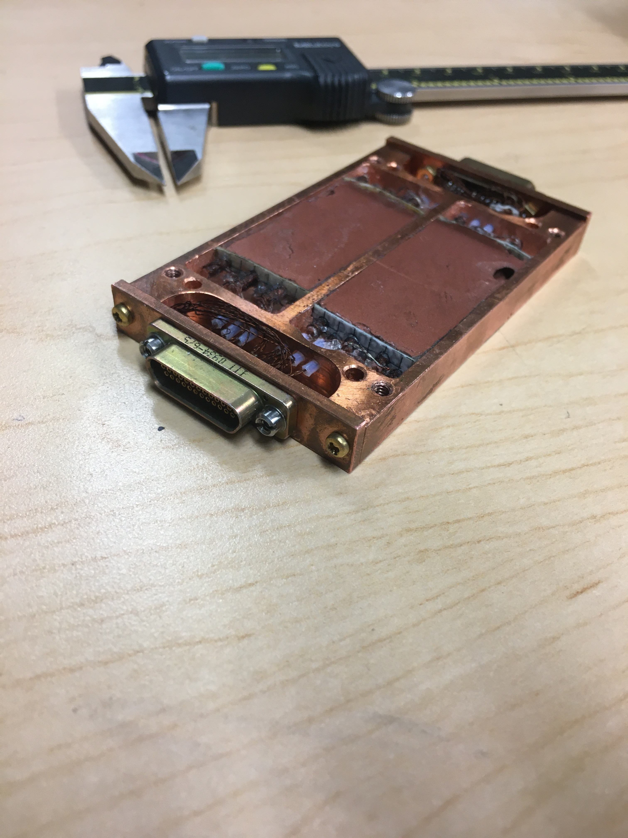
External EMI suppression
300K
Russian Doll of Faraday Cages
3.2 MHz Pi, conductive gaskets at 300K
Wire heatsinks feedthroughs encase twisted pairs in ”coppercast” for > O(10GHz) filtering
  Martinis, Devoret, Clarke (PRB 35.4682 1987)
Tested with external 900MHz modulated @200Hz source … Nothing
50K
4K
750mK
SQUIDS
John Clarke’s Lab
10mK

Slide 38
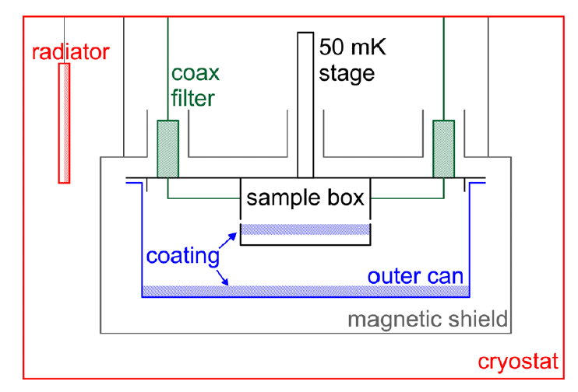
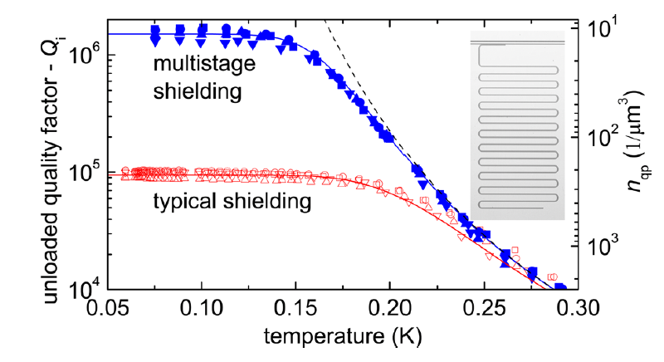
Black Body IR: QUBITs Decoherence & Resonator Losses
Black Body Radiation emitted from higher temperature thermal cans leaks through a single 10mK thermal shield and dominate the loss mechanisms in resonators and QUBITs (R. Barends et al 1105.4642,Baselmans et al, AIP 1185 2009)
1105.4642
Box + mm Absorber (eccosorb or coppercast) + Box minimizes IR transmission
How do the photons get in? Why isn’t a single light tight box enough?
1105.4642
Notes:
Martinis paper 1105.4642

Slide 39
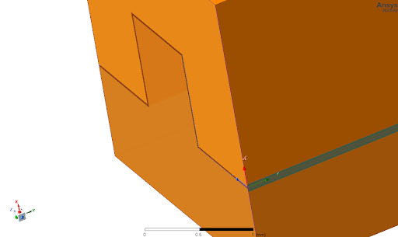
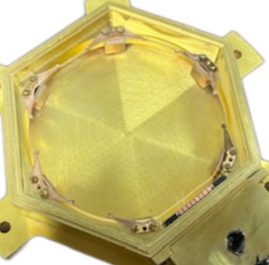
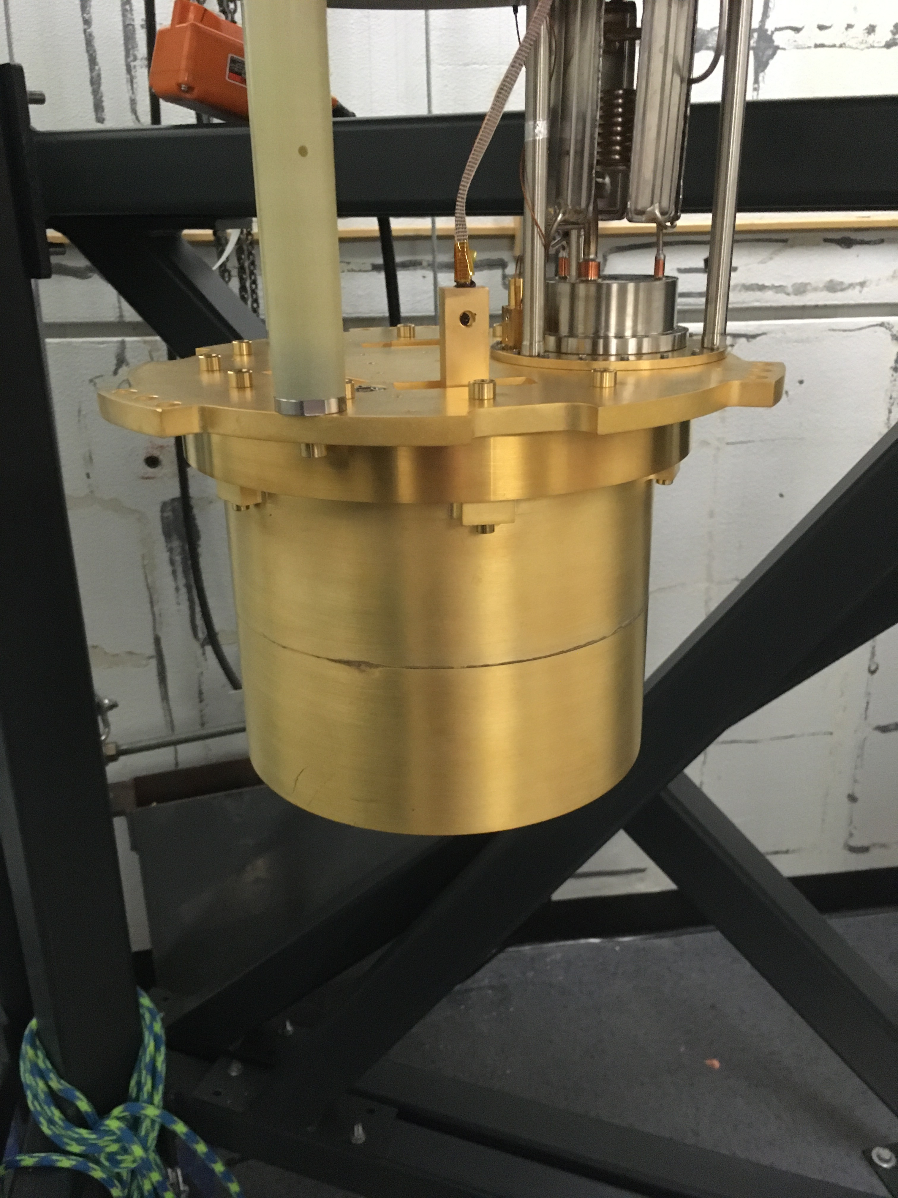
4 Photon Bend Flanges
Original Plan: With a “4 photon bend” flange, we won’t need a copper cast absorber!
Backup: slather on some coppercast
Inner Can
Outer Can
Coppercast Feedthrough

Slide 40
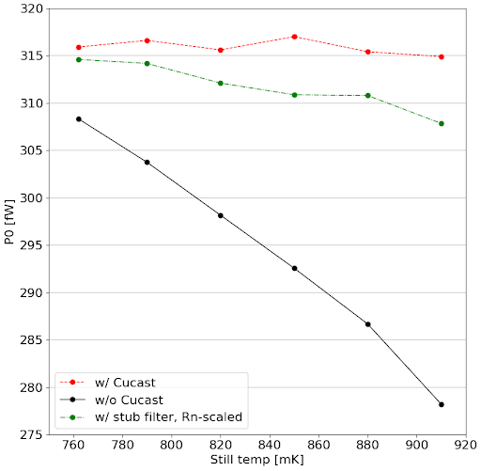
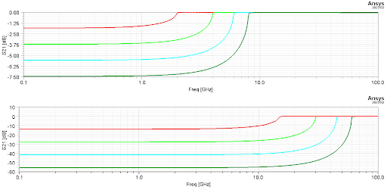
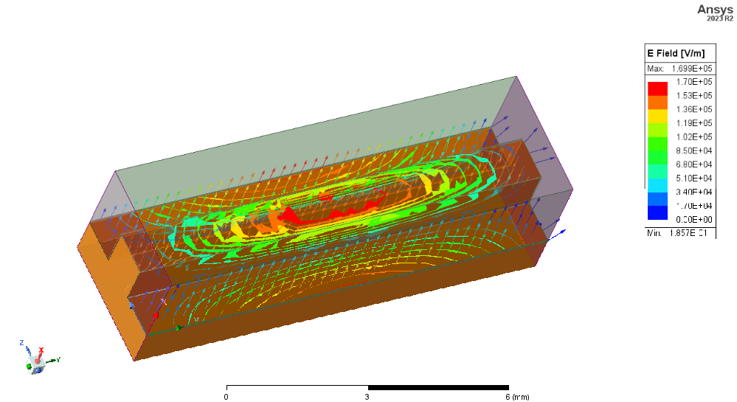
Black Body Leakage Through Flange
4 photon bend double box (no absorber) had 30fW of ~1K IR leakage!
Adding coppercast absorber dropped it to unmeasureable levels (Martinis was right)
How: HFSS simulations suggest 4 photon bend completely transparent above TE cutoff!
TES Bias Power [fW]
Publishing Soon!
Still Temperature [mK]

Slide 41
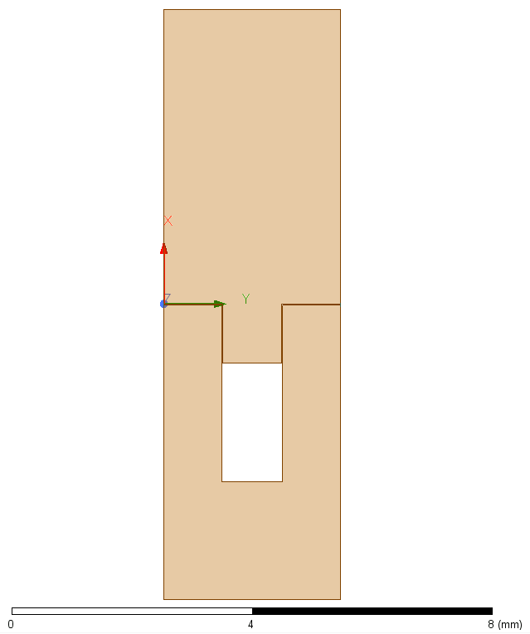
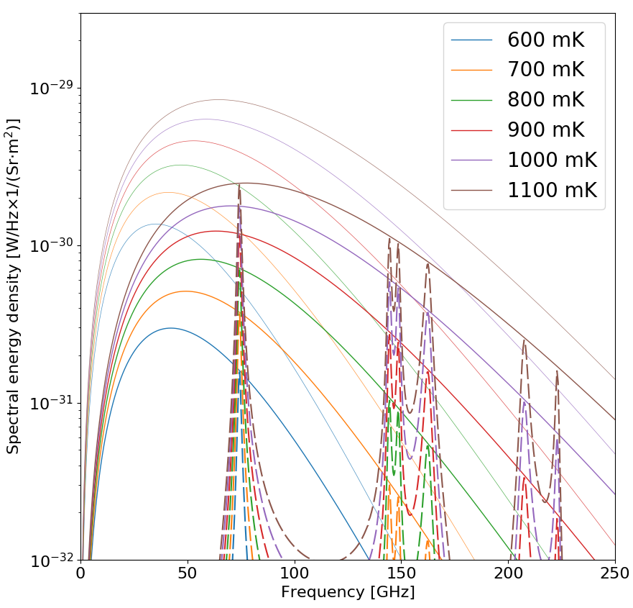
Impedance Mismatch Flange
Modify the 4 photon bend to have a mismatched optical cavity
2mm
Publishing Soon!
TES Bias Power [fW]
~ x6 decrease in IR absorption compared to
Standard flange (no absorber)
~ x10 expected from HFSS
Still Temperature [mK]

Slide 42
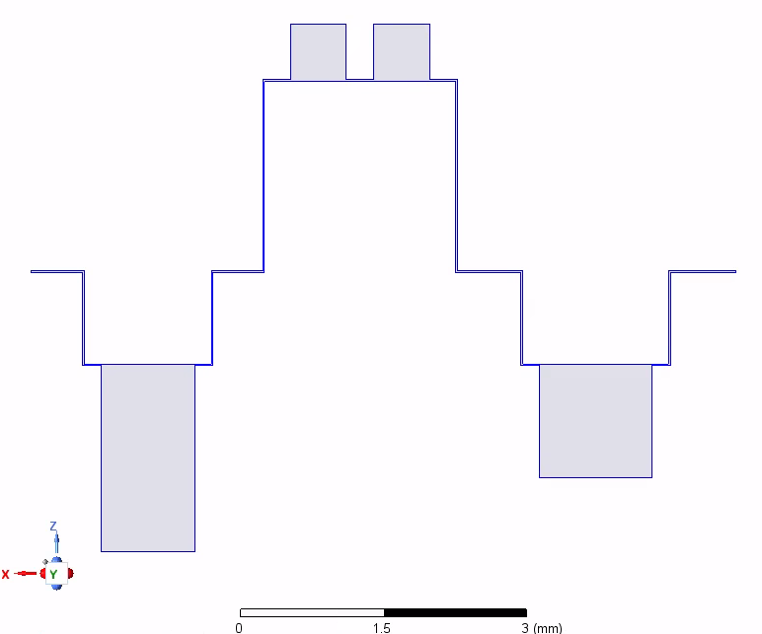
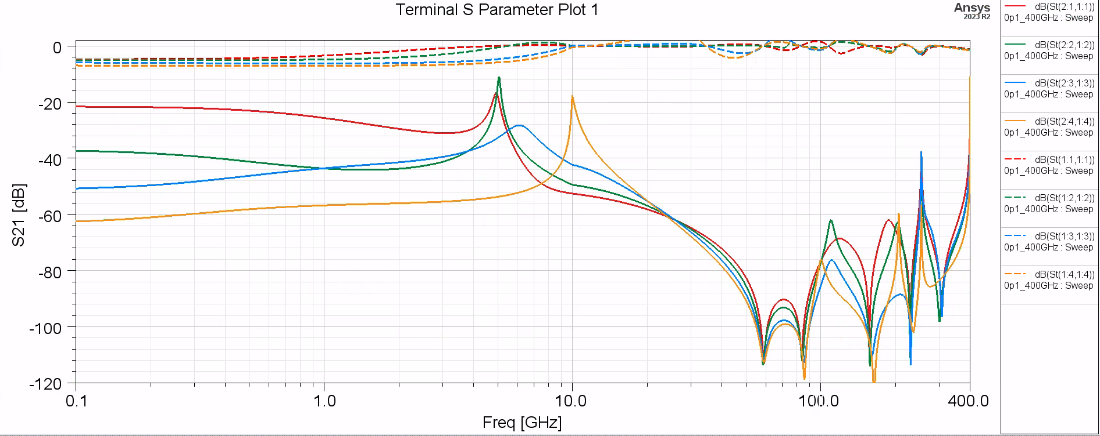
Future: Multiple Impedance Mismatched Cavities
Create a flange with multiple (2-3) impedance mismatched cavities with offset resonances
>-40dB suppression
Significant suppression even at low frequencies

Slide 43
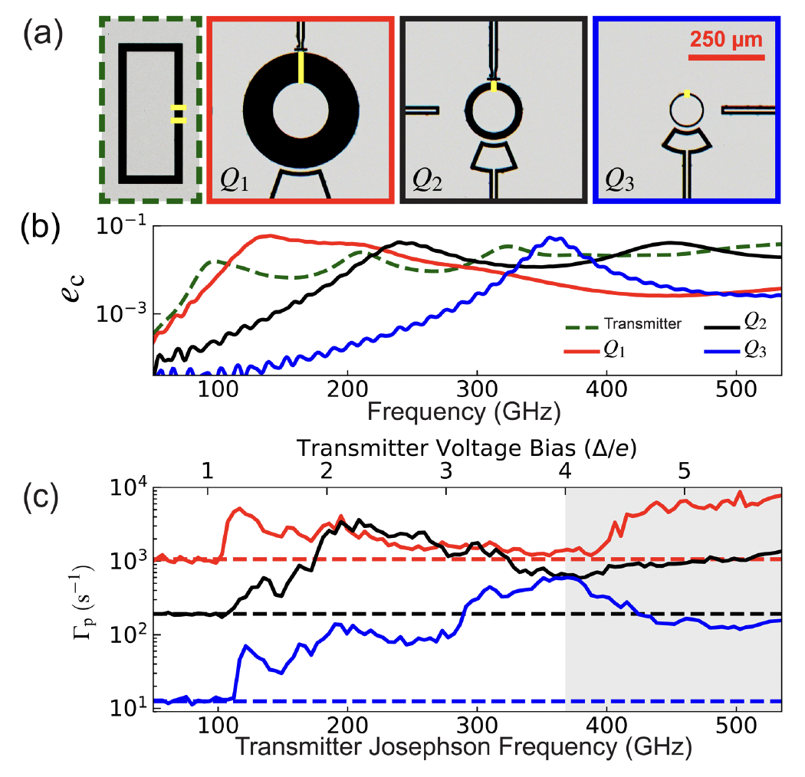
Environmental IR still dominate
Liu et al (2203.06577) finds that their residual charge parity switching rate varies enormously with the geometry of the charge island
Propose this is due to coupling of environmental photons in the 100GHz to THz
Mismatched flange could significantly improve background rates!

Slide 44
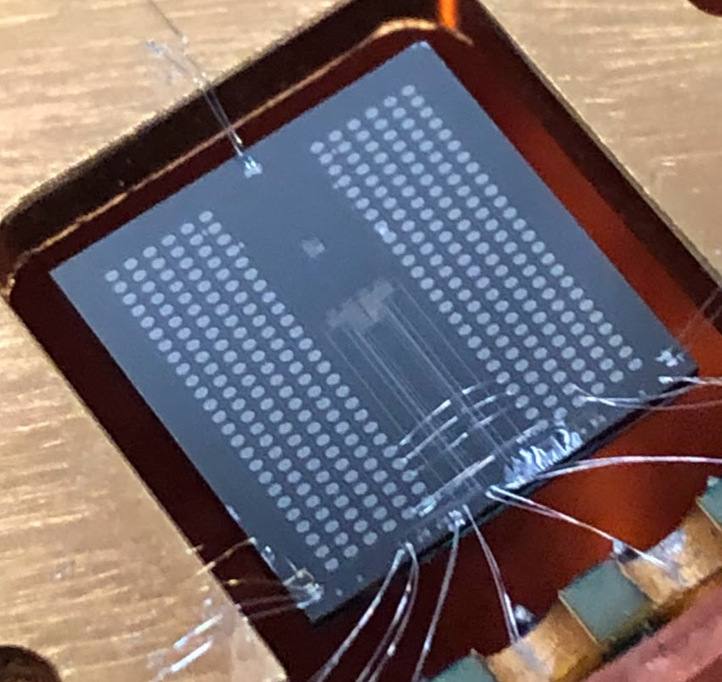
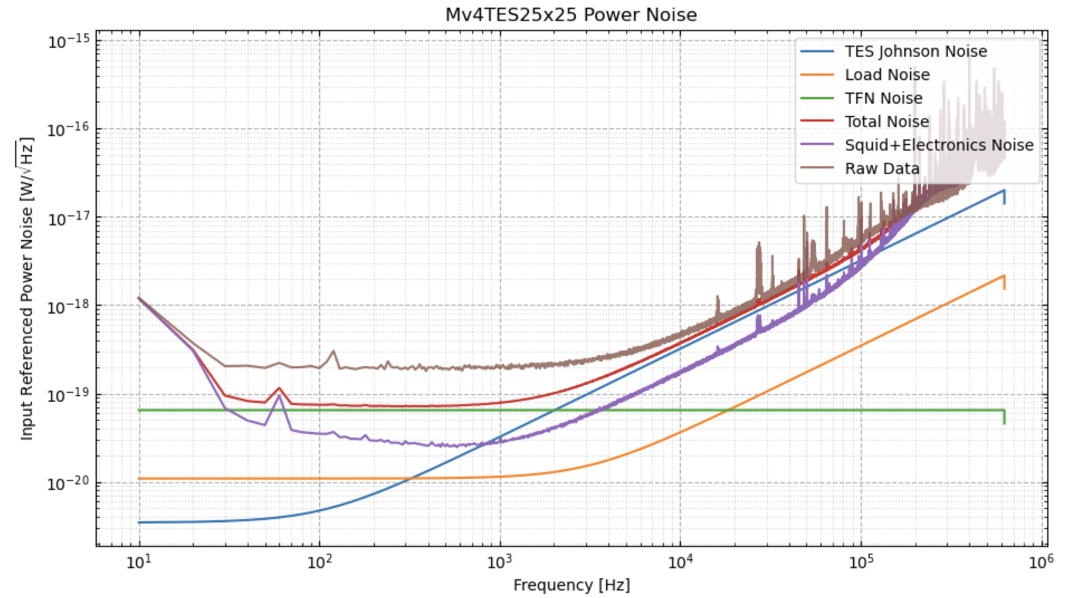
Current TES Sensitivity
1cm2x1mm Si chip with
  4% athermal phonon detector with
  25umx25umx60nm W TES
  25umx100umx60nm W TES
  200xumx800umx60nm W TES
Thicker TES used to maximize photon collection in TES electronic system
Tc = 50mK
Sensitivity limited by 2x10¹⁹ W/rtHz of unknown origin
  Doesn’t scale with TES size
100% collection … expect 7meV_{rms} sensitivity
Publishing Soon

Slide 45
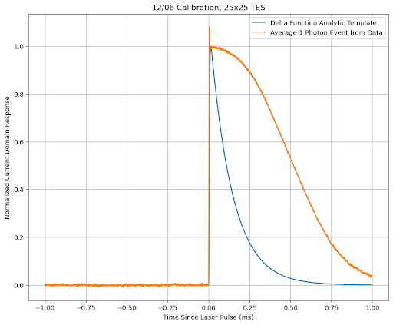
Future: IR calibration
450nm (2.75eV) photons badly saturate the 25umx25umx60nm TES
need IR photons to linearly calibrate
Can piece together collection efficiencies from the 200x800 and 100x400 devices and we can get 8-12meV rms

