Slide 1
What is the Geometry of Effective Field Theories?
Zhengkang "Kevin" Zhang (University of Utah)
PIKIMO 17, University of Michigan, Nov 16, 2024

Slide 2

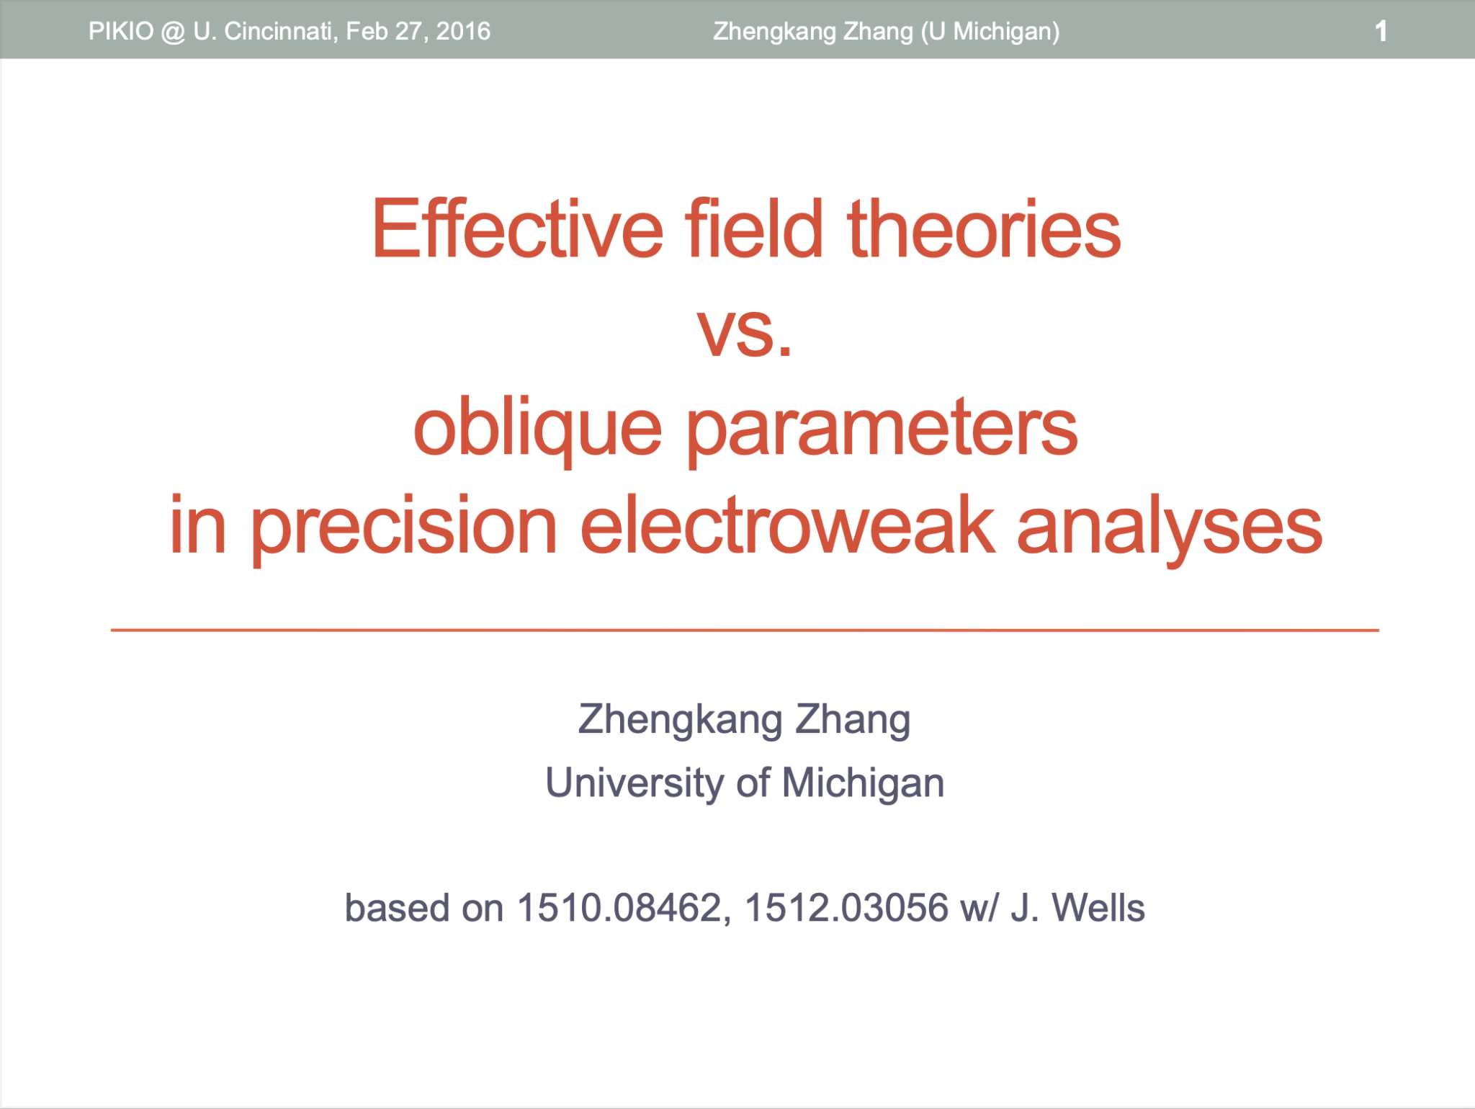



Slide 3

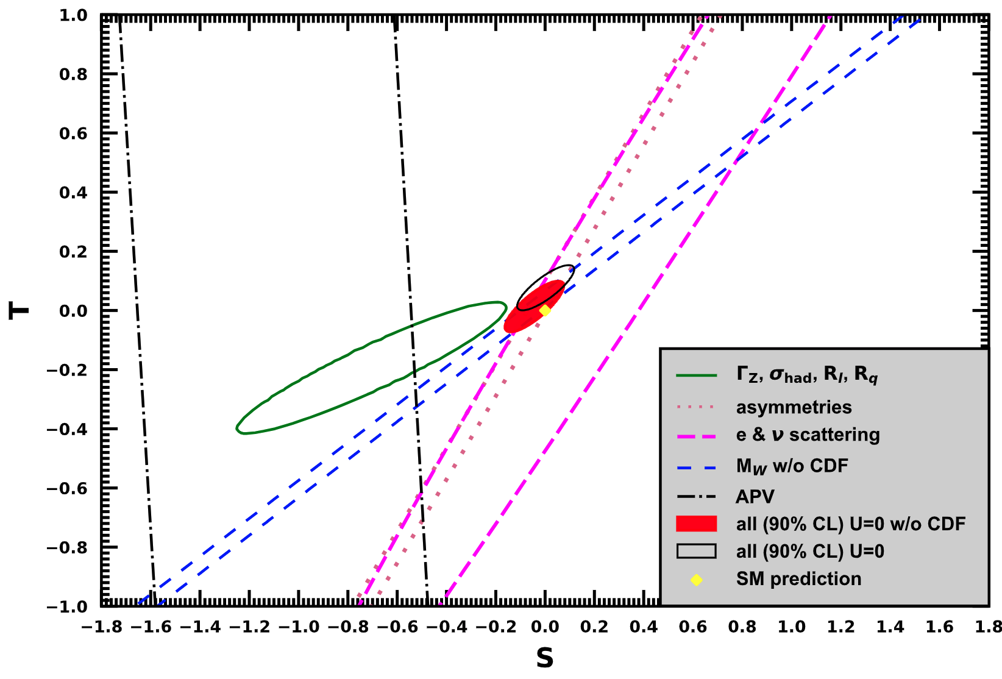

Oblique parameters
Prototype of modern EFT analyses of precision data.
Precision $⇒$ virtual effects of BSM physics.
[Particle Data Group]

Slide 4
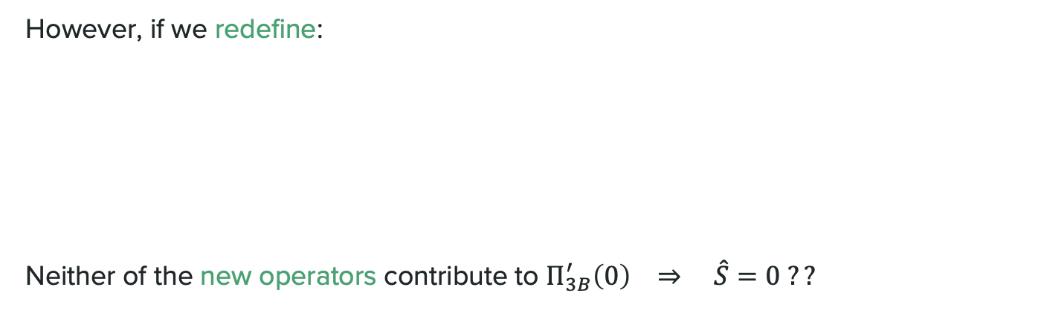
Let’s look at a simple example…
EOM:
However, if we redefine:
Neither of the new operators contribute to $Π_{3B}^{′}\left(0\right) ⇒ \hat{S}=0 ??$

Slide 5
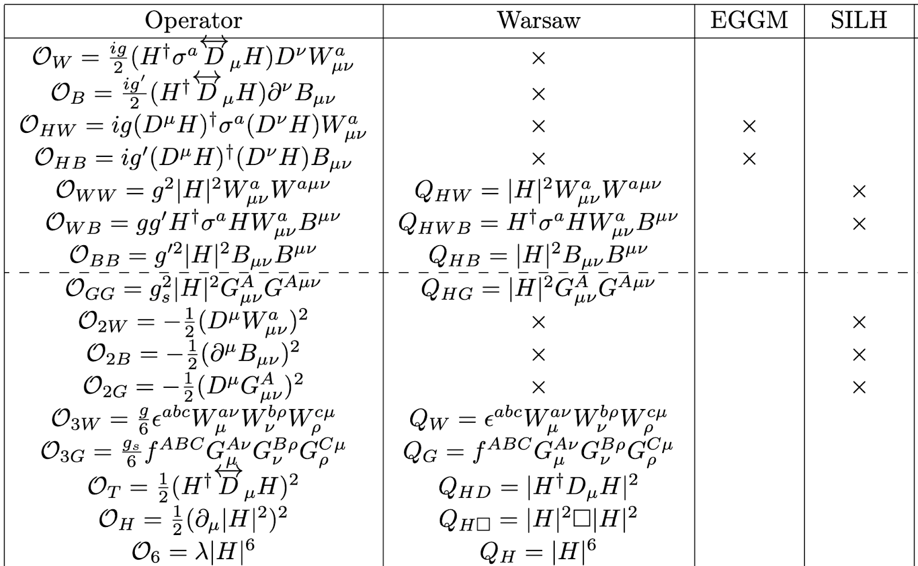
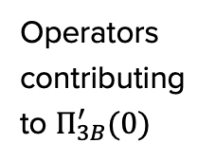
In an EFT, field redefinitions relate different operator bases
Operators contributing to $Π_{3B}^{′}(0)$
SILH basis
Warsaw basis

Slide 6
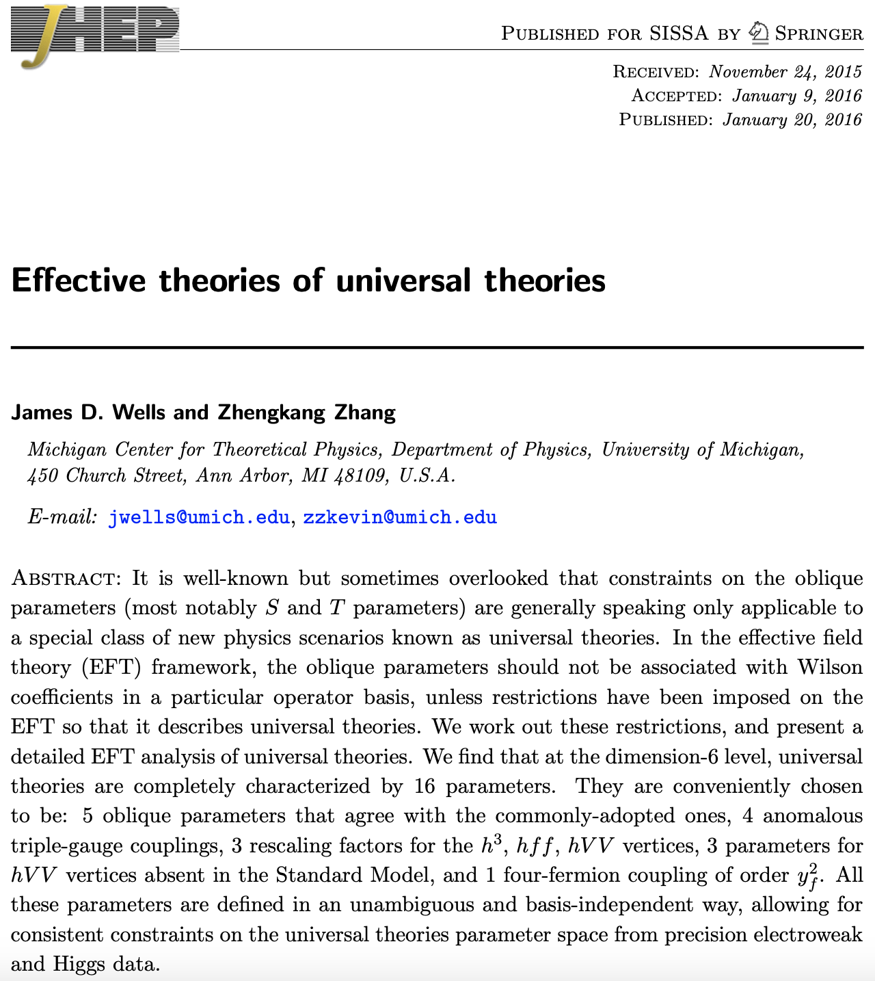

Slide 7
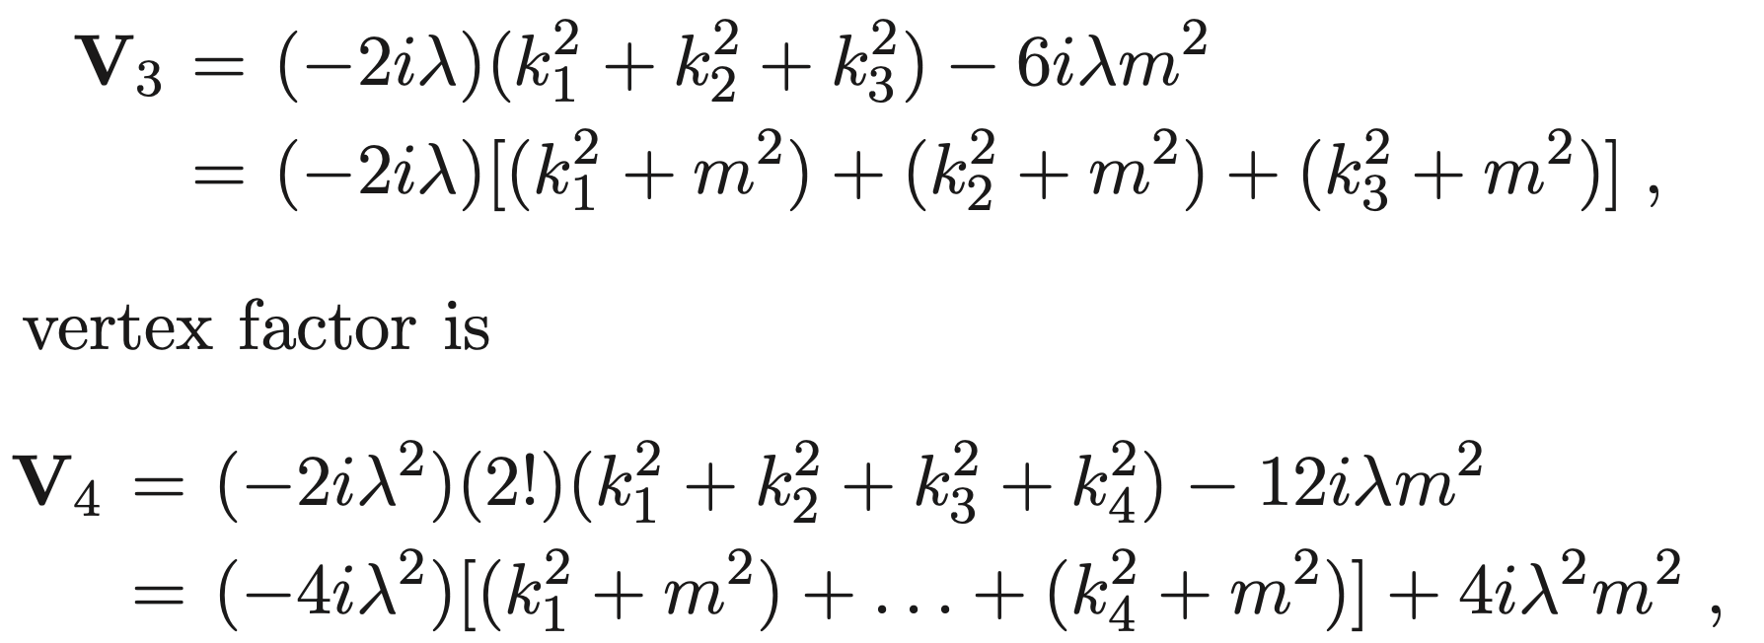
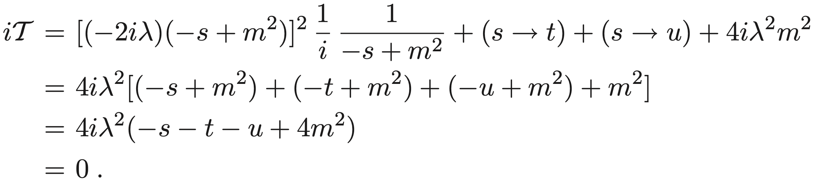

Theory parameters depend on the basis…
Physical observables don’t.
A QFT homework example [Srednicki] :
But this is in fact a free theory:
$φφ→φφ$ amplitude:

Slide 8
(Lagrangian formulation of) QFT has a huge amount of redundancy.
Not unique to QFT – true for any theory where we have to pick a coordinate system to calculate the physics.
A classical mechanics example: 2D harmonic oscillator.
We know this as a “coordinate transformation.”

Slide 9
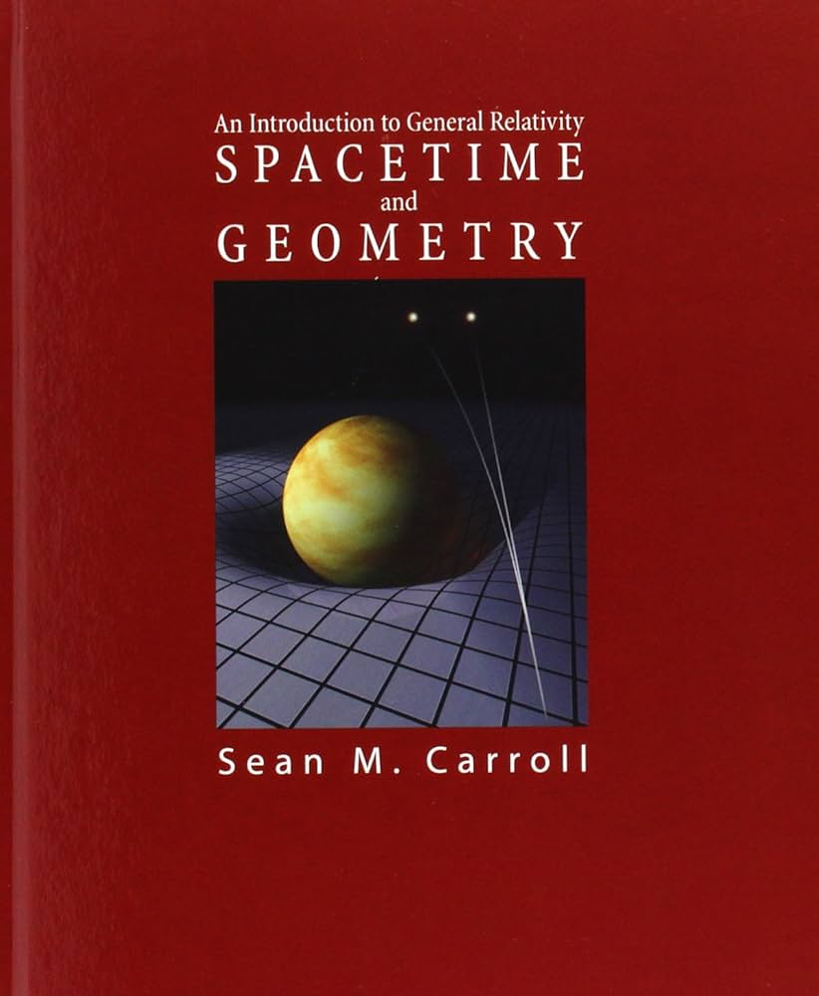
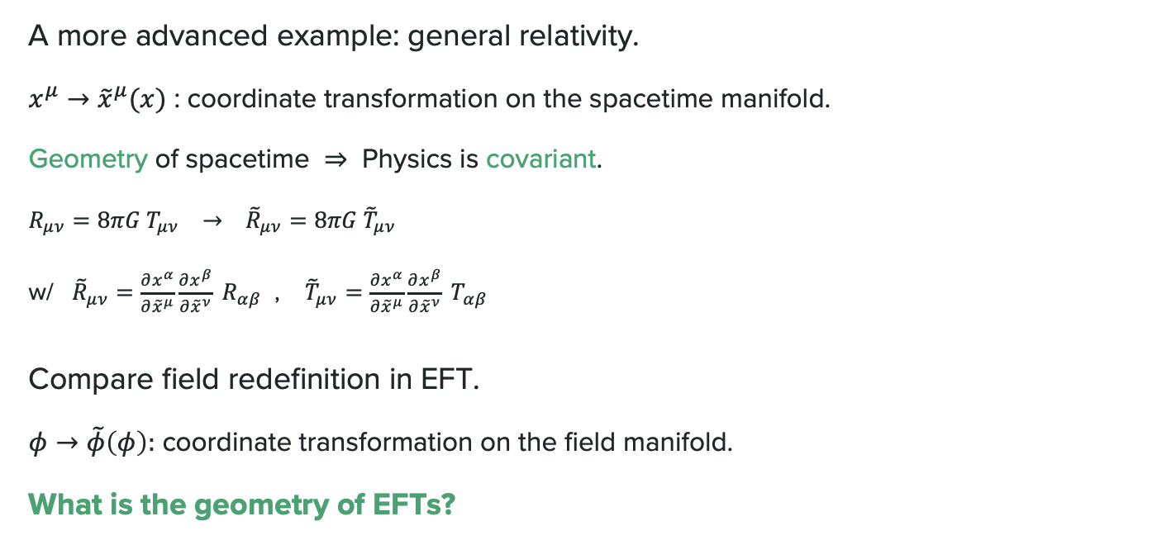
A more advanced example: general relativity.
$x^{μ}→{\tilde{x}}^{μ}(x)$ : coordinate transformation on the spacetime manifold.
Geometry of spacetime $⇒$ Physics is covariant.
$R_{μν}=8πG T_{μν} → {\tilde{R}}_{μν}=8πG {\tilde{T}}_{μν}$
w/ ${\tilde{R}}_{μν}=\frac{∂x^{α}}{∂{\tilde{x}}^{μ}}\frac{∂x^{β}}{∂{\tilde{x}}^{ν}} R_{αβ}$ , ${\tilde{T}}_{μν}=\frac{∂x^{α}}{∂{\tilde{x}}^{μ}}\frac{∂x^{β}}{∂{\tilde{x}}^{ν}} T_{αβ}$
Compare field redefinition in EFT.
$φ→\tilde{φ}\left(φ\right):$ coordinate transformation on the field manifold.
What is the geometry of EFTs?

Slide 10

Outline
$φ→\tilde{φ}=f(φ)$ : field space geometry.
$φ→\tilde{φ}=f\left(φ, ∂_{μ}φ, ∂_{μ}∂_{ν}φ, …\right)=F[φ]$ : functional geometry.*
Thoughts (and dreams).
* There is also a complementary approach to accommodate derivative field redefinitions utilizing Lagrange geometry and jet bundles: [Craig, Lee, Lu, Sutherland, 2305.09722] [Craig, Lee, 2307.15742] [Alminawi, Brivio, Davighi, 2308.00017] [Lee, 2410.21395].

Slide 11
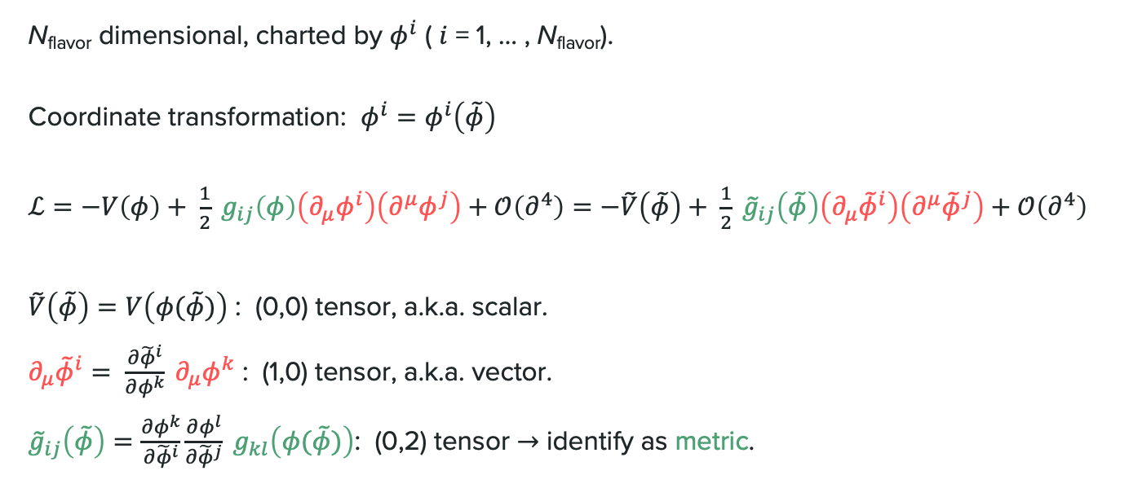
Field manifold
[(Callan,) Coleman, Wess, Zumino] [Honerkamp] [Volkov] [Tataru] [Alvarez-Gaume, Freedman(, Mukhi)] [Vilkovisky] [DeWitt] [Gaillard] [Georgi]
[Alonso, Jenkins, Manohar, 1511.00724 + 1605.03602]
N_{flavor} dimensional, charted by $φ^{i}$ ( $i$ = 1, … , N_{flavor}).
Coordinate transformation: $φ^{i}=φ^{i}\left(\tilde{φ}\right)$
$ℒ=−V\left(φ\right)+ \frac{1}{2} g_{ij}\left(φ\right)\left(∂_{μ}φ^{i}\right)\left(∂^{μ}φ^{j}\right)+𝒪\left(∂^{4}\right)=−\tilde{V}\left(\tilde{φ}\right)+ \frac{1}{2} {\tilde{g}}_{ij}\left(\tilde{φ}\right)\left(∂_{μ}{\tilde{φ}}^{i}\right)\left(∂^{μ}{\tilde{φ}}^{j}\right)+𝒪\left(∂^{4}\right)$
$\tilde{V}\left(\tilde{φ}\right)=V\left(φ(\tilde{φ})\right)$ : (0,0) tensor, a.k.a. scalar.
$∂_{μ}{\tilde{φ}}^{i}= \frac{∂{\tilde{φ}}^{i}}{∂φ^{k}} ∂_{μ}φ^{k}$ : (1,0) tensor, a.k.a. vector.
${\tilde{g}}_{ij}\left(\tilde{φ}\right)=\frac{∂φ^{k}}{∂{\tilde{φ}}^{i}}\frac{∂φ^{l}}{∂{\tilde{φ}}^{j}} g_{kl}\left(φ(\tilde{φ})\right)$: (0,2) tensor $→$ identify as metric.

Slide 12
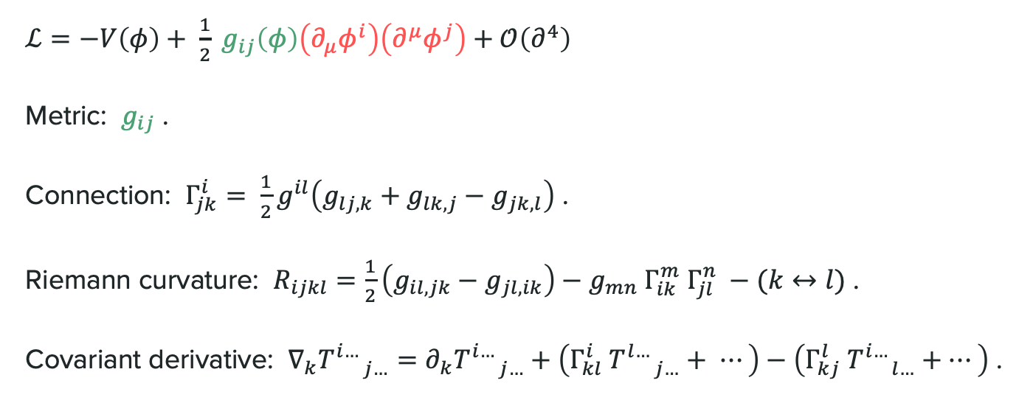
Riemannian geometry on the field manifold
$ℒ=−V\left(φ\right)+ \frac{1}{2} g_{ij}\left(φ\right)\left(∂_{μ}φ^{i}\right)\left(∂^{μ}φ^{j}\right)+𝒪\left(∂^{4}\right)$
Metric: $g_{ij}$ .
Connection: $Γ_{jk}^{i}= \frac{1}{2}g^{il}\left(g_{lj,k}+g_{lk,j}−g_{jk,l}\right)$ .
Riemann curvature: $R_{ijkl}=\frac{1}{2}\left(g_{il,jk}−g_{jl,ik}\right)−g_{mn} Γ_{ik}^{m} Γ_{jl}^{n} −(k↔l)$ .
Covariant derivative: $∇_{k}T_{ j…}^{i…}=∂_{k}T_{ j…}^{i…}+\left(Γ_{kl}^{i} T_{ j…}^{l…}+ ⋯\right)−\left(Γ_{kj}^{l} T_{ l…}^{i…}+⋯\right)$ .

Slide 13

Physics is invariant under change of coordinates
On-shell amplitudes = scalar functions of geometric quantities.
[Cohen, Lu, Craig, Sutherland, 2108.03240]
[Cheung, Helset, Parra-Martinez, 2111.03045]
$$⇓$$
standard Feynman rules
( ) = symmetrized
bar = evaluate at physical vacuum (point on field manifold)
vielbeins (wavefunction renormalization factors in LSZ)

Slide 14
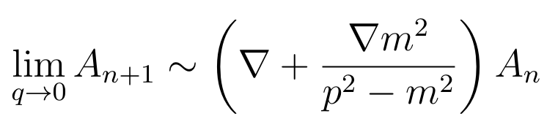
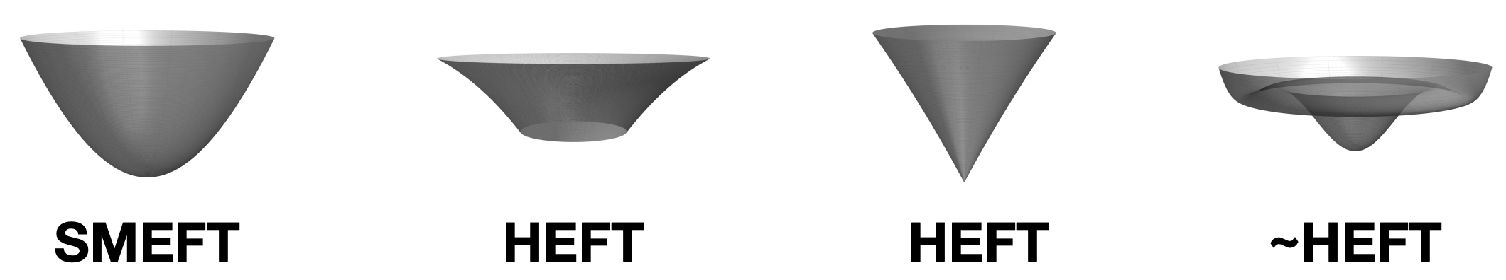

Many applications to theory & pheno
Geometric soft theorems.
Resummation of ${\left(\frac{v^{2}}{Λ^{2}}\right)}^{n}$ effects in SMEFT.
Classification of SM extensions: SMEFT vs. HEFT.
[Cheung, Helset, Parra-Martinez, 2111.03045]
[Helset, Martin, Trott, 2001.01453]
[Cohen, Lu, Craig, Sutherland, 2008.08597]
Figure from N. Craig @ HEFT 2021

Slide 15
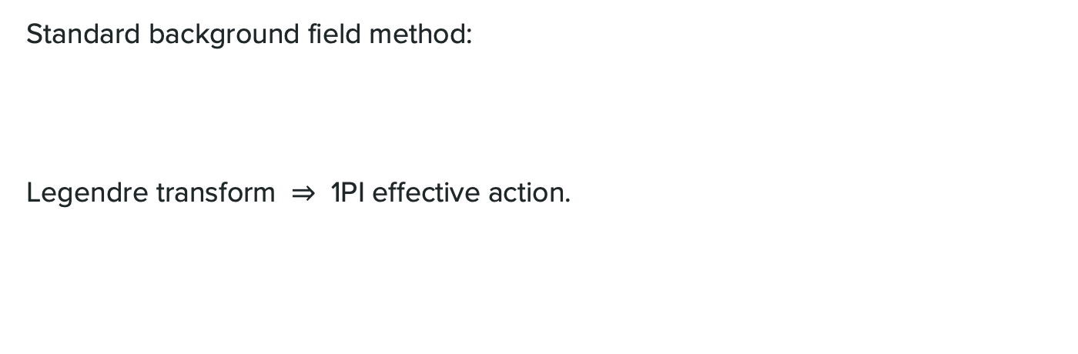
Beyond tree level: effective actions
Standard background field method:
Legendre transform $⇒$ 1PI effective action.
tree
1-loop

Slide 16





Beyond tree level: effective actions
Covariant version:
$⇒$ geometrized 1PI effective action:
geodesic $γ(λ)$
Figure from X.-X. Li @ HEFT 2024

Slide 17

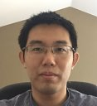

Beyond tree level: effective actions
$\frac{1}{ε_{UV}}$ terms $⇒$ RGE in terms of geometric objects (new insights on selection rules).
+ finite terms $⇒$ matching UV theory to EFT.
[Helset, Jenkins, Manohar, 2212.03253] [Assi, Helset, Manohar, Pagès, Shen, 2307.03187] [Jenkins, Manohar, Naterop, Pagès, 2308.06315 + 2310.19883]
[Li, Lu, ZZ, 2411.04173]
Xu-Xiang Li (U. Utah)
Xiaochuan Lu (UCSD)

Slide 18

Geometrizing EFT matching
$φ^{i}=\{Φ^{A}, φ^{a}\}$ with $M_{Φ}≫m_{φ}$ .
Integrate out a subset of coordinates $\left\{Φ^{A}\right\}$
$⇒$ EFT on the submanifold spanned by $\left\{φ^{a}\right\}$ .
Tree level: EOM.
scalar on EFT submanifold

Slide 19



Geometrizing EFT matching
1-loop level: use covariant derivative expansion (CDE).
[Gaillard] [Chan] [Cheyette] [Henning, Lu, Murayama, 1412.1837]
$∼$ intrinsic curvature of EFT submanifold
$∼$ (potential + intrinsic curvature)
$∼$ extrinsic curvature

Slide 20
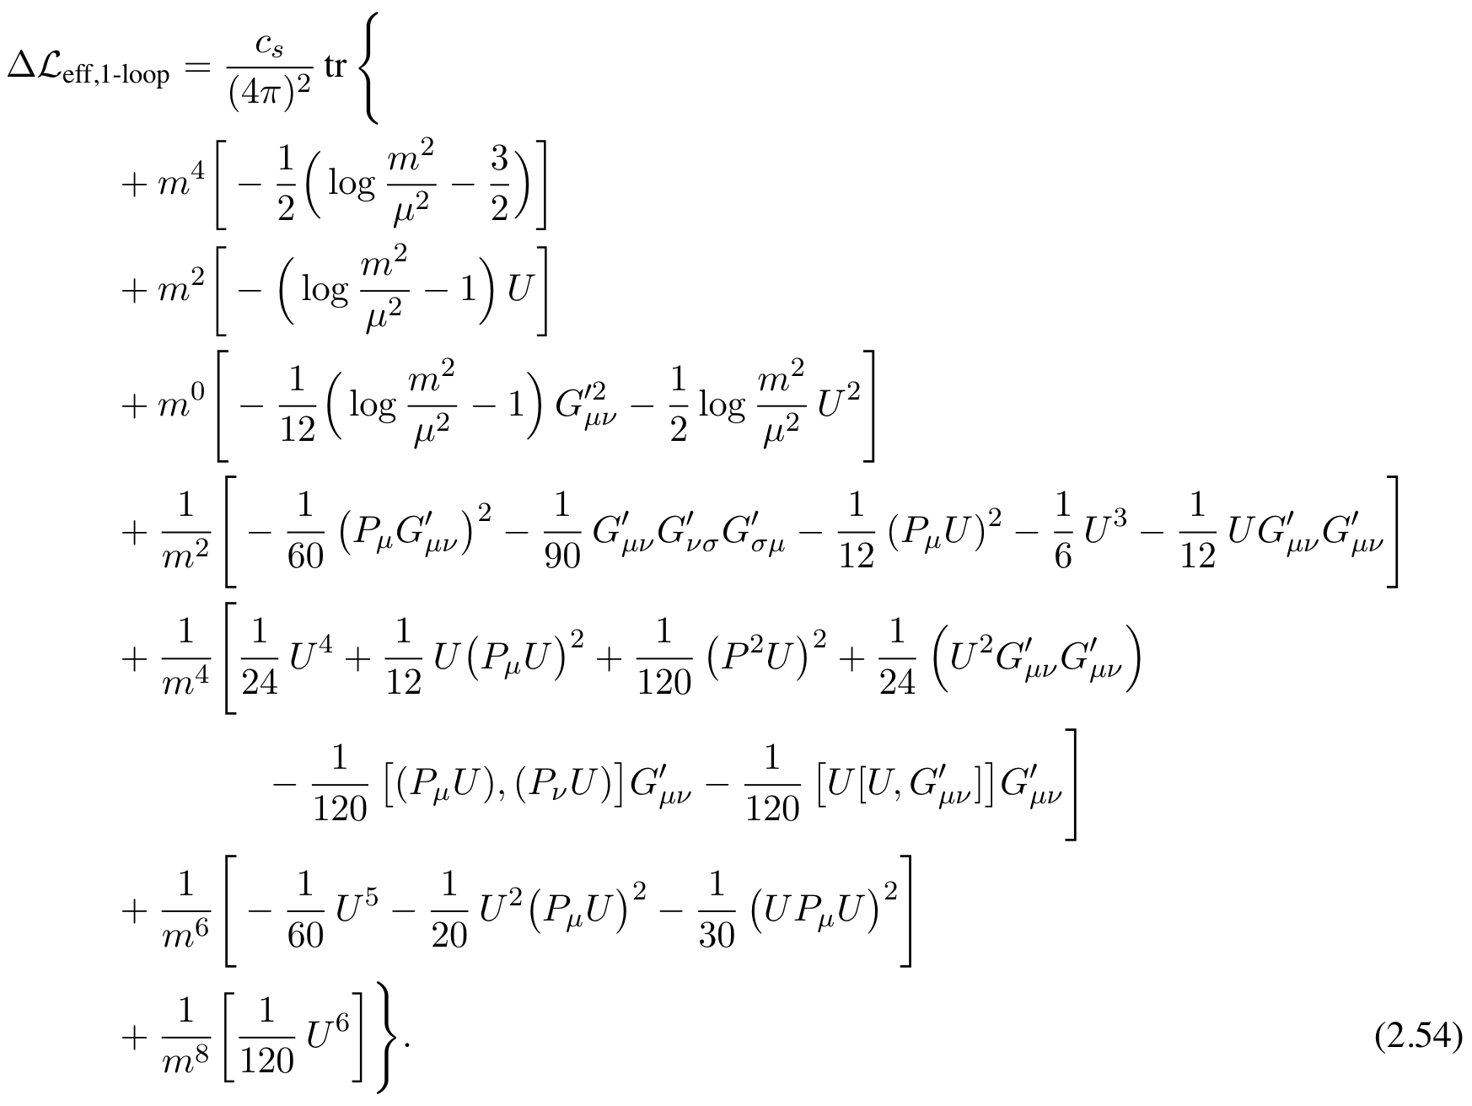


Universal One-Loop Effective Action (UOLEA)
“For any UV theory of the form $ℒ_{UV}= ⋯$ , the 1-loop EFT is $ℒ_{EFT}^{[1]}= ⋯$ ”
1st version: [Henning, Lu, Murayama, 1412.1837]
$ℒ_{UV}\left[Φ,φ\right]=ℒ\left[φ\right]+ \frac{1}{2} {\left(D_{μ}Φ\right)}^{2}$
$−\frac{1}{2} \left(M^{2}+U\left[φ\right]\right) Φ^{2}$
$+𝒪\left(Φ^{3}\right)$
$$⇒$$
non-derivative interactions

Slide 21
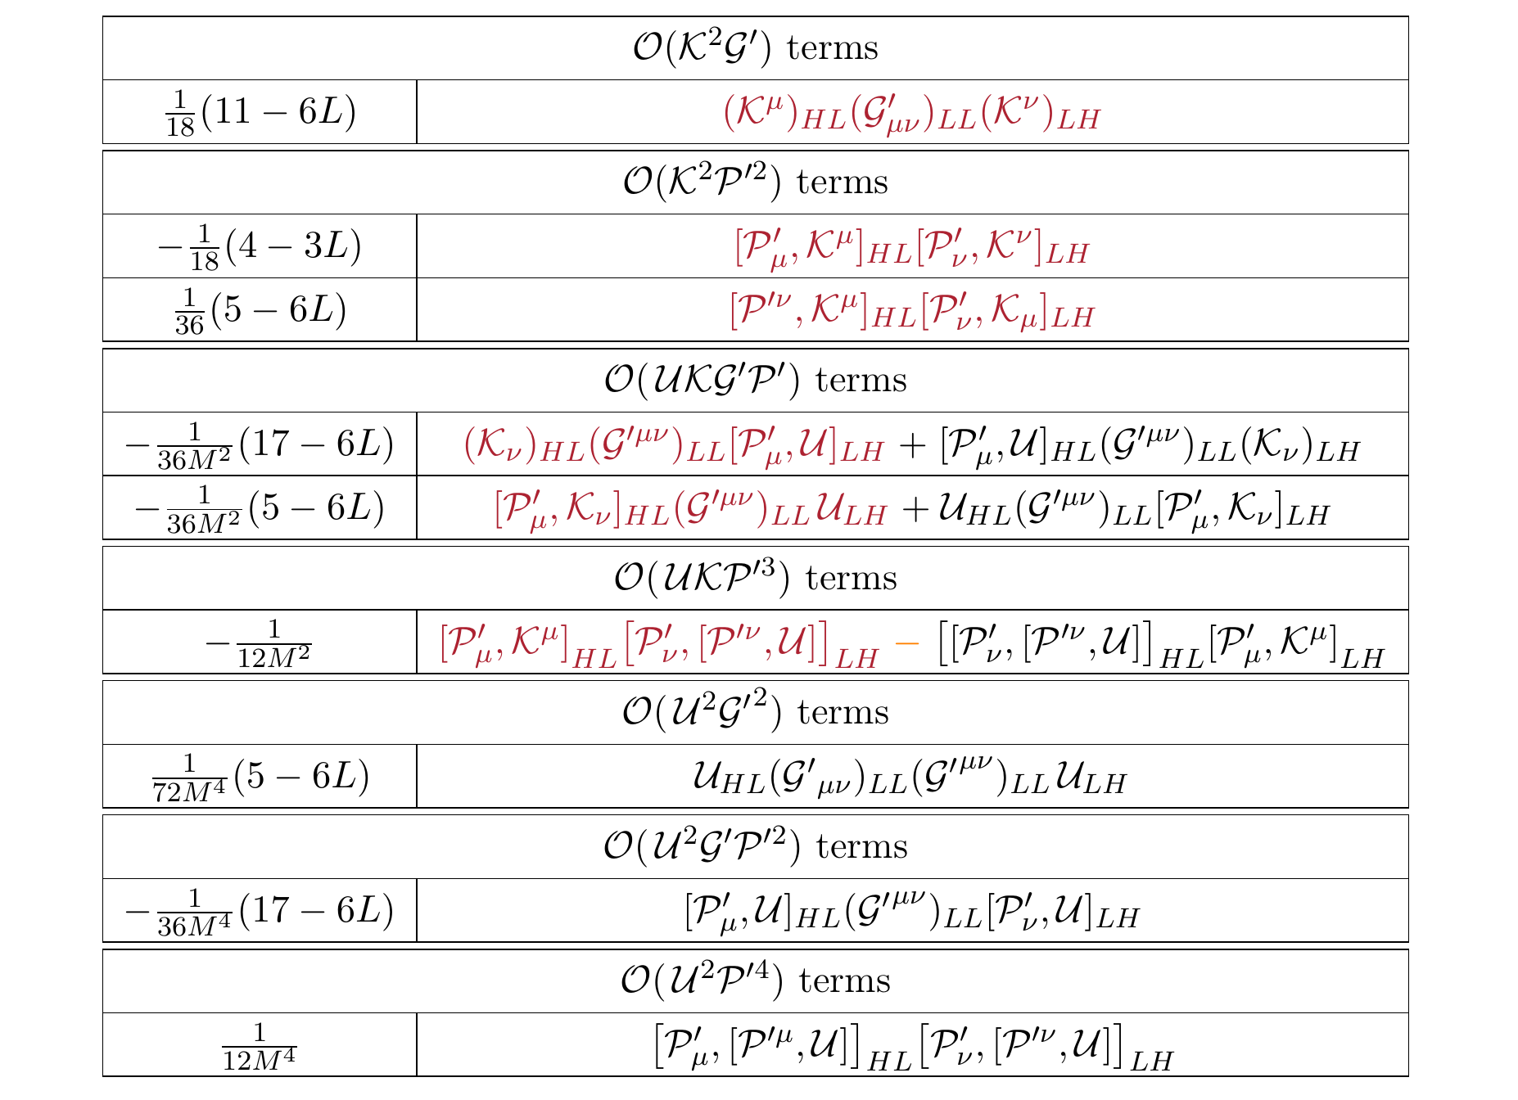

Universal One-Loop Effective Action (UOLEA)
“For any UV theory of the form $ℒ_{UV}= ⋯$ , the 1-loop EFT is $ℒ_{EFT}^{[1]}= ⋯$ ”
Geometric UOLEA: [Li, Lu, ZZ, 2411.04173]
$ℒ_{UV}\left[Φ,φ\right]= \frac{1}{2} g_{ij}\left(φ\right)\left(∂_{μ}φ^{i}\right)\left(∂^{μ}φ^{j}\right)−V\left(φ\right)$
$⇒ℒ_{EFT}^{\left[1\right]}=\frac{1}{16π^{2}}\sum_{i}{c_{i} \text{tr} 𝒪_{i}}$
derivative + non-derivative interactions
built from tensors on EFT submanifold (manifestly covariant)
(+ a few more tables)

Slide 22

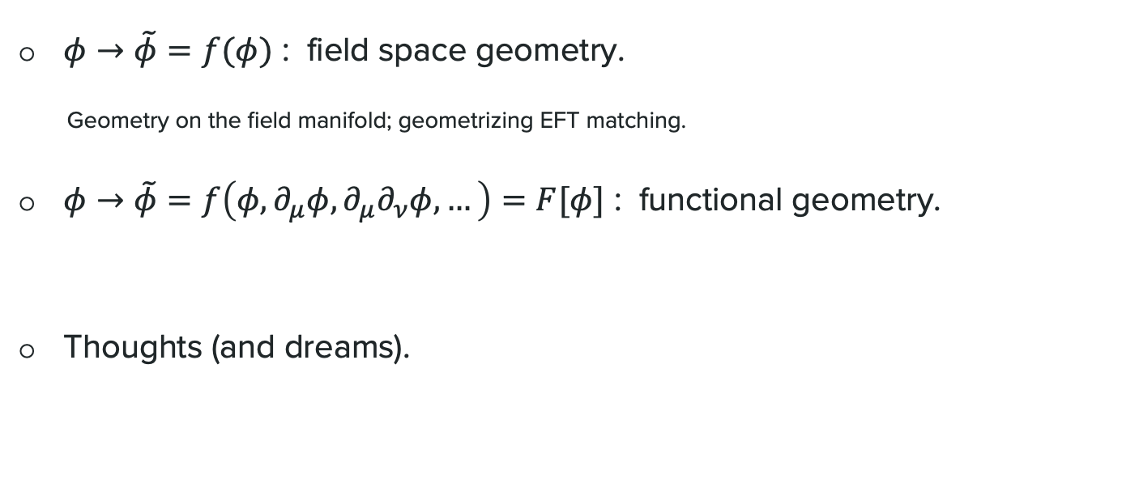
Outline
$φ→\tilde{φ}=f(φ)$ : field space geometry.
Geometry on the field manifold; geometrizing EFT matching.
$φ→\tilde{φ}=f\left(φ, ∂_{μ}φ, ∂_{μ}∂_{ν}φ, …\right)=F[φ]$ : functional geometry.
Thoughts (and dreams).

Slide 23
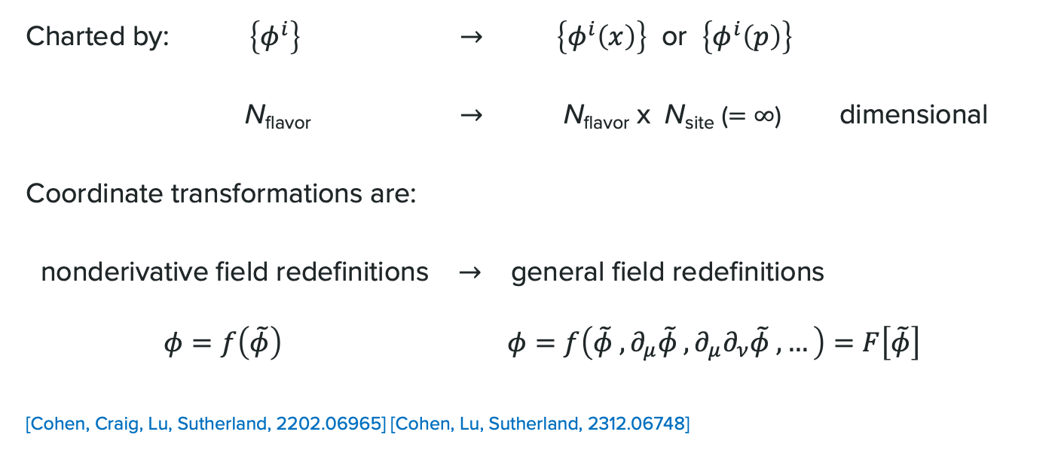
Upgrade field manifold $→$ functional manifold
Charted by: $\left\{φ^{i}\right\}$ $→$ $\left\{φ^{i}\left(x\right)\right\}$ or $\left\{φ^{i}\left(p\right)\right\}$
N_{flavor} $→$ N_{flavor} x N_{site} ($=∞$) dimensional
Coordinate transformations are:
nonderivative field redefinitions $→$ general field redefinitions
$φ=f\left(\tilde{φ}\right)$ $φ=f\left(\tilde{φ} , ∂_{μ}\tilde{φ} , ∂_{μ}∂_{ν}\tilde{φ} , …\right)=F\left[\tilde{φ}\right]$
[Cohen, Craig, Lu, Sutherland, 2202.06965] [Cohen, Lu, Sutherland, 2312.06748]

Slide 24
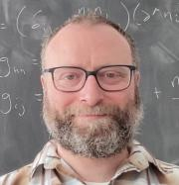
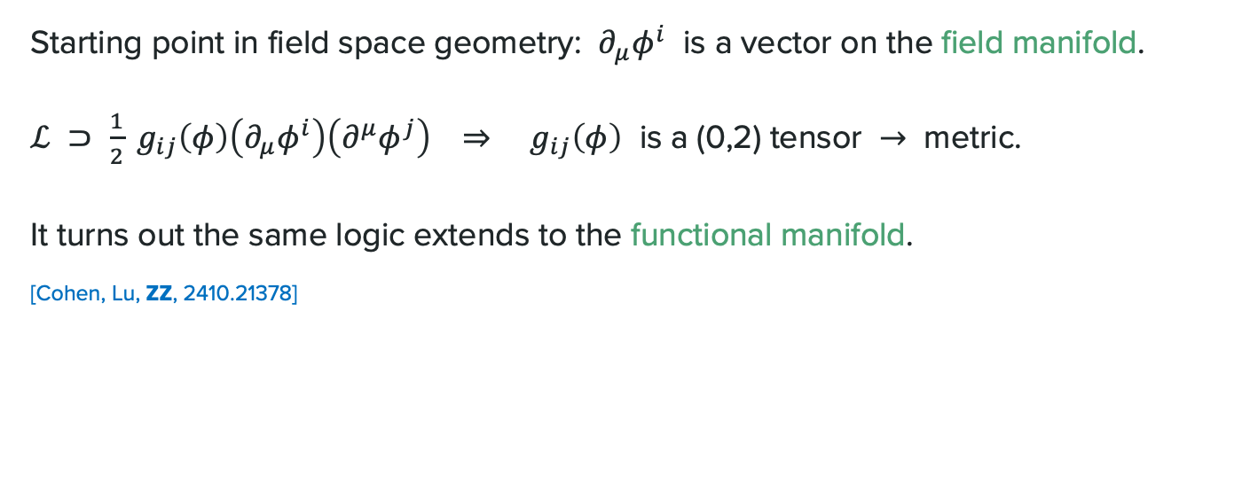
Geometry on the functional manifold
Starting point in field space geometry: $∂_{μ}φ^{i}$ is a vector on the field manifold.
$ℒ ⊃ \frac{1}{2} g_{ij}\left(φ\right)\left(∂_{μ}φ^{i}\right)\left(∂^{μ}φ^{j}\right) ⇒ g_{ij}\left(φ\right)$ is a (0,2) tensor $→$ metric.
It turns out the same logic extends to the functional manifold.
[Cohen, Lu, ZZ, 2410.21378]
Tim Cohen (CERN, EPFL & U. Oregon)
Xiaochuan Lu (UCSD)

Slide 25

Geometry on the functional manifold
“Field redefinitions $φ=F\left[\tilde{φ}\right]$ are the origin of operator redundancies in EFTs.”
Local, translation-invariant
[Cohen, Lu, ZZ, 2410.21378]
where
again transforms as a vector
metric on the functional manifold
[Cheung, Helset, Parra-Martinez, 2202.06972]

Slide 26
Example: $φ^{3}+φ^{4}$ theory
Metric:
Connection:
Riemann curvature:

Slide 27

Amplitudes on the functional manifold
… can be built from the 1PI effective action $Γ\left[φ\right]$ .
scalar on the functional manifold
functional derivative (differentiation on the functional manifold)

Slide 28
Amplitudes on the functional manifold
Can show recursively: [Cohen, Craig, Lu, Sutherland, 2202.06965] [Cohen, Lu, Sutherland, 2312.06748]
Quick way to see this can’t be right: (crossing symmetry).
All EFTs have vanishing curvature??
looks like a connection?
x
But it’s not!

Slide 29

The catch is that are off-shell amplitudes
… defined on the entire functional manifold & for arbitrary 4-momenta.
They are not covariant, but only “on-shell covariant.”
[Cohen, Craig, Lu, Sutherland, 2202.06965] [Cohen, Lu, Sutherland, 2312.06748]
with but
bar = evaluate at physical vacuum (point on functional manifold)
$$p_{i}^{2}=m_{i}^{2}$$

Slide 30
Amplitudes in terms of geometry
[Cohen, Lu, ZZ, 2410.21378]
Here’s the upshot:
e.g.
function recursively defined from standard Feynman rules

Slide 31
Amplitudes in terms of geometry
[Cohen, Lu, ZZ, 2410.21378]
Here’s the upshot:
where
e.g.
same function geometrized vertices
on-shell-covariant building blocks
manifestly on-shell covariant!

Slide 32
Sketch of the proof
[Cohen, Lu, ZZ, in preparation]
A family of equivalent recursions for off-shell amplitudes:
interpolates between standard and geometrized recursions.
linear differential operator parameterized by $γ_{bc}^{a}$

Slide 33
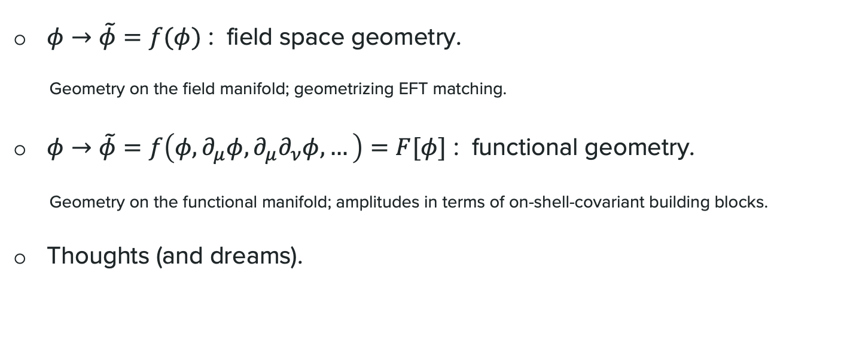
Outline
$φ→\tilde{φ}=f(φ)$ : field space geometry.
Geometry on the field manifold; geometrizing EFT matching.
$φ→\tilde{φ}=f\left(φ, ∂_{μ}φ, ∂_{μ}∂_{ν}φ, …\right)=F[φ]$ : functional geometry.
Geometry on the functional manifold; amplitudes in terms of on-shell-covariant building blocks.
Thoughts (and dreams).

Slide 34
Mysteries of small numbers
The universe as we know it:
dim-0: cosmological constant problem
dim-2: hierarchy problem
dim-4: strong CP problem
many more mysteries here!

Slide 35
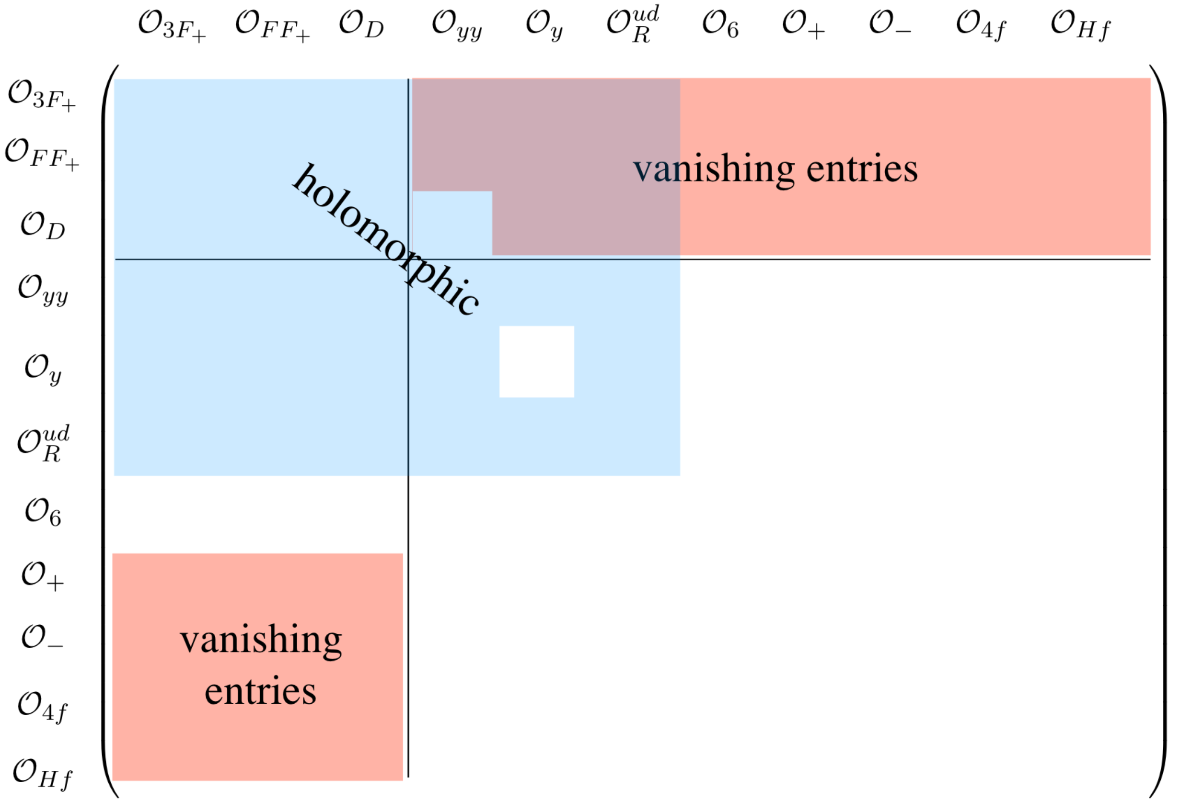
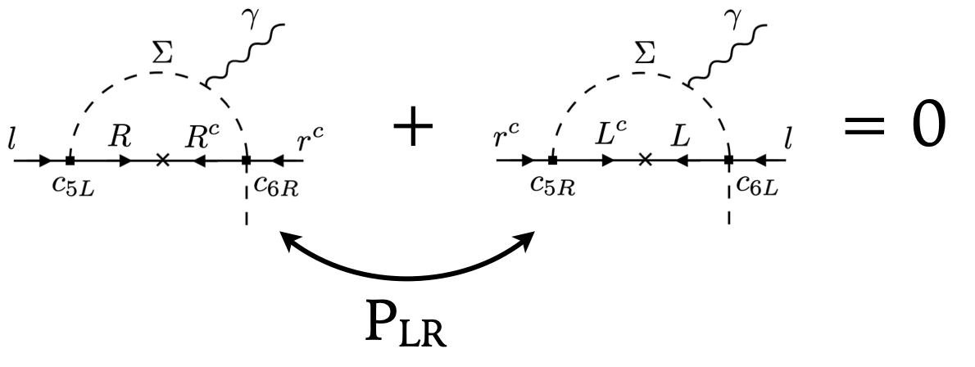


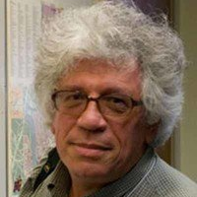

Magic zeroes?
Hidden symmetries and selection rules in EFT matching and running.
[Alonso, Jenkins, Manohar, 1409.0868] [Elias-Miro, Espinosa, Pomarol, 1412.7151] [Cheung, Shen, 1505.01844] [Bern, Parra-Martinez, Sawyer, 1910.05831] [Jiang, Shu, Xiao, Zheng, 2001.04481] [Arkani-Hamed, Harigaya, 2106.01373] [Delle Rose, Harling, Pomarol, 2201.10572] [Bao, Gu, Liu, Shu, Wang, 2408.08948] [Craig, Garcia Garcia, Vainshtein, ZZ, 2112.05770]
Nathaniel Craig
(UCSB & KITP)
Isabel Garcia Garcia
(KITP $→$ U Washington)
Arkady Vainshtein
(U Minnesota & KITP)

Slide 36

What can EFT geometry buy us?
Freedom to change basis $⇒$ clarify structures of EFTs? [Li, Lu, ZZ, 2411.04173]
Same story in the symmetry explanation of magic zero [Craig, Garcia Garcia, Vainshtein, ZZ, 2112.05770]
Marginal nonderivative $→$ irrelevant derivative $⇒$ unique spurion combination.
26 terms to compute for
1-loop matching up to dim-6
relevant/marginal nonderivative interactions
14 terms to compute for
1-loop matching up to dim-6
irrelevant derivative interactions
Notes:
Add arxiv number!

Slide 37
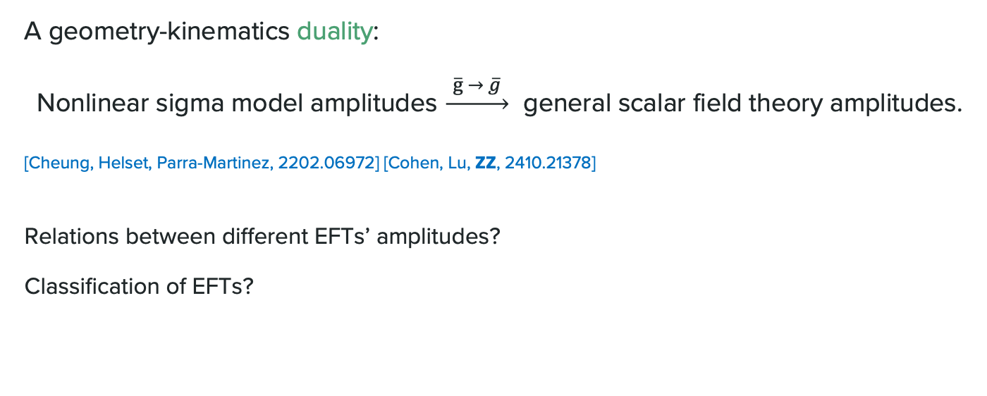
What can EFT geometry buy us?
A geometry-kinematics duality:
Nonlinear sigma model amplitudes $\underset{→}{ \overline{g} → \overline{g} }$ general scalar field theory amplitudes.
[Cheung, Helset, Parra-Martinez, 2202.06972] [Cohen, Lu, ZZ, 2410.21378]
Relations between different EFTs’ amplitudes?
Classification of EFTs?

Slide 38
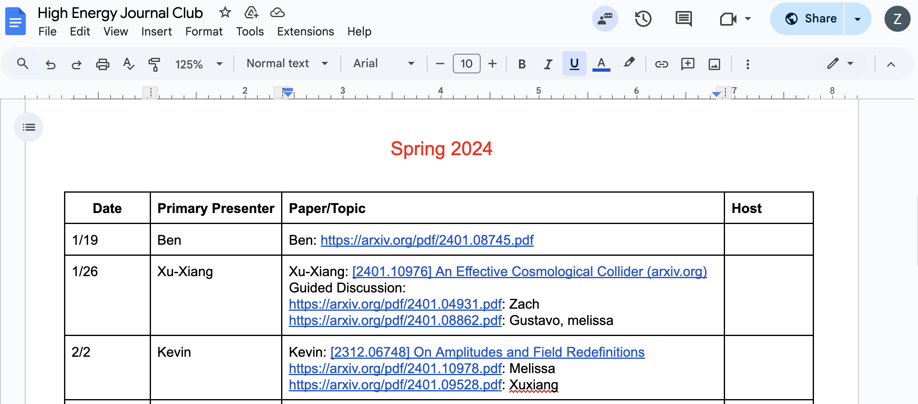
Before it ends…
I’d like to share the story of how it started:

Slide 39




Slide 40
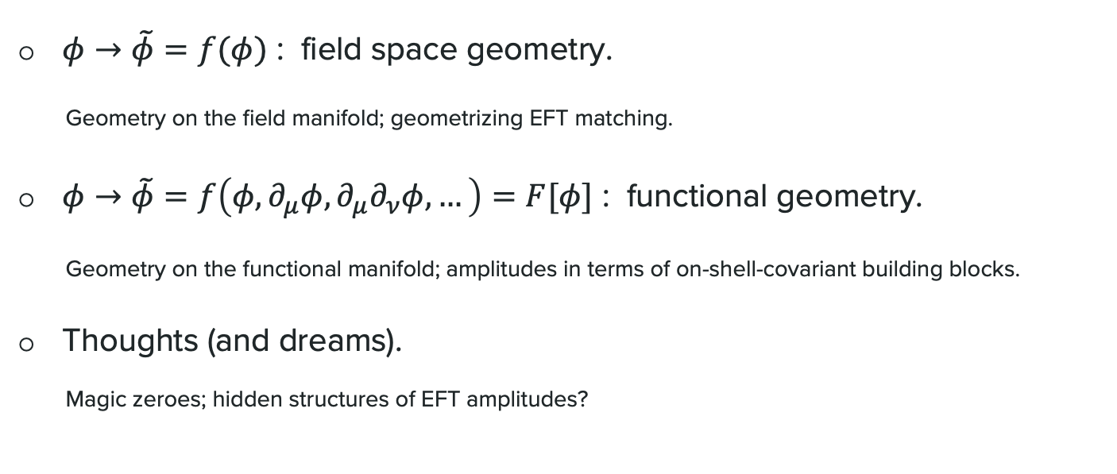
Summary
$φ→\tilde{φ}=f(φ)$ : field space geometry.
Geometry on the field manifold; geometrizing EFT matching.
$φ→\tilde{φ}=f\left(φ, ∂_{μ}φ, ∂_{μ}∂_{ν}φ, …\right)=F[φ]$ : functional geometry.
Geometry on the functional manifold; amplitudes in terms of on-shell-covariant building blocks.
Thoughts (and dreams).
Magic zeroes; hidden structures of EFT amplitudes?

