Slide 1

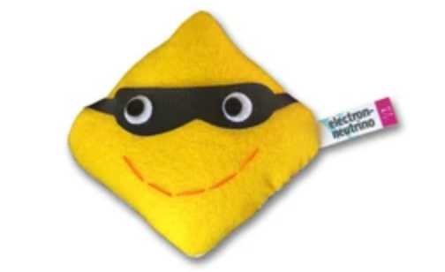


How Matter Matters:
The Story of Time Invariance Violation in Neutrino Oscillations
Olivia Meredith Bitter
PhD Student in Theoretical Neutrino Physics
PIKIMO Fall 2024
Neutrino pictures: https://www.particlezoo.net/

Slide 2
Motivation from the CPT symmetry story
If we follow that CPT is a fundamental symmetry.
C P T
Charge conjugation
Parity
Time reversal
2
PIKIMO Fall 2024

Slide 3
Motivation from the CPT symmetry story
Charge parity transform (CP) alone is violated in the weak sector.
If we follow that CPT is a fundamental symmetry.
C P T
C P
Charge conjugation
Parity
Time reversal
2
PIKIMO Fall 2024

Slide 4
Motivation from the CPT symmetry story
Charge parity transform (CP) alone is violated in the weak sector.
Time reversal transforms alone should also be violated in weak interactions, in order to preserve the overall symmetry.
If we follow that CPT is a fundamental symmetry.
C P T
T
C P
Charge conjugation
Parity
Time reversal
2
PIKIMO Fall 2024

Slide 5
Motivation from the CPT symmetry story
Neutrino physics is a well motivated probe for CP violation, but we are limited to “improper tests” due to our inability to build experiments in an anti-Earth.
3
PIKIMO Fall 2024

Slide 6
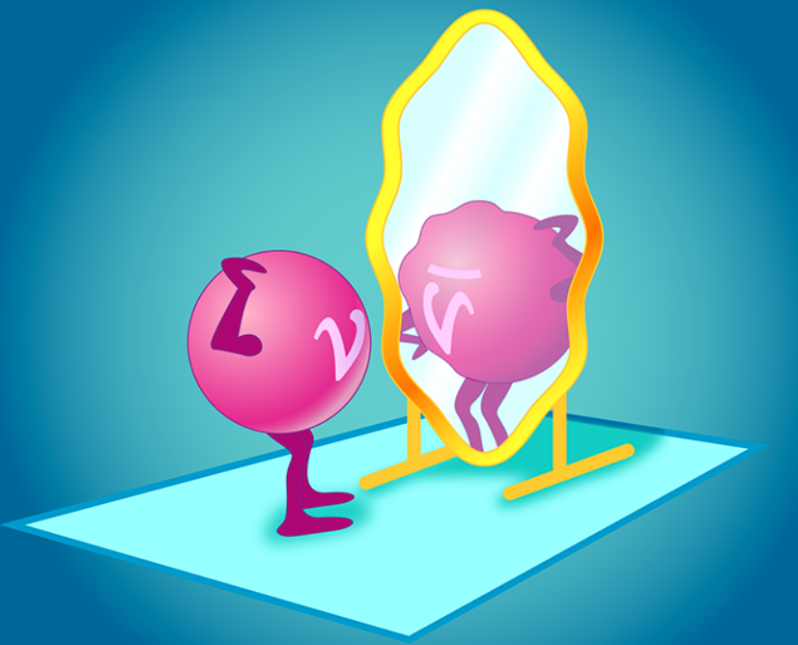
Motivation from the CPT symmetry story
Neutrino physics is a well motivated probe for CP violation, but we are limited to “improper tests” due to our inability to build experiments in an anti-Earth.
Let us then consider to what extent time invariance violation occurs within the neutrino sector.
Why? New physics may not impact both CP and time reversal in the same way.
3
Source:https://physics.aps.org/articles/v15/120
Credit:APS/Carin Cain
PIKIMO Fall 2024

Slide 7
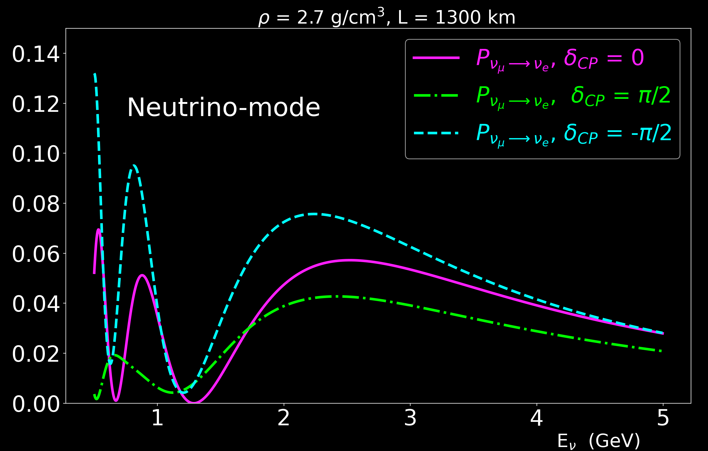
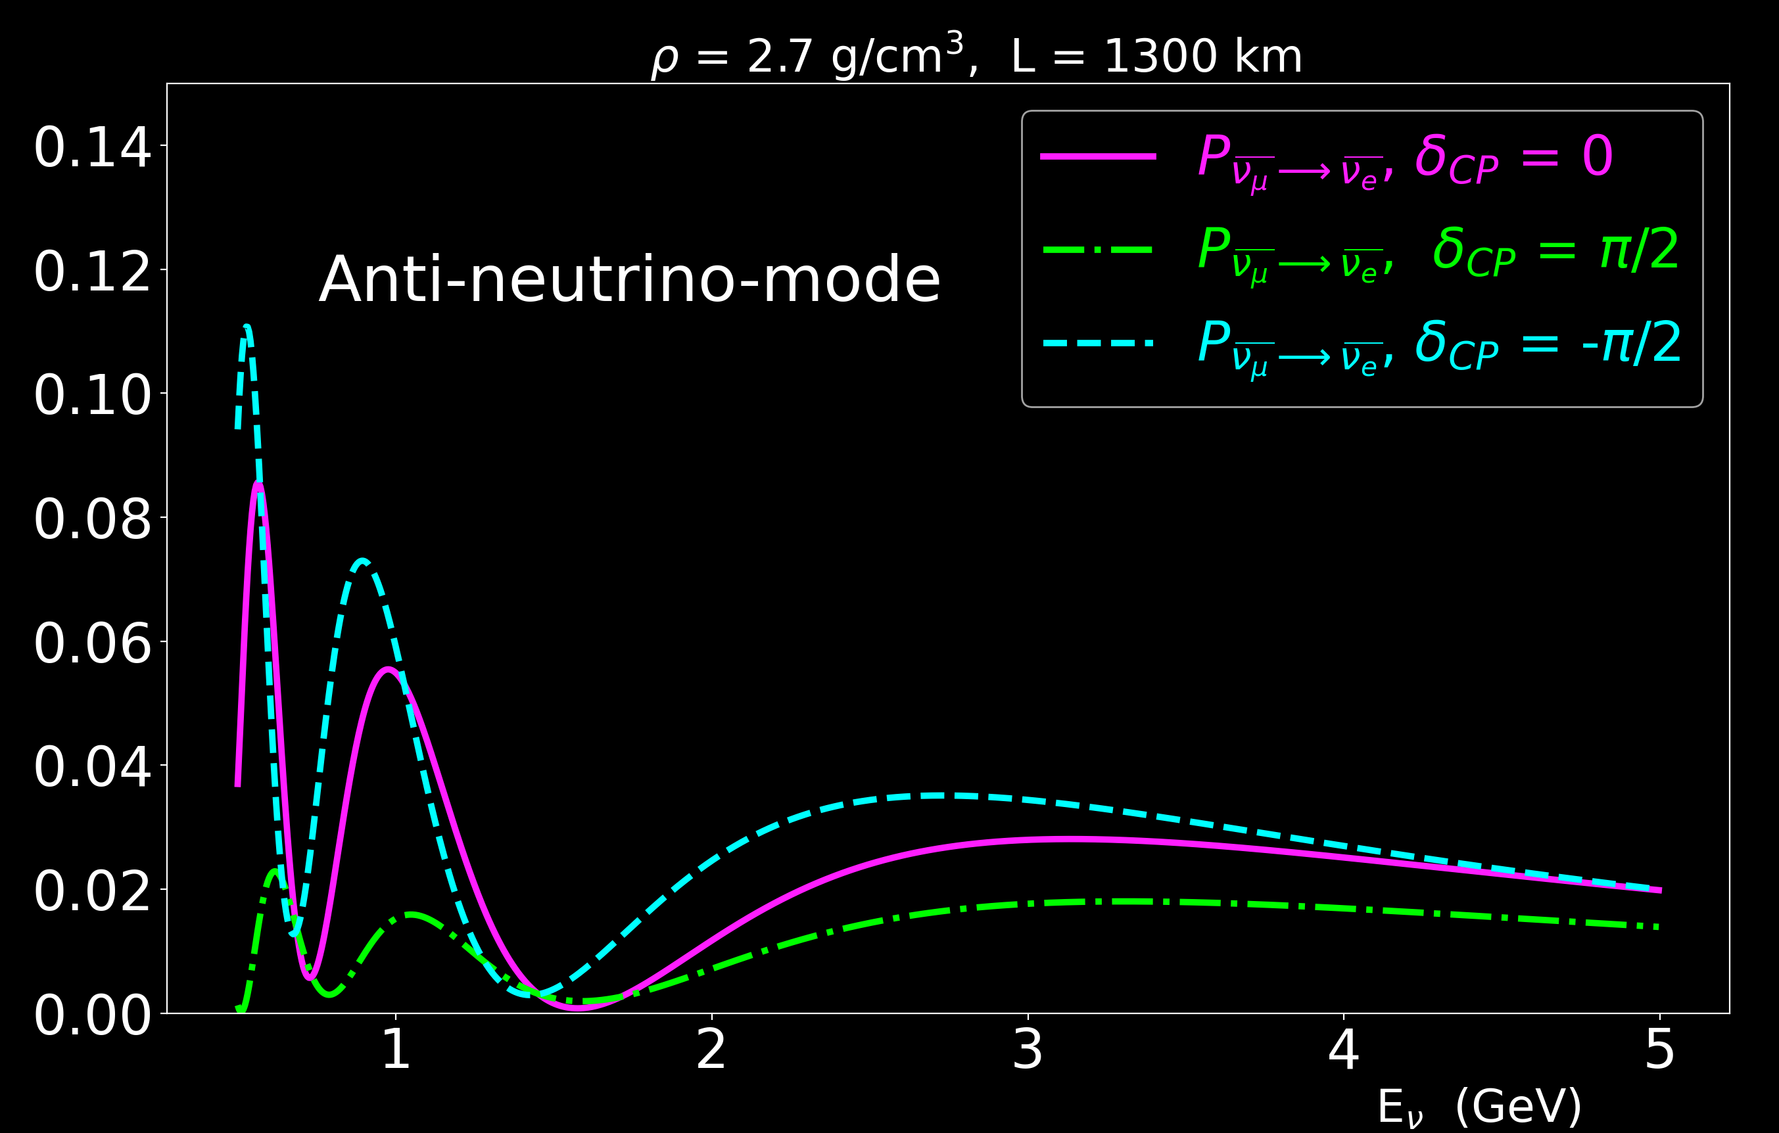

Motivation from the experiments story
Neutrino mode
Anti-neutrino mode
NO
NO
CP conjugate channels are the most common probes, as they are more accessible to experiments like long baselines.
4
Source:https://www.dunescience.org/
PIKIMO Fall 2024

Slide 8
Motivation from the experiments story
Neutrino mode
Anti-neutrino mode
Warning:
Non-trivial matter effects detected!
NO
NO
CP conjugate channels are the most common probes, as they are more accessible to experiments like long baselines.
4
Source:https://www.dunescience.org/
PIKIMO Fall 2024

Slide 9
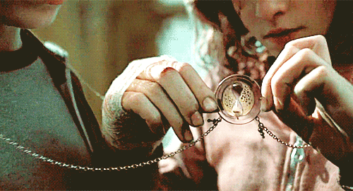
Enter Time Invariance Violation Tests
Time invariance violation tests may provide a clearer way* to aid in our understanding of how different matter profiles can affect neutrino oscillations
  (i.e. distinguishing between intrinsic & induced time invariance violation)
  *dependent upon matter potential profile
Source: (Time-turner) https://tenor.com/view/time-turner-harry-potter-moving-spinning-gif-16031036
5
New Perspectives, 2024

Slide 10
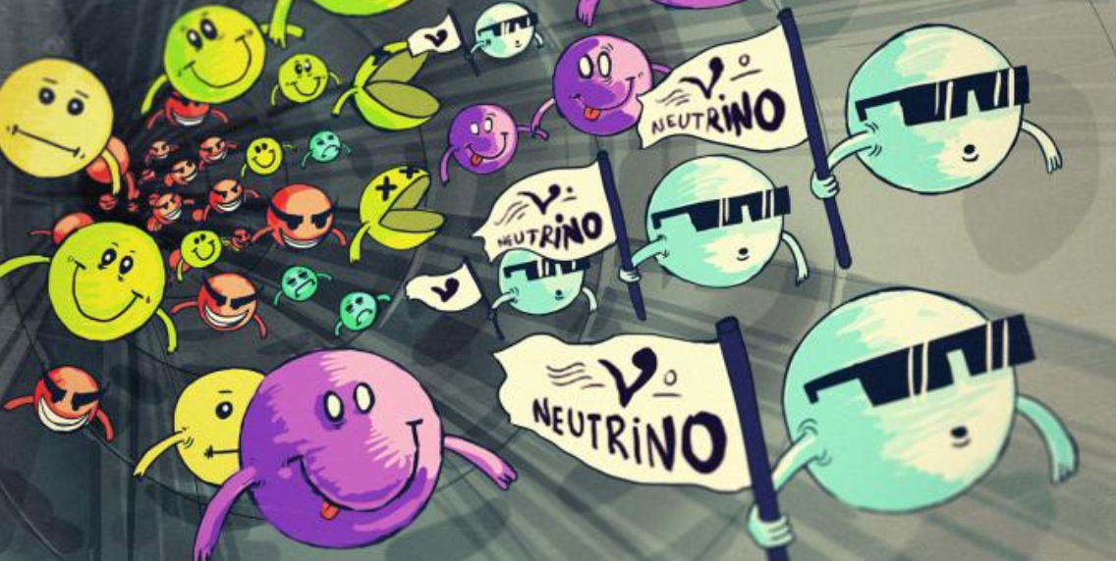
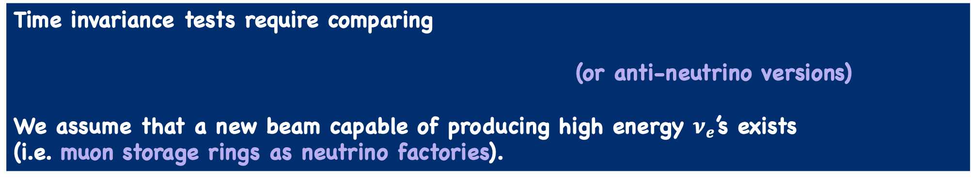
Enter Time Invariance Violation Tests
Time invariance tests require comparing
(or anti-neutrino versions)
We assume that a new beam capable of producing high energy $ν_{e}$’s exists
(i.e. muon storage rings as neutrino factories).
5
Source: https://www.symmetrymagazine.org/article/november-2012/how-to-make-a-neutrino-beam?language_content_entity=und
New Perspectives, 2024

Slide 11
Enter Time Invariance Violation Tests
Time invariance tests are not new, but the full range of nuances with a variety of different matter profiles, is perhaps not as widely appreciated.
Our aim is to provide a fresh perspective and different insight in this pedagogical study.
For more details about previous work around this topic, please see backup slides.
5
New Perspectives, 2024

Slide 12
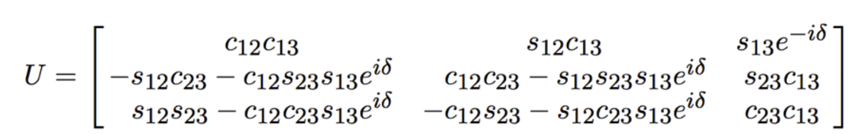
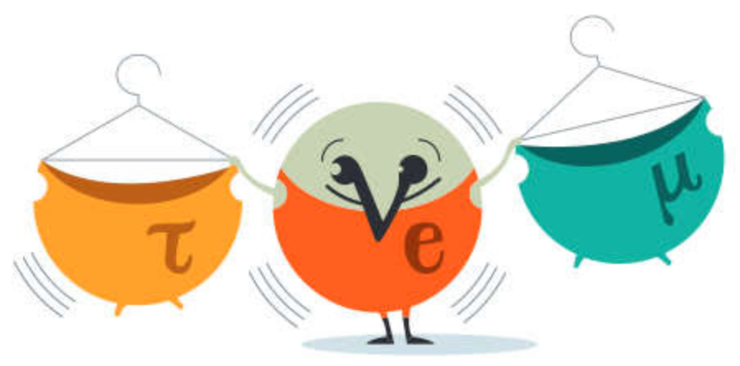





Recalling 3-Flavor Neutrino Oscillations with Charge-Current Matter Effects
(PMNS matrix)
$$M^{2}= \begin{matrix}0 & 0 & 0 \\ 0 & ∆m_{21}^{2} & 0 \\ 0 & 0 & ∆m_{31}^{2}\end{matrix}$$
$$A= \begin{matrix}\sqrt{2}G_{F}N_{e} & 0 & 0 \\ 0 & 0 & 0 \\ 0 & 0 & 0\end{matrix}$$
Sources: https://neutrino.syr.edu/research/neutrino-oscillations/ & https://neutrino-history.in2p3.fr/neutrino-oscillation/
6
+/- for neutrinos/antineutrinos
PIKIMO Fall 2024

Slide 13
Defining Time Invariance Measures
To clarify what ”comparisons” we are making in looking for time invariance violation effects, we’ve specified two distinct measures:
  proper time invariance: (aka: true time invariance violation)
    Not a good observable, but certainly no harder to calculate than CP conjugate channels.
    Requires comparing probabilities with final states exchanged and swapping the detector with source.
7
PIKIMO Fall 2024

Slide 14
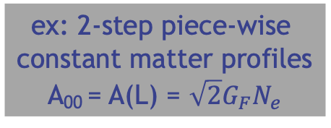




Defining Time Invariance Measures
To clarify what ”comparisons” we are making in looking for time invariance violation effects, we’ve specified two distinct measures:
  proper time invariance: (aka: true time invariance violation)
ex: 2-step piece-wise
constant matter profiles
A₀₀ = A(L) = $\sqrt{2}G_{F}N_{e}$
$$P_{v_{e}→v_{μ}} vs P_{v_{μ}→v_{e}}$$
_{(decreasing potential)}
_{(increasing potential)}
N_{e} changes depending on density
7
PIKIMO Fall 2024

Slide 15
Defining Time Invariance Measures
  improper time invariance: (next best thing!)
    Compares probabilities with only the final states exchanged.
$$P_{v_{e}→v_{μ}} vs P_{v_{μ}→v_{e}}$$
_{(decreasing potential)}
_{(decreasing potential)}
This is what an experiment can measure!
8
PIKIMO Fall 2024

Slide 16
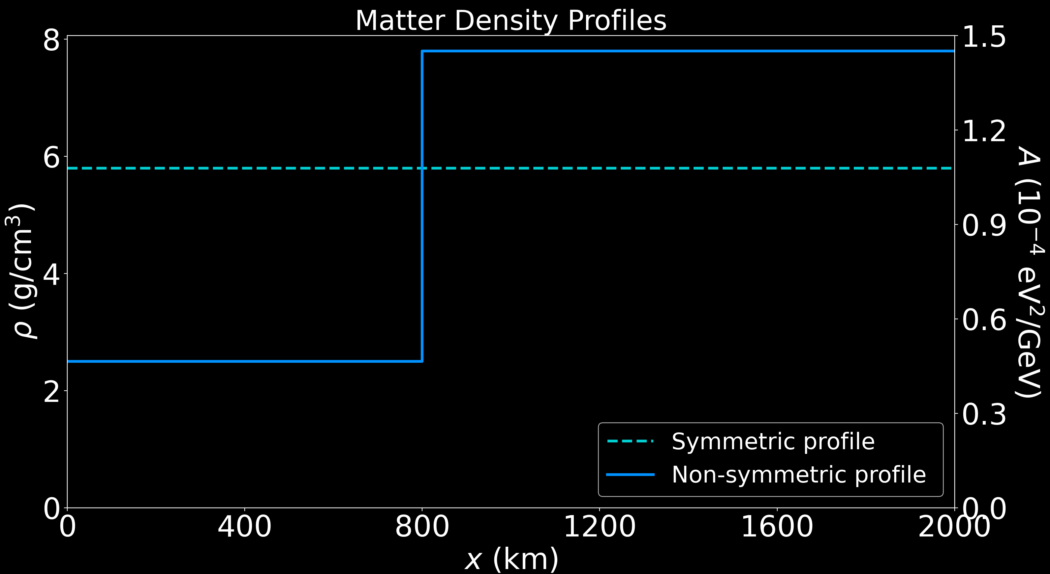
Modeling Matter Effects for 3-Flavors
For the purposes of our study, we separately two types of matter potential profiles.
Symmetric: vacuum or single step constant matter potential profile
Non-symmetric: piece-wise matter potential profiles (increasing or decreasing)
9
PIKIMO Fall 2024

Slide 17
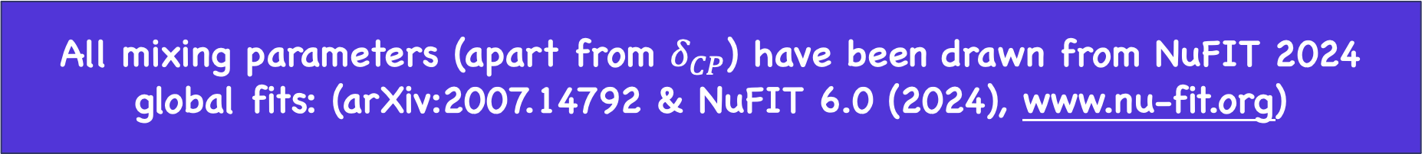
Modeling Matter Effects for 3-Flavors
For the purposes of our study, we separately two types of matter potential profiles.
Symmetric: vacuum or single step constant matter potential profile
Non-symmetric: piece-wise matter potential profiles (increasing or decreasing)
All mixing parameters (apart from $δ_{CP}$) have been drawn from NuFIT 2024 global fits: (arXiv:2007.14792 & NuFIT 6.0 (2024), www.nu-fit.org)
9
PIKIMO Fall 2024

Slide 18
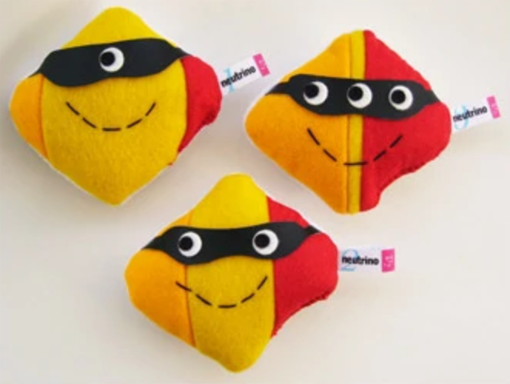
Disclaimer!
The first part of the following analysis is done with hypothetical/fictious matter effects, to get a general sense of how intrinsic versus induced time invariance violation behave with matter effects in cases that the have stronger oscillation differences.
10
PIKIMO Fall 2024

Slide 19
Symmetric Matter
Potential Profiles
11
PIKIMO Fall 2024

Slide 20
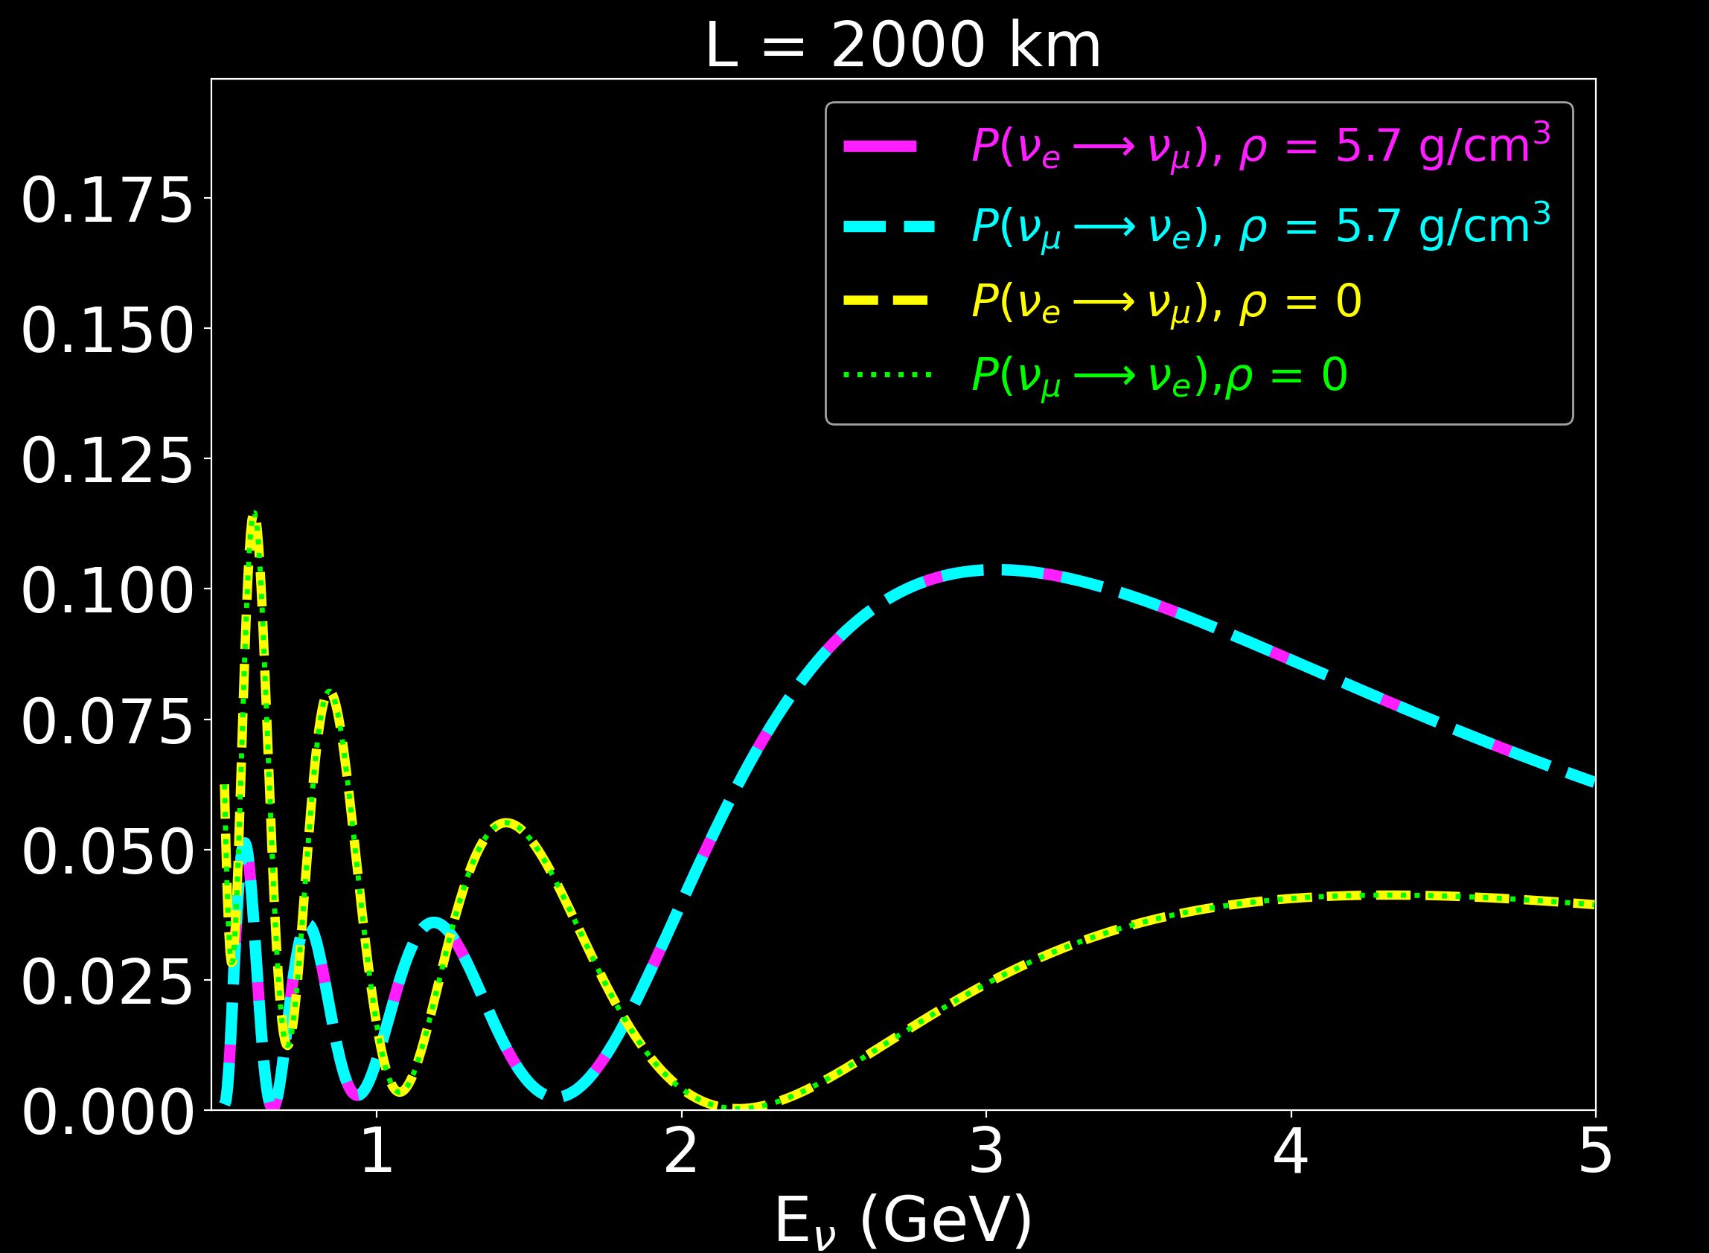
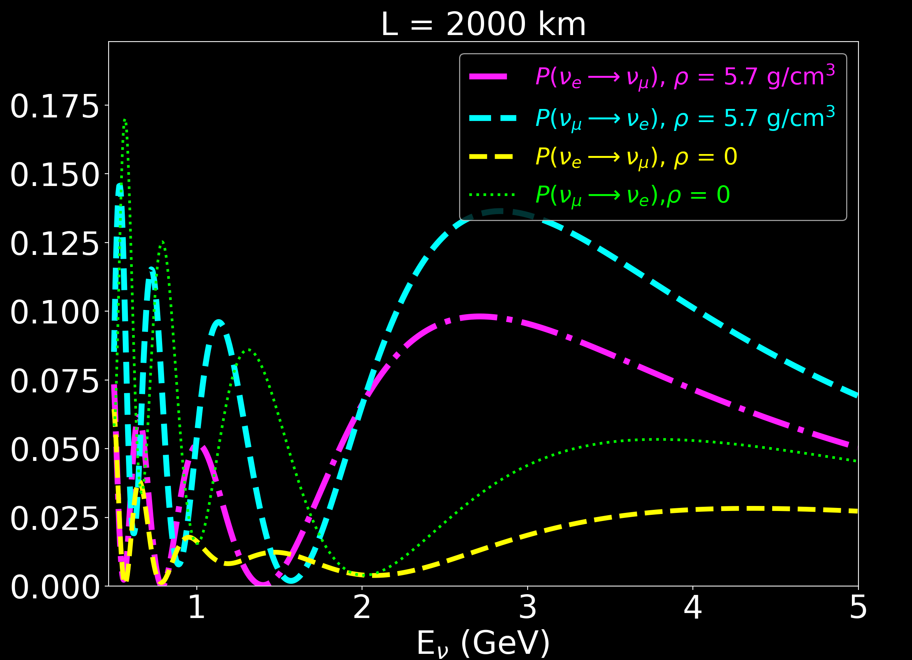
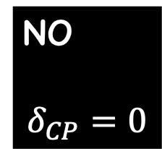
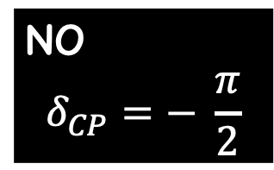
Symmetric matter effects for 3-Flavors
NO
$$δ_{CP}=− \frac{π}{2}$$
NO
$$δ_{CP}=0$$
matter channels
matter channels
vacuum channels
vacuum channels
Constant matter potential:
1.1x10⁻³ eV²/GeV ( 5.7 g/cm³)
12
PIKIMO Fall 2024

Slide 21
Symmetric matter effects for 3-Flavors
NO
$$δ_{CP}=− \frac{π}{2}$$
NO
$$δ_{CP}=0$$
1. Symmetric matter potentials cannot induce time invariance violation.
12
PIKIMO Fall 2024

Slide 22
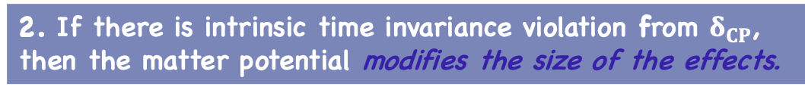
Symmetric matter effects for 3-Flavors
NO
$$δ_{CP}=− \frac{π}{2}$$
NO
$$δ_{CP}=0$$
1. Symmetric matter potentials cannot induce time invariance violation.
2. If there is intrinsic time invariance violation from $δ_{CP}$, then the matter potential modifies the size of the effects.
12
PIKIMO Fall 2024

Slide 23
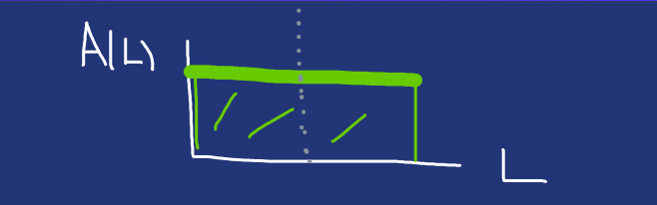

Symmetric matter effects for 3-Flavors
NO
$$δ_{CP}=0$$
If we exchange final states, same matter potential profile.
3. Improper and proper comparisons are the same if the matter potential is symmetric.
12
PIKIMO Fall 2024

Slide 24
Non-Symmetric Matter
Potential Profiles
13
PIKIMO Fall 2024

Slide 25
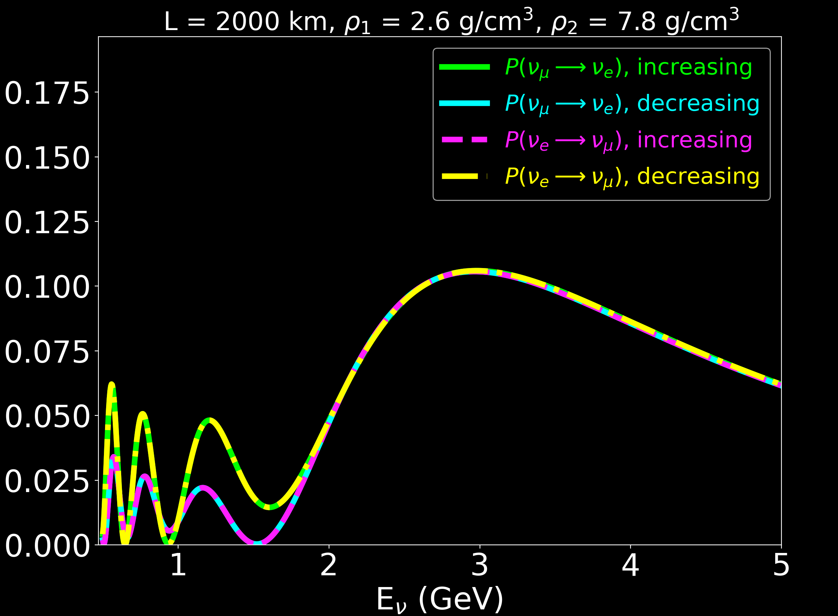
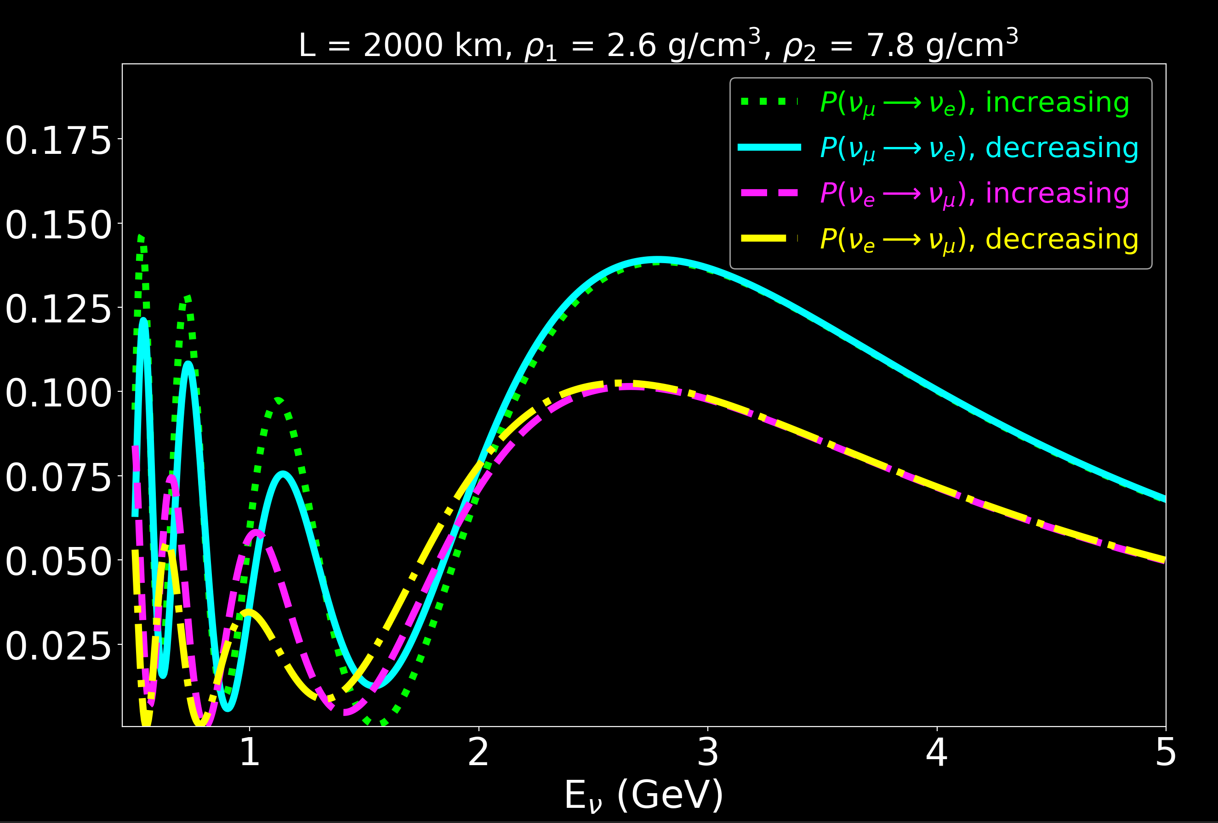
Non-symmetric matter effects for 3-Flavors
NO
$$δ_{CP}=− \frac{π}{2}$$
NO
$$δ_{CP}=0$$
Piecewise matter potential (2 steps):
A₁ =5x10⁻⁴ eV²/GeV (2.6 g/cm³)
A₂ =1.5 x10⁻³ eV²/GeV (7.8 g/cm³)
14
PIKIMO Fall 2024

Slide 26
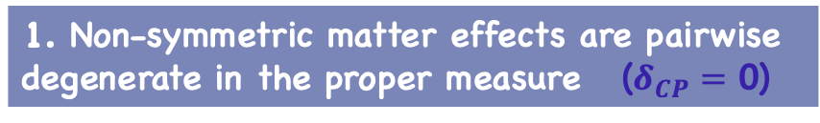

Non-symmetric matter effects for 3-Flavors
NO
$$δ_{CP}=− \frac{π}{2}$$
NO
$$δ_{CP}=0$$
Proper
1. Non-symmetric matter effects are pairwise degenerate in the proper measure ($δ_{CP}=$ 0)
14
PIKIMO Fall 2024

Slide 27
Non-symmetric matter effects for 3-Flavors
NO
$$δ_{CP}=− \frac{π}{2}$$
NO
$$δ_{CP}=0$$
Proper
1. Non-symmetric matter effects are pairwise degenerate in the proper measure ($δ_{CP}=$ 0)
14
PIKIMO Fall 2024

Slide 28
Non-symmetric matter effects for 3-Flavors
NO
$$δ_{CP}=− \frac{π}{2}$$
NO
$$δ_{CP}=0$$
Improper
1. Non-symmetric matter effects are pairwise degenerate in the proper measure ($δ_{CP}=$ 0)
2. Proper time remains invariant, but improper channels are different.
14
PIKIMO Fall 2024

Slide 29
Non-symmetric matter effects for 3-Flavors
NO
$$δ_{CP}=− \frac{π}{2}$$
NO
$$δ_{CP}=0$$
Improper
1. Non-symmetric matter effects are pairwise degenerate in the proper measure ($δ_{CP}=$ 0)
2. Proper time remains invariant, but improper channels are different.
14
PIKIMO Fall 2024

Slide 30
Non-symmetric matter effects for 3-Flavors
NO
$$δ_{CP}=− \frac{π}{2}$$
NO
$$δ_{CP}=0$$
3. No intrinsic time invariance violation but matter induced time invariance violation occurs.
14
PIKIMO Fall 2024

Slide 31
Non-symmetric matter effects for 3-Flavors
NO
$$δ_{CP}=− \frac{π}{2}$$
NO
$$δ_{CP}=0$$
14
4. No longer pairwise degenerate if ($δ_{CP}=$- $\frac{π}{2}$).
PIKIMO Fall 2024

Slide 32
Non-symmetric matter effects for 3-Flavors
NO
$$δ_{CP}=− \frac{π}{2}$$
NO
$$δ_{CP}=0$$
5. Matter potential changes magnitude of oscillations.
14
4. No longer pairwise degenerate if ($δ_{CP}=$- $\frac{π}{2}$).
PIKIMO Fall 2024

Slide 33
Realistic Matter
Potential Profiles
15
PIKIMO Fall 2024

Slide 34
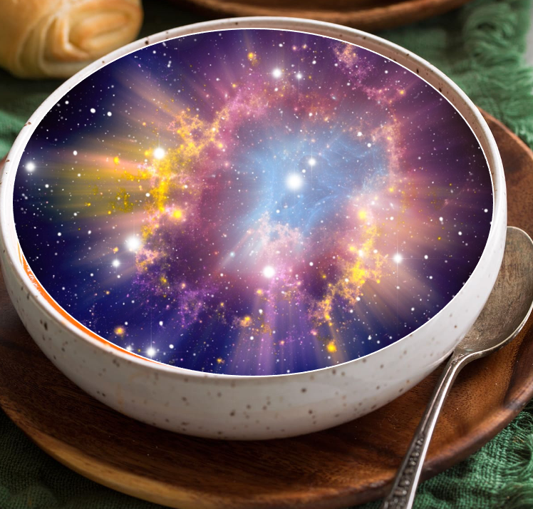
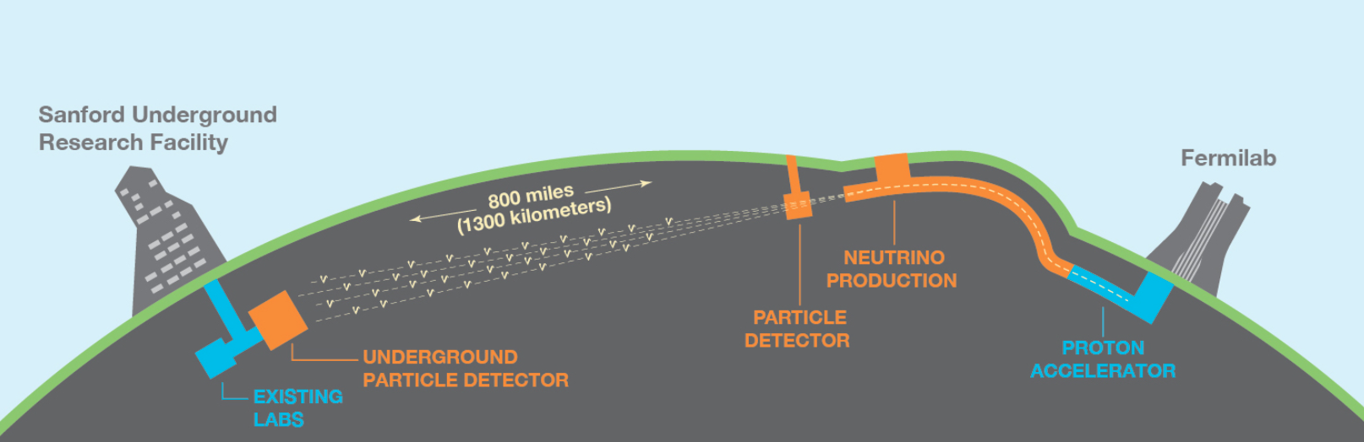
Realistic Considerations
We can play the same games for a more realistic model!
Our main model ingredients:
Assume the high energy neutrino factory beamline as before
Pick a well motivated baseline to test
(ex: Fermilab DUNE baseline at 1300 km)
Find the variations in Earth’s crust densities
Realistic model
16
Source:https://www.dunescience.org/
PIKIMO Fall 2024

Slide 35

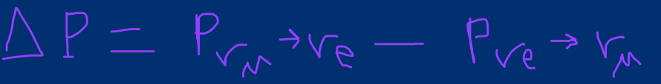
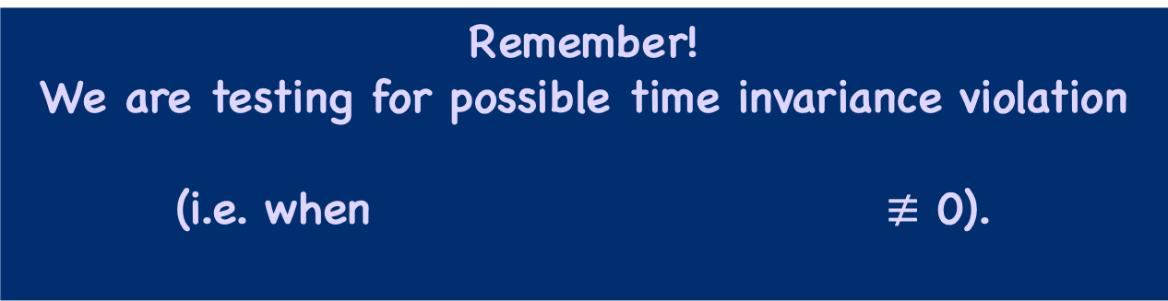
Realistic Considerations
Remember!
We are testing for possible time invariance violation
(i.e. when $≢$ 0).
Let’s call this “derived” observable:
16
PIKIMO Fall 2024

Slide 36

Realistic Considerations
But let’s also be clever in how we ask our question!
Can we meaningfully extract how much a possible time invariance violation is dependent upon the asymmetry in the potential? YES!
Let’s call this: Asymmetrically-Induced -
or Asym -
16
PIKIMO Fall 2024

Slide 37
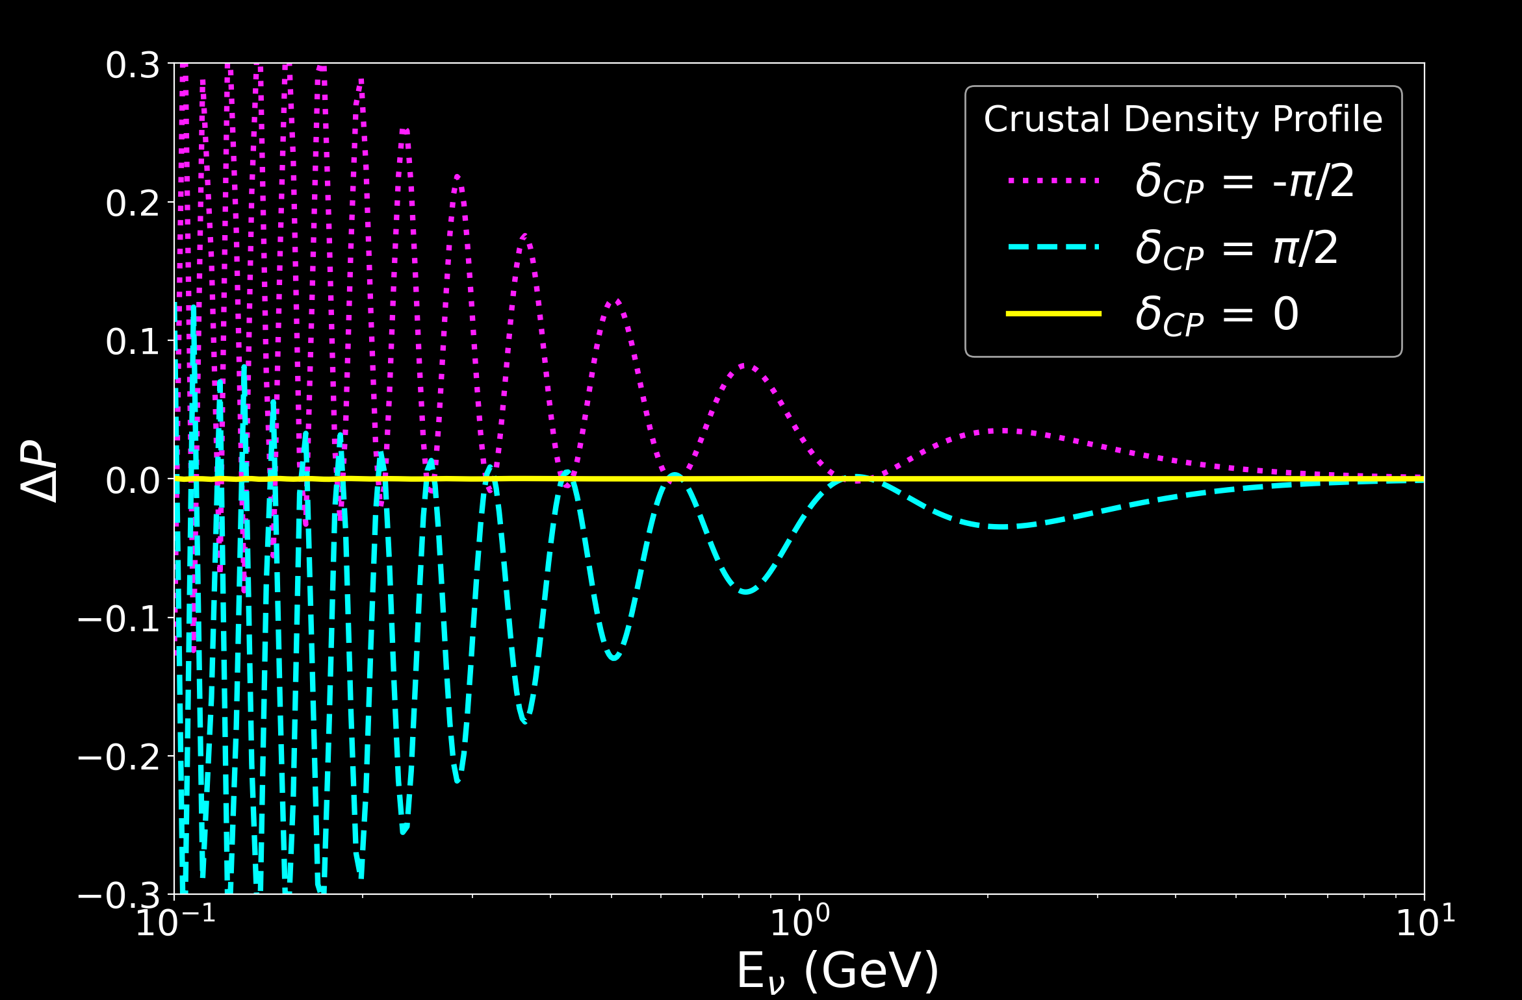
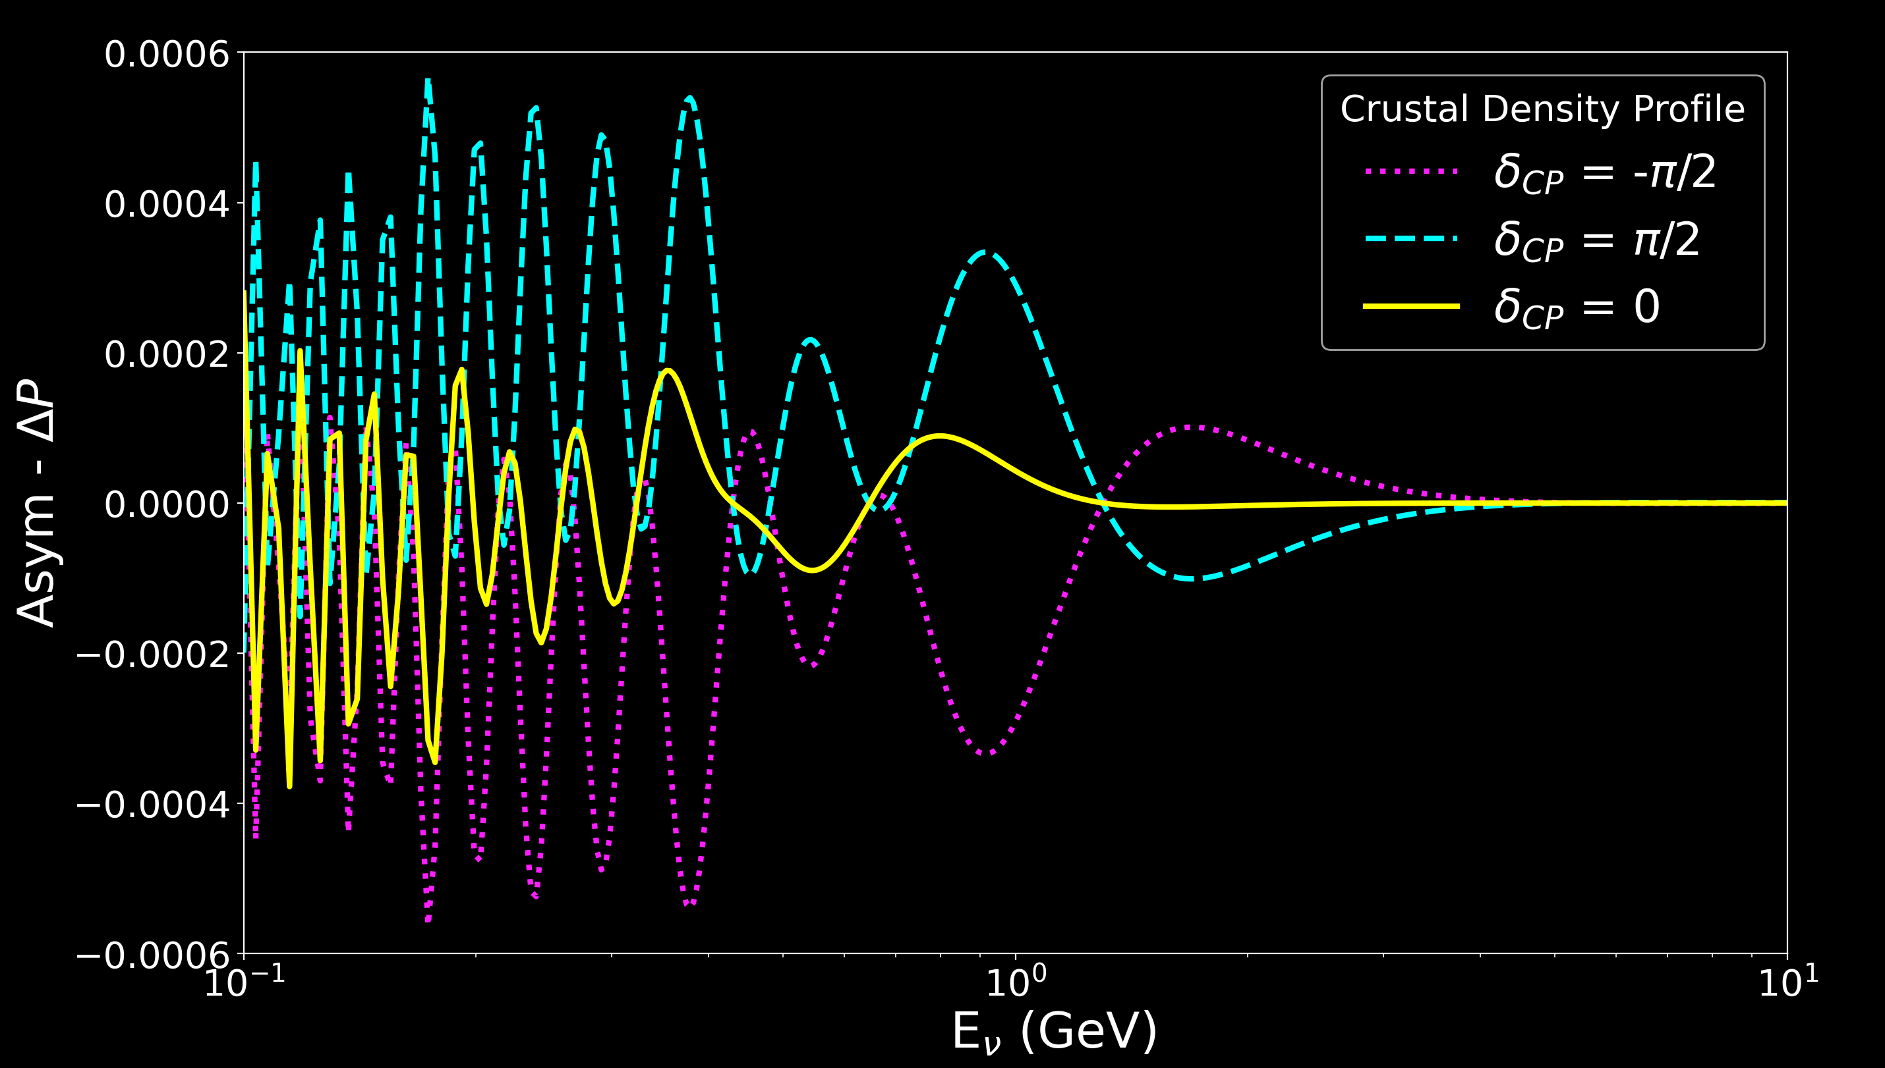
Realistic Matter Effects for 3-Flavors
NO
NO
Details for Crustal Density Profile:
https://ui.adsabs.harvard.edu/abs/2013EGUGA..15.2658L/abstract
K J Kelly and S J Parke (2018) arXiv:1802.06784
1300 km (DUNE-like baseline)
Asymmetric matter density profile
17
PIKIMO Fall 2024

Slide 38
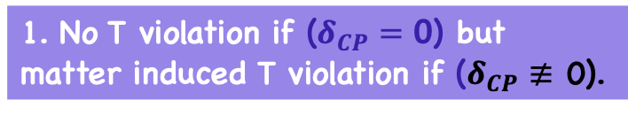
Realistic Matter Effects for 3-Flavors
NO
NO
1. No T violation if ($δ_{CP}=$ 0) but matter induced T violation if ($δ_{CP}$ $≢$ 0).
17
PIKIMO Fall 2024

Slide 39
Realistic Matter Effects for 3-Flavors
NO
NO
2. Meaning: for DUNE-like parameters, even in an extreme asymmetric matter, the density profile is symmetric enough not to induce any meaningful T-invariance violation if there is no intrinsic CP violation.
1. No T violation if ($δ_{CP}=$ 0) but matter induced T violation if ($δ_{CP}$ $≢$ 0).
17
PIKIMO Fall 2024

Slide 40
Realistic Matter Effects for 3-Flavors
NO
NO
3. T-invariance violation that is induced by the matter profile’s asymmetry.
17
PIKIMO Fall 2024

Slide 41
Realistic Matter Effects for 3-Flavors
NO
NO
4. The amount of T-violation due to the matter profile’s asymmetry, regardless of intrinsic CP violation, is insignificant and immeasurable at DUNE-like experiments.
3. T-invariance violation that is induced by the matter profile’s asymmetry.
17
PIKIMO Fall 2024

Slide 42
Main Takeaways
This study looked at how much time invariance violation (if at all) can be observed in neutrino oscillations, and their relation to simple neutrino matter potential models.
Symmetric potentials cannot induce time violation, but if time invariance is intrinsically violated, the matter potential simply changes the degree of the observed effects.
Symmetric potentials provide probes into proper time invariance.
Non-symmetric matter potentials can induce improper time violation, while proper time violation is more protected.
Realistic matter profiles induce immeasurable T violation effects for DUNE-like parameters.
18
PIKIMO Fall 2024

Slide 43
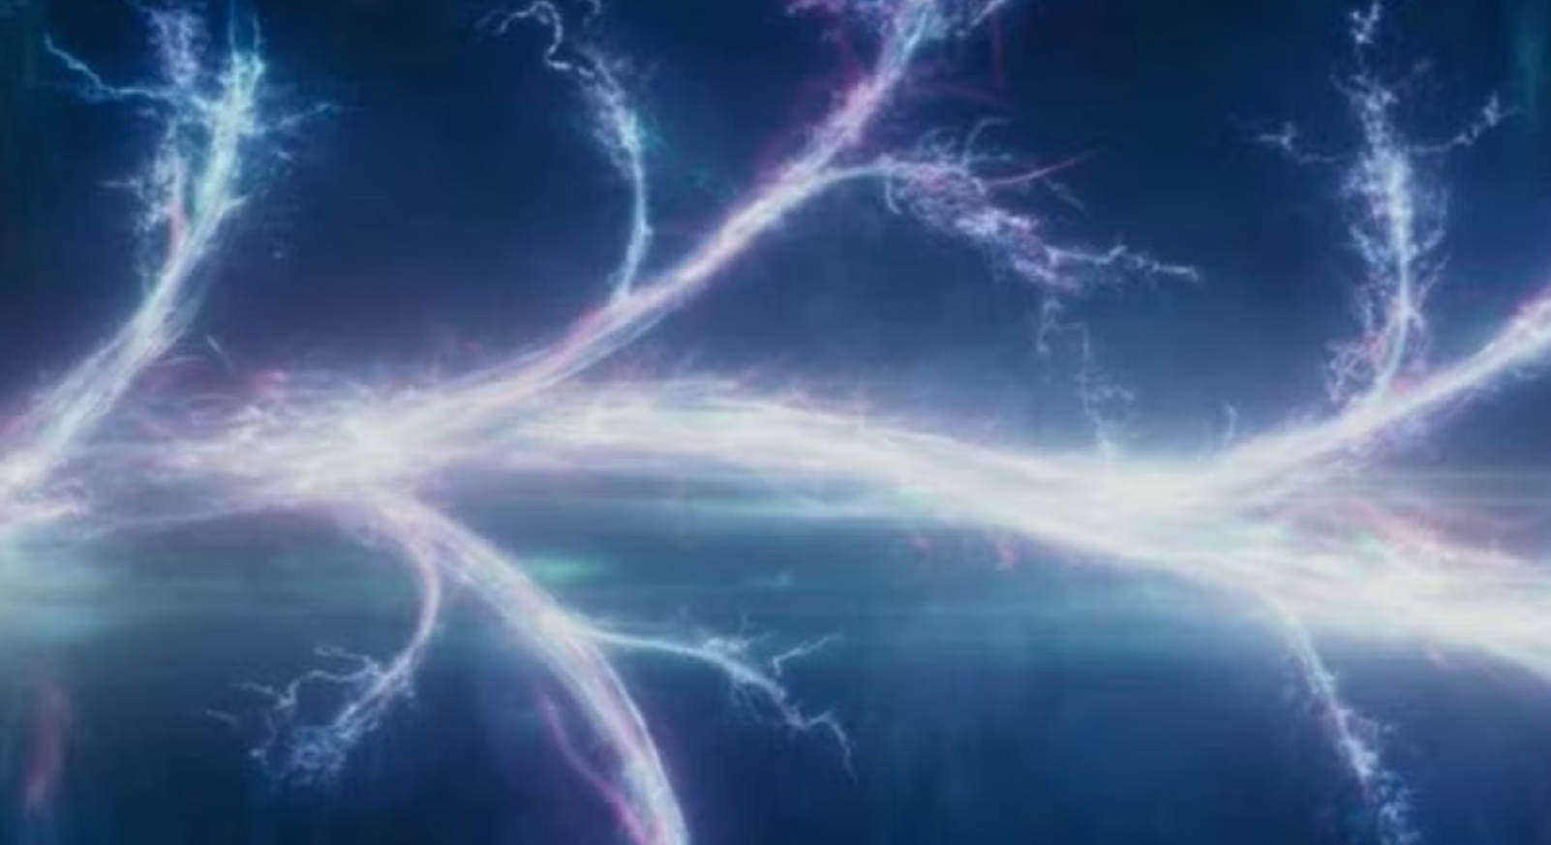



$v_{τ }$
$v_{μ}$
Thank You!
${ v}_{e}$

Slide 44
Backups

Slide 45
Past T invariance studies include:
This list is far from complete, but just to get a sense of the progress made over the years…
Discussions on possible Long-Baseline tests and future neutrino factories:
J. Arafune & J. Sato (arXiv: 9607437))
T. Miura, E. Takasugi, Y. Kuno, M. Yoshimura (arXiv: 0102111)
T. Schwetz & A. Segarra
(arXiv : 2106.16099 & arXiv: 2112.08801)
S. S. Chatterjee, S. Patra, T. Schwetz, K. Sharma (arXiv: 2408.06419)
Formalism developed in the late 1980s:
T.K. Kuo & J. Pantaleone (Phys. Lett. B 198 (1987))
S. Toshev (Phys. Lett. B 226 (1989) )
Details relating to characteristics extracted from neutrino probabilities developed (including oscillation parameters, Jarlskog invariant etc):
M. Blom & H. Minakata (arXiv: 0404142)
P. F. Harrison & W. G. Scott (arXiv: 9912435)
S. T. Petcov & Y-L. Zhou (arXiv: 1806.09112)
Z-Z. Xing (arXiv: 1304.7606)
S. J. Parke & T. J. Weiler (arXiv: 0011247)
E.Kh. Akhmedov, P. Huber, M. Lindner, T. Ohlsson (arXiv: 0105029)
J. Bernabeu & A. Segarra (arXiv: 1901.02761)
Exact formulaic derivations:
T K. Kimura , A. Takamura , H. Yokomakura (Physics Letters B 537 (2002))
O. Yasuda (https://doi.org/10.3390/e26060472)
PIKIMO Fall 2024

Slide 46
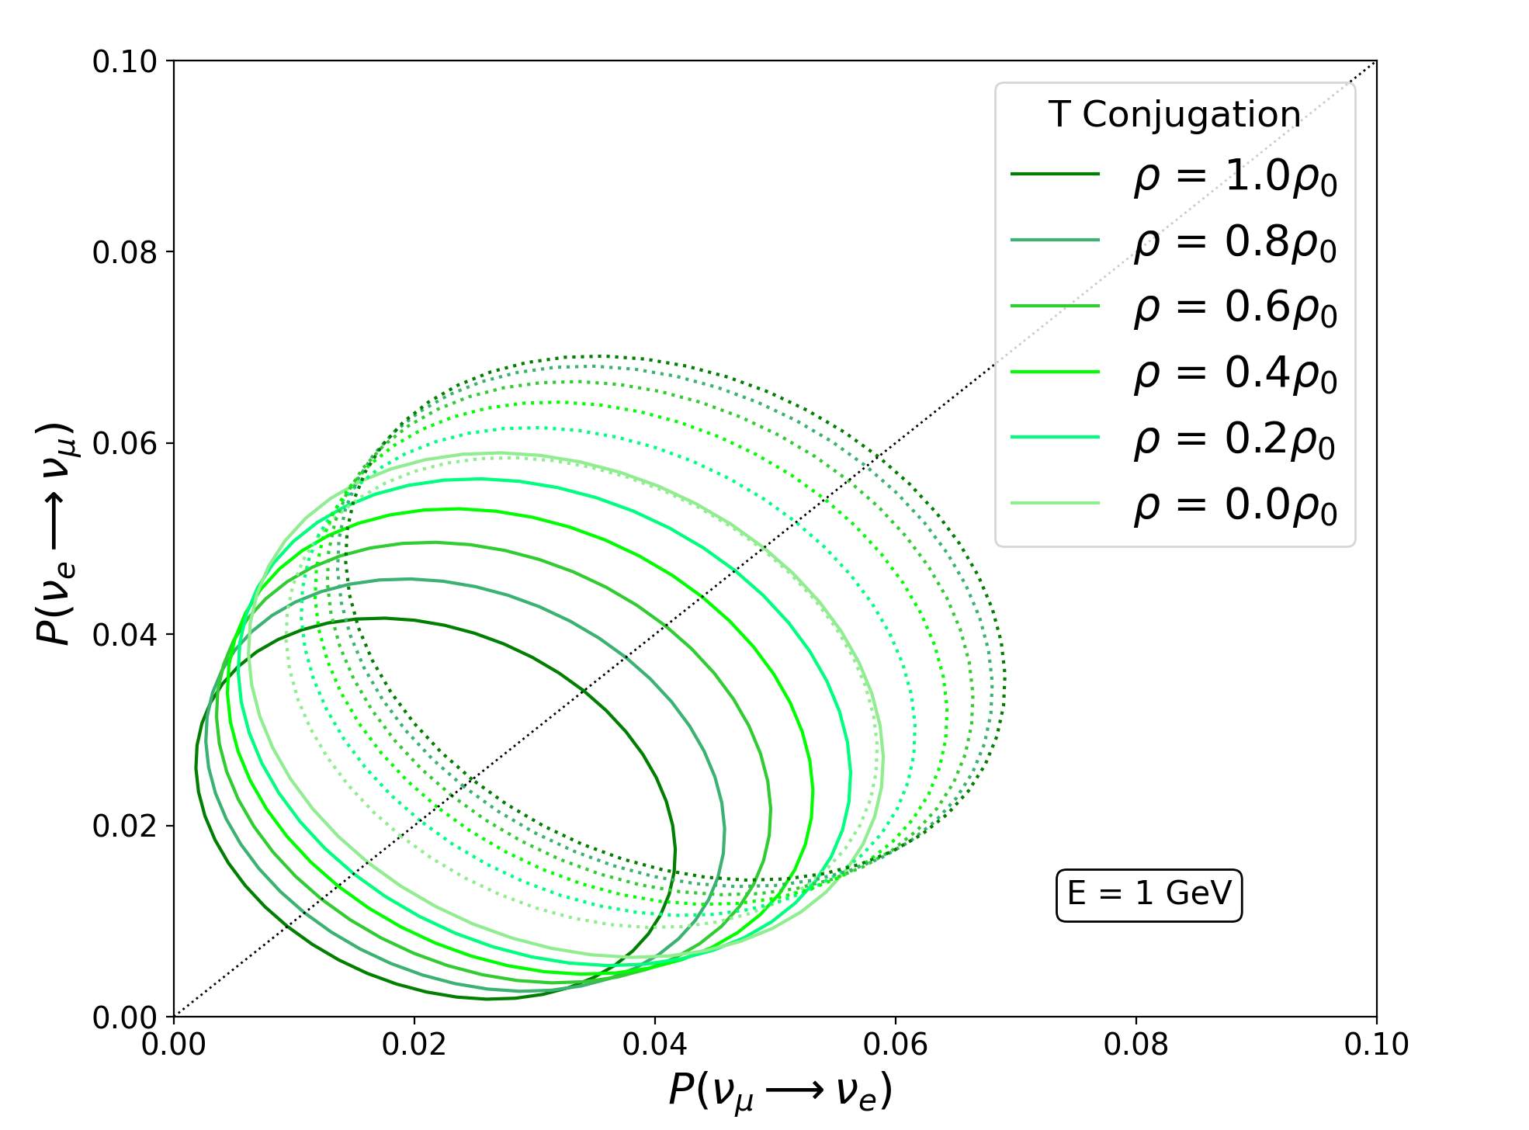
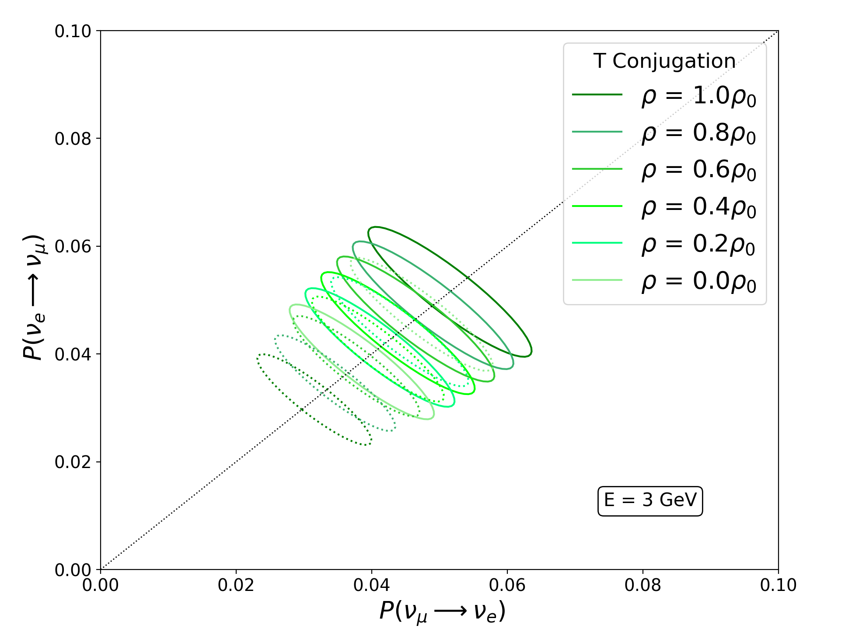
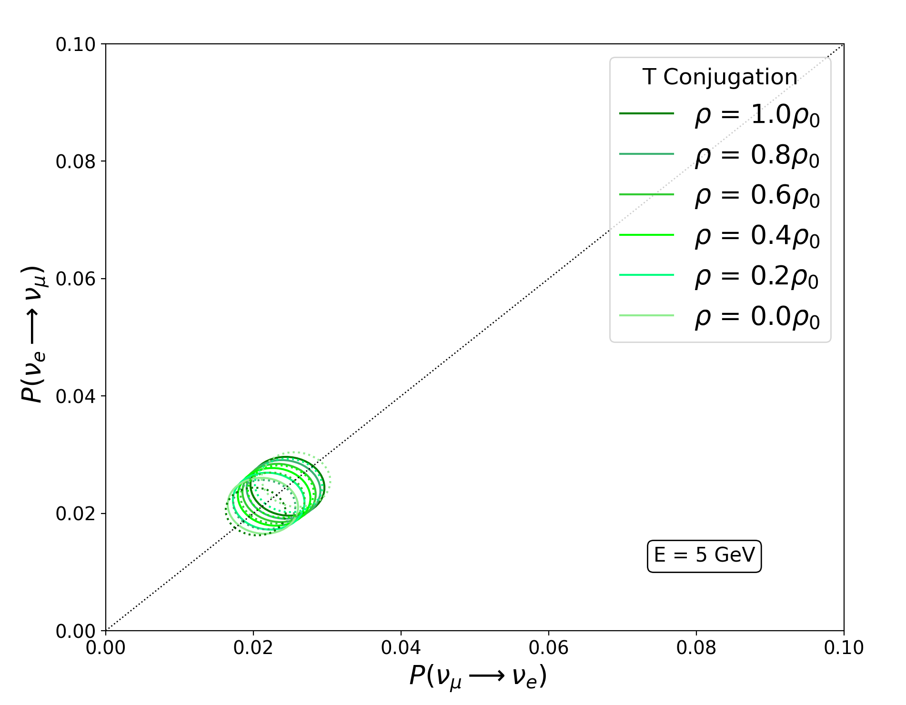
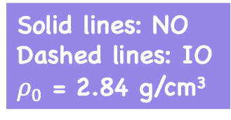
Bi-Probability Plots
Solid lines: NO
Dashed lines: IO
$ρ_{0}$ = 2.84 g/cm³
Showing the impact of neutrino mass ordering and energy on T-conjugation via bi-probability plots
PIKIMO Fall 2024

Slide 47
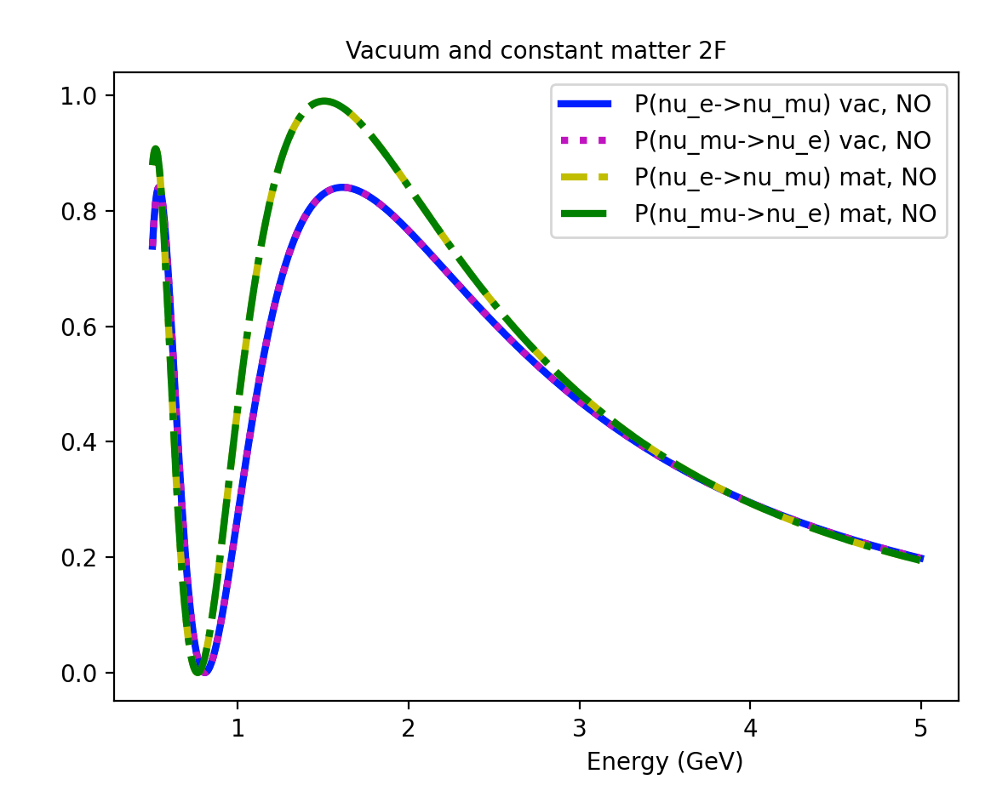
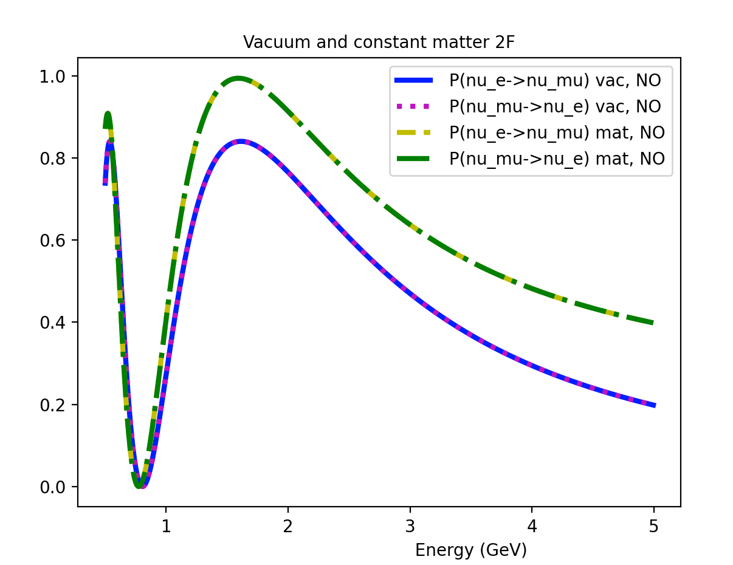








Symmetric matter effects for 2-Flavors (Normal Ordering, Baseline: 2000 km)
constant matter potential:
A $≈$ 5*10⁻⁴ eV²/GeV (2.6 g/cm³)
NSI + constant matter potential:
A $≈$ 5*10⁻⁴ eV²/GeV (2.6 g/cm³)
B $≈$ i * 2.5*10⁻⁴ eV²/GeV (1.3 g/cm³)
$P_{v_{μ}→v_{e}}$ & $P_{{v_{e}→v}_{μ}}$
$P_{v_{μ}→v_{e}}$ & $P_{{v_{e}→v}_{μ}}$
$P_{{v_{e}→v}_{μ}}$ (vacuum, NO)
$P_{v_{μ}→v_{e}}$ (vacuum, NO)
$P_{{v_{e}→v}_{μ}}$ (constant matter, NO)
$P_{v_{μ}→v_{e}}$ (constant matter, NO)
$P_{{v_{e}→v}_{μ}}$ (vacuum, NO)
$P_{v_{μ}→v_{e}}$ (vacuum, NO)
$P_{{v_{e}→v}_{μ}}$ (constant matter, NO)
$P_{v_{μ}→v_{e}}$ (constant matter, NO)
matter channels
matter channels
$$P_{v_{α}→v_{β} }$$
$$P_{v_{α}→v_{β} }$$
vacuum channels
vacuum channels
$α$, $β$ -> [$μ, e]$
PIKIMO Fall 2024

Slide 48
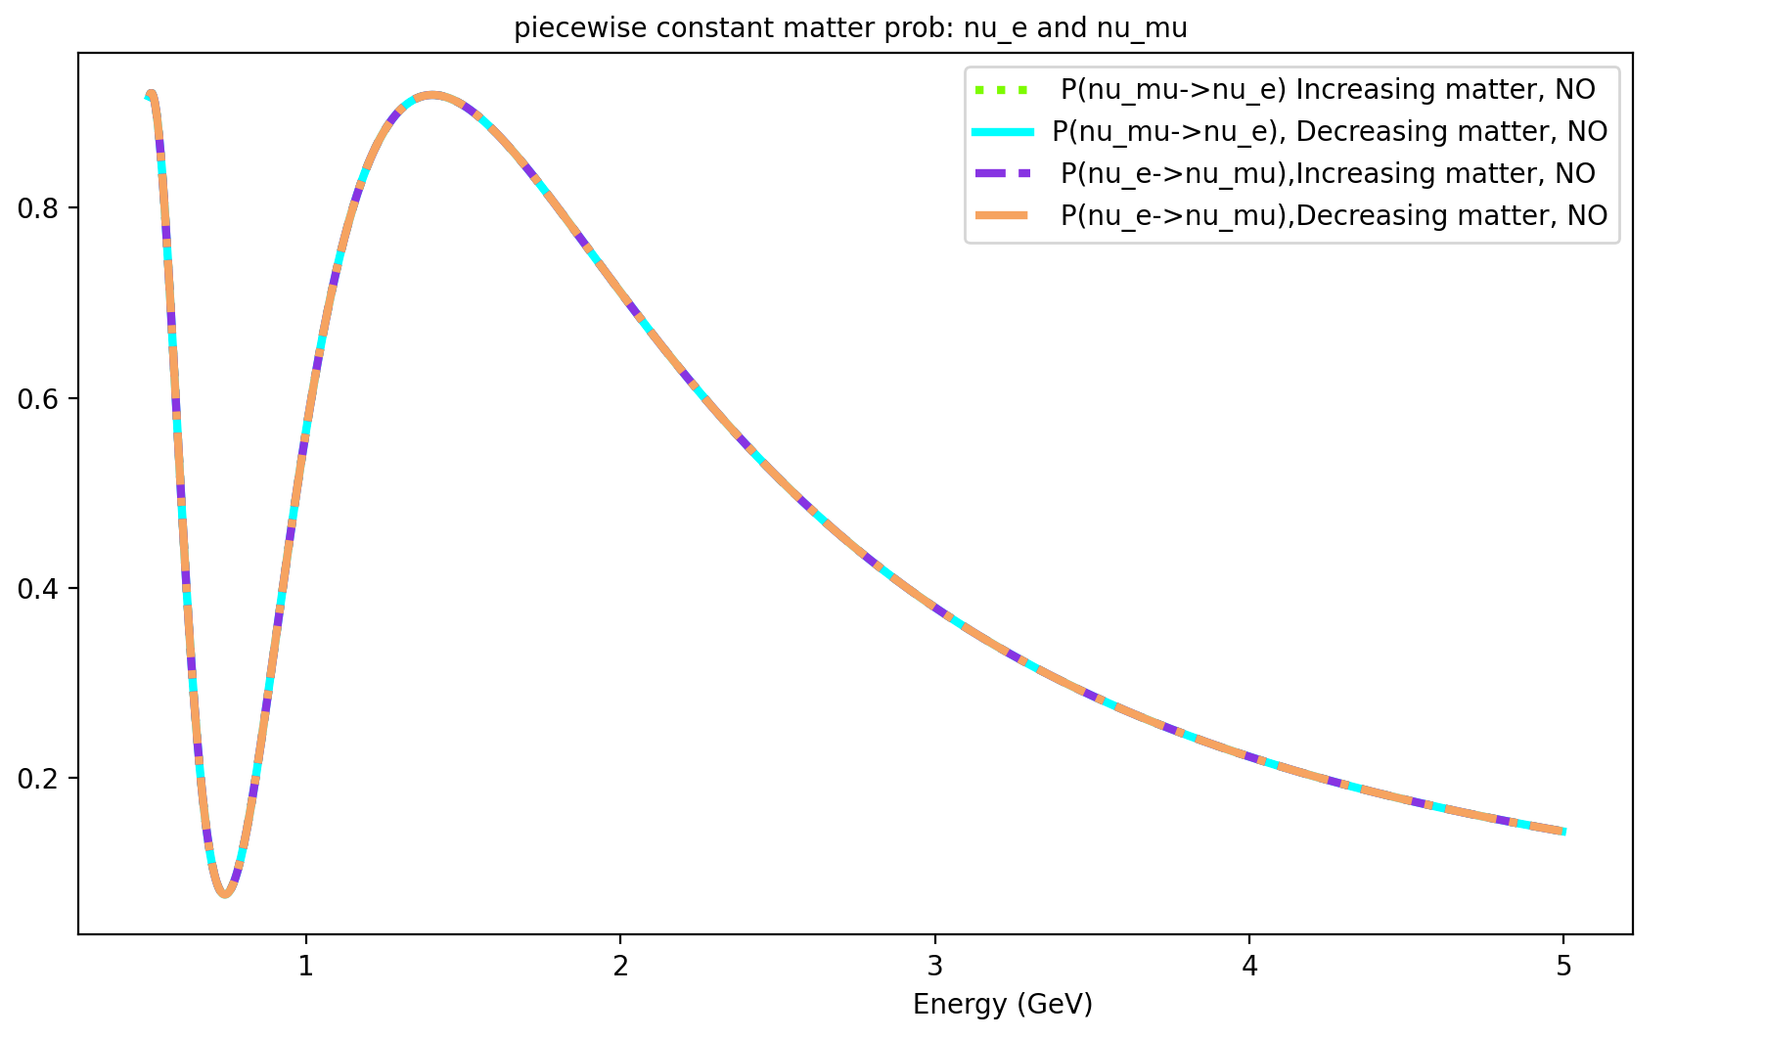
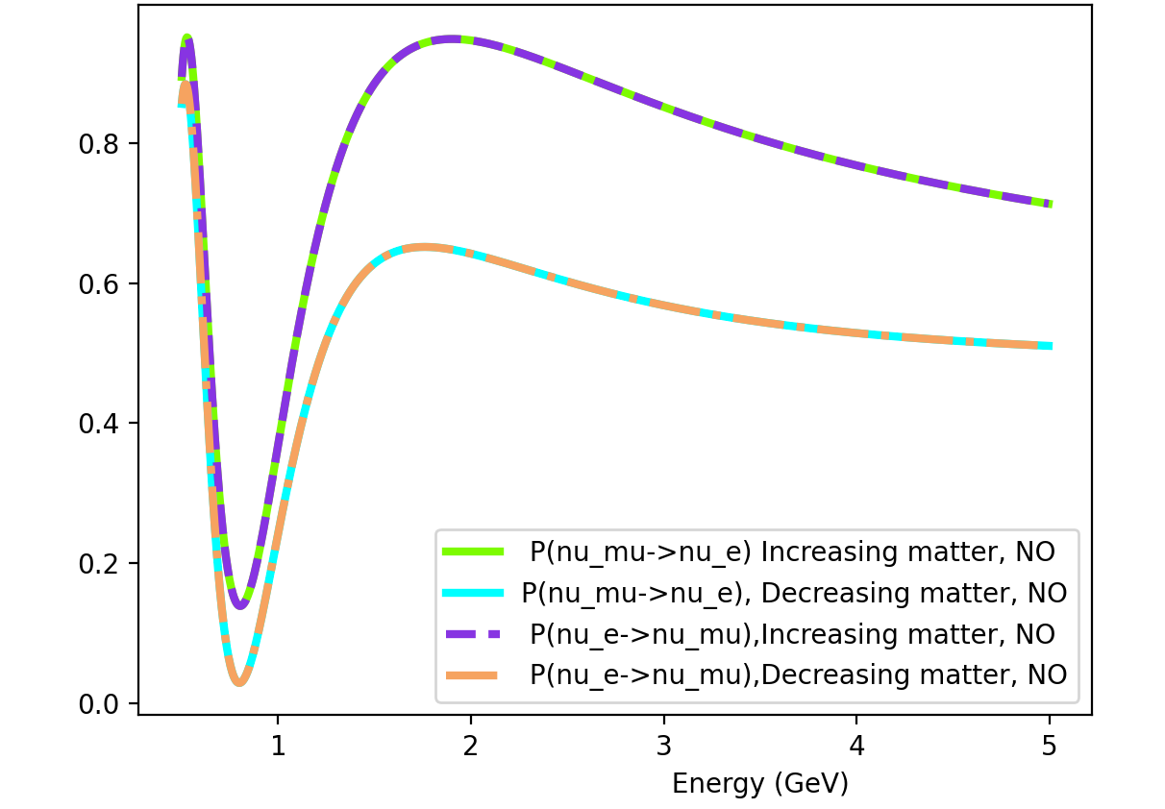




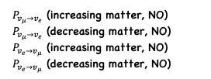

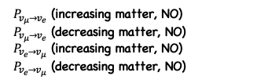
Non-symmetric matter effects for 2-Flavors (Normal Ordering, Baseline: 2000 km)
2 step constant matter potential:
A1 $≈$ 5*10⁻⁴ eV²/GeV (2.6 g/cm³)
A2 $≈$ 1.5*10⁻³ eV²/GeV (7.8 g/cm³)
NSI + 2 step constant matter potential:
A1 $≈$ 5*10⁻⁴ eV²/GeV (2.6 g/cm³)
B1 $≈$ i * 2.5*10⁻⁴ eV²/GeV (1.3 g/cm³)
A2 $≈$ 1.5*10⁻³ eV²/GeV (7.8 g/cm³)
B2 $≈$ i * 7.5*10⁻⁴ eV²/GeV (3.9 g/cm³)
$P_{v_{μ}→v_{e}}$ & $P_{{v_{e}→v}_{μ}}$
$P_{v_{μ}→v_{e}}$ (increasing matter, NO)
$P_{v_{μ}→v_{e}}$ (decreasing matter, NO)
$P_{{v_{e}→v}_{μ}}$ (increasing matter, NO)
$P_{{v_{e}→v}_{μ}}$ (decreasing matter, NO)
$P_{v_{μ}→v_{e}}$ & $P_{{v_{e}→v}_{μ}}$
increasing matter
$$P_{v_{α}→v_{β} }$$
2 flavors (general)
2 step constant matter potential
A1 $≈$ 5*10⁻⁴ eV²/GeV
A2 $≈$ 15*10⁻⁴ eV²/GeV
b1 $≈$ i * 2.5*10⁻⁴ eV²/GeV
b2 $≈$ i * 7.5*10⁻⁴ eV²/GeV
decreasing matter
$$P_{v_{α}→v_{β} }$$
$P_{v_{μ}→v_{e}}$ (increasing matter, NO)
$P_{v_{μ}→v_{e}}$ (decreasing matter, NO)
$P_{{v_{e}→v}_{μ}}$ (increasing matter, NO)
$P_{{v_{e}→v}_{μ}}$ (decreasing matter, NO)
$α$, $β$ -> [$μ, e]$
PIKIMO Fall 2024

Slide 49
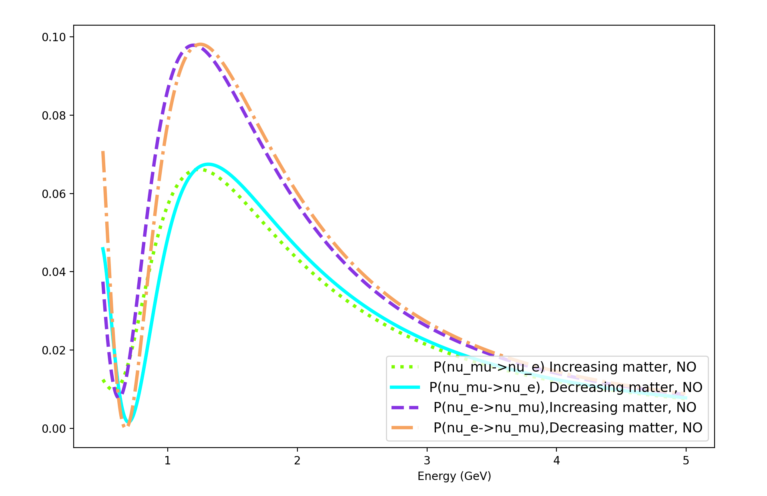
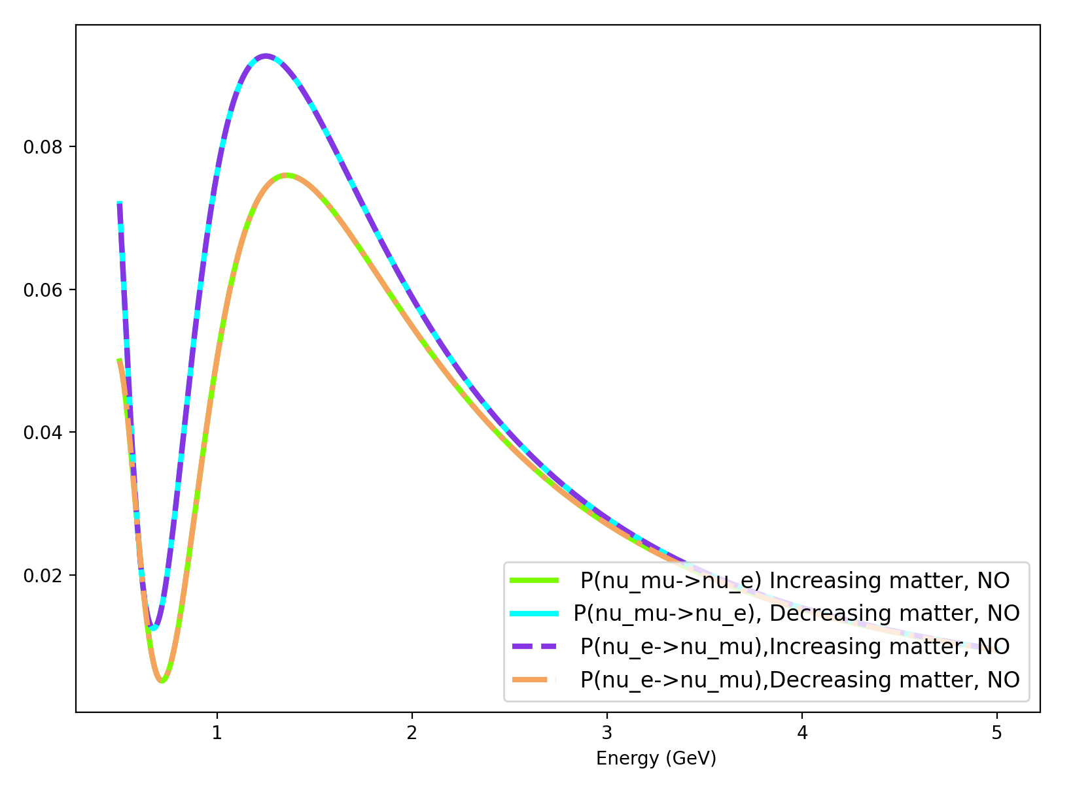







Non-symmetric matter effects for 3-Flavors, 3-Steps (Normal Ordering, Baseline: 2000 km)
3 step constant matter potential:
A1 $≈$ 5.0*10⁻⁴ eV²/GeV (2.6 g/cm³)
A2 $≈$ 1.5*10⁻³ eV²/GeV (7.8 g/cm³)
A3 $≈$ 3.0*10⁻³ eV²/GeV (15.6 g/cm³)
$P_{v_{μ}→v_{e}}$ & $P_{{v_{e}→v}_{μ}}$
$δ_{CP}$ = 90
$P_{v_{μ}→v_{e}}$ & $P_{{v_{e}→v}_{μ}}$
Proper channels are the same
$$P_{v_{α}→v_{β} }$$
$$P_{v_{α}→v_{β} }$$
$P_{v_{μ}→v_{e}}$ (increasing matter, NO)
$P_{v_{μ}→v_{e}}$ (decreasing matter, NO)
$P_{{v_{e}→v}_{μ}}$ (increasing matter, NO)
$P_{{v_{e}→v}_{μ}}$ (decreasing matter, NO)
$P_{v_{μ}→v_{e}}$ (increasing matter, NO)
$P_{v_{μ}→v_{e}}$ (decreasing matter, NO)
$P_{{v_{e}→v}_{μ}}$ (increasing matter, NO)
$P_{{v_{e}→v}_{μ}}$ (decreasing matter, NO)
$δ_{CP}$ = 0
$α$, $β$ -> [$μ, e]$
PIKIMO Fall 2024

Slide 50



Recalling 3-Flavor Neutrino Oscillations with charge-current matter effects
We include matter effects explicitly from the following prescription for the probabilities (useful in the context of this study):
$$P_{v_{α}→v_{β} }={\left|<v_{β}(0)|v_{α}\left(L\right)>\right|}^{2}$$
$|v_{α}\left(L\right)>$ = $U$ $|v_{α}\left(0\right)>$
where
U =$e^{−iLH}$
(H = H_{vacuum} + H_{matter})
with
PIKIMO Fall 2024

Slide 51
Recalling 3-Flavor Neutrino Oscillations with charge-current matter effects
As an example for a Baseline L, let’s break L up into 2 steps: L₁ and L_{2,} where each evolution U(L) will model different matter potentials A₁ and A₂ respectively.
PIKIMO Fall 2024

Slide 52



Recalling 3-Flavor Neutrino Oscillations with charge-current matter effects
As an example for a Baseline L, let’s break L up into 2 steps: L₁ and L_{2,} where each evolution U(L) will model different matter potentials A₁ and A₂ respectively.
U₁ =$e^{−iL_{1}H_{1}}$
&
U₂ =$e^{−iL_{2}H_{2}}$
where H_{i} contain different matter effects in the form:
A_{i} = $\sqrt{2}G_{F}N_{e}$ -> constant
PIKIMO Fall 2024

Slide 53




Recalling 3-Flavor Neutrino Oscillations with charge-current matter effects
In principle, one could consider an n multistep matter potential A = where each step is itself a constant matter potential (piecewise constant).
$$\sum_{i=1}^{n}{A_{i}}$$
n=2
n=1
PIKIMO Fall 2024

Slide 54
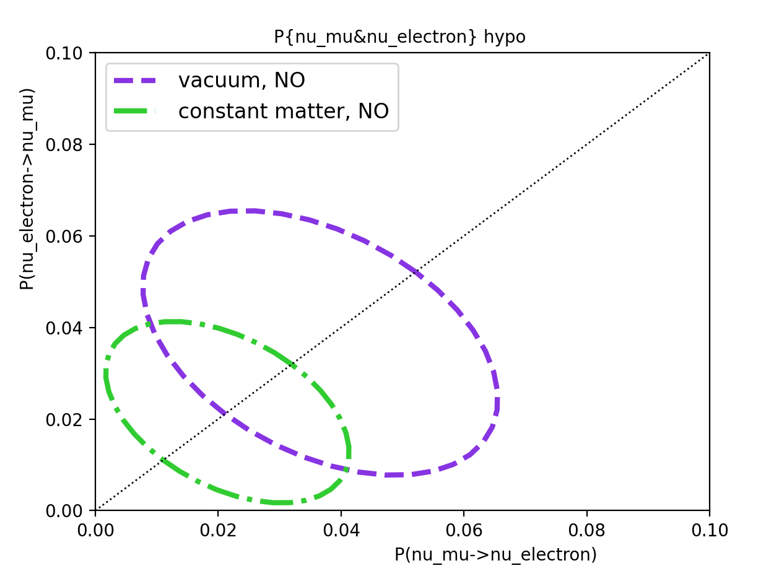
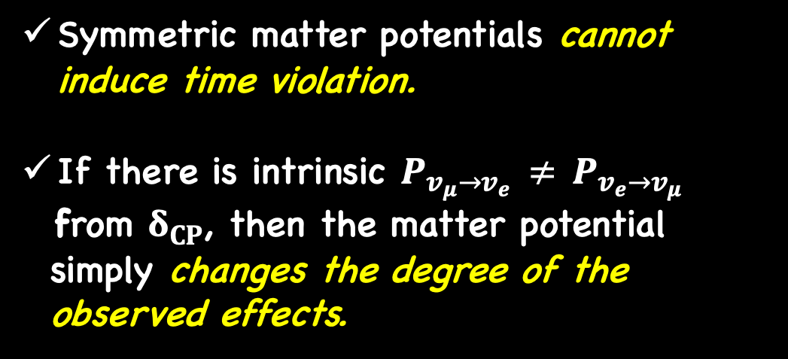


Symmetric matter effects for 3-Flavors
$P_{v_{μ}→v_{e}}$ & $P_{{v_{e}→v}_{μ}}$
Symmetric matter potentials cannot induce time violation.
If there is intrinsic $P_{v_{μ}→v_{e}}$ $≠$ $P_{{v_{e}→v}_{μ}}$
from $δ_{CP}$, then the matter potential
simply changes the degree of the
observed effects.
E = 1.5 GeV
$$P_{{v_{e}→v}_{μ}}$$
$$P_{v_{μ}→v_{e}}$$
PIKIMO Fall 2024

Slide 55
Symmetric matter effects for 3-Flavors
Note: Improper and proper comparisons are the same if the matter potential is symmetric.
Why?
  A single constant matter potential is by construction symmetric.
  We cannot tell the two measures apart if “exchanging source and detector” gives the same results.
$P_{v_{μ}→v_{e}}$ & $P_{{v_{e}→v}_{μ}}$
E = 1.5 GeV
$$P_{{v_{e}→v}_{μ}}$$
$$P_{v_{μ}→v_{e}}$$
PIKIMO Fall 2024

Slide 56
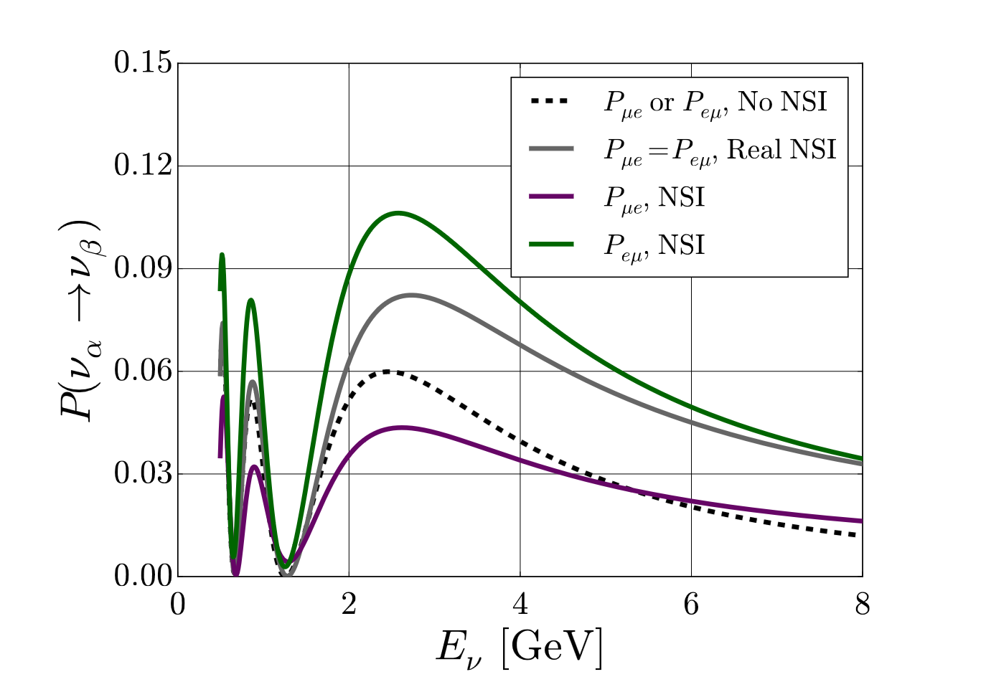
Future Studies
Interesting probes in cases where matter induced time violation occurs and/or realistic models are non-symmetric:
  Center of the Earth (annihilating dark matter to neutrinos scenario)
  Geo neutrinos (properties/applications)
Next steps include NSI time invariance probes applicable to DUNE, (a follow-up to previous work).
A. de Gouvêa & K. Kelly (2016) arXiv: 1511.05562
PIKIMO Fall 2024

