Slide 1
Project update 23/01/25
Mathias Zurbriggen

Slide 2
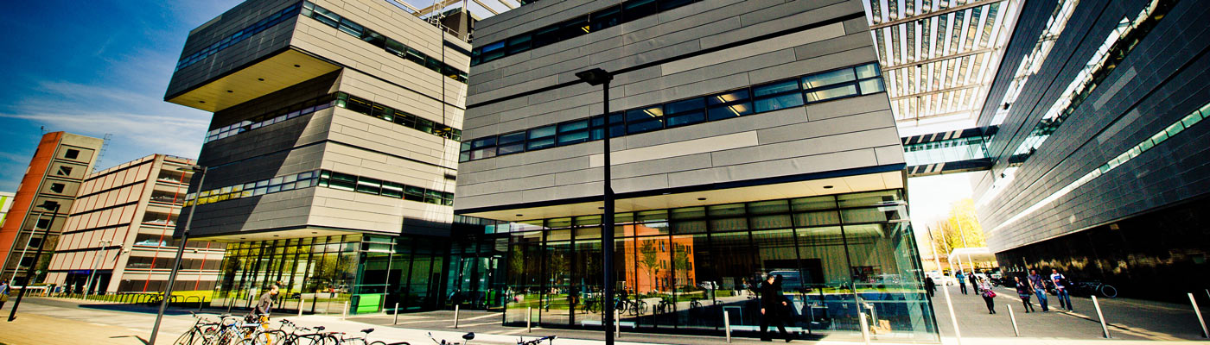
Graphene transfer
Vacuum oven identified within university facilities!
  The Photon Science Institute (just round the corner) seems to have one which is free to use for university registered PGRs
  This is pending induction, health and risk, and review from the technicians
Alternatives include UV light source (used for curing of glues) or stronger solvent (PG remover or heated acetone)

Slide 3
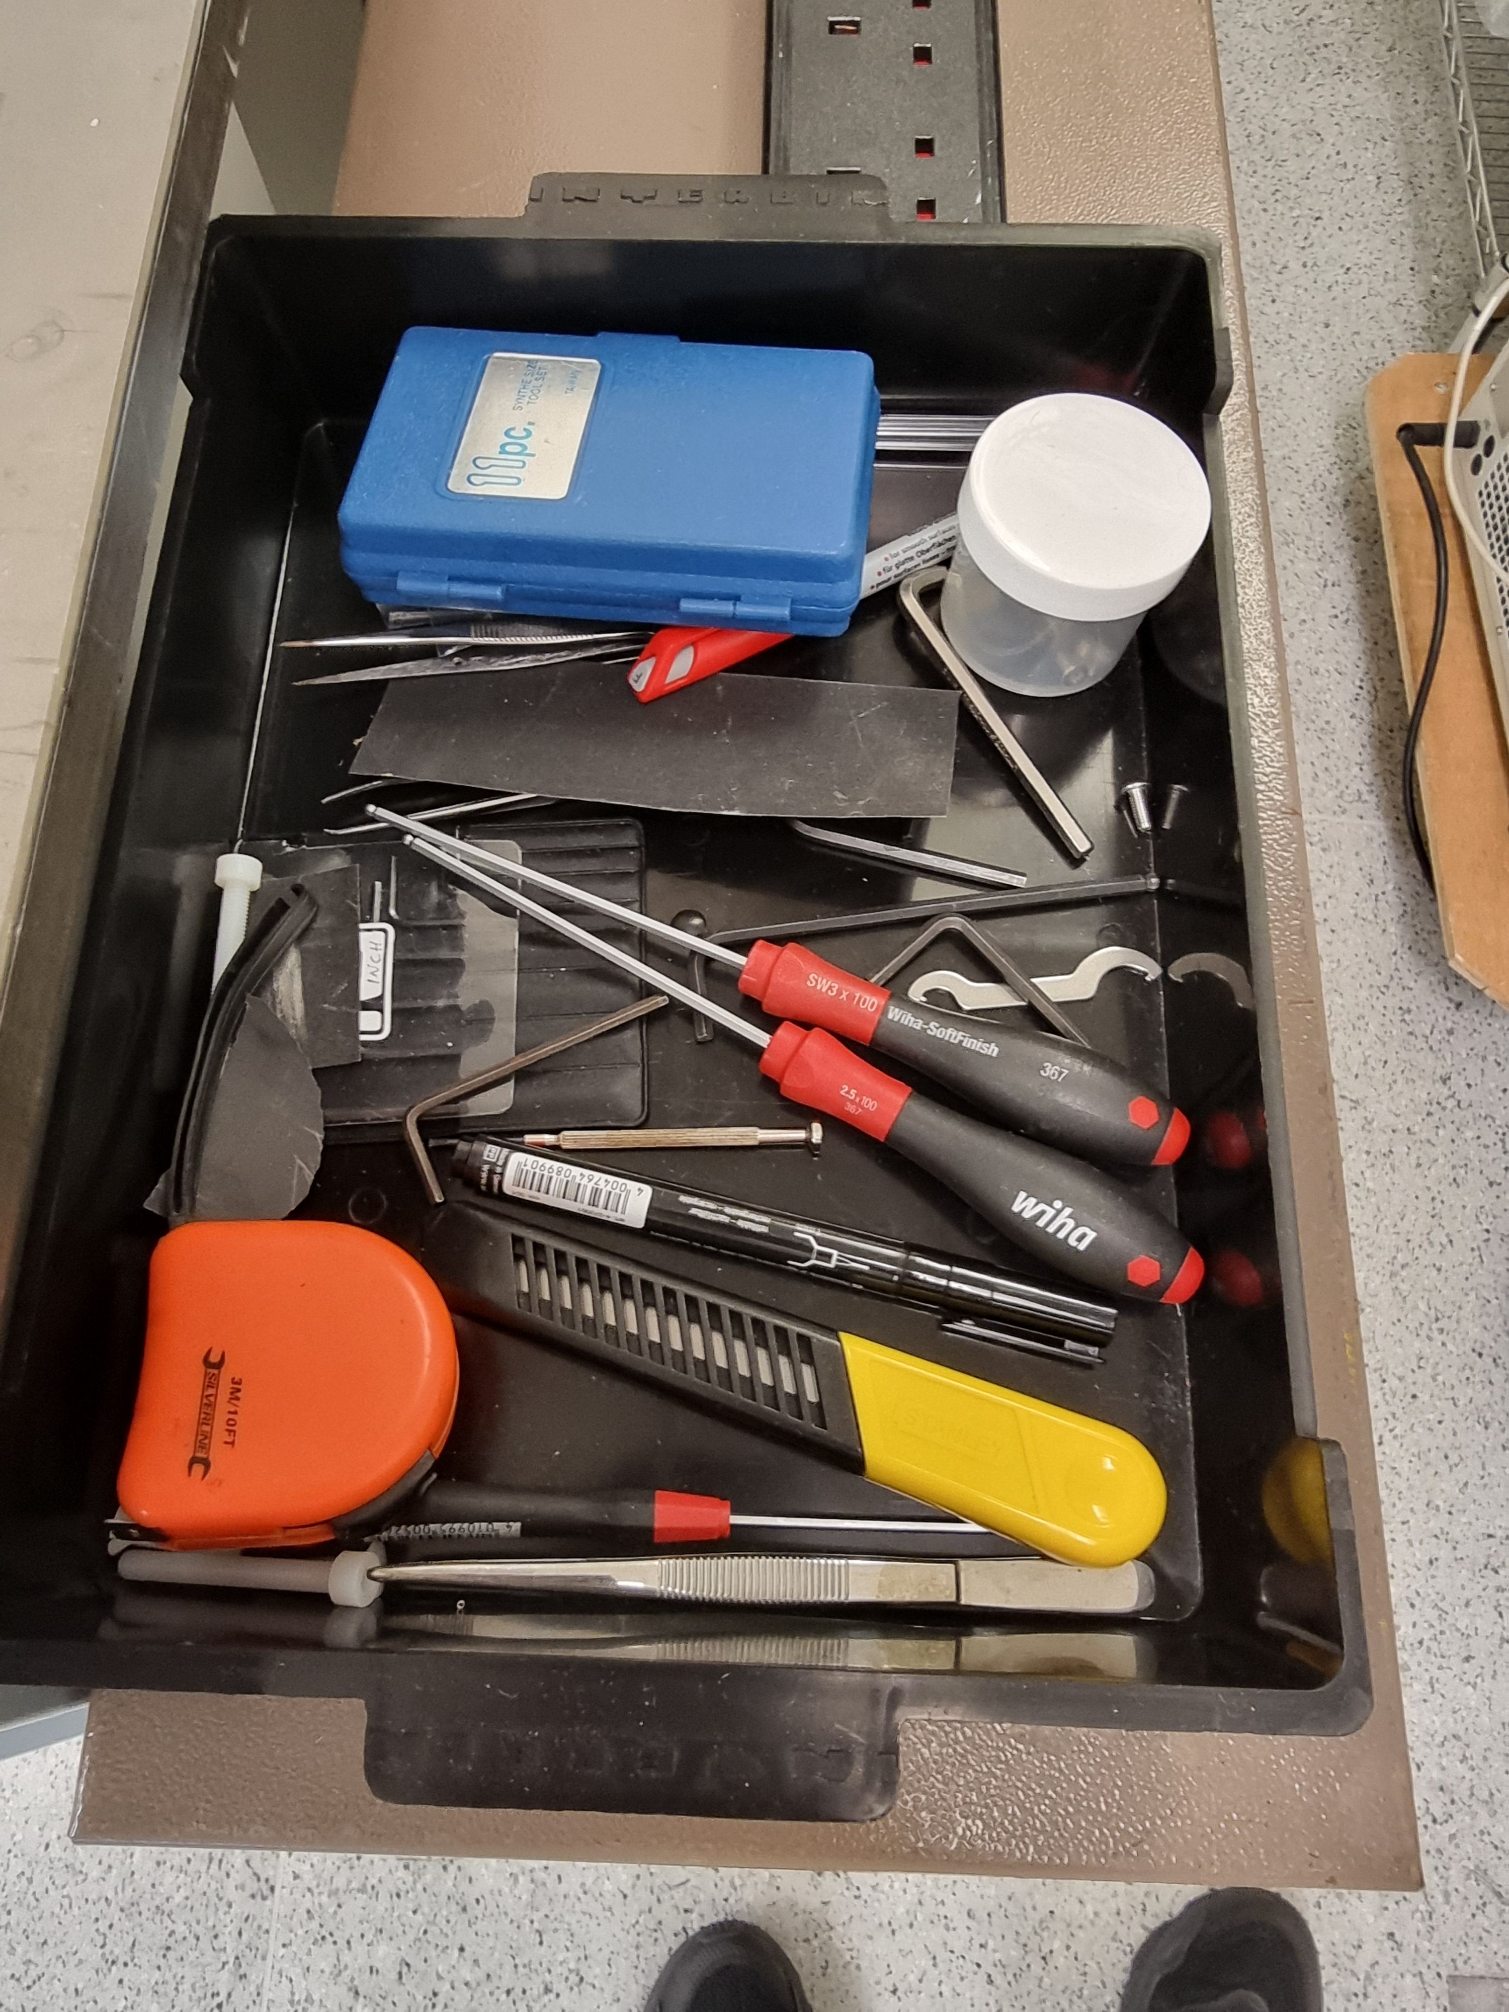
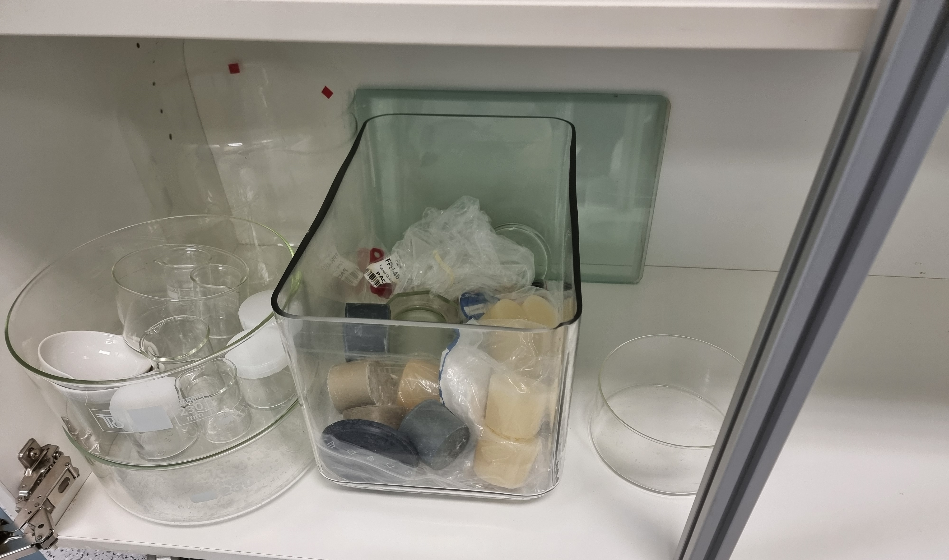
Graphene transfer
Items found on the 5th floor: bench to carry our work, tweezers, dishes, 100 deg C oven
Items ordered and now here: 1L of acetone, 1L of DI water
Missing: water dropper, but a syringe will do
Need some pliers to hold the window

Slide 4
Graphene transfer
To determine success of transfer:
  A USB microscope: take images of the sample after each step and to check for contamination
  Raman spectroscopy was used in unfinished paper to confirm number of layers of the graphene
    Redshift of the Raman data indicates PMMA removal
    Not sure about this as all other studies I found have SiO2 as window not MgF2
  AFM, atomic force microscopy, was used in other studies
    Can be used to view the surface before and after or;
    Returns a roughness number to quantify result and compare with other studies
  XPS, x-ray photoelectron spectroscopy, was also used in other studies
    the chemical states of PMMA have been well identified - https://doi.org/10.1002/sia.740170206
    This would likely be done after measurements have been taken
    https://doi.org/10.1016/j.carbon.2020.11.047

Slide 5
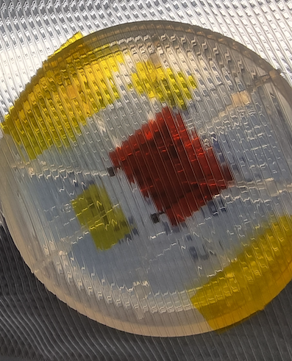
aSe detector
The detectors already come with connections that need to be extended (by soldering) to fit in the mounting to PCB of the flash lamp set-up
Solder here

Slide 6
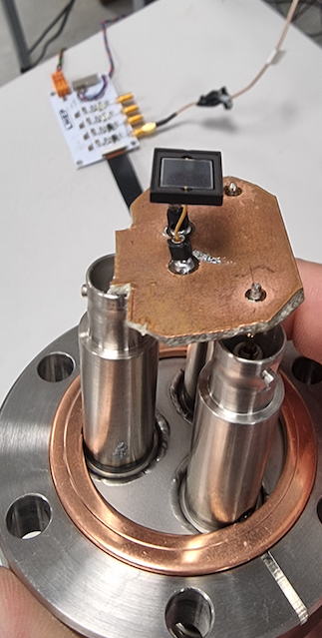
Flash lamp
Was not able to run set-up last time as at first the chamber wouldn’t reach correct vacuum and then the Sipm was found to have one of its connections broken
  Resoldering was attempted unsuccessfully
  Could be reused but likely needs cleaning and connectors reworked (re-tinning)

Slide 7
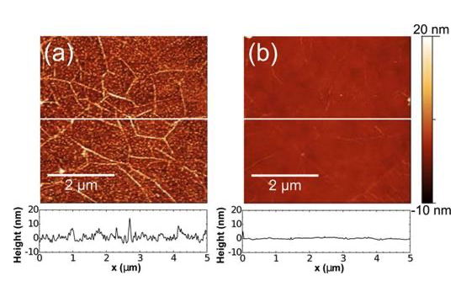
AFM
https://pubs.aip.org/aip/apl/article/99/12/122108/340687/The-effect-of-chemical-residues-on-the-physical
RMS Roughness are 4.6nm (a) and 0.6nm (b)
5 × 5 μm² area used for imaging
Option with least processing/data analysis

