Slide 1
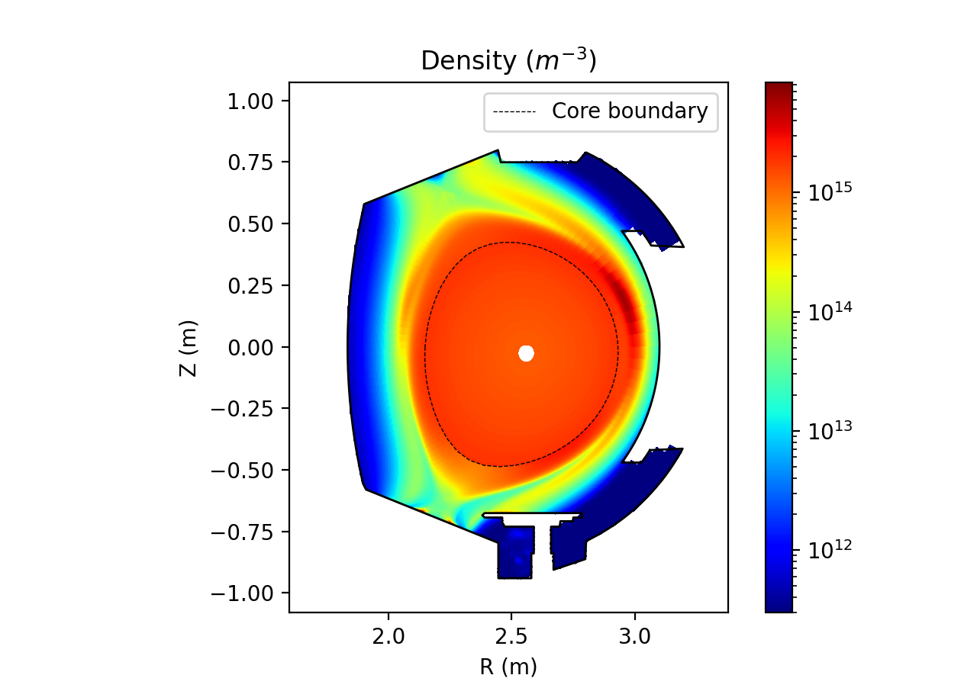


Integrated Modelling of Sources, Transport, and Radiation of Tungsten
N. Varadarajan¹, H. Bufferand¹, G. Ciraolo¹, P. Manas¹, S. Sureshkumar¹, A. Huart¹, N. Rivals¹, P. Tamain¹, J. Romazanov²
1 - IRFM, 13115 St. Paul lez Durance
2 - Forschungzentrum Julich, 52428 Jülich, Germany

Slide 2
Outline
Introduction & Motivations
Modelling Framework & Background
Validation of the Core Model
Analysis of W Transport
Conclusions & Outlook

Slide 3
Introduction and Motivations

Slide 4
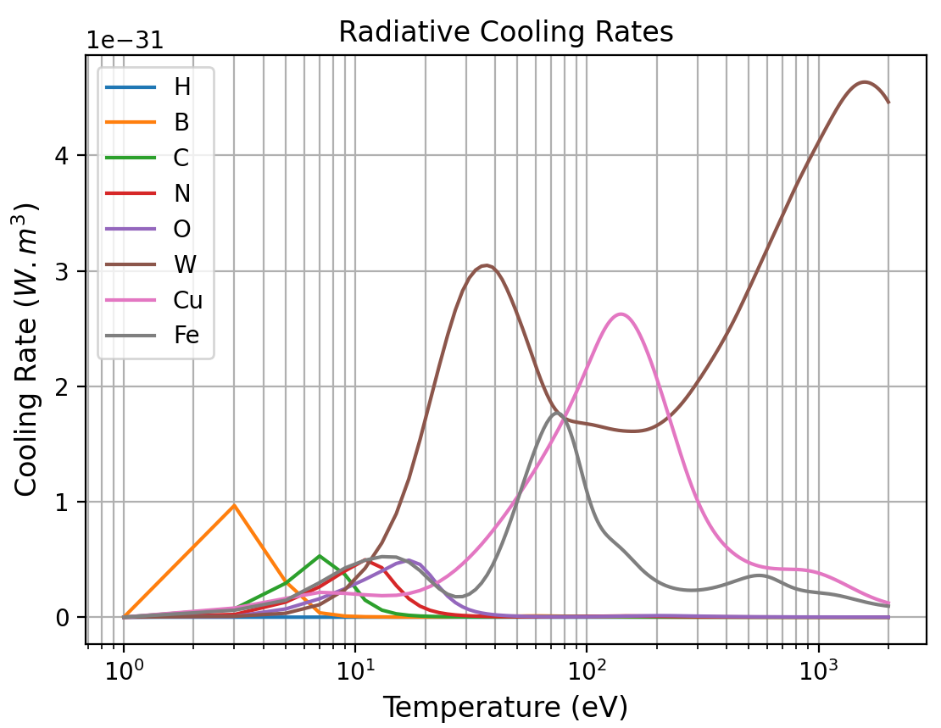
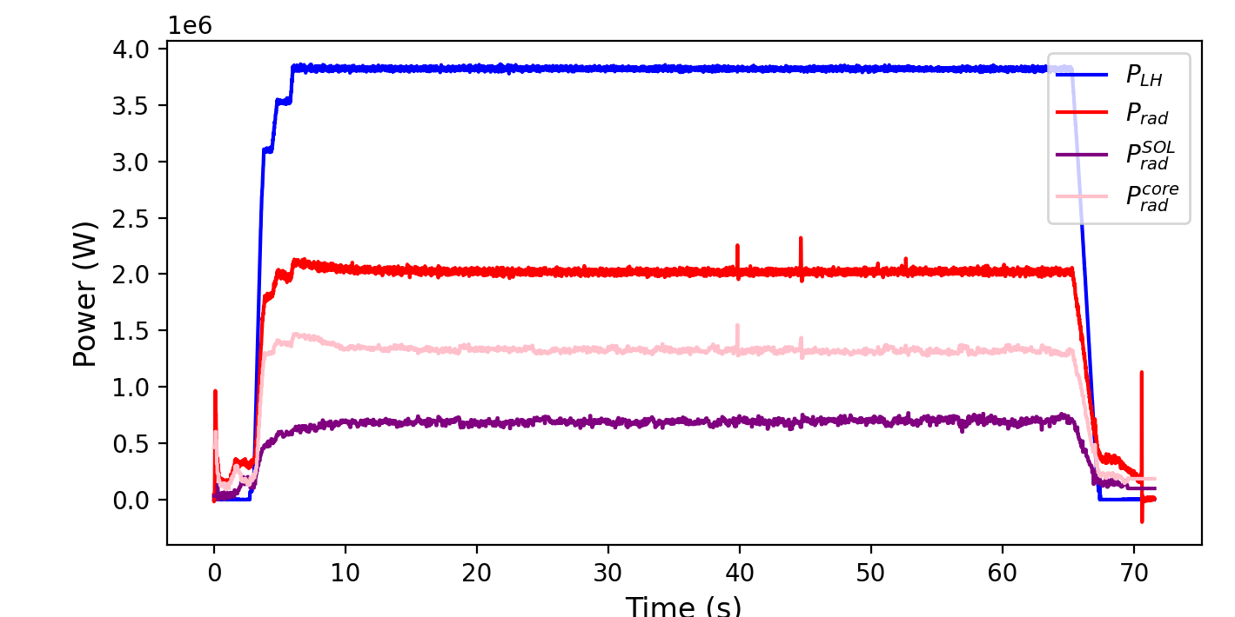
The Issue of Tungsten Radiation
Tungsten is the material of choice for first wall/divertor of several machines, for several reasons:
Low physical erosion and no chemical erosion
High melting point
Low tritium retention

Slide 5
Why Integrated Modelling?
For operation of current and future reactors, some of the key quantities to capture with modelling are:
Peak temperatures and densities in the core
Radiation in the core and edge by Tungsten, and consequently the power reaching the scrape-off layer
Heat and particle fluxes on the first wall, and consequently gross and net erosion
But, these are all interdependent => Self consistent integrated modelling needed

Slide 6
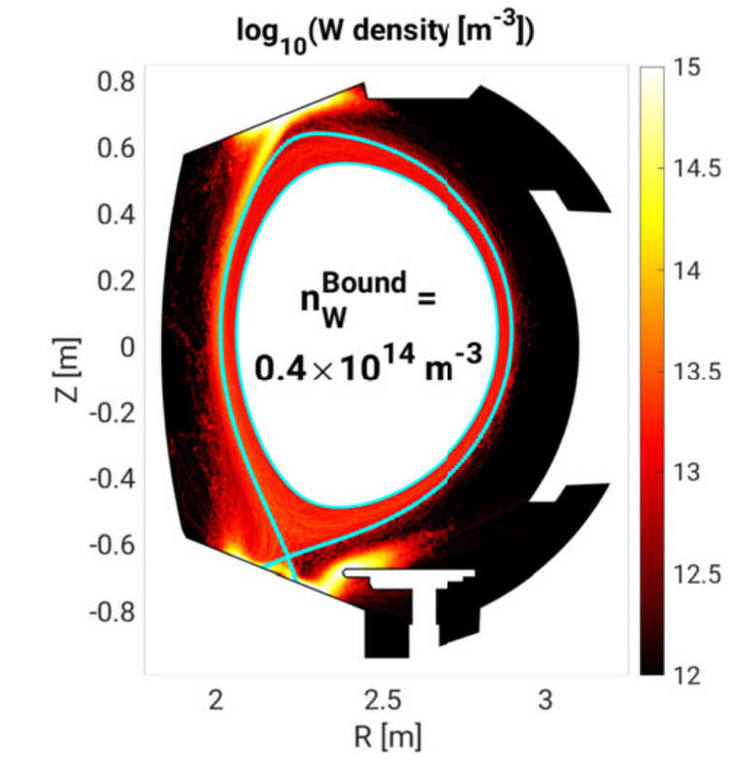
Existing Tungsten Workflow(s)
Background Plasma [Fluid]
Main Ion + Light Impurities [SOLEDGE-3X,SOLPS,EDGE2D]
Tungsten Transport [PIC]
ERO 2.0., WALLDYN3D, GITR
One-way coupling, so radiative impact of Tungsten on the main plasma unaccounted for.
AURORA,SICAS,JINTRAC, etc.: Similar to the approach used in this work
[S. di Genova J.Nuc.Mat 2023]

Slide 7
Modelling Framework and Background

Slide 8
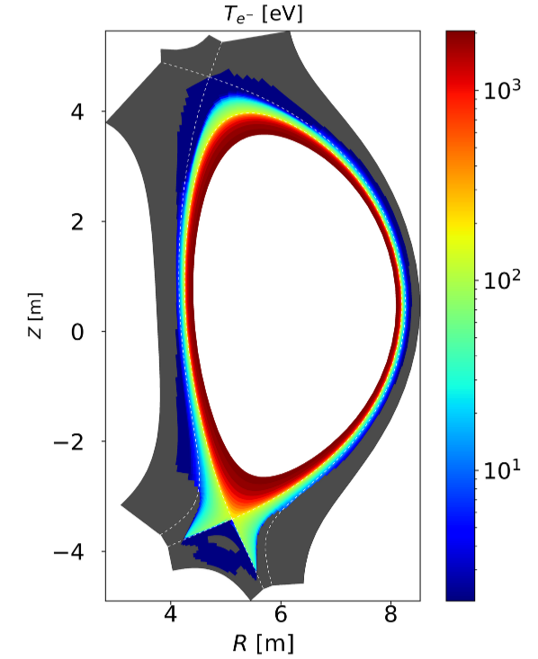
The SOLEDGE-3X Code
Flux-driven
Multi-fluid with Zhdanov closure
Edge-SOL up to first wall
Can run in either 2D “mean-field” or 3D
Native fluid neutrals model, or coupling to kinetic neutral code EIRENE
Sputtering/Redeposition
Core transport
2D Mean-field + Fluid Neutrals
[S. Sureshkumar]

Slide 9
Integrated Modelling Framework
EDGE-SOL PLASMA
“High-fidelity” multi-fluid model, limiting number of W charge states being solved for.
Particle, Heat Fluxes
PLASMA-WALL INTERACTION
Analytical formulae for gross sputtering and prompt redeposition + simple model for wall composition.
Sputtered Fluxes
Integrated Fluxes at boundary
Density, Temperature
CORE PLASMA
“Reduced” model for particle and energy transport, with transport coefficients obtained through coupling to a fast turbulence model.

Slide 10
Integrated Modelling Framework
EDGE-SOL PLASMA
“High-fidelity” multi-fluid model, limiting number of W charge states being solved for.
Particle, Heat Fluxes
PLASMA-WALL INTERACTION
Analytical formulae for gross sputtering and prompt redeposition + simple model for wall composition.
Sputtered Fluxes
Integrated Fluxes at boundary
Density, Temperature
CORE PLASMA
“Reduced” model for particle and energy transport, with transport coefficients obtained through coupling to a fast turbulence model.

Slide 11

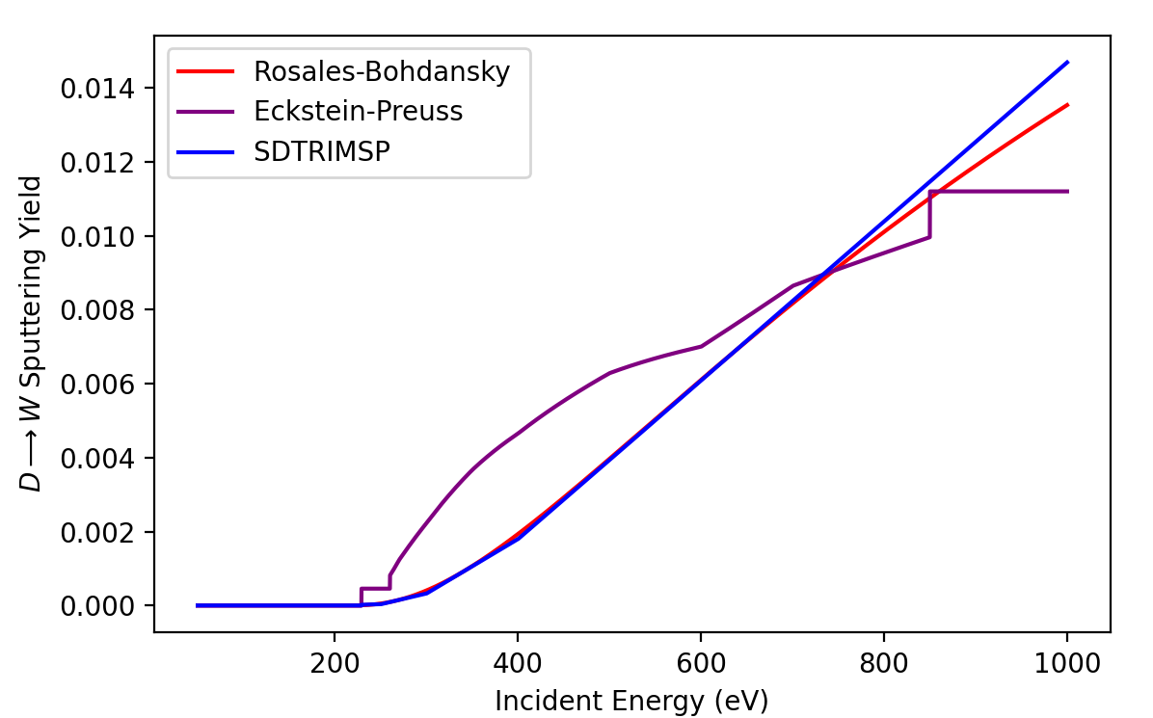

Physical Sputtering Model
Physically, enabled through collision cascade that occurs when a “sufficiently” energetic particle collides with the wall => some “threshold” energy below which no sputtering occurs.
Nuclear stopping cross-section
Incidence Energy
Analytical formulae fit to experiment, depending on incident-sputtered pair, roughly comparable to more accurate BCA codes like SDTRIMSP.
[G. Rosales J.Nuc.Mat. ‘95, Eckstein J.Nuc.Mat 2003]

Slide 12
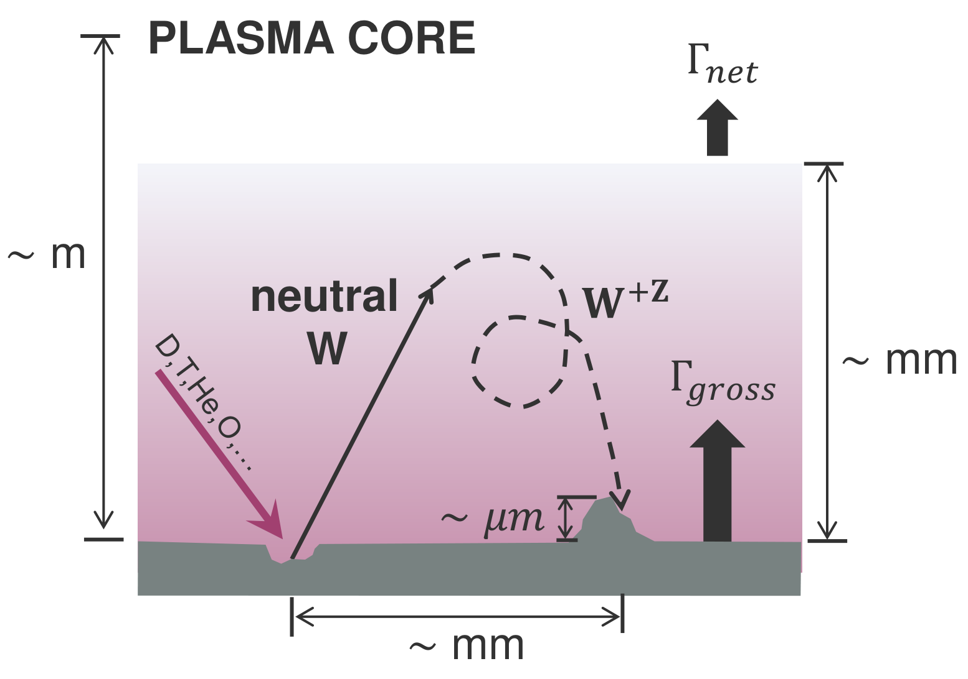
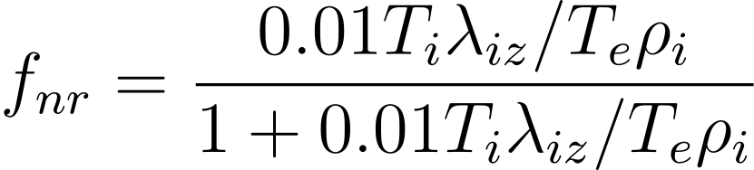
Prompt Redeposition
“Net” source of Tungsten that enters the plasma is lowered due to the sheath effects causing sputtered Tungsten to redeposit. Balance of ionization mean free path, gyro-radius, and sheath potential.
Ion thermal force
Iz. mean free path
Sheath potential
Sheath width
[D. Tskhakaya J. Nuc. Mat. 2015]
[L. Cappelli]

Slide 13
Integrated Modelling Framework
EDGE-SOL PLASMA
“High-fidelity” multi-fluid model, limiting number of W charge states being solved for.
Particle, Heat Fluxes
PLASMA-WALL INTERACTION
Analytical formulae for gross sputtering and prompt redeposition + simple model for wall composition.
Sputtered Fluxes
Integrated Fluxes at boundary
Density, Temperature
CORE PLASMA
“Reduced” model for particle and energy transport, with transport coefficients obtained through coupling to a fast turbulence model.

Slide 14
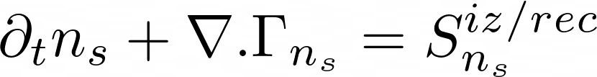
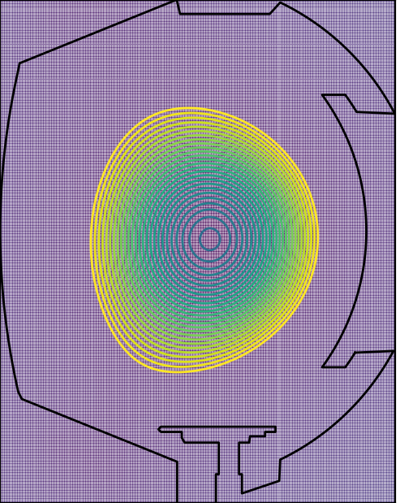
A Simplified Core Model for SOLEDGE-3X [I]
1D transport equations for density and temperature, for all charged species.
Diffusion + Pinch velocity
Key issue here is where do the transport coefficients come from? Imposing by hand as in the edge-SOL would make things less self-consistent.
Ideally, should depend on plasma parameters and magnetic geometry.

Slide 15
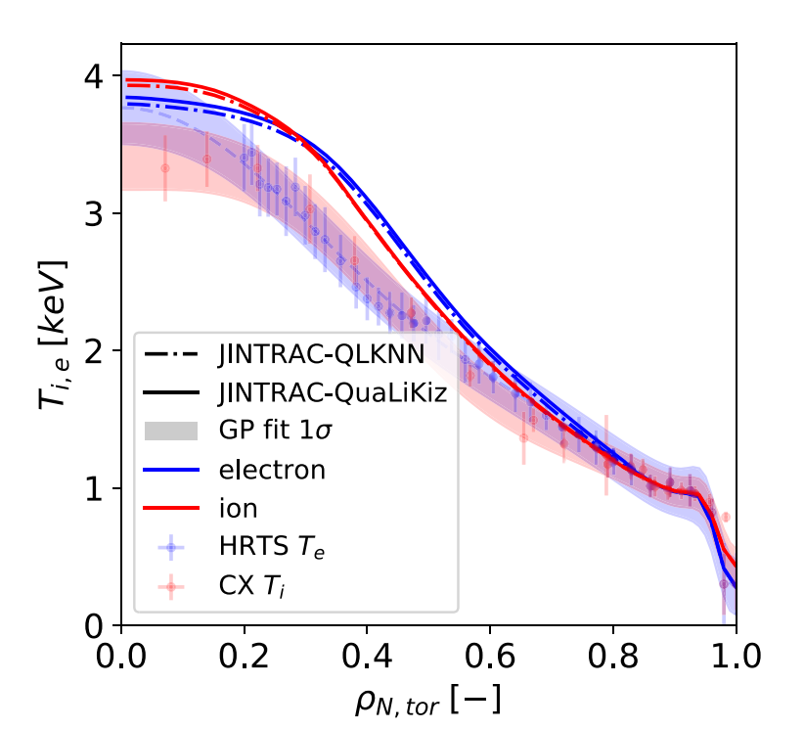
Reduced Models for Core Turbulence
For computational efficiency, need a fast model for core turbulence. Solution was to look to local “flux-tube” codes.
“Flux-Tube” Codes
Simulate a single flux-tube, fixing radial gradients and obtaining heat and particle fluxes driven by turbulence. Saturation rules are fit to large-scale gyrokinetic simulations.
QuaLiKiz - a quasilinear, Vlasov-Poisson code in s-ɑ geometry.
But, QuaLiKiz not sufficiently fast => Choice was made to use QLKNN-10D, a neural network trained on a database of ~3e8 QuaLiKiz simulations.
Better computation speed, keeping in mind the caveats of using a neural network.
[K.L. van de Plassche PoP 2020]

Slide 16




A Simplified Core Model for SOLEDGE-3X [II]
1D transport equations for density and temperature, for all charged species.
Diffusion + Pinch velocity
QLKNN-10D

Slide 17
First Results
1. Validation of the Core Model

Slide 18
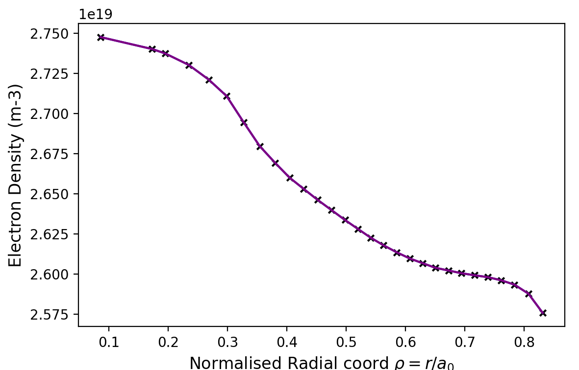
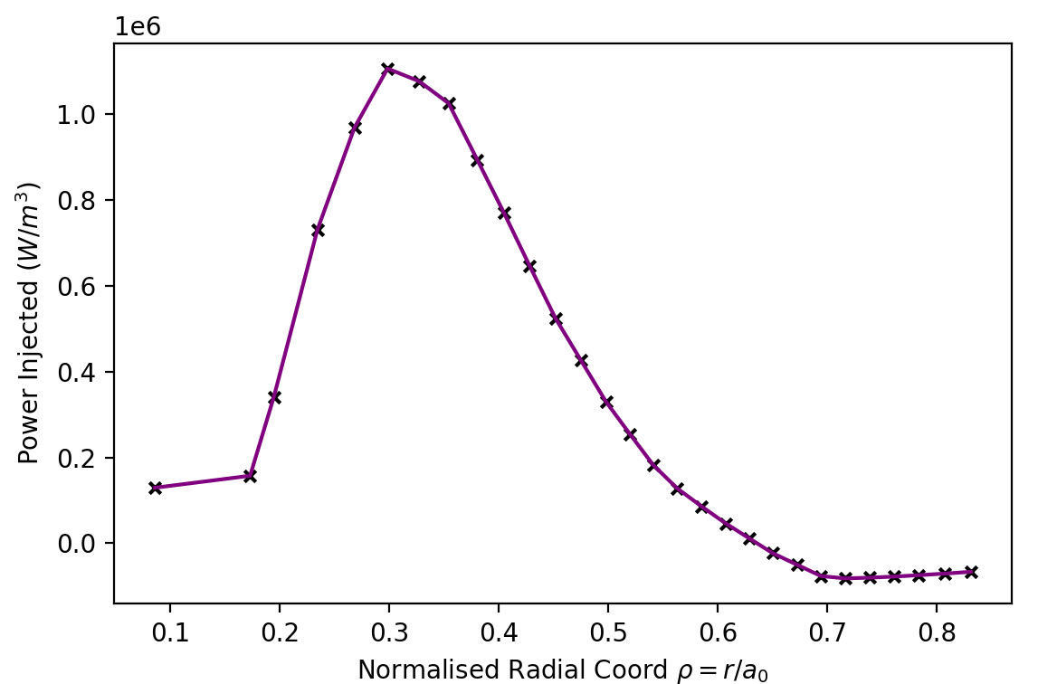
Validation of the Core Model
Benchmarking performed with existing core transport code METIS, on WEST #60675.
WEST #60675
Input Power (MW) [LH] | Radiated Power (MW) | Peak Density (m-3) | Peak Temperature (keV)
2.5 MW | 1 MW | 2.75e19 | 3
METIS
Solves for current balance, power deposition, and heat transport, coupled to fast turbulence models.

Slide 19
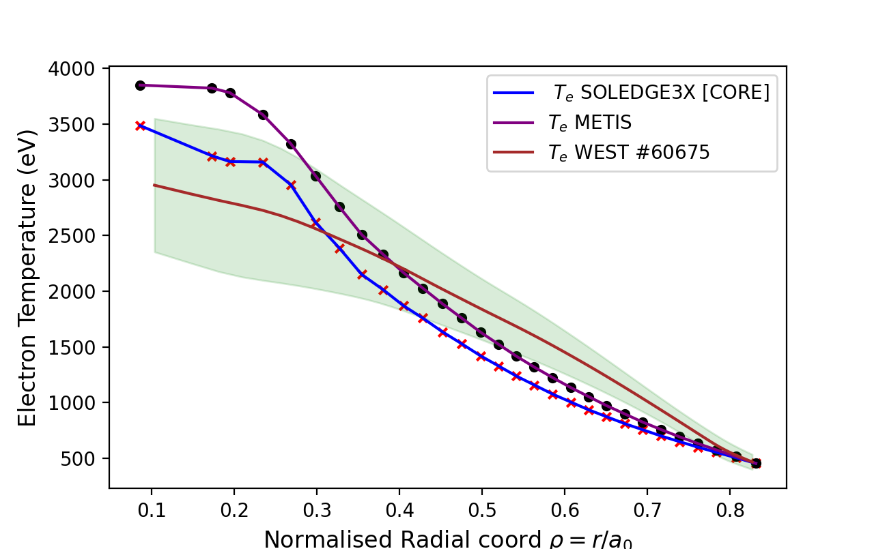
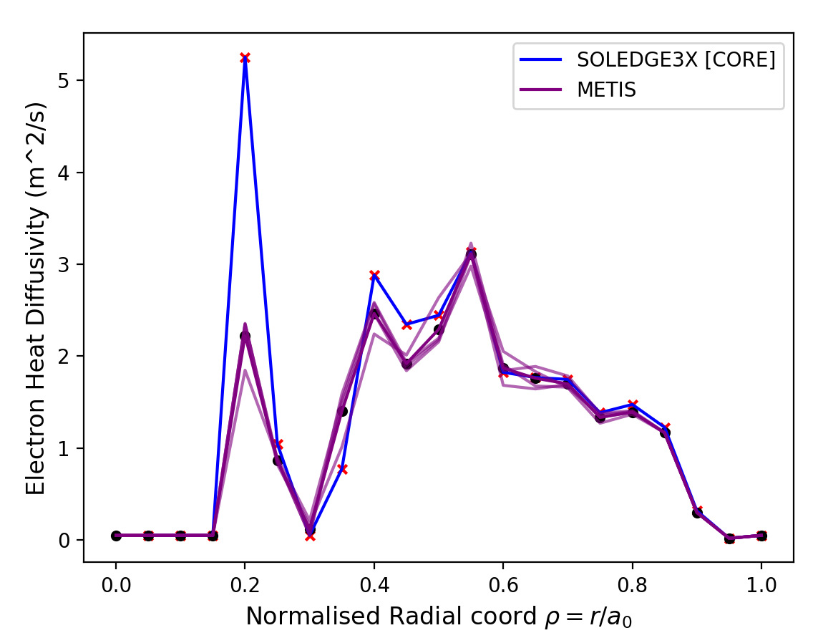
Validation of the Core Model
WEST #60675
Input Power (MW) [LH] | Radiated Power (MW) | Peak Density (m-3) | Peak Temperature (keV)
2.5 MW | 1 MW | 2.75e19 | 3
Higher transport estimated in the core compared to METIS, with more negligible differences at the edge.

Slide 20
First Results
2. Analysis of W Transport

Slide 21
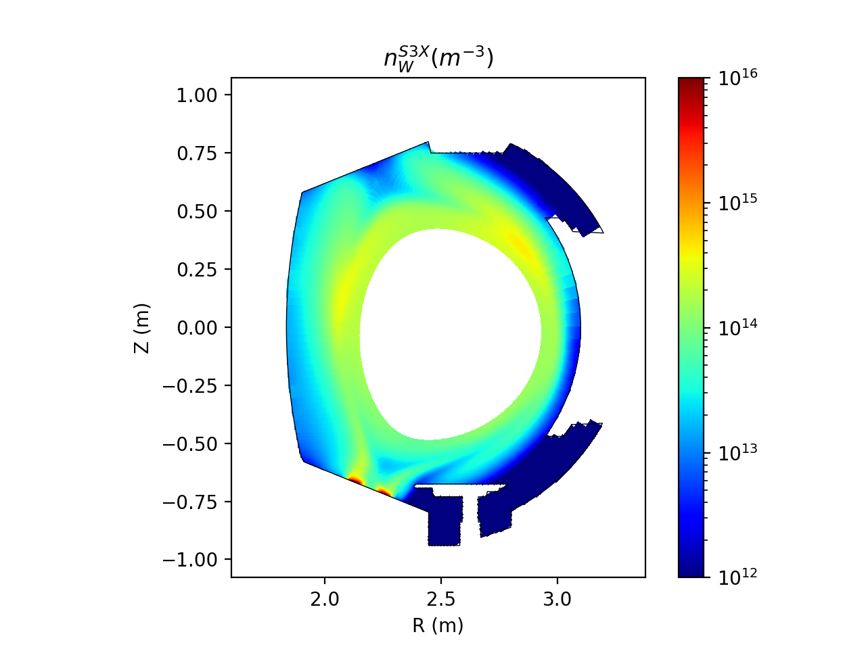
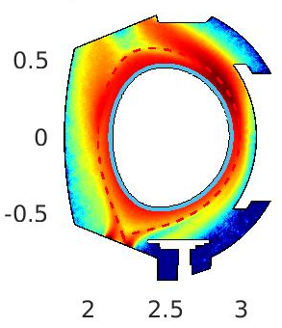
Comparisons of Fluid and Kinetic W [I]
Fluid Tungsten modelling with SOLEDGE-3X
Converge background plasma at a given input power (2 MW)
Kinetic Tungsten modelling with ERO 2.0.
SOLEDGE-3X
ERO 2.0.
Same sites of accumulation, but differing order of magnitude => transport in main plasma more or less the same, but potential differences in dynamics close to the wall.

Slide 22
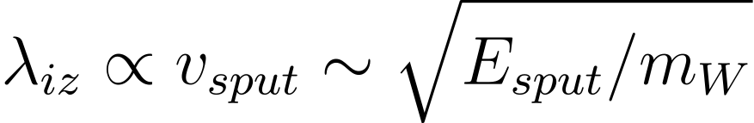




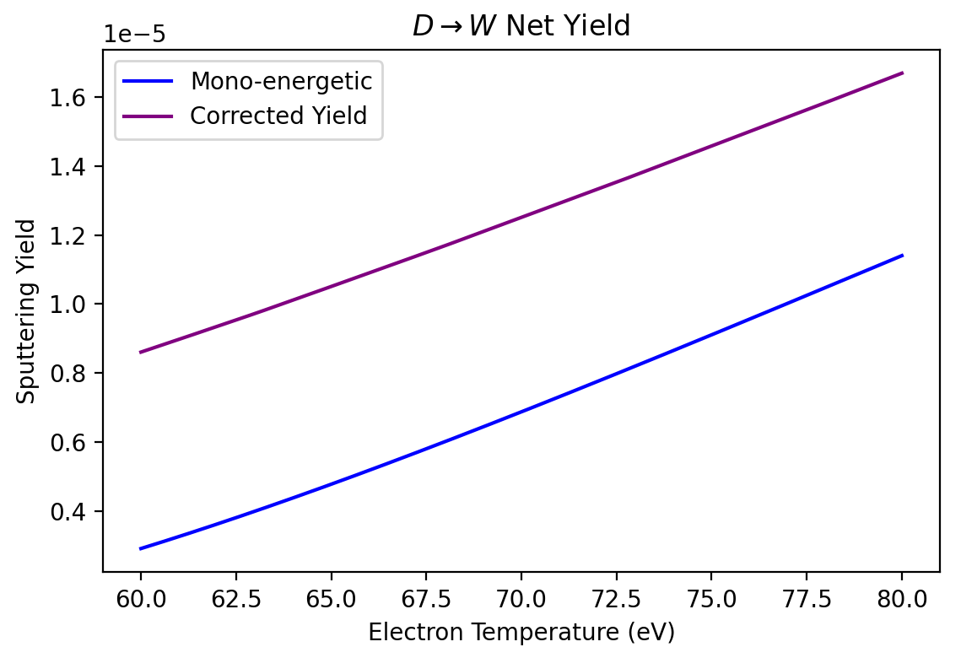
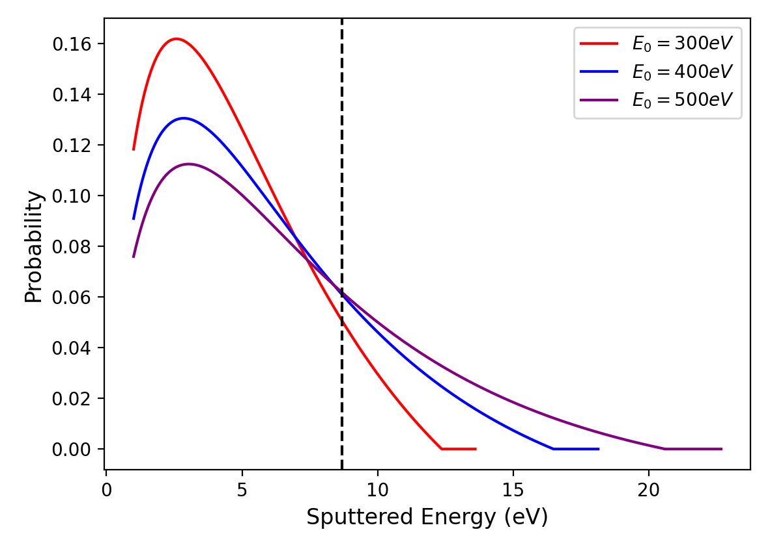

Comparisons of Fluid and Kinetic W [II]
Monoenergetic “beam”
Sampled from a Maxwellian to capture “high-energy tail” sputtering.

Slide 23
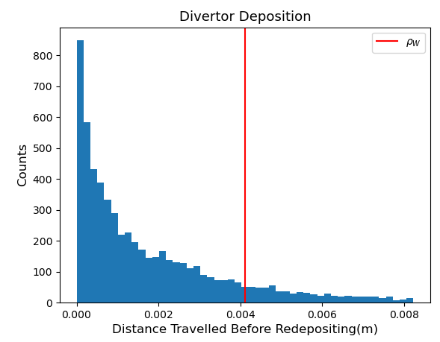
Comparisons of Fluid and Kinetic W [III]
In a fluid code, the implicit assumption has to be made that prompt redeposition is “local” i.e., occurs on a smaller scale length than the mesh resolution.
Gyro-radius ~ 4 mm
Scale-length of prompt redeposition ~ 2 mm ~ mesh resolution at strike points
=> In this scenario, fluid assumption not too far off.

Slide 24

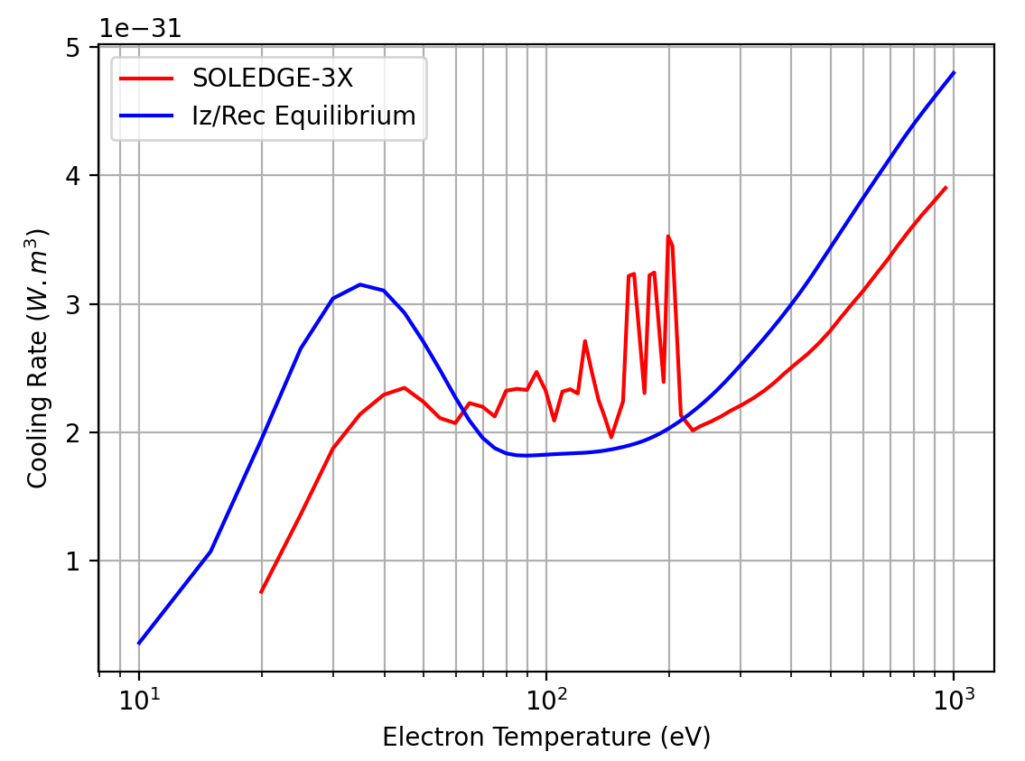
Non-Coronal Effects
Cooling rates are estimated at “coronal equilibrium” ignoring transport. Actual cooling efficiency of Tungsten could vary from this greatly.

Slide 25
Summary
Outlook
SOLEDGE-3X extended to perform core-edge simulations and estimate gross and net sputtering yields
Core model validated against METIS for WEST #60675
Comparison of fluid and kinetic modelling of Tungsten with ERO 2.0. performed, with notable differences in sputtering yields, but similar accumulation sites
Non-coronal effects of Tungsten radiation were observed
Comparison of gross sputtered fluxes in WEST to spectroscopy data + radiation in the core and edge to bolometry as experimental validation.
Further comparisons to ERO 2.0. needed with updated sputtering estimates.
Improvements to core model, in particular inclusion of neoclassical transport crucial to capture W distribution in the core.

Slide 26
EXTRA SLIDES

Slide 27
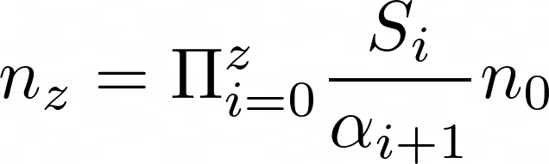
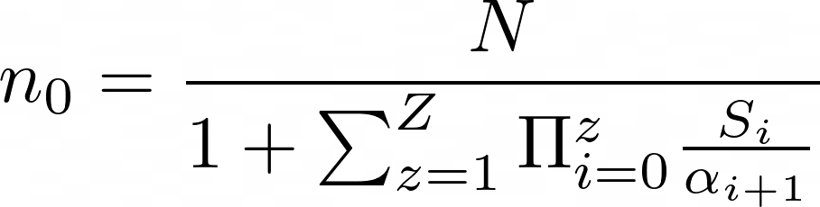
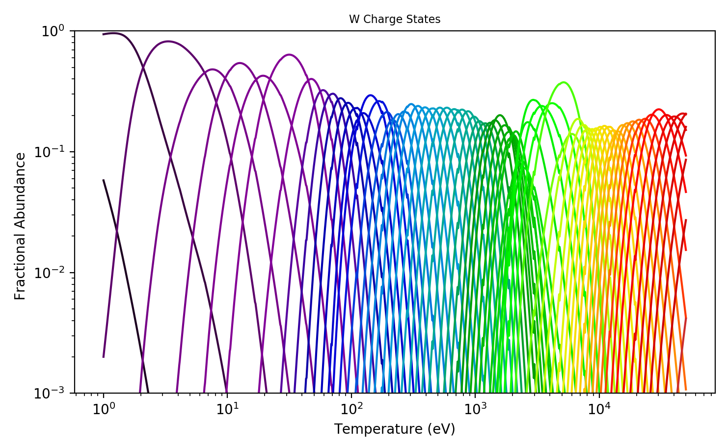
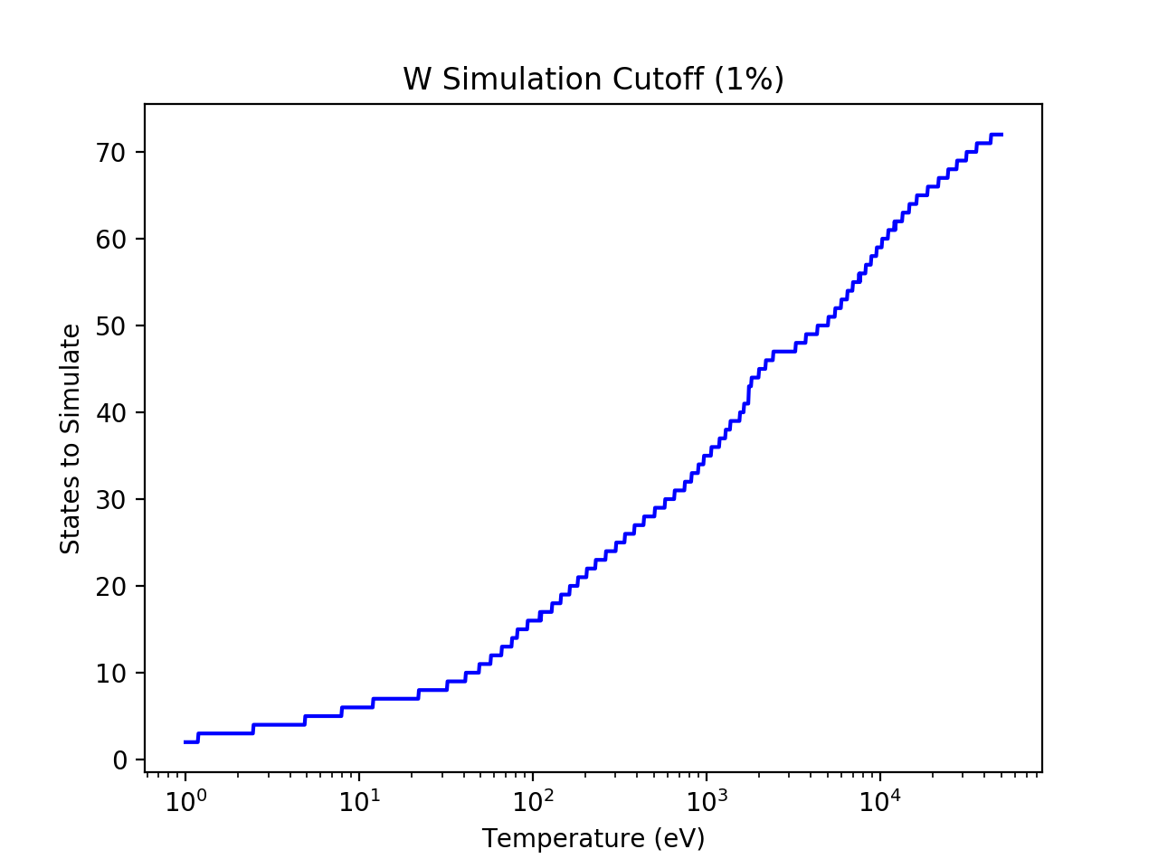
EXTRA: Coronal Equilibrium
Detailed Balance:
Steady-State Solution:

Slide 28
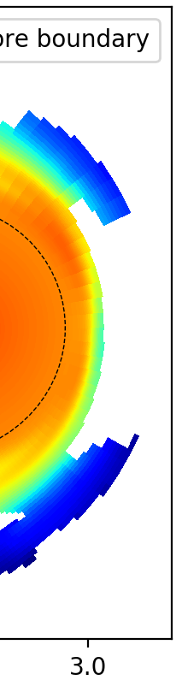
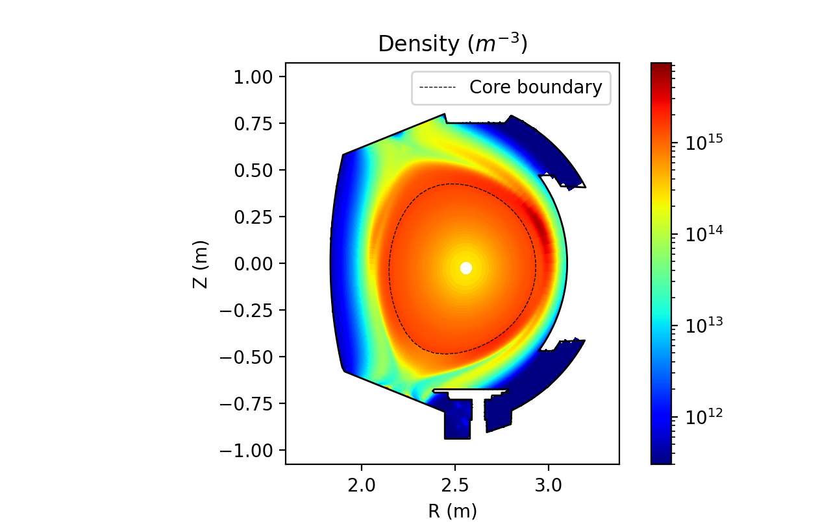




EXTRA: W Transport in the Edge-SOL
Building on previous work, Tungsten accumulation at OMP observed across input powers, ad-hoc SOL transport coefficients, and core models (or lack thereof).
Some indication that the parallel force balance plays the same role in these scenarios, i.e. that the parallel gradients are similar.
4 MW
2 MW
2.5 MW
Total Force =
Friction + Thermal + Pressure + Lorentz

Slide 29
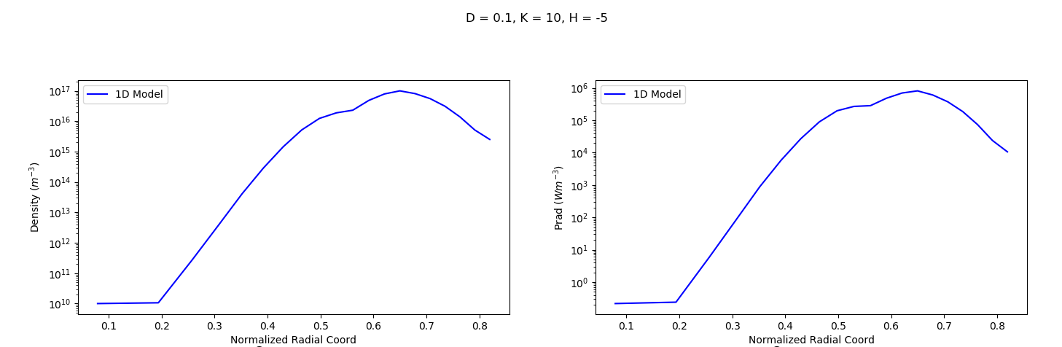
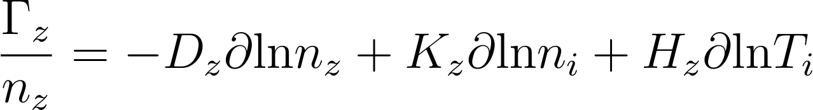
EXTRA: Neoclassical Model
grad Ti < grad ni
grad Ti > grad ni

Slide 30
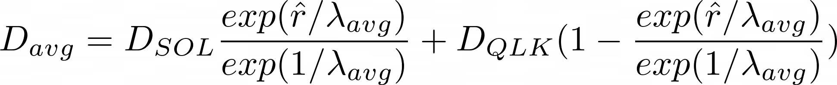
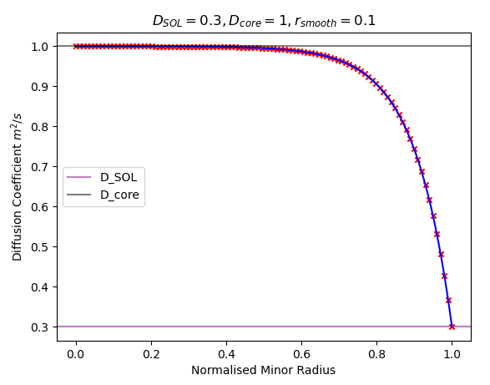
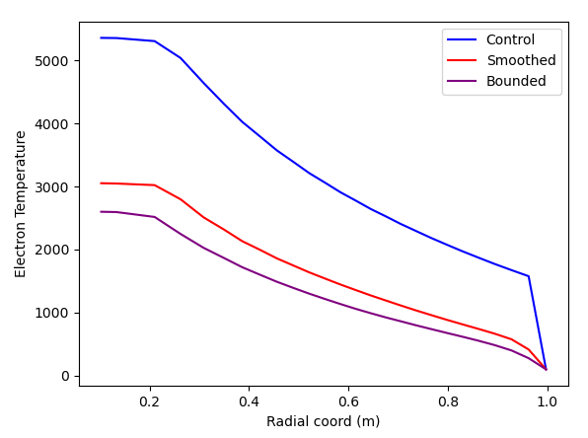
EXTRA: Boundary Smoothing

