Slide 1
JOREK modelling of Runaway Electron beam benign termination in JET
L.Singh, E. Nardon, V. Bandaru, H. Bergström, M. Hoelzl, C. Sommariva, JOREK Team and JET contributors
${21}^{st}$ European Fusion Theory Conference, Aix en Provence, 23-26 September 2025

Slide 2
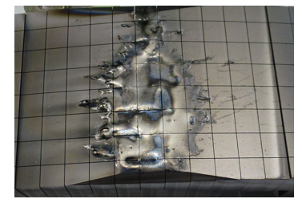
Motivation
Runaway electrons (RE) pose a serious threat in high-current tokamaks, such as ITER, where they can reach tens of MeV and damage plasma-facing components
Main strategies:
RE avoidance, challenging in large machines like ITER [1]
Sacrificial limiters (EU-DEMO)
Benign RE beam termination (ITER)
Damage caused by the RE beam in JET #86801
L. Chen, 5th Asia Pacific Conference on Plasma Physics, 26 Sep-1 Oct 2021
[1] Vallhagen et al 2024 Nucl. Fusion 64 086033

Slide 3
Outline
Introduction
  What are Runaway Electrons?
  What is benign termination?
JET pulse #95135: a famous case of RE benign termination
  Experiment Description
  Numerical Modelling
  Past Results
New Results
  Scan in resistivity
  Scan in viscosity
  Comparsion between the RE transport mechanism
  Moving towards a self-consistent evolution
Conclusions

Slide 4
Introduction
1

Slide 5
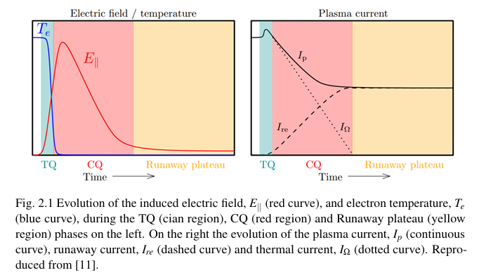


What are Runaway Electrons?
Generated during a disruption: TQ $→$ CQ $→$Possible Runaway Plateau
Drop in plasma temperature
Increase in plasma resistivity
Plasma current decay and rise in inductive electric field
Acceleration of electrons due to $E_{∥}$overcoming $F_{friction}→$ RE generation
M. Hoppe. PhD thesis, Department of Physics, Chalmers University of Technology, Goteborg, 2021
As the RE beam evolves (e.g. runs into the wall) an MHD instability can occur $→$ RE deconfinement and possible damage

Slide 6
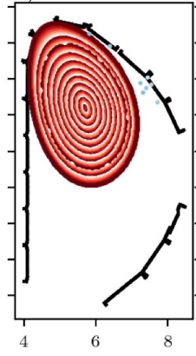
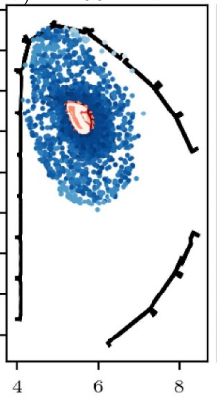
What is benign termination?
MHD instability
Magnetic field stochastization
RE beam broad deposition on the PFC
No reavalanching and conversion from magnetic to kinetic energy
BENIGN TERMINATION [1, 2]
Bergström et al 2024 Plasma Phys. Control. Fusion 66 095001
[1] Reux et al 2021 Phys. Rev. Lett. 126, 175001
[2] Paz-Soldan et al 2021 Nucl. Fusion 61 116058

Slide 7
JET pulse #95135
2
A famous case of RE benign termination

Slide 8
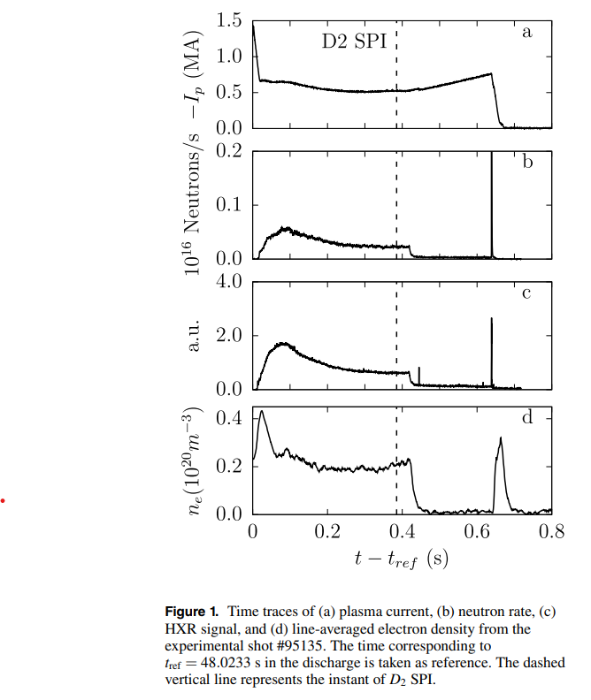
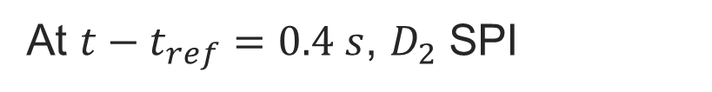
JET #95135: experiment description
Disruption (#95135) triggered by Argon MGI
Generation of RE
At $t−t_{ref}=0.4 s$, $D_{2}$ SPI
Plasma recombination and Argon flush out
Drop in the effective resistivity
RE current increases
Fast loss of RE with no wall damage
Bandaru et al, 2021 PPCF 63

Slide 9
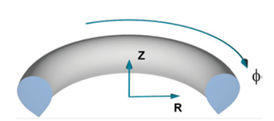
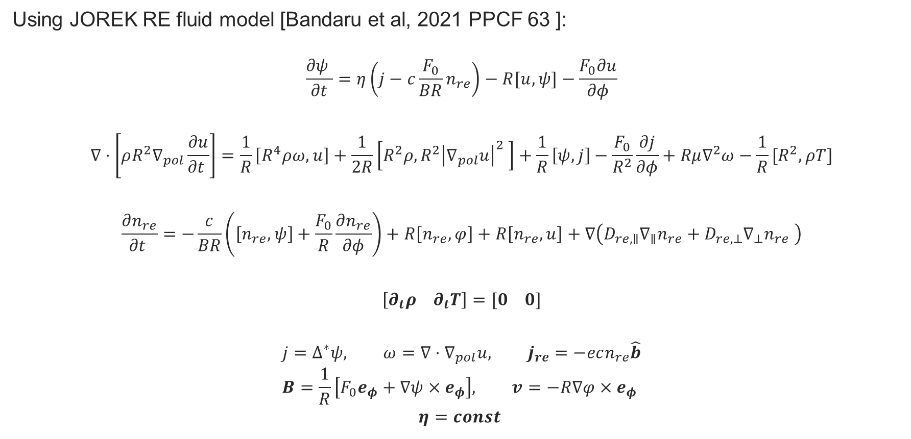

JOREK Modelling
Using JOREK RE fluid model [Bandaru et al, 2021 PPCF 63 ]:
$$\frac{∂ψ }{∂t}=η\left(j−c{\frac{F_{0}}{BR}n}_{re}\right)−R[u, ψ]−\frac{F_{0}∂u}{∂φ}$$
$$∇⋅\left[ρR^{2}∇_{pol}\frac{∂u}{∂t }\right]=\frac{1}{R}\left[R^{4}ρω, u\right]+\frac{1}{2R}\left[R^{2}ρ, R^{2}{\left|∇_{pol}u\right|}^{2} \right]+\frac{1}{R}\left[ψ, j\right]−\frac{F_{0}}{R^{2}}\frac{∂j}{∂φ}+Rμ∇^{2}ω−\frac{1}{R}[R^{2}, ρT]$$
$$\frac{∂n_{re}}{∂t }=−\frac{c}{BR}\left(\left[n_{re}, ψ\right]+\frac{F_{0}}{R}\frac{∂n_{re}}{∂φ}\right)+R\left[n_{re}, φ\right]+R\left[n_{re}, u\right]+∇\left(D_{re,∥}∇_{∥}n_{re}+D_{re,⊥}∇_{⊥}n_{re} \right)$$
$$\left[∂_{t}ρ ∂_{t}T\right]=[0 0]$$
$$j=∆^{∗}ψ, ω=∇⋅∇_{pol}u, j_{re}=−ecn_{re}\hat{b}$$
$$B=\frac{1}{R}\left[F_{0}e_{φ}+∇ψ×e_{φ}\right], v=−R∇φ×e_{φ}$$
$$η=const$$
RE current density $j_{RE}$
Advection term
Diffusion term

Slide 10
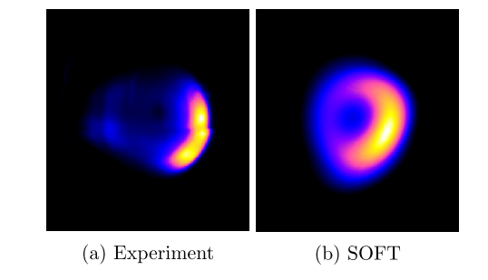
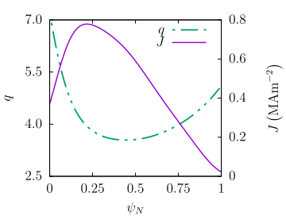
JOREK simulation setup
The initial current (and safety factor) profile derived from a comparison between the Infrared synchrotron image and SOFT [1] :
[1] Hoppe et al, 2018, Nuclear Fusion, 58(2), 026032.
2 q=4 surfaces (Double Tearing Mode)
Bandaru et al, 2021 PPCF 63

Slide 11
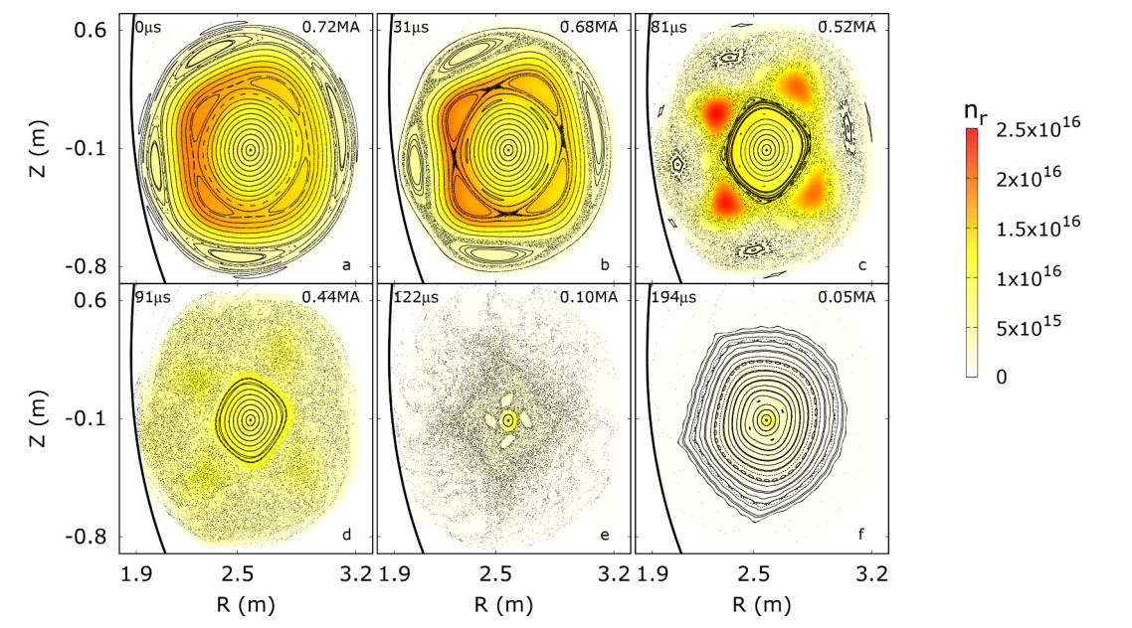
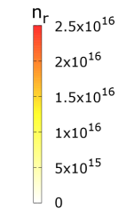
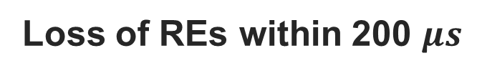
Past results
Bandaru et al, PPCF 63 (2021)
Evolution of a DTM
Full magnetic field stochastization
Loss of REs within 200 $μs$

Slide 12
New Results
2

Slide 13
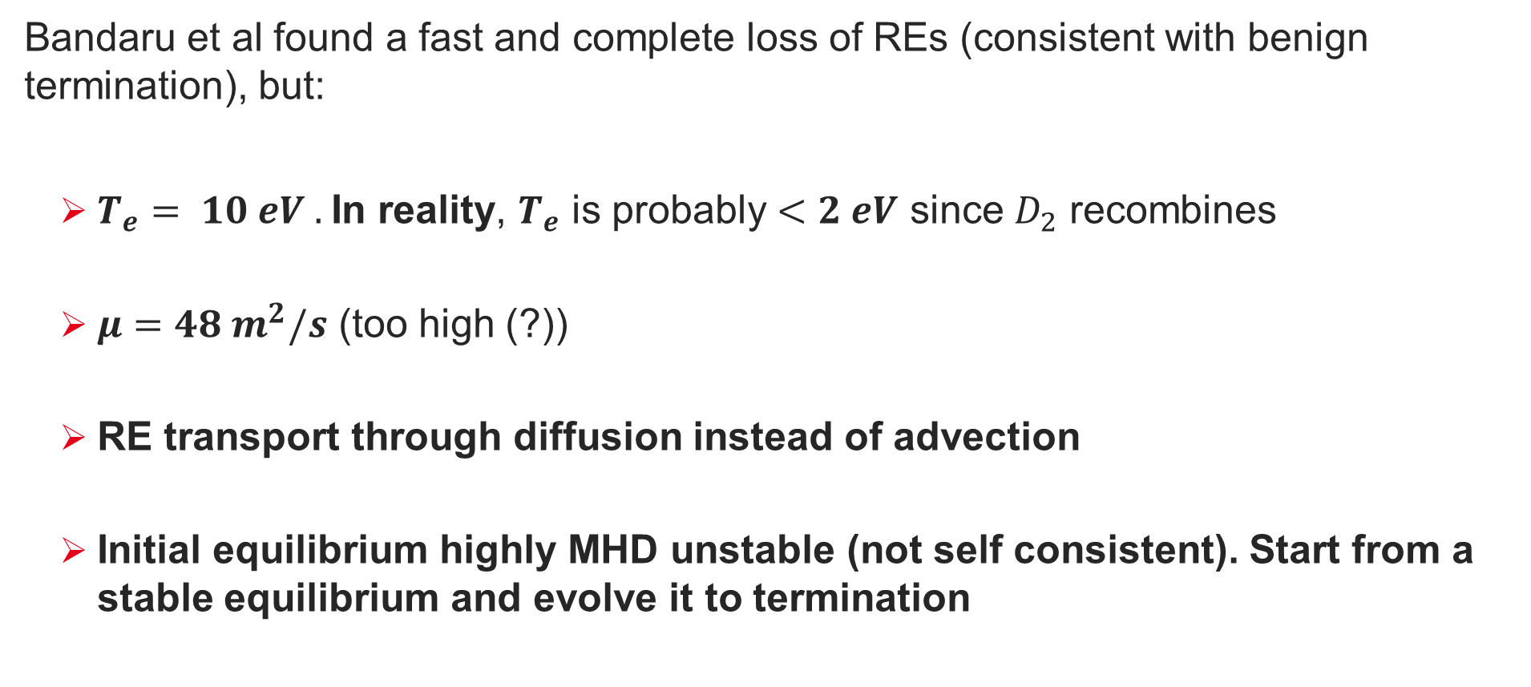
Aim: more realistic simulations
Bandaru et al found a fast and complete loss of REs (consistent with benign termination), but:
  $T_{e}= 10 eV .$In reality, $T_{e}$ is probably $<2 eV$ since $D_{2}$ recombines
  $μ=48 m^{2}/s$ (too high (?))
  RE transport through diffusion instead of advection
  Initial equilibrium highly MHD unstable (not self consistent). Start from a stable equilibrium and evolve it to termination

Slide 14
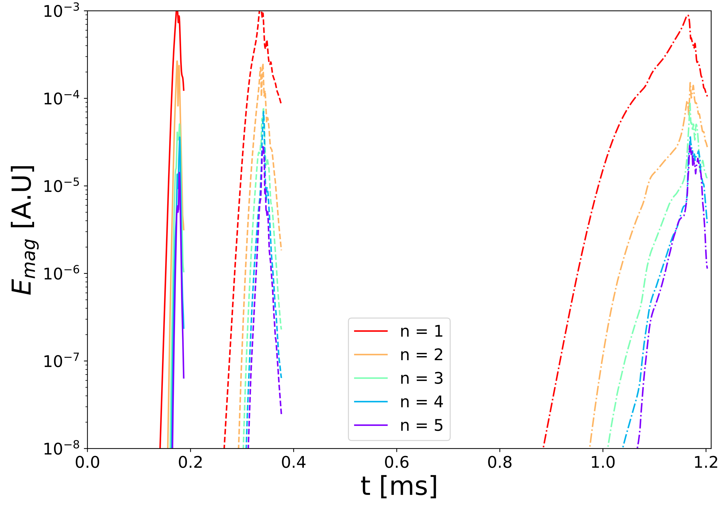
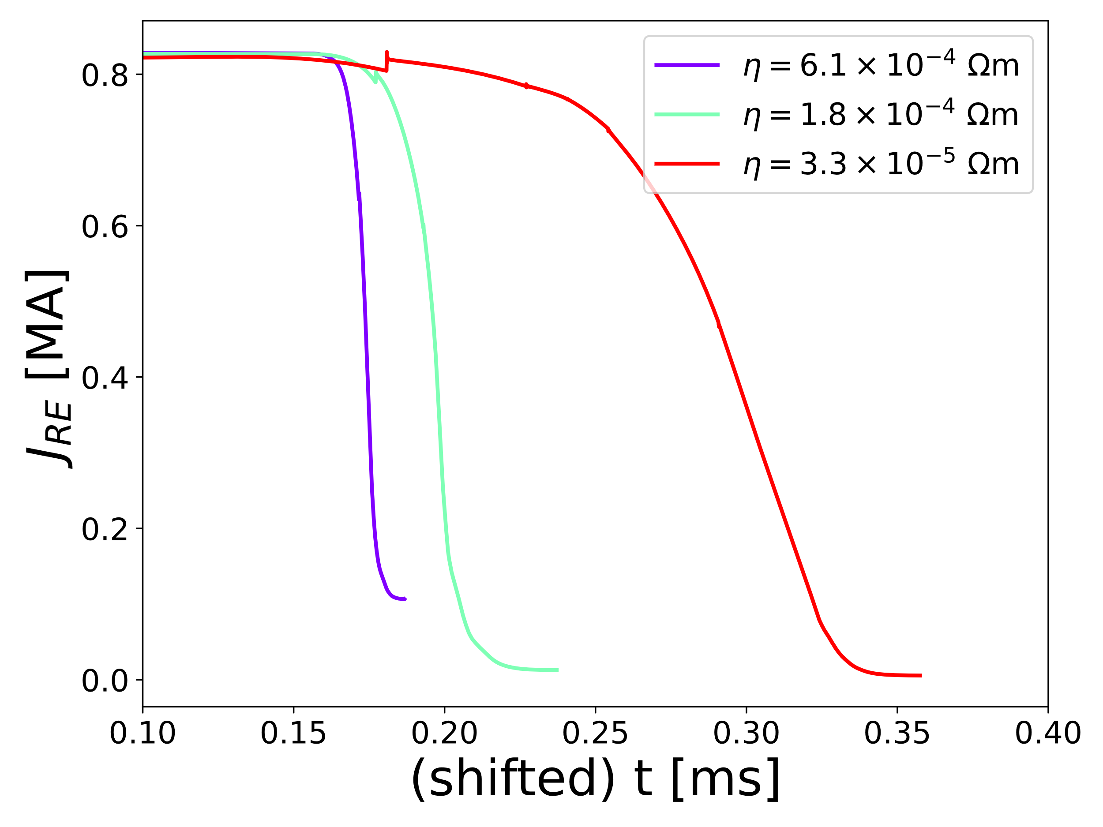








Scan in background resistivity with advection
  $$η=6.1∗{10}^{−4}Ωm \left(T≈1.5 eV\right), 1.8∗{10}^{−4} Ωm \left(T≈3.5 eV\right), 3.3∗{10}^{−5} Ωm (T≈10 eV)$$
Higher $η$ $→$ faster dynamics, shorter $I_{RE}$loss timescale BUT higher final $I_{RE}$
High $η$
Medium $η$
Low $η$
High $η$
Medium $η$
Low $η$
$$I_{RE} [MA]$$

Slide 15

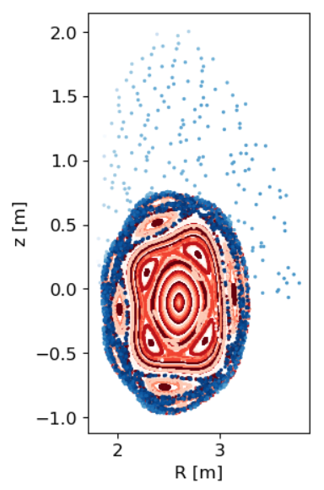
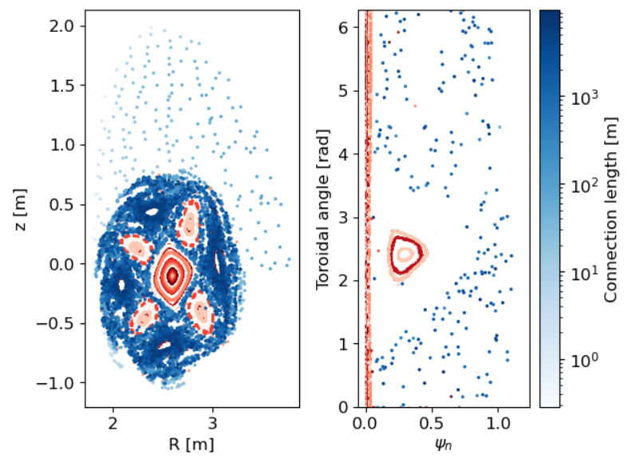
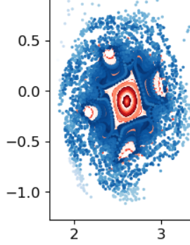
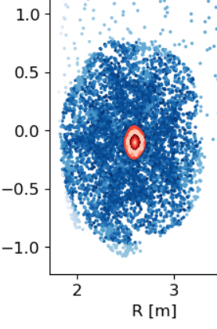
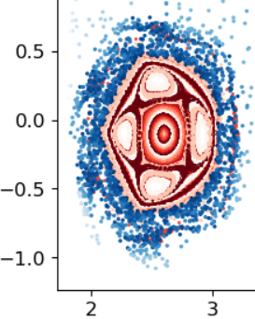
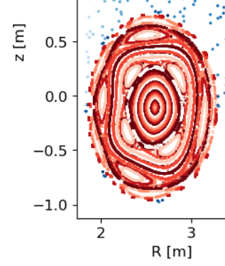





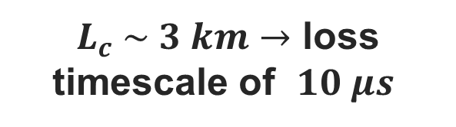

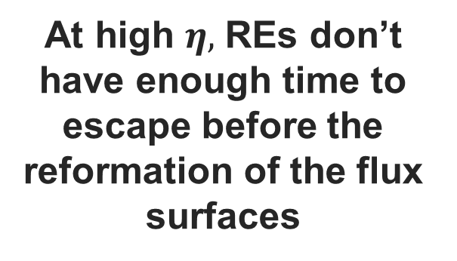

Higher final $I_{RE}$ at higher $η$, why?
  $$High η$$
$0.164 ms$, 0.82 MA
$$0.172 ms, 0.62 MA$$
$$0.182 ms, 0.11 MA$$
$L_{c} \sim 3 km→$ loss timescale of $10 μs$
$$Medium η$$
$$0.312 ms, 0.82 MA$$
$$0.339 ms, 0.24 MA$$
$$0.372 ms, 0.01 MA$$
At high $η,$ REs don’t have enough time to escape before the reformation of the flux surfaces

Slide 16
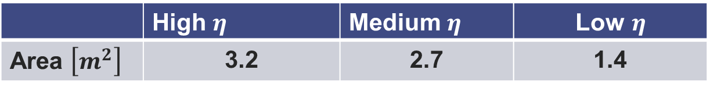
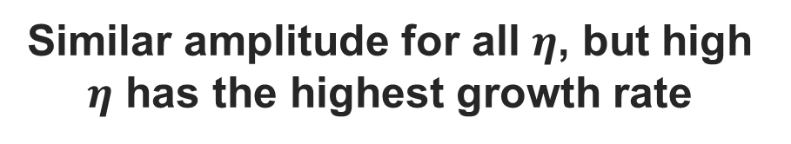
Faster dynamics leads to larger wetted area
 | High $η$ | Medium $η$ | Low$η$
Area $\left[m^{2}\right]$ | 3.2 | 2.7 | 1.4
REs losses occur as stochasticity develops.
Large MHD needed for large wetted area
RE footprint determined by MHD
growth rate
amplitude
Similar amplitude for all $η$, but high $η$ has the highest growth rate
LARGEST FOOTPRINT

Slide 17
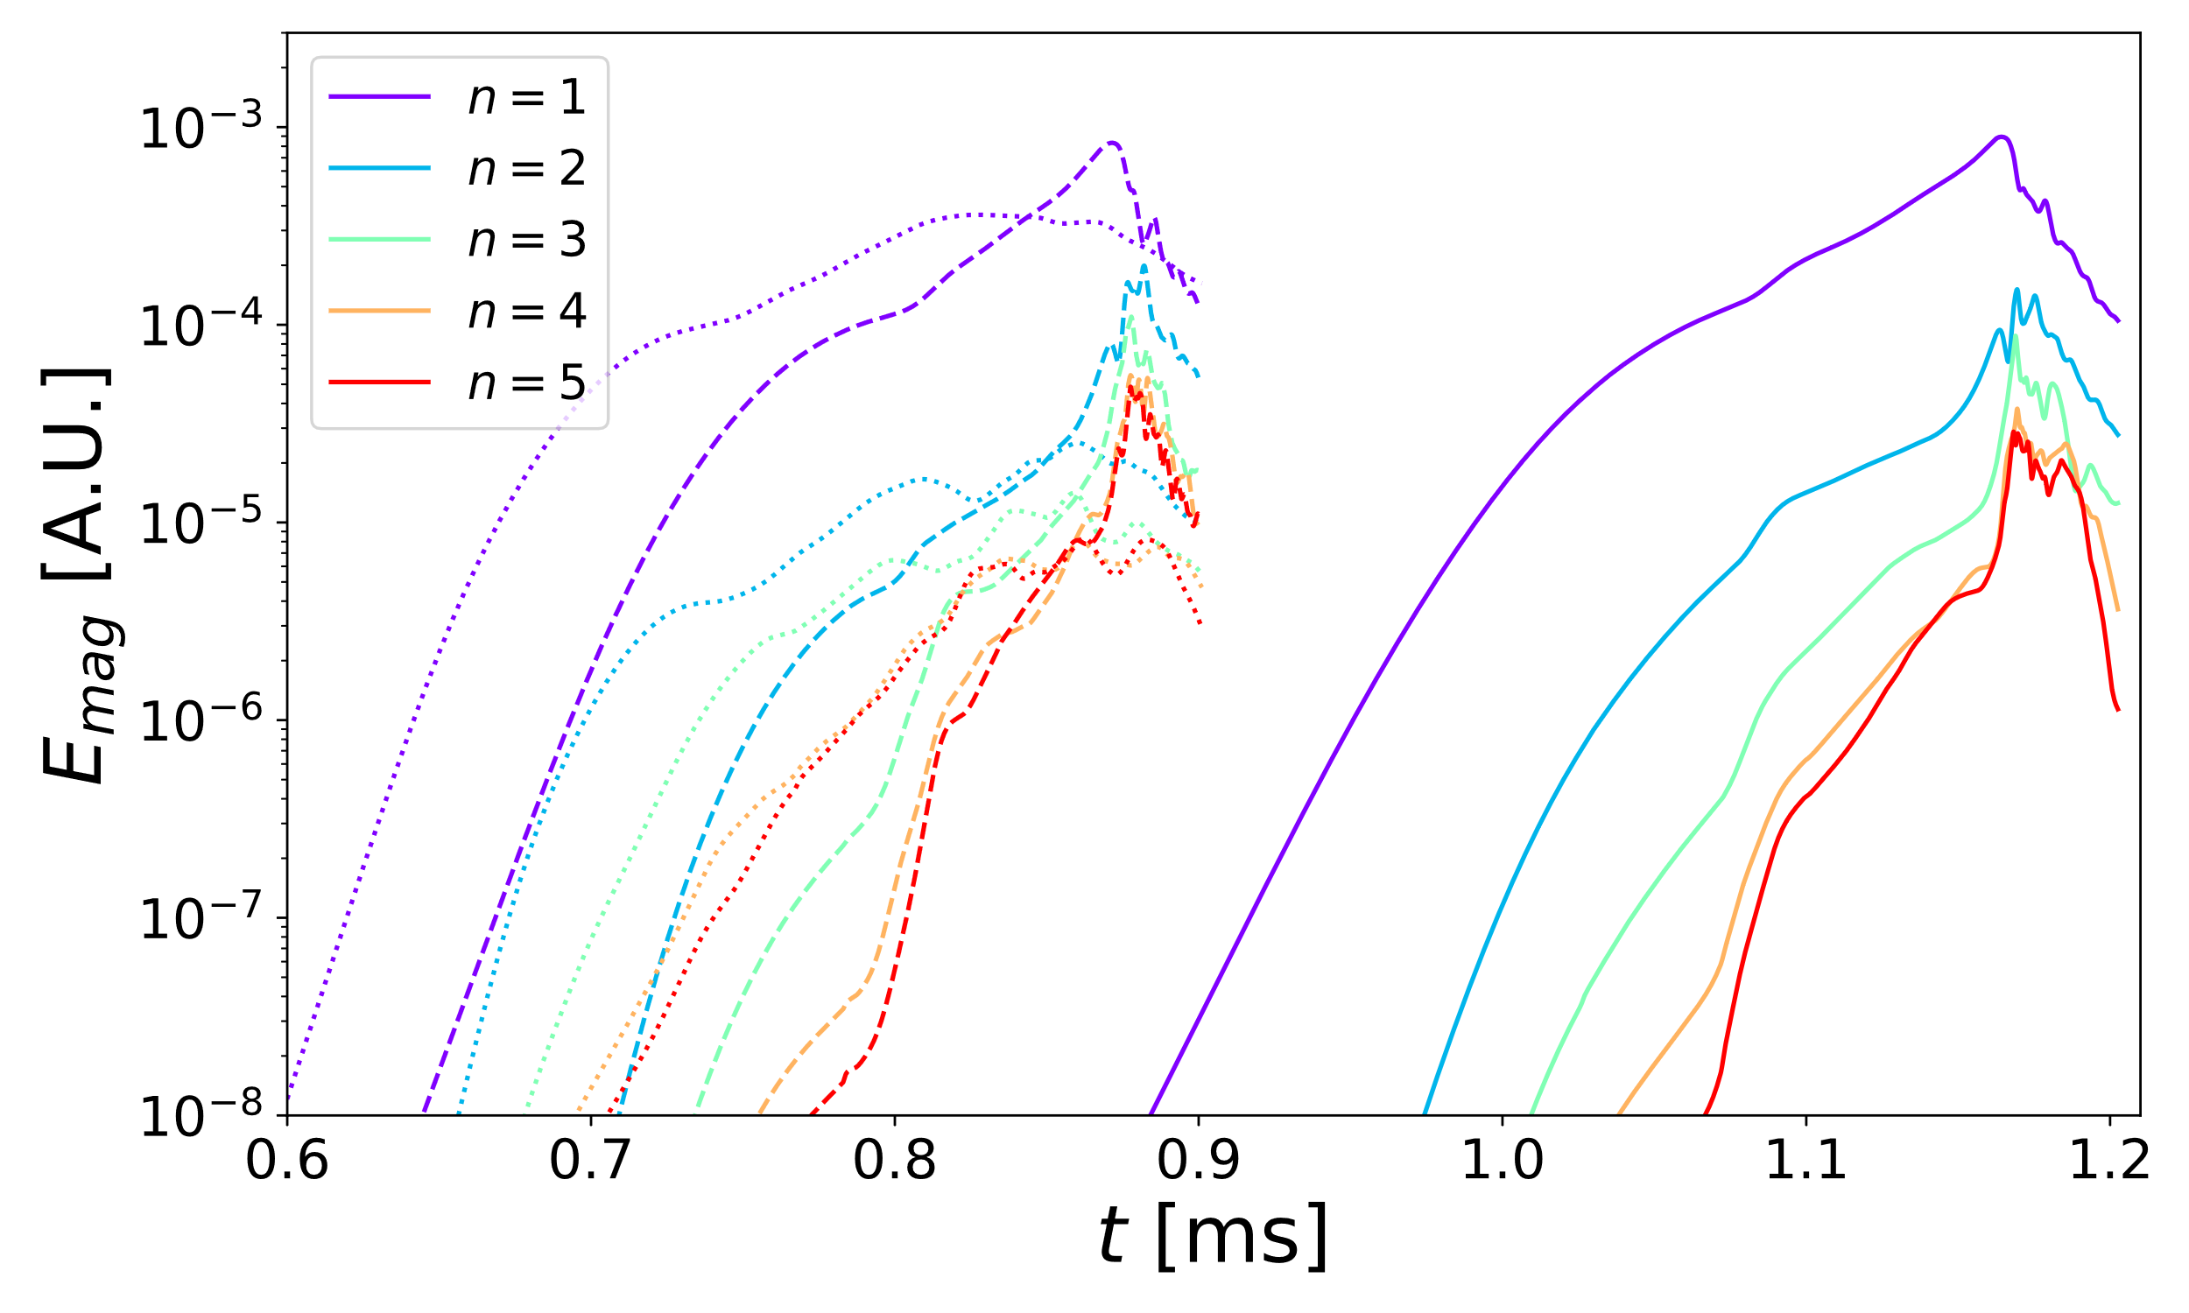




Viscosity effects on modes growth
$μ=48 m^{2}/s$, $μ=4.8 m^{2}/s$, $μ=0.48 m^{2}/s$ @ $η=3.3∗{10}^{−5} Ωm$
Lowest viscosity $→$ fastest linear growth rate, but lowest amplitude
Medium $μ$
High $μ$
Low $μ$

Slide 18
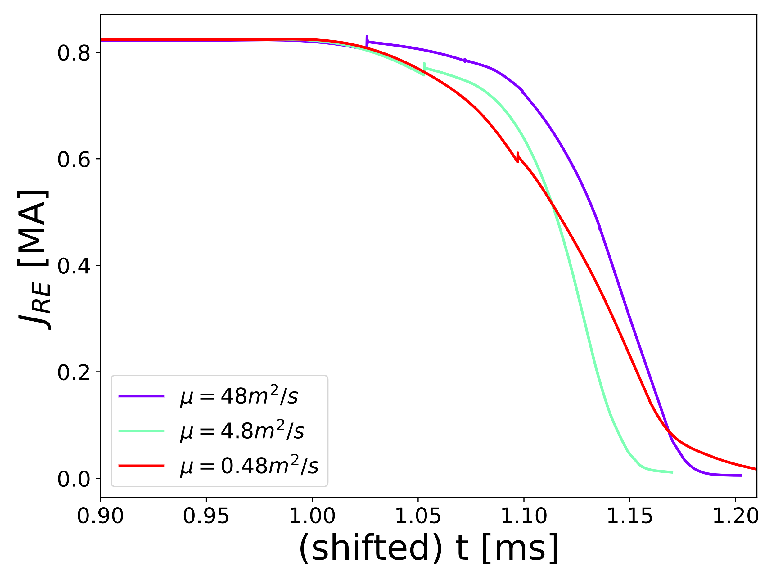

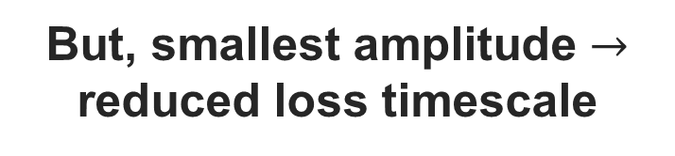
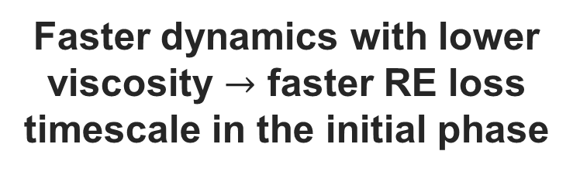
Viscosity Effects on RE current losses
Faster dynamics with lower viscosity $→$ faster RE loss timescale in the initial phase
$$I_{RE} [MA]$$
But, smallest amplitude $→$ reduced loss timescale

Slide 19
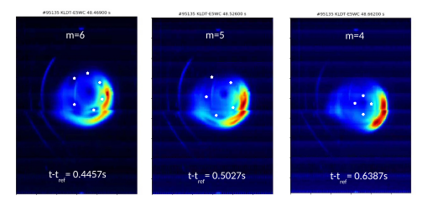
Moving towards a self-consistent evolution
Previous simulations started from unstable MHD equilibrium. Now, start from a stable equilibrium and evolve it to termination
Bandaru et al, PPCF 63 (2021)

Slide 20
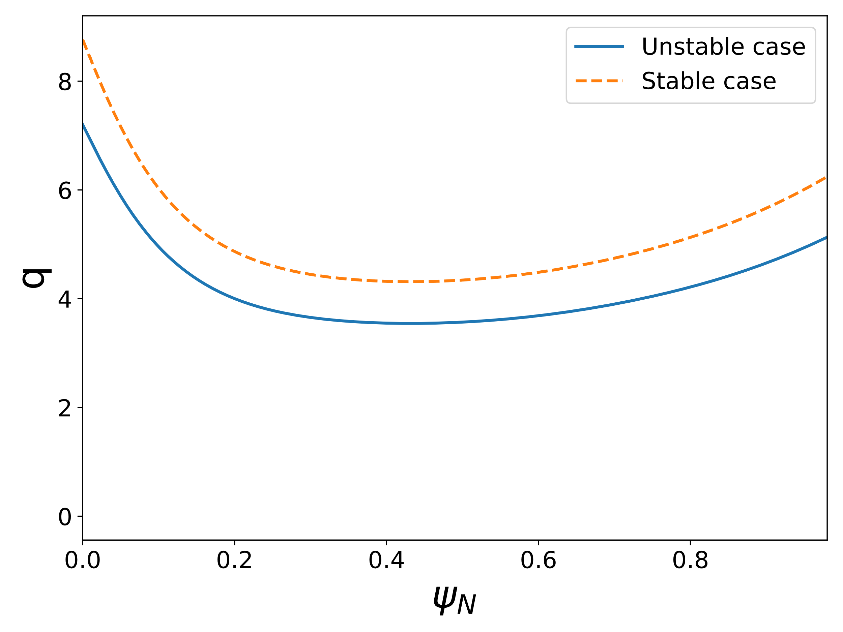
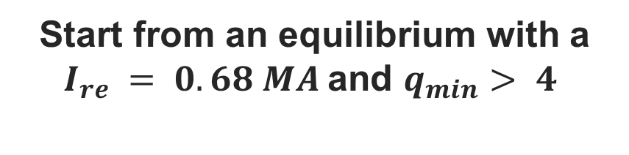
Current ramp up
Start from an equilibrium with a $I_{re} = 0.68 MA$and $q_{min}⁡> 4$
Ramp up the RE current by applying a loop voltage through Central Solenoid

Slide 21
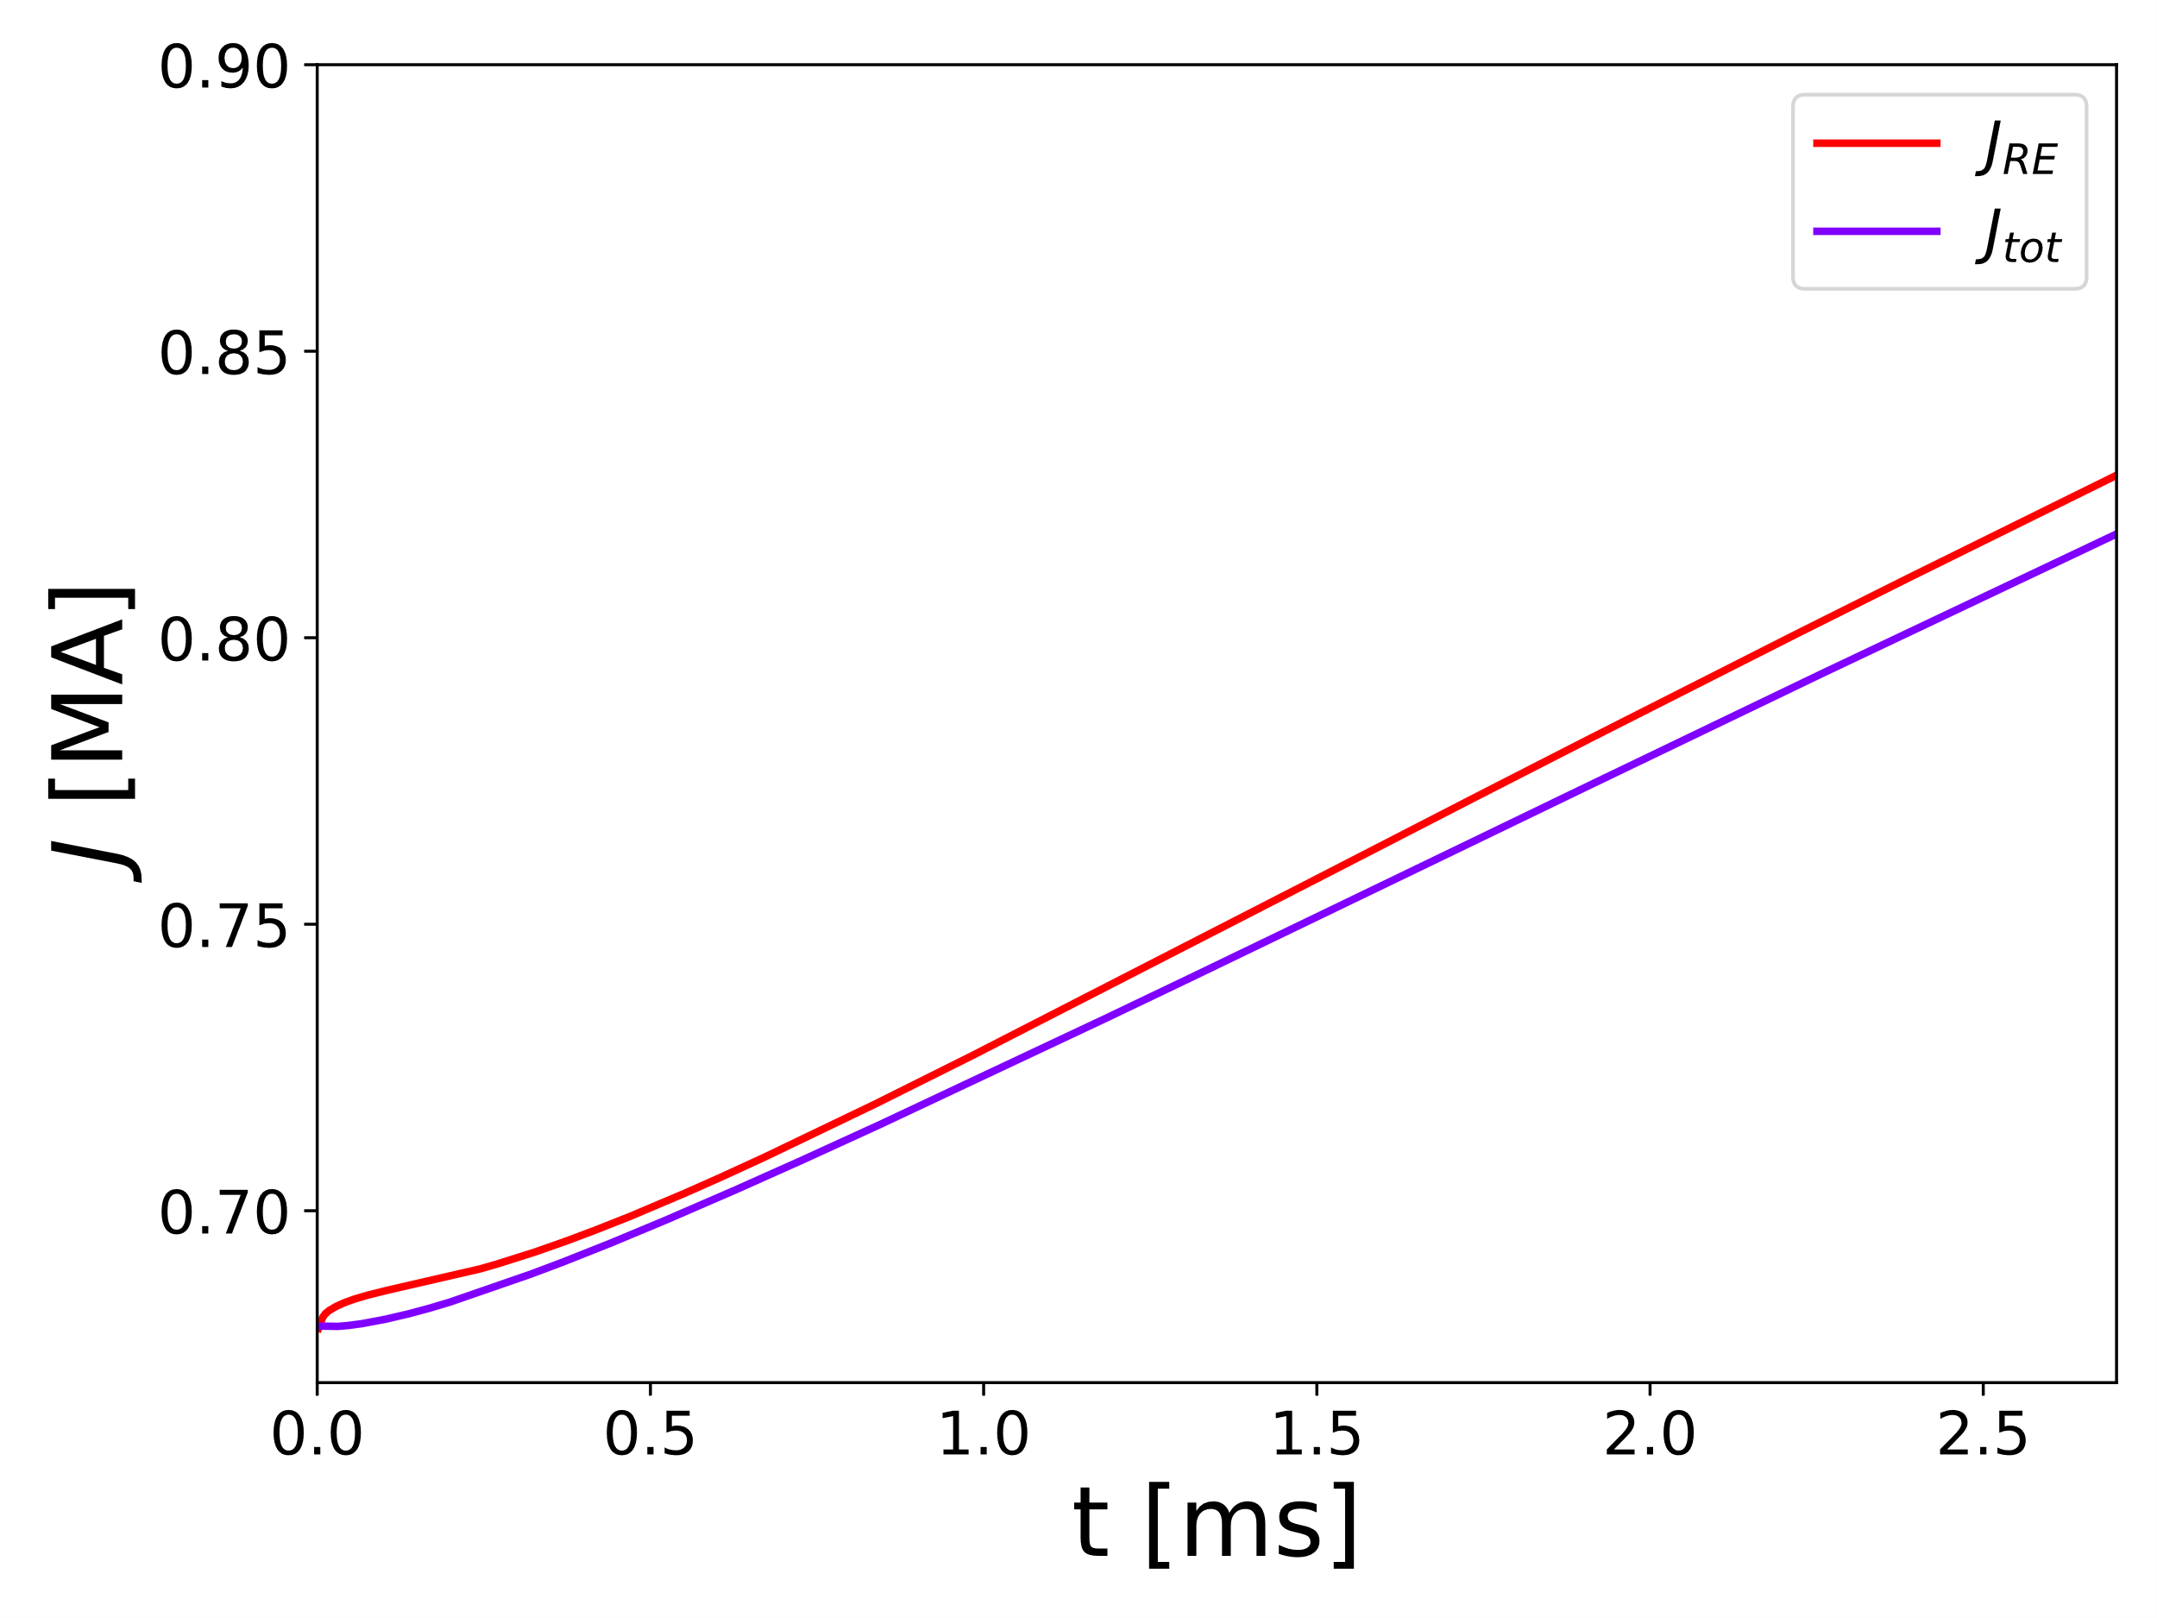
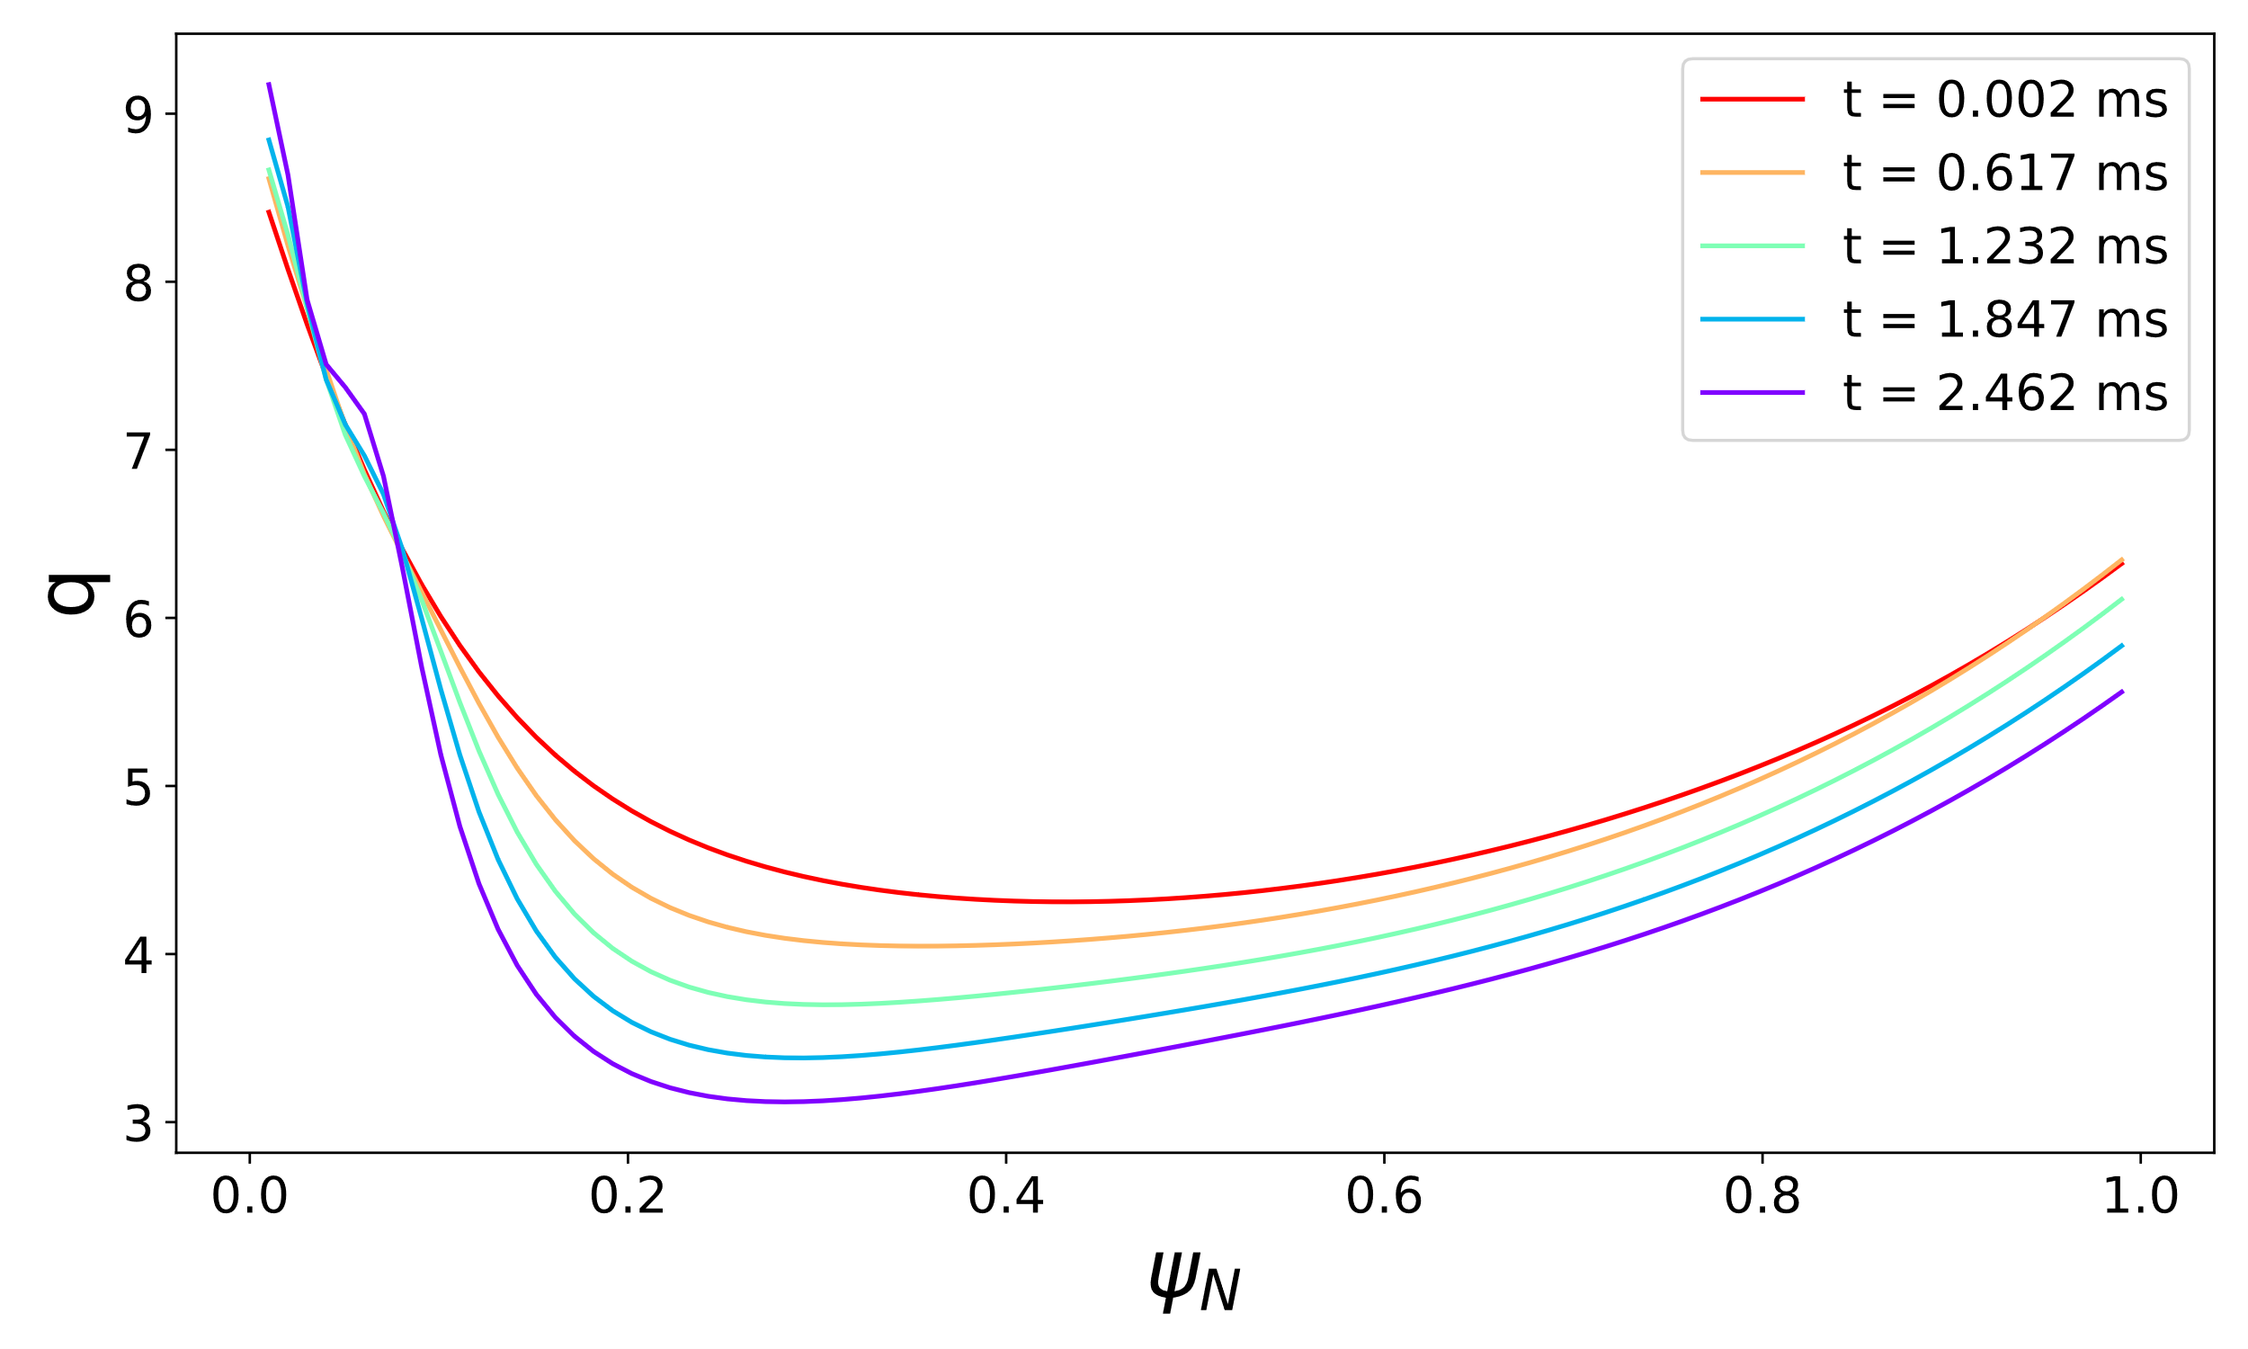

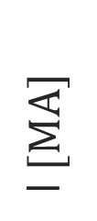
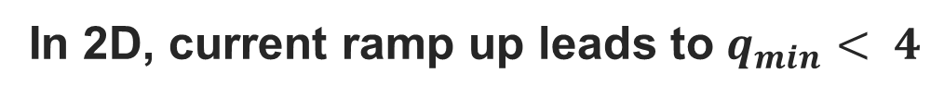
2D preliminary output
I$[MA]$
In 2D, current ramp up leads to $q_{min}⁡< 4$

Slide 22
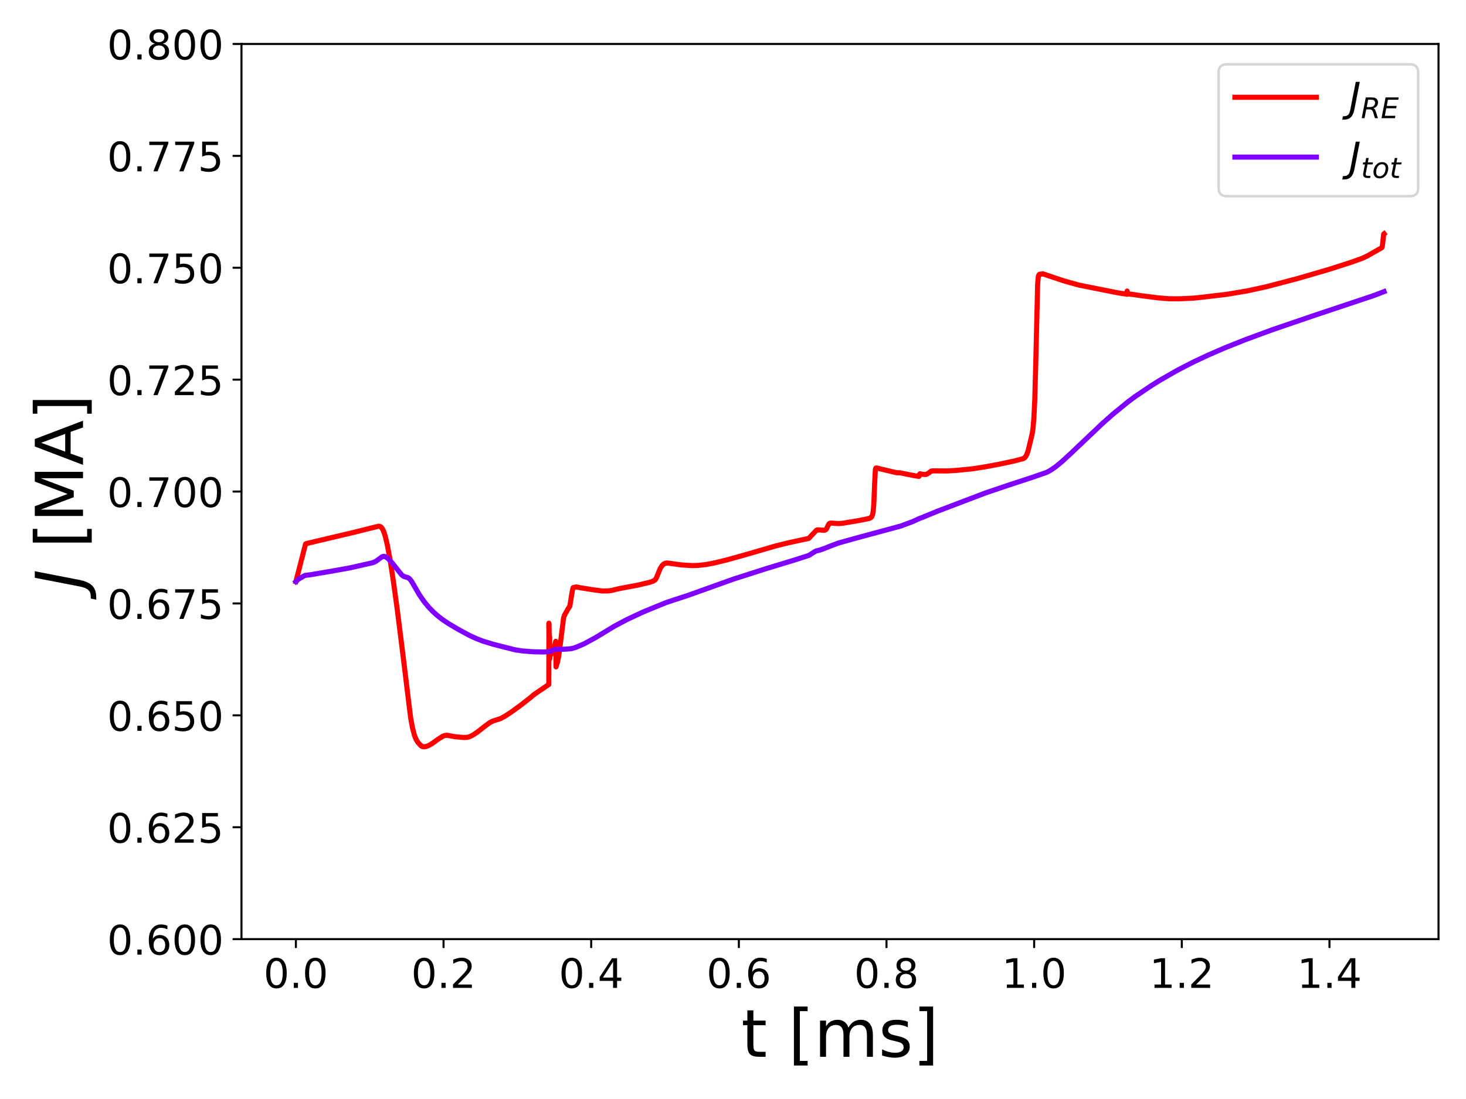
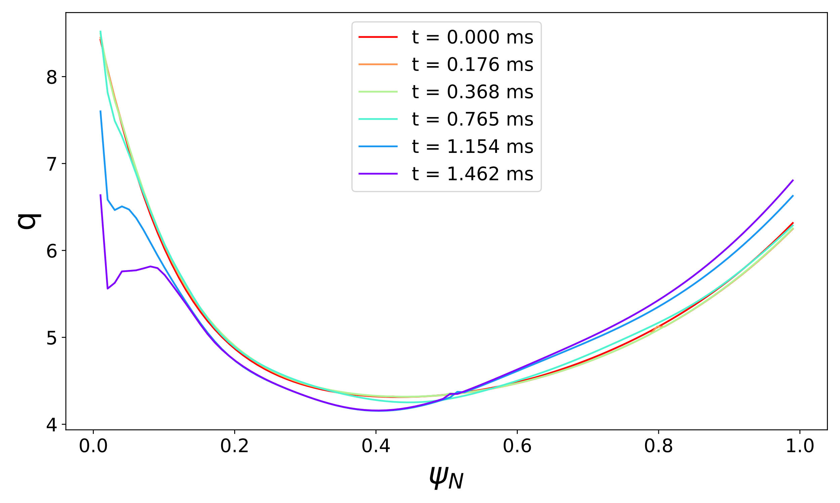
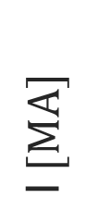
3D preliminary output
I$[MA]$
MHD activity during the irregular ramp up. In particular, in the core region $→$ cannot reach $q_{min}⁡= 4$ (numerical issues)

Slide 23
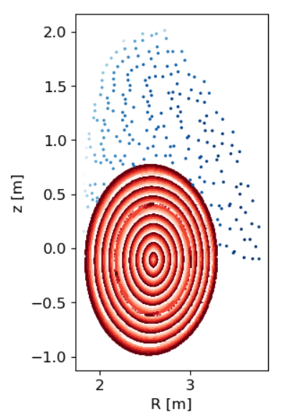
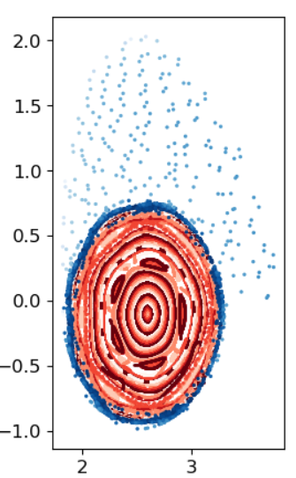
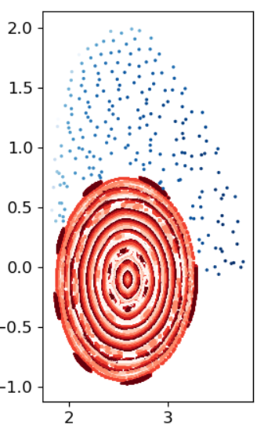
Initial MHD instability: mainly 5/1 DTM
t= 0.074 ms, 0.69 MA
t= 0.131 ms, 0.68 MA
t= 0.163 ms, 0.64 MA
5/1 islands as observed in experiment. But, afterwards MHD only in the core

Slide 24
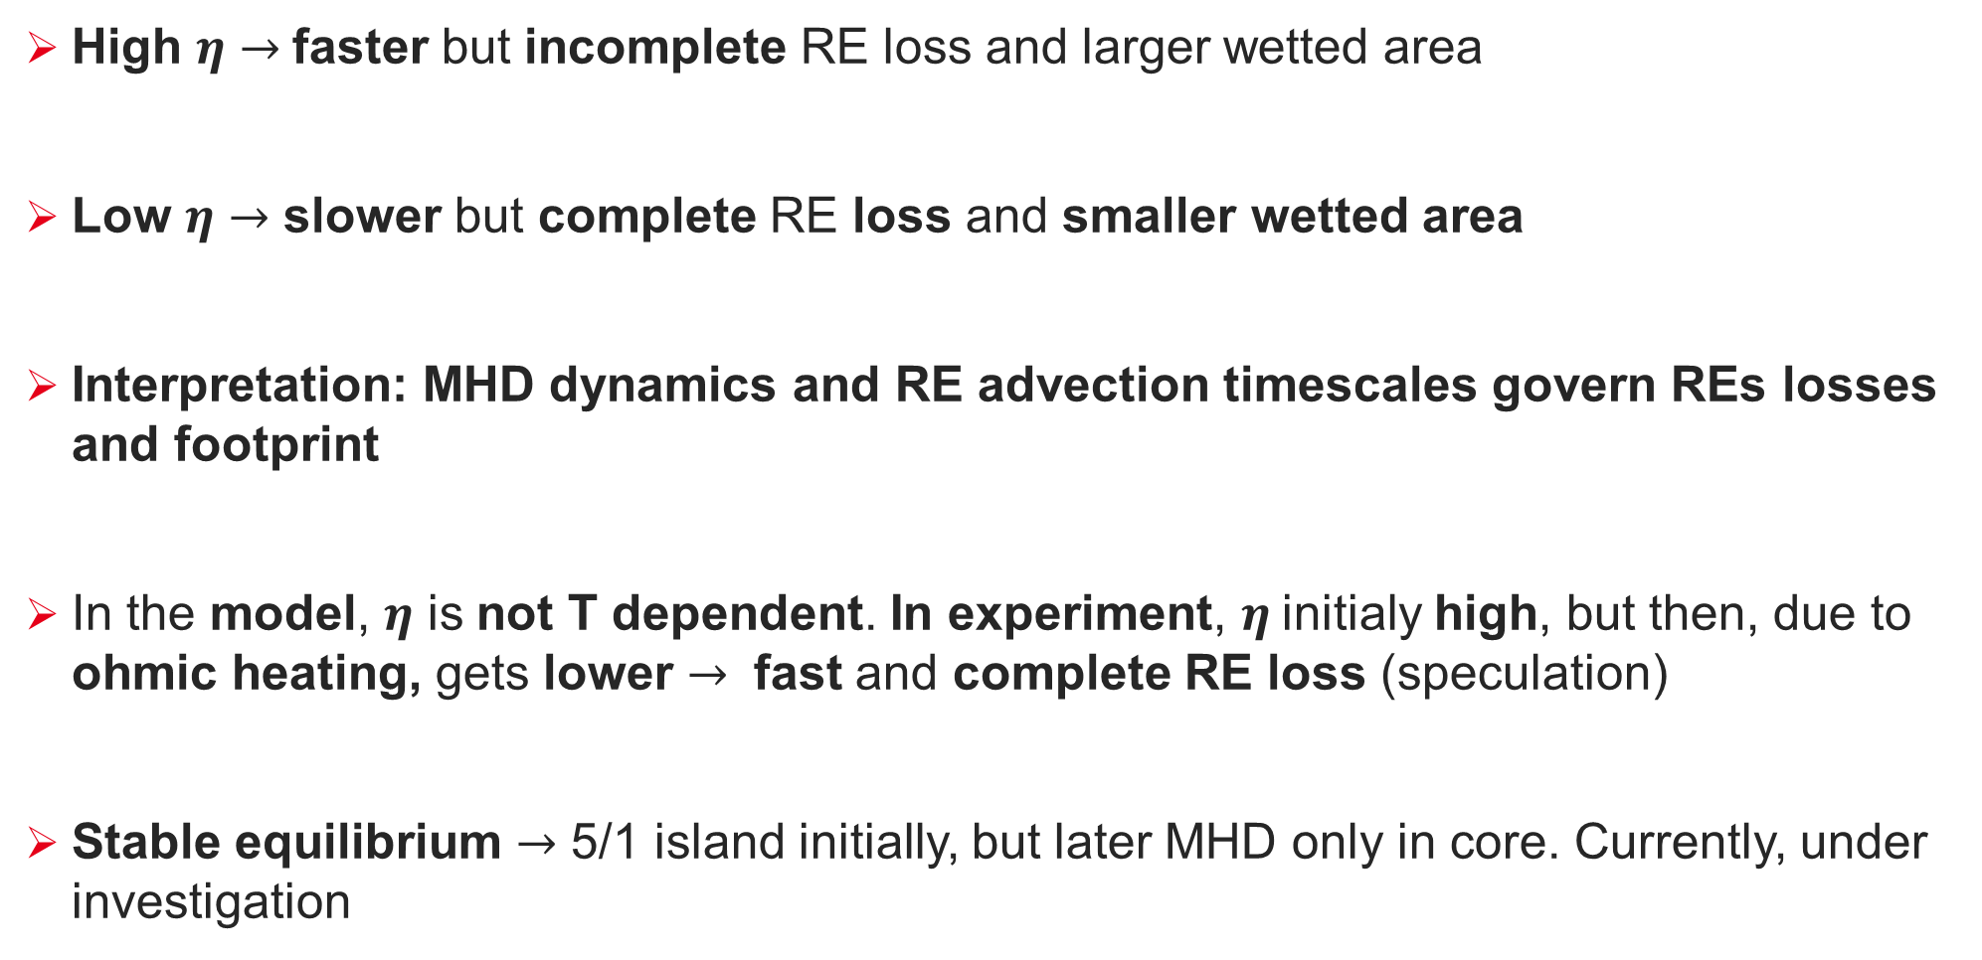
Summary and Outlook
High $η$ $→$faster but incomplete RE loss and larger wetted area
Low $η$ $→$ slower but complete RE loss and smaller wetted area
Interpretation: MHD dynamics and RE advection timescales govern REs losses and footprint
In the model, $η$ is not T dependent. In experiment, $η$initialy high, but then, due to ohmic heating, gets lower $→$ fast and complete RE loss (speculation)
Stable equilibrium $→$ 5/1 island initially, but later MHD only in core. Currently, under investigation

Slide 26
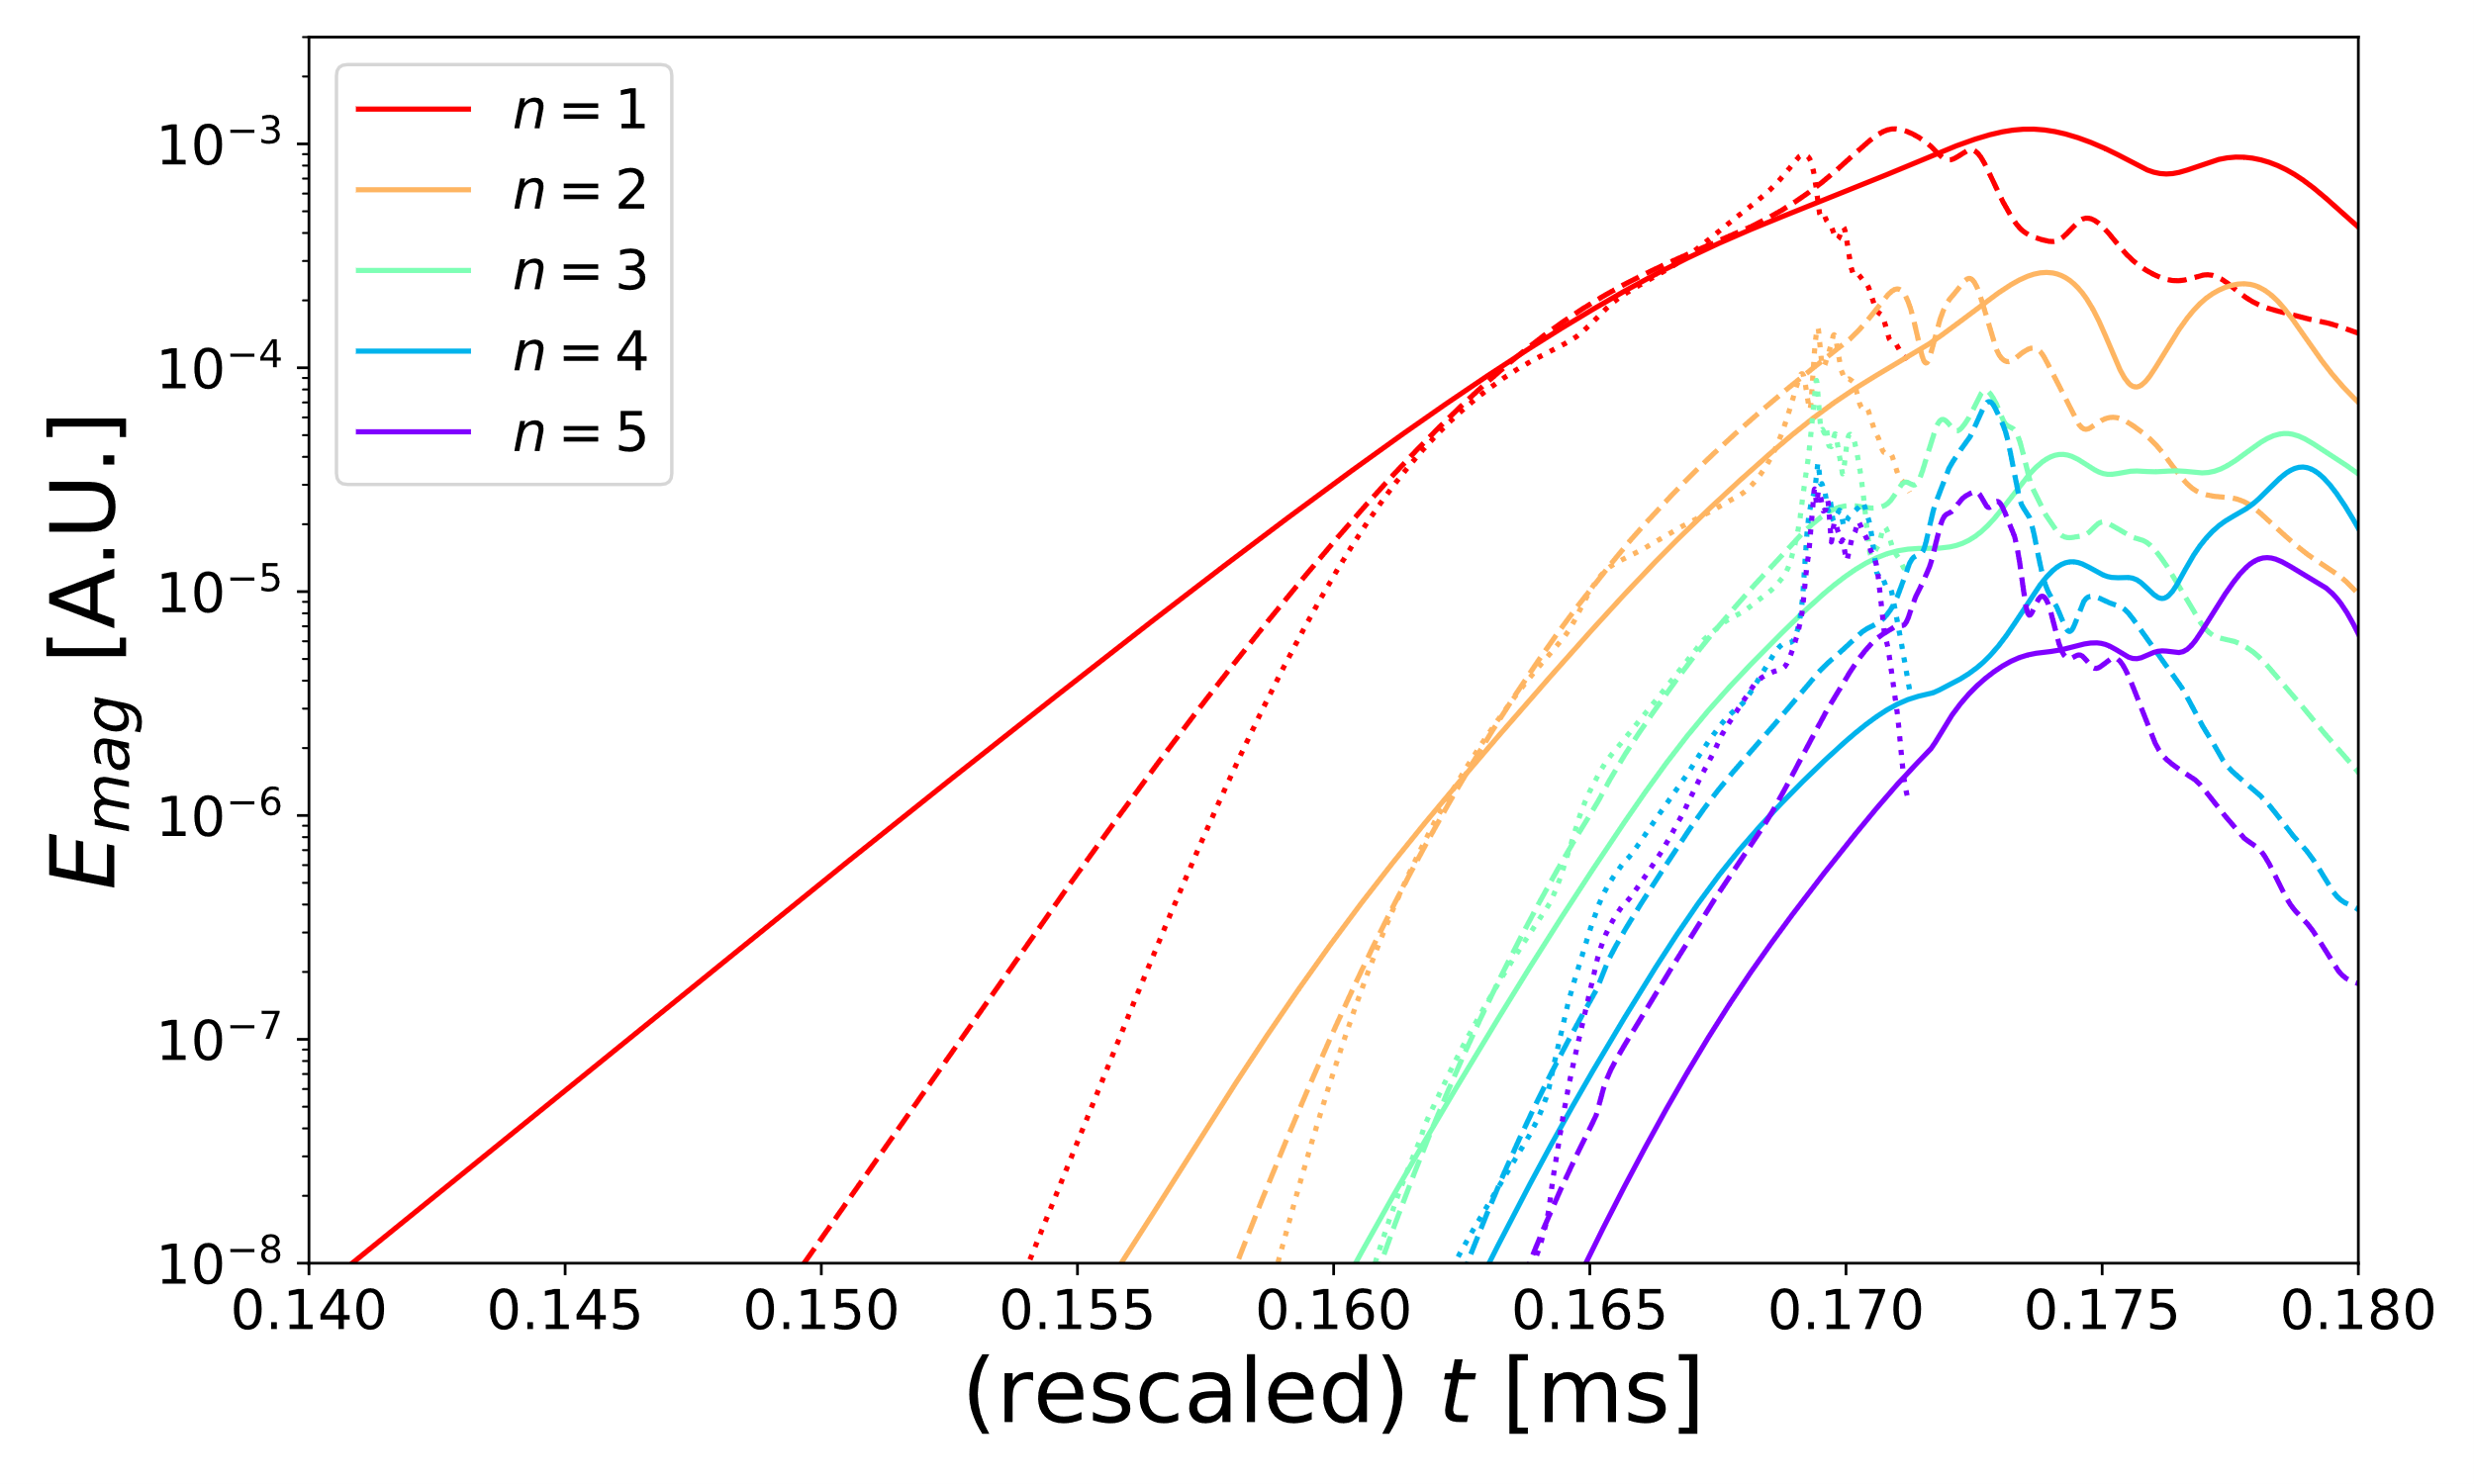
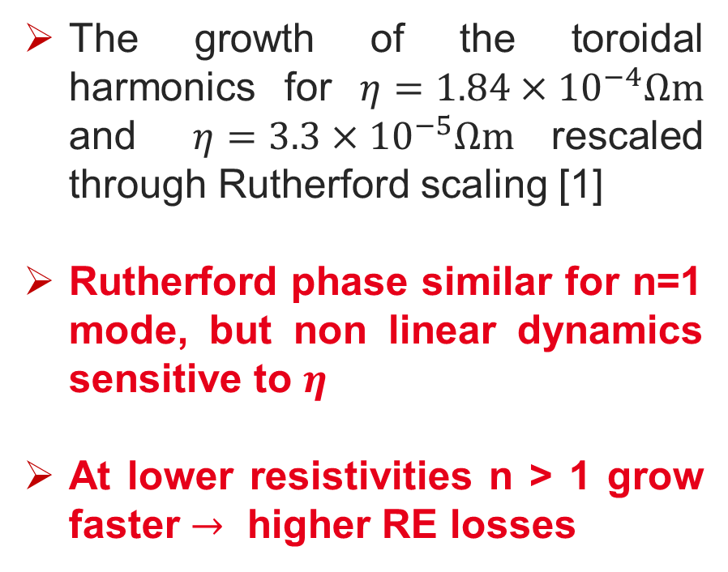
Higher final $J_{RE}$ amplitude, Why?
The growth of the toroidal harmonics for $η=1.84×{10}^{−4}Ωm$ and $η=3.3×{10}^{−5}Ωm$ rescaled through Rutherford scaling [1]
Rutherford phase similar for n=1 mode, but non linear dynamics sensitive to $η$
At lower resistivities n > 1 grow faster $→$ higher RE losses
[1] E. Nardon et al. Phys. Plasmas, 30:092502, 20

Slide 27

Faster dynamics leads to larger wetted area
In all cases, the primary mode n=1 which dominate the dynamics both linearly and non linearly
The dominance of the primary mode is directly linked to the wall area on which the RE energy deposition occurs.
The heat loads are computed using the JOREK particle tracing module
Since the MHD simulations provide no information about the RE distribution in the momentum space, each RE particle is assumed to have a kinetic energy of 10 MeV and a pitch angle of ζ =v∥/v⊥ =−0.99.
For $η=6.1×{10}^{−4}Ωm$ (with highest growth n=1) the largest area of energy deposition among all the simulated cases take place as reported in the table

Slide 28




Advection vs diffusion: modes growth (I)

Slide 29




Advection vs diffusion: modes growth (II)

Slide 30
Advection vs diffusion: modes growth (II)

Slide 31







Faster dynamics leads to larger wetted area
High $η$
Medium $η$
Low $η$
RE footprint determined by
Growth rate
n=1 maximum amplitude
Similar max values for all $η$, but high $η$ has the highest growth rate
LARGEST FOOTPRINT

Slide 32






Viscosity effects on modes growth
$μ=48 m^{2}/s$, $μ=4.8 m^{2}/s$, $μ=0.48 m^{2}/s$ @ $η=3.3∗{10}^{−5} Ωm$
Lowest viscosity $→$ fastest linear growth rate, but lowest amplitude $→$ Smallest Footprint
Medium $μ$
High $μ$
Low $μ$
 | $$48 m^{2}/s$$ | 4.8 $m^{2}/s$ | $0.48 m^{2}/s$
Area $\left[m^{2}\right]$ | 1.4 | 0.9 | 0.8
Similar max as high $μ$ and faster rates, but lower footprint (?)

Slide 33




Advection vs diffusion
$μ=48 m^{2}/s$, $μ=4.8 m^{2}/s$, $μ=0.48 m^{2}/s$ @ $η=3.3∗{10}^{−5} Ωm$
Lowest viscosity $→$ fastest linear growth rate, similar amplitude
Low $μ$
Medium $μ$
High $μ$

Slide 34

Advection vs diffusion: RE current loss
Larger RE loss rate due to faster growth of the modes and clear scaling with viscosity

Slide 35

Moving towards a self-consistent evolution
Previous simulations started from unstable MHD equilibrium. Now, start from a stable equilibrium and evolve it to termination
Bandaru et al, PPCF 63 (2021)

