Slide 1


Electromagnetic suppression of drift-wave turbulence and the L–H transition
B. De Lucca, P. Ricci, L. Stenger, Z. Tecchiolli, D. Mancini
École Polytechnique Fédérale de Lausanne (EPFL), Swiss Plasma Center
1

Slide 2
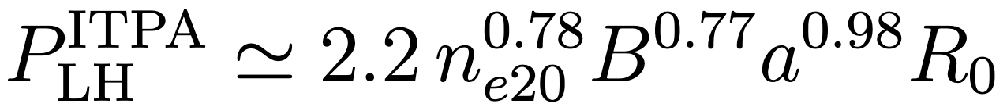
The L-H transition: some empirical facts
Power crossing separatrix exceeds threshold value: spontaneous pedestal and energy confinement time doubles
Universal mechanism: observed in wide range of tokamaks and even stellarators [Erckmann et al. PRL 1993]
Localised to the edge: Turbulent transport suppressed near the separatrix
Threshold power scales according to empirical ITPA scaling law [Martin et al. J. Phys.: Conf. Ser. 2008]
Threshold power is lower when ion grad-B drift is towards X-point (Favourable/Unfavourable)
ITPA scaling law for LH power
2

Slide 3
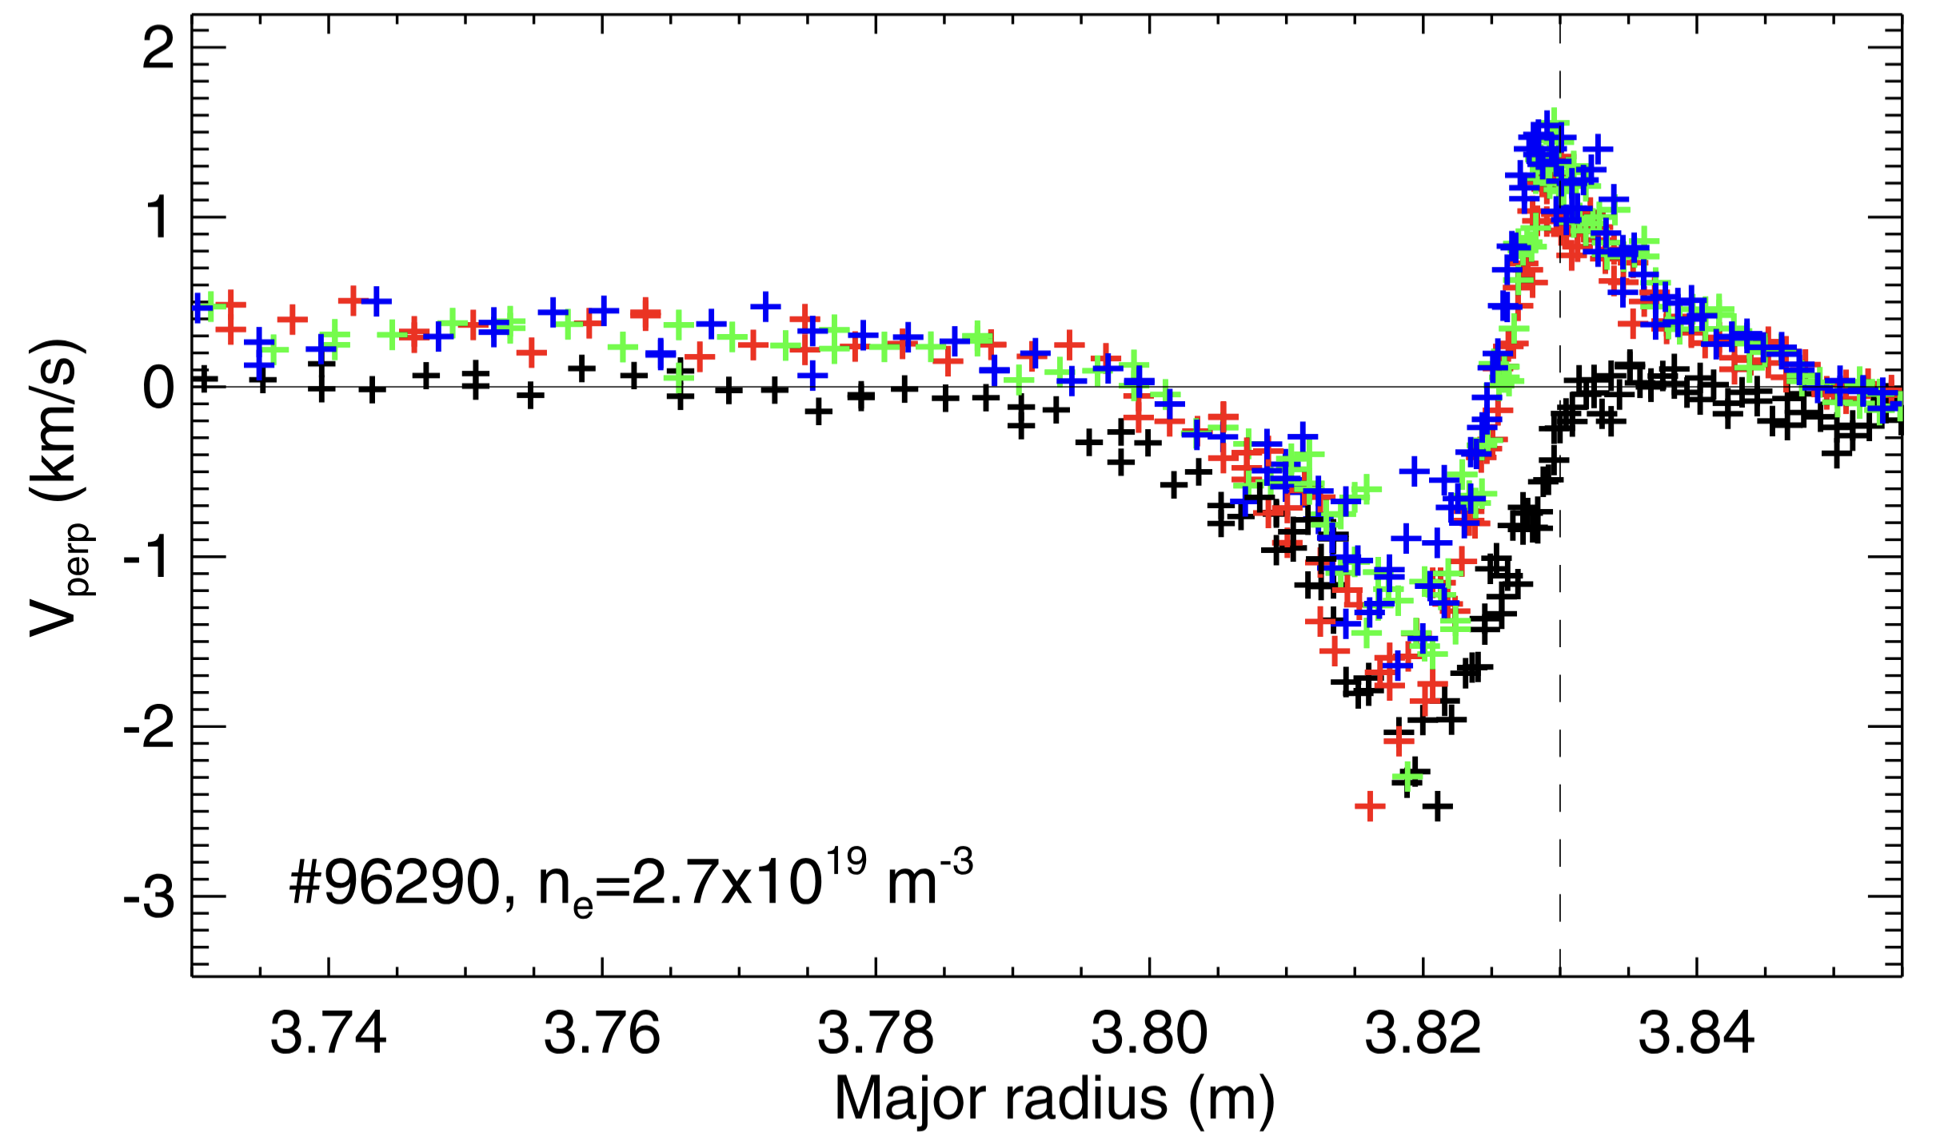

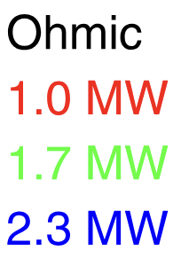
The L-H transition: some competing theories
Standard picture: turbulence suppressed by E✕B shear [Biglari et al. 1990]
Electric field shear and zonal flows at the edge suppresses turbulence, increasing electric field further via
Experiments in JET however: no significant change in electric field shear prior to transition [Silva et al. NF 2021]
Alternative: electromagnetic suppression of drift-wave turbulence [Guzdar PRL 2001, Connor & Pogutse PPCF 2001, Rogers et al. PRL 1998]
Global, flux-driven simulations of the tokamak edge now possible
Electric field across power ramp in JET [Silva et al. NF 2021]
3

Slide 4
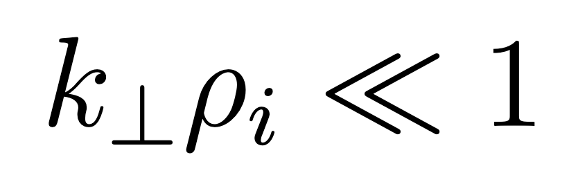
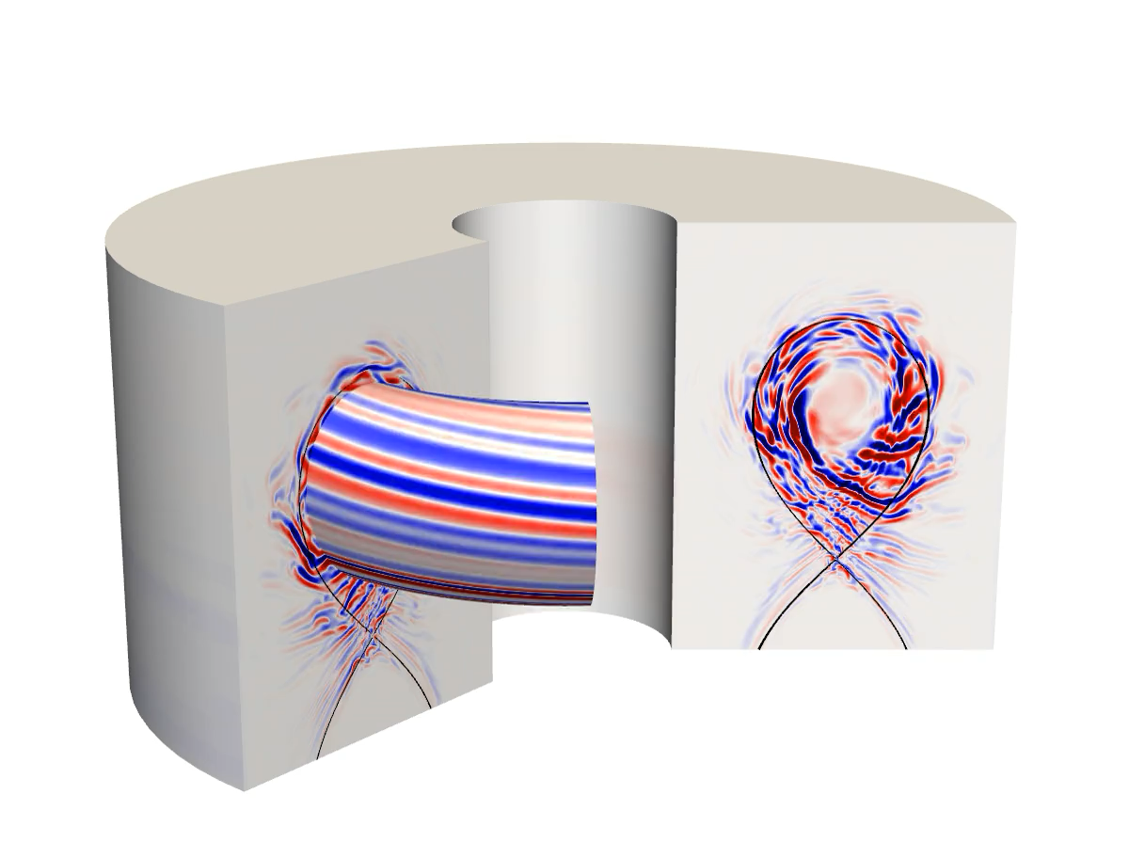
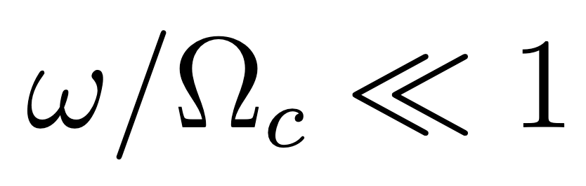
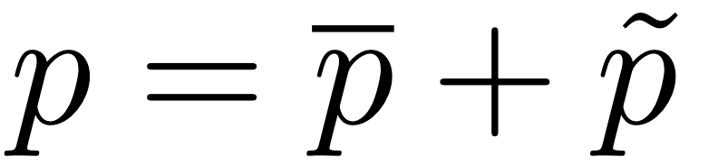
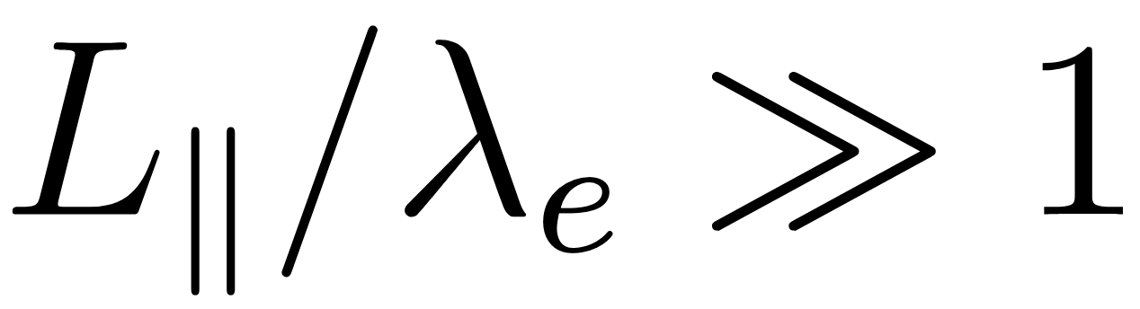
Edge turbulence simulated with GBS code
Edge and scrape-off-layer: turbulent fluctuations are O(1), large-scale and low-frequency:
Evolve background and fluctuations together
Collisionality: generally large enough for fluid description
GBS solves 2-fluid electromagnetic drift-reduced Braginskii equations [Ricci et al. PPCF 2012, Giacomin et al. JCP 2022]
Flux-driven: specify particle/heat sources and evolve global profiles
GBS
4

Slide 5
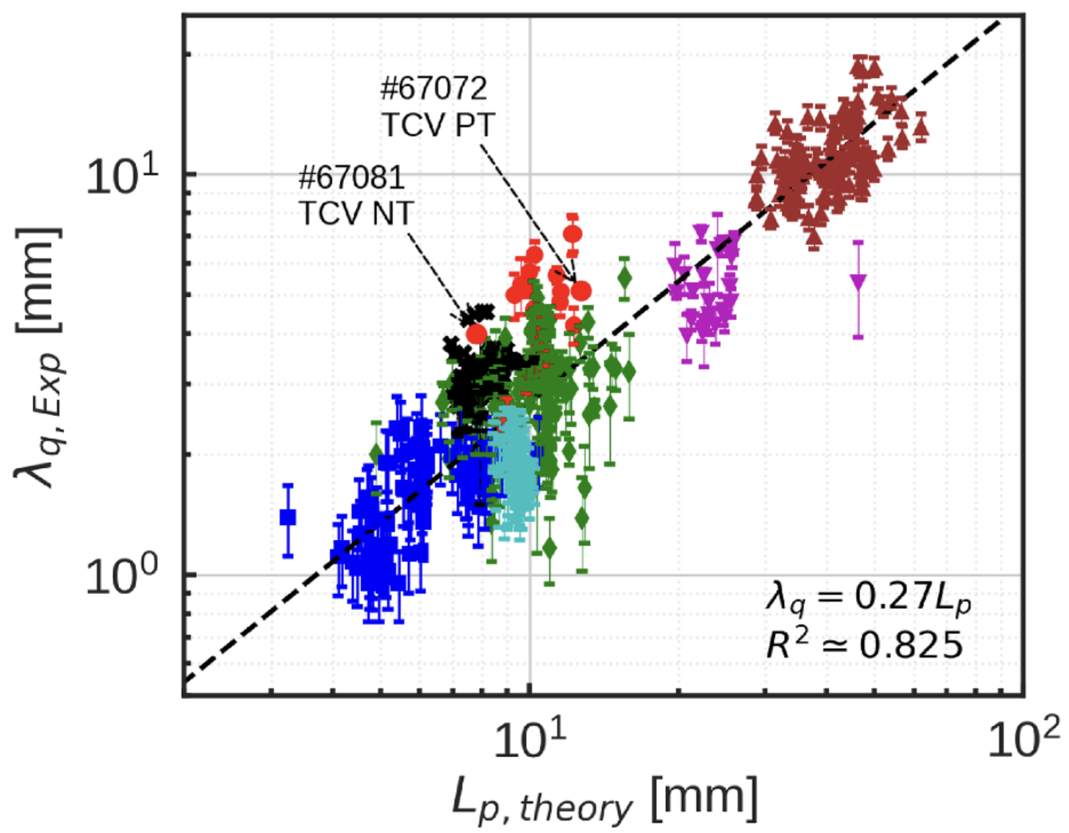

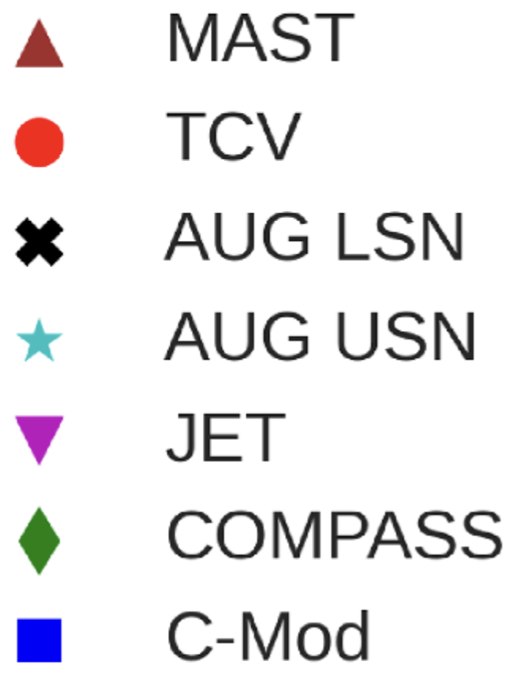
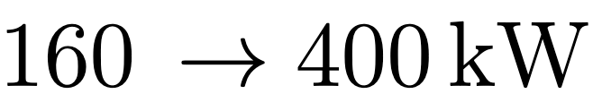
L–mode edge turbulence is resistive ballooning driven
Ballooning modes (BM): driven unstable by bad curvature
L-mode edge turbulence believed mainly driven by resistive branch (RBM) [Rogers et al. PRL 1998, Giacomin & Ricci PoP 2022]
Theoretical scaling law for in RBM dominated turbulence
Excellent agreement with experimental dataset [Lim et al. PPCF 2023]
Study L-H transition: From L-mode in analytical diverted equilibrium, we ramp up power
Simulations in both Favourable and Unfavourable configurations
Offset cost of parameter scan: reduced size (half-size TCV)
Scaling law vs multimachine L-mode heat-decay length [Lim et al. PPCF 2023]
5

Slide 6
Edge transport barriers due to turbulence transitions
Various suppressed transport regimes observed in global turbulence codes (GBS, XGC, Grillix, Soledge3X, …) [Giacomin & Ricci JPP 2020, Ku et al. PoP 2018, Zholobenko et al. submitted PRL 2025]
Increasing electron temperature (decreasing collisionality) in GBS: transition from resistive-ballooning driven to electron drift-wave turbulence
Resistive ballooning
Electron drift-wave
Pressure fluctuations
Increase power
6

Slide 7
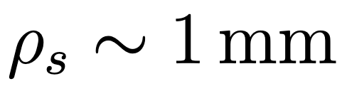
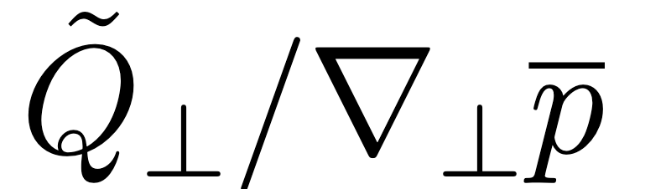
Favourable case: higher power leads to transition
Transition in Favourable case: pressure profiles steepen and turbulence suppressed
Distance from separatrix order of the sound larmor radius
Quantity to discern transport barriers: turbulent heat diffusivity
L-mode, no steep edge-gradient: we expect turbulent diffusivity to increase as we approach separatrix
Clear transition: turbulent diffusivity profile flattens and ∼ 2–3 ✕ reduction
Pressure profiles
Turbulent diffusivity profile
Increase power:
Pressure steepens
Increase power:
reduce turbulence
7

Slide 8
Unfavourable: no transition at same power
No clear transition in Unfavourable case, for same input power
Pressure profile increase slightly but much below Favourable level
Turbulent diffusivity profile: Unfavourable case remains close to L-mode transport level
To best of our knowledge, first global and flux-driven results of this kind
Difference between F/UF does not require kinetic effects (e.g. ion-orbit-losses)
We now focus on Favourable case
Pressure profiles: F/UF comparison
Turbulent diffusivity: F/UF comparison
8

Slide 9
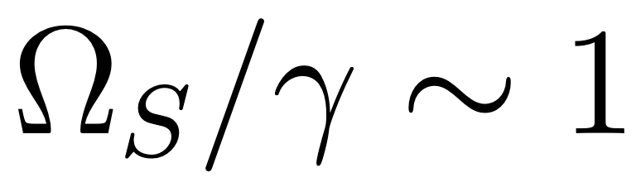
Favourable: E ✕ B shear alone cannot explain transition
E✕ B shear suppresses turbulence when shear rate Ω_{S} approaches nonlinear decorrelation time (∼ growth rate) [Terry, Rev. Mod. Phys, 2000]
Most common explanation given for L-H transition [Kim & Diamond PRL, 2003]
Simulation results: Electric-field well deepens but small difference in normalized shear rate
Need to look further: E✕ B shear alone cannot explain transition in Favourable
Drift-wave turbulence is suppressed by finite plasma β (electromagnetic effects)
Favourable: electric field
Favourable: normalised ExB shear
9

Slide 10
Electromagnetic suppression of drift-wave turbulence
Going to H-mode like conditions, edge turbulence changes to drift-wave dominated (DW)
Removing electromagnetic (EM) effects weakens the transition in Favourable case
In fact drift-wave instability suppressed by EM effects [Rogers & Dorland PoP 2005, Mosetto et al. PoP 2012]
EM suppression factor increases with pressure gradient (spontaneous pedestal formation)
EM fluctuations suppress transport
Linear theory: EM suppression of DW
Electrostatic
Electromagnetic
10

Slide 11
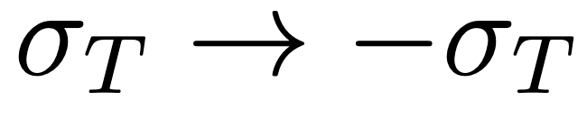
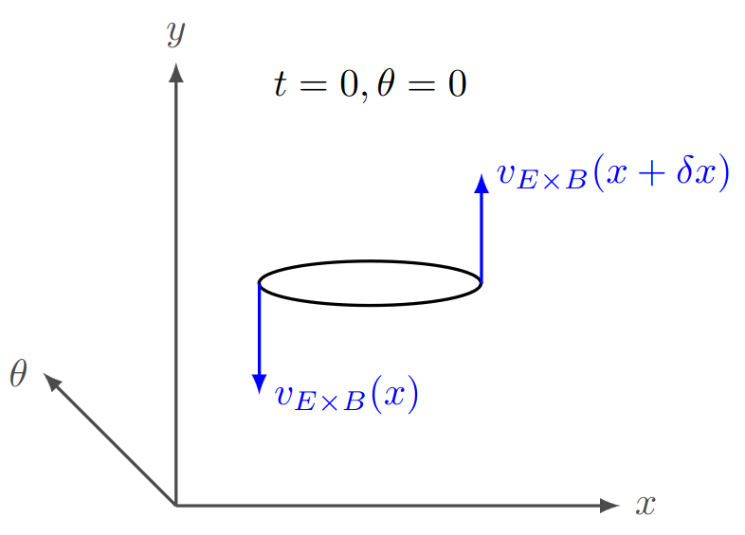
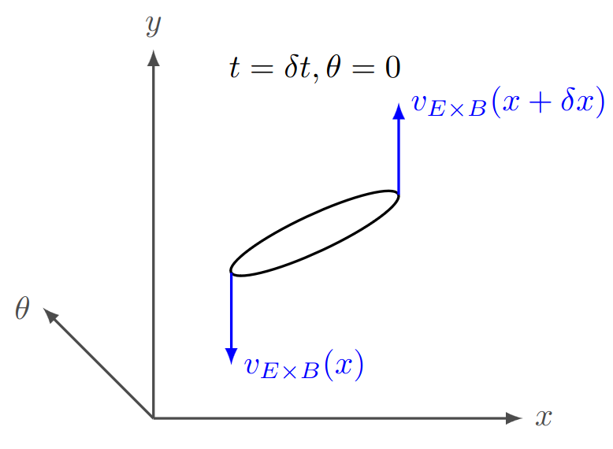
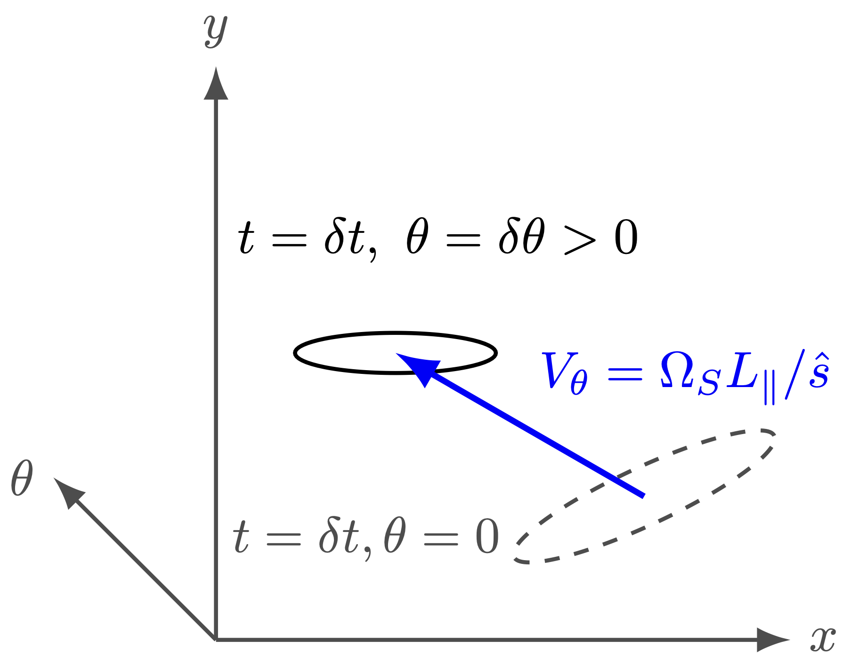
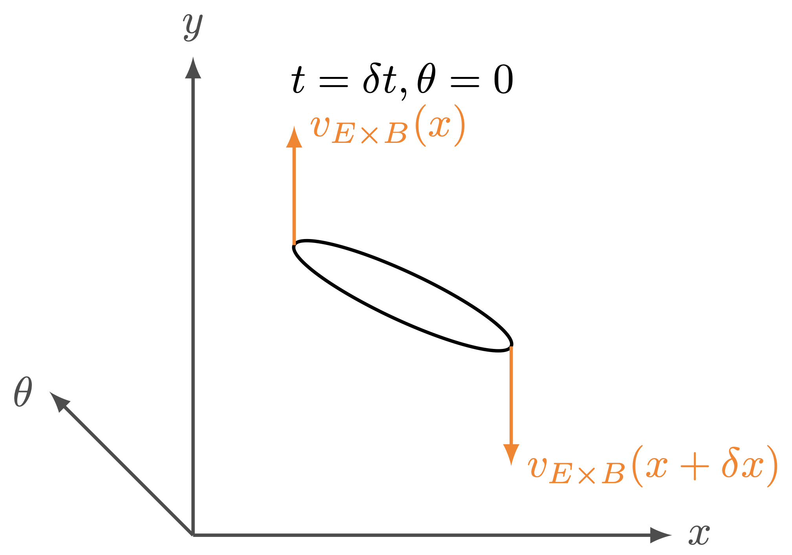
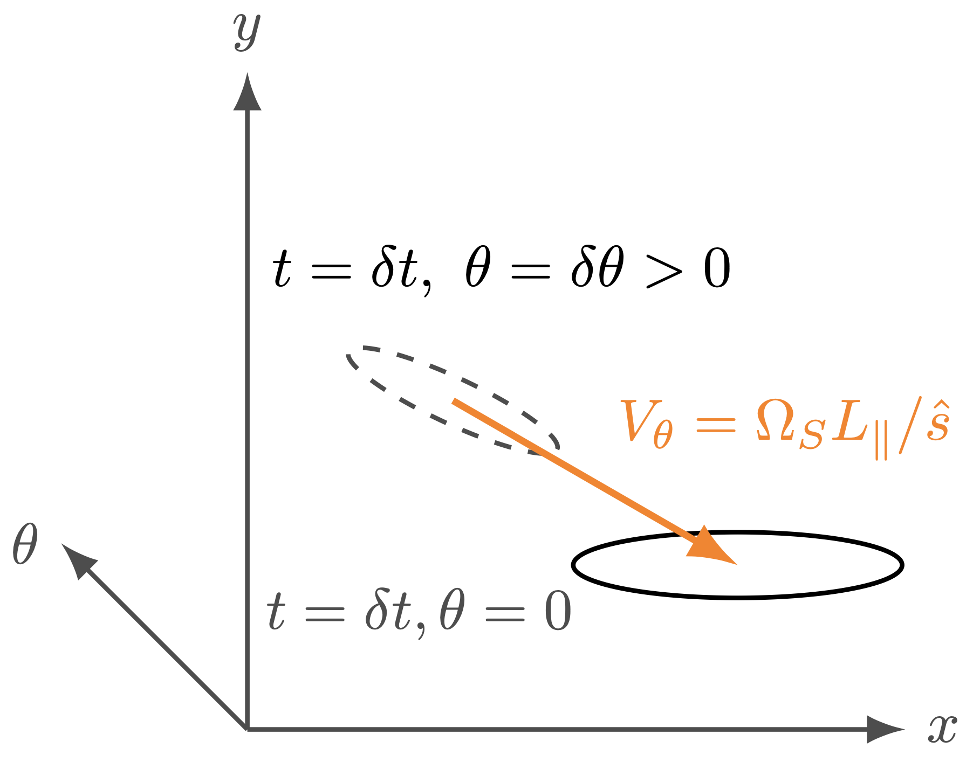
Favourable vs Unfavourable: Broken symmetry by E ✕ B shear
Favourable to Unfavourable is equivalent to flipping sign of toroidal field:
Drift velocities change direction: E✕ B flow shear at the outer-midplane (OMP) flips sign
In presence of flow & magnetic shear: unstable modes “move” along field-line in time [Newton et al. PPCF 2010]
Unfavourable mode moves forwards
Favourable mode moves backwards
11

Slide 12
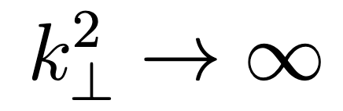
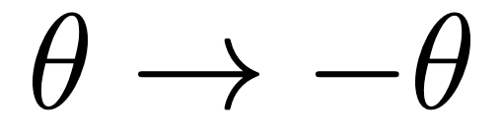
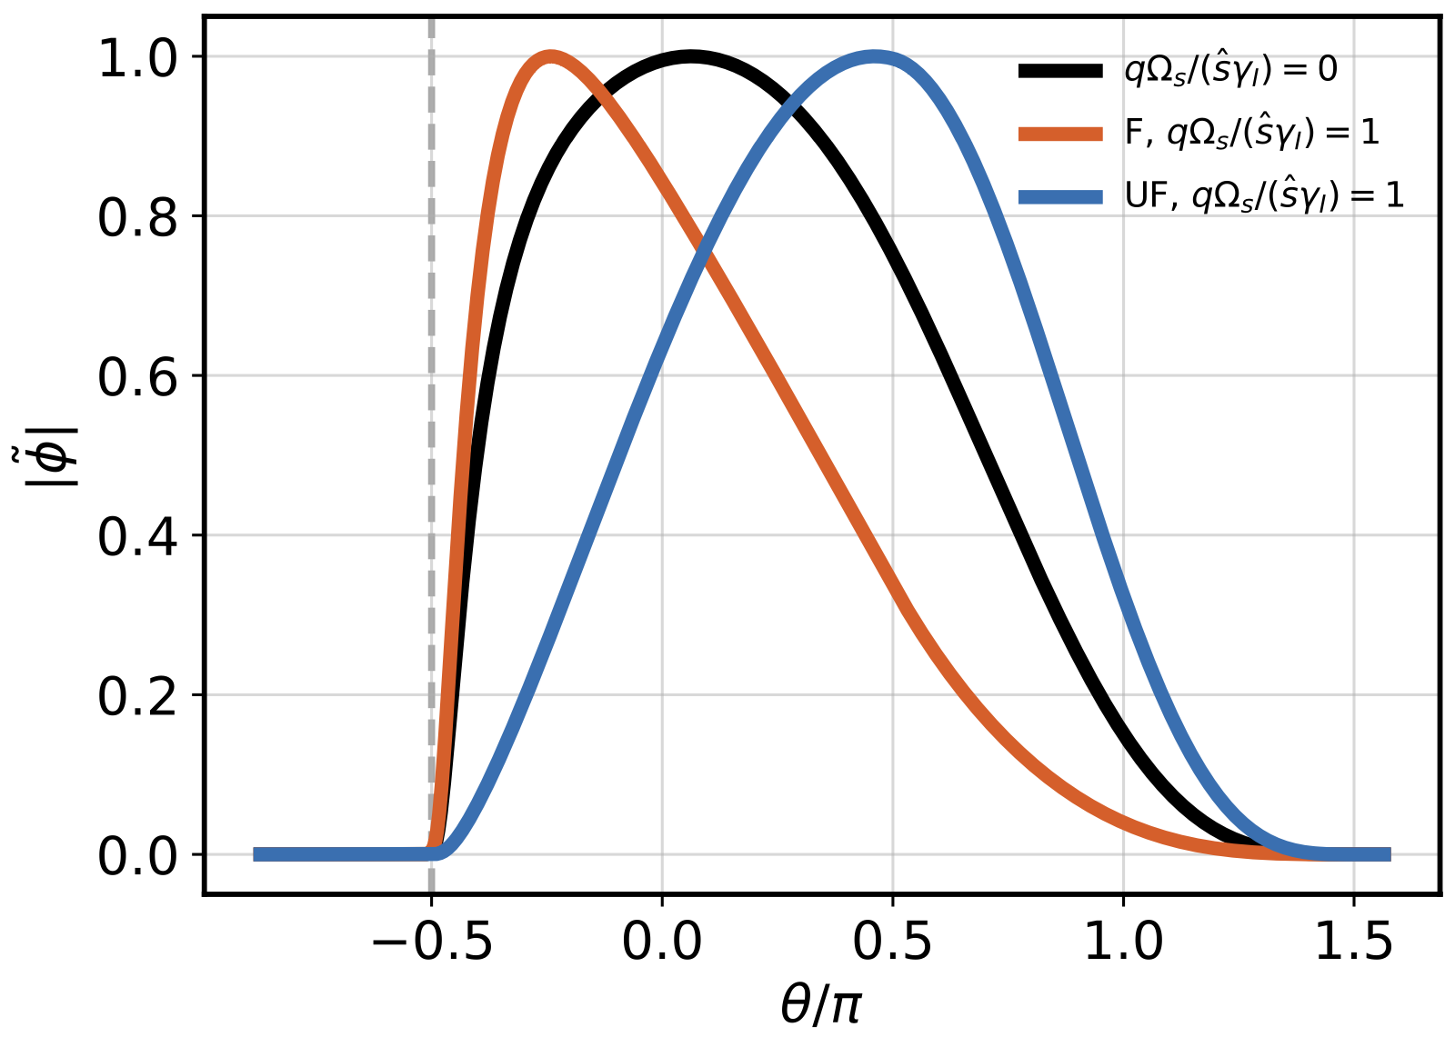
Unfavourable more ballooning unstable close to LH boundary
Mode localised more towards X-point (Favourable), region of weakest ballooning drive and
Mode localised more towards OMP (Unfavourable), region of strongest ballooning drive
Symmetry-breaking effect scales with E✕ B shear and up-down asymmetry of equilibrium
Close to the separatrix, this asymmetry is large
Linear analysis: Unfavourable more unstable to ballooning modes
Turbulent diffusivity: UF extends farther poloidally
Unfavourable Low Power
Favourable Low Power
Unstable BM modes localisation
Growth rates:
BM with ExB shear
X-pt
12

Slide 13
Unfavourable: Transition at higher power
Increasing input power even further (∼ 2 ✕ again) in Unfavourable case leads to transition
Turbulent diffusivity profile collapses towards Favourable case
Transition occurs at ∼ 2 ✕ Favourable power level (in line with experiments)
Higher power: the drift-wave instability can at last compete with ballooning-mode turbulence
Pressure profiles: UF higher power
Turbulent diffusivities: UF higher power
13

Slide 14
L-H transition mechanism
Increase in power → increase electron temperature → ballooning to drift-wave turbulence
Electromagnetic suppression proportional to edge pressure gradient: spontaneous pedestal
Flow-shear symmetry-breaking: unfavourable configuration more unstable to ballooning modes
Transition impeded, occurs at higher power
Mechanistic explanation of L-H transition consistent with GBS results
But ultimately, is it consistent with reality/experiments
14

Slide 15
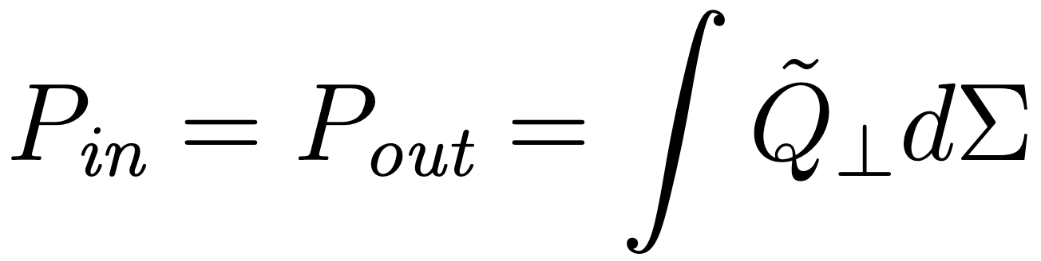
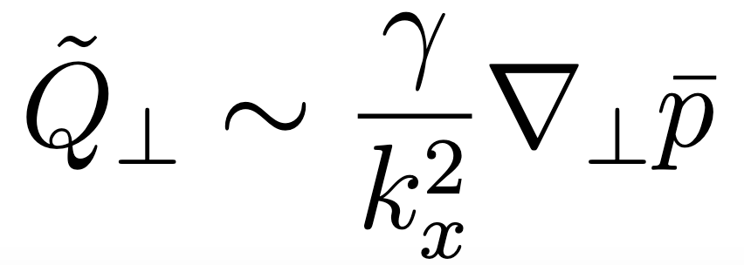
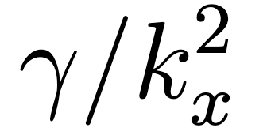
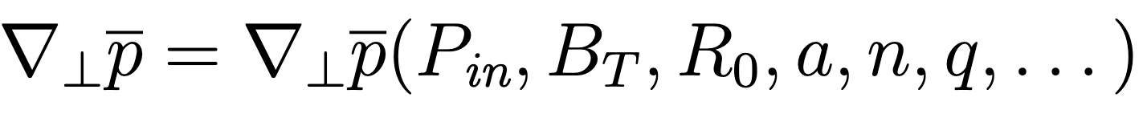
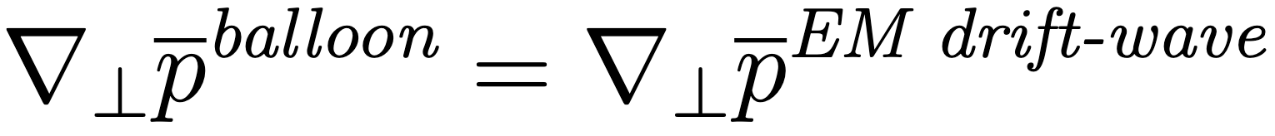

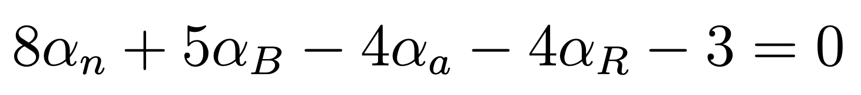
Analytical scaling law for favourable L-H power threshold
Following procedure in [Giacomin JPP 2020], can we derive analytical form for L-H power consistent with experiments?
Energy conservation
Assume turbulent transport is a random-walk (mixing-length estimate):
From linear theory in slab geometry (neglect ExB flow/magnetic shear), obtain analytical
Inverting the energy conservation equation we find
Transition criterium: turbulence can sustain the mean profiles
Transition power: 1 free parameter, K∼ O(1) overall scale
Analytical result: satisfies
Kadomtsev constraint
15

Slide 16

Comparison with L-H experimental data
L-H transition power threshold: analytical scaling law vs experimental data (favourable only)
TCV data newly added to ITPA database [Labit et al. PPCF 2025]
Transition power: 1 free parameter K∼ O(1)
Analytical scaling law LH
Empirical scaling law [Martin et al. 2008]
16

Slide 17
BACKUP SLIDES

Slide 18
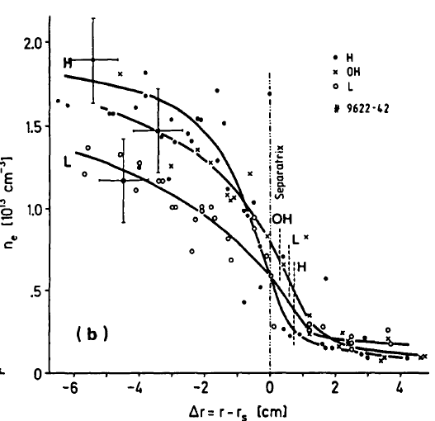
The LH transition in tokamaks
Usually: increase heating in fusion devices, increase turbulent transport (profiles are stiff)
But above a certain power, profile gradients increase spontaneously and confinement time roughly doubles
This is the Low-to-High (LH) confinement transition [ASDEX 1982]
Since its discovery, replicated across many different tokamaks and is baseline scenario for ITER [Loarte et al. PPCF 2025]
But more than 40 years on, we are still not sure what is happening
The H-mode of ASDEX [ASDEX team 1989]
18

Slide 19
Collisionality in the edge
Edge collisionality is generally large enough for fluid description
Normalised
collisionality
vs temperature
19

