Slide 1

Shafranov shift and zonal structure effects on the linear and nonlinear behavior of TAEs and ITGs in the presence of energetic particles
Baruch Rofman
Swiss Plasma Center (SPC)
École Polytechnique Fédérale de Lausanne (EPFL)
Together with
G. Di Giannatale, A. Mishchenko, E. Lanti, T.Hayward-Schneider, A. Bottino, B.F. McMillan, J.N. Sama, A. Biancalani, S. Brunner, and L. Villard

Slide 2
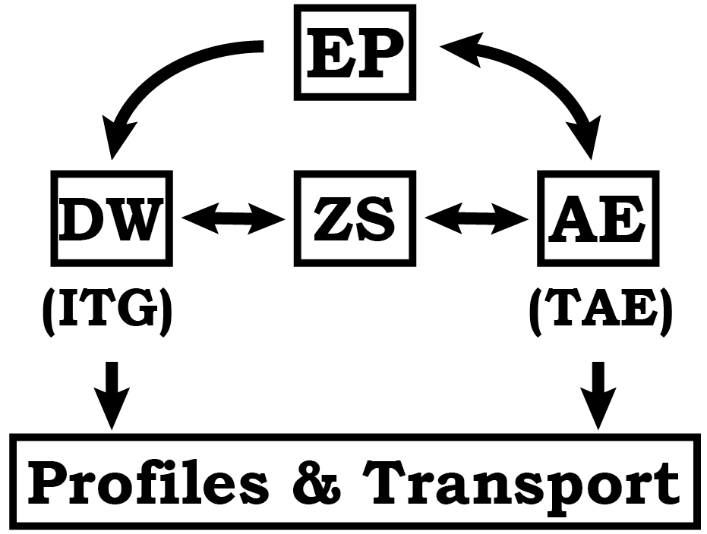
Part of the big picture of burning plasmas
In this work
TAE & ITG
Shafranov shift
EPs
Zonal structures
GAE (AAE)
Notes:
Burning plasma is a complex self-organizing dynamical system – where self-consistency matters.
Add zonca citation
We will excite two fusion relevant instabilities (TAE and ITG) in a single mode configuration and study their linear and nonlinear behavior as a function of Shafranov shift and, EP fraction.
In the nonlinear phase we add the zonal response as a nob, and look at the difference between how the systems self organize and what is the impact on the resulting fluxes.
We identify axisymmetric, non zonal, Alfven mode, that is nonlinearly excited in our plasmas and might be connected to observed enhanced heat and particle fluxes.

Slide 3
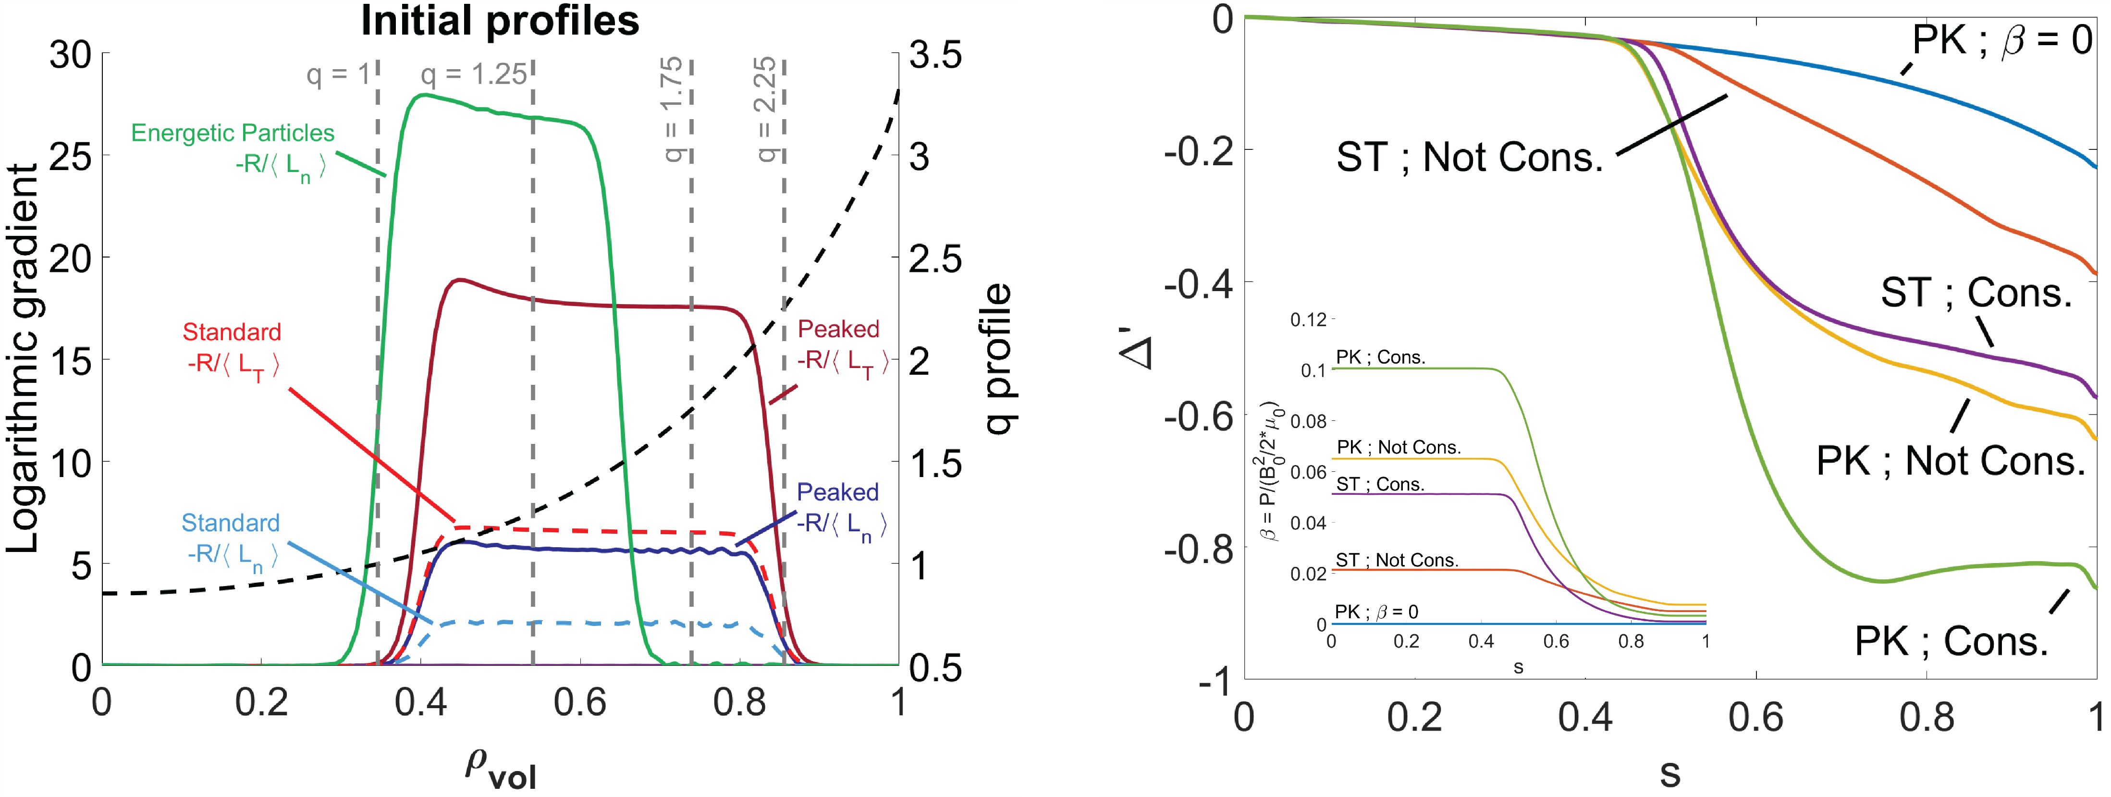

System and simulation parameters
All the simulations are done in ORB5
Electromagnetic
All species treated as kinetic
$\frac{m_{e}}{m_{i}}=\frac{1}{1000}$
Cyclone Based Case
  $a=0.61m$
  $R=1.7m$
  $B_{mag}=1.9 T$
  $ρ^{∗}=\frac{1}{180}$ $\left(ρ^{∗}=\frac{ρ_{cs_{0}}}{a} ;C_{s_{0}}=\sqrt{\frac{T_{e}\left(s_{0}\right)}{m_{i}}}\right)$
Shaped MHD equilibrium using CHEASE
$\frac{m_{e}}{m_{i}}=\frac{1}{1000}$
Local Maxwellian distribution functions
Lanti, E., et al, Comput. Phys. Commun. (2020)
Lutjens, H., et al, Comput. Phys. Commun. (1996)

Slide 4
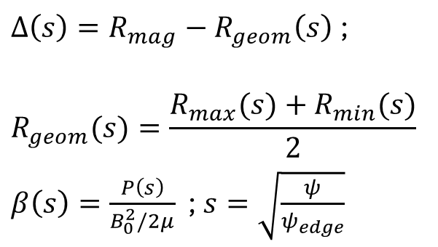
Shafranov shift
$Δ\left(s\right)=R_{mag}−R_{geom}\left(s\right)$ ;
$$R_{geom}(s)=\frac{R_{max}(s)+R_{min}(s)}{2}$$
$β\left(s\right)=\frac{P\left(s\right)}{B_{0}^{2}/2μ}$ ; $s=\sqrt{\frac{ψ}{ψ_{edge}}}$
ST – standard
PK – Peaked
Not Cons. – Thermal pressure w/o EPs
Cons. – Thermal pressure with EPs

Slide 5
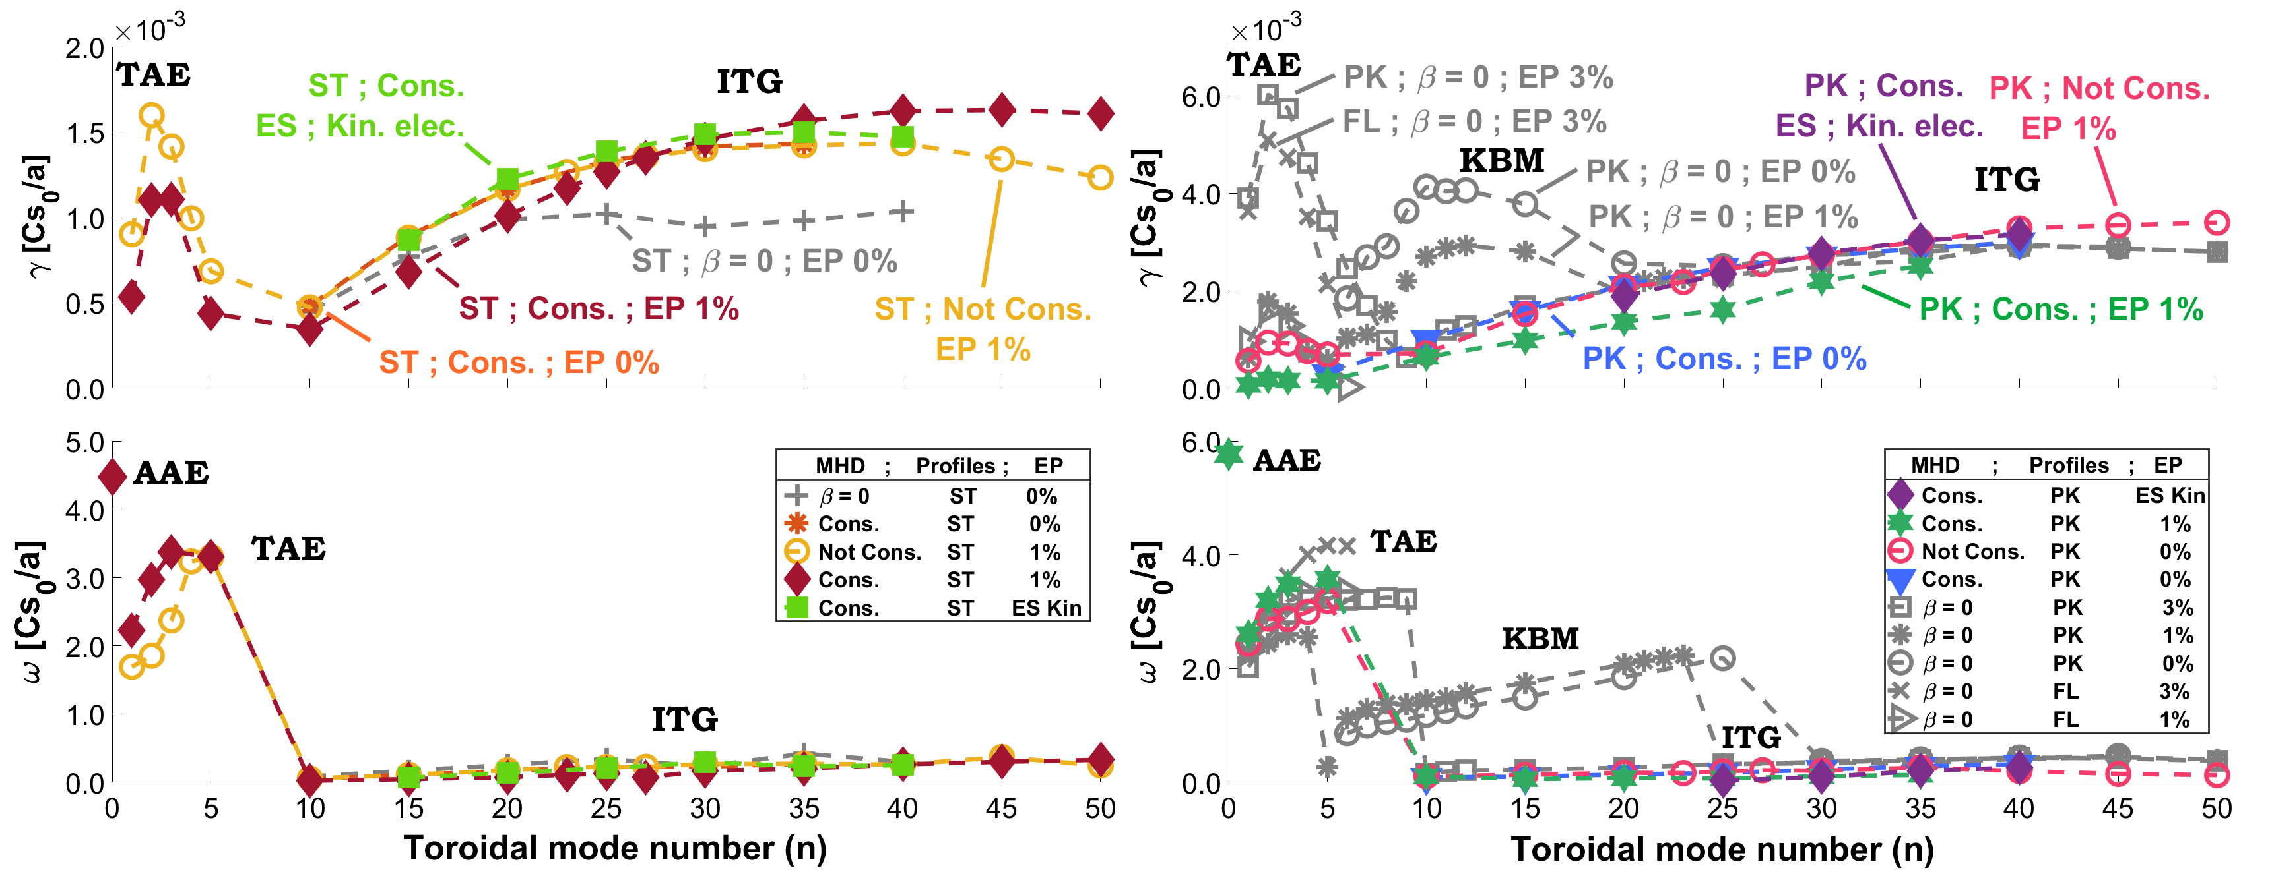
Linear dispersion relations
FL - Flat
ST – Standard
PK – Peaked
Not Cons. – Thermal pressure w/o EPs
Cons. – Thermal pressure with EPs
Notes:
the TAE is much more sensitive to Shafranov shift stabilization than the ITG mode.
Add ST – standard profiles
PK peaked profiles
Cons –
Not Cons –

Slide 6
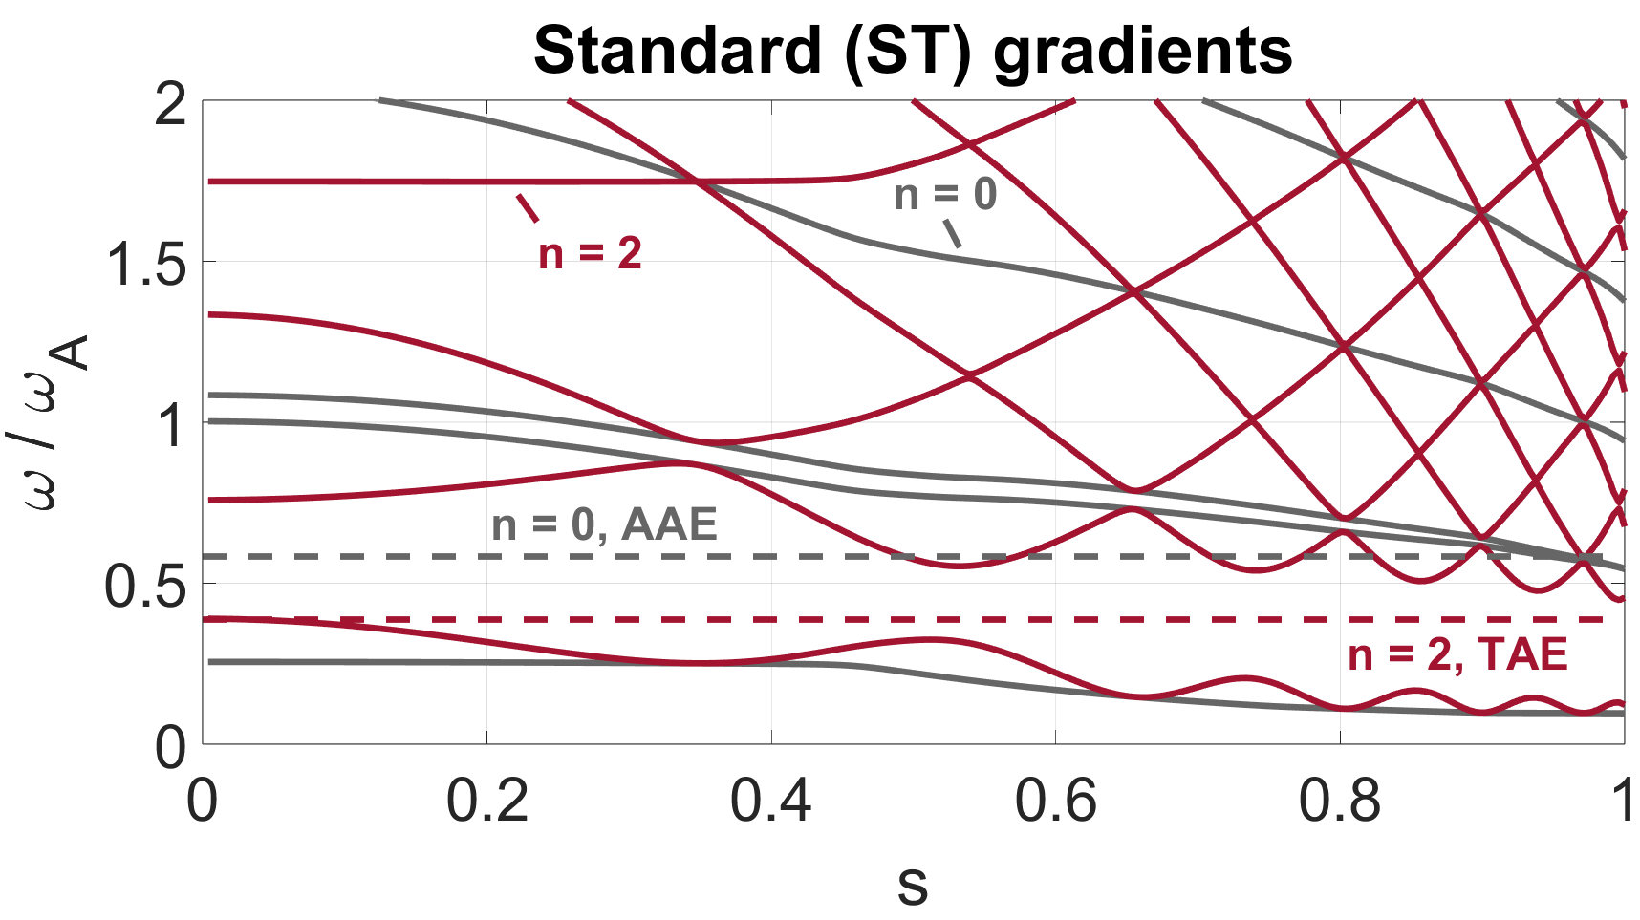
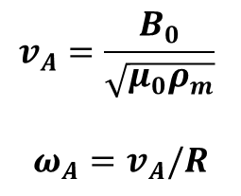
Alfvén continuum
EP fraction - 1% , slow sound approximation
$$v_{A}=\frac{B_{0}}{\sqrt{μ_{0}ρ_{m}}}$$
$$ω_{A}=v_{A}/R$$

Slide 7
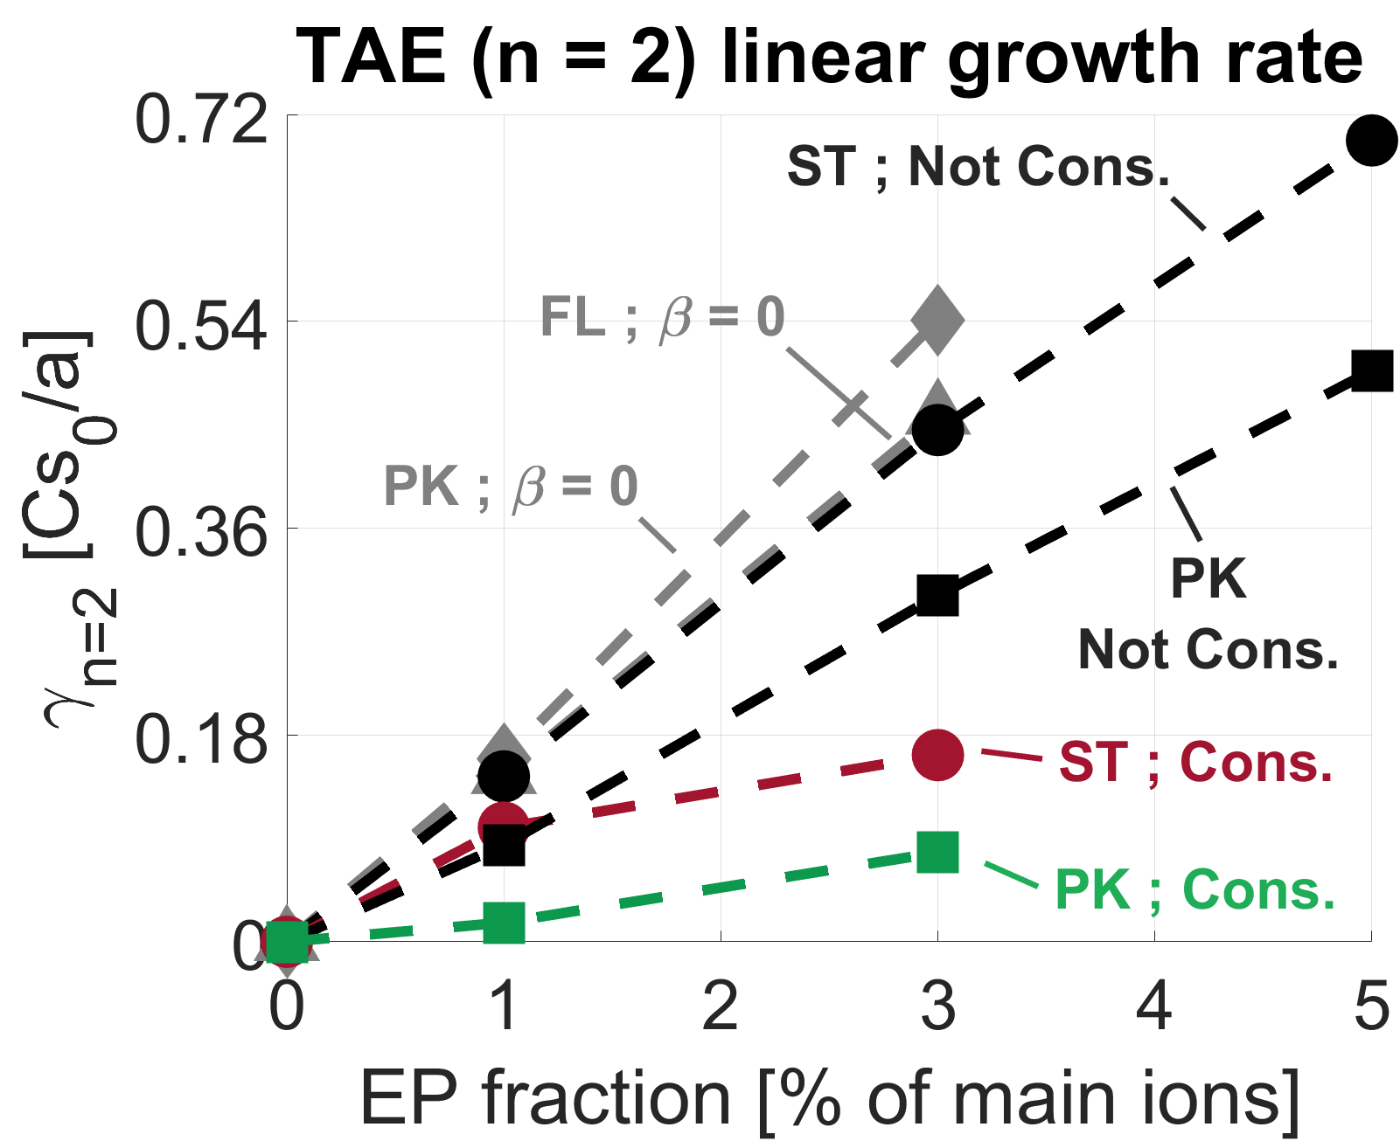
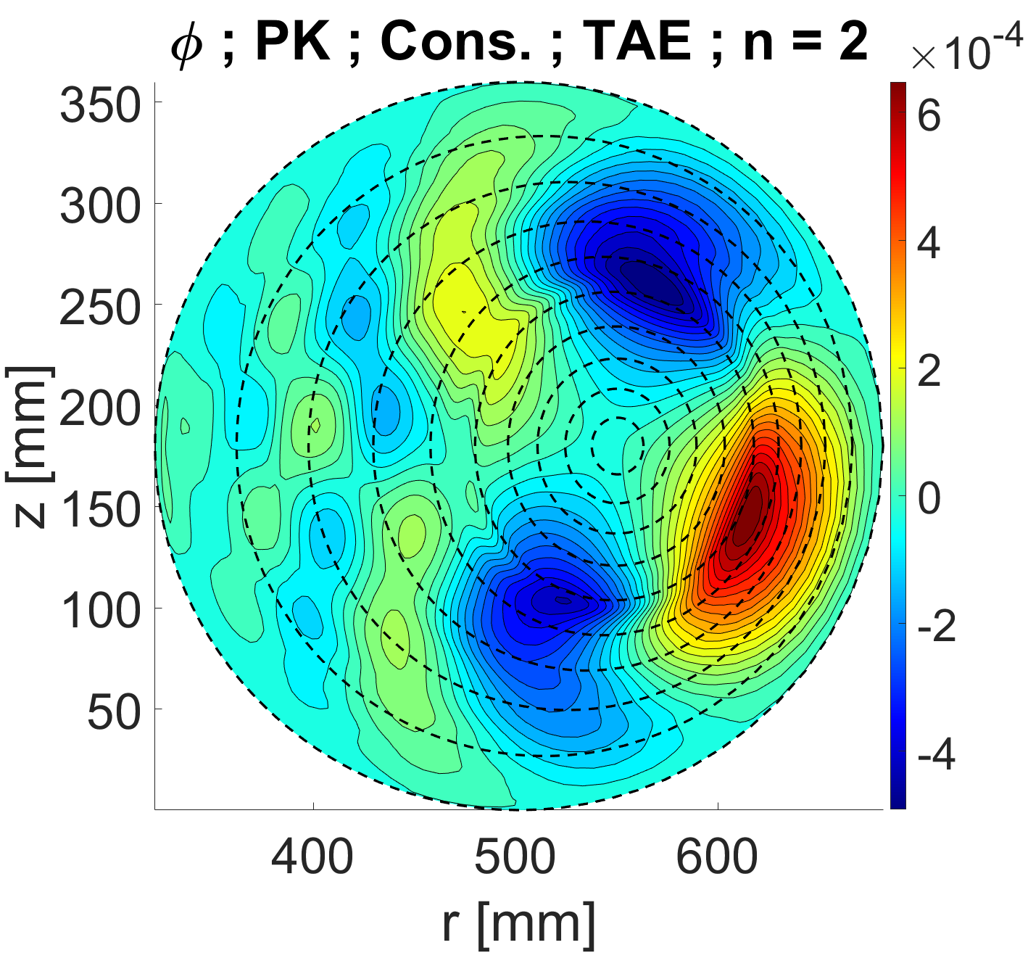
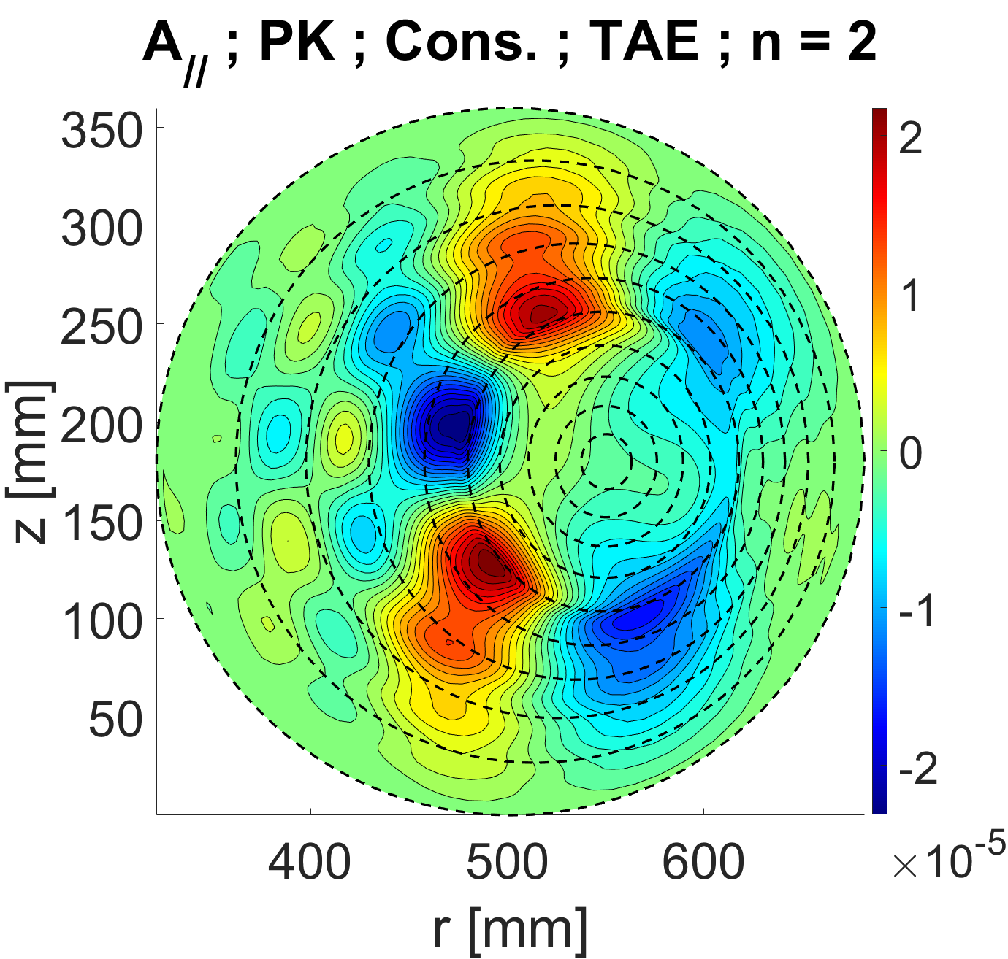
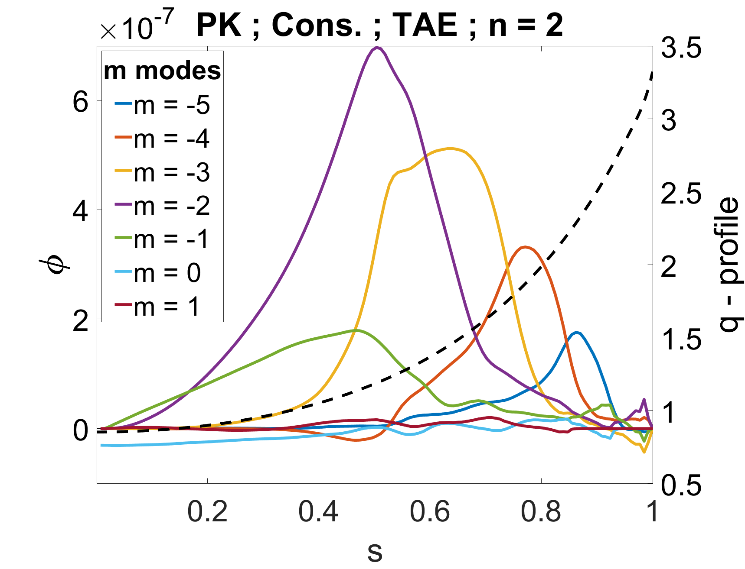
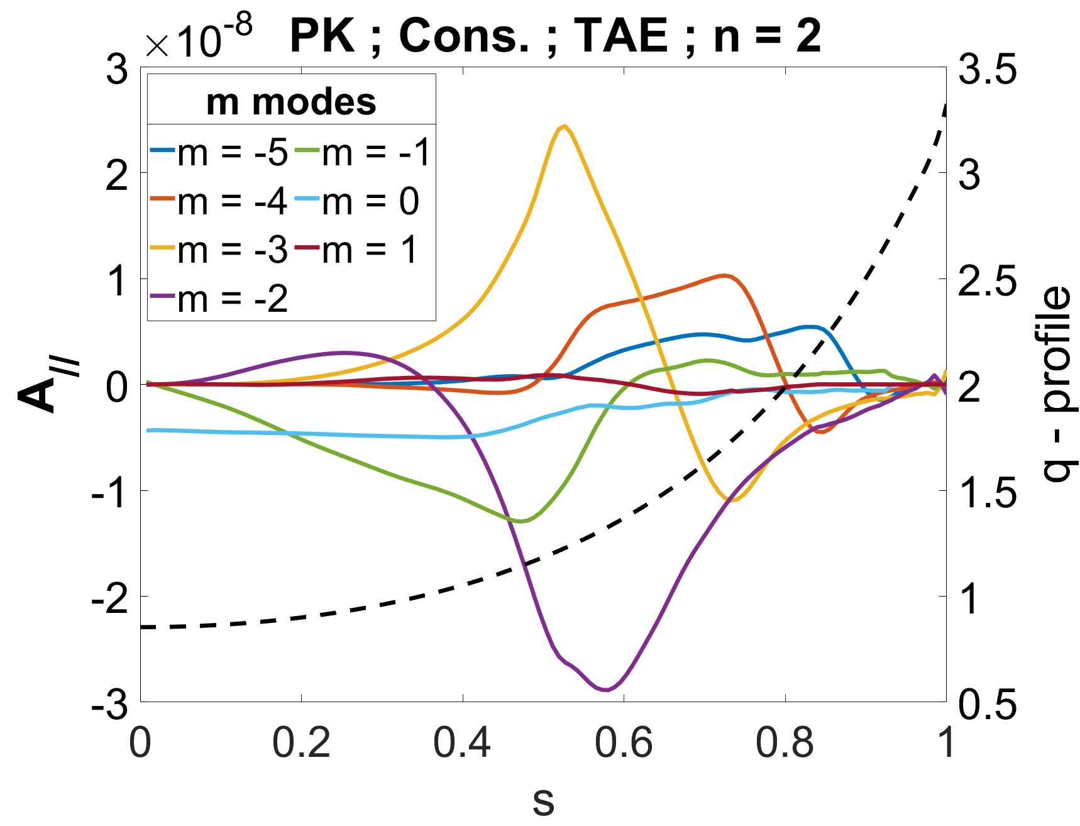
Linear TAE
Notes:
Beta =
The TAE growth rate increases with EP fraction.
The Shafranov shift due to bulk gradients stabilizes the TAE. Thus the TAE growth rate is higher in plasmas with standard gradients (ST) than with peaked gradients (PK), for all EP fractions.
Additional Shafranov shift due to EP pressure on top of the bulk stabilizes the TAE further, leading to a saturation in the mode growth rate with EP fraction
When the Shafranov shift effect is neglected (the $\beta = 0$ case) the growth rate is the highest and slightly increases with bulk gradients, an opposite trend to the cases with Shafranov shift.

Slide 8
Linear dispersion relation
FL - Flat
ST – Standard
PK – Peaked
Not Cons. – Thermal pressure w/o EPs
Cons. – Thermal pressure with EPs
Notes:
EP stabilization of KBM
Shafranov shift stabilization of KBM
Add Alexey citation

Slide 9
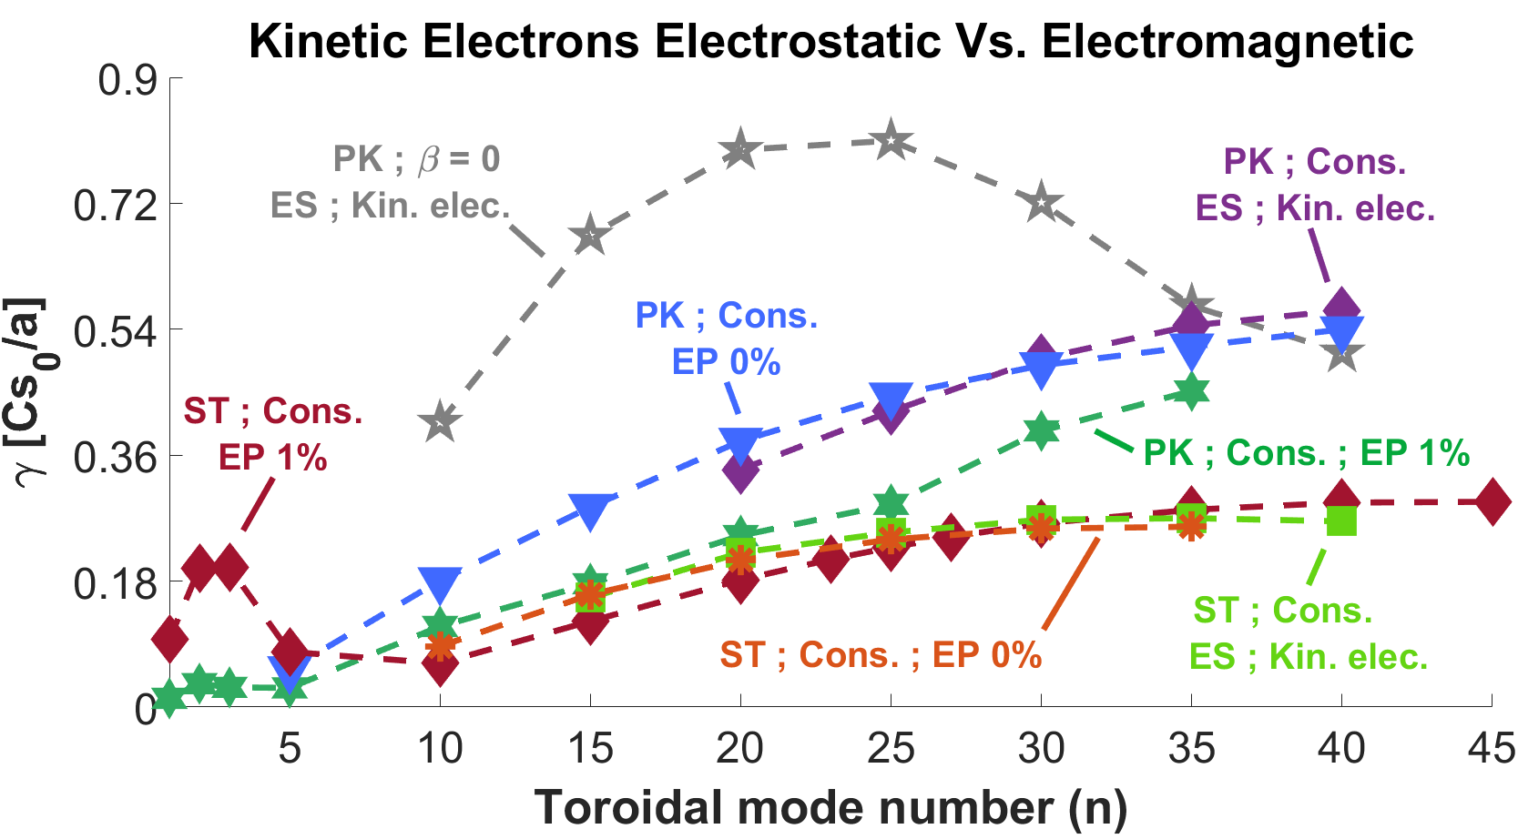
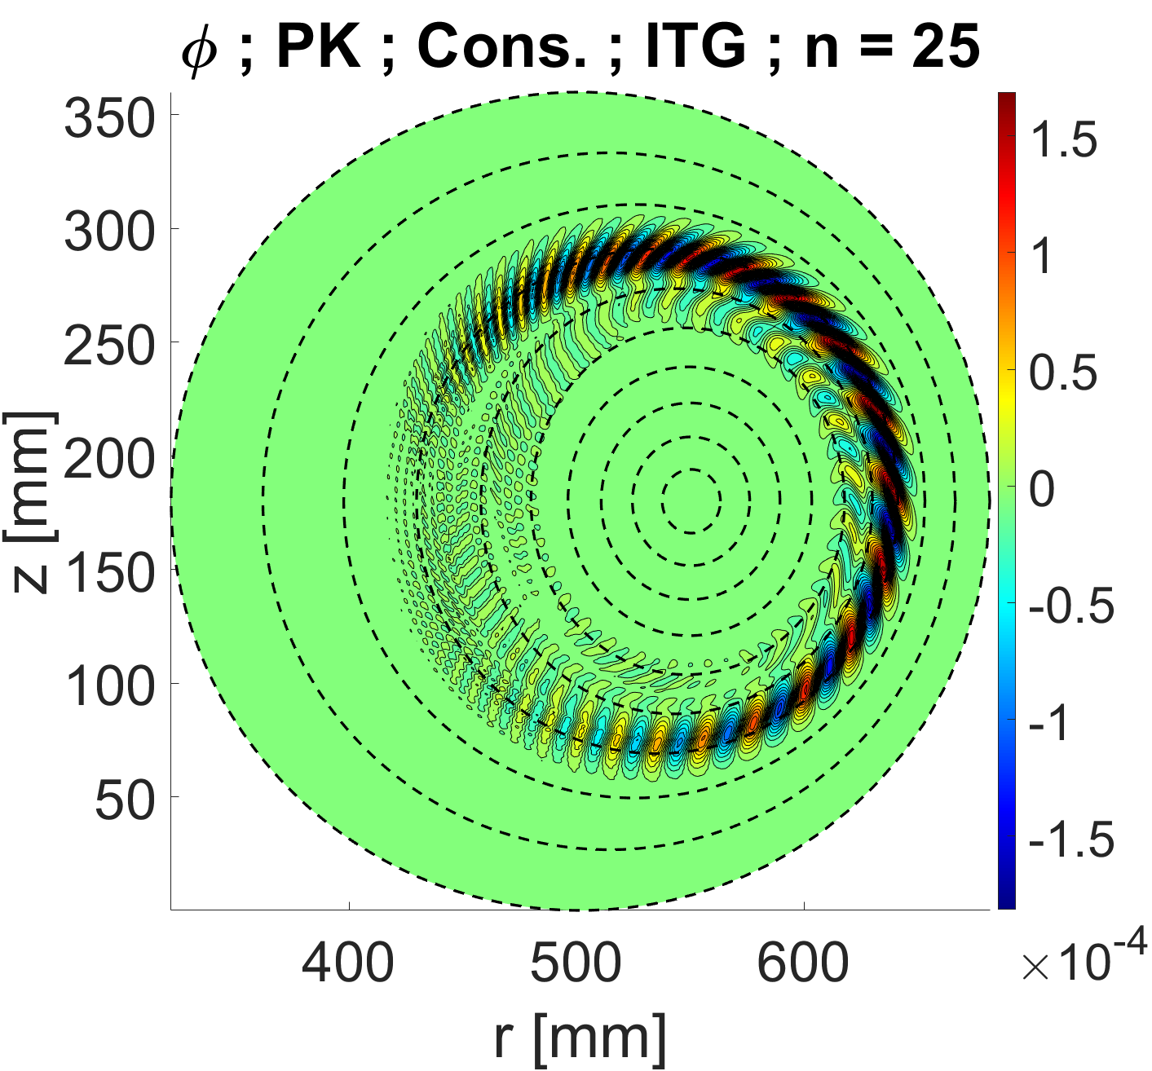
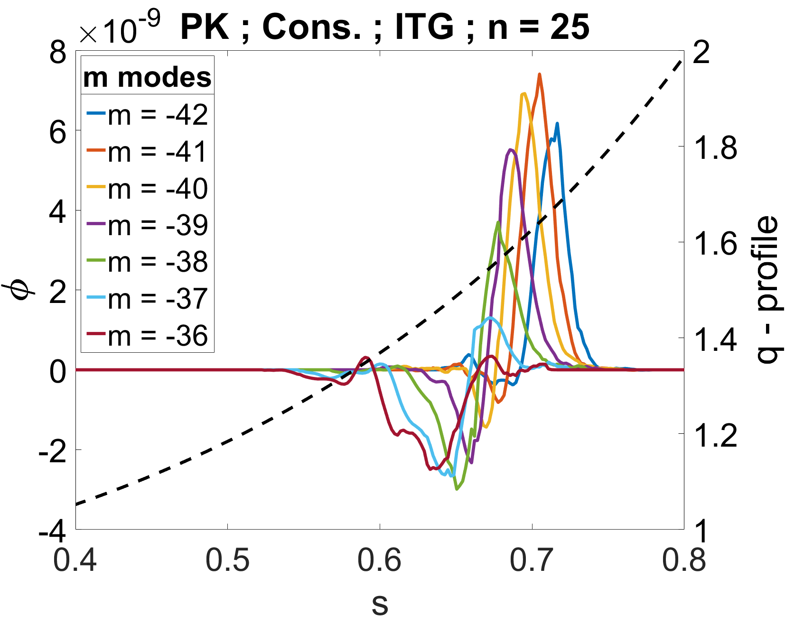
Linear ITG
Notes:
Shafranov shift stabilization
Shafranov shift stabilization is (n) dependent – stronger for low n modes

Slide 10
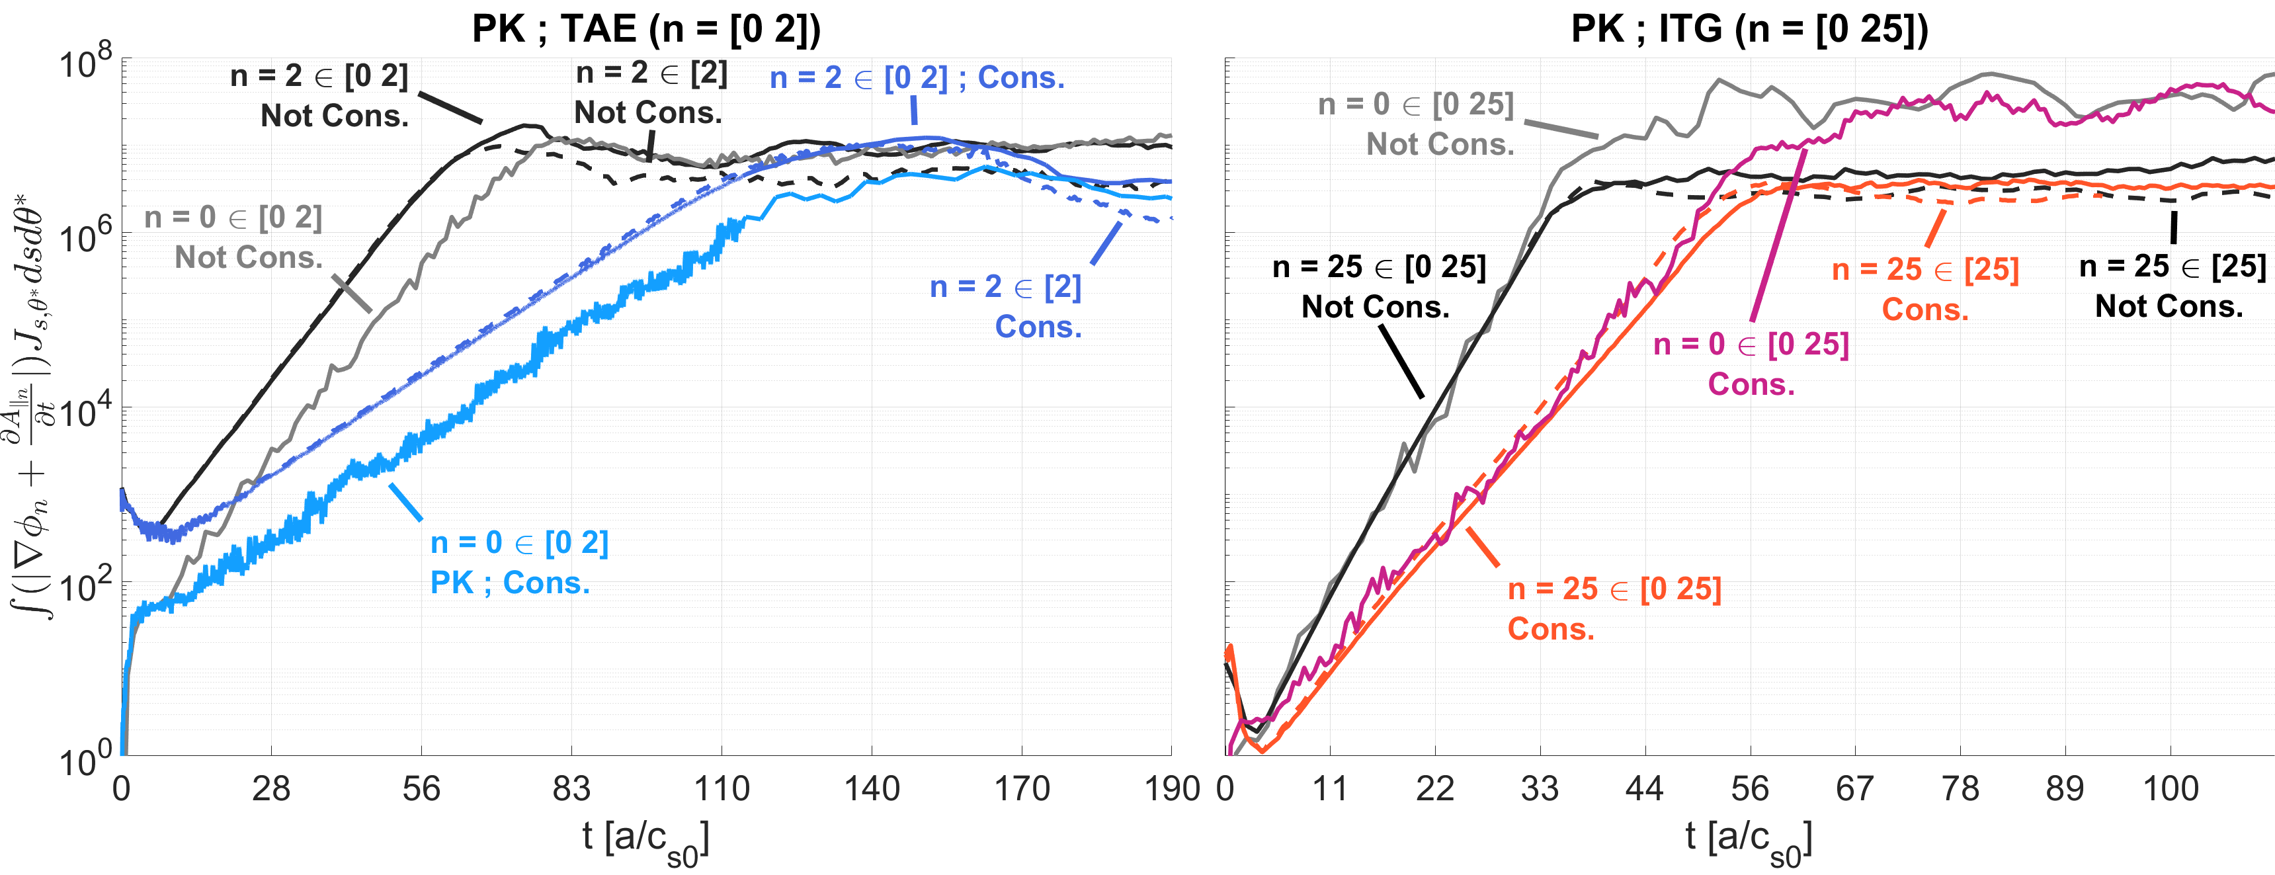
Nonlinear saturation
Notes:
The actual simulation are longer, here I just want to focus on the saturation phase.
We used later

Slide 11
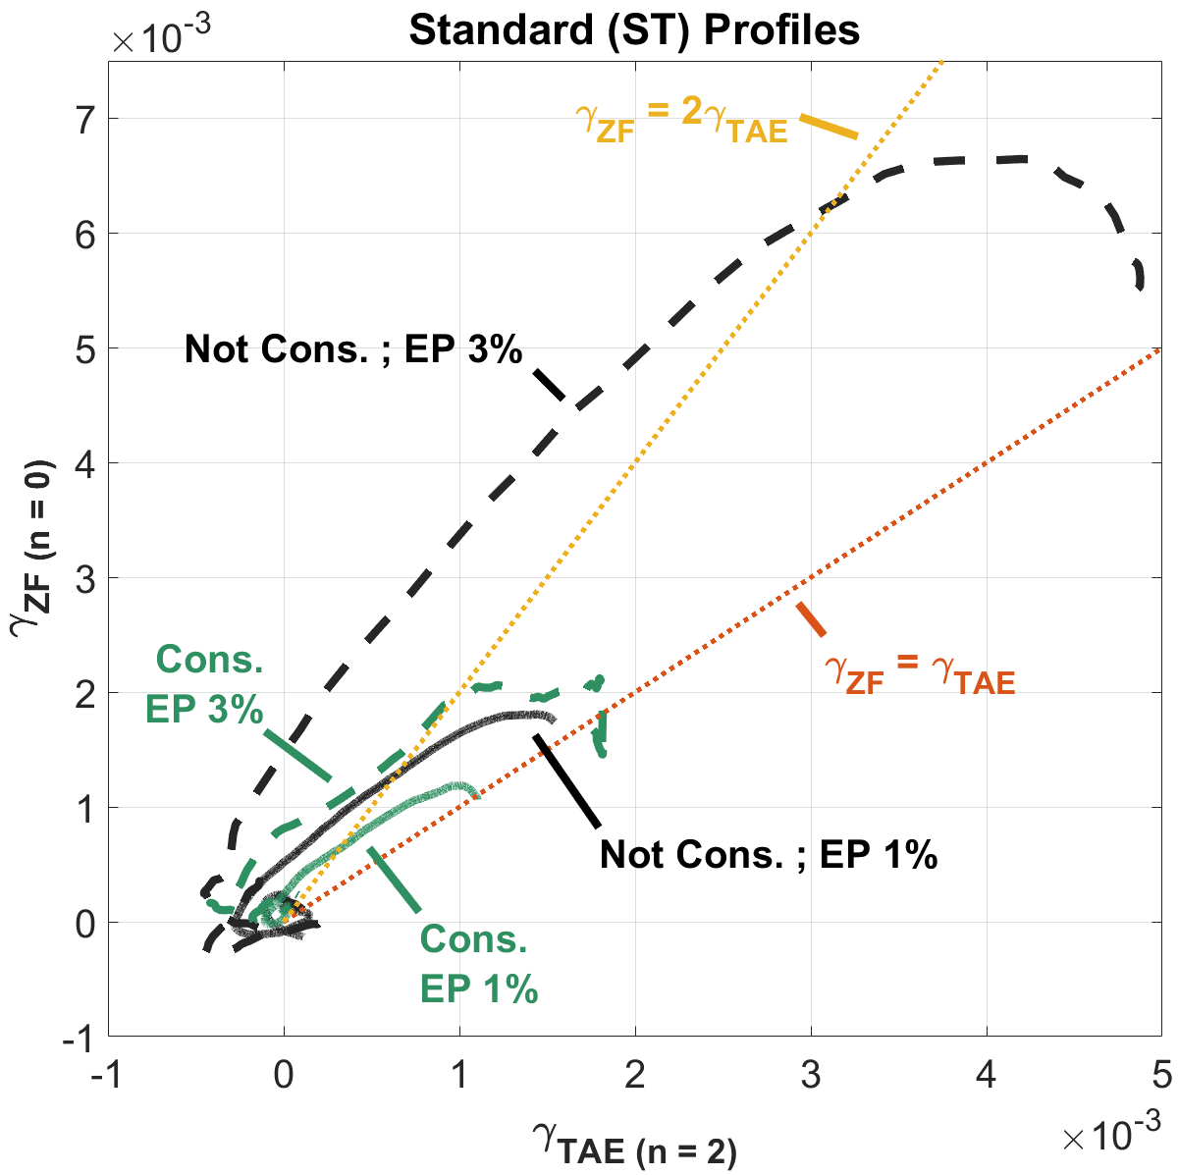
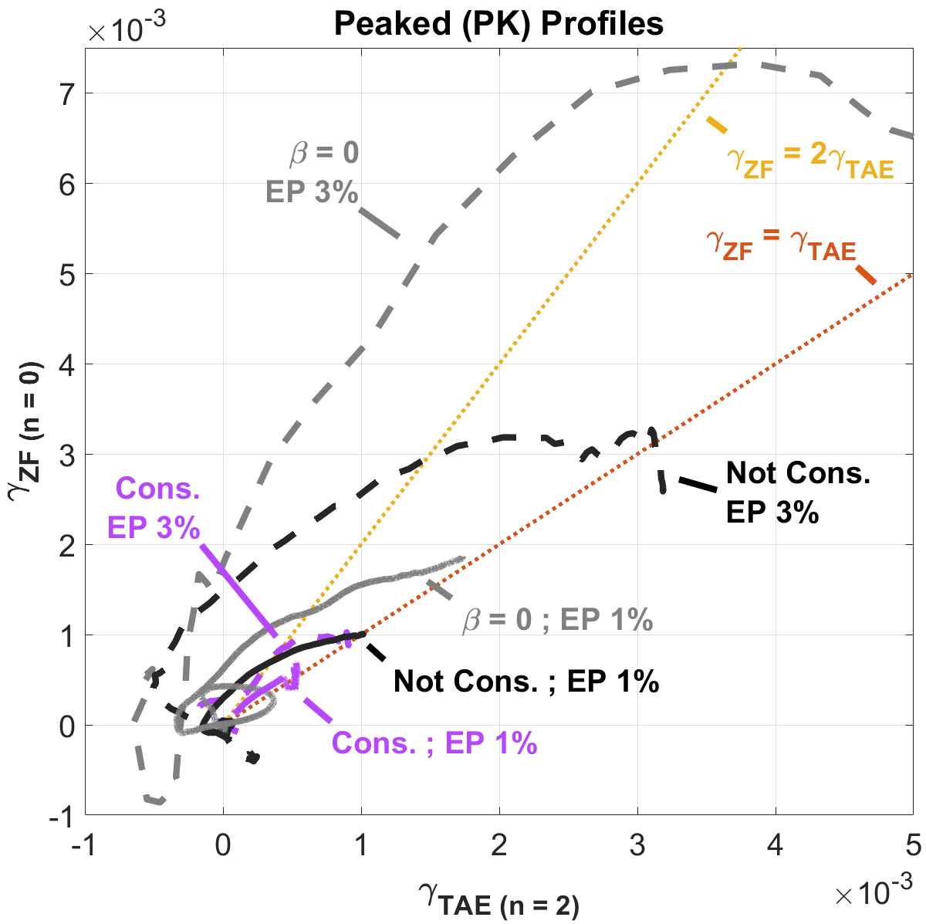
Nonlinear TAE saturation dynamics
Notes:
Here wan can see the nonlinear dynamics of the saturation phase. We plot for the same nonlinear simulation containing n = [0,2], the growth rate of the zonal component (n=0 mode) against the n = 2 TAE.
Zonal flows excited by DWs like ITG are most likely to spontaneously grow proportional to the mode fluctuations by way of nonlinear modulation instability.
While Zonal structures that are nonlinearly induced by EPMs tend to be forced-driven (nonlinearly beat-driven) by the mode. Growing at twice (and higher) of the mode’s linear growth rate.
Increasing the EP drive (%) pushes the zonal flows to higher growth rates, and increases the saturation level overshoot. While increasing the Shafranov shift reduced the zonal growth rates and reduces the overshoot.
This is consistent (qualitatively) with the upshift in linear TAE frequency and transition from EPM to TAE.

Slide 12
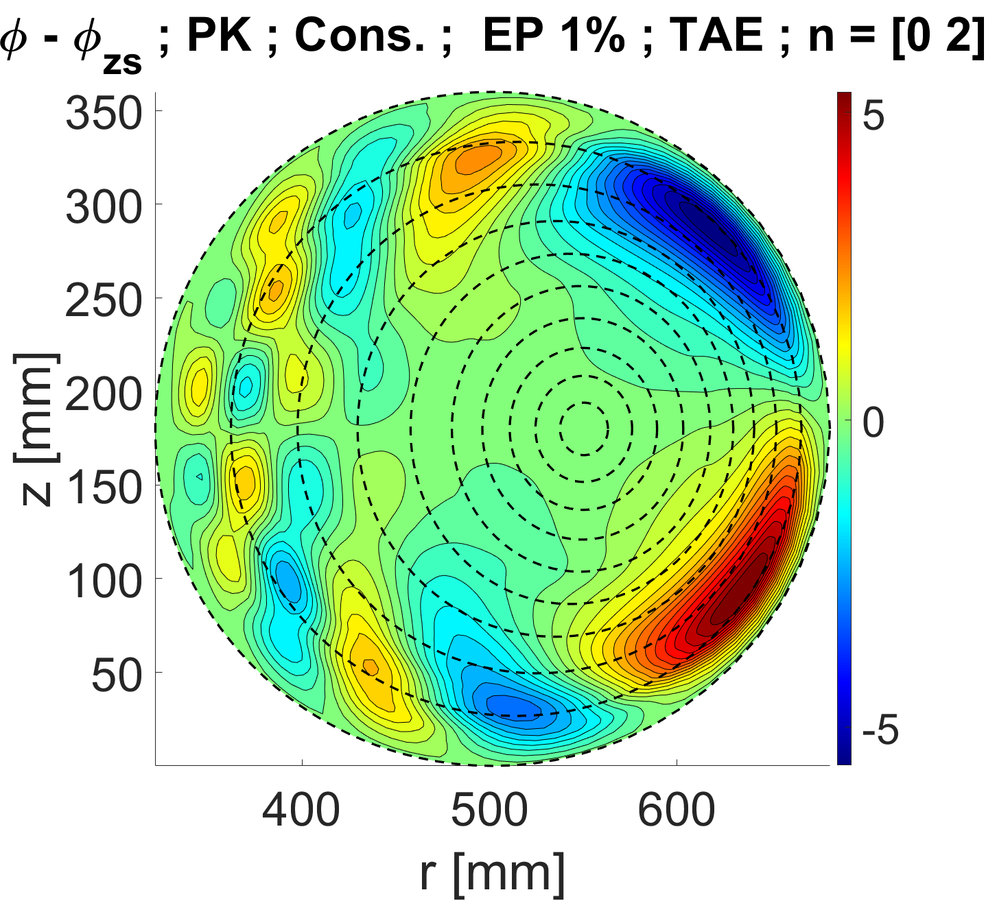
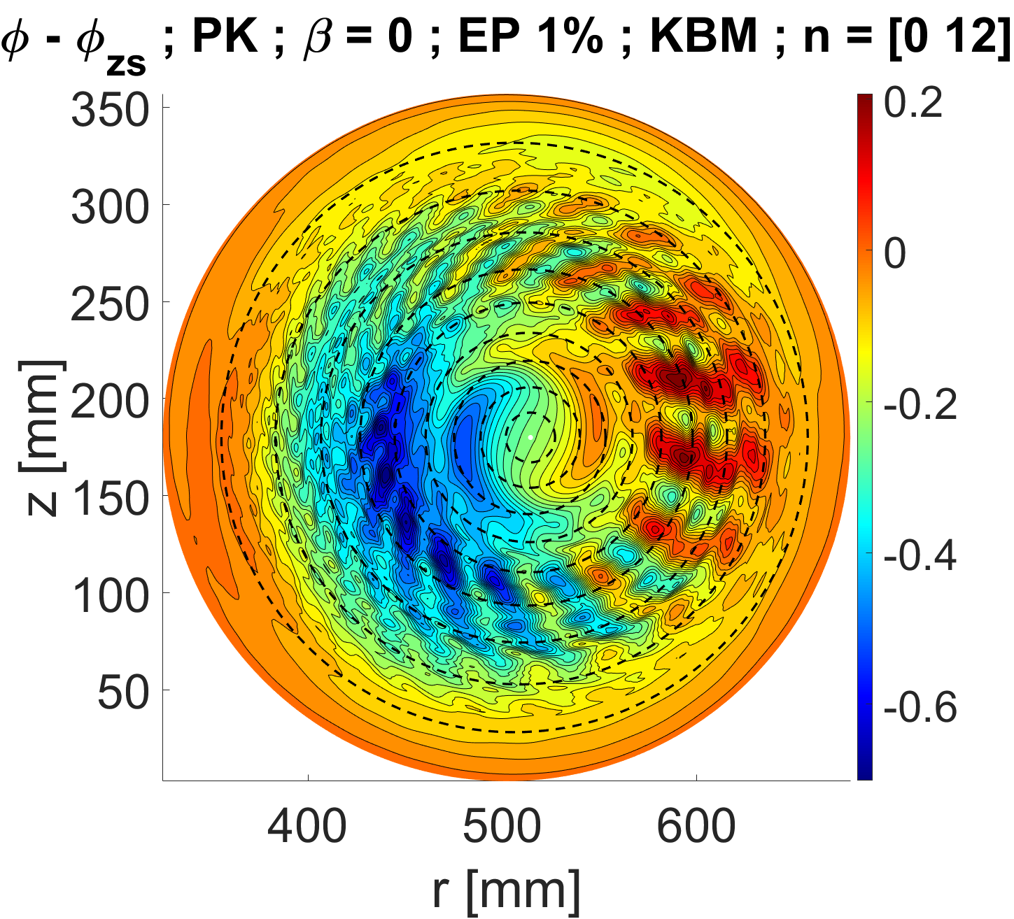
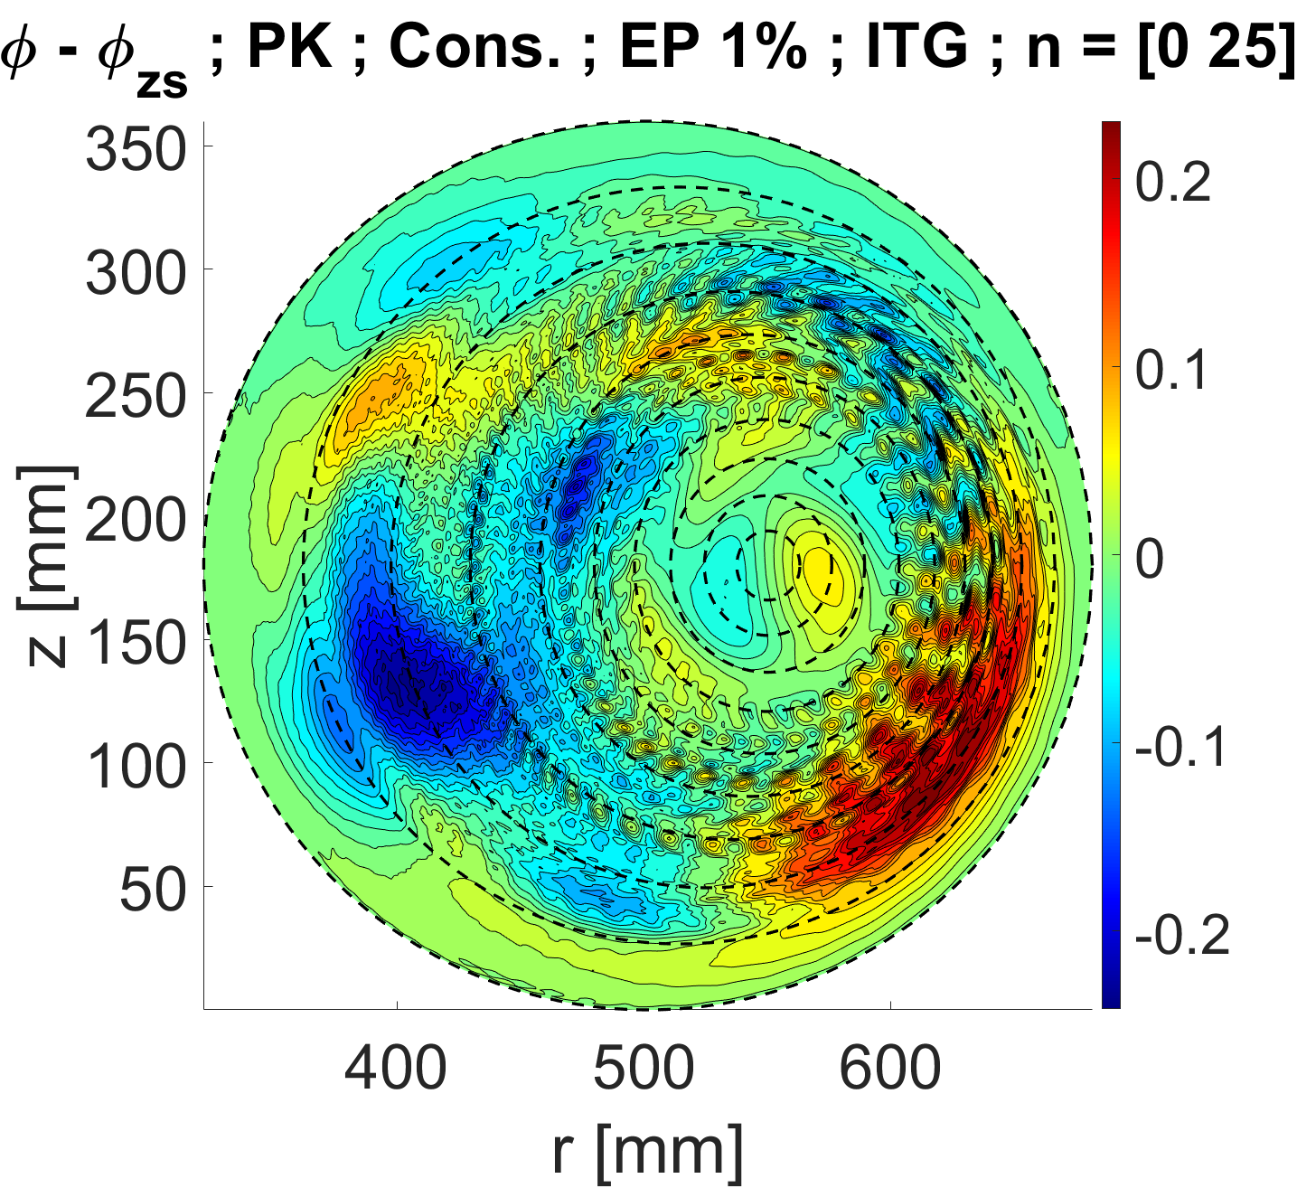
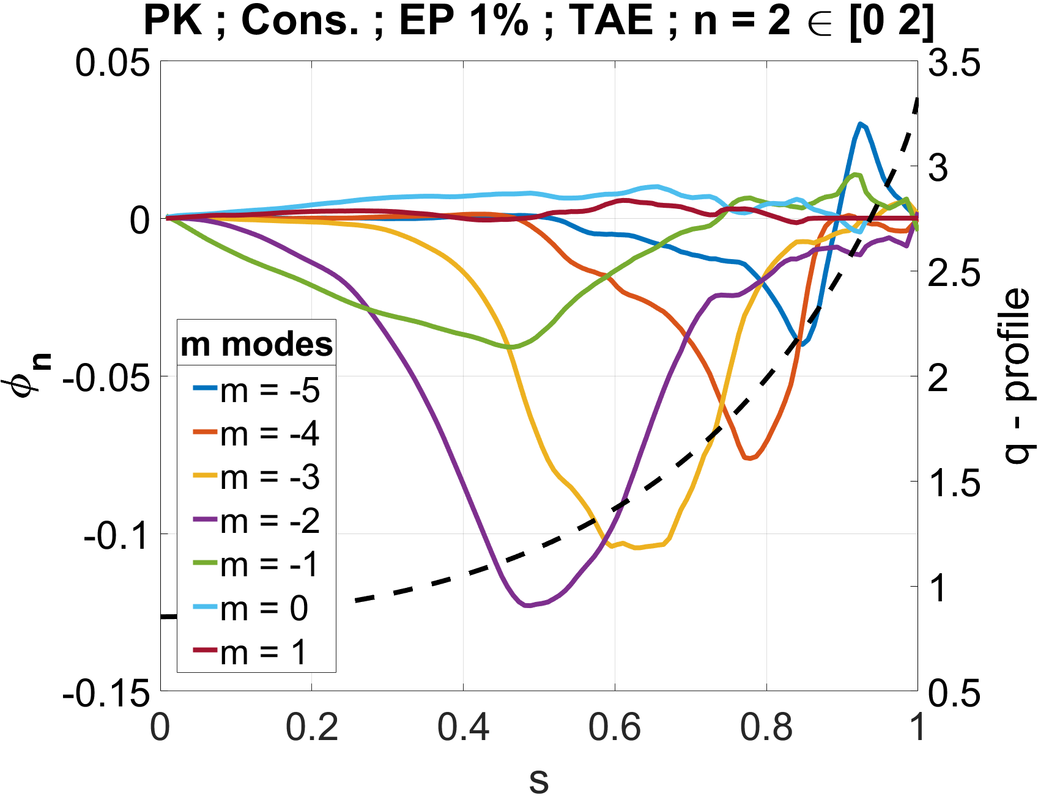
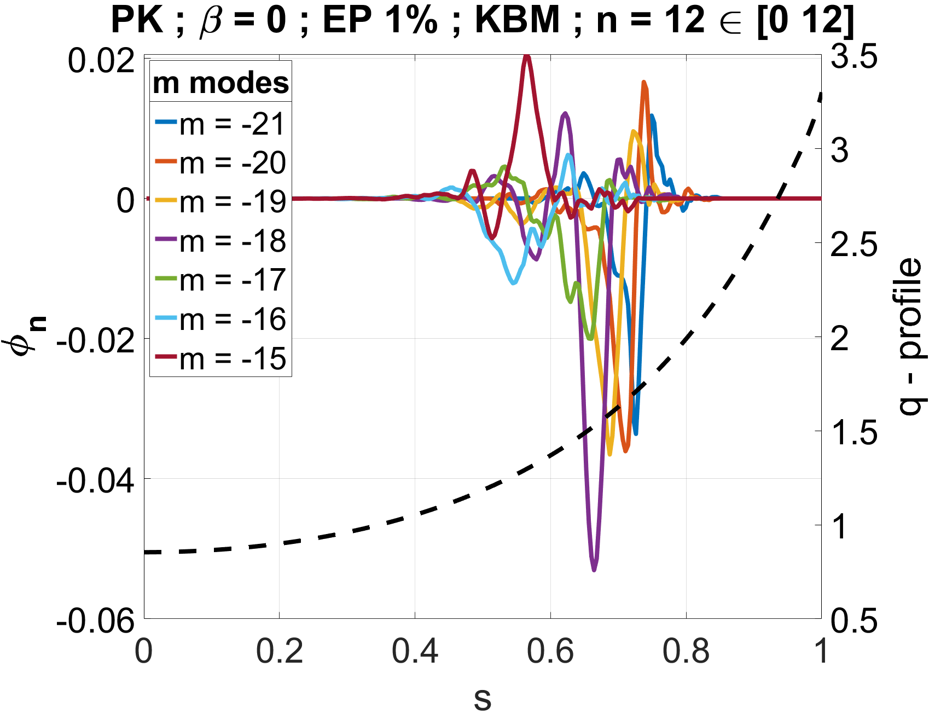
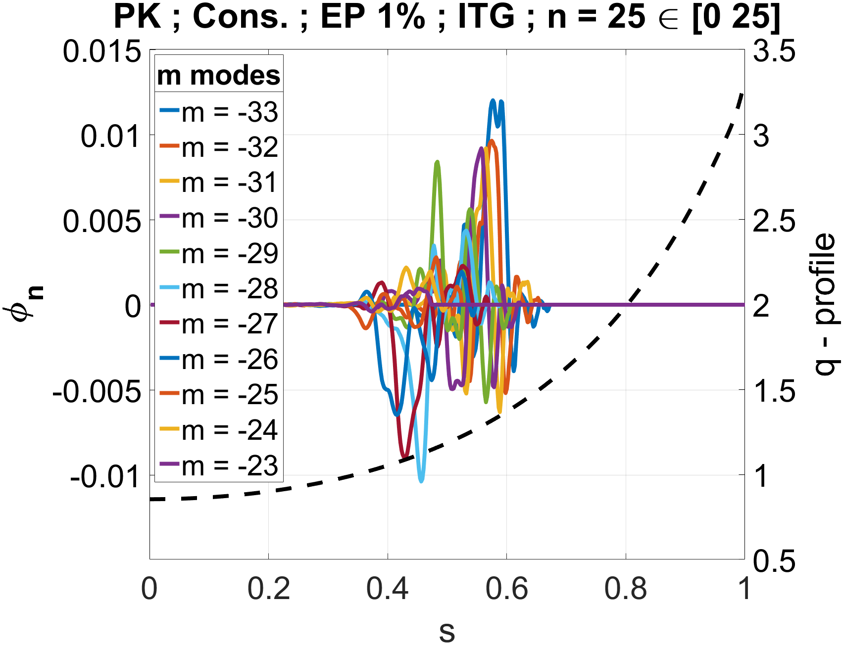
Nonlinear mode structure

Slide 13
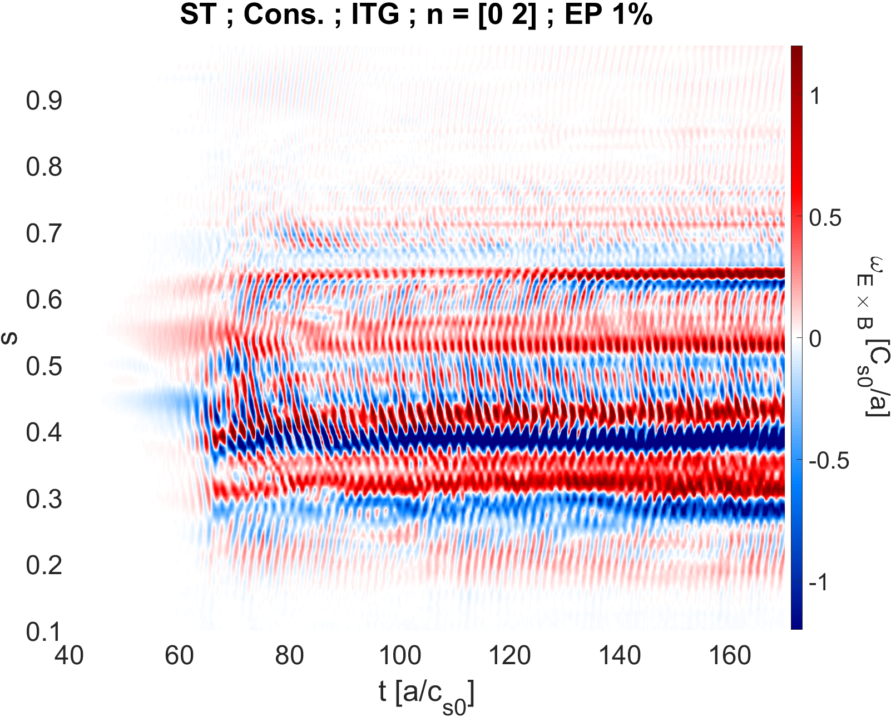
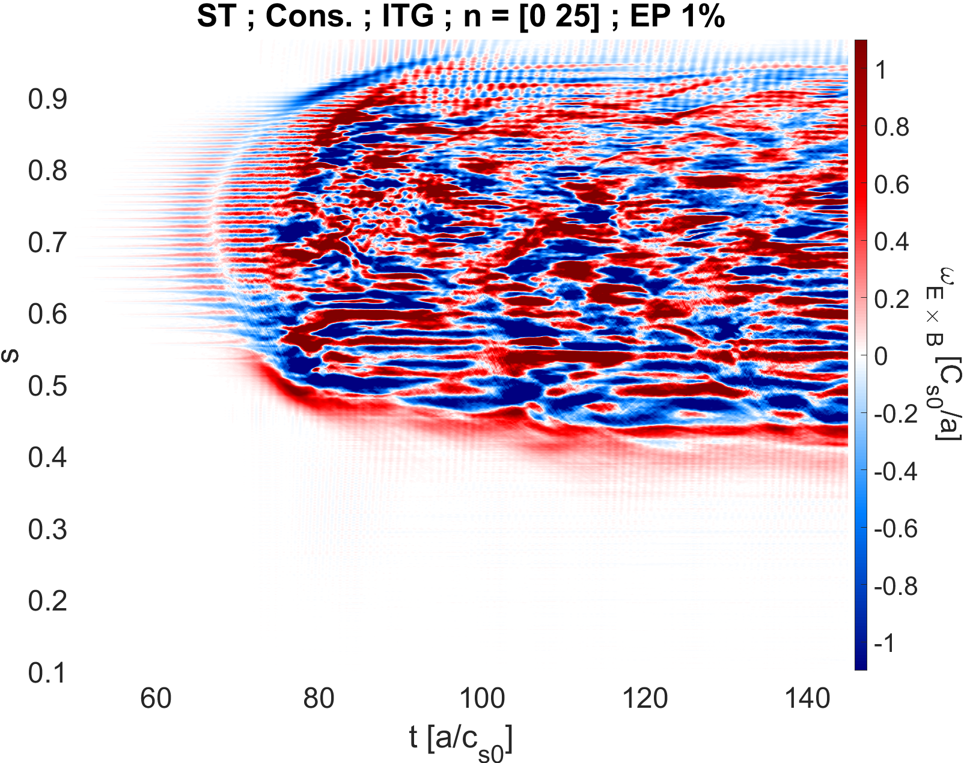
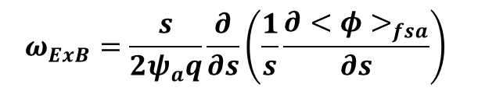
ω_{ExB} shearing rate – Time evolution
$$ω_{ExB}=\frac{s}{2ψ_{a}q}\frac{∂}{∂s}\left(\frac{1}{s}\frac{∂<φ>_{fsa}}{∂s}\right)$$
Notes:
NOT ITG -> TAE

Slide 14
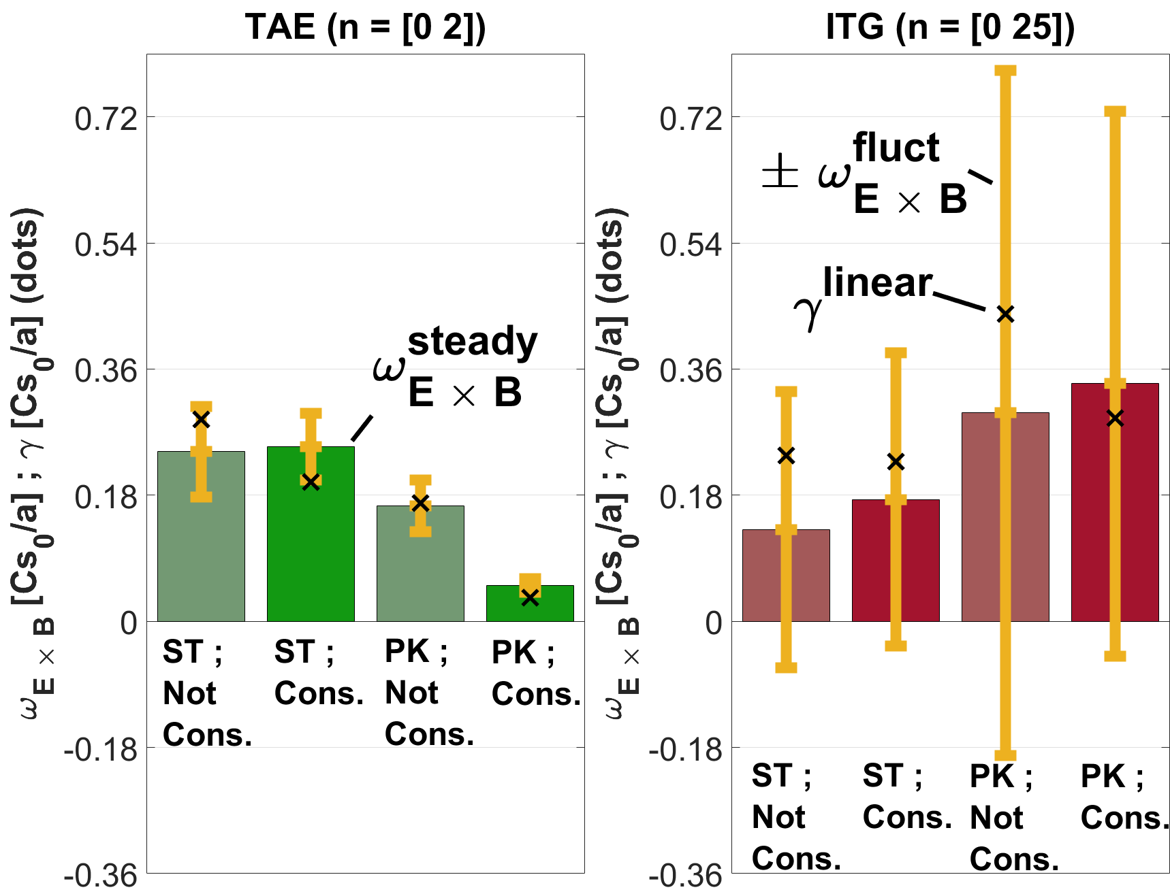



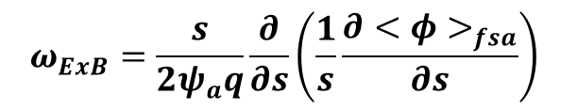

Time average - ω_{ExB} shearing rate
$$ω_{ExB}=\frac{s}{2ψ_{a}q}\frac{∂}{∂s}\left(\frac{1}{s}\frac{∂<φ>_{fsa}}{∂s}\right)$$
Steady state shearing rate
$$ω_{ExB}^{steady}\left(s\right)= {<ω}_{ExB}>_{t}$$
$$ω_{ExB}^{steady}= {<|<ω}_{ExB}>_{t}|>_{s}$$
Total shearing rate
$$ω_{ExB}^{tot}= {<|<ω}_{ExB}>_{s}|>_{t}$$
Fluctuating shearing rate
$$ω_{ExB}^{fluct}=ω_{ExB}^{tot}−ω_{ExB}^{steady}$$
Notes:
Here we compere the linear mode growth rate to the ExB sharing rate divided between the steady and fluctuating part.
In general, nonlinear saturation is reached when the zonal ExB shear matches the linear growth rate (of the mode).
Both the TAE and the ITG generate zonal flows, albite with opposite trends.
For the TAE, increasing the Shafranov shift decreases both the steady and fluctuating parts of the zonal flows.
Moreover, increasing the bulk plasma gradients, which self consistently also increases the Shafranov shift, results in a similar trend of lowering the shearing rate of the zonal flows.
While, for the ITG, increasing the Shafranov shift and the driving bulk gradients increases the steady shearing rate, perhaps on the expense of the fluctuating part.

Slide 15
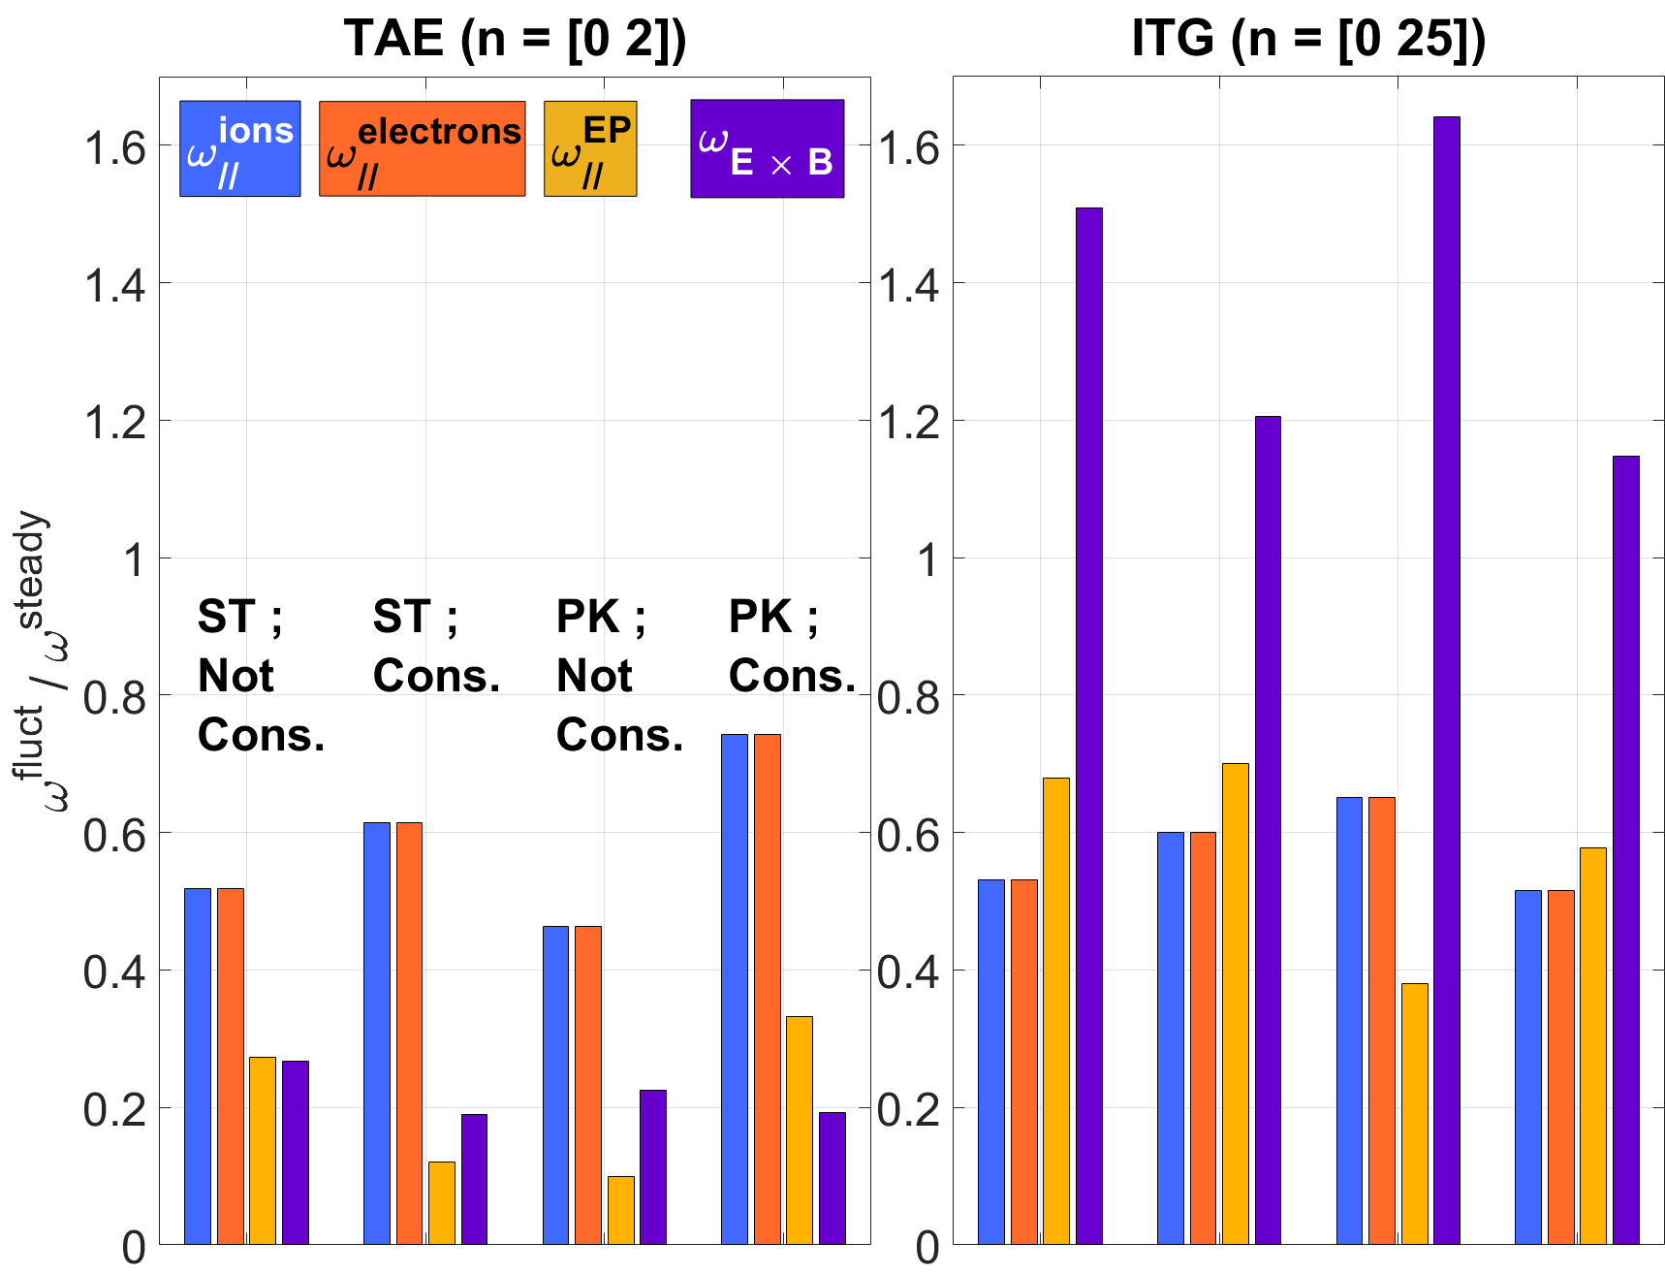
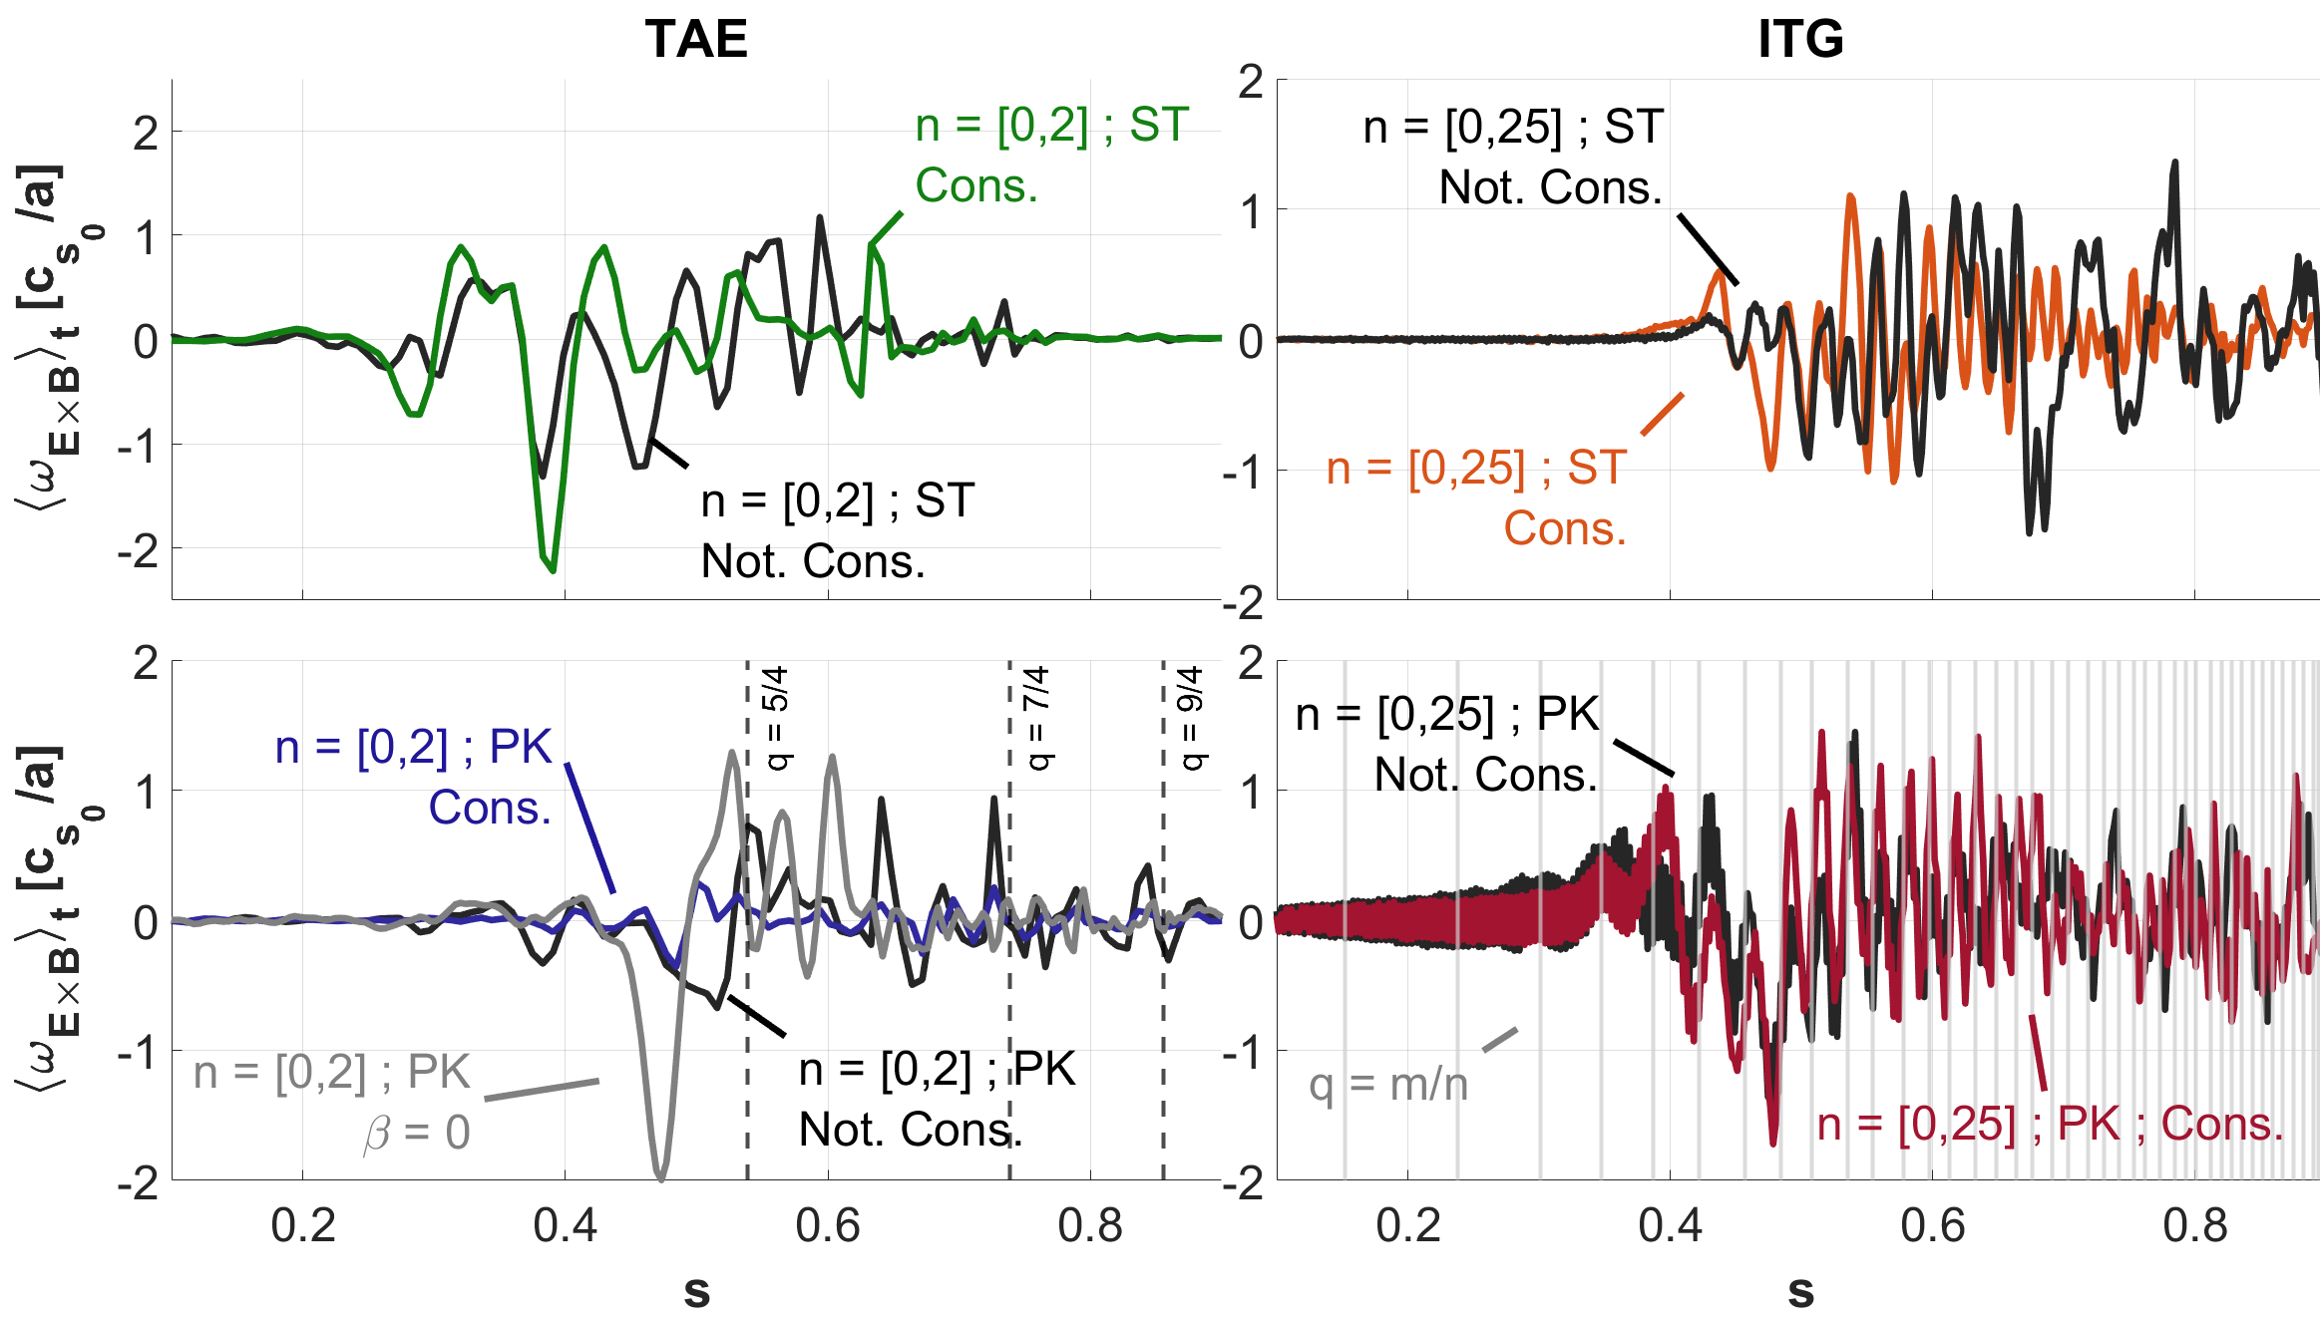
Shearing rate

Slide 16
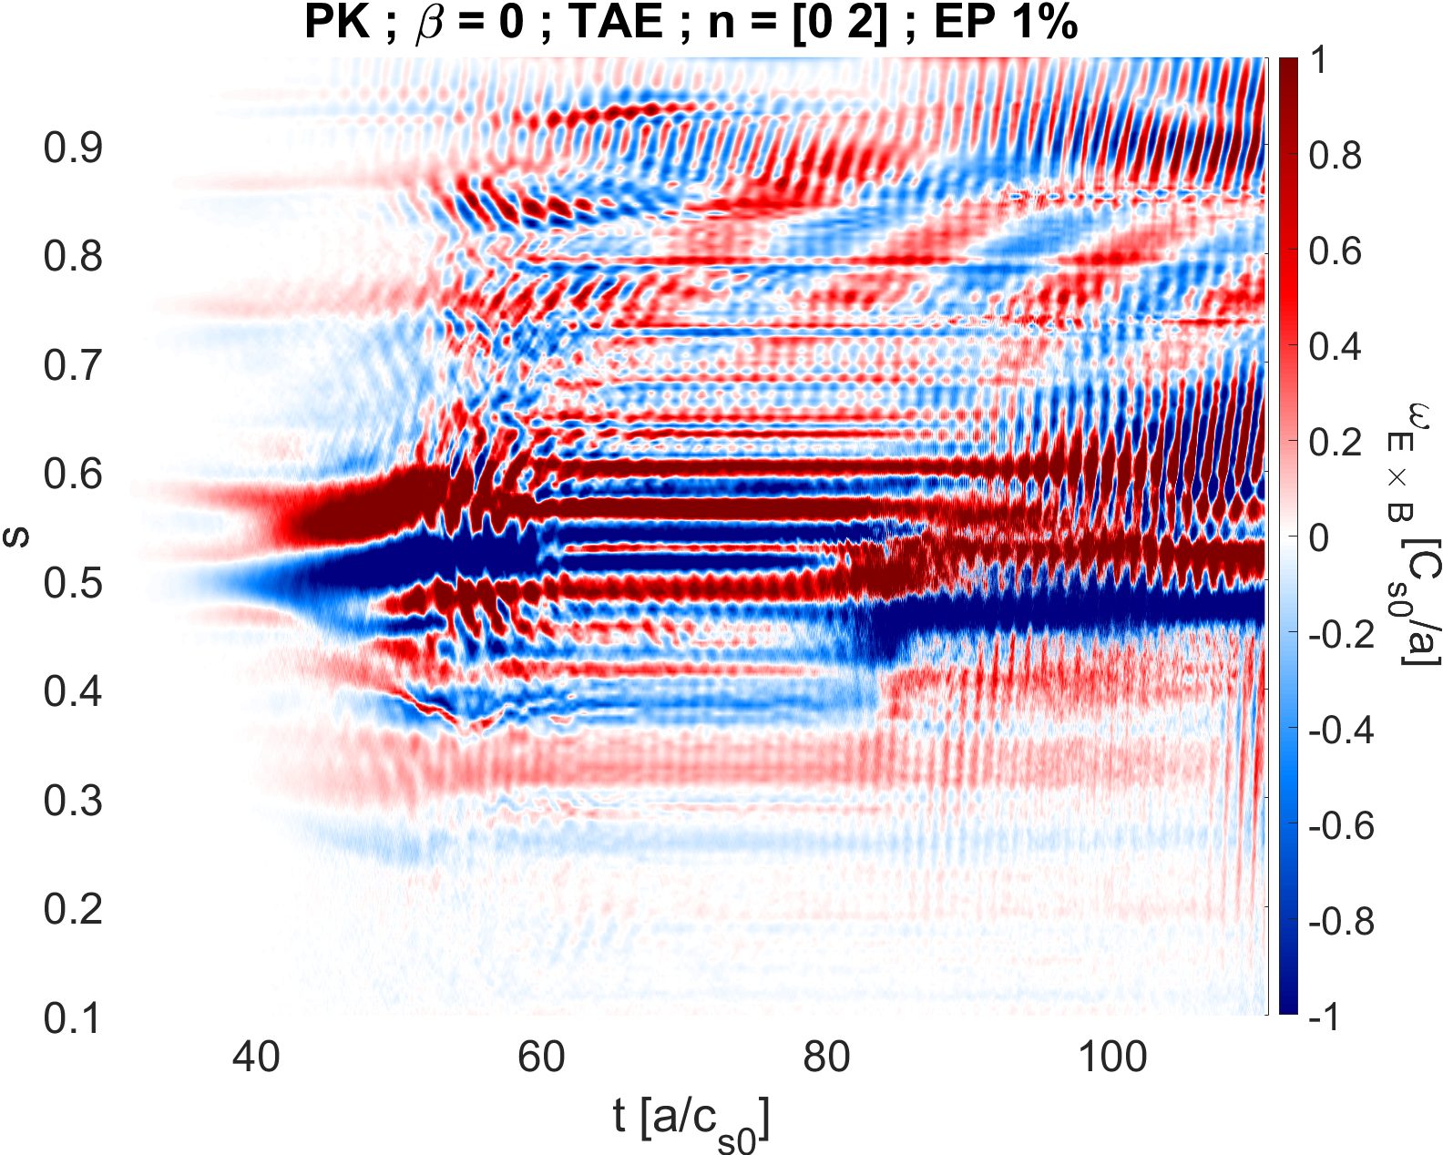
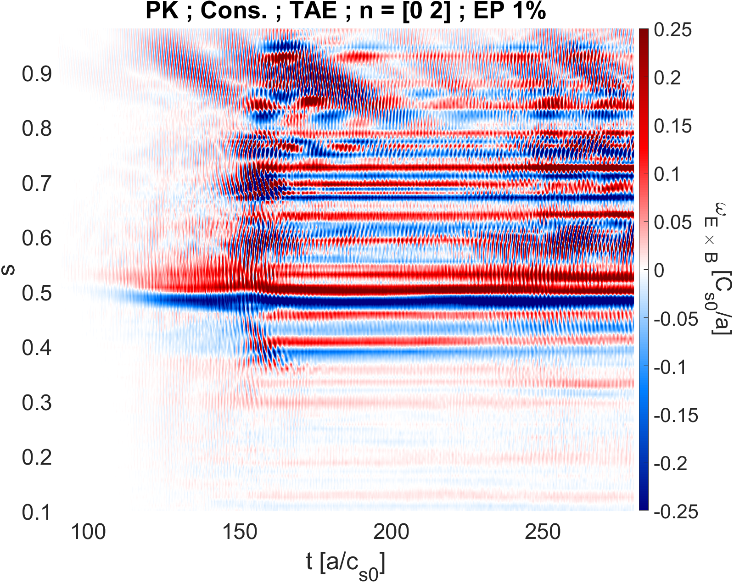
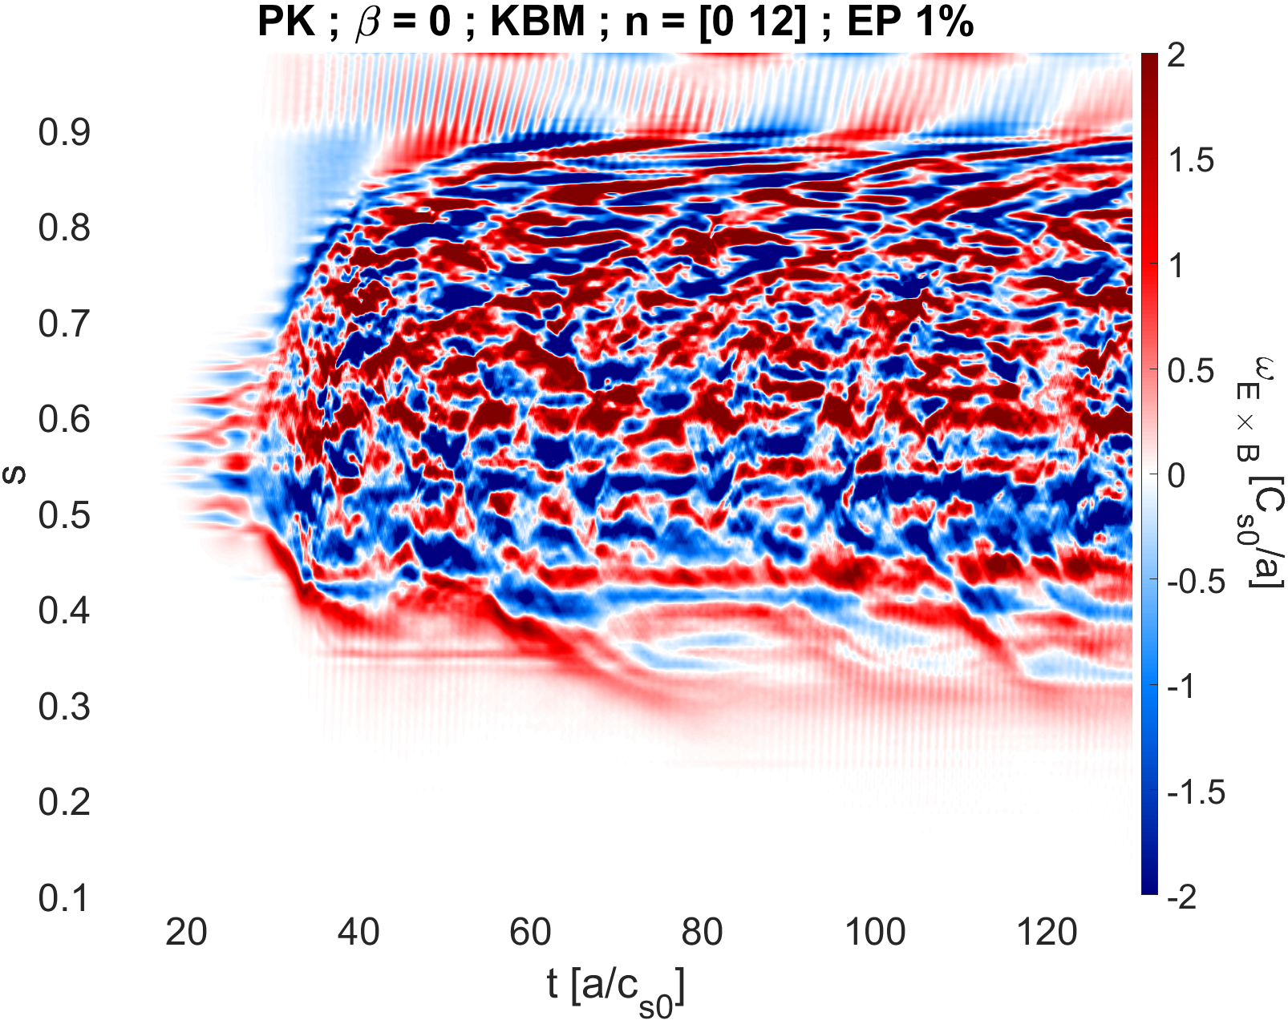
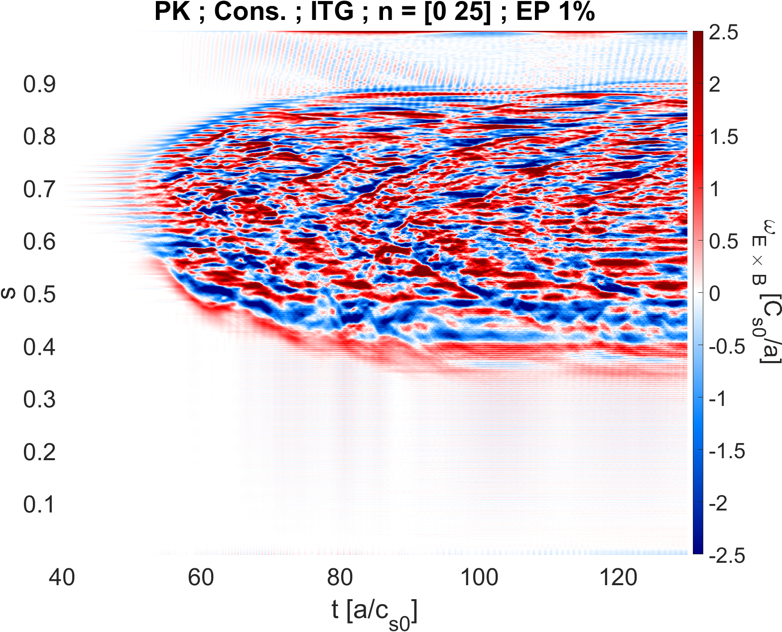
ω_{ExB} shearing rate – modes

Slide 17
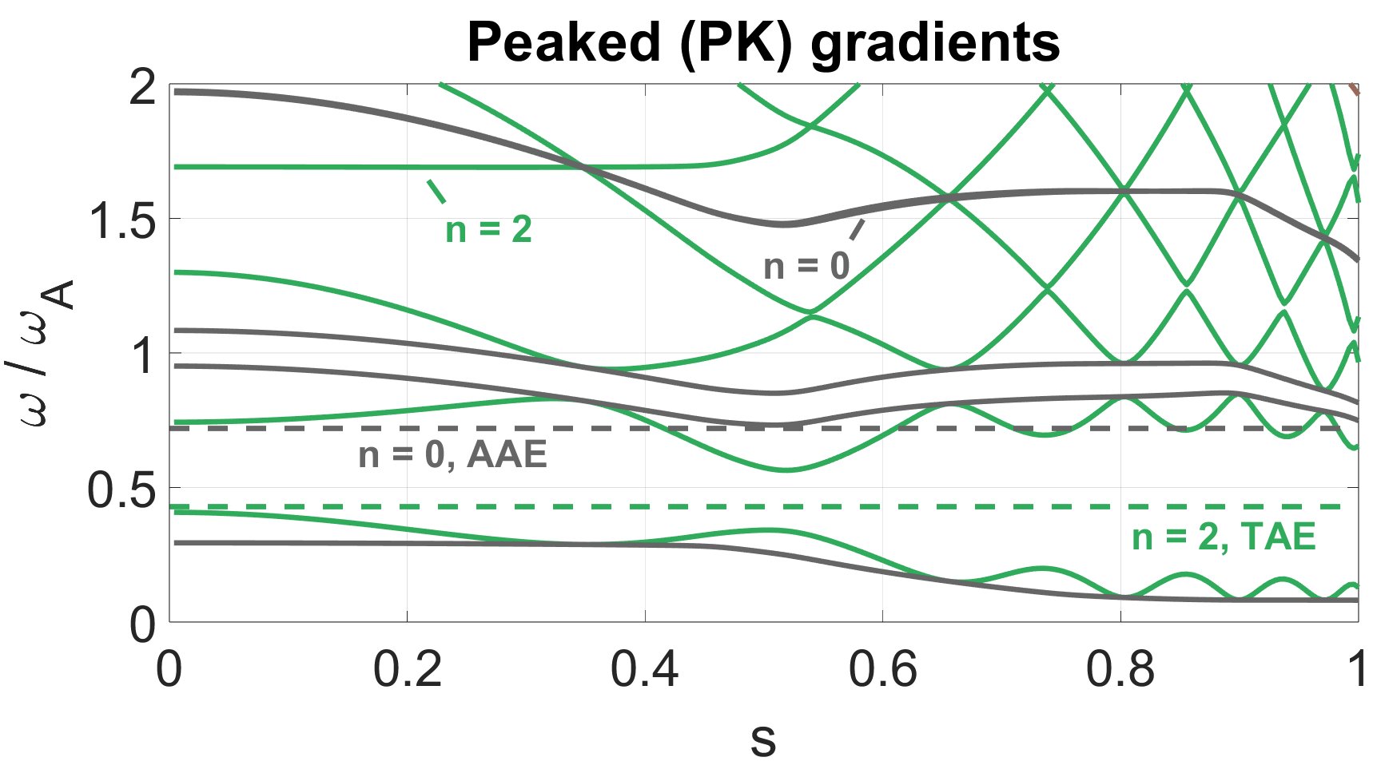
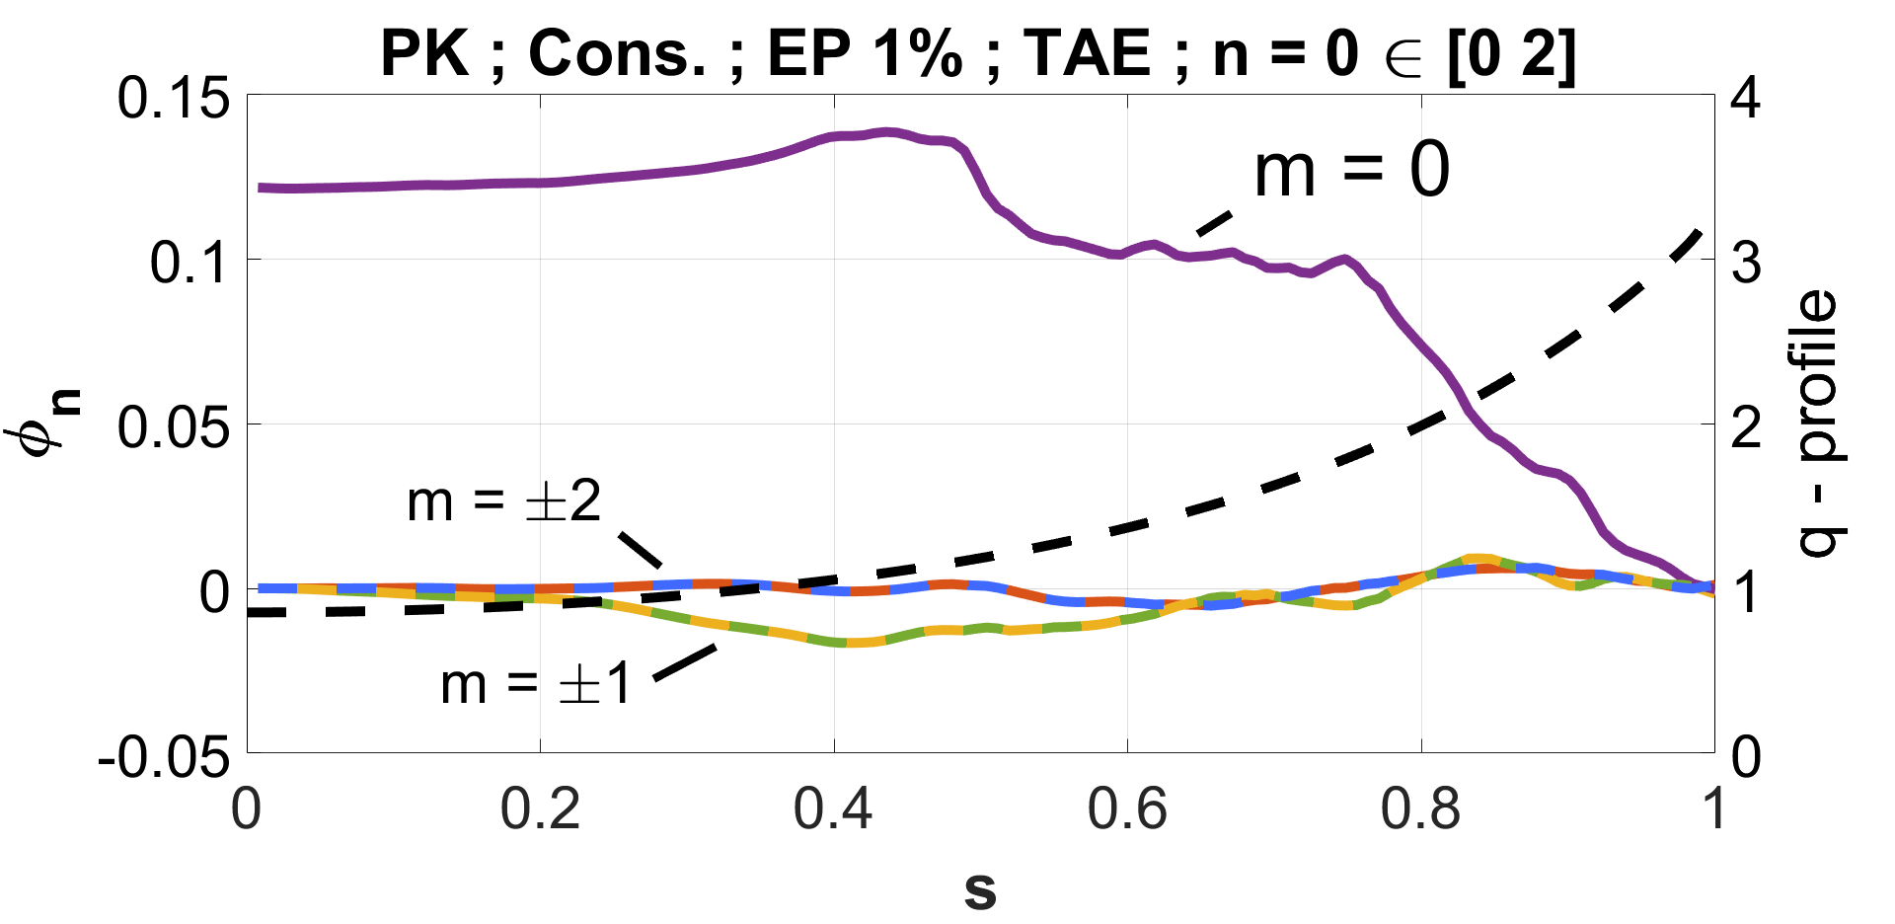
Axisymmetric Alfvén Eigenmode (AAE)
Chang, Z., et al., Nucl. Fusion (1995)
Villard, L., & Vaclavik, J. Nucl. Fusion (1997)
Notes:
AAE touches the extremum
ADD TFTR citation
Add LV citation
Add the mode structure
Add disperdion relation from LV

Slide 18
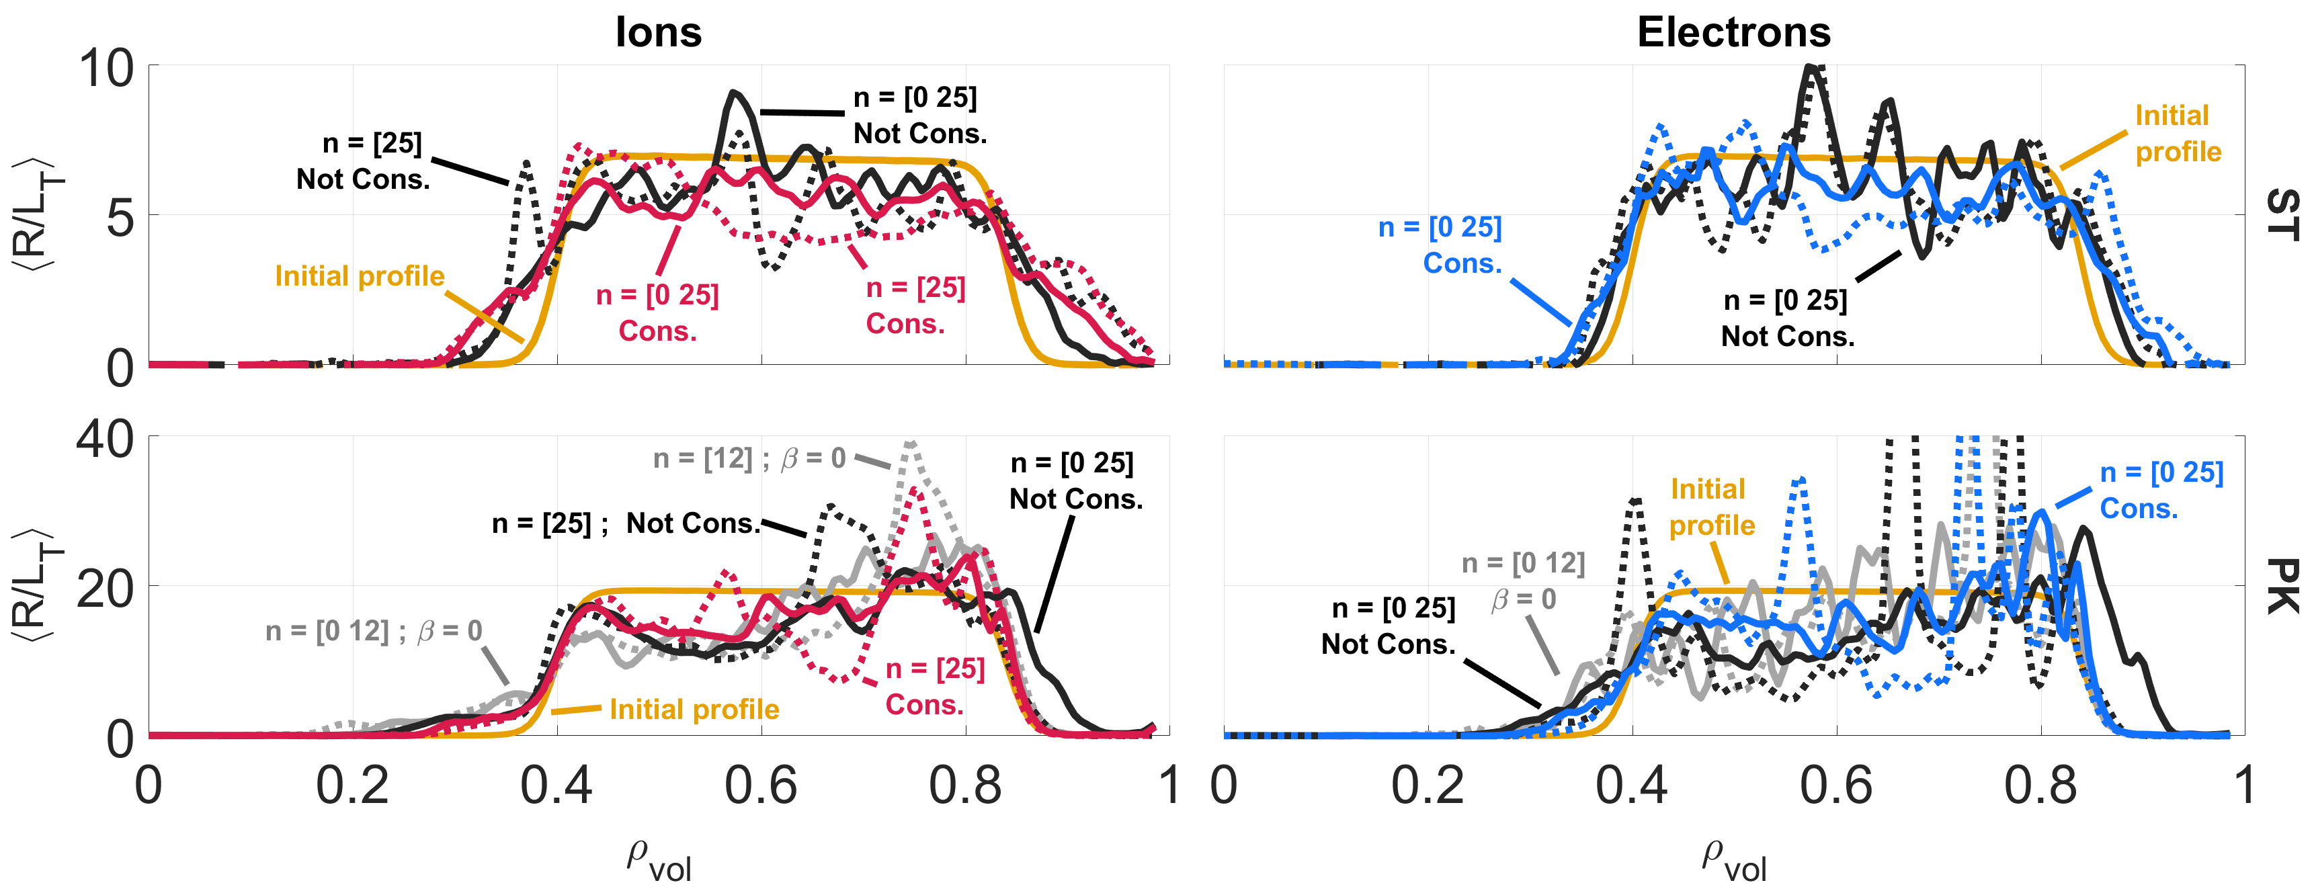
Nonlinear modification of the Temperature gradients

Slide 19
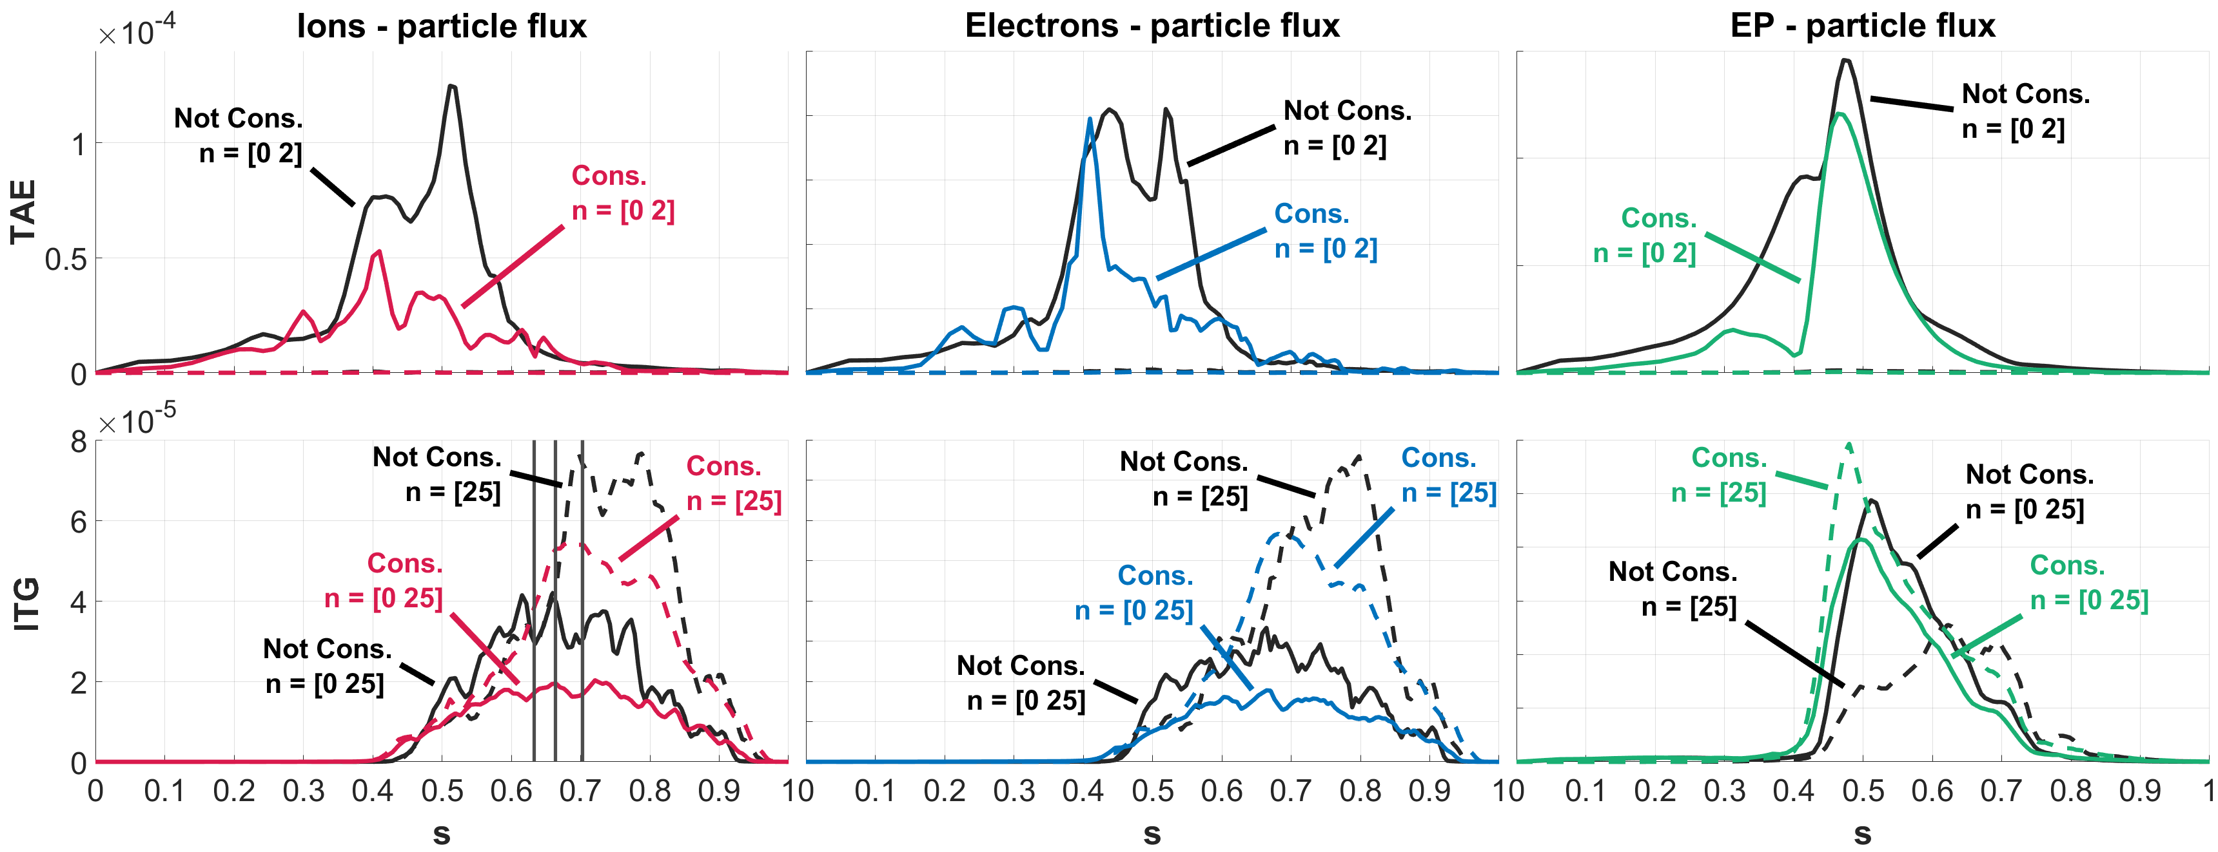
Nonlinear Particle flux – Standard profiles
Chen, L., et al., Nucl. Fusion (2024)
Notes:
Cite Chen….

Slide 20
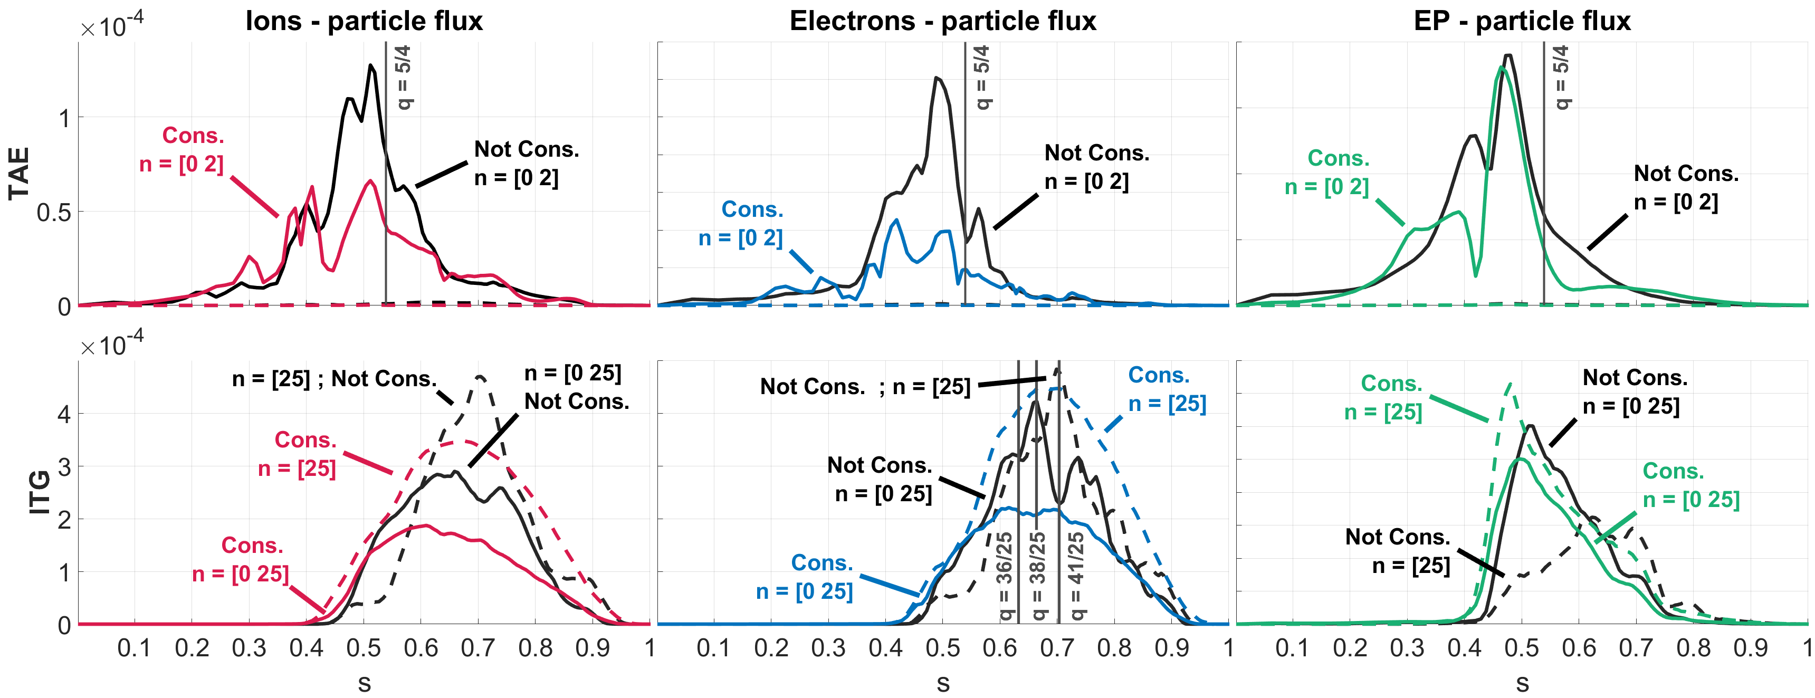
Nonlinear heat flux – Standard profiles (ST)
Notes:
hfluxw{jspc} = efluxw{jspc} - 2.5*temp{jspc}.*pfluxw{jspc}
Zonal flows increase the heat flux for the TAE and reduce it for the ITG.
Shafranov shift has a stabilizing effect that is rather weak for the EPs

Slide 21
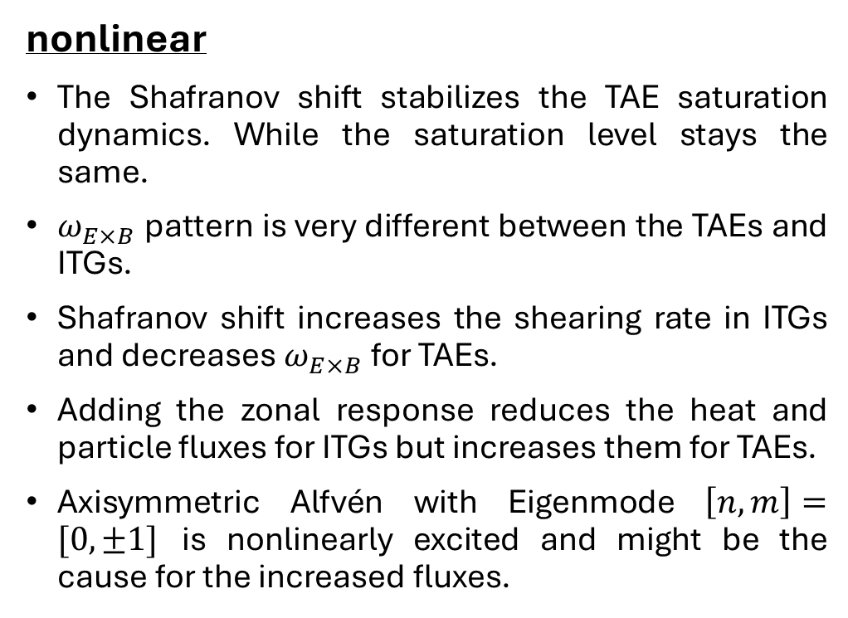
Summary
linear
KBMs are strongly damped by EPs and Shafranov shift
The Shafranov shift has a stronger effect in the low-n range
For TAEs the additional Shafranov shift from EP fraction competes with the drive leading to an apparent saturation in growth rate.
For ITGs the additional Shafranov shift from EPs results in a linear shift in the dispersion relation towards higher toroidal mode numbers.
nonlinear
The Shafranov shift stabilizes the TAE saturation dynamics. While the saturation level stays the same.
$ω_{E×B}$pattern is very different between the TAEs and ITGs.
Shafranov shift increases the shearing rate in ITGs and decreases $ω_{E×B}$for TAEs.
Adding the zonal response reduces the heat and particle fluxes for ITGs but increases them for TAEs.
Axisymmetric Alfvén with Eigenmode $\left[n,m\right]=[0, ±1]$ is nonlinearly excited and might be the cause for the increased fluxes.

Slide 22
Thank you for your attention
Questions?
Baruch Rofman
Swiss Plasma Center (SPC)
École Polytechnique Fédérale de Lausanne (EPFL)
Together with
G. Di Giannatale, A. Mishchenko, E. Lanti, T.Hayward-Schneider, A. Bottino, B.F. McMillan, J.N. Sama, A. Biancalani, S. Brunner, and L. Villard

Slide 23
Additional slides

Slide 24
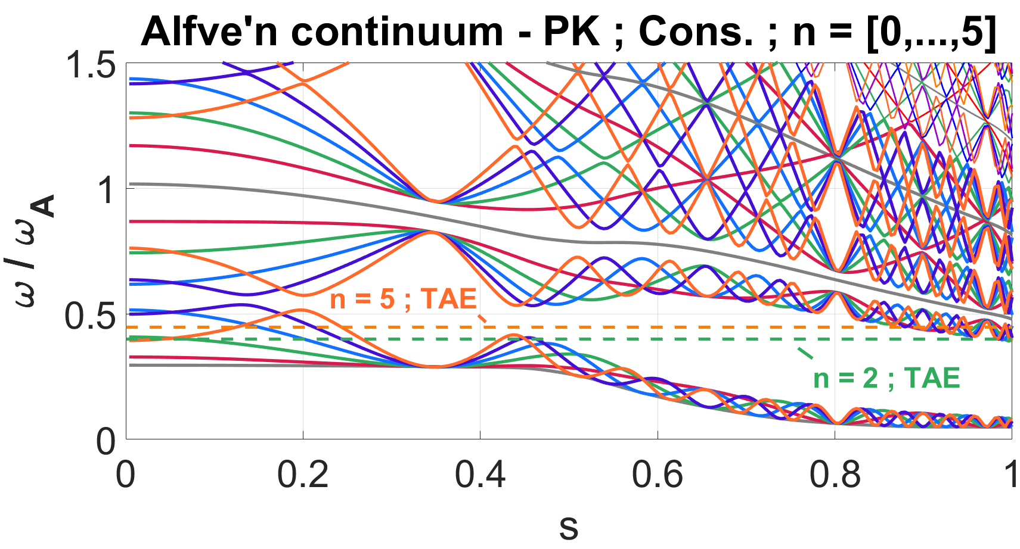

Slide 25
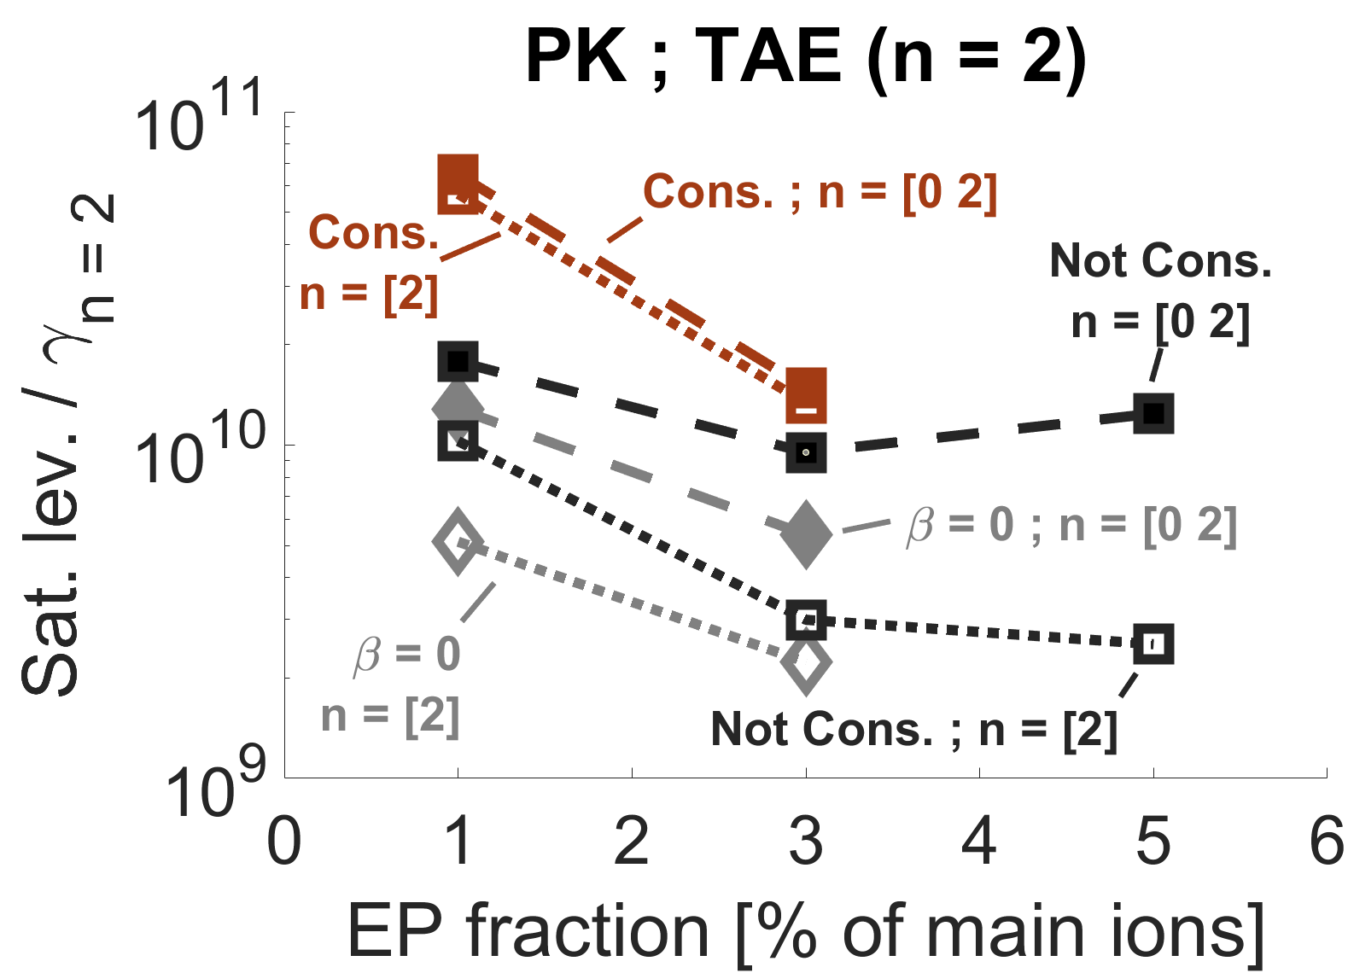
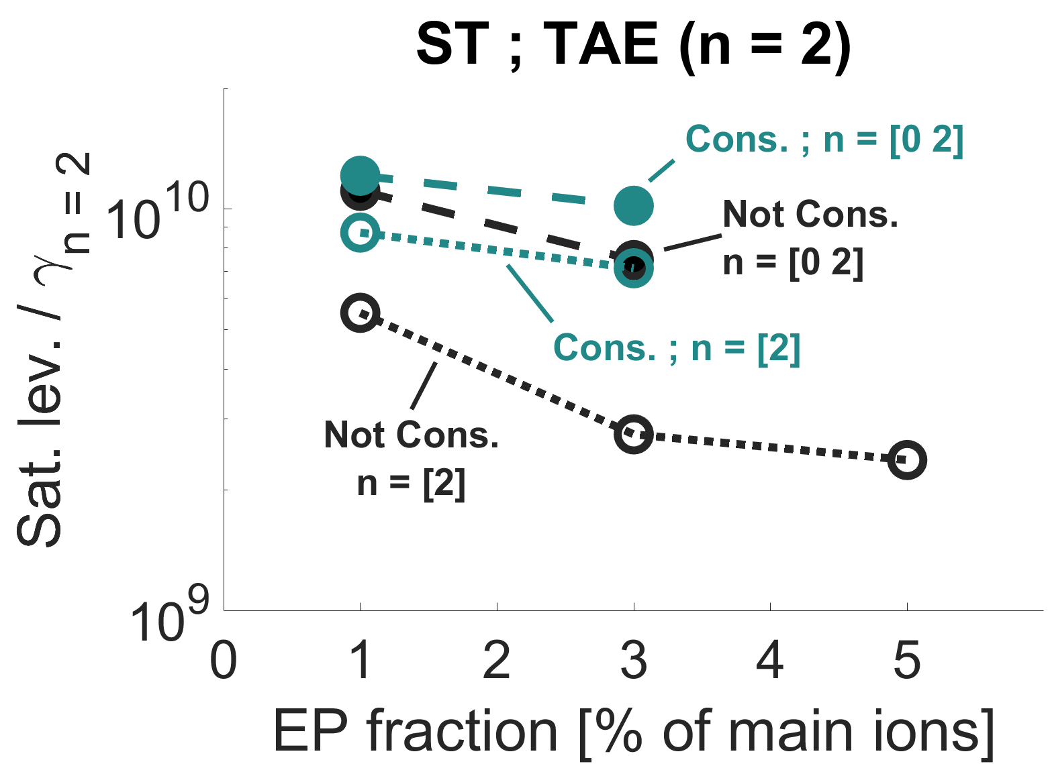

Slide 26
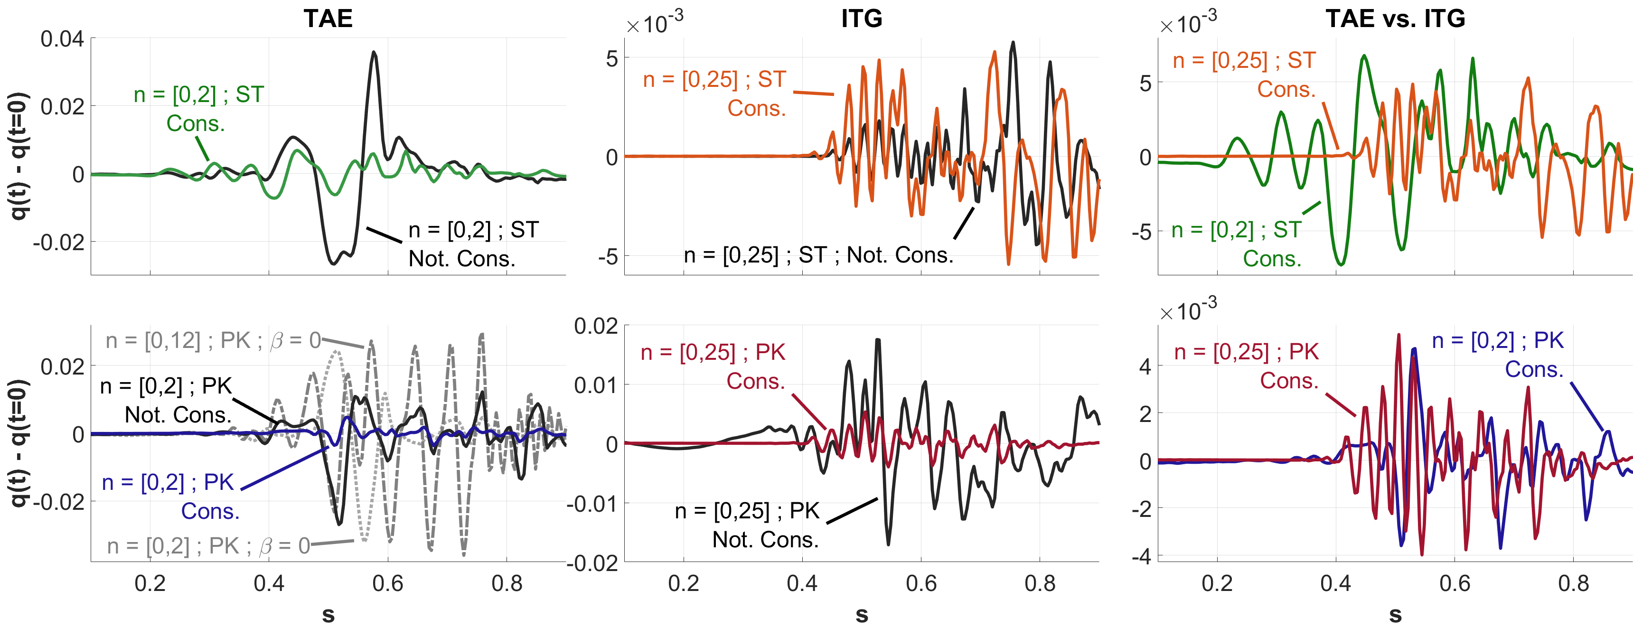
Nonlinear modification of the q-profile
Notes:
Here we account for the modification of the magnetic field by the zonal currents. (Through the A_par component)
An electromagnetic phenomena.
We notice that for both the TAE and ITG additional Shafranov shift reduces the modifications to the q profile.
Compering the self consistent cases to each other, we see that the effect of both modes is similar in magnitude, but with a different radial profile.
The additional Shafranov shift in the PK profiles suppresses most of the larger amplitude wider modulations of the TAE. The remaining modulations are most likely centered around the low order mode rational surfaces.

Slide 27
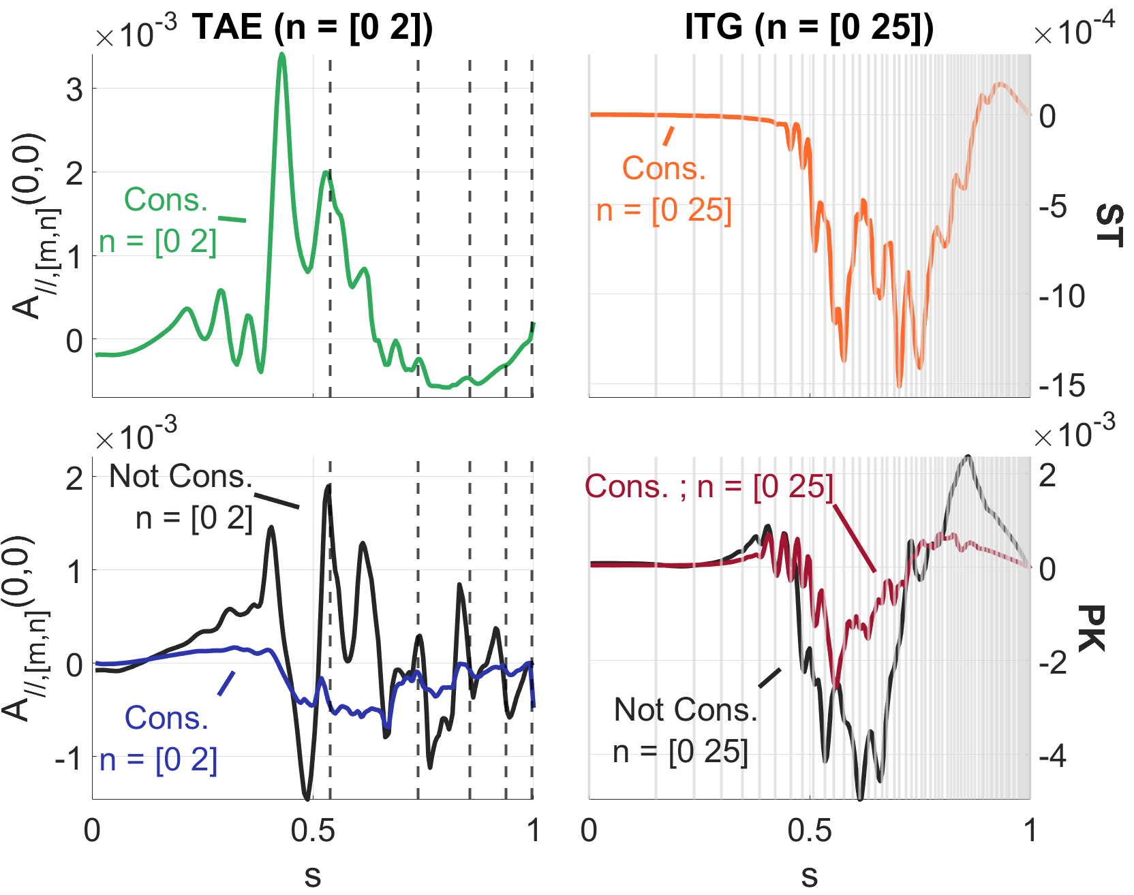
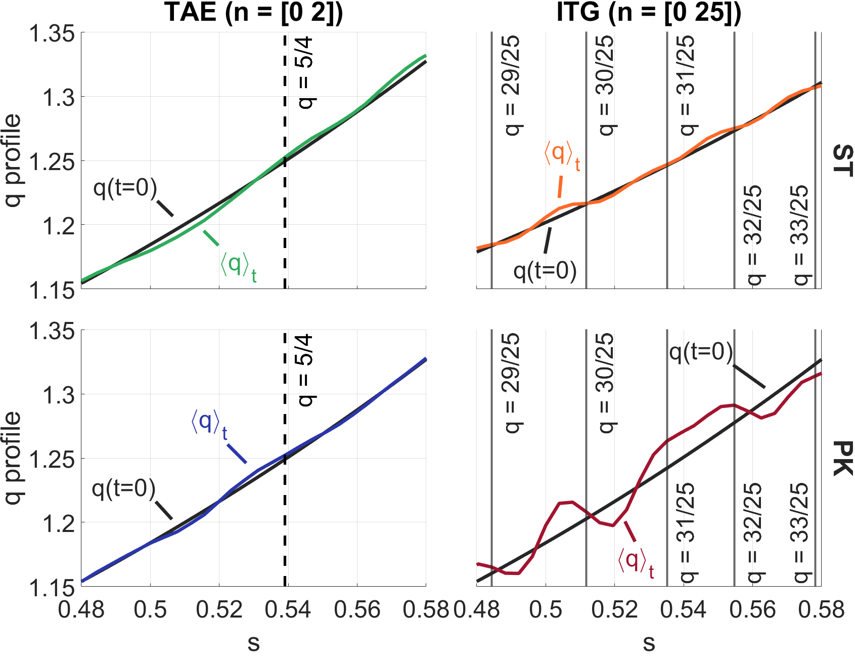
Nonlinear modification of the q-profile
Notes:
Here we account for the modification of the magnetic field by the zonal currents. (Through the A_par component)
An electromagnetic phenomena.
We notice that for both the TAE and ITG additional Shafranov shift reduces the modifications to the q profile.
Compering the self consistent cases to each other, we see that the effect of both modes is similar in magnitude, but with a different radial profile.
The additional Shafranov shift in the PK profiles suppresses most of the larger amplitude wider modulations of the TAE. The remaining modulations are most likely centered around the low order mode rational surfaces.

Slide 28
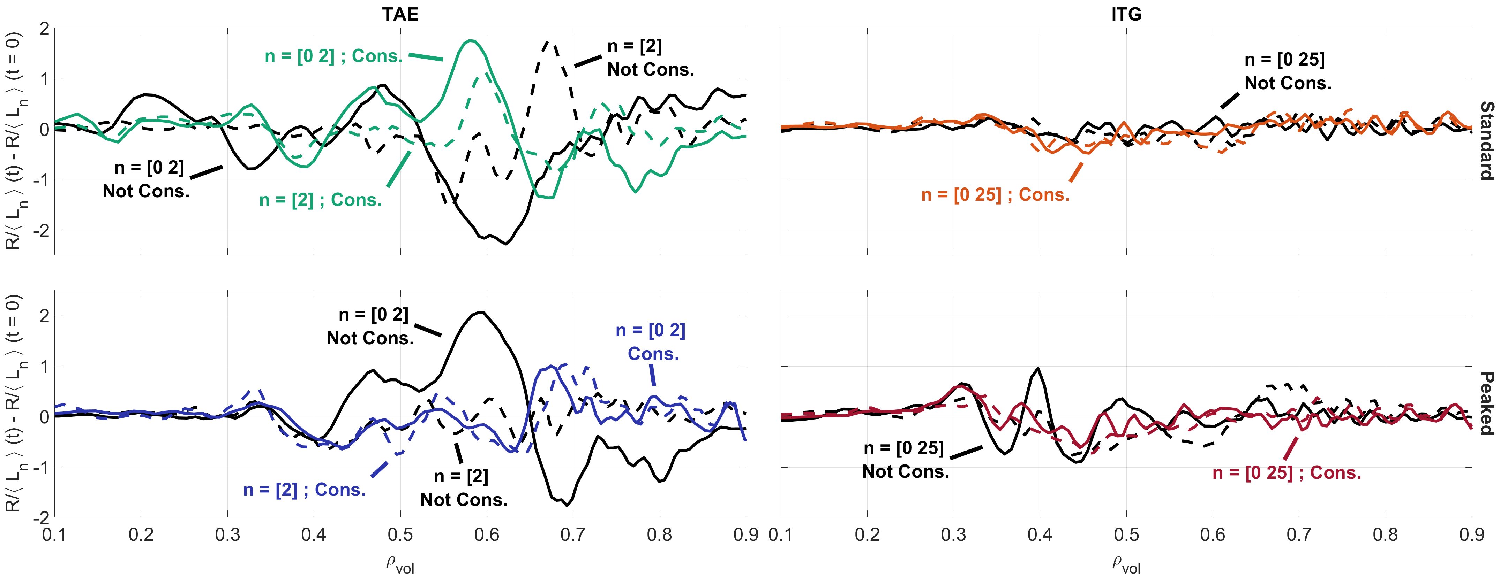
Nonlinear modification of the R/L_{n}
Notes:
In these cases, EP profile relaxation was not a major part of the nonlinear saturation phase.
For the TAE we see an overall weak stabilizing effect of the Shafranov shift, that is mainly apparent in the PK cases.
Zonal flows modify the radial relaxation pattern and weakly increase the particle redistribution (mainly apparent in the ST cases).

Slide 29
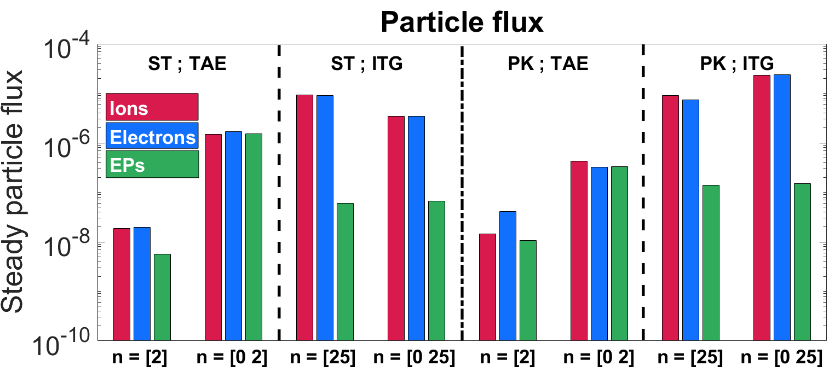
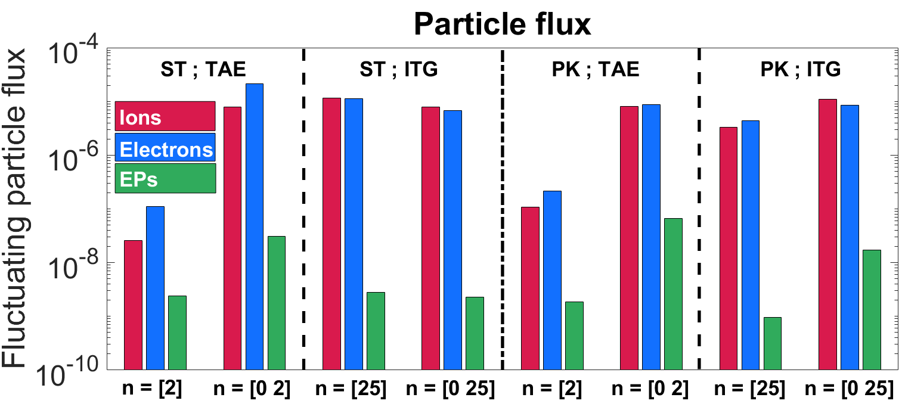

Particle fluxes – fluctuating vs. steady

