Slide 1
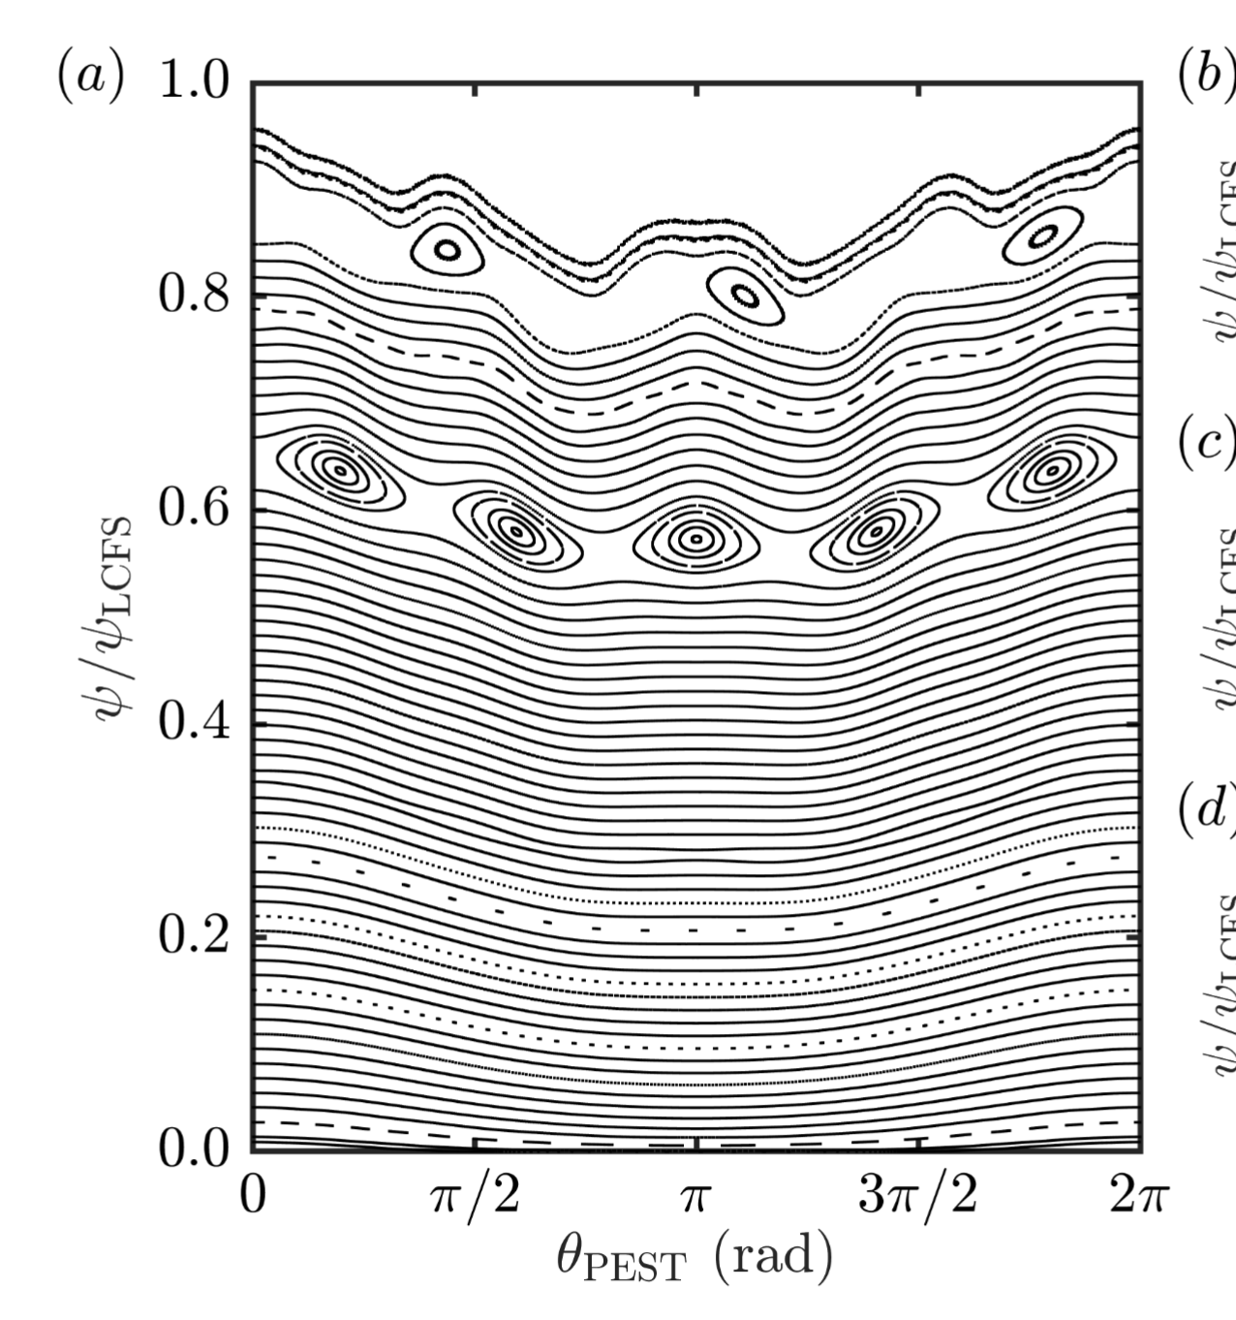
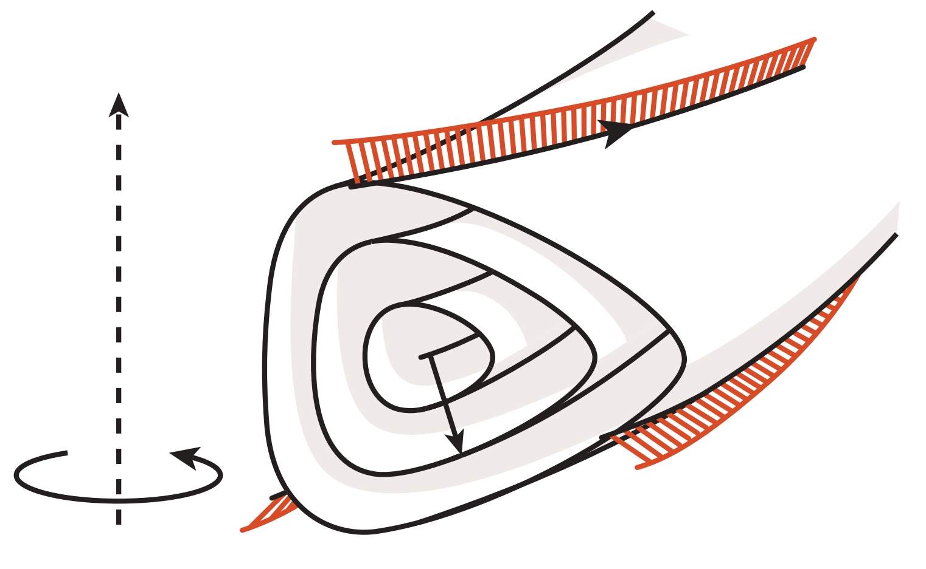
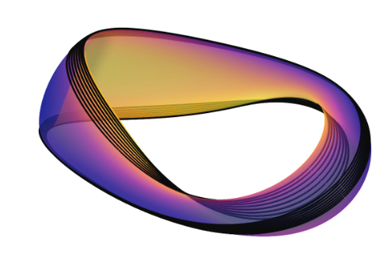


Alpha-particle orbits near rational flux surfaces in stellarators

Slide 2
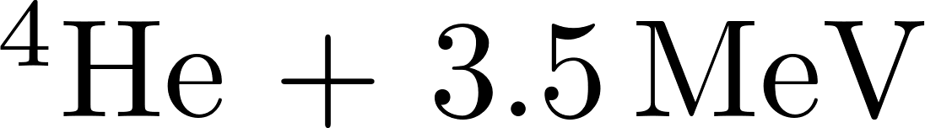
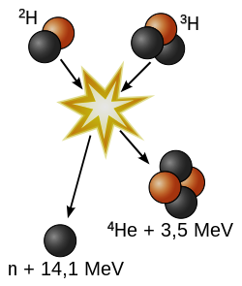

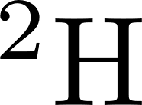
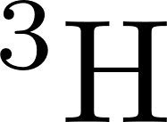

Background

Slide 3
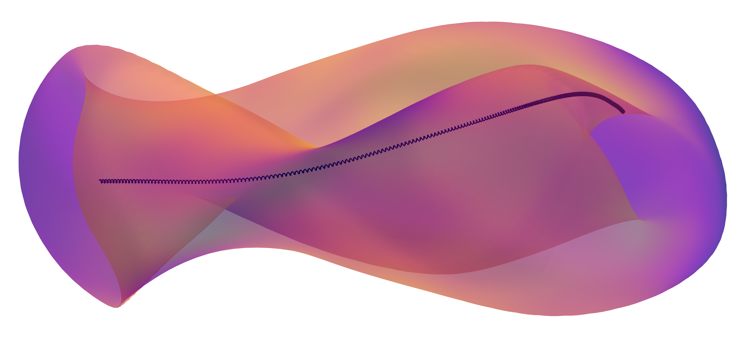
Background

Slide 4
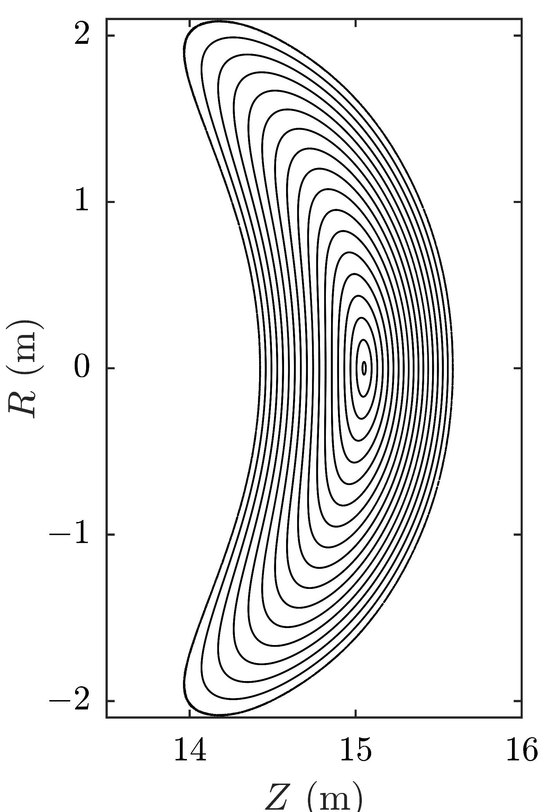
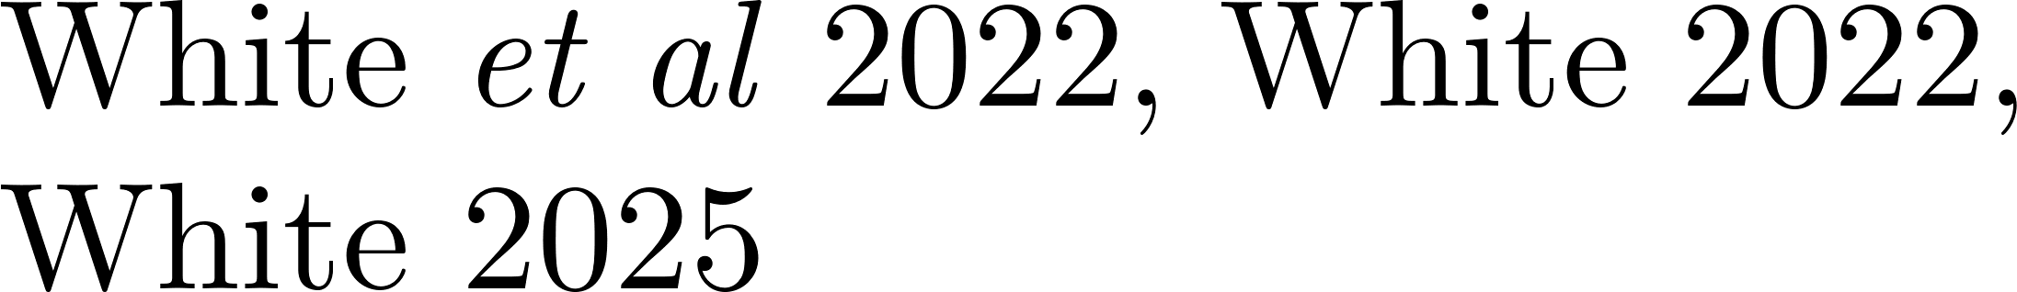

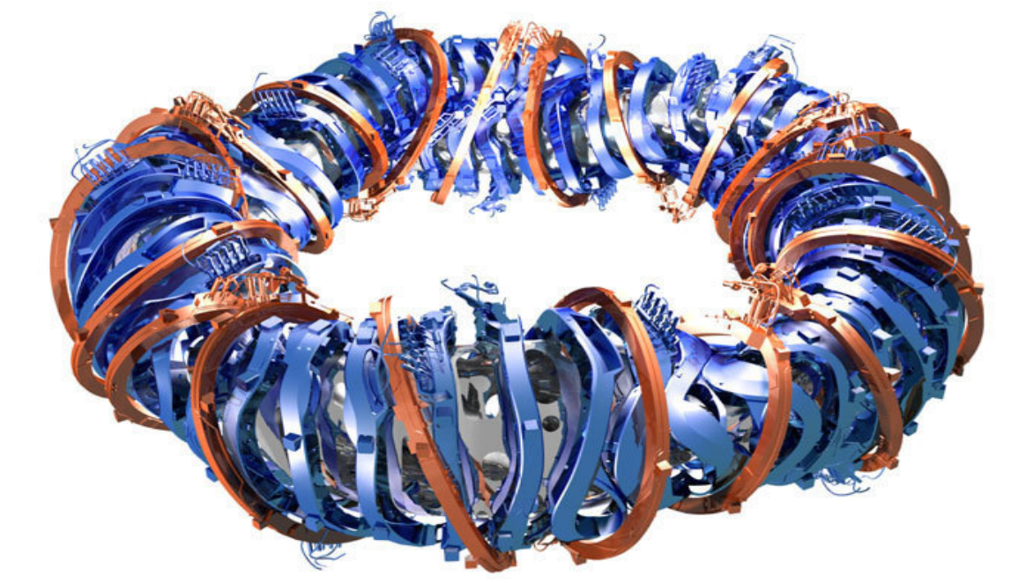


Background

Slide 5
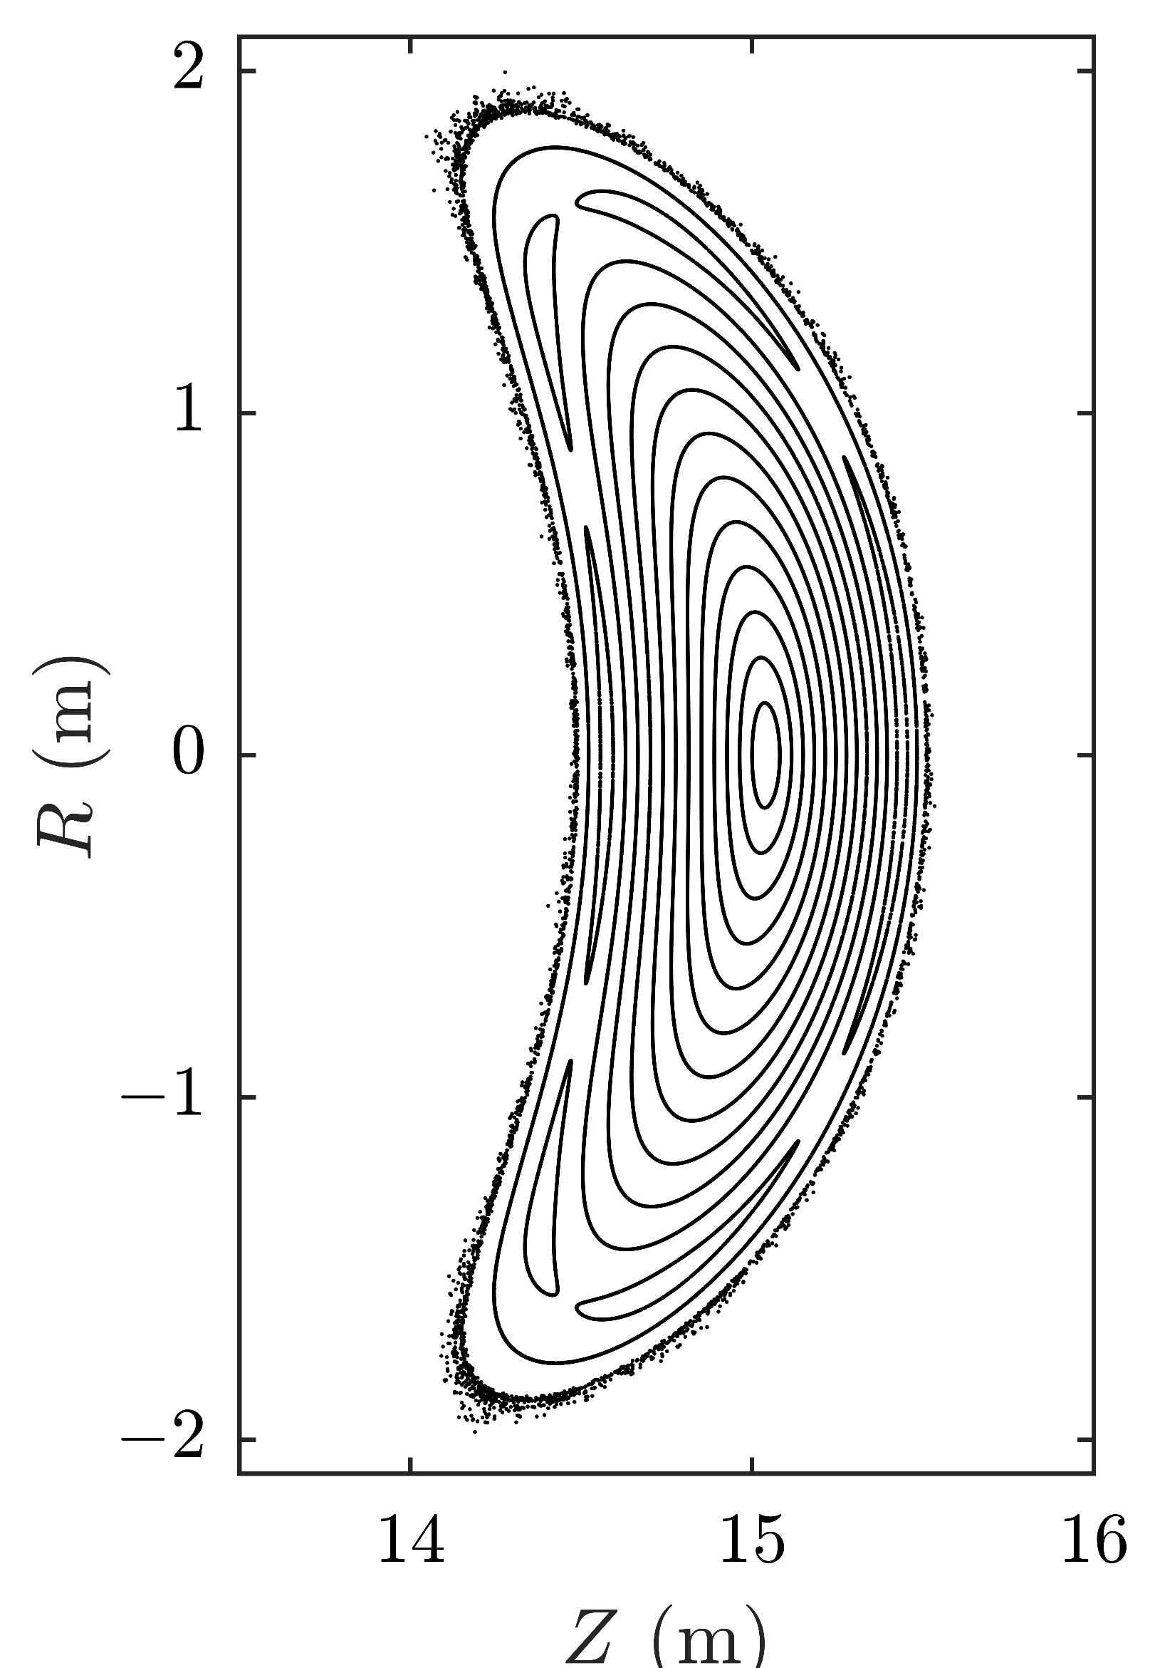
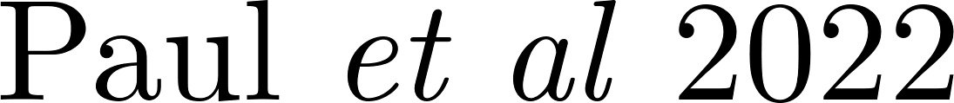
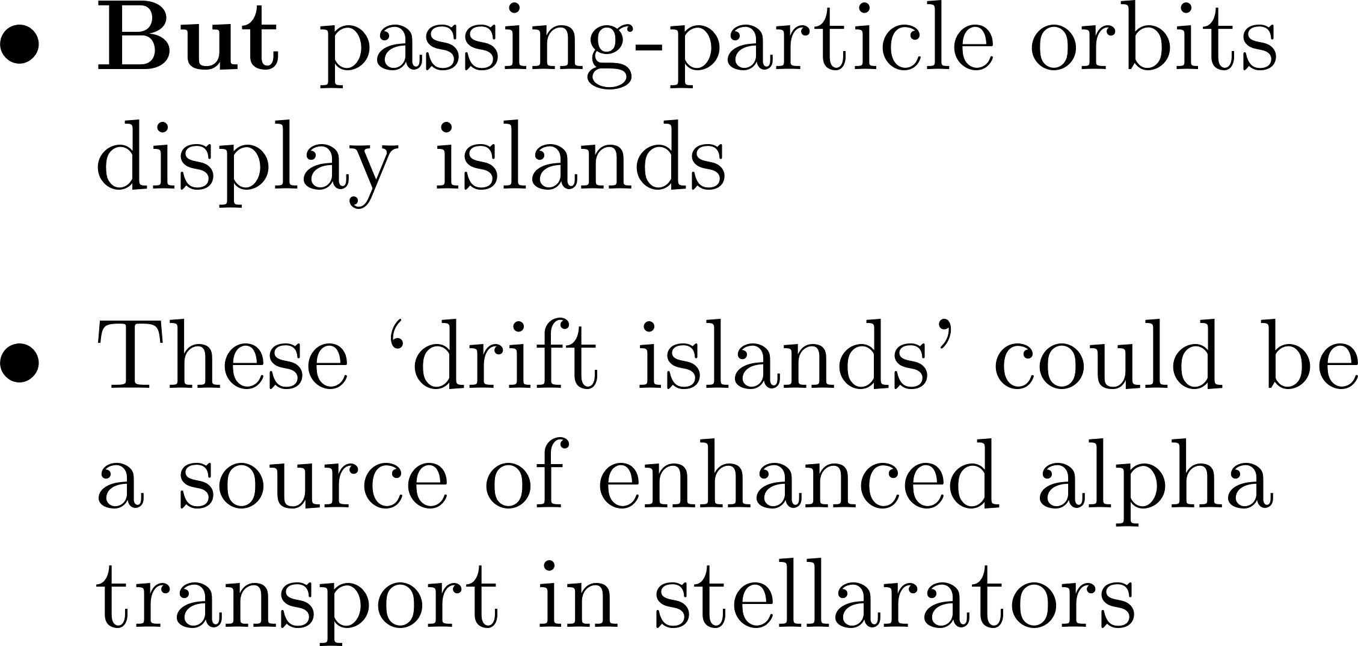
Background

Slide 6
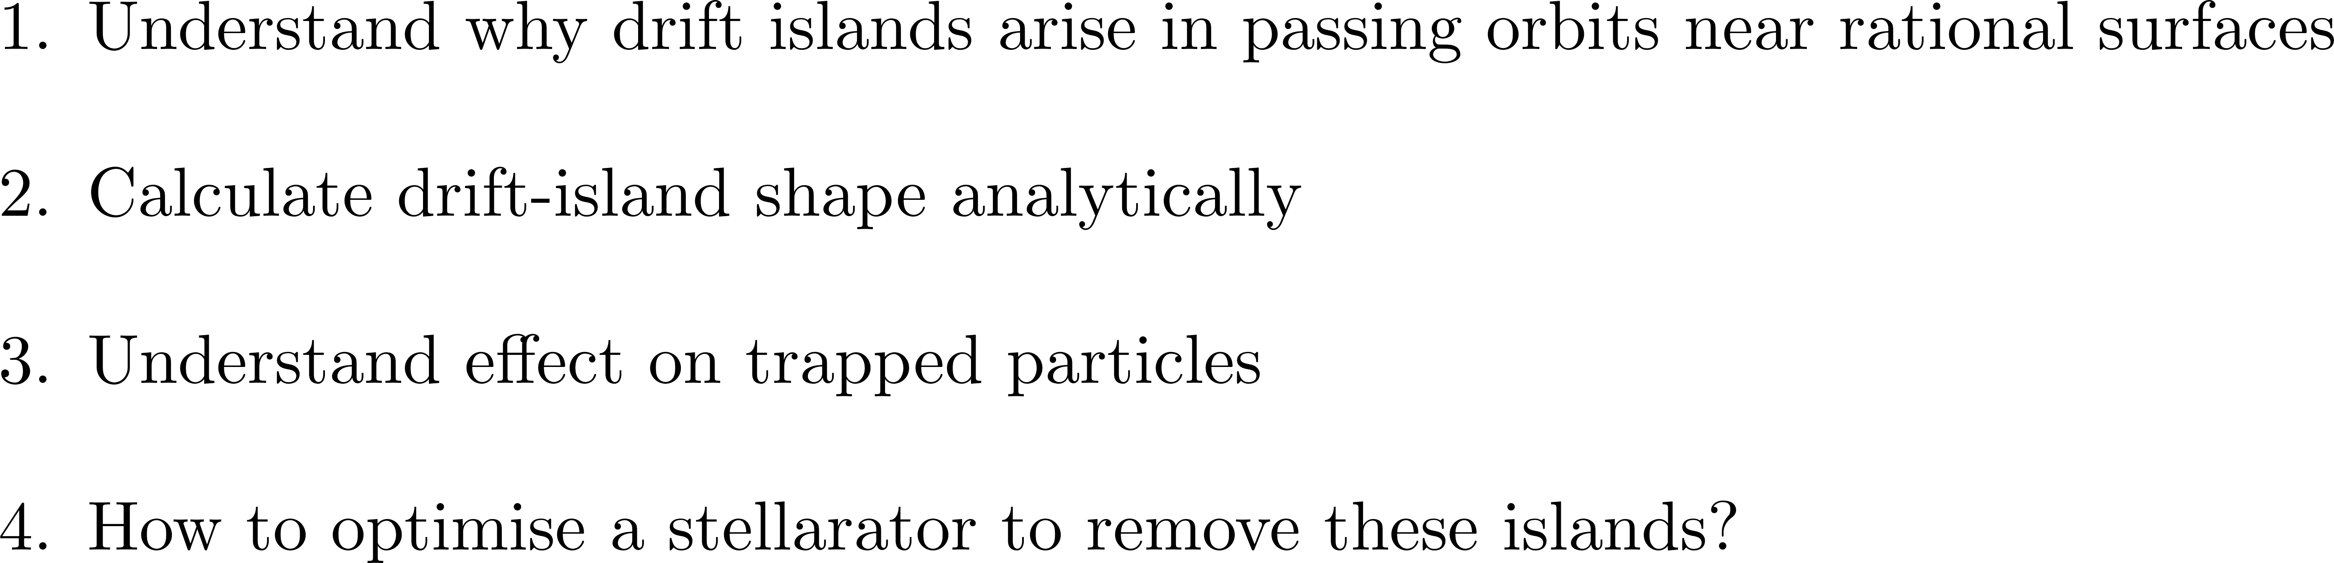
Plan

Slide 7
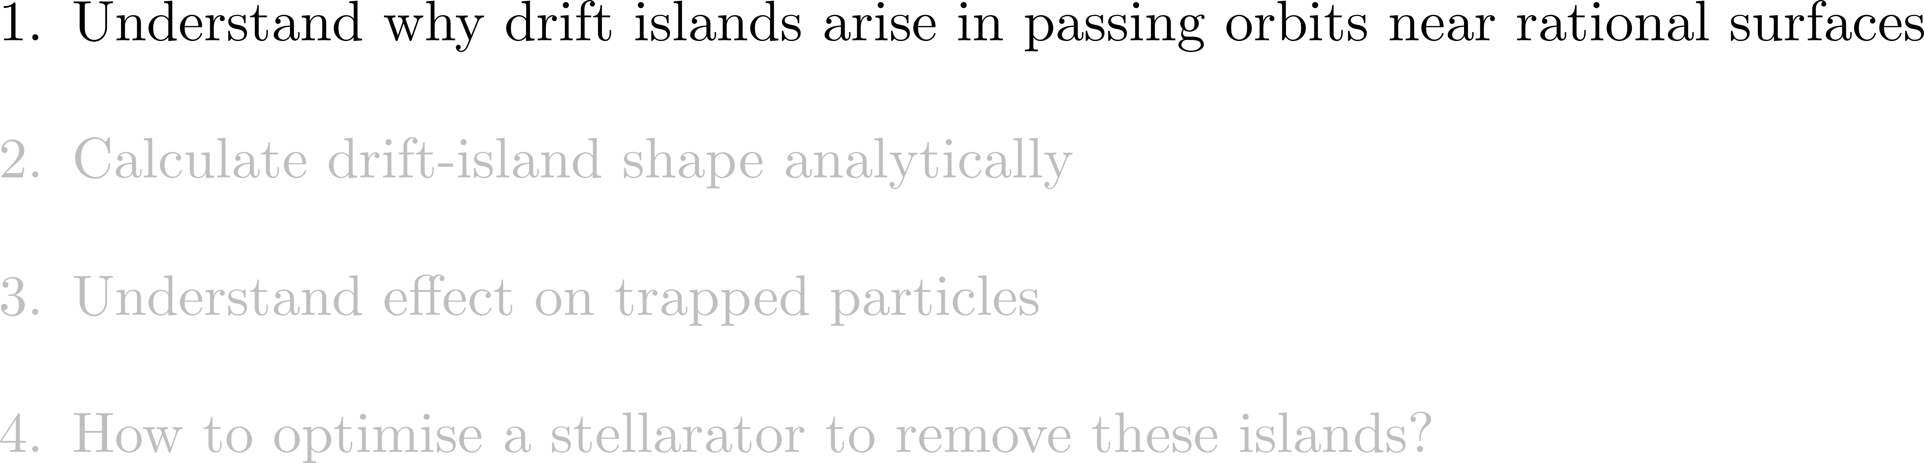
Plan

Slide 8
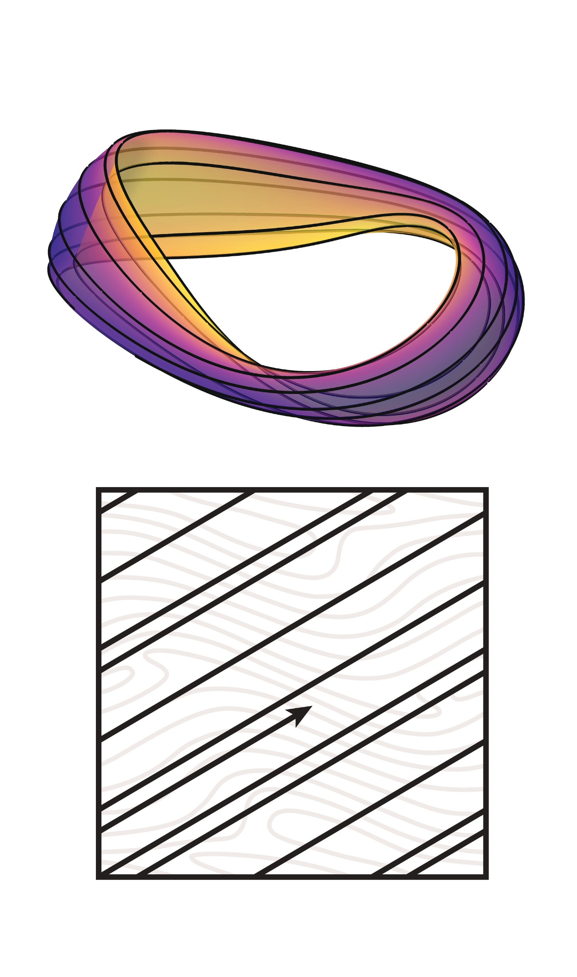
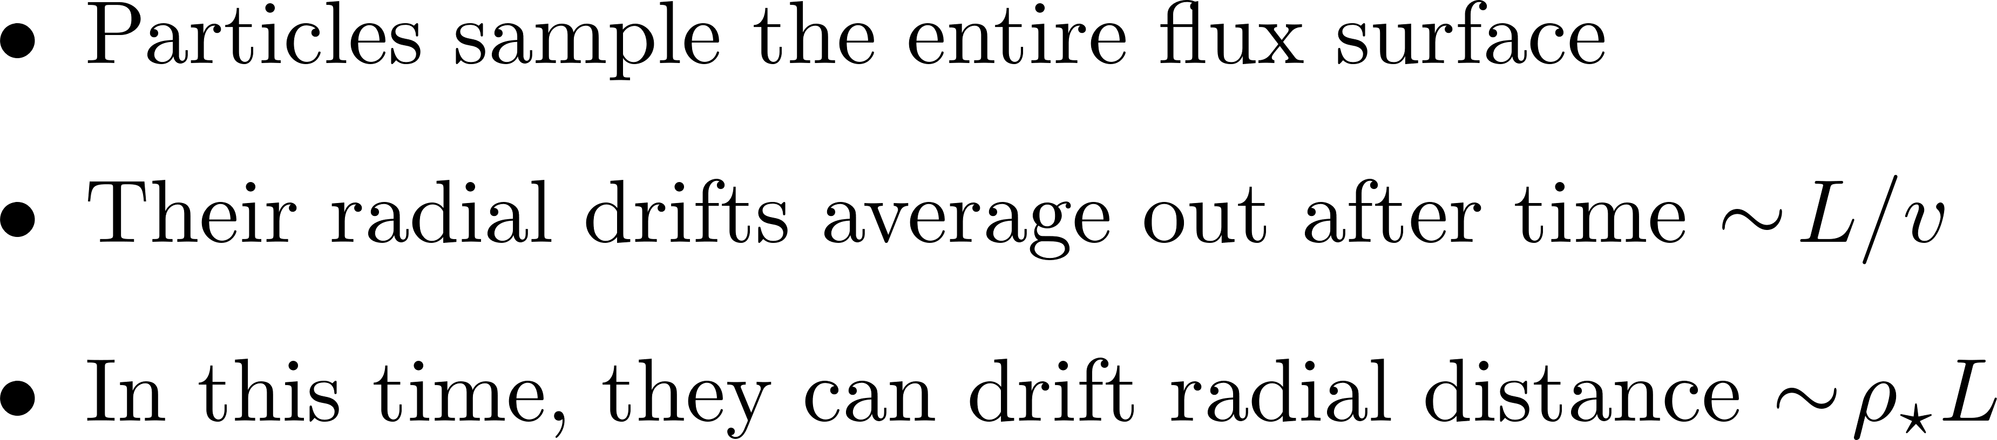
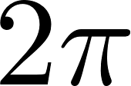



Orbit-width estimates

Slide 9
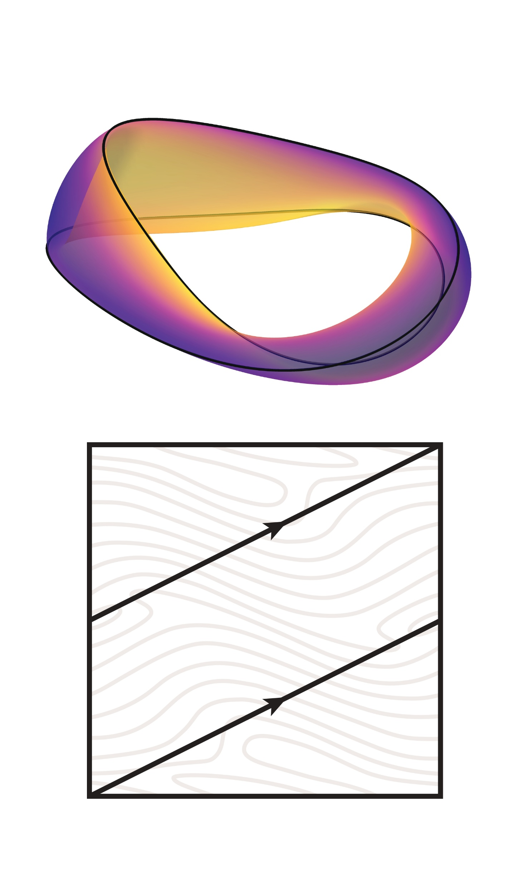
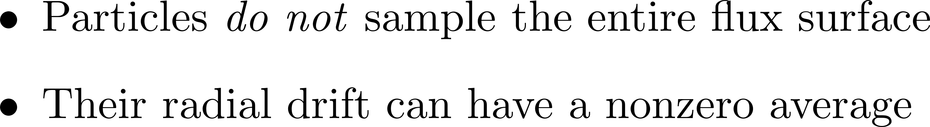
Orbit-width estimates

Slide 10

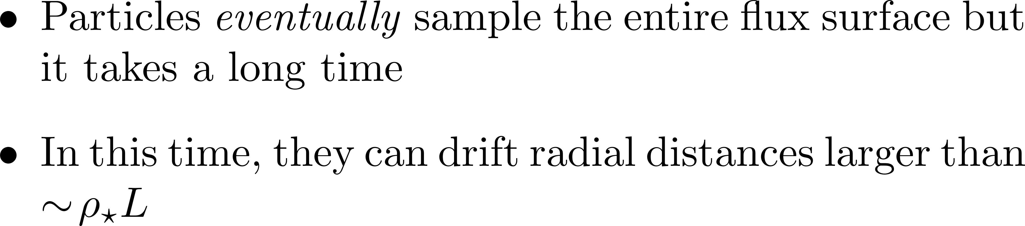
Orbit-width estimates

Slide 11
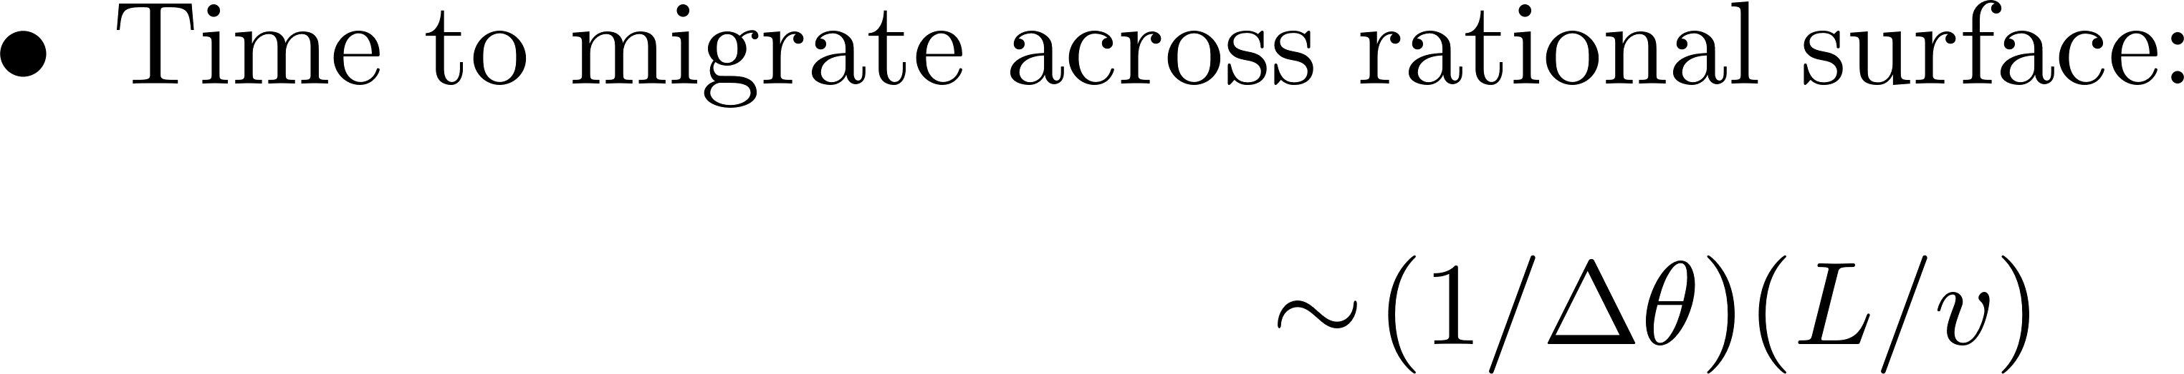
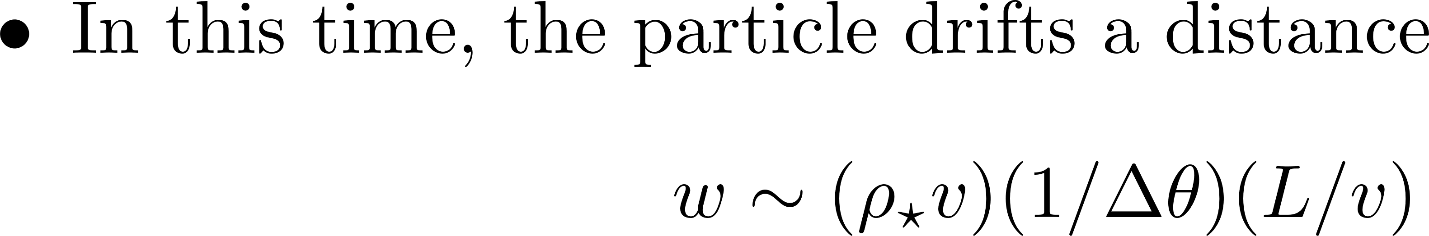
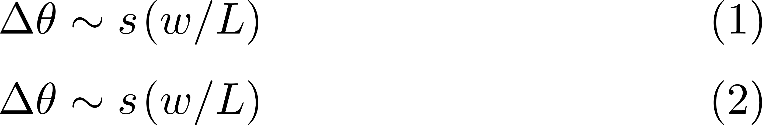
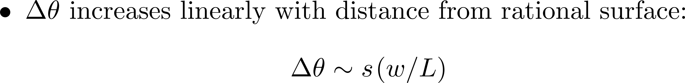
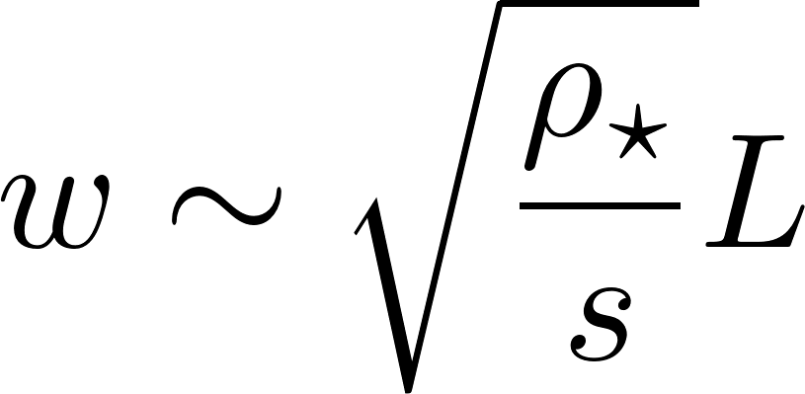

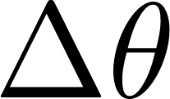
Orbit-width estimates

Slide 12
Plan

Slide 13
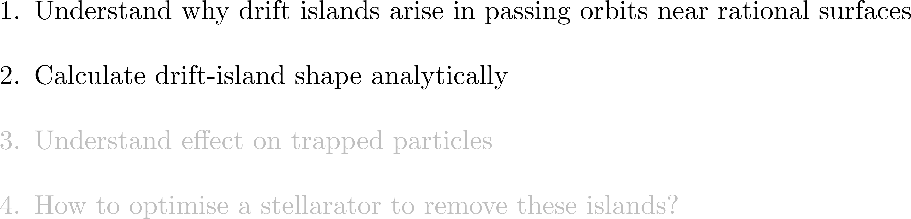
Plan

Slide 14

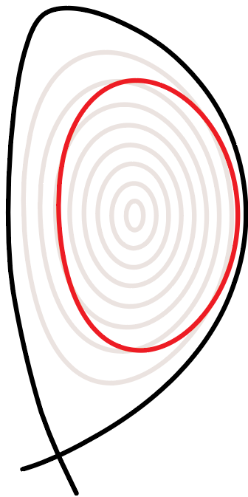
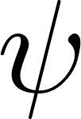
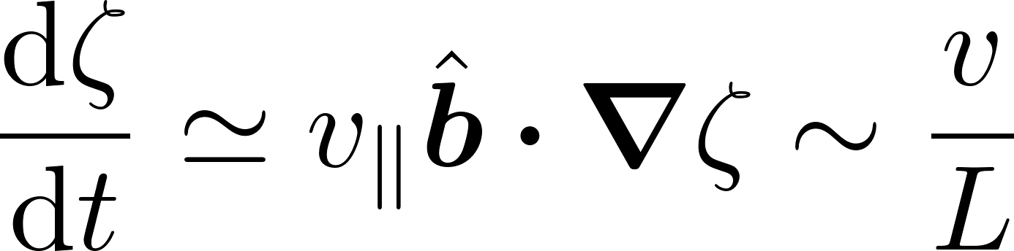
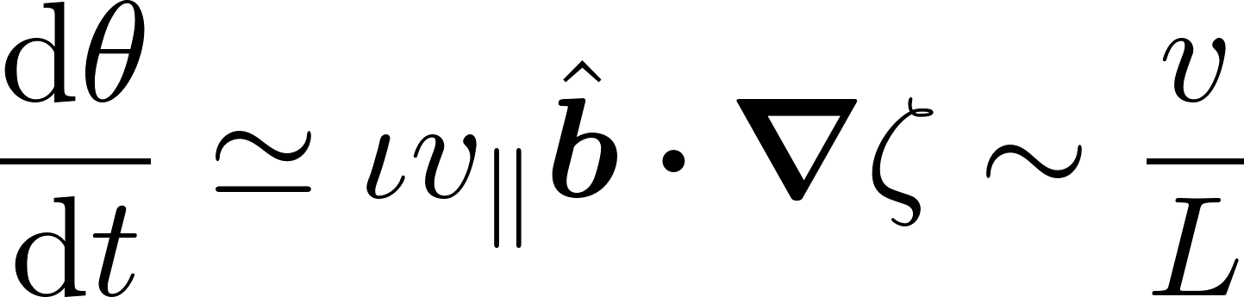
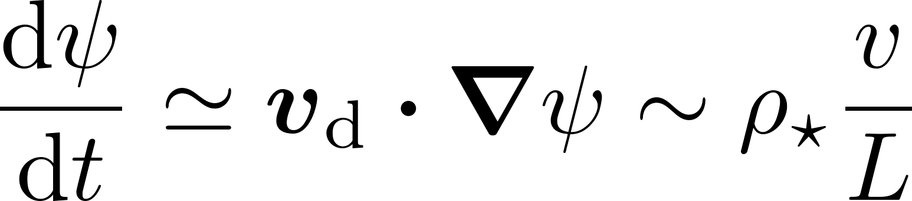
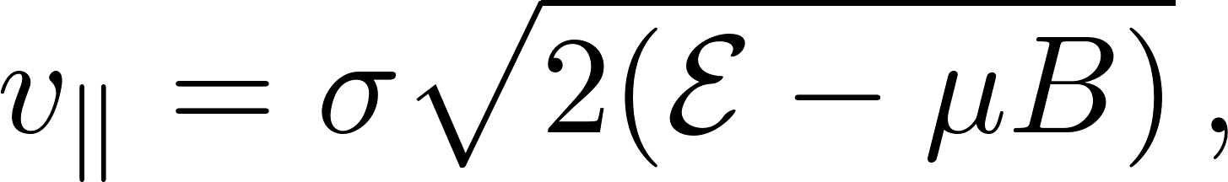
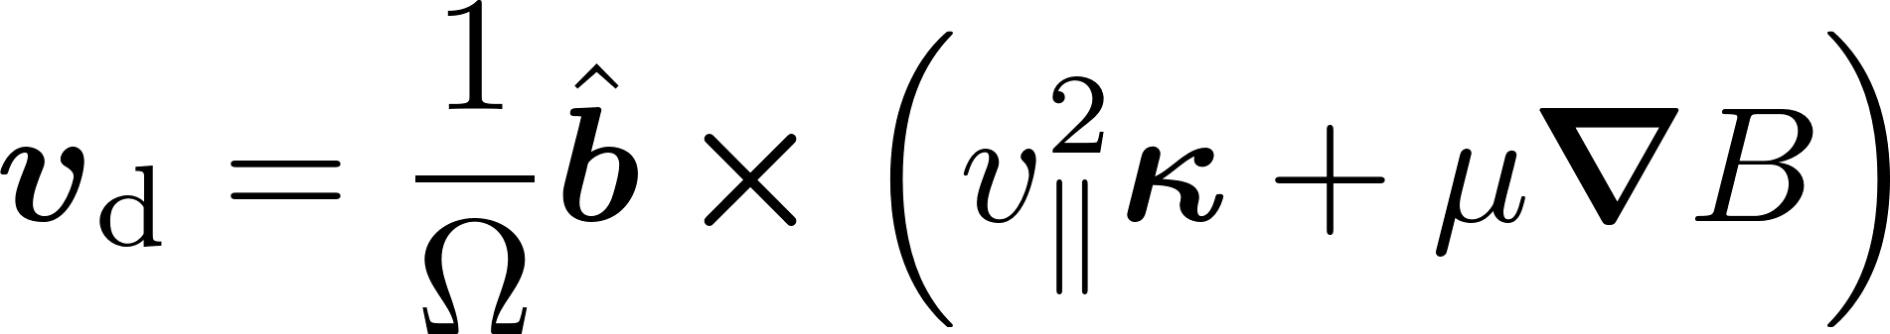


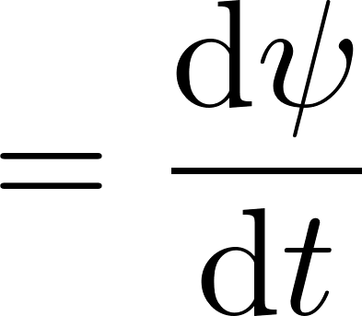
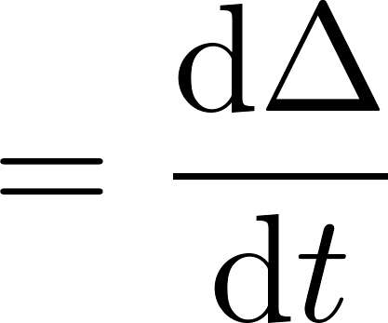
Calculation of orbits on irrational surfaces

Slide 15
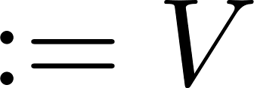
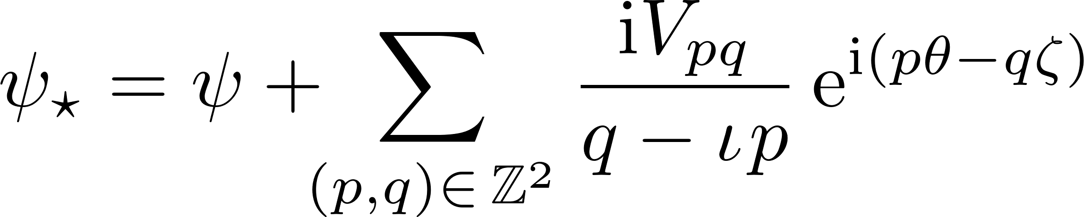
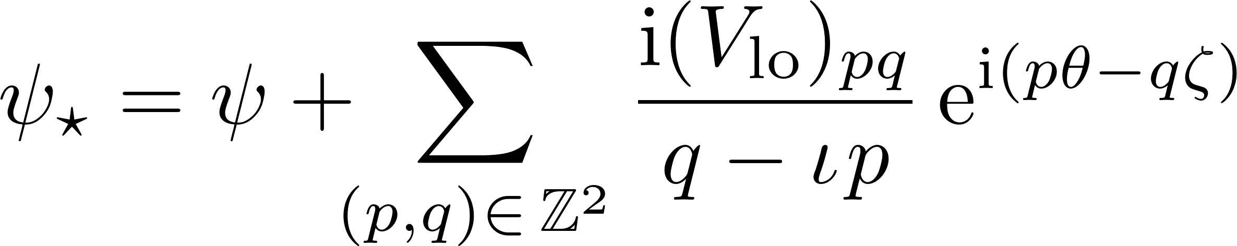

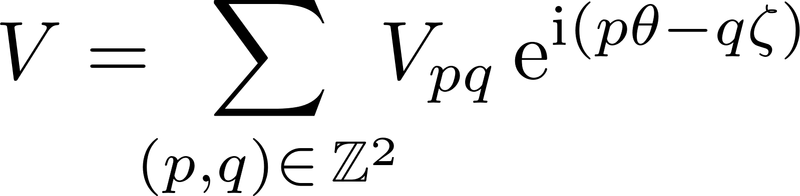
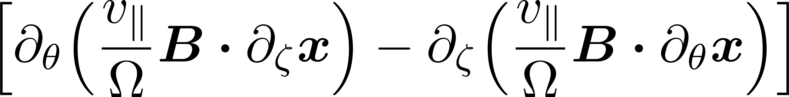
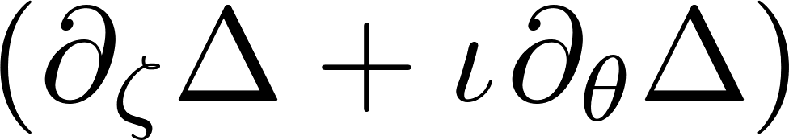

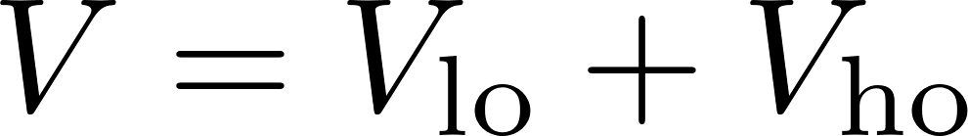

Calculation of orbits on irrational surfaces

Slide 16

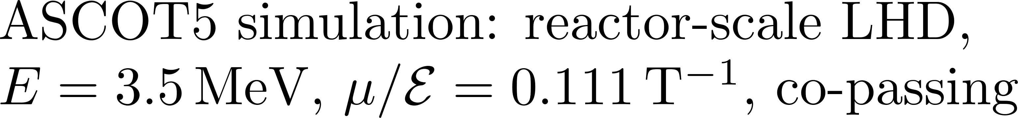
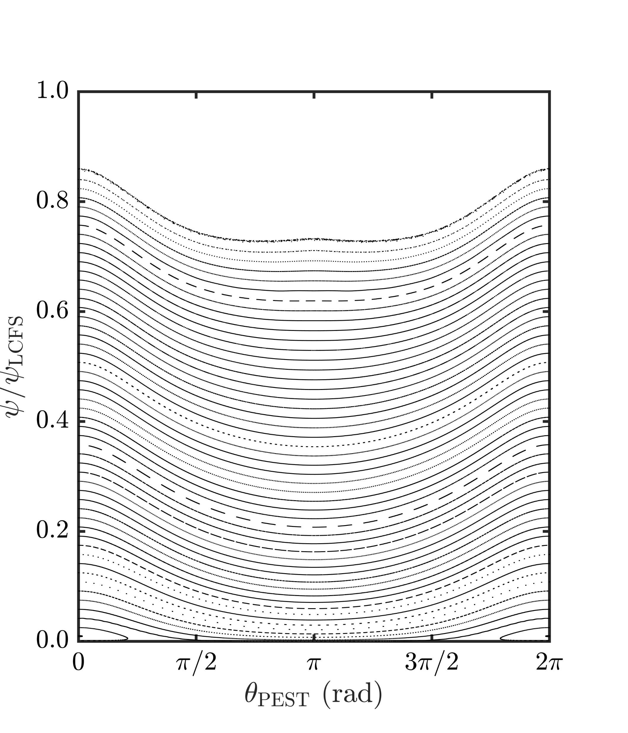
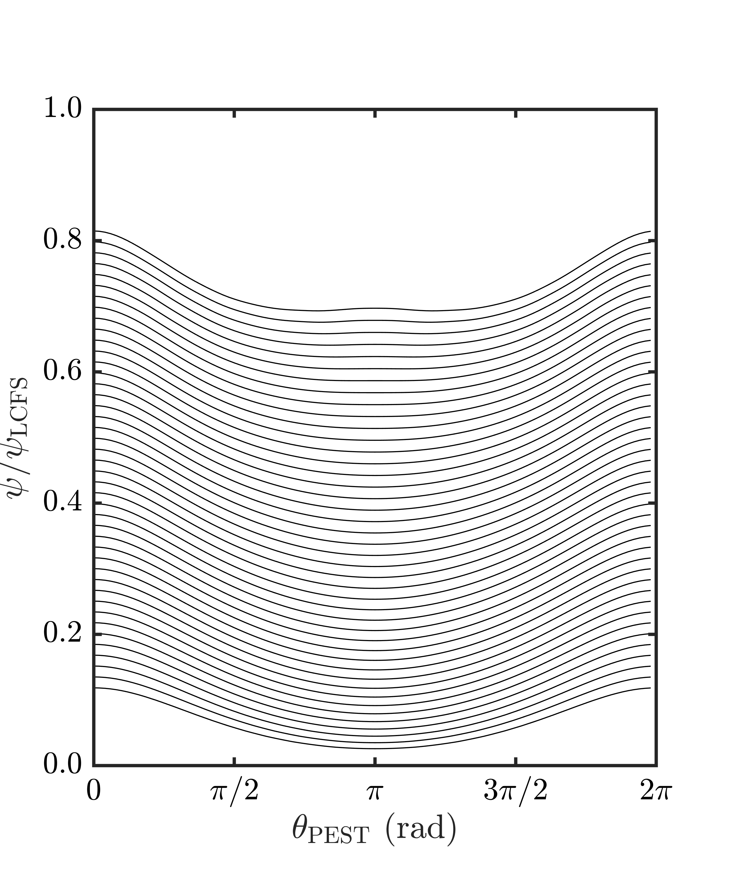



Theory vs. simulations

Slide 17
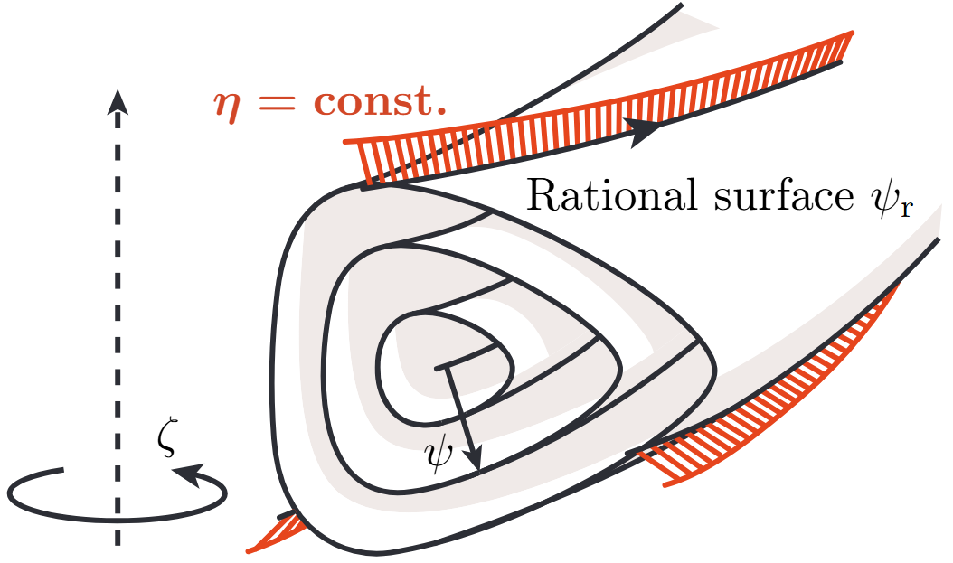
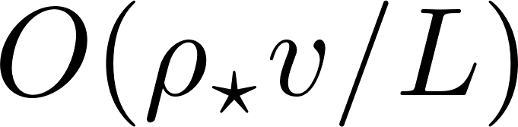




Calculation of orbits on rational surfaces

Slide 18













Calculation of orbits on rational surfaces
18

Slide 19











Plotting drift islands using transit invariant

Slide 20

Theory vs. simulations

Slide 21

Theory vs. simulations

Slide 22





Tangential drifts shift islands radially

Slide 23




Tangential drifts shift islands radially

Slide 24
Tangential drifts shift islands radially

Slide 25

Higher-order adiabatic invariants

Slide 26


Higher-order transit invariant

Slide 27

Theory vs. simulations: higher order

Slide 28
Theory vs. simulations: even higher order

Slide 29









Theory vs. simulations: even higher order

Slide 30
Theory vs. simulations: even higher order

Slide 31
Plan

Slide 32

Plan

Slide 33




Unusual trapped orbits near rational surfaces

Slide 34









Calculation of semi-trapped orbits

Slide 35










Stellarator symmetry

Slide 36
Plan

Slide 37
Plan

Slide 38


Optimisation for small drift islands

Slide 39






Optimisation for small drift islands

Slide 40
Optimisation for small drift islands

Slide 41

Optimisation for small drift islands

Slide 42

Piecewise cyclometry

Slide 43

Conclusions

Slide 44
Backup slides

Slide 45

Guiding-centre vs full-orbit

Slide 46

Guiding-centre vs full-orbit

