Slide 1
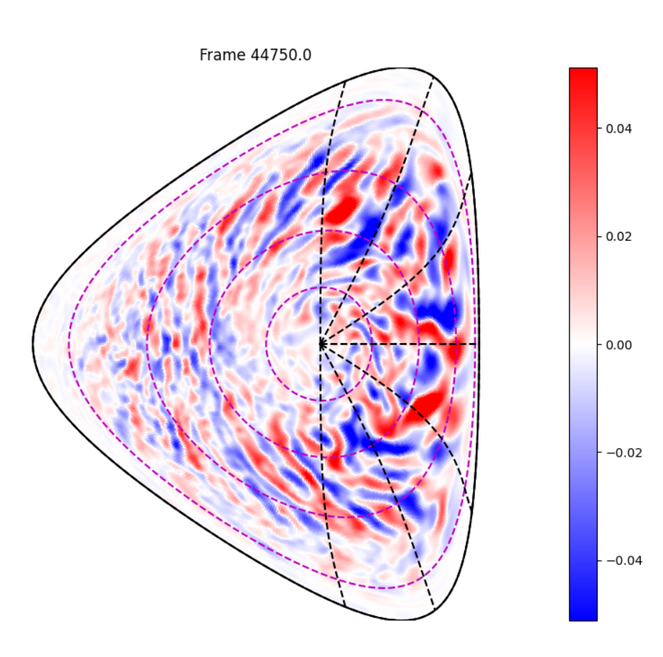
Effect of the magnetic geometry on Trapped Electron Modes instability: linear and non linear analysis
L. De Gianni¹, P. Donnel¹ , X. Garbet^{1,2},Y.Sarazin¹, G. Dif-Pradalier¹ , V.Grandgirard¹, K. Obrejan¹, M. Protais¹, R.Bigué^{1,4} , Z. Qu² , NG. J.Yang²
¹ CEA, IRFM, F-13108 Saint Paul-lez-Durance, France.
² School of Physical and Mathematical Sciences, NTU, 637371 Singapore.
³ SCITAS, EPFL, CH-1015 Lausanne, Switzerland
⁴ PIIM Laboratory, UMR 6633 CNRS-University of Provence, Marseille
EFTC 2025

Slide 2
OUTLINE
Motivation and goals of our work
Linear stability analysis: a reduced model
Non linear analysis : GK code Gysela
Conclusions and perspectives
1

Slide 3
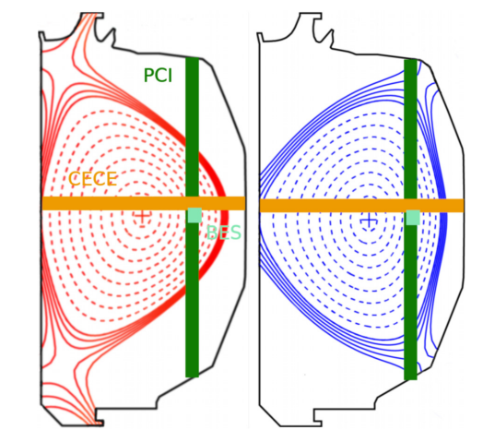
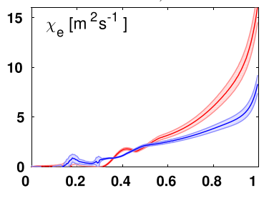
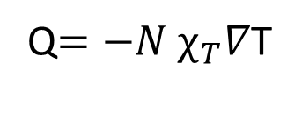
CONFINEMENT IMPROVEMENT IN NEGATIVE TRIANGULARITY
[Marinoni 09]
PT
Transport is lower in negative triangularity than in positive triangularity plasmas
Q$=−N χ_{T}∇\text{T}$
effective diffusion coefficient
NT
r/a
2

Slide 4
CONFINEMENT IMPROVEMENT IN NEGATIVE TRIANGULARITY
[Marinoni 09]
PT
Transport is lower in negative triangularity than in positive triangularity plasmas
Q$=−N χ_{T}∇\text{T}$
effective diffusion coefficient
NT
r/a
TRANSPORT
Dominated by microinstabilities, driven unstable from strong density or temperature gradients
2

Slide 5
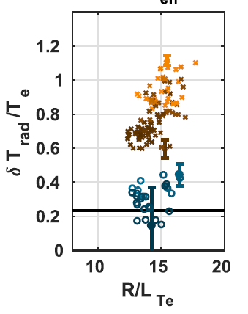
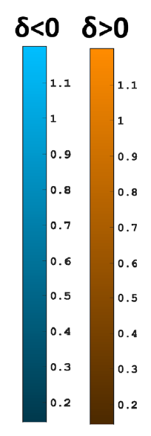
CONFINEMENT IMPROVEMENT IN NEGATIVE TRIANGULARITY
[Marinoni 09]
PT
Transport is lower in negative triangularity than in positive triangularity plasmas
Q$=−N χ_{T}∇\text{T}$
effective diffusion coefficient
NT
r/a
TRANSPORT
[Fontana 20]
Dominated by microinstabilities, driven unstable from strong density or temperature gradients
PT
INTERPRETATION
stabilizing role of negative triangularity in the electron channel
NT
Main responsible for the turbulent heat and particle transport through the electron channel: TRAPPED ELECTRONS MODES (TEMs)
2
Confirmed in other turbulent regimes

Slide 6
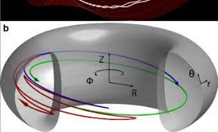

TRAPPED ELECTRON MODES
IMPORTANCE IN FUSION
resonant interaction between an electrostatic perturbation and the toroidal precessional drift of trapped electrons
Electron heating commonly used : control
Energetic ions heat electrons
T_{e}≥T_{i} in a fusion reactor
Precession frequency $ω_{d}$
3

Slide 7
TRAPPED ELECTRON MODES
IMPORTANCE IN FUSION
resonant interaction between an electrostatic perturbation and the toroidal precessional drift of trapped electrons
Electron heating commonly used : control
Energetic ions heat electrons
T_{e}≥T_{i} in a fusion reactor
Precession frequency $ω_{d}$
GOAL OF OUR WORK
Understand the physical mechanism for TEMs stabilization in NT for extrapolation
3

Slide 8
TRAPPED ELECTRON MODES
IMPORTANCE IN FUSION
resonant interaction between an electrostatic perturbation and the toroidal precessional drift of trapped electrons
Electron heating commonly used : control
Energetic ions heat electrons
T_{e}≥T_{i} in a fusion reactor
Precession frequency $ω_{d}$
GOAL OF OUR WORK
Understand the physical mechanism for TEMs stabilization in NT for extrapolation
Flexibile
Identification of the role of each parameter
Scans
Reduced model :
linear stability analysis
Local and linear
3

Slide 9
TRAPPED ELECTRON MODES
IMPORTANCE IN FUSION
resonant interaction between an electrostatic perturbation and the toroidal precessional drift of trapped electrons
Electron heating commonly used : control
Energetic ions heat electrons
T_{e}≥T_{i} in a fusion reactor
Precession frequency $ω_{d}$
GOAL OF OUR WORK
Understand the physical mechanism for TEMs stabilization in NT for extrapolation
Flexibile
Identification of the role of each parameter
Scans
Reduced model :
linear stability analysis
Local and linear
Non local effects
Auto-coherence between different scales structures
Gyro-kinetic code GYSELA:
non linear study
Less flexible and handy
3

Slide 10
LINEAR ANALYSIS

Slide 11


REDUCED MODEL: LINEAR STABILITY ANALYSIS
Vlasov equation
Quasi-neutrality
coupled to
[C.D. Stephens 21]
[Garbet 24]
4

Slide 12
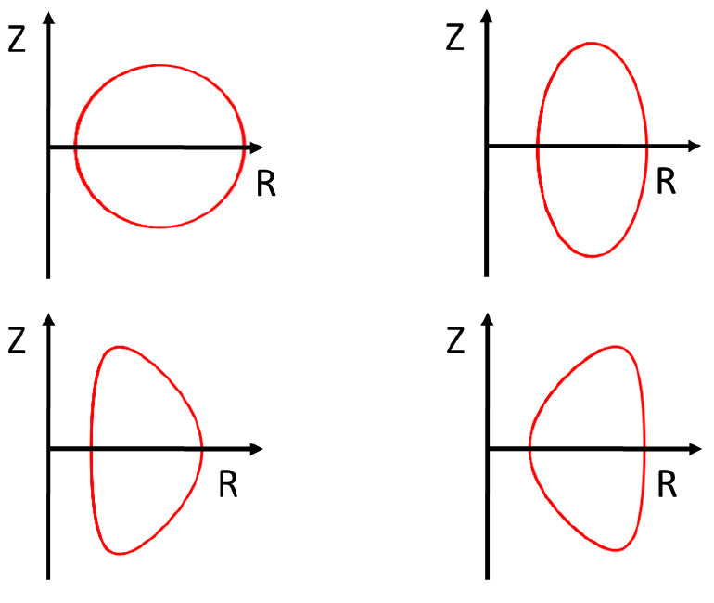
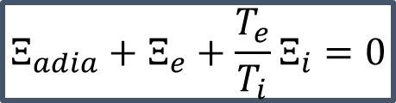
REDUCED MODEL: LINEAR STABILITY ANALYSIS
Vlasov equation
Quasi-neutrality
coupled to
[C.D. Stephens 21]
[Garbet 24]
Analytical equilibrium
Dispersion relation
$$Ξ_{adia}+Ξ_{e}+{\frac{T_{e}}{T_{i}}Ξ}_{i}=0$$
adiabatic contribution
passing ions contribution
trapped electrons contribution
[Garbet 24]
4

Slide 13

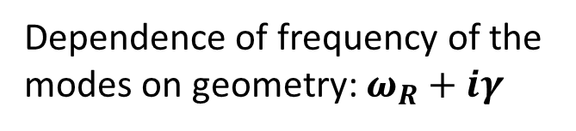
REDUCED MODEL: LINEAR STABILITY ANALYSIS
Vlasov equation
Quasi-neutrality
coupled to
[C.D. Stephens 21]
[Garbet 24]
Analytical equilibrium
Dispersion relation
$$Ξ_{adia}+Ξ_{e}+{\frac{T_{e}}{T_{i}}Ξ}_{i}=0$$
adiabatic contribution
passing ions contribution
trapped electrons contribution
Dependence of frequency of the modes on geometry: $ω_{R}+iγ$
[Garbet 24]
4

Slide 14


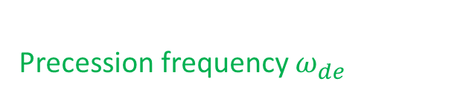
Trapped electronS contribution
Z
ζ
Average over energy $ε$=$\frac{E}{T}$
θ_{b}
θ
Average over bouncing angle
R
$$Ξ_{e}∝\int_{0}^{∞}{dε\int_{0}^{π}{dθ_{b}}\frac{1}{ω_{de}(θ_{b})ε−ω}}W^{2}\left(θ_{b}\right)$$
Precession frequency $ω_{de}$
Frequency of the perturbed electrostatic potential
5

Slide 15
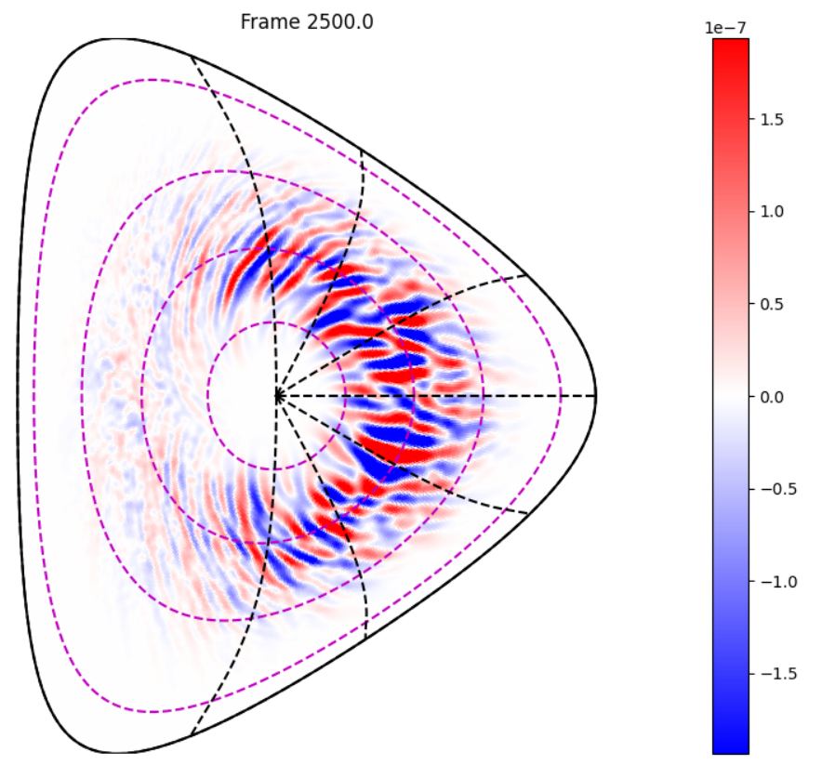
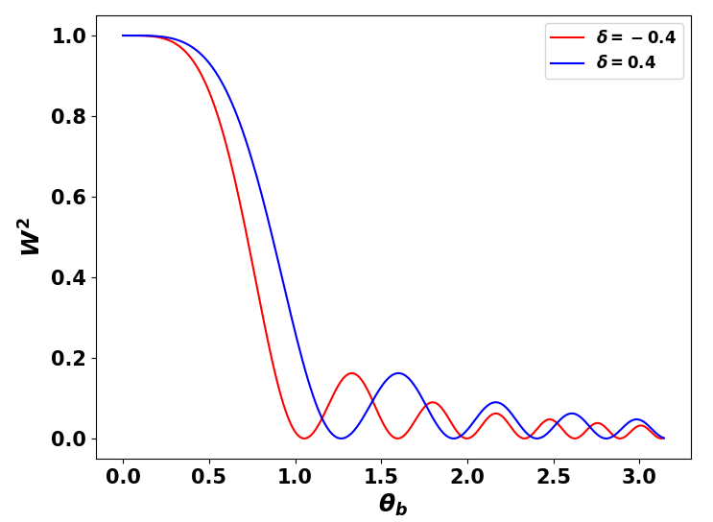

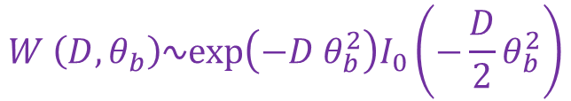
Trapped electronS contribution
Z
ζ
Average over energy $ε$=$\frac{E}{T}$
θ_{b}
θ
Average over bouncing angle
R
$$Ξ_{e}∝\int_{0}^{∞}{dε\int_{0}^{π}{dθ_{b}}\frac{1}{ω_{de}(θ_{b})ε−ω}}W^{2}\left(θ_{b}\right)$$
Precession frequency $ω_{de}$
Frequency of the perturbed electrostatic potential
BALLOONING
$${δΦ}_{n≠0}$$
$W :$Finite Mode Width effects (FMW) (= ballooning)
$$W \left(D,θ_{b}\right)∿exp\left(−D θ_{b}^{2}\right)I_{0}\left(−\frac{D}{2}θ_{b}^{2}\right)$$
Free parameter
5

Slide 16
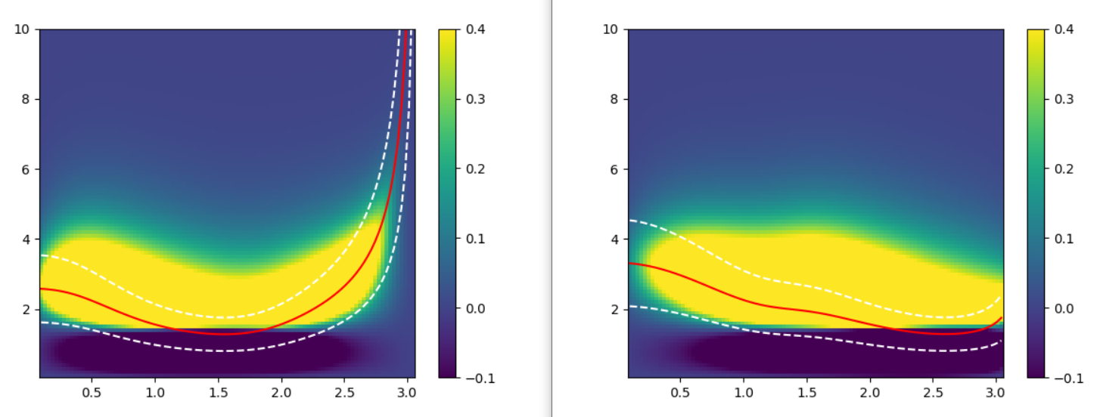




NT less stable THAN PT without BALLOONING
WITHOUT BALLOONING
Power $e^{−}$
δφ
Energy
Region with most
of the energy transfer
Resonance
$$ω_{de}ε=ω$$
Deeply trapped
Barely trapped
$$θ_{b}$$
Z
Z
ζ
Energy $e^{−}$
ζ
φ
θ_{b}
θ
θ_{b}
θ
R
R
6

Slide 17
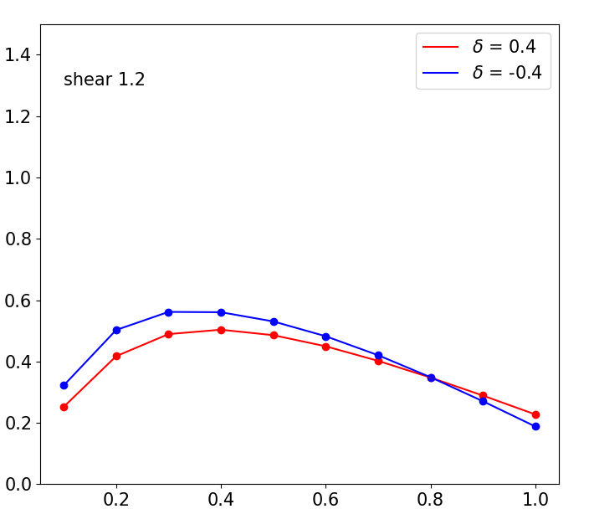


NT less stable THAN PT without BALLOONING
WITHOUT BALLOONING
Power $e^{−}$
δφ
Energy
Region with most
of the energy transfer
γR/$c_{s}$
NT
PT
Resonance
$$ω_{de}ε=ω$$
Deeply trapped
Barely trapped
$$k_{y}ρ_{s}$$
$$θ_{b}$$
Z
Z
ζ
Energy distributed between deeply and barely trapped electrons→ NT less stable than PT
Energy $e^{−}$
ζ
φ
θ_{b}
θ
θ_{b}
θ
R
R
6

Slide 18
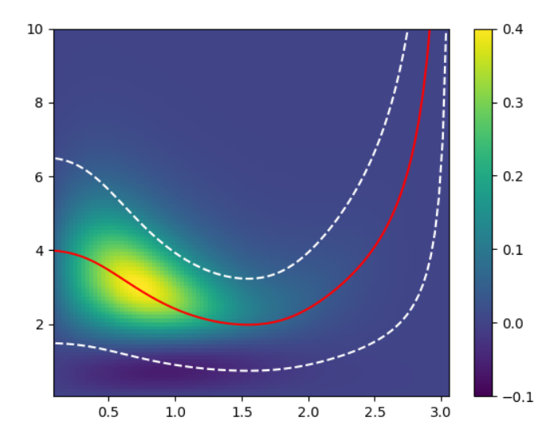



NT MORE stable THAN PT with BALLOONING
WITH BALLOONING
Power $e^{−}$
δφ
Energy
Region with most
of the energy transfer
Resonance
$$ω_{de}ε=ω$$
Deeply trapped
$$θ_{b}$$
Barely trapped
Z
Z
ζ
ζ
θ_{b}
θ
θ_{b}
θ
R
R
7

Slide 19
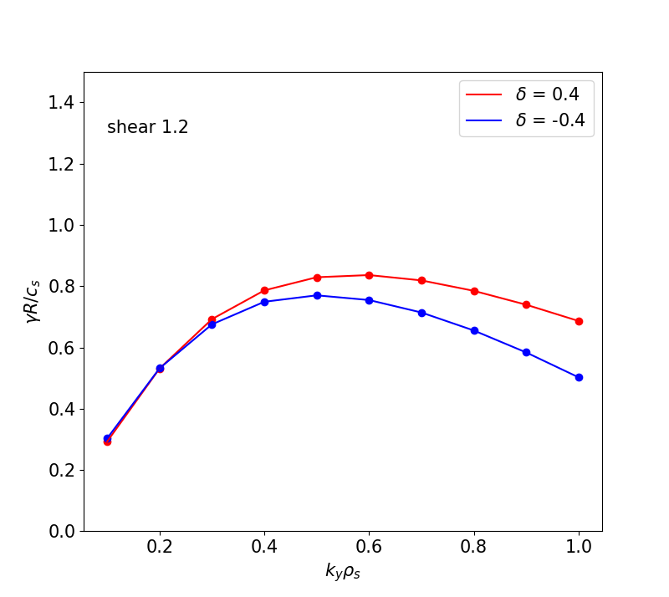


NT MORE stable THAN PT with BALLOONING
WITH BALLOONING
Power $e^{−}$
δφ
PT
Energy
Region with most
of the energy transfer
γR/$c_{s}$
NT
Resonance
$$ω_{de}ε=ω$$
Deeply trapped
$$θ_{b}$$
Barely trapped
$$k_{y}ρ_{s}$$
Z
Z
ζ
ζ
Energy localized on deeply trapped electrons → NT more stable than PT
θ_{b}
θ
θ_{b}
θ
R
R
7

Slide 20
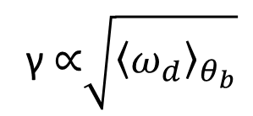
PHYSICAL INTERPRETATION
γ ∝$\sqrt{{\left\langle ω_{d}\right\rangle }_{θ_{b}}}$
far from threshold : INTERCHANGE
8

Slide 21
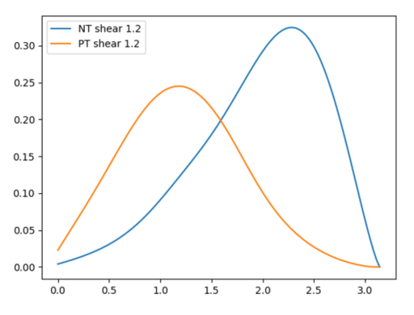


PHYSICAL INTERPRETATION
γ ∝$\sqrt{{\left\langle ω_{d}\right\rangle }_{θ_{b}}}$
far from threshold : INTERCHANGE
WITHOUT BALLOONING
POSITIVE TRIANGULARITY
NEGATIVE TRIANGULARITY
$$ω_{d}$$
Deeply trapped
Barely trapped
$$θ_{b}$$
Z
Z
ζ
ζ
θ
θ
θ_{b}
θ_{b}
R
R
8

Slide 22
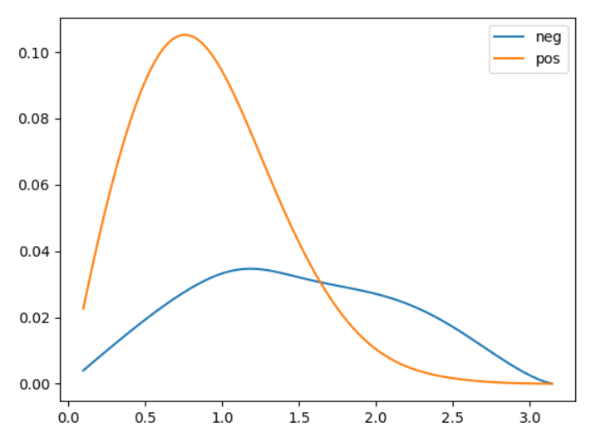


PHYSICAL INTERPRETATION
γ ∝$\sqrt{{\left\langle ω_{d}\right\rangle }_{θ_{b}}}$
far from threshold : INTERCHANGE
WITHOUT BALLOONING
WITH BALLOONING
POSITIVE TRIANGULARITY
POSITIVE TRIANGULARITY
NEGATIVE TRIANGULARITY
$ω_{d}⋅$ $W^{2}$ ($θ_{b}$)
$$ω_{d}$$
NEGATIVE TRIANGULARITY
Deeply trapped
Barely trapped
$$θ_{b}$$
$$θ_{b}$$
Z
Z
ζ
BALLOONING enhances response of deeply trapped electrons
ζ
θ
θ
θ_{b}
θ_{b}
R
Responsible of NT stabilization wrt PT
R
8

Slide 23
NON LINEAR ANALYSIS

Slide 24
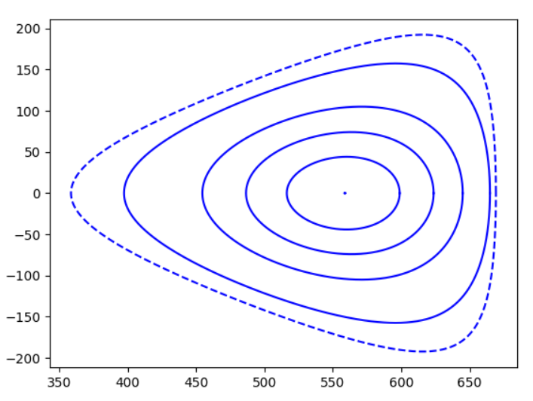
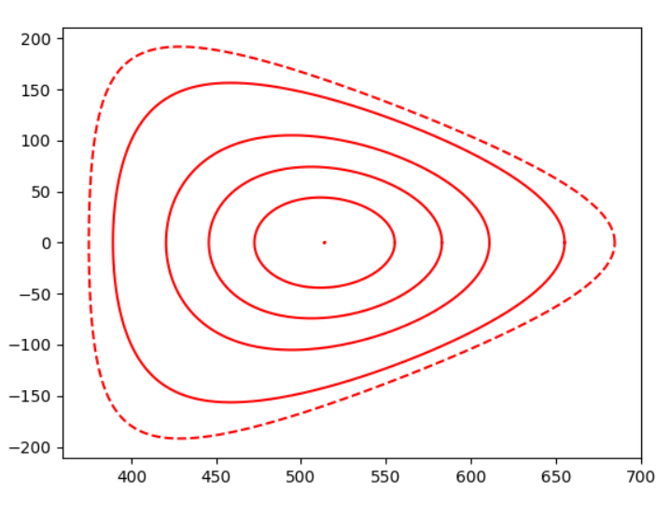






TCV-LIKE TEM SCENARIO
Flux driven with no source
Buffer region between r/a = 1. and r/a = 1.1
Experimental-like profiles [Di Giannatale22]
TEMs dominant
Temperature gradient driven
$δ_{LCFS}=−0.55$, $k_{LCFS}=1.2$
$δ_{LCFS}=0.55$, $k_{LCFS}=1.2$
LCFS: r/a=1
LCFS: r/a=1
Z/$ρ_{0}$
End of simulation domain: r/a = 1.1
End of simulation domain: r/a = 1.1
R /$ρ_{0}$
R /$ρ_{0}$
$ρ_{∗}=1/150$, aspect ratio = 3.5, $m_{i}$/ $m_{e}$= 100
9

Slide 25
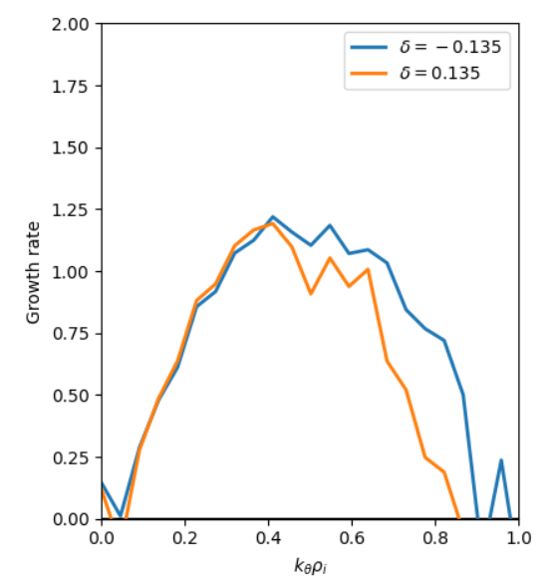
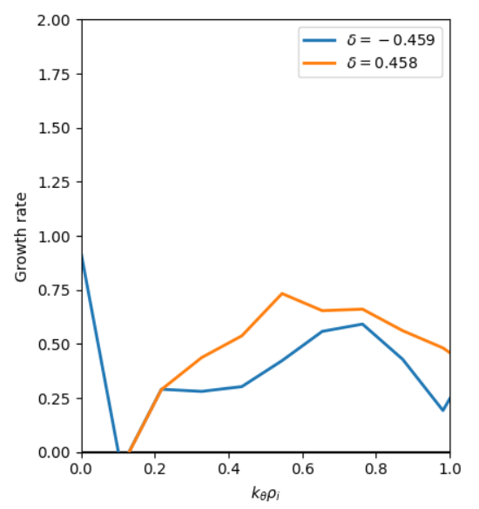



LINEARLY NOT A CLEAR PICTURE
r/a = 0.5
r/a = 0.9
$$γR$$
$$k_{ϴ}ρ_{i}$$
$$k_{ϴ}ρ_{i}$$
Linear stabilization only observed at the edge
9

Slide 26
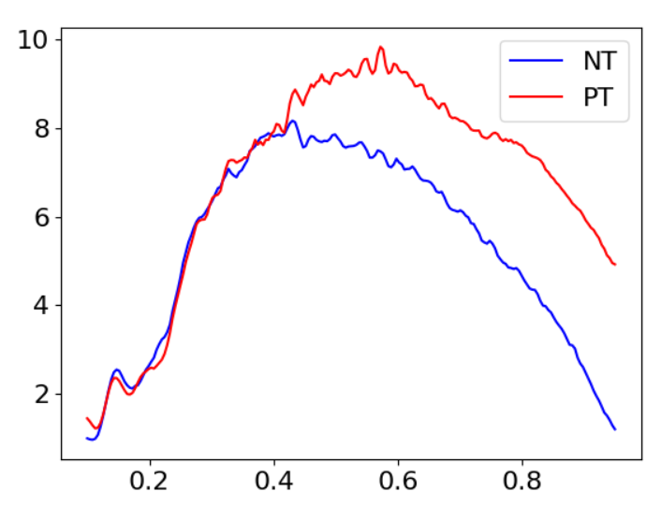
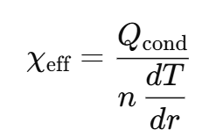
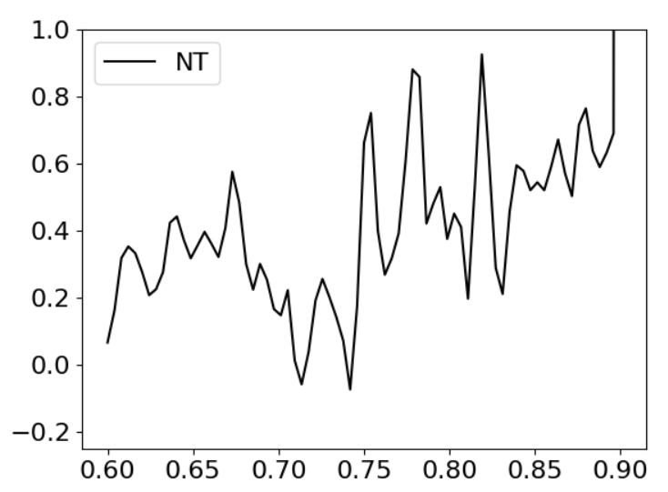

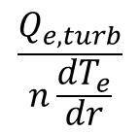

HEAT TRANSPORT AT THE EDGE LOWER FOR NT
$$Q_{e, turb}$$
r/a
$$\frac{Q_{e,turb}}{n\frac{dT_{e}}{dr}}$$
-
Evolution of profiles
10
r/a

Slide 27
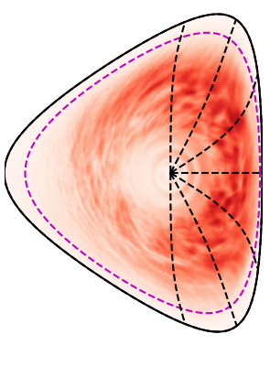

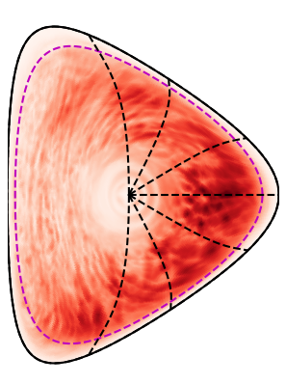

HEAT TRANSPORT AT THE EDGE LOWER FOR NT
$${<δϕ>}_{t, rms}$$
$$Q_{e, turb}$$
0.08
0.06
r/a
0.04
$$\frac{Q_{e,turb}}{n\frac{dT_{e}}{dr}}$$
-
Evolution of profiles
0.02
0.
Lower fluctuations
10
r/a

Slide 28
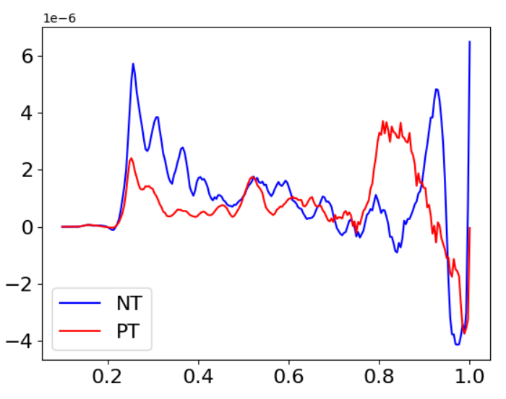


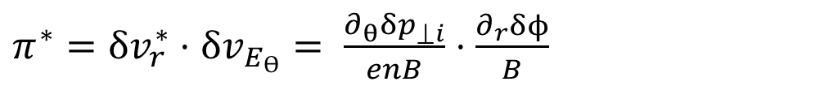

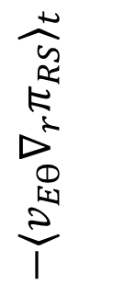

REYNOLDS ZONAL FLOW DRIVE HIGHER IN NT
$$\frac{1}{2}\frac{∂}{∂t}v_{Eϴ}^{2}=−v_{Eϴ}∇_{r}π_{RS}+ …$$
DIAMAGNETIC
${π^{∗}=δv}_{r}^{∗}⋅{δv}_{E_{ϴ}}= \frac{∂_{θ}{δp}_{⟘i}}{enB}⋅$ $\frac{∂_{r}δϕ}{B}$
Damping
Drive
$π_{RS}$=
$$−\frac{E_{r}}{B}$$
ELECTRIC
${π=δv}_{E_{r}}⋅δv_{E_{ϴ}}$= $\frac{∂_{θ}δϕ}{B}⋅$ $\frac{∂_{r}δϕ}{B}$
[Sarazin21]
$$−{{⟨v}_{Eϴ}∇_{r}π_{RS}〉}_{t}$$
r/a
12

Slide 29
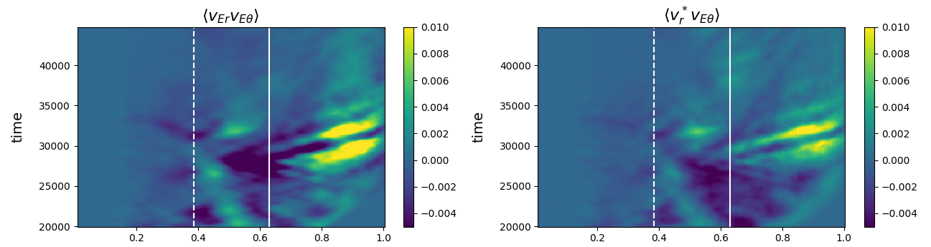
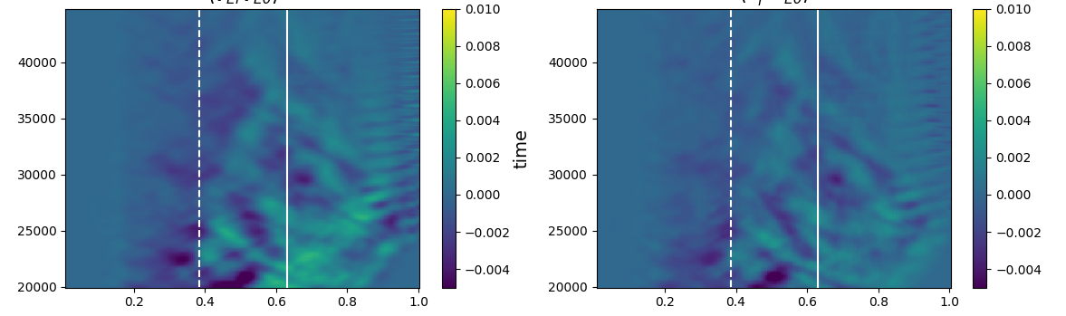



REYNOLD STRESSES:
SIMILAR ORDER OF MAGNITUDE FOR ELECTRIC AND DIAMAGNETIC COMPONENTS
$${π=δv}_{E_{r}}⋅δv_{E_{ϴ}}$$
$${π^{∗}=δv}_{r}^{∗}⋅{δv}_{E_{ϴ}}$$
ELECTRIC
DIAMAGNETIC
POSITIVE TRIANGULARITY
$ω_{c0}$t
r/a
r/a
$${π=δv}_{E_{r}}⋅δv_{E_{ϴ}}$$
$${π^{∗}=δv}_{r}^{∗}⋅{δv}_{E_{ϴ}}$$
ELECTRIC
DIAMAGNETIC
NEGATIVE TRIANGULARITY
$ω_{c0}$t
r/a
r/a
13

Slide 30
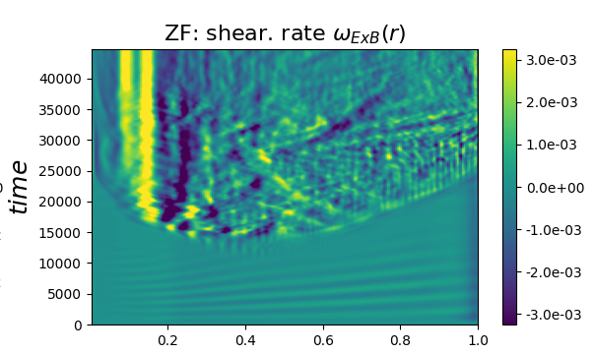
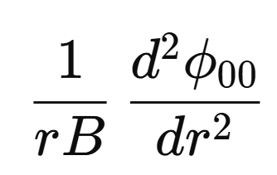
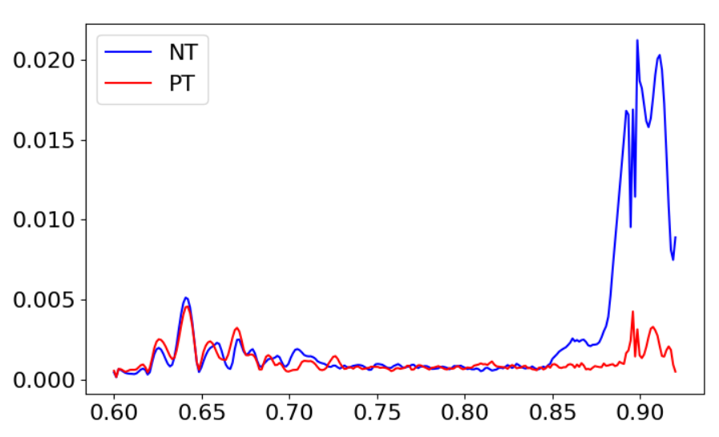
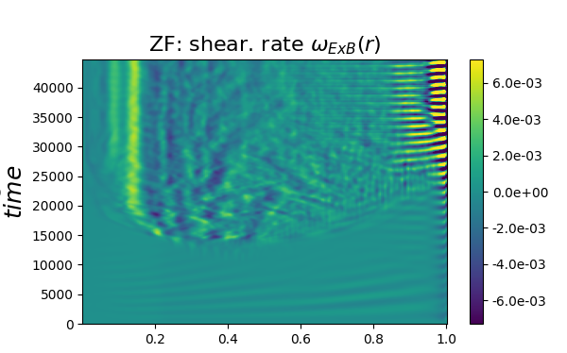


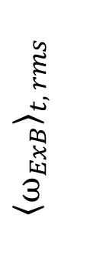


ZONAL FLOW MORE ACTIVE IN NT
POSITIVE TRIANGULARITY
$ω_{c0}$t
$$ω_{ExB}$$
r/a
$${⟨ω_{ExB}〉}_{t, rms}$$
NEGATIVE TRIANGULARITY
$ω_{c0}$t
$$ω_{ExB}$$
r/a
14
r/a

Slide 31

CONCLUSIONS
Ballooning property of the instability is crucial for linear stabilisation of TEM in NT compared with PT
Even if $γ_{NT}< γ_{PT}$, differences are small
Linear effect localised at the edge
Non linear simulations: much clearer difference on fluxes than growth rates
Differences in the Zonal Flow activity are observed
PERSPECTIVES
More realistic boundary conditions: limiter with kinetic electrons
More analysis on ZF activity
Collisionality and mass ratio scan
15

Slide 32
BACK-UP

Slide 33
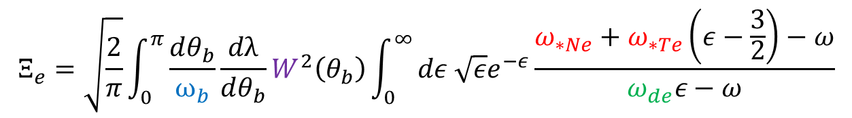

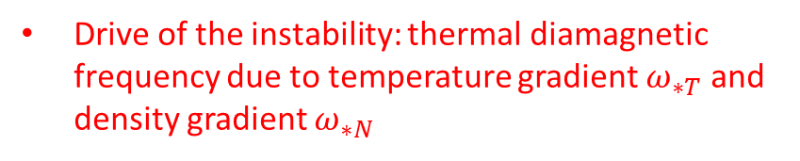


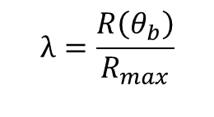
Trapped electron contribution
Drive of the instability: thermal diamagnetic frequency due to temperature gradient $ω_{∗T}$ and density gradient $ω_{∗N}$
$$λ=\frac{R\left(θ_{b}\right)}{R_{max}}$$
Average over energy $ε$=$\frac{E}{T}$
$$Ξ_{e}=\sqrt{\frac{2}{π}}\int_{0}^{π}{\frac{dθ_{b}}{ω_{b}}}\frac{dλ}{dθ_{b}}W^{2}\left(θ_{b}\right)\int_{0}^{∞}{dε \sqrt{ε}e^{−ε}\frac{ω_{∗Ne}+ω_{∗Te}\left(ε−\frac{3}{2}\right)−ω}{ω_{de}ε−ω}}$$
Precession frequency $ω_{de}$
Bounce frequency $ω_{b}$

Slide 34
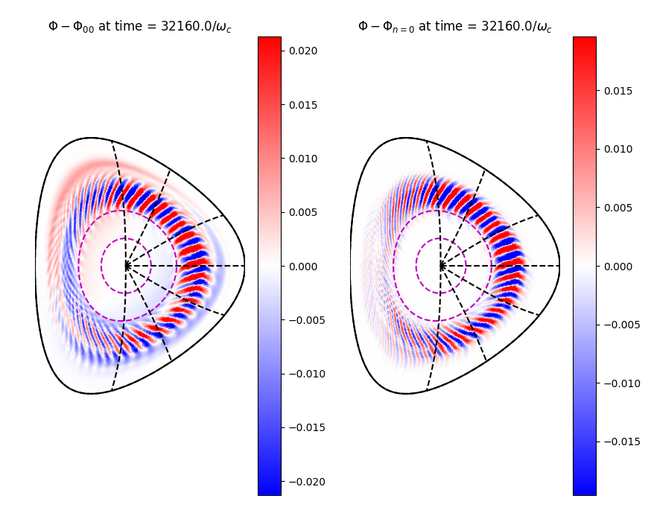


Trapped electron contribution
Drive of the instability: thermal diamagnetic frequency due to temperature gradient $ω_{∗T}$ and density gradient $ω_{∗N}$
$$λ=\frac{R\left(θ_{b}\right)}{R_{max}}$$
Average over energy $ε$=$\frac{E}{T}$
$$Ξ_{e}=\sqrt{\frac{2}{π}}\int_{0}^{π}{\frac{dθ_{b}}{ω_{b}}}\frac{dλ}{dθ_{b}}W^{2}\left(θ_{b}\right)\int_{0}^{∞}{dε \sqrt{ε}e^{−ε}\frac{ω_{∗Ne}+ω_{∗Te}\left(ε−\frac{3}{2}\right)−ω}{ω_{de}ε−ω}}$$
Precession frequency $ω_{de}$
Bounce frequency $ω_{b}$
$${δΦ}_{n≠0}$$
BALLOONING
$W :$Finite Mode Width effects (FMW) (= ballooning)
$$W \left(D,θ_{b}\right)∿exp\left(−D θ_{b}^{2}\right)I_{0}\left(−\frac{D}{2}θ_{b}^{2}\right)$$
Free parameter

Slide 35
Trapped electron contribution
Drive of the instability: thermal diamagnetic frequency due to temperature gradient $ω_{∗T}$ and density gradient $ω_{∗N}$
$$λ=\frac{R\left(θ_{b}\right)}{R_{max}}$$
Average over energy $ε$=$\frac{E}{T}$
$$Ξ_{e}=\sqrt{\frac{2}{π}}\int_{0}^{π}{\frac{dθ_{b}}{ω_{b}}}\frac{dλ}{dθ_{b}}W^{2}\left(θ_{b}\right)\int_{0}^{∞}{dε \sqrt{ε}e^{−ε}\frac{ω_{∗Ne}+ω_{∗Te}\left(ε−\frac{3}{2}\right)−ω}{ω_{de}ε−ω}}$$
Precession frequency $ω_{de}$
Functions of shaping
Bounce frequency $ω_{b}$
$${δΦ}_{n≠0}$$
BALLOONING
$W :$Finite Mode Width effects (FMW) (= ballooning)
$$W \left(D,θ_{b}\right)∿exp\left(−D θ_{b}^{2}\right)I_{0}\left(−\frac{D}{2}θ_{b}^{2}\right)$$
Free parameter

Slide 36



Passing ion contribution
$$Ξ_{i}=\int_{−π}^{π}{\frac{dθ}{2π}}{\left|Φ\right|}^{2}\left(θ\right)\int{ d^{3}v}{\left(\frac{m_{i}}{2πT_{i}}\right)}^{3/2}e^{−ε}\frac{ω_{∗Ni}+ω_{∗Ti}\left(ε−\frac{3}{2}\right) −ω}{ω}J_{0}^{2}(k_{⟂}\left(θ\right)ρ_{s} \frac{v_{⟂}}{v_{T}})$$
Finite Larmor Radius effects (FLR)
No ions resonance
$${(k}_{∥}v_{∥}, ω_{di}≪ω)$$
Larmor radius
14

Slide 37



Passing ion contribution
$$Ξ_{i}=\int_{−π}^{π}{\frac{dθ}{2π}}{\left|Φ\right|}^{2}\left(θ\right)\int{ d^{3}v}{\left(\frac{m_{i}}{2πT_{i}}\right)}^{3/2}e^{−ε}\frac{ω_{∗Ni}+ω_{∗Ti}\left(ε−\frac{3}{2}\right) −ω}{ω}J_{0}^{2}(k_{⟂}\left(θ\right)ρ_{s} \frac{v_{⟂}}{v_{T}})$$
Finite Larmor Radius effects (FLR)
No ions resonance
$${(k}_{∥}v_{∥}, ω_{di}≪ω)$$
Larmor radius
$k_{⟂}=k_{θ}\frac{r_{s}}{a_{s}}$ $\sqrt{1+\frac{a_{s}^{4}}{r_{s}^{4}}s^{2}θ^{2}}$
$a_{s}$ = ${dl}/{dθ}$
Function of shaping
FLR effects:
are stabilising for the TEM instability
increase with $k_{⟂}$
increase with the magnetic shear s
14

Slide 38






BENCH-MARK WITH GENE
shear = 0.8
Gyrokinetic results (GENE)[Merlo 23]
shear = 2.0
Theoretical results
15

Slide 39

BENCH-MARK WITH GENE
Gyrokinetic results (GENE)[Merlo 23]
shear
0.4
0.8
Theoretical results
1.2
2.0
Role of passing electrons dynamics
Inverse trend
Role of trapped parallel electrons dynamics

Slide 40
BENCH-MARK WITH GENE
Gyrokinetic results (GENE)[Merlo 23]
Magnetic shear
0.4
0.8
Theoretical results
1.2
2.0
PT more unstable than NT
Good qualitative agreement
stabilizing effect of shear

Slide 41



MICROINSTABILITIES
Turbulence driven by instabilities at cm and mm scale
INTERCHANGE TYPE
Magnetic field and pressure gradients
Stronger at low field side (ballooning)
Introducing vd?
phi
[Merlo’s thesis]

Slide 42








2. FINITE LARMOR RADIUS STABILIZING EFFECT PROPTO SHEAR
NO FLR effects
FLR effects
size
s=$\frac{r}{q}\frac{dq}{dr}=0.4$
$$\frac{\text{γ}R}{c_{s}}$$
$$\frac{\text{γ}R}{c_{s}}$$
Effect kperp with magnetic shear is a consequence of tilting: paper N fedorczak.
s=$\frac{r}{q}\frac{dq}{dr}=1.$2
$$\frac{\text{γ}R}{c_{s}}$$
$$\frac{\text{γ}R}{c_{s}}$$
Stabilizing effect of shear due to FLR

Slide 43





FLR stabilsation is key for small structures & large shear
NO FLR effects, D=1
FLR effects, D=1
s=1.2
$$\frac{\text{γ}R}{c_{s}}$$
$$\frac{\text{γ}R}{c_{s}}$$
Reminder, FLR effects:
are stabilising for the TEM instability
increase with $k_{⟂}$
increase with the magnetic shear s
$$k_{y}ρ_{s}$$
$$k_{y}ρ_{s}$$
$$\frac{\text{γ}R}{c_{s}}$$
$$\frac{\text{γ}R}{c_{s}}$$
s=2.0
$$k_{y}ρ_{s}$$
$$k_{y}ρ_{s}$$

Slide 44



Trapped fraction NT vS PT
Higher aspect ratio : more stable cause ft smaller
Circular approximation

Slide 45



PARAMETERS SCAN for $k_{y}ρ_{s}$= 0.3
Growth rates
Growth rates
stabilizing
δ
δ
shear
Inverse aspect ratio = a/R
Guide for choosing Gysela simulations parameters
Physical understanding of trends in the parameters space
The reduced model is:
21

Slide 46



Interpretation: Competition between two mecanisms
ballooning+precession frequency
FLR
In the limit of large gradients
γ ∝$\sqrt{{\left\langle \overline{Ω_{d}}\right\rangle }_{λ}}$
Explains the impact of triangularity on growth rate
If s↑ then $k_{⟂}$ $=k_{θ}\frac{r_{s}}{a_{s}}$ $\sqrt{1+\frac{a_{s}^{4}}{r_{s}^{4}}s^{2}θ^{2}}$ ↑ then $J_{0}^{2}(k_{⟂}ρ_{s} \frac{v_{⟂}}{v_{T}})$↓ then $Ξ_{i}$∝ $J_{0}^{2}(k_{⟂}ρ_{s} \frac{v_{⟂}}{v_{T}})$ ↓ then γ ↓

Slide 47




$${〈W^{2}Ω_{d}〉}_{θ_{b}}$$
$$δ$$

Slide 48












components of gamma: shear scan for TRAPPED ELECTRONS CURVATURE DYNAMICS
S = 0.4
S = 0.8
There’s the effect of the shear in the electron term already
$$γR/c_{s}$$
$$γR/c_{s}$$
$$k_{θ}ρ_{i}$$
$$k_{θ}ρ_{i}$$
Trapped electrons curvature dynamics does not explain reversed trend at s=0.4
S = 1.2
S = 2
$$γR/c_{s}$$
$$γR/c_{s}$$
$$k_{θ}ρ_{i}$$
$$k_{θ}ρ_{i}$$

Slide 49







Inversed trend for s = 0.4
It is explained through parallel dynamics of trapped electrons + passing electrons dynamics
All other electrons dynamics
$$γR/c_{s}$$
Trapped electrons curvature dynamics
$$k_{y}ρ_{s}$$
$$γR/c_{s}$$
$$k_{y}ρ_{s}$$

Slide 50




Energy exchange

Slide 51


W function

Slide 52





THE MODE STRUCTURE
The mode structure comes mostly from ions
BUT the Lagrangian approach does not allow to compute the mode structure
Ansatz: gaussian shape of the ES potential wrt θ: exp(-D$θ^{2}$)
fluid limit of the gyrokinetic dispersion relation
$${\frac{k_{∥}v_{∥}}{ω}≪1}_{}$$
$$k_{⟂}ρ_{i}≪1$$
$$\frac{ω_{di}}{ω}≪1$$
TAYLOR
EXPANSION
D ⁓ -i $\frac{a_{s}}{r_{s}}sqω{(k_{θ}ρ_{i})}^{2}$

Slide 53









COMPARISON TO GYSELA TEMs dominated cases
shear = 0.9
shear = 0.5
Gysela
Gysela
analytical model
analytical model
$$γ/{ω_{dT}}$$
$$k_{θ}ρ_{i}$$
$$k_{θ}ρ_{i}$$
$$k_{θ}ρ_{i}$$
$$k_{θ}ρ_{i}$$
Good comparison with Gysela
Main difference: in Gysela more stable at high $k_{θ}ρ_{i}$: probably due to ions contribution (still to be confirmed)

