Slide 1
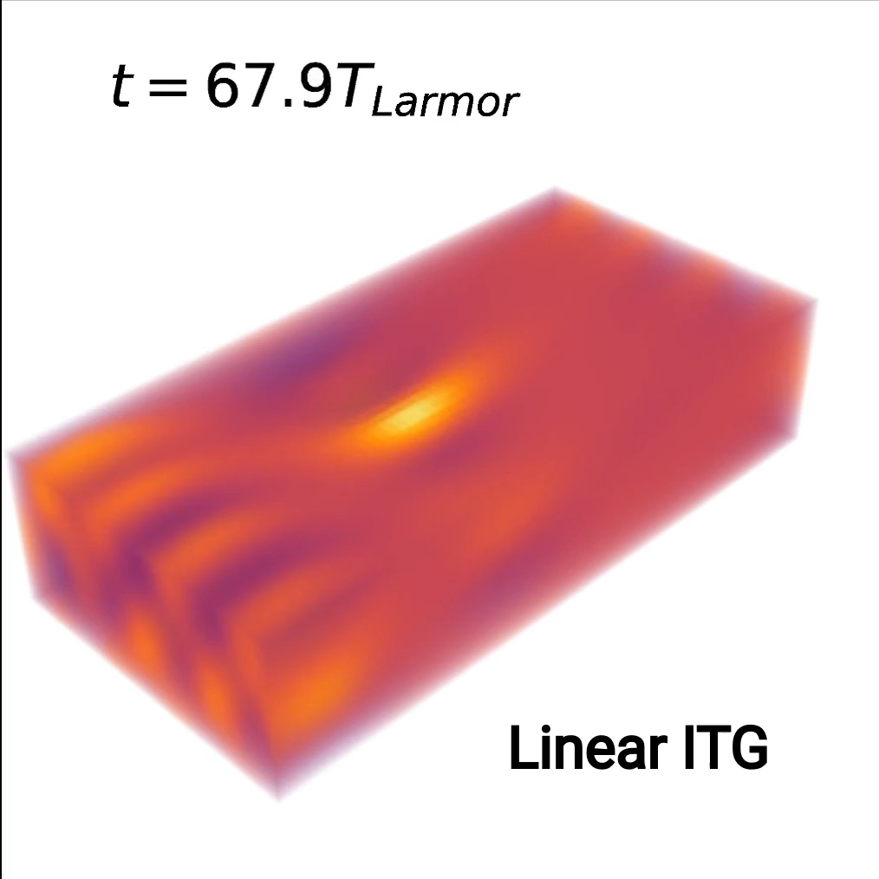
Non-gyrokinetic high-frequency mode instability for tokamak edge like gradients
K. Hallatschek, M. Raeth
BSL6D simulation of full 6D
ion distribution function of competing slab ITG and IBW turbulence
(density fluctuations)
Analytic Ion Bernstein wave (IBW) dispersion
How small temperature gradients can make IBW (and slab ITG) unstable.
Some exact threshold calculations
PRL 195101, 2024

Slide 2
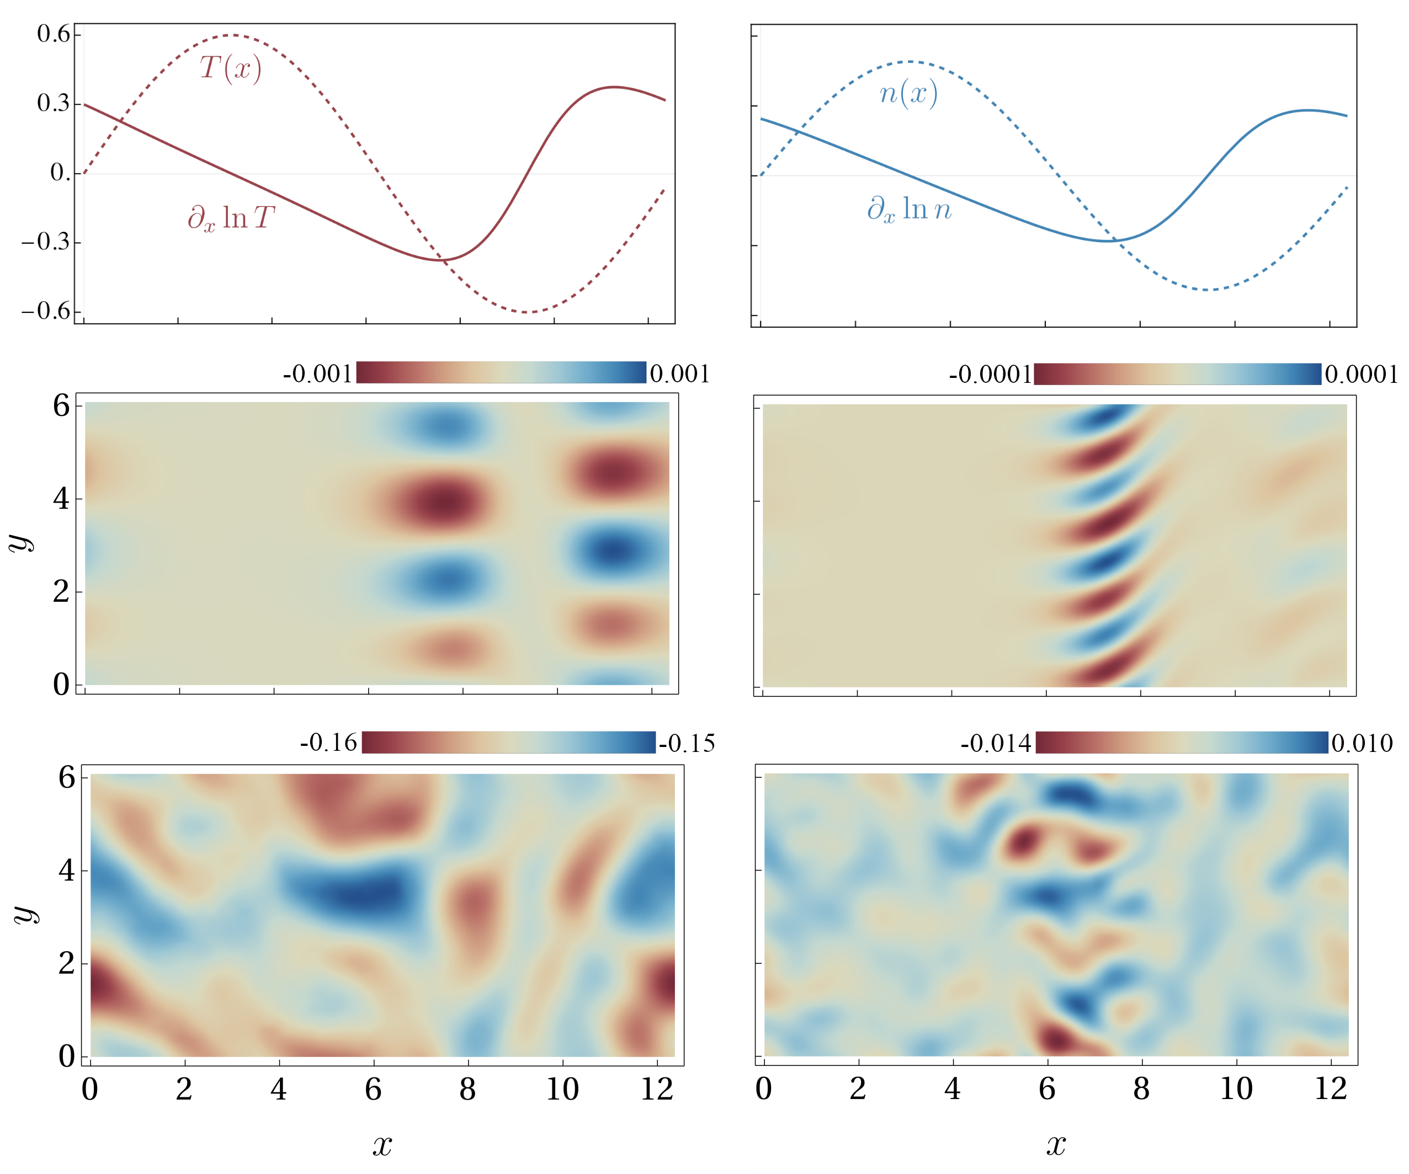
Non-gyrokinetic high-frequency mode instability for tokamak edge like gradients
K. Hallatschek, M. Raeth
PRL 195101, 2024
BSL6D simulation of
6D ion distribution of competing ITG and IBW turbulence
(density fluctuations)
Analytic Ion Bernstein wave (IBW) dispersion
How small temperature gradients can make IBW (and slab ITG) unstable.
Some exact threshold calculations
gyrokinetic ñ
non-gyrokinetic ñ

Slide 3


muss schon etwas schnell einsteigen, und versuche dann den “Gist” zu sagen
slide 1
Analytic IBW dispersion, crash course:
Linearized ion Vlasov equation:
background Maxwellian:
(set n=T=m=1 later, but need T derivative)
with non-adiabatic distribution function :
simple advection
along helices
source term
famous
“Gordeyev function”
integrate source along helices → Fourier transformed non-adiabatic density:
plasma dispersion function
(Landau damping parallel z)
use Bessel functions to represent ,

Slide 4



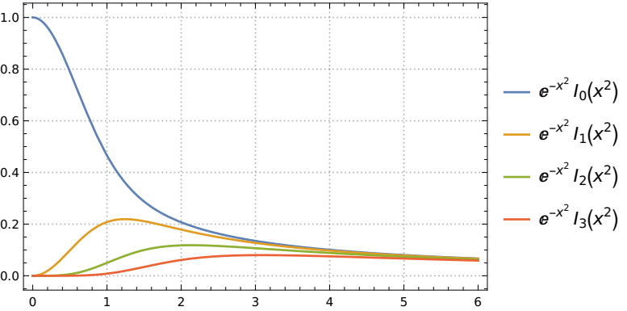
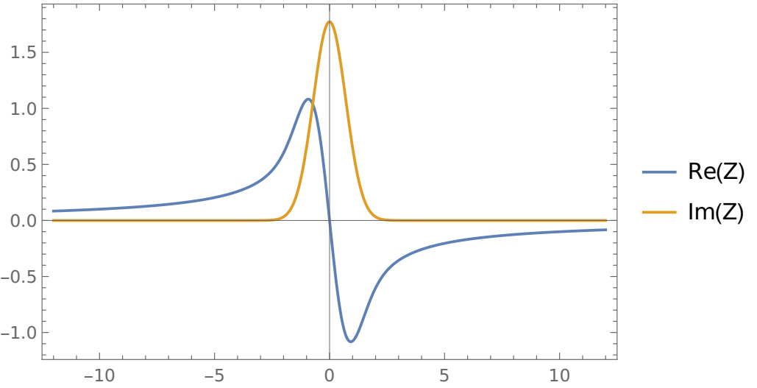
slide 1.5
filters certain perpendicular wavenumbers depending on p
represents parallel ion resonances (real part) and Landau damping (imaginary part)

Slide 5

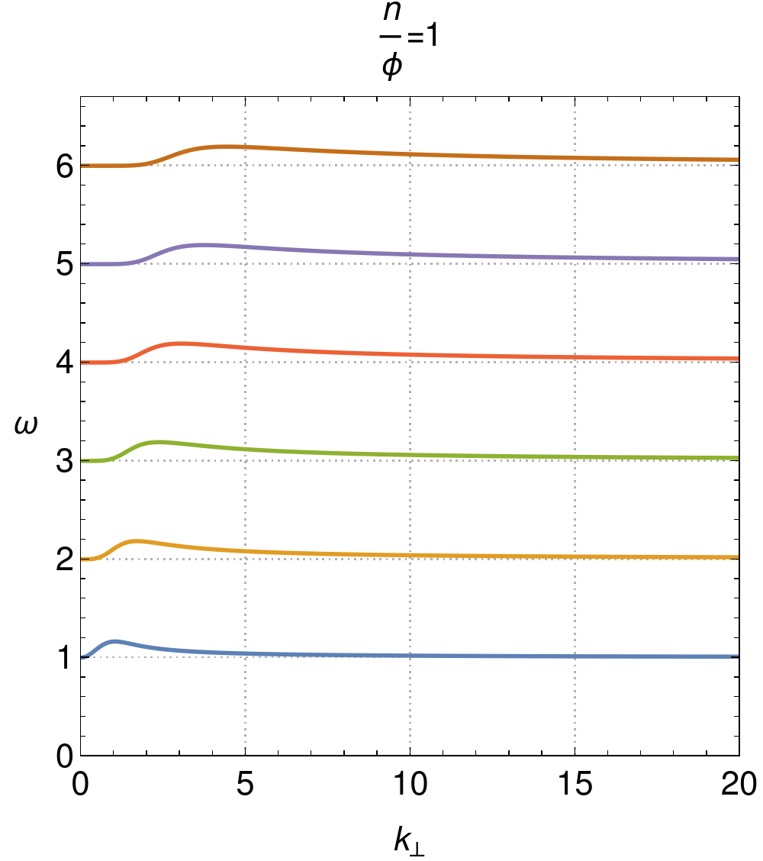
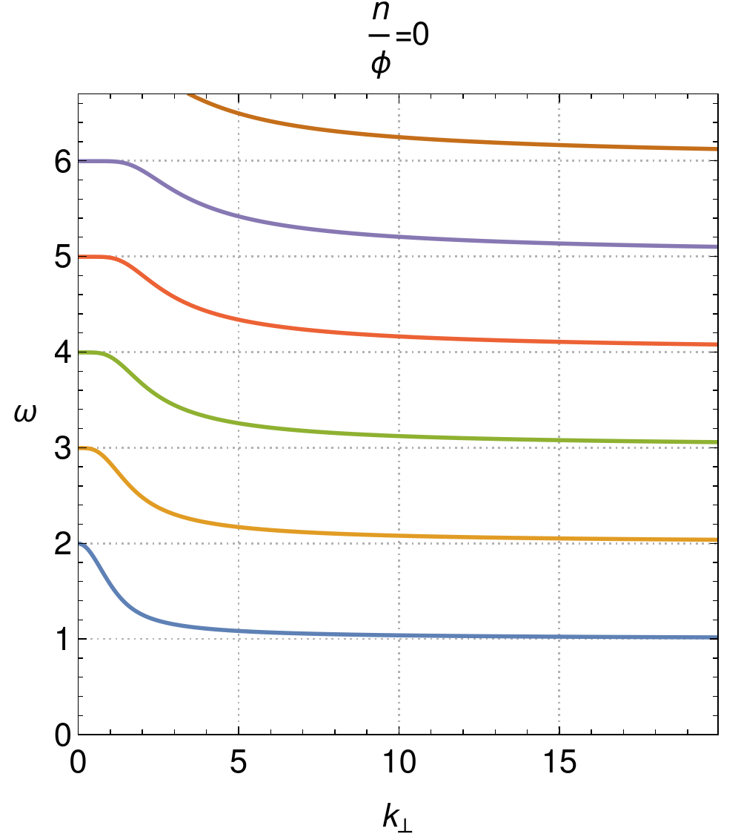

slide 2
Standard ion Bernstein waves :
Dispersion relation:
usually one p resonance balances constant terms or dominant p=0 term
no imaginary part in
for
→only high gradients cause
instability ( )
adiabatic electrons
fixed charge background
In the following we always use adiabatic electrons.
All chi are negative for small frequencies since the charges want to cancel the potential.

Slide 6



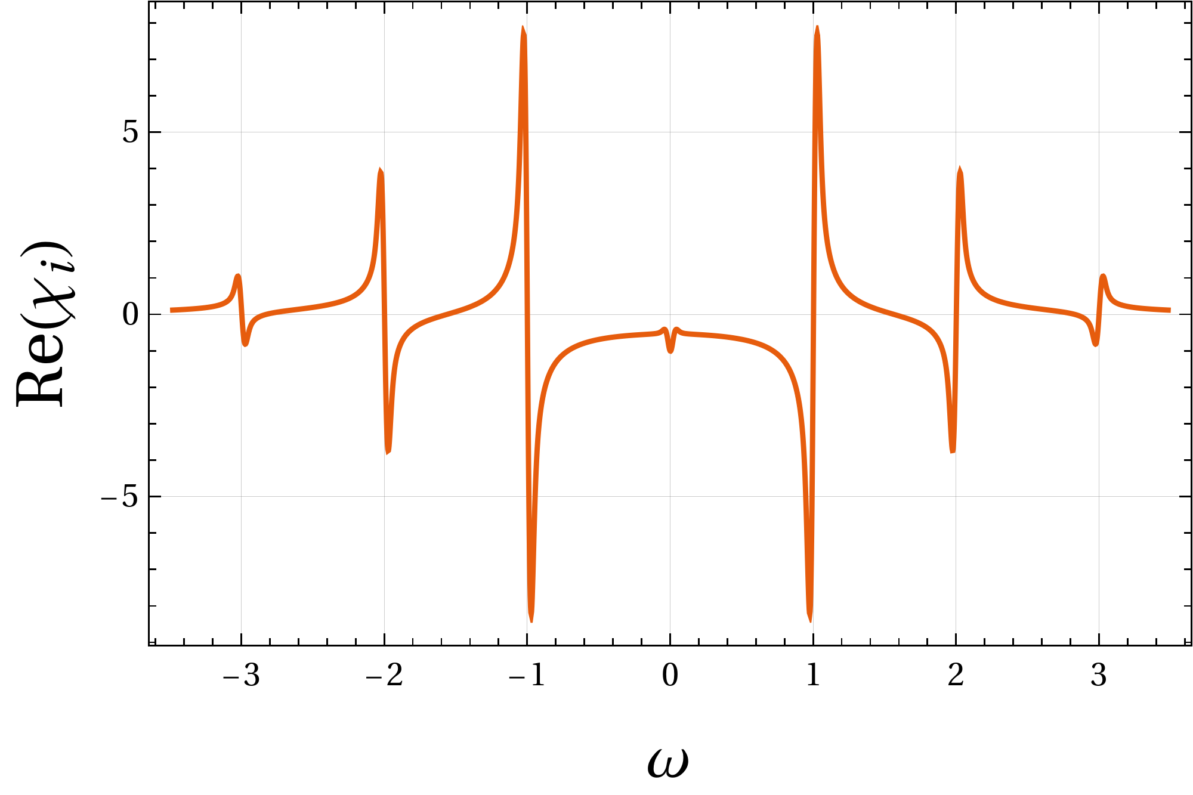
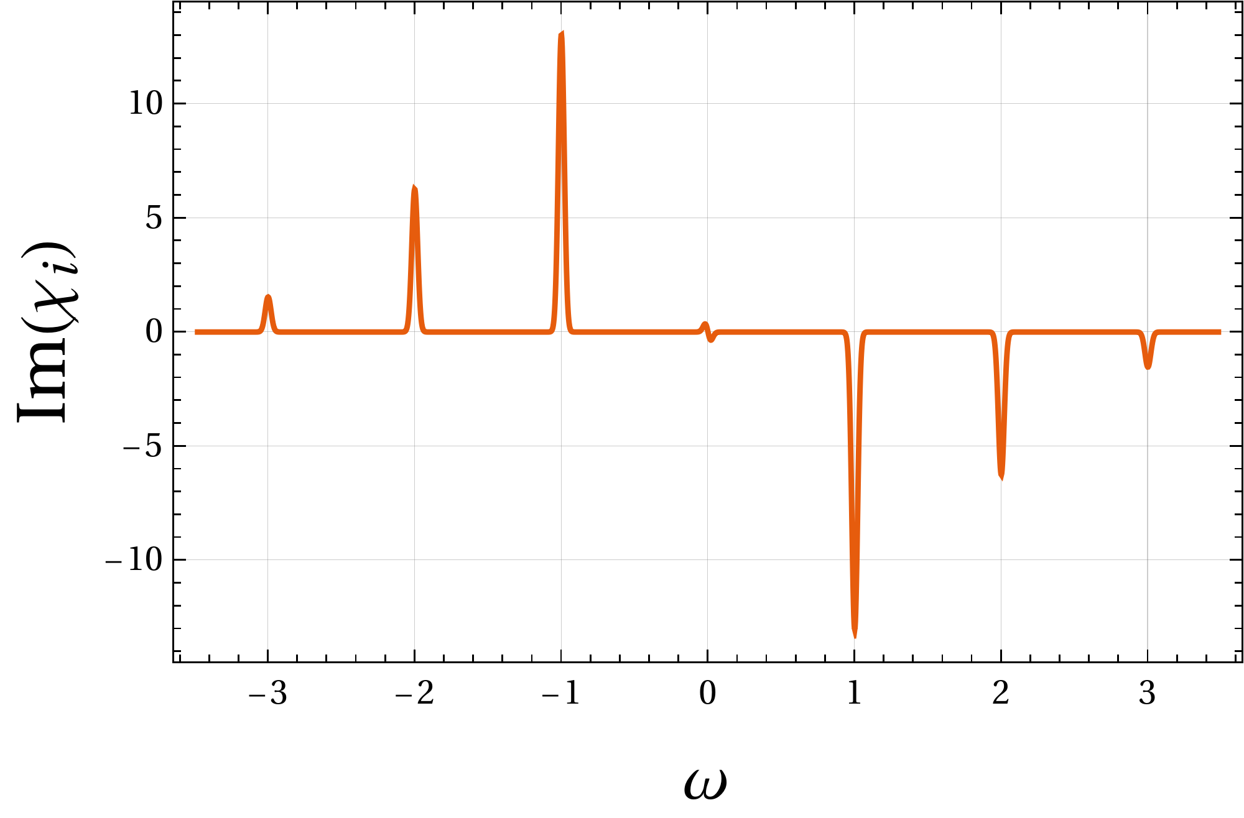
slide 3
Gaussian from resonant ion density
IBWs are damped for
for , the plasma dispersion function Z enters:
imaginary part always positive (with flat Maxwell equilibrium) for
derivative (practically) everywhere positive for
all possible modes are damped, i.e., , since the dispersion relation enforces
(argument analogous for )
(~ Landau damping)

Slide 7





slide 4
additional source term to Vlasov equation
Gradients:
normally dominates
for IBW
dominates for large v
Imaginary part for just one resonance p<0 (exact calculation):
can always make for small gradients if and large enough
for this, need small since , keep constant
Therefore possibility to flip sign of imaginary response:

Slide 8
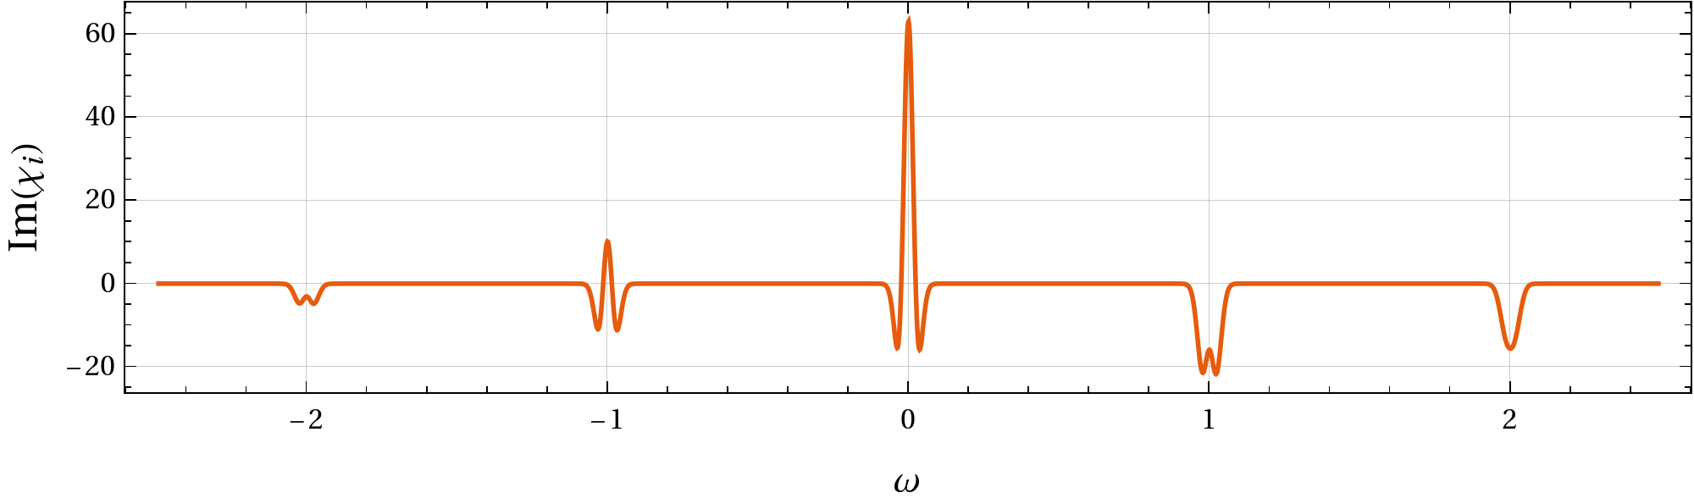

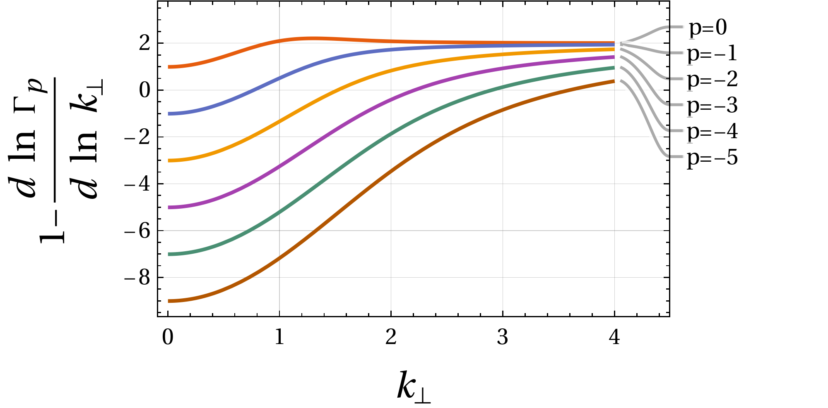


slide 5
Instability condition:
for
plot of imaginary chi near resonance
(large gradients for visibility)
Taylor expansion of invalid if too large and more detailed analysis (TLDR):
there needs to exist a , so that , then we have instability
i.e., when , instability if
Das sollte man in die Conclusions verbannen. Kann ich hier eh nicht richtig motivieren.
Hier sollte einfach nur ein grundsätzliches Beispiel kommen.
plot of kt prefactor
only valid for small gradients, but arbitrary k and
p=0: exact gyrokinetic ITG threshold condition (gyrokinetics assumes small gradients)

Slide 9
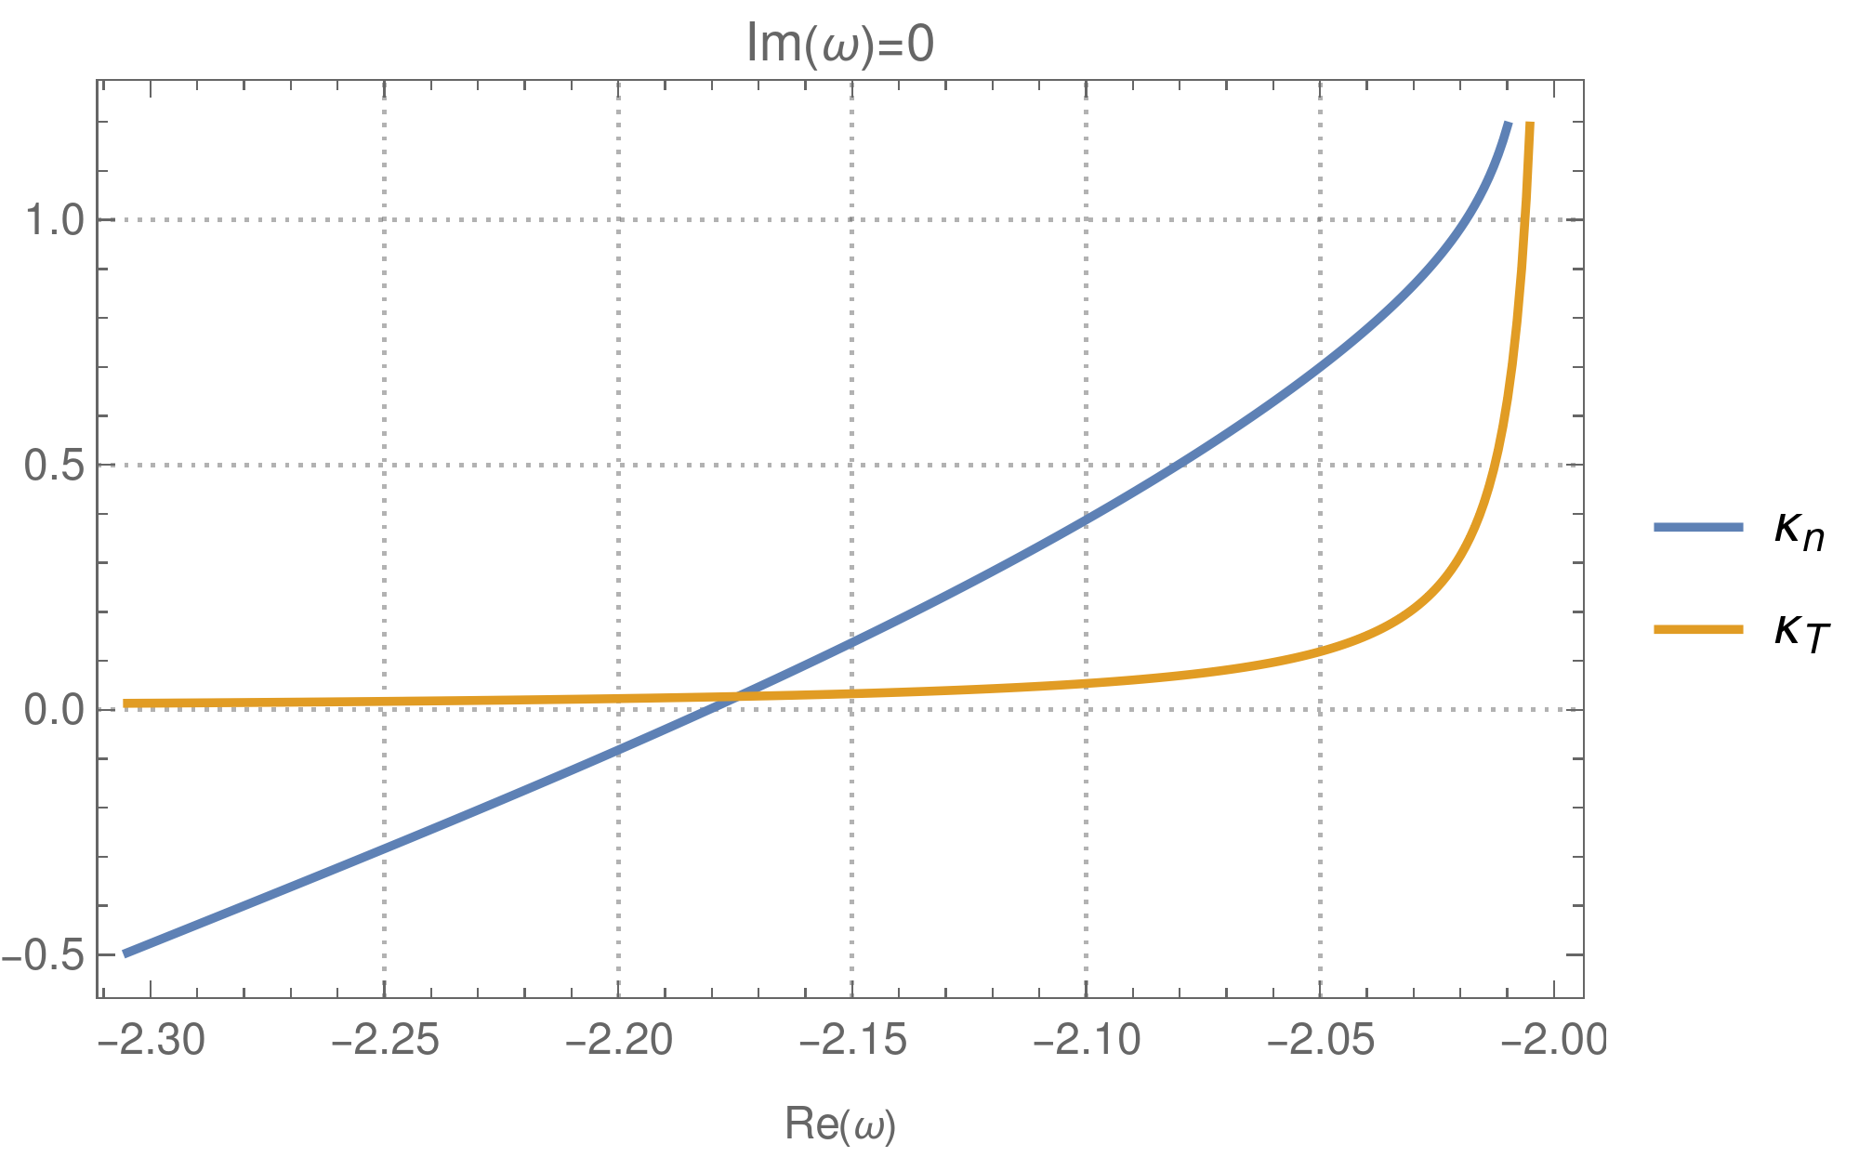

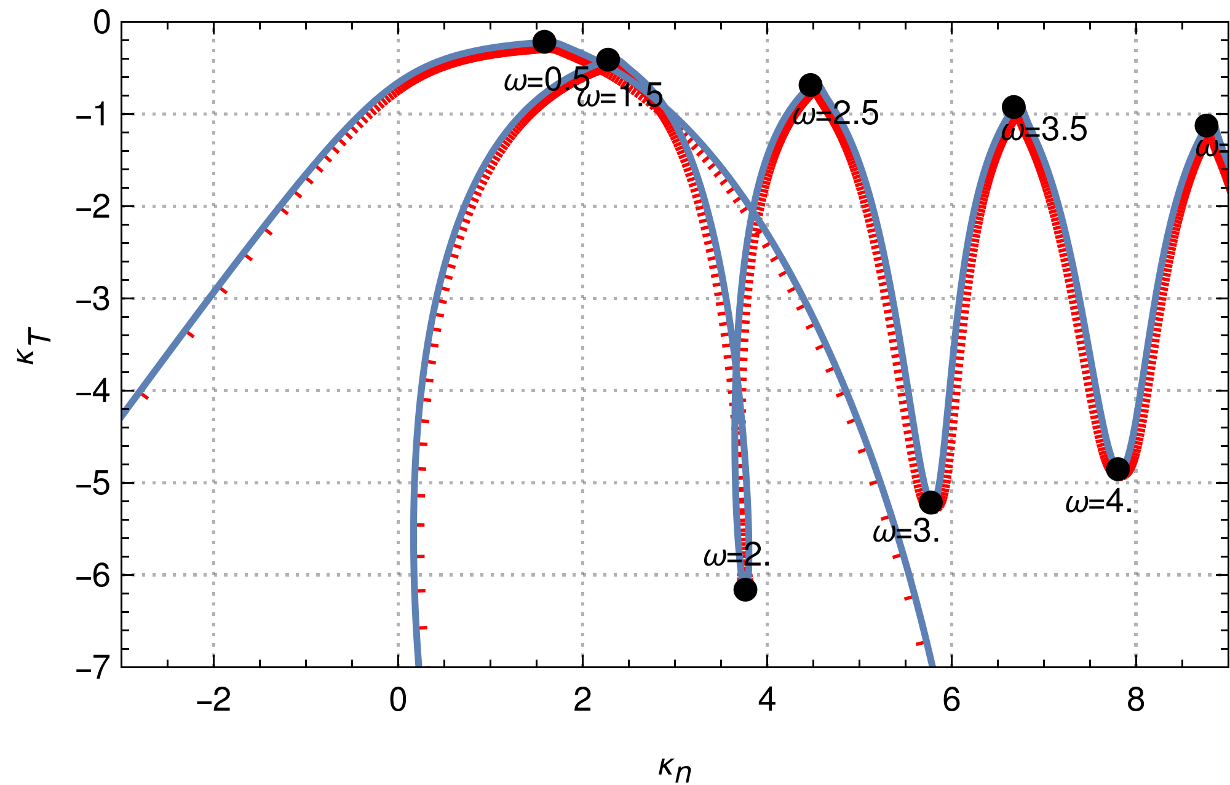
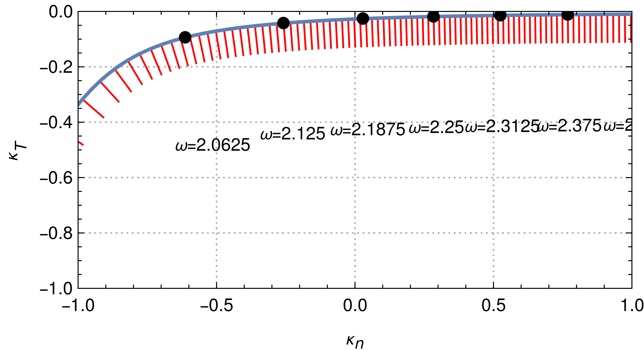

slide 6
Verification
Very difficult to solve dispersion relation for stable/unstable eigenmodes:
Very easy to solve for gradients at prescribed (real and imaginary eq.)!
zero growth rate lines for density and temperature gradient at given
lowest gradients at
lowest gradient threshold close to original IBW frequency
checking the numbers confirms “hand waving” calculation
plot for weak gradients
possibly exactly the previous example

Slide 10
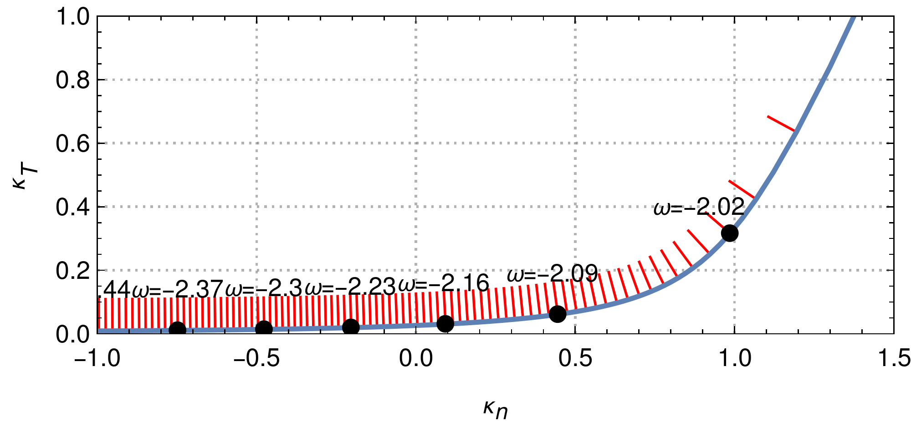
slide 6
Verification
Very difficult to solve dispersion relation for stable/unstable eigenmodes:
Very easy to solve for gradients at prescribed complex (real and imaginary eq.)!
lowest gradients at
single zero growth rate line in gradient space
red indicators point in direction of instability/positive growth rate
lowest gradient threshold close to original IBW frequency
checking the numbers confirms “hand waving” calculation
plot for weak gradients
possibly exactly the previous example

Slide 11
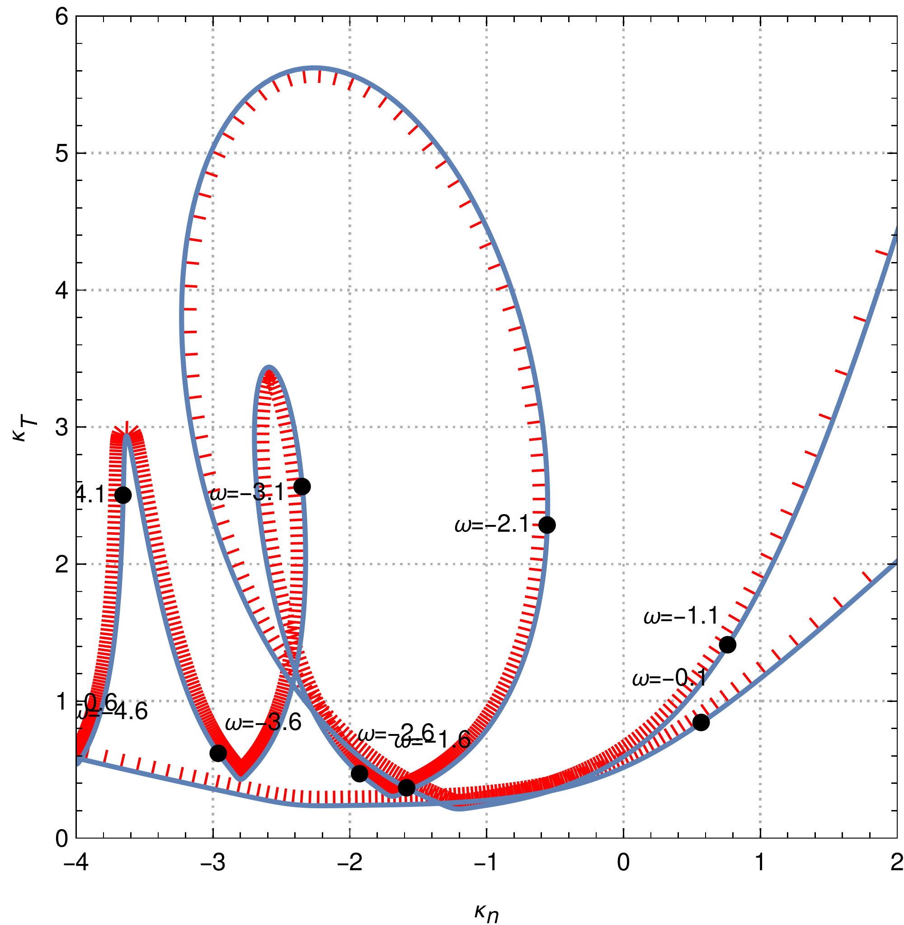
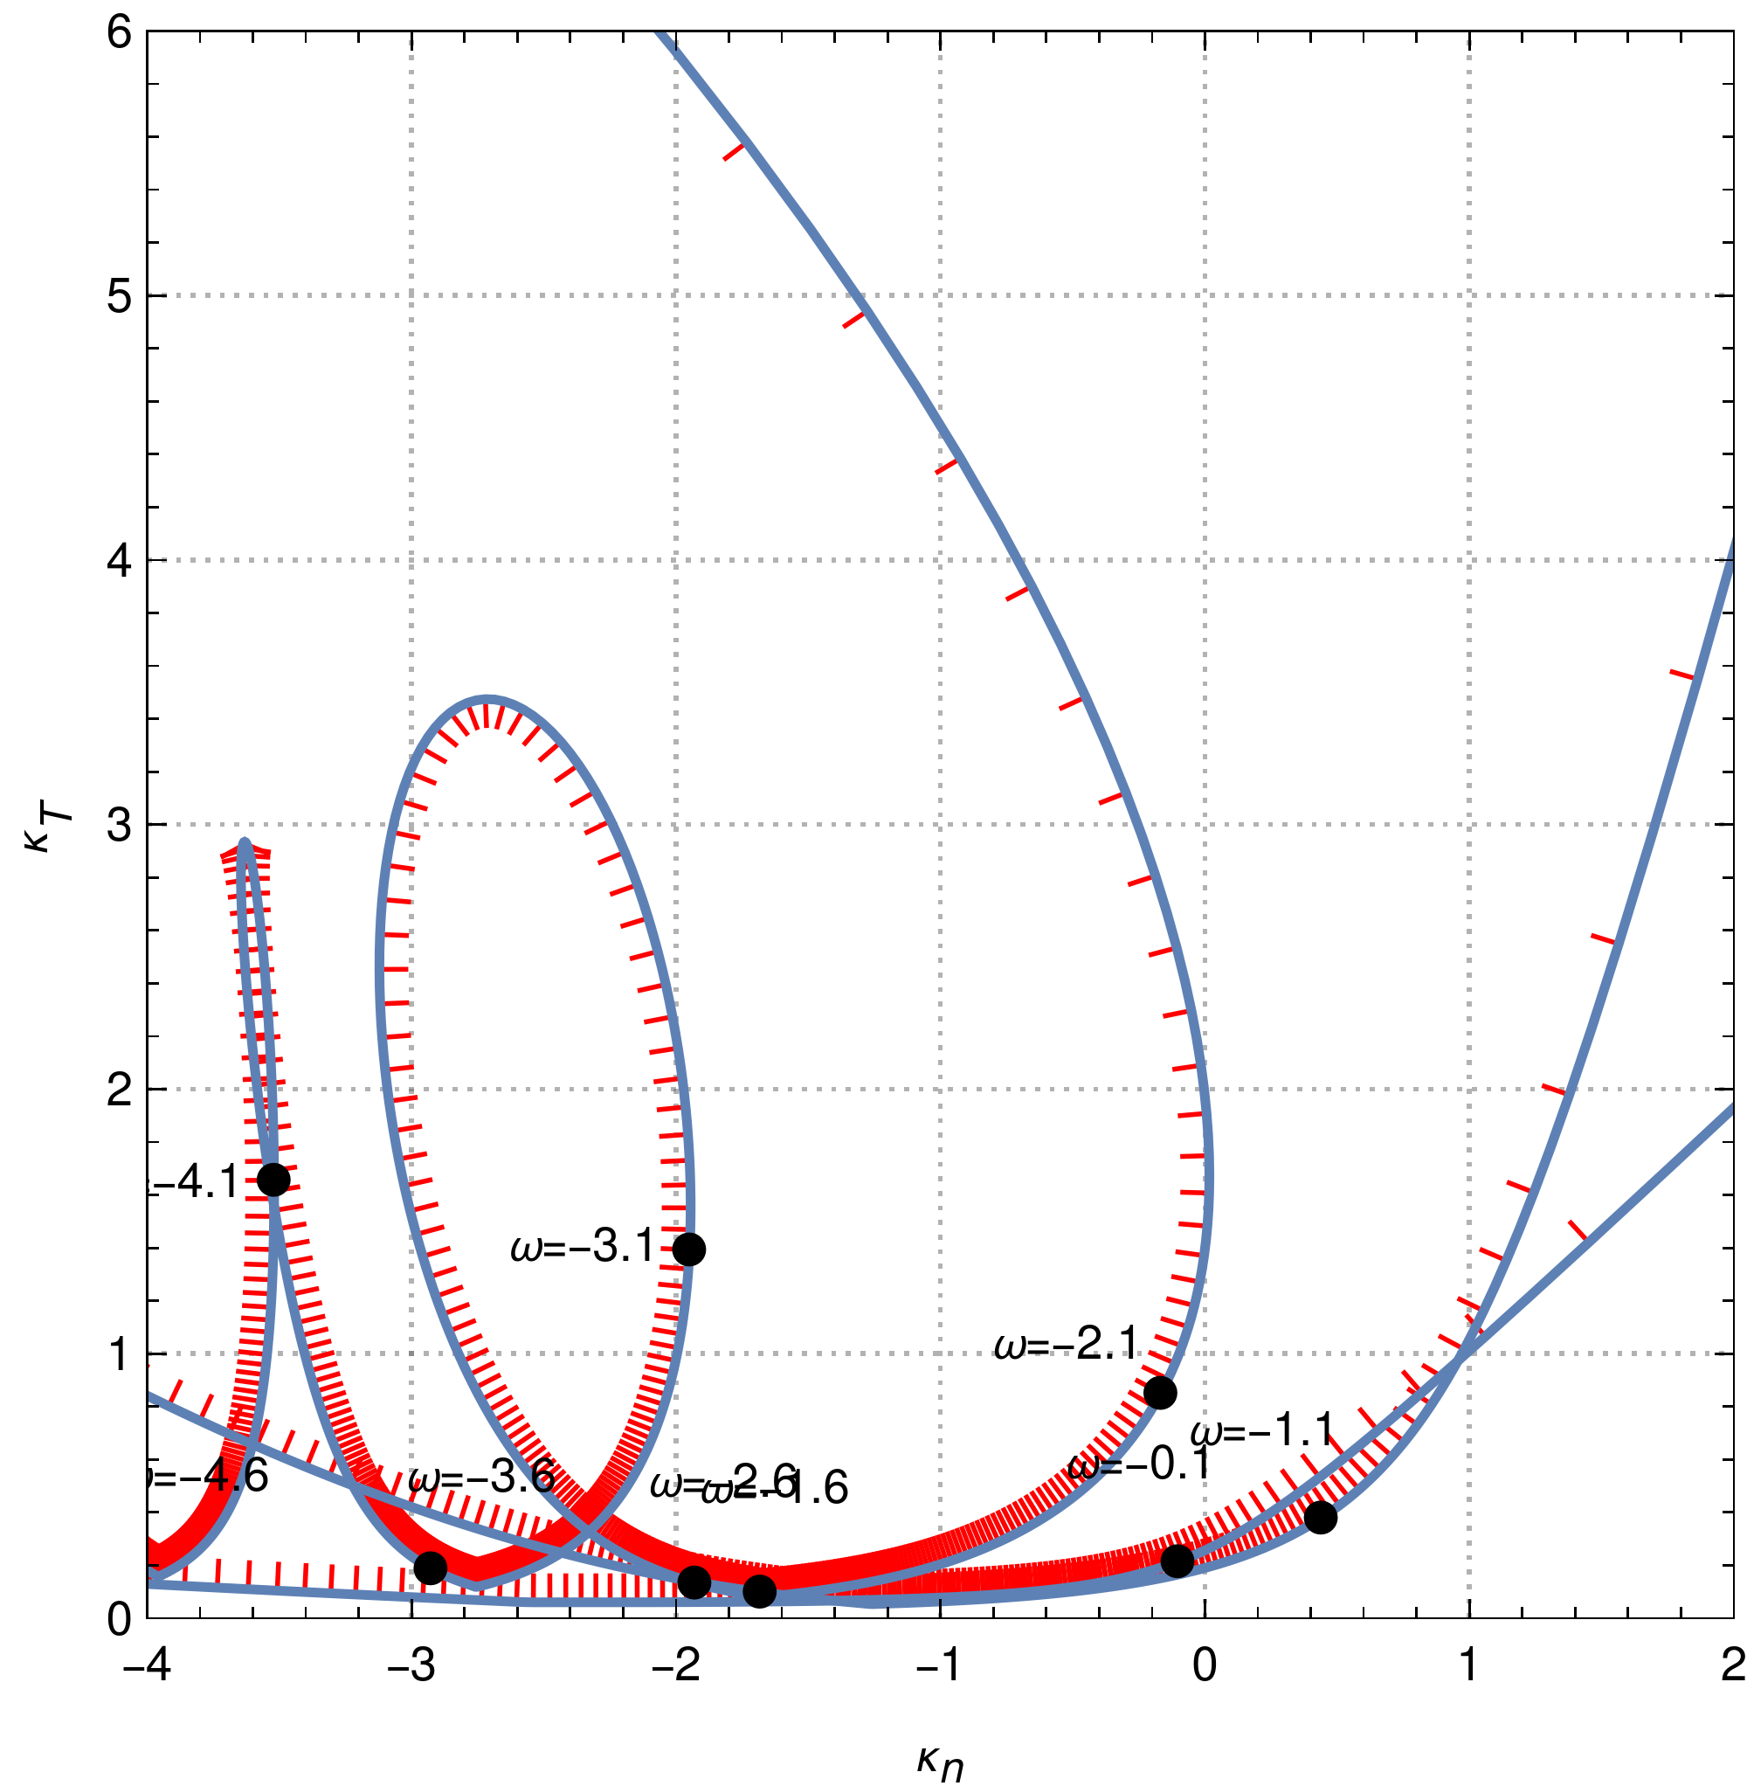
Verification
threshold behavior for decreasing
IBW
IBW
ITG
ITG
most unstable IBW close to standard IBW frequency ( )
ITG and IBW instability thresholds decrease with
IBW thresholds overtake ITG thresholds in their decrease

Slide 12
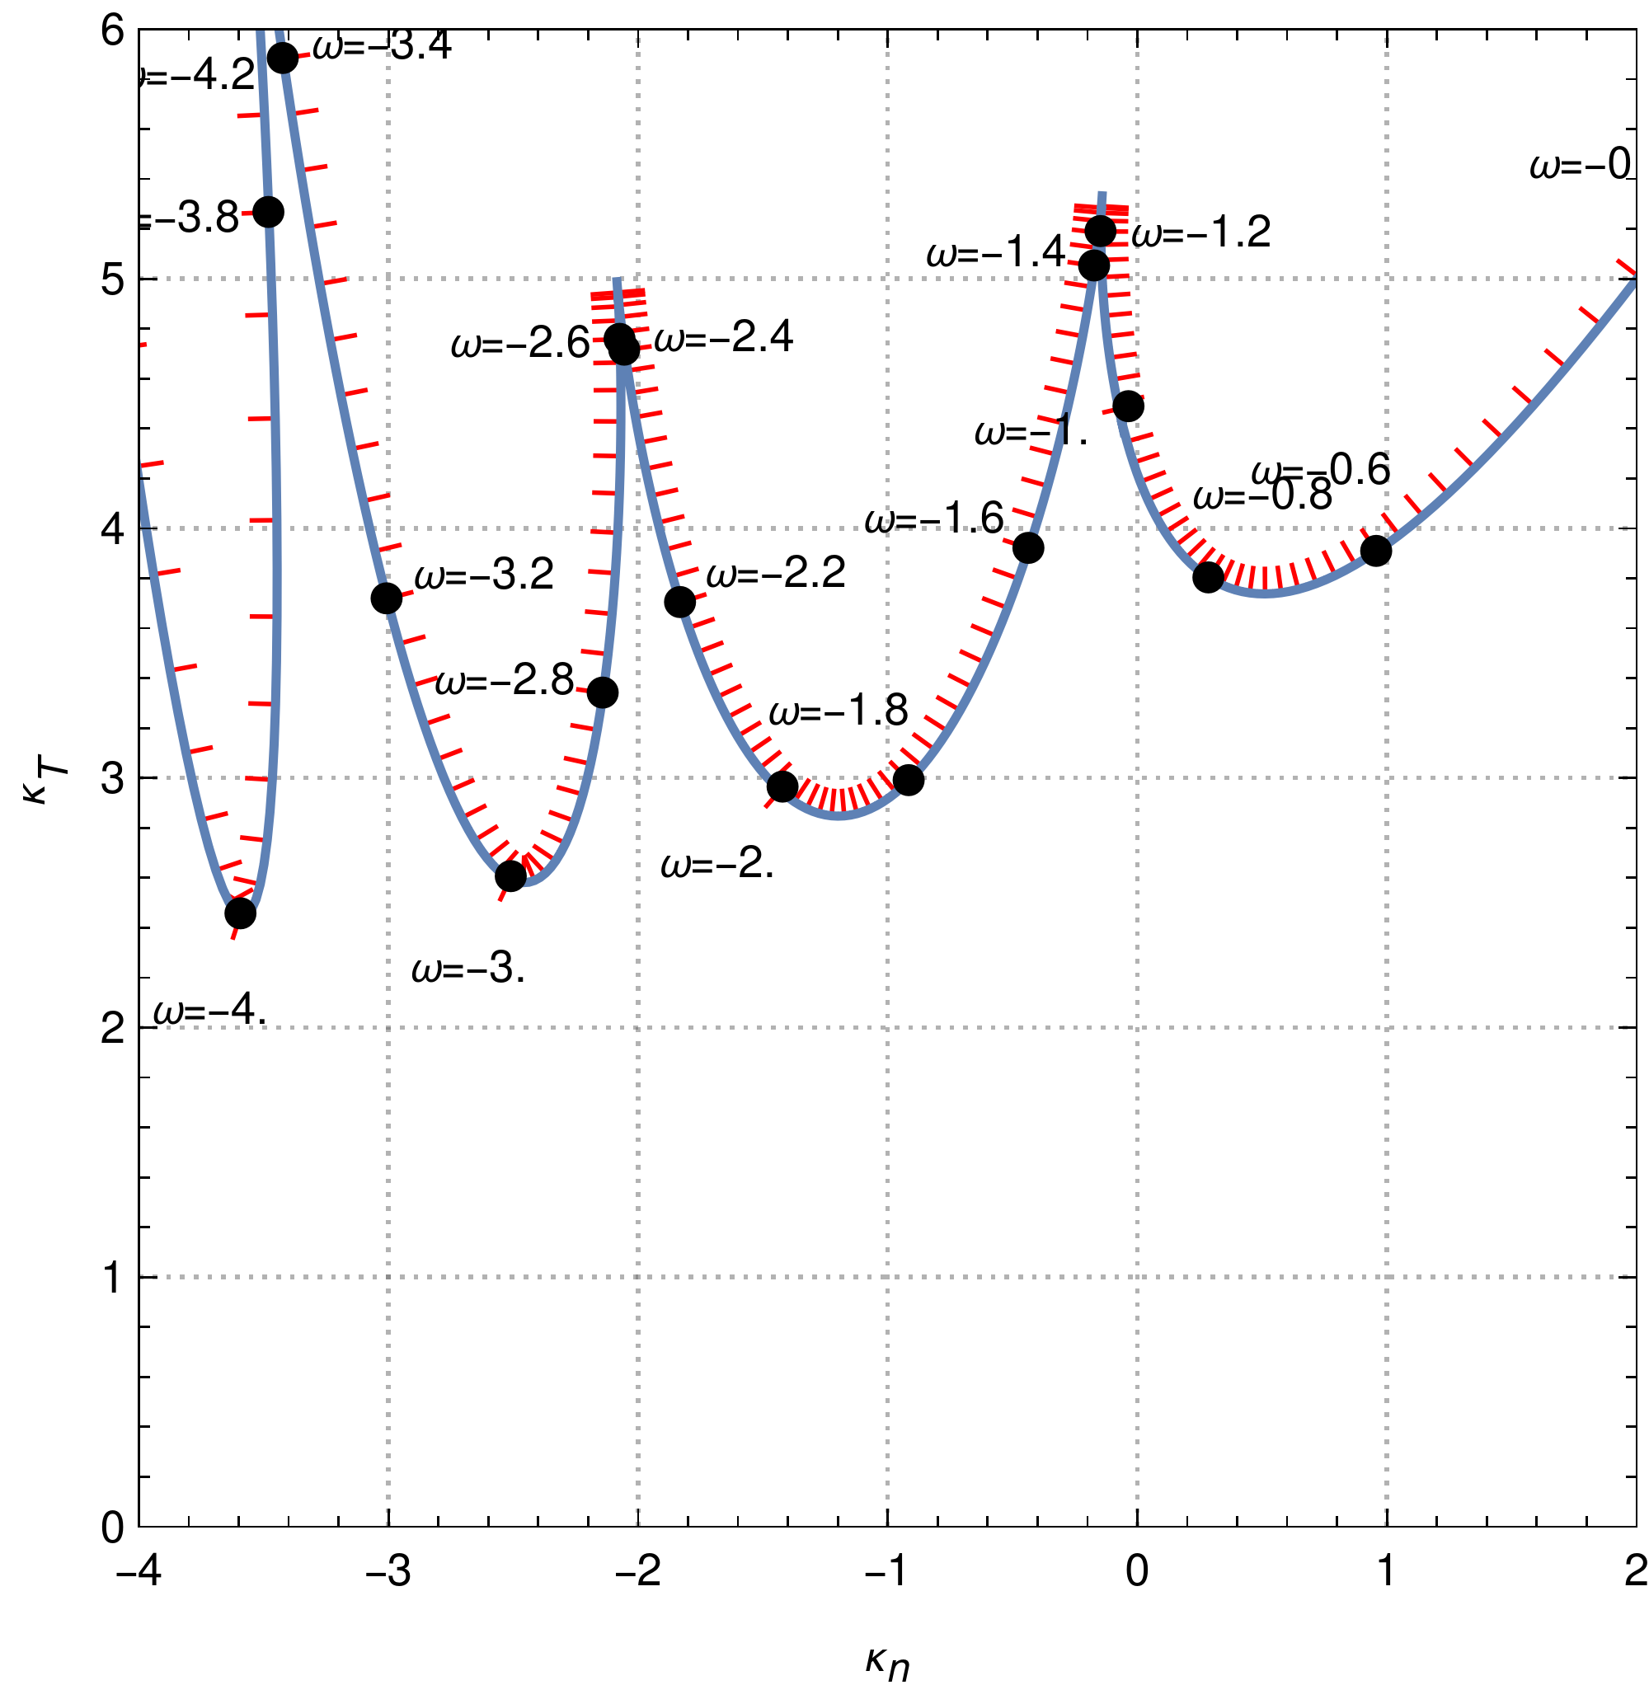
slide 7
Verification
threshold behavior for decreasing
What happens if we don’t admit finite , switch off parallel Landau damping?
purely perpendicular, “reactive” instability
much higher threshold for purely perpendicular IBW/ion cyclotron instability
minimal temperature gradient threshold close to standard IBW frequency
same plot of last slide
plot of reactive instability

Slide 13
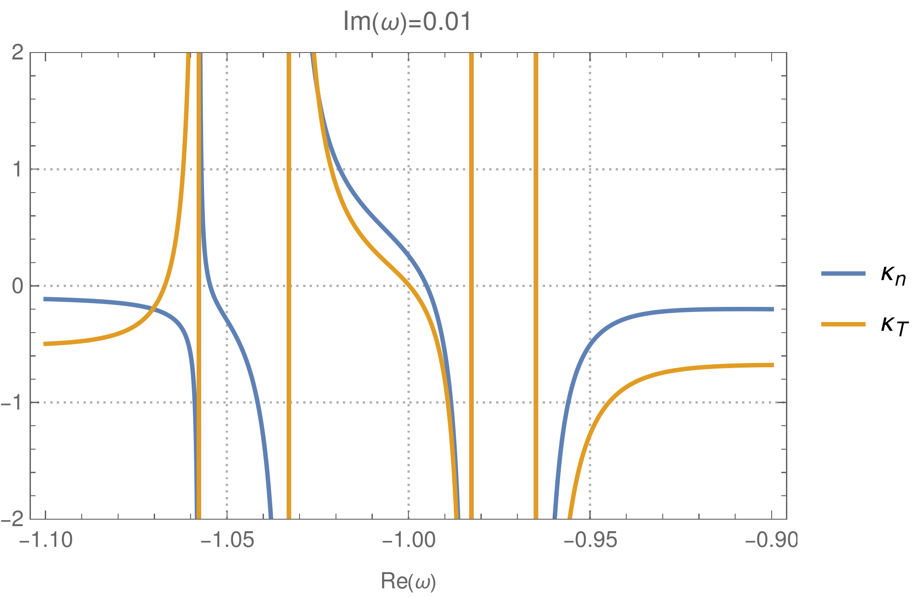


slide 8
Conclusions
always possible to find unstable gradients for non-gyrokinetic modes
temperature gradient required, no threshold; density gradient tends to boost instability
non-gyrokinetic instability possible for arbitrarily small gradients or wavenumbers
extended slab ITG threshold criterion to non-gyrokinetic ion Bernstein waves
Outlook
much stronger instabilities when electron physics is included, since not limited by gyroradius
e.g. first shot at driftkinetic electrons:
growthrate
at
open research area with many new opportunities!

