Slide 1

Semi-analytical model for the pellet rocket effect in magnetic confinement fusion plasmas
Oskar Vallhagen
Nico Guth, Per Helander, Tünde Fülöp, Amir Tresnjic,
Sarah Newton, István Pusztai
21st European Fusion Theory Conference, Aix-en-Provence 2025

Slide 2


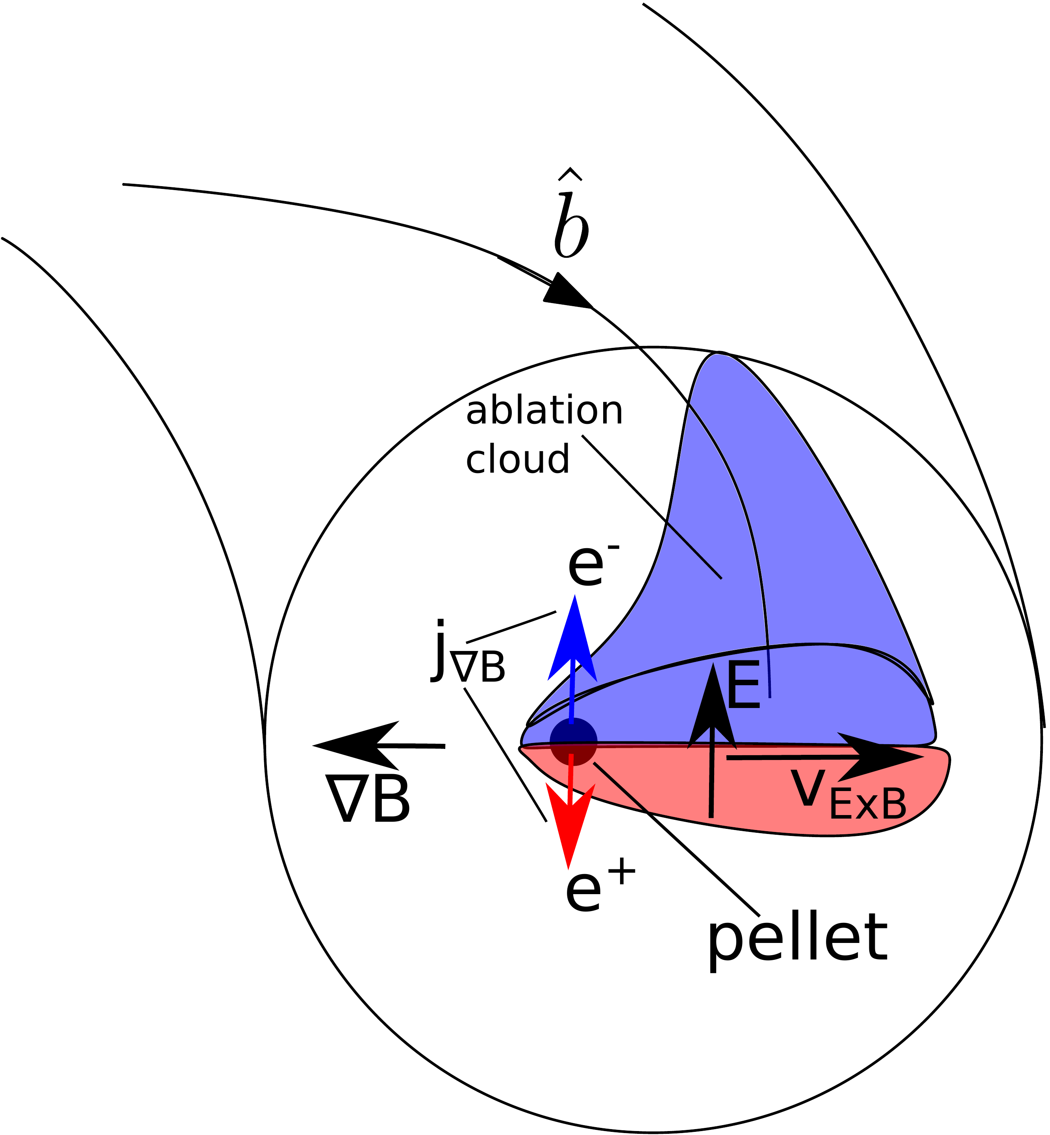
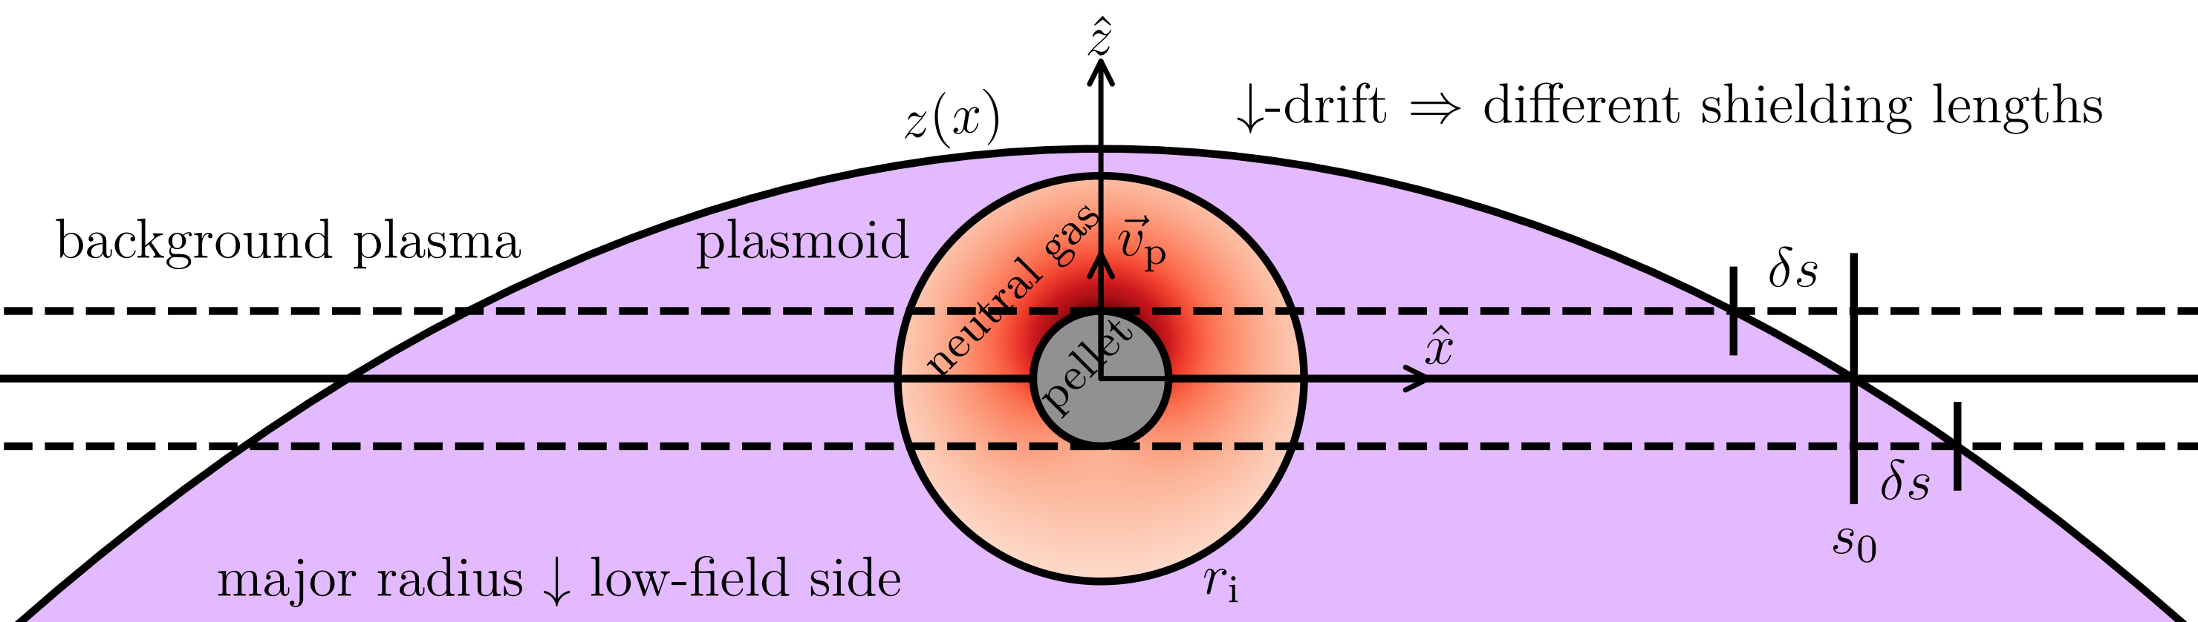
Pellet injection in tokamaks
Refueling, plasma control, diagnostics, disruption mitigation
  Shattered Pellet Injection (SPI) for disruption mitigation
Asymmetric heating leads to rocket force
  Ablation cloud polarised by -drift => -drift towards LFS
  Leads to asymmetric shielding of the pellet
  Additional asymmetry from gradients (temperature, density)
Important effect on D2 disruption SPI in JET [Kong et al. NF 2024]
Foreseen to be important in ITER [Samulyak et al. TSDW 2023]
rocket force
Notes:
Drop drifts
due to non-uniform magnetic field
not fully explain

Slide 3
Modelling the pellet rocket effect
Previous models
by Senichenkov et al. EPS (2007)
  ablation asymmetry (no pressure)
by Szepesi et al. EPS (2007)
  pressure asymmetry as semi-empirical parameter
by Samulyak et al. TSDW (2023)
  3D Lagrangian particle code
Goal: develop computationally inexpensive model from first principles
[Guth et al. PRL 2025, Guth et al. JPP (submitted)]
Notes:
Don’t really mention previous models
maybe give citations when we introduce the ideas take by them
don’t explain semi-analytical

Slide 4
Outline
Model derivation
Asymmetric perturbation on spherically symmetric Neutral Gas Shielding (NGS) ablation model [Parks & Turnbull 1978]
Semi-analytical with 3 parts
  Force on pellet surface, asymmetric neutral gas expansion, plasmoid shielding
Model evaluation
Penetration depths and pellet trajectories in AUG and ITER

Slide 5
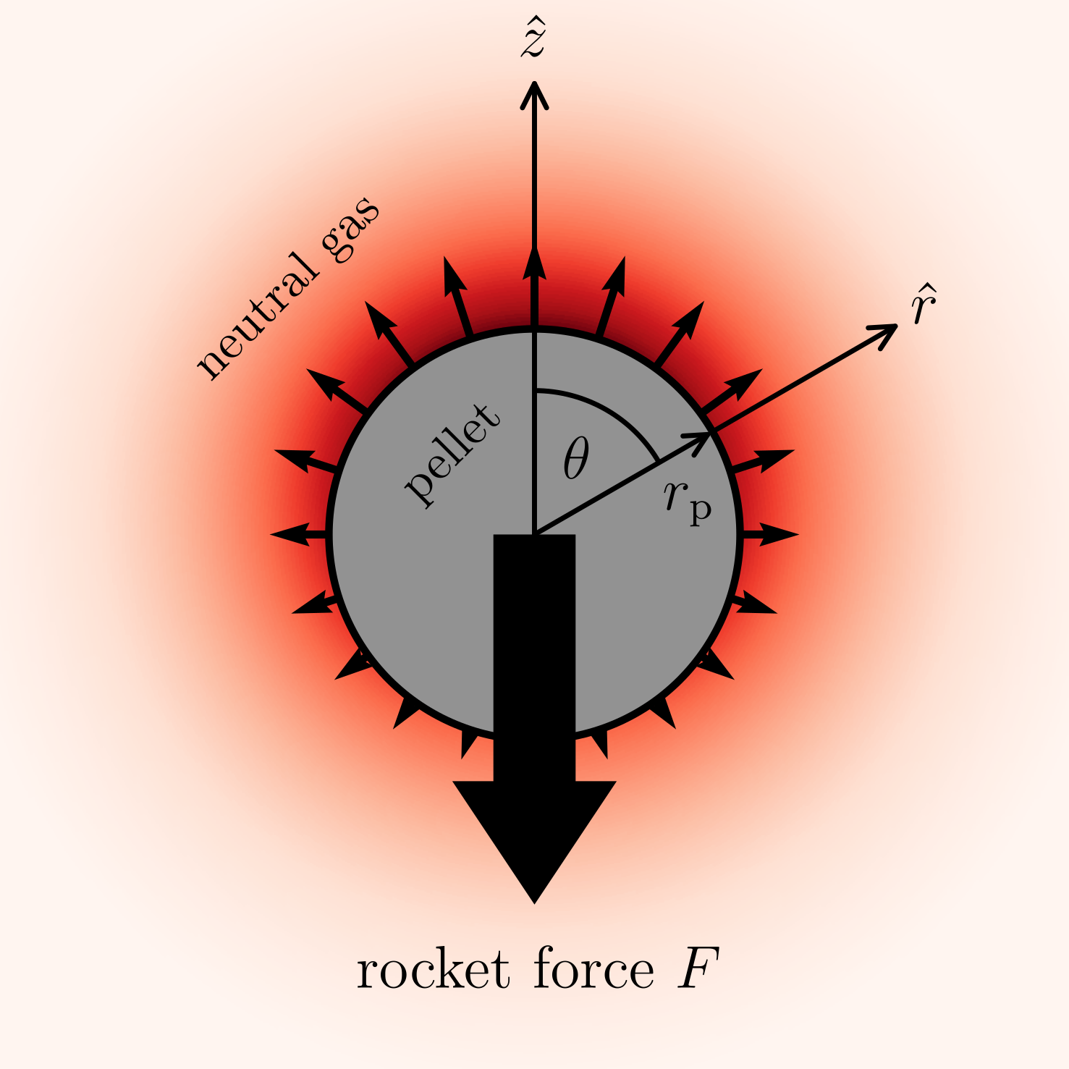
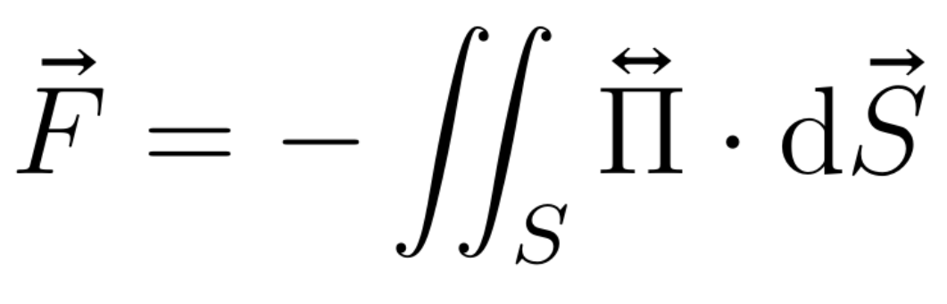
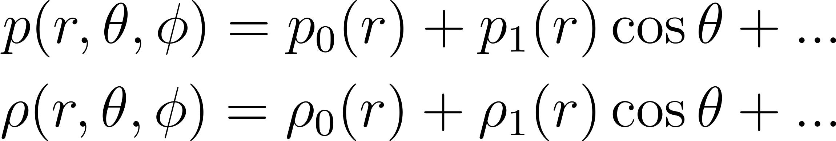
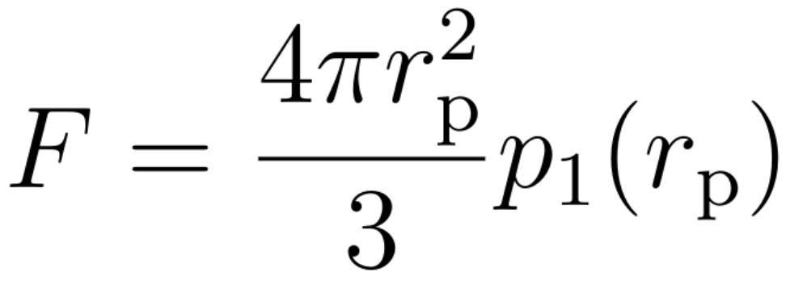
Force on pellet surface
Momentum transfer:
Expand in spherical harmonics
Result for cryogenic pellet:
Notes:
Stress tensor,
note cos theta dependence already here

Slide 6
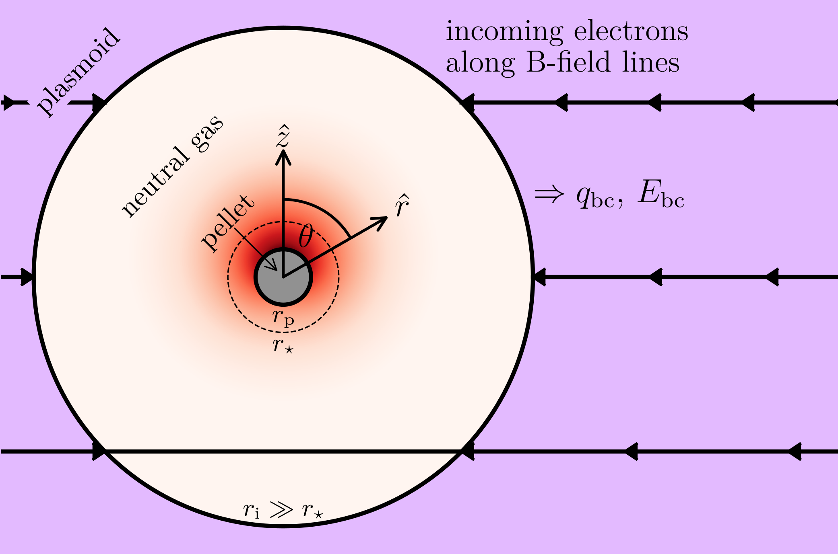
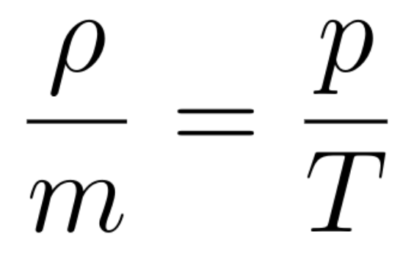
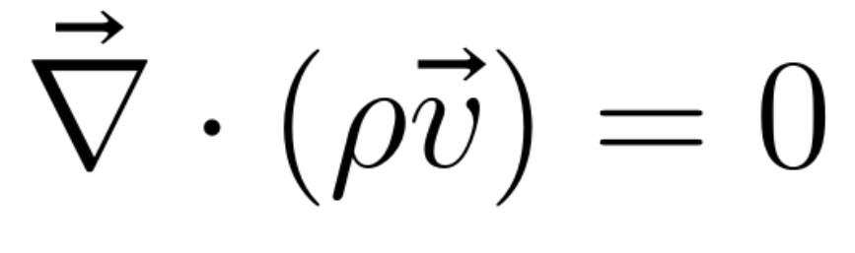
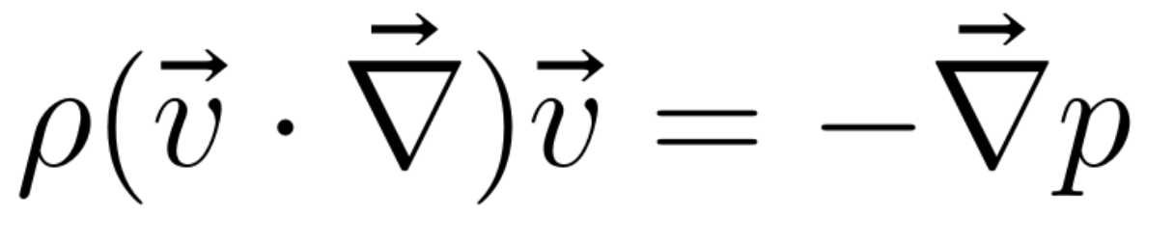
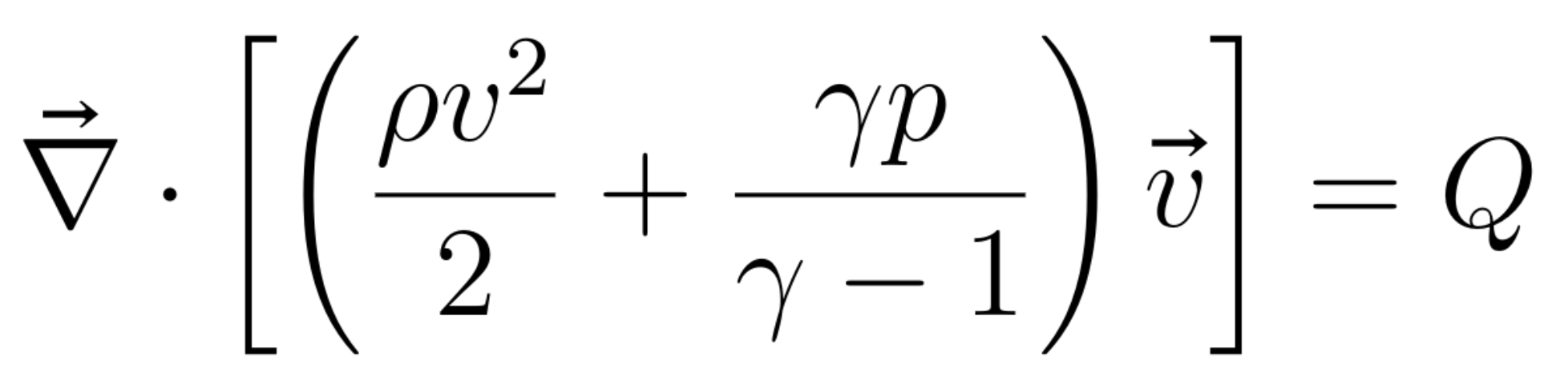
Neutral gas shielding (NGS)
Quasi steady-state ideal gas
balance equations:
(ideal gas law)
(mass)
(momentum)
(energy)

Slide 7
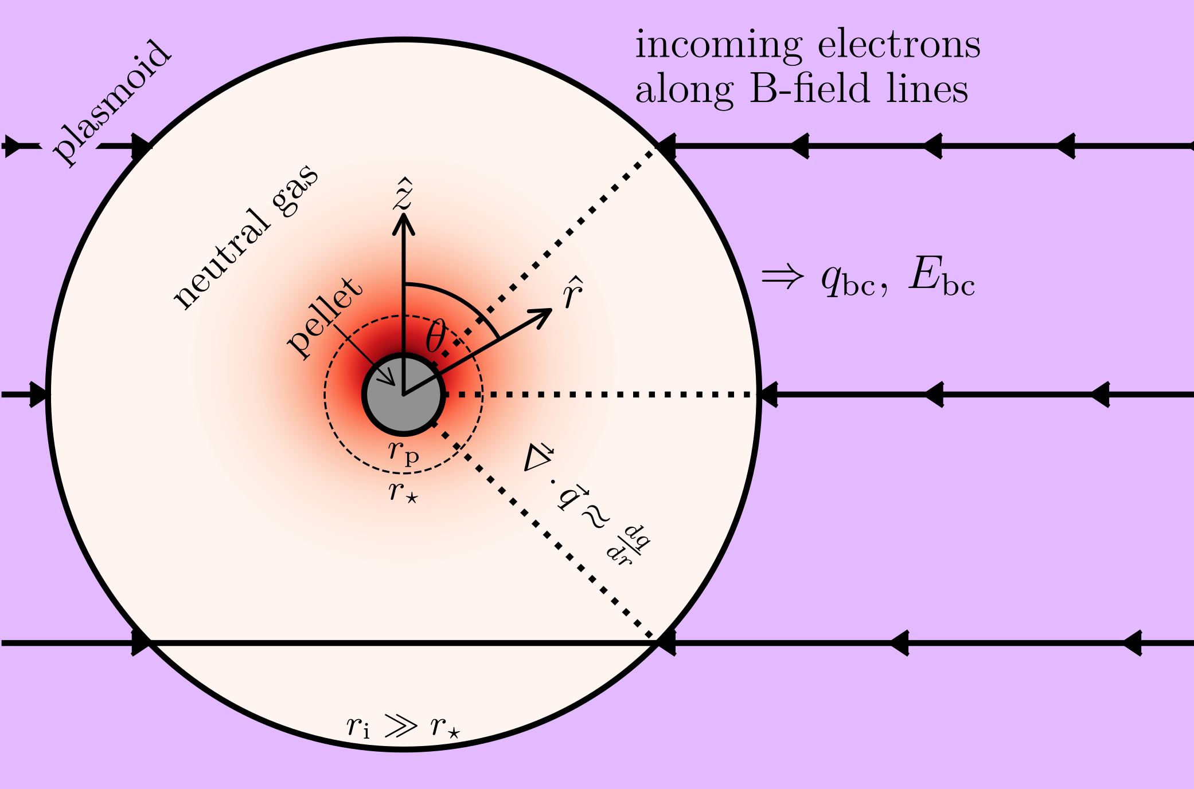
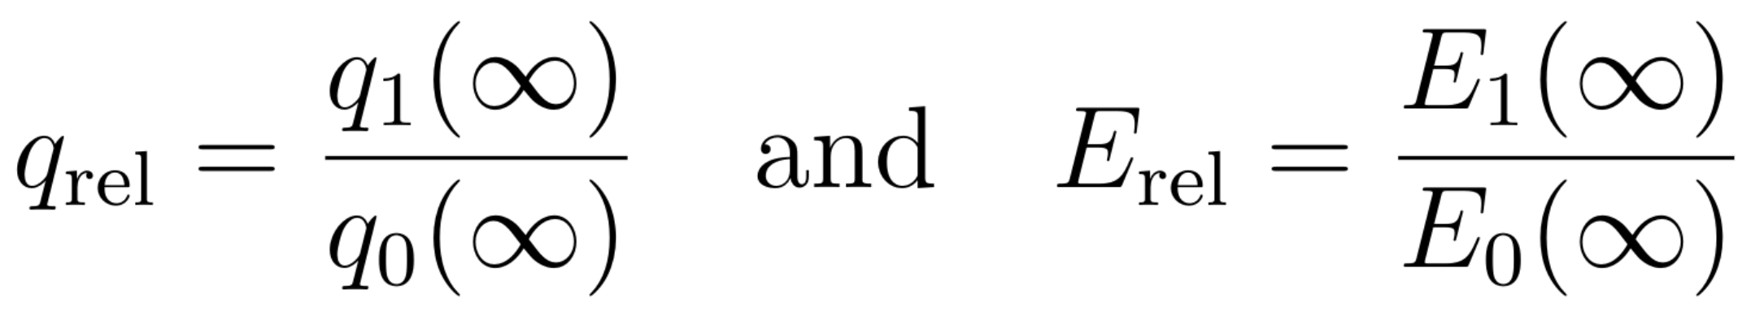
Neutral gas shielding (NGS)
Electron heating approximations:
  Mono-energetic beam
  Equivalent radial path
  Empirical energy loss functions
  Fully shielded
Heating asymmetry parameters
Small asymmetric perturbation -> linearise
0th order solution from original NGS model [Parks & Turnbull 1978]
Notes:
Reminder: cos theta = +1, 0, -1

Slide 8
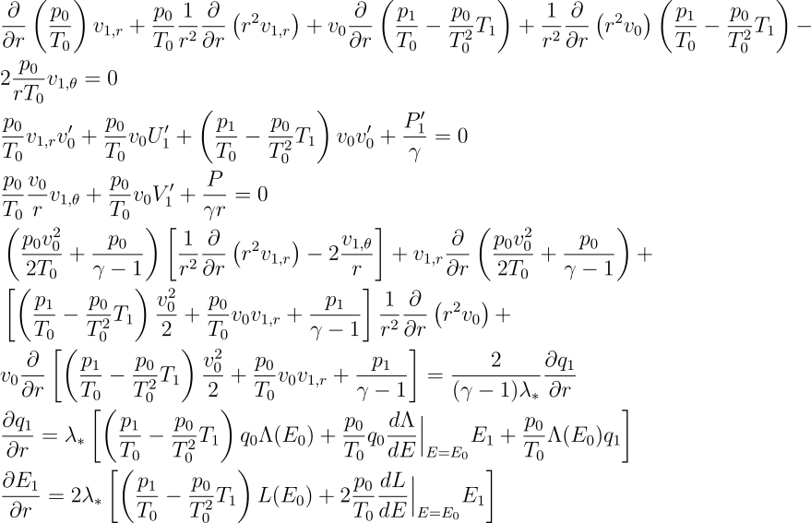
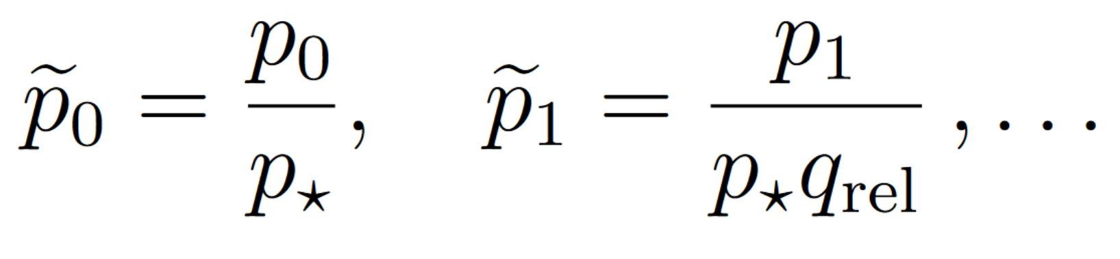
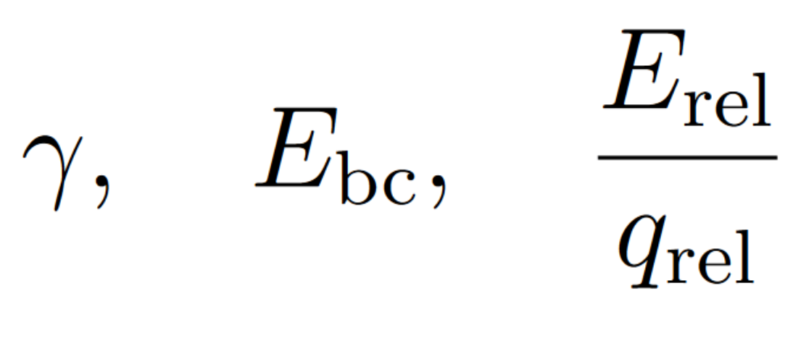

Normalized equation system
Complicated, but still linear 1D ODE system
Normalization
-> semi-analytical
Normalized solution parameters

Slide 9
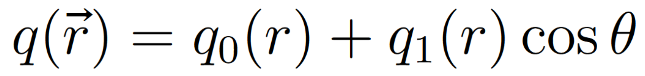
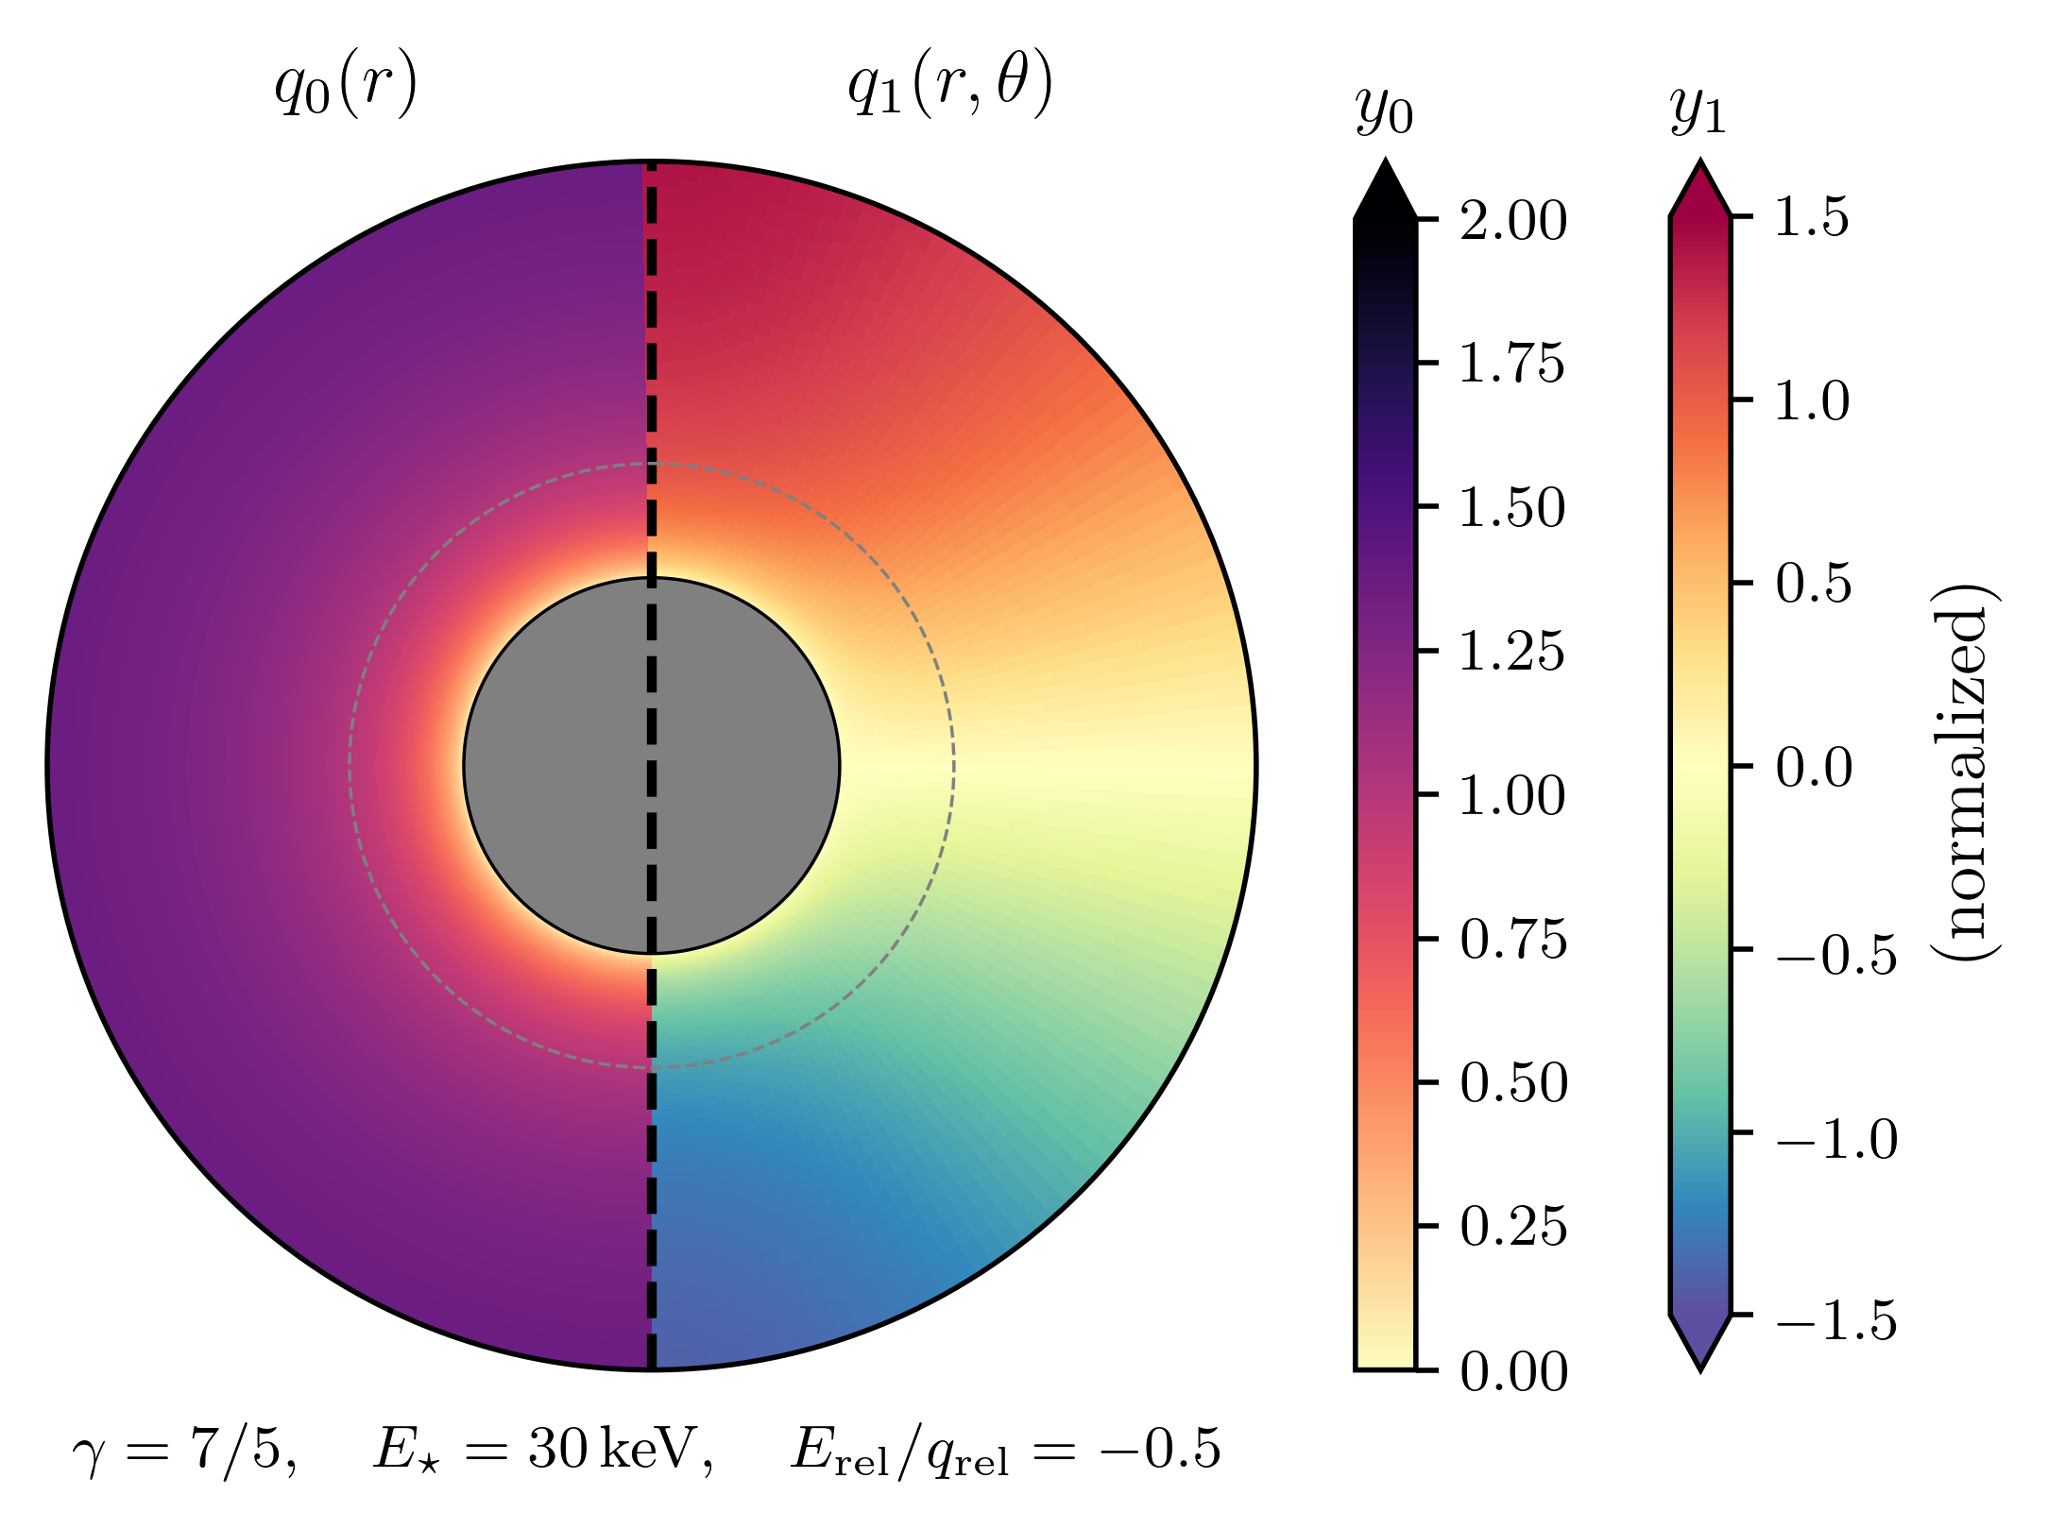
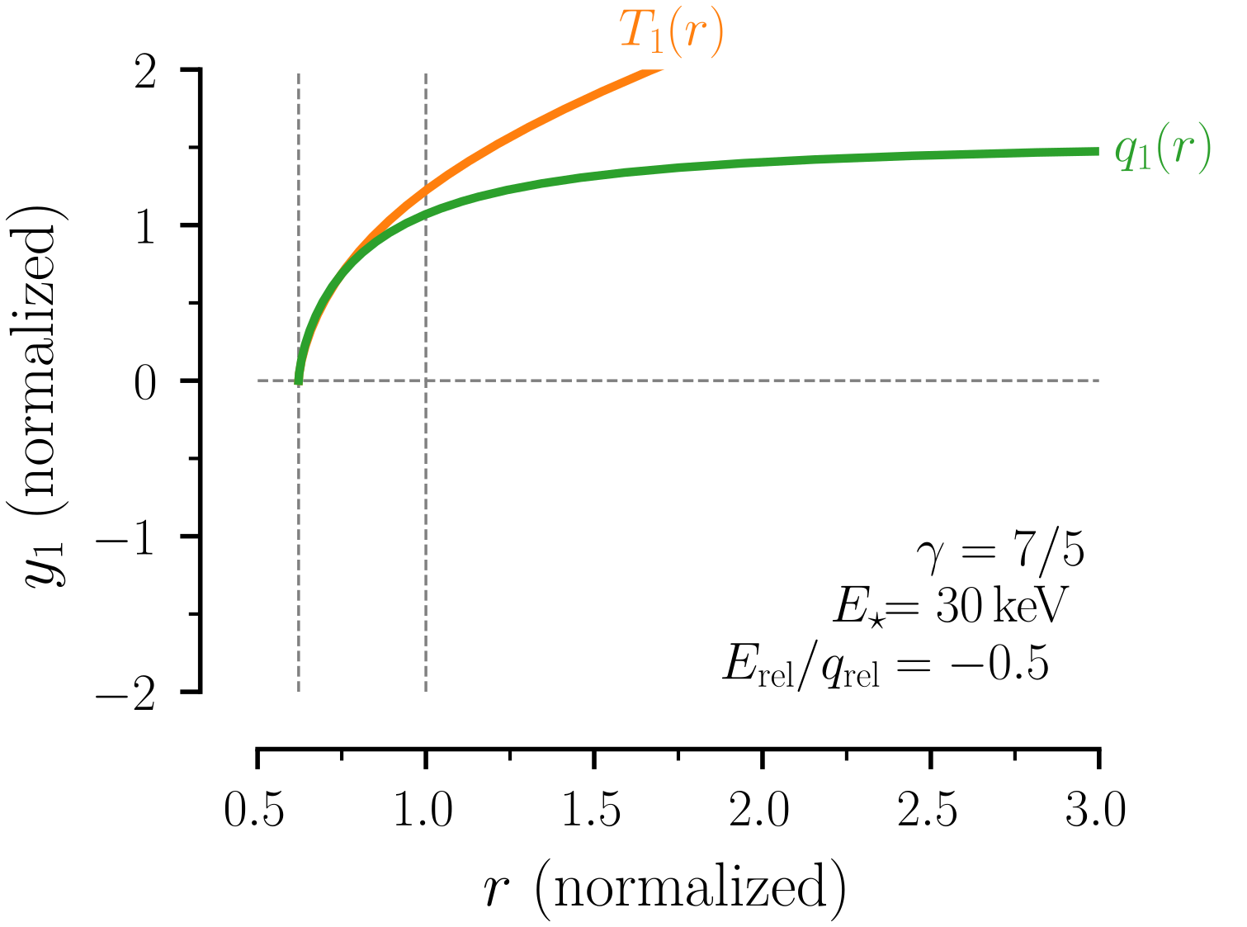
Asymmetric NGS solutions
Notes:
Split in 2 slides first only q (q_rel)
Then together with E (E_rel)
Put + and – on right side
Maybe keep this
explain erel qrel difference...

Slide 10
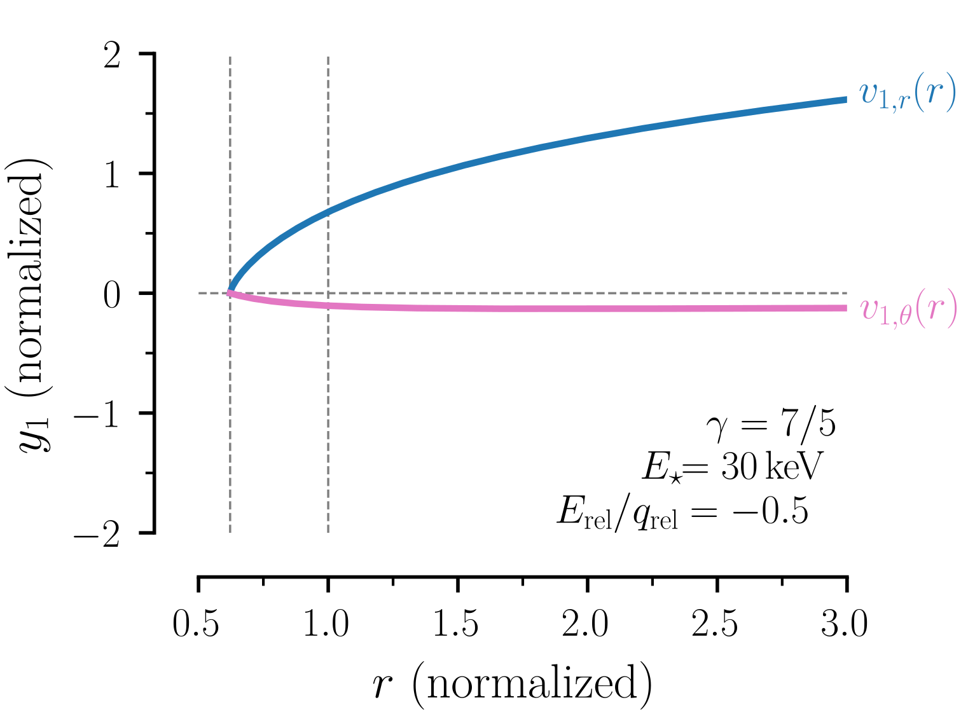
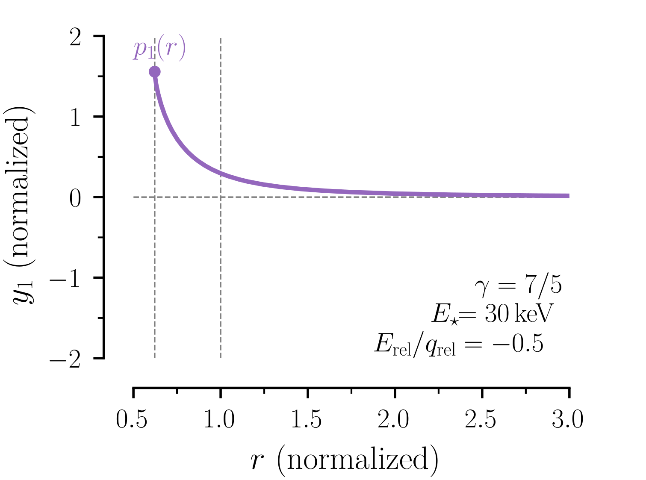
Asymmetric NGS solutions
Cryogenic pellet -> complete shielding ->
no energy for flow speed at the surface

Slide 11
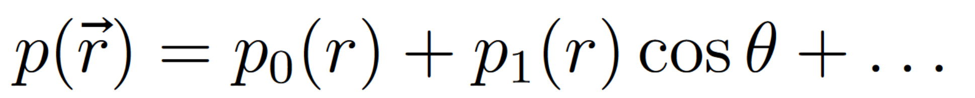
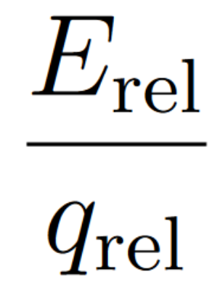
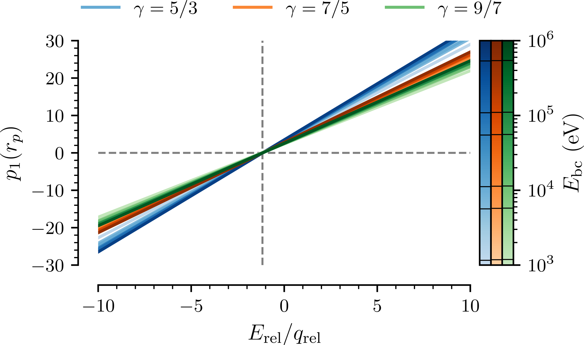
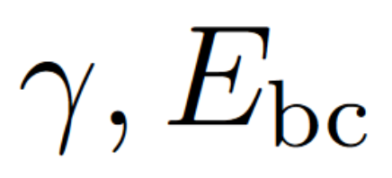
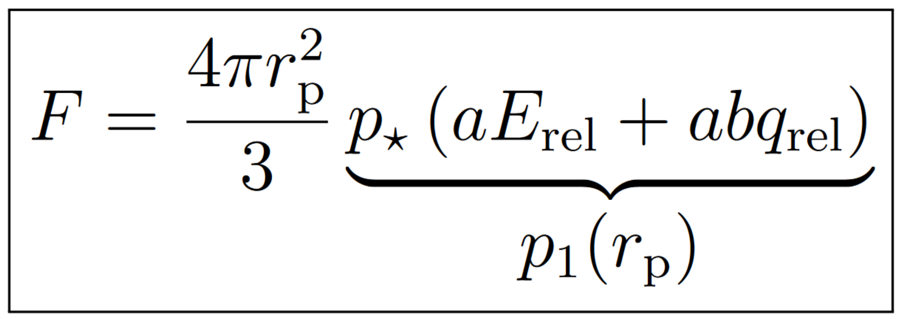

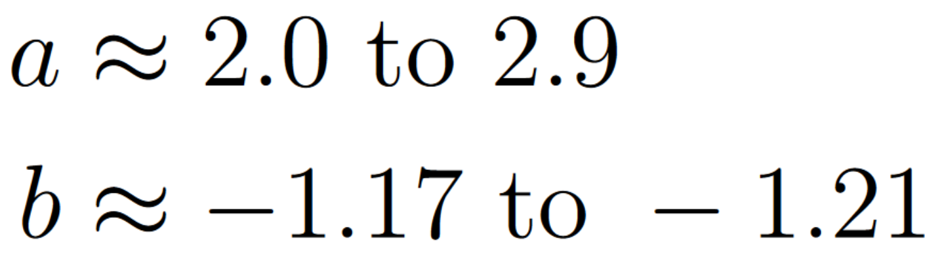
Pressure asymmetry at pellet surface
Linear dependence on
Weak dependence on
Final rocket force:
Notes:
Keep this put after explaining p1
mention interesting reversed rocket force, but don’t take too much time on it

Slide 12
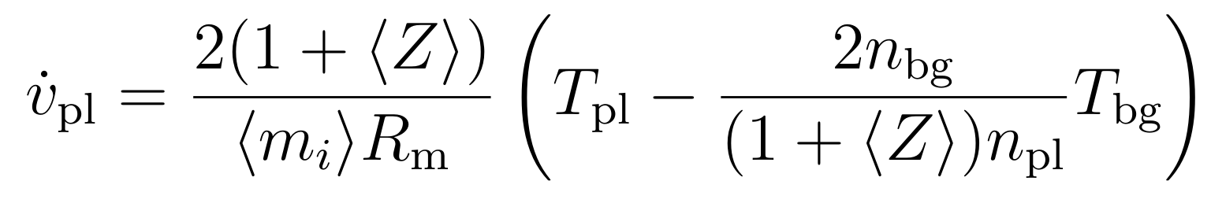
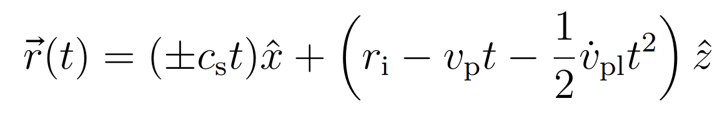
Plasmoid shielding asymmetry
Plasmoid boundary:
Expansion at speed of sound
Constant drift acceleration [Vallhagen et al. JPP 2023]
Gives trajectory of boundary that determines shielding length:
Notes:
One slide is enough maybe

Slide 13
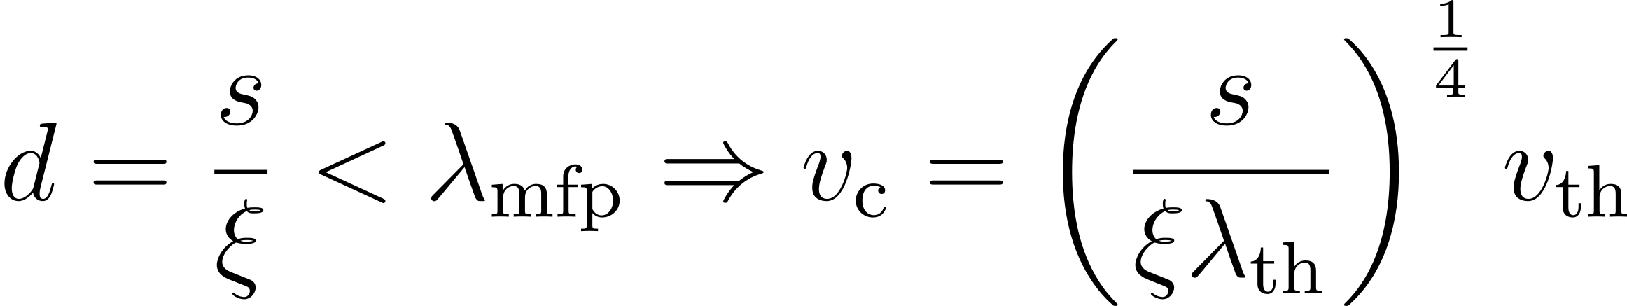
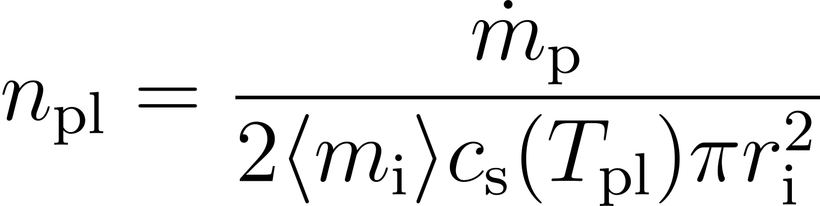
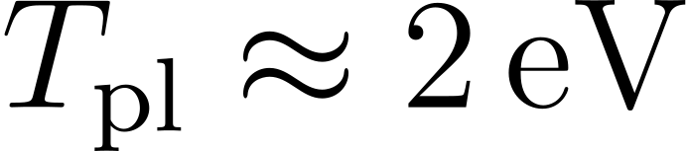
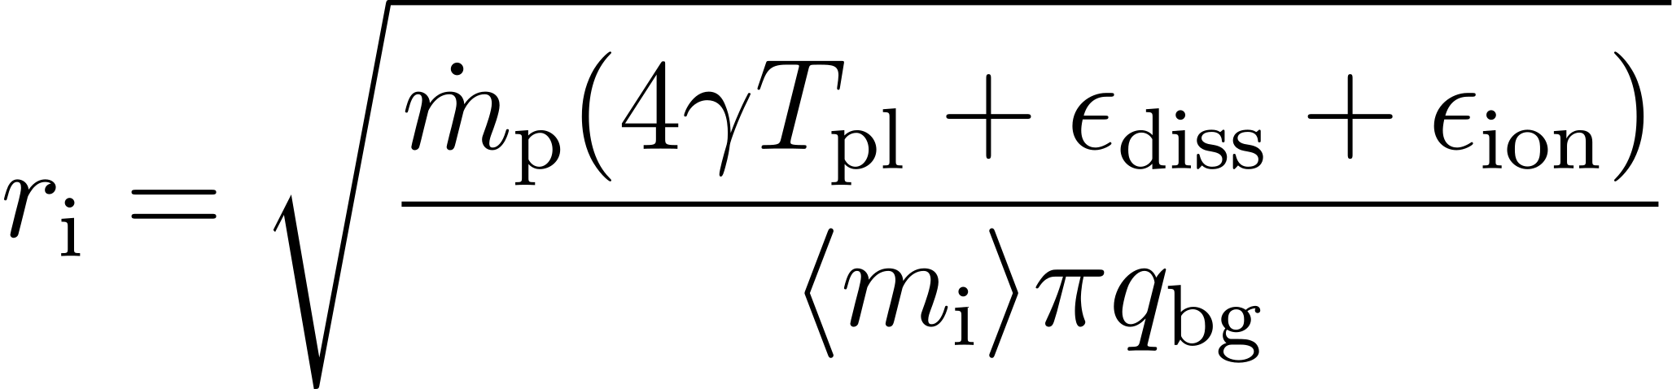
Plasmoid shielding asymmetry
Shielding assumptions:
Electron stopped when path length > mean free path
Uniform density from mass conservation
Temperature close to ionization threshold ( )
Assume cross-section absorbs energy needed for full ionization
Notes:
One slide is enough maybe

Slide 14
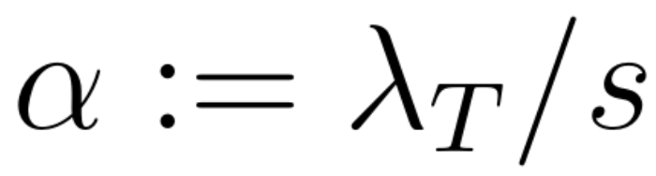
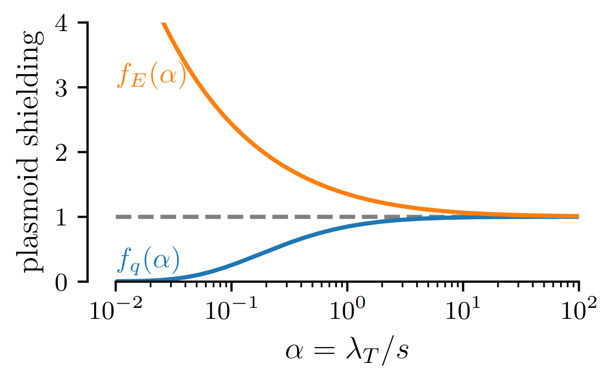
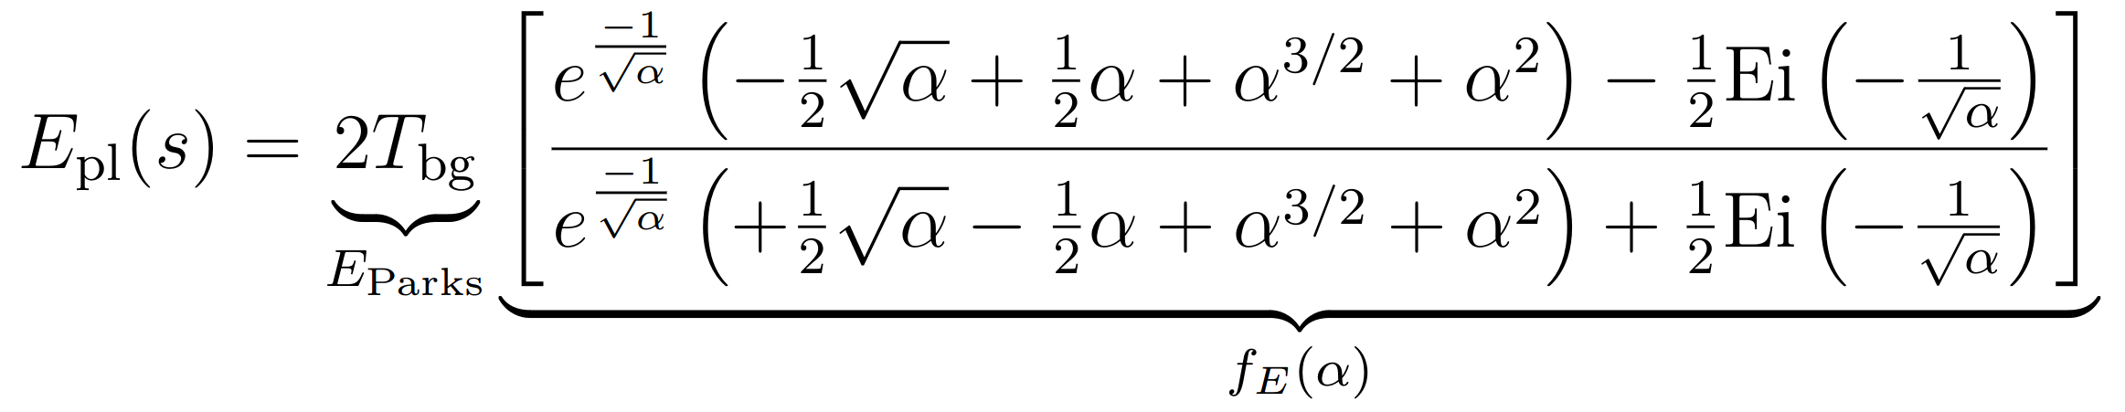
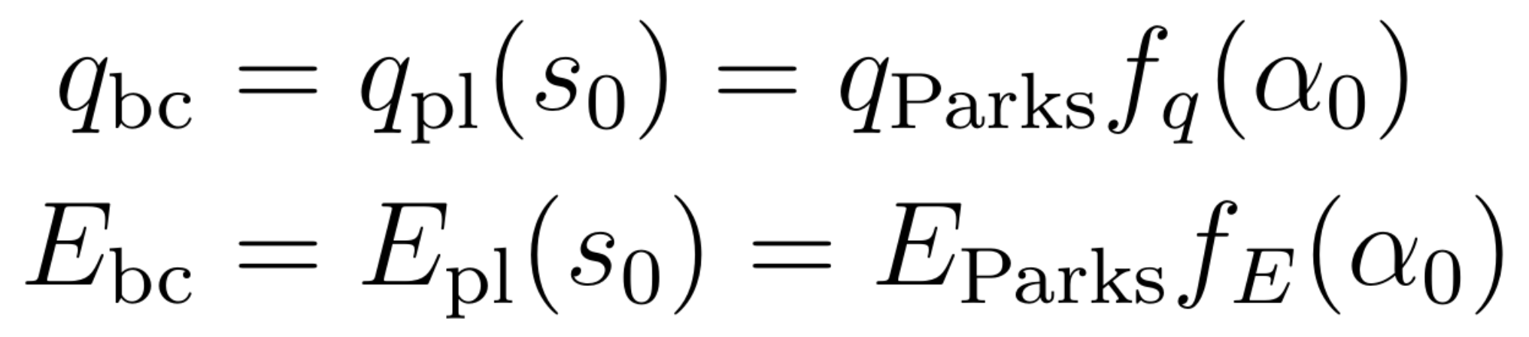
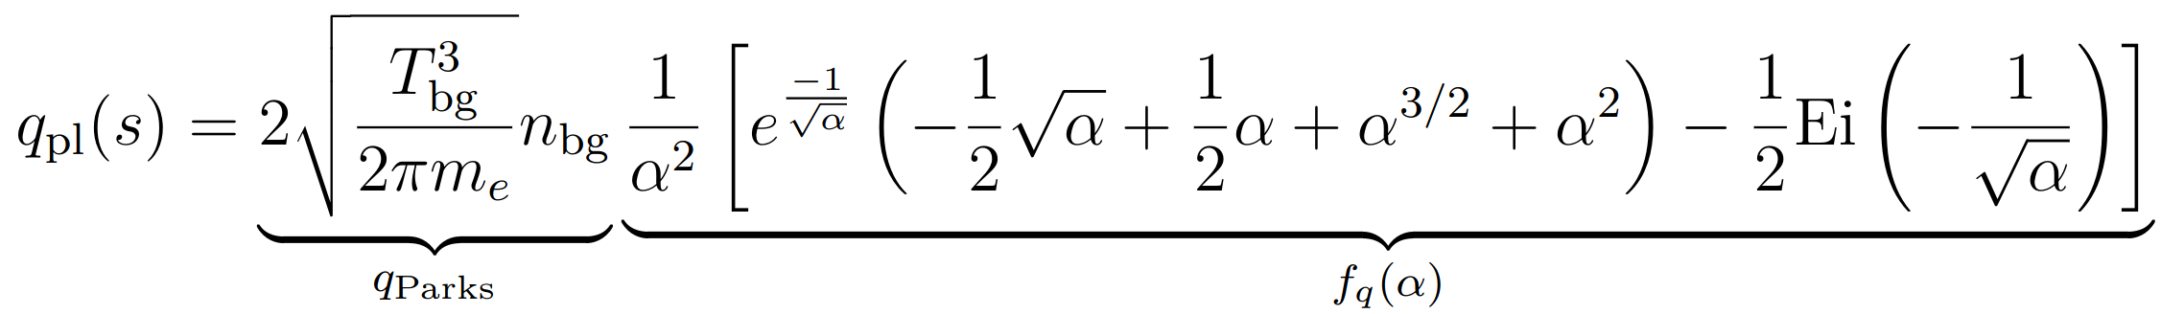
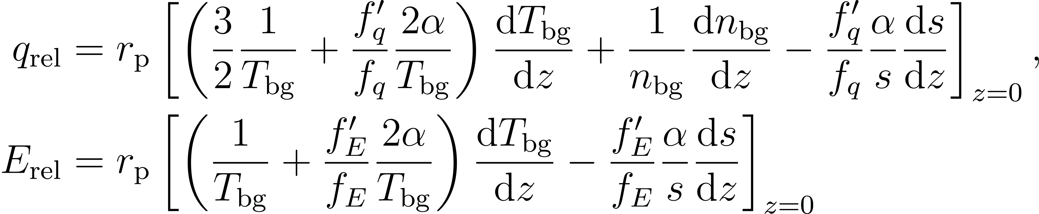
Plasmoid shielding asymmetry
isotropic heating:
asymmetric heating:

Slide 15
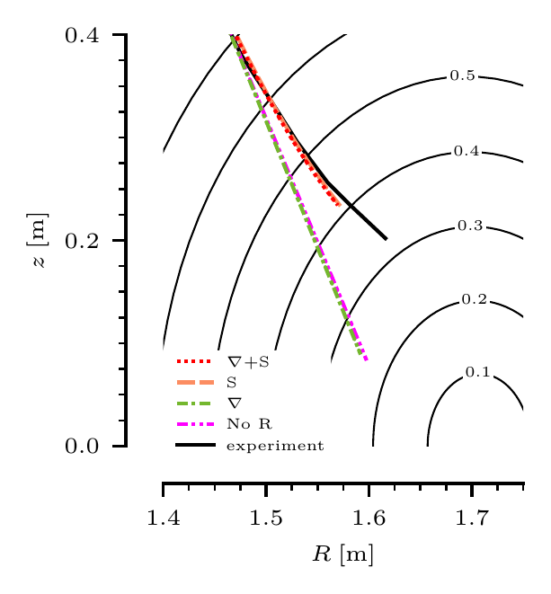
Pellet trajectory simulation in AUG
Coupled ablation rate and rocket force equations
Fix background plasma profiles
  Material drifts away from pellet
Profiles similar to Szepesi et al. JNM (2009)
Agrees reasonably well with AUG experiment
Shielding asymmetry dominates

Slide 16
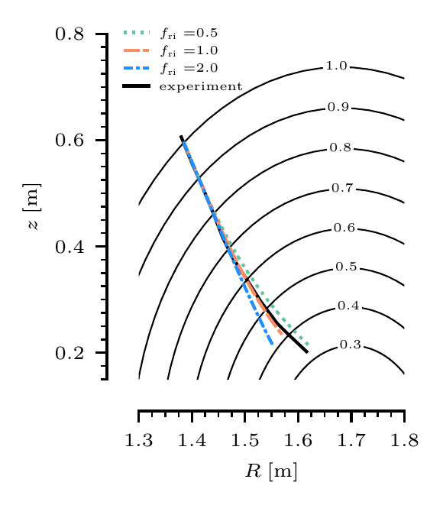

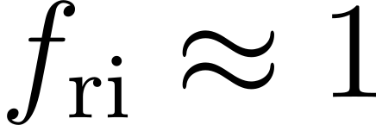
Pellet trajectory simulation in AUG
Coupled ablation rate and rocket force equations
Fix background plasma profiles
  Material drifts away from pellet
Profiles similar to Szepesi et al. JNM (2009)
Result sensitive to ionization radius scale factor , but agrees with experiment with

Slide 17
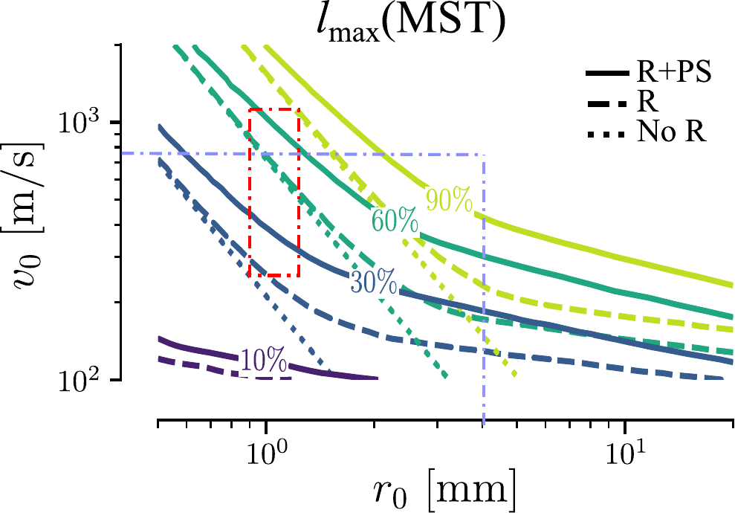
Penetration depth in medium sized tokamaks
Coupled ablation rate and rocket force equations
Fix background plasma profiles
  Material drifts away from pellet
LFS injection, mapping penetration depth in relation to minor radius
Representative H-mode MST profiles
Moderate effect except for slowest/largest pellets/shards
Fueling
+ ELM pacing
SPI shards

Slide 18
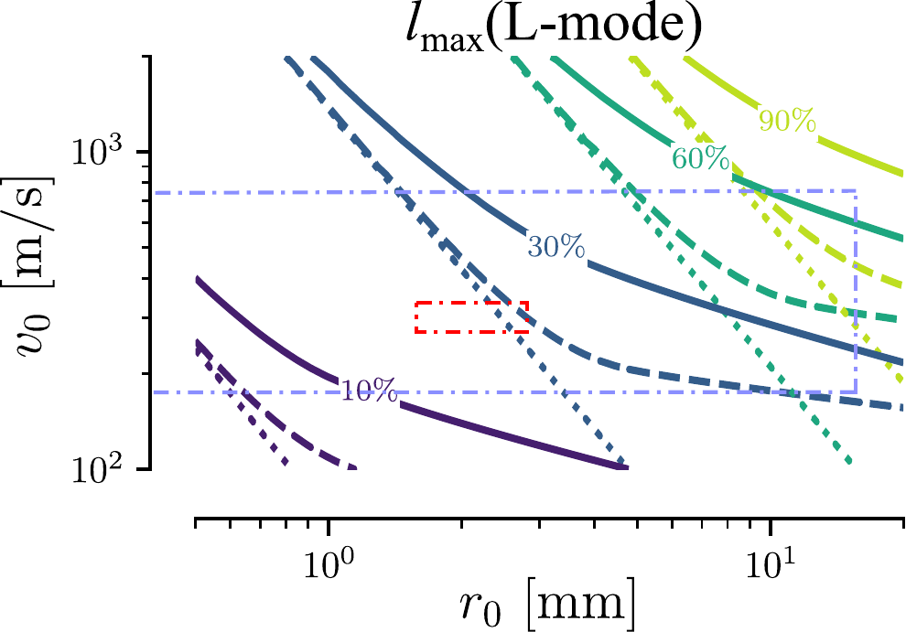
Penetration depth in ITER L-mode
Coupled ablation rate and rocket force equations
Fix background plasma profiles
  Material drifts away from pellet
LFS injection, mapping penetration depth in relation to minor radius
Scenario produced by the CORSICA code [Kim et al NF 2018, Vallhagen et al. NF 2024]
Still moderate rocket effect, but smaller penetration depths
Fueling
+ ELM pacing
SPI shards

Slide 19
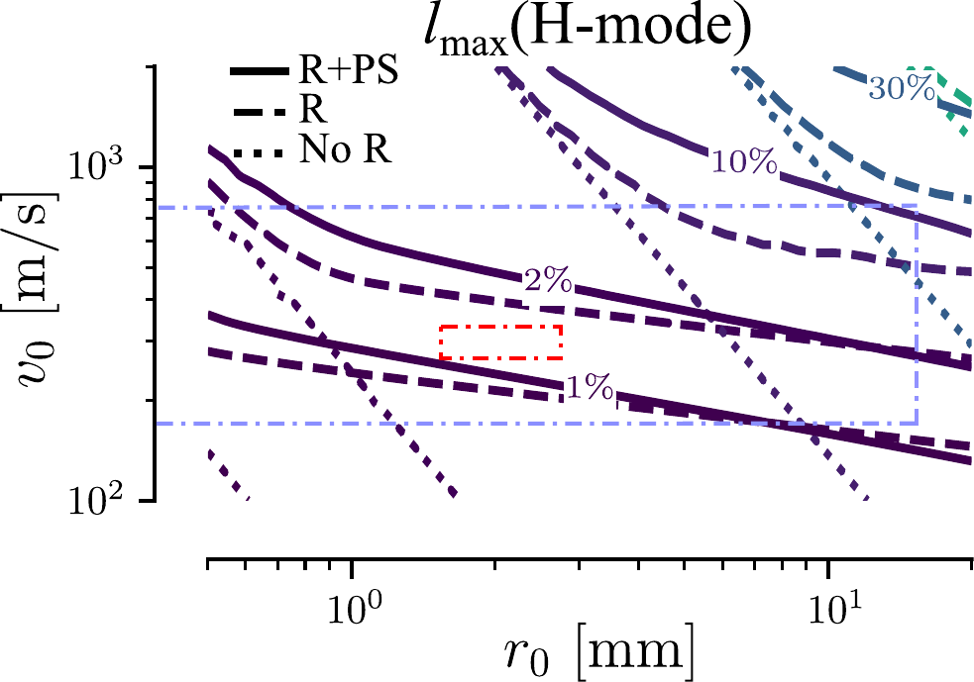
Penetration depth in ITER H-mode
Scenario produced by the CORSICA code [Kim et al NF 2018, Vallhagen et al. NF 2024]
Higher temperature, higher pedestal
=> stronger rocket force
Small penetration depths even without rocket force
  Need cumulative effect of SPI shards (or HFS injection)
Only moderate effect of shielding
  Decrease with ionization radius
  Shielding dampens ablation rate

Slide 20
Conclusion
Summary
Outlook
Developed a self-consistent semi-analytical model for the pellet rocket effect
Asymmetric NGS model
Reasonable agreement with AUG experiments
Could limit penetration depth in ITER, at least in H-mode
Improve on approximations
  Plasmoid profiles
  Effective ionization radius
  Mono-energetic beam
  Radial electron path
Include in self-consistent background plasma model
  HFS injections
  Effect on SPIs with several shards
Notes:
Transition reversed -> approximations
Maybe put Chatgpt joke on top right afterwards

Slide 21
Backup slides

Slide 22
Referenced publications
M. Kong, E. Nardon, M. Hoelzl, D. Bonfiglio, D. Hu, S.-J. Lee, R. Samulyak, U. Sheikh, S. Silburn, F.J. Artola, A. Boboc, G. Bodner, P. Carvalho, E. Delabie, J.M. Fontdecaba, S.N. Gerasimov, T.C. Hender, S. Jachmich, D. Kos, K.D. Lawson, S. Pamela, C. Sommariva, Z̆. S̆tancar, B. Stein-Lubrano, H.J. Sun, R. Sweeney, G. Szepesi, the JOREK Team and JET Contributors (2024). Interpretative 3D MHD modelling of deuterium SPI into a JET H-mode plasma. Nuclear Fusion, 64, 066004. https://iopscience.iop.org/article/10.1088/1741-4326/ad3b1c
Parks, P. B., & Turnbull, R. J. (1978). Effect of transonic flow in the ablation cloud on the lifetime of a solid hydrogen pellet in a plasma. The Physics of Fluids, 21(10), 1735–1741. https://doi.org/10.1063/1.862088
Samulyak, R. (2023). Simulation study of the influence of grad-B drift on pellet ablation dynamics. Theory and Simulation of Disruptions Workshop, Princeton Plasma Physics Laboratory. https://tsdw.pppl.gov/Talks/2023/Samulyak.pdf
Senichenkov, I., Rozhansky, V., & Gusakov, P. (2007). The pellet rocket acceleration caused by B-induced drift. Europhysics Conference Abstracts, 31F, P4.094. https://info.fusion.ciemat.es/OCS/EPS2007/pdf/P4_094.pdf
Szepesi, T., Kálvin, S., Kocsis, G., & Lang, P. T. (2007). Radial acceleration of solid hydrogen pellets in hot tokamak plasmas. 34th EPS Conference on Plasma Physics, 31F, P.4037. https://info.fusion.ciemat.es/OCS/EPS2007/pdf/P4_037.pdf
Szepesi, T., Kálvin, S., Kocsis, G., & Lang, P. T. & Senichenkov, I (2009). Comparison of pellet acceleration model results to experimentally observed penetration depths. Journal of Nuclear Materials, 390-391, 507-510. https://doi.org/10.1016/j.jnucmat.2009.01.063
O. Vallhagen, I. Pusztai, P. Helander, S.L. Newton & T. Fülöp (2023). Drift of ablated material after pellet injection in a tokamak. Journal of Plasma Physics 89 (3), 905890306. https://doi.org/10.1017/S0022377823000466
O. Vallhagen, L. Hanebring, F.J. Artola, M. Lehnen, E. Nardon, T. Fülöp, M. Hoppe, S.L. Newton & I. Pusztai (2024). Runaway electron dynamics in ITER disruptions with shattered pellet injections. Nuclear Fusion, 64 (8), 086033. https://iopscience.iop.org/article/10.1088/1741-4326/ad54d7
N. J. Guth, O. Vallhagen, P. Helander, I. Pusztai, S. L. Newton, & T. Fülöp (2025). Pellet Rocket Effect in Magnetic Confinement Fusion Plasmas. Physical Review Letters 134 (3), 035101. https://journals.aps.org/prl/abstract/10.1103/PhysRevLett.134.035101
N. J. Guth, O. Vallhagen, P. Helander, T. Fülöp, A. Tresnjic, S. L. Newton & I. Pusztai (2025). Submitted to Journal of Plasma Physics. https://arxiv.org/abs/2412.15824

Slide 23
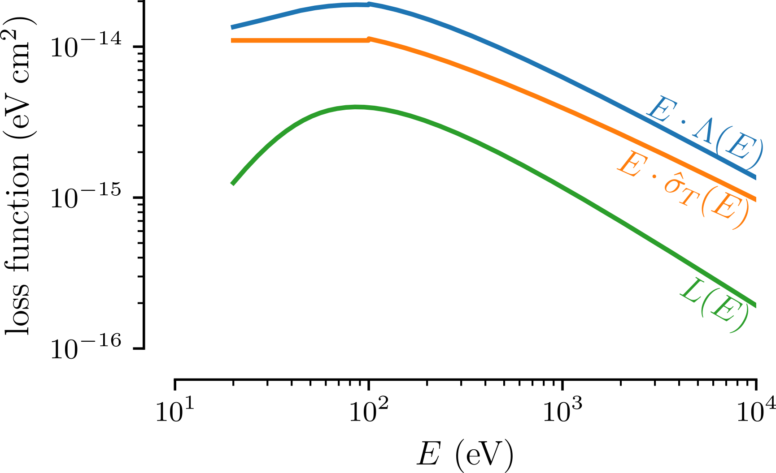
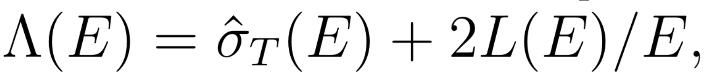
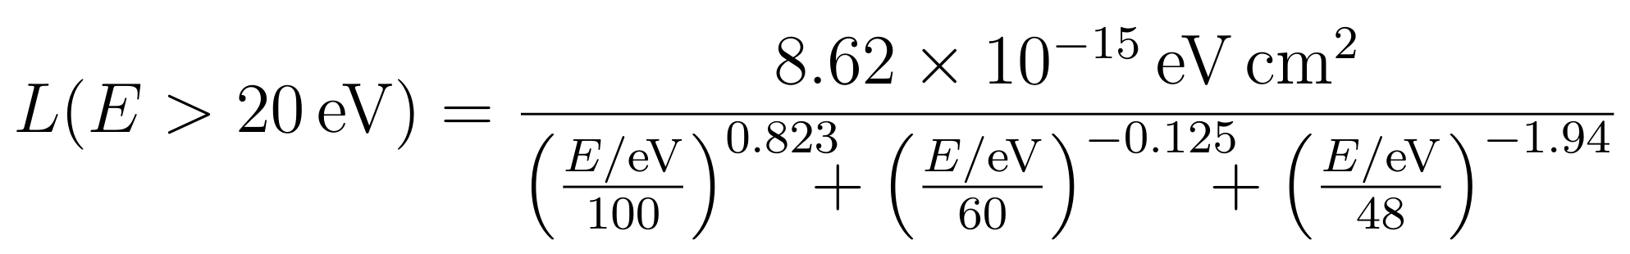
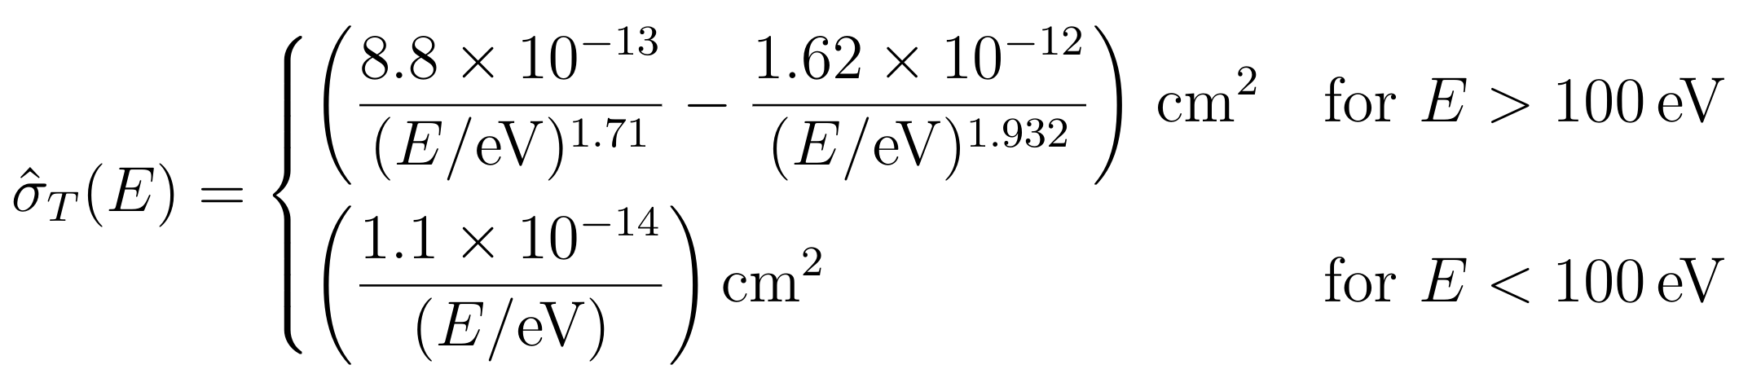
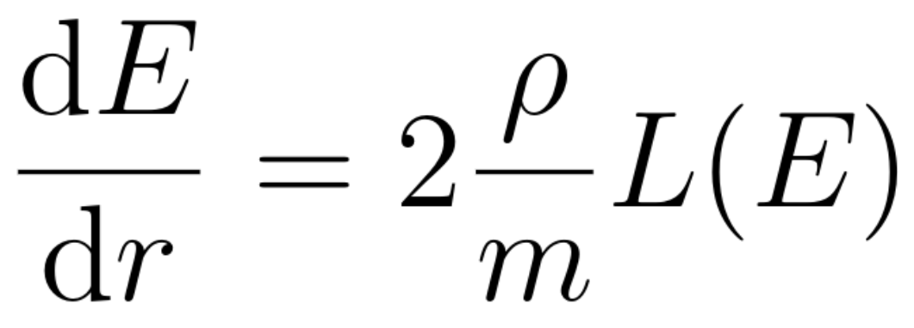

Empirical energy attenuation

Slide 24
Outline of solution
Write in matrix form (algebra using SymPy)
Apparent singularity in C at sonic radius
Enforce continuity => eliminate one unknown
Derivatives at sonic radius from L'Hopitals rule
Initial value problem starting from sonic radius
Find remaining unknowns at sonic radius that satisfy BCs

Slide 25



Full NGS solution

Slide 26





Pressure asymmetry scaling law parameters

Slide 27


Ablation asymmetry at pellet surface
Relative contribution to the rocket force:

Slide 28



Plasmoid shielding length equations

Slide 29





Effect of shielding on instantaneous acceleration
Shielding may affect by factor for most temperatures and gradients
  More with smaller ionization radius
  Indirect effect via ablation rate not included here
  Most deceleration at end of trajectory (at highest temp.) => penetration depth quite insensitive
Ratio of accelerations without/with shielding (ablation rate without shielding!)

Slide 30






Isotropic NGS solutions
ablation rate:
speed of sound:
normalization:
...
Notes:
Don’t show parks results/solutions
skip,

Slide 31

Isotropic NGS scaling laws
validates implementation
  Parks & Turnbull (1977)
weak E dependence (log-scale!)
important for rocket effect:
Notes:
skip

Slide 32

Asymmetric NGS unexpected solutions
Temperature higher
on less heated side
Density explains it
Notes:
skip

Slide 33

Asymmetric NGS unexpected solutions
Pressure higher
on less heated side
→ reversed rocket effect
High-energy electrons
Not observed experimentally
Notes:
skip

Slide 34


Plasmoid shielding asymmetry
Lower energy electrons at less shielded side => negative contribution to
High energy tail on both sides, lower energy electrons stopped earlier in neutral cloud
  Not accounted for with monoenergetic beam
  Energy asymmetry may be underestimated => may use =0 as upper limit

