Slide 1
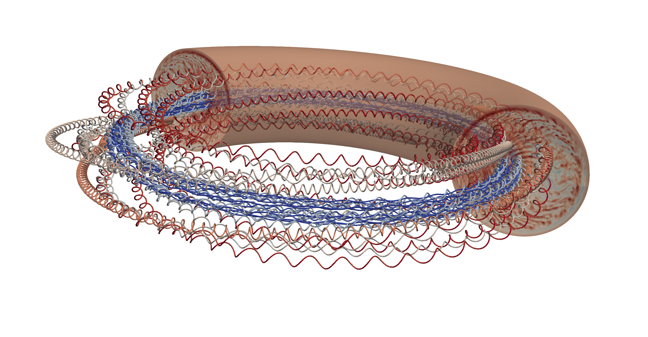
Energetic particle transport in theory, modelling and experiments in magnetically confined plasmas
D. Zarzoso
Aix Marseille Univ, CNRS, Centrale Med, M2P2 UMR 7340, Marseille, France
Acknowledgments
H. Betar, D. del-Castillo-Negrete, B. Clavier, I. Mavrogiannis, J. Varela-Rodriguez, L. Garcia G. Dif-Pradalier, V. Grandgirard, P. Donnel and X. Du
AIM4EP Project (ANR-21-CE30-0018), funded by the French National Research Agency (ANR)

Slide 2
Outline of the presentation
Fundamental physics of energetic particles in tokamaks and basics on transport
Toroidal Accelerated PArticle Simulator (TAPAS)
↪ Example of application to realistic experimental case
Non axi-symmetric modes, both static and rotating (tearing modes)
↪ Purely magnetic large scale $\left(m,n\right)=(2,1)$, $ω≪0$
Ion-temperature gradient (ITG) driven turbulence
↪ Electrostatic with a broad spectrum $(m,n,k_{r})$

Slide 3
Outline of the presentation
Fundamental physics of energetic particles in tokamaks and basics on transport
Toroidal Accelerated PArticle Simulator (TAPAS)
↪ Example of application to realistic experimental case
Non axi-symmetric modes, both static and rotating (tearing modes)
↪ Purely magnetic large scale $\left(m,n\right)=(2,1)$, $ω≪0$
Ion-temperature gradient (ITG) driven turbulence
↪ Electrostatic with a broad spectrum $(m,n,k_{r})$

Slide 4
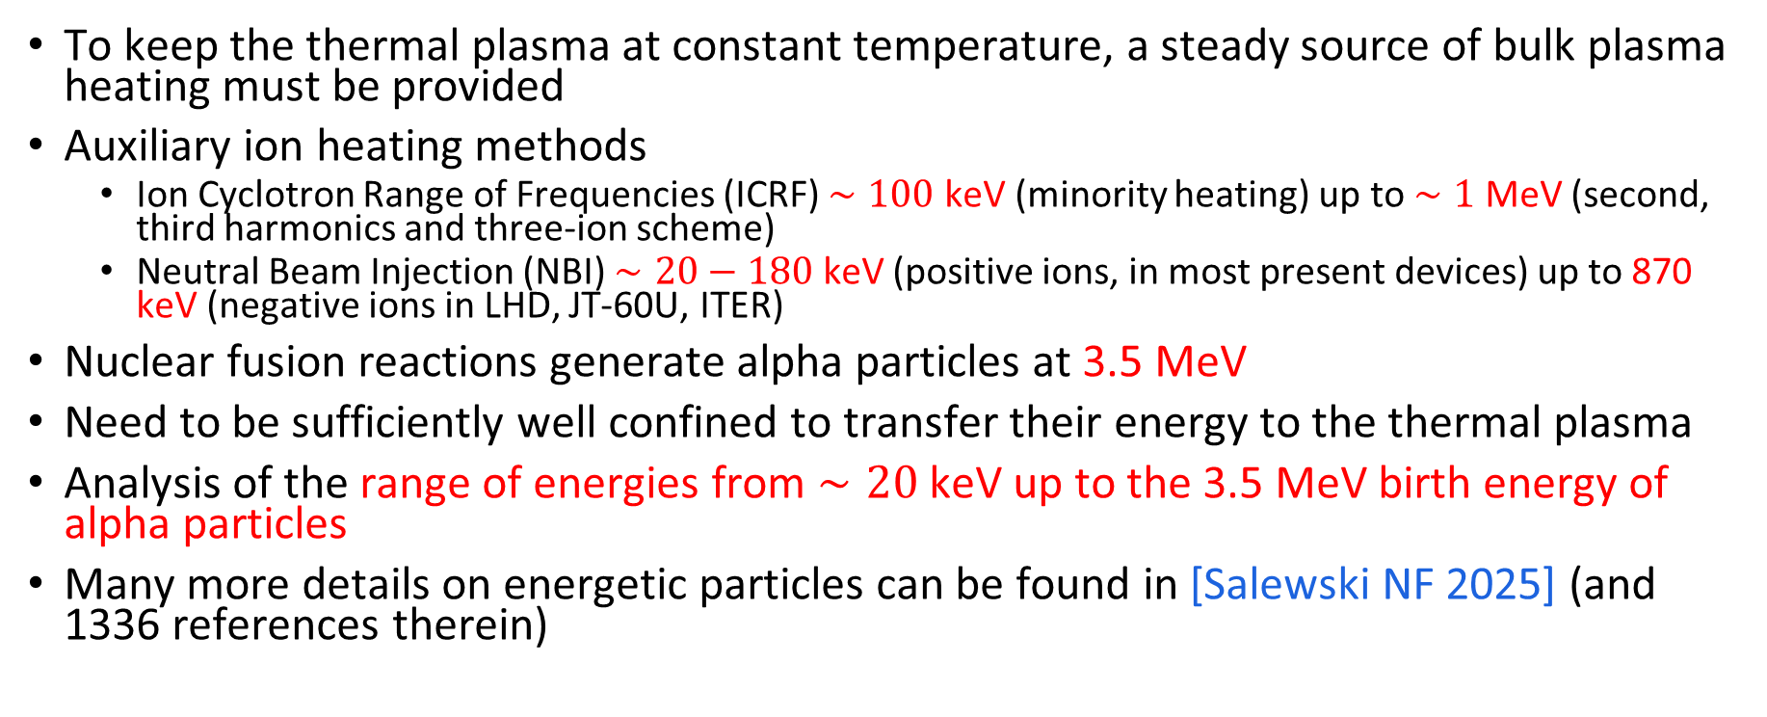
The energies of energetic ions
To keep the thermal plasma at constant temperature, a steady source of bulk plasma heating must be provided
Auxiliary ion heating methods
  Ion Cyclotron Range of Frequencies (ICRF) $∼100$ keV (minority heating) up to $∼1$ MeV (second, third harmonics and three-ion scheme)
  Neutral Beam Injection (NBI) $∼20−180$ keV (positive ions, in most present devices) up to 870 keV (negative ions in LHD, JT-60U, ITER)
Nuclear fusion reactions generate alpha particles at 3.5 MeV
Need to be sufficiently well confined to transfer their energy to the thermal plasma
Analysis of the range of energies from $∼20$ keV up to the 3.5 MeV birth energy of alpha particles
Many more details on energetic particles can be found in [Salewski NF 2025] (and 1336 references therein)

Slide 5



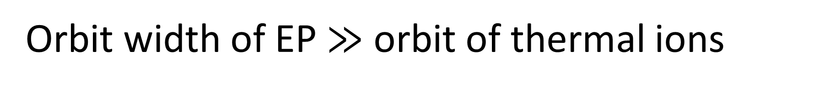
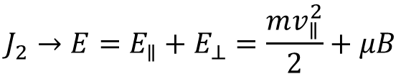

Orbit width of EP $≫$ orbit of thermal ions
The motion of a charged particle in a tokamak is quasi-periodic around the magnetic field lines and in the poloidal and toroidal directions → we define a set of action-angle variables
$⇒J$ are motion invariants associated to the three periodic directions
$$J_{1}=−\frac{mμ}{eZ}$$
$$J_{2}→E=E_{∥}+E_{⊥}=\frac{mv_{∥}^{2}}{2}+μB$$
$J_{3}≡P_{φ}=−eZψ+m\frac{B_{φ}}{B}v_{∥}$
Deviation from the flux surfaces → Orbit width
$$Δ_{passing}∼2qρ_{i}$$
$$Δ_{trapped}∼2qρ_{i}/\sqrt{ε}$$
$Δ_{trapped,α}∼15\%$ to $50\%$ of the minor radius in ITER and JET, respectively

Slide 6
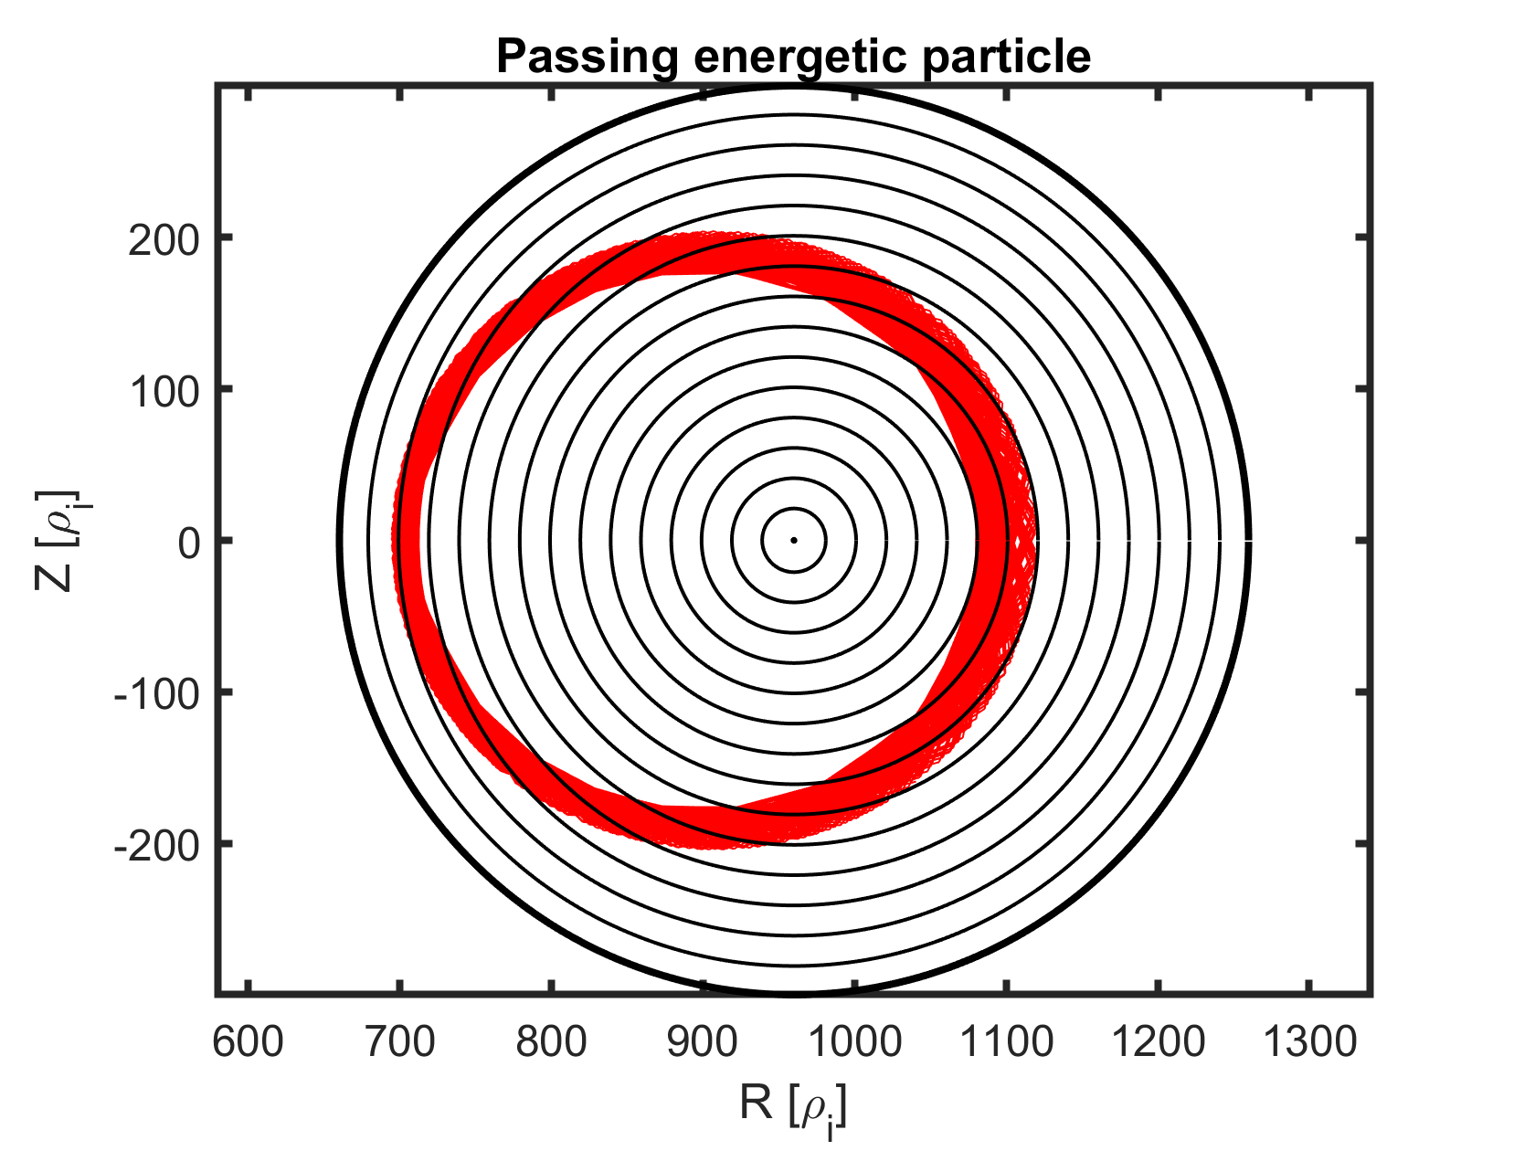
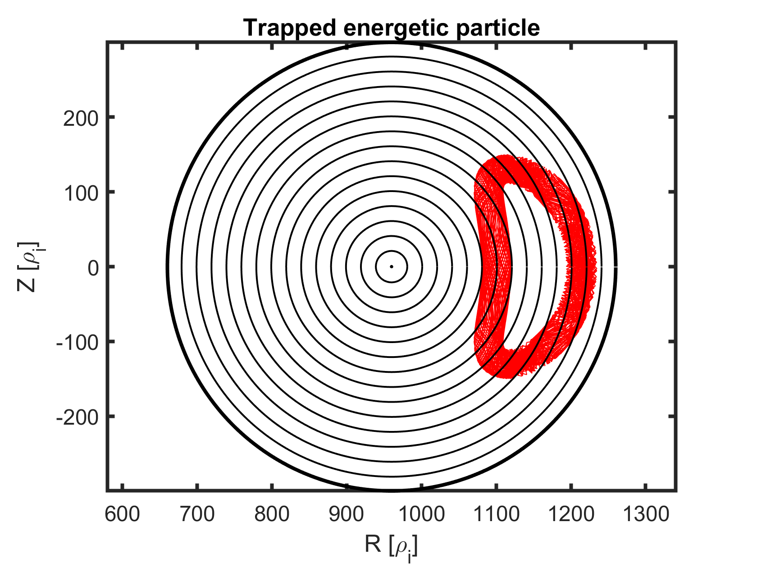
Orbit width of EP $≫$ orbit of thermal ions
The motion of a charged particle in a tokamak is quasi-periodic around the magnetic field lines and in the poloidal and toroidal directions → we define a set of action-angle variables
$⇒J$ are motion invariants associated to the three periodic directions
$$J_{1}=−\frac{mμ}{eZ}$$
$$J_{2}→E=E_{∥}+E_{⊥}=\frac{mv_{∥}^{2}}{2}+μB$$
$J_{3}≡P_{φ}=−eZψ+m\frac{B_{φ}}{B}v_{∥}$
Deviation from the flux surfaces → Orbit width
$$Δ_{passing}∼2qρ_{i}$$
$$Δ_{trapped}∼2qρ_{i}/\sqrt{ε}$$
$Δ_{trapped,α}∼15\%$ to $50\%$ of the minor radius in ITER and JET, respectively

Slide 7
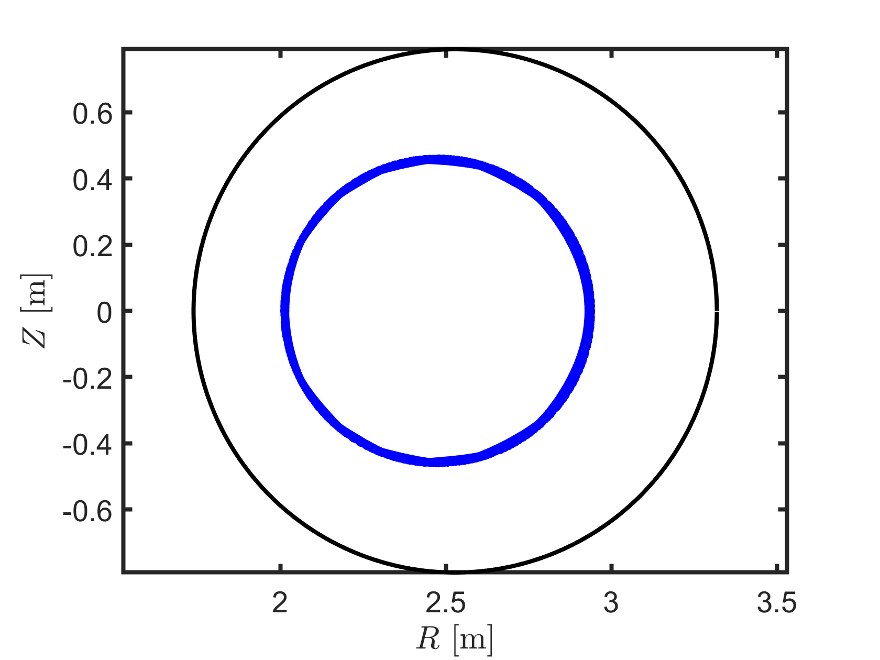
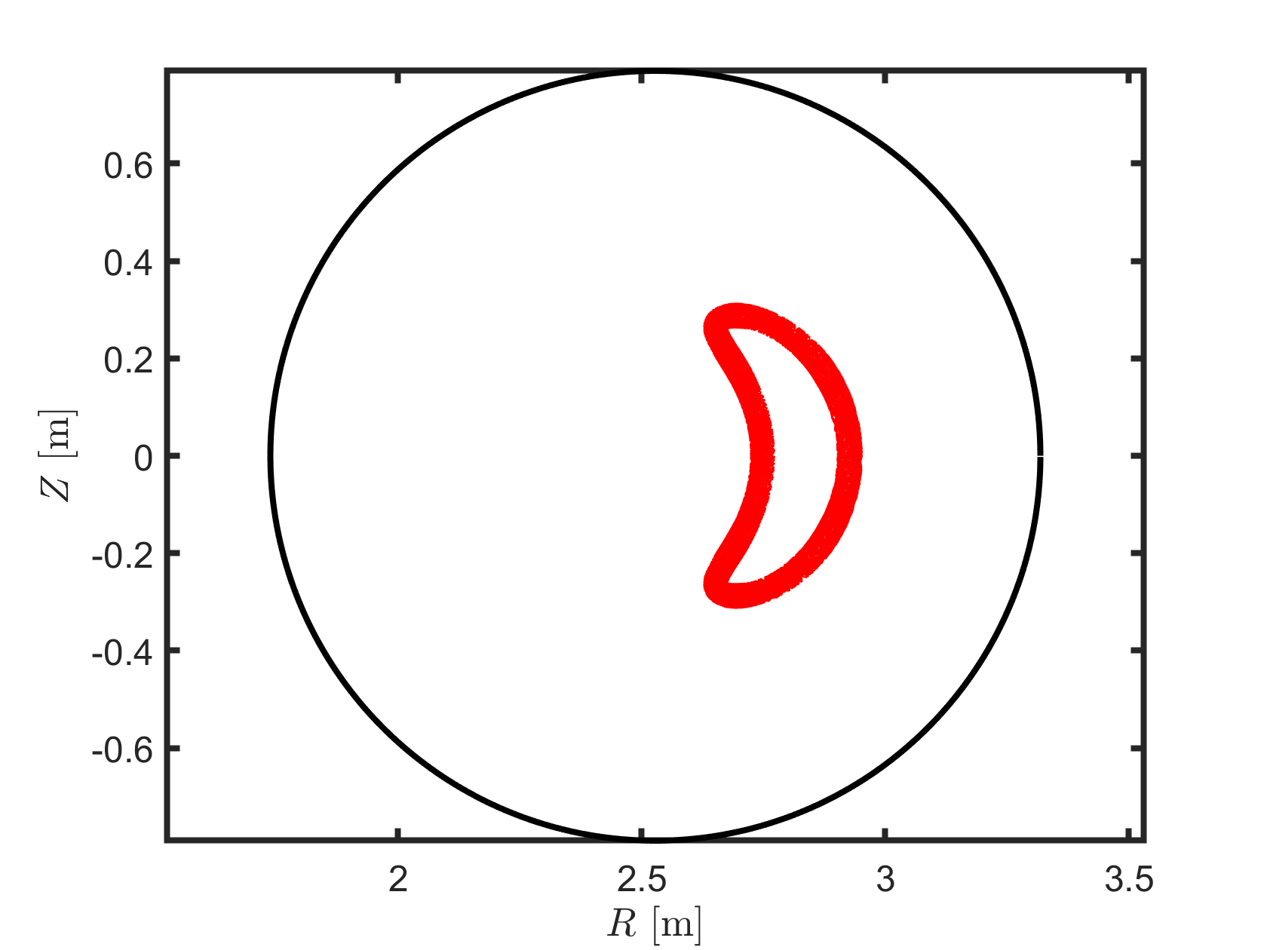
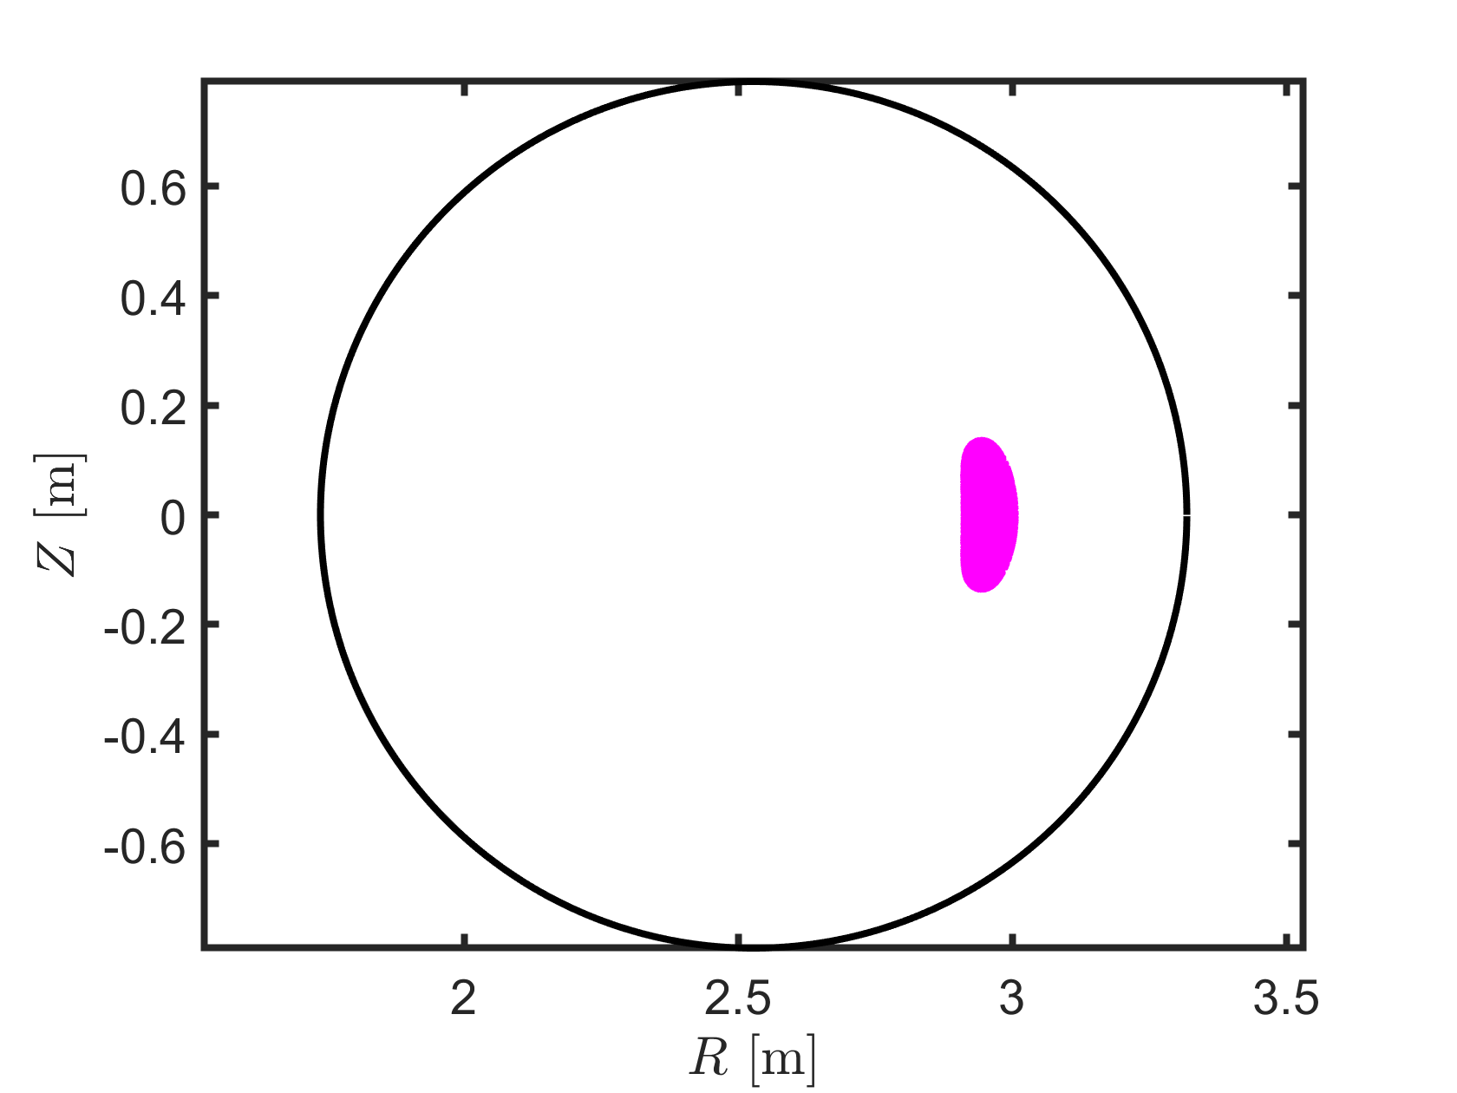
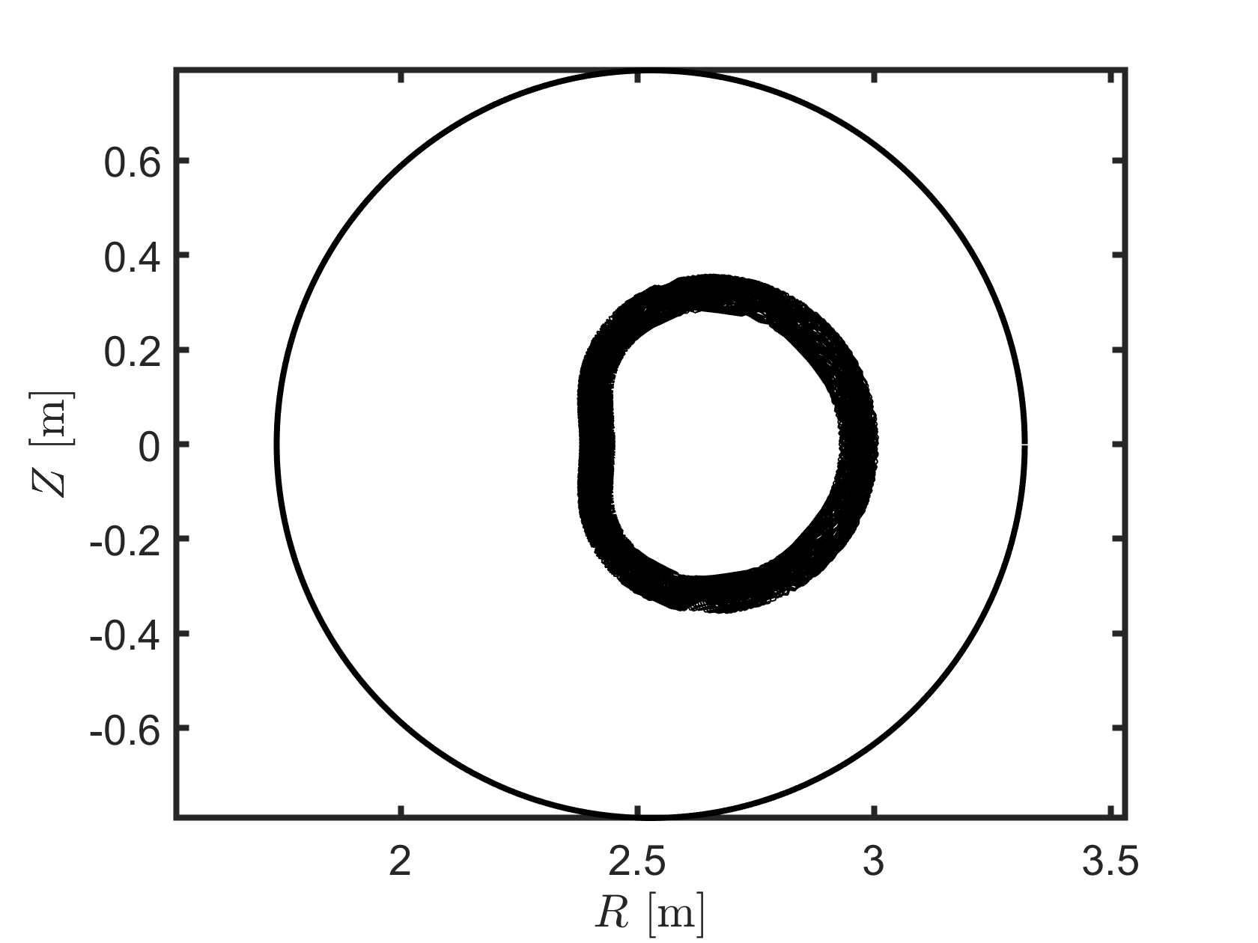
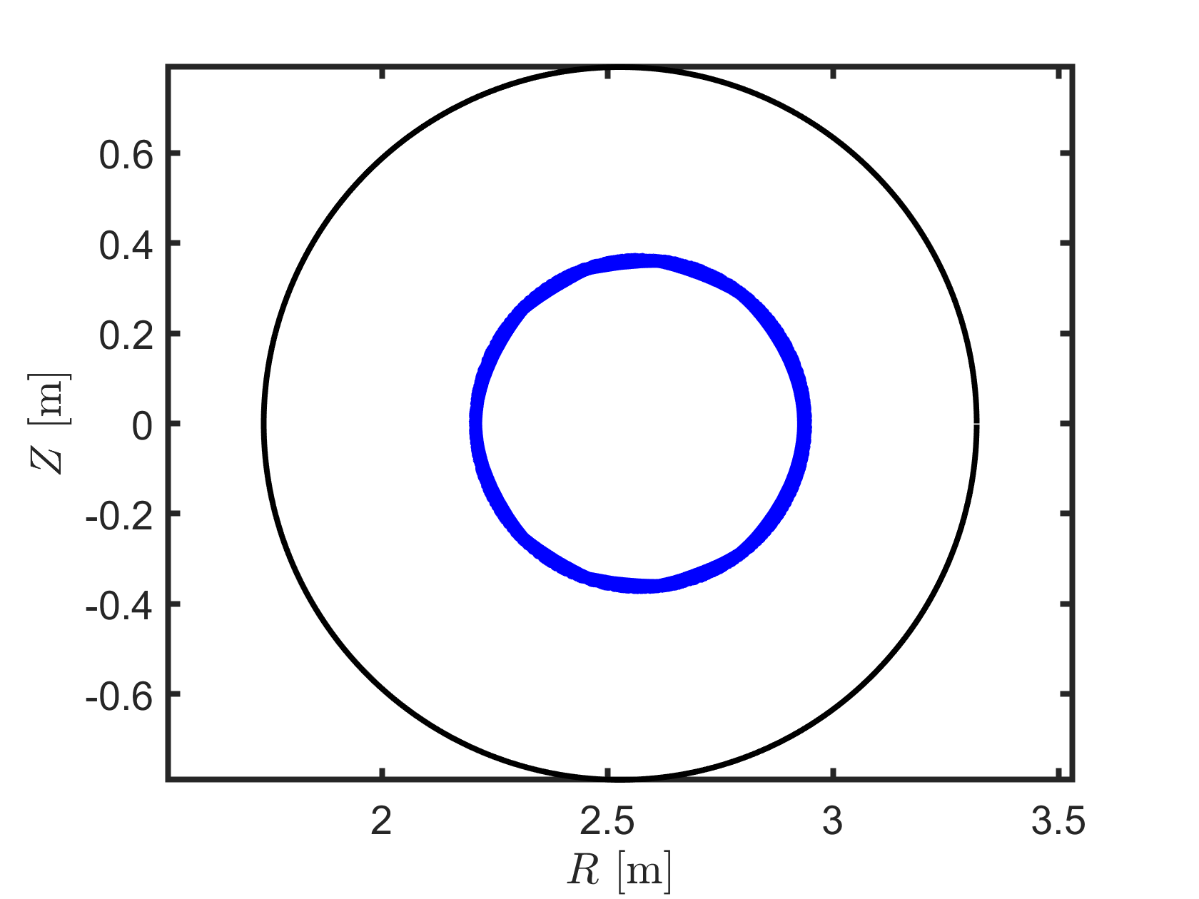
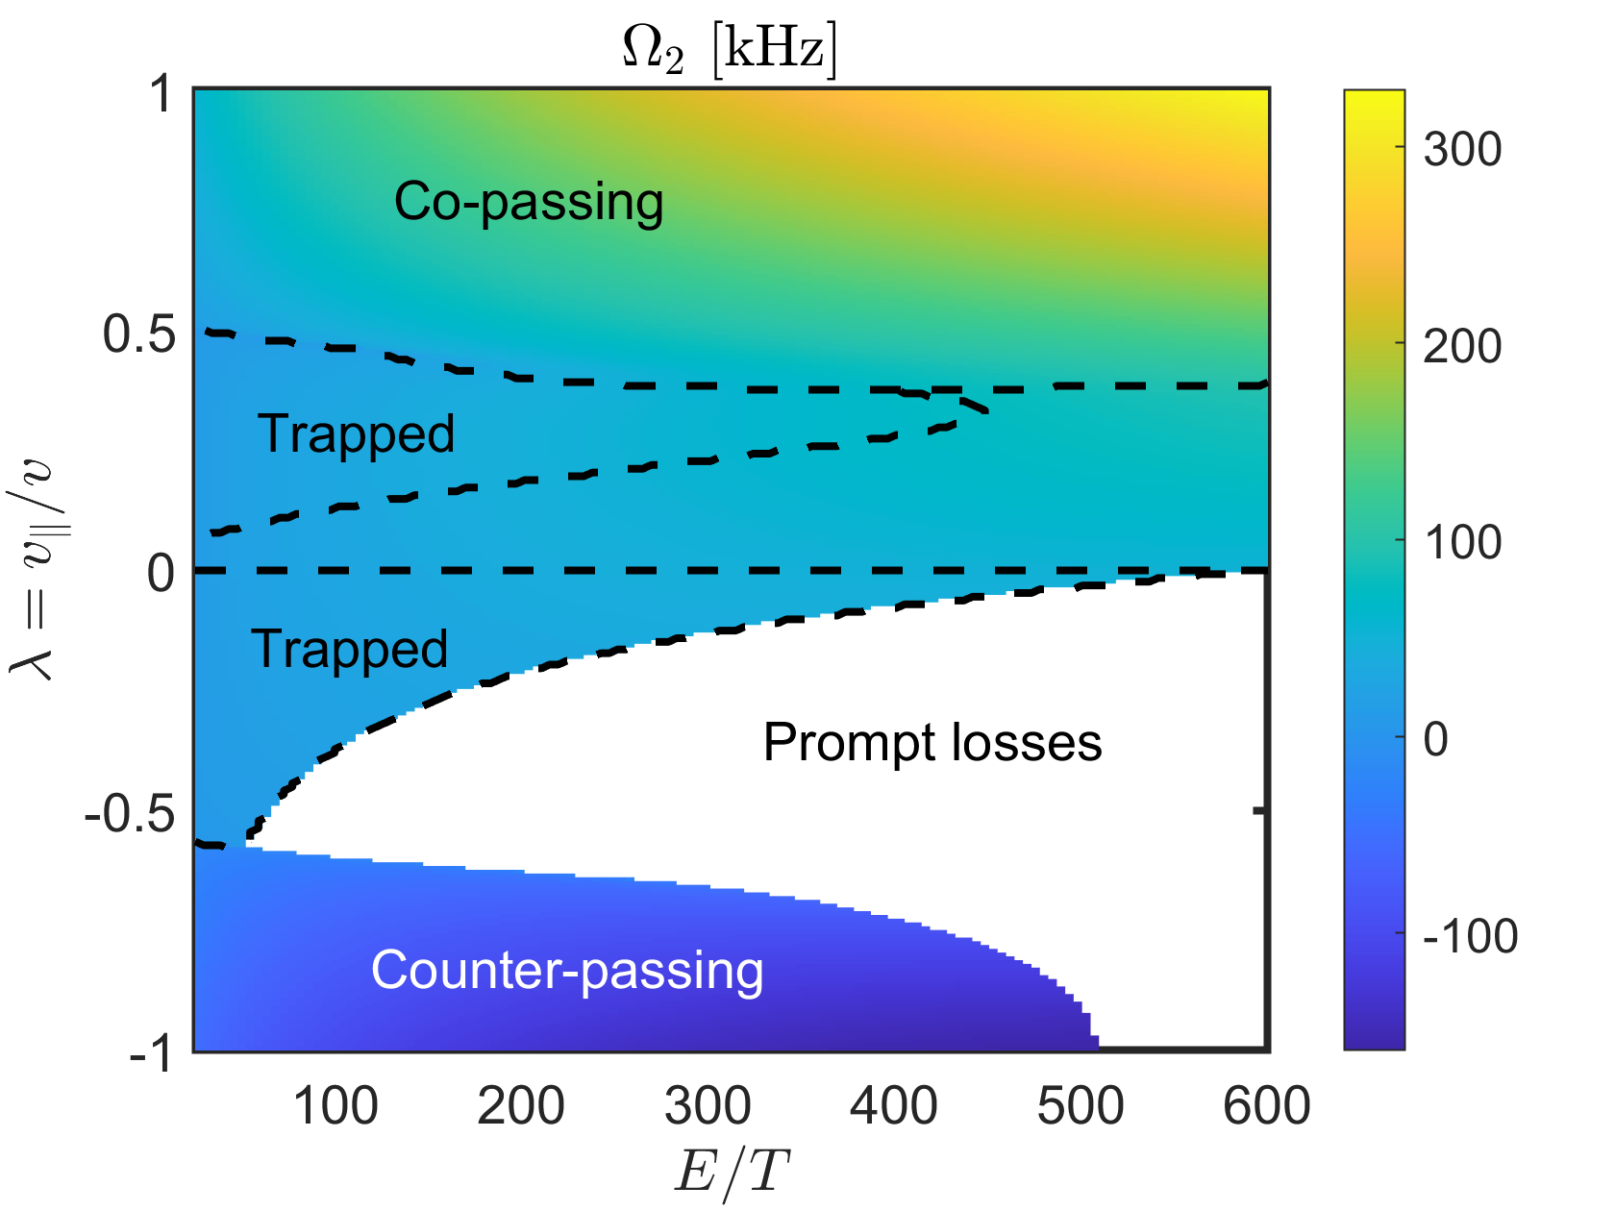
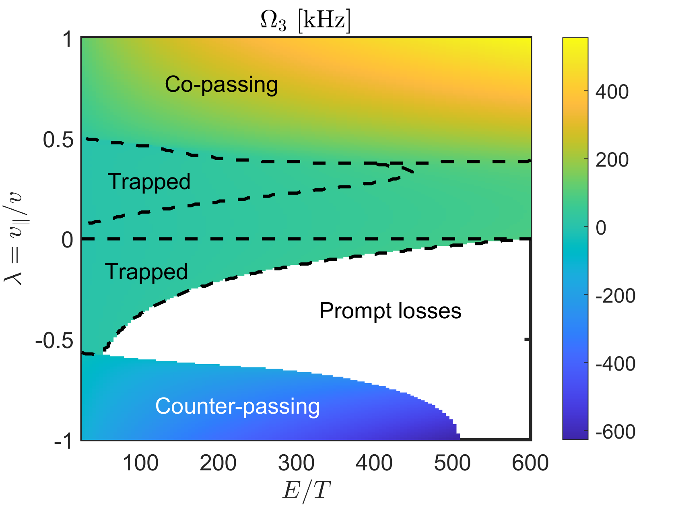
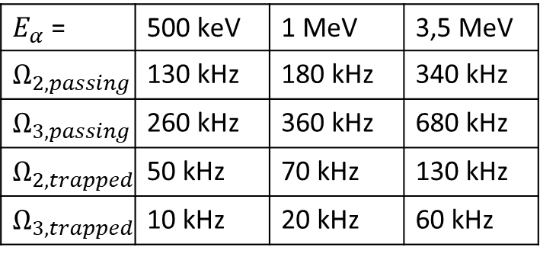
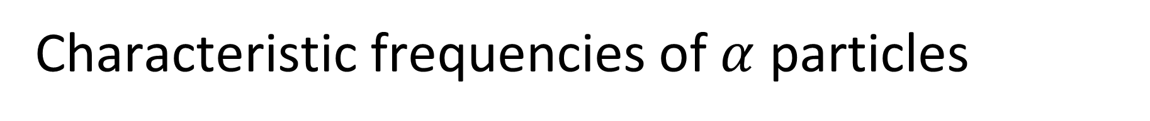
Characteristic frequencies of $α$ particles
Linear resonance: $ω−n_{2}Ω_{2} −n_{3}Ω_{3}=0$ (NL resonances only for large perturbations [Sanchis PPCF 2018, Kramer PRL 2012])
Potato
$E_{α}$ = | 500 keV | 1 MeV | 3,5 MeV
$$Ω_{2,passing}$$ | 130 kHz | 180 kHz | 340 kHz
$$Ω_{3,passing}$$ | 260 kHz | 360 kHz | 680 kHz
$$Ω_{2,trapped}$$ | 50 kHz | 70 kHz | 130 kHz
$$Ω_{3,trapped}$$ | 10 kHz | 20 kHz | 60 kHz
Stagnation

Slide 8
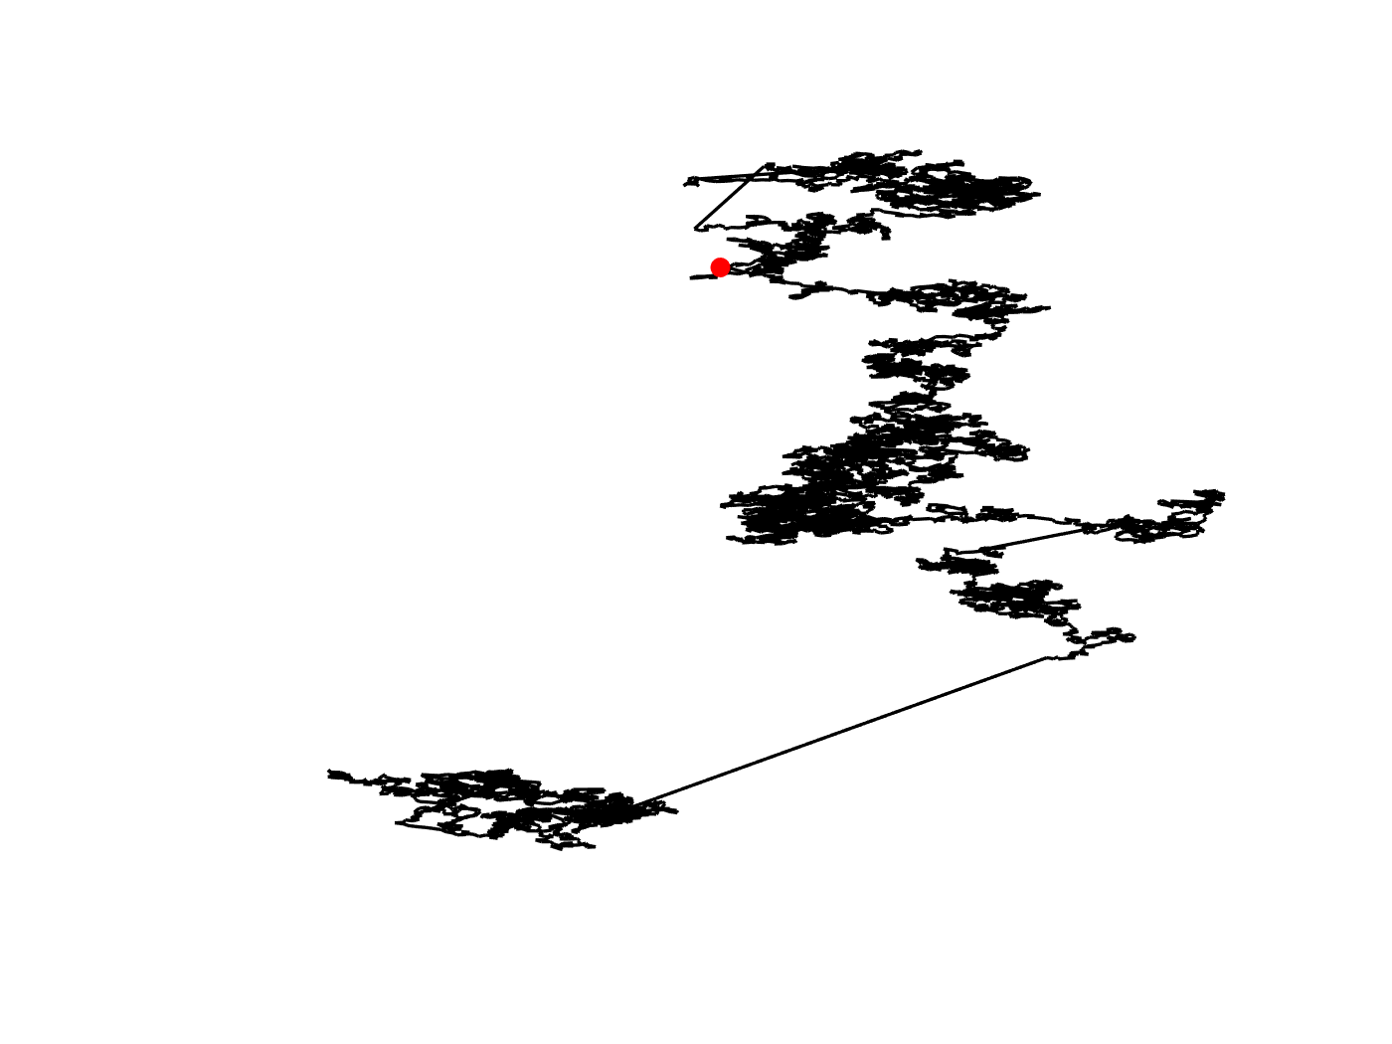
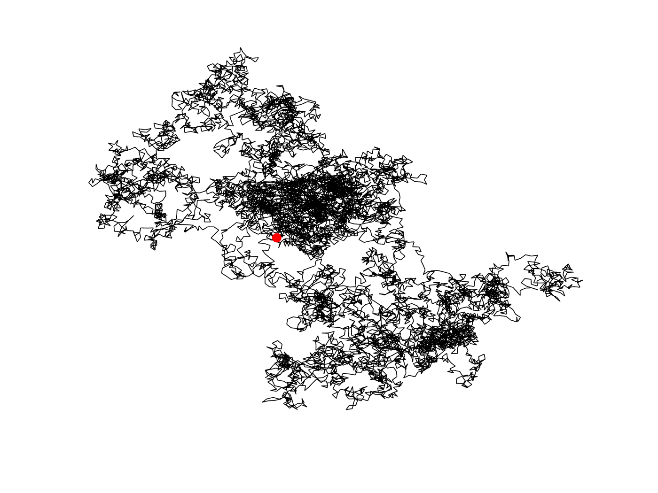
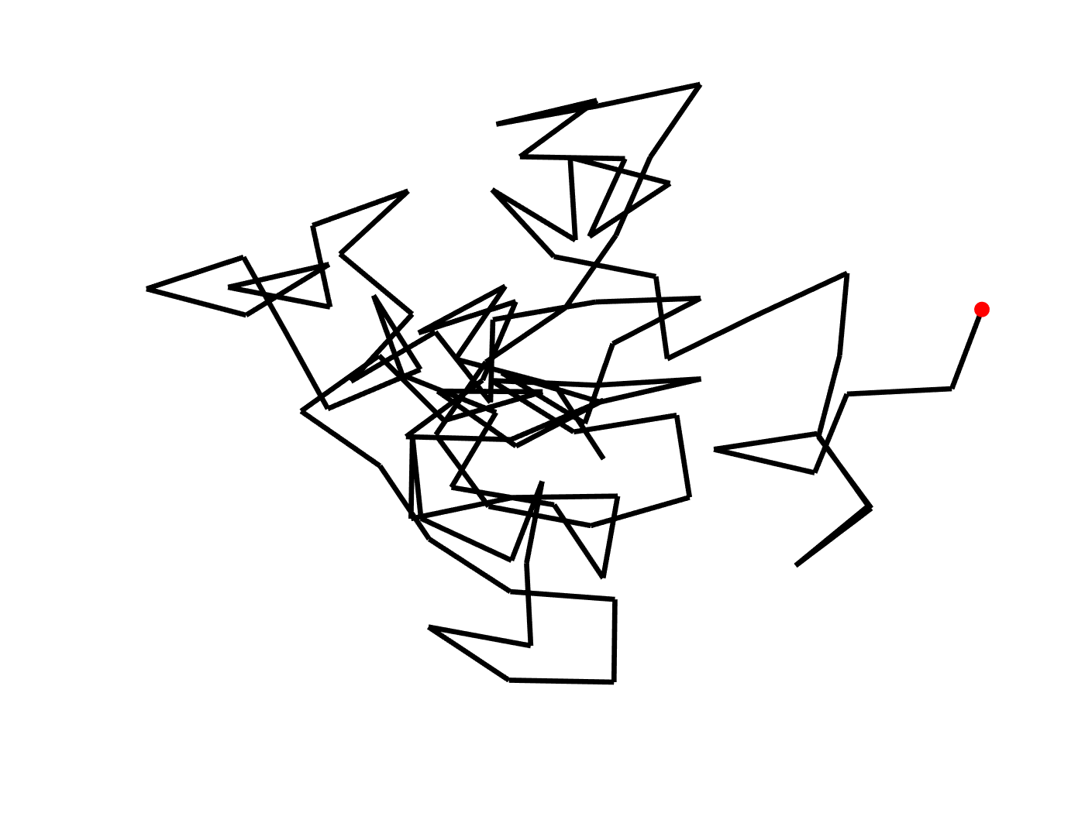
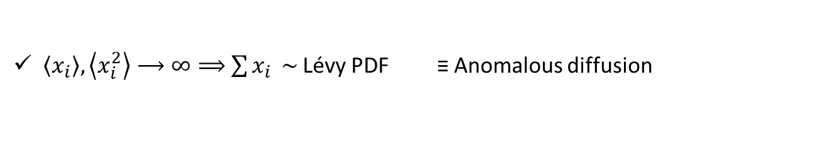
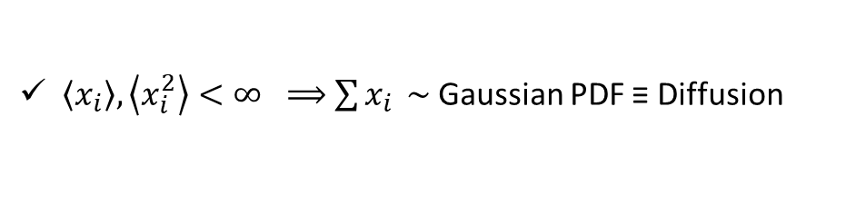

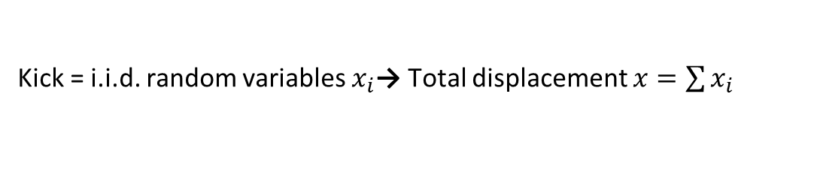


From micro- to macroscopic transport
Microscopic random kicks → Macroscopic transport
$$D_{x}=\frac{1}{2}\frac{dσ_{x}^{2}}{dt}=\frac{1}{2}\frac{d}{dt}⟨{\left(Δx−\left\langle Δx\right\rangle \right)}^{2}⟩$$
$↪$ Statistics of micro-scale motion governs the nature of transport
Kick = i.i.d. random variables $x_{i}$→ Total displacement $x=\sum{x_{i}}$
$\left\langle x_{i}\right\rangle ,\left\langle x_{i}^{2}\right\rangle <∞ ⟹$ $\sum{x_{i}} \sim$Gaussian PDF ≡ Diffusion
$\left\langle x_{i}\right\rangle ,\left\langle x_{i}^{2}\right\rangle ⟶∞⟹$ $\sum{x_{i}} \sim$Lévy PDF ≡ Anomalous diffusion
$$\left\langle {Δx}^{2}\right\rangle ∼t$$
$$\left\langle {Δx}^{2}\right\rangle ∼t^{γ},γ≠1$$
From [Heidbrink PoP 2020]

Slide 9
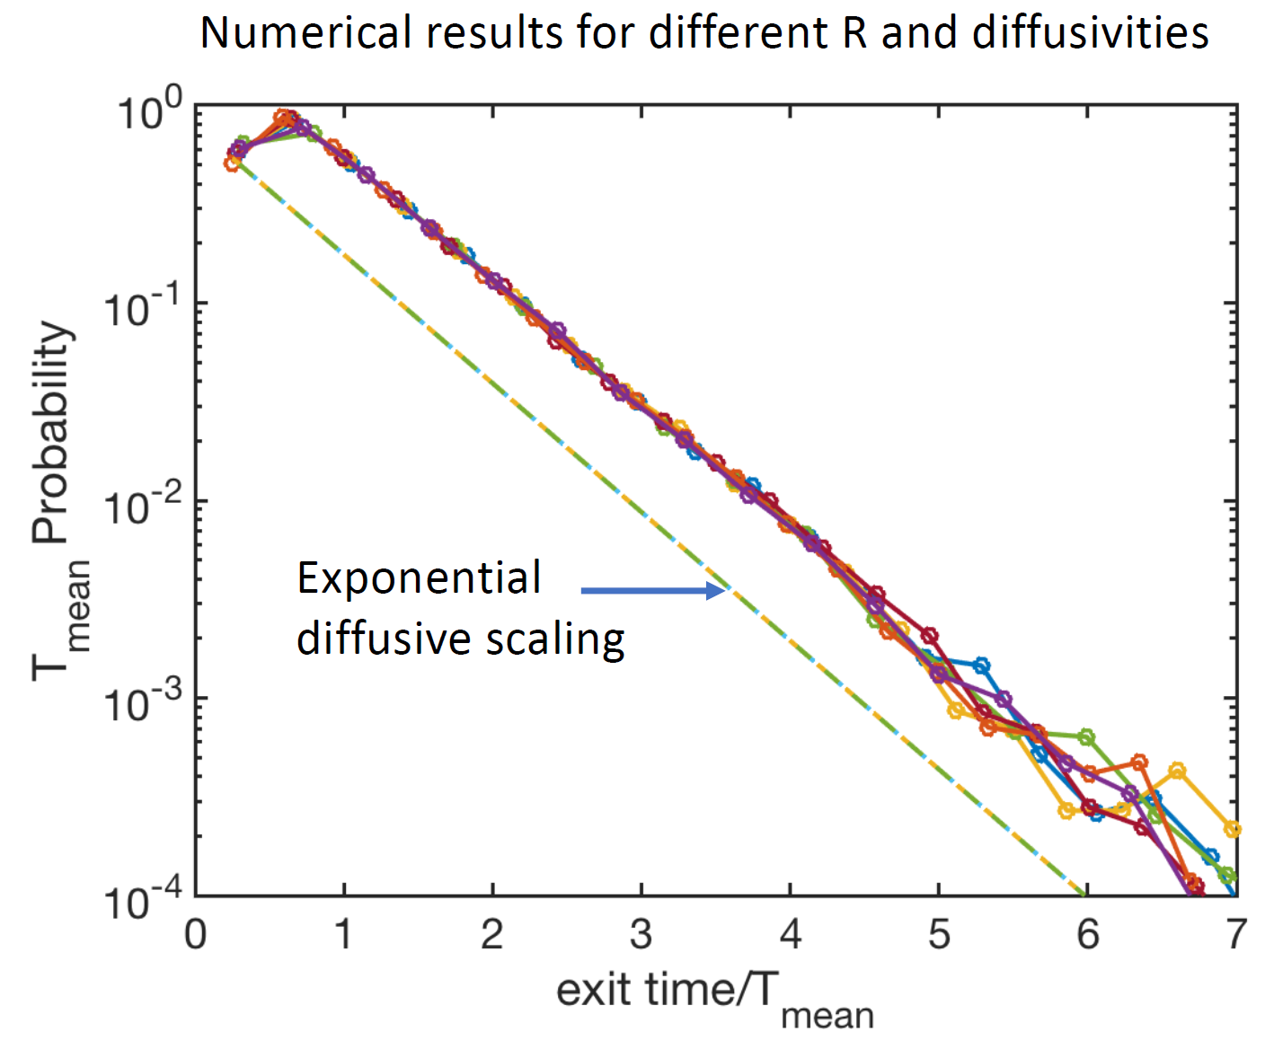
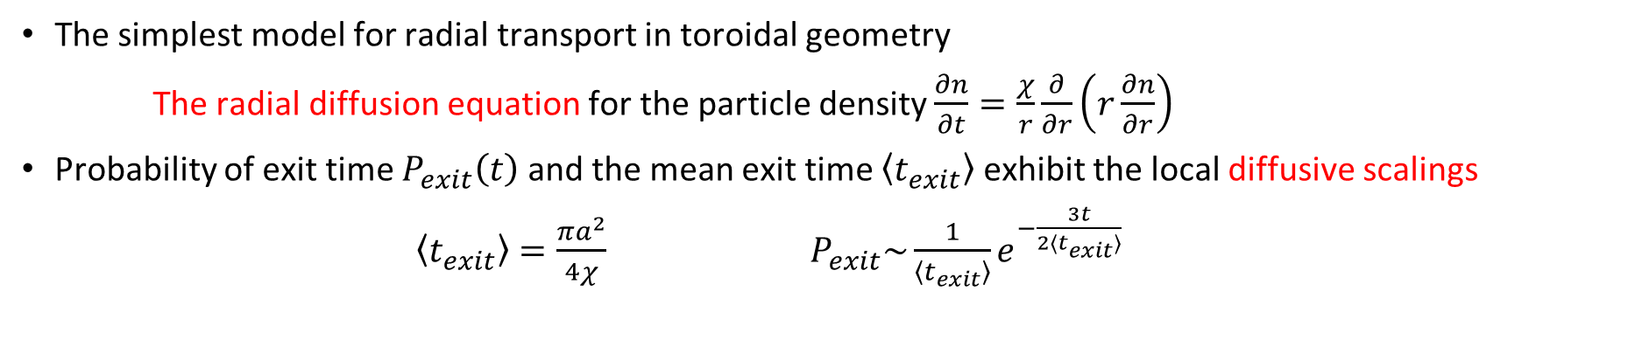

Diffusion → Exponential decay $P_{exit}∼e^{−μ_{e}t}$
The simplest model for radial transport in toroidal geometry
The radial diffusion equation for the particle density $\frac{∂n}{∂t}=\frac{χ}{r}\frac{∂}{∂r}\left(r\frac{∂n}{∂r}\right)$
Probability of exit time $P_{exit}\left(t\right)$ and the mean exit time $\left\langle t_{exit}\right\rangle$ exhibit the local diffusive scalings
$\left\langle t_{exit}\right\rangle =\frac{πa^{2}}{4χ}$ $P_{exit}\sim \frac{1}{\left\langle t_{exit}\right\rangle }e^{−\frac{3t}{2⟨t_{exit}⟩}}$
$$a$$

Slide 10
Outline of the presentation
Fundamental physics of energetic particles in tokamaks and basics on transport
Toroidal Accelerated PArticle Simulator (TAPAS)
↪ Example of application to realistic experimental case
Non axi-symmetric modes, both static and rotating (tearing modes)
↪ Purely magnetic large scale $\left(m,n\right)=(2,1)$, $ω≪0$
Ion-temperature gradient (ITG) driven turbulence
↪ Electrostatic with a broad spectrum $(m,n,k_{r})$

Slide 11
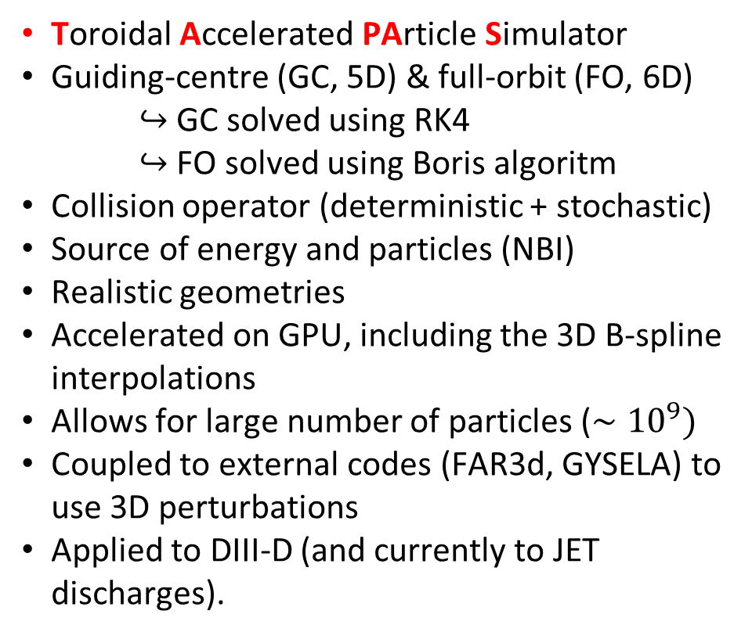
TAPAS to study the transport of EP
Toroidal Accelerated PArticle Simulator
Guiding-centre (GC, 5D) & full-orbit (FO, 6D)
↪ GC solved using RK4
↪ FO solved using Boris algoritm
Collision operator (deterministic + stochastic)
Source of energy and particles (NBI)
Realistic geometries
Accelerated on GPU, including the 3D B-spline interpolations
Allows for large number of particles ($∼{10}^{9})$
Coupled to external codes (FAR3d, GYSELA) to use 3D perturbations
Applied to DIII-D (and currently to JET discharges).
[H. Betar, D. Zarzoso et al Nuclear Fusion 2024]

Slide 12
Coupling with FAR3d code to model EP transport
FAR3d solves the reduced MHD equations for the thermal plasma and the density and parallel velocity equations for the EP population using a two-pole closure model [Varela Frontiers in Physics 2024]
Applied to the discharge #159243 of DIII-D with $β_{EP}=3\%$ using the modes $n=0 \left(m=−14,…,14\right), n=3 \left(m=−20,…,20\right), n=6 (−52,…,52)$
RSAE excited by passing Deuterium (tangential NBI), with presence of zonal flows and bursty behaviour in the inner part of the plasma, correlated with the location of the Alfvén activity
Monoenergetic beam exhibits losses near the prompt losses region [Betar NF 2024]

Slide 13
Outline of the presentation
Fundamental physics of energetic particles in tokamaks and basics on transport
Toroidal Accelerated PArticle Simulator (TAPAS)
↪ Example of application to realistic experimental case
Non axi-symmetric modes, both static and rotating (tearing modes)
↪ Purely magnetic large scale $\left(m,n\right)=(2,1)$, $ω≪0$
Ion-temperature gradient (ITG) driven turbulence
↪ Electrostatic with a broad spectrum $(m,n,k_{r})$

Slide 14
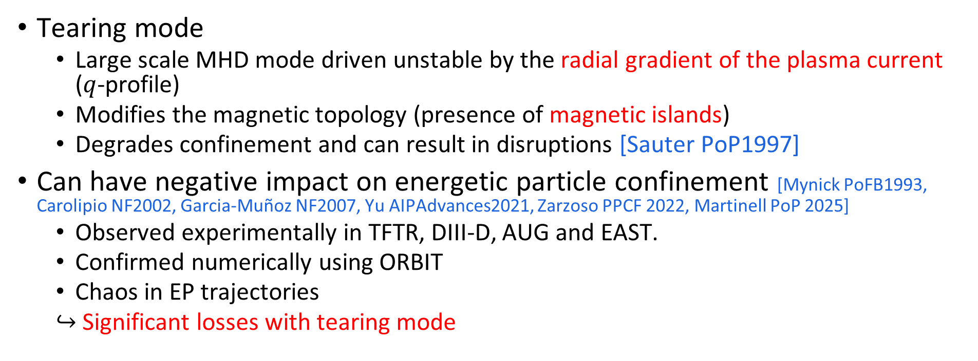
Magnetic islands → EP transport and losses
Tearing mode
  Large scale MHD mode driven unstable by the radial gradient of the plasma current ($q$-profile)
  Modifies the magnetic topology (presence of magnetic islands)
  Degrades confinement and can result in disruptions [Sauter PoP1997]
Can have negative impact on energetic particle confinement [Mynick PoFB1993, Carolipio NF2002, Garcia-Muñoz NF2007, Yu AIPAdvances2021, Zarzoso PPCF 2022, Martinell PoP 2025]
  Observed experimentally in TFTR, DIII-D, AUG and EAST.
  Confirmed numerically using ORBIT
  Chaos in EP trajectories
  ↪ Significant losses with tearing mode
With tearing mode
W/o tearing mode
From [Garcia-Muñoz NF2007]

Slide 15



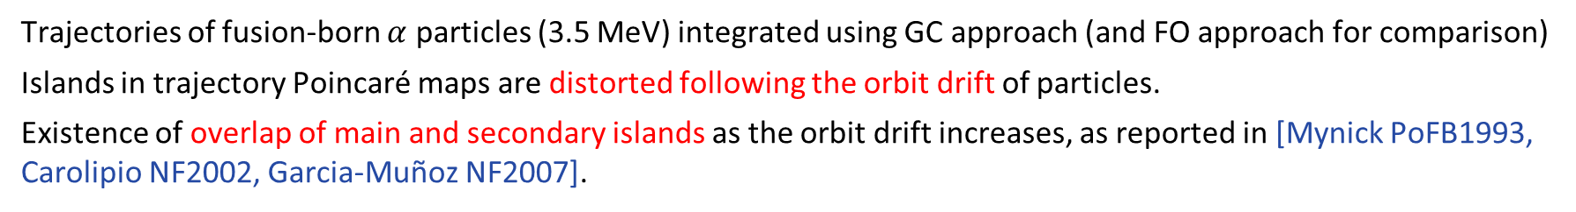
Transition to chaos
Trajectories of fusion-born $α$ particles (3.5 MeV) integrated using GC approach (and FO approach for comparison)
Islands in trajectory Poincaré maps are distorted following the orbit drift of particles.
Existence of overlap of main and secondary islands as the orbit drift increases, as reported in [Mynick PoFB1993, Carolipio NF2002, Garcia-Muñoz NF2007].
$E=5$ keV
$E=1$ MeV
$E=3.5$ MeV

Slide 16
Mainly passing particles are affected by the magnetic island
Losses increase with the width of the island (as expected), more important for passing than for trapped particles
Significant losses, but less pronounced than in [Bonofiglo NF 2025], with mild stochasticity due to the absence of higher order harmonics and different initialization of $α$ particle population.
Further analyses are required to assess the impact on the $α$ confinement during the whole slowing-down process.

Slide 17
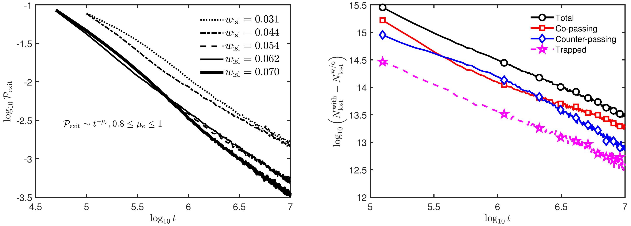
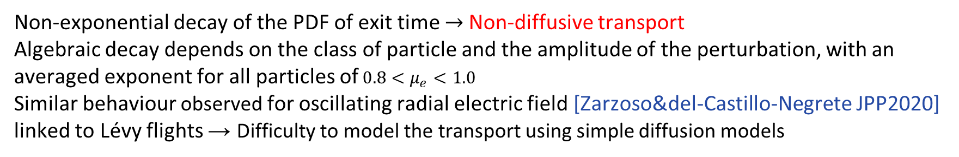
Magnetic island induced transport is non-diffusive
Non-exponential decay of the PDF of exit time → Non-diffusive transport
Algebraic decay depends on the class of particle and the amplitude of the perturbation, with an averaged exponent for all particles of $0.8<μ_{e}<1.0$
Similar behaviour observed for oscillating radial electric field [Zarzoso&del-Castillo-Negrete JPP2020] linked to Lévy flights → Difficulty to model the transport using simple diffusion models

Slide 18


Impact of rotation on the losses of particles
A magnetic island rotates in the plasma frame, except when it is locked
We introduce a rotation in the ion direction ($ω_{island}>0$) or in the opposite direction ($ω_{island}<0$)
Losses are increased for trapped particles and for co-passing particles for $ω_{island}>0$
Losses are reduced for counter-passing particles for $ω_{island}<0$
$$ω_{island}<0$$
$$ω_{island}>0$$

Slide 19



Effects of resonances on the losses of particles
Resonances mainly present in the co- and counter-passing regions → Losses of passing particles are more pronounced
Negative rotation frequency → Resonances are pushed towards the inner part of the counter-passing region and towards the outer part of the co-passing region $⇒$ Counter-passing particles are more affected by islands with $ω_{island}<0$
Positive rotation frequency → Resonances are pushed towards the trapped region $⇒$ Trapped particles are more affected by islands with $ω_{island}>0$
$$ω_{island}<0$$
$$ω_{island}=0$$
$$ω_{island}>0$$

Slide 20
Effects of resonances on the losses of particles
Resonances mainly present in the co- and counter-passing regions → Losses of passing particles are more pronounced
Negative rotation frequency → Resonances are pushed towards the inner part of the counter-passing region and towards the outer part of the co-passing region $⇒$ Counter-passing particles are more affected by islands with $ω_{island}<0$
Positive rotation frequency → Resonances are pushed towards the trapped region $⇒$ Trapped particles are more affected by islands with $ω_{island}>0$
The location of the resonances is correlated with the probability of losses, similar to [Sanchis PPCF 2018]
$$ω_{island}<0$$
$$ω_{island}=0$$
$$ω_{island}>0$$

Slide 21
Finite Larmor radius effects through full-orbit simulations
Need to perform simulations in full-orbit, following [Martinell PoP 2025]
↪ Energies characteristic of NBI heating (10 keV and 50 keV)
↪ Similar behaviour due to island rotation (resonances effect)
↪ But GC less sensitive to magnetic island rotation than FO

Slide 22
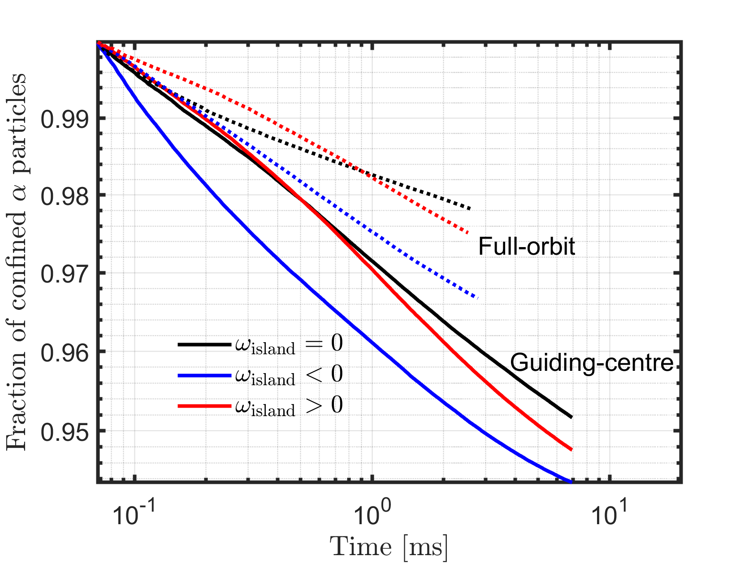
Finite Larmor radius effects through full-orbit simulations
Need to perform simulations in full-orbit, following [Martinell PoP 2025]
↪ Energies characteristic of NBI heating (10 keV and 50 keV)
↪ Similar behaviour due to island rotation (resonances effect)
↪ But GC less sensitive to magnetic island rotation than FO
In TAPAS, full-orbit seems to produce less transport than GC ($α$ particles at 3.5 MeV with an island width $\sim ρ_{α}$)

Slide 23
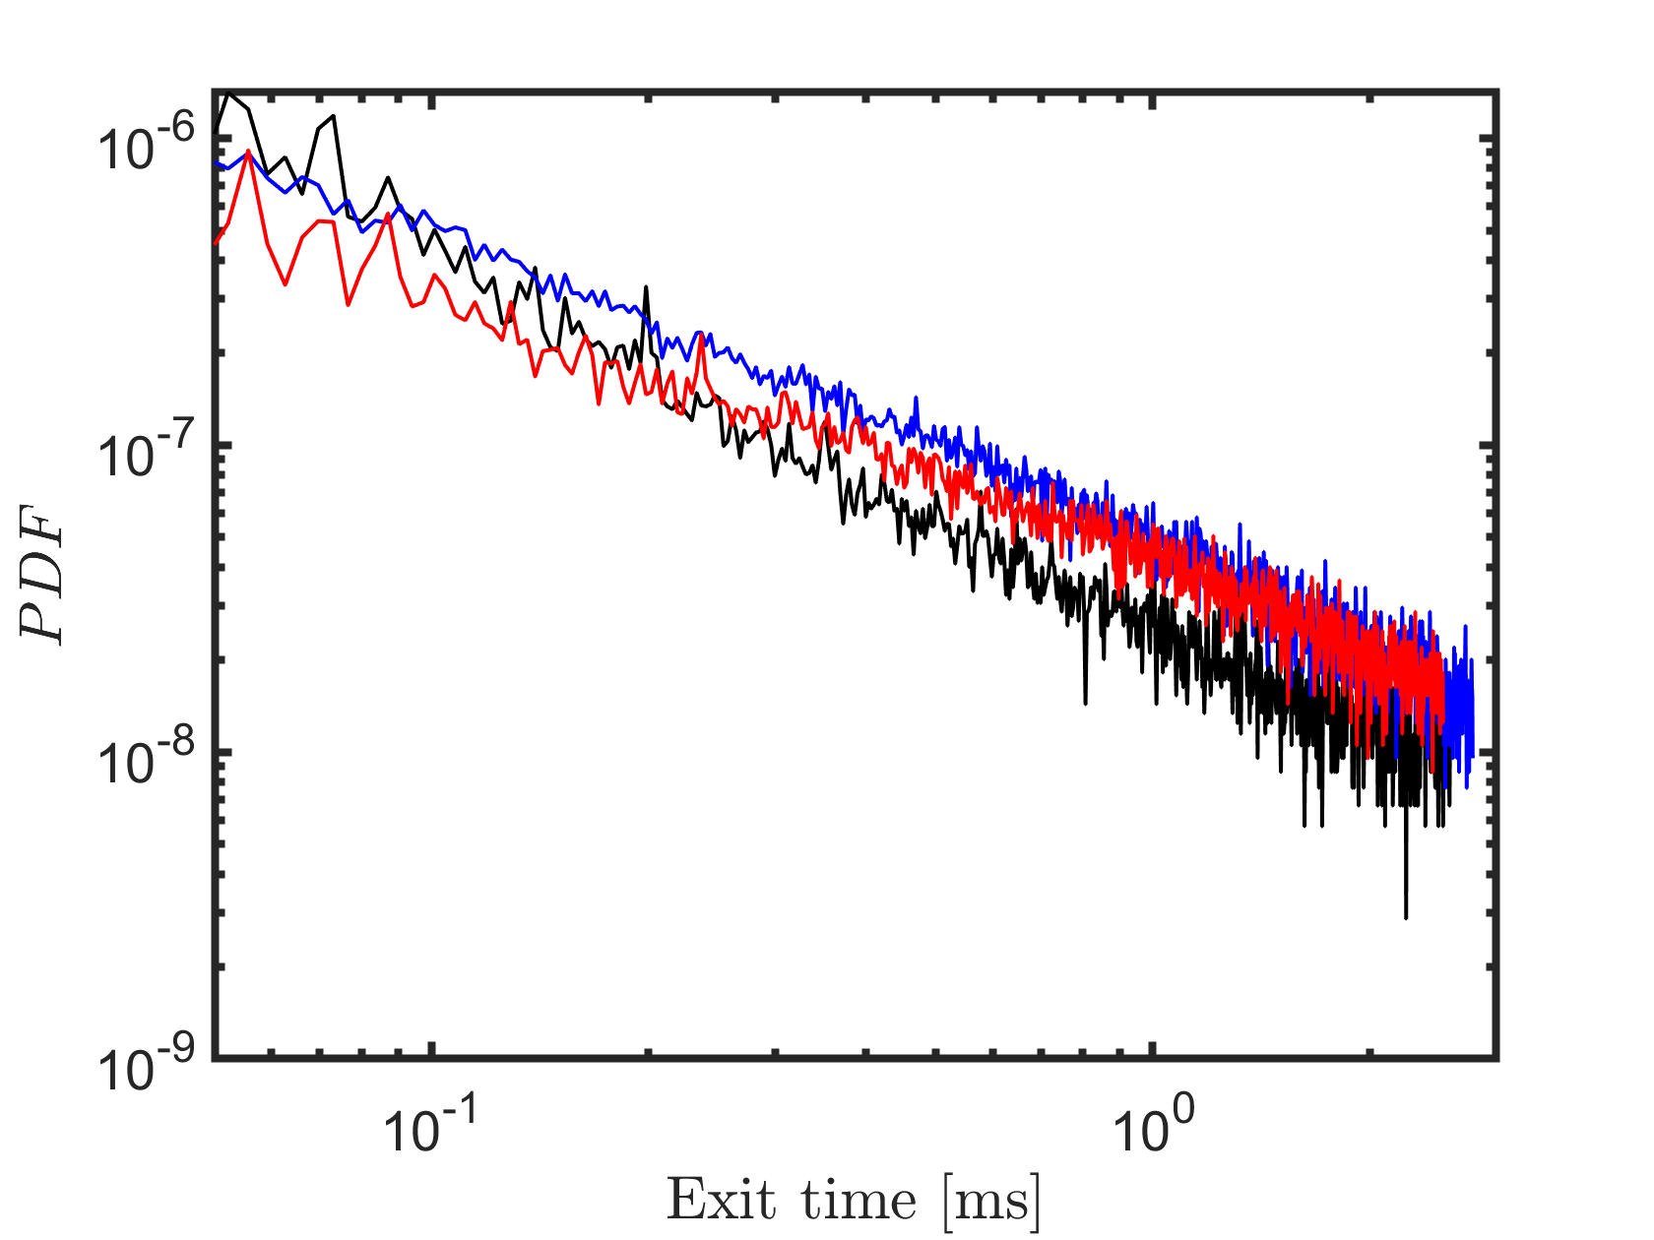
Finite Larmor radius effects through full-orbit simulations
Need to perform simulations in full-orbit, following [Martinell PoP 2025]
↪ Energies characteristic of NBI heating (10 keV and 50 keV)
↪ Similar behaviour due to island rotation (resonances effect)
↪ But GC less sensitive to magnetic islands than FO
In TAPAS, full-orbit seems to produce less transport than GC ($α$ particles at 3.5 MeV with an island width $\sim ρ_{α}$)
Transport remains non-diffusive

Slide 24
Finite Larmor radius effects through full-orbit simulations
Need to perform simulations in full-orbit, following [Martinell PoP 2025]
↪ Energies characteristic of NBI heating (10 keV and 50 keV)
↪ Similar behaviour due to island rotation (resonances effect)
↪ But GC less sensitive to magnetic islands than FO
In TAPAS, full-orbit seems to produce less transport than GC ($α$ particles at 3.5 MeV with an island width $\sim ρ_{α}$)
Transport remains non-diffusive
Analyse JET discharges using either an equivalent Maxwellian or during the slowing-down process with an $α$ particle source (ongoing work with J. Varela and J. Garcia)

Slide 25
Outline of the presentation
Fundamental physics of energetic particles in tokamaks and basics on transport
Toroidal Accelerated PArticle Simulator (TAPAS)
↪ Example of application to realistic experimental case
Non axi-symmetric modes, both static and rotating (tearing modes)
↪ Purely magnetic large scale $\left(m,n\right)=(2,1)$, $ω≪0$
Ion-temperature gradient (ITG) driven turbulence
↪ Electrostatic with a broad spectrum $(m,n,k_{r})$

Slide 26
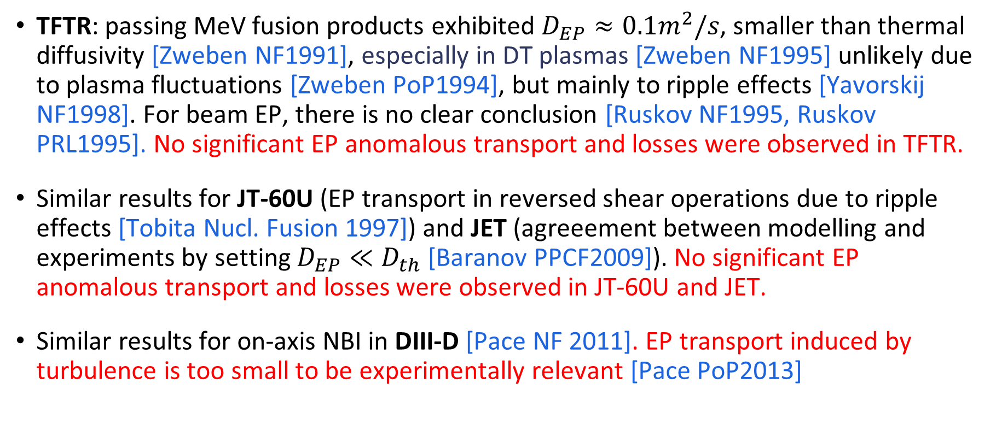
Absence of turbulence-induced EP transport in experiments
TFTR: passing MeV fusion products exhibited $D_{EP}≈0.1m^{2}/s$, smaller than thermal diffusivity [Zweben NF1991], especially in DT plasmas [Zweben NF1995] unlikely due to plasma fluctuations [Zweben PoP1994], but mainly to ripple effects [Yavorskij NF1998]. For beam EP, there is no clear conclusion [Ruskov NF1995, Ruskov PRL1995]. No significant EP anomalous transport and losses were observed in TFTR.
Similar results for JT-60U (EP transport in reversed shear operations due to ripple effects [Tobita Nucl. Fusion 1997]) and JET (agreeement between modelling and experiments by setting $D_{EP}≪D_{th}$ [Baranov PPCF2009]). No significant EP anomalous transport and losses were observed in JT-60U and JET.
Similar results for on-axis NBI in DIII-D [Pace NF 2011]. EP transport induced by turbulence is too small to be experimentally relevant [Pace PoP2013]

Slide 27
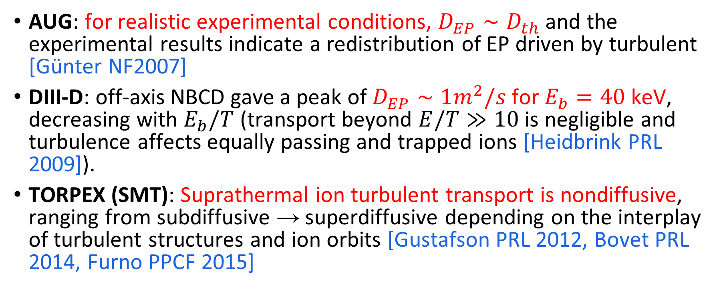
Evidence of turbulence-induced EP transport in experiments
AUG: for realistic experimental conditions, $D_{EP}∼D_{th}$ and the experimental results indicate a redistribution of EP driven by turbulent [Günter NF2007]
DIII-D: off-axis NBCD gave a peak of $D_{EP}∼1m^{2}/s$ for $E_{b}=40$ keV, decreasing with $E_{b}/T$ (transport beyond $E/T≫10$ is negligible and turbulence affects equally passing and trapped ions [Heidbrink PRL 2009]).
TORPEX (SMT): Suprathermal ion turbulent transport is nondiffusive, ranging from subdiffusive → superdiffusive depending on the interplay of turbulent structures and ion orbits [Gustafson PRL 2012, Bovet PRL 2014, Furno PPCF 2015]

Slide 28
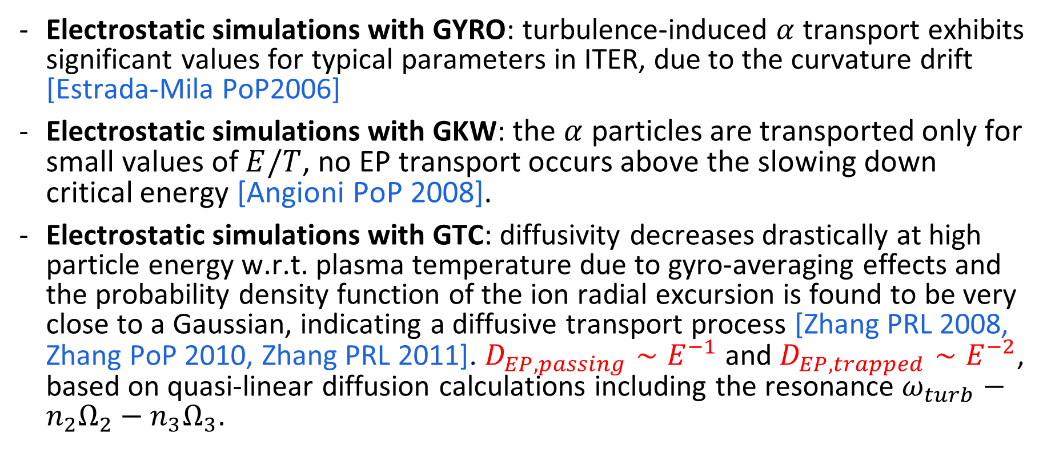
Turbulence-induced EP transport in simulations and theory
Electrostatic simulations with GYRO: turbulence-induced $α$ transport exhibits significant values for typical parameters in ITER, due to the curvature drift [Estrada-Mila PoP2006]
Electrostatic simulations with GKW: the $α$ particles are transported only for small values of $E/T$, no EP transport occurs above the slowing down critical energy [Angioni PoP 2008].
Electrostatic simulations with GTC: diffusivity decreases drastically at high particle energy w.r.t. plasma temperature due to gyro-averaging effects and the probability density function of the ion radial excursion is found to be very close to a Gaussian, indicating a diffusive transport process [Zhang PRL 2008, Zhang PoP 2010, Zhang PRL 2011]. $D_{EP,passing}∼E^{−1}$ and $D_{EP,trapped}∼E^{−2}$, based on quasi-linear diffusion calculations including the resonance $ω_{turb}−n_{2}Ω_{2}−n_{3}Ω_{3}$.

Slide 29
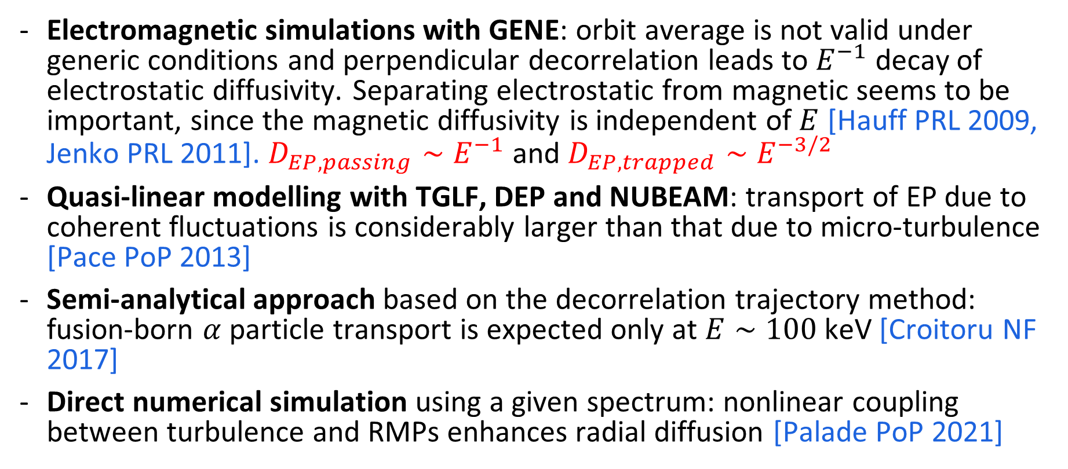
Turbulence-induced EP transport in simulations and theory
Electromagnetic simulations with GENE: orbit average is not valid under generic conditions and perpendicular decorrelation leads to $E^{−1}$ decay of electrostatic diffusivity. Separating electrostatic from magnetic seems to be important, since the magnetic diffusivity is independent of $E$ [Hauff PRL 2009, Jenko PRL 2011]. $D_{EP,passing}∼E^{−1}$ and $D_{EP,trapped}∼E^{−3/2}$
Quasi-linear modelling with TGLF, DEP and NUBEAM: transport of EP due to coherent fluctuations is considerably larger than that due to micro-turbulence [Pace PoP 2013]
Semi-analytical approach based on the decorrelation trajectory method: fusion-born $α$ particle transport is expected only at $E∼100$ keV [Croitoru NF 2017]
Direct numerical simulation using a given spectrum: nonlinear coupling between turbulence and RMPs enhances radial diffusion [Palade PoP 2021]

Slide 30
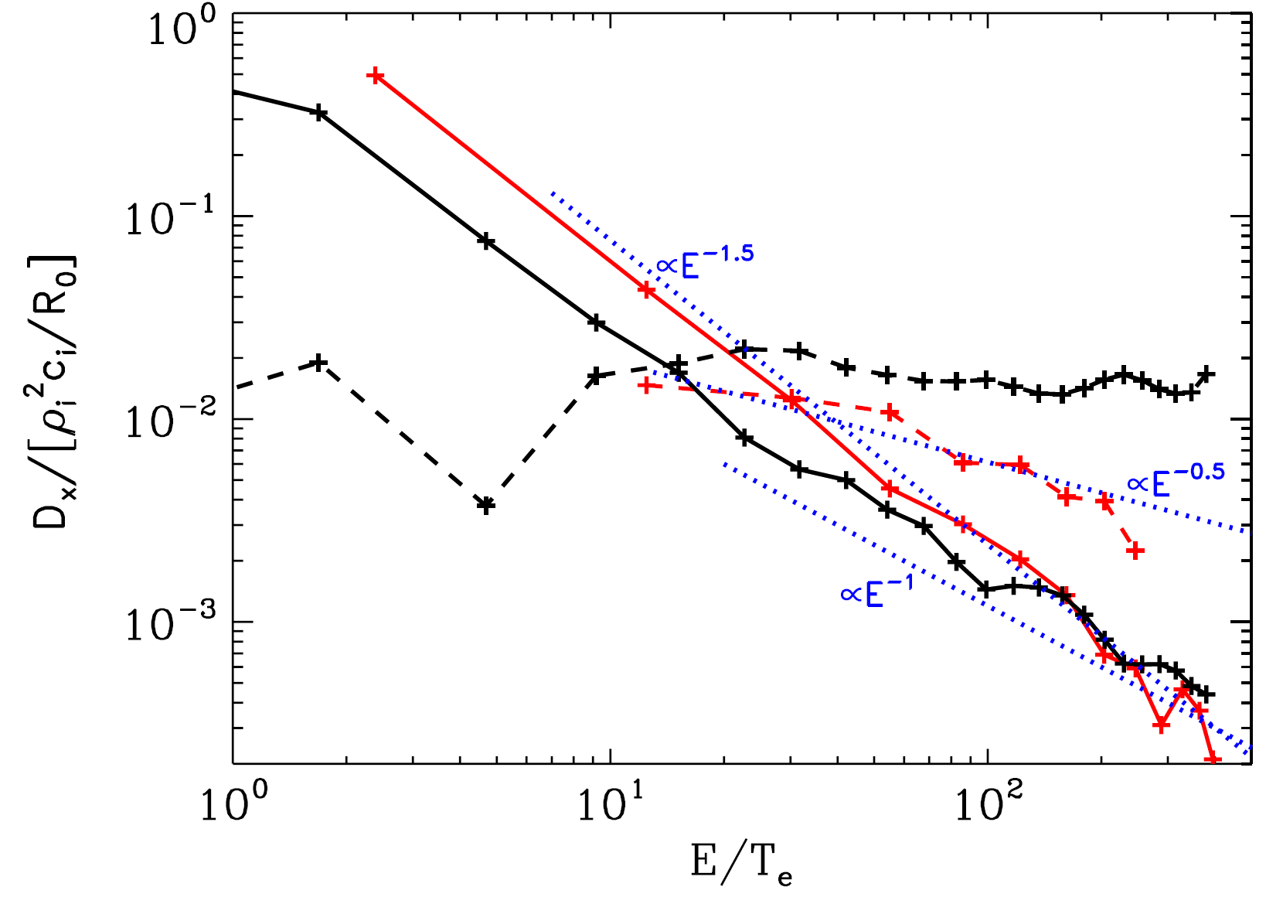


Examples of some scalings reported in gyrokinetics
$D∼E^{−1}$ for passing
$D∼E^{−2}$ for trapped
[From Zhang et al PRL 2008]
[From Hauff et al PRL 2009]

Slide 31
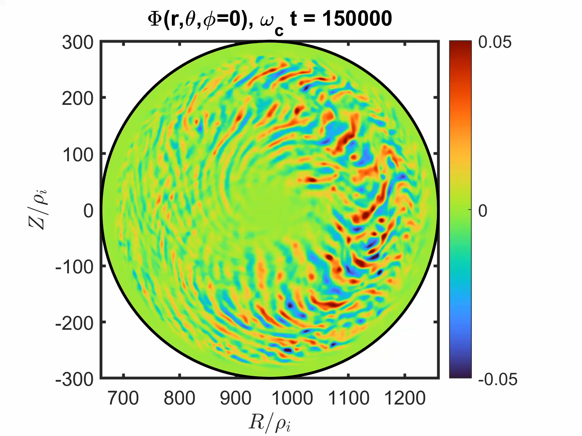
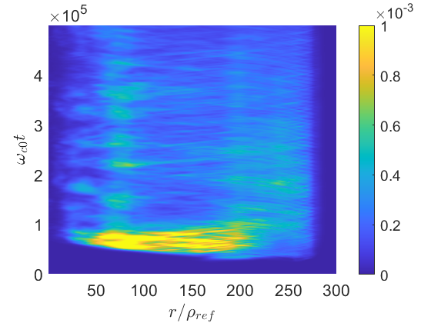
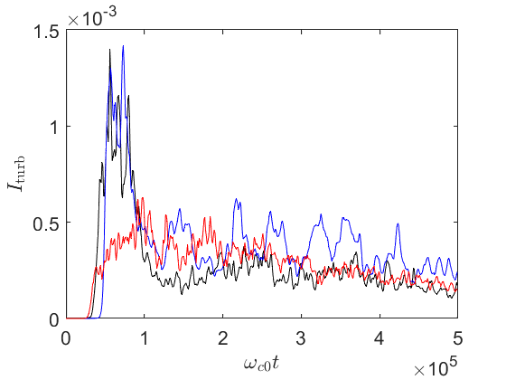
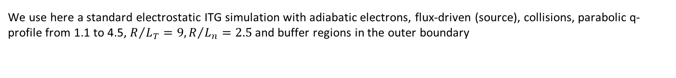
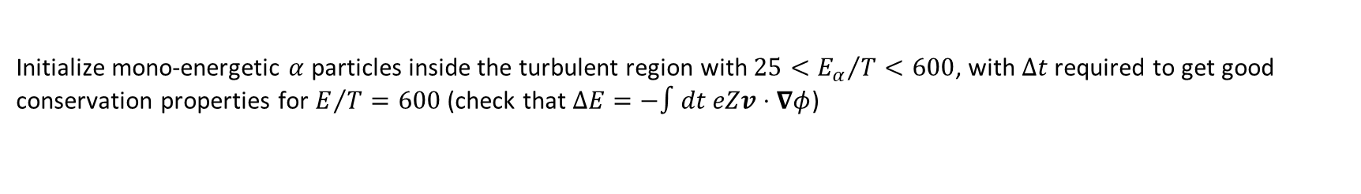
Ion Temperature Gradient driven turbulence
GYSELA [Grandgirard CPC 2016] solves the full-F gyro-kinetic equation in flux-driven and gradient-driven configurations, with collisions, coupled to the quasi-neutrality equation and Ampère’s law.
We use here a standard electrostatic ITG simulation with adiabatic electrons, flux-driven (source), collisions, parabolic q-profile from 1.1 to 4.5, $R/{L_{T}}=9,R/{L_{n}}=2.5$ and buffer regions in the outer boundary
Reference values are $T_{ref}=5$ keV, $B_{ref}=3$ T, $R_{0}=3$ m, $m_{ref}=2m_{p}$, $Z_{ref}=1$.
Initialize mono-energetic $α$ particles inside the turbulent region with $25<{E_{α}}/T<600$, with $Δt$ required to get good conservation properties for $E/T=600$ (check that $ΔE=−∫dt eZv⋅∇φ$)

Slide 32
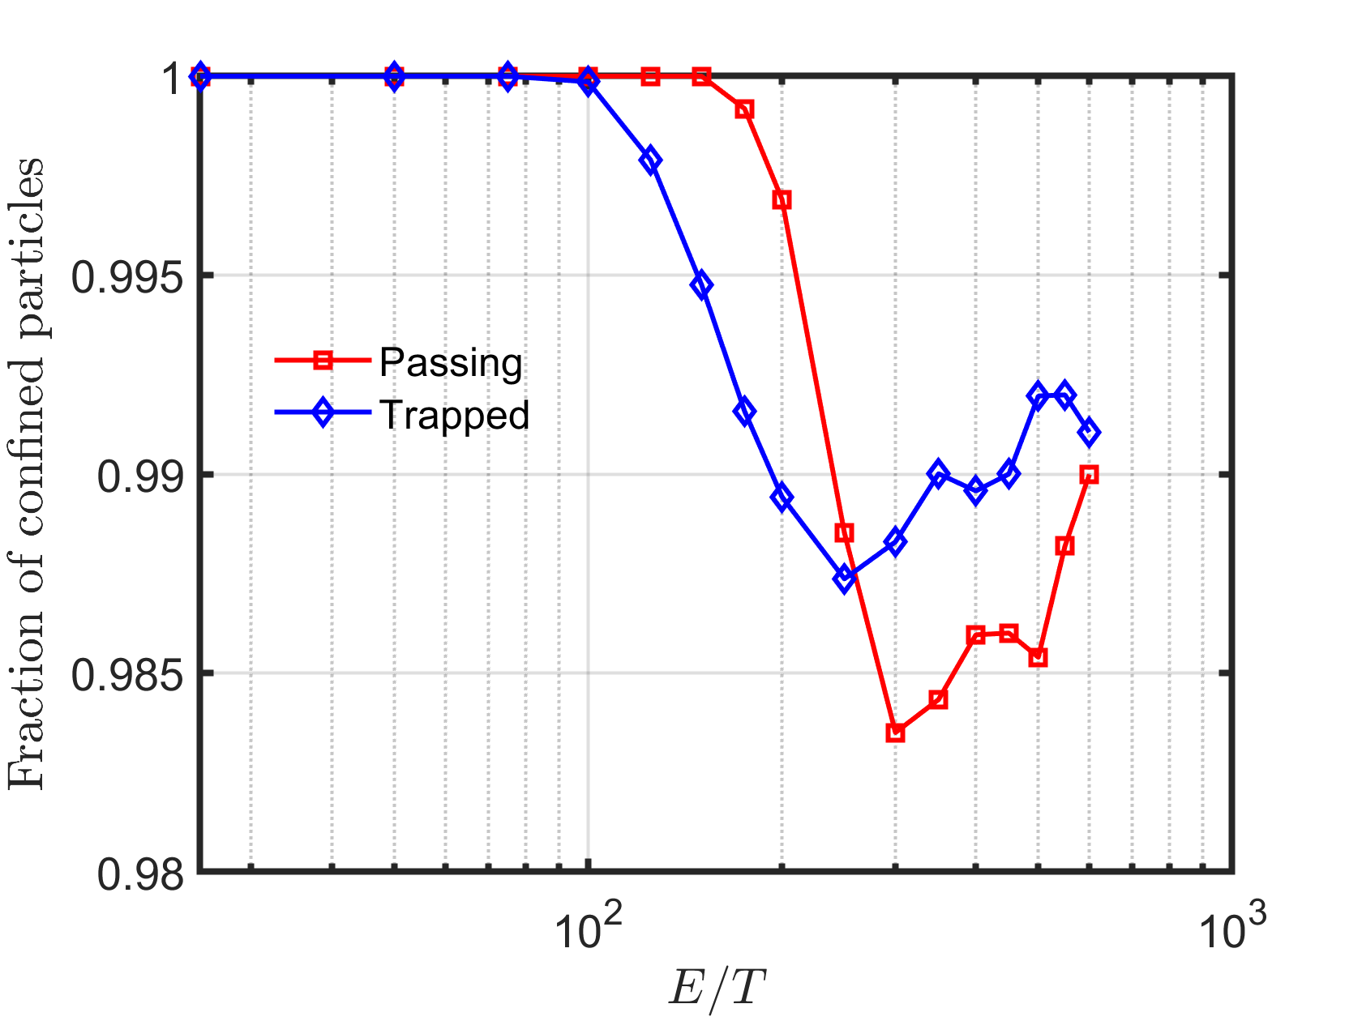
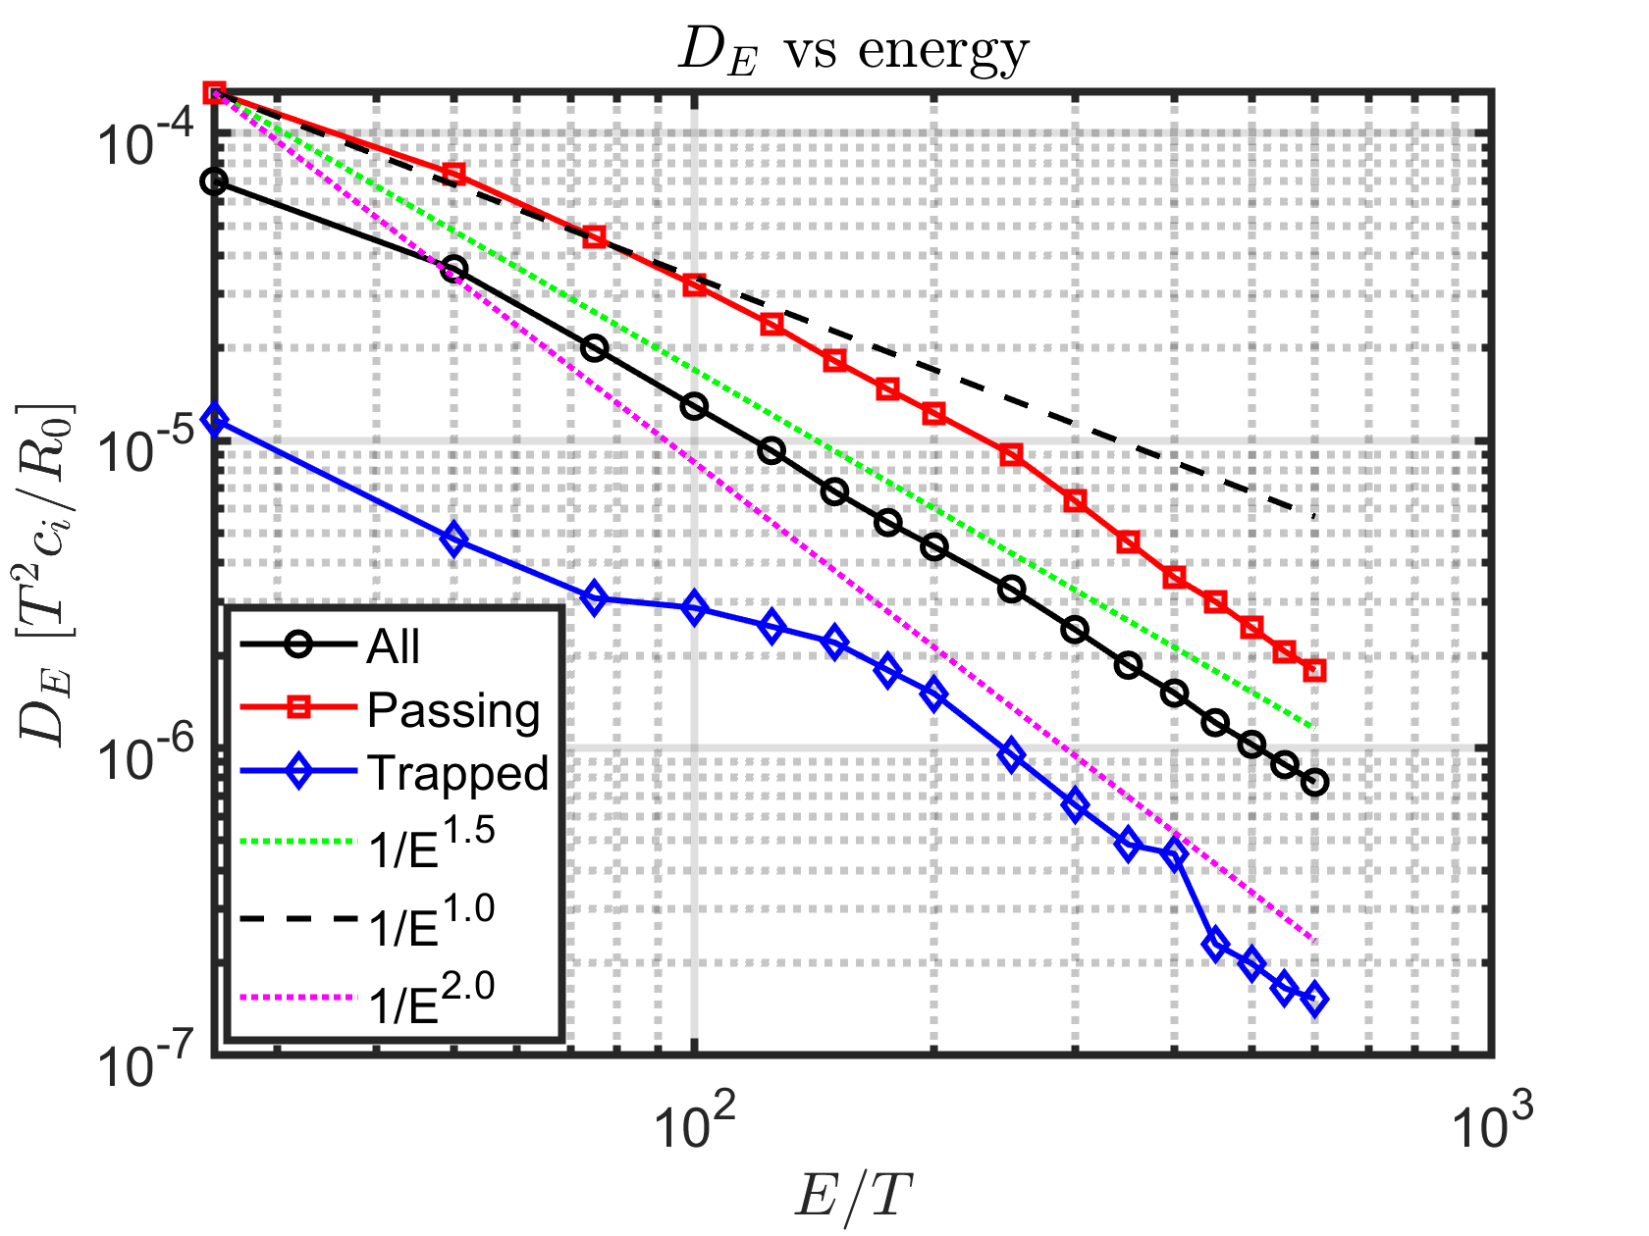
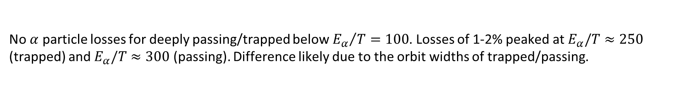
Energy diffusion coefficient decreases with $E/T$
No $α$ particle losses for deeply passing/trapped below ${E_{α}}/T=100$. Losses of 1-2% peaked at $E_{α}/T≈250$ (trapped) and $E_{α}/T≈300$ (passing). Difference likely due to the orbit widths of trapped/passing.
The effect on the kinetic energy of particles remains small. The diffusivity decreases with $E_{α}/T$.
$ω_{turb}−n_{2}Ω_{2}−n_{3}Ω_{3}≈0⇒$ $n_{2}Ω_{2}+n_{3}Ω_{3}≈0$, especially for high energies → Changes in the kinetic energy are small

Slide 33
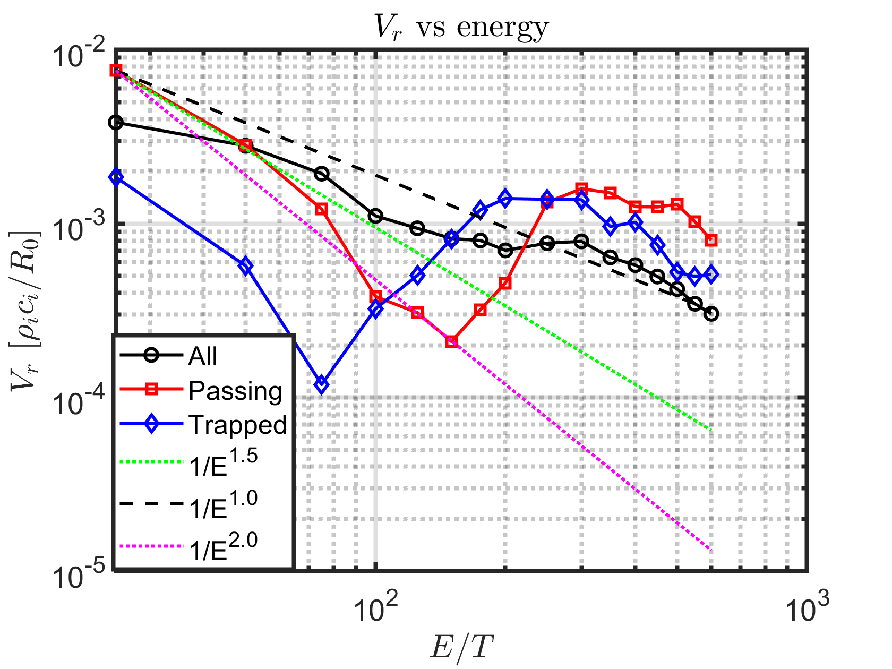
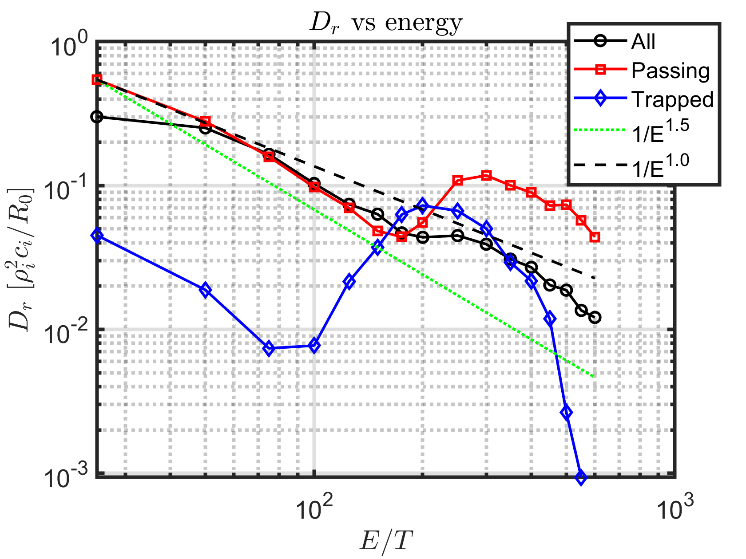
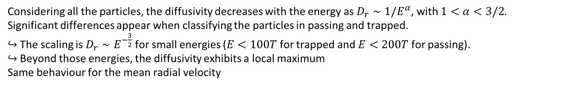
Non trivial behaviour of the radial dynamics
Considering all the particles, the diffusivity decreases with the energy as $D_{r}∼1/E^{α}$, with $1<α<3/2$.
Significant differences appear when classifying the particles in passing and trapped.
↪ The scaling is $D_{r}∼E^{−\frac{3}{2}}$ for small energies ($E<100T$ for trapped and $E<200T$ for passing).
↪ Beyond those energies, the diffusivity exhibits a local maximum
Same behaviour for the mean radial velocity

Slide 34
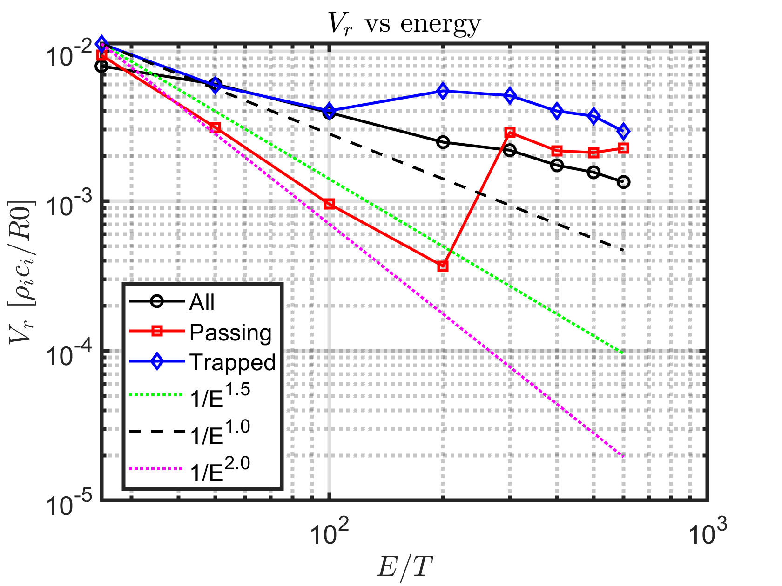
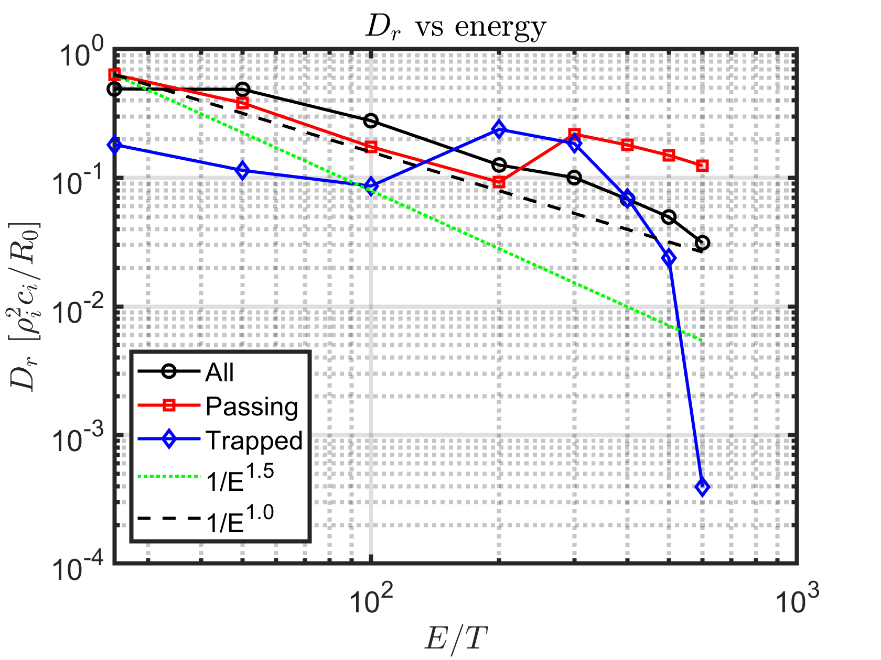
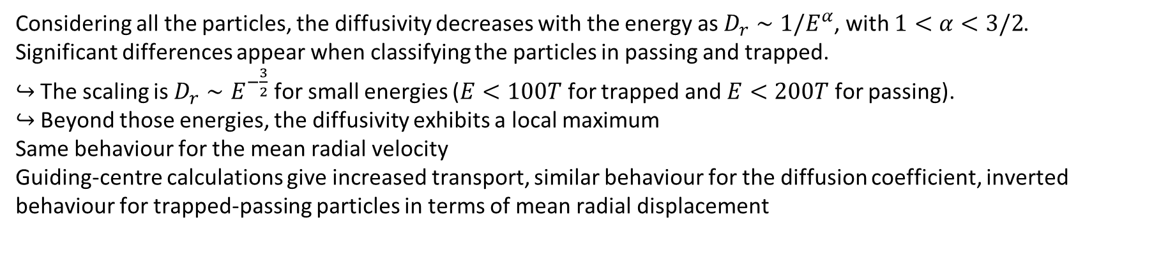
Non trivial behaviour of the radial dynamics
Considering all the particles, the diffusivity decreases with the energy as $D_{r}∼1/E^{α}$, with $1<α<3/2$.
Significant differences appear when classifying the particles in passing and trapped.
↪ The scaling is $D_{r}∼E^{−\frac{3}{2}}$ for small energies ($E<100T$ for trapped and $E<200T$ for passing).
↪ Beyond those energies, the diffusivity exhibits a local maximum
Same behaviour for the mean radial velocity
Guiding-centre calculations give increased transport, similar behaviour for the diffusion coefficient, inverted behaviour for trapped-passing particles in terms of mean radial displacement

Slide 35
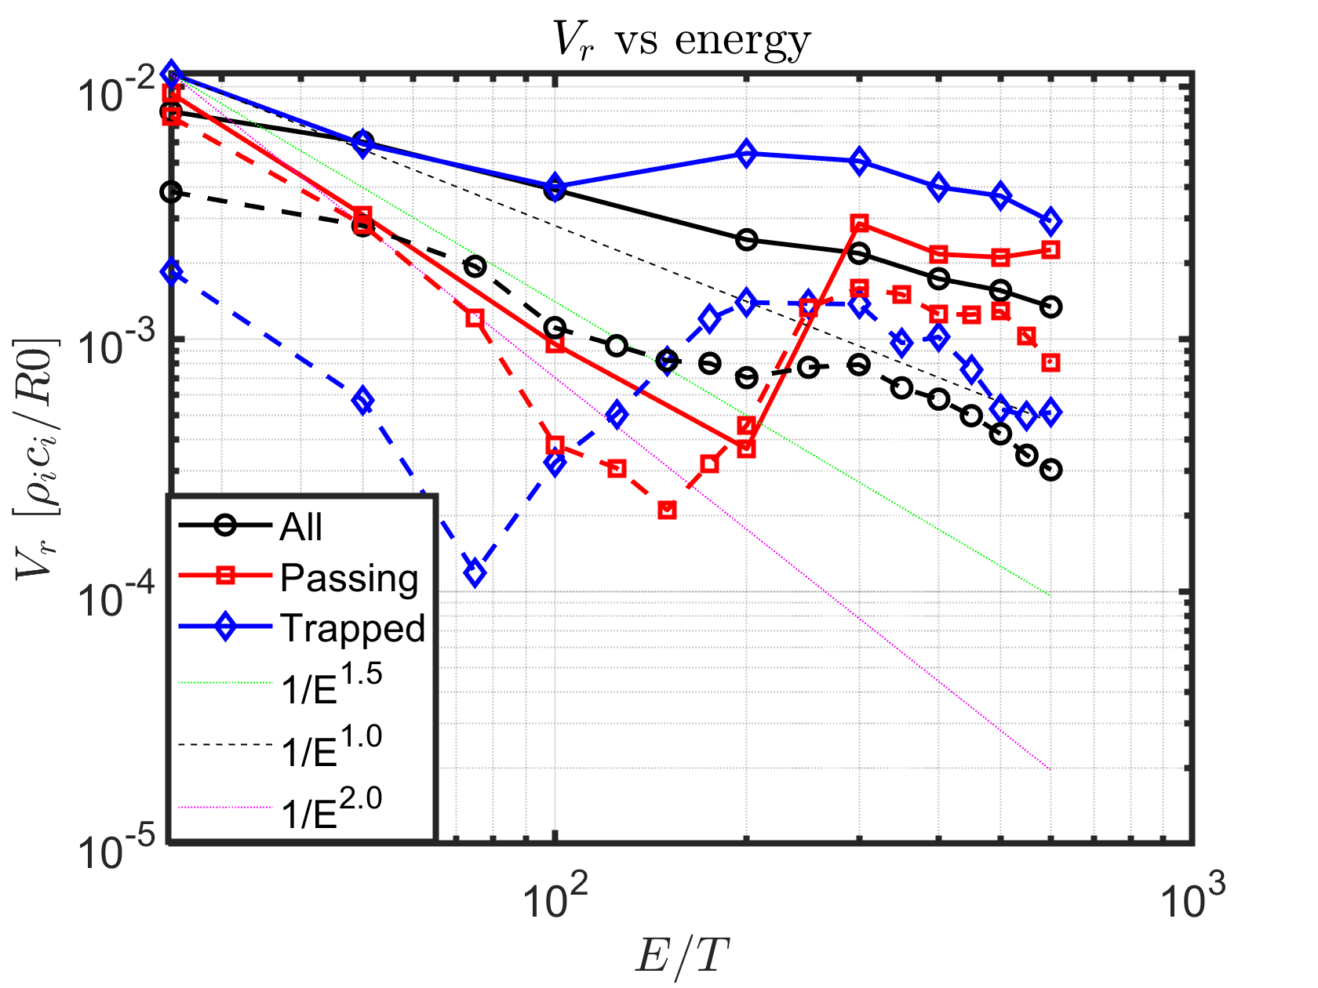

Non trivial behaviour of the radial dynamics
Considering all the particles, the diffusivity decreases with the energy as $D_{r}∼1/E^{α}$, with $1<α<3/2$.
Significant differences appear when classifying the particles in passing and trapped.
↪ The scaling is $D_{r}∼E^{−\frac{3}{2}}$ for small energies ($E<100T$ for trapped and $E<200T$ for passing).
↪ Beyond those energies, the diffusivity exhibits a local maximum
Same behaviour for the mean radial velocity
Guiding-centre calculations give increased transport, similar behaviour for the diffusion coefficient, inverted behaviour for trapped-passing particles in terms of mean radial displacement

Slide 36



Possible reasons for the observed scaling
Particles with $λ<−0.6$ (counter-passing) and $−0.3<λ<0$ (trapped close to the prompt losses region) are lost.
The energy remains almost constant $ω−n_{2}Ω_{2}−n_{3}Ω_{3}≈n_{2}Ω_{2}+n_{3}Ω_{3}=0$
  Presence of resonances for the turbulent modes that can lead to the observed losses.
Further analyses are required to assess the diffusive nature of the transport
  For small energies, the PDF of displacements exhibits a Gaussian behaviour
  For larger energies, the PDF departs from a Gaussian
  Superdiffusion occurs when turbulent structures are relatively static with respect to the ions beyond a given threshold in turbulence amplitude [Gustafson PRL 2012]

Slide 37
Possible reasons for the observed scaling
Particles with $λ<−0.6$ (counter-passing) and $−0.3<λ<0$ (trapped close to the prompt losses region) are lost.
The energy remains almost constant $ω−n_{2}Ω_{2}−n_{3}Ω_{3}≈n_{2}Ω_{2}+n_{3}Ω_{3}=0$
  Presence of resonances for the turbulent modes that can lead to the observed losses.
Further analyses are required to assess the diffusive nature of the transport
  For small energies, the PDF of displacements exhibits a Gaussian behaviour
  For larger energies, the PDF departs from a Gaussian
  Superdiffusion occurs when turbulent structures are relatively static with respect to the ions beyond a given threshold in turbulence amplitude [Gustafson PRL 2012]

Slide 38


Possible reasons for the observed scaling
Particles with $λ<−0.6$ (counter-passing) and $−0.3<λ<0$ (trapped close to the prompt losses region) are lost.
The energy remains almost constant $ω−n_{2}Ω_{2}−n_{3}Ω_{3}≈n_{2}Ω_{2}+n_{3}Ω_{3}=0$
  Presence of resonances for the turbulent modes that can lead to the observed losses.
Further analyses are required to assess the diffusive nature of the transport
  For small energies, the PDF of displacements exhibits a Gaussian behaviour
  For larger energies, the PDF departs from a Gaussian
  Superdiffusion occurs when turbulent structures are relatively static with respect to the ions beyond a given threshold in turbulence amplitude [Gustafson PRL 2012]

Slide 39


Possible reasons for the observed scaling
Particles with $λ<−0.6$ (counter-passing) and $−0.3<λ<0$ (trapped close to the prompt losses region) are lost.
The energy remains almost constant $ω−n_{2}Ω_{2}−n_{3}Ω_{3}≈n_{2}Ω_{2}+n_{3}Ω_{3}=0$
  Presence of resonances for the turbulent modes that can lead to the observed losses.
Further analyses are required to assess the diffusive nature of the transport
  For small energies, the PDF of displacements exhibits a Gaussian behaviour
  For larger energies, the PDF departs from a Gaussian
  Superdiffusion occurs when turbulent structures are relatively static with respect to the ions beyond a given threshold in turbulence amplitude [Gustafson PRL 2012]

Slide 40

Future directions
Radial dependence of $D_{r}$
Different regimes of turbulence (amplitude, size of the machine)
Different regimes of heating
  $α$ particle heating: analyses for a distribution function (instead of mono-energetic simulations) and during the slowing-down process
  NBI (and ICRH): use the ionization (and RF) module of TAPAS in realistic configurations together with the collision operator
Perform longer simulations
  With a 3D non evolving potential ($ω_{turbulence}≪Ω_{2},Ω_{3}$ for high energies).
  With synthetic turbulence using generative deep-learning [Clavier PRE 2025, Clavier PoP 2025, Liu PhysRevFluids 2025] (see poster by B. Clavier)

Slide 41

Summary
Complexity of the dynamics of energetic particles
Use of the Toroidal Accelerated Particle Simulator (TAPAS) to study EP transport phenomena (used for DIII-D RSAE case)
Analyses of different cases show a non-diffusive behaviour of EP transport
  Short times and radial scales → Nondiffusive $≈$ Diffusive
  Need to extent the models for long time regimes involving several spatial scales
Further studies are required to assess the diffusive/no-difffusive transport depending on the regimes

Slide 42
BACK-UP SLIDES

Slide 43






Motion invariants to characterise EP trajectories
We define an equilibrium Hamiltonian $H_{eq}(J)=∫dαH\left(α,J\right)$
$⇒J$ are motion invariants associated to the three periodic directions
$$J_{1}=−\frac{mμ}{eZ}$$
$$J_{2}=Φ\left(J_{3}\right)+\frac{1}{2π}\int_{0}^{2π}{mv⋅bds}$$
$J_{3}≡P_{φ}=−eZψ+m\frac{B_{φ}}{B}v_{∥}$
$$Ω_{1}=\frac{∂H_{eq}}{∂J_{1}}$$
$$Ω_{2}=\frac{∂H_{eq}}{∂J_{2}}$$
$$Ω_{3}=\frac{∂H_{eq}}{∂J_{3}}$$

Slide 44



Motion invariants to characterise EP trajectories
We define an equilibrium Hamiltonian $H_{eq}(J)=∫dαH\left(α,J\right)$
$⇒J$ are motion invariants associated to the three periodic directions
$$Ω_{1}=\frac{∂H_{eq}}{∂J_{1}}⇒Ω_{1}=\frac{eZB}{m}$$
$$Ω_{2}=\frac{∂H_{eq}}{∂J_{2}}⇒Ω_{2}=Ω_{c,th}ρ_{⋆}ε_{a}σ\frac{1}{q}\sqrt{E−\left(1−ε\right)μB_{0}}\frac{π}{\sqrt{2}}\left\{\begin{matrix}𝕂^{−1}\left(κ\right), κ<1 \\ κ𝕂^{−1}\left(\frac{1}{κ}\right), κ>1\end{matrix}\right.$$
$$Ω_{3}=\frac{∂H_{eq}}{∂J_{3}}⇒Ω_{3}=Ω_{c,th}ρ_{⋆}ε_{a}\frac{Ω_{t}}{Ω_{c,th}}\frac{qE}{ε}{\overline{Ω}}_{d}+δ_{passing}qΩ_{2}$$

Slide 45



Motion invariants to characterise EP trajectories
We define an equilibrium Hamiltonian $H_{eq}(J)=∫dαH\left(α,J\right)$
$⇒J$ are motion invariants associated to the three periodic directions
$$Ω_{1}=\frac{∂H_{eq}}{∂J_{1}}⇒Ω_{1}=\frac{eZB}{m}$$
$$Ω_{2}=\frac{∂H_{eq}}{∂J_{2}}⇒Ω_{2}=Ω_{c,th}ρ_{⋆}ε_{a}σ\frac{1}{q}\sqrt{E−\left(1−ε\right)μB_{0}}\frac{π}{\sqrt{2}}\left\{\begin{matrix}𝕂^{−1}\left(κ\right), κ<1 \\ κ𝕂^{−1}\left(\frac{1}{κ}\right), κ>1\end{matrix}\right.$$
$$Ω_{3}=\frac{∂H_{eq}}{∂J_{3}}⇒Ω_{3}=Ω_{c,th}ρ_{⋆}ε_{a}\frac{Ω_{t}}{Ω_{c,th}}\frac{qE}{ε}{\overline{Ω}}_{d}+δ_{passing}qΩ_{2}$$
[Zarzoso PoP2019]

Slide 46


Motion invariants to characterise EP trajectories
We define an equilibrium Hamiltonian $H_{eq}(J)=∫dαH\left(α,J\right)$
$⇒J$ are motion invariants associated to the three periodic directions
$$Ω_{1}=\frac{∂H_{eq}}{∂J_{1}}⇒Ω_{1}=\frac{eZB}{m}$$
$$Ω_{2}=\frac{∂H_{eq}}{∂J_{2}}⇒Ω_{2,passing}≈\frac{v_{∥}}{{qR}_{0}},Ω_{2,trapped}≈\frac{v}{qR_{0}}\sqrt{\frac{ε}{2}}$$
$E_{α}$ = | 500 keV | 1 MeV | 3,5 MeV
$$Ω_{2,passing}$$ | 130 kHz | 180 kHz | 340 kHz
$$Ω_{3,passing}$$ | 260 kHz | 360 kHz | 680 kHz
$$Ω_{2,trapped}$$ | 50 kHz | 70 kHz | 130 kHz
$$Ω_{3,trapped}$$ | 10 kHz | 20 kHz | 60 kHz
$$Ω_{3}=\frac{∂H_{eq}}{∂J_{3}}⇒Ω_{3,passing}=\frac{v_{∥}}{R_{0}}, Ω_{3,trapped}≈\frac{qE}{eZB_{0}R_{0}r}$$

Slide 47






Fundamental and high order resonances
If $Ω_{1}≫ω⇒n_{1}=0⇔\frac{1}{2π}∮dφ_{c}⇒$
Linear resonance: $ω−n_{2}Ω_{2} −n_{3}Ω_{3}=0$
Nonlinear resonances should also be considered if the amplitude of the perturbation is sufficiently large to strongly modify the unperturbed trajectories [Sanchis PPCF 2018]
$θ=δ_{passing}α_{2}+θ_{0}Θ\left(α_{2}\right),$ $ψ=\overline{ψ}+{\hat{ψ}}_{0}Ξ\left(α_{2}\right)$with $Θ,Ξ$ periodic functions of $α_{2}$
↪ Deeply trapped particles $⇒θ≈θ_{0}\sin{α_{2}}$
$${∆ψ}_{EP}$$
$$H=H_{m,n}\left(ψ\right)e^{i\left(mθ+nφ\right)}={e^{{Ξ\left(α_{2}\right)∂}_{ψ}}H}_{m,n}\left(\overline{ψ}\right)e^{i\left(mΘ\left(α_{2}\right)+nφ\right)}=\sum_{n_{2}}{…{J_{n_{2}}({\hat{ψ}}_{0}k_{ψ})e}^{in_{2}α_{2}}}$$

Slide 48






Fundamental and high order resonances
$$F=F_{eq}(J)+\underset{nω}{∑}δF_{nω}e^{i(n⋅α−ωt)}$$
$$⇒δF_{n,ω}=−\frac{n⋅∂_{J}F_{eq}}{ω−n⋅Ω}δH_{nω}$$
$$H=H_{eq}(J)+\underset{nω}{∑}δH_{nω}e^{i(n⋅α−ωt)}$$
If $Ω_{1}≫ω⇒n_{1}=0⇔\frac{1}{2π}∮dφ_{c}⇒$
Linear resonance: $ω−n_{2}Ω_{2} −n_{3}Ω_{3}=0$
Nonlinear resonances should also be considered if the amplitude of the perturbation is sufficiently large to strongly modify the unperturbed trajectories [Sanchis PPCF 2018]
$θ=δ_{passing}α_{2}+θ_{0}Θ\left(α_{2}\right),$ $ψ=\overline{ψ}+{\hat{ψ}}_{0}Ξ\left(α_{2}\right)$with $Θ,Ξ$ periodic functions of $α_{2}$
↪ Deeply trapped particles $⇒θ≈θ_{0}\sin{α_{2}}$
$$H=H_{m,n}\left(ψ\right)e^{i\left(mθ+nφ\right)}={e^{{Ξ\left(α_{2}\right)∂}_{ψ}}H}_{m,n}\left(\overline{ψ}\right)e^{i\left(mΘ\left(α_{2}\right)+nφ\right)}=\sum_{n_{2}}{…{J_{n_{2}}({\hat{ψ}}_{0}k_{ψ})e}^{in_{2}α_{2}}}$$

Slide 49





Computing the diffusion coefficient from microscopic displacements
Displacement in arbitrary direction:
Lagrangian velocity: $v_{x}(t)=\frac{dΔx}{dt}$
$$Δx\left(t\right)=x\left(t\right)−x\left(0\right)⇒$$
Taylor’s expression relates the Lagrangian velocity autocorrelation function to the rate of change of the variance of the displacement $σ_{x}^{2}=⟨{\left(Δx−\left\langle Δx\right\rangle \right)}^{2}⟩$
$$\frac{dσ_{x}^{2}}{dt}=2\int_{0}^{t}{⟨v_{x}\left(0\right)v_{x}\left(t^{′}\right)⟩dt′}$$
If the autocorrelation decays fast enough, $\lim_{t→∞}\int_{0}^{t}{⟨v_{x}\left(0\right)v_{x}\left(t^{′}\right)⟩dt′}$ exists and the diffusion coefficient is
$$D=\lim_{t→∞}\int_{0}^{t}{⟨v_{x}\left(0\right)v_{x}\left(t^{′}\right)⟩dt′}⇒σ_{x}^{2}∼t$$
In general $σ_{x}^{2}∼t^{γ}\left\{\begin{aligned}γ<1⇒ \\ γ=1⇒ \\ 1<γ<2⇒ \\ γ=2⇒\end{aligned}\right.$
Subdiffusive
Diffusive
Superdiffusive
Ballistic

Slide 50
Collision operator in TAPAS
Collisions of energetic particles on a Maxwellian background, $n_{b}, T_{b}$, with electrons and ions
Essential for long time simulations, modelling the slowing-down of EP for alphas, NBI and ICRH
[H. Betar, D. Zarzoso et al Nuclear Fusion 2024]

Slide 51


Larmor radius of $α$ particles

Slide 52
Some examples of EP transport reviewed in this presentation
Axi-symmetric modes or oscillating radial electric field (EGAM)
↪ Electrostatic large scale $\left(m,n\right)=(0,0)$, $ω≈ω_{GAM}≠0$
Non axi-symmetric modes, both static and rotating (tearing modes)
↪ Purely magnetic large scale $\left(m,n\right)=(2,1)$, $ω≪0$
Ion-temprature gradient (ITG) driven turbulence
↪ Electrostatic with a broad spectrum $(m,n,k_{r})$

Slide 53

Oscillating $E_{r}$ → Anomalous transport and losses
Reduced model for the potential $φ=\left[φ_{00}\left(r\right)+φ_{10}\left(r\right)\sin{θ}\right]\cos{ωt}$
Oscillating radial electric field
$v_{E×B}⋅∇r=0⟹$ No convective transport
[Nazikian PRL 2008]
[Fisher NF 2012]

Slide 54
Oscillating $E_{r}$ → Anomalous transport and losses
Reduced model for the potential $φ=\left[φ_{00}\left(r\right)+φ_{10}\left(r\right)\sin{θ}\right]\cos{ωt}$
Oscillating radial electric field
$v_{E×B}⋅∇r=0⟹$ No convective transport
[Nazikian PRL 2008]
[Fisher NF 2012]

Slide 55


Oscillating $E_{r}$ → Anomalous transport and losses
Reduced model for the potential $φ=\left[φ_{00}\left(r\right)+φ_{10}\left(r\right)\sin{θ}\right]\cos{ωt}$
Oscillating radial electric field
$v_{E×B}⋅∇r=0⟹$ No convective transport
Analyse losses of energetic particles confined in the absence of perturbation, using the GC version of TAPAS
Algebraic decay of exit time
$$≠$$
Exponential decay of exit time
$$⟹$$
Radial transport is anomalous

Slide 56






Oscillating $E_{r}$ → Chaotic separatrix
Co-passing
Counter-passing
Trapped
Trapped
Trapped
Counter-passing
Without any perturbation → Integrable system. Trajectories = Passing & Trapped
Passing/Trapped boundary = separation between positive (co-passing) & negative (counter-passing) poloidal displacements
With perturbation → Chaotic separatrix: particles can alternate positive and negative displacements.

Slide 57



Transport of EP is non diffusive
Time-dependent variance
Poloidal spreading $Δθ\left(t\right)=θ\left(t\right)−θ\left(t\right)$ observed when increasing time.
Study of the variance $σ_{θ}^{2}=\left\langle {\left(Δθ−\left\langle Δθ\right\rangle \right)}^{2}\right\rangle$
In our case: $σ_{θ}^{2}∼t^{γ}$, with $γ=1.64⇒$Super-diffusive transport (anomalous) transport

Slide 58

Reference Deuterium plasma for JET size (R₀=2.9m, a=1m, B₀=3.5T, T_{ref}=5keV)
Simplified circular geometry with concentric flux surfaces
Reversed q-profile from 1.5 to 7.0, tearing-unstable ($Δ^{′}>0$)
$A_{∥}$ calculated from a shooting module

Slide 59
Exit probability
  Up-down symmetric
  Shifted following orbit drift w.r.t. flux surfaces
  Reflects the structure of the magnetic island
Mean exit time
  Same structure as the exit probability
  General behaviour: large exit times for low exit probability → rare events

Slide 60




Methodology to compute the coefficients
Radial displacement $Δr=r−r(t=0)$ for each particle
Mean radial displacement $⟨Δr⟩=⟨r−r\left(t=0\right)⟩$

Slide 61


Methodology to compute the coefficients
Radial displacement $Δr=r−r(t=0)$ for each particle
Mean radial displacement $⟨Δr⟩=⟨r−r\left(t=0\right)⟩$
Compute the « mean velocity» as $V_{r}=\frac{d⟨Δr⟩}{dt}$

Slide 62

Methodology to compute the coefficients
Radial displacement $Δr=r−r(t=0)$ for each particle
Mean radial displacement $⟨Δr⟩=⟨r−r\left(t=0\right)⟩$
Compute the « mean velocity» as $V_{r}=\frac{d⟨Δr⟩}{dt}$
Variance $σ_{r}^{2}=⟨{\left(Δr−\left\langle Δr\right\rangle \right)}^{2}⟩$

Slide 63


Methodology to compute the coefficients
Radial displacement $Δr=r−r(t=0)$ for each particle
Mean radial displacement $⟨Δr⟩=⟨r−r\left(t=0\right)⟩$
Compute the « mean velocity» as $V_{r}=\frac{d⟨Δr⟩}{dt}$
Variance $σ_{r}^{2}=⟨{\left(Δr−\left\langle Δr\right\rangle \right)}^{2}⟩$
Compute the « diffusion coefficient » as $D_{r}=\frac{1}{2}\frac{dσ_{r}^{2}}{dt}$

Slide 64

Methodology to compute the coefficients
Radial displacement $Δr=r−r(t=0)$ for each particle
Mean radial displacement $⟨Δr⟩=⟨r−r\left(t=0\right)⟩$
Compute the « mean velocity» as $V_{r}=\frac{d⟨Δr⟩}{dt}$
Variance $σ_{r}^{2}=⟨{\left(Δr−\left\langle Δr\right\rangle \right)}^{2}⟩$
Compute the « diffusion coefficient » as $D_{r}=\frac{1}{2}\frac{dσ_{r}^{2}}{dt}$

Slide 65



Possible reasons for the observed scaling
Particles with $λ<−0.6$ (counter-passing) and $−0.3<λ<0$ (trapped close to the prompt losses region) are lost.
The energy remains almost constant $ω−n_{2}Ω_{2}−n_{3}Ω_{3}≈n_{2}Ω_{2}−n_{3}Ω_{3}=0$
  Presence of resonances for the turbulent modes that can lead to the observed losses.
Further analyses are required to assess the diffusive nature of the transport
  For small energies, the PDF of displacements exhibits a Gaussian behaviour
  For larger energies, the PDF departs from a Gaussian
  Superdiffusion occurs when turbulent structures are relatively static with respect to the ions beyond a given threshold in turbulence amplitude [Gustafson PRL 2012]

Slide 66
Different transport mechanisms of EP
Energetic particles = high energy → Collisions are rare
Neoclassical transport is reduced ($D<0.1m^{2}/s$)
If 3 invariants → prompt losses = only possibility of « transport »
Particles whose orbits intercept the wall (first orbit losses)
If < 3 invariants → transport
Enhanced prompt losses (by small perturbations or small kicks)
Convective resonant or non resonant transport
Diffusive and non-diffusive (anomalous) transport
Several modes → Interaction between linear resonances
One mode → overlap of higher order resonances
Fractional resonances (large amplitude) [Kramer PRL2012]
Integer resonances (small amplitude) interacting with trapping cone [Zarzoso JPP2020]

