Slide 1

Average energy
of the X-ray spectrum
as a model-independent proxy
for the mass of galaxy clusters
Aleksei Kruglov, Ildar Khabibullin, Natalya Lyskova
Space Research Institute (IKI RAS)
arXiv:2408.12026
Submitted to JCAP

Slide 2
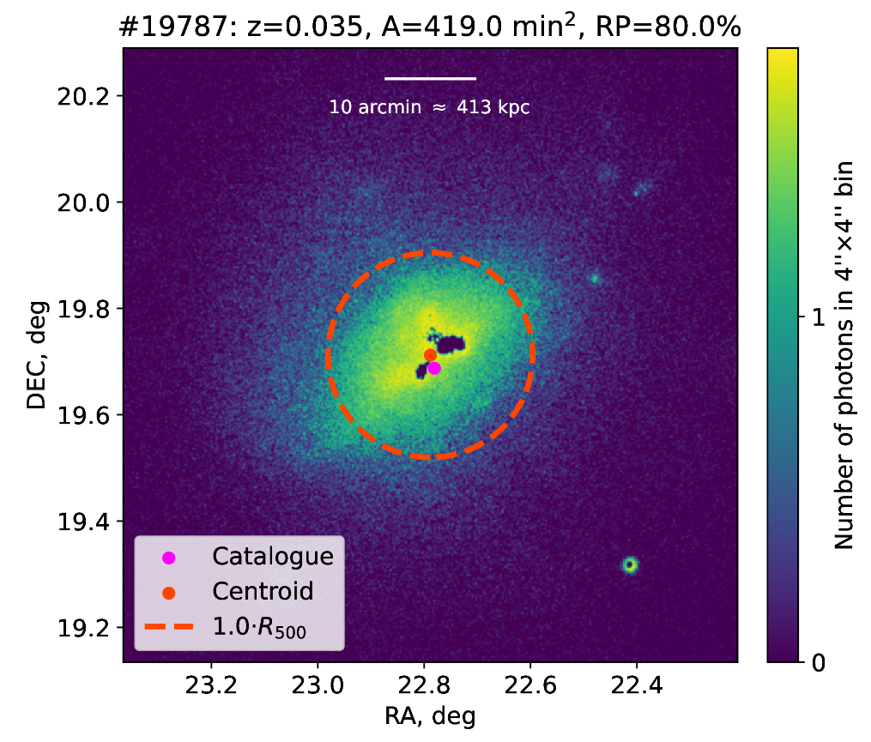
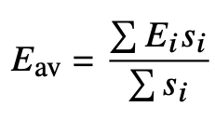
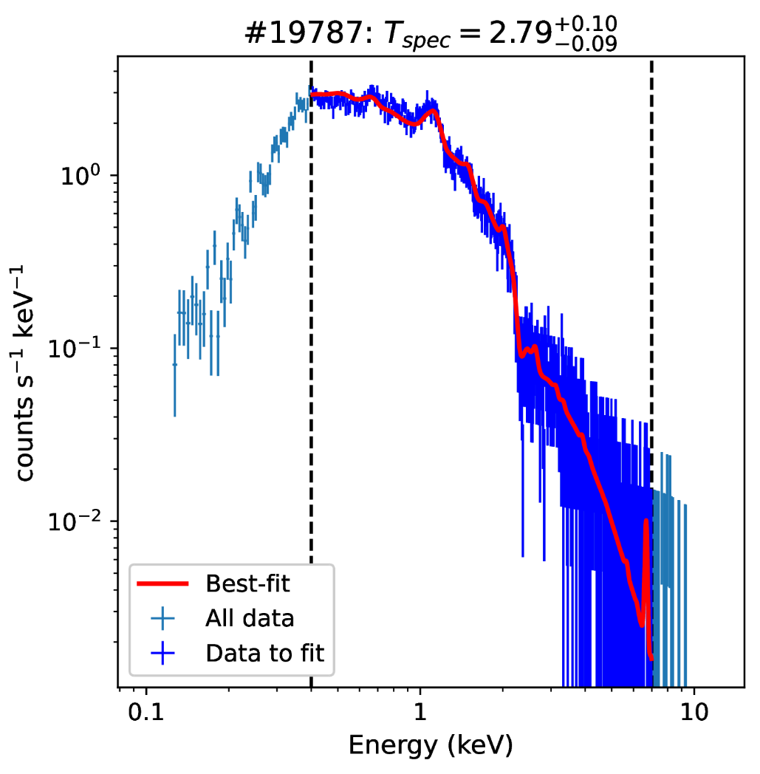
Reason: need for a mass proxy for wide area X-ray surveys
We suggest yet another indicator
of temperature and mass -
average energy
of observed X-ray spectrum:
(idea: Vikhlinin 2006)
To calibrate it, we
(1) use realistic mock clusters from
Magneticum simulations: 84 clusters
with M₅₀₀ > 10¹⁴ M_{sun} h⁻¹ and z < 0.2
(2) mimic SRG/eROSITA observations and derive cluster temperature, luminosity and average energy
Example of cluster’s filtered image
and corresponding spectrum
Notes:
‹#›

Slide 3
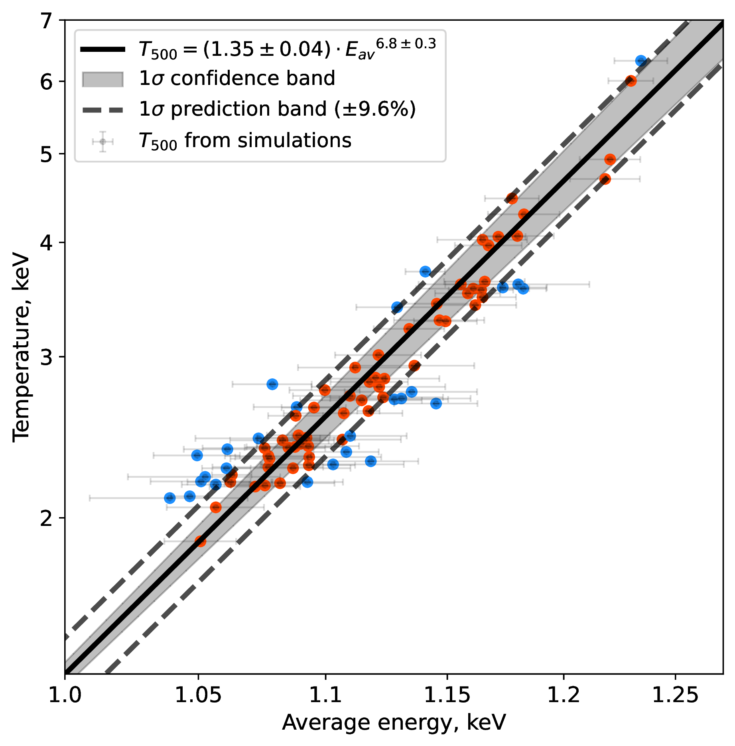
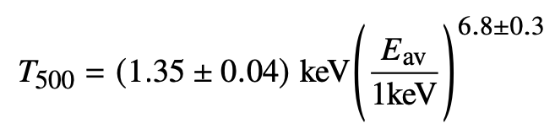
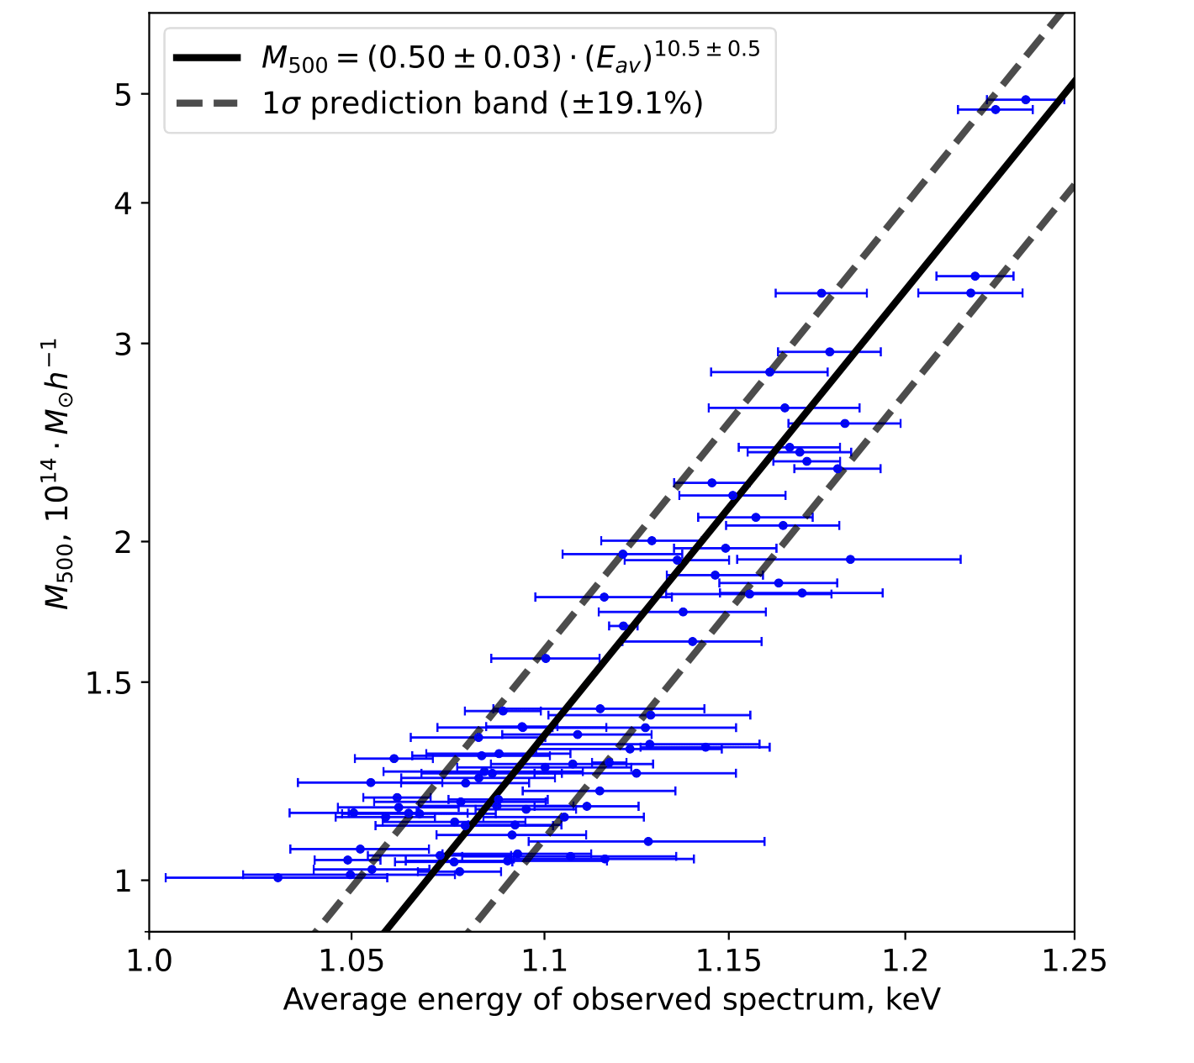
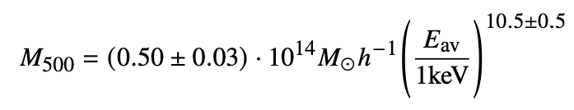
RESULTS:
Database of cluster images and spectra
Single-T approximation is acceptable
Temperature as a function of E_{av}:
with ~10% scatter (incl. background)
Mass as a function of E_{av}:
with ~20% scatter (comparable to
scatter of T-M and L-M relations)
No need in assumptions about the model
Temperature
Mass
Average energy

Slide 4
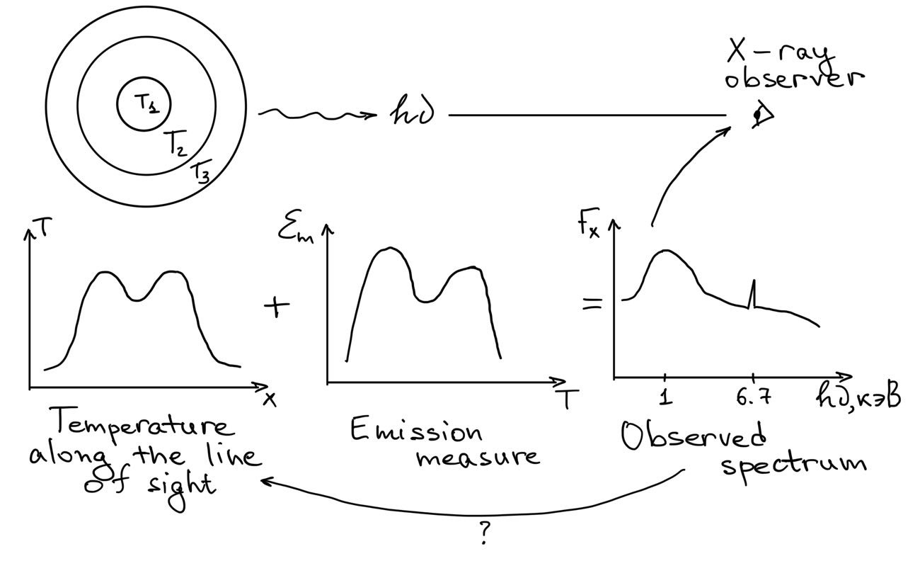
Database: github.com/pi4imu/RRCS_DB
Preprint: arXiv:2408.12026
?
Notes:
‹#›

