Slide 1

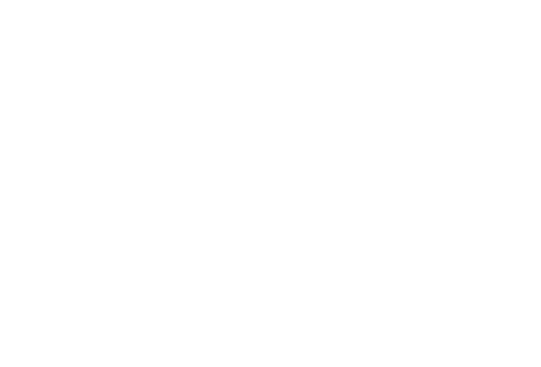
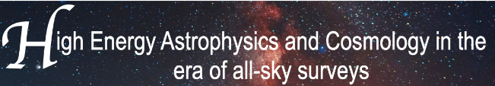


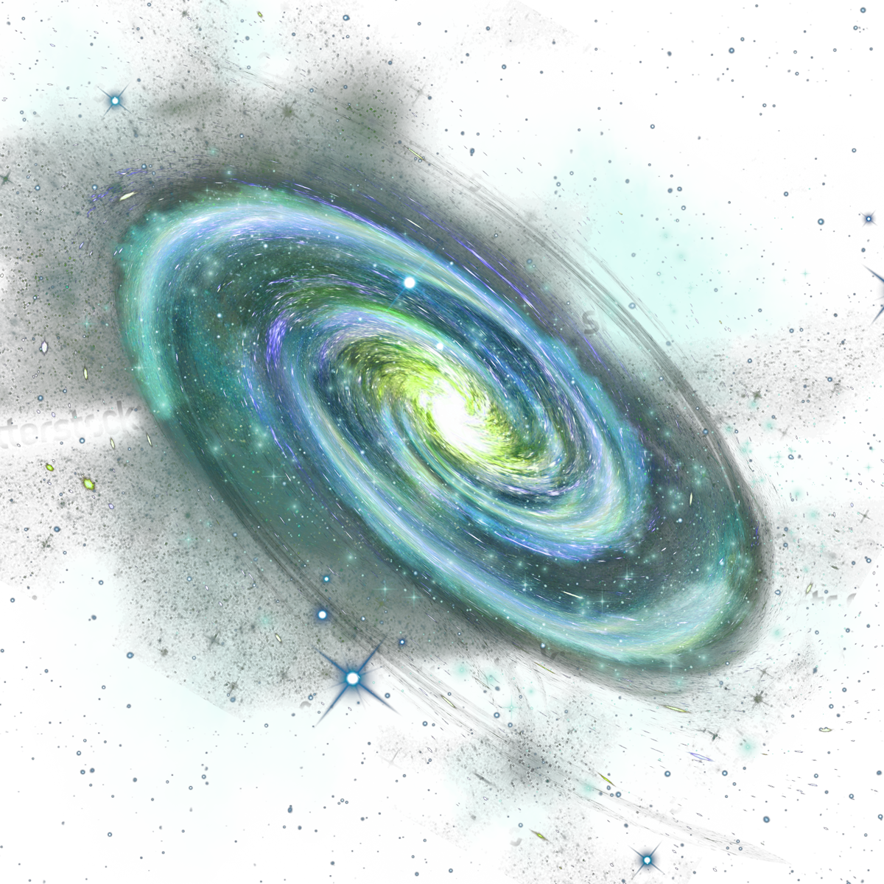
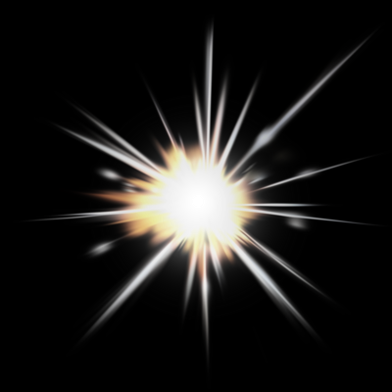

Investigating the Formation of Heavy Elements in Neutron Star Collisions and Rapid Neutron Capture Process
Presenter:
Sara karimi
In collabration with:
Soroush Shakeri
Parisa Hashemi

Slide 2
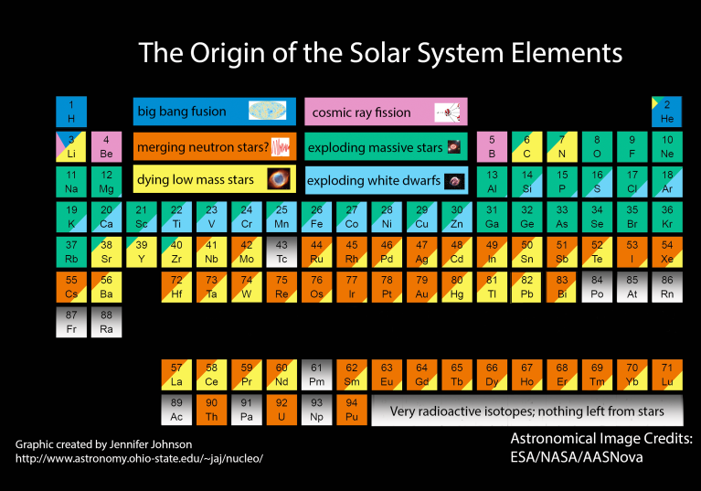
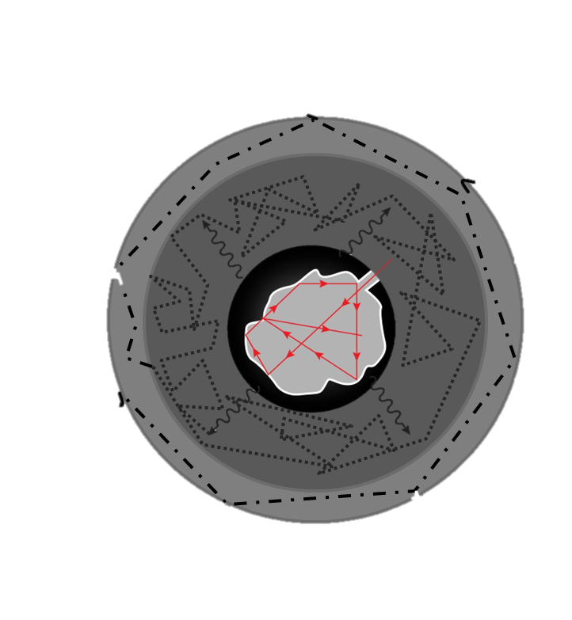
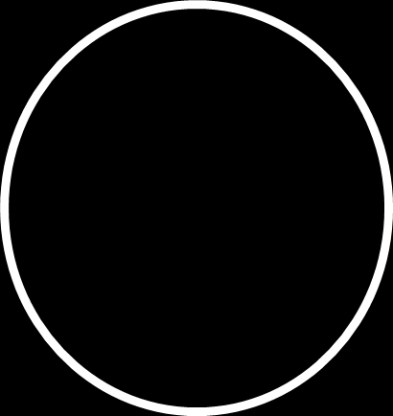
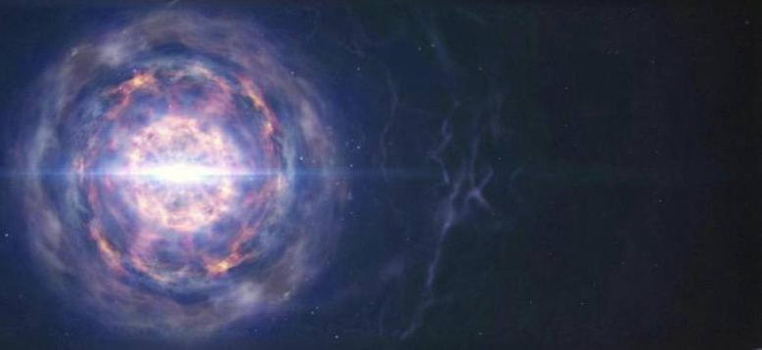
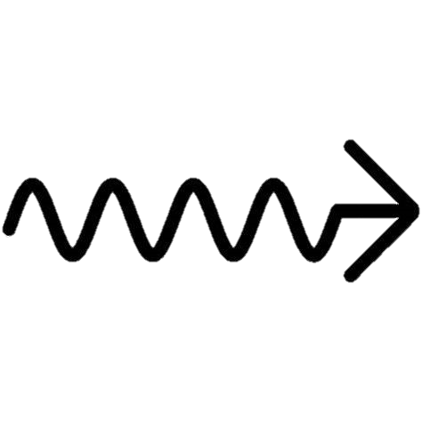
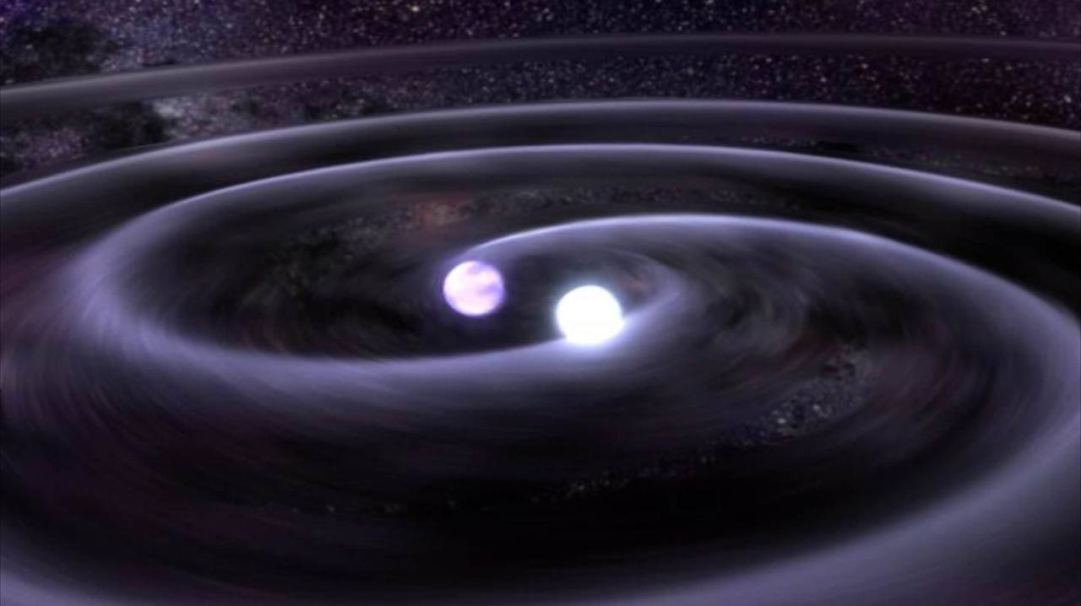

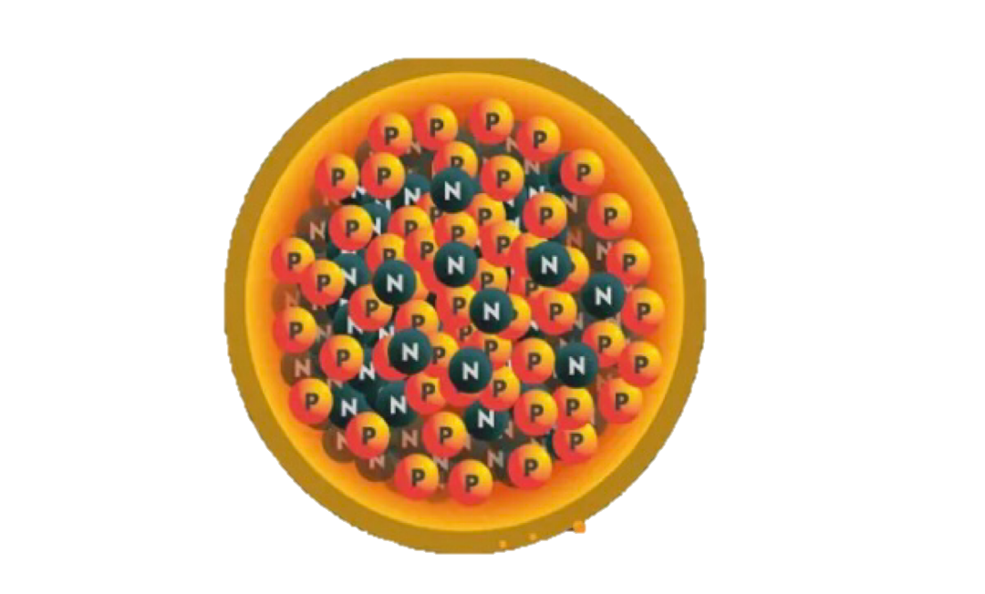
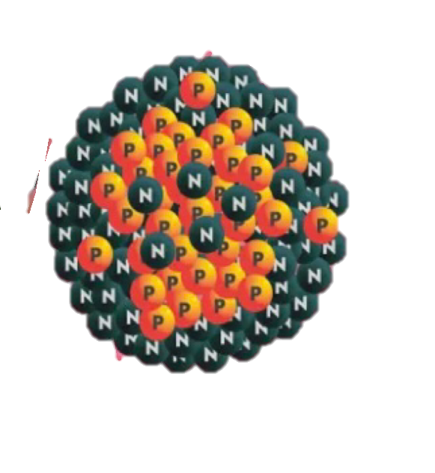
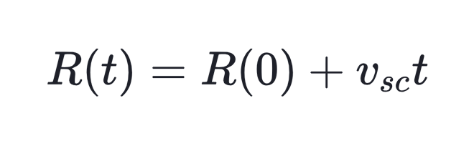





Diffusion time
"R-Process and Kilonova Emission in Neutron Star Mergers"
Heavy,neutron-rich,
Radioactive elements
Thermal emission(kilonova)
Rapid neutron capture
Heating due to
Radioactive decays
Neutron rich ejecta
N
N
N
N
N
N
N
N
N
N
N
N
N
N
N
N
N
N
Ejecta becames
transparent
N
N
N
N
N
N
N
N
N
N
N
Iron nucleus
N
N
N
N
Beta particle
N
Gold nucleus
Decompression homologous expansion
Time line
$$\sim hours$$
$$\sim days$$
$$\sim days,weeks$$
$$t_{d}=\frac{BκM_{ej}}{cR}$$
Time to peak
$$t_{d}\sim t$$
Li, L.-X., & Paczyński, B(1998). Transient Events from Neutron Star Mergers |
Metzger, B. D. (2019). Kilonovae. Living Reviews in Relativity

Slide 3
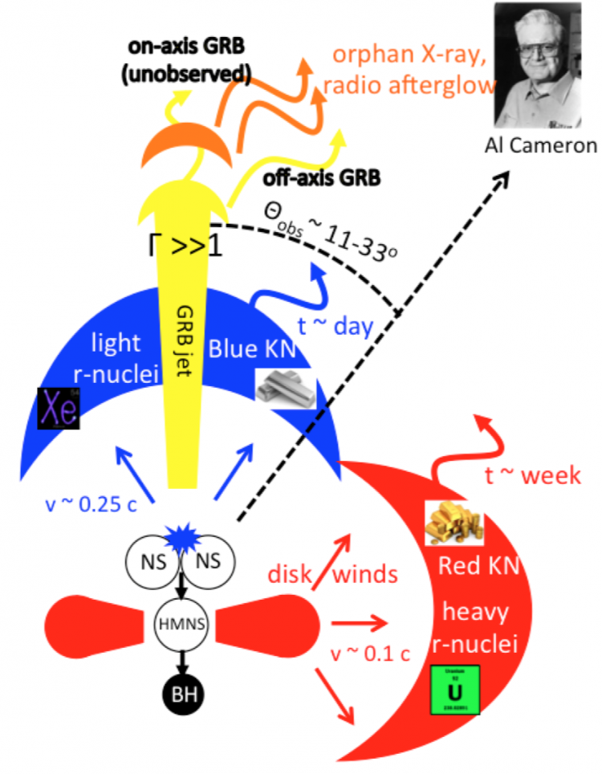
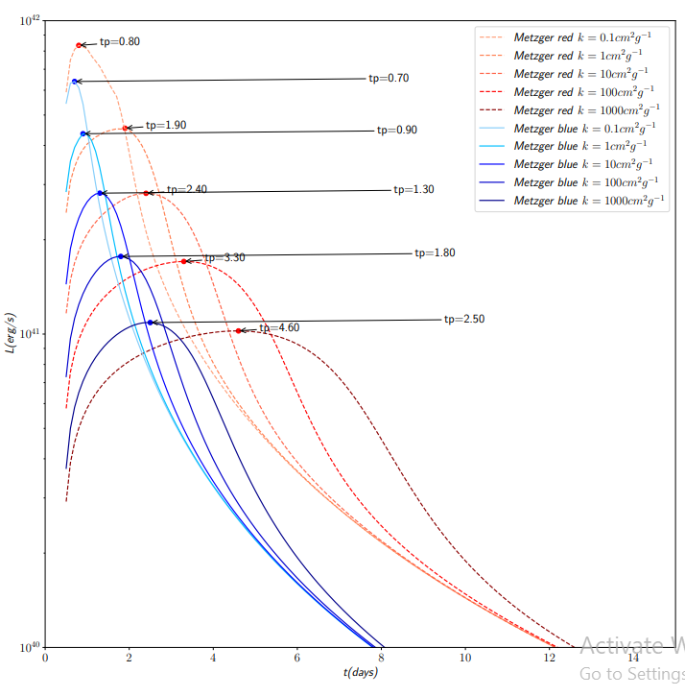
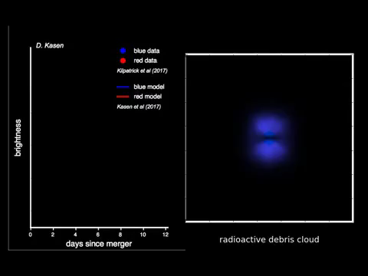

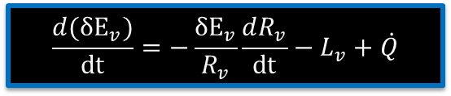
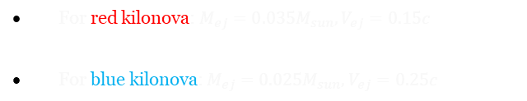
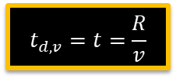

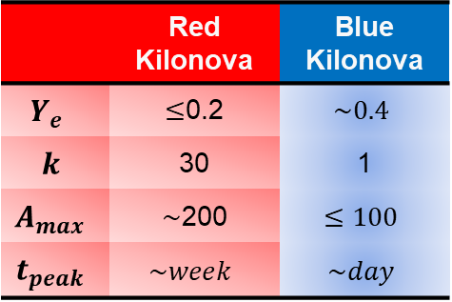
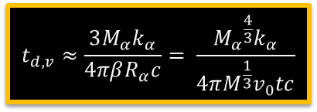



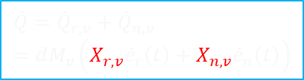
Evolution of thermal energy
blue vs red kilonova
"Impact of Opacity k in Two Kilonova Models”
Model properties
For red kilonova: $M_{ej}=0.035M_{sun},V_{ej}=0.15c$
For blue kilonova: $M_{ej}=0.025M_{sun},V_{ej}=0.25c$
 | Red Kilonova | Blue Kilonova
$$Y_{e}$$ | $≤$0.2 | $$\sim 0.4$$
$$k$$ | 30 | 1
$$A_{max}$$ | $\sim$200 | $$≤100$$
$$t_{peak}$$ | $$\sim week$$ | $$\sim day$$
$$\frac{d({δE}_{v})}{dt}=−\frac{{δE}_{v}}{R_{v}}\frac{dR_{v}}{dt}−L_{v}+\dot{Q}$$
$$M_{α}=M{(\frac{v}{v0})}^{−β}$$
$Y_{e}$is the electron fraction
plays an important role in the
r-process and the
kilonova light curve
$$t_{d,v}≈\frac{3M_{α}k_{α}}{4πβR_{α}c}= \frac{{M_{α}}^{\frac{4}{3}}k_{α}}{4πM^{\frac{1}{3}}v_{0}tc}$$
$$\dot{Q}={\dot{Q}}_{r,v}+{\dot{Q}}_{n,v}=dM_{v}\left(X_{r,v}{\dot{e}}_{r}\left(t\right)+X_{n,v}{\dot{e}}_{n}\left(t\right)\right)$$
The sources of thermal energy include heating from the decay of radioactive elements.
$$t_{d,v}=t=\frac{R}{v}$$
initial mass fraction of free neutrons
Metzger, B. D. (2017). Lessons from a Neutron Star Merger and the Landscape Ahead. Columbia University.
$$X_{n,v}=\frac{2}{π}\left(1−Y_{e}\right)arctan⁡\left(\frac{M_{n}}{M_{v}}\right),$$
the $r$-process mass fraction in mass layer $M_{v}$
$X_{r,v}=1−X_{n,v}$
https://github.com/mcoughlin/gwemlightcurves.git
"Blue and Red Kilonova Simulations and Data Kasen 2017." Wikimedia Commons, 2017

Slide 4
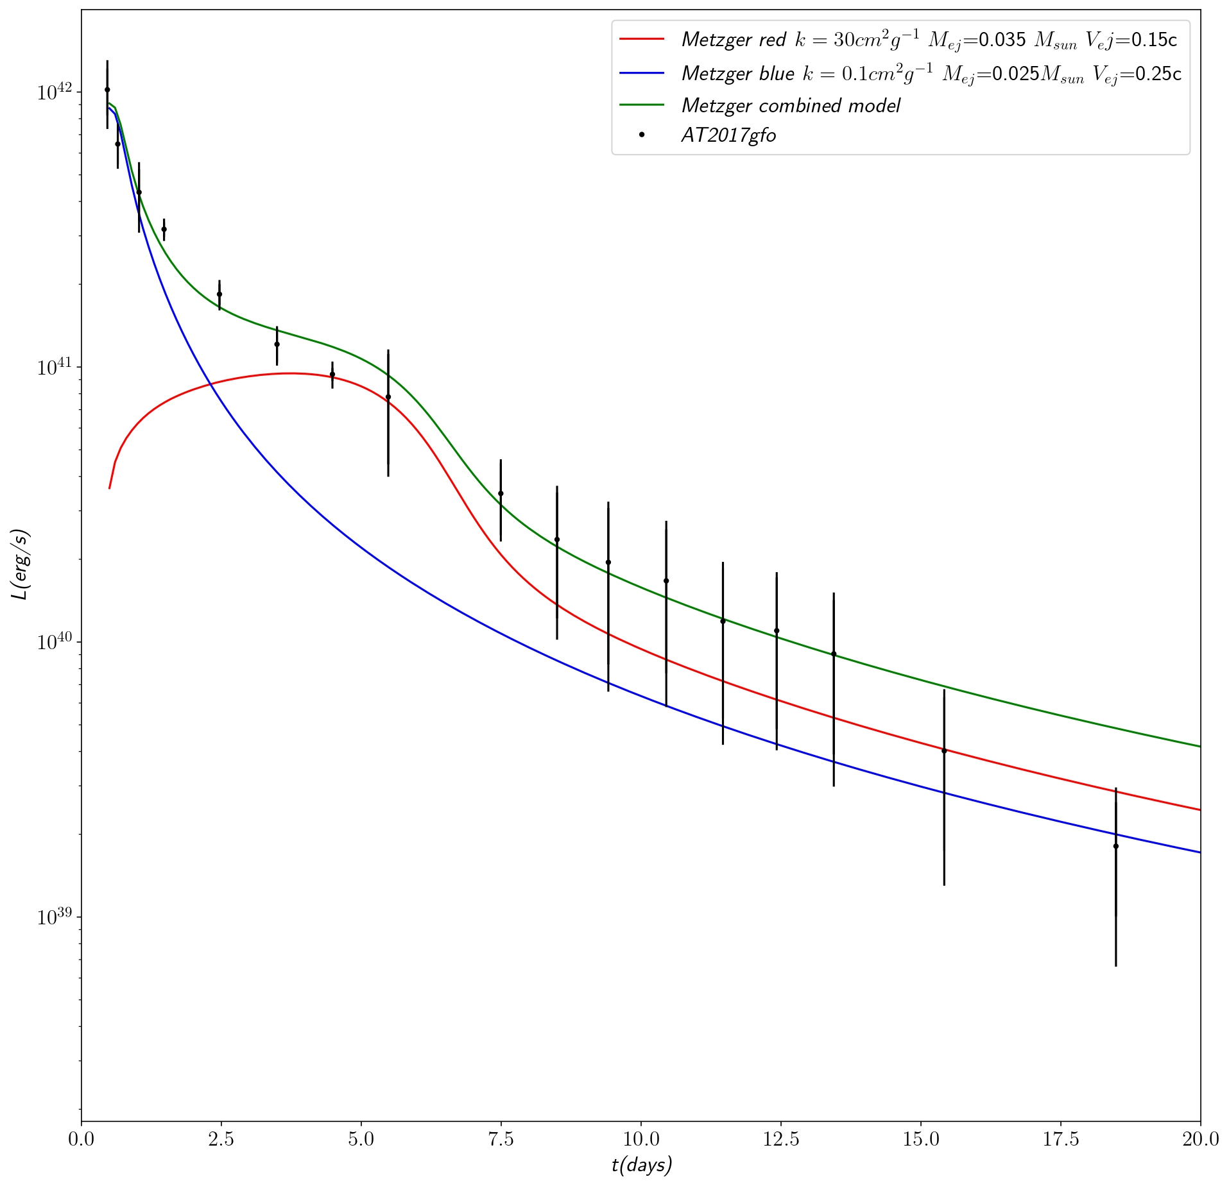
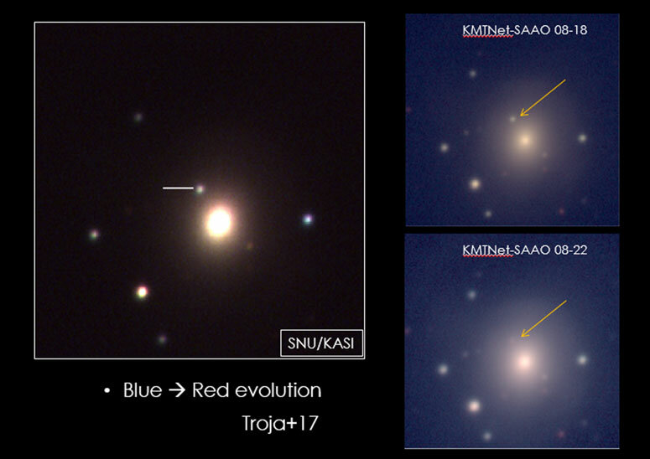
A Revolutionary Discovery in
Multi-Messenger Astronomy
The Cosmic Symphony of GW170817:
Unraveling the AT2017gfo Kilonova
Im, M., Paek, G., Kim, J., & Lim, G. (2023). Proc. Int. Astron. Union, 16, 207-210.
https://doi.org/10.1017/S1743921322000503
Sara Karimi, Parisa Hashemi and Soroush Shakeri in preparation 2024
Abbott, B. P., et al. (2017). Astrophys. J. Lett., 848

Slide 5
Thanks!

