Slide 1

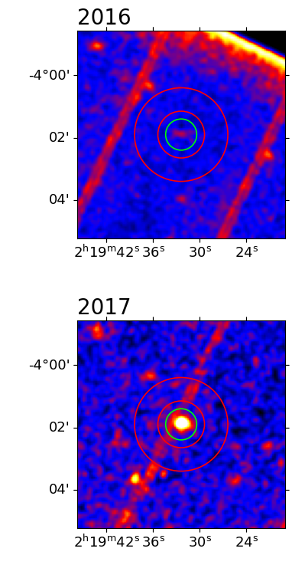
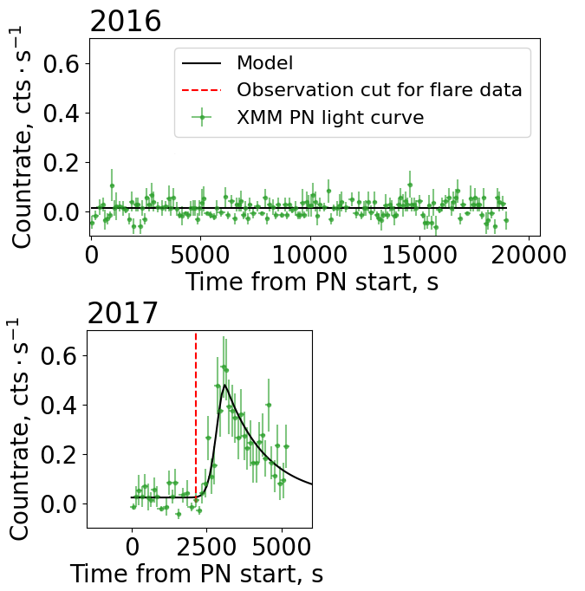
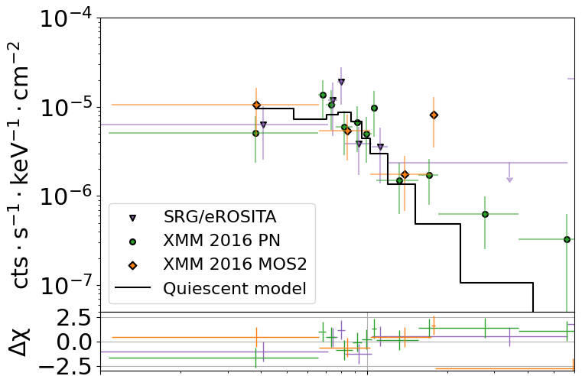
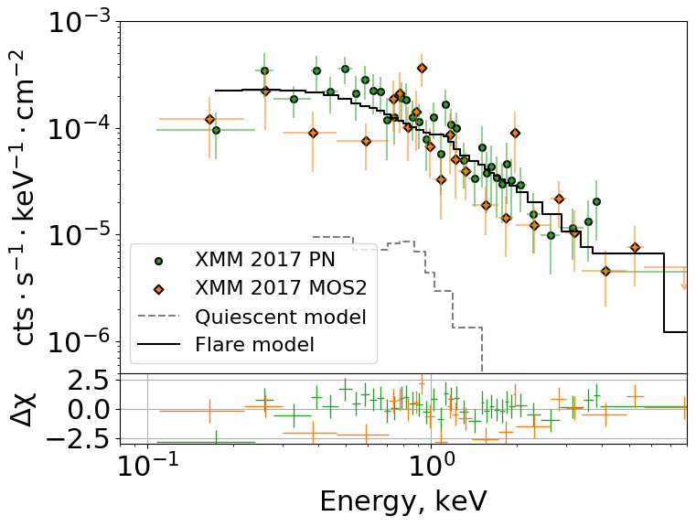
Superflare of a Sun-like star observed with XMM-Newton and SRG/eROSITA
ArXiv:
2408.07442
Mukhin Andrey (corr. author, amukhin@cosmos.ru),
Krivonos R., Bikmaev I., Gorbachev M., Khamitov I., Sazonov S., Gilfanov M., Sunyaev R.

Slide 2
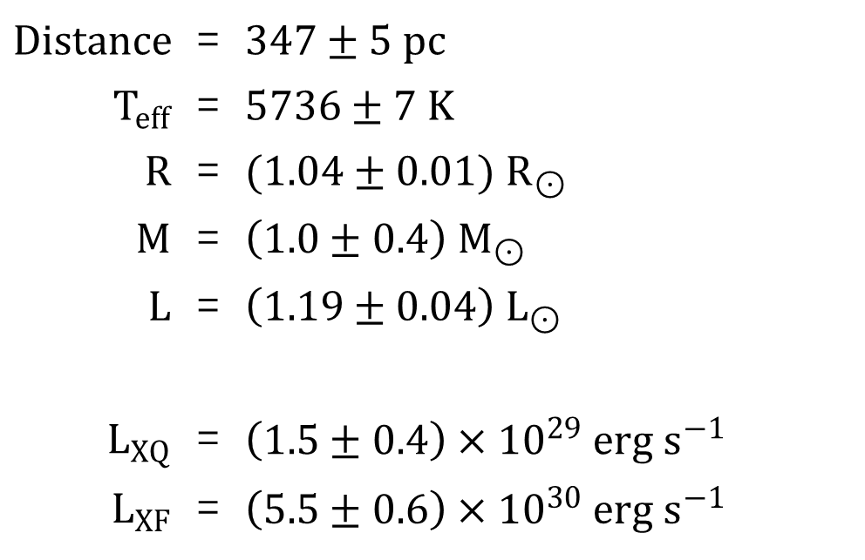





Superflare of a Sun-like star observed with XMM-Newton and SRG/eROSITA
ArXiv:
2408.07442
Mukhin Andrey (corr. author, amukhin@cosmos.ru),
Krivonos R., Bikmaev I., Gorbachev M., Khamitov I., Sazonov S., Gilfanov M., Sunyaev R.
Gaia DR3
X-ray superflare
$Distance$ | = | $347±5 pc$
$T_{eff}$ | = | $5736±7 K$
$R$ | = | $(1.04±0.01) R_{⊙}$
$M$ | = | $\left(1.0±0.4\right) M_{⊙}$
$L$ | = | $\left(1.19±0.04\right) L_{⊙}$
$L_{XQ}$ | = | $\left(1.5±0.4\right)×{10}^{29} erg s^{−1}$
$L_{XF}$ | = | $\left(5.5±0.6\right)×{10}^{30} erg s^{−1}$
$$E_{X}=\left(1.7±0.2\right)×{10}^{34} erg$$
$$E>{10}^{33} erg$$
G type star
Rotational period
$$P_{rot}=3.2±0.5 days$$
Starspot area upper limit
$$A/A_{1/2⊙}<0.4 \%$$
$A_{1/2⊙}=3×{10}^{32} cm^{2}$
Single G star or binary?
Gaia DR3 + APOGEE-2 DR17

