Slide 1
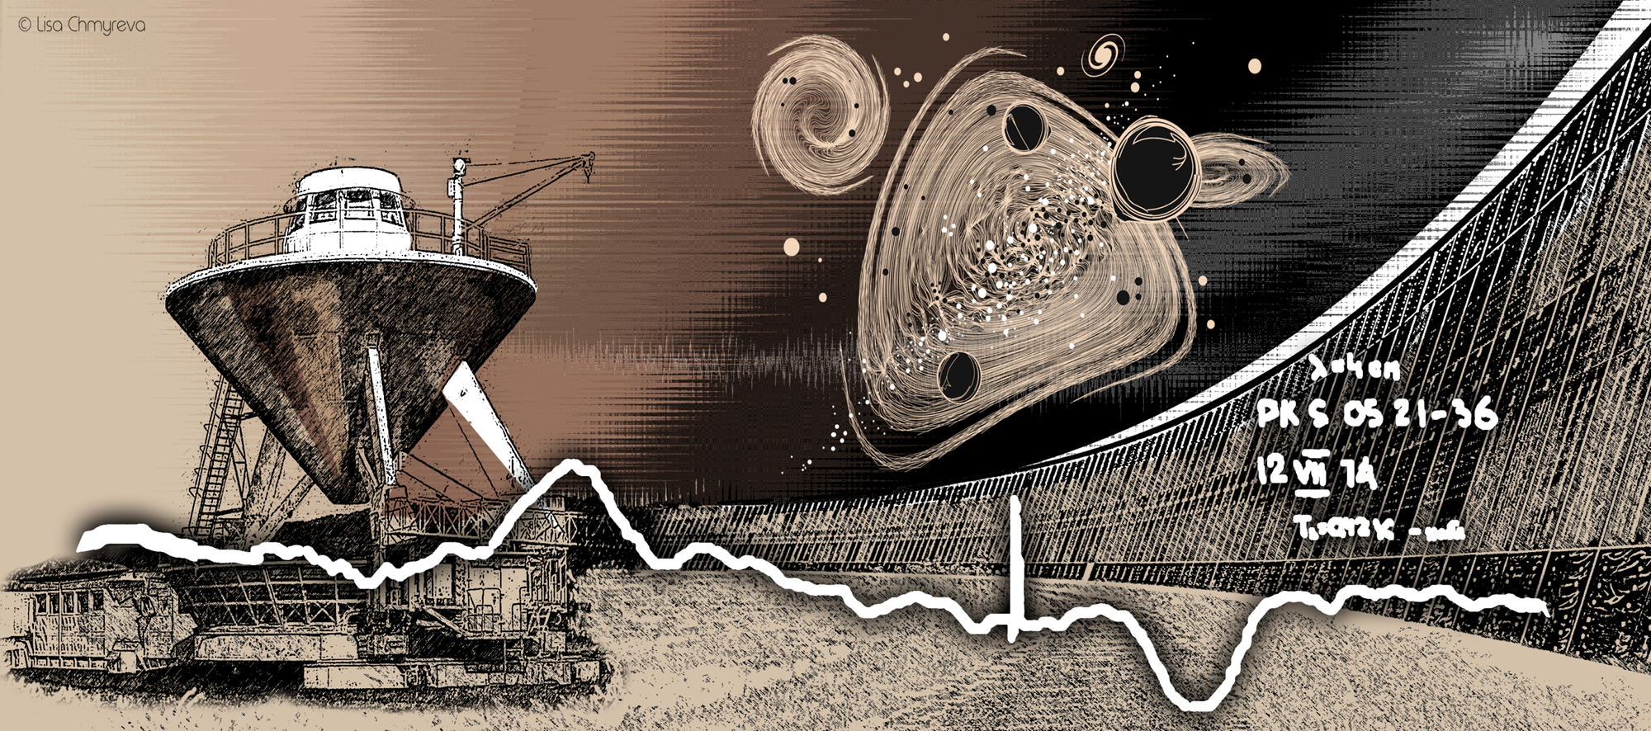
Broadband radio properties of the FR0 radio galaxies
Mikhailov Alexander¹, Sotnikova Yulia¹, Stolyarov Vladislav^{1,2}
¹SAO RAS, ²University of Cambridge
8 October 2024
HEACOSS-2024

Slide 2
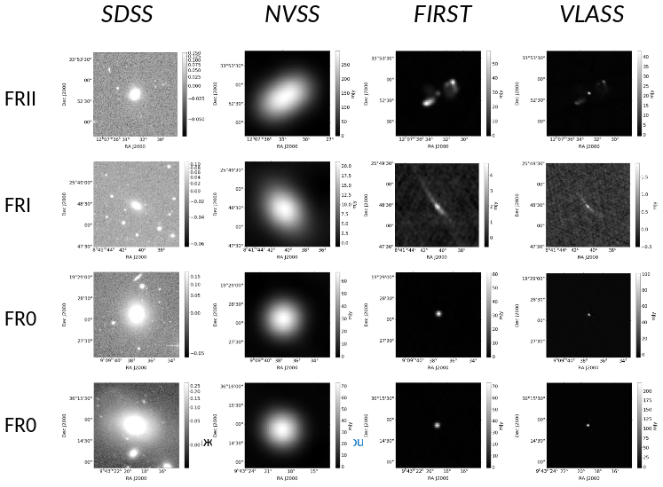
Radio galaxies in surveys

Slide 3
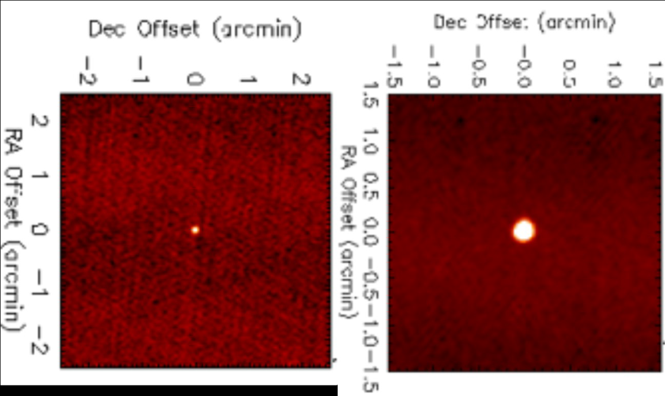
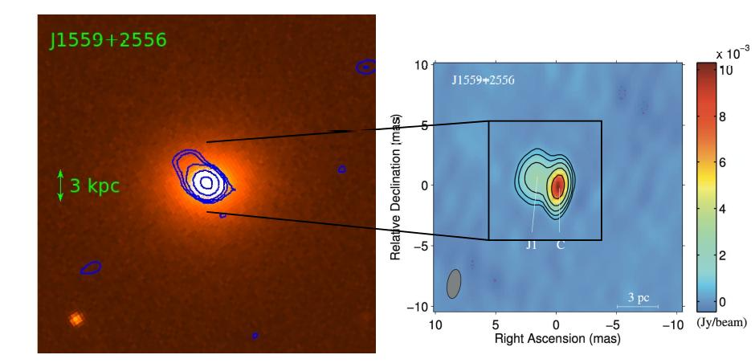
FR0s in the nearby Universe
red elliptical galaxies, M_{BH}~10⁸-10⁹M☉
Best et al. 2005: 2215 objects at z< 0.3,
SDSS + NVSS + FIRST
The most objects have a deficit of extended radio emission compared to classical FRI/FRII
Ghisellini 2011, Baldi et al., 2015, 2018
“FR0 galaxies”
linear size < 3 kpc
FR0 and FRI: space density 5:1
similar properties of host galaxies

Slide 4
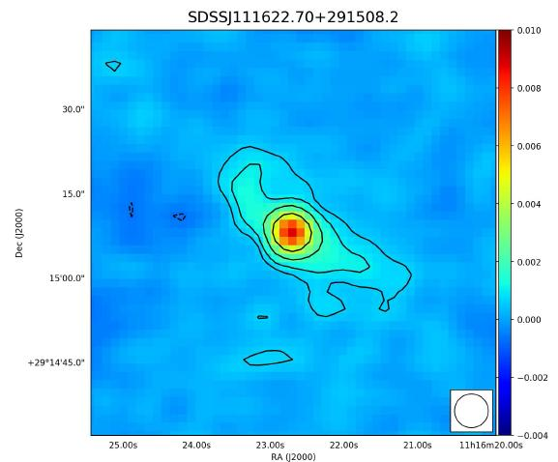
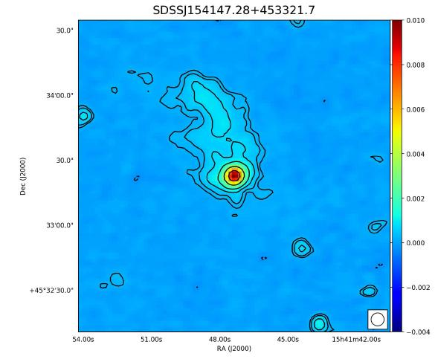
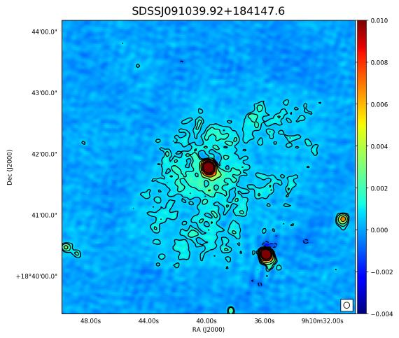
FR0s from LoTSS (Capetti et al. 2020)
Detection 66/66
54 point-like sources (linear size < 3-6 kpc)
12 extended sources (15-50 kpc)
LOFAR observations, 150 МГц
angular resolution 6”

Slide 5
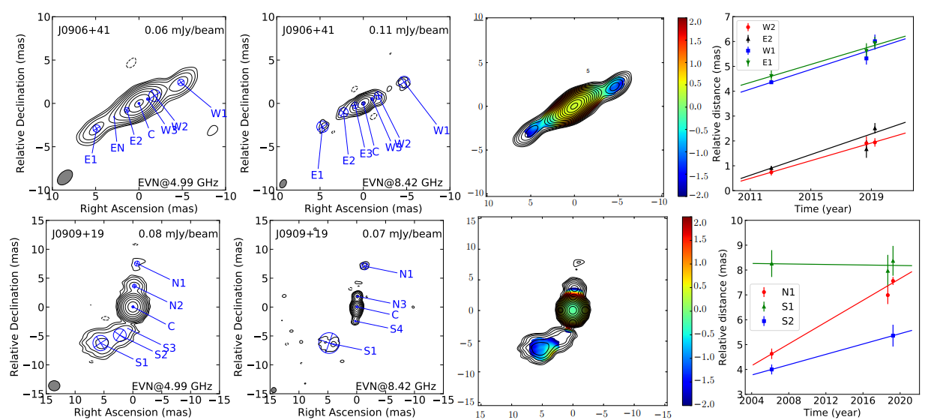
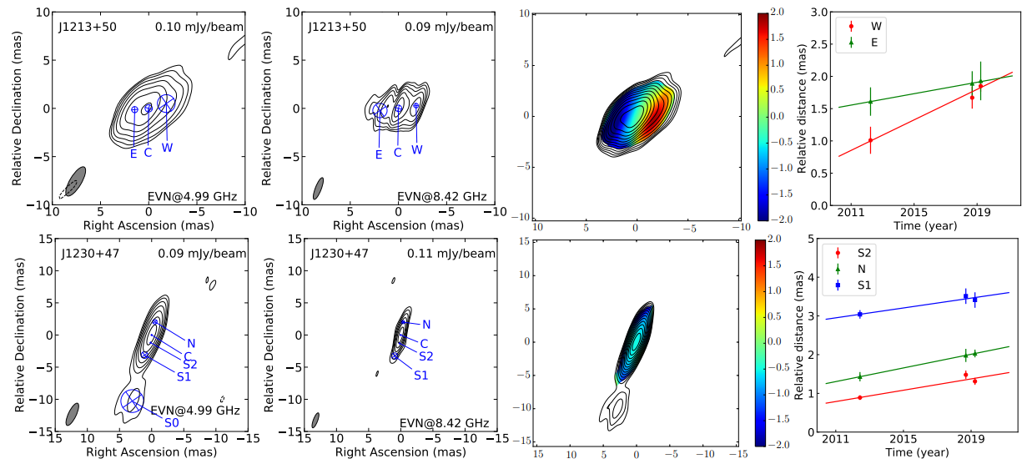
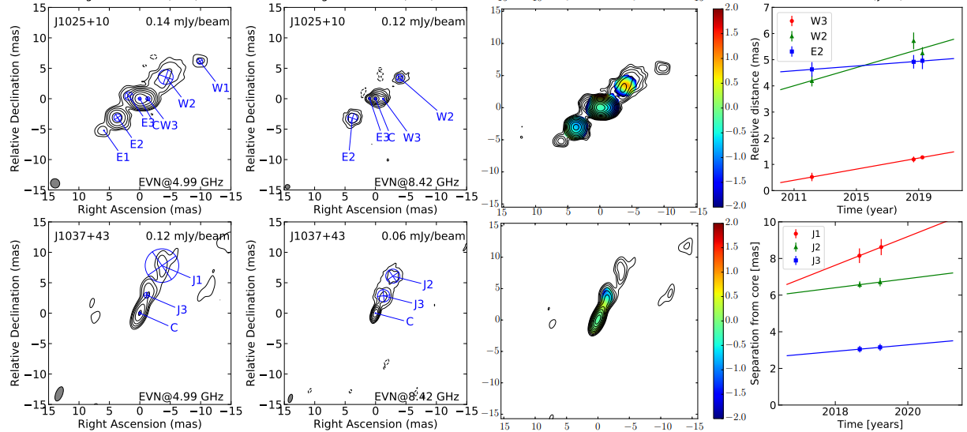
FR0’s parsec scale radio morphology (EVN, VLBA)
Cheng & An 2018, Cheng et al. 2021, Giovannini et al. 2023
25 sources were studied:
most of them are resolved on the scale of 1-20 pc;
flat radio spectra;
moderately relativistic jets (jet components speed is 0.2-0.5 с)

Slide 6
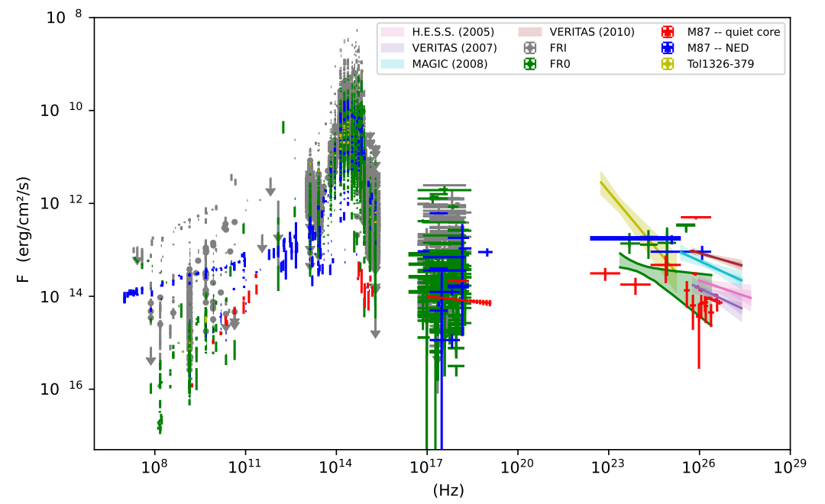
SEDs
Broad-band spectrum of FR0 almost coincides with spectrum of core М87 (FRI) in a quiet state
Boughelilba & Reimer 2023

Slide 7
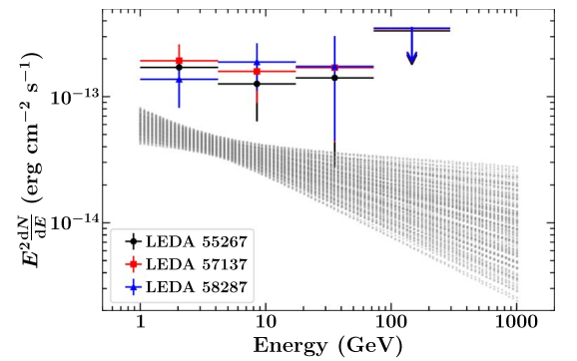
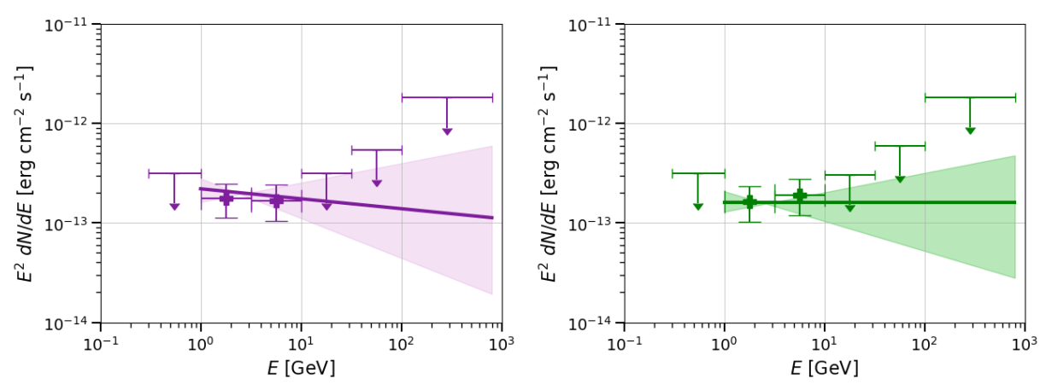
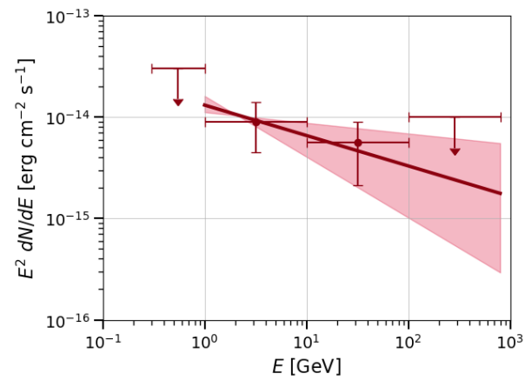
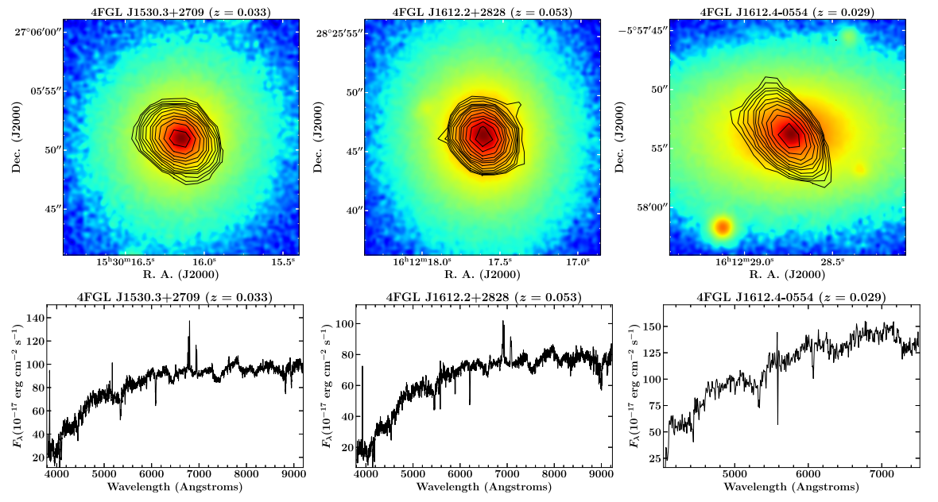
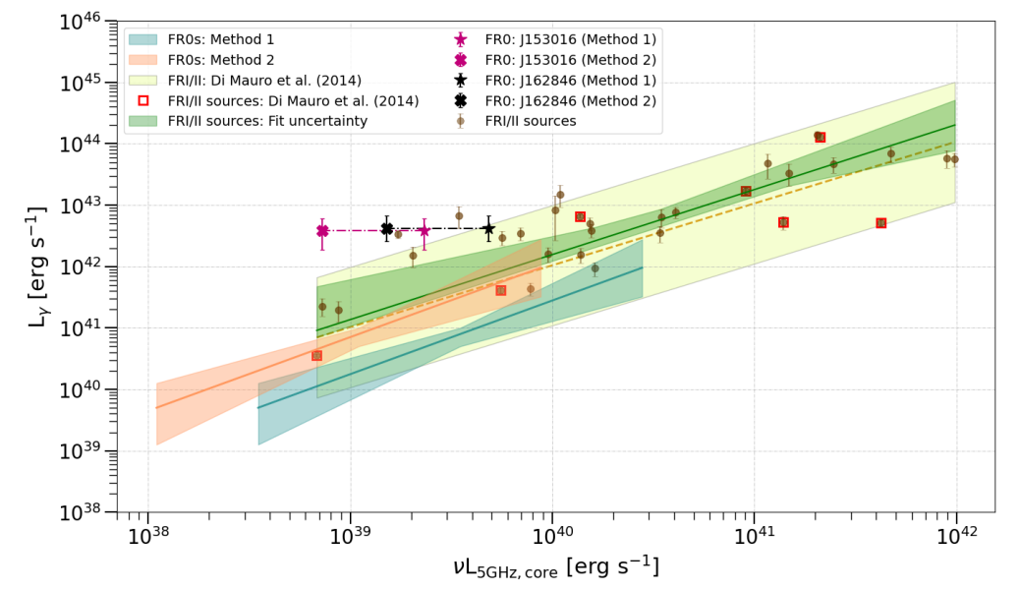
γ-ray FR0s
sub-threshold sample
LEDA 55267 LEDA 58287
Paliya 2021
Khatiya et al. 2023
Pannikkote et al. 2023
Khatiya et al. 2023

Slide 8
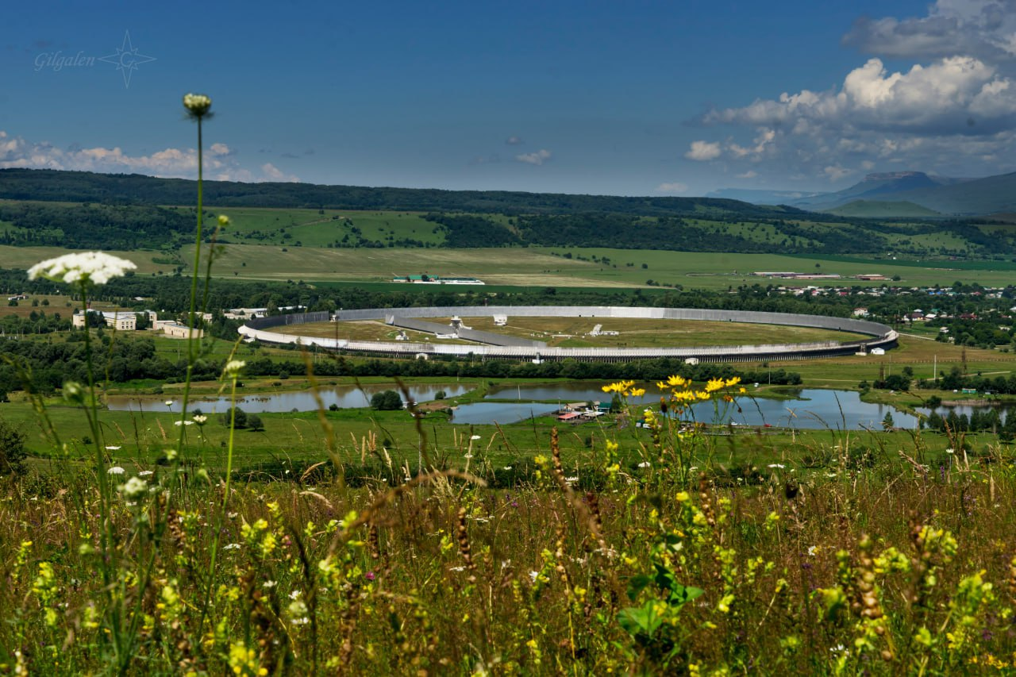
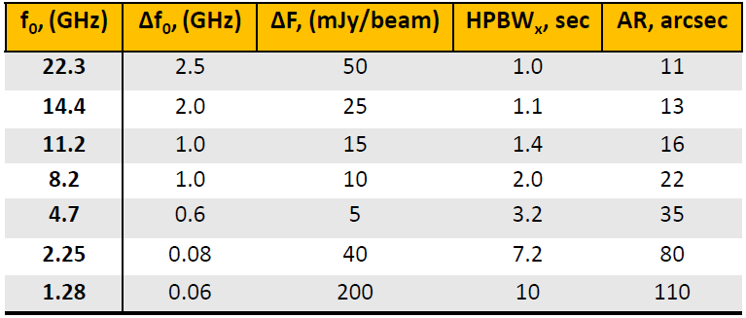
The sample and RATAN-600 observations
34 FR0CAT objects from Baldi et al. 2018, S_{1.4} > 30 mJy
z < 0.05, -09◦ < Dec < 47◦, 01^{h} < RA < 17^{h}
RATAN-600: 1.28, 2.25, 4.7, 8.2, 11.2, 14.4, 22.3 GHz
Quasi-simultaneous spectra: the result of records averaging of the source passage at the 7-10 days time scale
Observations: February 2020 up to the present day
7-20 observational epochs for each source

Slide 9
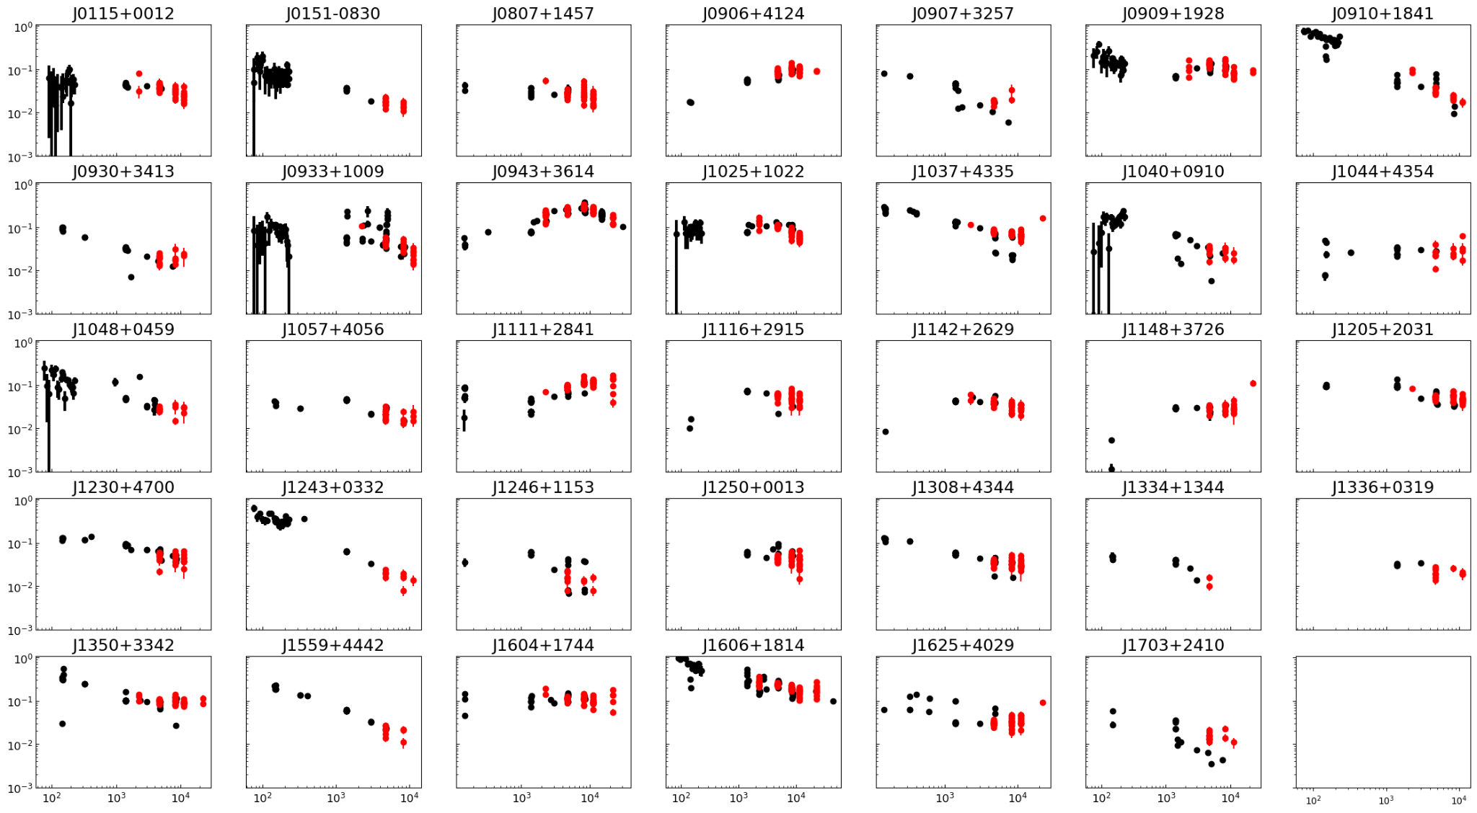
Radio spectra
The RATAN-600 measurements - red points
Flux density, Jy
Frequency, MHz

Slide 10
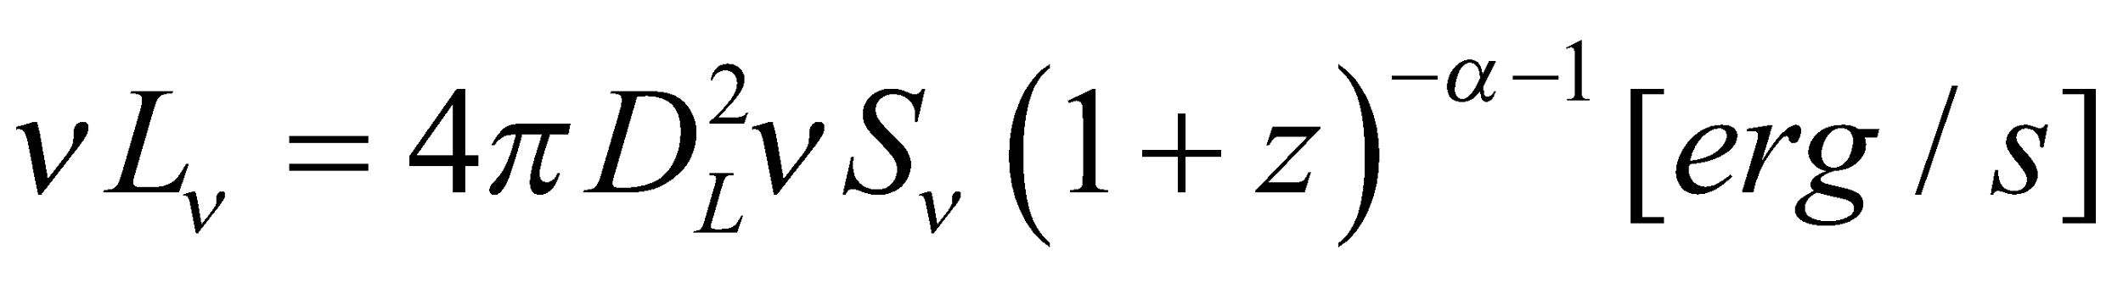
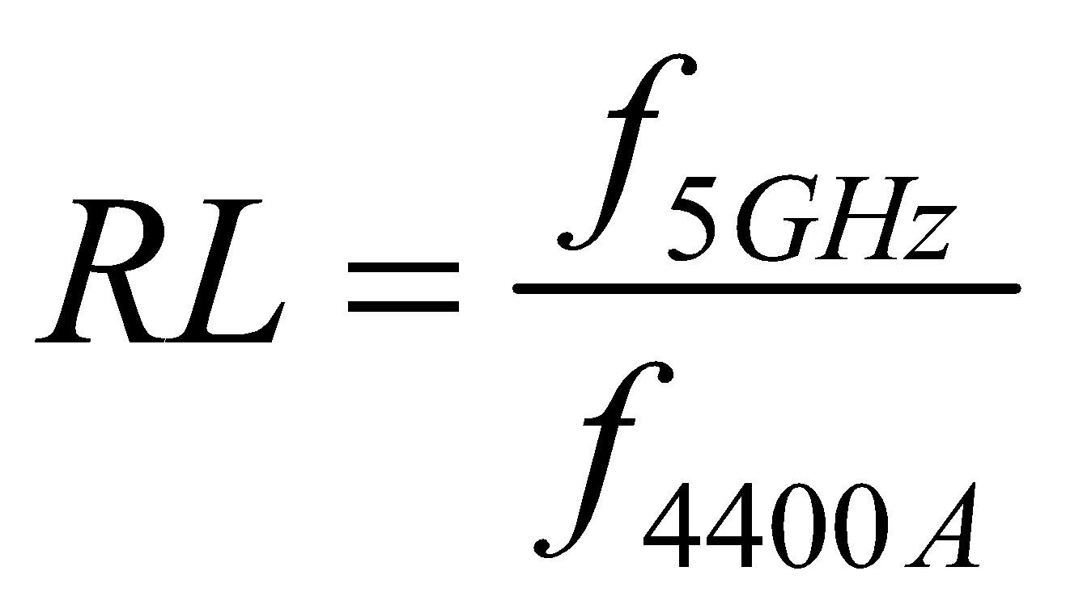
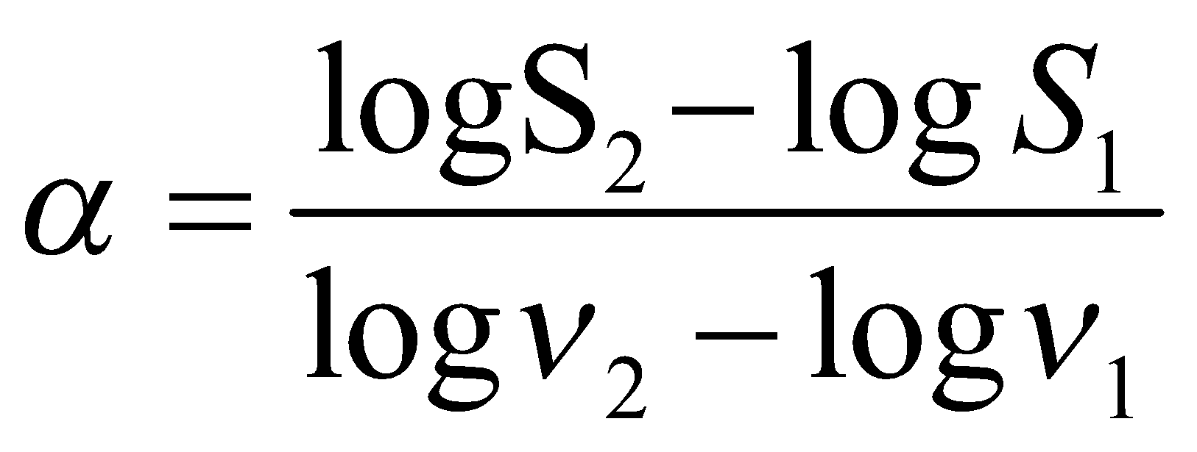
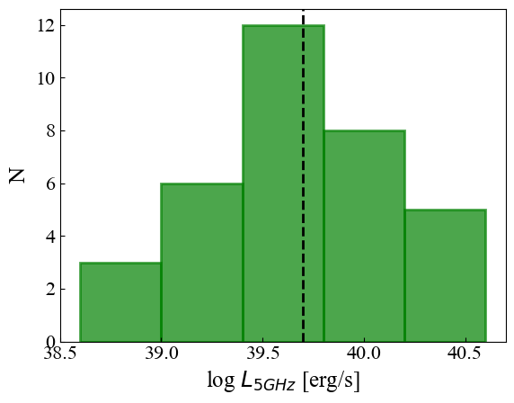
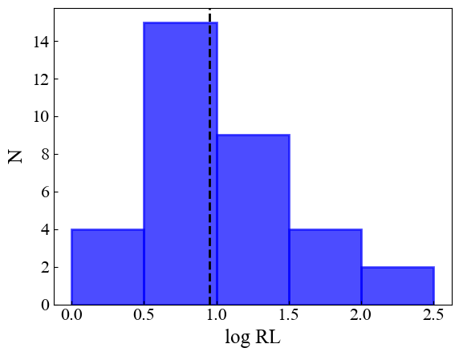
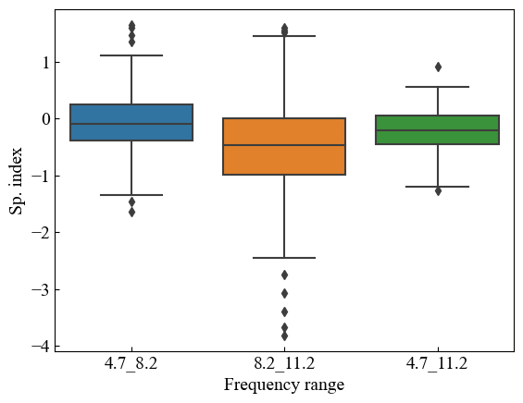
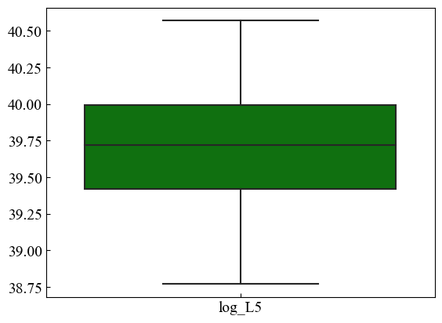
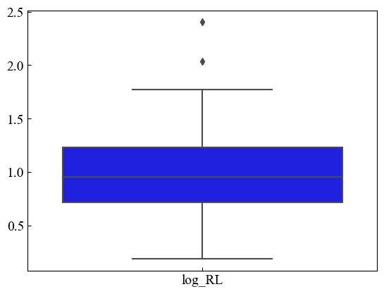
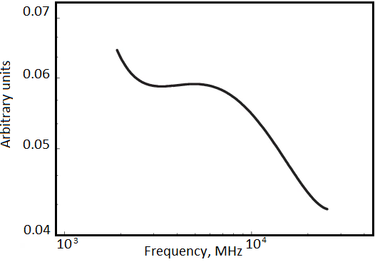
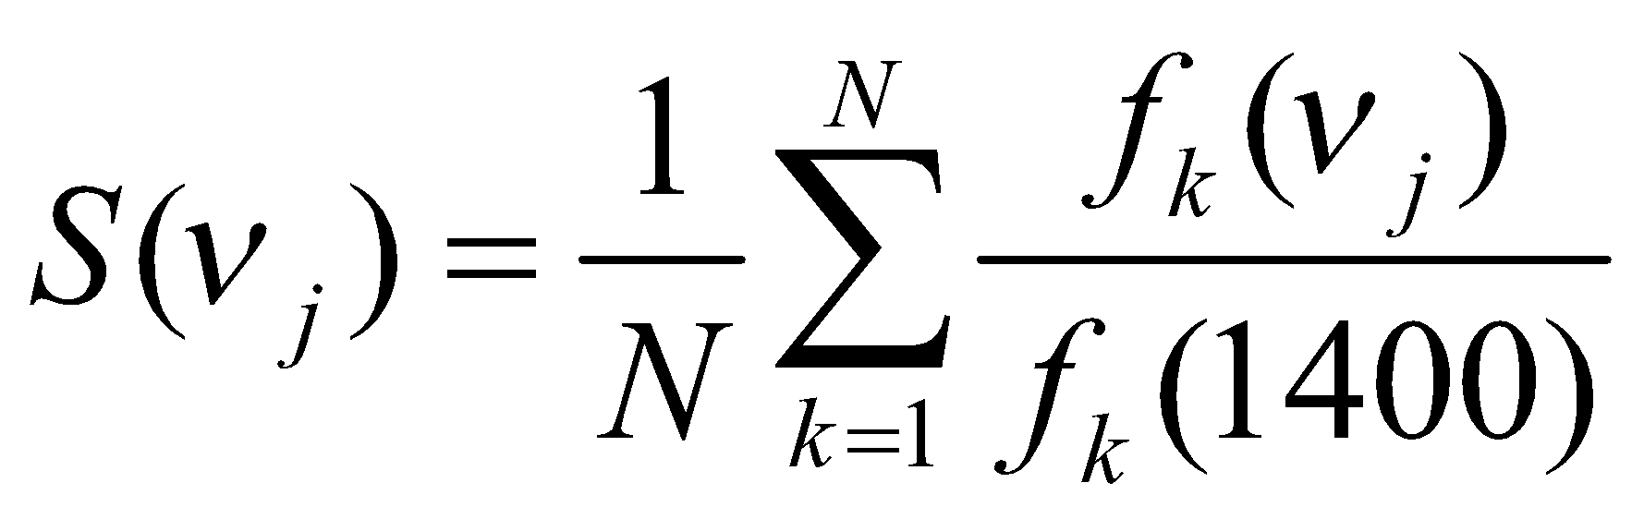
Radio properties
Radio loudness
Quasi-simultaneous spectra
Spectral indices
Radio luminosity
spectral type | %
steep | 29
inverted | 12
peaked | 42
upturn | 17
Mikhailov and Sotnikova 2021

Slide 11
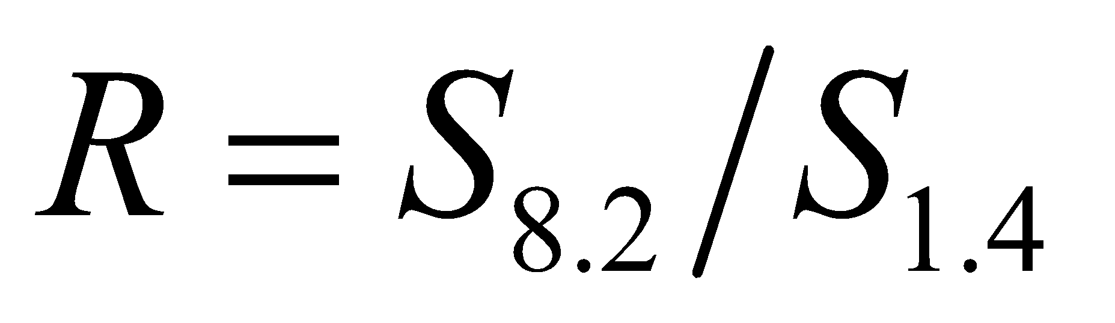
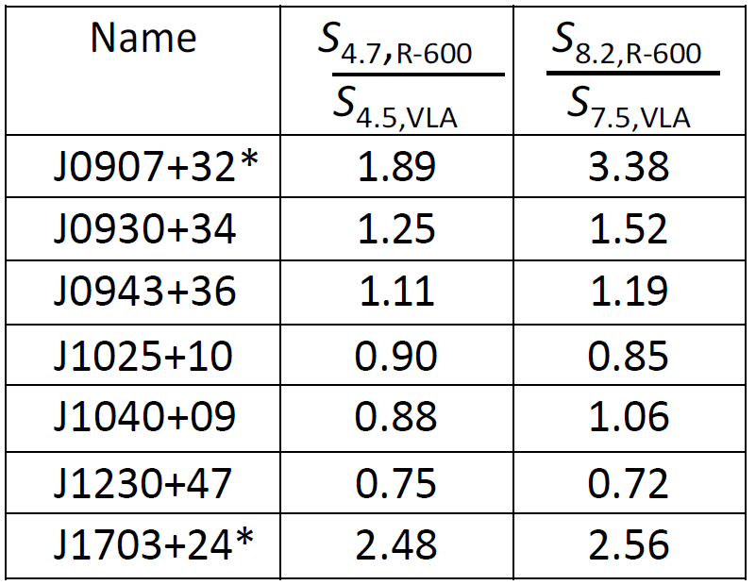
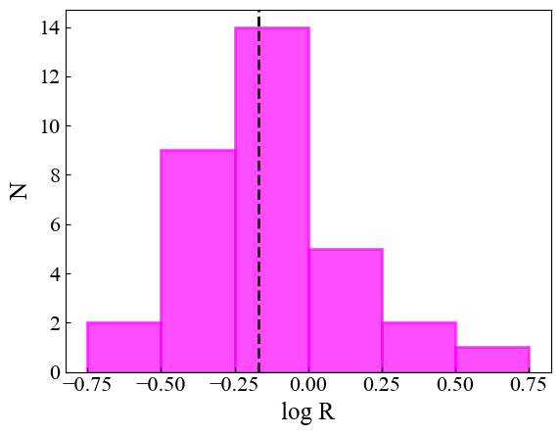
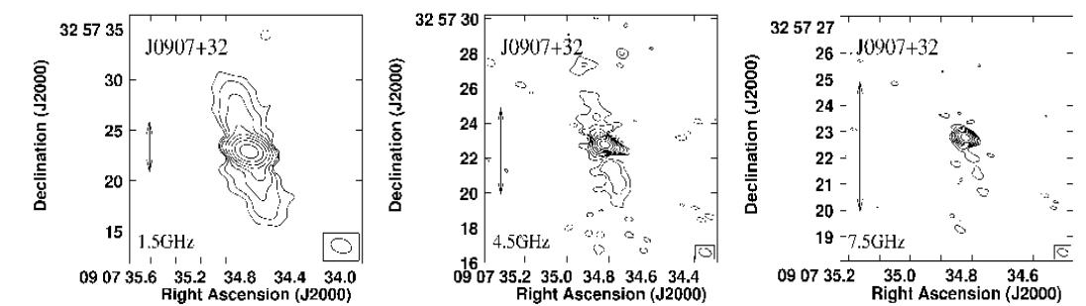
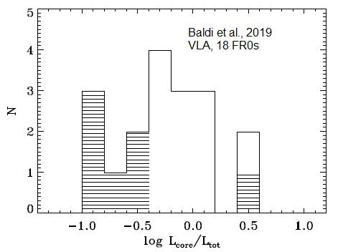
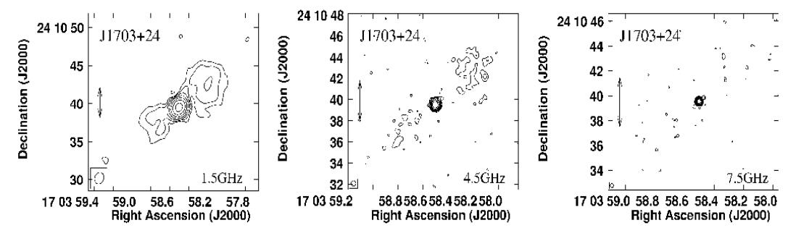
Core dominance parameter
VLA (Baldi et al. 2019):
1.5, 4.5, 7.5 ГГц, angular resolution ~0.3 arcsec,
extended radio structures - 4/18 objects
Mikhailov and Sotnikova 2021

Slide 12
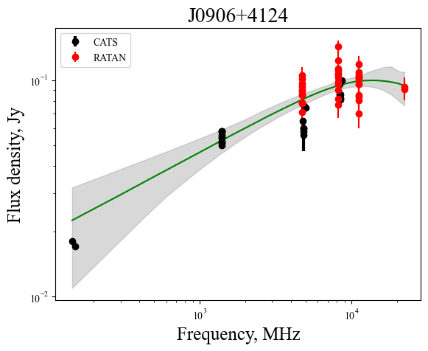


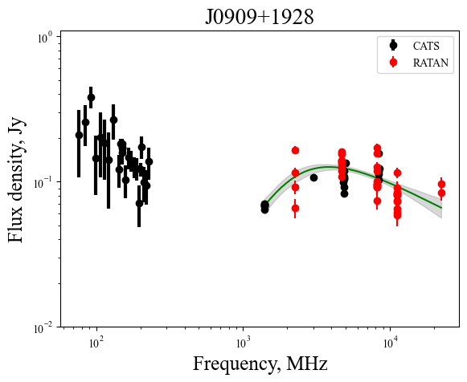
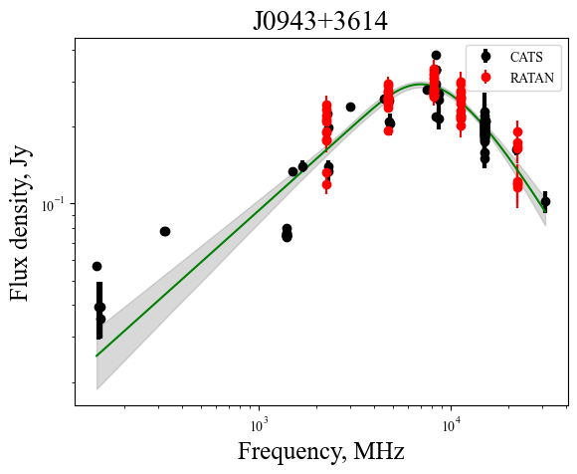
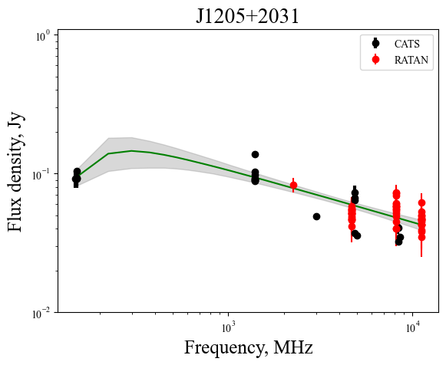
Peaked spectra modeling
Synchrotron self-absorption (SSA) processes are preferred to free-free absorption (FFA) ones
some examples

Slide 13
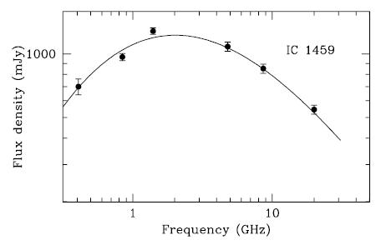
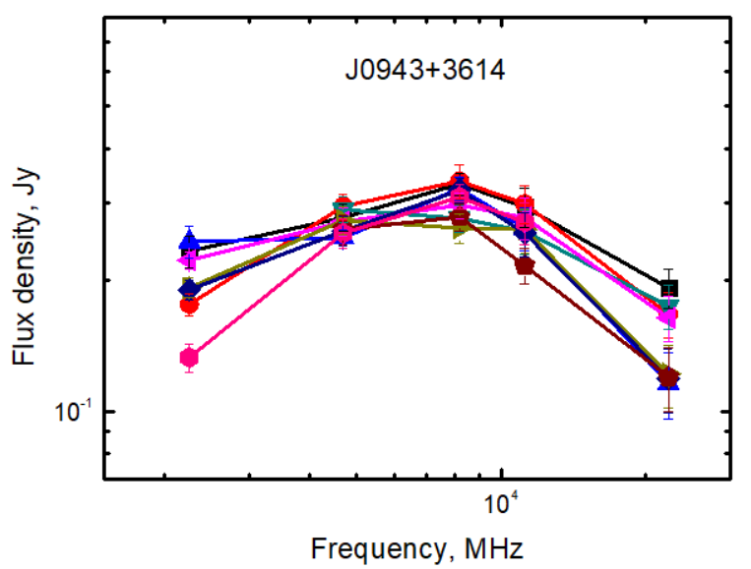
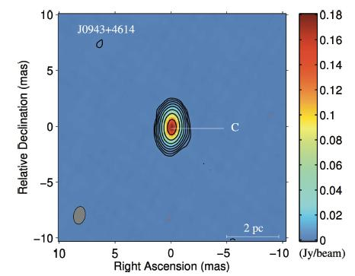
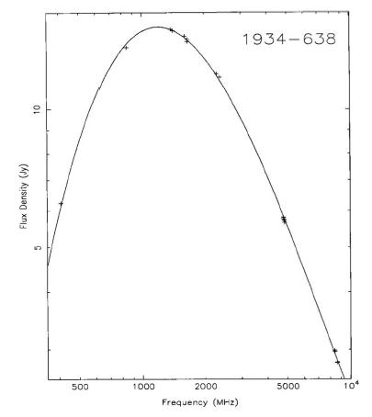
FR0 and GPS
Criteria: O’Dea+ 91, de Vries+ 97
α_{below} = +0.5
α_{above} = -0.7
FWHM ≈ 1.2
3 candidates among of 34 FR0s
example
Tingay et al. 2003
Relatively constant spectral shape, radio variability level ~10 %, Peak frequency is ~8 GHz
VLBI image at 8.3 GHz
(Cheng & An 2018)
Reynolds 1994

Slide 14
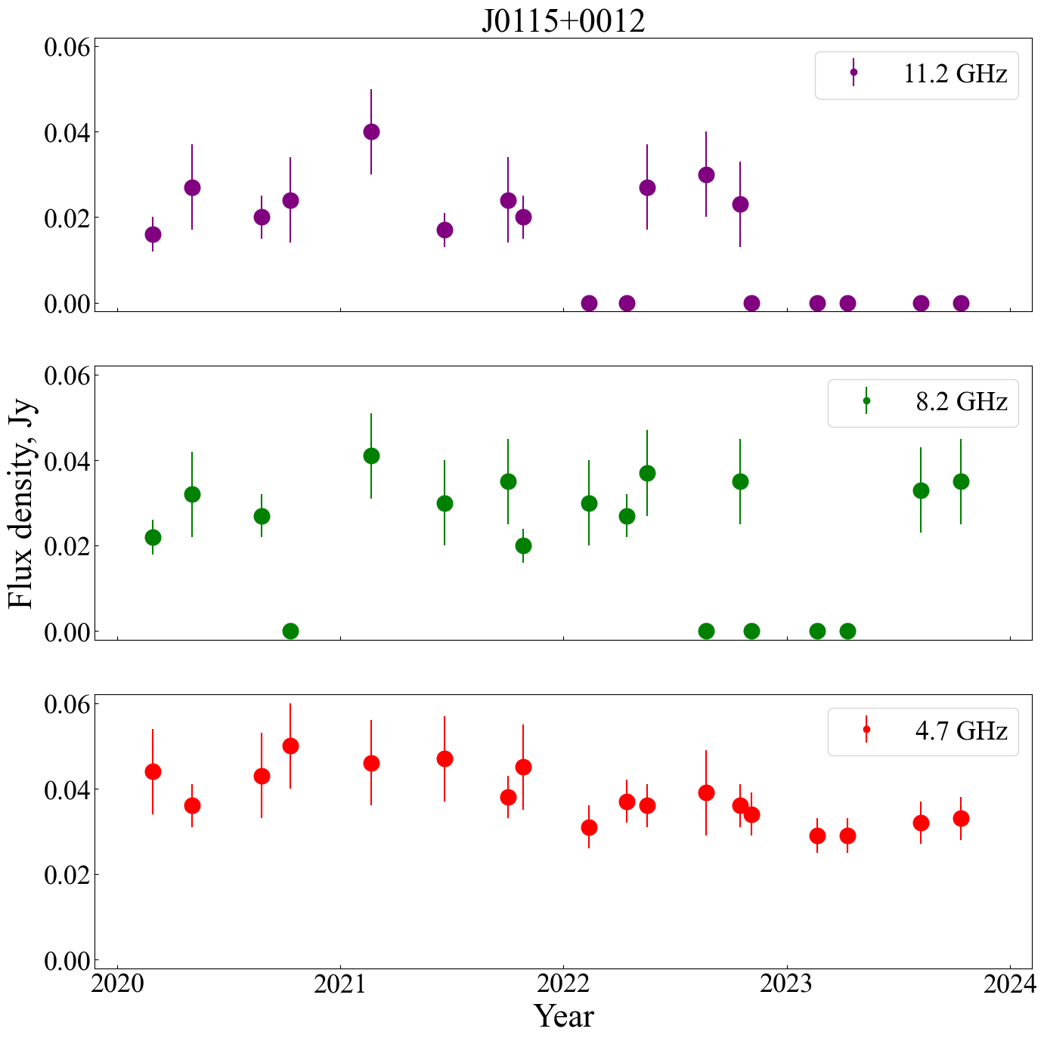
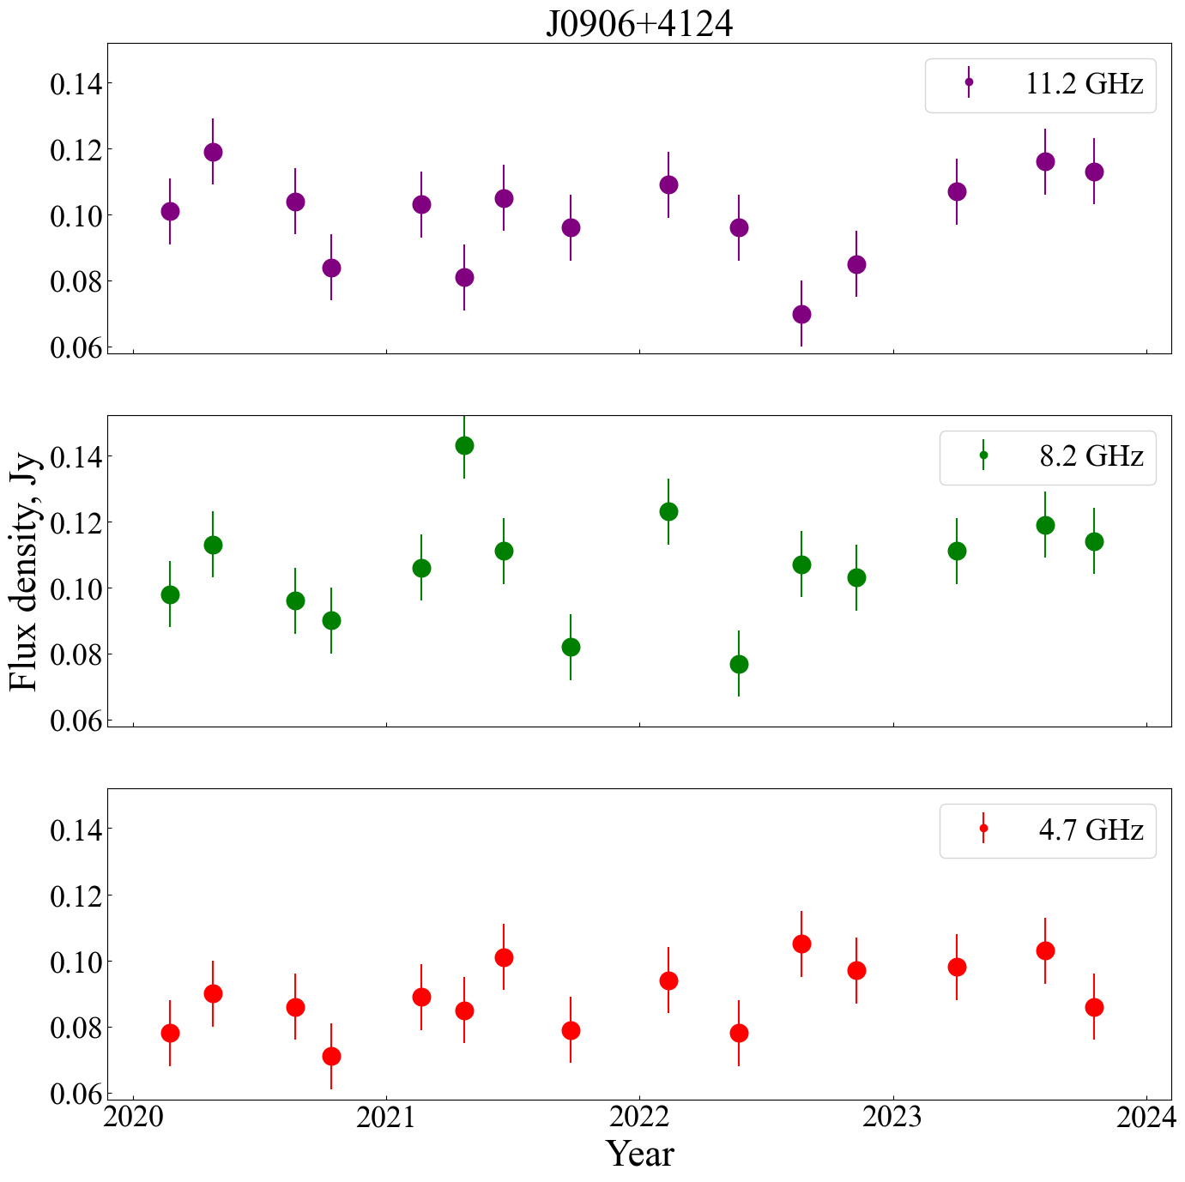
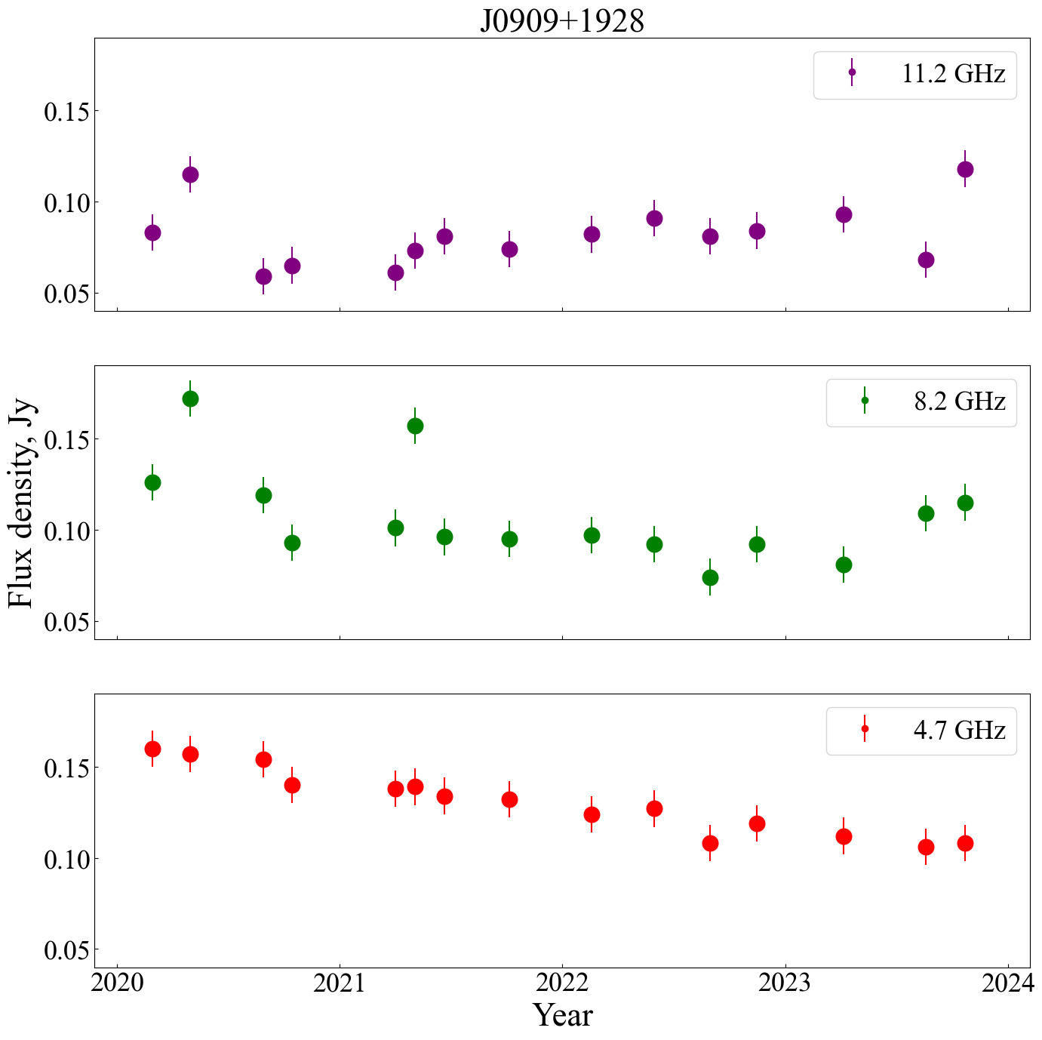
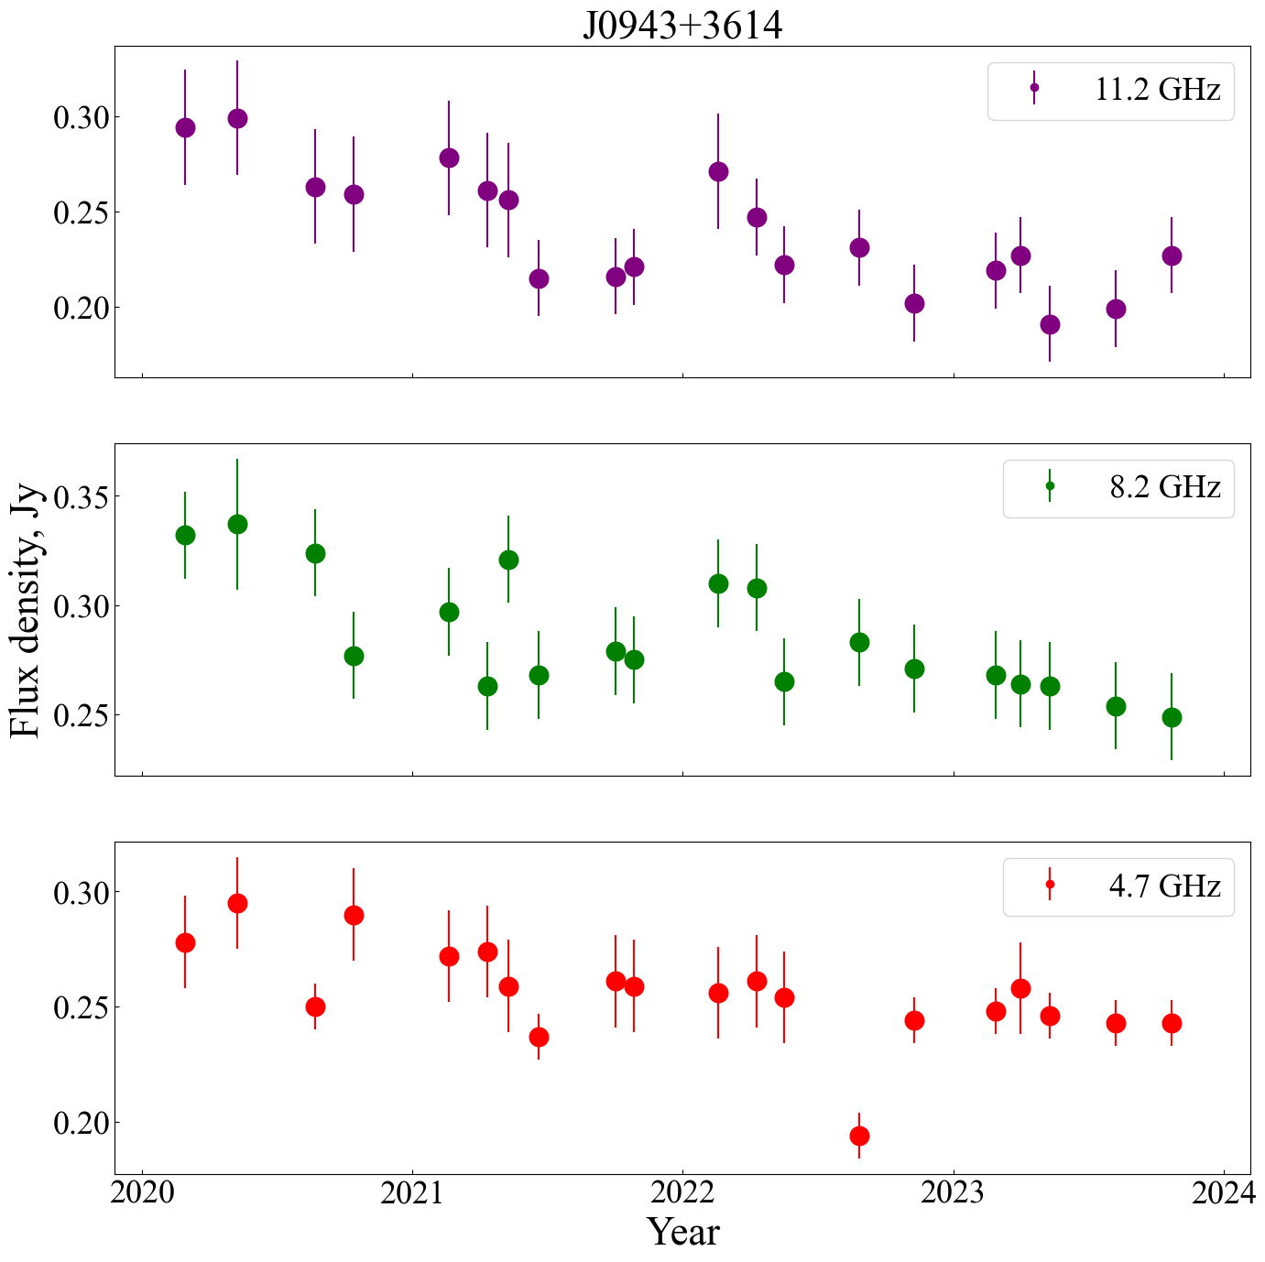
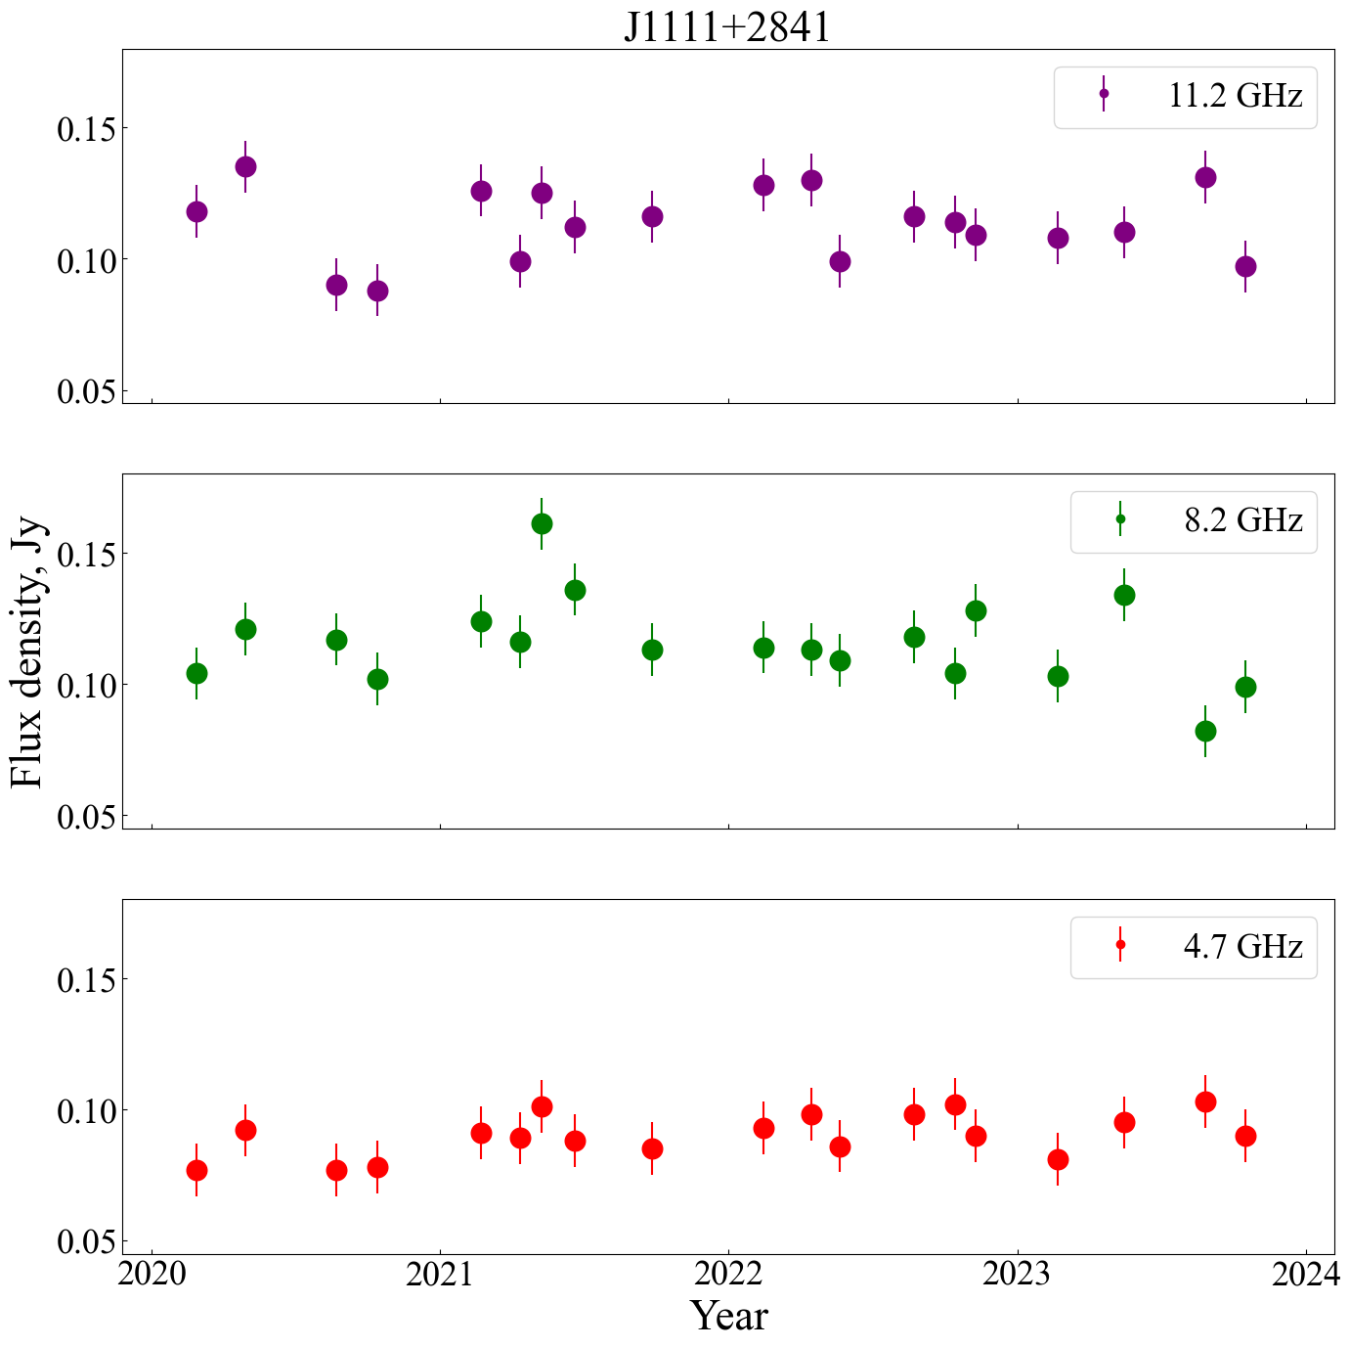
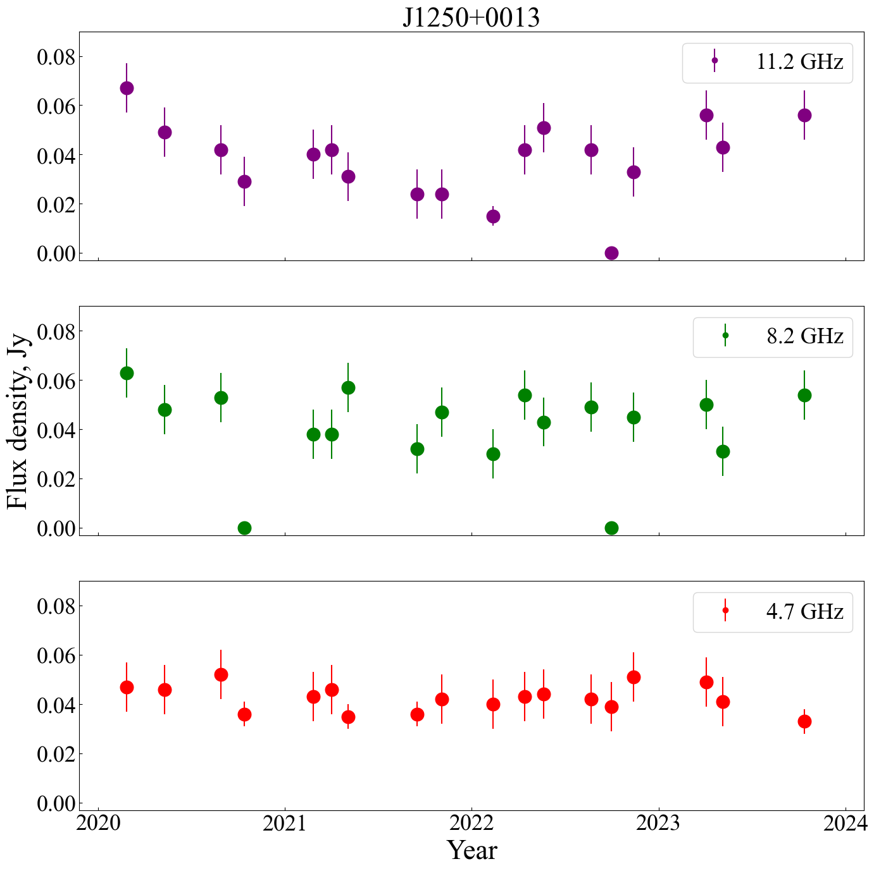
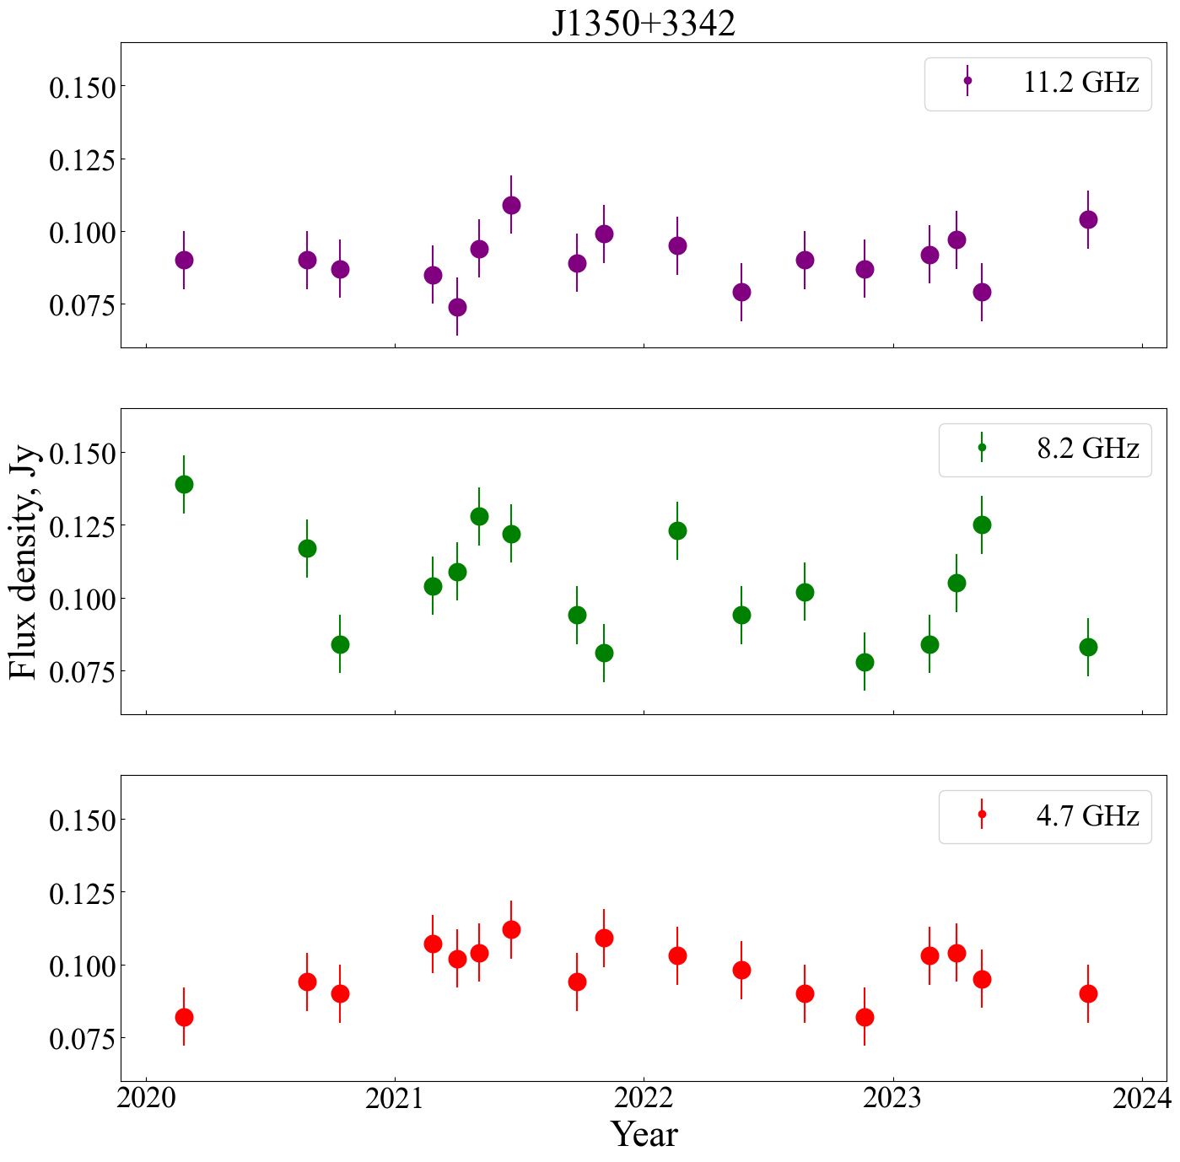

Light curves (examples)

Slide 15





Radio variability level
Aller et al. 1992
Kraus et al. 2003
Vaughan et al. 2003

Slide 16









Structure functions (examples)
Simonetti et al. 1985,
Hughes et al. 1992

Slide 17


The FR0 nature
Young radio galaxies evolving in FRI?
Short-time accretion stages?
Low-spin SMBHs?
?
GPS/CSS
An & Baan 2012
FR0
Cheng & An 2018

Slide 18
SUMMARY
Multifrequency catalog of FR0 measurements at 2-22 GHz, 2020-2024
Moderate radio luminosity, deficit of extended radio emission was confirmed
Flat spectrum, contribution of several compact components
Low luminosity GPS candidates (~10%)
Characteristic variability level doesn’t exceed 20% at the time scale of ~4 yrs
Significant contribution to background radiation (from radio to gamma)
QUESTIONS
Properties of variability at long time scales
Relationship with other classes of compact (GPS/CSS) and extended radio sources (FRI/FRII)
Low-contrast extended radio structures

