Slide 1
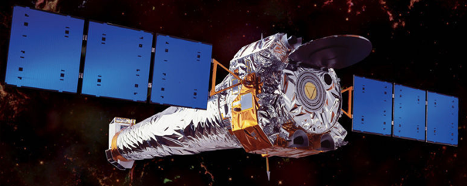
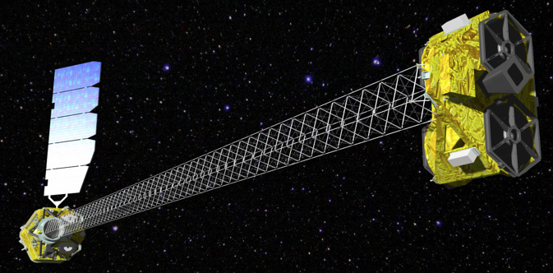
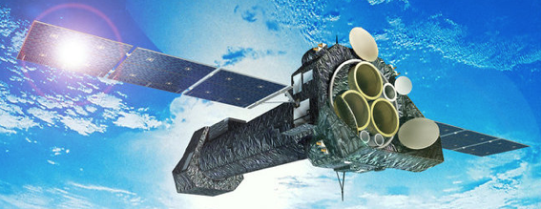
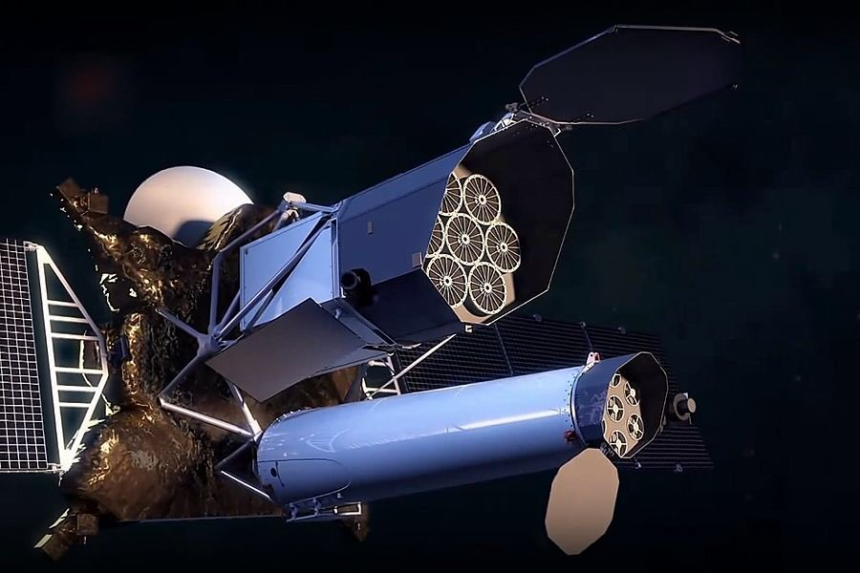
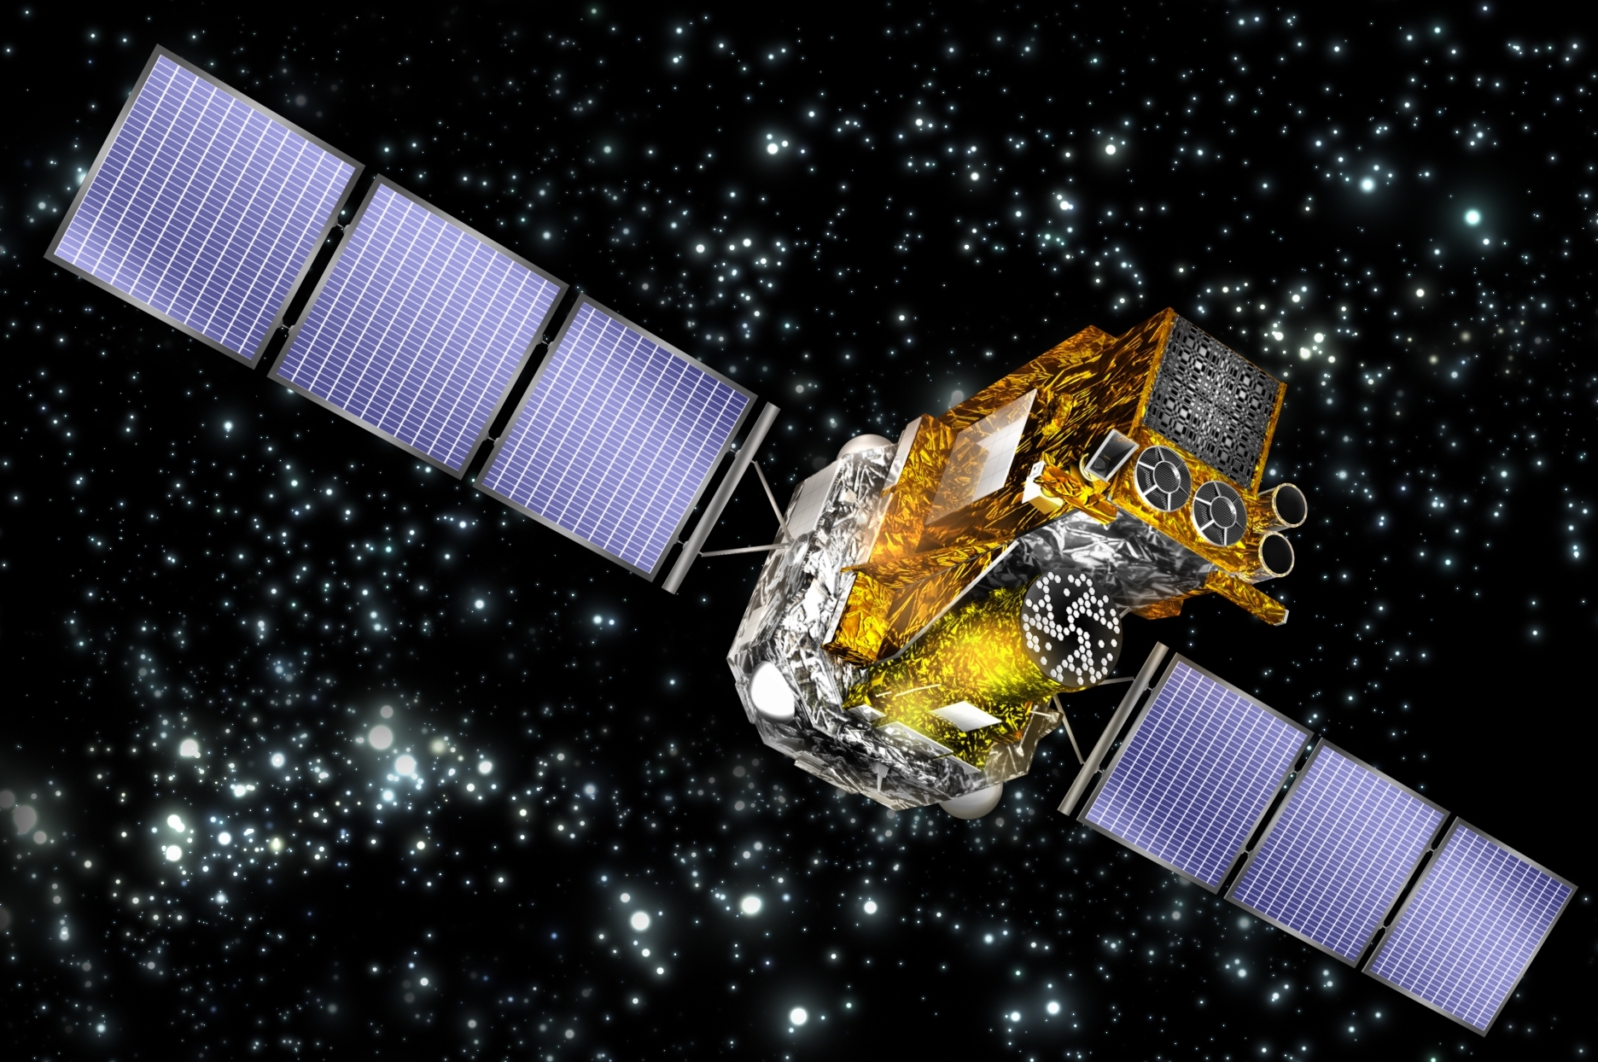
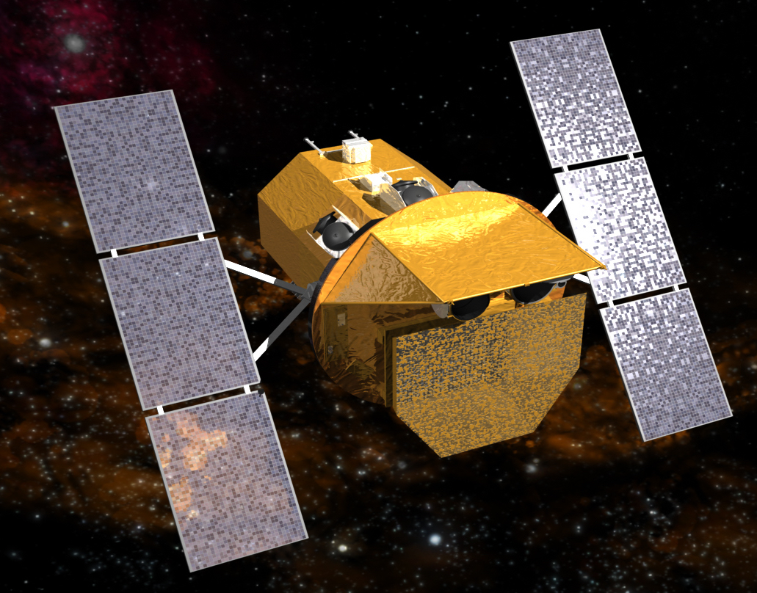
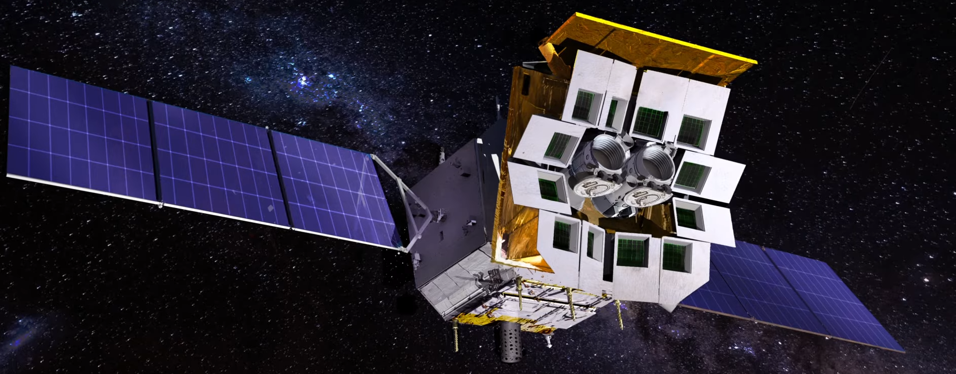
Extragalactic X-ray Surveys from Deep to Wide
W. Niel Brandt (Penn State)
Chandra - 1999
NuSTAR - 2012
XMM-Newton - 1999
SRG - 2019
INTEGRAL - 2002
Swift - 2004
Einstein Probe - 2024

Slide 2
Big 25-Year Survey Successes: AGNs
Contribution of AGNs to the cosmic backgrounds.
Revealed most/much of obscured SMBH growth.
Totally changed understanding of AGN evolution
and the “cosmic balance of power”.
Much better understanding of high-redshift
AGNs and their contribution to reionization.
Clarification of AGN-galaxy and AGN-LSS
connections.

Slide 3
Big 25-Year Survey Successes:
Galaxies, Clusters, and Transients
Cosmic evolution of X-ray binary populations.
Development of the intracluster and intragroup
medium.
Cosmological constraints from large samples of
clusters and groups.
New populations of X-ray transients.

Slide 4
Talk Outline
Utility of X-ray Surveys
The Surveys and Their Follow-Up
A Few Selected AGN Science Results
The Future: Questions and Prospects

Slide 5
Utility of X-ray Surveys

Slide 6
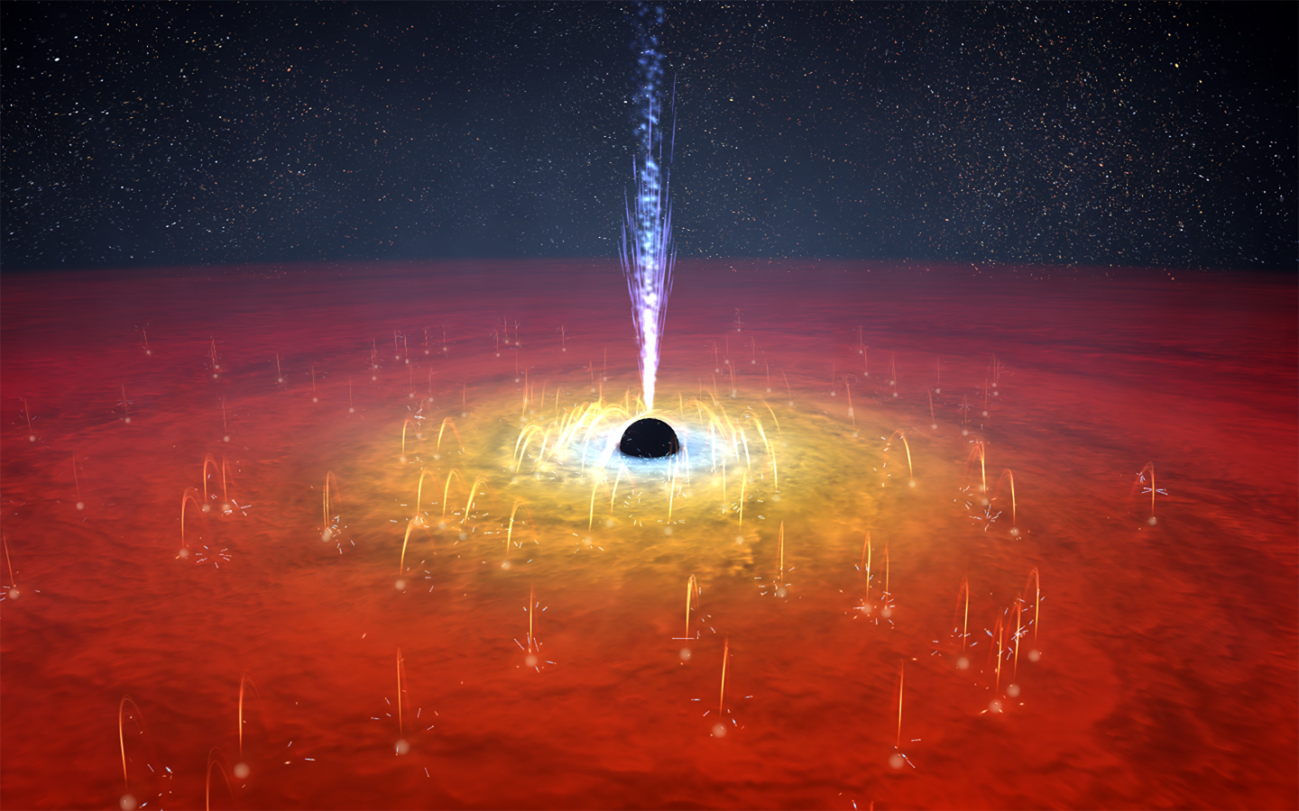
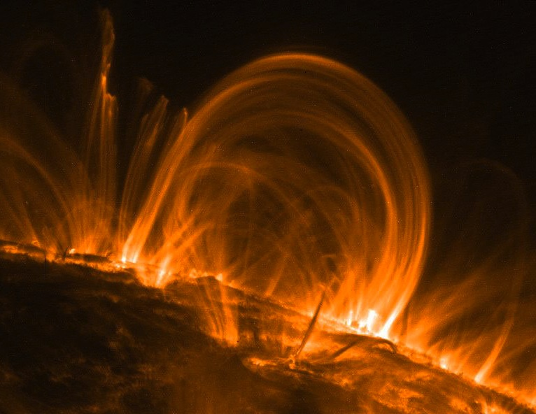
X-ray Emission from Active Galactic Nuclei
Nearly universal from luminous AGNs. From immediate vicinity of black hole.
UV to X-ray
image
X-ray
Compton up-scattering
by nonthermal jet
Compton reflection
or Fe Kα emission
UV
X-ray
X-ray
UV
Compton up-scattering
of photons by ~ 10⁹ K
accretion-disk “corona”
Solar Coronal Loops
Seen in EUV with TRACE
Tr’Ehnl & Brandt (2017)

Slide 7
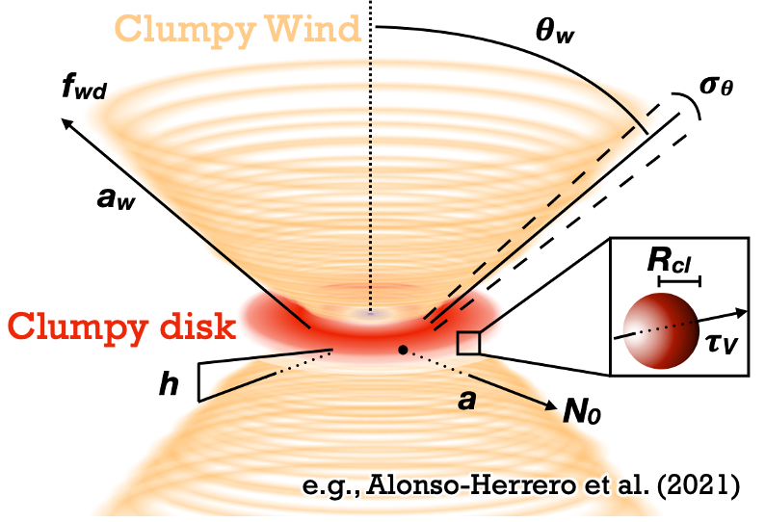
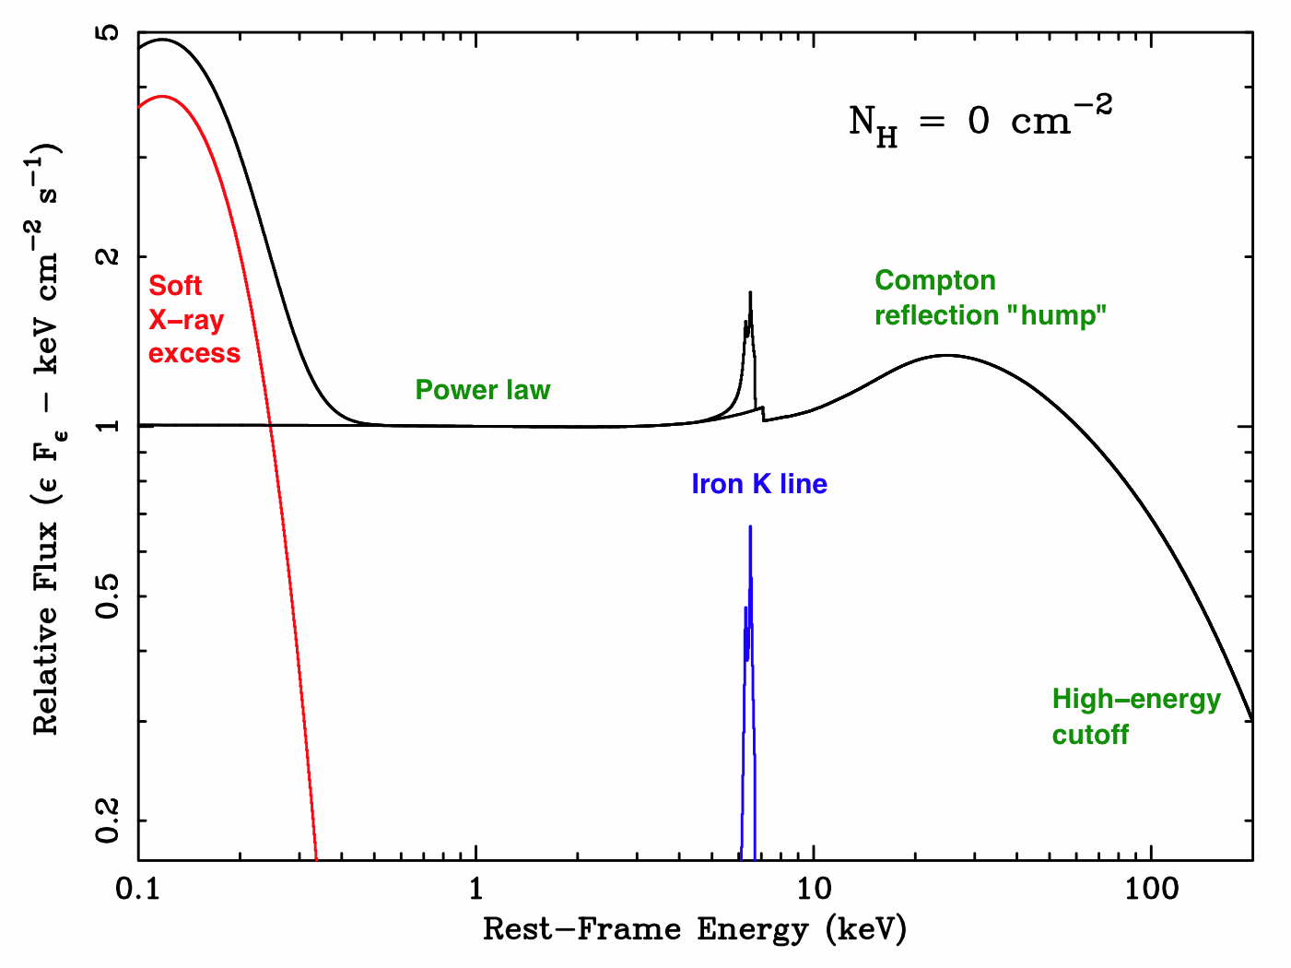
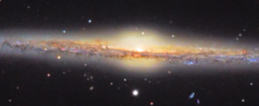
X-ray Emission is Penetrating with Reduced Absorption Bias
AGN light usually
substantially obscured
by both nuclear and
galaxy-scale material
X-ray emission can penetrate and measure large column densities. Hand (10²³ cm⁻²), chest (10²⁴ cm⁻²).
Absorption bias drops going to high redshift, as gain access to increasingly penetrating rest-frame X-rays.

Slide 8
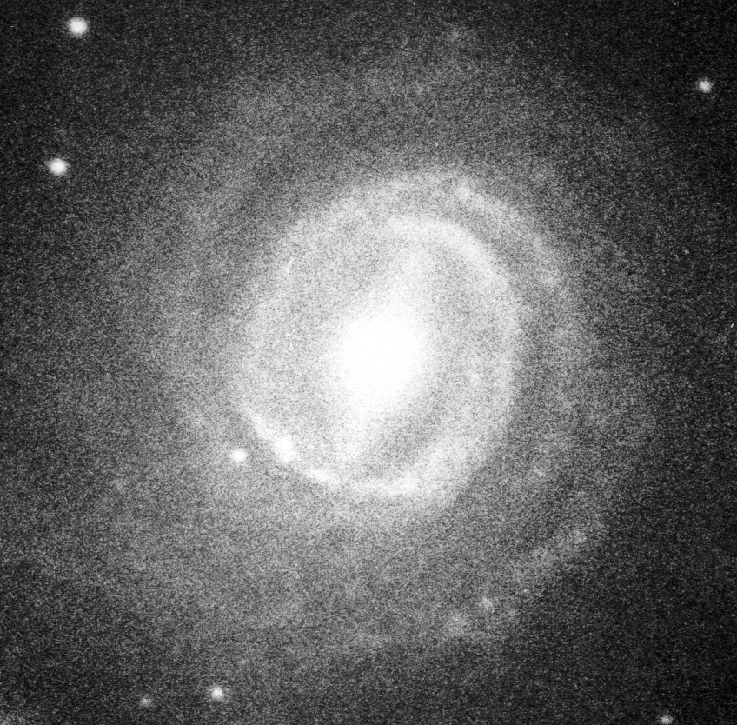
X-rays Have Low Dilution by Host Starlight
Optical vs. X-ray Emission from a Local AGN (NGC 3783)
Optical
2-10 keV
At high redshift cannot spatially resolve AGN light from host starlight.
X-rays maximize contrast for “cleanest” samples.

Slide 9
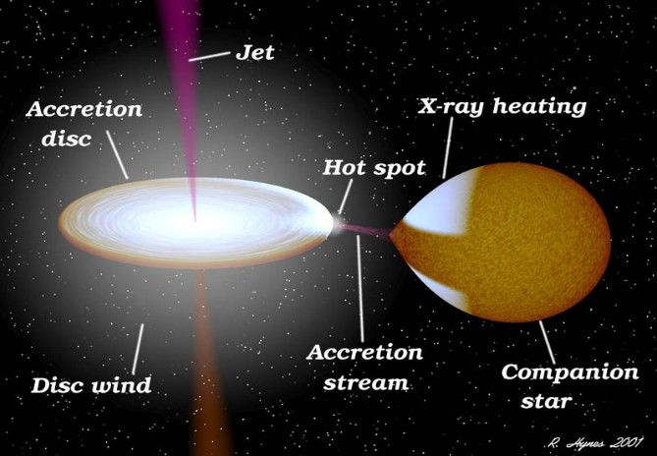
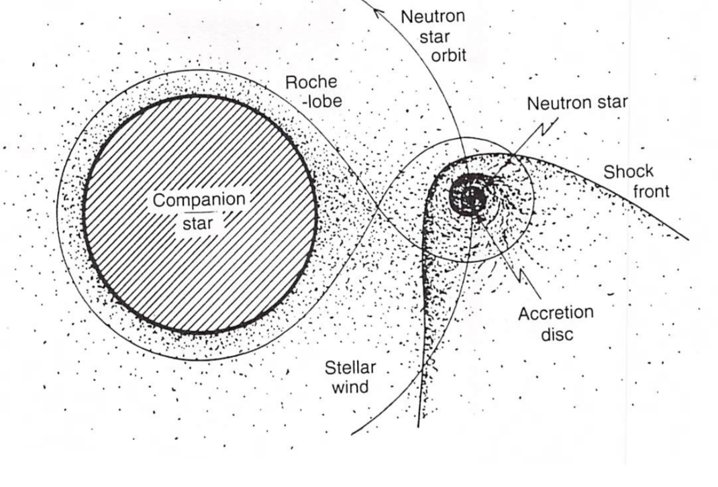
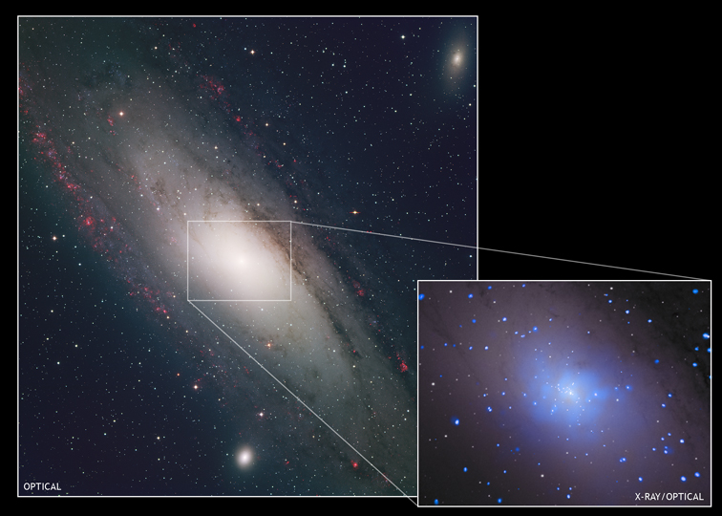
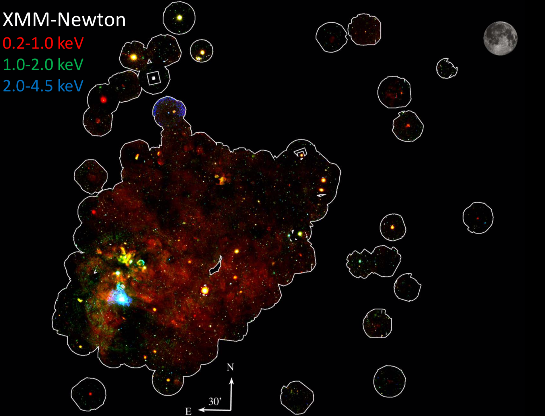
X-ray Binaries, ULXs, and Hot Gas
M31 – e.g., Pietsch et al.
LMXB
HMXB
LMC – e.g., Haberl et al.
M82 – e.g., Griffiths et al.
NGC 4697 – e.g., Sarazin et al.

Slide 10
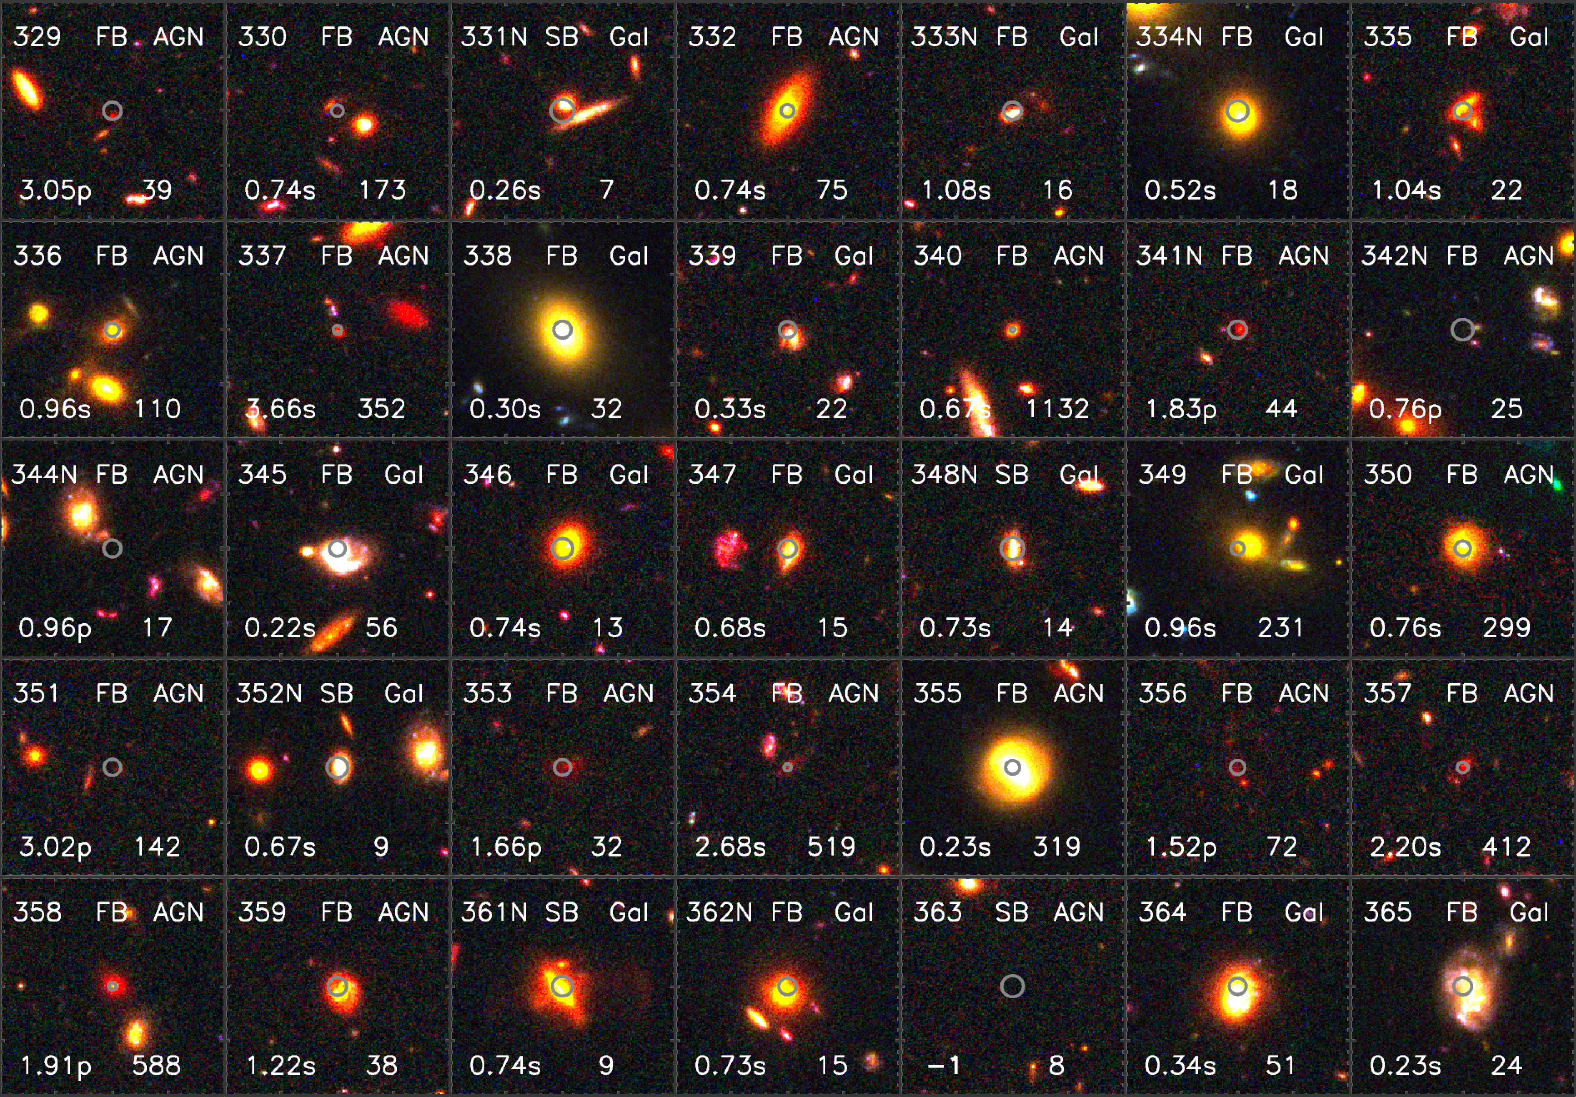
CDF-S X-ray IDs
68% error circles
Luo et al. (2017)
12” x 12”
GOODS B
GOODS z
CANDELS F160W

Slide 11
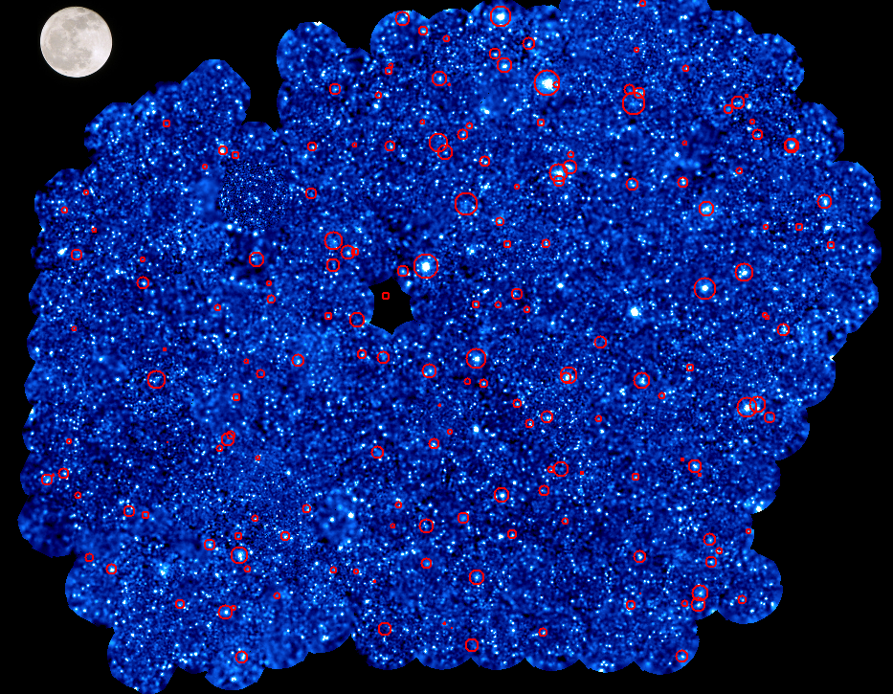
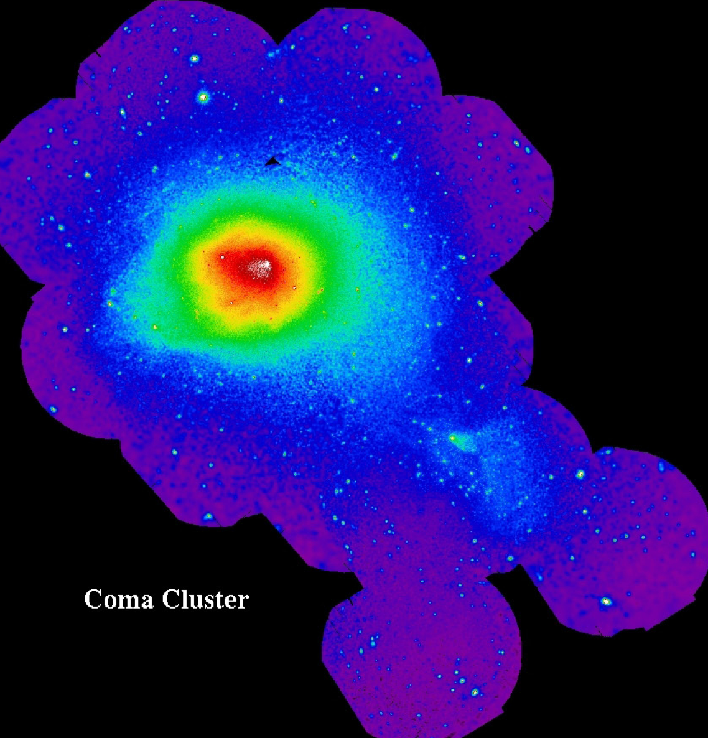
Clusters and Groups
XMM-XXL South
Pierre et al. (2015)

Slide 12
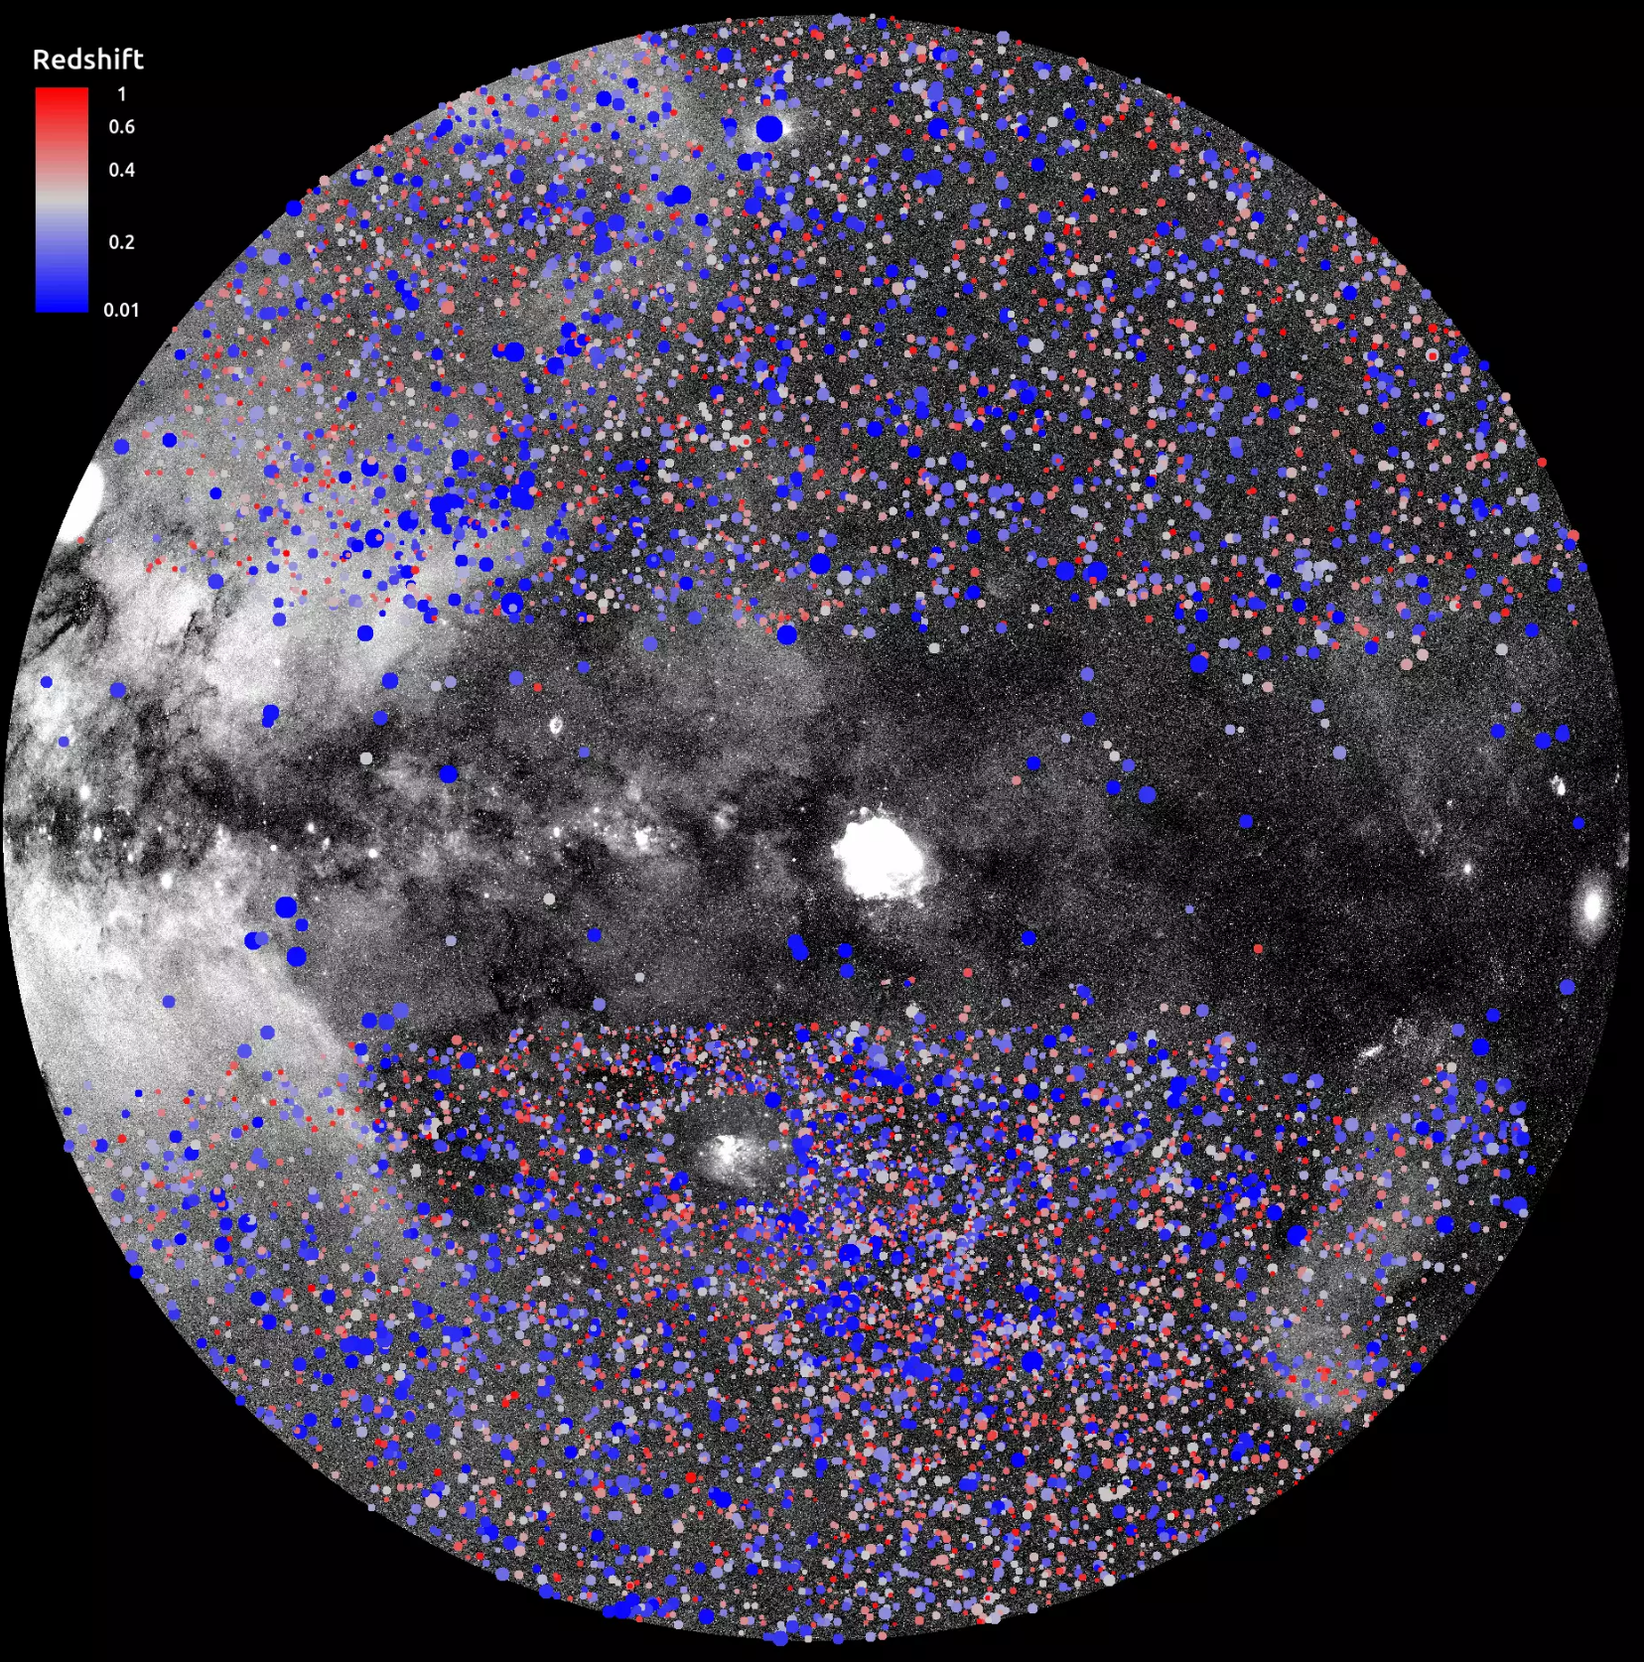
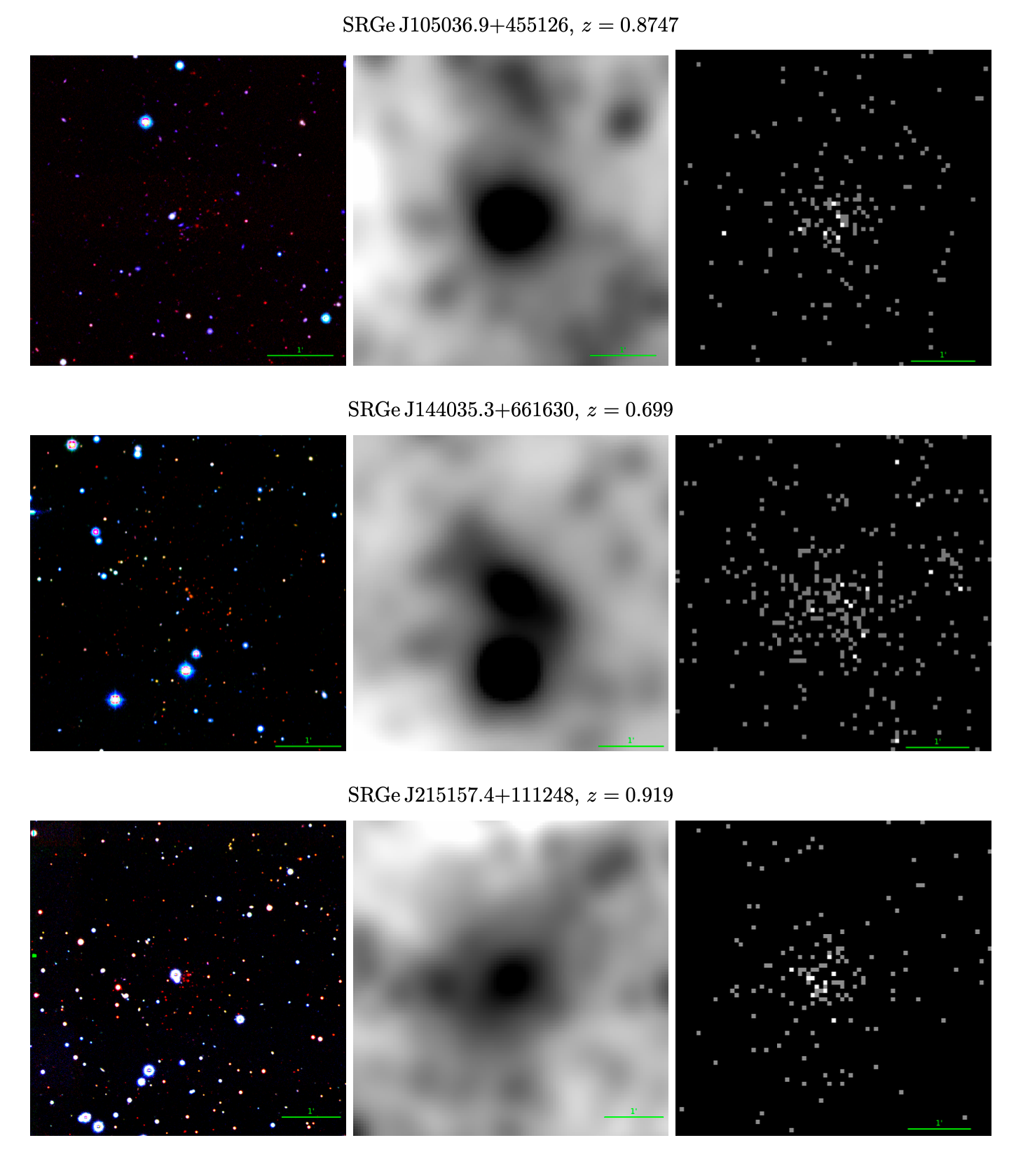
eROSITA Clusters
DESI
WISE-3.4
eROSITA
Zaznobin et al. (2024)
Ghirardini et al. (2024)

Slide 13
The Surveys and
Their Follow-Up

Slide 14
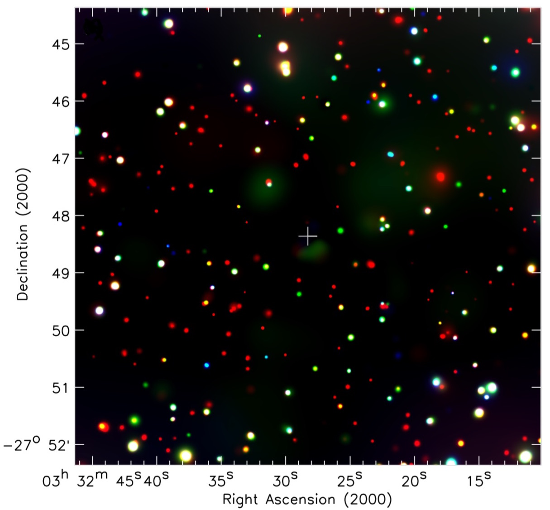
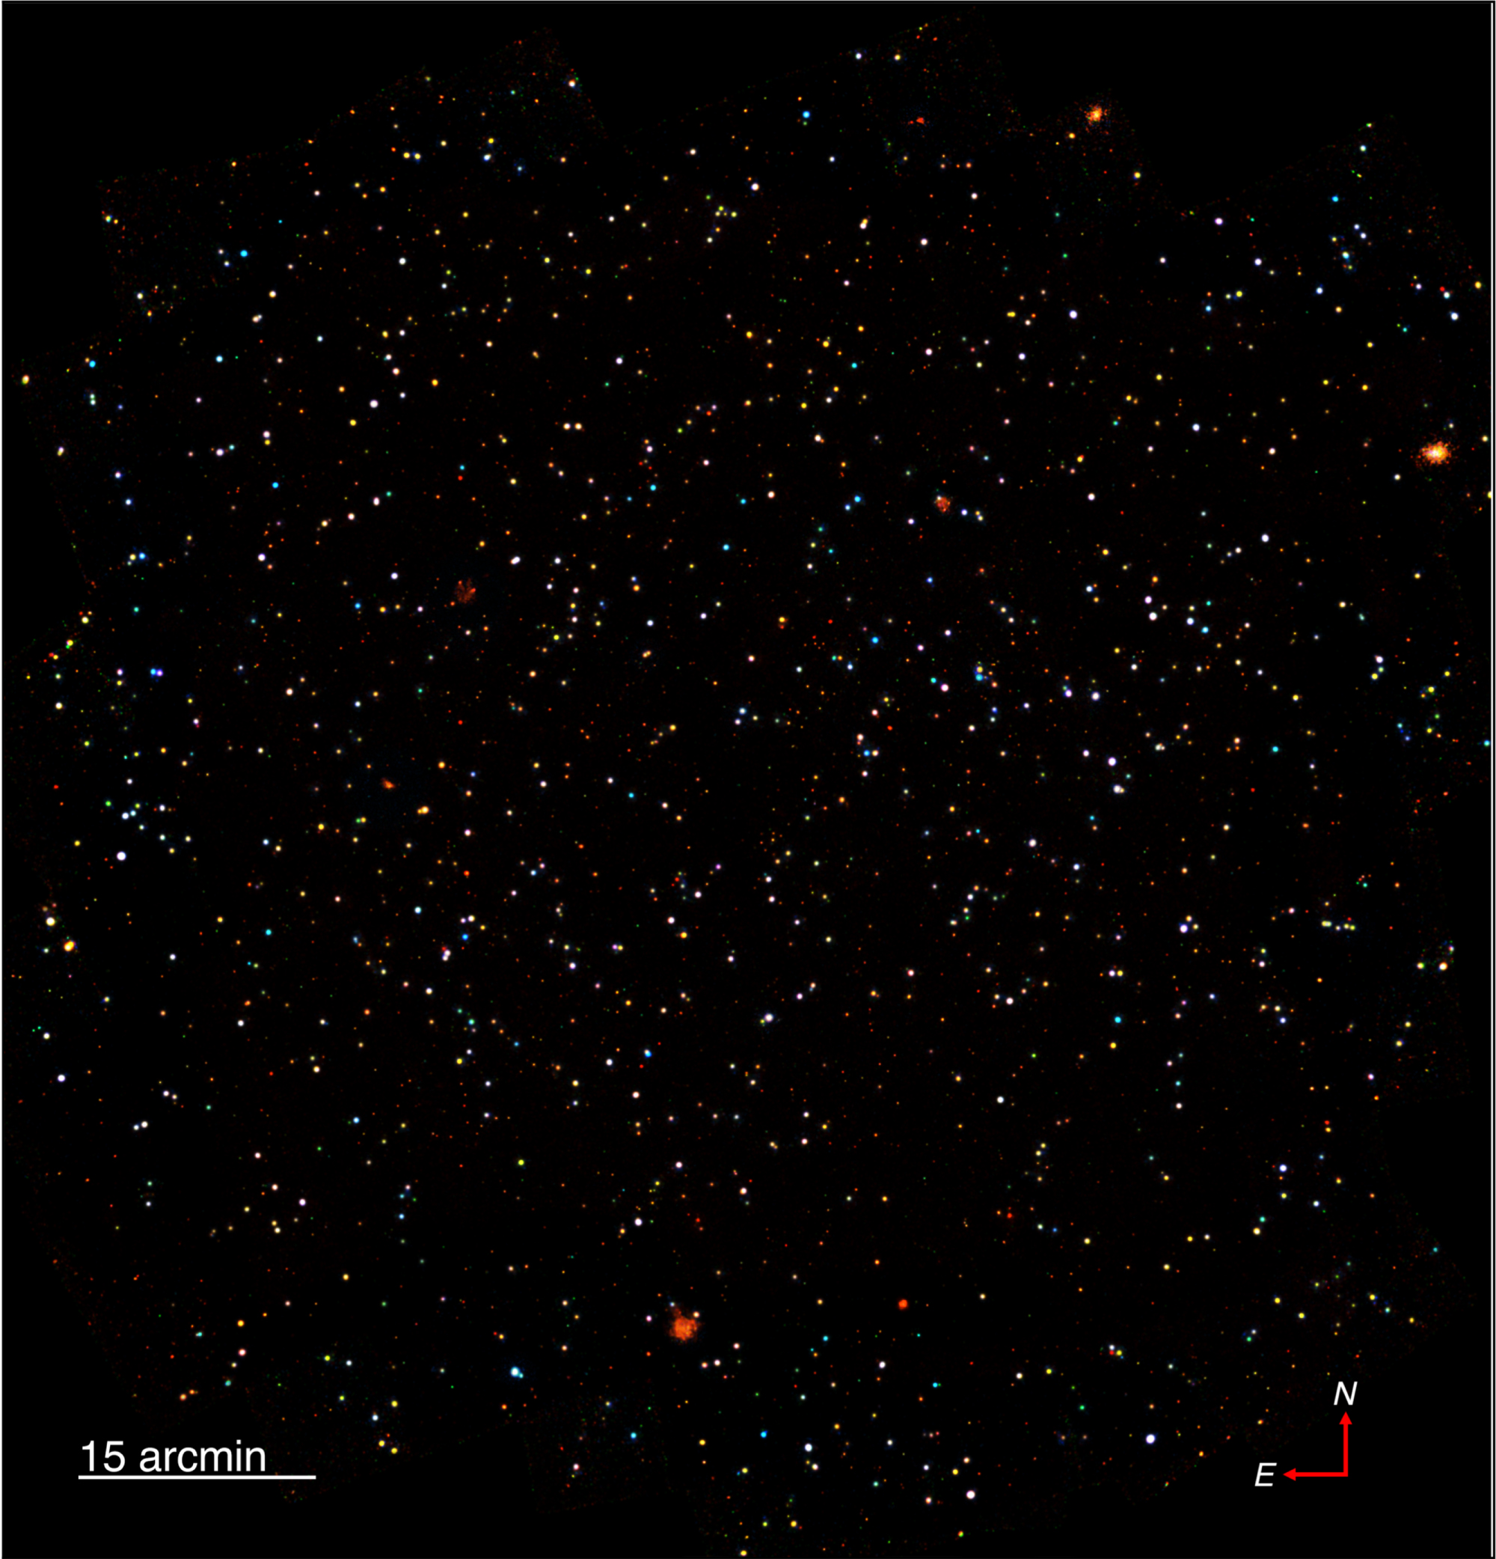
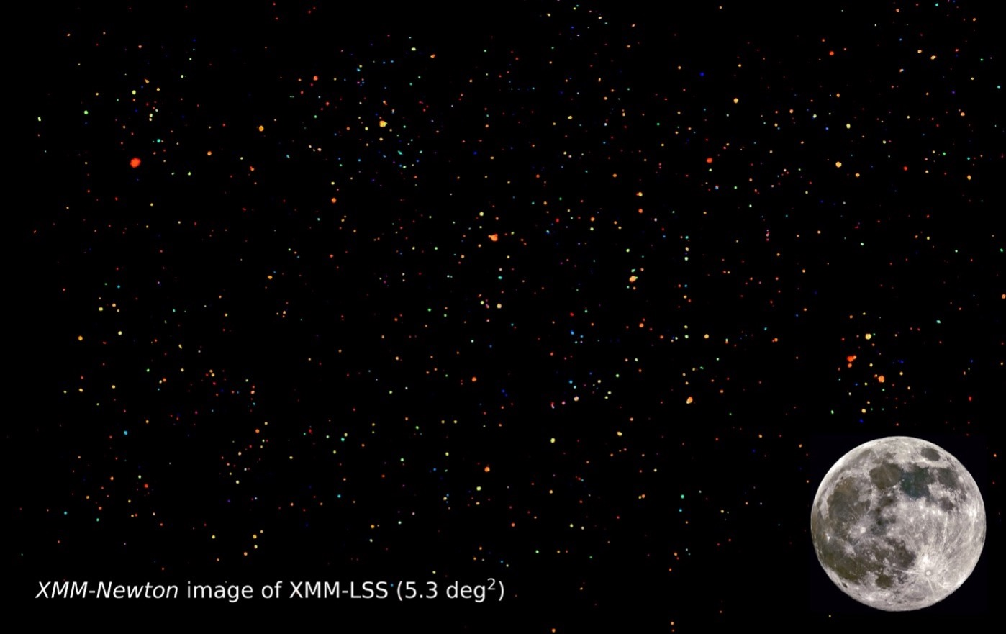
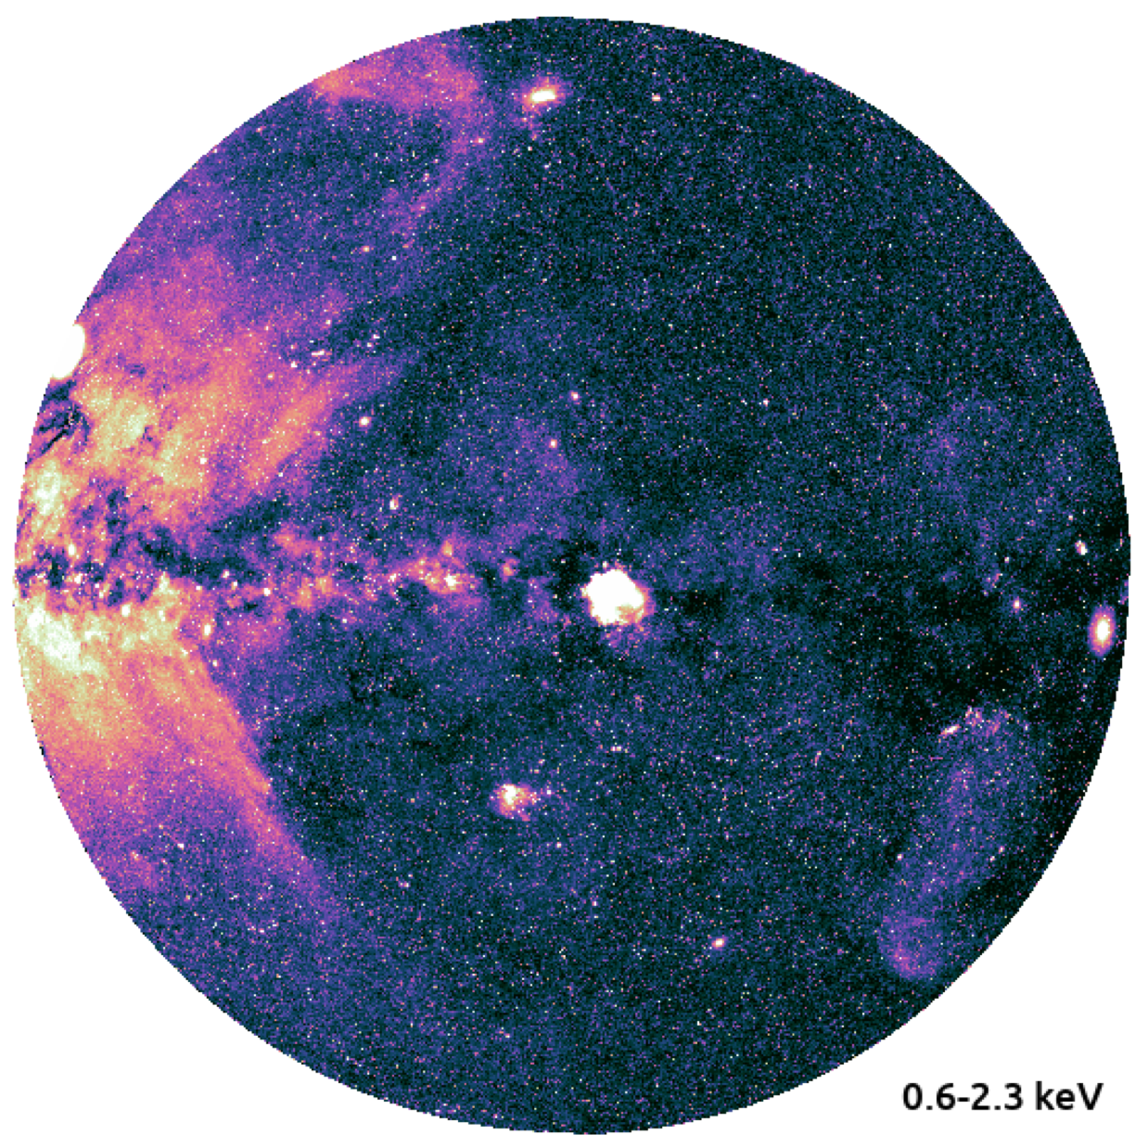
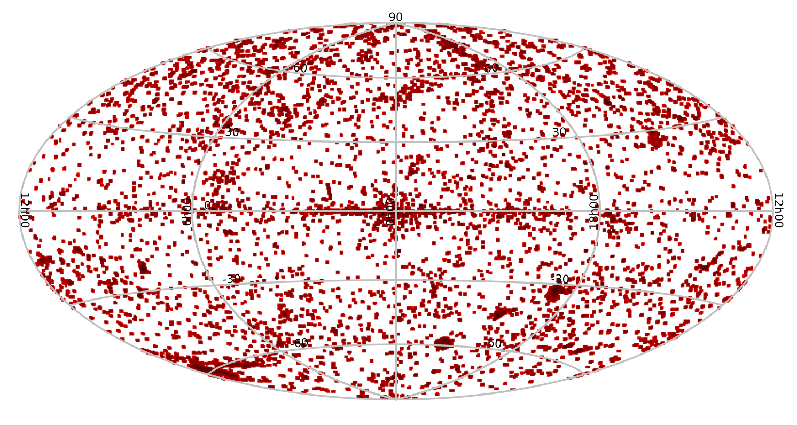
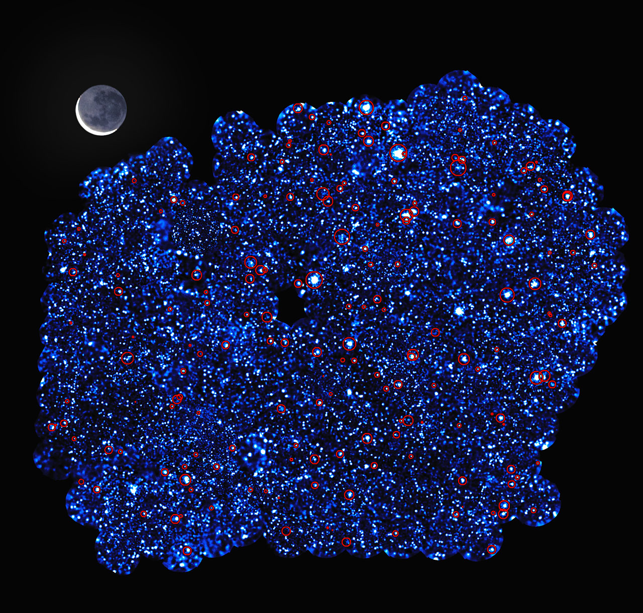
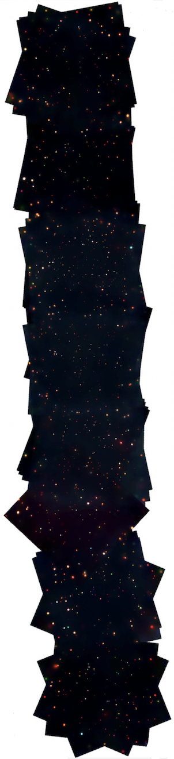
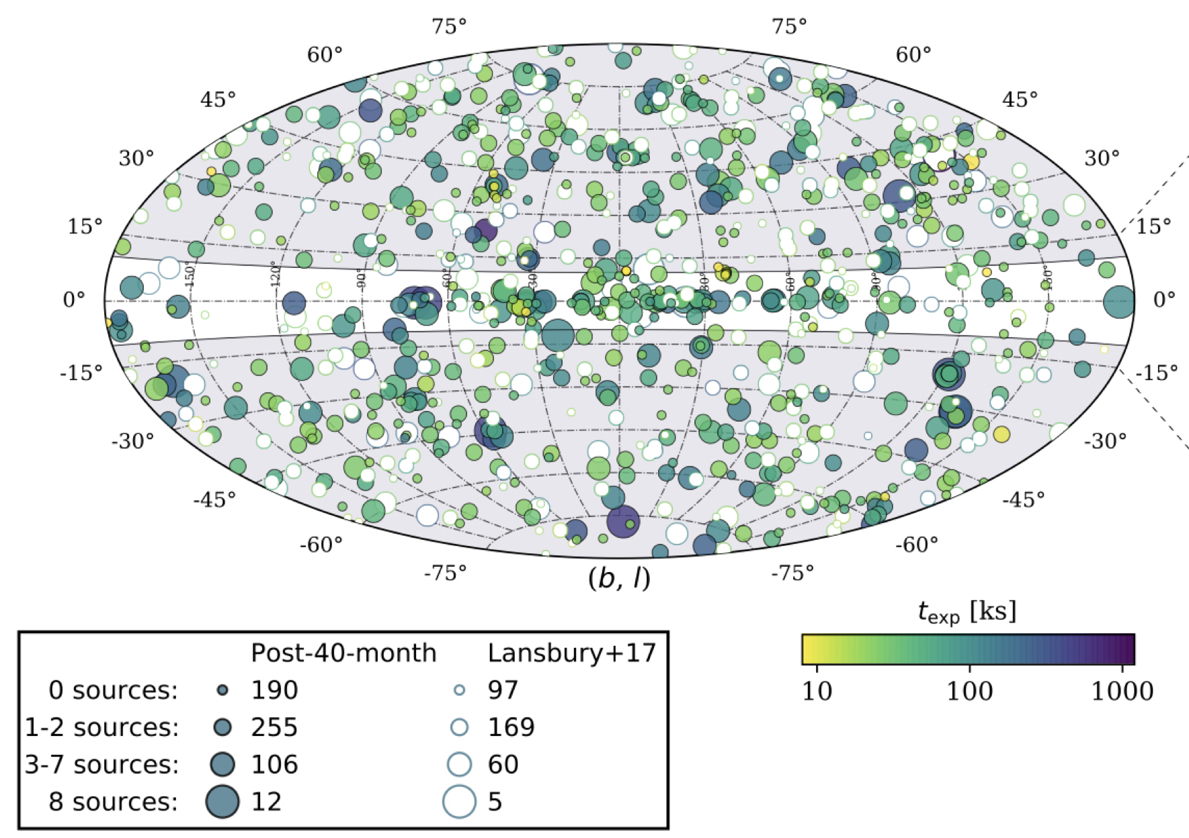
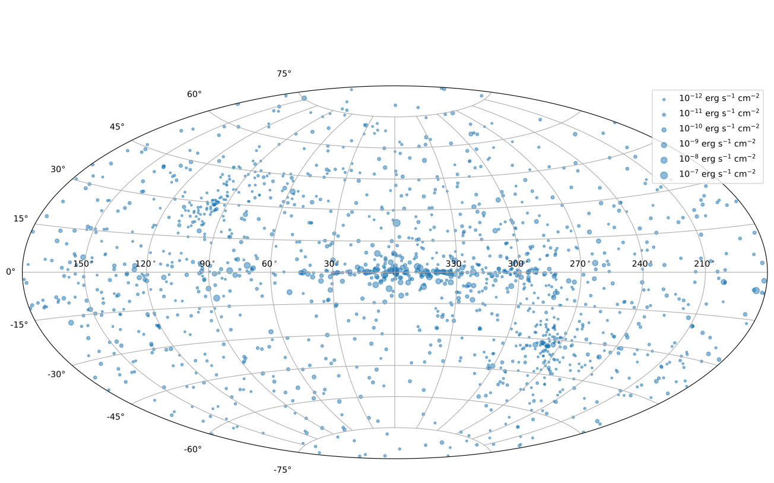
Chandra COSMOS Legacy
Civano et al. (2016)
XMM-Newton XMM-SERVS
Chen et al. (2018); Ni et al. (2021)
Chandra Deep Field-South
Luo et al. (2017)
eROSITA-West
Merloni et al. (2024)
4XMM
Webb et al. (2020)
NuSTAR NSS80
Greenwell et al. (2024)
ART-XC SS1-5
Sazonov et al. (2024)
XMM-Newton XXL-South
Pierre et al. (2015)
Chandra AEGIS-X
Nandra et al. (2015)

Slide 15
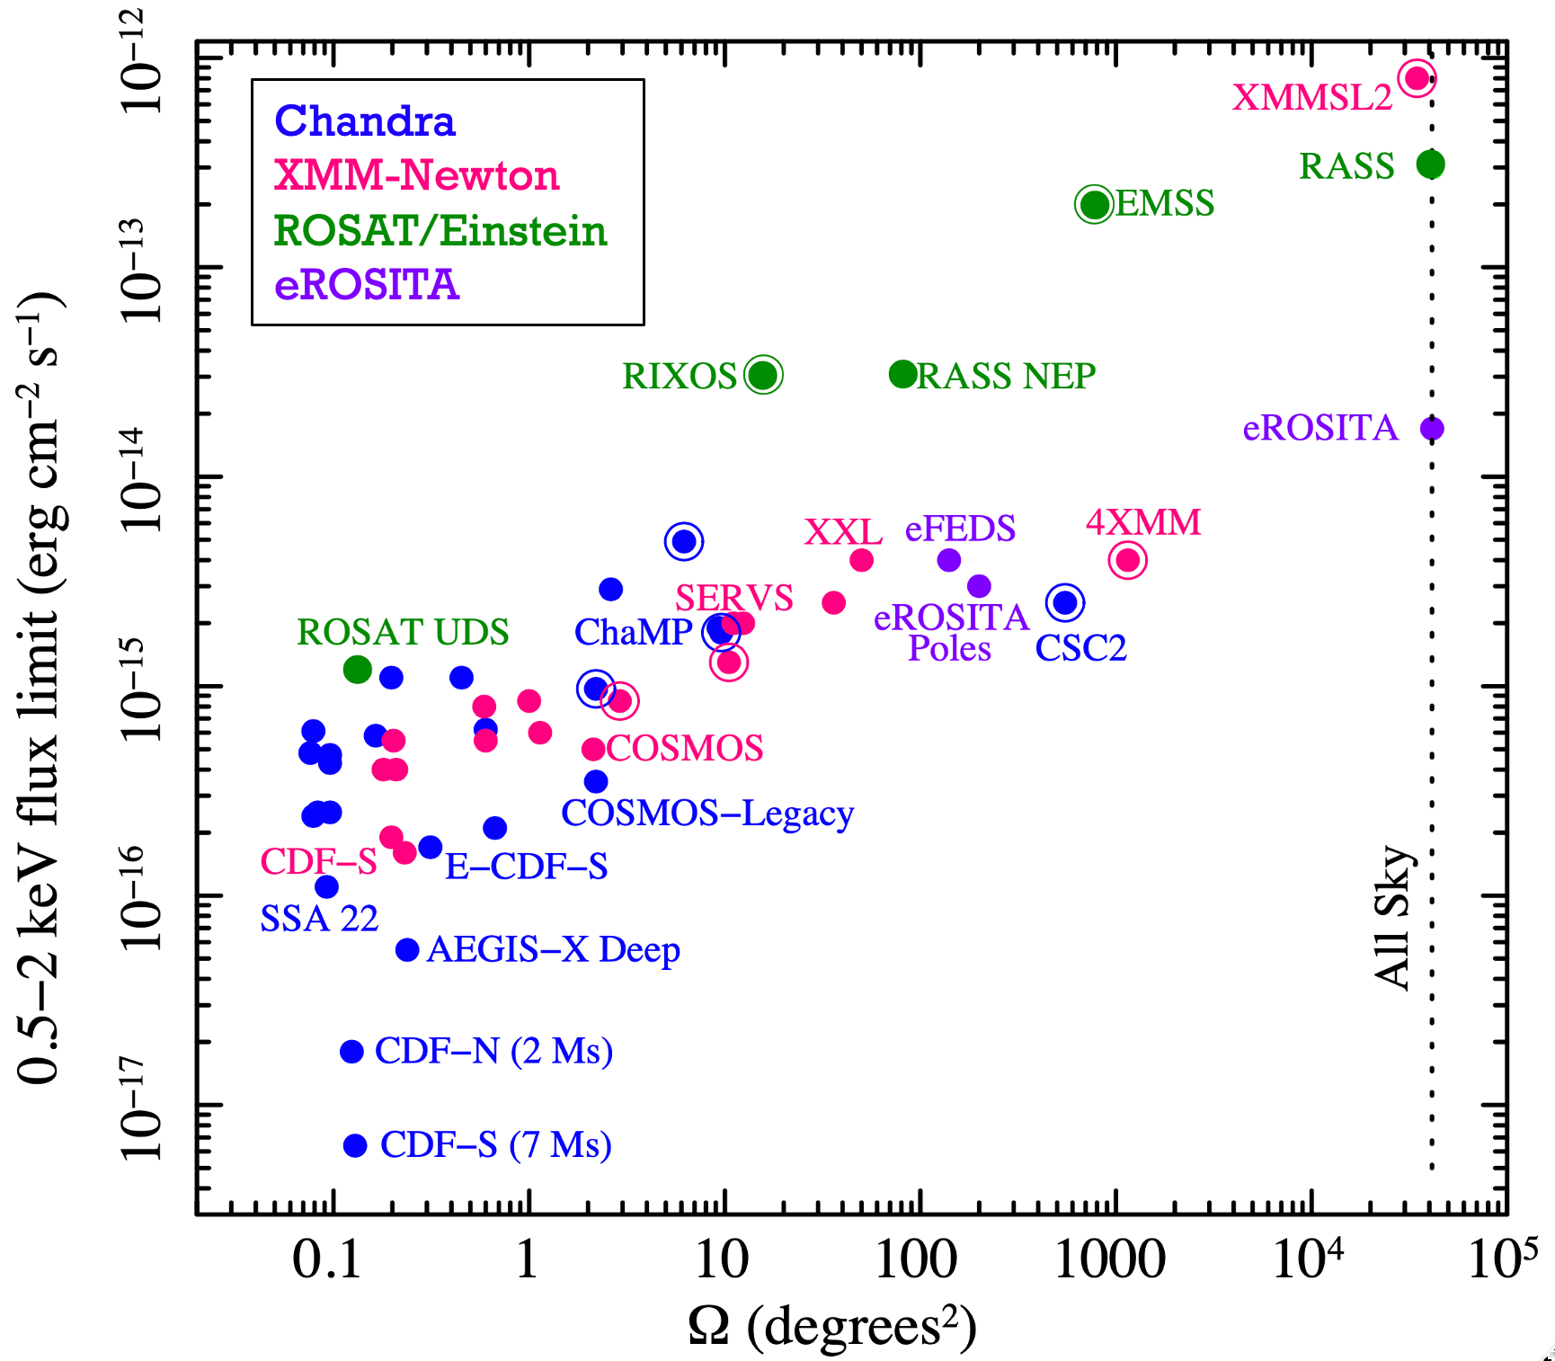
Have now filled much
of the F_{X}-Ω “discovery
space” in the standard
“wedding cake” design.
Very ambitious projects
or new missions would
be needed for further
large advances.
A lot more work is
needed on federated
survey analyses.
Brandt & Yang (2022)

Slide 16
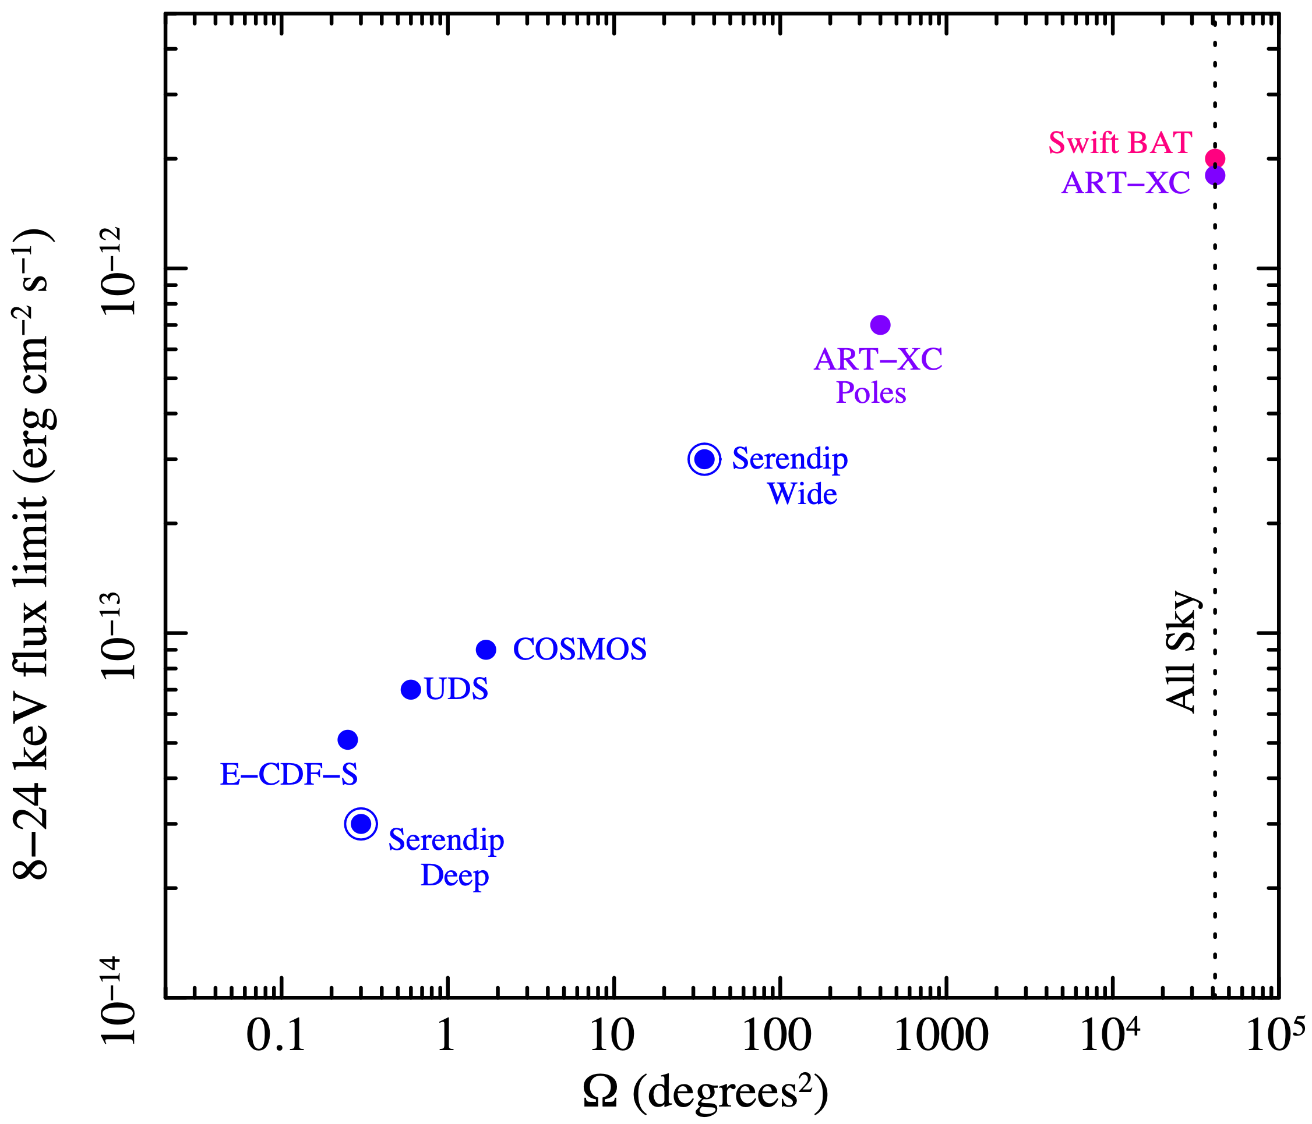
Have now filled much
of the F_{X}-Ω “discovery
space” in the standard
“wedding cake” design.
Very ambitious projects
or new missions would
be needed for further
large advances.
A lot more work is
needed on federated
survey analyses.
NuSTAR
Swift BAT
ART-XC
Brandt & Yang (2022)

Slide 17
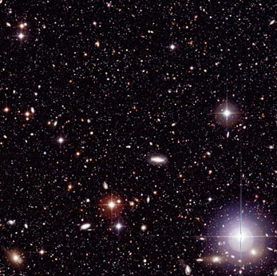
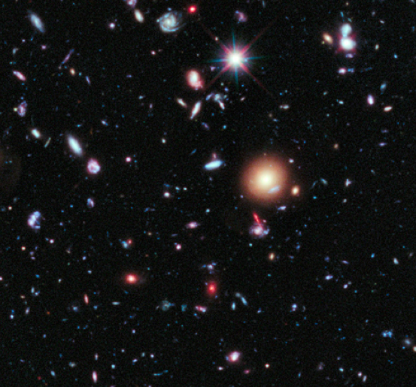
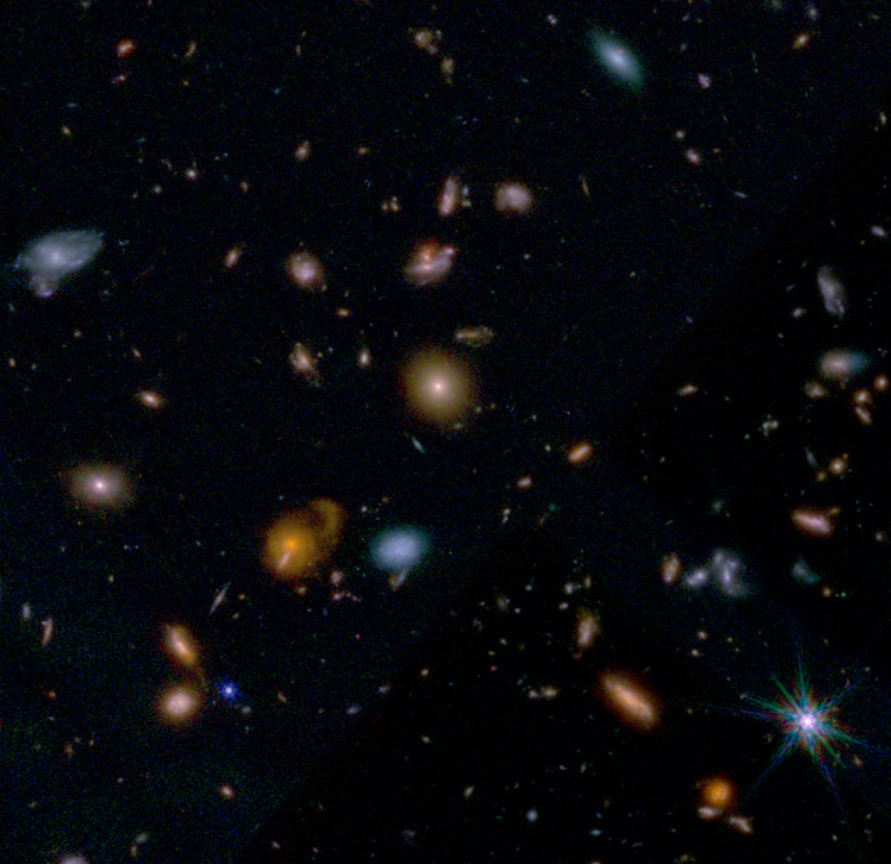
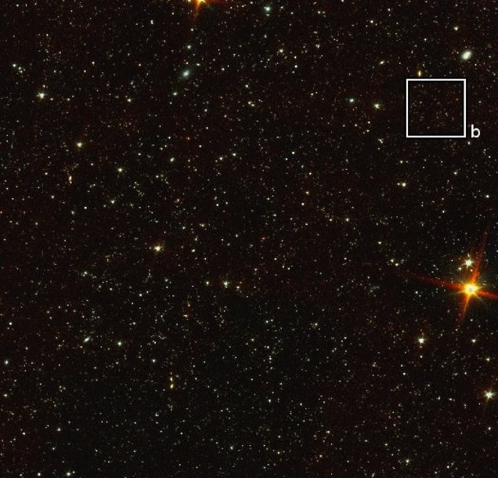
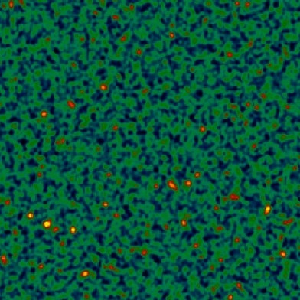
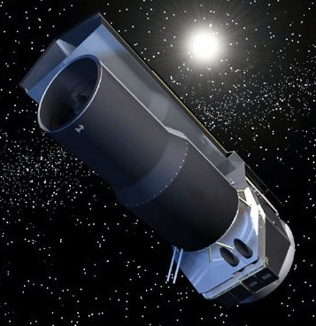
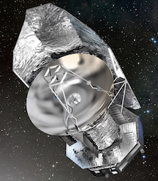
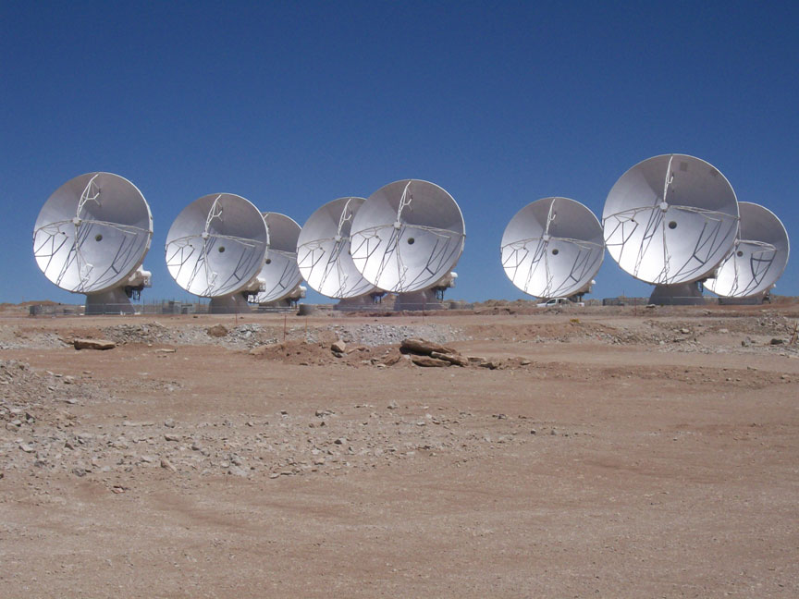
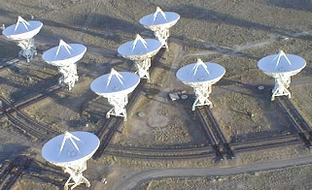
Ultradeep Multiwavelength Coverage (CDF-S Examples)
Ground-Based
Optical/NIR
HST Optical/NIR
e.g., Giavalisco et al. (2004)
Rix et al. (2004)
Beckwith et al. (2006)
Grogin et al. (2011)
Koekemoer et al. (2011)
JWST NIR/MIR
e.g., D’Eugenio et al.
Eisenstein et al.
Rieke et al.
Spitzer and Herschel
MIR / FIR
e.g., Damen et al. (2011)
Magnelli et al. (2012)
Dickinson et al.
VLA radio
e.g., Kellermann et al. (2008)
Miller et al. (2013)
APEX and
ALMA submm
e.g., Weiss et al. (2009)
Hodge et al. (2013)
Continues to improve rapidly, keeping the science exciting.

Slide 18
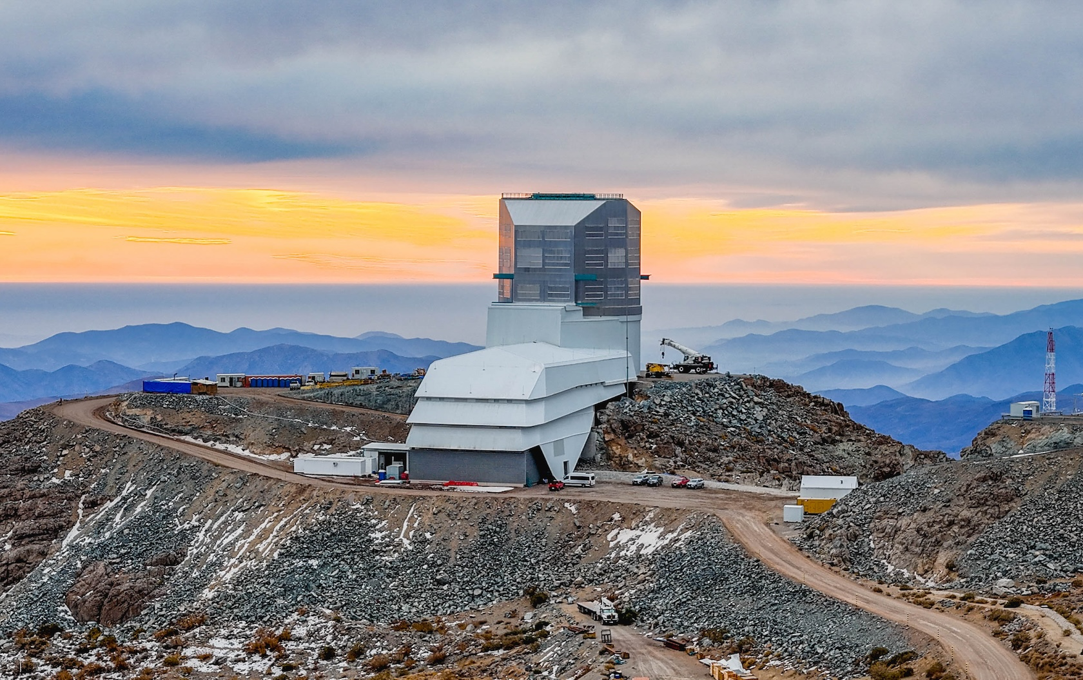
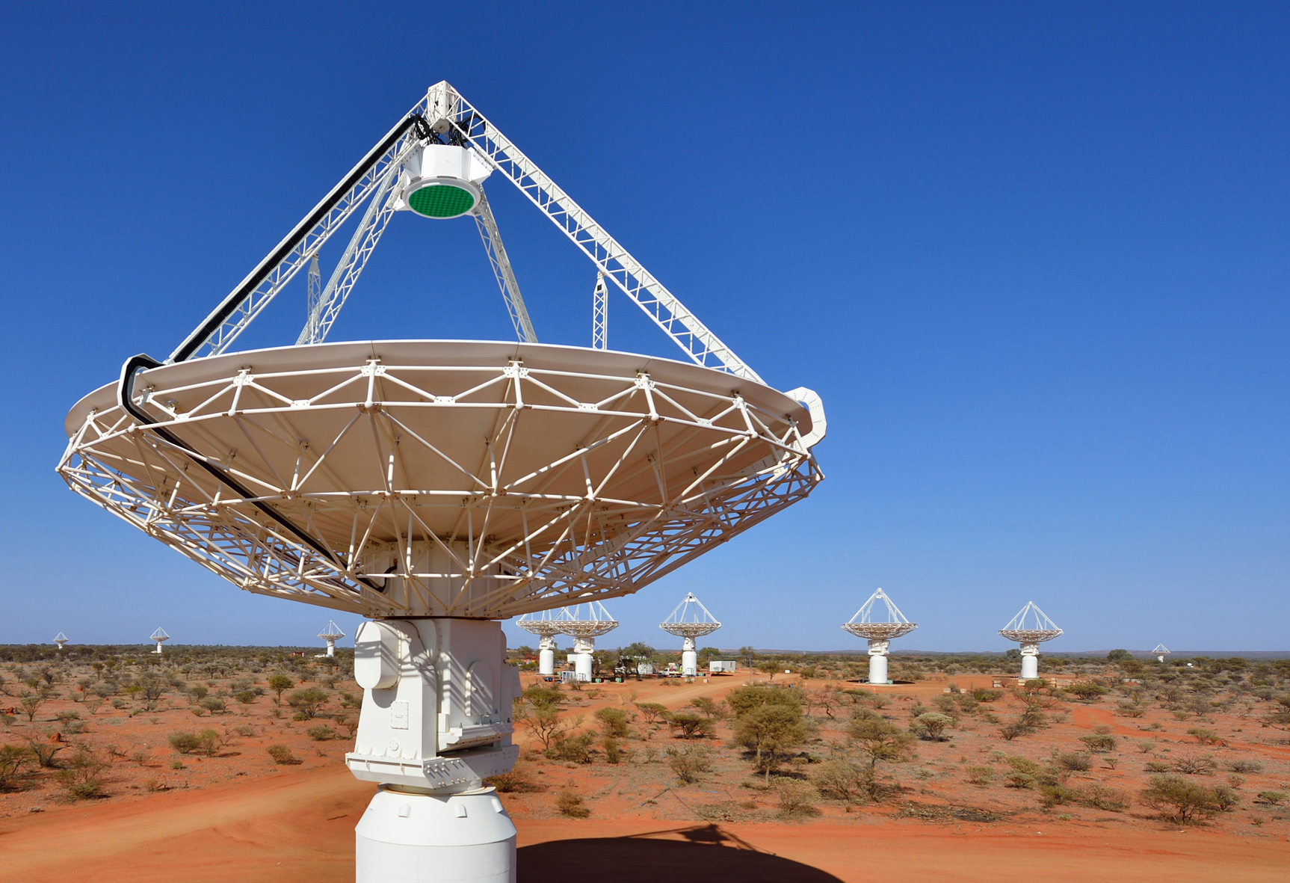


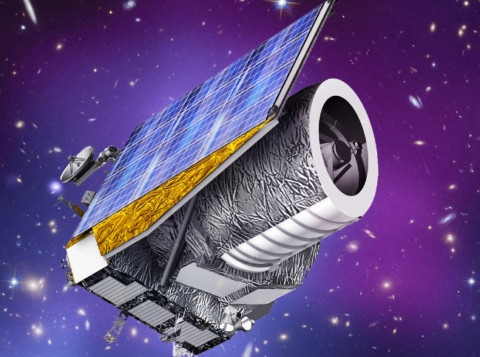
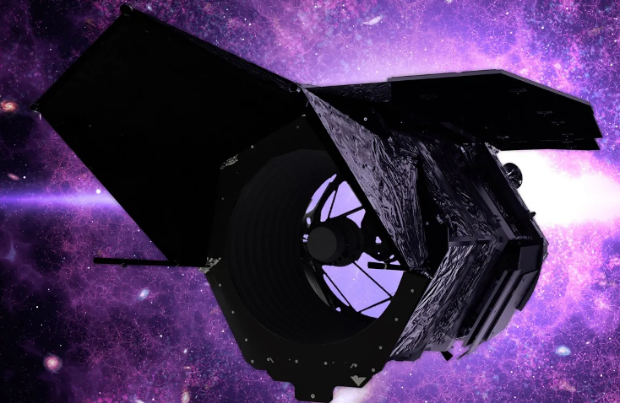
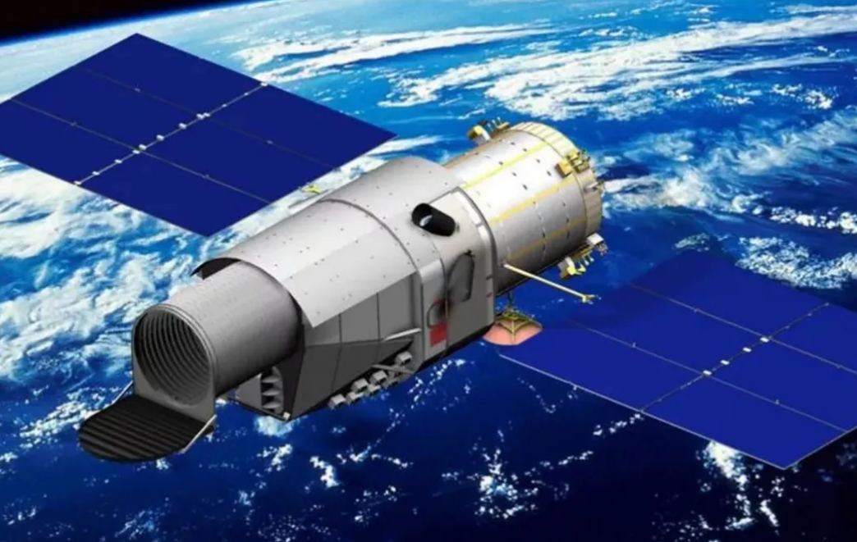
Very Wide-Field Multiwavelength Coverage
ASKAP
And similar projects – e.g., ZTF, HSC, DES, WFST
Euclid
Xuntian
Roman
Also, powerful wide-field spectrographs – e.g., SuMIRe PFS, 4MOST, SPHEREx.

Slide 19
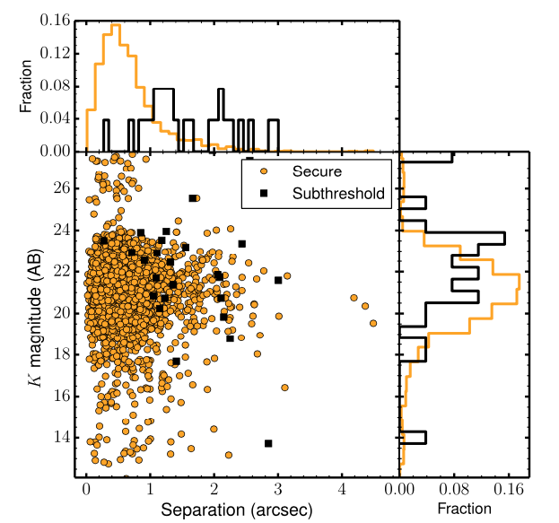
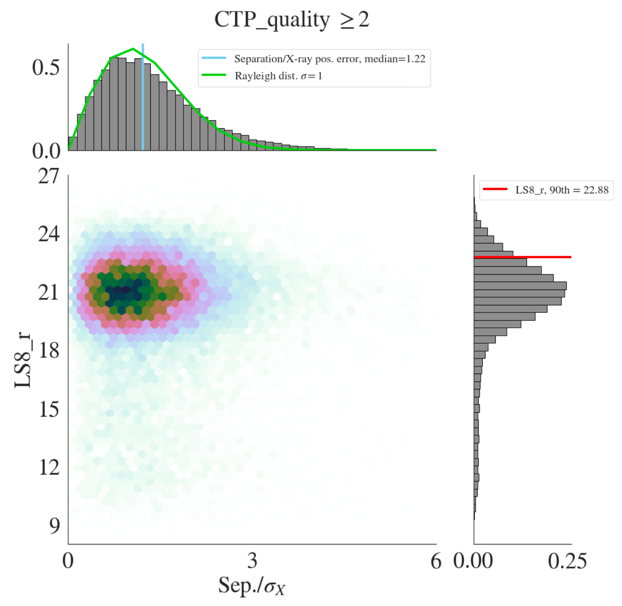
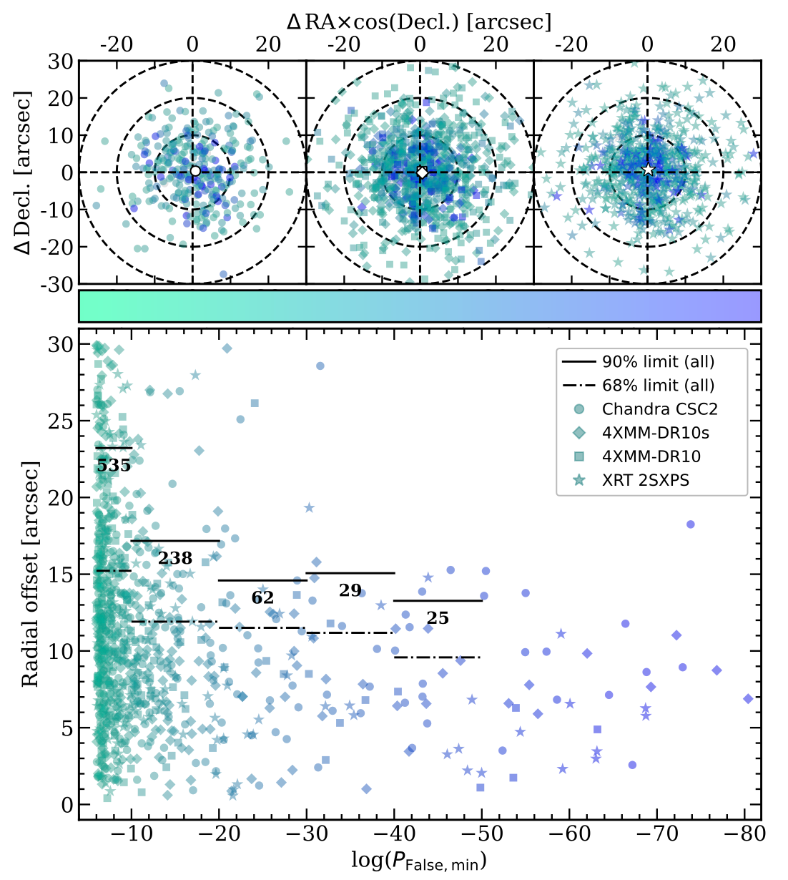

Source Identification
COSMOS Legacy IDs - Marchesi et al. (2016)
eROSITA EFEDS - Salvato et al. (2022)
Serendipitous NuSTAR IDs - Greenwell et al. (2024)
W-CDF-S IDs - Ni et al. (2021)
Chandra
XMM
Swift XRT

Slide 20




Spectroscopic Redshifts
A large enterprise and rate-limiting step for ~ 25 years.
Many telescopes used, including
the best on Earth and in space.
Chandra Deep Field-North
Barger et al. (2003)
Keck spectroscopy
Spectroscopic
completeness
typically drops
beyond ~ 24th mag.
Quality X-ray
redshifts still rare.
COSMOS
Marchesi et al. (2016)
VLT spectroscopy
Faint X-ray source spectroscopy remains challenging - driver for ELTs!

Slide 21




Photometric Redshifts
Need Many Bands Spanning Optical-NIR Range and AGN Templates
Salvato et al. (2018)
Photo-z - CDF-S AGNs
Photo-z - COSMOS AGNs
Photo-z – eROSITA EFEDS
Luo et al. (2017)
Salvato
et al. (2022)
In total, large samples generated from z ~ 0 to z ~ 3-4. Some sources at even higher redshifts.

Slide 22
X-ray Source Classification
X-ray luminosity, spectral shape, variability, and morphology
X-ray-to-optical/infrared flux ratio
Broad-band SED fitting
Optical/infrared emission-line and continuum properties
Radio morphology and core surface brightness
Usually, several independent approaches
are used to cross-check classifications

Slide 23
Extragalactic X-ray Source Types
Active Galactic Nuclei (AGNs): z ≈ 0-5
Galaxies: z ≈ 0-1.5
Clusters and groups: z ≈ 0-2
Transients: e.g., FXTs, TDEs, QPEs
AGNs are energetically and
usually numerically dominant

Slide 24

Detected Source Number Counts
In deepest surveys, AGN number counts now reach 10,000-24,000 deg⁻².
1.0 billion across entire sky!
Large population of cosmologically distant normal and starburst
galaxies - X-ray binaries.
Padovani (2016)
Luo et al. (2017)

Slide 25
A Few Selected
AGN Science Results

Slide 26
Big 25-Year Survey Successes: AGNs
Contribution of AGNs to the cosmic backgrounds.
Revealed most/much of obscured SMBH growth.
Totally changed understanding of AGN evolution
and the “cosmic balance of power”.
Much better understanding of high-redshift
AGNs and their contribution to reionization.
Clarification of AGN-galaxy and AGN-LSS
connections.

Slide 27


Obscured SMBH Growth
Local Universe - Intrinsic Absorption
CDF-S - Intrinsic Absorption
NuLANDS
Boorman
et al. (2024)
Liu et al. (2017)
f_{obs} rises with redshift
f_{obs} declines with luminosity
f_{obs} declines with λ_{Edd}
X-ray and optical/IR obscuration
generally linked, with exceptions

Slide 28


SMBH Growth Constraints
Mass Function Build-Up Action is at z ~ 1-4
Most SMBH Growth Driven by Accretion
Zou et al. (2024)
(Seeded)
Integrating observed SMBH growth can plausibly explain the local mass density
of SMBHs (Soltan argument).
No exotic growth mechanisms required.

Slide 29
Big 25-Year Survey Successes: AGNs
Contribution of AGNs to the cosmic backgrounds.
Revealed most/much of obscured SMBH growth.
Totally changed understanding of AGN evolution
and the “cosmic balance of power”.
Much better understanding of high-redshift
AGNs and their contribution to reionization.
Clarification of AGN-galaxy and AGN-LSS
connections.

Slide 30



Resolving the CXRB
Total Intensity vs. 8-24 keV
Flux for NuSTAR Surveys
Resolved Fraction in 7 Ms CDF-S vs. Energy
Luo et al.
Harrison et al. (2016)
Still need better resolution of the CXRB peak and beyond

Slide 31

Luminous Quasar Evolution
M_{i} < -27.6
How will more typical
AGNs evolve?
e.g., Richards et al.

Slide 32


AGN Evolution Revised
Basic idea of
AGN “cosmic
downsizing” from
2003 seems well
established.
Some details
still under debate.
Ueda et al. (2014)
Hard X-ray results
do not greatly
alter the strong
XLF evolution seen at lower energies.
Key absorption vs. reflection constraints.
Likely driven by
cold-gas content of
galaxies with
different M*.
Detailed causes
still need
clarification.
Aird et al. (2015)
NuSTAR

Slide 33


Cosmic Balance of Power
SMBH Accretion
Stellar Fusion
vs.
Press release from 1999…
What has dominated cosmic
radiated power since the
formation of galaxies?

Slide 34

Cosmic Balance of Power
Primordial plasma
Hasinger & Gilli (2009)
Dust – 90-95% stars and 5-10% AGNs
Stars
AGNs
SMBHs have made 5-10% of cosmic power since the formation of galaxies, and
stars made 90-95% – see Section 5 of Brandt & Alexander (2015) for details.

Slide 35
Big 25-Year Survey Successes: AGNs
Contribution of AGNs to the cosmic backgrounds.
Revealed most/much of obscured SMBH growth.
Totally changed understanding of AGN evolution
and the “cosmic balance of power”.
Much better understanding of high-redshift
AGNs and their contribution to reionization.
Clarification of AGN-galaxy and AGN-LSS
connections.

Slide 36
Stellar Mass
For the general galaxy population
at z = 0.1-4, long-term SMBH growth
correlates most strongly with M*
Effect spans ~ 3 orders of magnitude
Implications for the high-redshift
decline of quasars
Also have fairly precise p(λ|M*, z)
constraints, encoding rich information
about SMBH growth (λ = L_{X}/M*)
8000 AGNs within
1.3 million galaxies
e.g. Zou et al. (2024); Yang et al. (2018)

Slide 37

SMBH – Bulge Relations
M$●$ tightly related to bulge M* – but not tightly related to total M* or disk M*
$$\frac{d}{dt}$$
e.g., Kormendy & Ho (2013)

Slide 38

SFR for Bulge-Dominated Galaxies
(Not Bulge-Dominated)
Results cover z = 0.5-3.0, reaching
into the peak era of SMBH growth.
BHAR/SFR for bulge-dominated
galaxies (~ 1/302) similar to
typical M_{BH}/M_{Bulge} locally.
Evidence for true co-evolution - since we observe apparent
lockstep growth of SMBHs and bulges, at least at z = 0.5-3.0.
See Yang et al. (2022) for assessment of creation vs.
maintenance.
Yang et al. (2019, 2022)

Slide 39



Compactness
Compactness is a measure of the
mass/size ratio of galaxies
BHAR vs. Compactness for
Star-Forming Galaxies
At least for gas-rich, star-forming
galaxies, Σ₁ may also serve as a tracer
of central-gas density on a kpc-scale.
e.g., Ni et al. (2019, 2021);
Aird et al. (2022)
Σ₁ “survives” partial-correlation
testing vs. other factors
Compactness Examples for log M* ~ 10.3
Not seen for quiescent galaxies, suggesting the role of gas density.
Redshift dependence can also be
understood via gas evolution.
z = 0.3-0.5 COSMOS I-band

Slide 40



for the great in-depth talks coming up!
arXiv:2111.01156
arXiv:1501.01982

Slide 41
The Future:
Questions and Prospects

Slide 42
A Few Big Questions for X-ray Surveys
Growth and feedback of highly obscured SMBHs
through the z ~ 1-4 galaxy formation era.
SMBH growth in the first galaxies at z ~ 5-15.
Host-galaxy properties driving SMBH growth.
Drivers of X-ray binary population evolution.
ICM formation and SMBHs in protoclusters.
Distant X-ray transient populations.
Multi-messenger connections.

Slide 43

A Toast to Good Health!
Good to build missions to last!
Just from these missions, hope for another great decade of X-ray surveys.
Aggressive projects needed to make big advances on the key questions.

Slide 44









Massive Archive Exploitation
+
CSC
Evans et al. (2024)
And wide-field spectrographs

Slide 45




Surveys with NASA X-ray Probes
AXIS
HEX-P
STROBE-X
LEM
See Civano talk

Slide 46


Surveys with International Missions
SVOM – launched June 2024
HUBS – Hot Universe Baryon Surveyor

Slide 47

NewAthena Surveys
NewAthena
and AXIS

Slide 48

X-ray Missions Still Need Progress in Very Wide-Field Surveys
X-ray: F_{eROSITA} / F_{CDF-S} ~ 2000
Optical: F_{DES} / F_{HST-UDF} ~ 100
(with LSST ratio will be ~ 10)
Ground-based optical rapidly benefits from relentless growth of information technology
(wide-field detectors, large-volume data storage and transmission). And X-ray mirrors tough!

Slide 49




The End
arXiv:1501.01982

Slide 50
Extra Slides

Slide 51







X-ray Emission from Active Galactic Nuclei
Typical AGN X-ray Spectral Energy Distribution
Chandra ACIS
Swift BAT
XMM-Newton EPIC
SRG eROSITA
SRG ART-XC
NuSTAR FPM
X-ray detectors provide broad-band spectra and variability for all sources.
Primary survey bands: Chandra (0.5-8 keV), XMM-Newton (0.3-10 keV), NuSTAR (3-24 keV), Swift BAT (14-195 keV), INTEGRAL (17-60 keV), eROSITA (0.2-5 keV), ART-XC (4-30 keV)

Slide 52



Cosmic Environment
0.1-1 Mpc Scales
1-10 Mpc Scales
Using COSMOS UltraVISTA
Probe environments from field
to M_{Halo} ~ 10¹⁴ M☉ clusters
M* is linked with environment
Partial-correlation testing shows M* easily beats environment
Any environmental enhancement
arises because massive galaxies
tend to live in rich environments
Must push above M_{Halo} ~ 10¹⁴ M☉ with LSST DDFs and MOONS – to
connect to targeted protoclusters
Yang et al. (2018)

Slide 53
High-Redshift Demography in 1999
Constraints on high-redshift (z > 3.5) demography highly uncertain.
Hints of no decline in the X-ray quasar number density at high redshift.
AGNs plausibly dominated reionization.
No Decline of X-ray
Quasars at High Redshift?
One prediction for Chandra…
Miyaji et al. (2000)

Slide 54


Space Density and Obscured Fraction at z ~ 3-5 for High-to-Moderate L_{X} AGNs
High-Redshift Decline at Low,
Moderate, and High Luminosities
High Obscured Fraction (N_{H} > 10²³ cm⁻²)
of Chandra Deep Fields AGNs
Vito et al. (2018)
Decline at low-to-moderate L_{X} slightly steeper than at high luminosities.
High-L_{X} decline has similar form to decline of massive galaxies, but not moderate-L_{X} decline.

Slide 55


7 Ms Stacking - Seeds of First SMBHs
Pushing as faint as possible to constrain first SMBH seeds with Chandra.
X-ray stacking of individually undetected galaxies (100-1400 per bin) can provide
average X-ray detections to z = 4.5-5.5, and useful upper limits at higher redshifts.
Signal appears to be mostly from high-mass X-ray binaries in massive galaxies.
Most high-redshift SMBH accretion occurs in short AGN phase – continuous low-rate
accretion contribution appears small.
AGNs unlikely to dominate cosmic reionization, but will have secondary effects.
Vito et al. (2016, 2017)

