Slide 1


Recent progress on inflation and dark energy from string theory
Michele Cicoli
Bologna Univ. and INFN
Lemaitre Conference, 21 June 2024
Based on recent work in collaboration with:
Bansal, Brunelli, Cunillera, Hebecker, Kuespert, Padilla, Pedro
See also: ‘String cosmology: from the early universe to today’
MC, Conlon, Maharana, Parameswaran, Quevedo, Zavala

Slide 2
Inflation

Slide 3
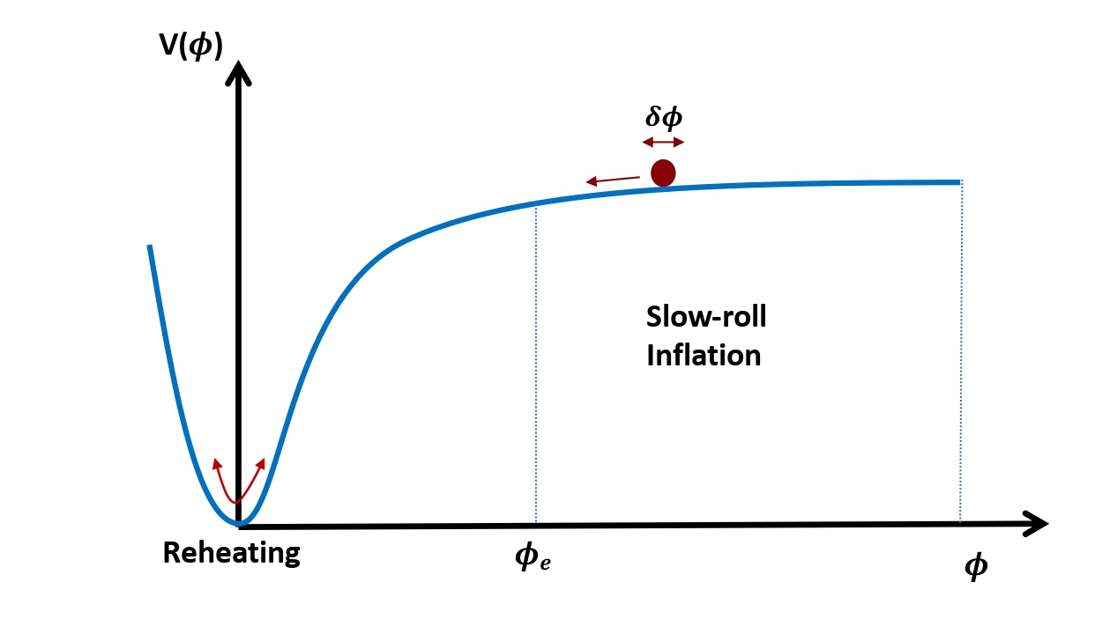
Standard slow-roll
$$V\left(ϕ\right)=V_{0}\left[1−g\left(ϕ\right)\right]≃V_{0} \text{since} g\left(ϕ\right)≪1 \text{for} ϕ≫1$$

Slide 4
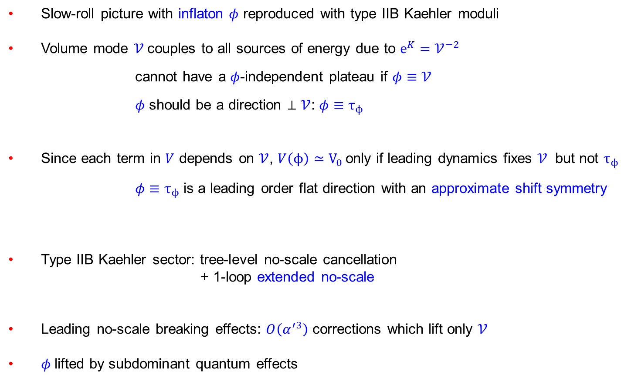
Inflating with string moduli
Slow-roll picture with inflaton $φ$ reproduced with type IIB Kaehler moduli
Volume mode $𝒱$couples to all sources of energy due to $e^{K}=𝒱^{−2}$
cannot have a $φ$-independent plateau if $φ≡$ $𝒱$
$φ$ should be a direction $⊥𝒱$: $φ≡τ_{ϕ}$
Since each term in $V$ depends on $𝒱$, $V\left(ϕ\right)≃V_{0}$ only if leading dynamics fixes $𝒱$ but not $τ_{ϕ}$
$φ≡τ_{ϕ}$ is a leading order flat direction with an approximate shift symmetry
Type IIB Kaehler sector: tree-level no-scale cancellation
+ 1-loop extended no-scale
Leading no-scale breaking effects: $O\left(α^{′3}\right)$ corrections which lift only $𝒱$
$φ$lifted by subdominant quantum effects
[Burgess,MC,Quevedo,Williams][Burgess,MC,deAlwis,Quevedo]
[MC,Conlon,Quevedo]

Slide 5
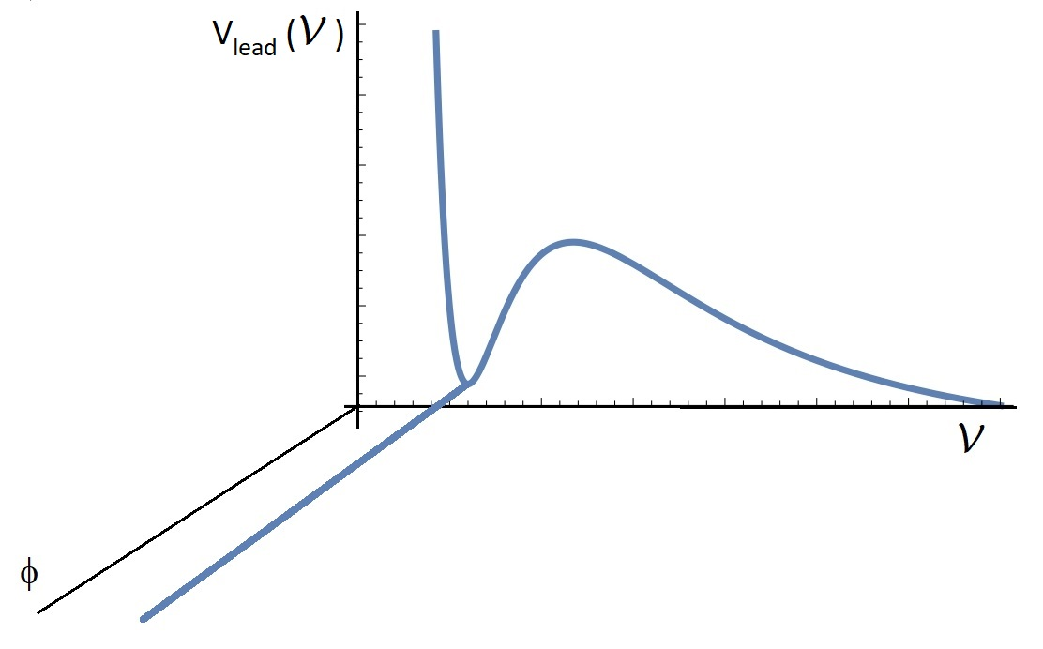

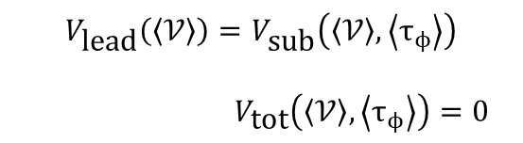
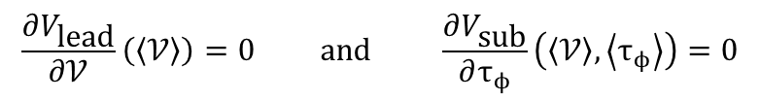

Leading dynamics
Total potential:
Stabilisation:
with:
$$V_{\text{tot}}\left(𝒱,τ_{ϕ}\right)=V_{\text{lead}}\left(𝒱\right)−V_{\text{sub}}\left(𝒱,τ_{ϕ}\right)$$
$$V_{\text{sub}}\left(𝒱,τ_{ϕ}\right)≪V_{\text{lead}}\left(𝒱\right)$$
$$\frac{∂V_{\text{lead}}}{∂𝒱}\left(\left\langle 𝒱\right\rangle \right)=0 \text{and} \frac{∂V_{\text{sub}}}{∂τ_{ϕ}}\left(\left\langle 𝒱\right\rangle ,\left\langle τ_{ϕ}\right\rangle \right)=0$$
$$V_{\text{lead}}\left(\left\langle 𝒱\right\rangle \right)=V_{\text{sub}}\left(\left\langle 𝒱\right\rangle ,\left\langle τ_{ϕ}\right\rangle \right)$$
$V_{\text{tot}}\left(\left\langle 𝒱\right\rangle ,\left\langle τ_{ϕ}\right\rangle \right)=0$

Slide 6
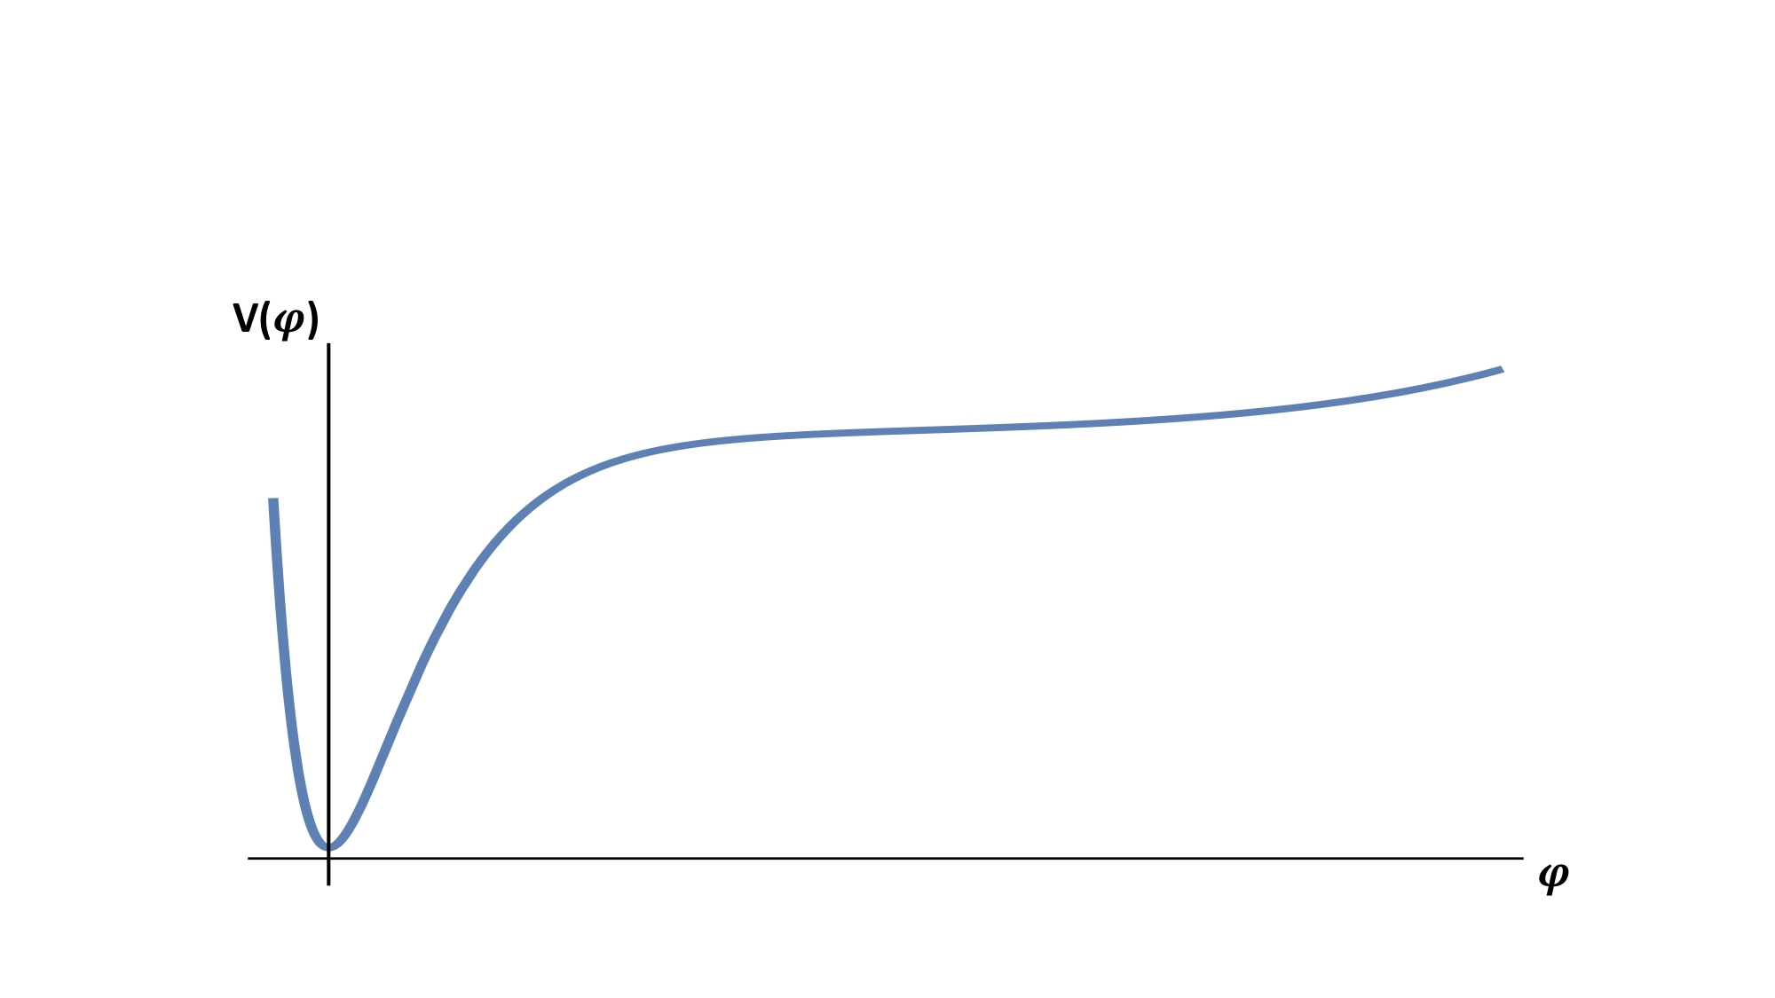



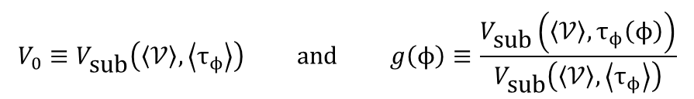



Subleading dynamics
Setting $𝒱=\left\langle 𝒱\right\rangle$, $V_{\text{tot}}\left(\left\langle 𝒱\right\rangle ,τ_{ϕ}\right)$becomes:
with:
with $τ_{ϕ}(ϕ)$ determined by canonical normalisation
Since $τ_{ϕ}$is a leading order flat direction
$$V\left(ϕ\right)=V_{0}\left[1−g\left(ϕ\right)\right]$$
$$V_{0}≡V_{\text{sub}}\left(\left\langle 𝒱\right\rangle ,\left\langle τ_{ϕ}\right\rangle \right) \text{and} g\left(ϕ\right)≡\frac{V_{\text{sub}}\left(\left\langle 𝒱\right\rangle ,τ_{ϕ}\left(ϕ\right)\right)}{V_{\text{sub}}\left(\left\langle 𝒱\right\rangle ,\left\langle τ_{ϕ}\right\rangle \right)}$$
$$V_{\text{sub}}\left(\left\langle 𝒱\right\rangle ,τ_{ϕ}\right)≪V_{\text{sub}}\left(\left\langle 𝒱\right\rangle ,\left\langle τ_{ϕ}\right\rangle \right)$$
$${\text{for} τ}_{φ}>\left\langle τ_{φ}\right\rangle$$
$$g\left(ϕ\right)≪1$$
$\text{and} V\left(ϕ\right)≃V_{0}$ $\text{for} ϕ≫1$

Slide 7
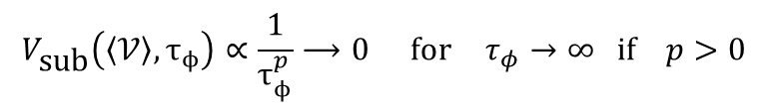



String inflation potentials
Function $g\left(ϕ\right)$ depends on 2 features:
Origin of effects which generate $V_{\text{sub}}\left(\left\langle 𝒱\right\rangle ,τ_{ϕ}\right)$:
Perturbative effects:
Non-perturbative effects:
Topology of $τ_{ϕ}$which determines $τ_{ϕ}(ϕ)$ (canonical normalisation):
Bulk (fibre) modulus:
Local (blow-up) modulus:
$$V_{\text{sub}}\left(\left\langle 𝒱\right\rangle ,τ_{ϕ}\right)∝\frac{1}{τ_{ϕ}^{p}}⟶0 \text{for} τ_{φ}→∞ if p>0$$
$$V_{\text{sub}}\left(\left\langle 𝒱\right\rangle ,τ_{ϕ}\right)∝e^{−kτ_{ϕ}}⟶0 \text{for} τ_{φ}→∞ if k>0$$
$$τ_{ϕ}=e^{λϕ} \text{with} λ∼𝒪\left(1\right)$$
$$τ_{ϕ}=μ 𝒱^{2/3} ϕ^{4/3} \text{with} μ∼𝒪\left(1\right)$$

Slide 8
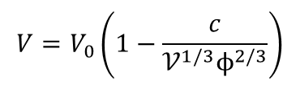






String inflation potentials
$$V\left(ϕ\right)=V_{0}\left[1−g\left(ϕ\right)\right]$$
Non-perturbative Blow-up Inflation:
Non-perturbative Fibre Inflation:
Loop Fibre Inflation:
Loop Blow-up Inflation:
[Conlon,Quevedo][Bond,Kofman,Prokushkin,Vaudrevange]
$$g\left(ϕ\right)∝ e^{−kμ 𝒱^{2/3} ϕ^{4/3}}≪1 \text{for} ϕ>0$$
[MC,Pedro,Tasinato][Luest,Zhang]
$$g\left(ϕ\right)∝e^{−k e^{λϕ}}≪1 \text{for} ϕ>0$$
[MC,Burgess,Quevedo][Broy,Ciupke,Pedro,Westphal][MC,Ciupke,deAlwis,Muia]
$$g\left(ϕ\right)∝e^{−pλϕ}≪1 \text{for} ϕ>0$$
α-attractor realisation
see Linde’s talk
[Bansal,Brunelli,MC,Hebecker,Kuespert]
$$g(φ)∝\frac{1}{𝒱^{2p/3} ϕ^{4p/3}}≪1 \text{for} ϕ≲1$$
$$V=V_{0}\left(1−\frac{c}{𝒱^{1/3}ϕ^{2/3}}\right)$$
$$p=1/2$$

Slide 9
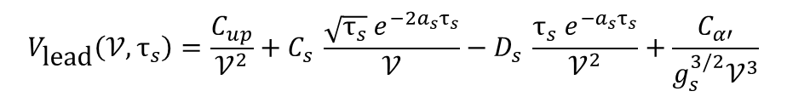

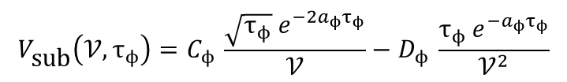







The model
Type IIB compactification on CY with volume:
Kaehler potential (tree-level + $α^{′3}$) and superpotential (tree-level + non-pert.):
Scalar potential:
LVS Minkowski mininum at:
$$𝒱=τ_{b}^{3/2}−τ_{s}^{3/2}−τ_{ϕ}^{3/2}≃τ_{b}^{3/2}$$
$$T_{i}=τ_{i}+iϑ_{i}$$
$$K=−2\text{l}\text{n}\left(𝒱+\frac{ξ}{g_{s}^{3/2}}\right)$$
$$W=W_{0}+ e^{−a_{s}T_{s}}+ e^{−a_{ϕ}T_{ϕ}}$$
$$V=V_{\text{lead}}\left(𝒱,τ_{s}\right)+V_{\text{sub}}\left(𝒱,τ_{ϕ}\right)$$
$$V_{\text{lead}}\left(𝒱,τ_{s}\right)=\frac{C_{up}}{𝒱^{2}}+C_{s} \frac{\sqrt{τ_{s}}{ e}^{−2a_{s}τ_{s}}}{𝒱}−D_{s} \frac{τ_{s}{ e}^{−a_{s}τ_{s}}}{𝒱^{2}}+\frac{C_{α′}}{g_{s}^{3/2}𝒱^{3}}$$
$$V_{\text{sub}}\left(𝒱,τ_{ϕ}\right)=C_{ϕ} \frac{\sqrt{τ_{ϕ}} e^{−2a_{ϕ}τ_{ϕ}}}{𝒱}−D_{ϕ} \frac{τ_{ϕ} e^{−a_{ϕ}τ_{ϕ}}}{𝒱^{2}}$$
$$a_{φ}≫a_{s}$$
$$τ_{s}∼g_{s}^{−1} 𝒱∼e^{a_{s}τ_{s}}∼e^{a_{ϕ}τ_{ϕ}}$$

Slide 10
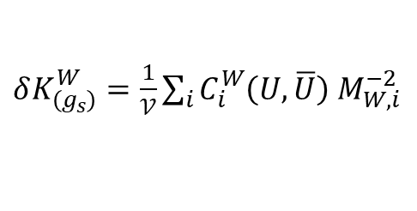
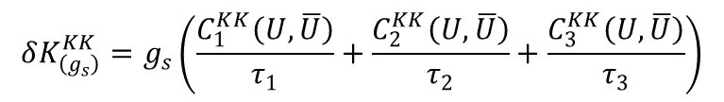
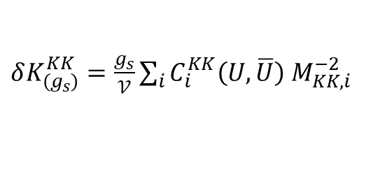

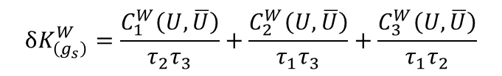

Loop corrections
1-loop K computed only in toroidal orientifolds:
i) tree-level exchange of KK closed strings between parallel D7/O7s:
ii) tree-level exchange of winding closed strings at D7 intersection:
Conjecture for 1-loop K for CYs:
[Berg,Haack,Koers]
$$𝒱=\sqrt{τ_{1}τ_{2}τ_{3}}$$
$$δK_{\left(g_{s}\right)}=δK_{\left(g_{s}\right)}^{KK}+δK_{\left(g_{s}\right)}^{W}$$
$$δK_{\left(g_{s}\right)}^{KK}=g_{s}\left(\frac{C_{1}^{KK}\left(U,\overline{U}\right)}{τ_{1}}+\frac{C_{2}^{KK}\left(U,\overline{U}\right)}{τ_{2}}+\frac{C_{3}^{KK}\left(U,\overline{U}\right)}{τ_{3}}\right)$$
$$δK_{\left(g_{s}\right)}^{W}=\frac{C_{1}^{W}\left(U,\overline{U}\right)}{{τ_{2}τ}_{3}}+\frac{C_{2}^{W}\left(U,\overline{U}\right)}{τ_{1}τ_{3}}+\frac{C_{3}^{W}\left(U,\overline{U}\right)}{τ_{1}τ_{2}}$$
[Berg,Haack,Pajer]
$δK_{\left(g_{s}\right)}^{KK}$ $=\frac{g_{s}}{𝒱}\sum_{i}{C_{i}^{KK}\left(U,\overline{U}\right) M_{KK,i}^{−2}}$
Extended no-scale cancellation in V
[MC,Conlon,Quevedo]
$δK_{\left(g_{s}\right)}^{W}$ $=\frac{1}{𝒱}\sum_{i}{C_{i}^{W}\left(U,\overline{U}\right) M_{W,i}^{−2}}$

Slide 11
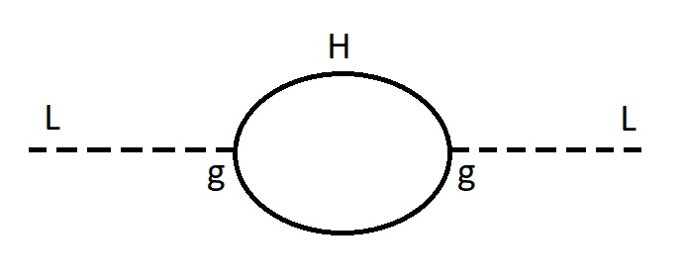
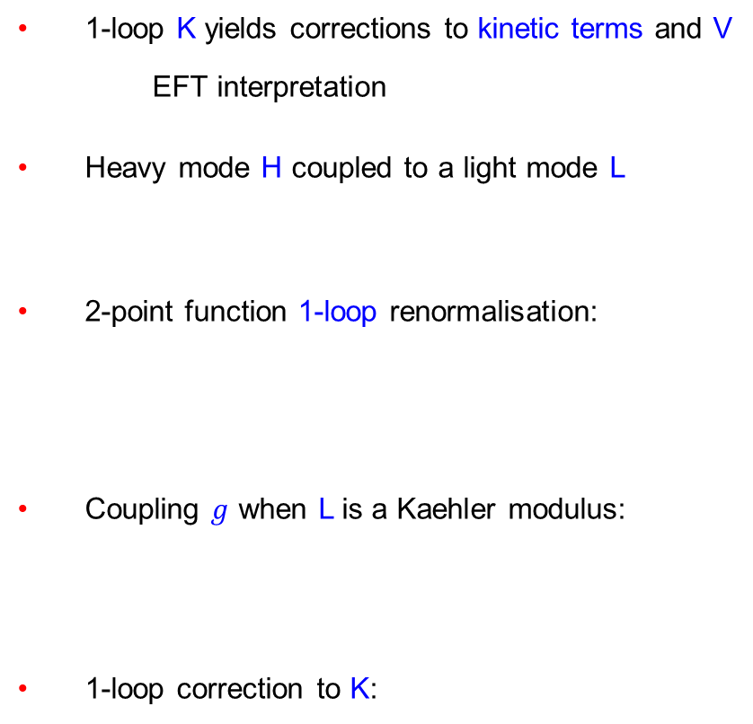




Loop corrections from EFT
1-loop K yields corrections to kinetic terms and V
EFT interpretation
Heavy mode H coupled to a light mode L
2-point function 1-loop renormalisation:
Coupling $g$ when L is a Kaehler modulus:
1-loop correction to K:
[von Gersdorff,Hebecker][MC,Conlon,Quevedo][Gao,Hebecker,Schreyer,Venken]
$$ℒ⊃M^{2}H^{2}+g L H^{2}$$
$$ℒ_{kin}=\left[1+\frac{1}{16π^{2}}{\left(\frac{g}{M}\right)}^{2}\right]∂_{μ}L∂^{μ}L$$
$$g≃\frac{M^{2}}{M_{p}}$$
$$δK≃\frac{1}{16π^{2}}{\left(\frac{M}{M_{p}}\right)}^{2}$$

Slide 12








Loop corrections from 4D
$$δK≃c_{\text{loop}}{\left(\frac{M}{M_{p}}\right)}^{2}$$
If H = massive string state:
If H = winding mode:
If H = Kaluza-Klein mode:
$$M≡M_{s}≃\frac{M_{p}}{\sqrt{𝒱}} ⇒ δK≃\frac{c_{\text{loop}}}{𝒱}$$
matches $δK_{α^{′3}}$
[Becker,Becker,Haack,Louis]
$$M≡M_{W}≃\frac{M_{p}}{\sqrt{𝒱}}τ^{1/4} ⇒ δK≃c_{\text{loop}}\frac{\sqrt{τ}}{𝒱}$$
matches $δK_{(g_{s})}^{KK}$
[Berg,Haack,Pajer]
$δK_{(g_{s})}^{KK}$ = tree-level KK closed strings = 1-loop winding open strings
extended no-scale cancellation in V
[MC,Conlon,Quevedo]
$$M≡M_{KK}≃\frac{M_{p}}{\sqrt{𝒱}{ τ}^{1/4}} ⇒ δK≃\frac{c_{\text{loop}}}{𝒱\sqrt{τ}}$$
matches $δK_{(g_{s})}^{W}$
[Berg,Haack,Pajer]
$δK_{(g_{s})}^{W}$ = tree-level winding closed strings = 1-loop KK open strings
$$if τ=τ_{ϕ} δK≃\frac{c_{\text{loop}}}{𝒱\sqrt{τ_{ϕ}}} ⇒ δV≃\frac{c_{\text{loop}}}{𝒱^{3}\sqrt{τ_{ϕ}}}$$
leading correction to V crucial for inflation

Slide 13





Loop corrections from 4D
1-loop K from KK modes in loop should match 1-loop Coleman-Weinberg potential:
Supertrace in supergravity:
Cut-off Λ given by KK mass of open strings on D7s
i) D7s on $τ_{b}$: $Λ≃\frac{M_{p}}{𝒱^{2/3}}$
ii) D7s on $τ_{ϕ}$: $Λ≃\frac{M_{p}}{τ_{ϕ}^{1/4}\sqrt{𝒱}}$
If there is no D7 on $τ_{ϕ}$, can still have KK modes of $τ_{ϕ}$(closed strings) in loop
$Λ≃\frac{M_{p}}{τ_{ϕ}^{1/4}\sqrt{𝒱}}$
$$V_{\text{1−}\text{loop}}^{CW}≃\frac{1}{16π^{2}} Λ^{2} \text{Str}{ M}^{2}$$
[MC,Conlon,Quevedo]
$$\text{Str}{ M}^{2} ≃m_{3/2}^{2}≃\frac{M_{p}^{2}}{𝒱^{2}}$$
$$δV_{\left(g_{s}\right)}≃\frac{c_{\text{loop}}}{𝒱^{10/3}}$$
$$δV_{\left(g_{s}\right)}≃\frac{c_{\text{loop}}}{𝒱^{3}\sqrt{τ_{ϕ}}}$$
same as from 1-loop 2-pt function
$τ_{ϕ}$-dependent loop corrections to V are unavoidable

Slide 14
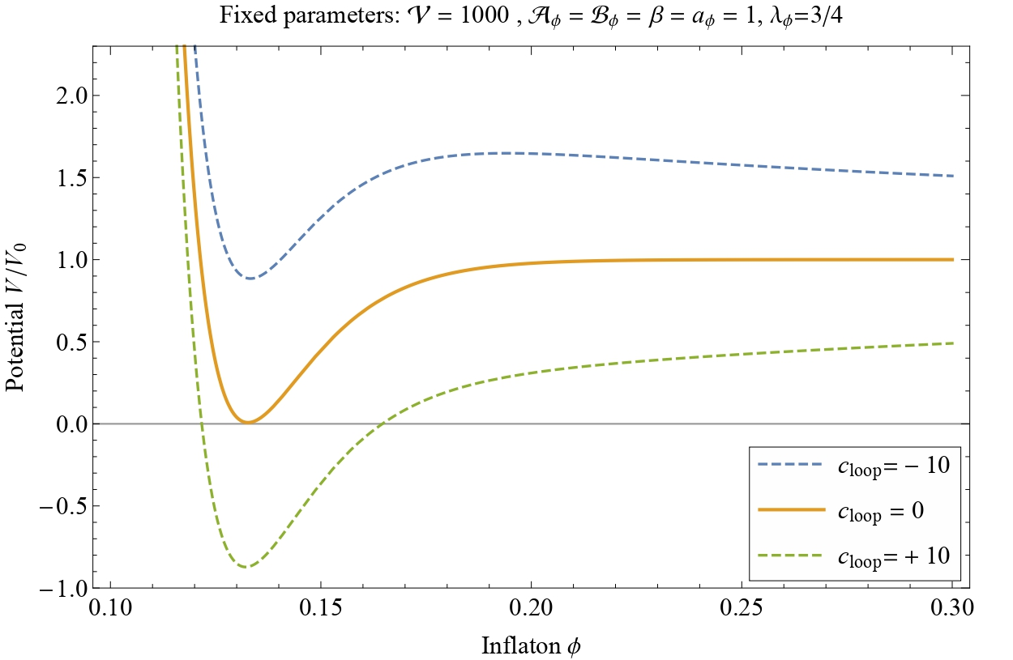





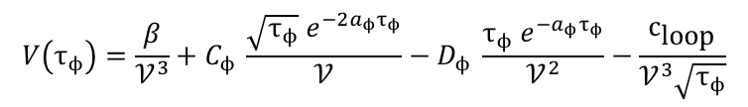
Inflaton potential
[Bansal,Brunelli,MC,Hebecker,Kuespert]
Potential with loops:
Non-perturbative blow-up inflation requires $c_{\text{loop}}≪{10}^{−6}$
For $c_{\text{loop}}≳{10}^{−6}$ potential in inflationary region is
$$V\left(τ_{ϕ}\right)={\frac{β}{𝒱^{3}}+C}_{ϕ} \frac{\sqrt{τ_{ϕ}} e^{−2a_{ϕ}τ_{ϕ}}}{𝒱}−D_{ϕ} \frac{τ_{ϕ} e^{−a_{ϕ}τ_{ϕ}}}{𝒱^{2}}−\frac{c_{\text{loop}}}{𝒱^{3}\sqrt{τ_{ϕ}}}$$
$$ϕ=\sqrt{\frac{4}{3𝒱}} τ_{ϕ}^{3/4}$$
$${C_{ϕ} =D}_{ϕ}=a_{ϕ}=β=1$$
[Conlon,Quevedo]
$$V≃V_{0}\left(1−\frac{c_{\text{loop}}}{{𝒱^{1/3}ϕ}^{2/3}}\right)$$
$$V_{0}≡\frac{β}{𝒱^{3}}$$

Slide 15

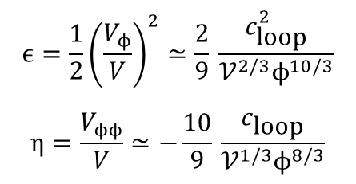
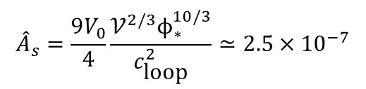

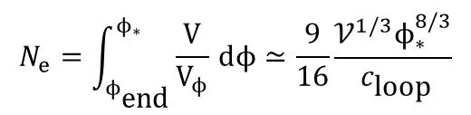

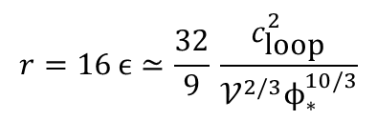
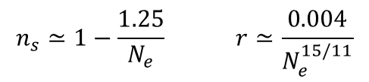
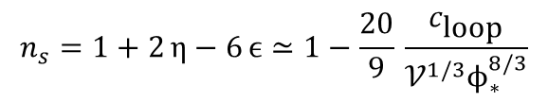

Inflationary dynamics
Slow-roll parameters:
Cosmological observables:
$$ϵ=\frac{1}{2}{\left(\frac{V_{ϕ}}{V}\right)}^{2}≃\frac{2}{9} \frac{c_{\text{loop}}^{2}}{𝒱^{2/3}ϕ^{10/3}}$$
$$η=\frac{V_{ϕϕ}}{V}≃−\frac{10}{9} \frac{c_{\text{loop}}}{𝒱^{1/3}ϕ^{8/3}}$$
$$N_{e}=\int_{ϕ_{\text{end}}}^{ϕ_{∗}}{\frac{V}{V_{ϕ}}} ⅆϕ≃\frac{9}{16}\frac{{𝒱^{1/3}ϕ}_{∗}^{8/3}}{ c_{\text{loop}}}$$
$$ϕ_{∗}=0.06 N_{e}^{7/22}$$
$$c_{\text{loop}}≃\frac{1}{16π^{2}}$$
$${\hat{A}}_{s}=\frac{9V_{0}}{4}\frac{𝒱^{2/3}ϕ_{∗}^{10/3}}{c_{\text{loop}}^{2}}≃2.5×{10}^{−7}$$
$$𝒱=1743 N_{e}^{5/11}$$
$$r=16 ϵ≃\frac{32}{9} \frac{c_{\text{loop}}^{2}}{𝒱^{2/3}ϕ_{∗}^{10/3}}$$
$$n_{s}=1+2 η−6 ϵ≃1−\frac{20}{9} \frac{c_{\text{loop}}}{𝒱^{1/3}ϕ_{∗}^{8/3}}$$
$$n_{s}≃1−\frac{1.25}{N_{e}} r≃\frac{0.004}{N_{e}^{15/11}}$$
$$r≃0.003{\left(1−n_{s}\right)}^{15/11}$$

Slide 16
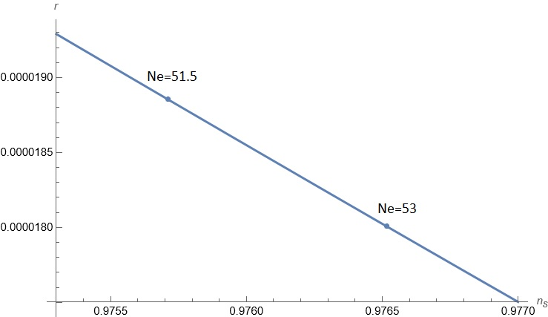

Cosmological predictions
$$r≃0.003{\left(1−n_{s}\right)}^{15/11}$$
$$for 51.5≲N_{e}≲53 n_{s} in agreement with CMB data r≃2×{10}^{−5}$$
determined by post-inflationary evolution

Slide 17
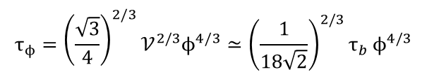

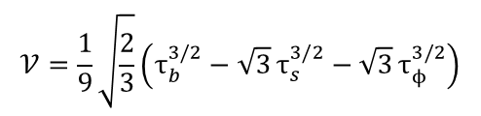


Control over EFT
Values of UV parameters:
Canonical normalisation:
Check in an explicit CY example from [MC,Krippendorf,Mayrhofer,Quevedo,Valandro]:
Kaehler cone conditions:
Canonical normalisation:
At horizon exit:
$$for 51.5≲N_{e}≲53 {𝒱=1743 N_{e}^{5/11}∼𝒪\left({10}^{4}\right) ϕ}_{∗}=0.06 N_{e}^{7/22}∼𝒪\left(0.2\right)$$
$$ϕ≃τ_{φ}^{3/4}/\sqrt{𝒱}≃{(τ_{φ}/τ_{b})}^{3/4}$$
$ϕ∼𝒪\left(0.2\right)$ implies $τ_{ϕ}≲τ_{b}$ can have inflation within Kaehler cone?
$$𝒱=\frac{1}{9}\sqrt{\frac{2}{3}}\left(τ_{b}^{3/2}−\sqrt{3} τ_{s}^{3/2}−\sqrt{3} τ_{ϕ}^{3/2}\right)$$
$$τ_{b}=\frac{27}{2} t_{b}^{2} τ_{s}=\frac{9}{2} t_{s}^{2} τ_{ϕ}=\frac{9}{2} t_{ϕ}^{2}$$
$$t_{b}+t_{s}>0 t_{b}+t_{ϕ}>0 t_{s}<0 t_{ϕ}<0$$
$$τ_{ϕ}={\left(\frac{\sqrt{3}}{4}\right)}^{2/3}𝒱^{2/3}ϕ^{4/3}≃{\left(\frac{1}{18\sqrt{2}}\right)}^{2/3}τ_{b} ϕ^{4/3}$$
$\frac{\left|t_{ϕ}\right|}{t_{b}}={\left(\frac{1}{2\sqrt{6}}\right)}^{1/3} ϕ^{2/3}≃0.6 ϕ^{2/3}$ $≃0.2 for ϕ≃0.2$
well inside Kaehler cone!

Slide 18
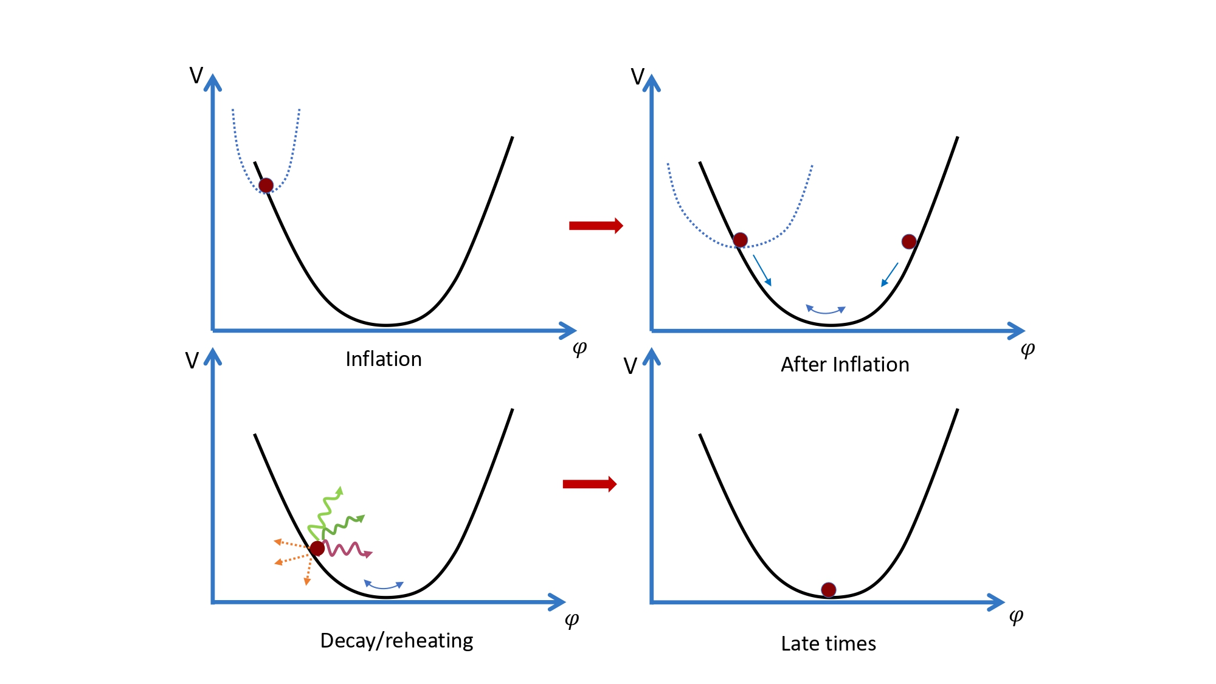






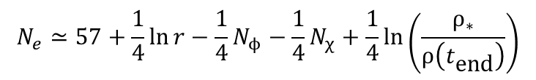

N_{e} from post-inflation
$$N_{e}≃57+\frac{1}{4}\ln{r}−\frac{1}{4}N_{ϕ}−\frac{1}{4}N_{χ}+\frac{1}{4}\ln\left(\frac{ρ_{∗}}{ρ\left(t_{\text{end}}\right)}\right)$$
τ_{φ} domin.
$𝒱$ domin.
$$φ≡τ_{ϕ} \text{or} 𝒱$$
$$φ$$
$$Γ_{φ→SM}$$
$$Γ_{φ→ϑ_{b}ϑ_{b}}$$
$$ΔN_{\text{eff}}≲0.2−0.5 \text{at} 95\% \text{CL}$$
SM dof
τ_{b} axions
$$ΔN_{\text{eff}}≠0$$

Slide 19

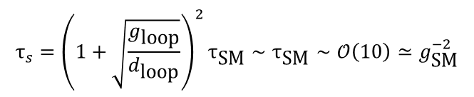
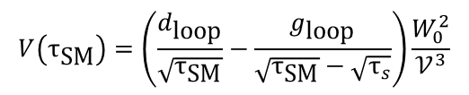

SM realisation
SM D7s cannot wrap τ_{s} due to tension between non-pert effects and chirality
SM D7s cannot wrap τ_{φ} since τ_{φ}-dependent FI-term would make τ_{φ} too heavy
need to introduce 2 additional intersecting blow-ups τ_{SM} and τ_{int}
D-term stabilisation:
i) if λ = 0, τ_{SM} → 0 SM on D3-branes at a CY singularity
ii) if λ ≠ 0, ξ_{FI} = 0 fixes τ_{int} in terms of τ_{SM} and τ_{SM} remains as a flat direction fixed by loops
SM on D7-branes wrapped around τ_{SM}
[Blumenhagen,Moster,Plauschinn]
$$𝒱=τ_{b}^{3/2}−τ_{s}^{3/2}−τ_{ϕ}^{3/2}−τ_{\text{S}\text{M}}^{3/2}−λ{\left(τ_{\text{int}}−τ_{\text{SM}}\right)}^{3/2}$$
$${ξ_{FI}=0 ⇔ τ}_{\text{SM}}=λ^{2}\left(τ_{\text{int}}−τ_{\text{SM}}\right)$$
$$V\left(τ_{\text{SM}}\right)=\left(\frac{d_{\text{loop}}}{\sqrt{τ_{\text{SM}}}}−\frac{g_{\text{loop}}}{\sqrt{τ_{\text{SM}}}−\sqrt{τ_{s}}}\right)\frac{W_{0}^{2}}{𝒱^{3}}$$
[MC,Mayrhofer,Valandro]
$$τ_{s}={\left(1+\sqrt{\frac{g_{\text{loop}}}{d_{\text{loop}}}}\right)}^{2}τ_{\text{SM}}∼τ_{\text{SM}}∼𝒪\left(10\right)≃g_{\text{SM}}^{−2}$$

Slide 20

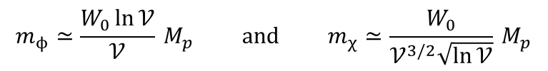

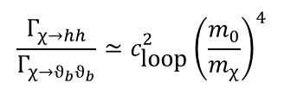
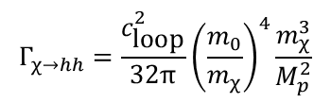


Volume decay rates
Masses of canonically normalised moduli: τ_{φ} becomes φ and V becomes χ
Decays of volume χ:
i) closed string axions ϑ_{b}
ii) MSSM Higgses H_{u} and H_{d}
iii) SM Higgses h
SM on D7s:
χ decays into SM Higgses h
SM on D3s:
χ decays into ϑ_{b} axions, H_{u} and H_{d}
$$m_{ϕ}≃\frac{W_{0}\ln{𝒱}}{𝒱} M_{p} \text{and} m_{χ}≃\frac{W_{0}}{𝒱^{3/2}\sqrt{\ln{𝒱}}} M_{p}$$
$$Γ_{χ→ϑ_{b}ϑ_{b}}=\frac{1}{48π}\frac{m_{χ}^{3}}{M_{p}^{2}}$$
$$Γ_{χ→H_{u}H_{d}}=2Z^{2}{ Γ}_{χ→ϑ_{b}ϑ_{b}}$$
$$Γ_{χ→hh}=\frac{c_{\text{loop}}^{2}}{32π}{\left(\frac{m_{0}}{m_{χ}}\right)}^{4}\frac{m_{χ}^{3}}{M_{p}^{2}}$$
$$\frac{Γ_{χ→hh}}{Γ_{χ→ϑ_{b}ϑ_{b}}}≃c_{\text{loop}}^{2}{\left(\frac{m_{0}}{m_{χ}}\right)}^{4}$$
$$m_{0}≃\frac{M_{p}}{𝒱}≫m_{χ} \frac{Γ_{χ→hh}}{Γ_{χ→ϑ_{b}ϑ_{b}}}≃{\left(c_{\text{loop}}𝒱\right)}^{2}≫1$$
$$m_{0}≲ m_{χ} \frac{Γ_{χ→hh}}{Γ_{χ→ϑ_{b}ϑ_{b}}}≲c_{\text{loop}}^{2}≪1$$

Slide 21

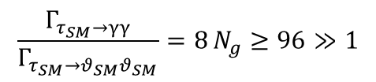
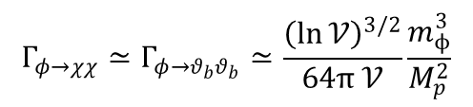
Inflaton decay rates
Inflaton wrapped by hidden D7s:
decay into hidden gauge bosons γ_{h}
Inflaton not wrapped by any D7:
i) decay into volume moduli χ and ϑ_{b} axions
SM on D7s: χ then decays istantaneously into h h
SM on D3s: χ then decays later on into H_{u} and H_{d}, and ϑ_{b} ϑ_{b}
ii) for SM on D7s, extra decays into SM gauge bosons γ, τ_{SM} moduli and ϑ_{SM} (QCD) axions
τ_{SM} then decays istantaneosuly into γ γ, and ϑ_{SM} ϑ_{SM} with
$$Γ_{ϕ→γ_{h}γ_{h}}≃\frac{𝒱}{64π}\frac{m_{ϕ}^{3}}{M_{p}^{2}}$$
$$Γ_{φ→χχ}≃Γ_{φ→θ_{b}θ_{b}}≃\frac{{\left(\ln{𝒱}\right)}^{3/2}}{64π 𝒱}\frac{m_{ϕ}^{3}}{M_{p}^{2}}$$
$Γ_{φ→τ_{SM}τ_{SM}}≃Γ_{φ→θ_{SM}θ_{SM}}≃Γ_{φ→χχ}$ $Γ_{φ→γγ}≃N_{g} Γ_{φ→χχ}≃12 Γ_{φ→χχ}$
[MC,Hebecker,Jaeckel,Wittner]
$$\frac{Γ_{τ_{SM}→γγ}}{Γ_{τ_{SM}→θ_{SM}θ_{SM}}}=8 N_{g}≥96≫1$$

Slide 22
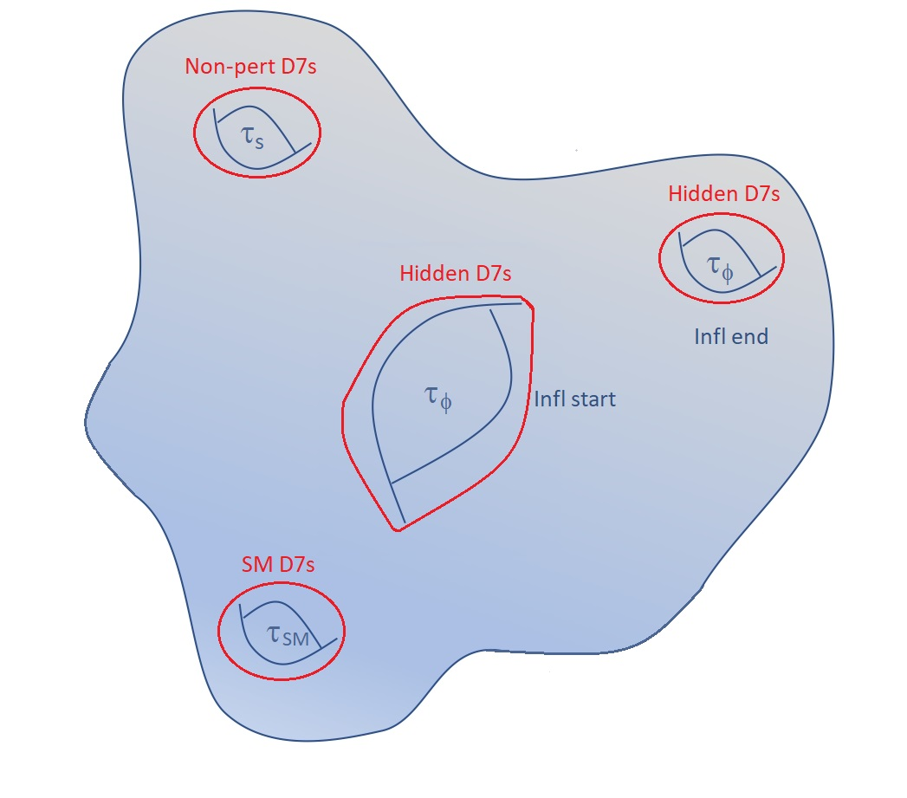
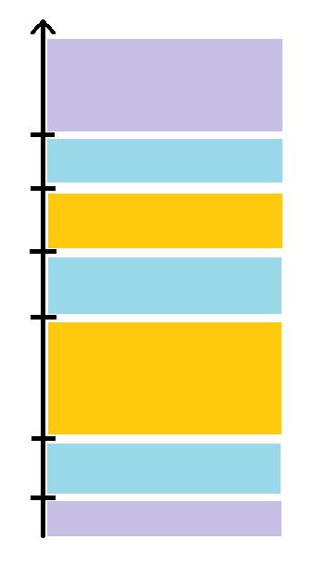




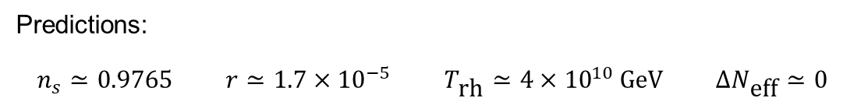

SM on D7s and inflaton wrapped by D7s
E
Inflation
$$N_{e}≃53$$
Inflaton dom.
$$N_{ϕ}≃1$$
$$ϕ→γ_{h}γ_{h}$$
Radiation dom.
Volume dom.
$$N_{χ}≃3$$
$$χ→hh$$
Radiation dom.
Matter dom.
Dark energy
Predictions:
$$n_{s}≃0.9765 r≃1.7×{10}^{−5} T_{\text{rh}}≃4×{10}^{10} \text{GeV} ΔN_{\text{eff}}≃0$$

Slide 23
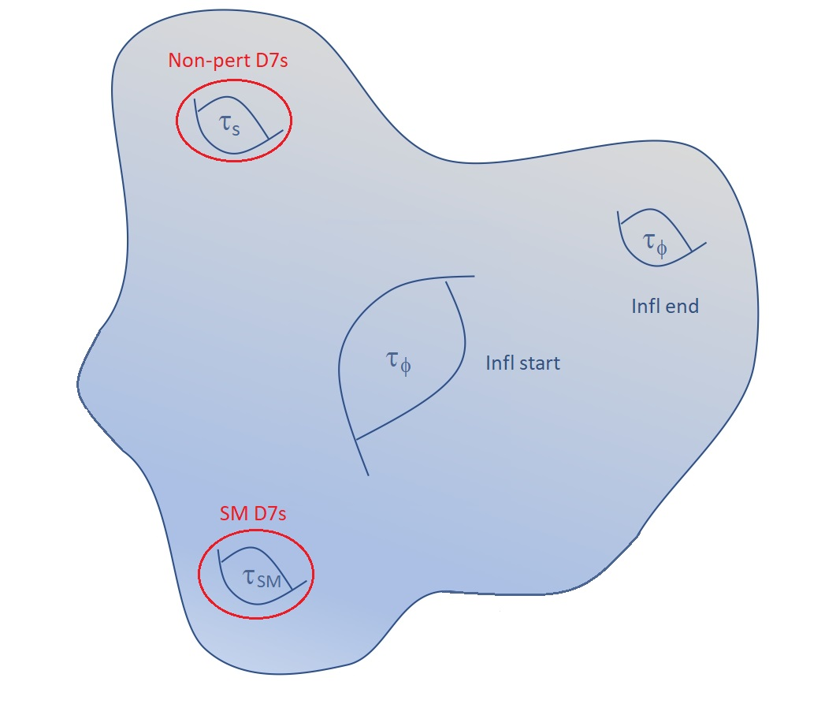






SM on D7s and unwrapped inflaton
E
Inflation
$$N_{e}≃52$$
Inflaton dom.
$$N_{ϕ}≃8$$
$$ϕ→γγ,ϑ_{b}ϑ_{b}$$
$$N_{χ}=0$$
Radiation dom.
Matter dom.
Dark energy
Predictions:
$$n_{s}≃0.9761 r≃1.7×{10}^{−5} T_{\text{rh}}≃3×{10}^{12} \text{GeV} ΔN_{\text{eff}}≃0.14$$

Slide 24







SM on D3s and inflaton wrapped by D7s
E
Inflation
$$N_{e}≃51.5$$
Inflaton dom.
$$N_{ϕ}≃1$$
$$ϕ→γ_{h}γ_{h}$$
Radiation dom.
Volume dom.
$$N_{χ}≃10.5$$
$$χ→H_{u}H_{d}, ϑ_{b}ϑ_{b}$$
Radiation dom.
Matter dom.
Dark energy
Predictions:
$$n_{s}≃0.9757 r≃1.8×{10}^{−5} T_{\text{rh}}≃1×{10}^{8} \text{GeV} ΔN_{\text{eff}}≃\frac{1.43}{Z^{2}}≃0.36 Z=2$$

Slide 25









SM on D3s and unwrapped inflaton
E
E
Inflation
$$N_{e}≃51.5$$
Inflation
Inflaton dom.
$$N_{ϕ}≃11$$
Inflaton dom.
$φ→χχ$, $ϑ_{b}ϑ_{b}$
Radiation dom.
Volume dom.
Volume dom.
$$N_{χ}≃0.5$$
$$χ→H_{u}H_{d}, ϑ_{b}ϑ_{b}$$
Radiation dom.
Radiation dom.
Matter dom.
Matter dom.
Dark energy
Dark energy
as before same predictions:
$$n_{s}≃0.9757 r≃1.8×{10}^{−5} T_{\text{rh}}≃1×{10}^{8} \text{GeV} ΔN_{\text{eff}}≃\frac{1.43}{Z^{2}}≃0.36 Z=2$$
$$N_{ϕ}+N_{χ}≃11.5$$

Slide 26


Conclusions on inflation
Type IIB Kaehler moduli $⊥𝒱$ are good inflatons $ϕ$due to approximate shift symmetries
$V(ϕ)$determined by nature of breaking effects (pert/non-pert.) and topology (bulk/local cycle)
can have several scenarios
New model: Loop Blow-up Inflation
Inflation driven by a blow-up mode with $V(ϕ)$ generated by 1-loop corrections to K
1-loop K: conjecture from toroidal computation
+ EFT matching with 1-loop 2-point function and Coleman-Weinberg potential
Inflaton potential:
EFT under control with inflation inside Kaehler cone
Microscopic parameters: ${𝒱∼𝒪\left({10}^{4}\right) \text{and} ϕ}_{∗}∼𝒪\left(0.2\right)$
Predictions: ${0.9757≲n}_{s}≲0.9765 \text{and} r≃2×{10}^{−5}$
Post-inflation with moduli domination and reheating from moduli decay
Depending on SM realisation: $51.5≲N_{e}≲53$ and $0≲ΔN_{\text{eff}}≲0.36$
[Bansal,Brunelli,MC,Hebecker,Kuespert]
$$V(ϕ)=V_{0}\left(1−\frac{c}{𝒱^{1/3}ϕ^{2/3}}\right)$$

Slide 27
Dark energy

Slide 28

dS from string theory?
Stable dS does not exist
Difficulty to get dS with EFT under control
Extreme point of view: metastable dS may also be incompatible with QG
No dS conjectures
DE has to be quintessence
Conservative point of view: no dS conjecture applies only at boundary of moduli space
can have metastable dS in interior of moduli space
No dS with parametric control but dS with numerical control is OK due to small parameters
$W_{0}≪1$ in KKLT and $𝒱^{−1}∼e^{{−1/g}_{s}}≪1$ in LVS
Several uplifting mechanisms:
anti-D3s, D-terms, T-branes, α’ effects, F^{cx str} ≠ 0, non-pert. effects at singularities
Progress in classifying α’ and g_{s} corrections using 10D symmetries
Global CY models with SM on D3s and dS from T-branes
Metastable dS may exist but its lifetime is upper-bounded
see Ooguri’s talk
[MC,de Alwis,Maharana,Muia,Quevedo]
[Burgess,MC,Ciupke,Krippendorf,Quevedo]
[MC,Garcia Extebarria,Quevedo,Schacher,Shukla,Valandro]
see talks by Dvali and Vafa

Slide 29

Quintessence from string theory?
Take no metastable dS point of view
implications for quintessence?
Models that would be ruled out:
i) Saxion quintessence slow-roll down a shallow potential (due to no dS conjecture)
ii) Axion quintessence with ${f≳M}_{p}$ (due to WGC)
Models that would be OK:
i) Saxion/axion hilltop for a Minkowski/AdS vacuum
ii) Saxion runaway

Slide 30


No quintessence at boundary of moduli space
Focus on type IIB volume mode (similar results for type IIA and heterotic)
Potential for $∂_{τ}W=0$and $τ→∞$ (α’ expansion under control)
If $\left|D_{U}W\right|$ = $\left|D_{S}W\right|$ = 0, quantum corrections give a larger suppression for $τ→∞$
Similar results for dilaton $s→∞$ (g_{s} expansion under control)
[MC,Cunillera,Padilla,Pedro]
$$K=−3\text{ln}{τ} ⇒ ℒ_{kin}=\frac{3}{4τ^{2}}∂_{μ}τ∂^{μ}τ=\frac{1}{2}∂_{μ}φ∂^{μ}φ τ=e^{\sqrt{2/3}φ}$$
$$V=e^{K}\left({\left|D_{U}W\right|}^{2}+{\left|D_{S}W\right|}^{2}\right)=\frac{V_{0}}{τ^{3}}$$
$$V=\frac{V_{0}}{τ^{3+p}}=V_{0} e^{−λφ} λ=\sqrt{6} \left(1+p\right) p>0$$
$$ε=\frac{1}{2} {\left(\frac{V_{φ}}{V}\right)}^{2}=\frac{λ^{2}}{2}=3 {\left(1+p\right)}^{2}>1$$
No acceleration

Slide 31





Multifield quintessence?
Quintessence could still work due to kinetic coupling with axion
non-geodesic motion in curved field space gives acceleration
Idea:
gives effective time-dependent contribution to $V(φ)$ if $\dot{θ}≠0$
However it does not work in string theory:
[MC,Dibitetto,Pedro]
$$T=τ+iθ ⇒ ℒ_{kin}⊃\frac{3}{4τ^{2}}∂_{μ}θ∂^{μ}θ=\frac{3}{4}e^{−2\sqrt{\frac{2}{3}}φ}{\dot{θ}}^{2}$$
$$V_{eff}=V_{0} e^{−λφ} −\frac{3}{4}e^{−2\sqrt{\frac{2}{3}}φ}{\dot{θ}}^{2}$$
$${\dot{θ}}^{2}∝\frac{1}{a^{6}} m_{θ}≃0$$
$$V=V_{0} e^{−\sqrt{2p} φ} −\frac{p}{4}e^{−2\sqrt{\frac{2}{p}}φ}{\dot{θ}}^{2}$$
$$K=−p \text{ln}{(X+\overline{X})}$$
today
fixed points of dynamical system
[Brinkmann,MC,
Dibitetto,Pedro]
matter dom.
initial cond.

Slide 32





Challenges for quintessence
Quintessence, as dS, has to be in bulk of moduli space
Same control issue as dS + extra challenges:
i) Ultra-light quintessence field
ii) String and SUSY scale above 1 TeV
iii) Heavy volume mode
Leading order: $𝒱$is lifted while φ is flat:
$$m_{φ}≲H_{0}∼{10}^{−60} M_{p} from η=\frac{V_{φφ}}{V}≲1$$
radiatively stable?
fifth-forces?
$$M_{s}≃\frac{M_{p}}{\sqrt{𝒱}}≳1 TeV ⇔ 𝒱≲{10}^{30}$$
$$m_{𝒱}≳1 meV≃{10}^{−30} M_{p}$$
from fifth-forces (screening/sequestering hard to work)
$${⇒ m}_{𝒱}≫m_{φ}$$
$$V=V_{lead}\left(𝒱\right)+V_{sub}\left(𝒱,φ \right)$$
$$\frac{V_{lead}}{V_{sub}}∼{\left(\frac{m_{φ}}{m_{𝒱}}\right)}^{2}≲{10}^{−60}$$
cannot be obtained with perturbative corrections
since
$$\frac{V_{loop}}{V_{α^{′3}}}∼\frac{1}{𝒱^{1/3}}≲{10}^{−60} ⇔ 𝒱≳{10}^{180} ⇒ M_{s}≪1 TeV$$

Slide 33




Quintessence model building
Quintessence as challenging as dS + extra challenges (fifth forces, right scales, stability)
Metastable dS seems easier to build
But what if quintessence is preferred by data? (DESI?)
Best candidate: axion quintessence
$V_{lead}(𝒱)$has a SUSY breaking Minkowski vacuum and axion φ is flat
$V_{sub}(φ,𝒱)$generated by non-perturbative effects
i) Right hierarchy: $V_{sub}\left(φ,𝒱\right)≪V_{lead}(𝒱)$
ii) Radiative stability due to perturbative shift symmetry
iii) No fifth-force problem
But axion potential yields acceleration only for ${f≳M}_{p}$
Never obtained in EFT + forbidden by WGC
For ${f<M}_{p}$ can have quintessence from axion hilltop
[MC,Cunillera,Padilla,Pedro]
$$V_{\text{sub}}∼e^{−aτ}∼e^{−a𝒱^{2/3}}$$
$\frac{V_{lead}}{V_{sub}}∼\frac{e^{a𝒱^{2/3}}}{𝒱^{3}}≳{10}^{60}$ $for 𝒱≲{10}^{30}$ ${ and M}_{s} ≳1 TeV$
$$V_{sub}\left(φ,𝒱\right)=Λ\left(𝒱\right)\left[1−cos⁡\left(\frac{φ}{f}\right)\right]$$

Slide 34









Axion hilltop
[MC,Cunillera,Padilla,Pedro]
Focus on axions in LVS
Leading order stabilisation: SUSY breaking Minkowski vacuum at
Subleading order:
$f=\sqrt{\frac{3}{2}}\frac{M_{p}}{a_{b}τ_{b}}$
$$K=−2\text{l}\text{n}\left(𝒱+\frac{ξ}{g_{s}^{3/2}}\right)$$
$$𝒱=τ_{b}^{3/2}−τ_{s}^{3/2}$$
$$W=W_{0}+e^{−a_{s}T_{s}}+e^{−a_{b}T_{b}}$$
$${θ_{s}=0 τ}_{s}∼g_{s}^{−1} ≫1$$
$𝒱∼e^{a_{s}τ_{s}}∼e^{a_{s}/g_{s}}$ $≫1 θ_{b} is flat$
$$V_{lead}\left(𝒱_{max}\right)∼m_{𝒱}$$
$$V_{sub}\left(φ,𝒱\right)∼e^{−\sqrt{\frac{3}{2}}\frac{M_{p}}{f}}M_{p}^{4}\left[1−cos⁡\left(\frac{φ}{f}\right)\right]$$
$${10}^{−120} for f∼0.003 M_{p} ⇔ 𝒱≃τ_{b}^{3/2}∼{10}^{3}$$
natural + EFT under control
$$m_{𝒱}∼{10}^{13} GeV$$

Slide 35



Hilltop and initial conditions
How close should φ be to the maximum to get acceleration with $ω_{φ}≃−1$and $Ω_{φ}≃0.7$?
Quantum diffusion during inflation causes fluctuations $Δφ∼H_{inf}$
Need to require $H_{inf}{≲Δ}_{max}$
i) $f≃0.1 M_{p}$ $H_{inf}{≲10}^{−4}M_{p}∼{10}^{14} GeV$
ii) $f≃0.02 M_{p}$ $H_{inf}{≲10}^{−18}M_{p}∼1 GeV$
In (i) use poly-instantons to generate axion potential with right DE scale
In (ii) use axion alignment to get an effective $f≃0.1 M_{p}$
[MC,Cunillera,Padilla,Pedro]
but can get DE scale for $f≃0.1 M_{p}$?
tiny and even lower for $f≃0.003 M_{p}$

Slide 36


Quintessence from poly-instantons
LVS in fibred CYs:
Potential:
$V=V_{lead}\left(𝒱,τ_{s},θ_{s}\right)+V_{inf}\left(τ_{f}\right)+V_{sub}\left(θ_{b},θ_{f}\right)$
Loop Fibre Inflation:
$V_{inf}≃V_{0}(1−\frac{4}{3}e^{−φ/\sqrt{3}}$) and $H_{inf}≃{10}^{−5}M_{p}$
2 light bulk axions: ϑ_{b} = spectator (0.2% of DM) and ϑ_{f} = DE via poly-instantons
$W=W_{LVS}+e^{−a_{b}T_{b}+ e^{−a_{f}T_{f}}}$
Axion potential:
$$V_{sub}∼e^{−a_{b}τ_{b}}\left[1−\cos\left(\frac{φ_{b}}{f_{b}}\right)\right]+e^{−a_{b}τ_{b}−a_{f}τ_{f}}\left[1−\cos\left(\frac{φ_{b}}{f_{b}}+\frac{φ_{f}}{f_{f}}\right)\right]$$
$V_{DE}∼$ $e^{−f_{f}^{−1}−f_{b}^{−1}}\left[1−\cos\left(\frac{φ_{f}}{f_{f}}\right)\right]$ after fixing $φ_{b}=0$
$f_{f}=\frac{N_{f}}{2\sqrt{2}πτ_{f}}M_{p}≃0.1 M_{p}$ and $f_{b}=\frac{N_{b} }{2πτ_{b}}M_{p}≃0.005 M_{p}$
Numerical results:
$$τ_{f}∼O\left(5\right) τ_{b}∼O\left(500\right) N_{1}∼{ O\left(5\right) N}_{2}∼O\left(10\right)$$
$m_{b}≃{10}^{−29} eV m_{f}≃{10}^{−32} eV$
$$𝒱 =\sqrt{τ_{f}}τ_{b}−τ_{s}^{3/2}$$
[MC,Padilla,Pedro]
[MC,Burgess,Quevedo]
[Blumenhagen,Schmidt-Sommerfeld;Luest,Zhang]

Slide 37

Conclusions on dark energy
No quintessence at boundary of moduli space where α’ and g_{s} expansions are under control
Multifield string models can give late time acceleration but without $ω_{φ}≃−1$and $Ω_{φ}≃0.7$
Quintessence as challenging as dS + extra challenges (fifth forces, right scales, stability)
dS models seem easier to build
If quintessence is preferred by data (DESI?), axions are the best candidates to drive DE
But simplest axion potential does not yield acceleration
Need to rely on axion hilltop:
i) $f≃0.1 M_{p}$ $H_{inf}{≲10}^{−4}M_{p}∼{10}^{14} GeV$
ii) $f≃0.02 M_{p}$ $H_{inf}{≲10}^{−18}M_{p}∼1 GeV$
In (i) do not get right DE scale for a single axion
poly-instantons, not tuned but need an explicit CY example
In (ii) need alignment to get an effective $f≃0.1 M_{p}$ but contrived and tuned

