Slide 1
Ligo is quantum
W. Unruh
Lemaitre Vatican Museum
Jun 2024

Slide 2

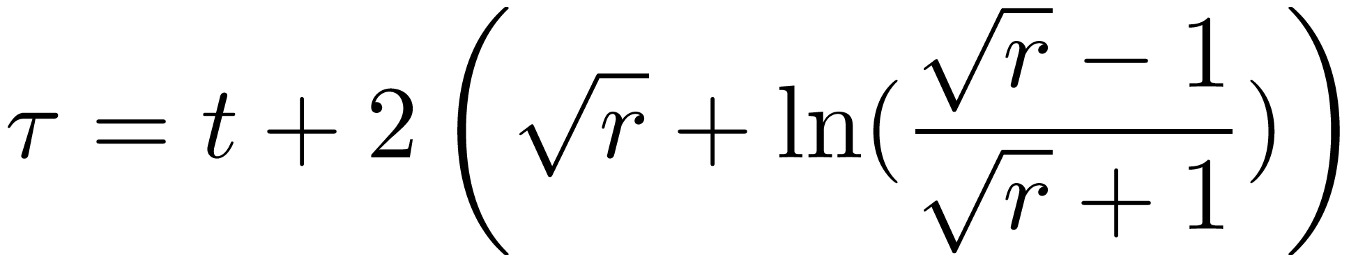
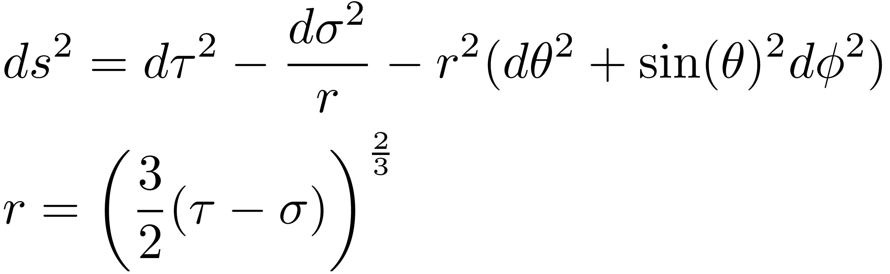
Lemaitre
The first to realize that Schw Horizon was regular
Very strange coords. Part was Painelevi-Gulstrand.
First to show they were coord. trans. of Schwarz. (Suspected
by Einstein in ‘23). Second part was proper time along
const to match to dust universe.

Slide 3
World Atom (I hate it because it gives entirely wrong
image of birth of universe) The whole universe as a
quantum system.
Is there a limit to QM? Is Macroscopic different from
Microscopic-- classical vs quantum?
Belief vs experiment. How do we show that that there is
no such difference?
Many have argued the opposite. Bohm, Leggett, Penrose,
Oppenheim,...

Slide 4
Since invention of QM, there has been conflict as to whether
there are limits to Quantum Mechanics?
Not helped by Bohr’s discussion of measurement in which
measurement made by coupling a quantum system to a
macroscopic classical system, where “Measurement” has
a well accepted meaning (values exist even if not measured
Measurement simply reveal those pre-existing values.)
Is there a limit to the validity of Quantum Mechanics?
Many otherwise very good physicists have taken the position
that there is.

Slide 5
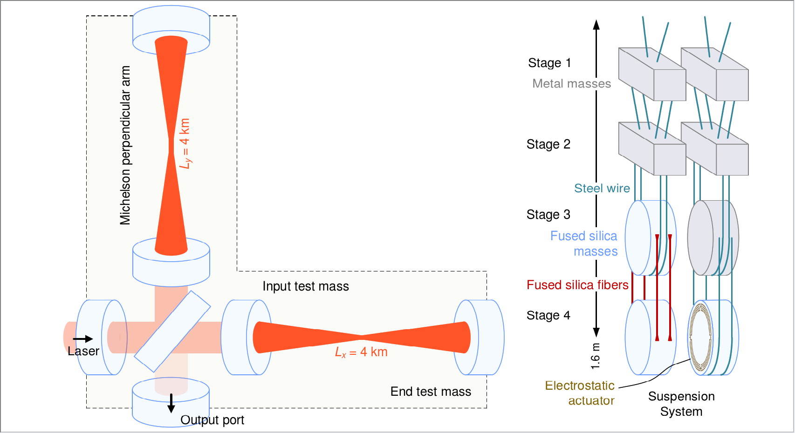

LIGO (Laser Interferometer gravity wave observatory)
Huge system-- 4 km long, masses of mirrors 40Kg
Energy of laser beam: ~1MW (10⁻¹¹ kg/s)

Slide 6
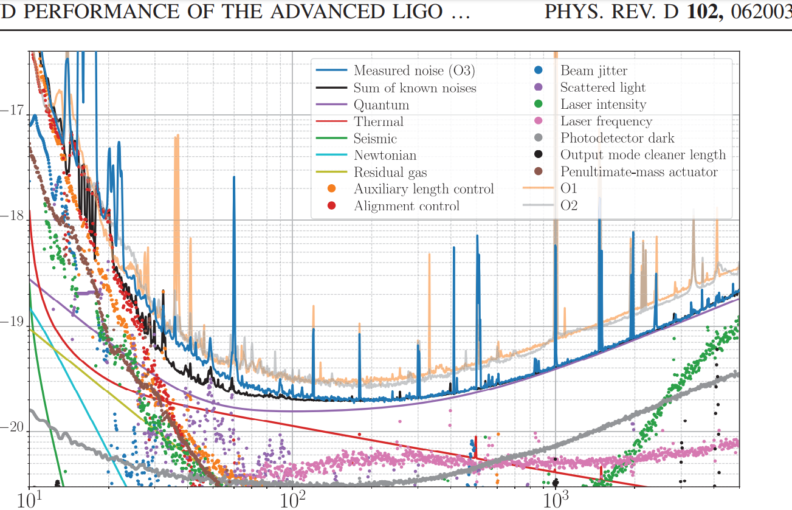
LIGO Noise Budget

Slide 7
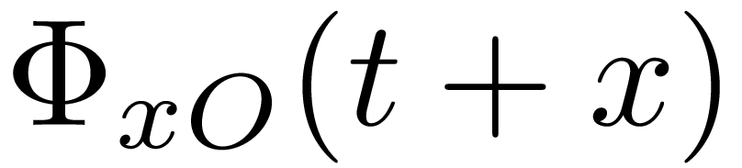
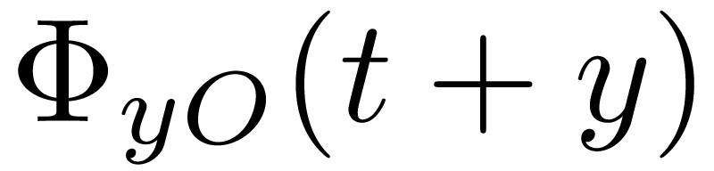
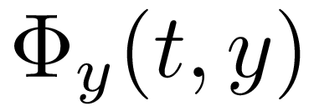
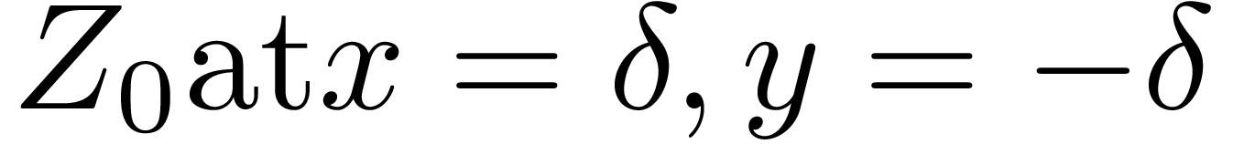
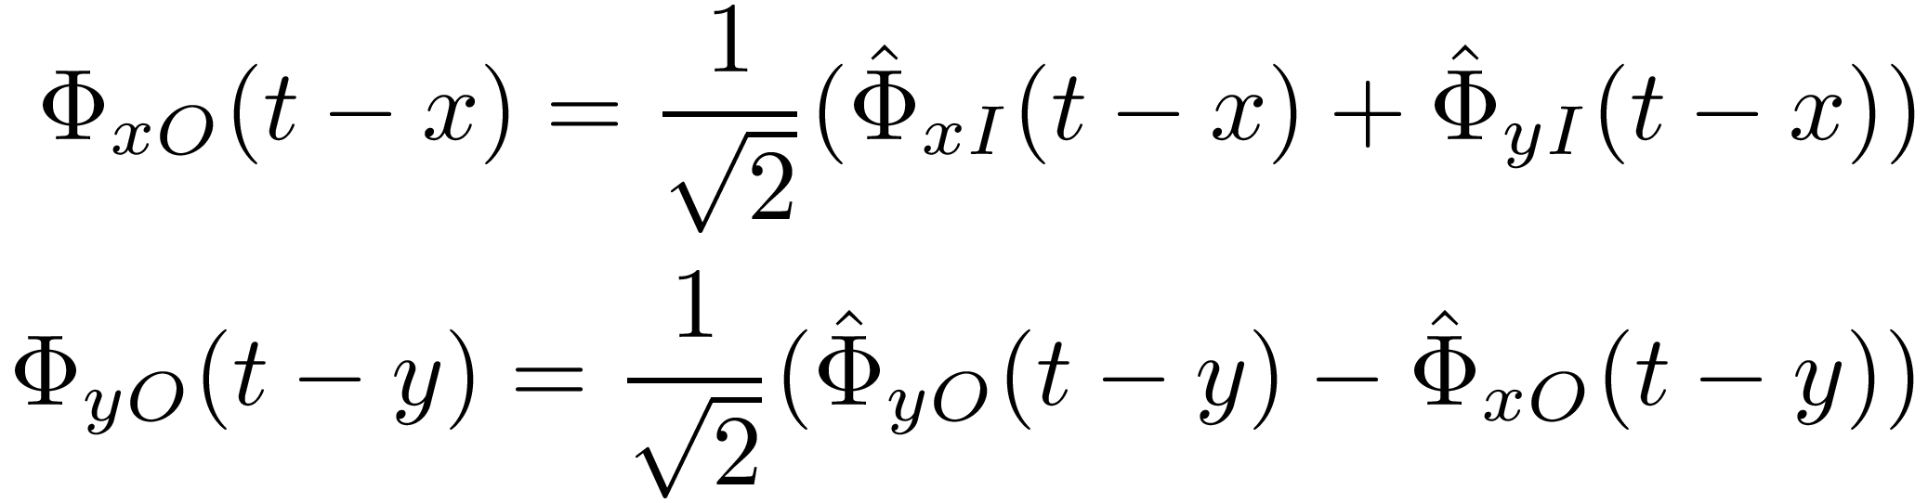
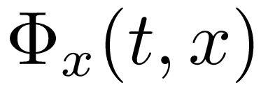
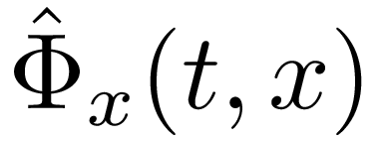
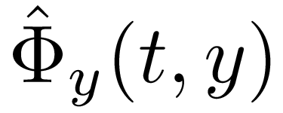
Quantum noise is dominant noise source.
Does not mean that mirror CM are quantum objects.
Simplifed Model
Free Mirror
y
Z
Beam Splitter
x-->

Slide 8
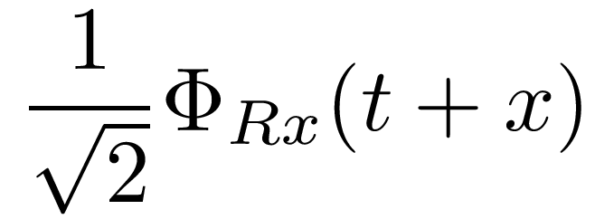
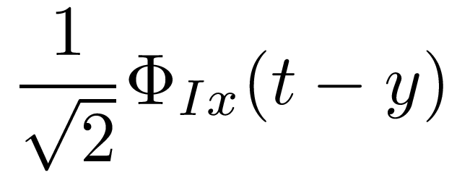
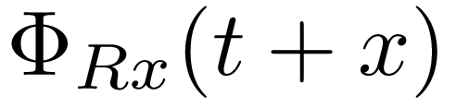
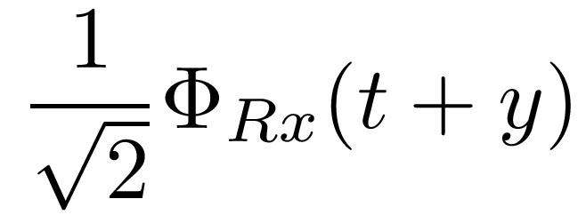
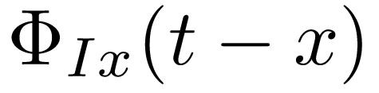
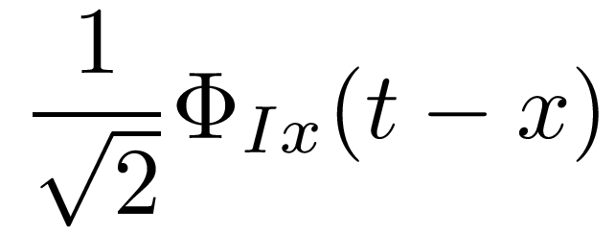
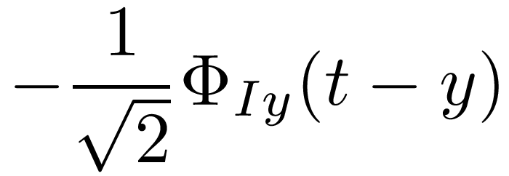
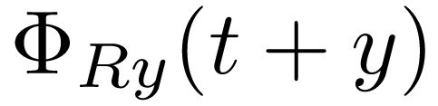
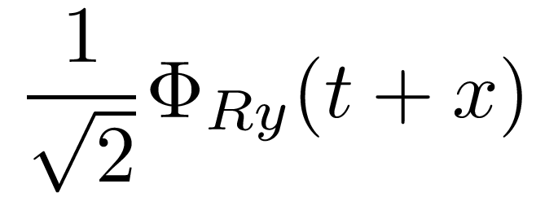
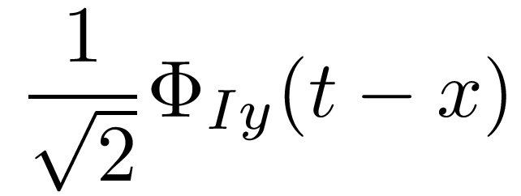
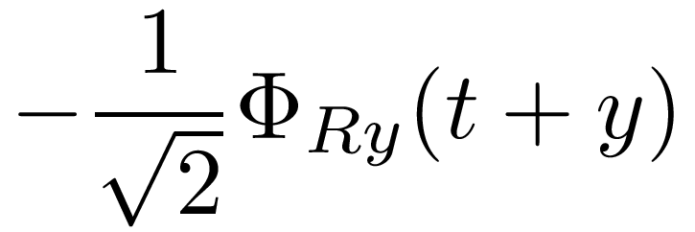
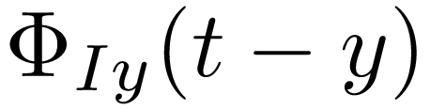
Beam Splitter

Slide 9
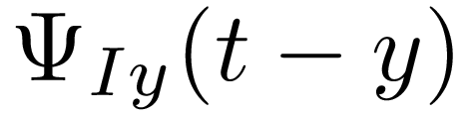
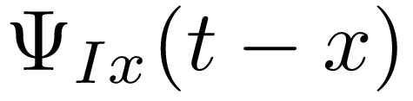
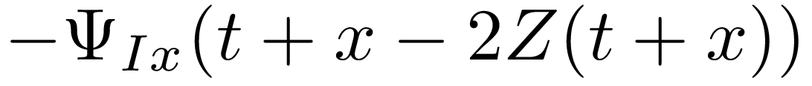
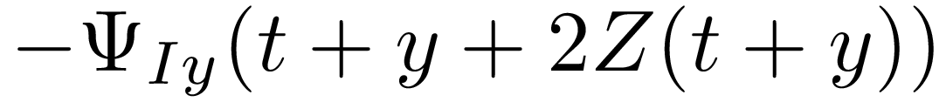

Mirror
Z
Should be t+x-2Z(t+x-2Z)
At mirror
is zero.
Z occurs in phase of reflected beam.

Slide 10
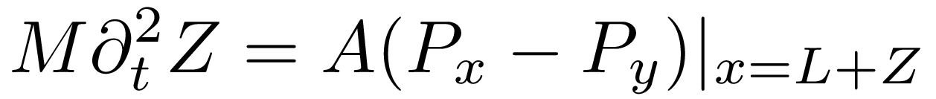
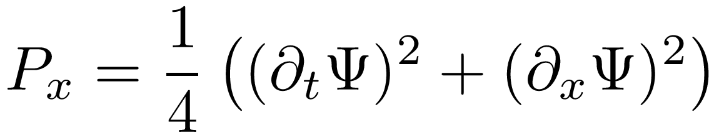
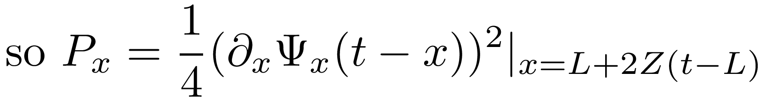
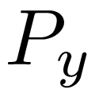
Motion of Mirror
A is the beam area
P is radiation pressure of beam on mirror.
and similarly for

Slide 11
Detection
At detection, Light falls onto a Photodiode
Photodiode detects number of photons in the beam
Photocurrent in diode measures the flux of photons

Slide 12
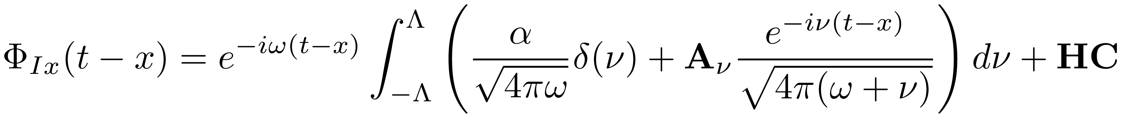
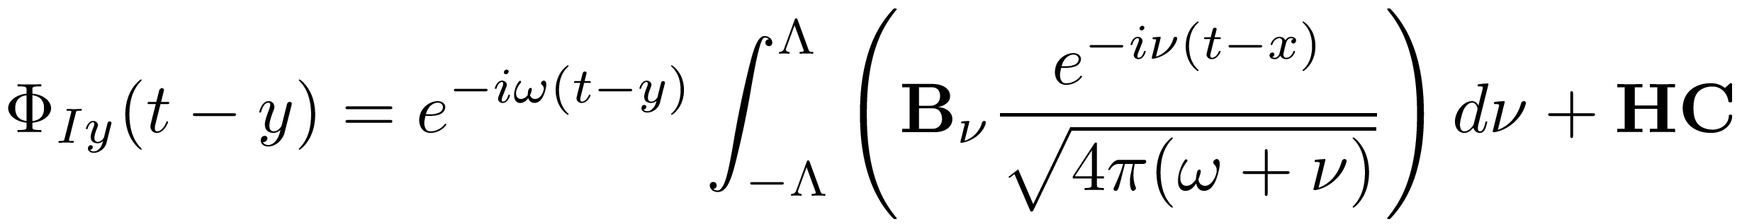
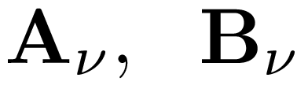

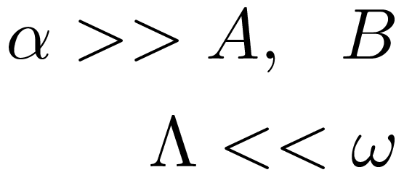
“Coherent State”
Incoming EM field
are annihilation operators at frequency
Assume

Slide 13
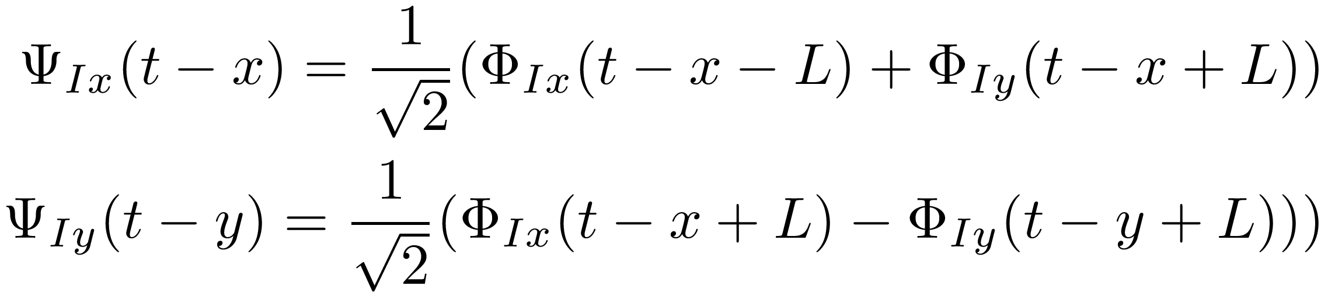
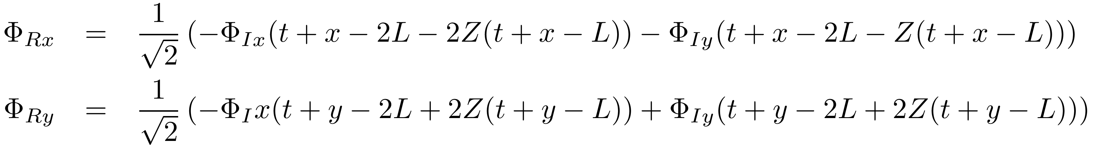
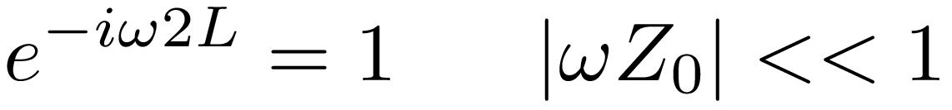
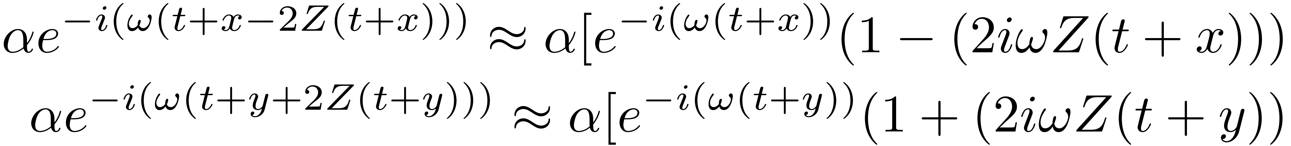
and
Now choose
Then

Slide 14
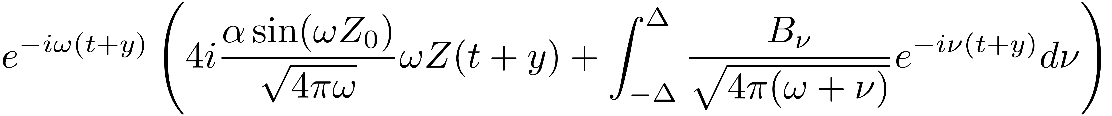
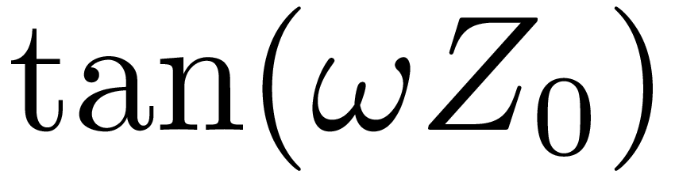
Output out the y (B) port.
The quantum noise comes from the B operators ( coming into
the dark port (ie the one which is NOT where the laser comes
in). (Caves 1980). The noise from the laser port is suppressed
by

Slide 15
The B in that formula comes from the direct reflection of the
incoming beams from the mirror.
However there is an additional source of noise. Namely due
to the Radiation pressure on the mirrors. The radiation
pressure on the mirrors due to and A are symmetric on the
mirror, and thus exert the same pressure on the x side as on
the y side and cancel in their effect on the mirror.
However the radiation pressure due to the B noise is, to
lowest order, of opposite sign on the two sides of the mirror.
They do not cancel.

Slide 16
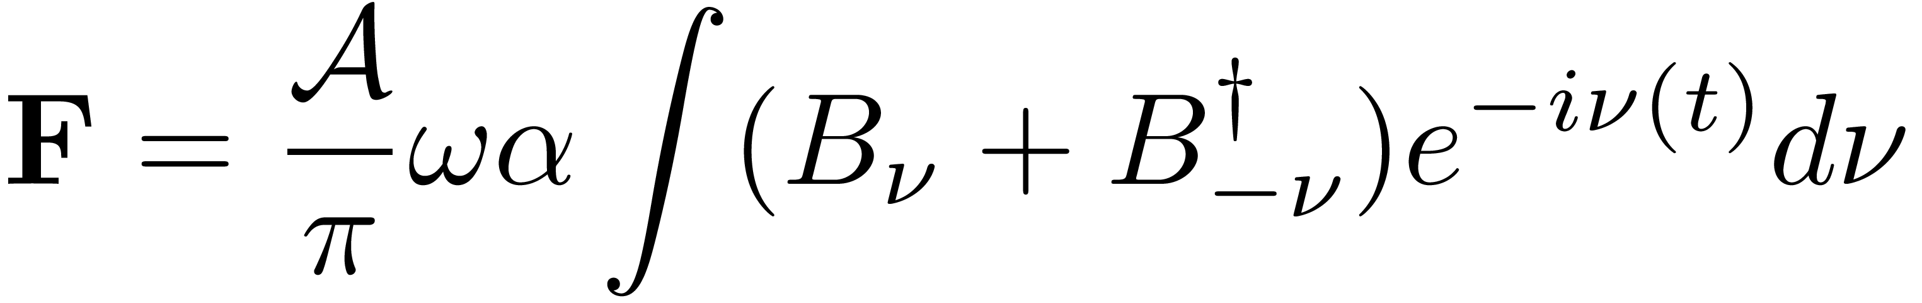
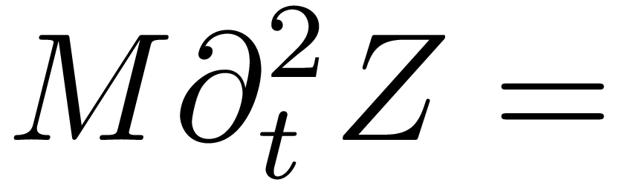
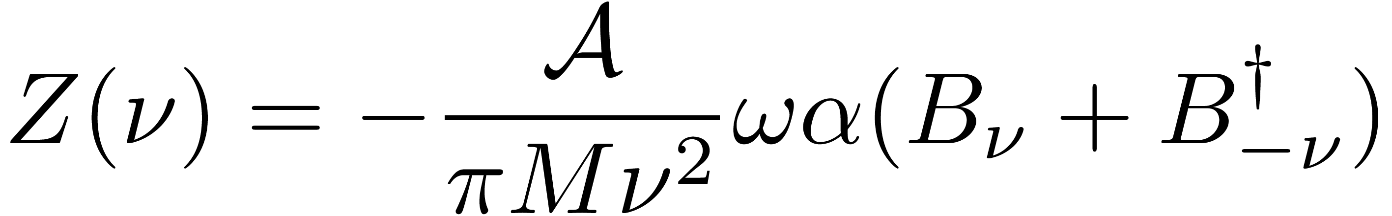
The force on the mirror is thus given by
The equation of motion of the mirror (I will approximate it as
a free particle, rather than an oscillator, since the restoring
force is small and the resonant frequency is much less than
the frequencies of interest (about 3Hz rather than 40-1000 Hz)

Slide 17
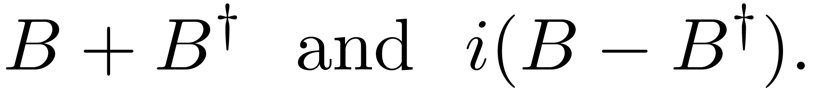

The motion of the mirror due to the quantum nature of the light
dies off with frequency . It also dies off with the mass of the
mirror, and increases with the amplitude of the laser light on
the mirror.
One thus, at a given frequency, one has two sources of
quantum noise due to the quantum fluctuations coming in to
the dark port. One is the direct reflection of the quantum light
from the mirror, and one is due to the motion of the mirror
due to the radiaiton pressure on the mirror. These also have
different phases --
and different frequency dependencies.(
)

Slide 18
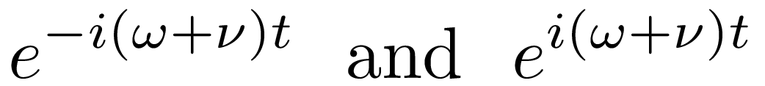
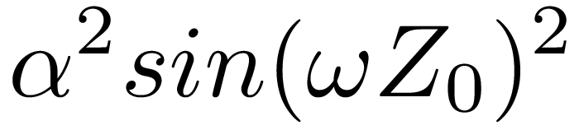
How does the detector detect photons as a function of time?
Hard to model. Glauber argued that it measured some average of the
flux
Ie the normal ordered symplectic flux of the field
(The +,- superscripts refer to the negative and positive freq
of the EM field. )
there will be two terms-- the one prop to the
the other prop. to terms linear in B

Slide 19
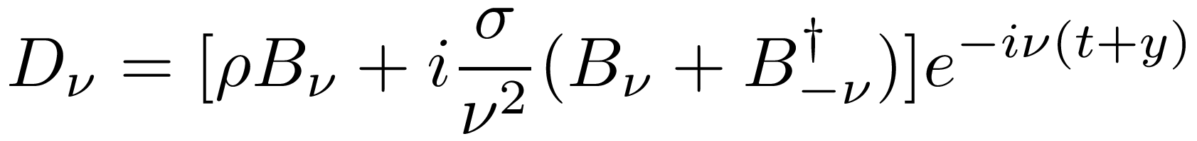
That other term will have the form of
where rho and sigma are complex constants which depend on
the amplitude of the incoming flux, the Mass of the mirror,
the freq of the light, etc. For Ligo, the two terms have equal
magnitude around 50 Hz.
Ie the outgoing flux will that of a two mode squeezed state.

Slide 20
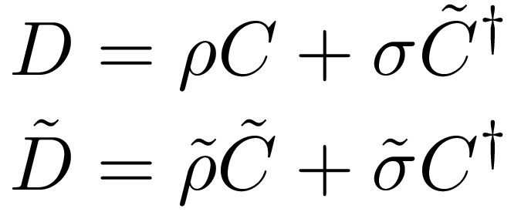


Two mode sqeezed states
commutation relations
Amplifier
Ligo acts as an amplifier of noise.

Slide 21

Radiation noise and shot noise are approx equal in the 50-100 Hz
band.
Note that they simply add to each other. If instead of feeding in
a vacuum state into the B port , one feeds in the vacuum for D
(Ie a two mode squeezed state
one will reduce the noise to vacuum noise.
One can reduce it even further for a single phase by doing a
further single mode squeezing. Eg for single mode
One can make the noise arb. small for a given phase

Slide 22

Ie, one can make the shot noise and the rad pressue noise
interfere destructively with each other.
Ligo test about 2 years ago now. (theory 1979-1983)

Slide 23
Quantum Interference.
What if the mirrors were classical?
The shot noise would not change since it is due to purely
specular deflection by the mass. It does not probe any quantum
dynamics of the mirror.
However, the radiation pressure noise would change. It is due to
the response of the mirror to the quantum nature of the light.
How does a classical system respond to a quantum system?

Slide 24
Semiclassical: Mirror responds to expectation-value of the
Quantum force.
But we have seen that to linear order, the quantum force is
proportional to the Operators B and its conjugate.
Their expectation value is 0. Ie, under this theory, if the mirror
were classic, there would be no radiation pressure noise.
Already disproven 20 years ago. It has never been a serious
contender for classicality.
Stochastic Gravity.-- Take into account statistical nature of QM
Jonathan Oppenheim has been exploring classical/quantum
interaction (Gravity classical, matter quantum).

Slide 25



Quantum system exerts forces which are classical but stochastic.
Quantum effect is, when measuring the response of a classical
system, like a stochastic noise.
Response of mirror would be
has the same prob distribution as
(zero mean, Gaussian distr, with same variance as the quantum
operator)

Slide 26


However a quantum operator and a classical one cannot interfer
(cannot cancel)
has same distribution as
while single mode squeezing can reduce the single phase
uncertainty of a quantum operator, so one can use single
mode squeezing to reduce the shot noise or the rad pressure
noise, it cannot reduce the sum of them.
LIGO is Quantum. 40kg mirrors behave as
quantum systems.

Slide 27
2021 Squeezing of input state (Ie, Feeding in noise --2mode
squeezed state – into the “dark port” of interferometer
reduces the noise in the output of the interferometer, as
I predicted in 1979-83)

Slide 28
This has now been implimented in both Hanford and Livingston
and is part of current runs. About 3dB (2) improvement to noise.
The current LIGO depends crucially on the mirrors –40Kg of
silicon di-oxide-- being quantum objects.

Slide 29

Quantum mechanics is the physics of the small.
Well 40Kg is not small.
However the motion of that mirror IS small.
Is that which makes it quantum?
Room for creating a theory which is quantum for small dist.,
but classical for large is shrinking.
Note that if your theory acts in the same way as a quantum
theory for short times, Maybe it could still pass the ligo test.
But it is hard.

Slide 30
Ligo IS Quantum!

