Slide 1
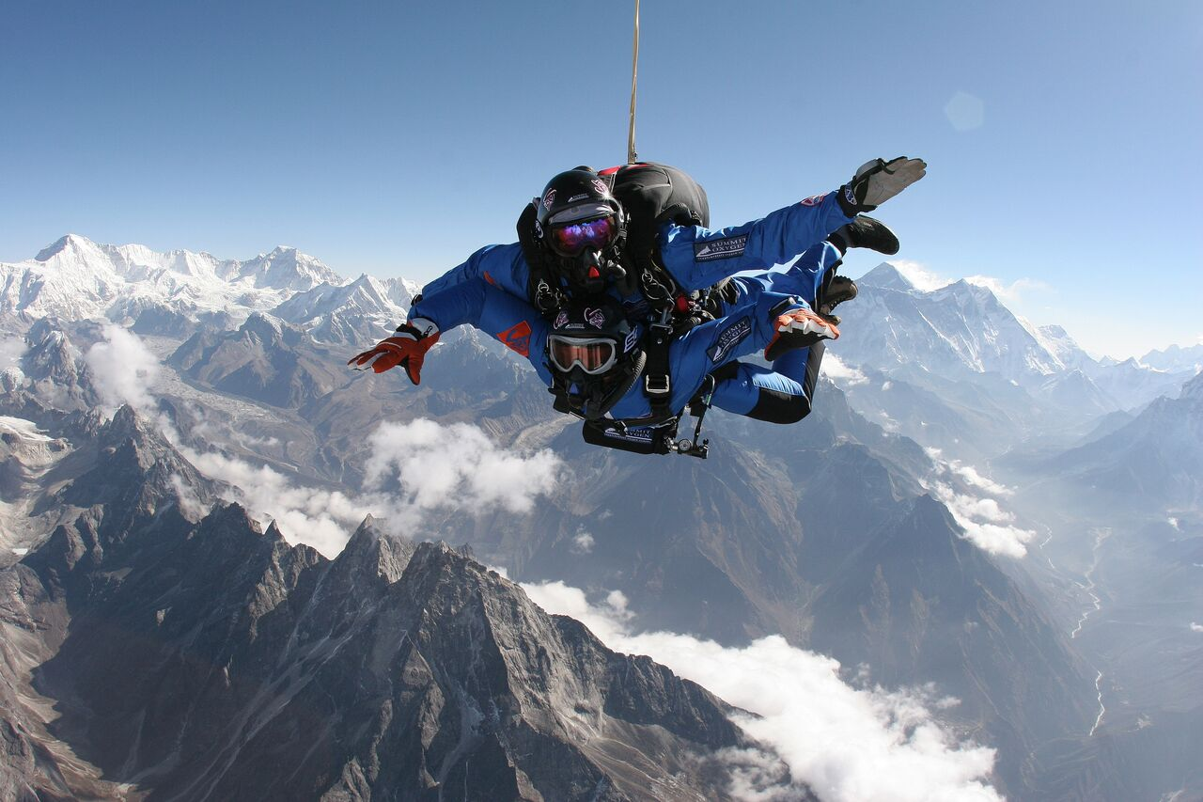

Getting to the top of the mountain
Climb up from the bottom
Parachute in from above

Slide 2
Notable quotes (apologies for twisted words)
It is foggy at the frontiers of knowledge
In science, consensus is the starting point
Cosmology has been stuck on the same path since 1933
1% precision is very hard
1% is really, really hard
We find what we look for
There is no difference between me and an LHC detector

Slide 3
Some themes and questions
Future of cosmology
  Cosmology now involves 1000s of people and billions of dollars: Will we see the commensurate payback? What and when? NB: CMB, Cosmic Acceleration, Dark Matter and Expansion of Universe all cost << 1 billion
  Can someone match Joe’s creative vision for ”nonbaryonic cosmology”?
Still trying to measure H₀ (most important number in cosmology)
  When will we know that we have pinned down H₀ to 1%?
New windows, new ideas
  GWs are amazing and a technological wonder; when do we get a surprise?
  How do connect big ideas with big data?

