Slide 1
BACK TO THE MOON
The future of cosmology
Joseph Silk
15 June 2024
IAP, JHU, Oxford

Slide 2
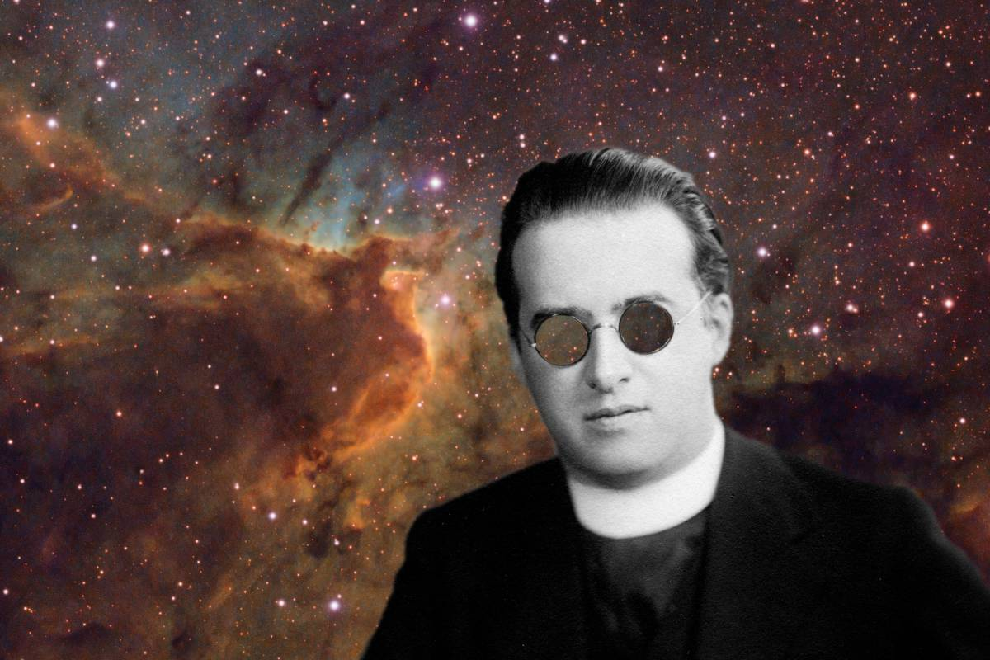
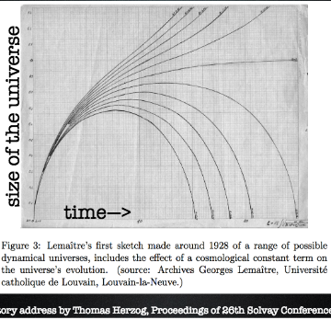
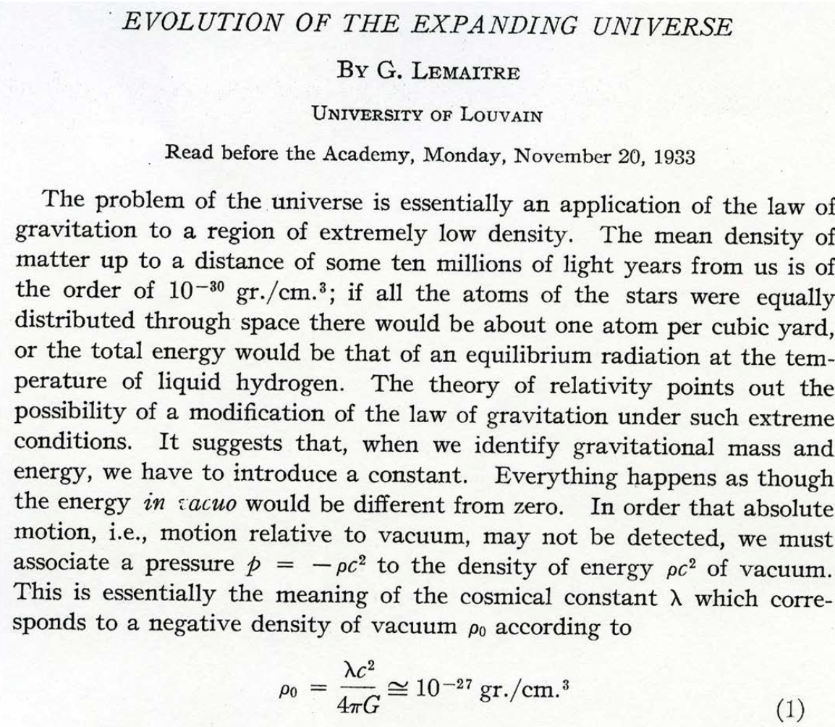
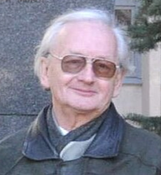
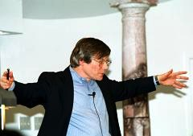
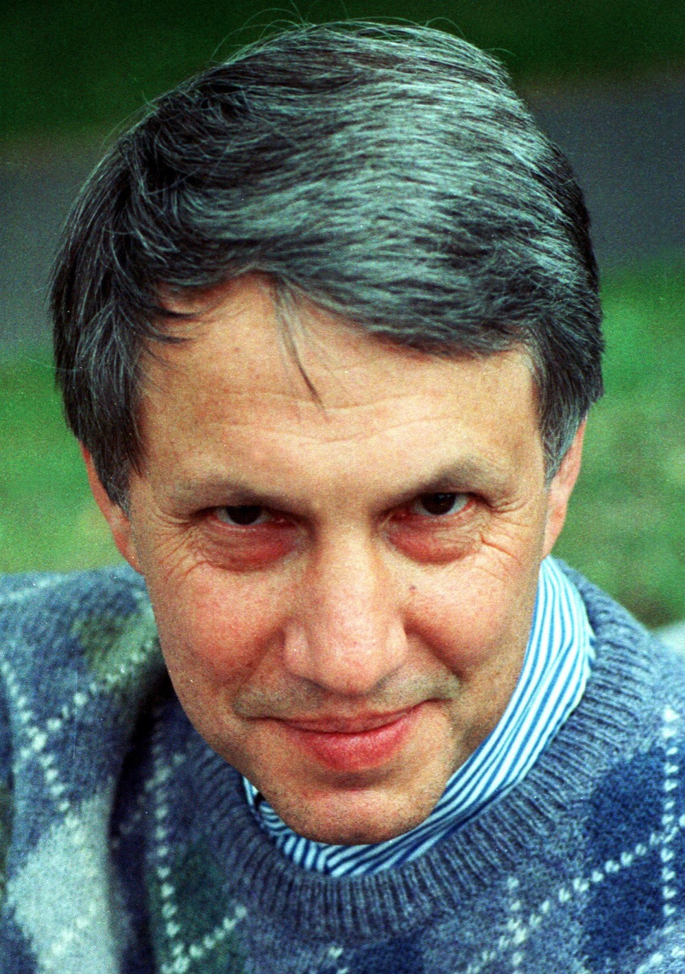
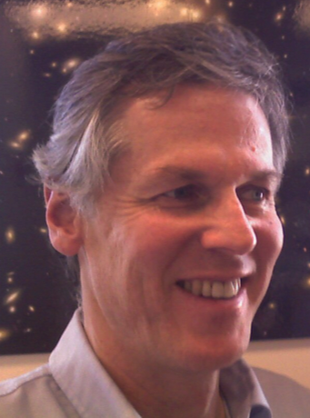
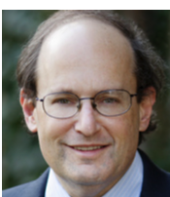
The birth of modern cosmology
Einstein’s Cosmological constant at work
Dark energy
1933
Dark matter
1927
Georges Lemaitre
Alexei Starobinsky
Alan Guth
Inflation was a great success, c. 1980!
Andreas Albrecht
Paul Steinhardt
Andrei Linde

Slide 3
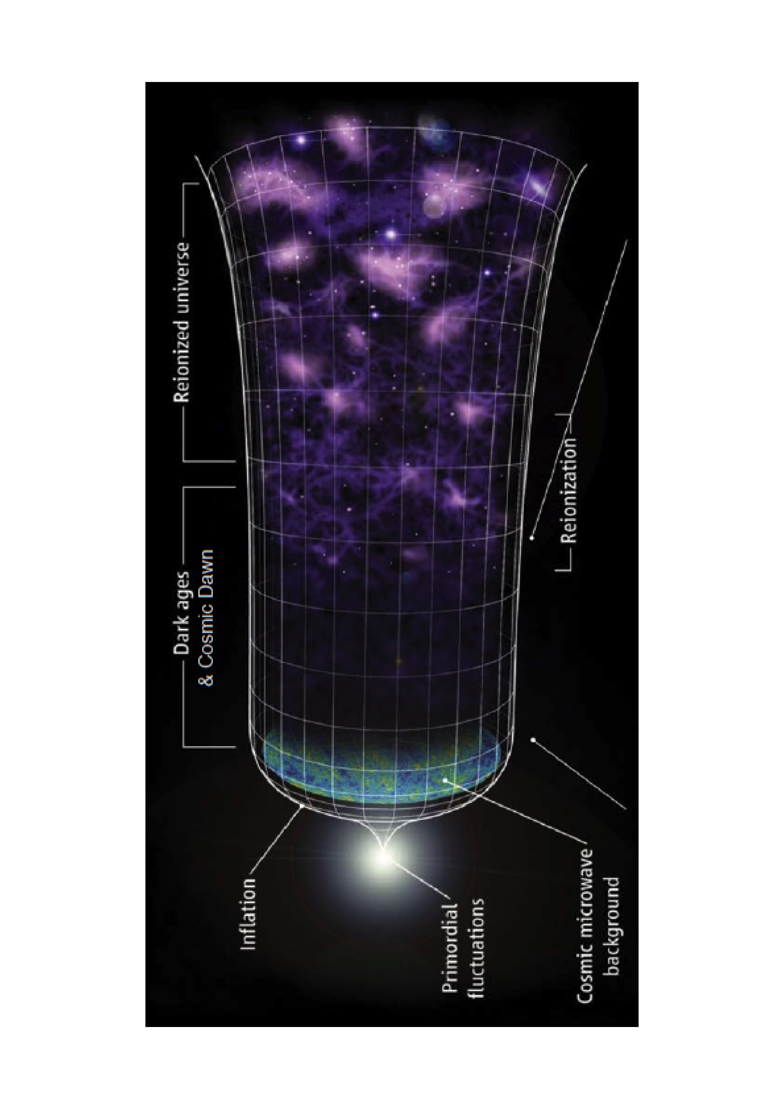
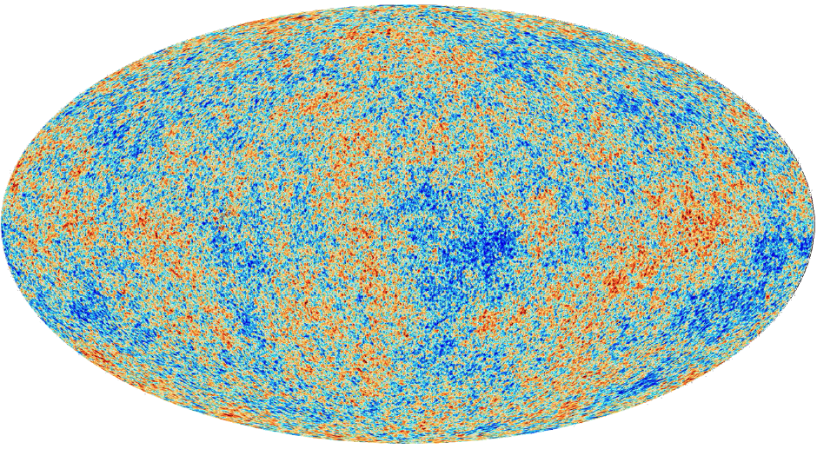
Our biggest questions
?
?
?
Pimentel 2021
Pimentel 2021
Dark
ages?
Are we
alone?
Beginning?

Slide 4
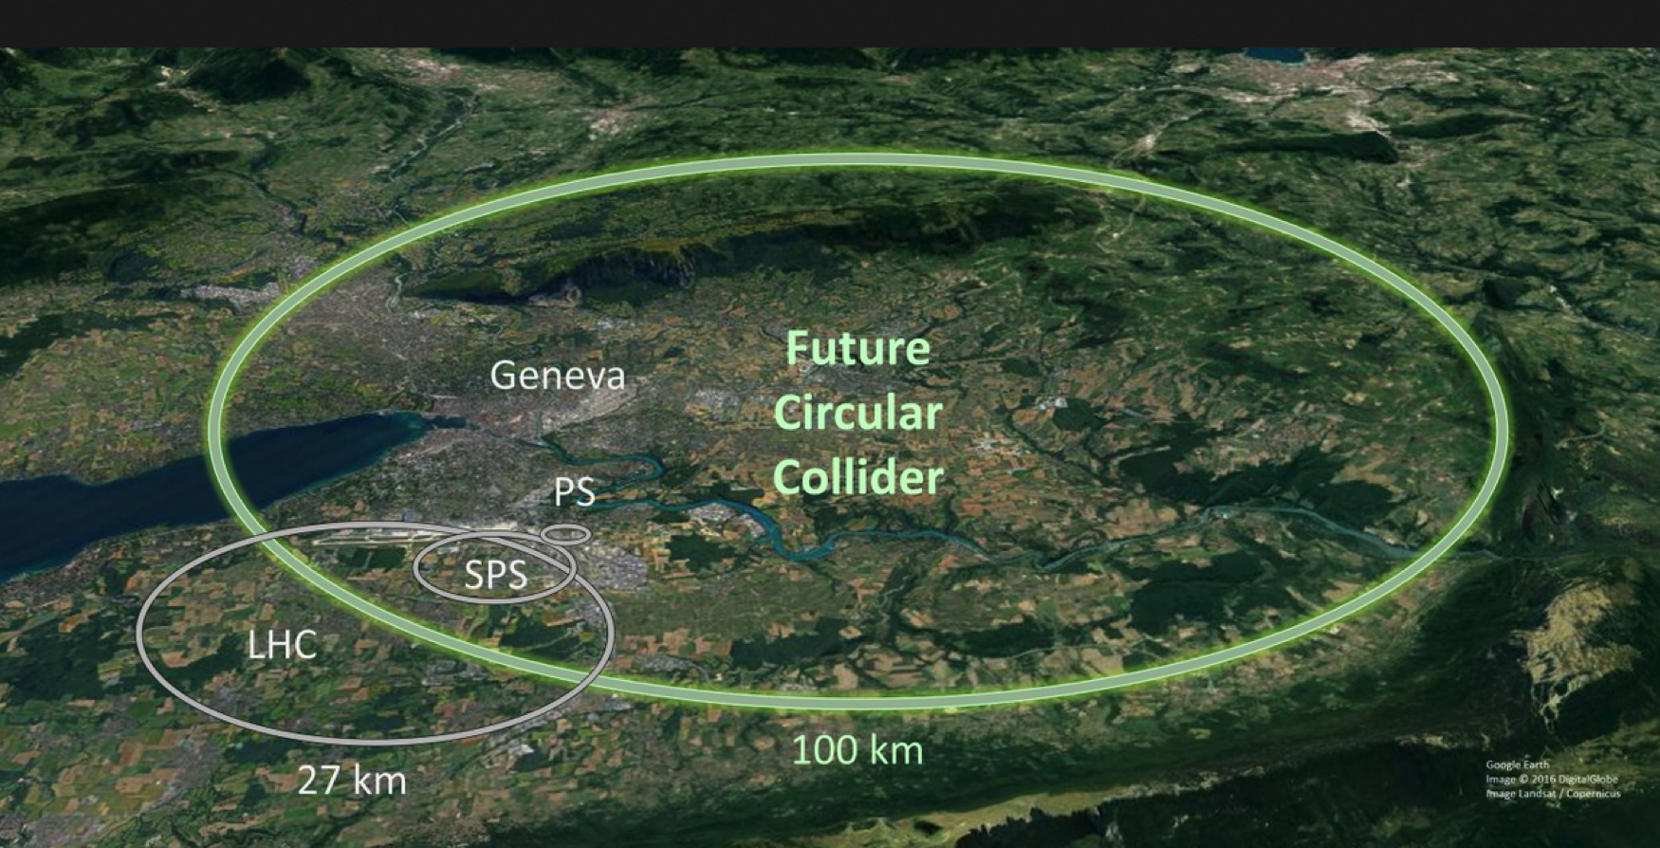
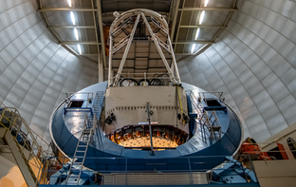
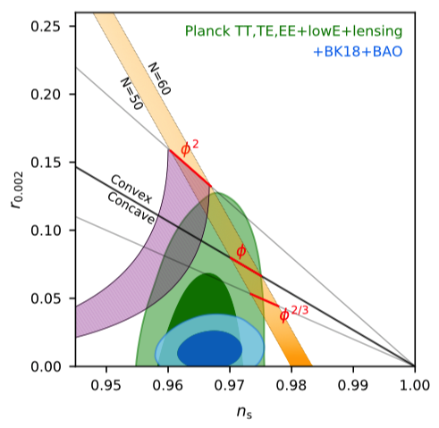
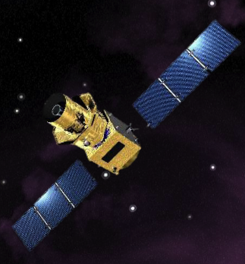
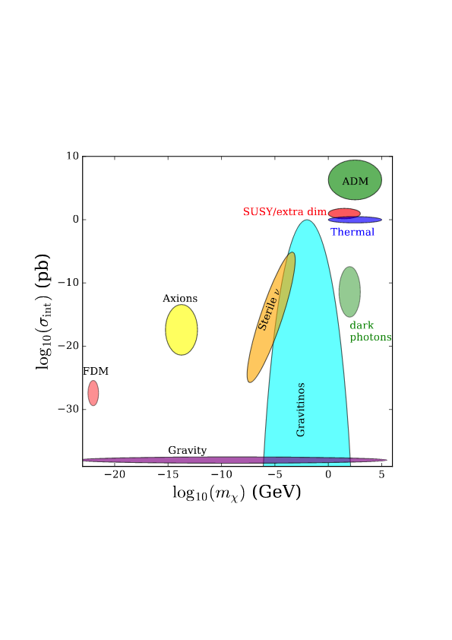
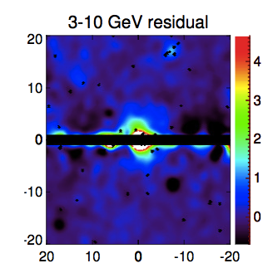
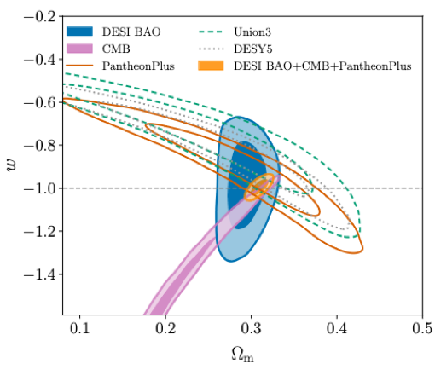
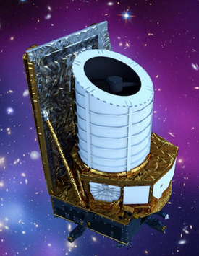
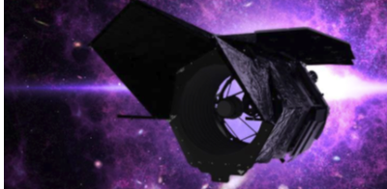
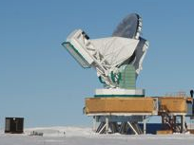
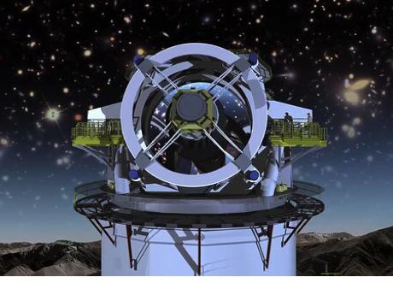
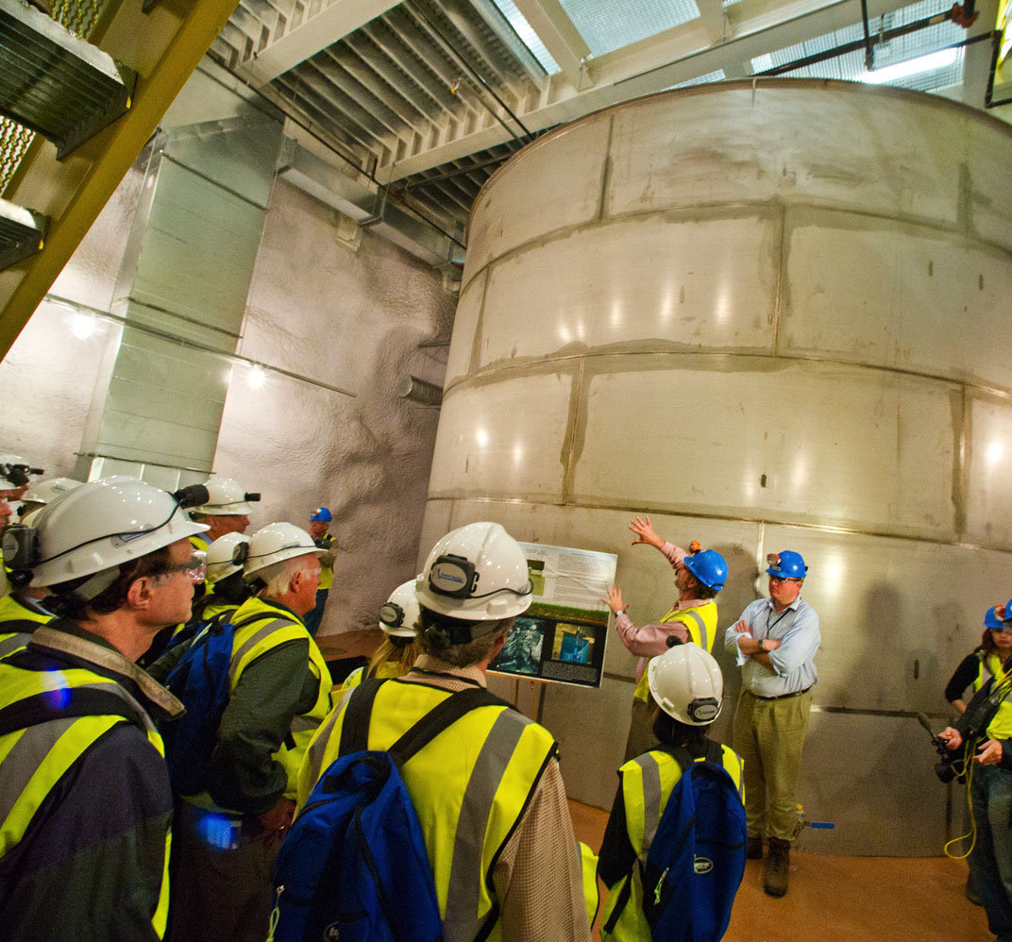
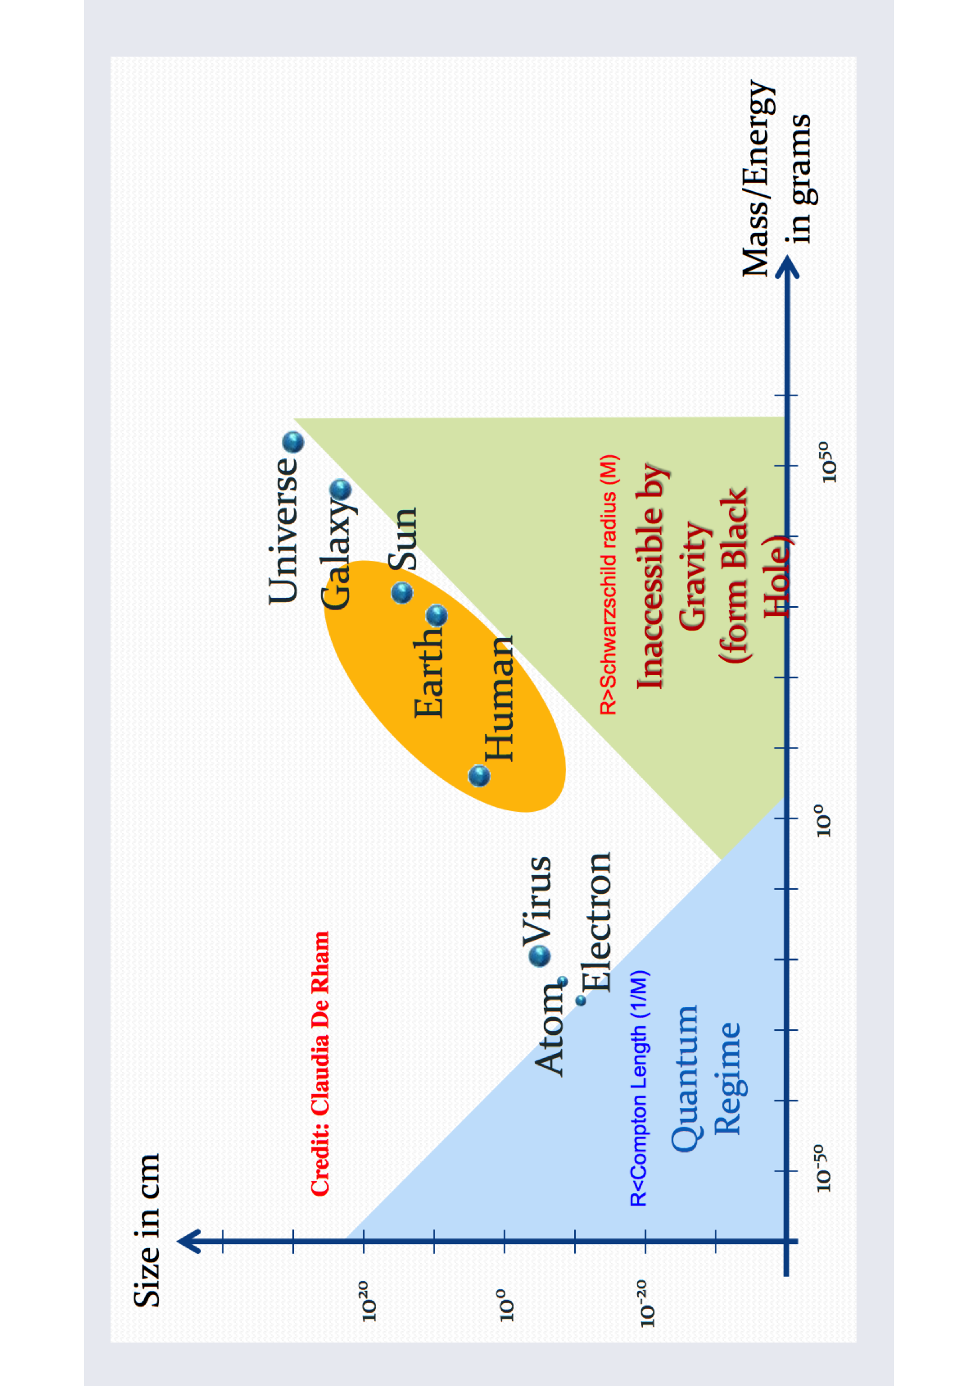
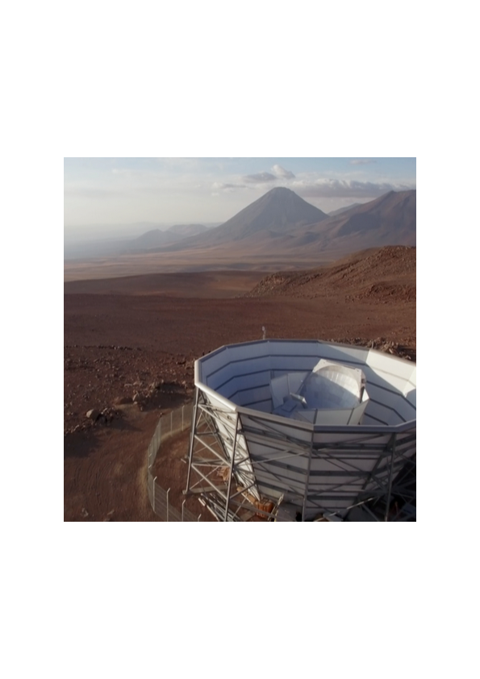
current progress in cosmology
dark energy
DESI
dark matter
seeking SUSY
CMB
w
Euclid
r
LiteBIRD
size
Future 100 TeV collider
Particle cross-section
Fermi GC excess
Roman
Particle mass
modifying gravity
Ω_{m}
Rubin
n_{s}
CMB S4
LZ in Lead , SD
size
Simons Obs
mass
in common for all current or planned experiments:
no guaranteed return!

Slide 5
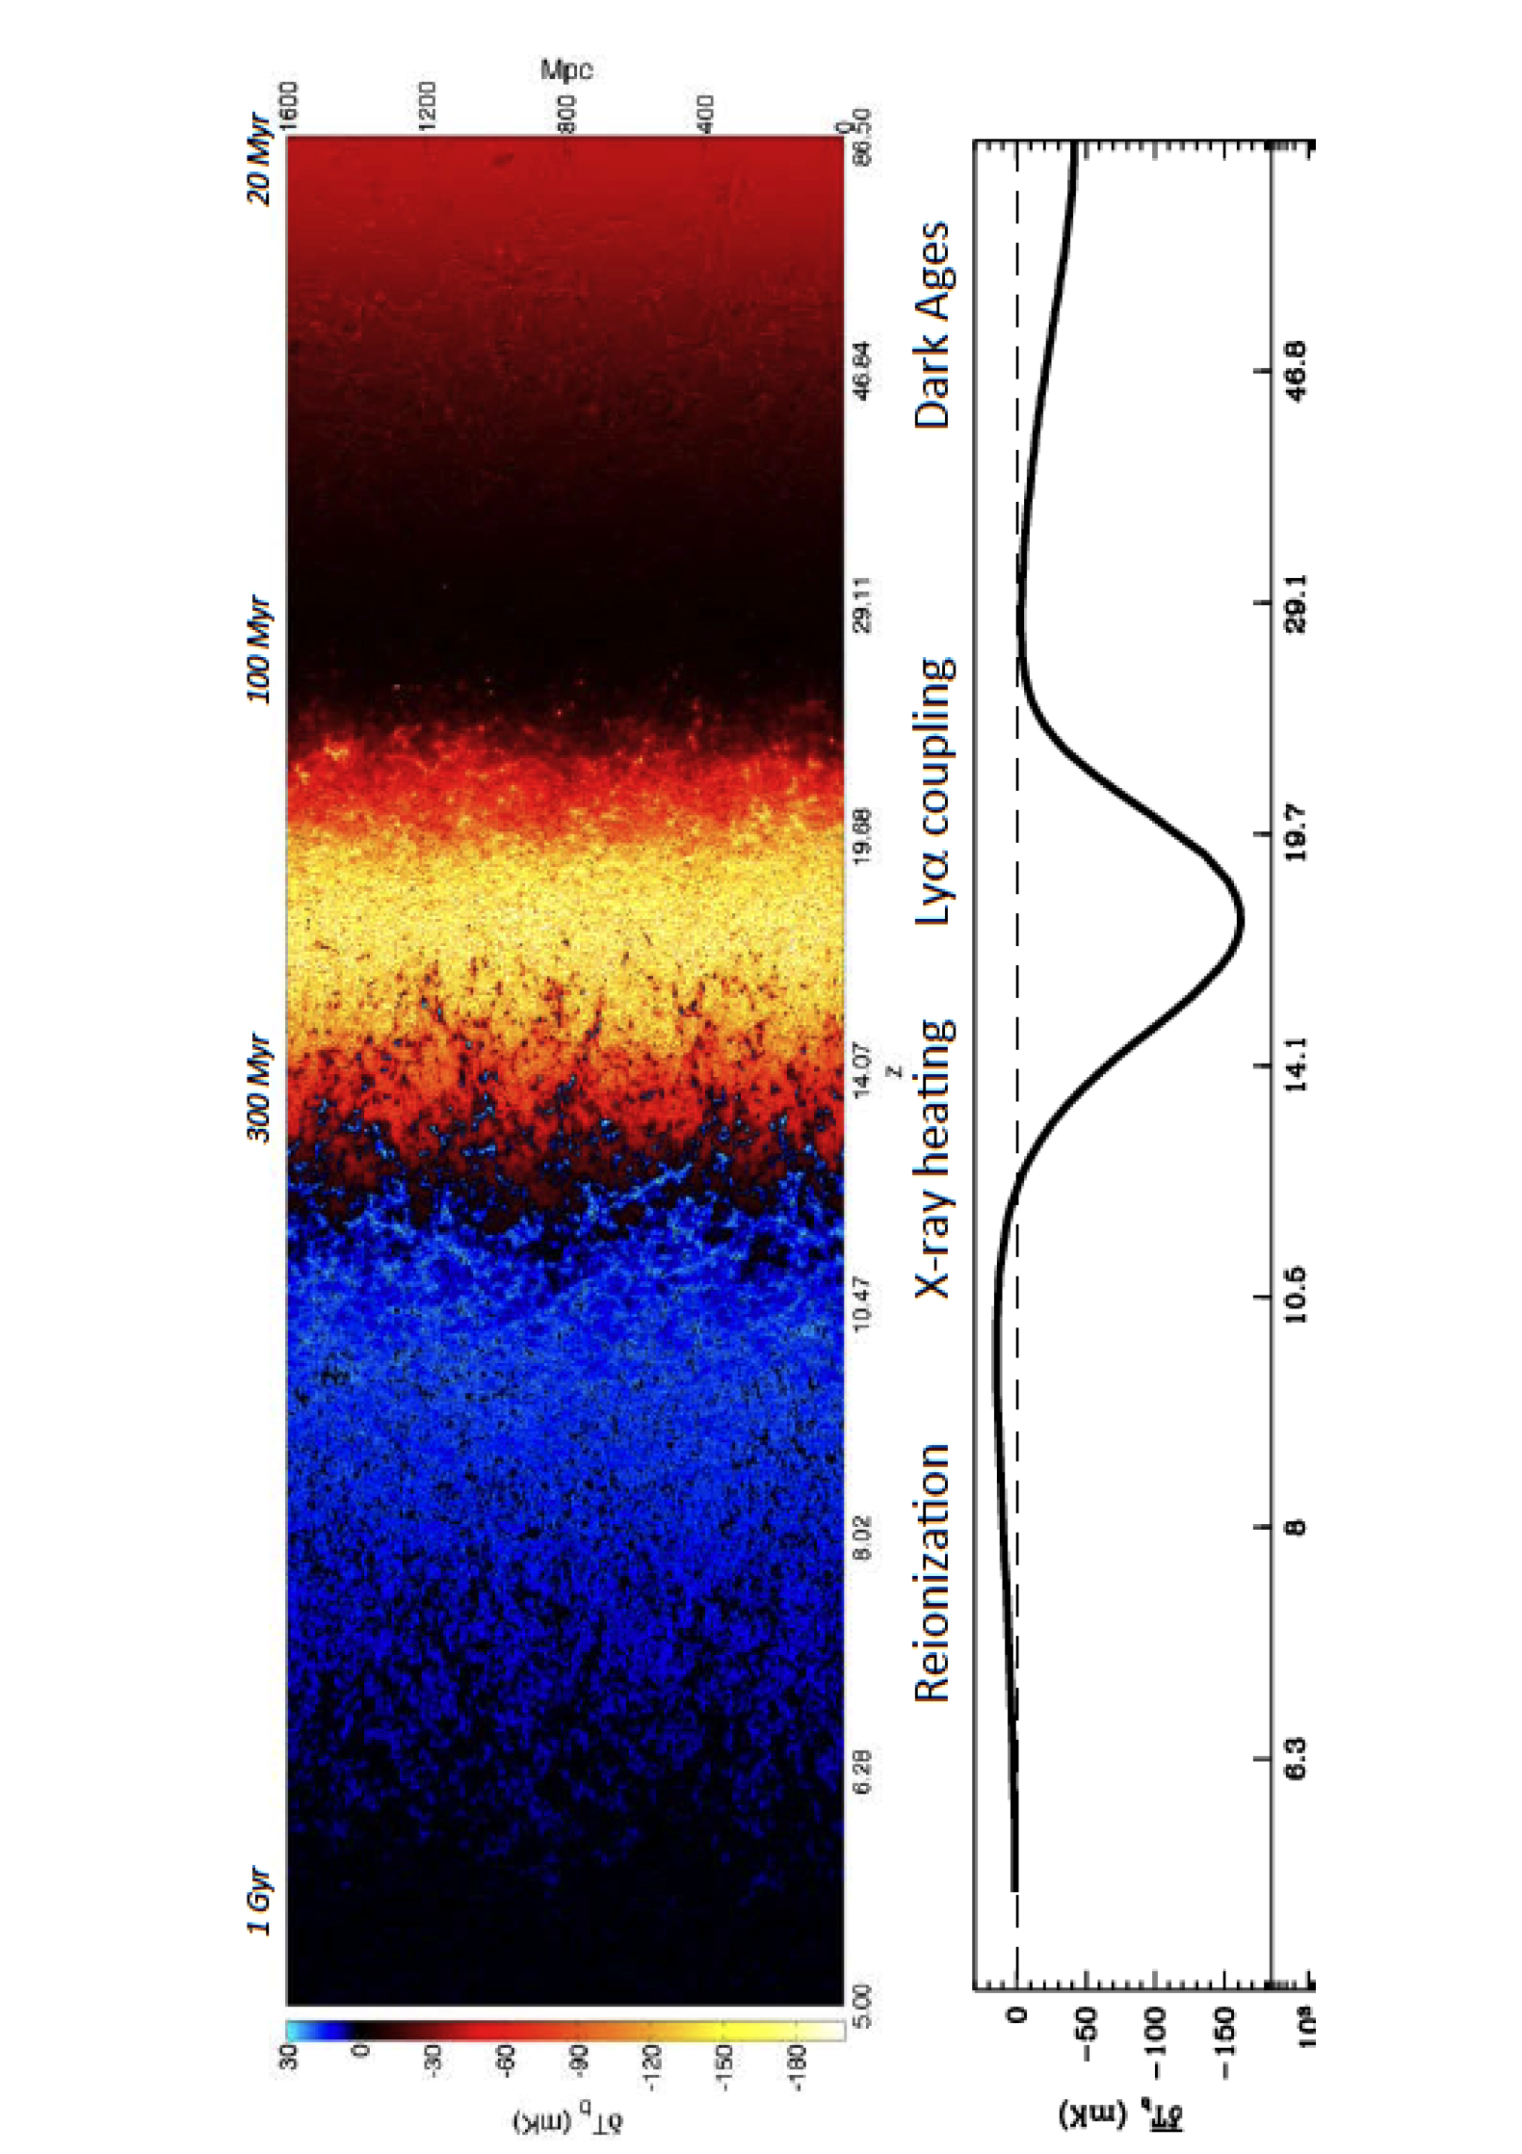
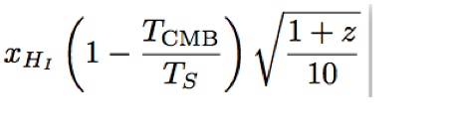
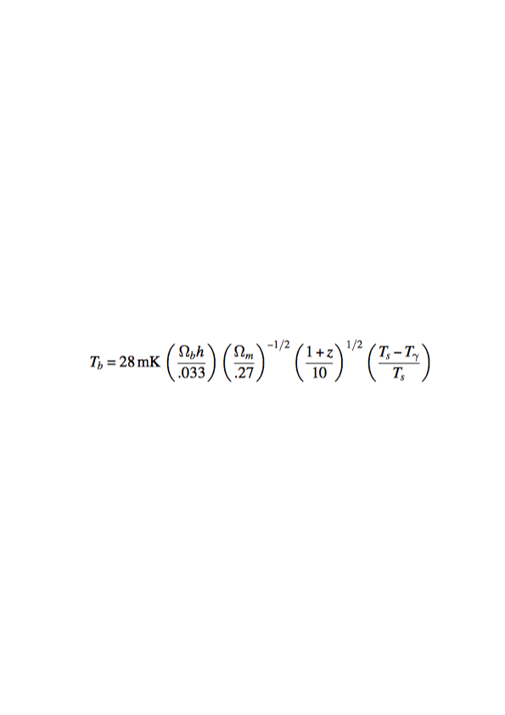
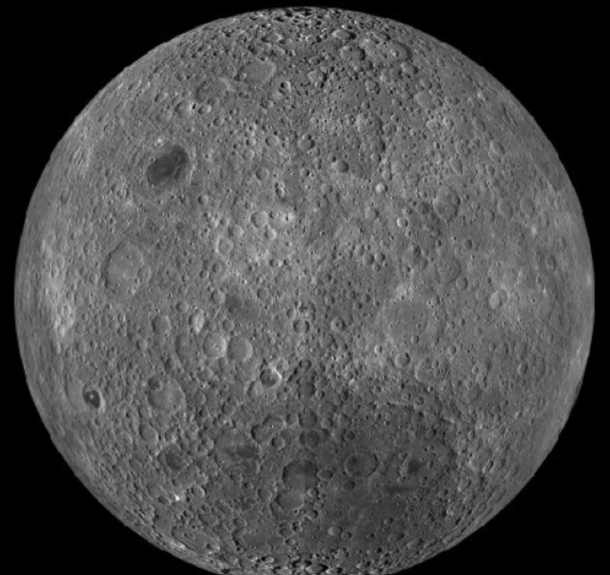
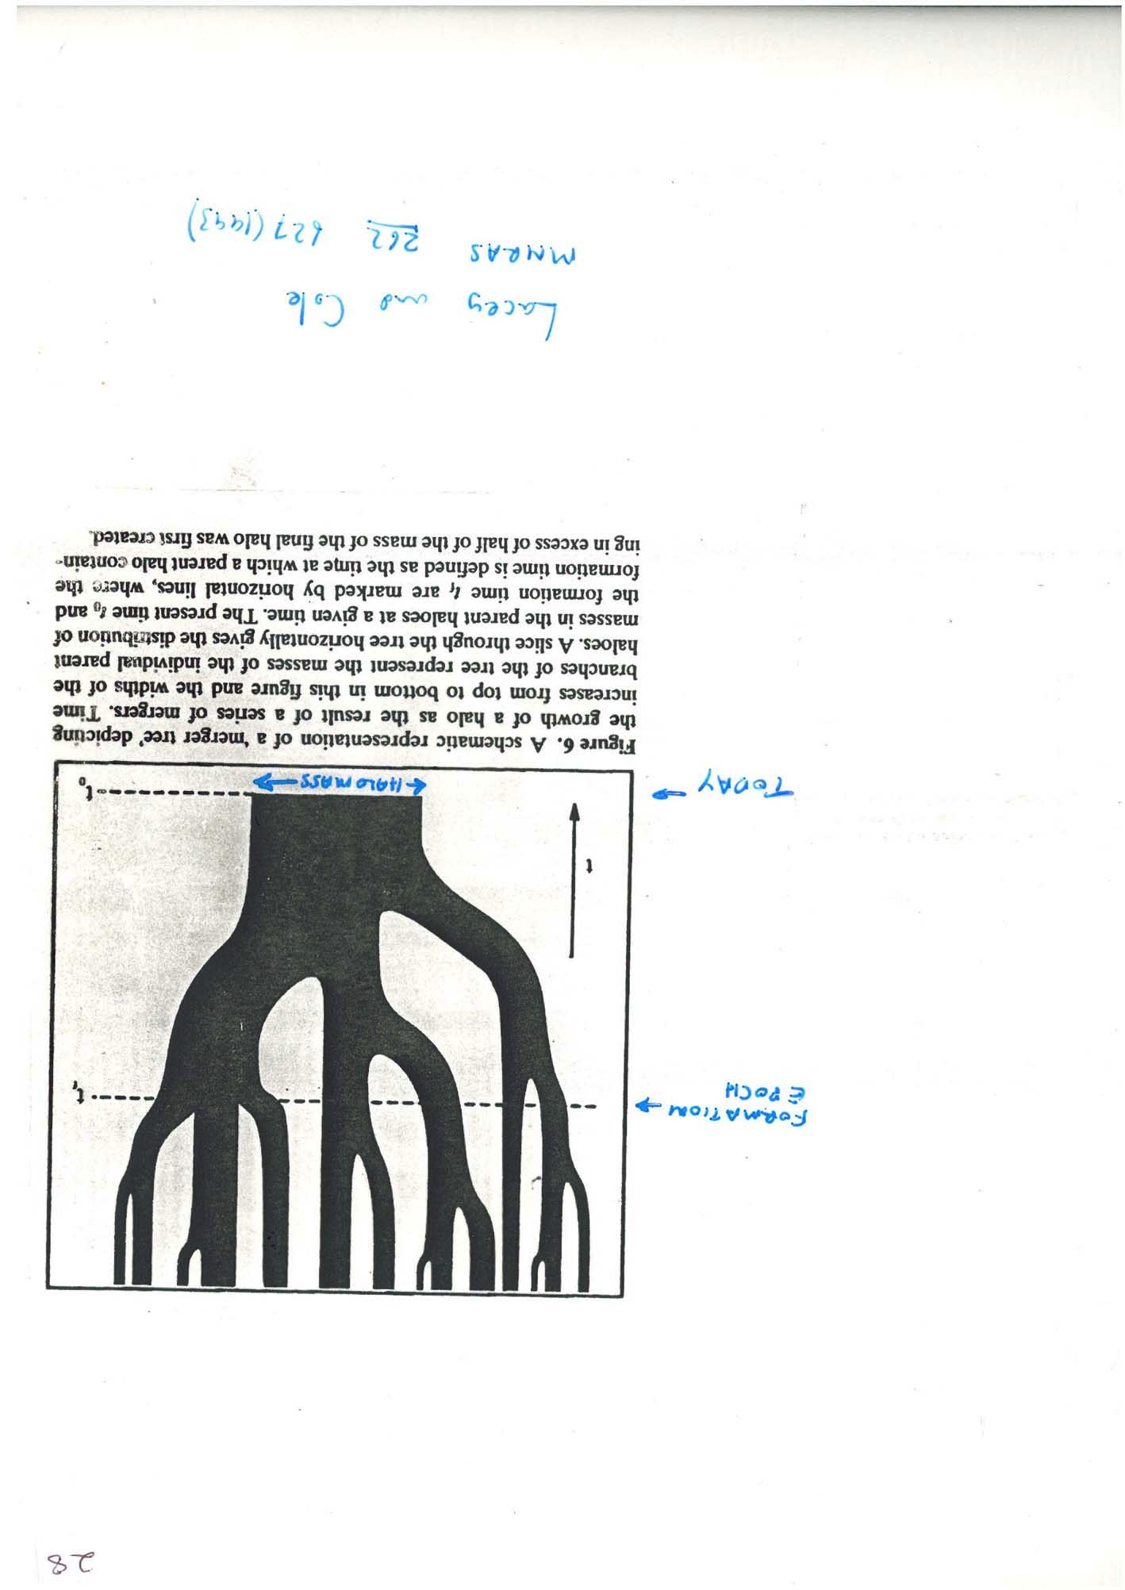
1
Dark ages are new frontier
21cm brightness temperature in mK
ground-based instruments
space-based instruments
+
_-
Where? there’s only one place to go: the far side of the Moon
many clouds, building blocks of galaxies
trillions of modes give ultimate precision
How to unlock this? Information at high z
no ionosphere
no terrestrial radio interference
most radio quiet environment
in inner solar system
Frenk+
Cole + JS 2021

Slide 6
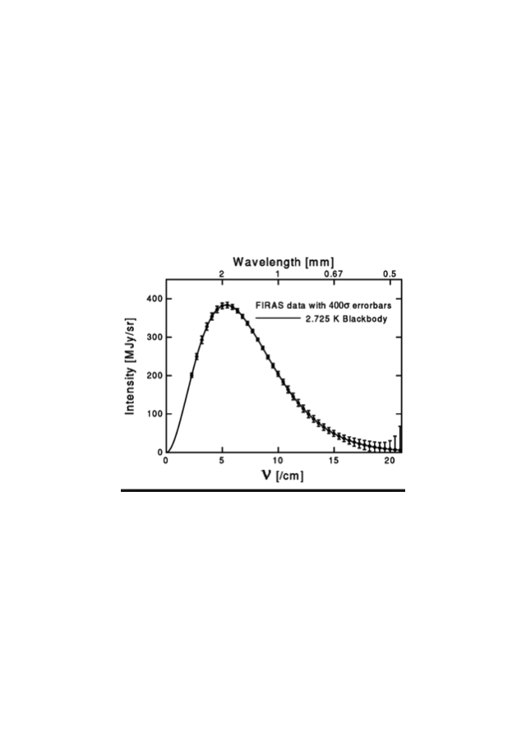
Analogy with the CMB
2018. PLANCK
1990. COBE
First: detection of the dark ages shadow
Next: the fluctuations

Slide 7
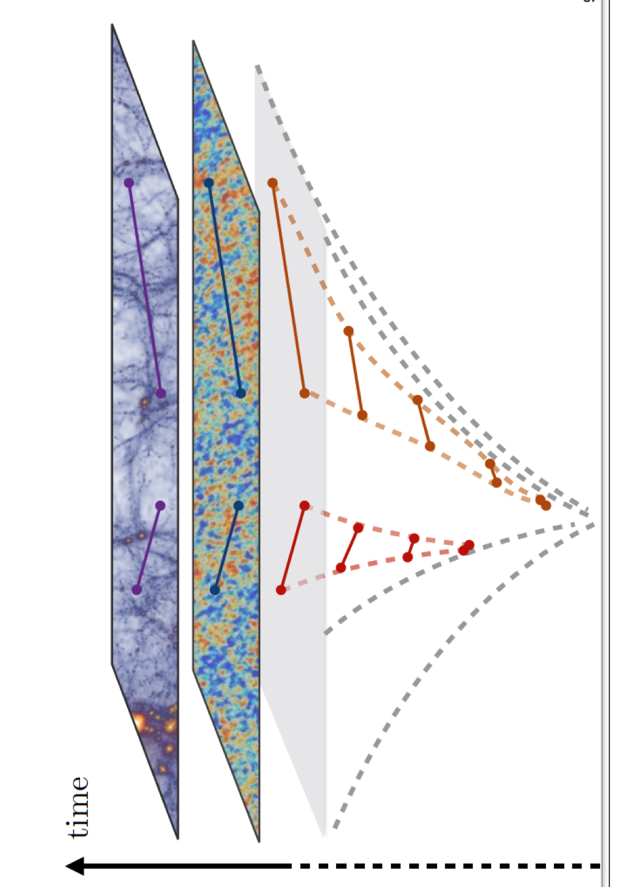
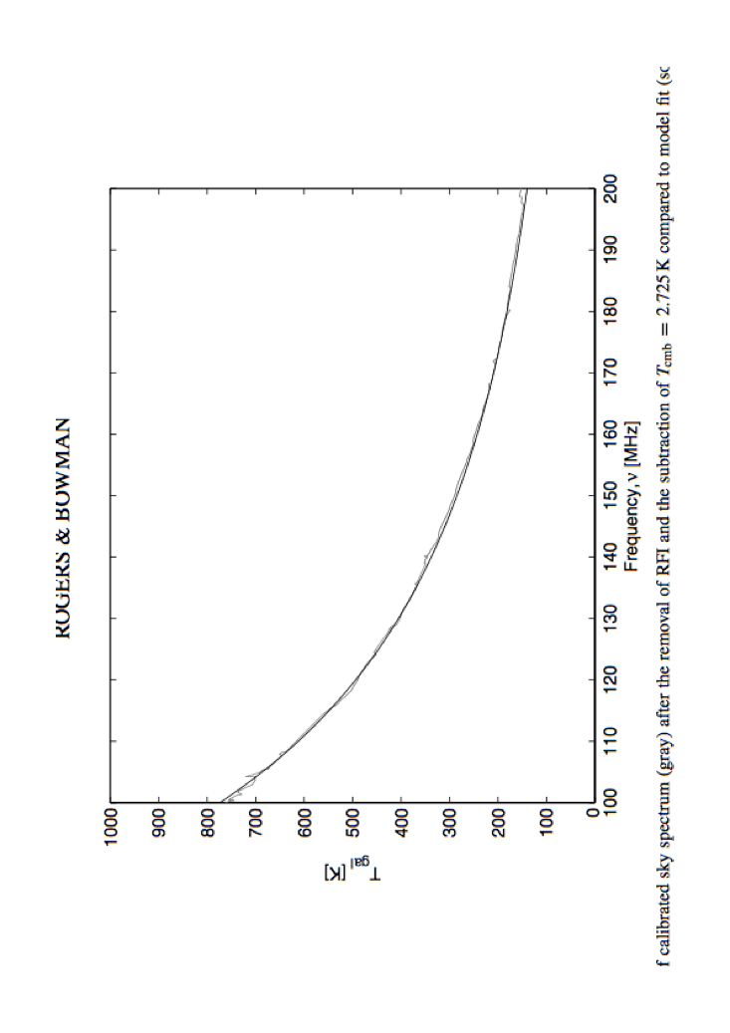
Lunar far side interferometer
baryon
density
δT/T (1+ f_{NL} δT/T)
21cm: probe z=50 at λ~ 10 m or 30MHz
100 x CMB resolution l ~ 10⁵ or k~ 10Mpc⁻¹
Optimal array l λ/2π or D~100 km
Sensitivity: millions of dipoles: ~10⁶
f_{NL} ~ -5/12 (n_{s}-1) ~ 0.01 n_{s}=0.96 (9 σ)
10³ cm⁻³
Maldacena 2003, Cabass + 2017; Mattarese + 2021
N ~ 10⁶
CMB pixels f_{nl}~10
N~ 10⁸
galaxies f_{nl}~1
N~ 10¹²
hydrogen clouds f_{nl}~0.01
10⁻¹ cm⁻³
dark ages 21cm
T~ ν ^{-2.5}
10⁻⁵ cm⁻³
10km/s
Halo velocity dispersion
10mK signal in
1000K foreground
Test inflation via primordial nongaussianity:
ultimate precision cosmology
wedge
Rogers and Bowman 2008

Slide 8
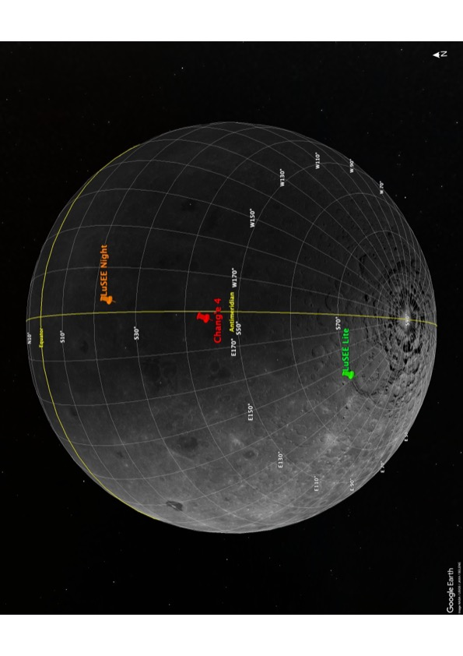
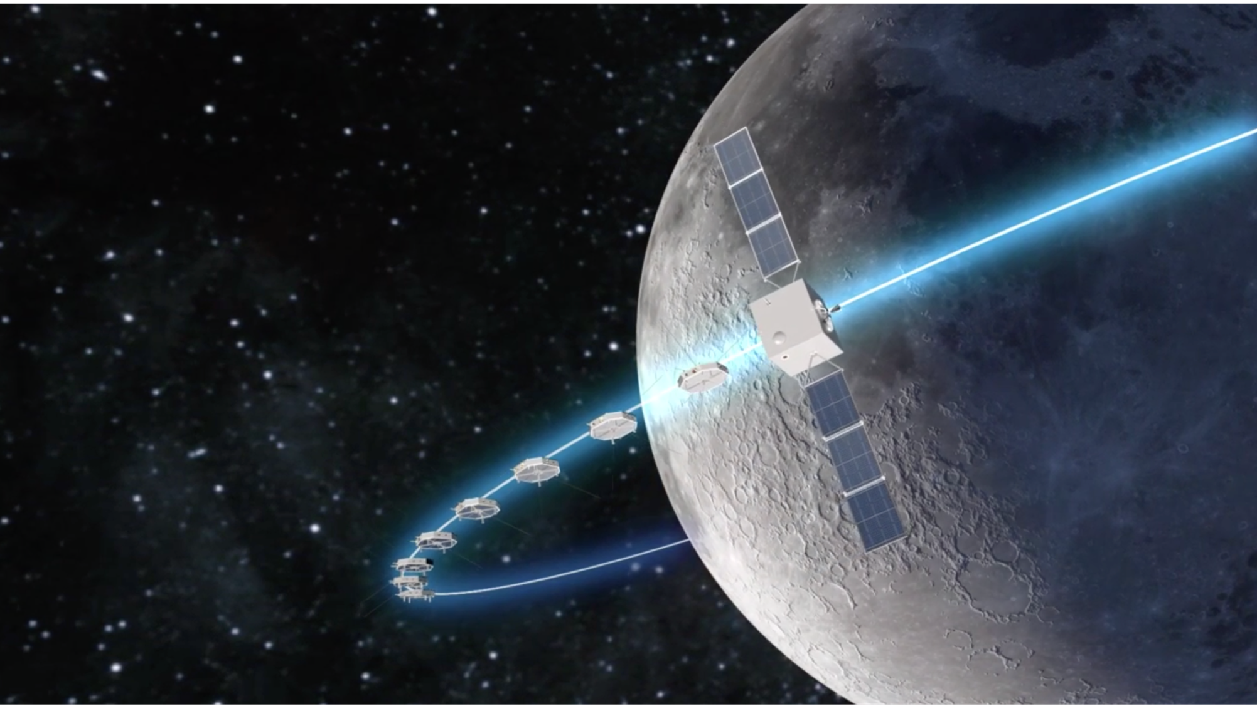
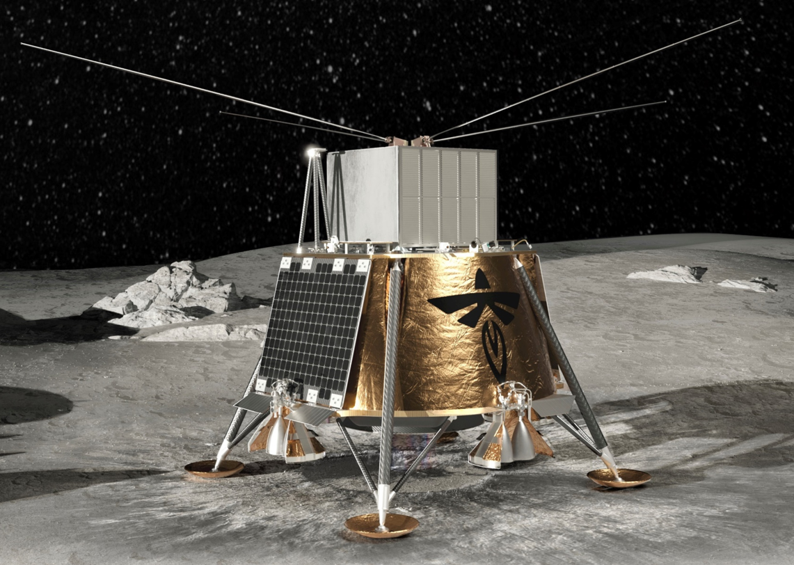
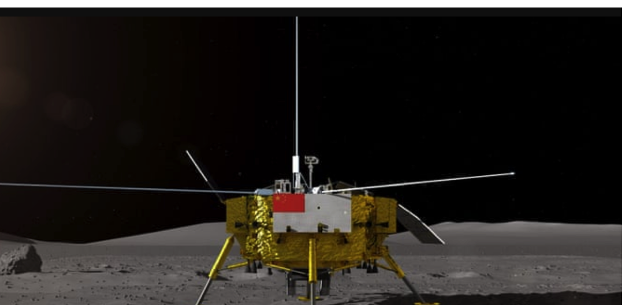

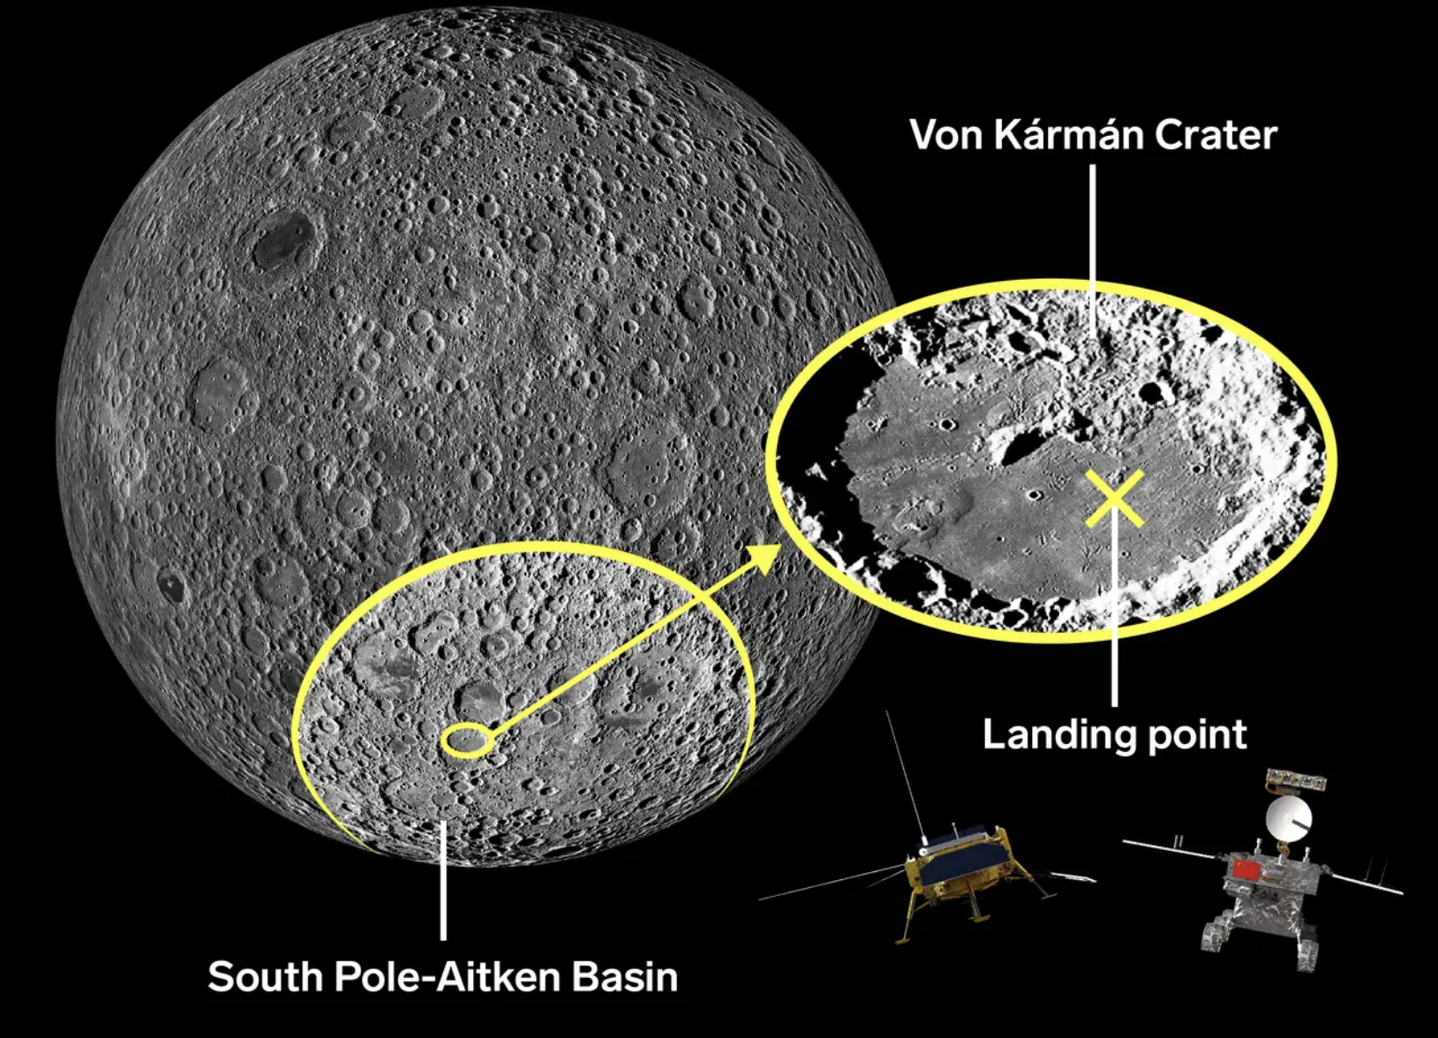
Its happening soon: 2026!
2026: DSL lunar orbit array 8 +1
PI: Xuelei Chen (NAOC)
2019 Chang’e 4
NASA CLPS LUSEE-Night PI: Stuart Bale (UCB)
Launch – December 2025 on Falcon 9. Land: January 2026
Firefly Aerospace ‘Blue Ghost’ lunar lander

Slide 9
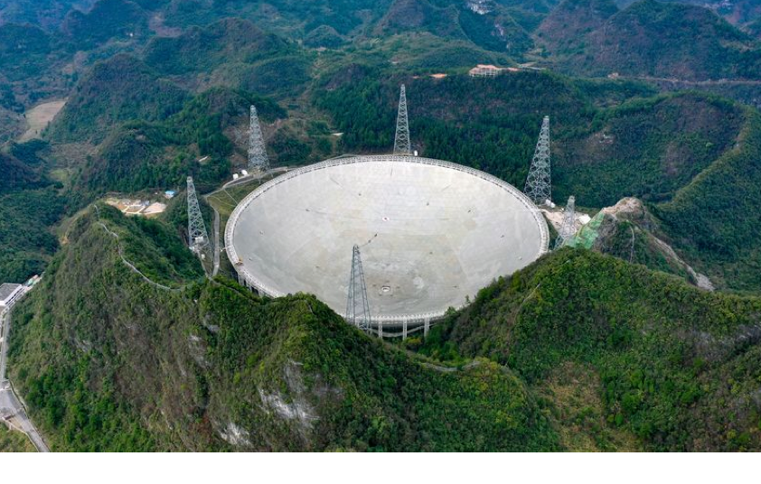
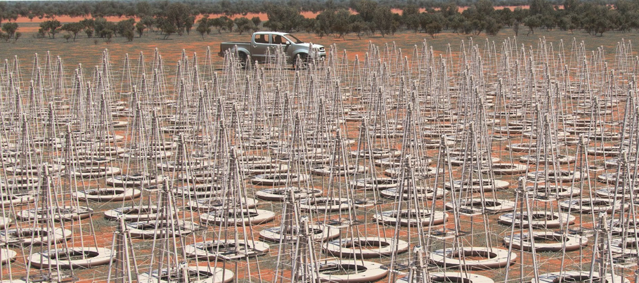
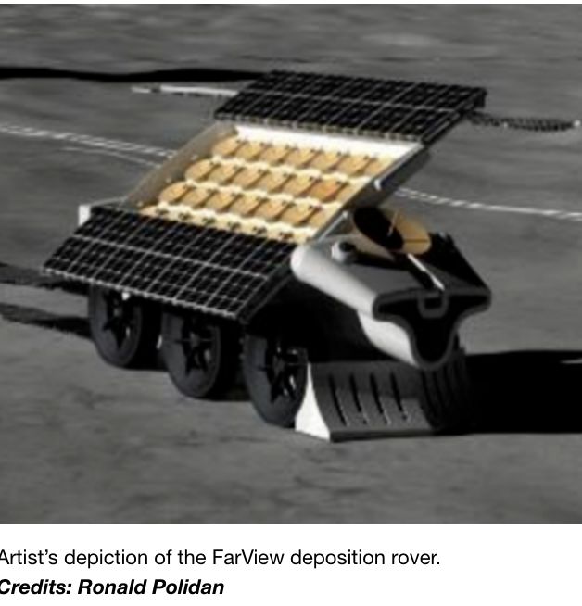
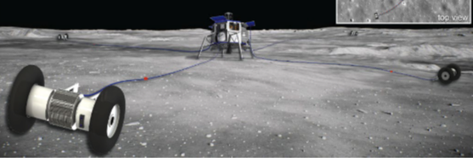
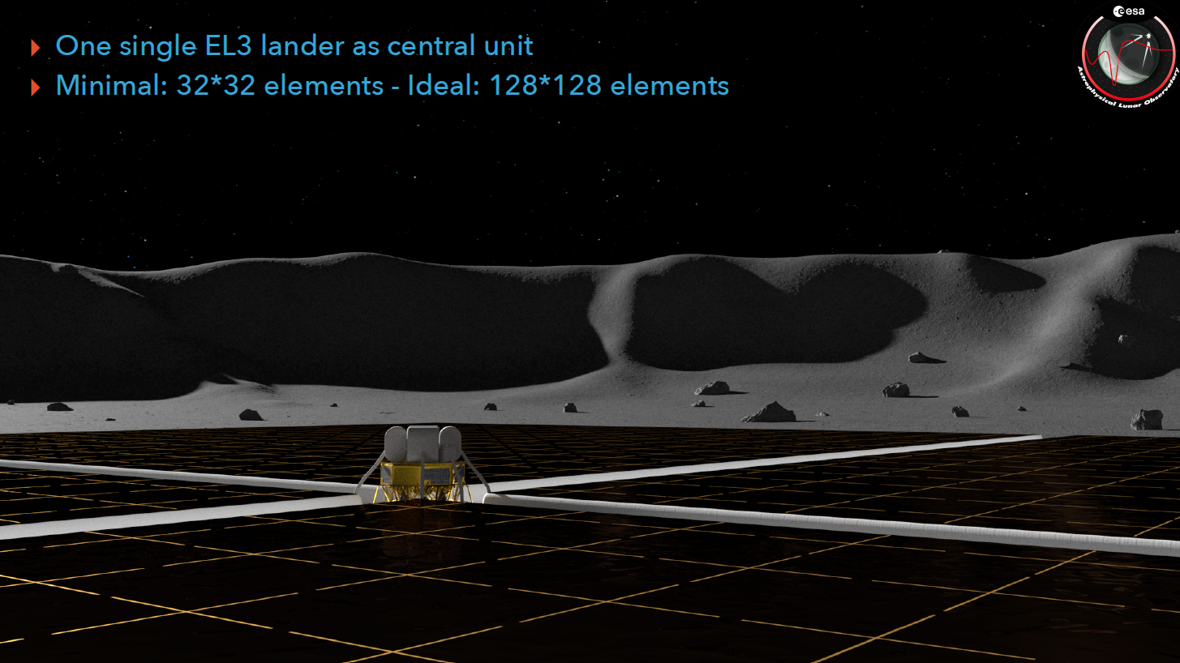
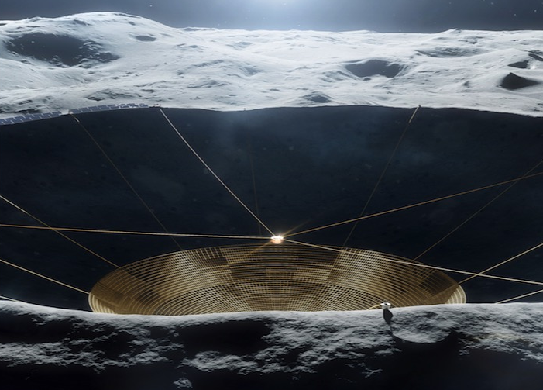

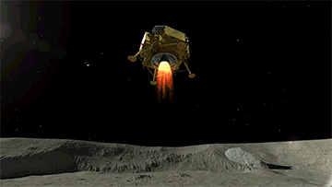
2030-2050: lunar radio telescopes
baryon
density
FAST 500m Guizhou China
We can do this!
10³ cm⁻³
SKA-Low: an array of 100000+ 50-350 MHz antennae in Western Australia: 2028
10⁻¹ cm⁻³
ESA. Astronomical Lunar Observatory
Farview: 10⁵ antennae
over 20km (Polidan 2022)
10⁻⁵ cm⁻³
FARSIDE 128 antennae PI: Jack Burns
10km/s
Far side lunar crater
radio telescope
LARAF: 270 dipoles, 10 km

Slide 10
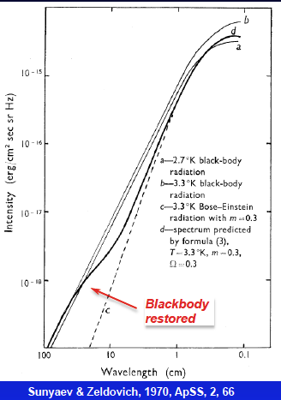
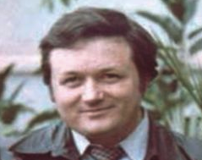
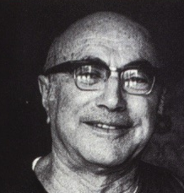
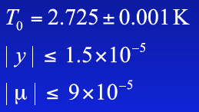
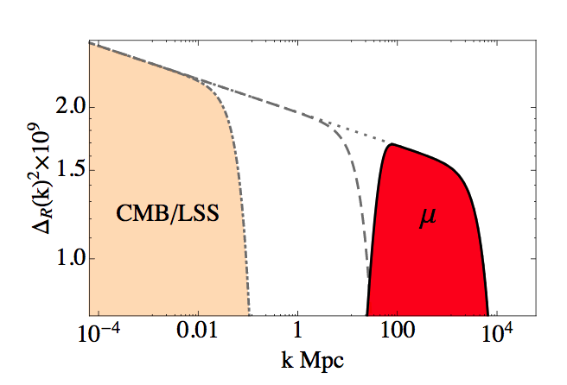
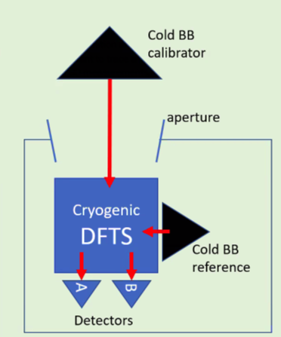
2. Cosmic microwave background radiation
μ distortion
early
1990
Rashid Sunyaev
Yaakov Zeldovich
bottom-up formation is fundamental
prediction of cold dark matter cosmology
Fourier transform interferometer in space
PIXIE rejected (2011, 2017) by NASA MIDEX: 55cm telescope μ < 10⁻⁸
the most perfect blackbody is in the sky.
Trillions of modes from dwarf galaxy precursors
inject early energy --> spectral distortions
?
ESA Voyage2050: CMB spectral distortion
L class mission. 1m telescope + FTS μ < 10⁻⁹
S. Masi

Slide 11



Why not on the moon?
South pole of the Moon
90--2000 GHz bolometer array in a ~30K permanently dark crater
1 m telescope cooled to 2.5 K.
Scan sky by lunar rotation. Sunlit rims for perpetual solar power
Probe μ ~ 10⁻⁹ COBE FIRAS 1990 μ > 5.10⁻⁵
FIRAS
ESA Voyage2050
H, He. recombination lines
Hart & Chluba 2021

Slide 12







3.
Lunar optical/IR telescopes
6.5m HWO
Habitable Worlds Observatory
no atmosphere: FIR spectroscopy
larger apertures: exoplanet numbers and resolution
from < 25 Earth twins with HWO
to thousands for a lunar 100m telescope!
Chinese 15cm telescope
observing since 2014
number
Artemis-enabled Stellar Imager
K. Carpenter 2024
aperture----->
Maillard 2024
Schneider & Labeyrie 2023
Integrate combining beams for hours vs msec on Earth
10μsec resolution at Trappist-1 system at 12.5 pc
Shackleton crater
4 km deep, 21 km wide
eternal darkness, cold ~30K
Optical/IR interferometer in lunar polar crater
Notes:
Lunar orbit is 5 degrees of of ecliptic. Polar craters are in the twilight zone
LRO reflectance/DIVINER temperature

Slide 13






Is it too expensive?
NASA commercial launch providers
ESA’s Argonaut lander 1.5 ton payload
Larger lunar payloads are feasible
Telescopes will piggyback on lunar exploration: cf HST
Chinese astronauts on Moon by 2030
Launch costs/ton are plummeting
Elon Musk
Jeff Bezos
SpaceX Starship
June 2024
ARTEMIS-3 2026 ?
Blue Origins
NewGlenn
NASA’s budget
Artemis cost 2017-2025: ~$90B
astronauts on Moon 2026
20M$?
500M$ ?
45t
SLS BlockII 95t
Apollo
Notes:
23

Slide 14



Competition
rare earth mining
Earth: 140 megatonnes (China 55 Mt, US 14 Mt)
Terrestrial reserves are limited
The Moon has huge reserves: a trillion tons
Thorium radioactive tracer
ice mining
Icy polar craters
India’s Chandrayaan-1
tourism
ESA’s Moon village concept

Slide 15




Issues for the future of lunar exploration
Property law/Mineral rights/Criminal law/Pollution
Enforcement?
Number of suitable sites is limited
5-50 km scale craters with smooth/mild slopes
far side for low terrestrial interference
permanently shadowed cold polar craters
High rims for solar power
United Nations Outer Space Treaty of 1967
provides basic framework on international space law,
1969
Elvis 2023
2024
Lets avoid the wild west scenario!

Slide 16

There is a space race
for commercial reasons and inspiration
Apollo 8 (1968)
Compelling science is relatively inexpensive and humanity will benefit
The future of cosmology: what were our cosmic origins?
The future of astronomy: are we alone?
Low frequency radio astronomy
Far infrared
Optical/IR at high resolution
Gravity waves at decihertz
X-rays at keV
Now’s the time to plan
There are no limits but the sky
Miguel de Cervantes

