Slide 1
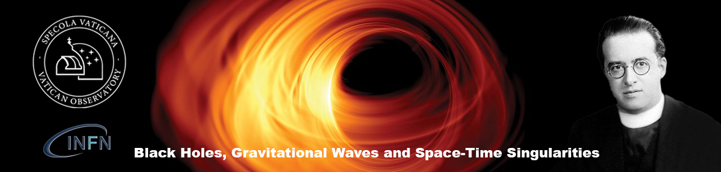
ΛCDM: the road ahead
18 June 2024
Michael S. Turner
Department of Physics and Astronomy, UCLA
and
Kavli Institute for Cosmological Physics
University of Chicago

Slide 2
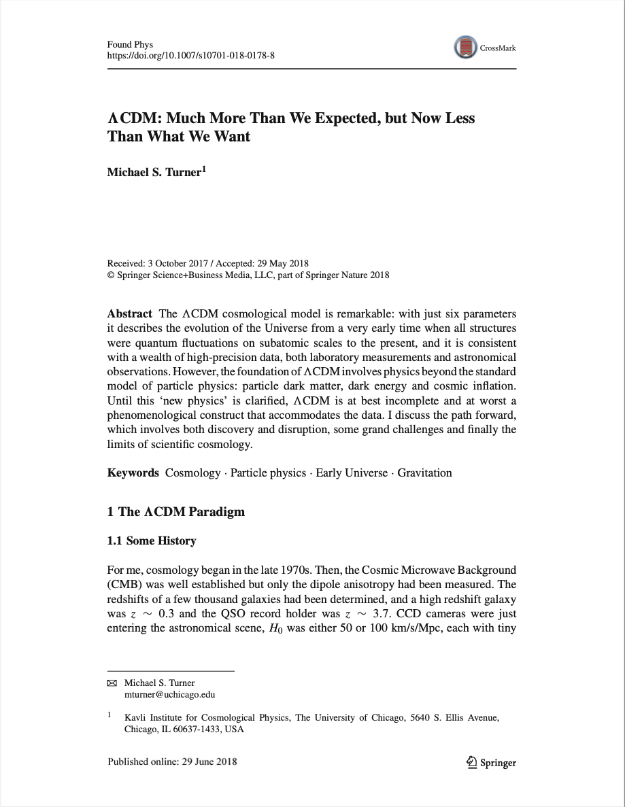
Lemaître 2017

Slide 3
ΛCDM is a precision (few percent) phenomenological model supported by a wealth of data, which describes the evolution of the Universe from a tiny fraction of a second until today

Slide 4
ΛCDM in plain English
… very-early accelerated expansion driven by the potential energy of a scalar field gives rise to a very-large, smooth, spatially flat patch that becomes all that we can see today. Quantum fluctuations during this inflationary phase grow into the seeds for galaxies. The conversion of potential field energy into heat produces the quark soup that evolves a baryon asymmetry and long-lived dark matter particles. The excess of quarks over antiquarks (baryogenesis) becomes neutrons and protons, later some light elements and finally atoms. The gravity of the dark matter particles drives the formation of structure from galaxies to superclusters and a mere 5 billion years ago the repulsive gravity of dark energy (Λ) again drove accelerated expansion …
Notes:
None part of the standard model, all are big mysteries and portals to a deeper understanding. The three are tied together in their asking and answering.

Slide 5
… a lot of new physics in that plain language
The repulsive gravity of Dark Energy explains cosmic acceleration and Λ (quantum vacuum energy) is the default dark energy candidate. What is dark energy, why now, why so small?
A very early burst of tremendous expansion – Inflation – explains our smooth, flat Universe with seeds for galaxies grown from quantum fluctuations. Really? how?
The gravity of slowly-moving Dark Matter particles (CDM) holds all cosmic structures together. Which particle(s)?
Baryogenesis produces an excess of matter over anti-matter and the survival of a small number of baryons today (few per billion photons). Baryons are important; more details please!
Notes:
None part of the standard model, all are big mysteries and portals to a deeper understanding. The three are tied together in their asking and answering.

Slide 6
ΛCDM is a phenomenological model that can be ungraded to a fundamental model of the Universe (or not)
Gravity and spacetime: done!, but could be improved
Dark matter: particle in the “BSM theory”
Inflation: inflaton in the BSM theory
Baryogenesis: B, C and CP violation in the BSM
Can we find the BSM theory?
Cosmology will help!

Slide 7
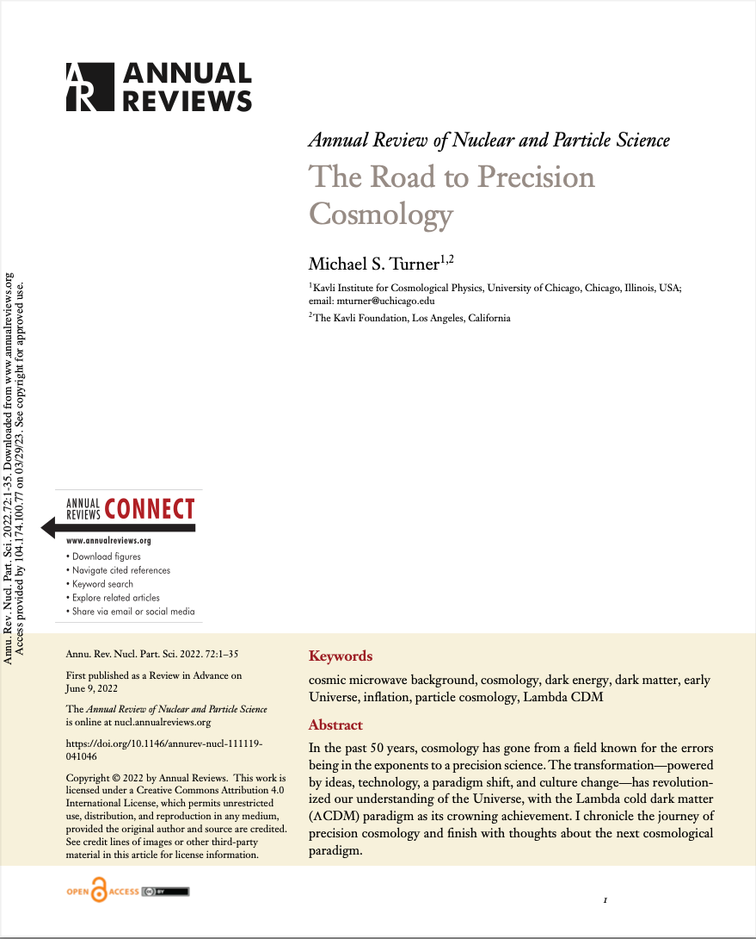
A long road to precision cosmology!

Slide 8
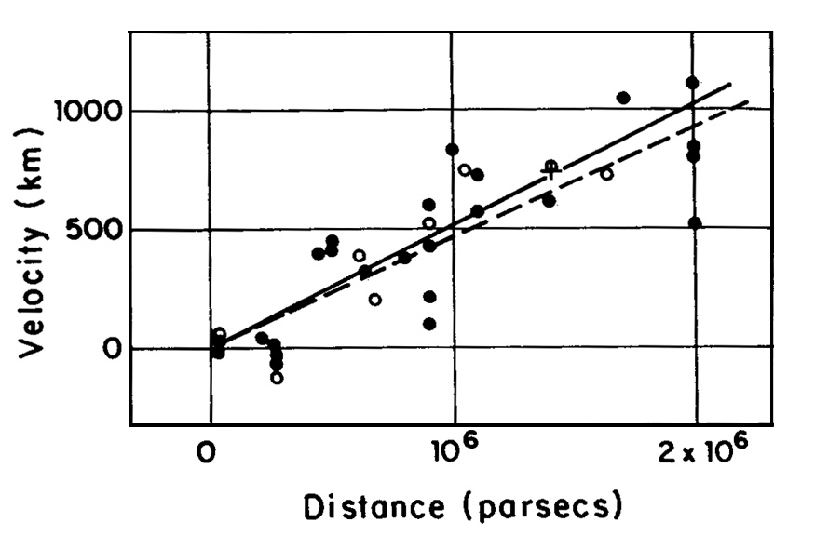
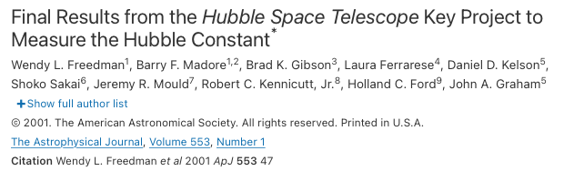
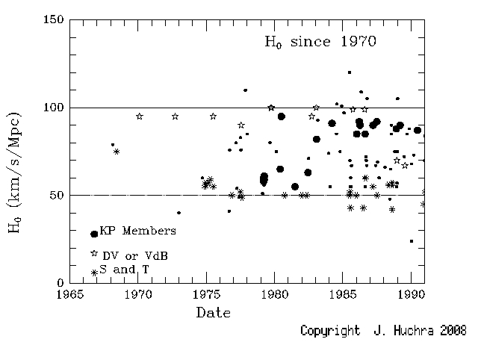
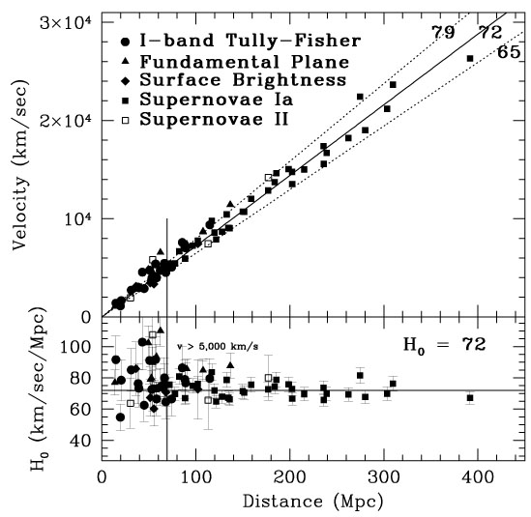
A long road to precision cosmology!
Two exemplars for precision cosmology: CMB and Baryons

Slide 9
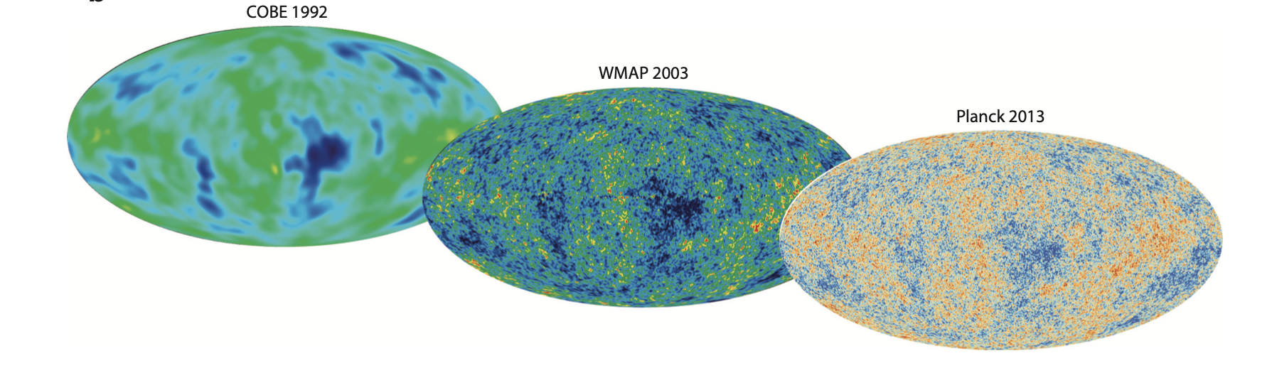

Slide 10
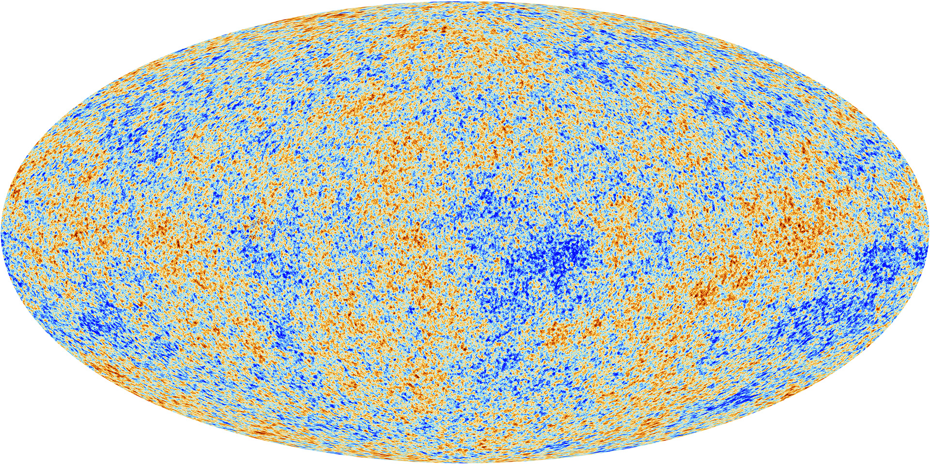
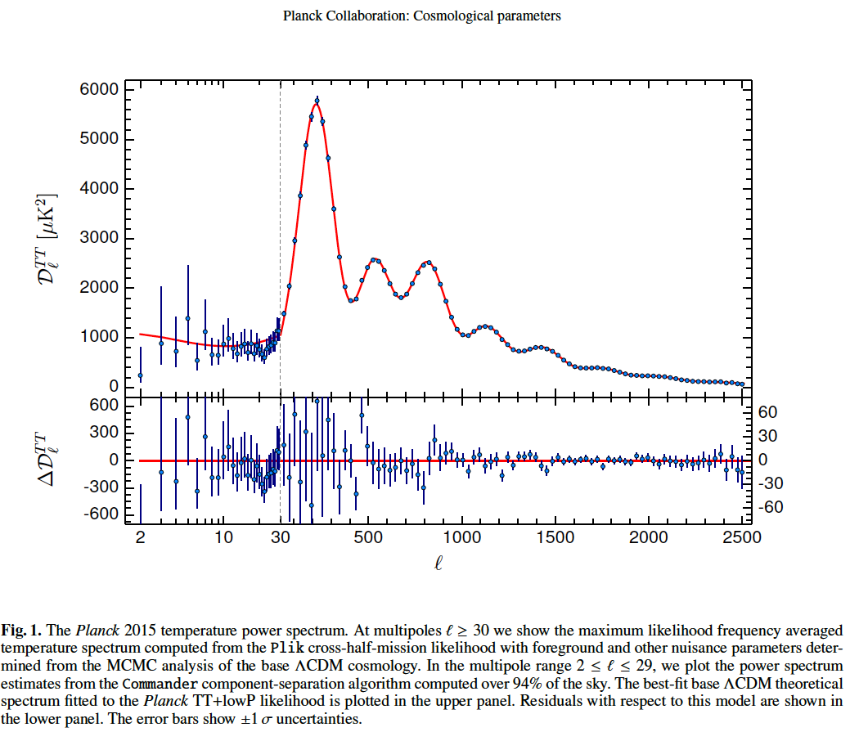
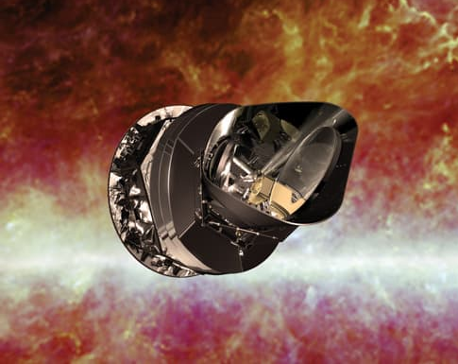
6 physical parameters
Baryon mass density
CDM mass density
Density perturbation amplitude
Tilt
Sound horizon
Optical depth
Notes:
Here is the spherical harmonic power spectrum and the LCDM curve determined by 6 parameters. On the right is the polarization power spectrum. Much of this data is from experiments we have been involved in, including WMAP and the SPT. Just think of that: 6 numbers describe our Universe
Baryon density, Matter density, tau, n, Q and age/Omega_L

Slide 11
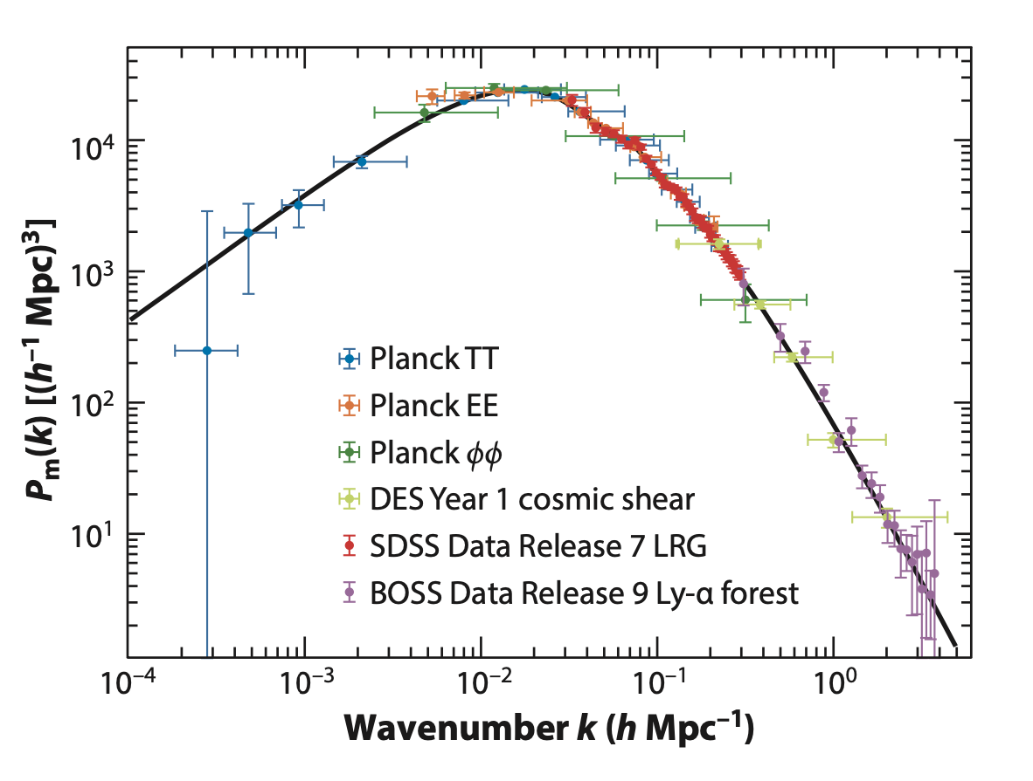
Measurements of large-scale structure agree with ΛCDM
Hubble volume
clusters
galaxies

Slide 12
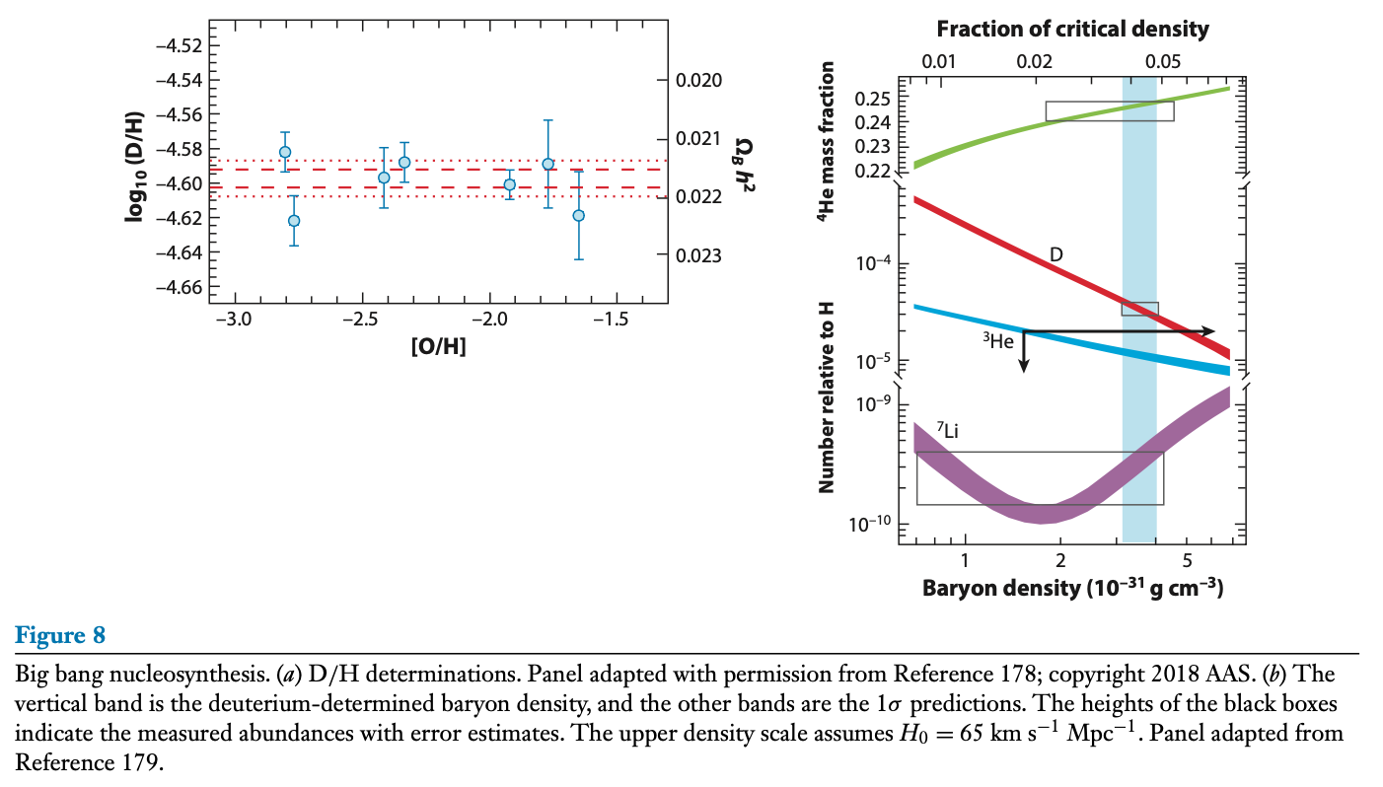
Cosmic consistency:
Ω_{B}h² at <1% precision
CMB + Gravity driven acoustic oscillations at t = 380,000 yrs → Ω_{b}h² = 0.02237 ± 0.00015
D/H + Nuclear physics at t ~ 1 sec → Ω_{b}h² = 0.02166 ± 0.00015

Slide 13
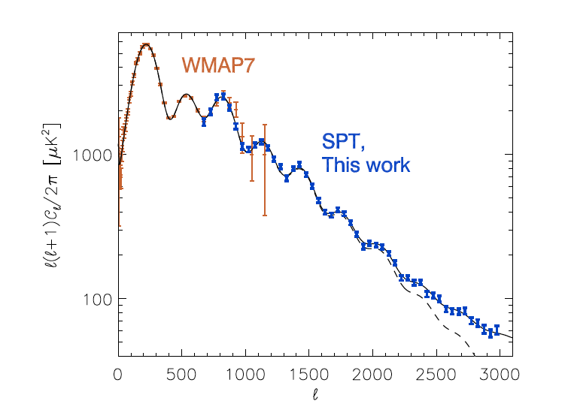
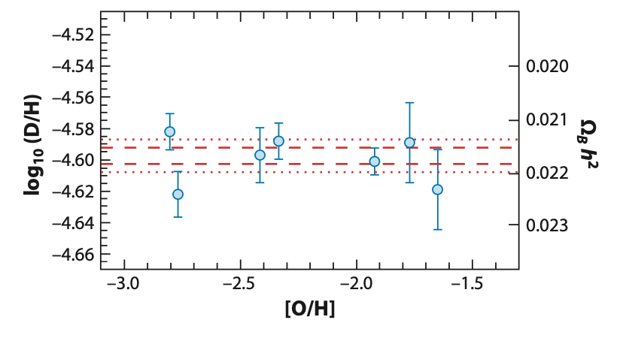
Airtight evidence for nonbaryonic DM
CMB & BBN
Ω_{B}h² = 0.0222 ± 0.0002
vs.
CMB/SDSS/DES/DESI
Ω_{M}h² = 0.143 ± 0.001
> 50σ discrepancy

Slide 14
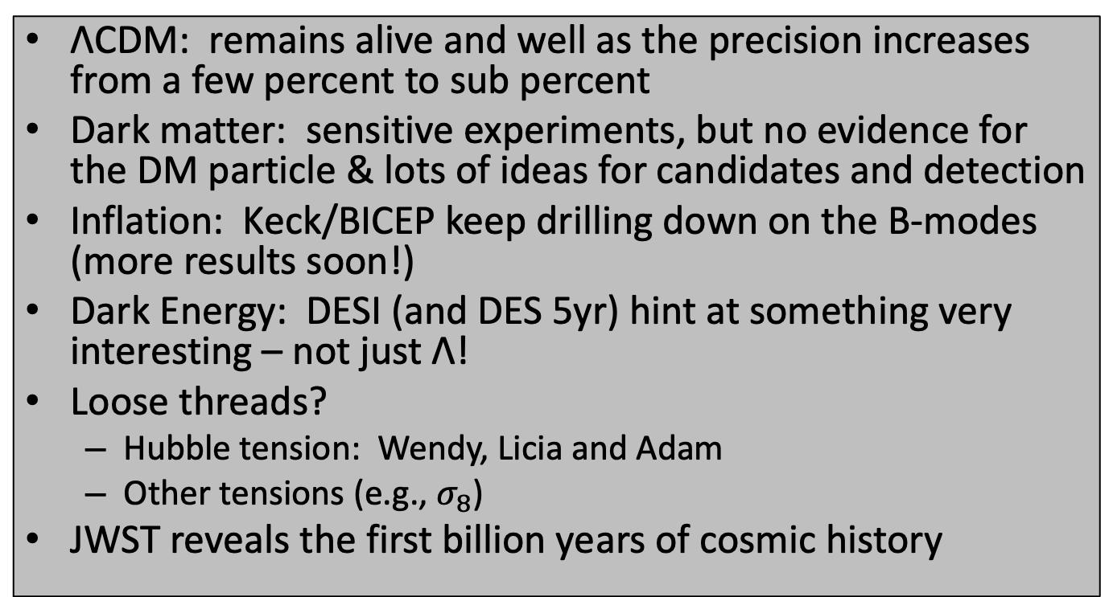
Since “Lemaître 2017”
ΛCDM: remains alive and well as the precision increases from a few percent to sub percent
Dark matter: sensitive experiments, but no evidence for the DM particle & lots of ideas for candidates and detection
Inflation: Keck/BICEP keep drilling down on the B-modes (more results soon!)
Dark Energy: DESI (and DES 5yr) hint at something very interesting – not just Λ!
Loose threads?
  Hubble tension: Wendy, Licia and Adam
  Other tensions (e.g., $σ_{8}$)
JWST reveals the first billion years of cosmic history

Slide 15
DM: Circa 1990 – 2010
Neutrinos contribute a few 0.1%

Slide 16

Full Court Press!!
Produce at LHC
Detect particles in our halo
Detect annihilation products
But where is the WIMP?

Slide 17
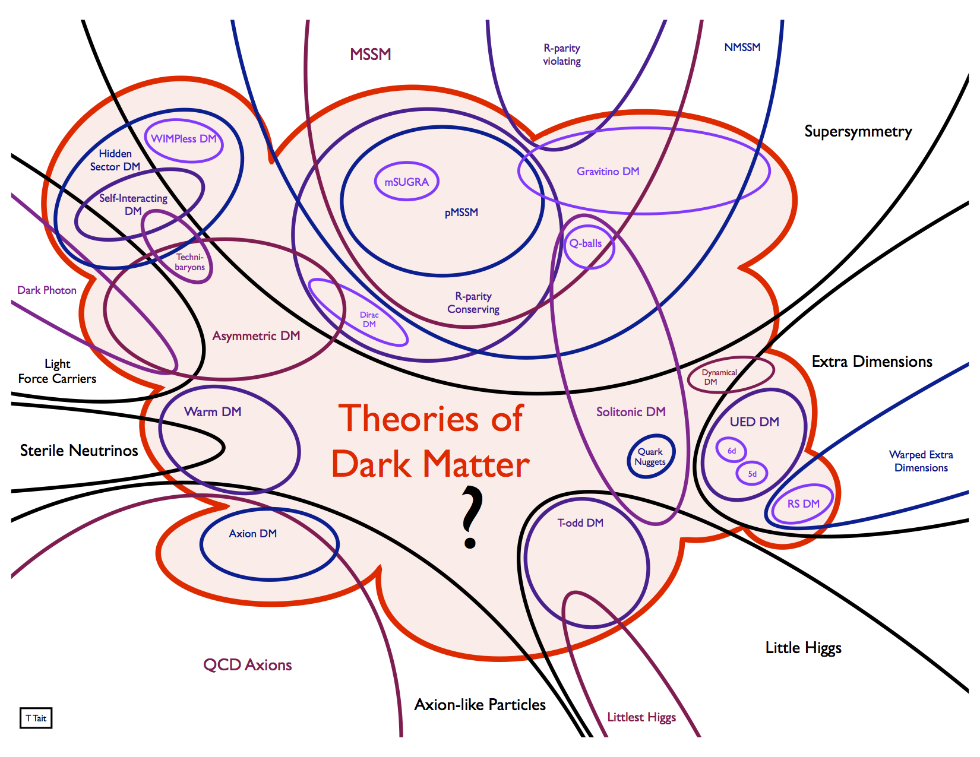
No lack of new ideas!

Slide 18
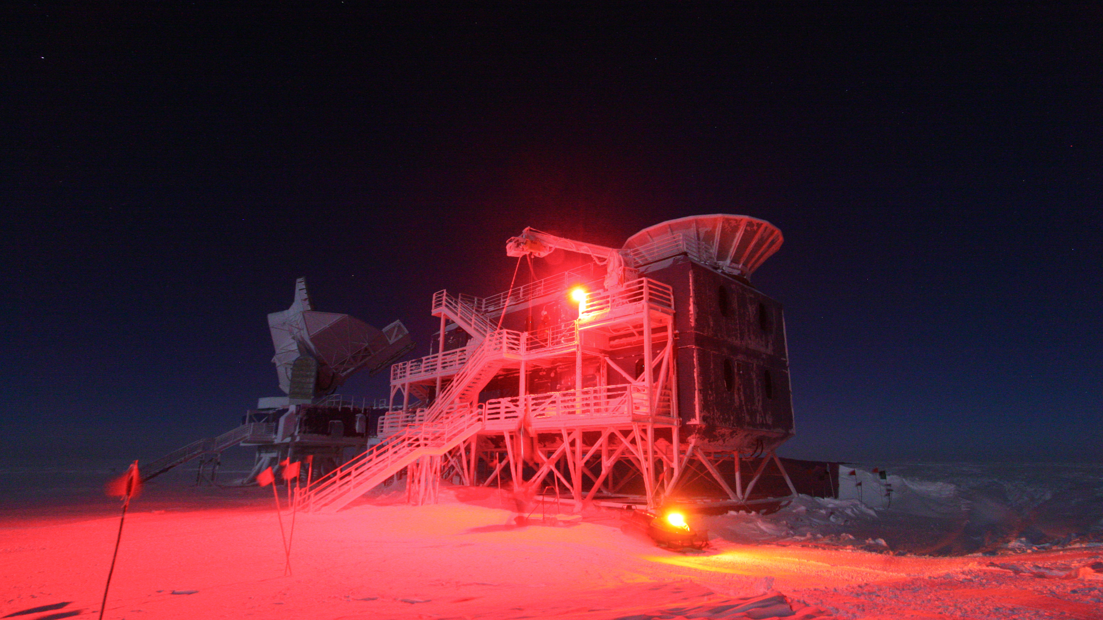
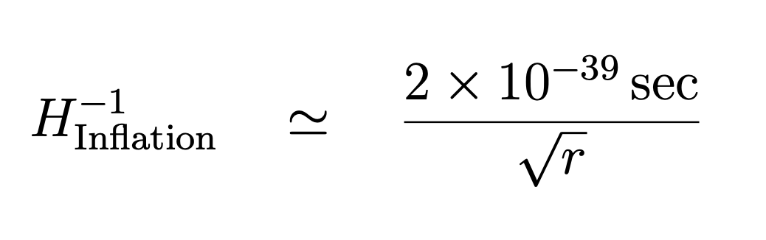
Keck/BICEP continue to lead the way on B-modes

Slide 19
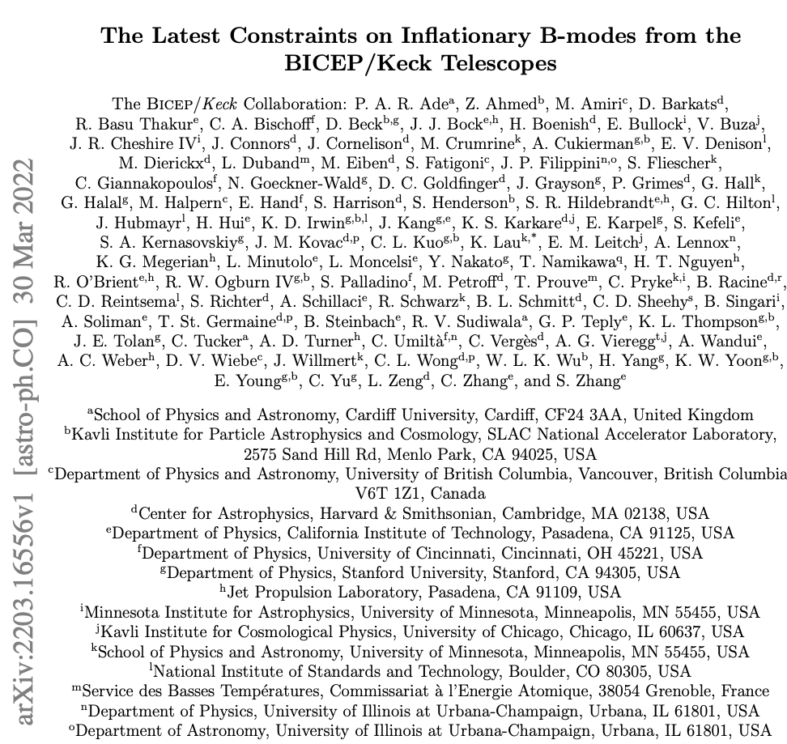
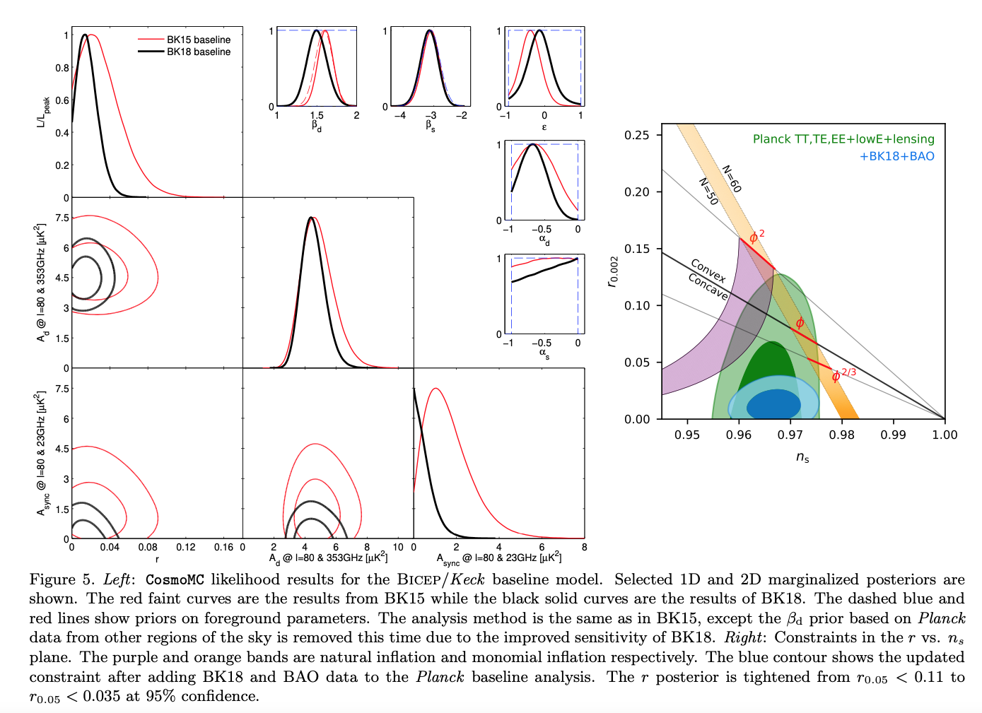
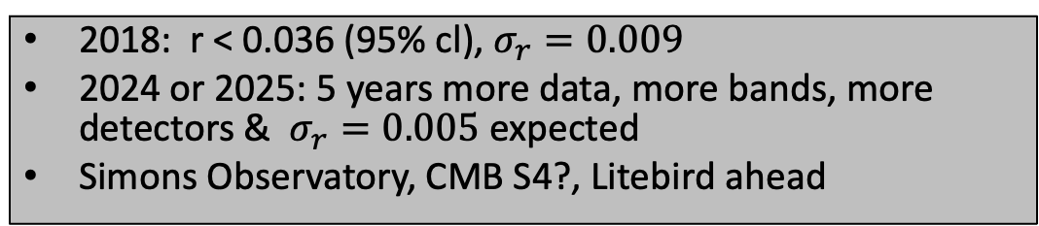
2018: r < 0.036 (95% cl), $σ_{r}=0.009$
2024 or 2025: 5 years more data, more bands, more detectors & $σ_{r}=0.005$expected
Simons Observatory, CMB S4?, Litebird ahead

Slide 20
JWST reveals the billion years bigger aperture, IR, better site, higher resolution and SPECTRA
“Uninhibited,” bursty star formation – faster than expected
Small, messy galaxies with lots of UV radiation beyond z = 10 with spectra not seen at low z
But, hard to connect light to mass to constrain ΛCDM (don’t believe everything you read!). Some lessons?
  Early lenses reveal galactic substructure down to 10⁷ solar masses (Keeley et al arXiv:2405.01620) → m > 6 keV
  SMBH at z > 4 with masses from 4 x 10⁵ to 8 x 10⁷ solar masses (Maiolino et al, arXiv:230801230) -- challenge to make (need seeds?)
New light on the distance scale (Wendy and Adam)

Slide 21
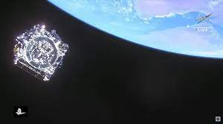
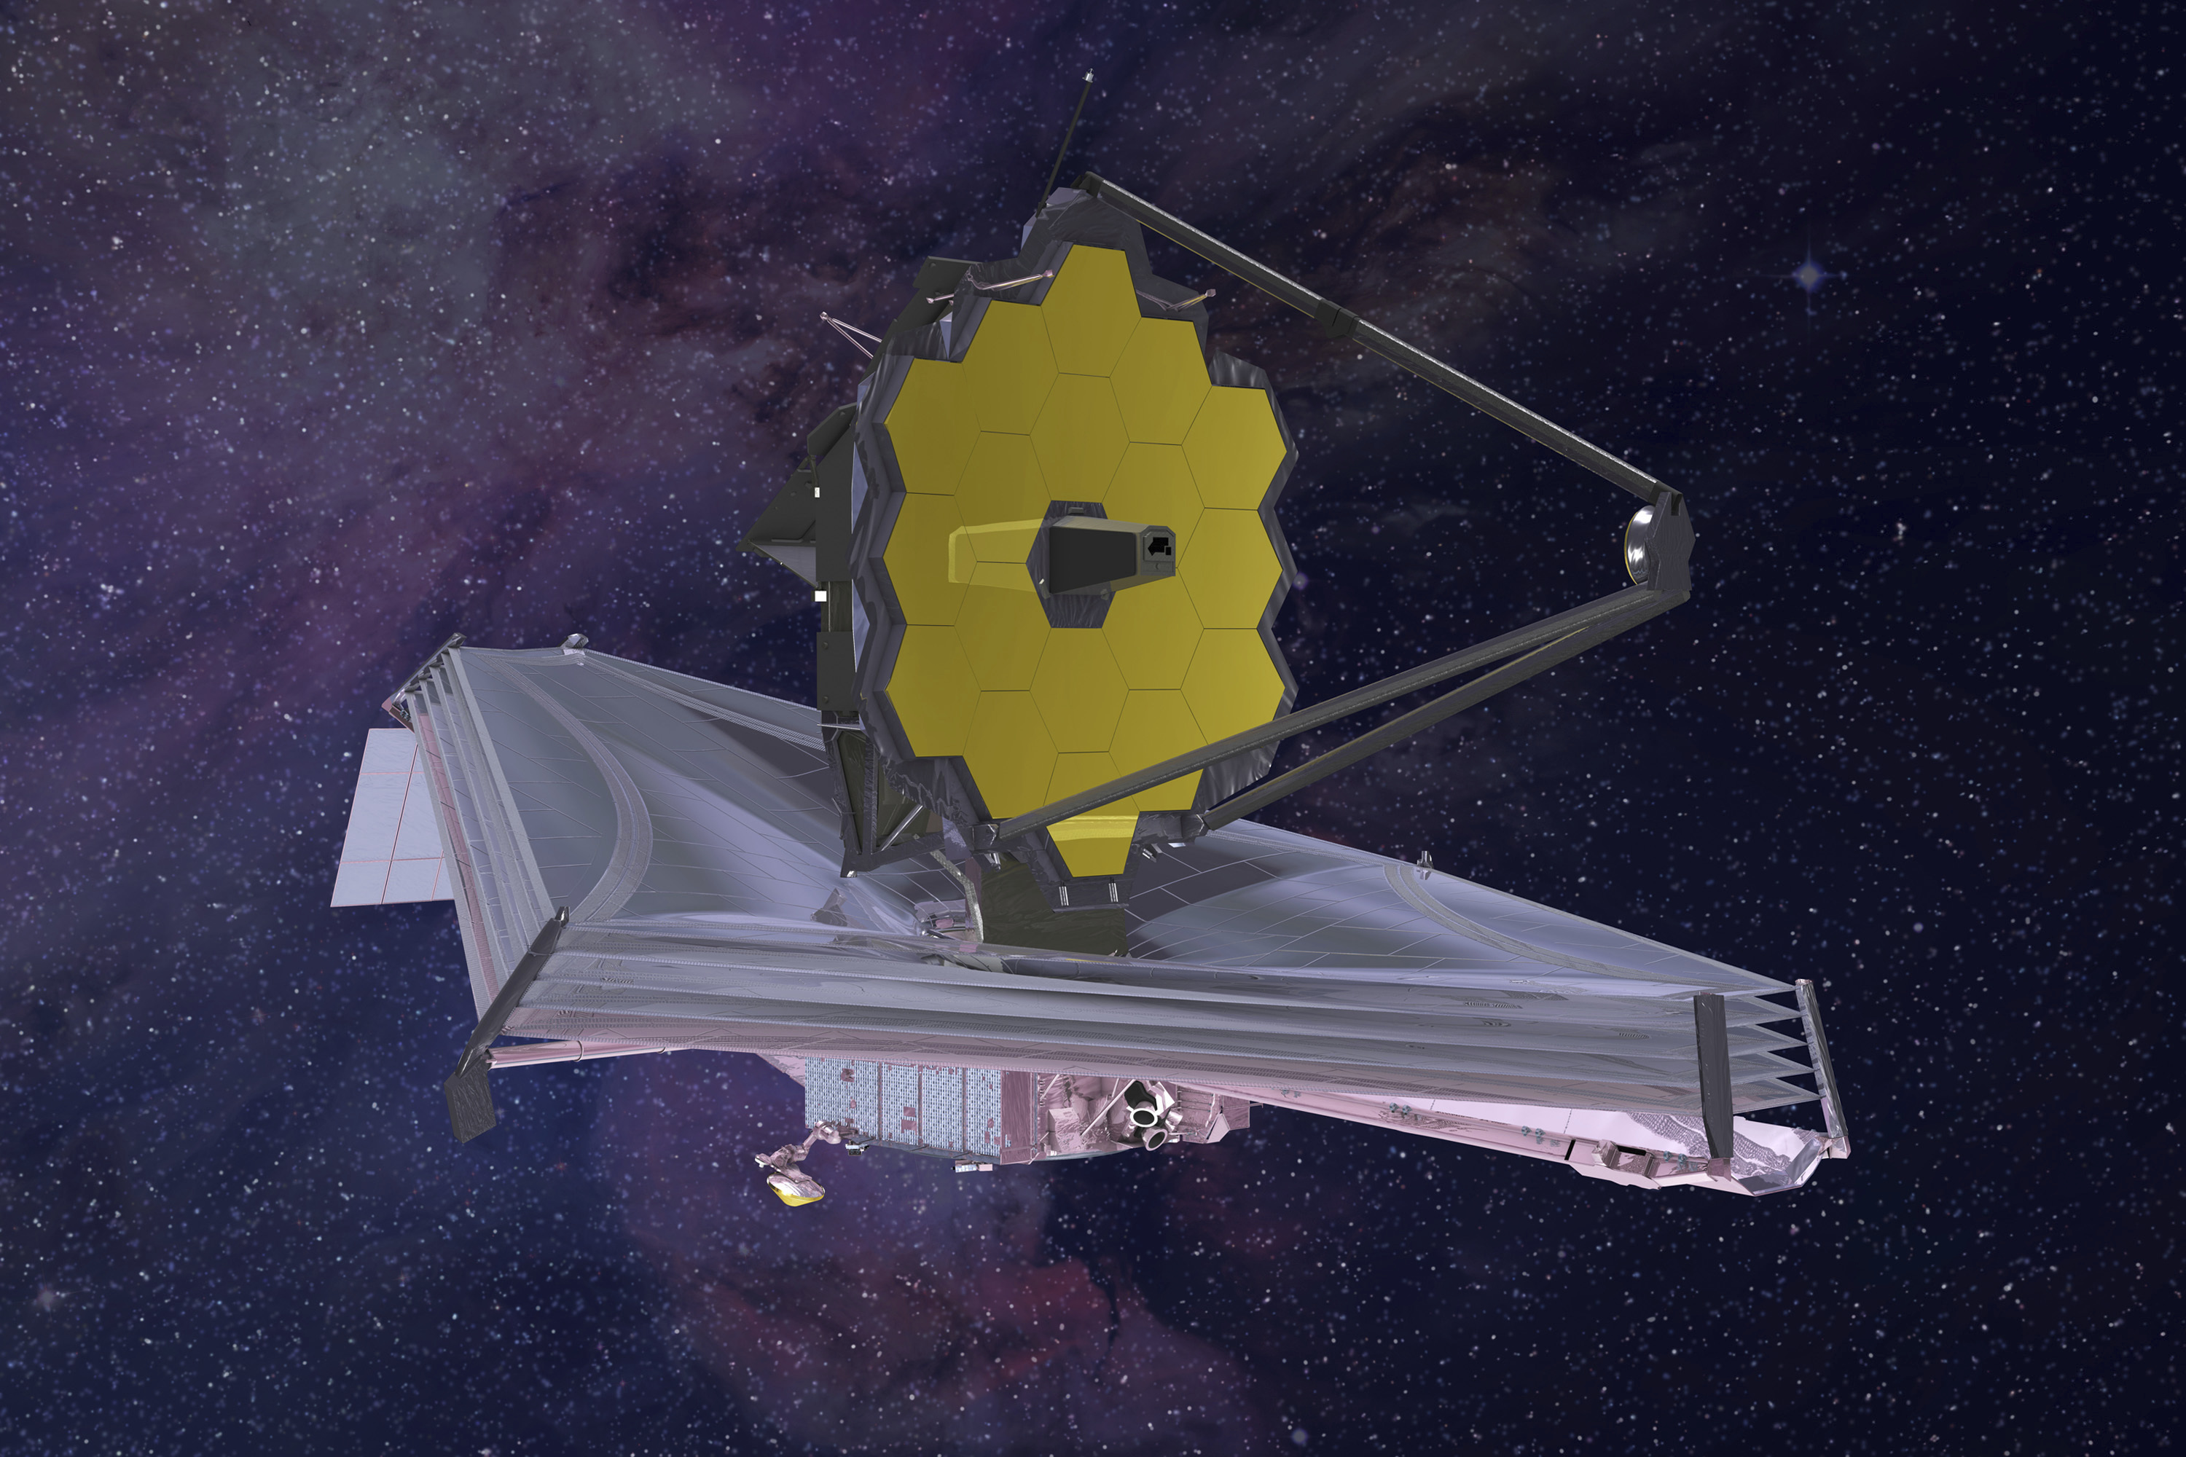
Adieu James: December 25, 2021

Slide 22
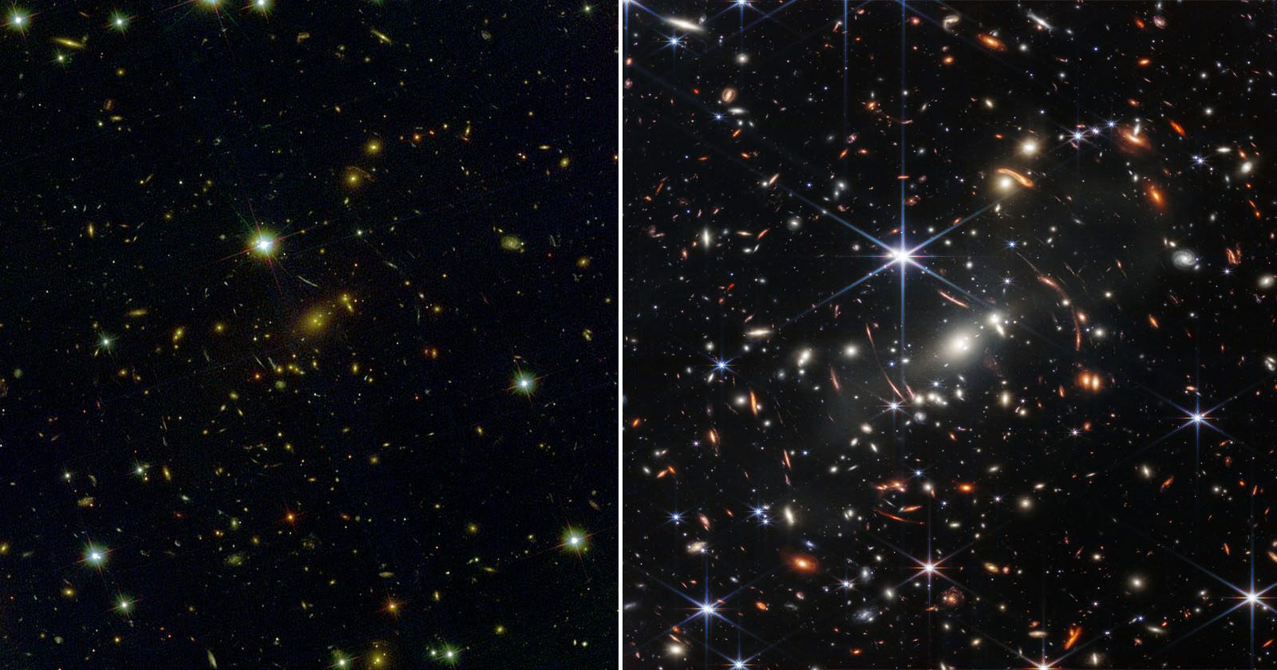
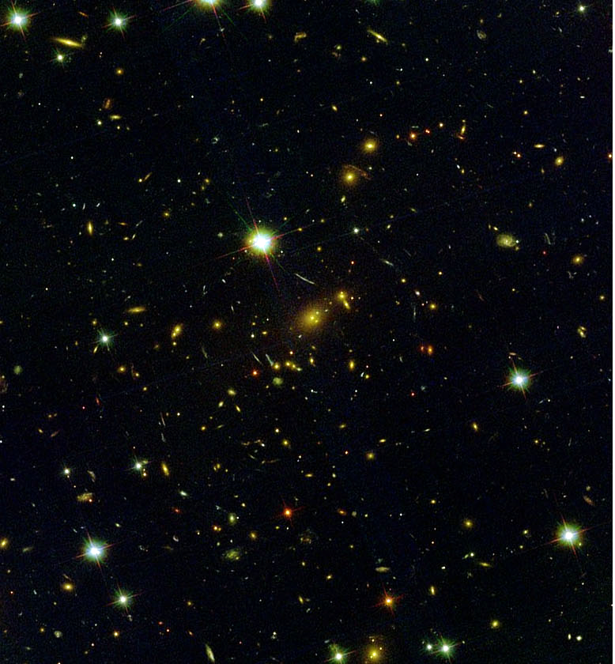
The power of infrared eyes!
Hubble Optical Deep Field
JWST NIR Deep Field

Slide 23
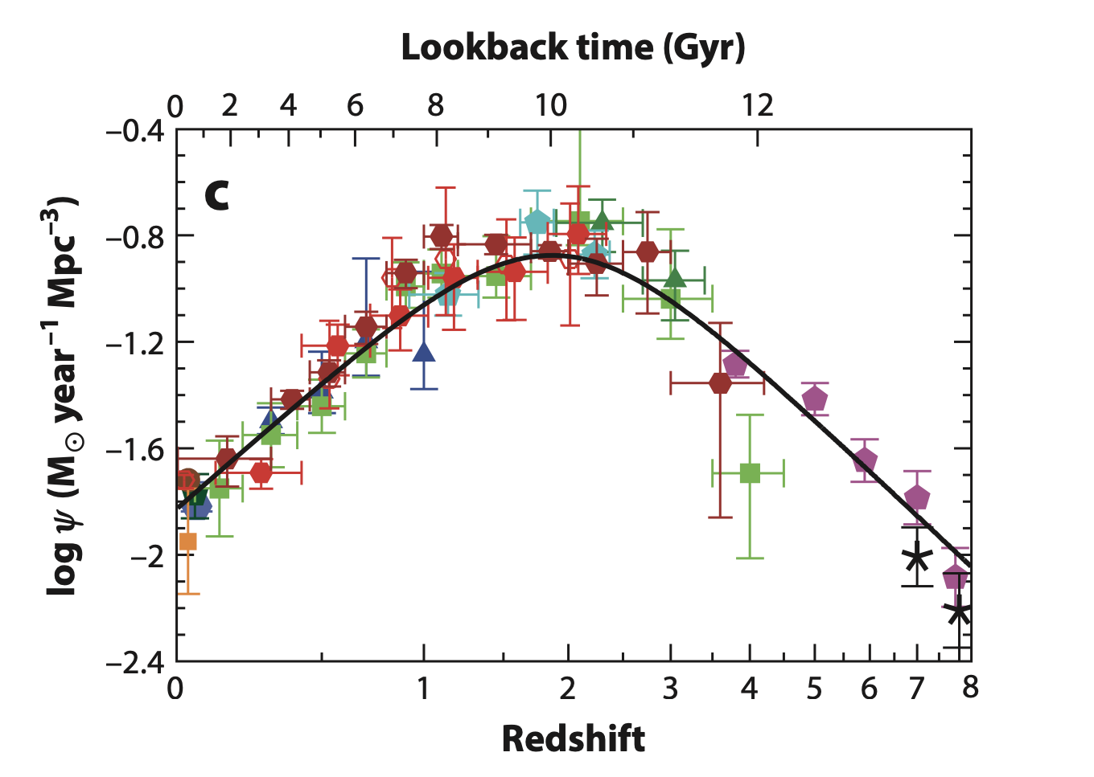
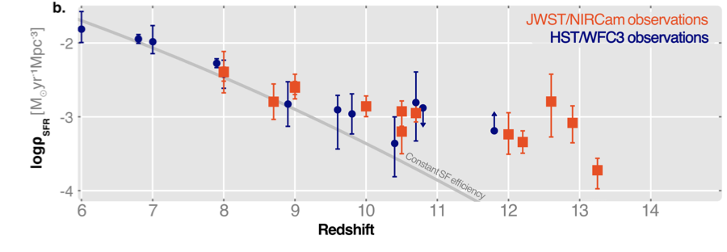
Lots of early, bursty and uninhibited star formation (unexpected)
Madau & Dickinson, 2014
ISSI Workshop, arXiv: 2405.21054

Slide 24
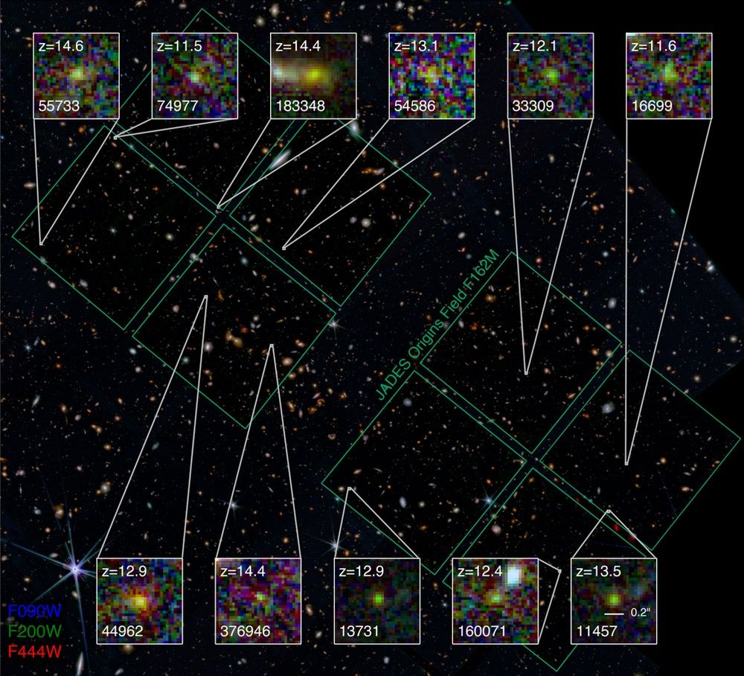
Lots of high redshift galaxies

Slide 25
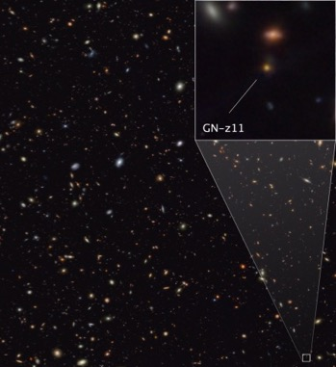
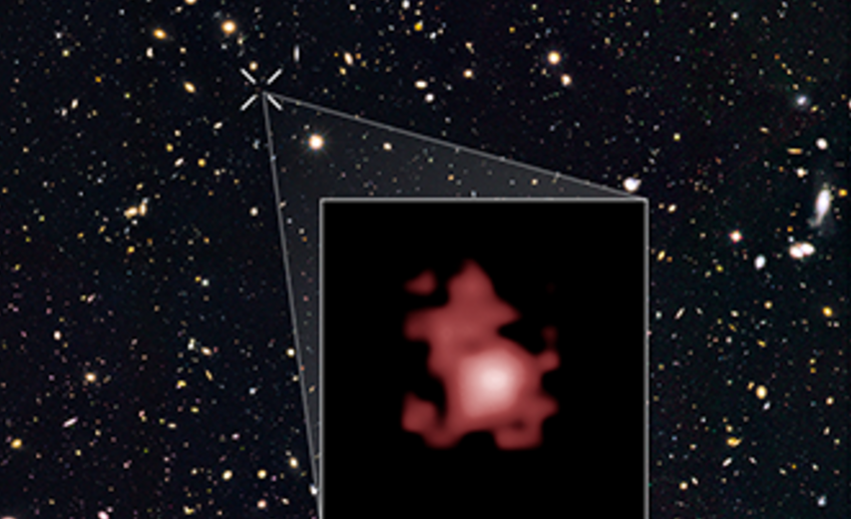
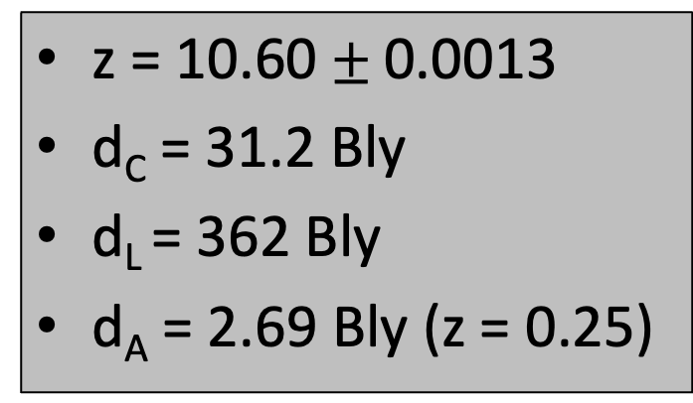
Poster child: GN-z11 found with HST (candidate z = 11 galaxy), studied with JWST
z = 10.60 $±$0.0013
d_{C} = 31.2 Bly
d_{L} = 362 Bly
d_{A} = 2.69 Bly (z = 0.25)
NB: d_{A} = d_{C}/(1+z) and d_{L} = (1+z)d_{C}

Slide 26
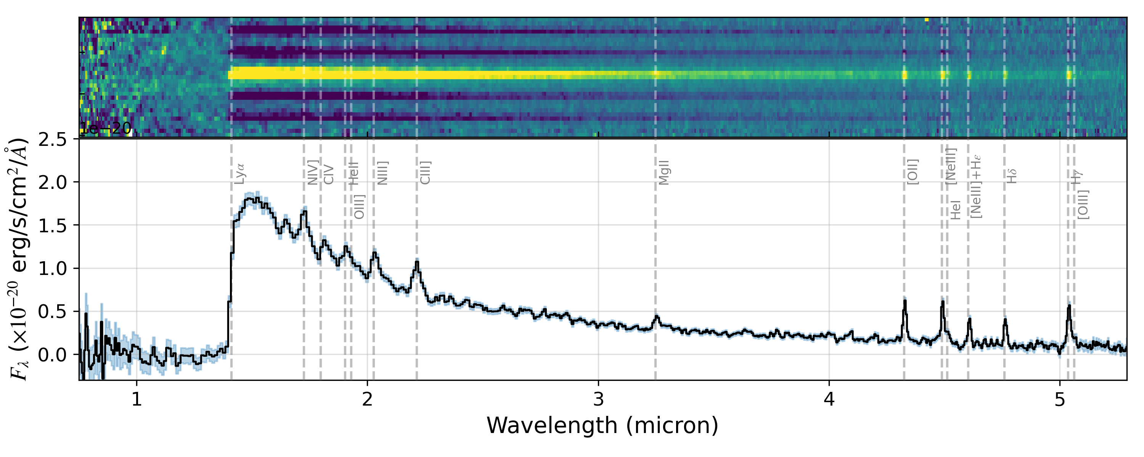
GN-z11 (cont’d)
100 pc resolution at d_{C} = 32 BLy
10⁹ solar masses in stars
few x 10⁶ solar mass BH (so big, so early)
Look at that spectrum of a redshift 10.6 object!

Slide 27
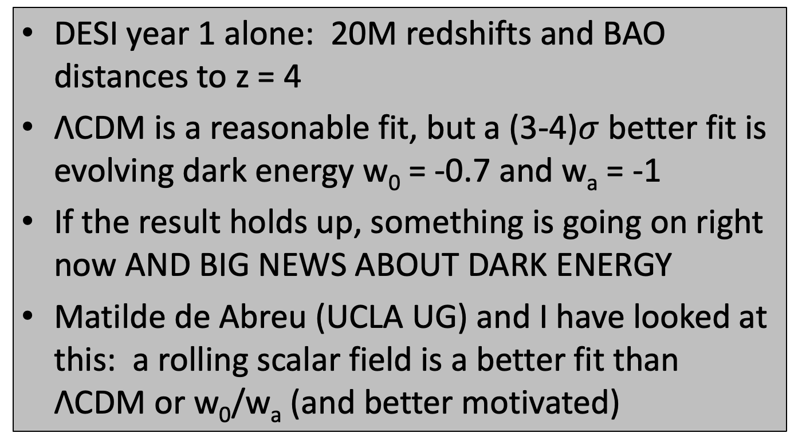
DESI (and DES 5 yr) hints that dark energy evolves (i.e., not Λ)
DESI year 1 alone: 20M redshifts and BAO distances to z = 4
ΛCDM is a reasonable fit, but a (3-4)$σ$ better fit is evolving dark energy w₀ = -0.7 and w_{a} = -1
If the result holds up, something is going on right now AND BIG NEWS ABOUT DARK ENERGY
Matilde de Abreu (UCLA UG) and I have looked at this: a rolling scalar field is a better fit than ΛCDM or w₀/w_{a} (and better motivated)

Slide 28
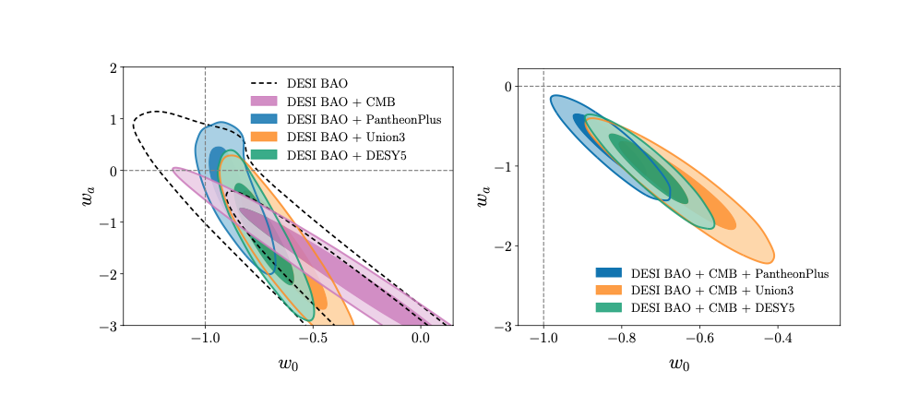
DESI fits to w₀w_{a} (DES 5yr similar)
NB: w = w₀ + w_{a}(1-a) = w₀ + w_{a}z/(1+z)

Slide 29
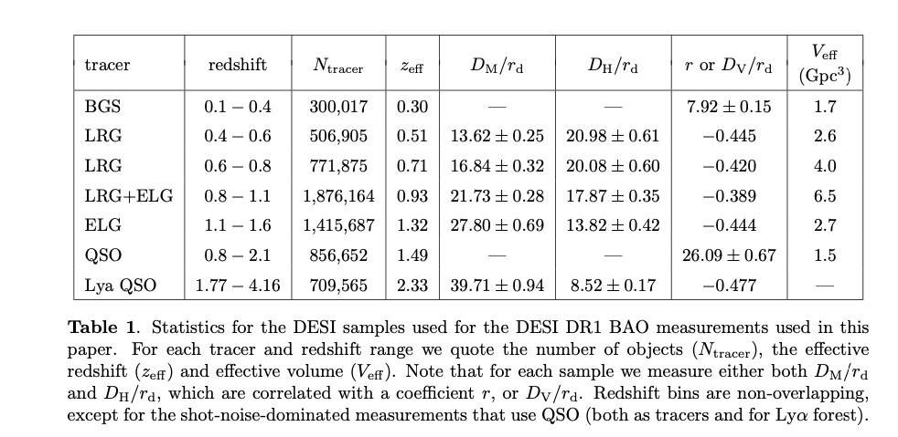

DESI BAO distances (few % precision) note: $D_{H}=\frac{1}{H\left(z\right)}$ and $D_{M}=∫dz/H(z)=d_{C}$

Slide 30
Best-fit w₀w_{a} model compared to ΛCDM is the Universe is giving us the @@#!?

Slide 31
w₀w_{a} parameterization maybe useful, but it is unphysical

Slide 32
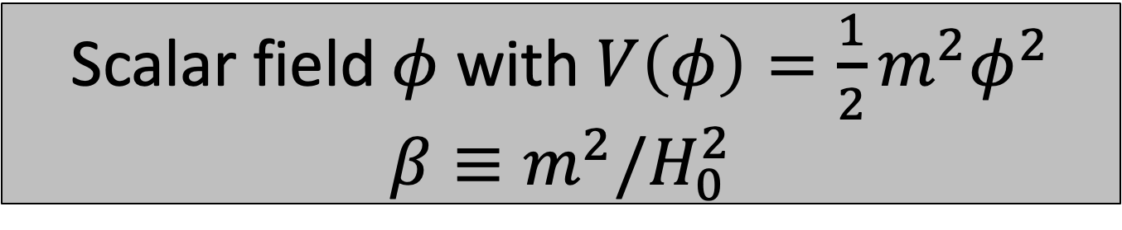
Scalar field $φ$ with $V\left(φ\right)=\frac{1}{2}m^{2}φ^{2}$
$$β≡m^{2}/H_{0}^{2}$$

Slide 33
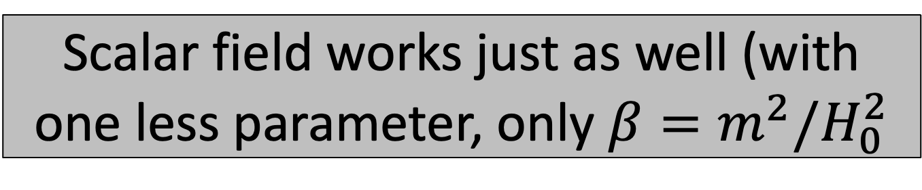

Scalar field works just as well (with one less parameter, only $β=m^{2}/H_{0}^{2}$
Exciting, but this is not the time to get carried away! Much more to come and remember precision cosmology is really hard!
and $m≃{10}^{−33}$ eV

Slide 34
The path forward
ΛCDM: Make it, break it, or extend it
Big data and precision measurements are likely to lead the way: DESI, Euclid, LSST, Roman, CMB-S4, Litebird, HL-LHC, DUNE, FCC, …, dark matter searches
But, don’t give up on bold ideas

Slide 35
Ambitions for “the third paradigm”
Fundamental model(s) for dark matter, dark energy and “inflation” (or something better)
No parameters: the “automatic” Universe
Origin of the space, time and the Universe
Destiny of the Universe
Multiverse: up or out
That is, finish Lemaître’s big dream!

Slide 36
The grandest challenge in cosmology:
Connect big ideas with big data

Slide 37
Precision Cosmology!
Precision Cosmology
is Hard
Accurate Cosmology
is even Harder!

Slide 38
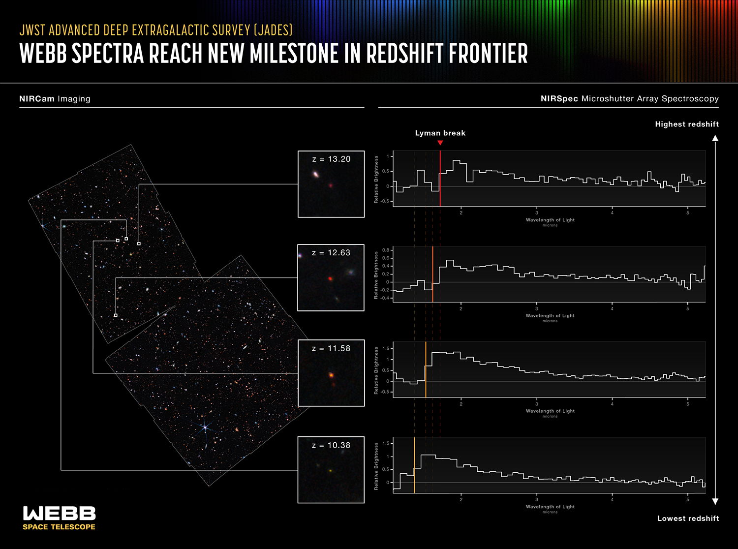

Slide 39
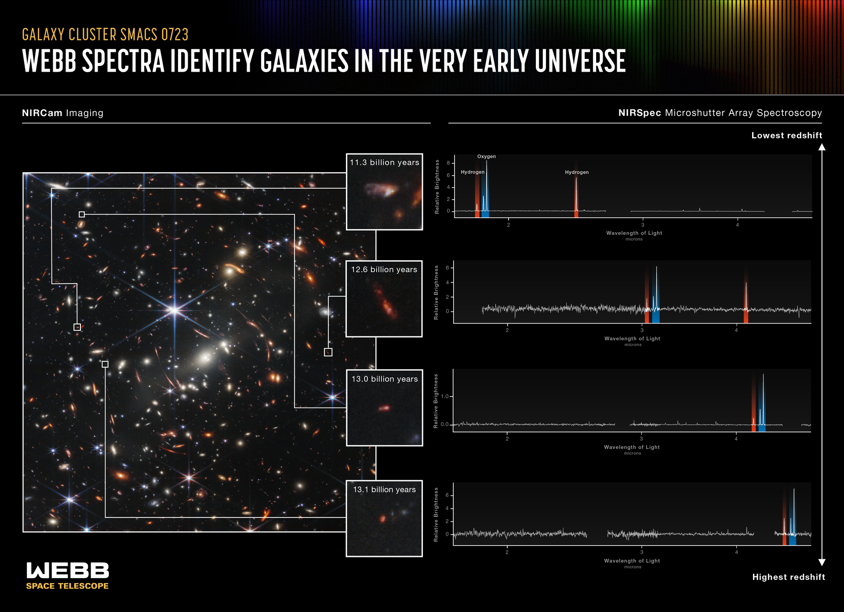

Slide 40
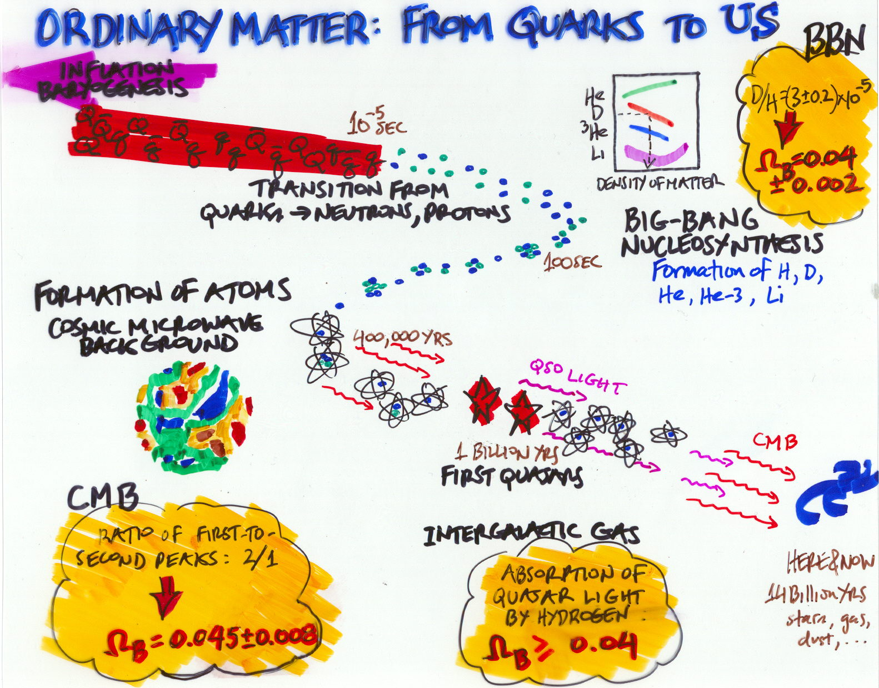
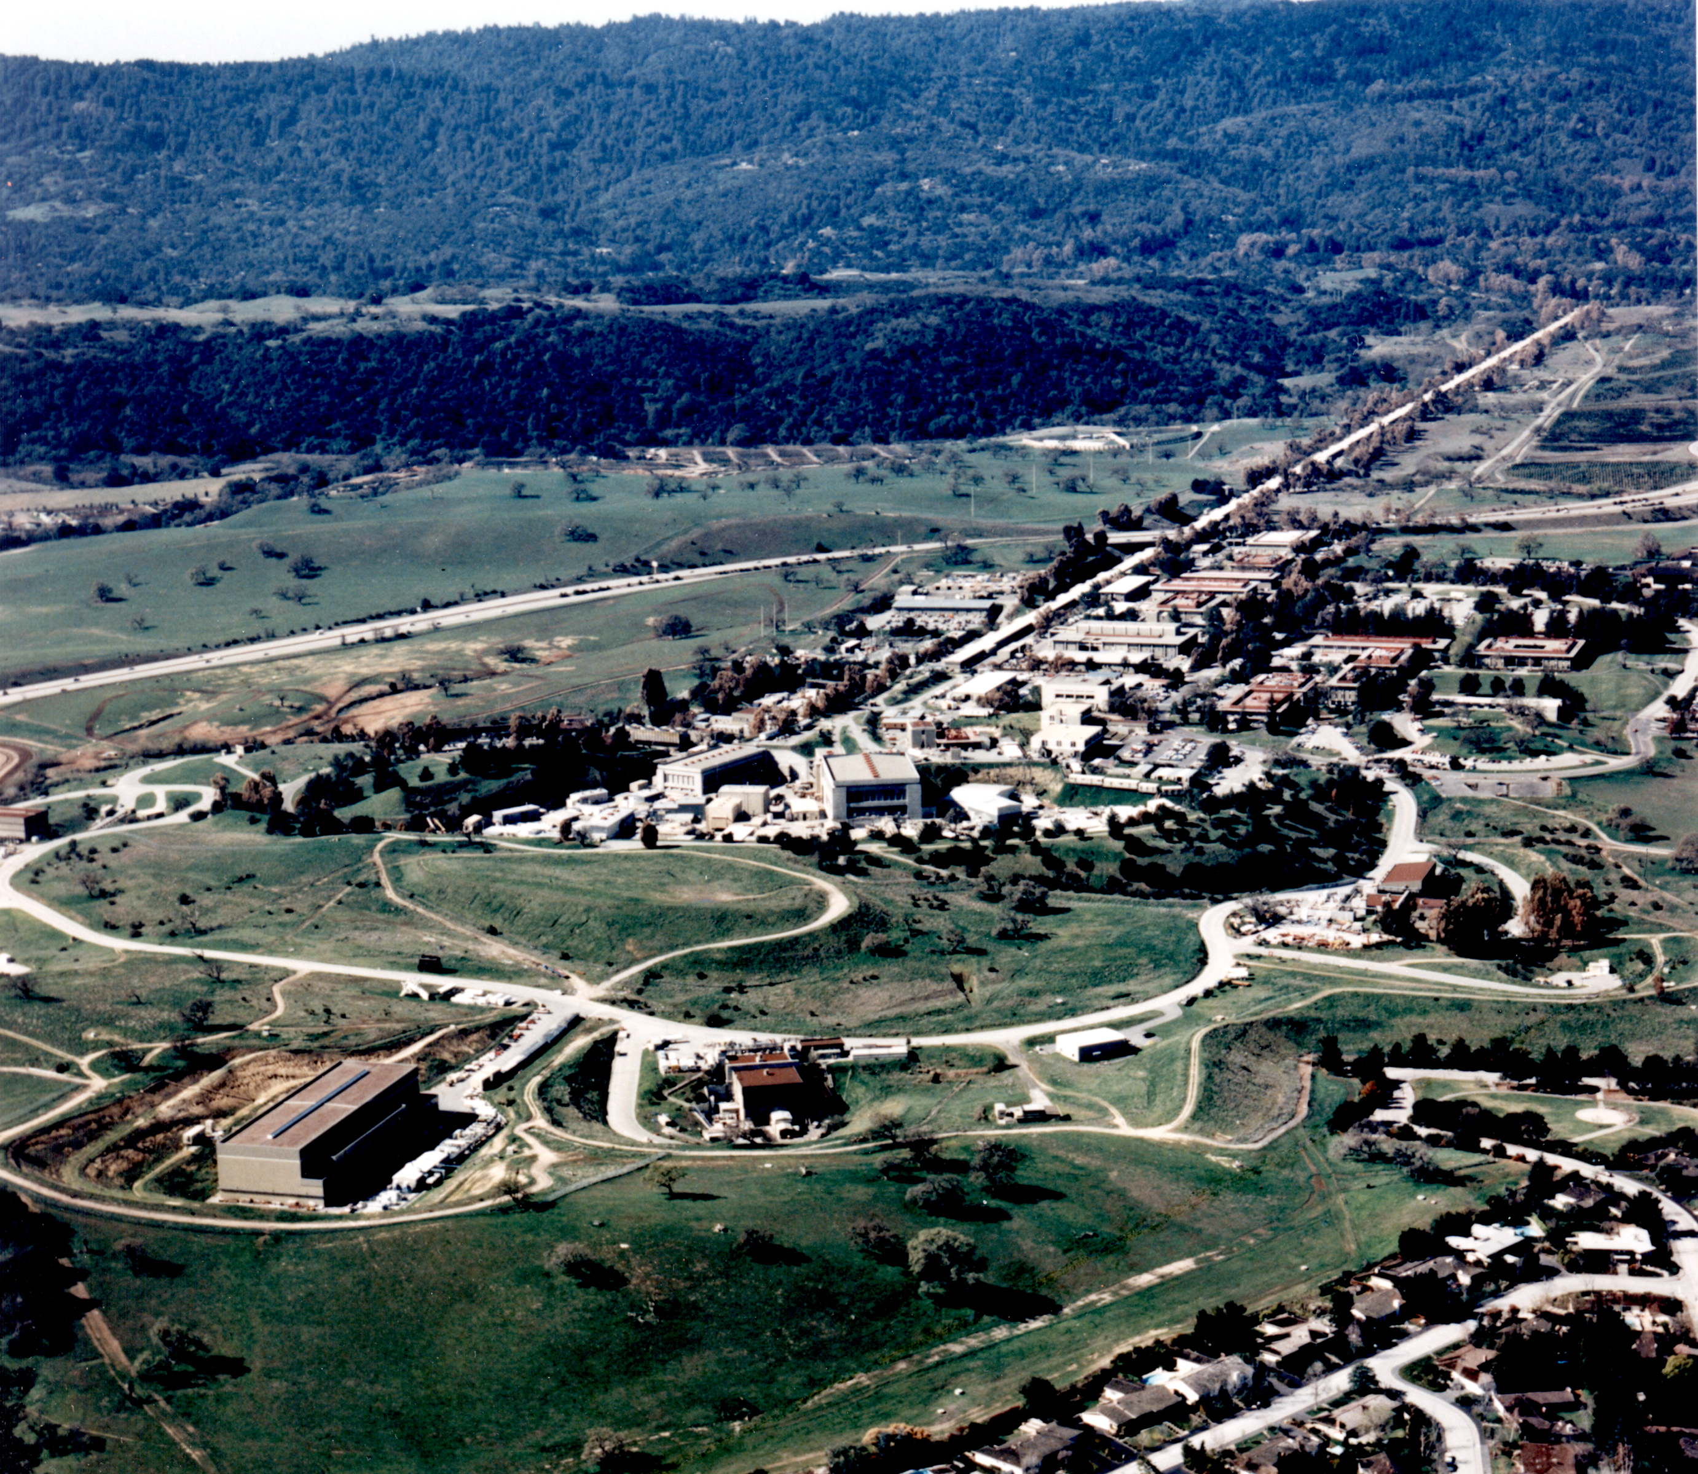
1980: Fall of “The Hadron Wall” seeds in the pudding & asymptotic freedom

Slide 41
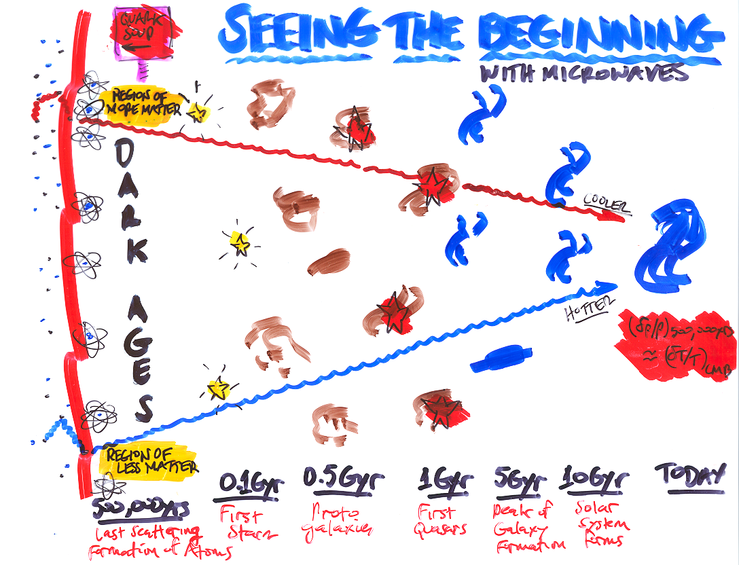

Slide 42
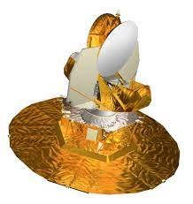
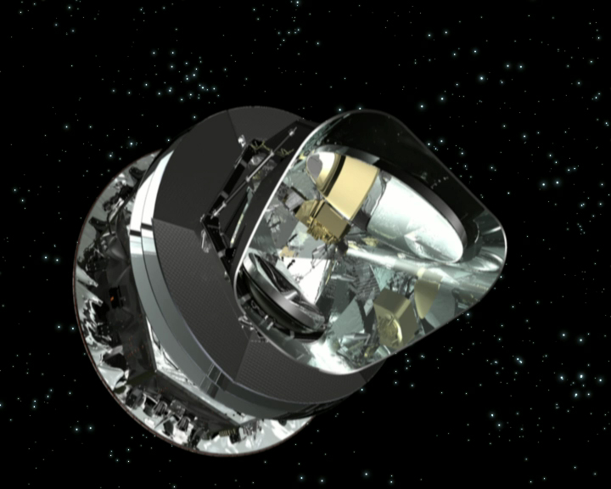
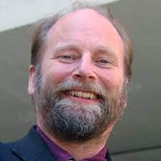
Seeing the beginning with increasing resolution and precision

Slide 43
The Universe at 380,000 years
Notes:
Here is the spherical harmonic power spectrum and the LCDM curve determined by 6 parameters. On the right is the polarization power spectrum. Much of this data is from experiments we have been involved in, including WMAP and the SPT. Just think of that: 6 numbers describe our Universe
Baryon density, Matter density, tau, n, Q and age/Omega_L

Slide 44
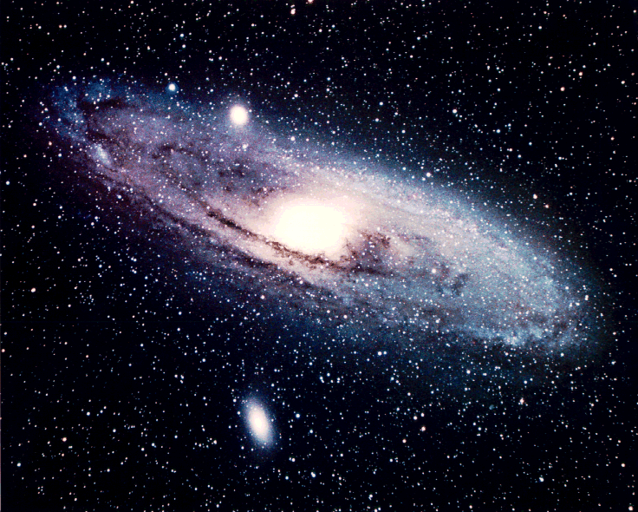
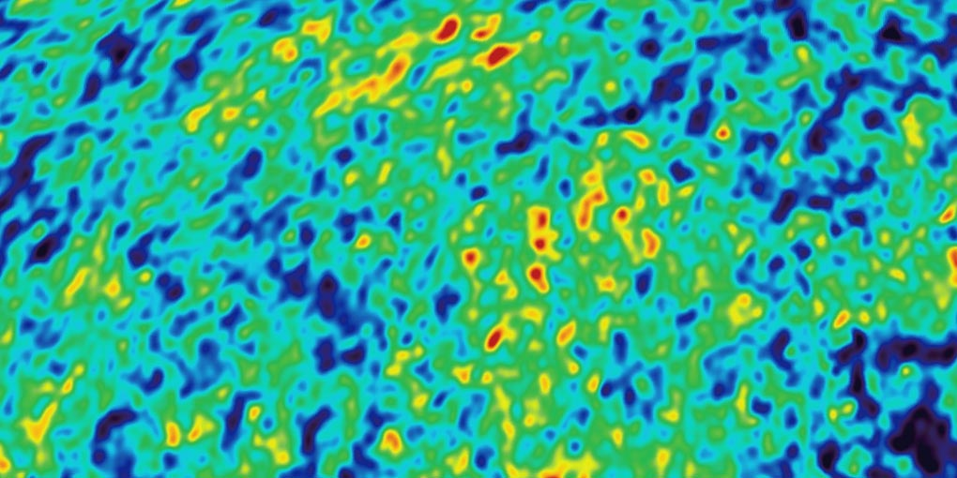
Grandest quantum connection
Quantum fluctuations on unimaginably small scales lead to structure on cosmic scales

Slide 45
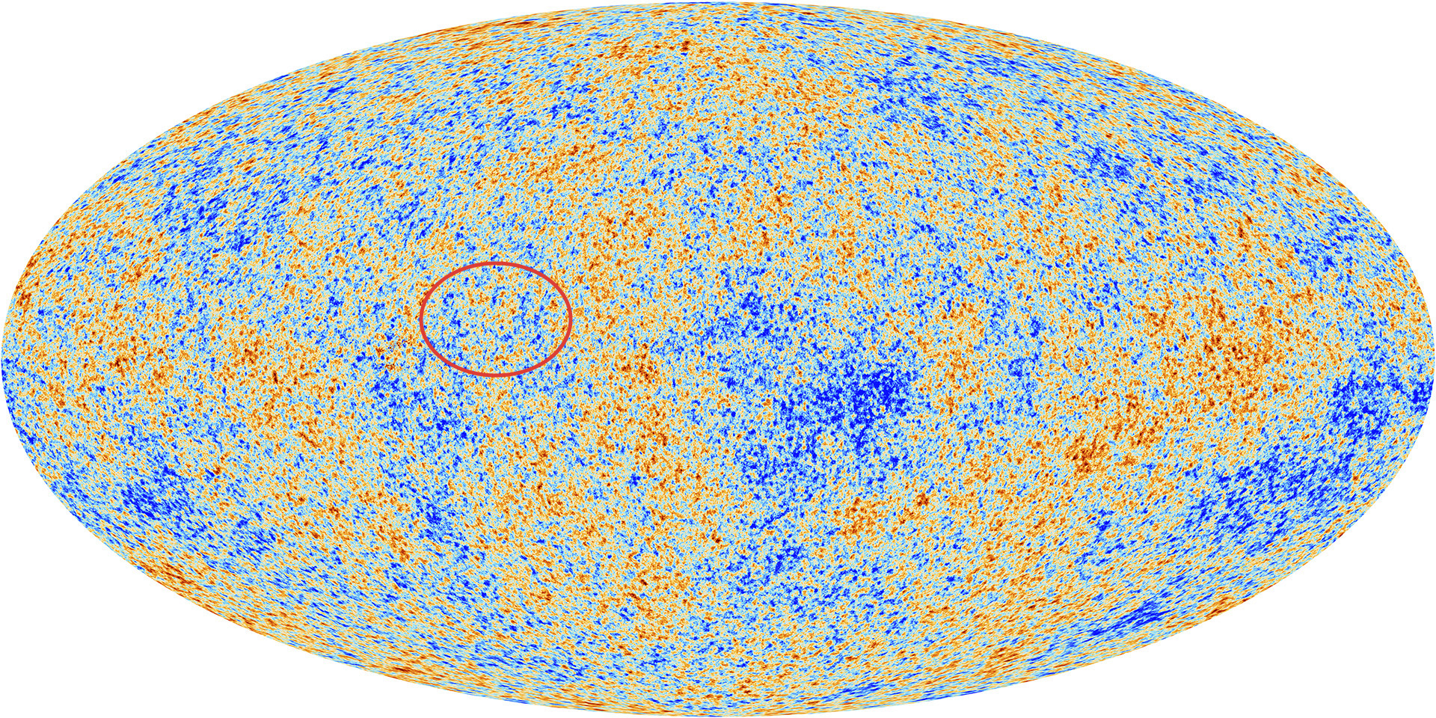
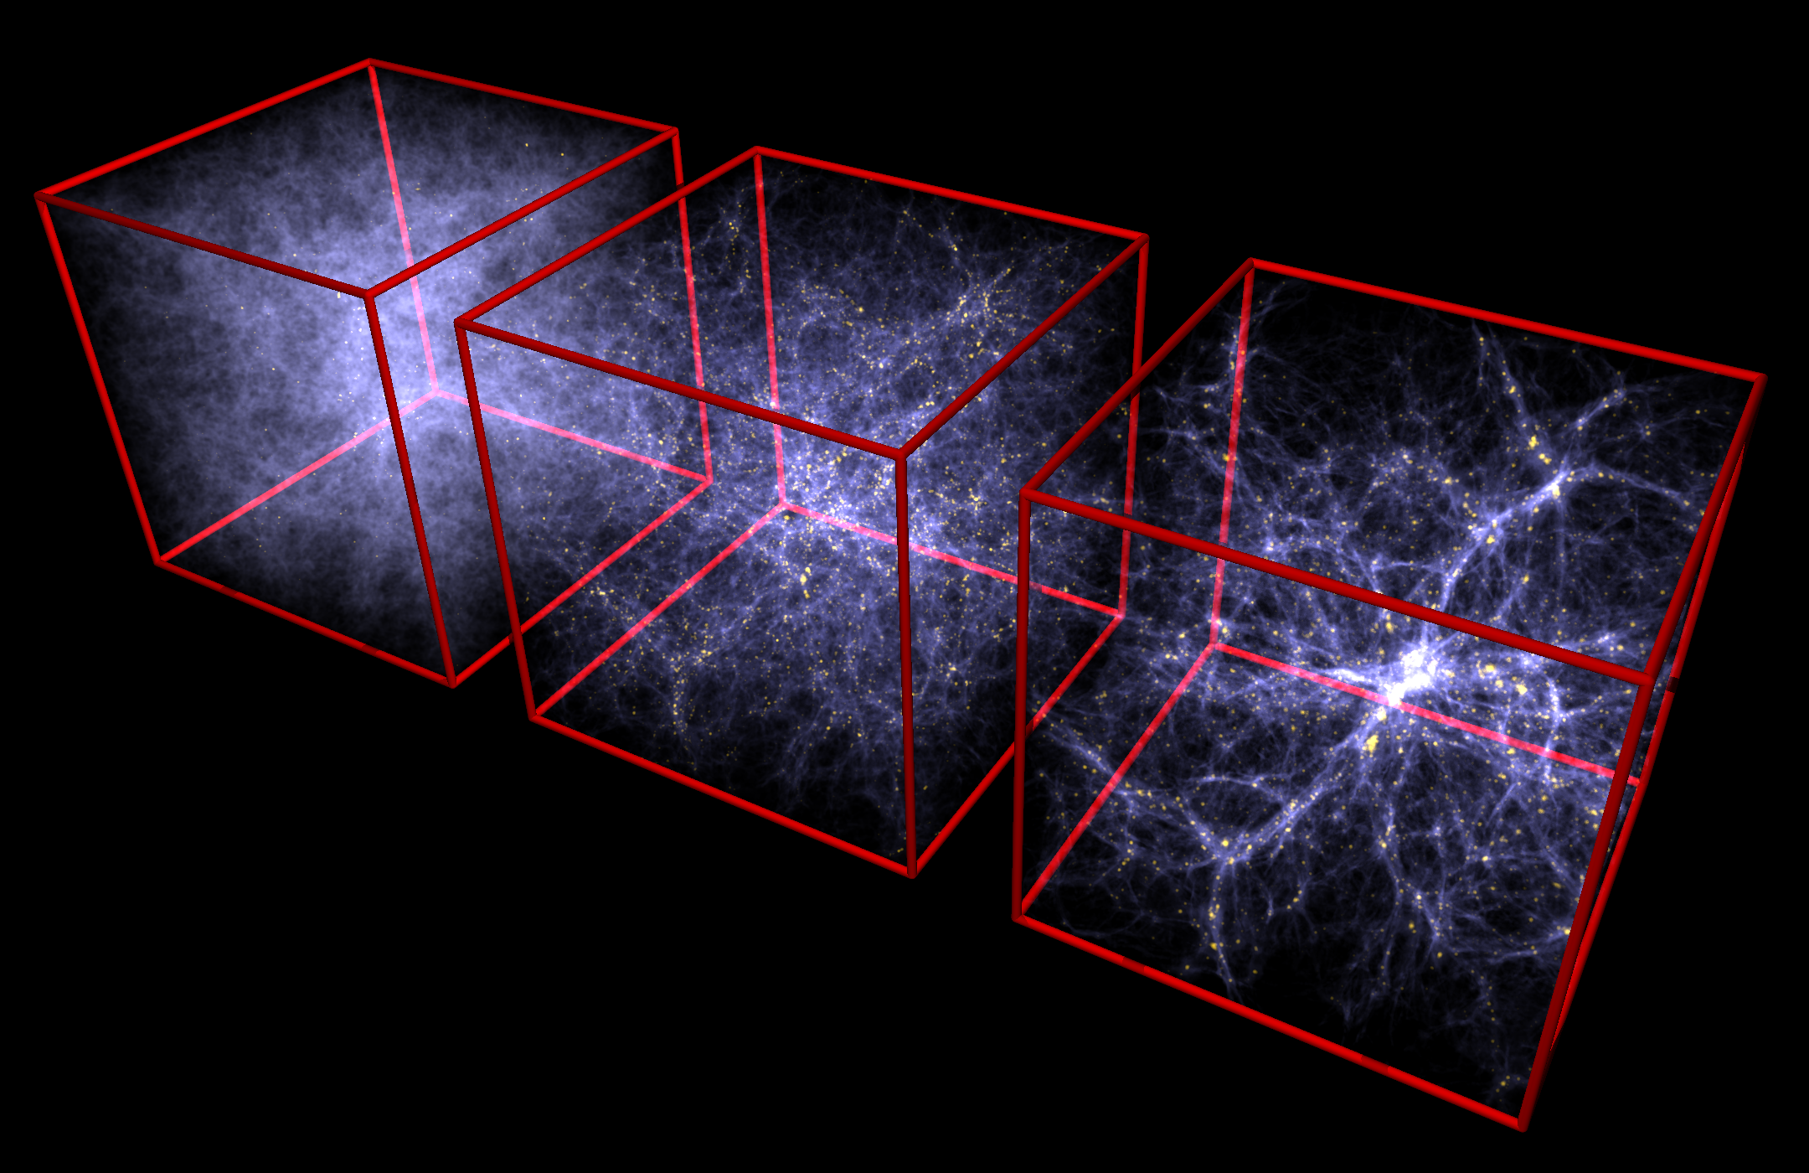

Tracing the history from a slightly lumpy
Universe to galaxies ablaze

Slide 46
Dark Matter
Galaxies and clusters of galaxies are held together by the gravity of dark matter
Without the gravity of dark matter cannot make observed structure
More diffuse (less condensed) than stellar matter
Moves slowly (cold) and bashful (doesn’t interact much with ordinary matter)
Not enough atoms to account for it, must be new form of matter

Slide 47

Dark Matter: this?
Stars
The dark matter particle
WIMPs or axions

Slide 48
Dark Matter: or that?
Dark Matter
The dark sector

Slide 49



Λ (vacuum energy) fits the date but why so small?
Evidence of the rich vacua of string theory and the multiverse?
Related to inflation (accelerated expansion) or something else?

Slide 50

CMB anisotropy consistent with predictions: Gaussian, almost scale-invariant density perturbations and flat Universe, but no “standard model” or signature of “when”
Wanted: odd-parity (B) mode of CMB polarization produced by gravitational waves

Slide 51


GWs and B-mode CMB polarization
n = 1
n = 0.85
r << 1
r = 1

Slide 52
Predictions are hard … especially about the future
… Y. Berra and N. Bohr
Astrophysical cosmology (story of stars and galaxies) will be interesting (and exciting)
The connections between the very small and very large will deepen
There will be surprises!

Slide 53
1980: Coming together of cosmology and particles changed the vocabulary, the players and the experimental techniques
Dark Matter
WIMPs
Inflation
Baryogenesis
Dark Energy
CDM
Quark Soup

Slide 54


Hubble troubles

Slide 55



1970 Allan Sandage

Slide 56


H₀ reined in, part one
H₀ = 72 ± 2 ± 6 km/s/Mpc
70

Slide 57



Hubble troubles again!
Indirect (pink): 67.5 ± 0.5 km/s/Mpc
Direct (cyan): 73.2 ± 1.3 km/s/Mpc
5-sigma difference!
“early”
George Efstathiou (Planck)
“late”
Adam Riess (SHoES)
arXiv:2103.01183

Slide 58



Measuring different things!
Direct (today):
  NB: “v easy, d hard”
  Distance ladder: standard candles – Cepheids, TRB, SNe1a
  Time delay (jump ladder)
  Both agree
Indirect (early via CMB)
Direct and indirect could both be correct and paradigm wrong! Or, one or both measurements could be wrong and ΛCDM correct

Slide 59

“New physics”
The two discrepant measurements could both could be right if ΛCDM is wrong!
New ingredient(s) to ΛCDM
  Early dark energy
  Extra radiation
  None compelling yet
Or one or both measurements could be wrong or NEW PHYSICS! Big mystery; stay tuned!

Slide 60


ΛCDM paradigm shift: adding one (odious) thing, solved FIVE problems with Inflation + CDM. H₀ doesn’t look quite as compelling

Slide 61

Einstein got the right answer for the wrong reason?
= Emergence of space and time

Slide 62


Cosmic Destiny
In the Presence of Dark
Energy, a Flat Universe
Can Expand Forever,
Re-collapse, or Even
Experience a Big Rip!

Slide 63


Slide 64

The multiverse

Slide 65

What to do about the multiverse
Most important “discovery” since Copernicus?
But is it science? (not testable – yet)

Slide 66
My aspiration: zero numbers once given the ”laws of physics”
Laws of physics (not initial conditions or parameters) determine the present large-scale features of the Universe and statistical properties (climate not weather)
Agnostic to the uniqueness of “TOE”, the “watchmaker,” and to the existence of a multiverse/“ensembiverse”
Successes:
  Big bang nucleosynthesis (no need to specify initial chemical abundances; nuclear physics + expansion determines the primordial mix)
Partial successes:
  Baryogenesis (no need to specify initial baryon asymmetry or large entropy per baryon; baryon number + C/CP violation + expansion determine the outcome)
  Structure formation (once the initial homogeneity is specified, gravity + expansion and hydro determine the outcome)

Slide 67



Learning from/testing inflation
Inflation: essential part of automatic Universe (reduces sensitivity to initial state). Tie descriptive Planck parameters (A_{S}, n_{s}, dn_{s}/dlnk, r, n_{T}) to theory parameters

Slide 68
Learning from/testing inflation
Inflation: essential part of automatic Universe (reduces sensitivity to initial state). Tie descriptive Planck parameters (A_{S}, n_{s}, dn_{s}/dlnk, r, n_{T}) to theory parameters

Slide 69

What could possibly go wrong
Initial conditions might matter
  Axion dark matter
  Penrose: it is all about the initial singularity
Universe is often just beyond the reach of our biggest ideas and most powerful instruments
  No TOE or too many missing pieces

Slide 70
Back to the “numbers question”
Zero : Unifying physical theory is all that is needed
  Gell-Mann, Hartle-Hawking
Handful: Descriptive (largely theory agnostic)
  For example, the “CMB 6” or H₀/q₀
Handful: Anthropic/multiverse (infer from first principles what is needed for our existence!)*
  Rees, West Coast, …
*That is why it is often called the narcissistic principle

Slide 71

A very complicated Universe
Atoms : Democritus to 1964
+ photons: 1964
+ neutrinos (e, μ): 1967
+ exotic dark matter: 1981
+ CDM: 1983/4
+ massive neutrinos: 1998
+ dark energy: 1998
+ τ neutrino: 2000
Done? Not likely!
Why is Ω_{CDM}/Ω_{B} ≈ 5?
I.I. Rabi
Who ordered that?
How much room for more:
UR: ~0.2ρ_{CMB}
NR: ~0.1ρ_{crit}
Other leftovers: ??

Slide 72
And then, the limits of cosmology
Limited by past light cone (GFR Ellis)
“The iron curtains”: CMB, neutrinosphere, inflation
Testability in an historical science
  e.g., what constitutes proof of inflation? dark matter?
Technology (hard and soft)
  Dogs cannot understand QM; can we, creatures of time, understand the Universe?
Nature of science: theories are disprovable, not provable & the assumption of objective reality
… but hopefully not by our passion to understand our Universe

Slide 73



Boltzmann brain
The Boltzmann brain argument suggests that it is more likely for a single brain to spontaneously and briefly form in a void (complete with a false memory of having existed in our universe) than it is for the universe to have come about as the result of a random fluctuation in a universe in thermal equilibrium. It was first proposed as a reductio ad absurdum response to Ludwig Boltzmann's early explanation for the low-entropy state of our universe.

Slide 74

Murray Gell-Mann: 0 numbers
There is a unique Theory Of Everything (the TOE) – a string theory – and the rest is “weather”*
*paraphrasing here, he said environmental science

Slide 75


Lord Rees of Ludlow: just 6 numbers
3 dimensions of space
Weak gravity = 10⁻³⁶ x EM
Energy release in 4 H → He is 0.007mc²
Flat Universe
Small Λ
Density perturbations: Q = 10⁻⁵

Slide 76



ΛCDM 6 numbers: new version of q₀/H₀?
Baryon density
Matter density
Density perturbation amplitude
Tilt
Sound horizon
Optical depth

Slide 77


Ideas from particle physics
The coming together of the very big and the very small
David Schramm circa 1980
Fermilab Symposium May 1984

Slide 78




Slide 79

Era of Precision Cosmology
(plenty of well measured numbers)

Slide 80

?

