Slide 1
Present Status of Inflationary Cosmology
Andrei Linde
Lemaitre Conference 2024

Slide 2
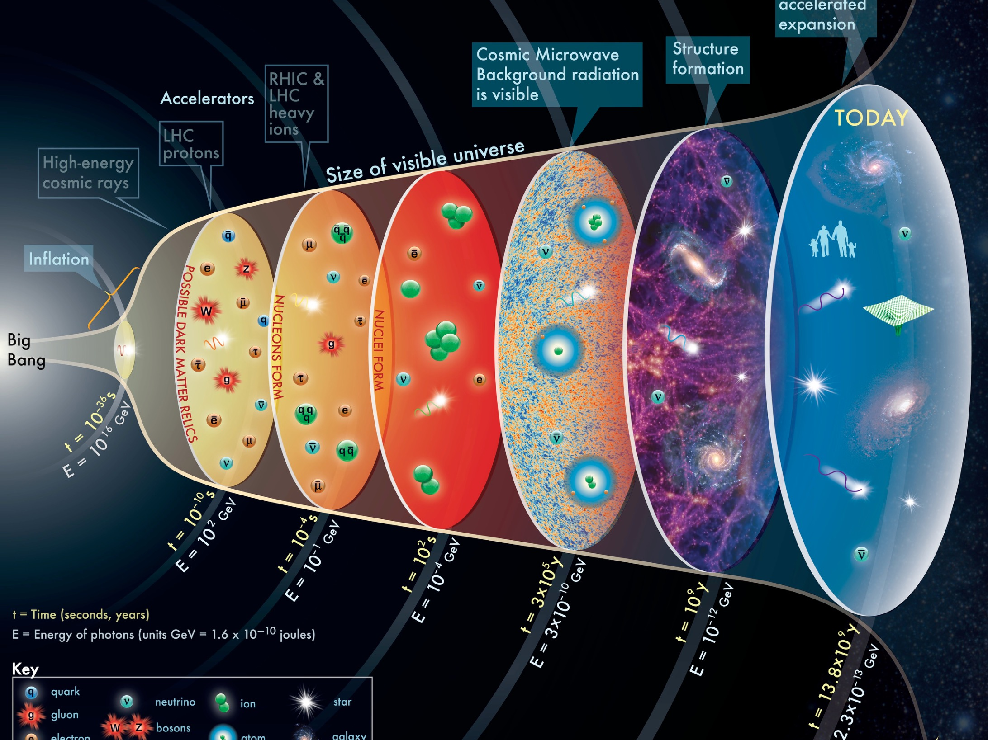

Slide 3
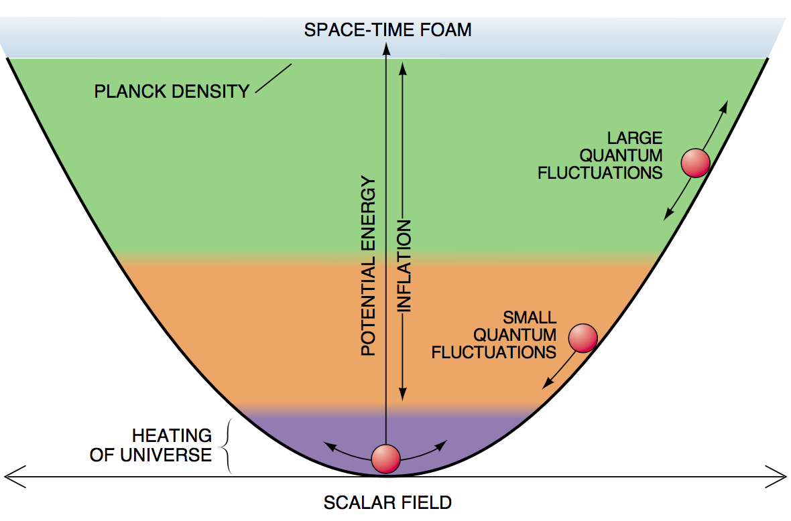
The simplest inflationary model
Eternal Inflation

Slide 4
Consider a tiny universe of a smallest possible size 10⁻³³ cm at the Planck density. If the potential energy of the scalar field in this domain was greater than its kinetic and gradient energy, it starts growing fast.
Within 10⁻⁴² s the universe becomes homogeneous and completely dominated by the potential energy of the scalar field.
Equation for the scalar field
Einstein’s equation
The solution shows that the universe grows approximately exponentially. At the end of inflation, the universe grows up by a factor
Here φ₀ is the initial value of the field.

Slide 5
A newborn universe could be as small as 10⁻³³ cm and as light as 10⁻⁵ g
(it could be born from nothing at all…)

Slide 6
Inflationary universe 10⁻³⁵ seconds old
in ANY units of length

Slide 7
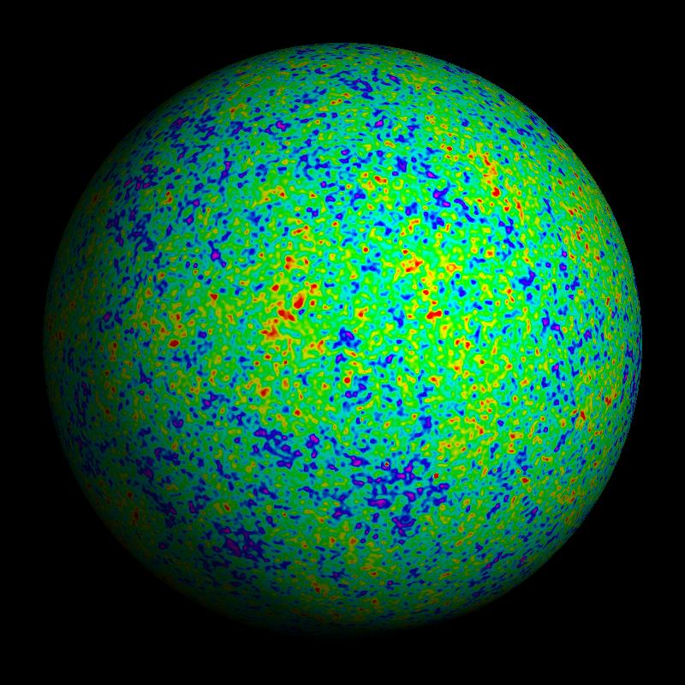
The universe after inflation becomes huge and almost absolutely uniform, but quantum fluctuations make it slightly non-uniform. This leads to formation of galaxies and tiny perturbations of the temperature of the universe

Slide 8
Origin of structure:
In this theory, original inhomogeneities are stretched away, but new ones are produced from quantum fluctuations amplified during the exponential growth of the universe.
Galaxies are children of quantum fluctuations produced in the first 10⁻³⁵ seconds after the birth of the universe.

Slide 9
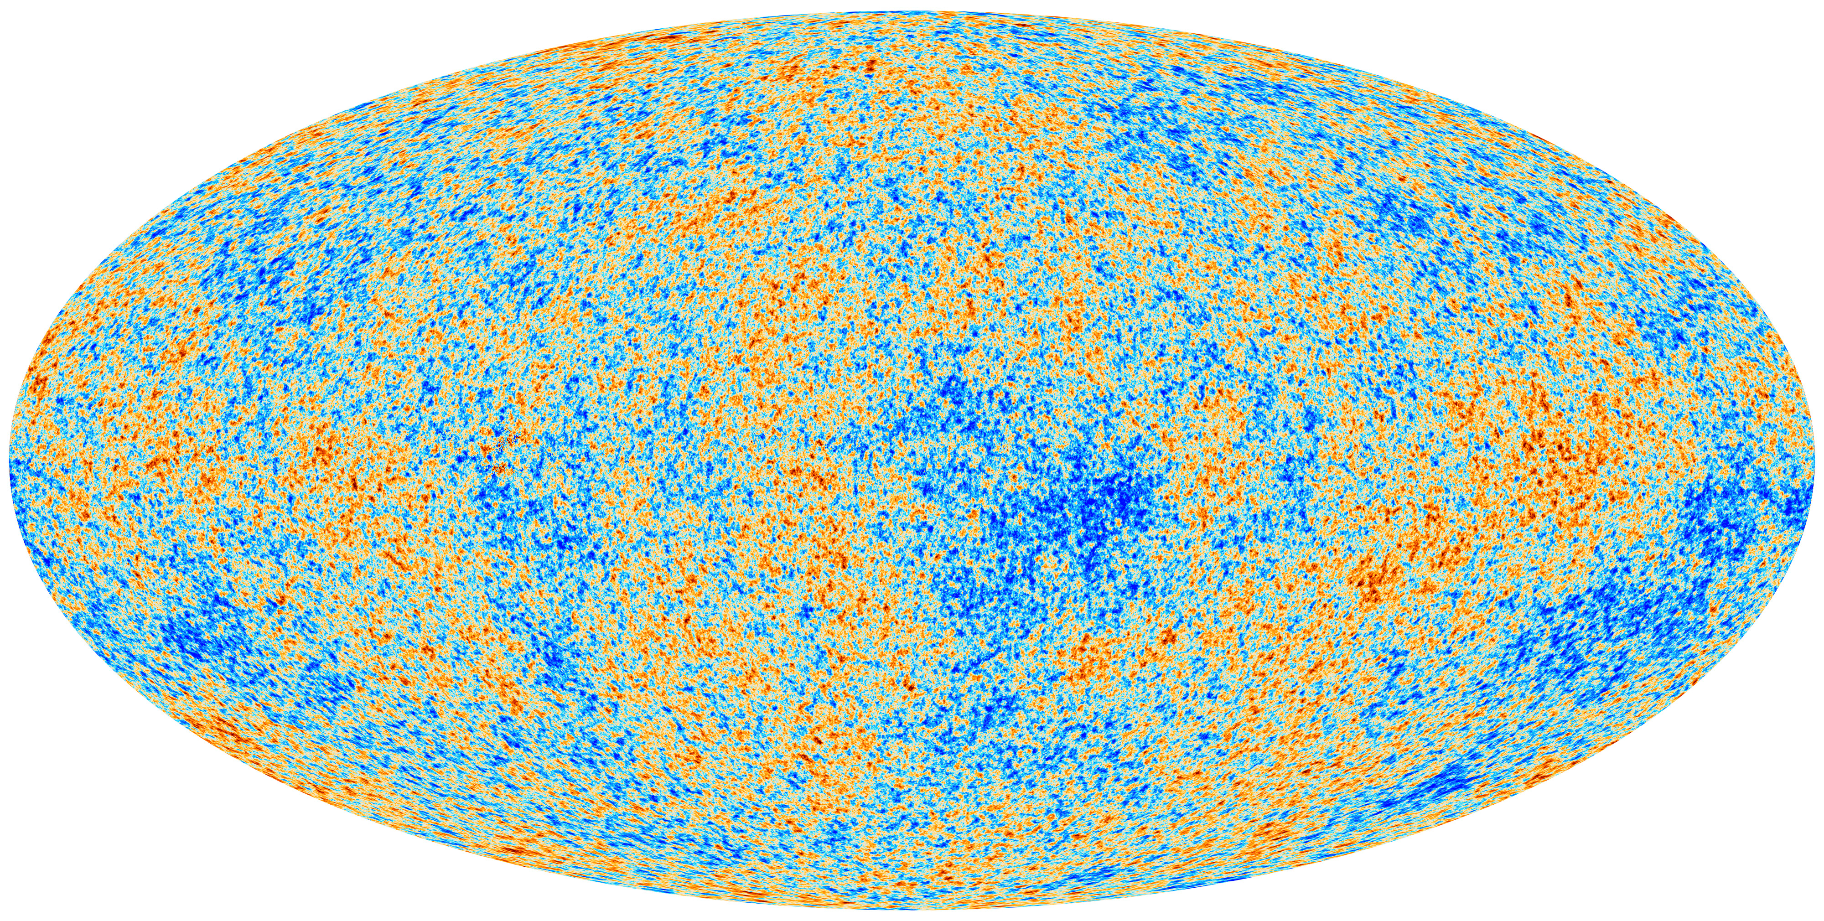
Planck satellite: Perturbations of temperature
This is an image of quantum fluctuations produced by inflation 10⁻³⁵ seconds after the Big Bang. These tiny fluctuations were stretched by inflation to incredibly large size, and now we can observe them using all sky as a giant photographic plate

Slide 10
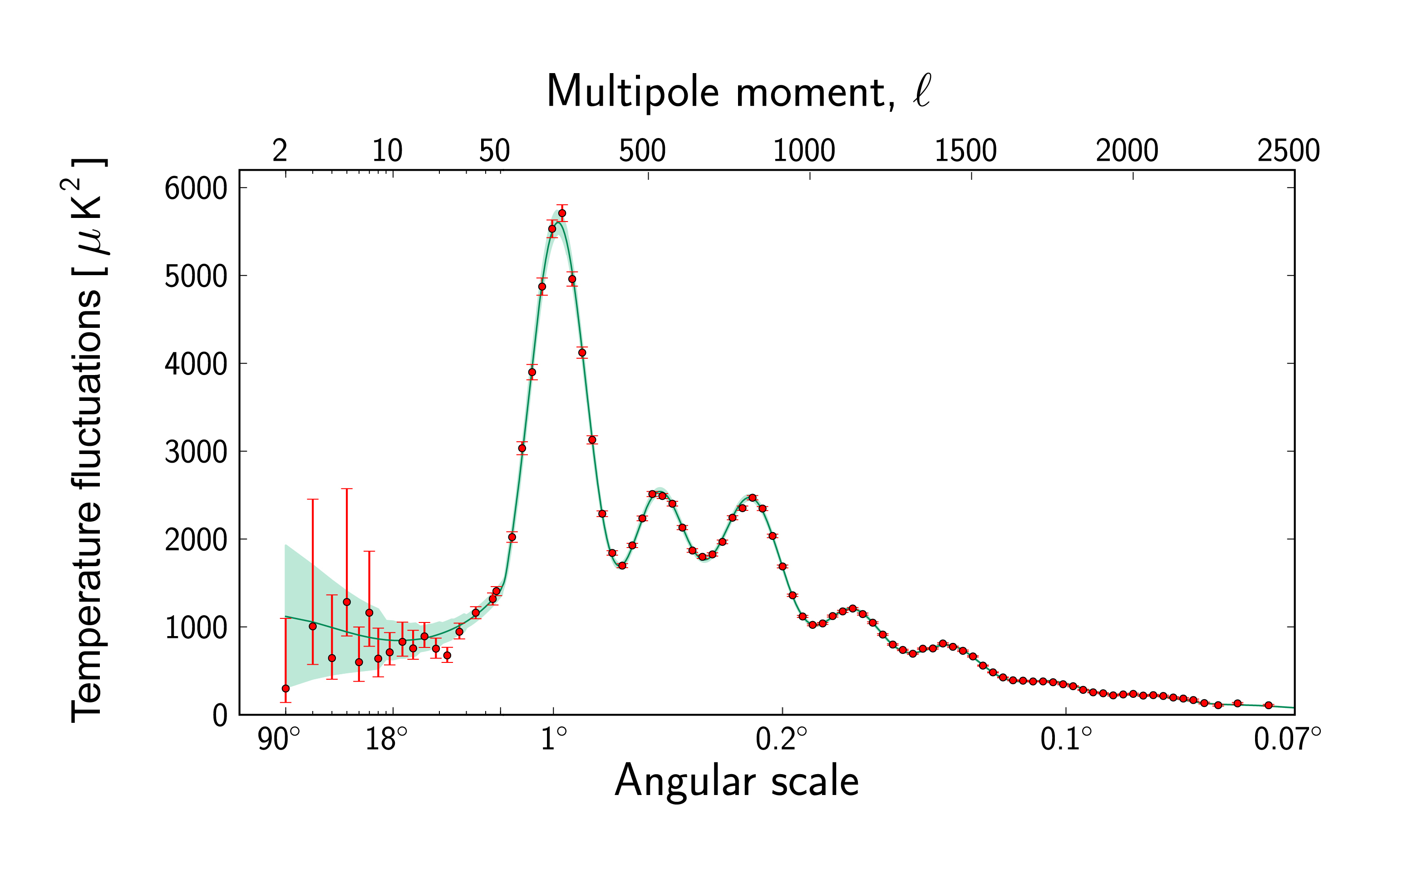
Planck satellite: Perturbations of temperature (red dots) and predictions of inflationary theory (green line)

Slide 11
Planck 2018

Slide 12
Inflation and Planck 2018
Universe is flat with accuracy about 10⁻²
Planck + SPT + BAO
Spectrum of perturbations is nearly flat
According to Planck 2018, non-inflationary HZ spectrum with n_{s} = 1 is ruled out at a better than 6σ level, just as predicted in 1981 by Mukhanov and Chibisov. (This is an important prediction of inflation, similar to asymptotic freedom in QCD.)
Agrees with predictions of the simplest inflationary models with accuracy O(10⁻⁴).
An impressive success of inflationary theory

Slide 13
Can we test inflation even better ?
B-modes: a special polarization pattern which can be produced by gravitational waves generated during inflation. A discovery of the gravitational waves of this type could provide a strong additional evidence in favor of inflation.
A.A. Starobinsky, Pis'ma Zh. Eksp. Teor. Fiz. 30 (1979) 719
V.A. Rubakov, M.V. Sazhin, A.V. Veryaskin, Phys.Lett.B 115 (1982)
BICEP/Keck, LiteBIRD and other experiments
A non-discovery of B-modes is fine too: many models predict gravitational waves with a tiny amplitude.
A discovery of inflationary gravitational waves is NOT required for proving inflation, but it would be a great gift indeed, and not only for inflation, but for investigation of quantum gravity and processes at energies many orders above LHC.

Slide 14
Testing predictions of inflation
1) The universe is flat, Ω = 1. (In the mid-90’s, the consensus was that Ω = 0.3, until the discovery of dark energy confirming inflation.)
2) The observable part of the universe is uniform (homogeneous).
3) It is isotropic. In particular, it does not rotate. (Back in the 80’s we did not know that it is uniform and isotropic at such an incredible level.)
4) Perturbations produced by inflation are adiabatic
5) Unlike perturbations produced by cosmic strings, inflationary perturbations lead to many peaks in the spectrum
6) The large angle TE anti-correlation (WMAP, Planck) is a distinctive signature of superhorizon fluctuations (Spergel, Zaldarriaga 1997), ruling out many alternative possibilities

Slide 15
7) Inflationary perturbations should have a nearly flat (but not exactly flat) spectrum. A small deviation from flatness is one of the distinguishing features of inflation. It is as significant for inflationary theory as the asymptotic freedom for the theory of strong interactions
8) Inflation produces scalar perturbations and tensor perturbations with nearly flat spectrum, and it does not produce vector perturbations.
9) In the early 80’s it could seem that inflation is ruled out because scalar perturbations are not observed at the expected level 10⁻³ required for galaxy formation. Thanks to dark matter, smaller perturbations are sufficient, and they were found by COBE.
10) Scalar perturbations are Gaussian. In non-inflationary models, the parameter f_{NL}^{local} describing the level of local non-Gaussianity can be as large as 10⁴, but it is predicted to be O(1) in all single-field inflationary models. Confirmed by Planck. Prior to the Planck2013 data release, there were rumors that f_{NL}^{local} >> O(1), which would rule out all single field inflationary models

Slide 16
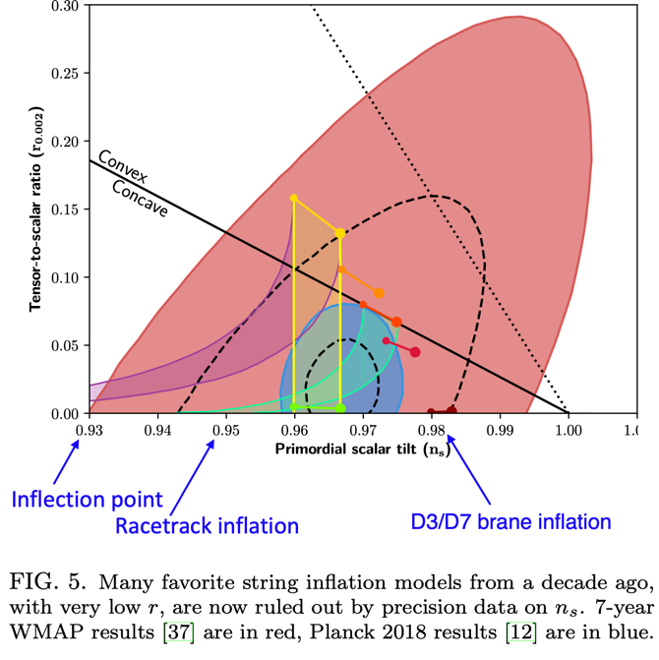

Slide 17
Planck 2018

Slide 18
One can fit all Planck data by a polynomial, with inflation starting at the Planck density
Destri, de Vega, Sanchez, 2007
Nakayama, Takahashi and Yanagida, 2013
Kallosh, AL, Westphal 2014
Kallosh, AL, Roest, Yamada 1705.09247
No problem with initial conditions
3 observables: A_{s}, n_{s}, r
3 parameters: m, a, b
Example: m =10⁻⁵, a = 0.12, b=0.29

Slide 19
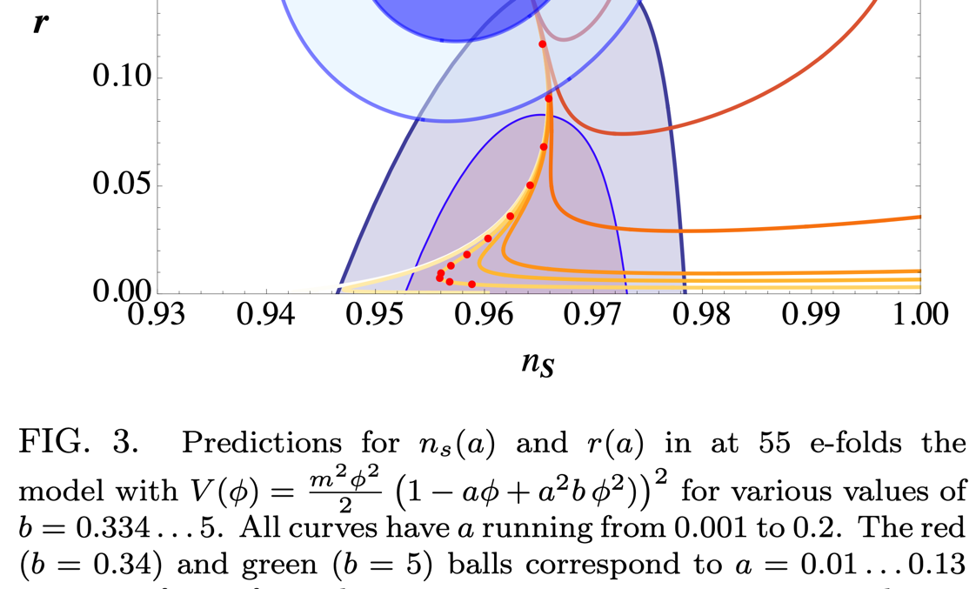
A simple polynomial superpotential with 3 parameters can describe the full range of all possible values of A_{s}, n_{s} and r, all the way to r = 0 and n_{s} = 1
Kallosh, AL, Westphal 2014

Slide 20
List of models favored by Planck2018

Slide 21
Planck 2018: Not all theories fit the data
α-attractors, Starobinsky, Higgs, fiber inflation, D-brane inflation saxion flat direction: plateau potentials
α-attractors
2013
Natural Inflation
axion flat direction
Monodromy
axion flat direction
1990
Silverstein, Westphal 2008

Slide 22
Subsequent developments:

Slide 23
Natural inflation, new inflation, and monomial potentials are disfavored by Planck + BICEP/Keck 2021

Slide 24
2208.00188

Slide 25
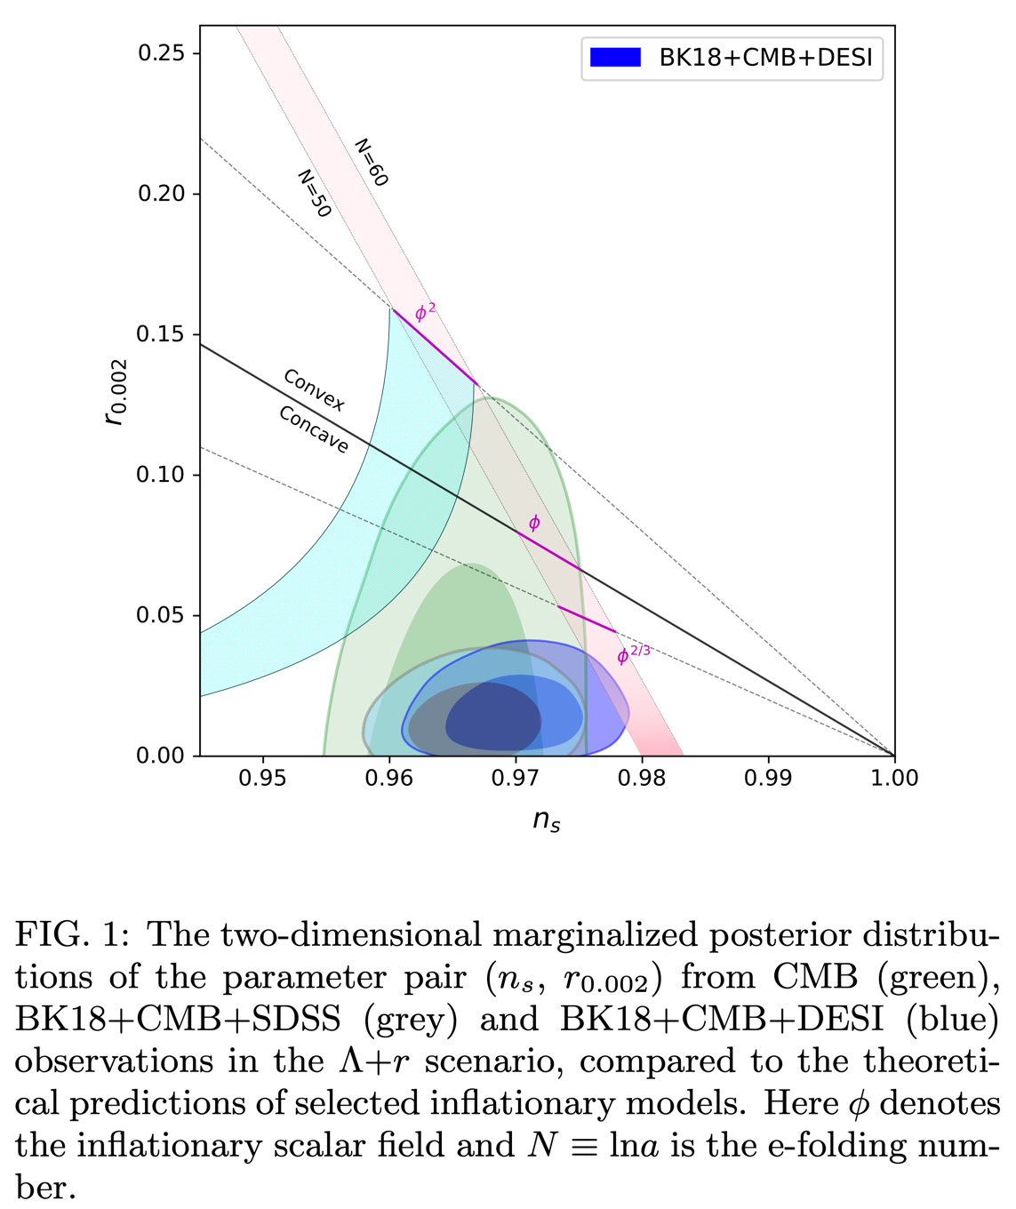
2404.06796

Slide 26

How do we park H₀ ?
George Efstathiou, April 2024

Slide 27
Planck2018 – BICEP/Keck2021 constraints
How do we “park” inflation?

Slide 28
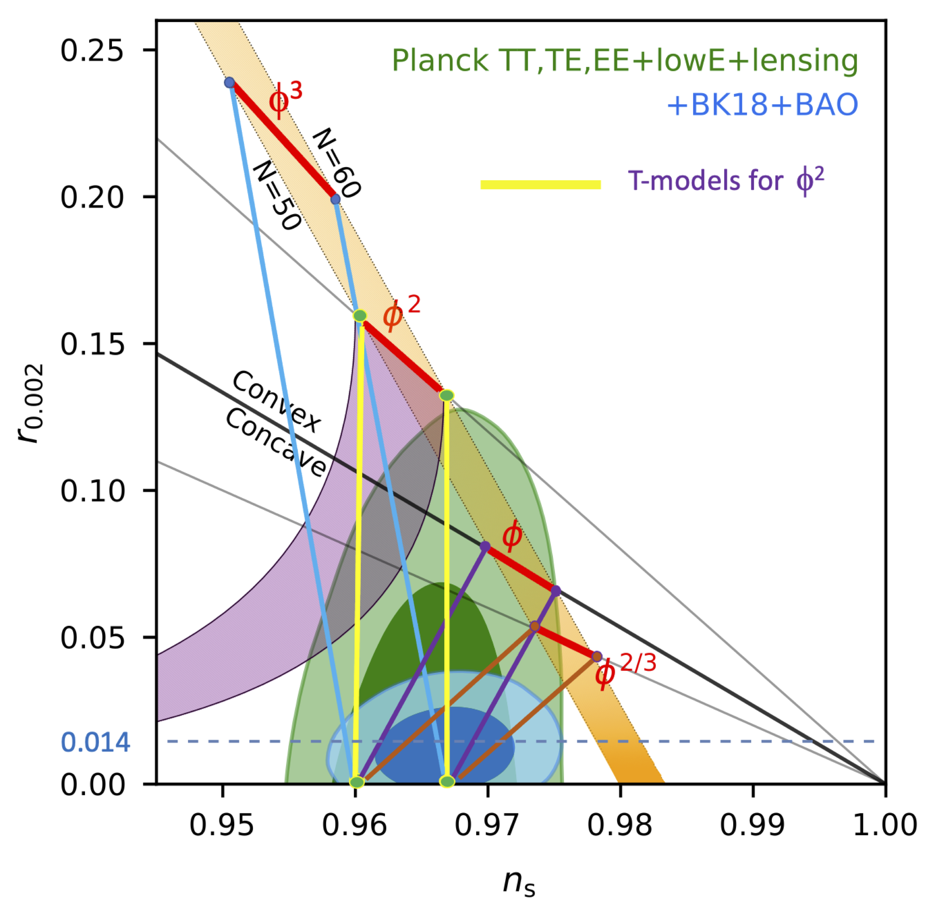
Parking Inflation:
Predictions for n_{s} in α-attractor models at α< Ο(1) practically do not depend on the choice of the potential
α-attractors saving monomial potentials
Starobinsky model and Higgs inflation

Slide 29
α-attractors
Kallosh, AL, Roest 2013
To match observations, the simplest chaotic inflation model
should be modified:
Switch to canonical variables
The potential becomes
This model (α-attractor T-model) is consistent with observational data for m ~ 10⁻⁵ and any value of α smaller than O(5).

Slide 30
What is the meaning of α-attractors?
More generally:
In canonical variables
Asymptotically at large values of the field
Here This factor can be absorbed in the redefinition (shift) of the field. Therefore, at small α, values of n_{s} and r depend only on V₀ and α, not on the shape of V(φ).

Slide 31
E-models of α-attractors
Kallosh, AL, Roest 2014
Start with the model
Switch to canonical variables
In particular, for the potential becomes
This model (E-model) coincides with the Starobinsky model for α =1. In general case these models predict

Slide 32
Planck2018 – BICEP/Keck2021 constraints
Starobinsky model and Higgs inflation

Slide 33

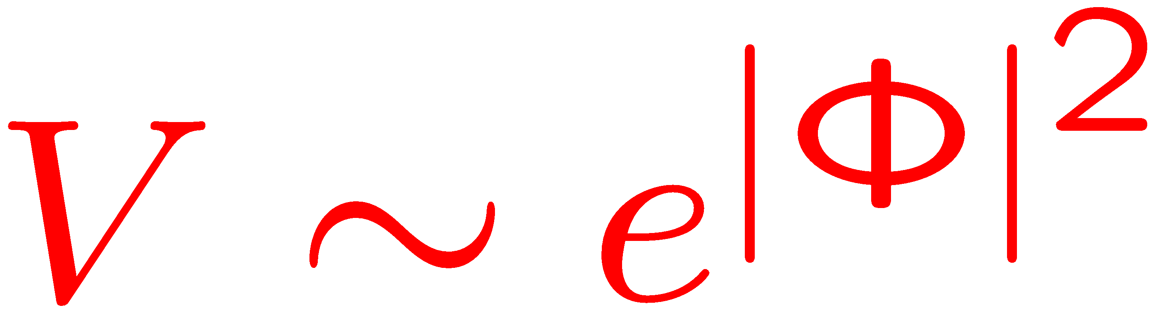
Inflation in supergravity
Main problem:
Canonical Kahler potential is
Therefore, the potential blows up at large |Φ|, and slow-roll inflation is impossible:
Too steep, no inflation…

Slide 34
A general solution
Kallosh, A.L. 2010, Kallosh, A.L., Rube, 2010
Superpotential must be a real holomorphic function. The Kahler potential is any function of the type
The potential as a function of the real part of at X = 0 is
FUNCTIONAL FREEDOM in choosing inflationary potential
This method and its generalizations are especially powerful if X is a nilpotent field, X²=0.
Antoniadis, Dudas, Ferrara, Sagniotti 2014
Ferrara, Kallosh, A.L. 2014

Slide 35
Kallosh, A.L, Roest, Yamada 1705.09247;
Gunaydin, Kallosh, A.L, Yamada 2008.01494,
Kallosh, A.L, Wrase, Yamada 2108.08491, 2108.08492
Consider a theory with a Kahler potential
and superpotential
Here X is a nilpotent field, and
Then the potential along the direction is given by
and the cosmological constant is

Slide 36
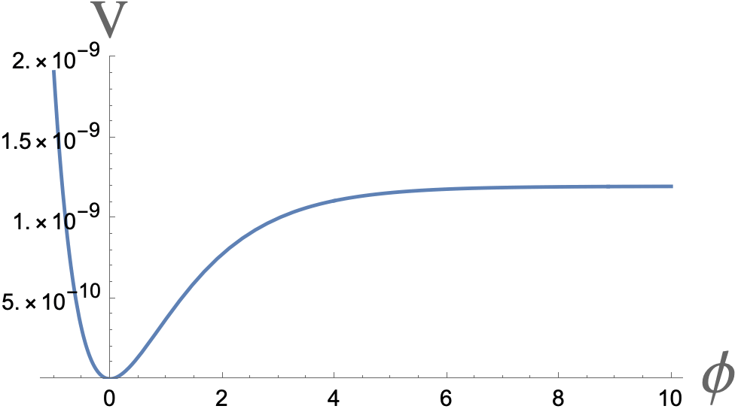
Example: single-field α-attractor
In canonical variables, along the real T flat direction one has the α-attractor potential

Slide 37
Towards sequestered inflation
The same results remain true in the theory with many moduli T_{i} if we add to the superpotential any function such that
along the direction
In the absence of the nilpotent field X, this theory would describe supersymmetric Minkowski flat directions, but in our construction the potential along the flat (inflaton) directions is given by
Importantly, this potential does NOT depend on the value of the superpotential outside of the flat inflaton directions.
This allows to disentangle, sequester, dynamics of inflation from the large energy scale encoded in .

Slide 38
IIB string theory: STU model
Kallosh, A.L, Wrase, Yamada 2108.08492
Superpotential due to Aldazabal, Camara, Font and Ibanez, 2006
Tadpole cancellation: Bianchi Identities in 10D supergravity with local sources

Slide 39
Type IIB string theory and sequestered inflation
Kallosh, A.L, Roest, Yamada 2108.08491, 2108.08492
Seven chiral superfields
Example of a flux superpotential satisfying tadpole cancellation conditions with supersymmetric Minkowski flat directions
1 flat direction
After uplifting of this flat direction and transformation to canonical variables, one finds α-attractor inflationary potential with 3α = 7 and r = 10⁻²
Describes the upper nearly horizontal line in this figure

Slide 40
BICEP/Keck2021 do not claim a discovery of the gravitational waves. The error bars of their result are too large, .
However, it is quite intriguing that the yellow and red dashed lines, which show the predictions of the largest option α = 7/3, go straight through the center of the dark blue ellipse favored by Planck/BICEP/Keck data.
BICEP/Keck hope to reach σ(r) = 0.003 within 5 years.

Slide 41
Can we use the same method to “park” inflation AND dark energy?
Akrami, Kallosh, AL, Vardanyan 2017
Consider the simplest linear potential
The corresponding α-attractor potential in canonical variables is
inflation
Requires α ~ 10⁻²
dark energy

Slide 42
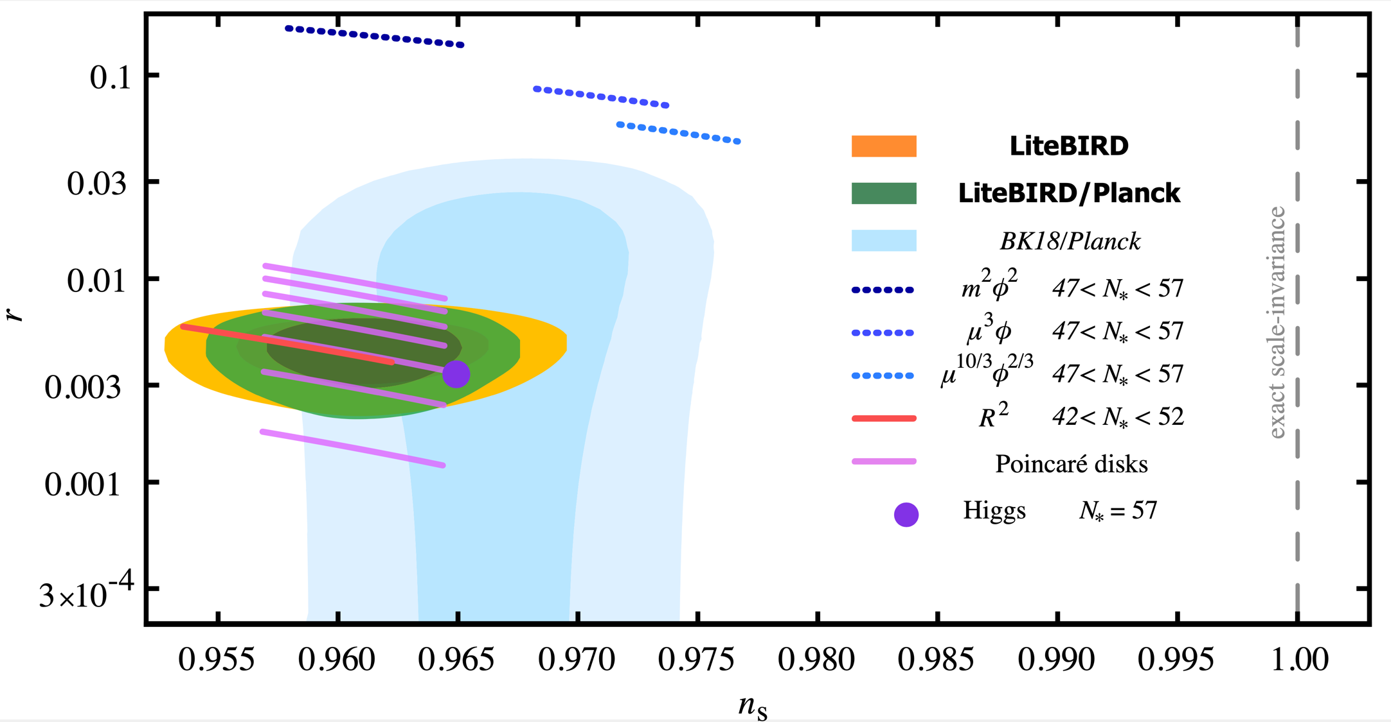
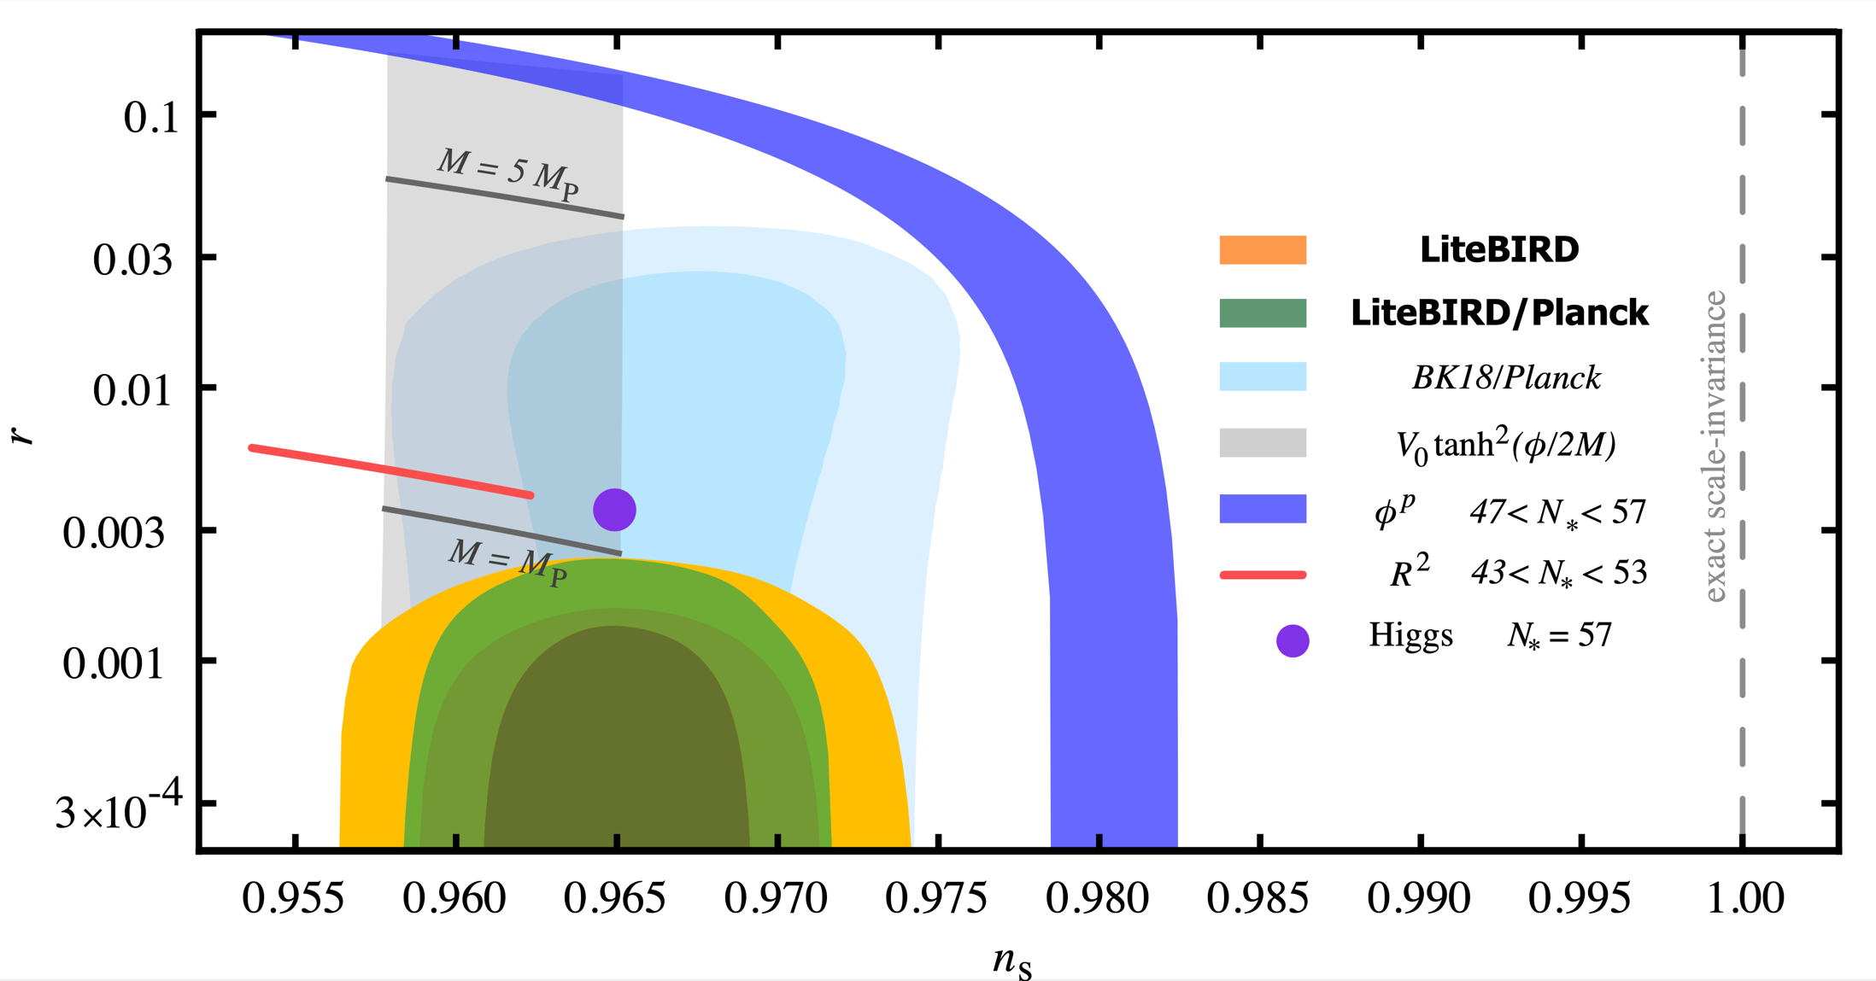
LiteBIRD
Probing Cosmic Inflation with the LiteBIRD Cosmic Microwave Background Polarization Survey
2202.02773
Are there any good models for the right side of the blue area favored by BICEP/Keck ??

Slide 43
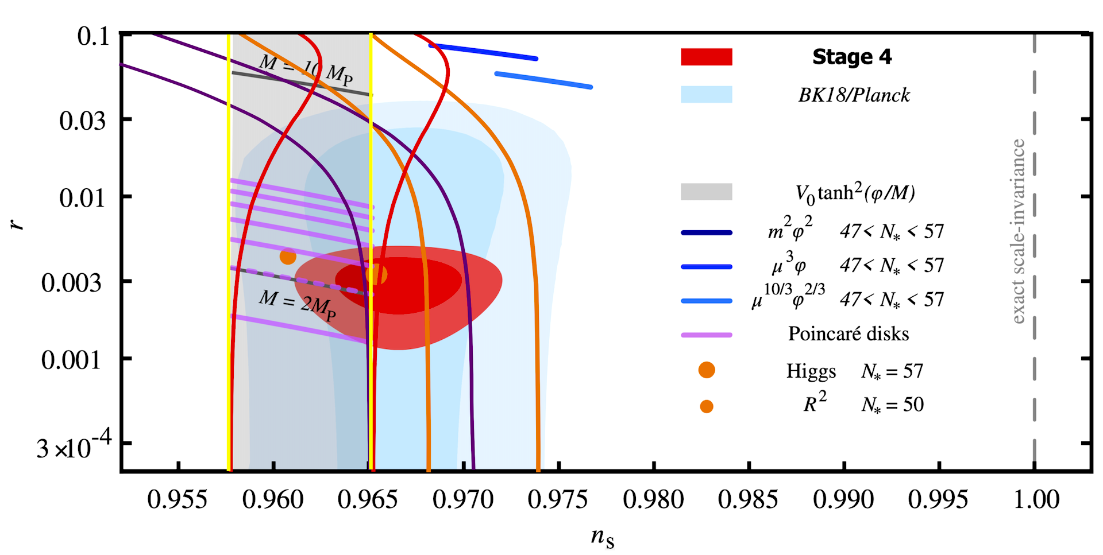
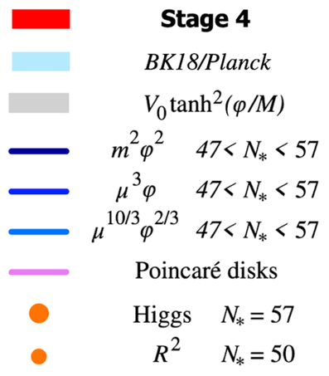
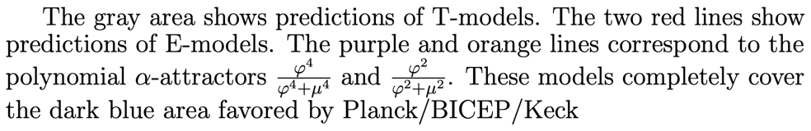
CMB-S4
Snowmass2021 Cosmic Frontier: CMB Measurements White Paper

Slide 44
Some authors trying to address the H0 problem complain that they do not know any inflationary model that could describe a broad range of n_{s}
Inflationary potential as seen from different angles
Giare, Pan, Yang, Di Valentino, De Haro, Melchiorri 2305.15378
“Despite significant efforts to explore various inflationary scenarios, no single model emerges as a comprehensive solution”

Slide 45
A simple polynomial superpotential with 3 parameters can describe the full range of all possible values of A_{s}, n_{s} and r, all the way to r = 0 and n_{s} = 1
Kallosh, AL, Westphal 2014

Slide 46
A possible comprehensive solution: Hybrid α-attractors
There is a special class of inflationary models where n_{s} = 1 is an attractor point: Hybrid Inflation
AL 1991, 1994
For σ = o, it is just the quadratic potential uplifted by M⁴/4λ
By increasing the uplifting term one can increase V without changing any derivatives of V. Therefore, in the large uplift limit, for generic V we have an attractor prediction n_{s} = 1.

Slide 47
Hybrid α-attractors: Two attractor regimes
Just as in all α-attractors, we have a universal large N attractor prediction
However, if uplift is very large, the last 60 e-foldings occur at small φ. Then for N ~ 60 one has the standard hybrid inflation prediction n_{s} = 1.
Thus, by changing V_{uplift} one can obtain any value of n_{s} in the range between the two attractor predictions
Kallosh, AL 2204.02425
Hybrid attractors are more complicated than the simplest α-attractors. However, if H₀ problem is real, this flexibility may be desirable.

Slide 48
CMB-S4
Snowmass2021 Cosmic Frontier: CMB Measurements White Paper
Hybrid attractors

Slide 49
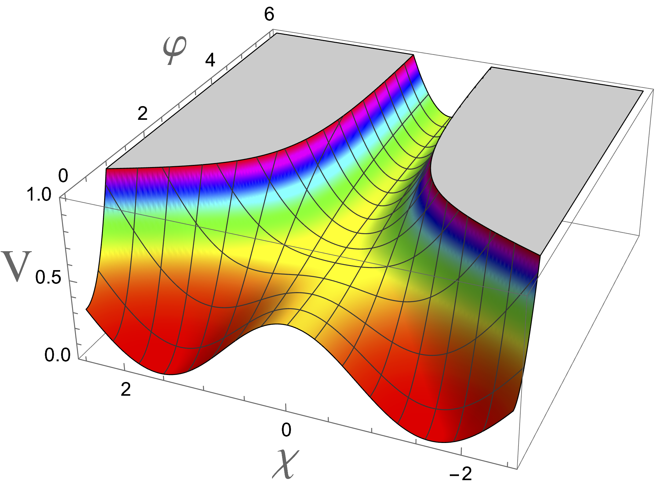
Hybrid α attractors: New possibilities
Original hybrid inflation model:
It’s α-attractor generalization:
χ₀
−χ₀
The results that we discussed so far are valid for hybrid inflation where the amplitude of spontaneous symmetry breaking is sub-Planckian, χ₀ << 1.
In the opposite case χ₀ > 1 the tachyonic mass of the field χ along the ridge χ= 0 is smaller than the Hubble constant, which leads to eternal inflation with the amplitude of perturbations O(1). It is very easy to produce large PBH and even eternally inflating topological defects in this scenario.
Garcia-Bellido, A.L., Wands 1996,
Randall, Soljacic, Guth, 1996,
Braglia, A.L., Kallosh, Finelli, 2211.14262

Slide 50
Conclusions:
1. Many predictions of inflationary theory have been tested and confirmed by observations during the last 40 years.
2. Some inflationary models, such as the Starobinsky model, the Higgs inflation, and a broad class of α-attractors can describe all available CMB inflation-related data by a single parameter.
3. Predictions of α-attractors are stable with respect to modifications of the potential. These models can describe any small value of r, all the way down to r = 0.
4. BICEP/Keck results are moving close to the range necessary for testing tensor modes in these models. LiteBIRD would move us much further.
5. There is a significant progress in implementing inflationary models in supergravity.
6. Hybrid α-attractors can describe copious production of PBH, while remaining consistent with the Planck/BICEP/Keck data.

Slide 51
Backup slides about the multiverse

Slide 52
Here comes the multiverse

Slide 54
Pessimist:
If each part of the multiverse is huge, we will never see other parts, so it is impossible to prove that we live in the multiverse.
Optimist:
If each part of the multiverse is huge, we will never see other parts, so it is impossible to disprove that we live in the multiverse.
I'd rather be an optimist and a fool than a pessimist and right. Albert Einstein
This scenario is more general (otherwise one would need to explain why all colors but one are forbidden). Therefore, the theory of the multiverse, rather than the theory of the universe, is the basic theory.
Moreover, even if one begins with a single-colored universe, quantum fluctuations make it multi-colored.

Slide 55
Example: SUSY landscape
Supersymmetric SU(5)
V
SU(5)
SU(4)xU(1)
SU(3)xSU(2)xU(1)
Weinberg 1982: Supersymmetry forbids tunneling from SU(5) to SU(3)xSU(2)XU(1). This implied that we cannot break SU(5) symmetry.
A.L. 1983: Inflation solves this problem. Inflationary fluctuations bring us to each of the three minima. Inflation makes each of the parts of the universe exponentially large. We can live only in the SU(3)xSU(2)xU(1) minimum.

Slide 56

Kandinsky Universe

Slide 57
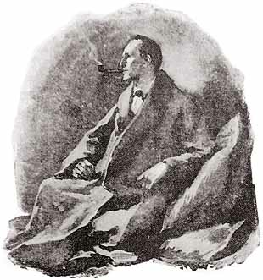
Can we test the multiverse theory ?
This theory provides the only known explanation of numerous experimental results (extremely small vacuum energy, strange masses of many elementary particles). In this sense, it was already tested many times.
“When you have eliminated the impossible, whatever remains, however improbable, must be the truth.”
Sherlock Holmes

Slide 58
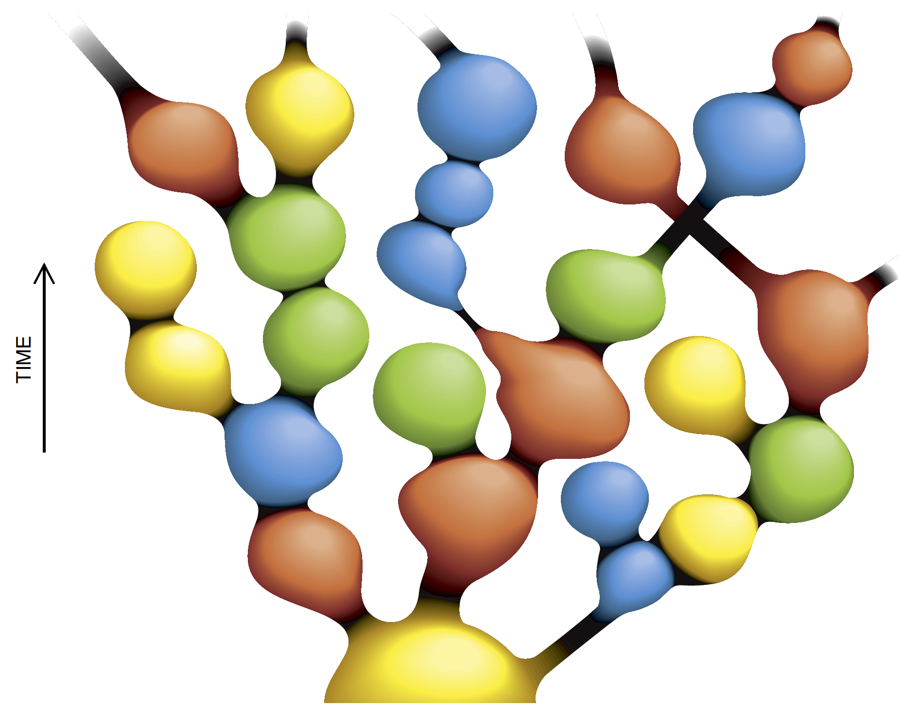

Physicists can live only in those parts of the multiverse where mathematics is efficient and the universe is comprehensible.

