Slide 1

Phenomenology of Jet Drift in Heavy Ion Collisions
Supported in part by DoE Grant (DE-SC0024560)
Supported in part by a start-up grand from NMSU
(arXiv: 2110.03590) & (arXiv:2412.05474)
Hot Jets (UIUC) 2025
9th January, 2025
Jo Bahder
In collaboration with
Hasan Rahman, Matthew Sievert,
and Ivan Vitev

Slide 2
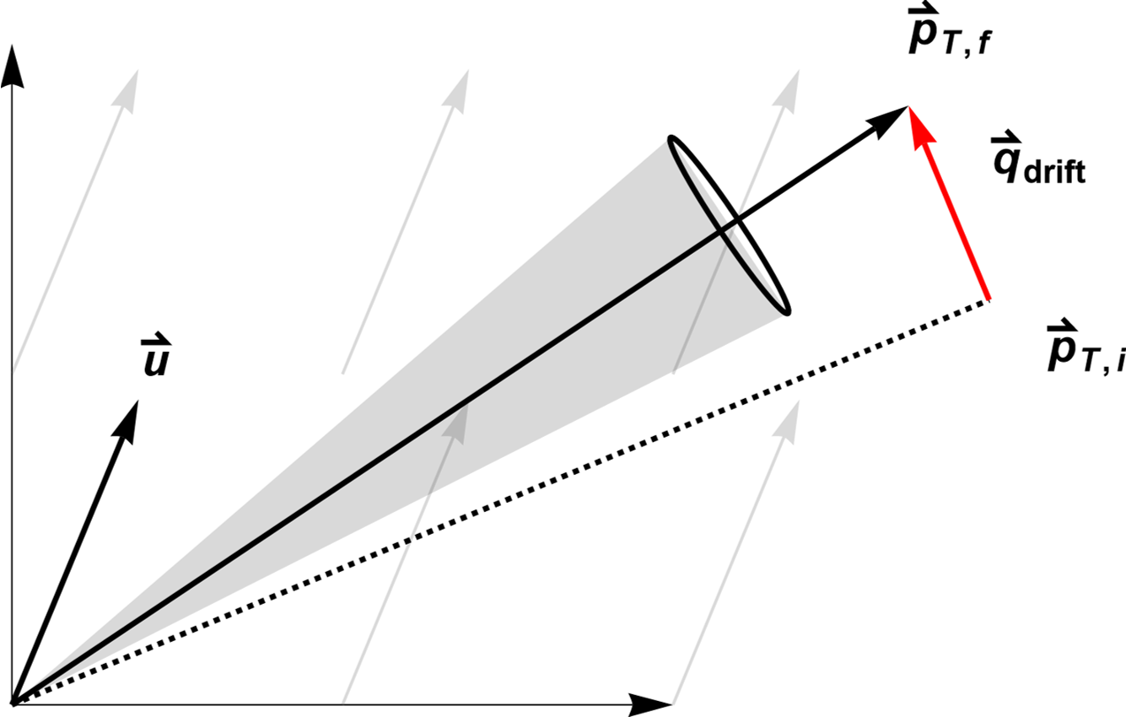
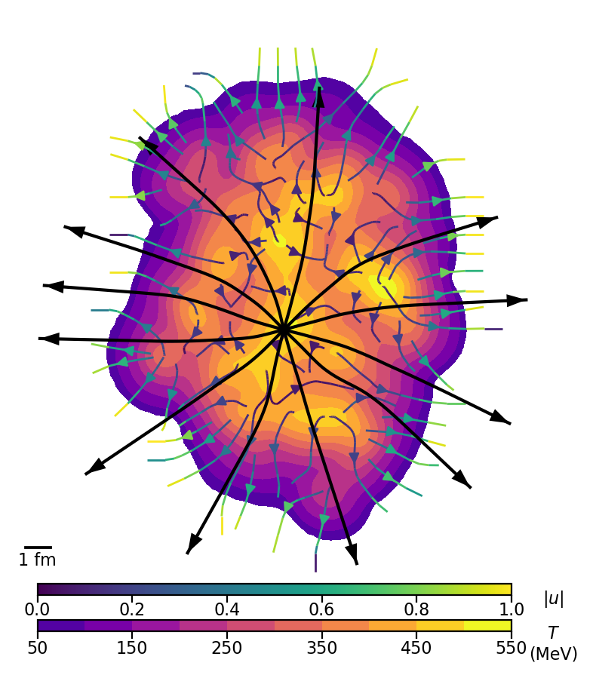
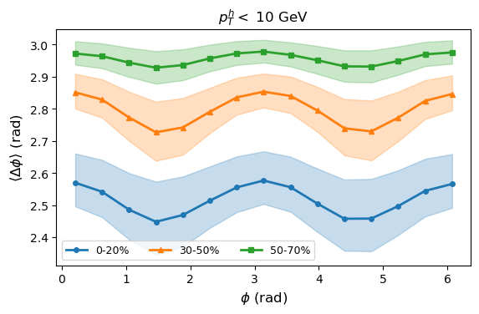
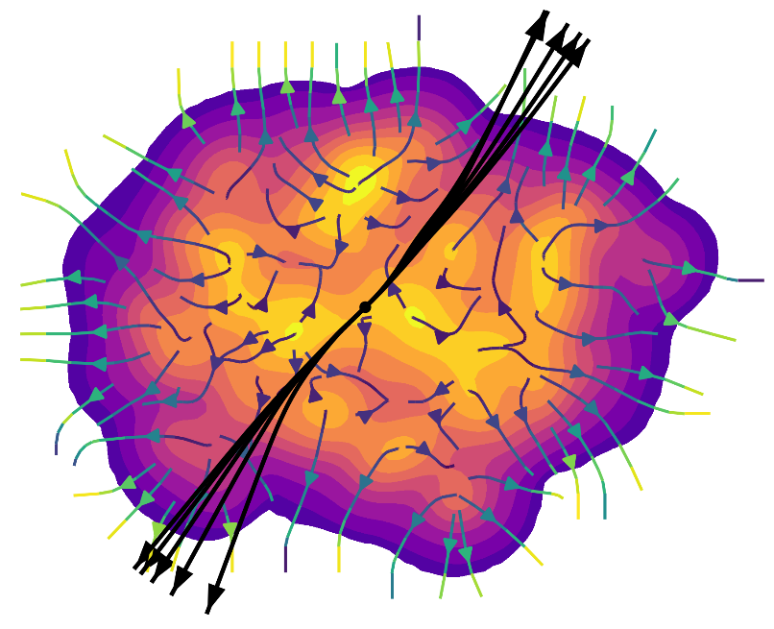
Outline
Motivation, Reminder of Jet Drift, & Possible Signatures
Introduction of Anisotropic Parton Evolution (APE)
Selected APE Results
Discussion of Implications

Slide 3
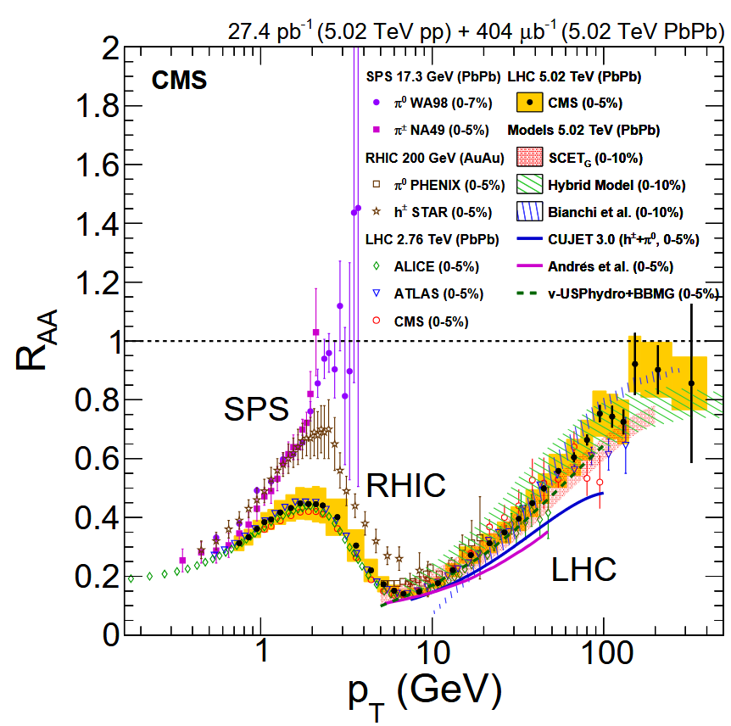
The State of Hard Probe Tomography
Delivery of hard probe tomography lackluster
  Many microscopic models obtain results similar to data (e.g. ch. had. R_AA)
Two options for successful hard probe tomography
  More discriminating observables (EECs?, jet substructure?)
  More discriminating regions of phase space (e.g. < 10 GeV)
Both require new precision perturbative calculations
arXiv:2405.10785

Slide 4
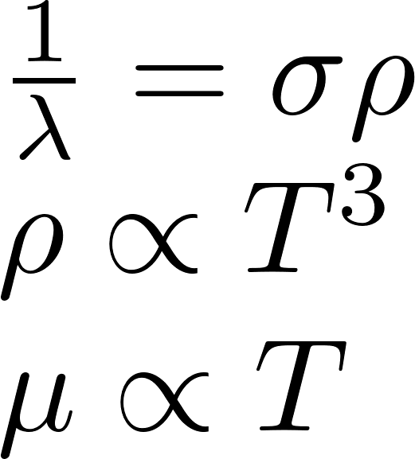
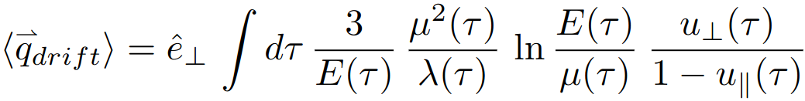
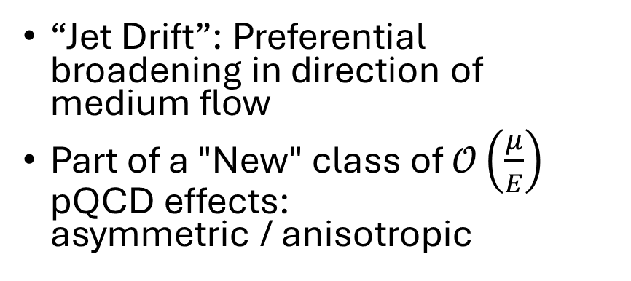

Anisotropic Jet Broadening: Jet Drift
“Jet Drift”: Preferential broadening in direction of medium flow
Part of a "New" class of $𝒪\left(\frac{μ}{E}\right)$ pQCD effects:
asymmetric / anisotropic
Flow enhanced and flow direction controlled
Analytic Pheno.
L. Antiporda, J. Bahder, H. Rahman
& M. D. Sievert
Phys.Rev.D 105 (2022)
(arXiv: 2110.03590)
Energy suppressed
Temperature/Density Enhanced
Notes:
Goal: Convince you that low-pT hard probes have new and interesting physics (especially jet drift).

Slide 5
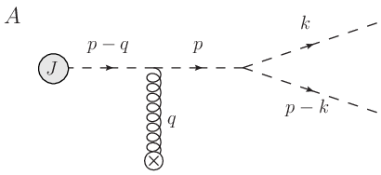
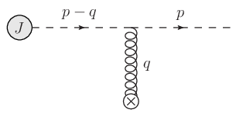
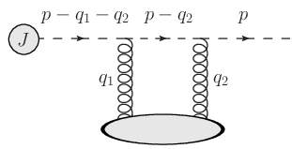
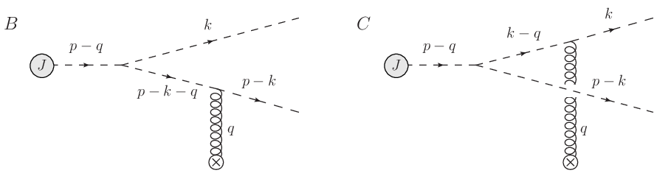
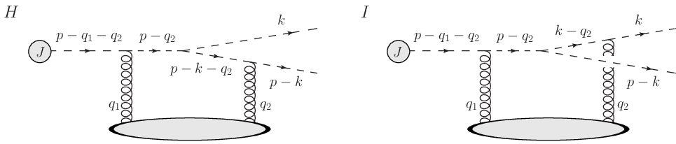
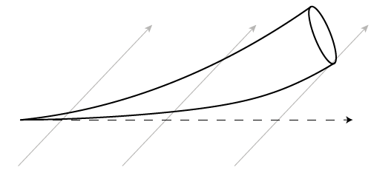
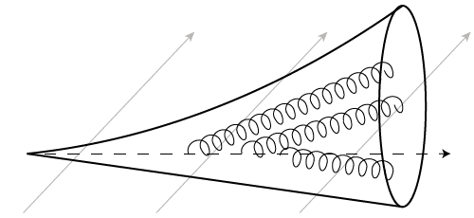
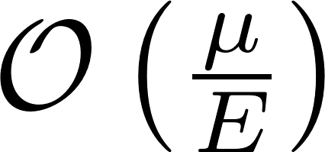
Momentum Broadening & Radiation in the Presence of Flow
Born & Double-Born Momentum Broadening Diagrams
Derivation
A. V. Sadofyev, I. Vitev, & M. D. Sievert
Phys.Rev.D 104 (2021)
(arXiv:2104.09513)
E.G. Born & Double-Born Radiation Diagrams
“Jet Drift”
New systematic behavior at
Notes:
Computing collisional and radiative diagrams in the presence of flow
Regge scalar kinematics
Parton species enters in few ways
See paper for Regge universality demonstration
s -> inf, t & m fixed and small
Holds to at least first subeikonal order
Few, if any, effects can mimic the coupling of hard particles to anisotropies in the medium
Few local vector directions:
Collective Flow & Gradients

Slide 6
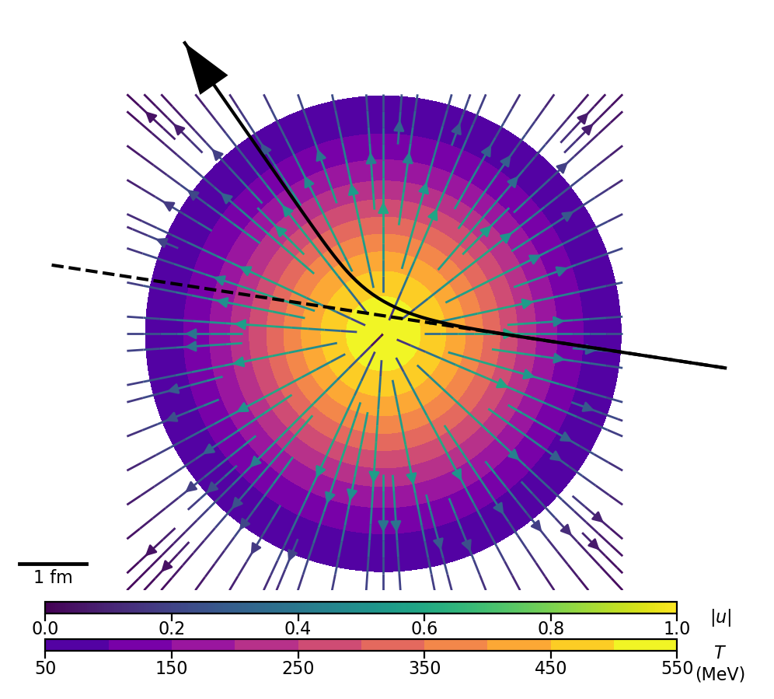
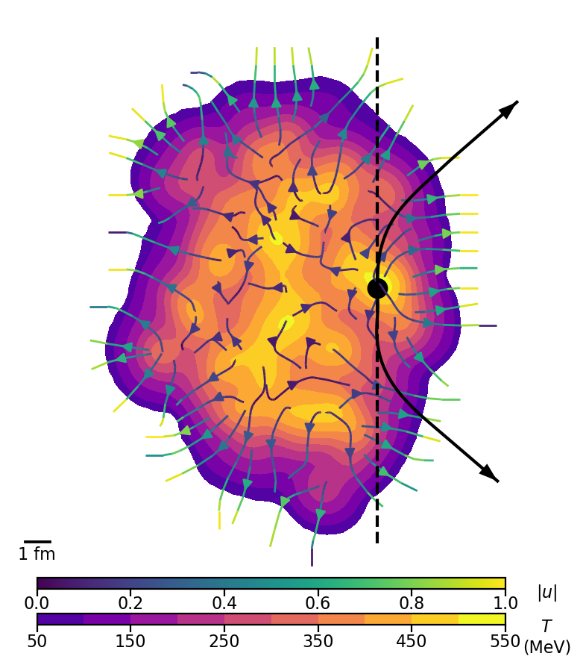
Possible Signatures of Jet Drift in Leading Hadrons
A
Modification of suppression (A)
  Deflecting away from flowing hot spots
  Particle sees reduced integrated density
Dihadron/dijet acoplanarity enhancements (B)
  Particles couple to same “attractor” in the medium
Anisotropic flow modification (C)
  Particles couple to soft anisotropic flow
B
C

Slide 7
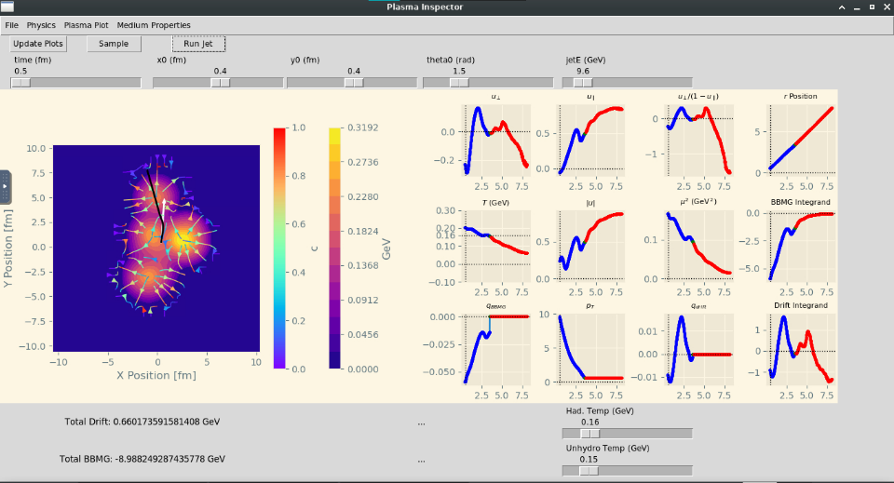


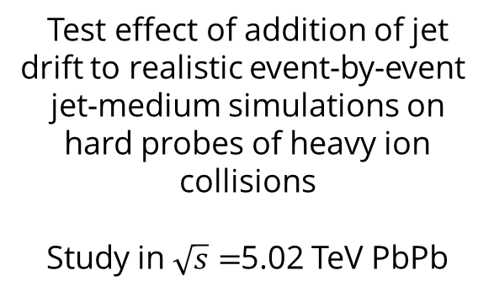
APE: A Primitive Man’s Monte Carlo
Test effect of addition of jet drift to realistic event-by-event
jet-medium simulations on hard probes of heavy ion collisions
Study in $\sqrt{s}=$5.02 TeV PbPb
APE & Drift Pheno.
J. Bahder, H. Rahman, M. D. Sievert, & I. Vitev
Preprint
(arXiv:2412.05474)
Perturbative Tree Level Scatterings
Perturbative Partonic Evolution
Perturbative Fragmentation
Hard
Particles
(APE Workflow)
Anisotropic
Partonic
Evolution
(APE)
Pythia
pp Hard Scatterings
+ Perturbative CNM
Fragmentation
Functions (FFs)
Observables
Soft Particles
(DukeQCD
Event Generator)
Trento
+ Freestreaming
Initial Conditions
OSU-Hydro
(VISHNU)
Hydrodynamics
Cooper-Frye Freezeout
+ UrQMD
Hadronic Transport
Realistic 2+1D soft HIC model tuned to pPb & PbPb data
(arXiv:1808.02106)
Notes:
Collisional energy loss as optional switch – neglecting fluctuations serious issue

Slide 8
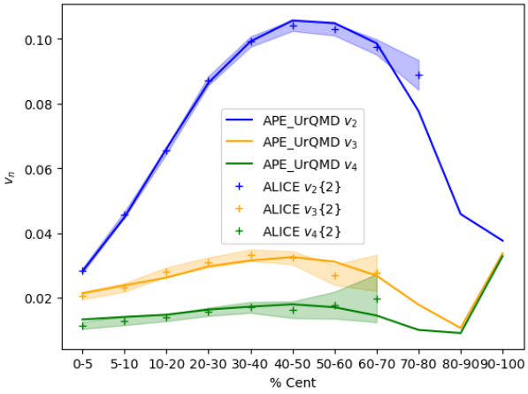
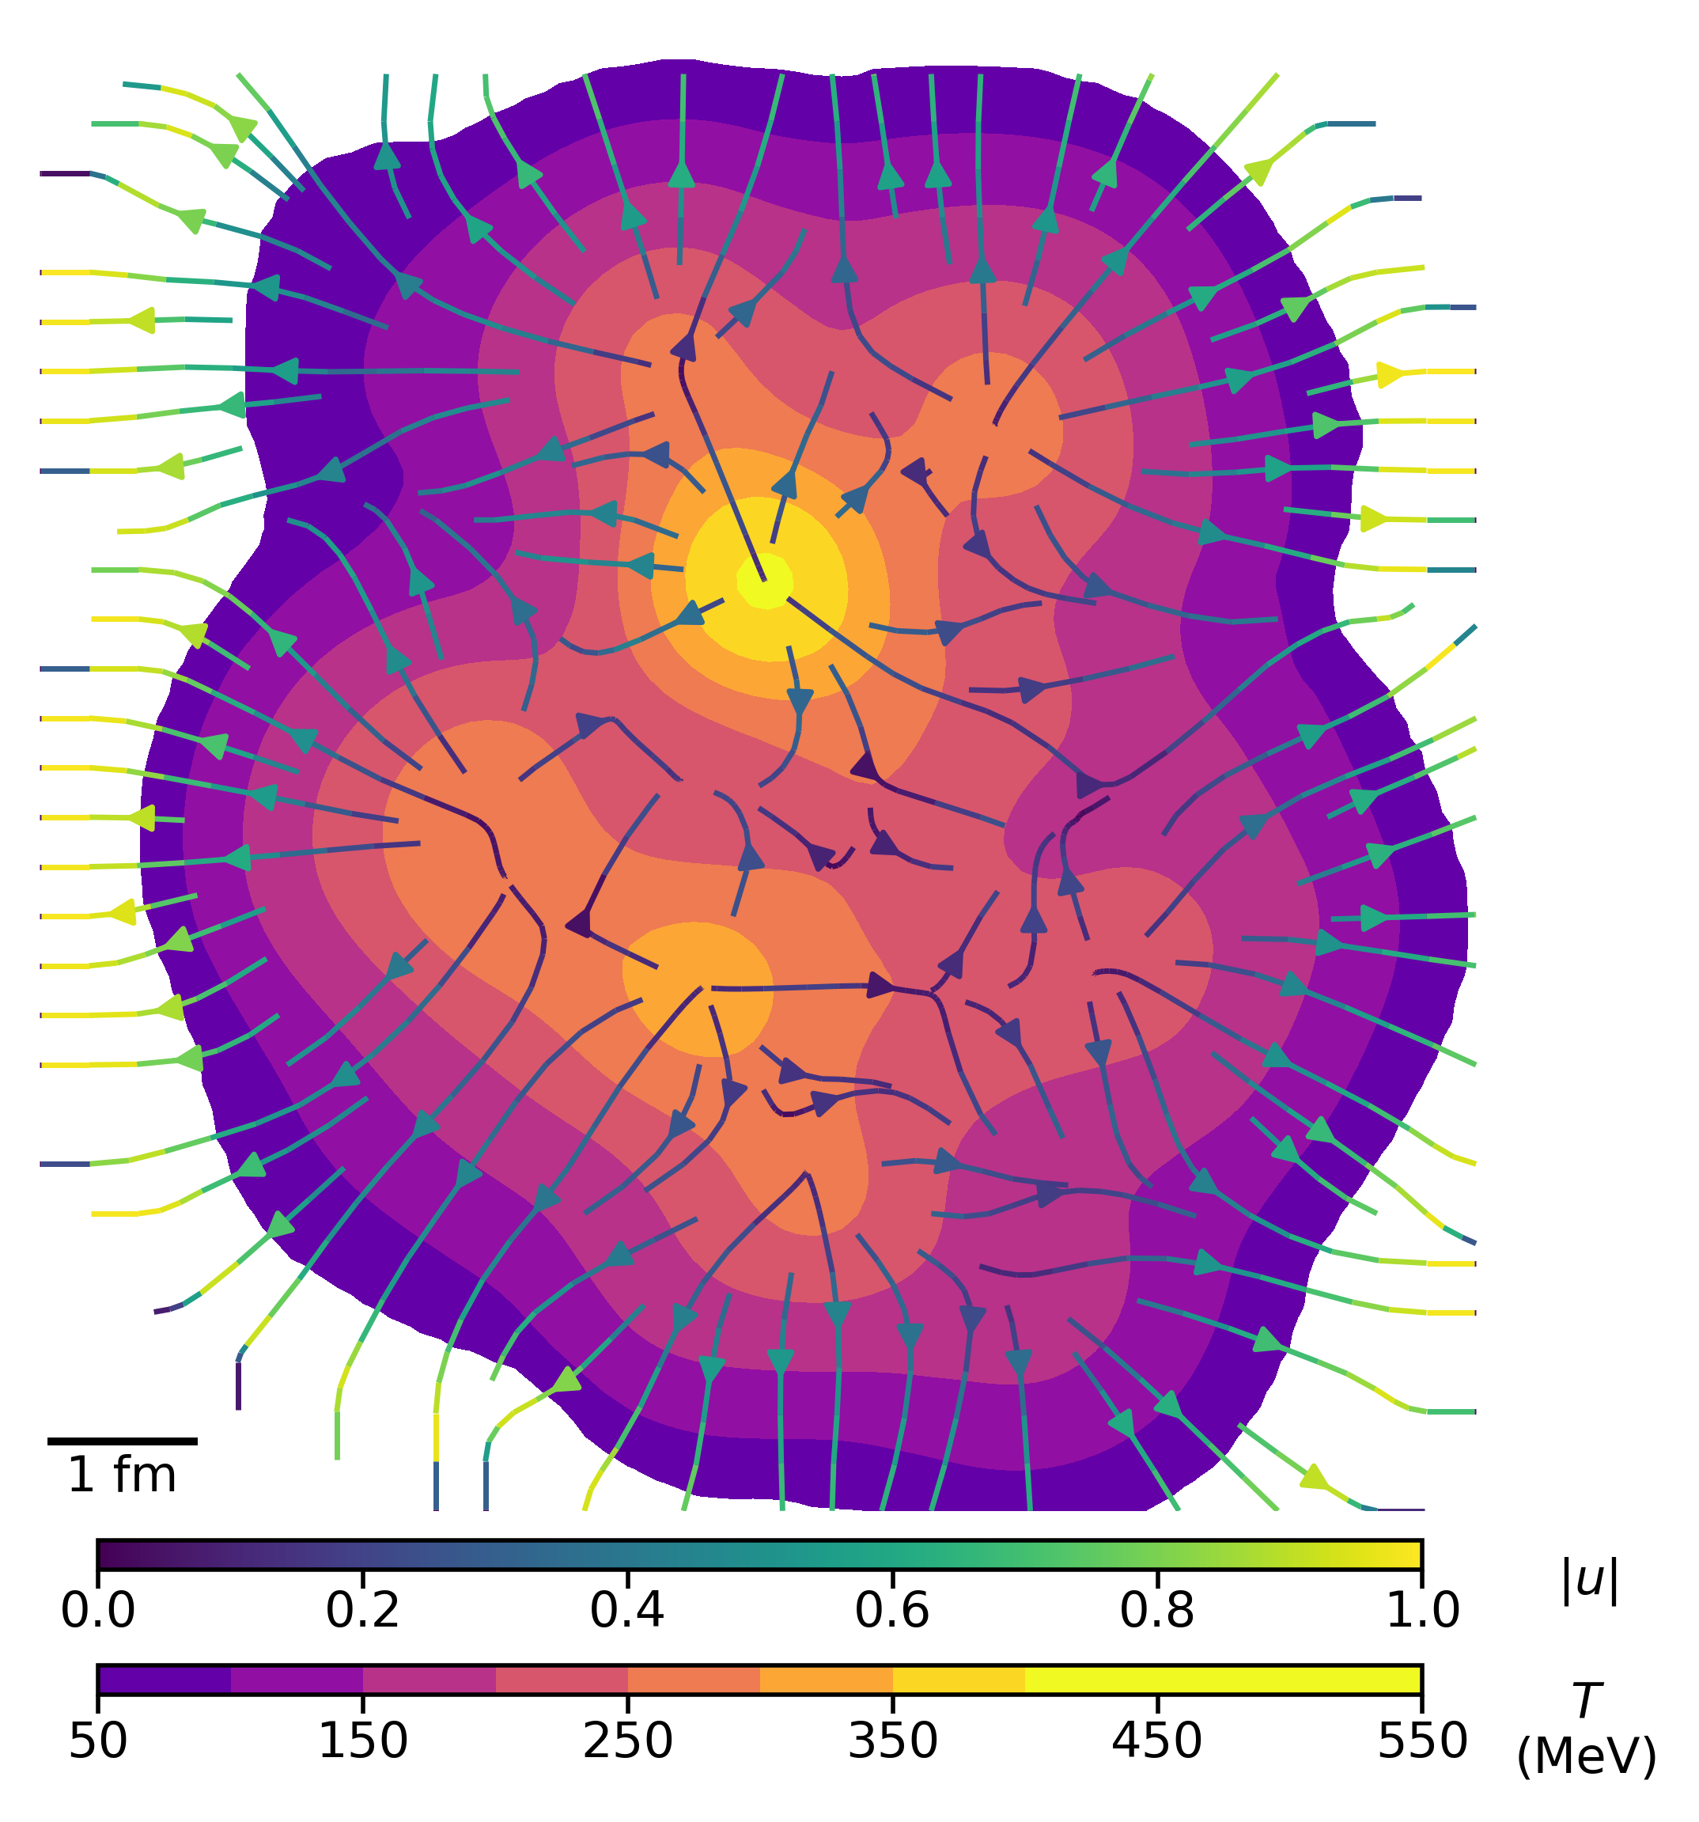
DukeQCD’s HIC Event Generator
Highly tuned to soft sector observables
  Reliable picture of final state
  Not necessarily good description of intermediate dynamics – drift distinguishes
Large event-by-event fluctuations
  Maximizes disruption of event-correlated drift
Energy suppressed
PRELIMINARY
Target: Lower Bound of Drift
See also multiplicities, mean pT, pT fluctuation, etc.: (arXiv:1808.02106)

Slide 9

The Wonders of the Open Science Grid
Do you have high throughput computing needs?
Do you work for a US institution?
Check out the
Open Science Pool!
https://osg-htc.org/
Total core hours this project has used to date:
~1.589 MILLION core hours
Or… 181 core Years

Slide 10
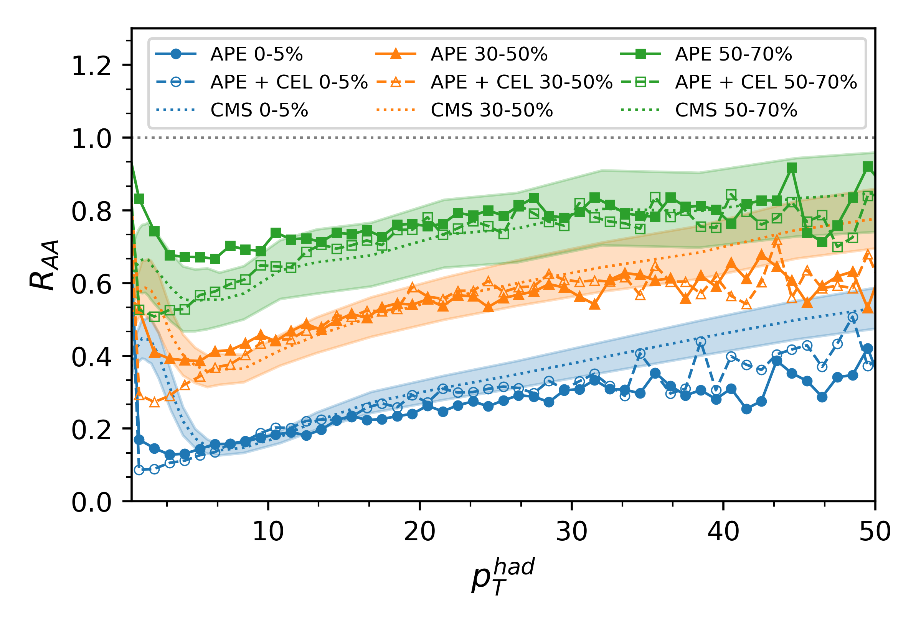
No Suppression Reduction
Drift does not measurably modify R_AA(p_T)
  Very useful – can tune coupling
  Rad: g=2.0, Rad + Coll: g=1.6
Additional sources of high-pT energy loss reduce effective drift coupling
Better performance at low-pT can only enhance drift

Slide 11
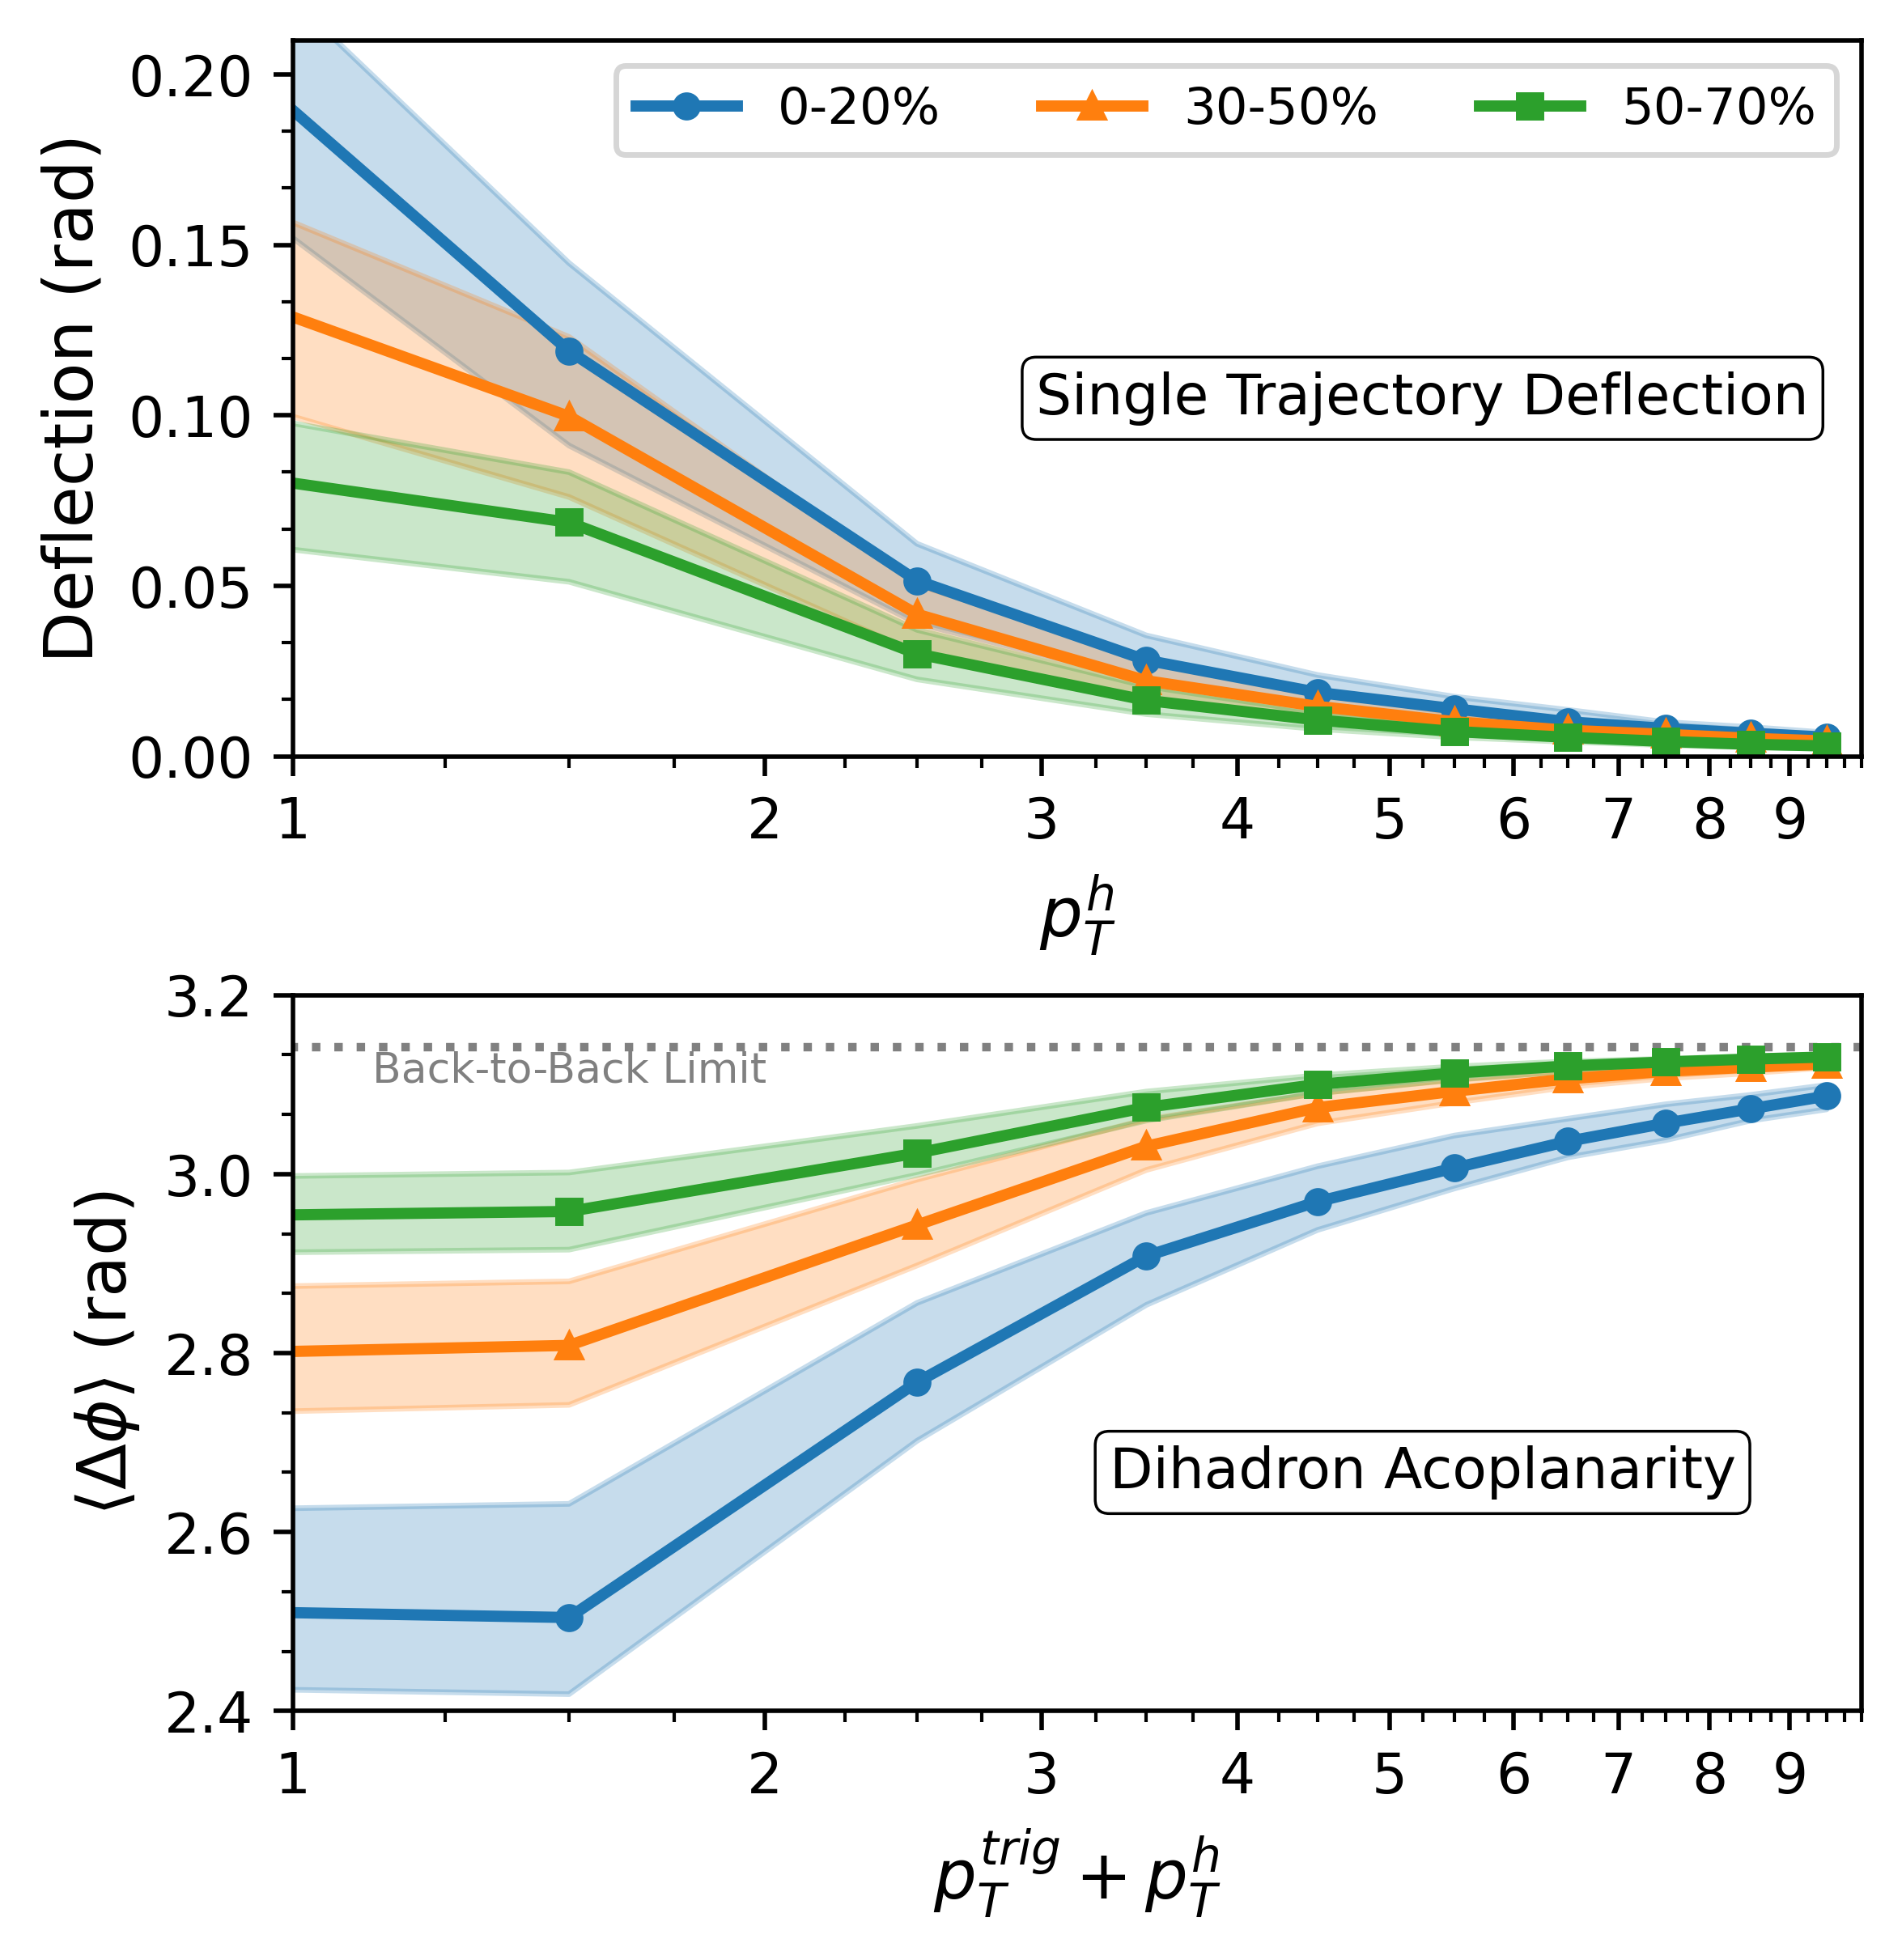

Deflection Size & Acoplanarity Enhancement
Note centrality reversal
  V_2 correlated to event plane
  Acoplanarities access absolute deflections
Initial acoplanarity fluctuation will change magnitude
  Currently tree-level scattering:
  coplanar “dijets”
$$Δφ$$
Colored band: drift +/- 25 % strength

Slide 12

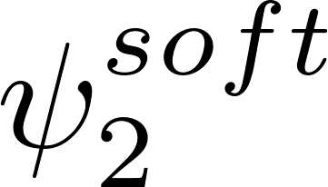
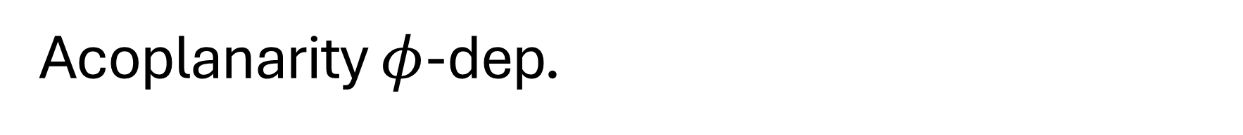
Acoplanarity $φ$-dep.
Stronger
Weaker
Acoplanarity modulation is still tied to event plane
  Possible selection cuts for velocity tomography
  Difficult to measure independent of pathlength effects
Collimation effect possible along event plane
Colored band: drift +/- 25 % strength

Slide 13
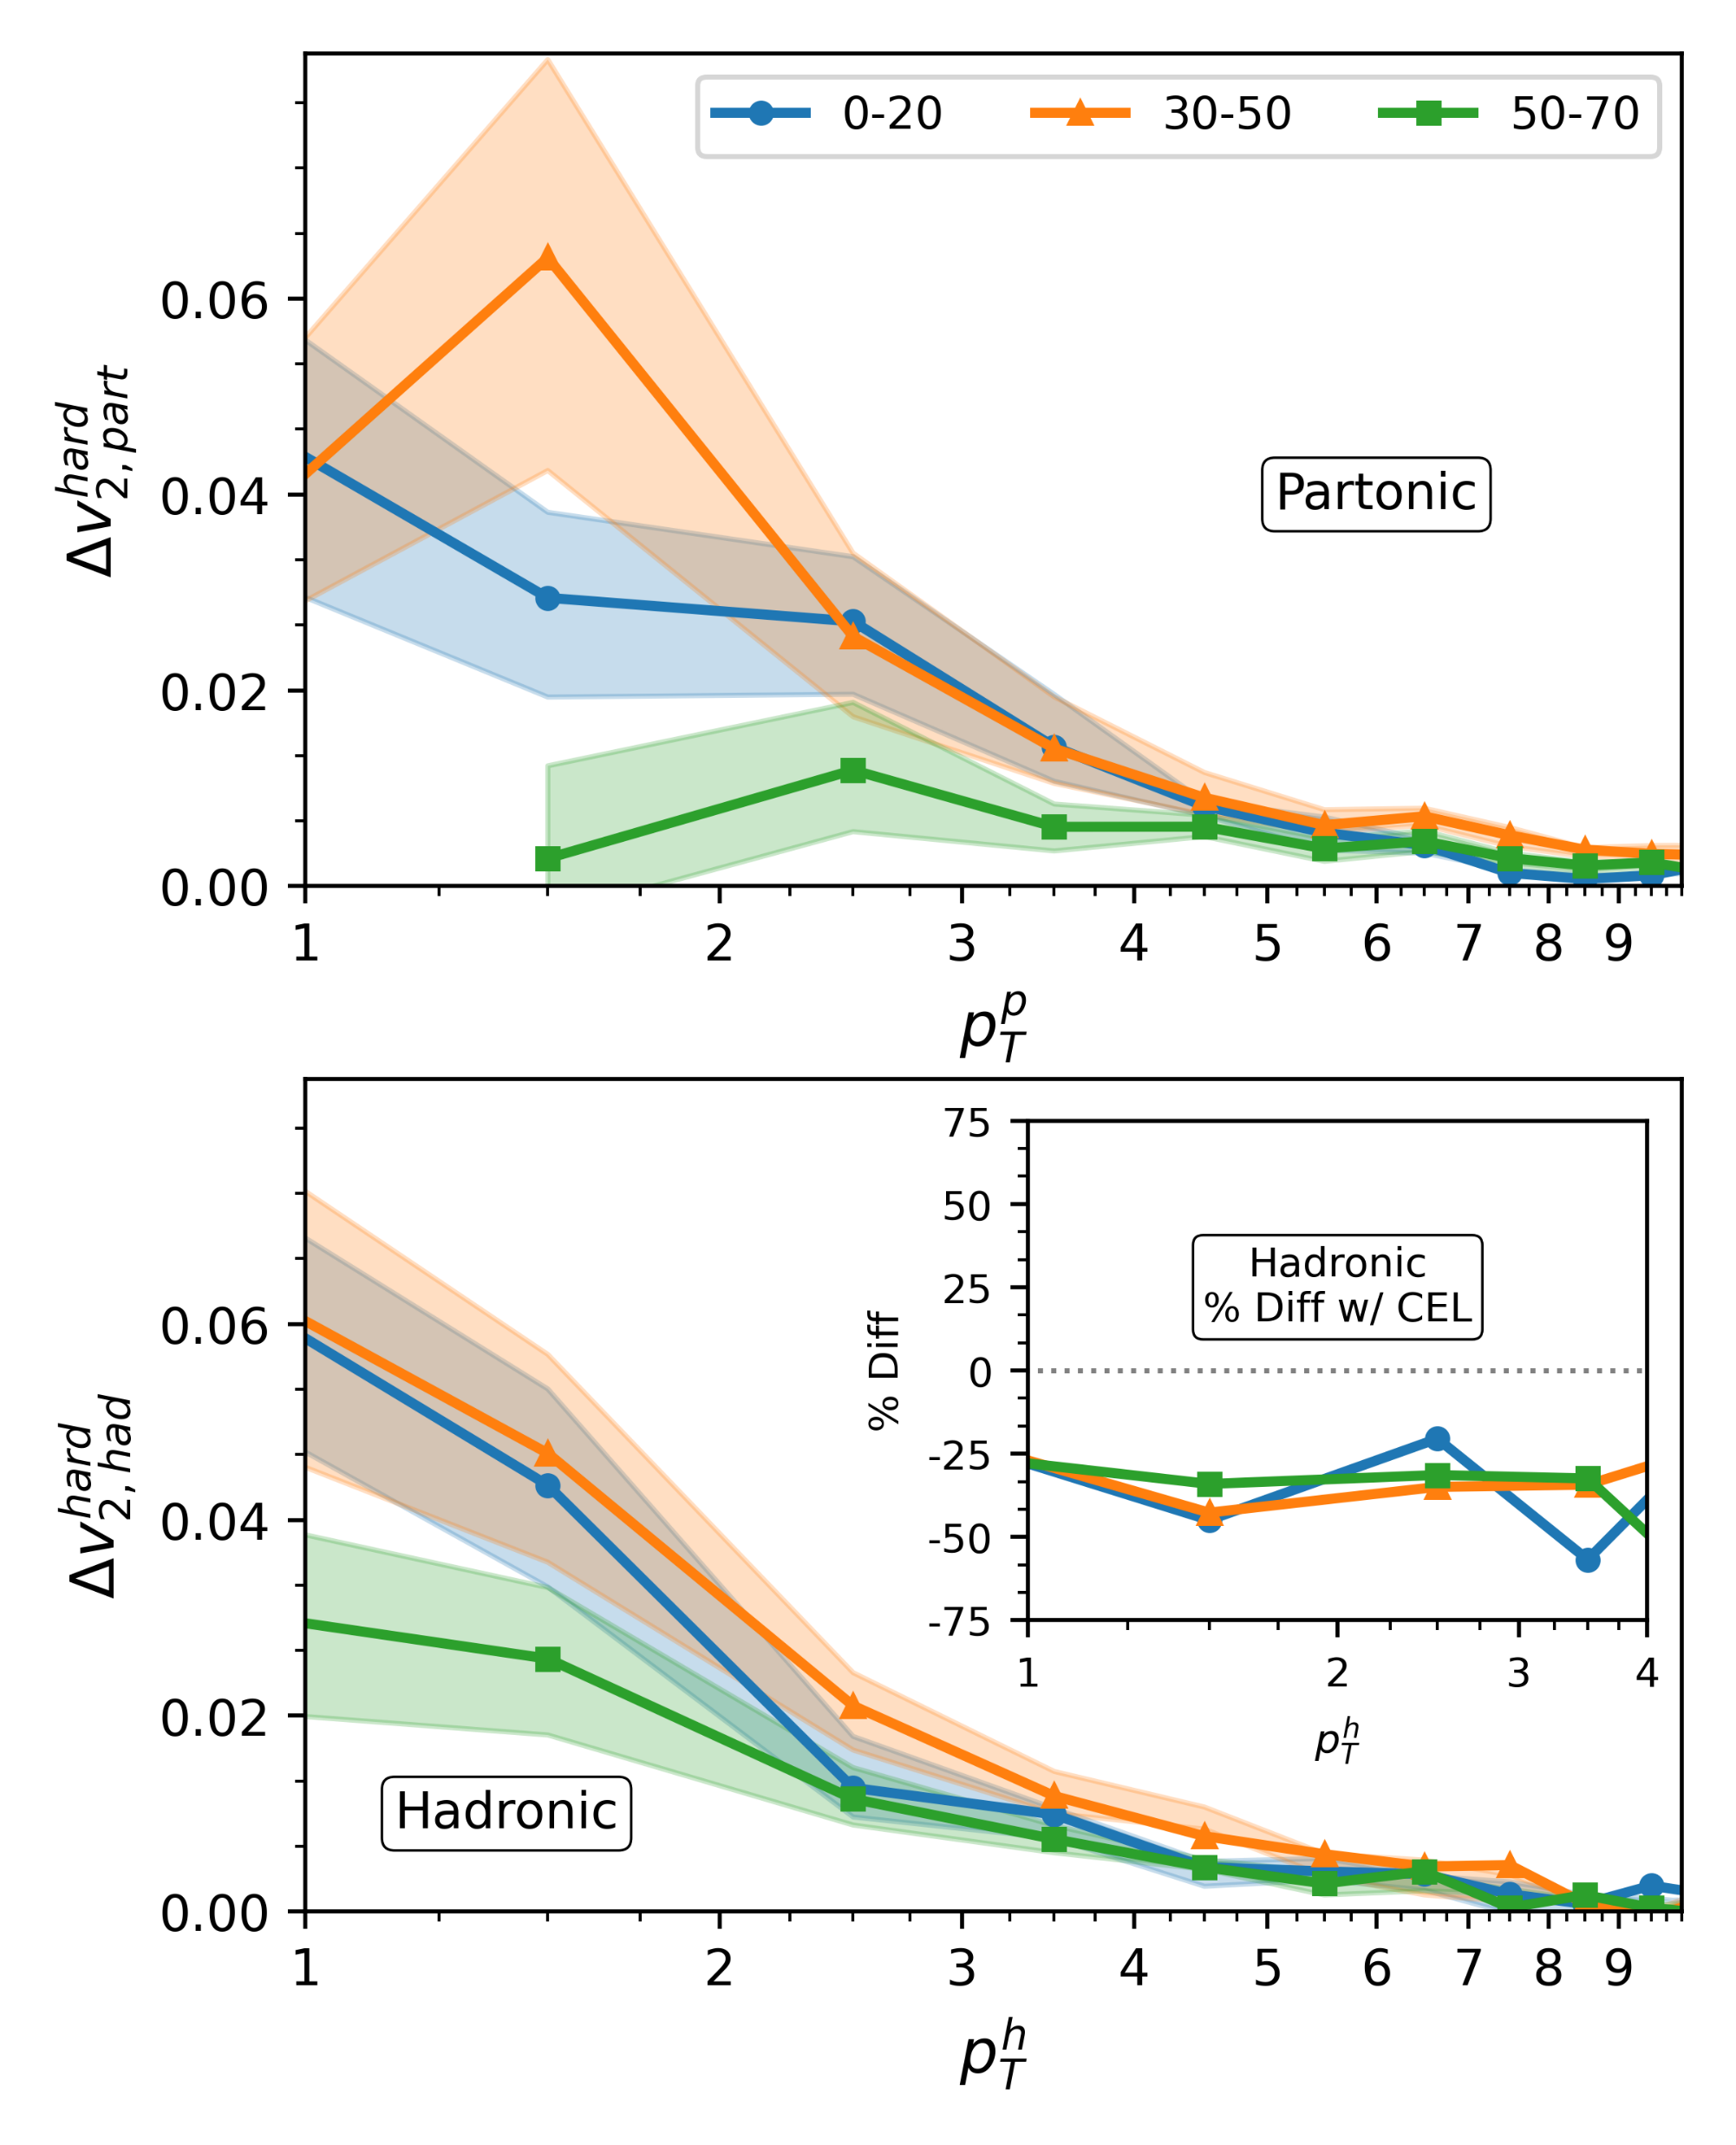
V₂ is Enhanced by Drift
Large surviving v₂ modulation at low-p_{T}
  Compare to: ~ +/- 0.005 exp. uncertainty
Conservative estimate of drift
  Low temp cutoff removes large drift region
  CNM effects + Coll. Energy loss reduce relative strength
Colored band: drift +/- 25 % strength

Slide 14
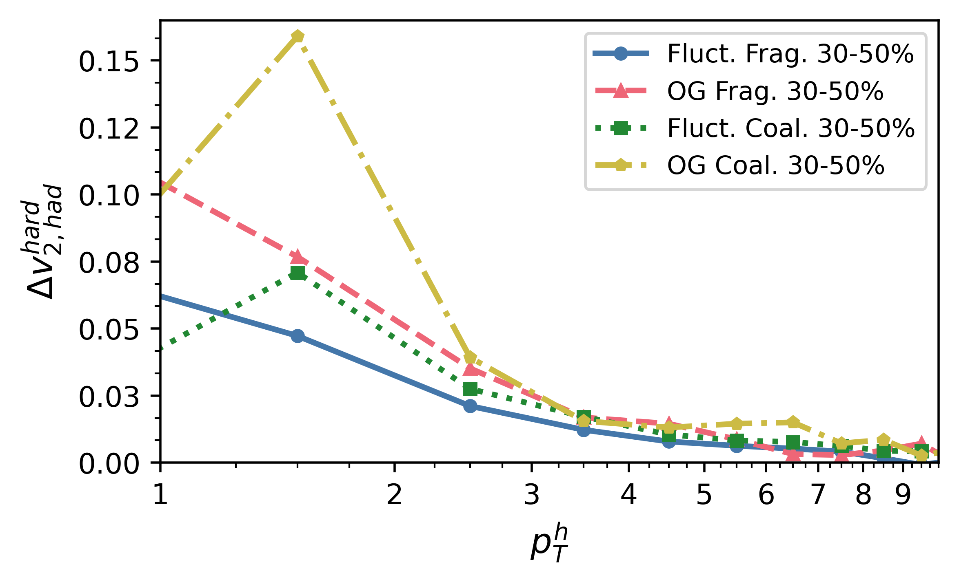
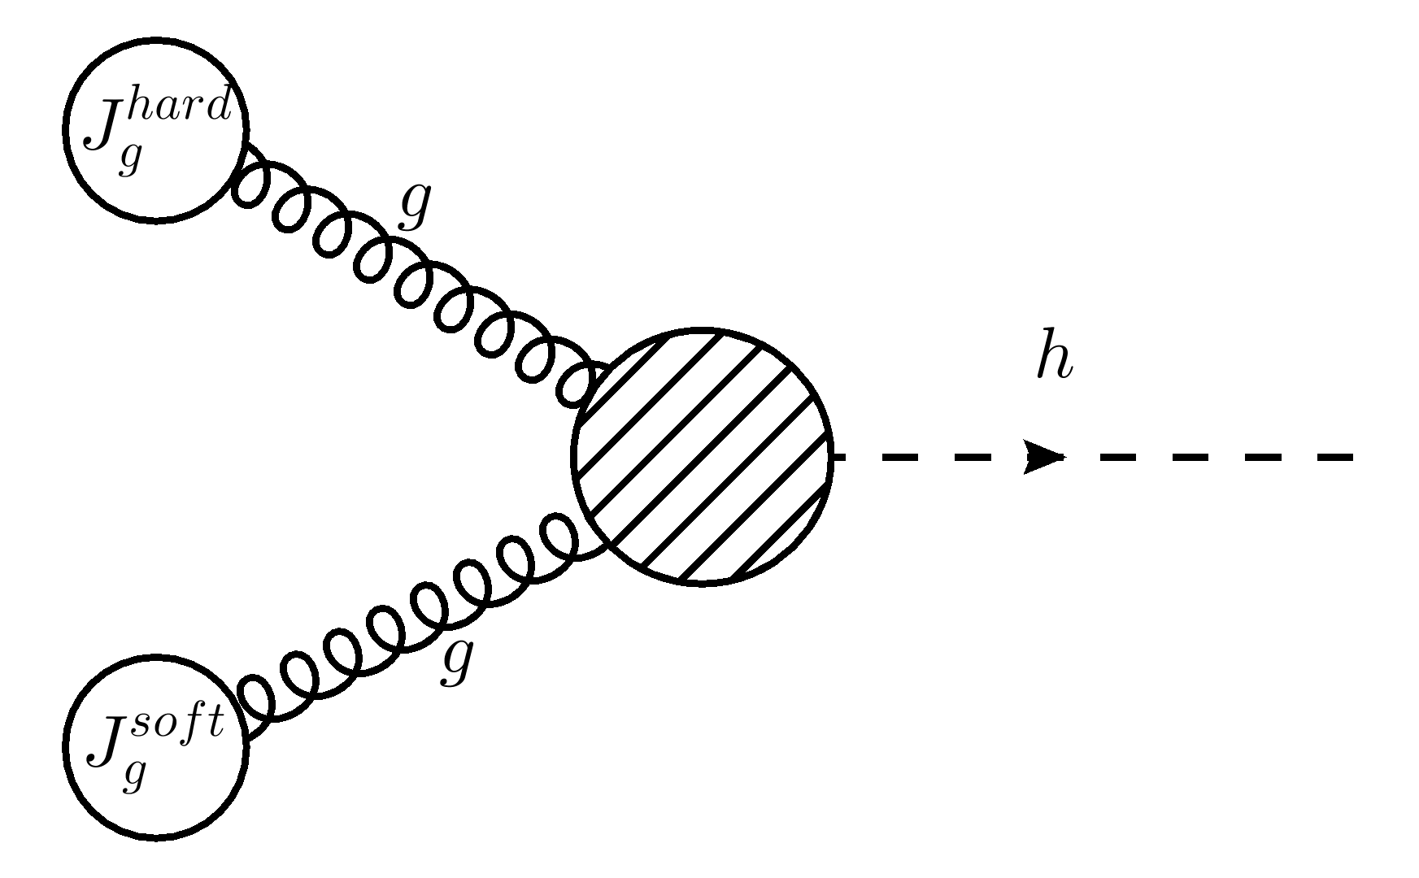
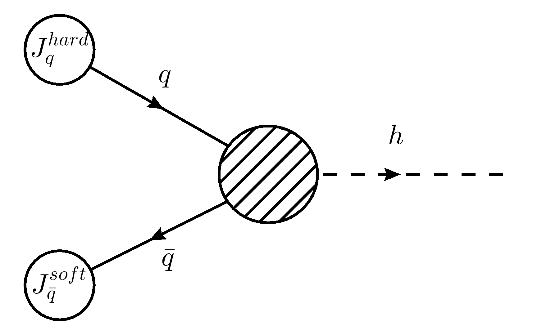
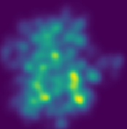
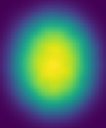
Effect too Small for You?
Many Choices to Enhance!
Hadronization variation
  E.g. “uniform Wigner Distribution” coalescence model
  (arxiv:nucl-th/0301093)
Effect may be large in varied medium models
  E.g. enhancement in optical Glauber initial conditions
1% Enhancement
Example
“Fluct.”
Cartoon
“OG”

Slide 15
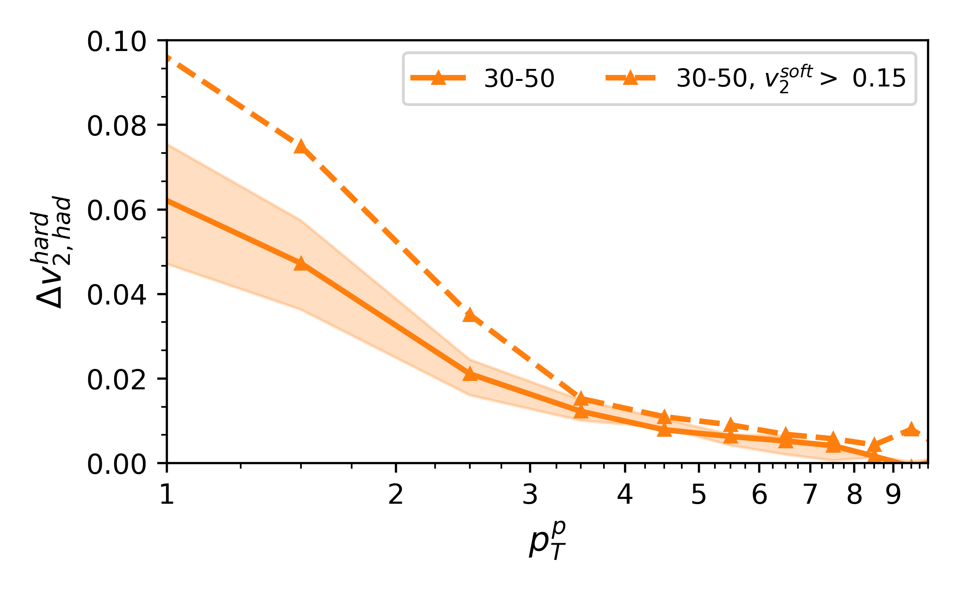
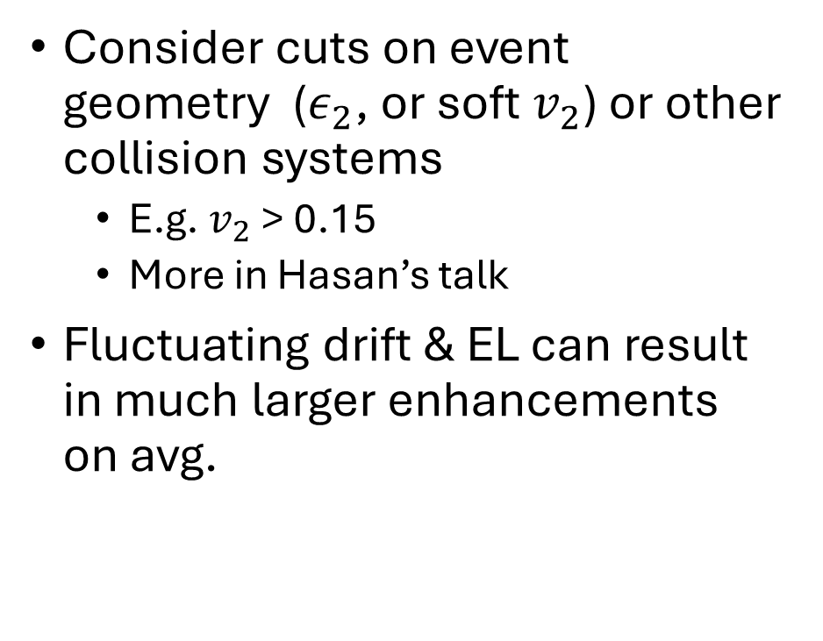
Effect too Small for You?
Make selection cuts!
Consider cuts on event geometry ($ε_{2}$, or soft $v_{2}$) or other collision systems
  E.g. $v_{2}$ > 0.15
  More in Hasan’s talk
Fluctuating drift & EL can result in much larger enhancements on avg.
1% Enhancement

Slide 16
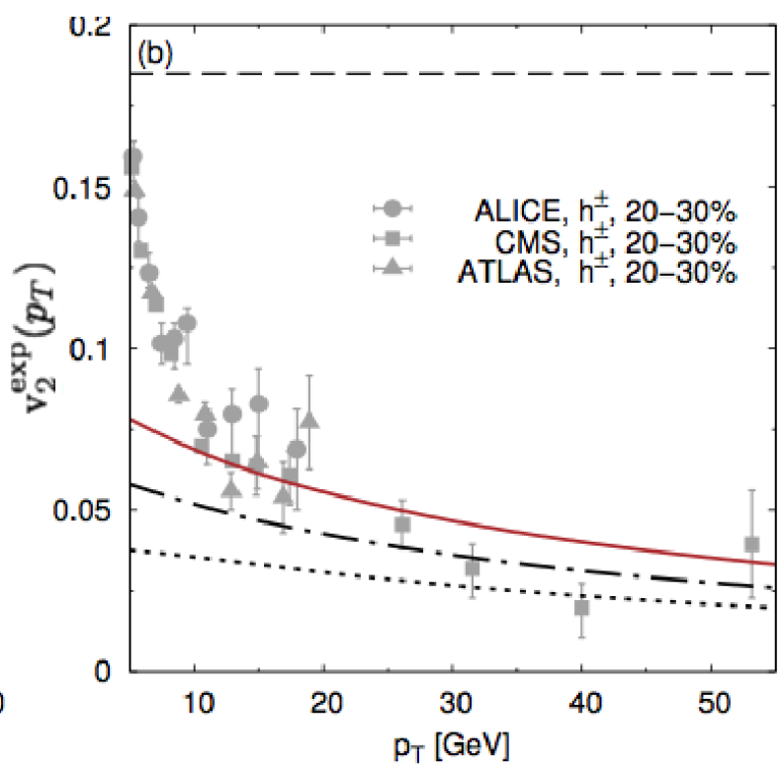
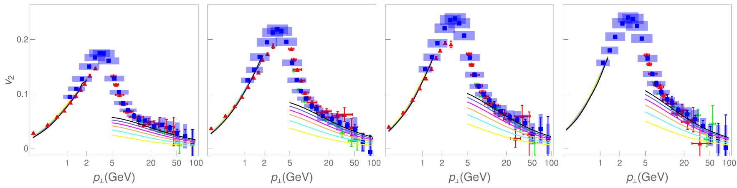


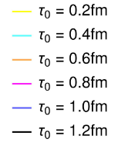
Importance for the R_AA x v_2 Puzzle
Drift produces measurable elliptic modulation at low pT that
qualitatively matches elliptic flow missing in perturbative & similar calculations!
DREENA-A Ch. Had.
LHC PbPb
sqrt(s) = 5.02 TeV
Perturbative Energy Loss
Stojku et al.
(iNSPIRE:2640923)
Parametric Energy Loss
Noronha-Hostler et al:
(arXiv: 1602.03788)

Slide 17
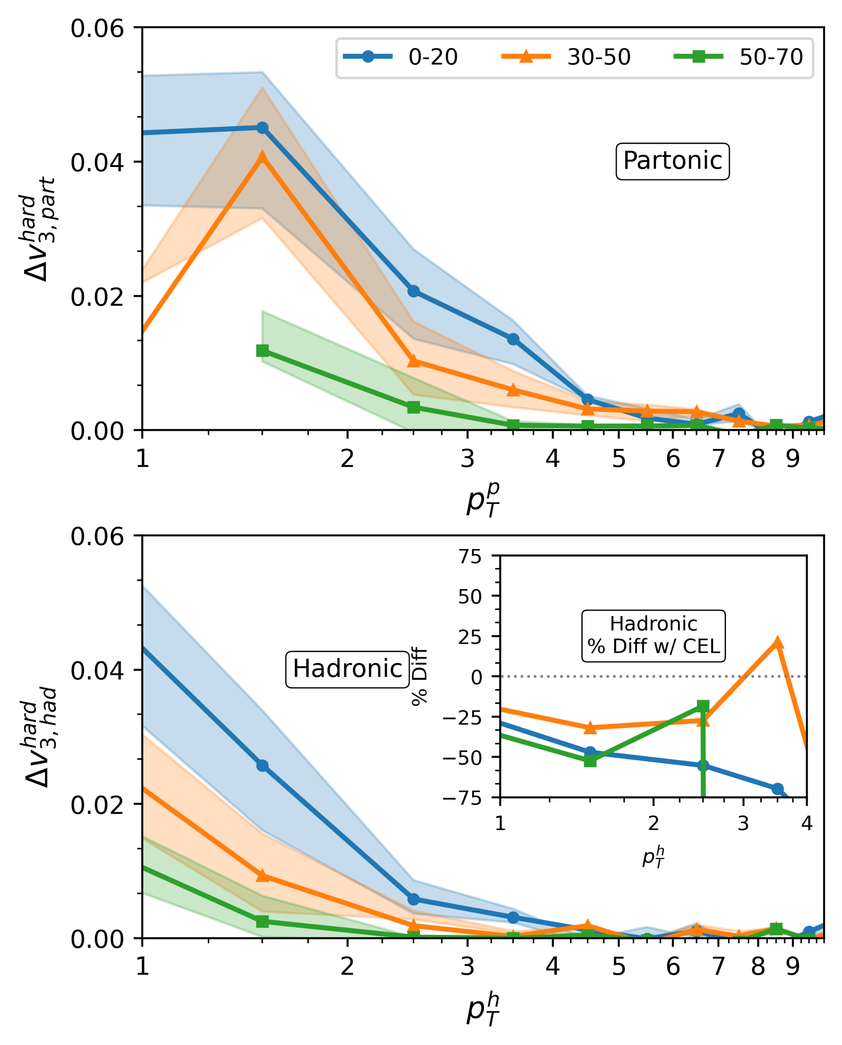
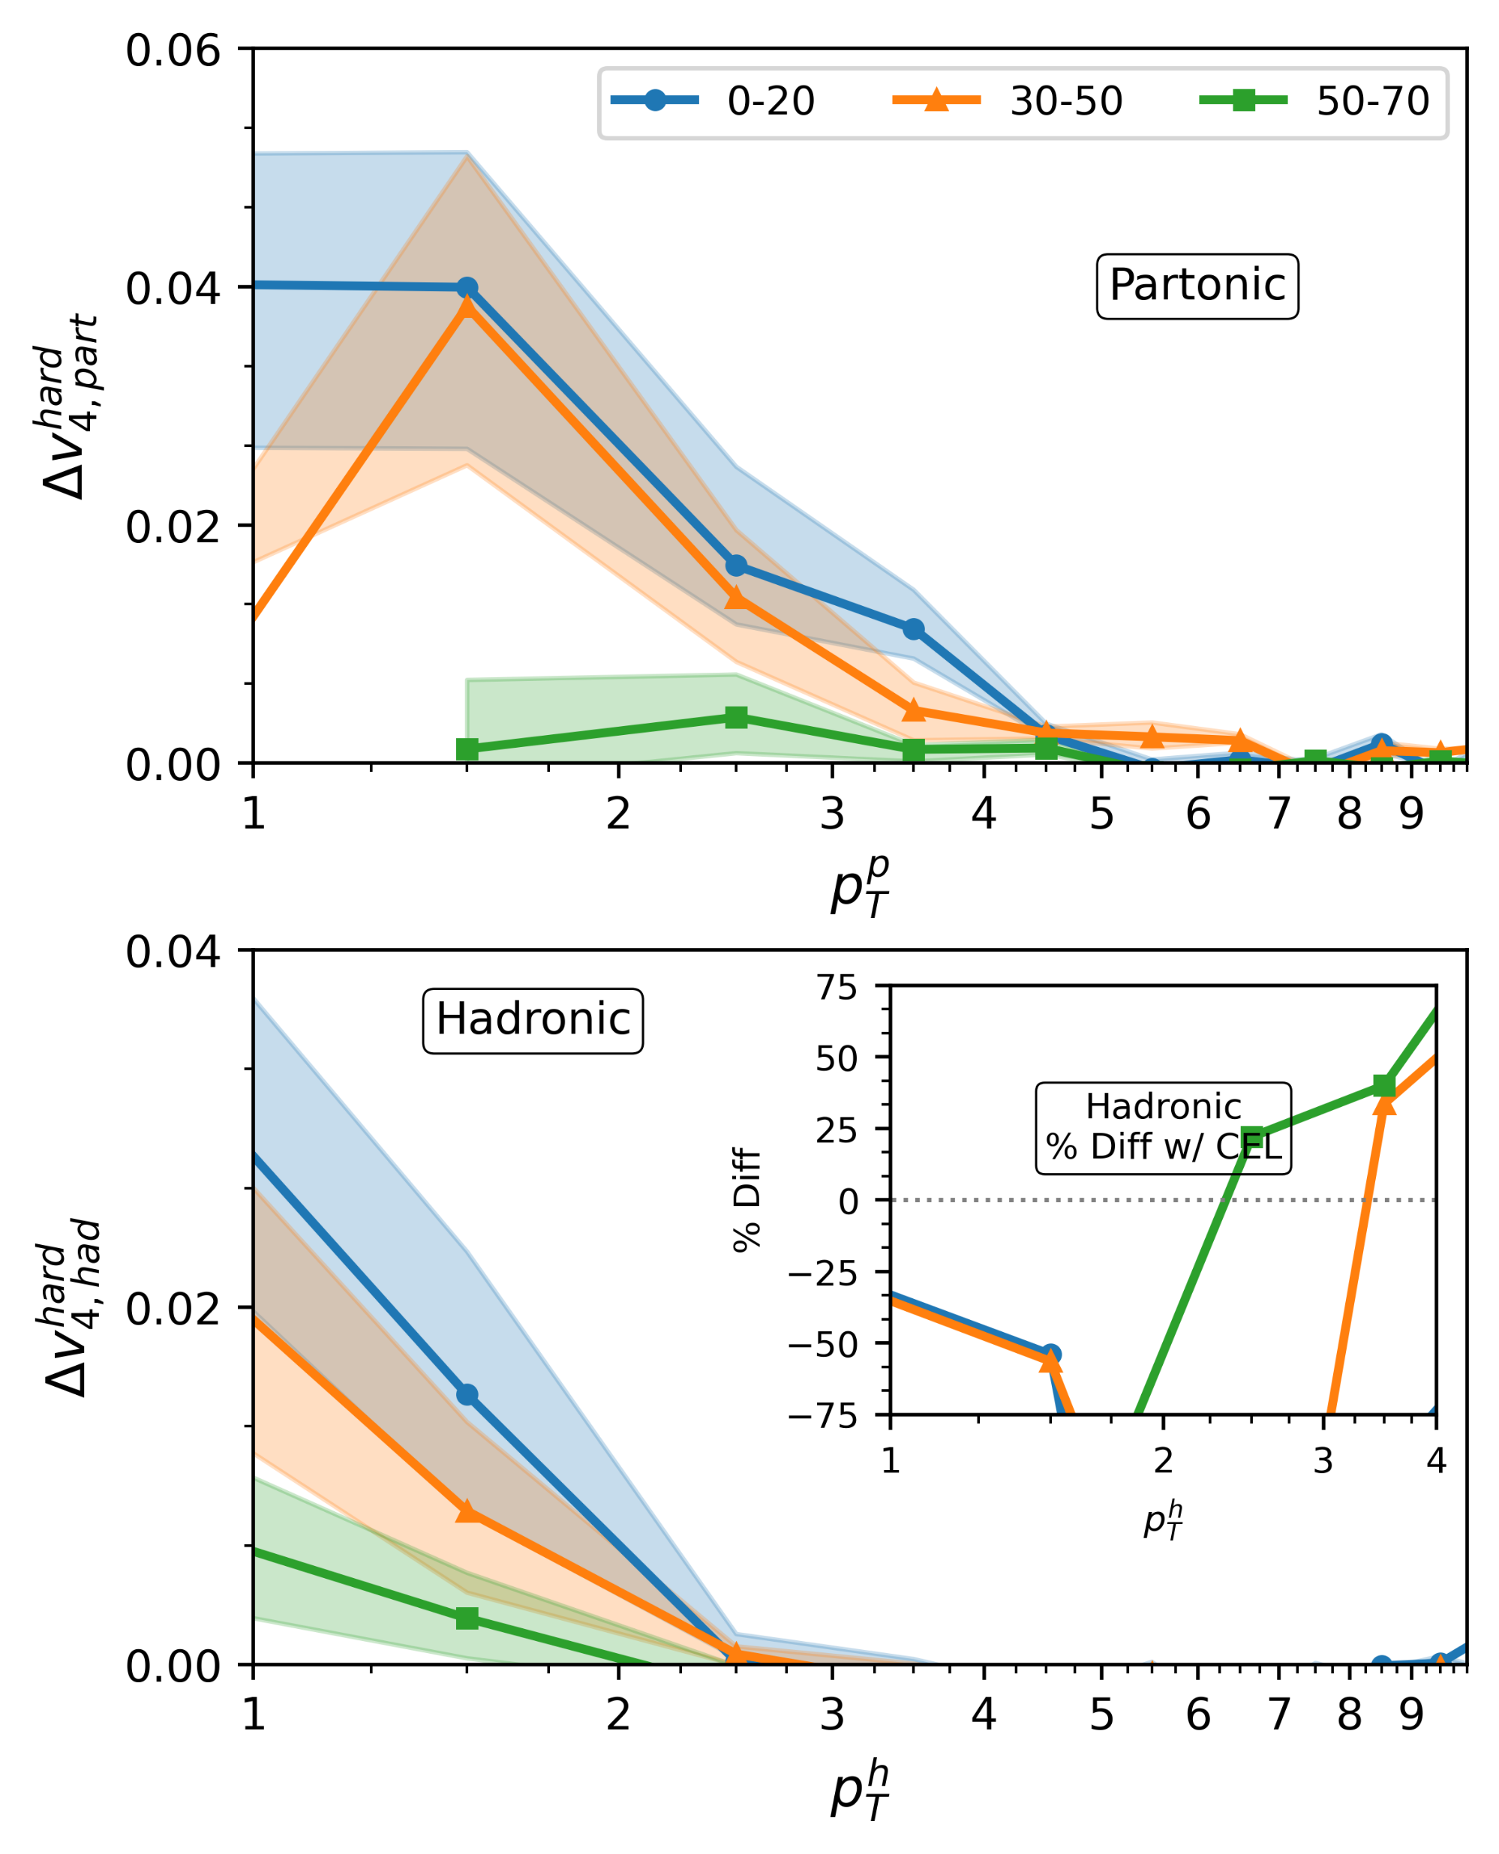
Higher Harmonic V_{n}’s are Enhanced by Drift
PRELIMINARY

Slide 18
v3 & v4 from Perturbative Energy Loss
E.g. DREENA results:
Drift produces higher harmonic coupling
Possible importance to v₃ & v₄ puzzle
Difficult to couple to small anisotropies with energy loss alone
(arXiv:2208.09886)

Slide 19
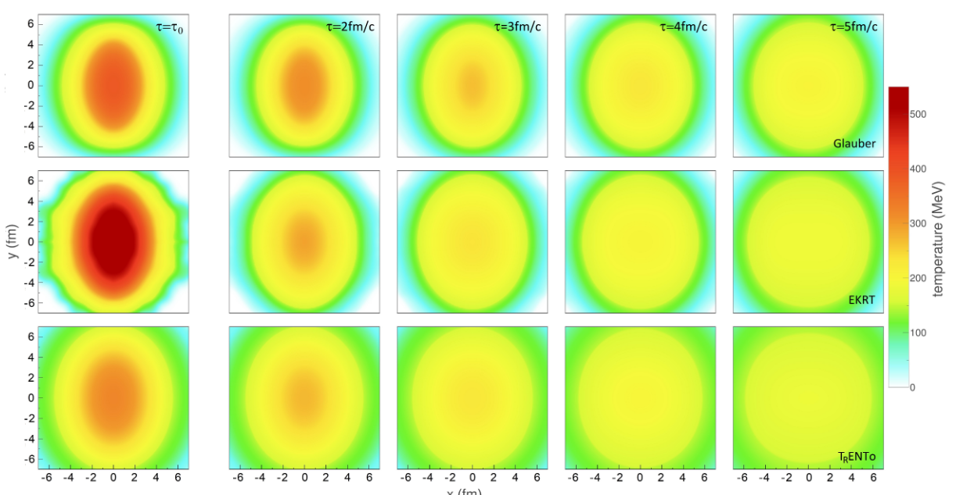
Drift v_{n} sensitive to pathlength ordered internal medium props.
(iNSPIRE:2640923)
Drift distinguishes between high anisotropy at early times vs at late times via interplay with energy loss
  Powerful additional constraint on evolution dynamics!!!
How would a hard + soft Bayesian parameter extraction like Bayes-DREENA differ with the inclusion of drift?
  Possibly selects on slightly smaller anisotropy, likely changes story of free streaming parameters
+ Drift = ?
(iNSPIRE:2606181)

Slide 20
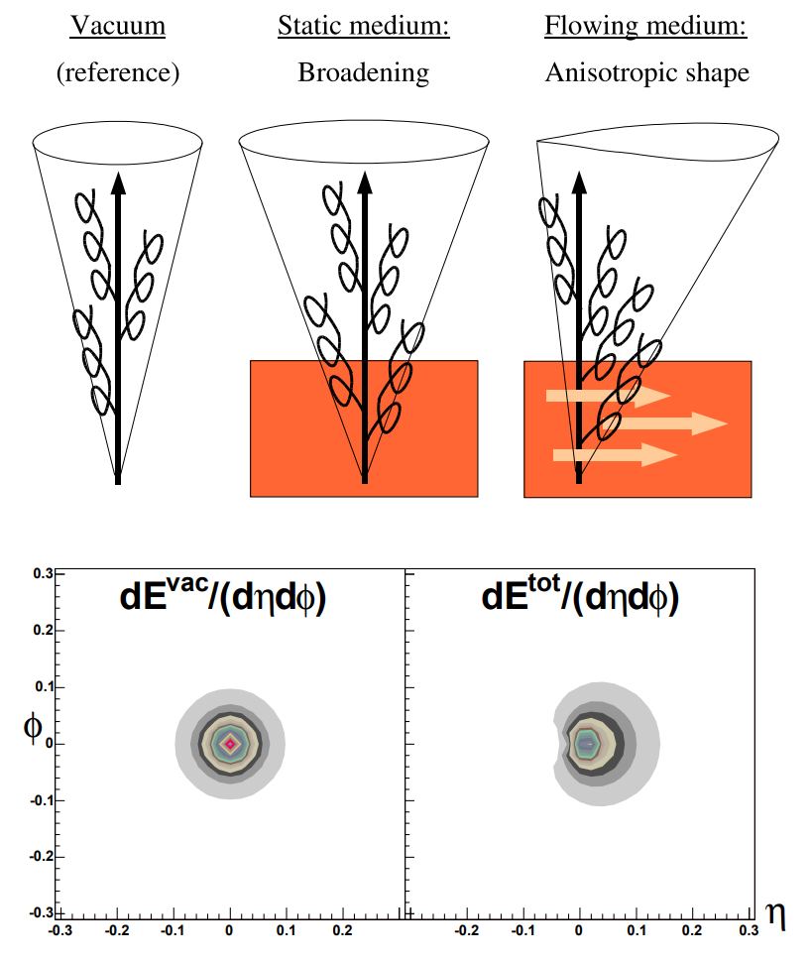
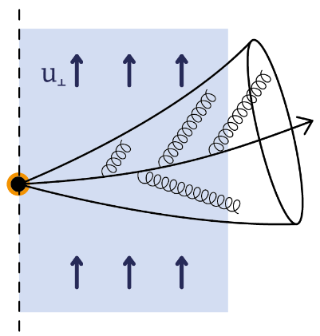
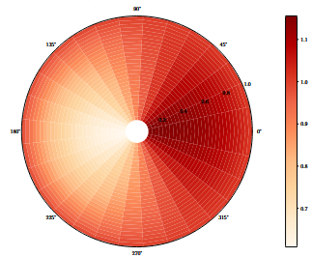
Anisotropic Jet Substructure
People have been thinking about anisotropic radiation distribution for some time
  Flow anisotropy as Lorentz boost
  (Armesto, Salgado, & Wiedemann)
  Perturbative scalar calculation of radiation
  (Sievert, Sadofyev, Vitev)
  Jet substructure harmonics
  (Barata, Milhano, & Sadofyev)
  Perturbative real gluon calculation of radiation
  (Kuzmin & López)
Drift of jet particles is also likely important!
(arXiv:2104.09513)
(arXiv:0405301)
(arXiv:2308.01294)

Slide 21

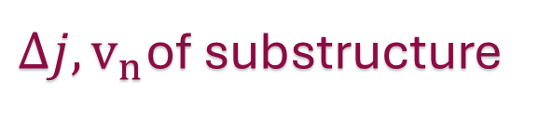
Drift of Ensemble of Particles
$Δj, v_{n}$of substructure
Energy suppression naturally produces dispersion of hard and soft particles within jet
Sub-eikonal property a detriment for inclusive measurements, but well suited for jet substructure modification
Energy suppressed

Slide 22

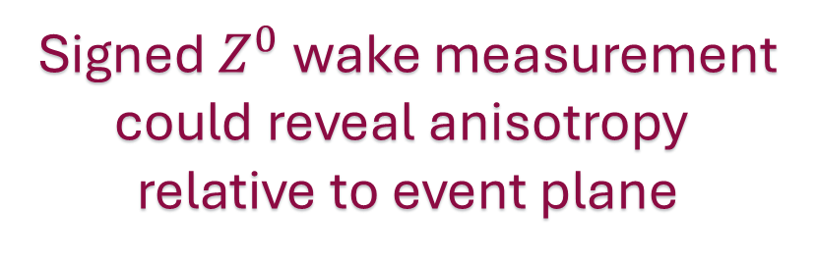
Anisotropic Jet Wake
Signed $Z^{0}$ wake measurement
could reveal anisotropy
relative to event plane
Conservation of momentum – should be anisotropic wake
  Constructive with induced radiation anisotropy
How does this interplay with jet substructure anisotropies?
  Possible anisotropic background contamination of jet substructure observables
Diffusion Wake 1
Mach Cone 2
Diffusion Wake 2
Mach Cone 1

Slide 23
The Elephant in the Room…
Is this even a perturbative regime?
How seriously should you take these results?
These results are manifestly incomplete, but they show that drift has robust signatures that are nonzero in even the most conservative estimate.

Slide 24
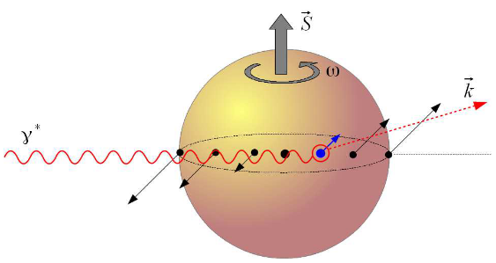
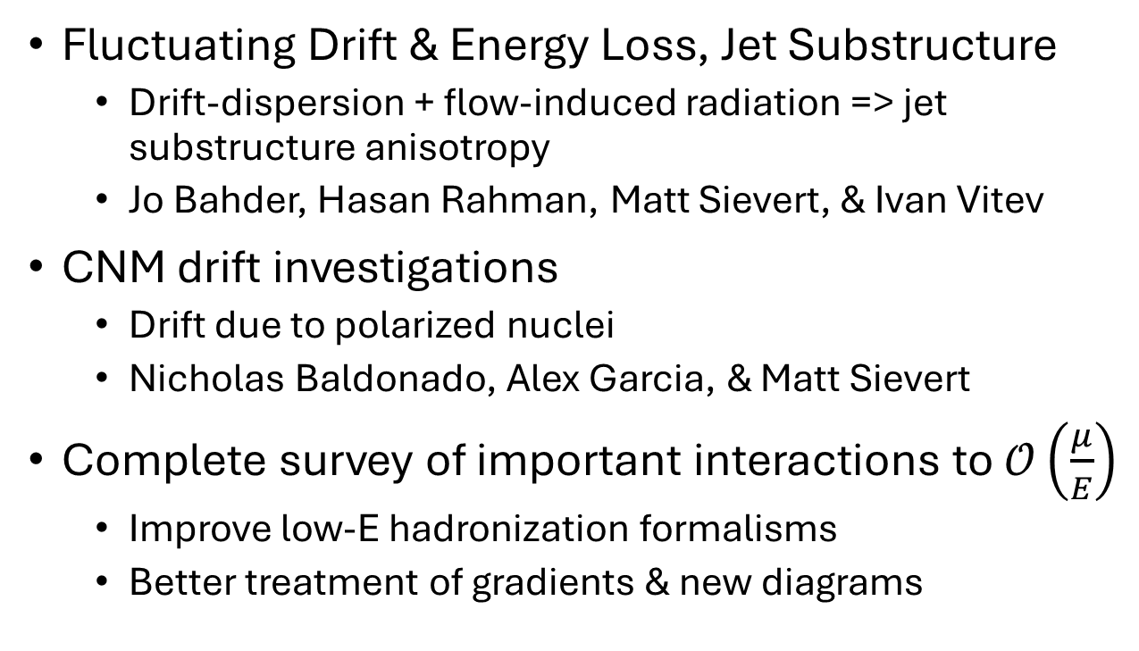
Next Steps:
Fluctuating Drift & Energy Loss, Jet Substructure
  Drift-dispersion + flow-induced radiation => jet substructure anisotropy
  Jo Bahder, Hasan Rahman, Matt Sievert, & Ivan Vitev
CNM drift investigations
  Drift due to polarized nuclei
  Nicholas Baldonado, Alex Garcia, & Matt Sievert
Complete survey of important interactions to $𝒪\left(\frac{μ}{E}\right)$
  Improve low-E hadronization formalisms
  Better treatment of gradients & new diagrams
(arXiv:1310.5028)
Notes:
Drift at EIC:
Cold nuclear matter anisotropies can couple similarly to QGP flow
“Spin flow”, gradients, etc.
Possible distinction between pre-equilibrium and equilibrium anisotropy
Could provide constraints on pre-equilibrium qhat
Possible large impact on tomographic parameter extraction via hard probes
Comparative laboratory for jet substructure dispersion

Slide 25
Thanks a Bunch!
See more details:
(arXiv:2412.05474)
Also see Hasan Rahman’s
talk in mere moments!!!

Slide 26
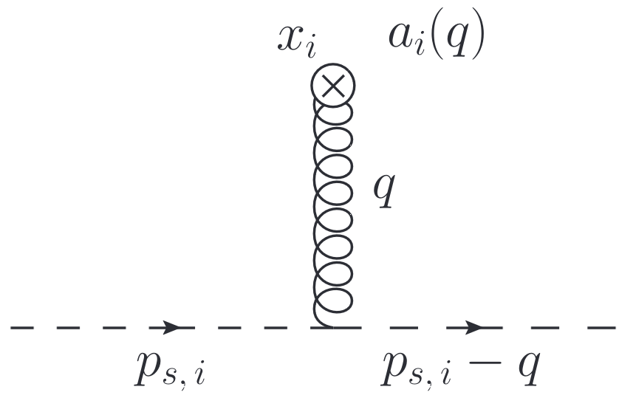
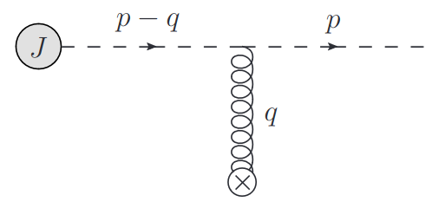

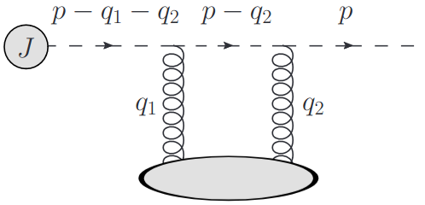
Jet Broadening – Isotropic vs Anisotropic
A. V. Sadofyev, I. Vitev, & M. D. Sievert
Phys.Rev.D 104 (2021)
(arXiv:2104.09513)
Isotropic
No vector info
Difference in setup – constraints on external gluon field
Isotropic
  Jet quark moves lightcone (+),
  medium quark moves lightcone (-)
Anisotropic
  Jet quark moves lightcone (+),
  medium quark moves with medium flow
Two vector directions associated with the medium
  Flow
  Gradients
Anisotropic
Preferred direction!

Slide 27


Medium Gluon Field Potentials
Simple Isotropic
Potential
Eikonal
delta function
(antiparallel)
v(q)
Isotropic scattering centers
Quark moves with medium
Anisotropic Flow Potential
Regge Kinematics
A. V. Sadofyev, I. Vitev, & M. D. Sievert
Phys.Rev.D 104 (2021)
(arXiv:2104.09513)
v(q)
Directional scattering centers

Slide 28




All Diagrams
Born & Double-Born Momentum Broadening Diagrams
Born & Double-Born Radiation Diagrams
Notes:
Computing collisional and radiative diagrams in the presence of flow
Regge scalar kinematics
Parton species enters in few ways
See paper for Regge universality demonstration
s -> inf, t & m fixed and small
Holds to at least first subeikonal order

Slide 29





Does Drift Survive Event Averaging?
L. Antiporda, J. Bahder, H. Rahman
& M. D. Sievert
Phys.Rev.D 105 (2022)
(arXiv: 2110.03590)
Naively, one might expect cancellation via event averaging
Coupling to event anisotropic flow shown in glauber elliptic geometry to preserve effect
  Fluctuating event plane, centrality
What about in realistic heavy ion collisions?
Harmonic
Analogous to

Slide 30




Energy Loss Effects
Radiative
Collisional
Single Emission GLV @ 1st order in opacity w/ finite kinematic bounds (q, k)
Interpolated tabulated results
Gyulassy, Levai, Vitev (2000) (arXiv:0006010)
Braaten & Thoma (1991) (iNSPIRE:317898)
Light quarks: E >> m^2/T regime
Gluons: CA/CF = 9/4 (arXiv:2305.13182)
E.g.
E.g.

Slide 31
Ape Trajectories
Approx. Binary collision density weighting of production points
Computed within QGP phase of hydro backgrounds
  EL & Drift cut off at T < 155 MeV
  Cuts off highest flow region!!!
Dynamic trajectories respond to medium flow
  Deflections, zigzags, weirdness

Slide 32
Parameter Fits
& Model Choices
DukeQCD “hic-eventgen” medium model parameters set by Bayesian parameter estimation
(arXiv:1804.06469)
Pythia input + pCNM determines partonic spectra
Coupling from high pT RAA
(30-50%)
Choice of fragmentation function fits
  Large change to scale of results!
Coupling
Tuned to high-pT RAA
Fragmentation Functions
JAM20 Fits
Jet Spectra
Constrained by Pythia pp tune
Medium
Model
Fixed by DukeQCD Tune

Slide 33


How can delta v_{n} increase after fragmentation?
Deflections increase v₂ on average, but some deflections decrease v₂ (relative to energy loss alone)
Fragmentation increases the relative correlation of deflections to flow, despite decreasing the average magnitude

Slide 34


Uniform Wigner Coalescence
Fermi / Bose Dist.
Choose uniform
Wigner distribution
Similar for gluons…
(arxiv:nucl-th/0301093)

Slide 35
Drift at the EIC
Cold nuclear matter anisotropies can couple similarly to QGP flow
  “Spin flow”, gradients, etc.
Possible distinction between pre-equilibrium and equilibrium anisotropy
  Could provide constraints on pre-equilibrium qhat
Possible large impact on tomographic parameter extraction via hard probes
Comparative laboratory for jet substructure dispersion
(arXiv:1310.5028)

