Slide 1

Response of Jets to Collective Flow in Heavy-Ion Collisions
Matthew D. Sievert
Hot Jets 2025
1/8/2025
M. Sievert
Response of Jets to Collective Flow
1 / 22

Slide 2
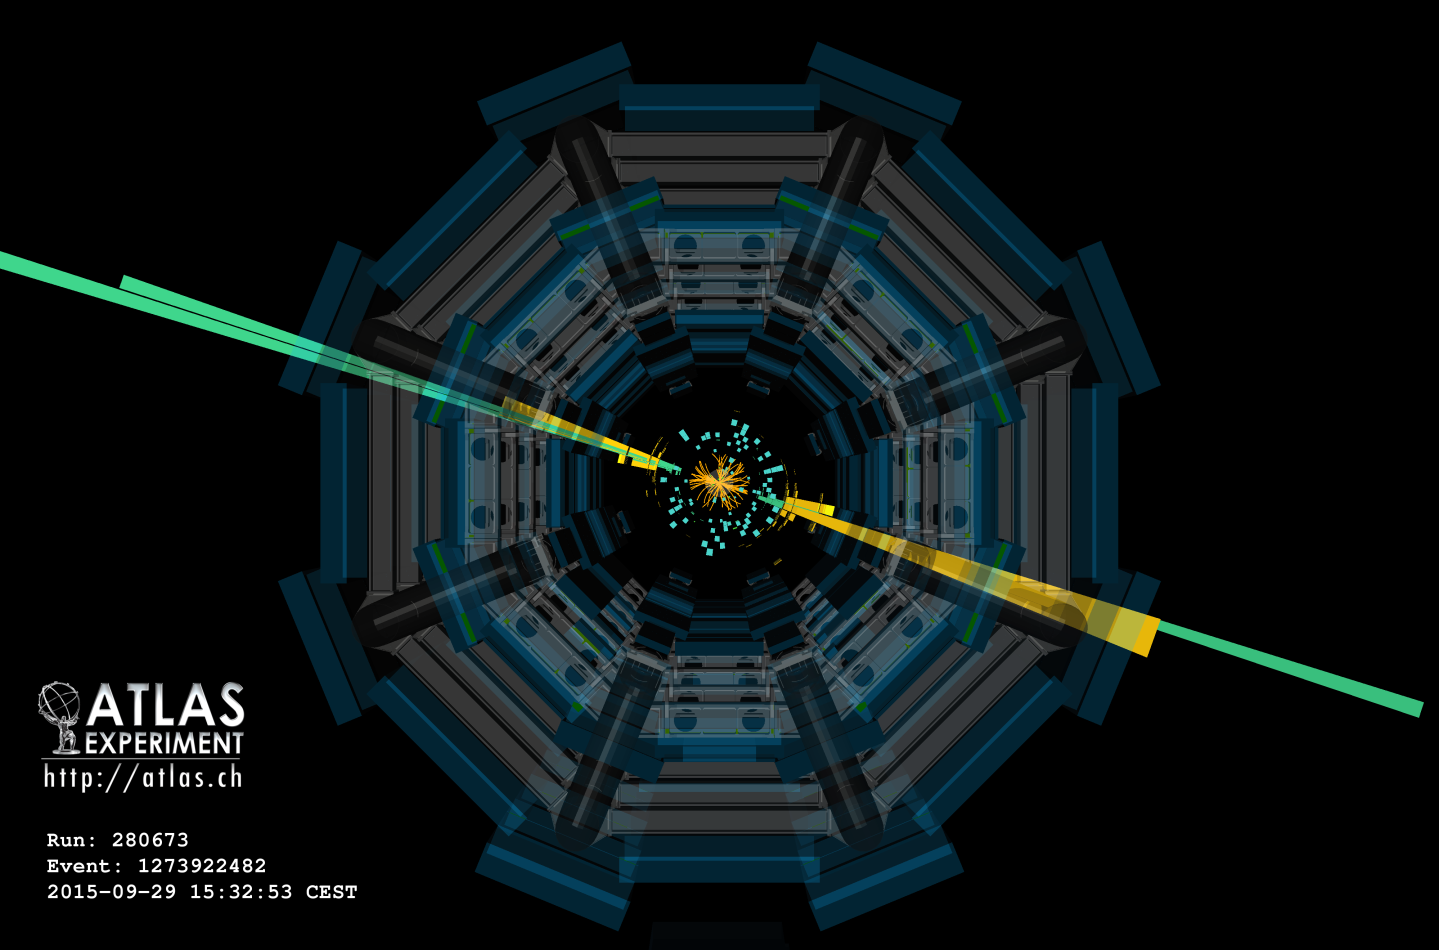
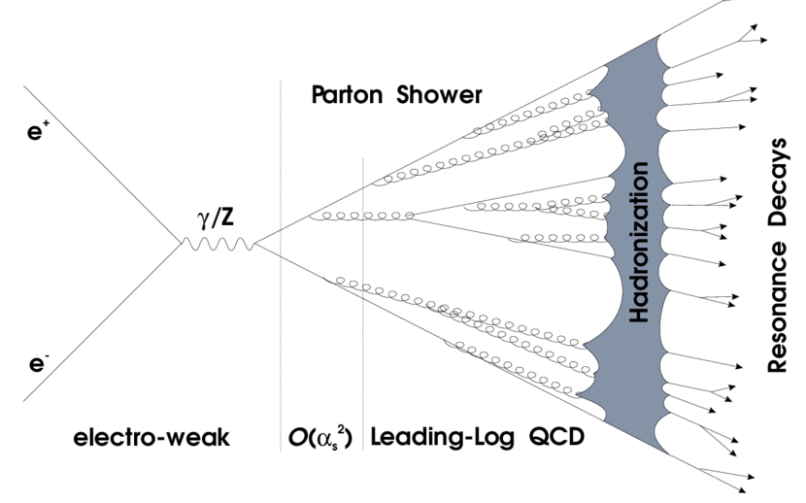
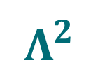
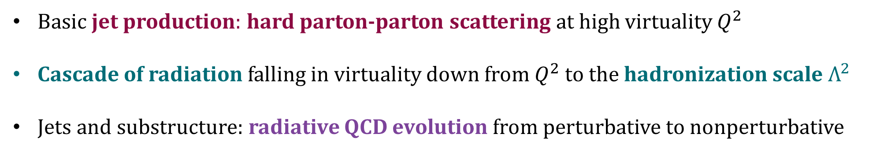


Jets in Vacuum: a Microcosm of QCD
$$e^{+}+e^{−}→{jet}_{1}+{jet}_{2}+X$$
$$Q^{2}$$
$$Λ^{2}$$
Basic jet production: hard parton-parton scattering at high virtuality $Q^{2}$
Cascade of radiation falling in virtuality down from $Q^{2}$ to the hadronization scale $Λ^{2}$
Jets and substructure: radiative QCD evolution from perturbative to nonperturbative
M. Sievert
Response of Jets to Collective Flow
2 / 22

Slide 3
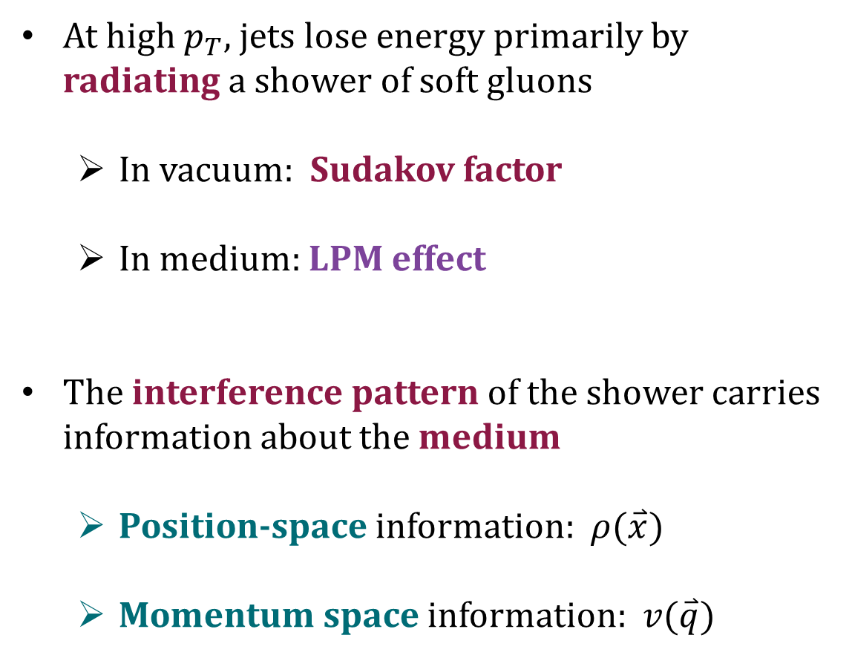
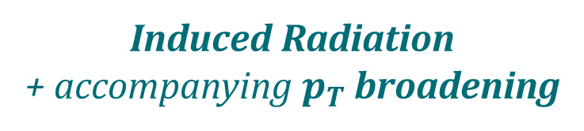
Jets in Medium: Multi-Scale Probes
At high $p_{T}$, jets lose energy primarily by radiating a shower of soft gluons
  In vacuum: Sudakov factor
  In medium: LPM effect
The interference pattern of the shower carries information about the medium
  Position-space information: $ρ(\overset{⃑}{x})$
  Momentum space information: $v(\overset{⃑}{q})$
Induced Radiation
+ accompanying $p_{T}$ broadening
Landau, Pomeranchuk, Dokl. Akad. Nauk Ser. Fiz 92 (1953)
Migdal, Phys. Rev. 103 (1956)
M. Sievert
Response of Jets to Collective Flow
3 / 22

Slide 4
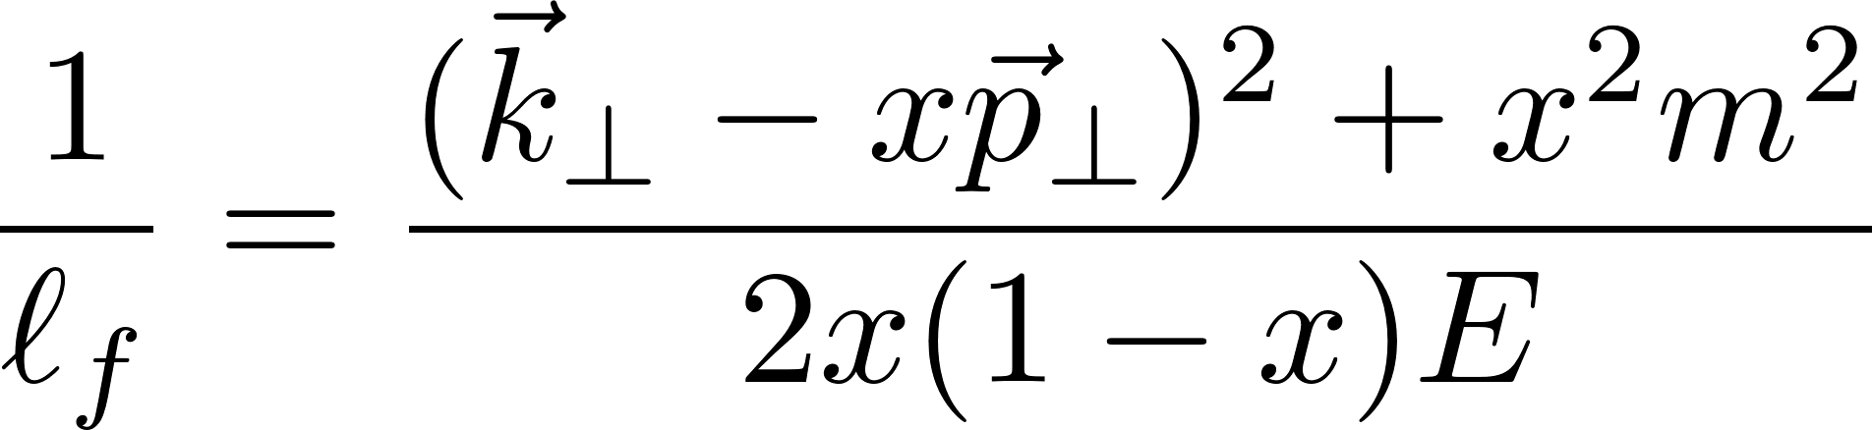
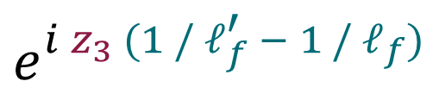
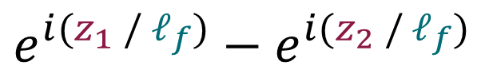
Jets as Interferometers for Medium-Induced Radiation
Edge phases of the emission region
Phase slip from scattering
Formation Time
$$e^{i(z_{1} / ℓ_{f})}−e^{i(z_{2} / ℓ_{f})}$$
$$e^{i z_{3} (1 / ℓ_{f}^{′} − 1 / ℓ_{f})}$$
M. Sievert
Response of Jets to Collective Flow
4 / 22

Slide 5
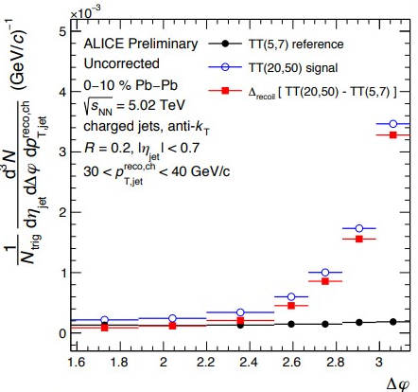


Canonical Signatures of Medium Modification
ALI-PREL-353023
He, Vitev, Zhang, Phys. Lett. B713 (2012)
Energy Loss
Transverse Momentum Broadening
  Jet quenching, $γ$+jet imbalance …
  Dijet / $γ$+jet acoplanarities …
M. Sievert
Response of Jets to Collective Flow
5 / 22

Slide 6
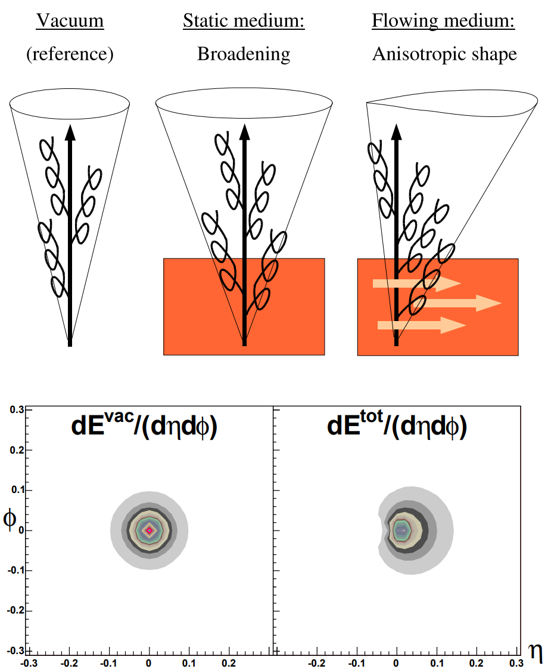
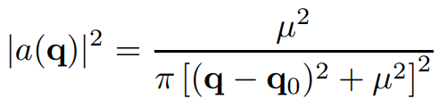
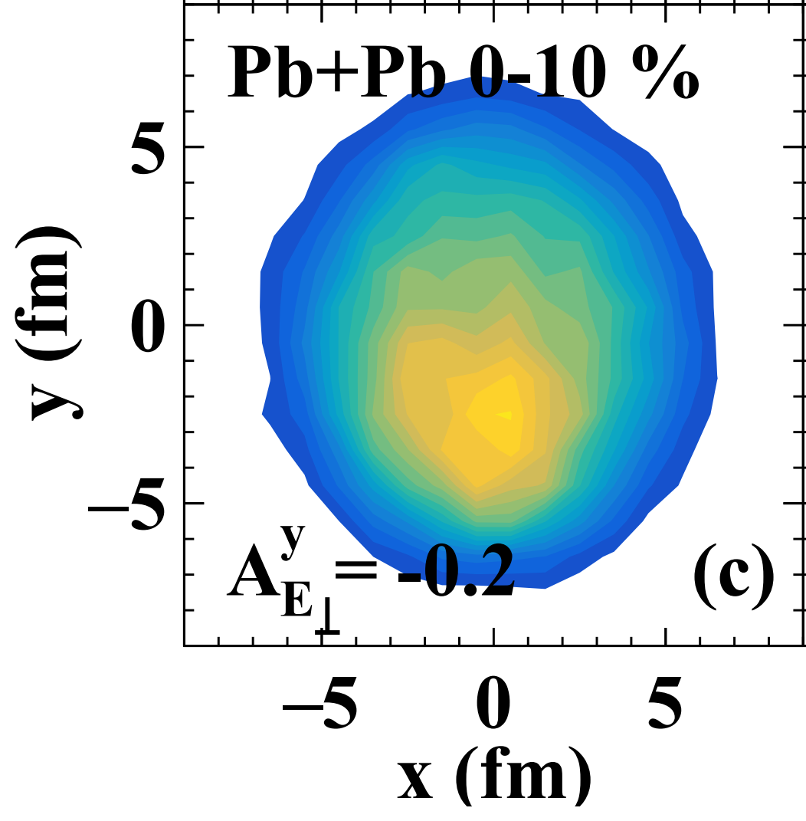
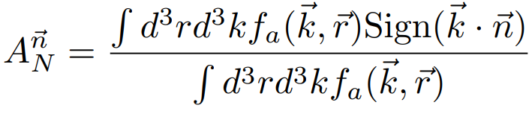
Asymmetric Measures of Medium Modification
Model employing shifted potentials to mimic boosted fluid flow.
Armesto, Salgado, Wiedemann,
Phys.Rev.Lett. 93 (2004)
Linearized Boltzmann Transport calculation of of jet asymmetries induced by gradients
He, Pang, Wang
Phys.Rev.Lett. 125 (2020)
M. Sievert
Response of Jets to Collective Flow
6 / 22

Slide 7



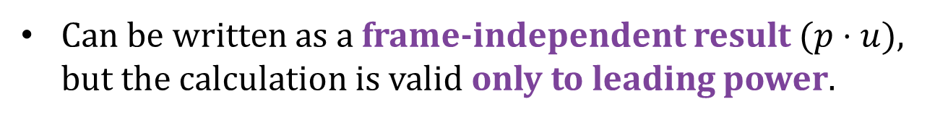
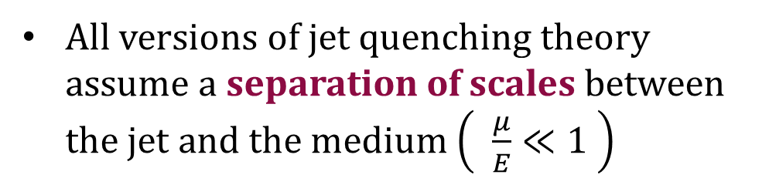

Coupling to Collective Flow: Leading Power
All versions of jet quenching theory assume a separation of scales between the jet and the medium $\left( \frac{μ}{E}≪1 \right)$
At leading (eikonal) power in the jet energy, the medium is effectively static:
$\left(p⋅u\right)≈E u^{0}+⋯$
Can be written as a frame-independent result $(p⋅u)$,
but the calculation is valid only to leading power.
e.g., Xiao et al., Phys. Rev. C109 (2024)
M. Sievert
Response of Jets to Collective Flow
7 / 22

Slide 8
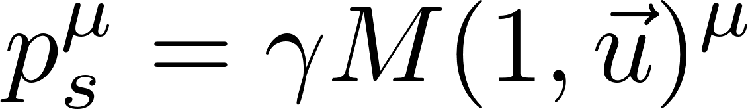
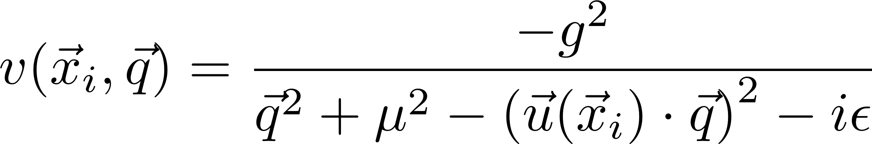
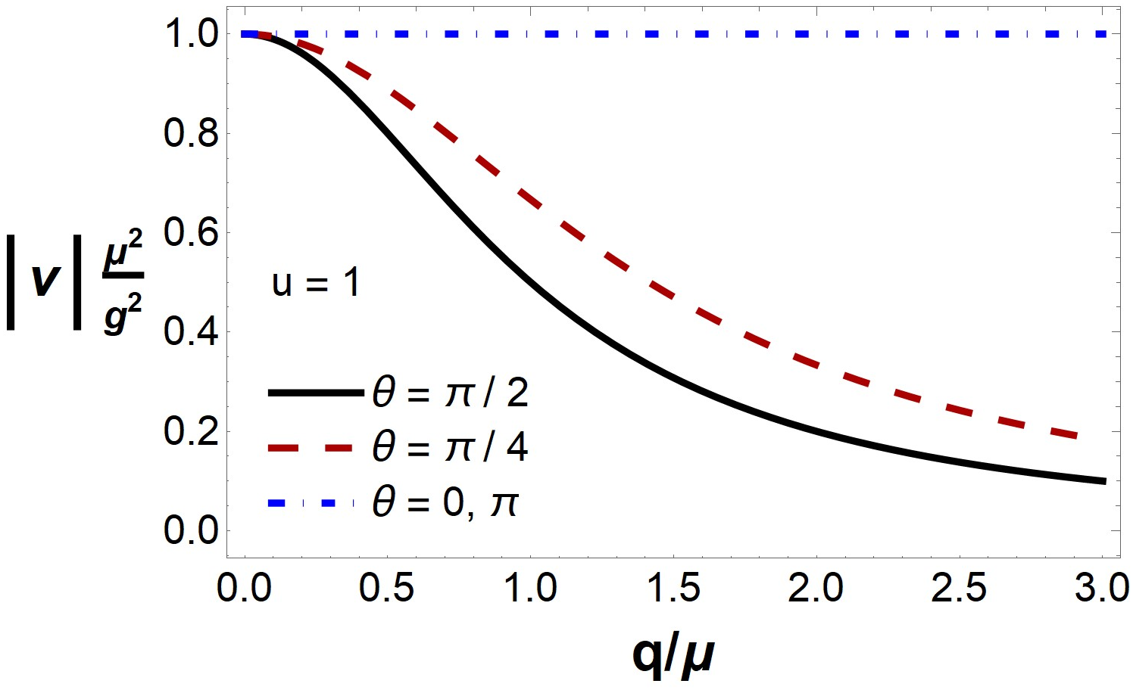
Coupling to Collective Flow: Sub-Leading Power
Sadofyev, MDS, Vitev, Phys. Rev. D104 (2021)
Fully relativistic velocity
Velocity-dependent potential
GW: Target masses assumed to be heavy (neglects medium recoil)
Propagate the sub-eikonal, velocity-dependent corrections to the Gyulassy-Wang potential
Gyulassy, Wang, Nucl. Phys. B420 (1994)
Enhanced collinear scattering with the flow
Correlated collisional energy transfer
M. Sievert
Response of Jets to Collective Flow
8 / 22

Slide 9
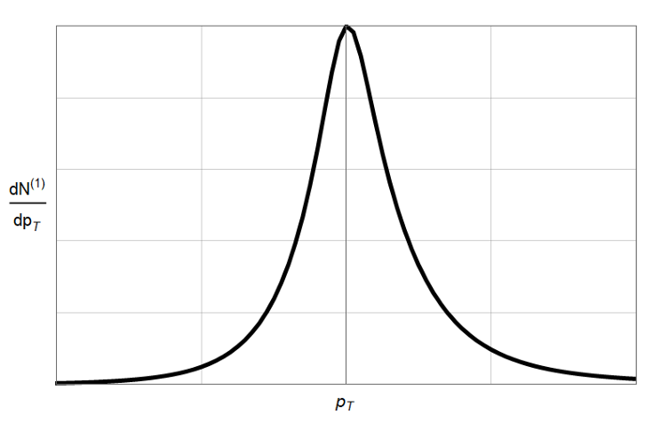
Jet Drift: Skewed Momentum Broadening
Sadofyev, MDS, Vitev, Phys. Rev. D104 (2021)
The leading (linear) flow-dependent correction skews the jet distribution preferentially along the direction of the flow velocity.
Sub-eikonal vertex
Shifted potential
Energy Shift
M. Sievert
Response of Jets to Collective Flow
9 / 22

Slide 10
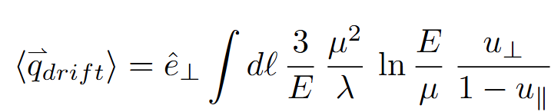

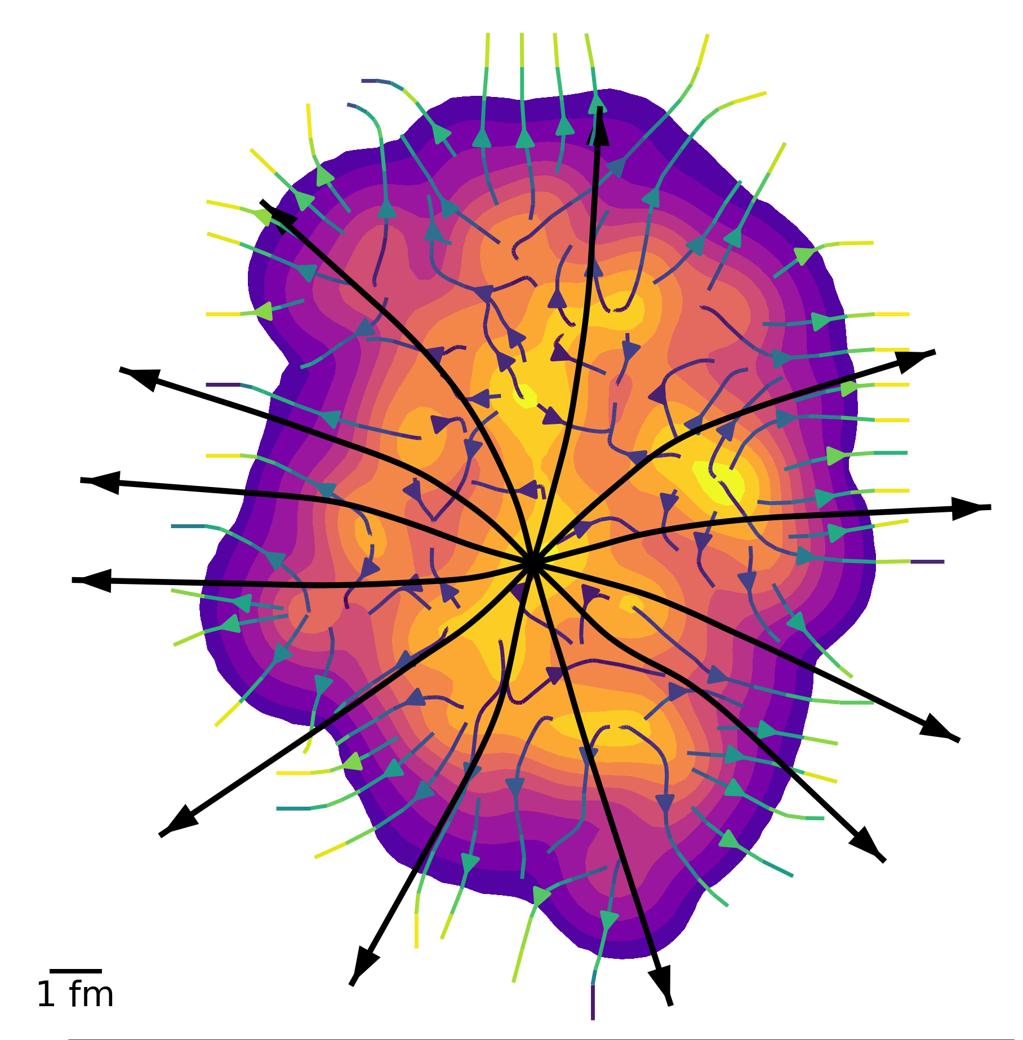


Jet Drift: Skewed Momentum Broadening
Jo Bahder,
Thurs 1/9, 10am
Simplest implementation: the net transverse deflection due to the preferred direction.
Jets inherit the correlation to geometry embedded in the collective flow $u(x)$
Geometry coupling above and beyond path-length dependence.
Jet drift influences many observables
Hasan Rahman,
Thurs 1/9, 11am
M. Sievert
Response of Jets to Collective Flow
10 / 22

Slide 11


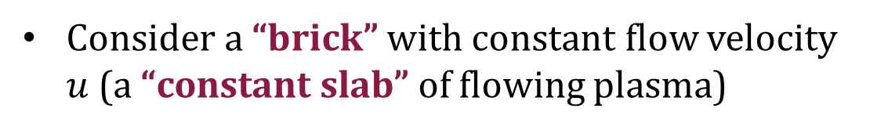



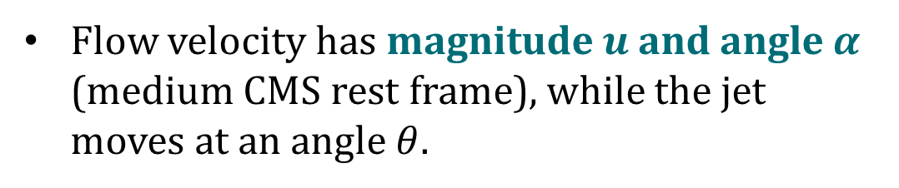
What We Can We Learn from Jet Drift – The Constant Slab
Antiporda, Bahder, Rahman, MDS, Phys. Rev. D105 (2022)
$$\vec{u}$$
$$u_{⊥}$$
Initial jet direction
$$u_{∥}$$
Consider a “brick” with constant flow velocity $u$ (a “constant slab” of flowing plasma)
$$θ$$
$$L$$
$$u_{y}$$
Flow velocity has magnitude $u$ and angle $α$ (medium CMS rest frame), while the jet moves at an angle $θ$.
$$α$$
$$u_{x}$$
Lab frame
Mid-rapidity (2+1D)
M. Sievert
Response of Jets to Collective Flow
11 / 22

Slide 12
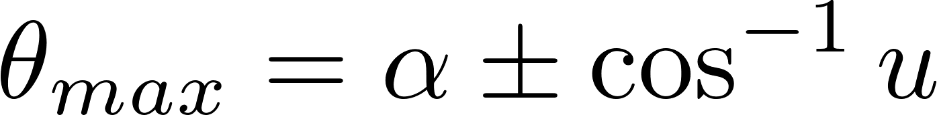


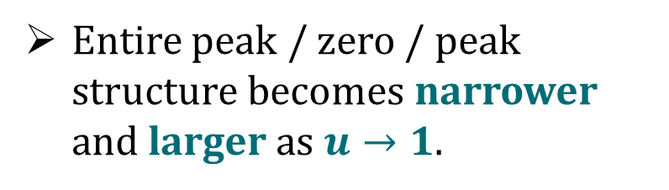


What We Can We Learn from Jet Drift – The Constant Slab
Antiporda, Bahder, Rahman, MDS, Phys. Rev. D105 (2022)
Deflection encodes tomographic information about the flow:
$${2 cos}^{−1}{u}$$
Zero crossing when $θ=α$
$$α$$
Two extrema centered about $α$ with total width $2 \cos^{−1} u$
Entire peak / zero / peak structure becomes narrower and larger as $u→1$.
M. Sievert
Response of Jets to Collective Flow
12 / 22

Slide 13
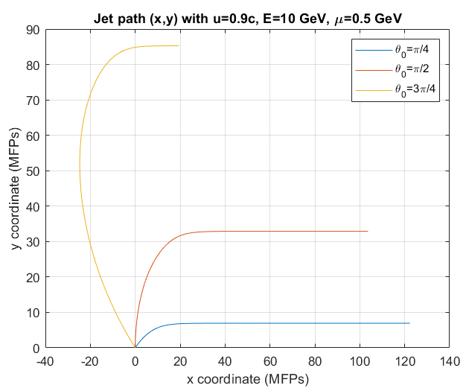
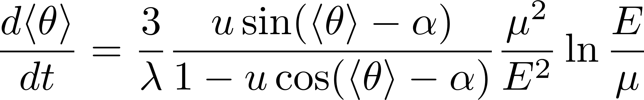
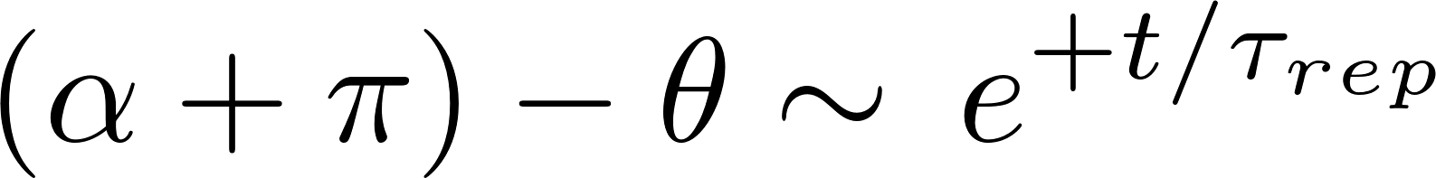
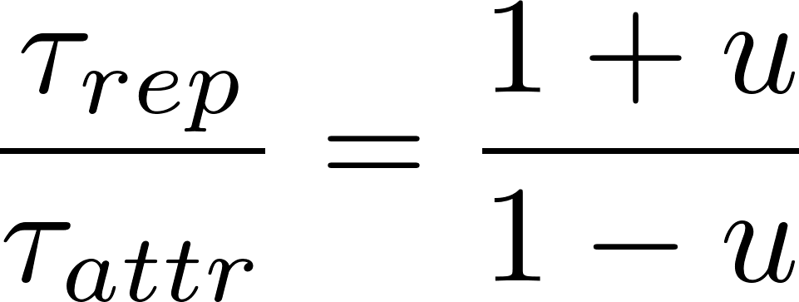
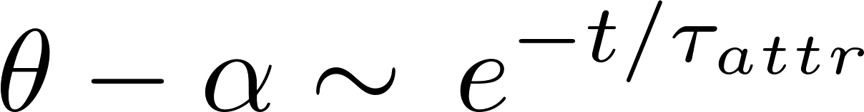
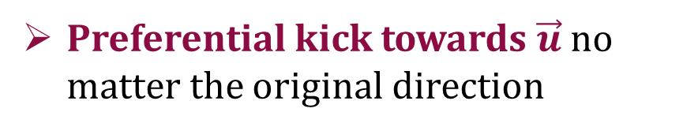
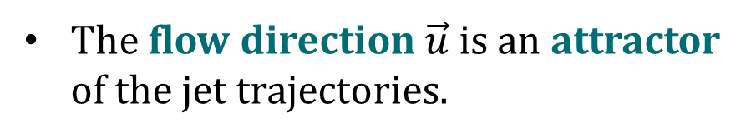
What We Can We Learn from Jet Drift – The Constant Slab
The flow direction $\vec{u}$ is an attractor of the jet trajectories.
Antiporda, Bahder, Rahman, MDS,
Phys. Rev. D105 (2022)
Preferential kick towards $\vec{u}$ no matter the original direction
Given enough time, jet trajectories converge to the flow direction
The time constants carry information about the fluid speed.
M. Sievert
Response of Jets to Collective Flow
13 / 22

Slide 14
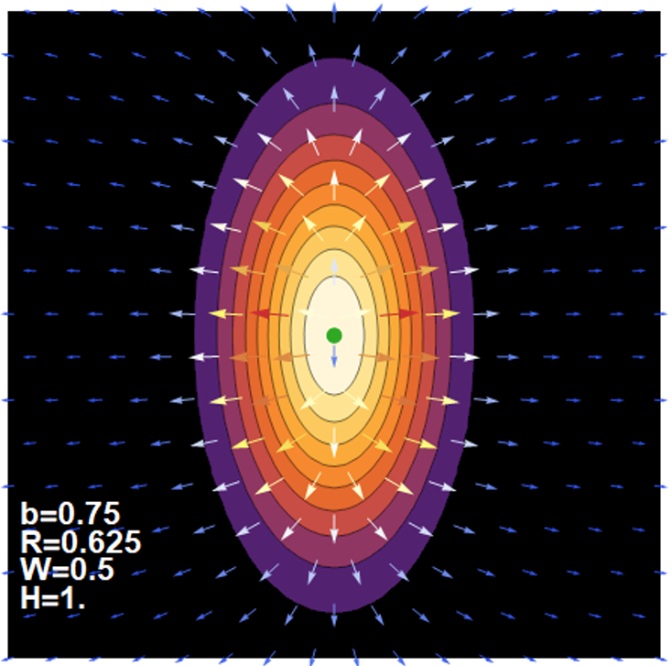
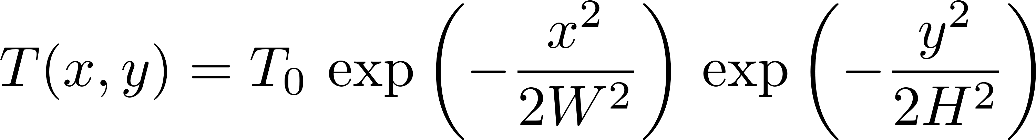
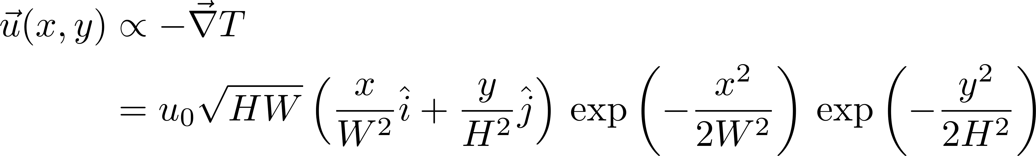

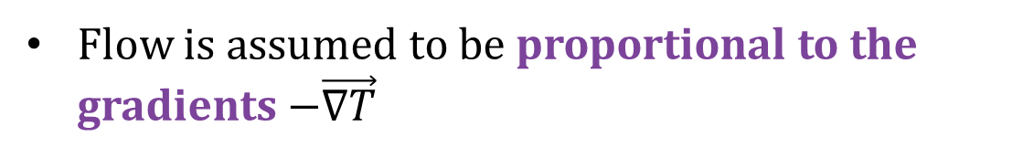

What We Can Learn from Jet Drift: Fluctuating Gaussian
Consider Gaussian ellipse toy model, with the geometry and flow determined from a fluctuating impact parameter
$$W=2 R −b$$
$$H={\left(4R^{2}−b^{2}\right)}^{1/2}$$
Flow is assumed to be proportional to the gradients $−\vec{∇T}$
Antiporda, Bahder, Rahman, MDS,
Phys. Rev. D105 (2022)
M. Sievert
Response of Jets to Collective Flow
14 / 22

Slide 15



What We Can Learn from Jet Drift: Fluctuating Gaussian
Folding jet drift with the event geometry converts what is locally a directed flow (“v1 of jets”) into a global elliptic flow (v2).
Local $\cos{φ}$ → global $\cos{2 φ}$
Antiporda, Bahder, Rahman, MDS,
Phys. Rev. D105 (2022)
$$W=1$$
H = 2
Simplest picture for jets produced at the center:
The event plane (minor axis) becomes the attractor for jet trajectories
The perpendicular direction (major axis) becomes a repulsor for jet trajectories
$$⟨q_{drift}⟩$$
M. Sievert
Response of Jets to Collective Flow
15 / 22

Slide 16
What We Can Learn from Jet Drift: Fluctuating Gaussian
The conclusions are robust and survive the inclusion of fluctuations:
Antiporda, Bahder, Rahman, MDS,
Phys. Rev. D105 (2022)
Production point fluctuations
(binary collision sampling)
Impact parameter fluctuations
M. Sievert
Response of Jets to Collective Flow
16 / 22

Slide 17

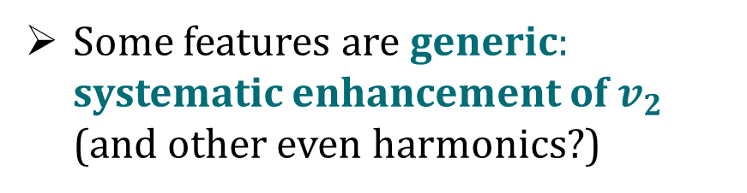
Implications: Jet Drift and Elliptic Flow
Through folding with the event geometry, jet drift (a locally “v1 type” effect) is converted into elliptic flow (a “v2 type” correlation with the event plane).
Antiporda, Bahder, Rahman, MDS,
Phys. Rev. D105 (2022)
Some features are specific to this model (e.g., $v_{3}=0$)
Some features are generic: systematic enhancement of $v_{2}$ (and other even harmonics?)
M. Sievert
Response of Jets to Collective Flow
17 / 22

Slide 18
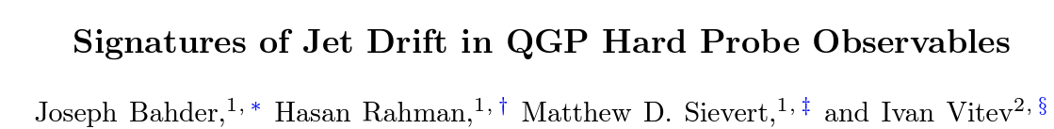
The Next Frontier: Jet Drift in EBE Heavy-Ion Collisions
arXiv: 2412.05474
Studies jet drift in event-by-event viscous hydrodynamics simulations.
Quantitative enhancement to v2 of jets, especially at lower pT (sub-eikonal effect)
Competes with conventional mechanisms (path-length-dependent energy loss) for v2.
M. Sievert
Response of Jets to Collective Flow
18 / 22

Slide 19
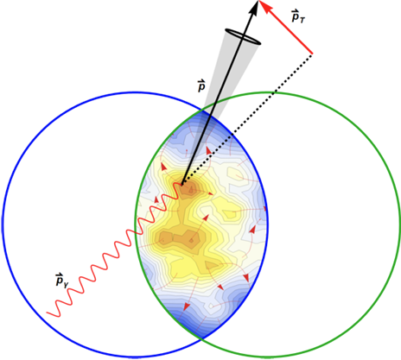
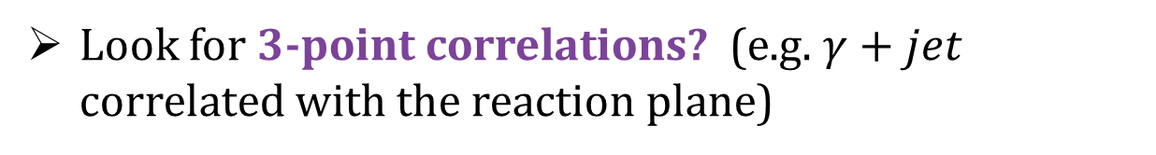
Searching for “Designer” Observables
Although “low hanging fruit,” the enhancement of v2 due to drift is not unique to drift.
Natural missing element of the “$R_{AA}$ to v2 Puzzle”
Larger impact on the deflection magnitudes (acoplanarities) although not correlated to the event plane.
Look for 3-point correlations? (e.g. $γ+jet$ correlated with the reaction plane)
M. Sievert
Response of Jets to Collective Flow
19 / 22

Slide 20
A New Industry: Asymmetric Measures of Jets
A representative selection: (note that groups overlap)
Wang et al:
2001.08273
2204.05323
2210.06519
2402.00264
Sievert et al:
2104.09513
2110.03590
2207.07679
2412.05474
Sadofyev et al:
2202.08847
2207.07141
2304.03712
2309.00683
Vitev et al:
2412.12250
M. Sievert
Response of Jets to Collective Flow
20 / 22

Slide 21

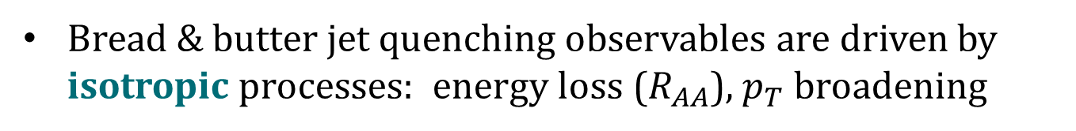

Lesson: Power of Antisymmetry
Bread & butter jet quenching observables are driven by isotropic processes: energy loss ($R_{AA}$), $p_{T}$ broadening
$$θ$$
$$θ_{0}$$
Even locally, there are many competing “backgrounds”:
vacuum Sudakov shower, gluon saturation, cold nuclear matter effects, etc
Antisymmetric observables can select on different microscopic channels which have fewer backgrounds than the symmetric ones
Cold QCD: transverse spin asymmetries, parity-violating asymmetries, etc.
Hot QCD: preferred deflection of jets
Power-suppressed effects introduce new quantum numbers to the process (flow)
M. Sievert
Response of Jets to Collective Flow
21 / 22

Slide 22
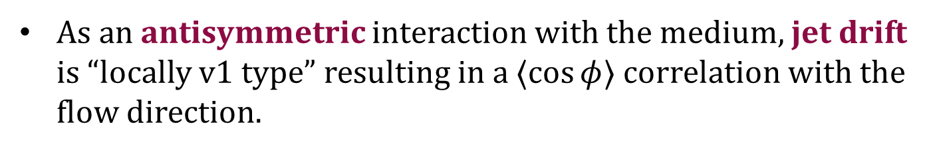
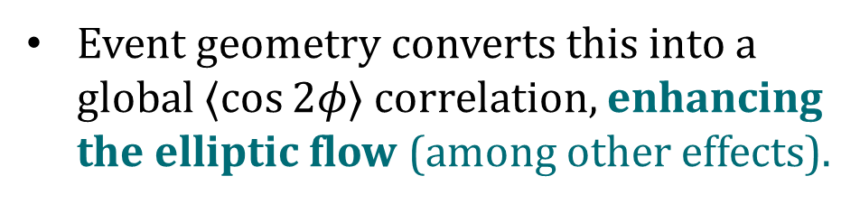
Conclusions
The radiation emitted by a hard parton is a sensitive interferometer to details of the nuclear medium.
As an antisymmetric interaction with the medium, jet drift is “locally v1 type” resulting in a $⟨\cos{φ⟩}$ correlation with the flow direction.
Event geometry converts this into a global $⟨\cos{2φ⟩}$ correlation, enhancing the elliptic flow (among other effects).
M. Sievert
Response of Jets to Collective Flow
22 / 22

