Slide 1
Quantifying Jet Quenching And Medium Response With Two Particle Correlations With PHENIX
Anthony Hodges for the PHENIX Collaboration
Hot Jets: Advancing the Understanding of High Temperature QCD With Jets
January 8th, 2024

Slide 2
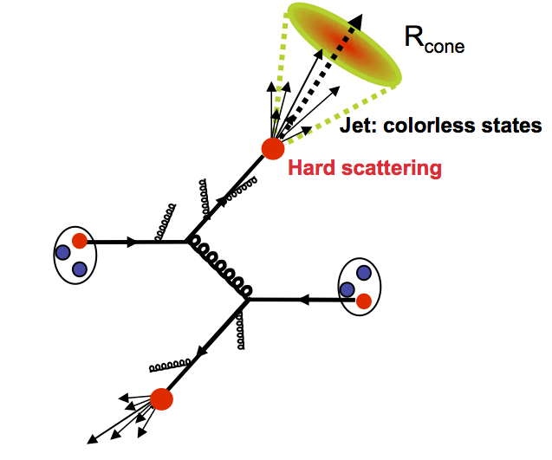
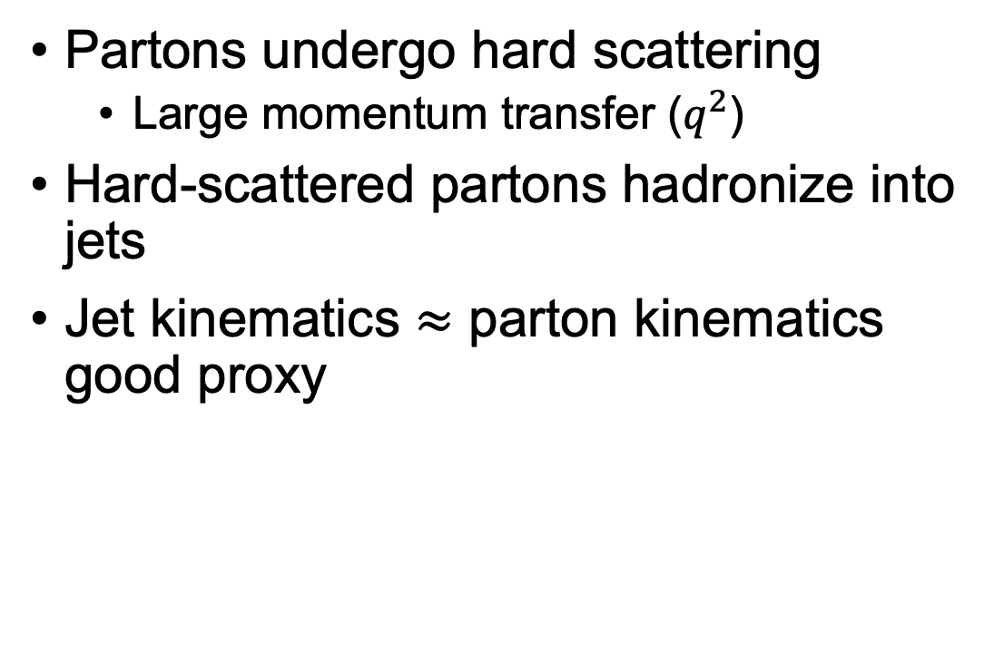
Jets as QCD Probes
Partons undergo hard scattering
  Large momentum transfer ($q^{2}$)
Hard-scattered partons hadronize into jets
Jet kinematics $≈$ parton kinematics good proxy
Proton
Hard Scattering
Proton
p+p Collision
Notes:
Now, the probability of this process happening it proportional to these terms here, and don’t be alarmed, we really only want to keep track of one of them

Slide 3
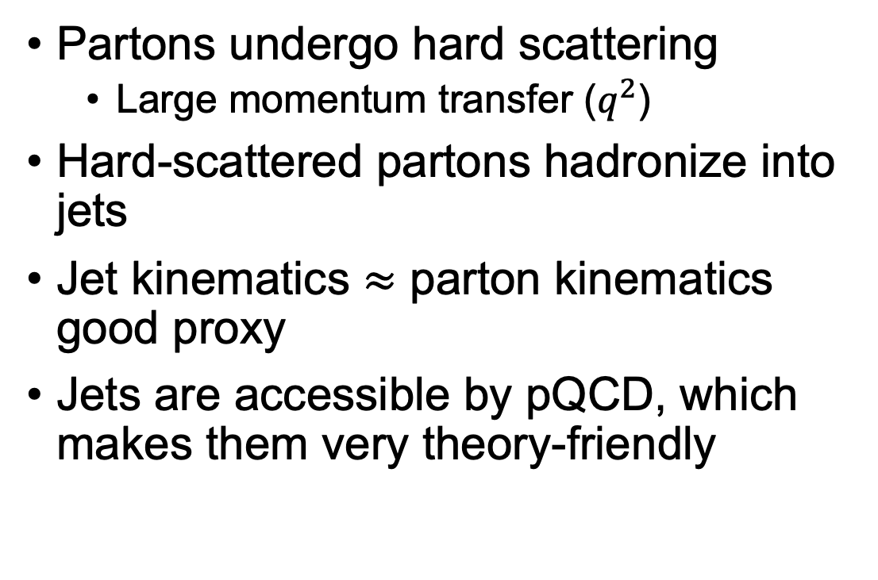
Jets as QCD Probes
Partons undergo hard scattering
  Large momentum transfer ($q^{2}$)
Hard-scattered partons hadronize into jets
Jet kinematics $≈$ parton kinematics good proxy
Jets are accessible by pQCD, which makes them very theory-friendly
Proton
Hard Scattering
Proton
Differential cross section
$$dσ=∫∫∫f_{a}^{A}\left(x_{a}\right)f_{b}^{B}\left(x_{b}\right)⋅dσ_{ab→cX}⋅D_{c}^{h}\left(z\right)dx_{a}dx_{b}dz$$
p+p Collision
Notes:
Now, the probability of this process happening it proportional to these terms here, and don’t be alarmed, we really only want to keep track of one of them

Slide 4
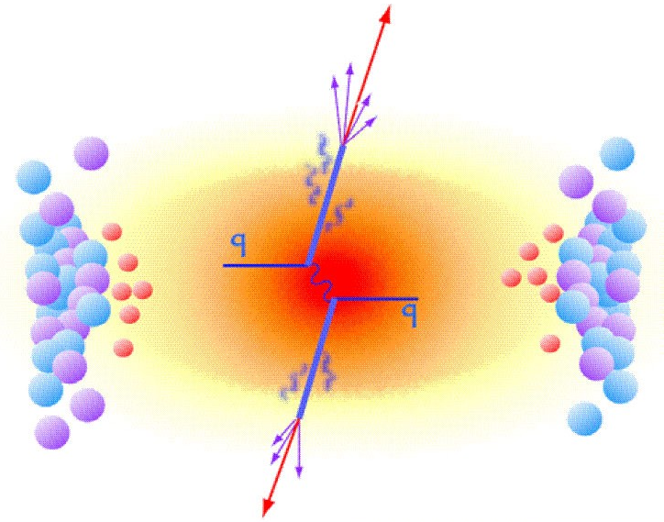
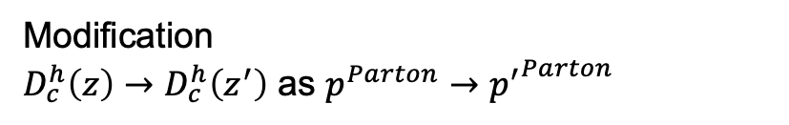
Jets in Heavy Ion Collisions
Hard-scattered partons now traverse dense QGP medium
Energy lost to medium yields modified jets
Measurement of jet modification allows us to study parton-medium interactions
Differential cross section
$$dσ=∫∫∫f_{a}^{A}\left(x_{a}\right)f_{b}^{B}\left(x_{b}\right)⋅dσ_{ab→cX}⋅D_{c}^{h}\left(z\right)dx_{a}dx_{b}dz$$
Heavy Ion Collision
Modification
$D_{c}^{h}\left(z\right)→D_{c}^{h}\left(z^{′}\right)$ as $p^{Parton}→{p^{′}}^{Parton}$

Slide 5
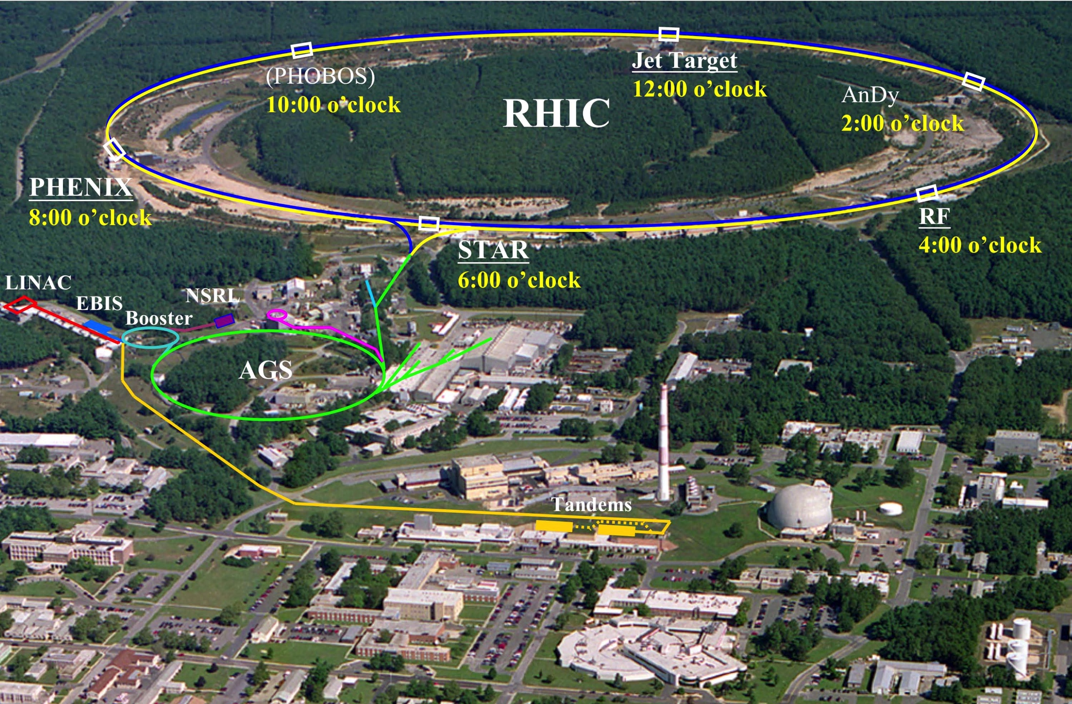
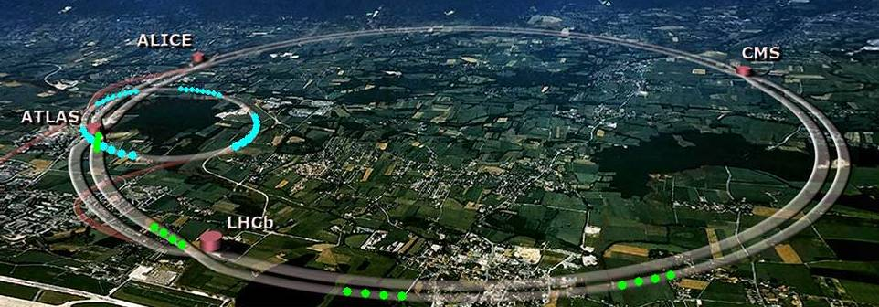


Jet Factories: RHIC and the LHC
Relativistic Heavy Ion Collider
Large Hadron Collider
Notes:
And of course you need very heavy duty machinery to do this. Namely particle colliders, or synchrotrons as they’re technically known. Here are the two most prominent experiments in the field today. On the left we have the relativistic heavy ion collider, or RHIC, on the left located at Brookhaven National Lab in Upton New York, and on the right we have the Large Hadron Collider, or LHC, which straddles the Franco-Swiss border . Today though, we’re going to focus solely on RHIC

Slide 6
The Relativistic Heavy-Ion Collider
LHC
Highly versatile collider
Decades of expansive data collected
Notes:
So RHIC’s job is primarily to smash nuclei together near the sped of light, but it’s primary advantage as a facility is all the different ways in which it can do that. You can see on the right the different collisions measured by the PHENIX, one of RHIC’s detector experiments, over the course of its sixteen year run time. You can see that RHIC is capable of colliding many different species at many different center of mass energies.

Slide 7
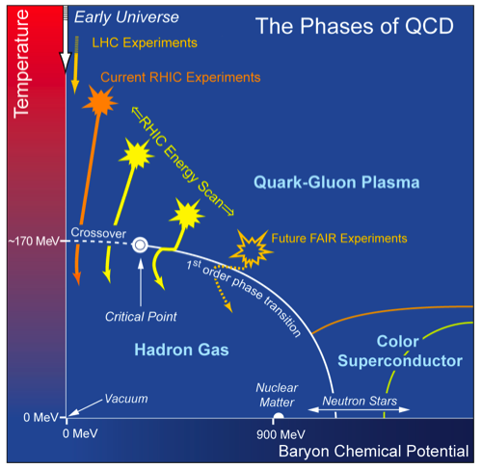
The Relativistic Heavy-Ion Collider
LHC
Capable of probing large swathe of QCD phase space!
Notes:
So RHIC’s job is primarily to smash nuclei together near the sped of light, but it’s primary advantage as a facility is all the different ways in which it can do that. You can see on the right the different collisions measured by the PHENIX, one of RHIC’s detector experiments, over the course of its sixteen year run time. You can see that RHIC is capable of colliding many different species at many different center of mass energies.

Slide 8
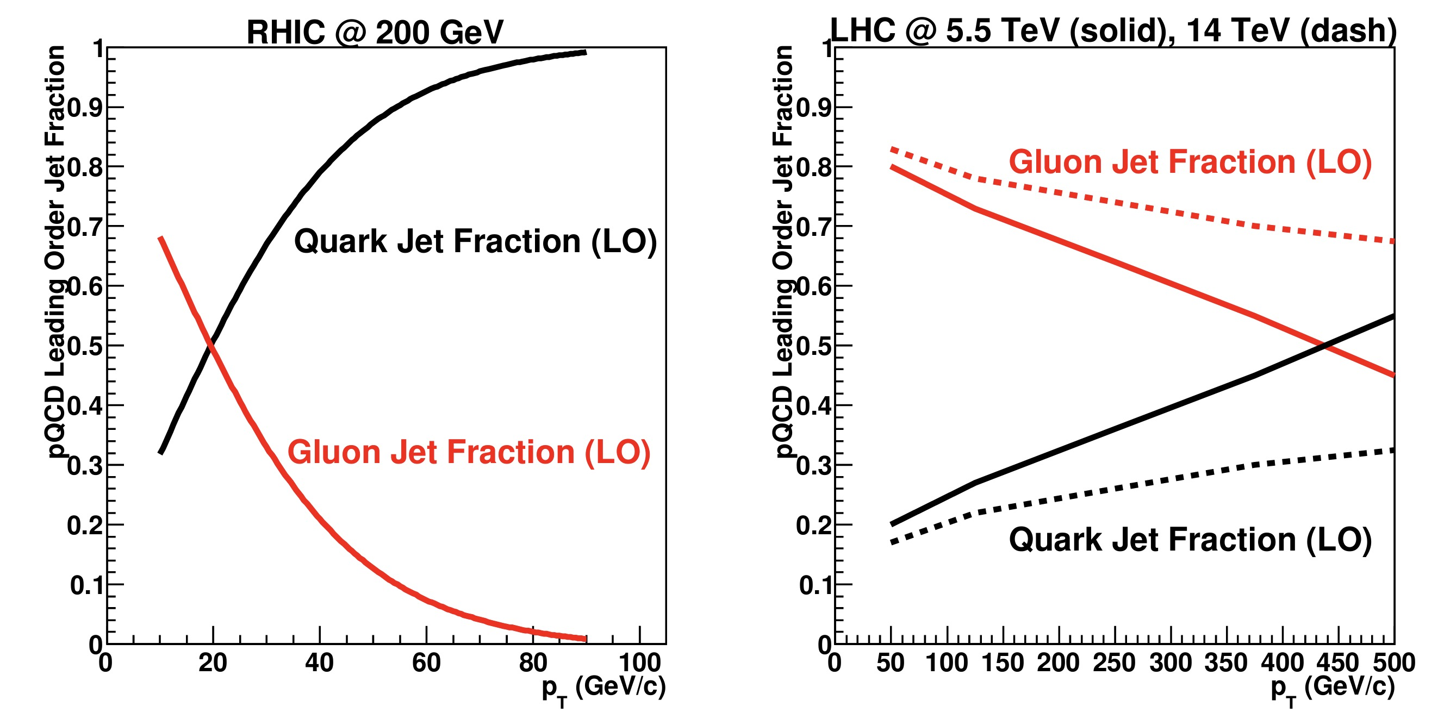
Why Jets at RHIC?
Different jet populations!
LHC jets largely initiated by gluons
RHIC jets dominated by quark-initiated jets

Slide 9
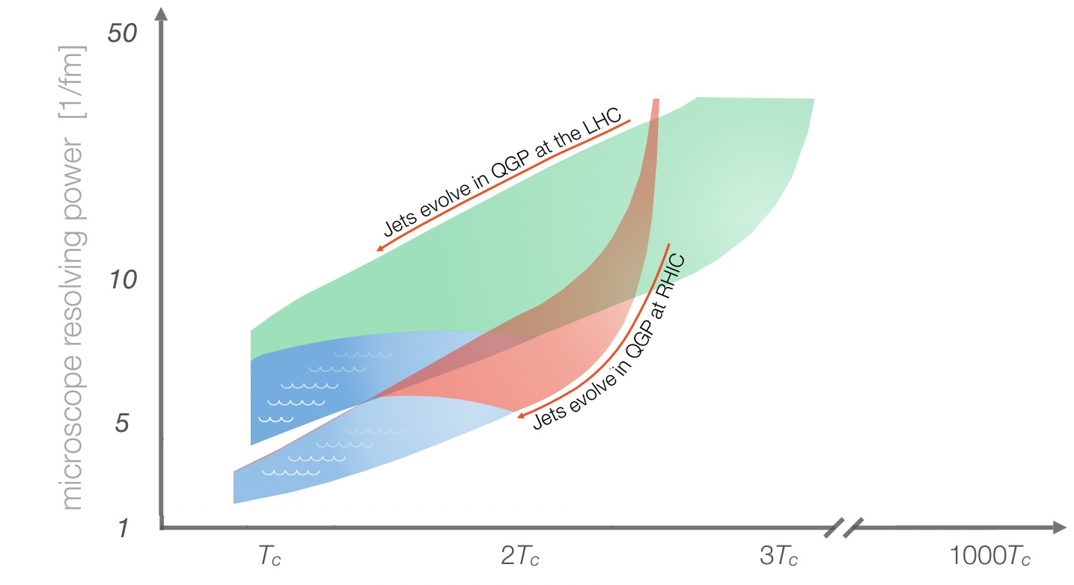
Why Jets in Heavy-Ion Collisions at RHIC?
Jet-medium interactions at RHIC and the LHC have subtle differences
Jet energies at RHIC typically closer to medium energy scale
RHIC jets also spend larger part of their evolution in the medium than LHC jets

Slide 10
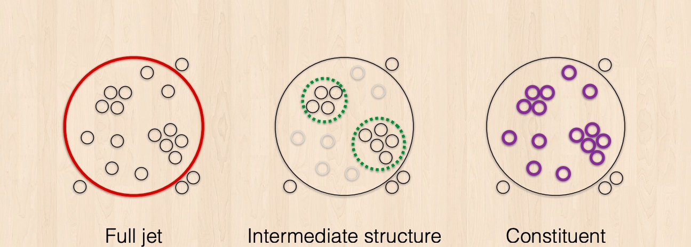
How We Study Jets
PC: Yi Chen, QM2019

Slide 11
How We Study Jets
PC: Yi Chen, QM2019

Slide 12
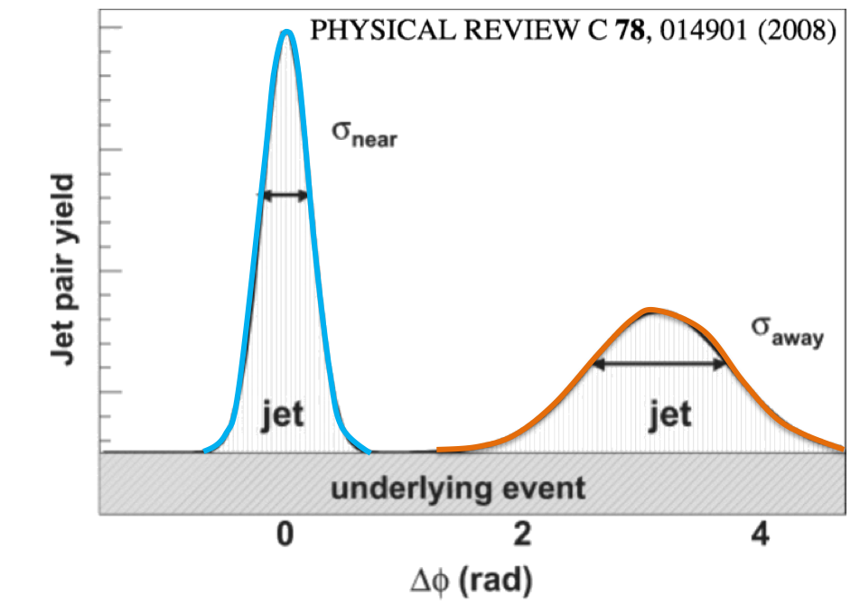
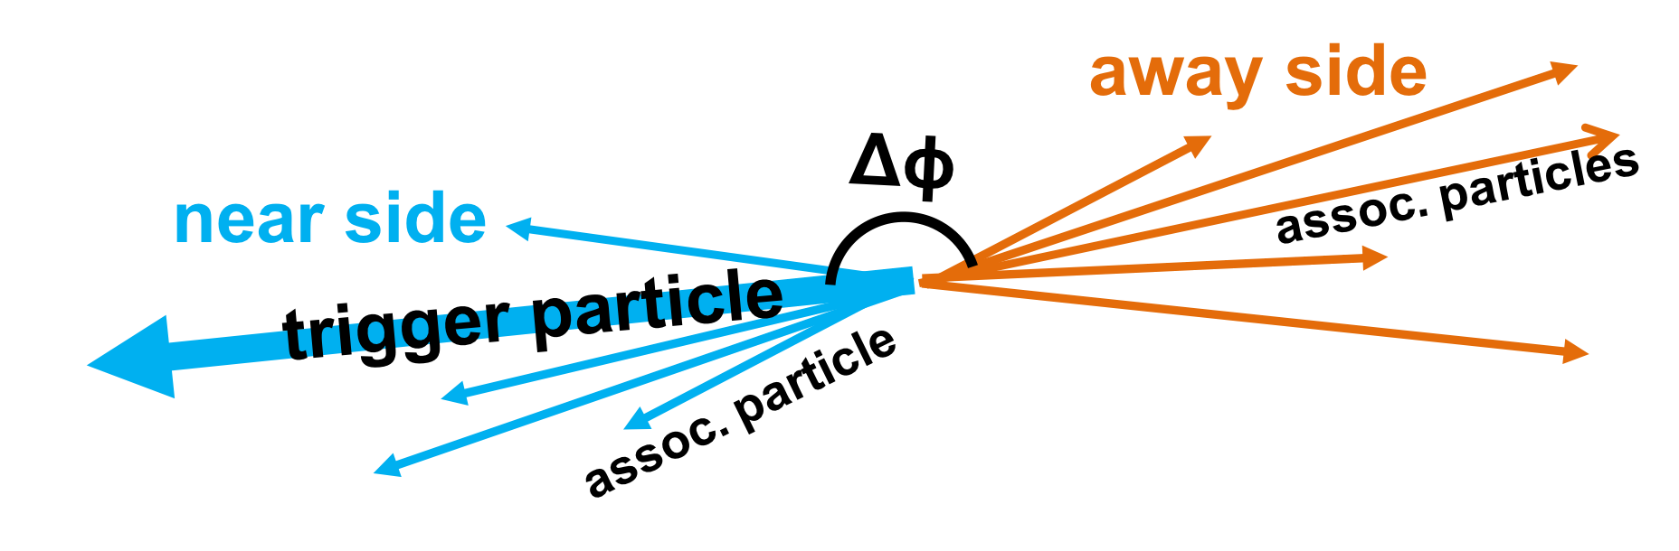

Measuring Jets – Two Particle Correlations
Direct photons: colorless, well-calibrated probe, but statistically limited
$$γ$$
Notes:
Now, the next contemporary method we have is two particle correlations. So what we’re going to do is select a high momentum particle such a neutral pion or a photon, and this is going to stand in for our jet. Then, we’re going to correlate all the charged hadrons in the event to this trigger via their separation in delta phi. This is going to give you a result that looks like this, with a peak at delta phi about 0 and pi, the near-side and away-side, respectively. Here in blue, this is where our trigger particle lives inside of one jet, and over here 180 degrees is where our reooil jet is.

Slide 13


Measuring Jets – Two Particle Correlations
Direct photons: colorless, well-calibrated probe, but statistically limited
Neutral pion ($π^{0}$): not colorless, but abundant
  Good for high-precision, differential measurements
$$π^{0}$$
Notes:
Now, the next contemporary method we have is two particle correlations. So what we’re going to do is select a high momentum particle such a neutral pion or a photon, and this is going to stand in for our jet. Then, we’re going to correlate all the charged hadrons in the event to this trigger via their separation in delta phi. This is going to give you a result that looks like this, with a peak at delta phi about 0 and pi, the near-side and away-side, respectively. Here in blue, this is where our trigger particle lives inside of one jet, and over here 180 degrees is where our reooil jet is.

Slide 14
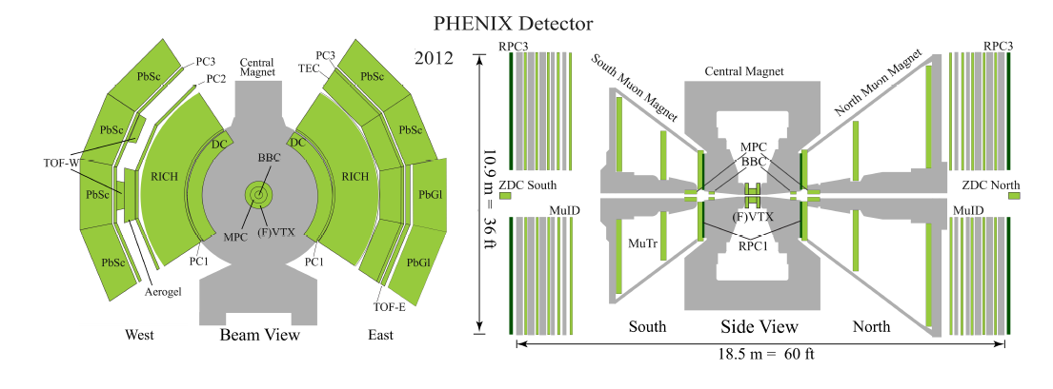
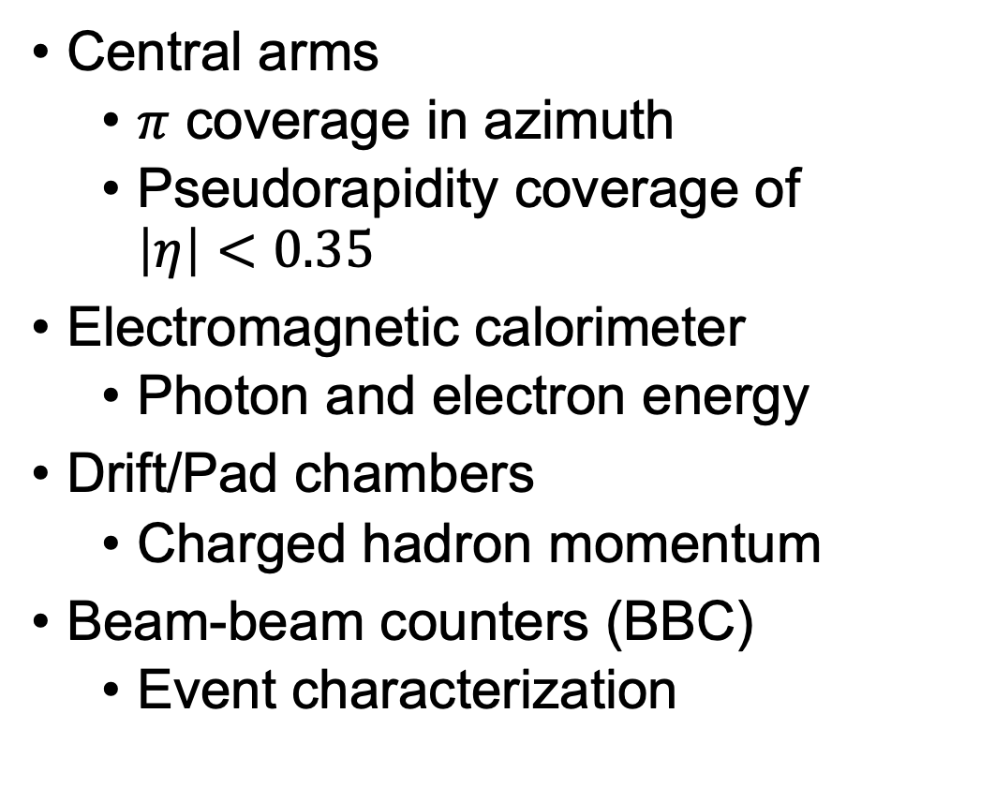
The PHENIX Detector
Central arms
  $π$ coverage in azimuth
  Pseudorapidity coverage of $\left|η\right|<0.35$
Electromagnetic calorimeter
  Photon and electron energy
Drift/Pad chambers
  Charged hadron momentum
Beam-beam counters (BBC)
  Event characterization

Slide 15
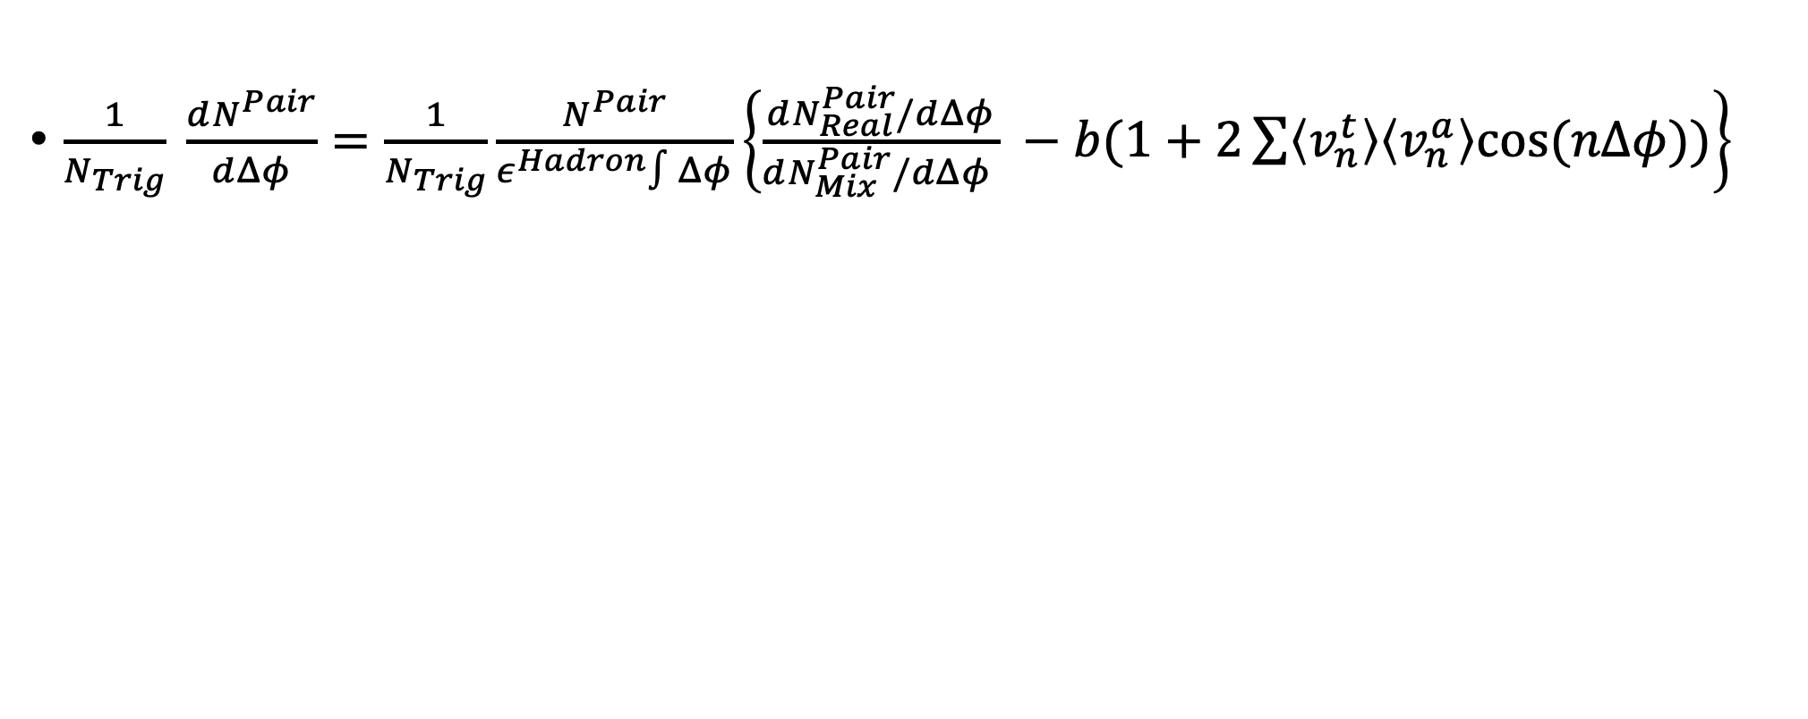
Two-Particle Correlation Anatomy
$\frac{1}{N_{Trig}} \frac{dN^{Pair}}{dΔφ}=\frac{1}{N_{Trig}}\frac{N^{Pair}}{ε^{Hadron}∫Δφ}\left\{\frac{dN_{Real}^{Pair}/dΔφ}{dN_{Mix}^{Pair}/dΔφ } −b(1+2\sum{\left\langle v_{n}^{t}\right\rangle \left\langle v_{n}^{a}\right\rangle cos⁡(nΔφ))}\right\}$

Slide 16
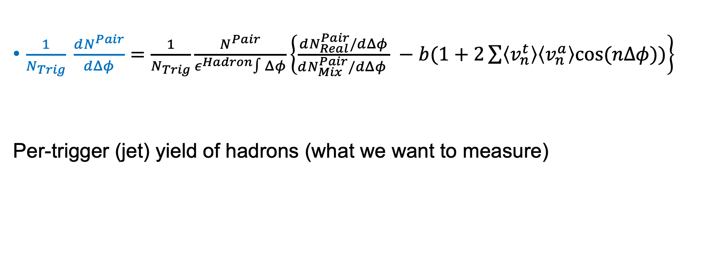
Two-Particle Correlation Anatomy
$\frac{1}{N_{Trig}} \frac{dN^{Pair}}{dΔφ}=\frac{1}{N_{Trig}}\frac{N^{Pair}}{ε^{Hadron}∫Δφ}\left\{\frac{dN_{Real}^{Pair}/dΔφ}{dN_{Mix}^{Pair}/dΔφ } −b(1+2\sum{\left\langle v_{n}^{t}\right\rangle \left\langle v_{n}^{a}\right\rangle cos⁡(nΔφ))}\right\}$
Per-trigger (jet) yield of hadrons (what we want to measure)

Slide 17
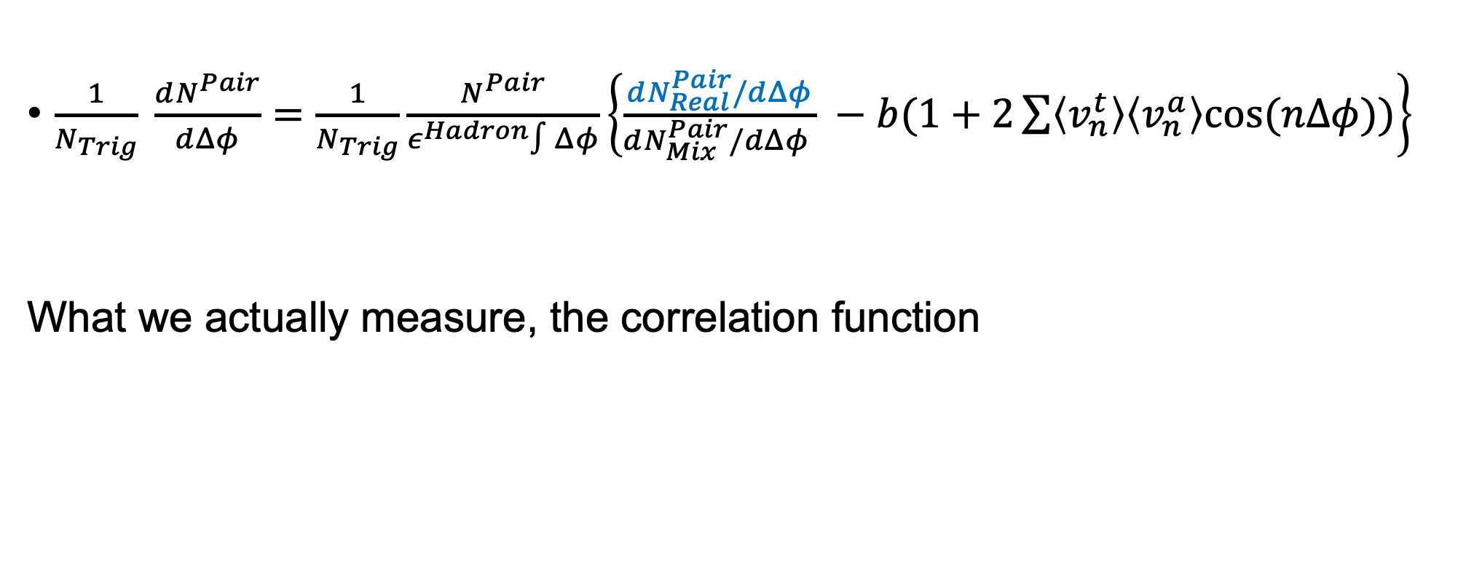
Two-Particle Correlation Anatomy
$\frac{1}{N_{Trig}} \frac{dN^{Pair}}{dΔφ}=\frac{1}{N_{Trig}}\frac{N^{Pair}}{ε^{Hadron}∫Δφ}\left\{\frac{dN_{Real}^{Pair}/dΔφ}{dN_{Mix}^{Pair}/dΔφ } −b(1+2\sum{\left\langle v_{n}^{t}\right\rangle \left\langle v_{n}^{a}\right\rangle cos⁡(nΔφ))}\right\}$
What we actually measure, the correlation function

Slide 18
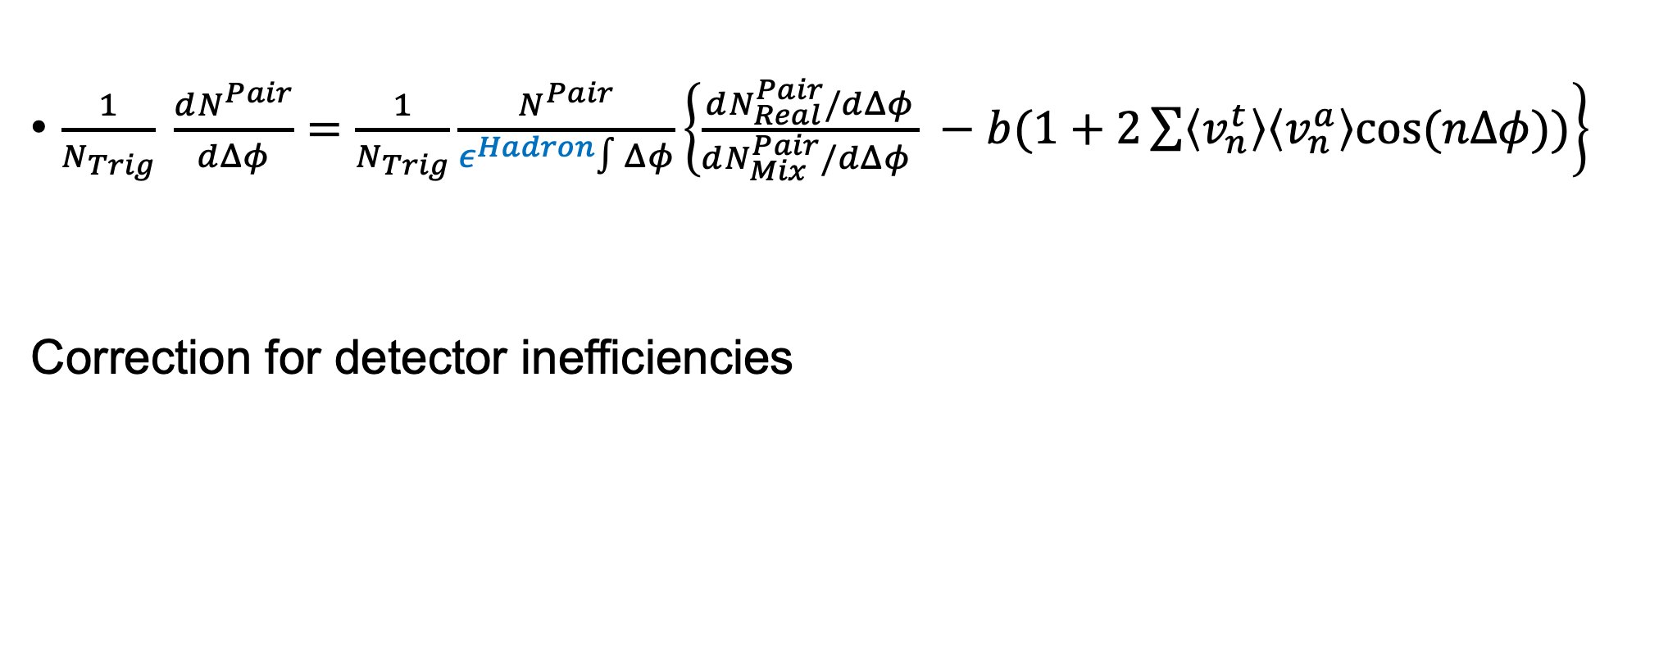
Two-Particle Correlation Anatomy
$\frac{1}{N_{Trig}} \frac{dN^{Pair}}{dΔφ}=\frac{1}{N_{Trig}}\frac{N^{Pair}}{ε^{Hadron}∫Δφ}\left\{\frac{dN_{Real}^{Pair}/dΔφ}{dN_{Mix}^{Pair}/dΔφ } −b(1+2\sum{\left\langle v_{n}^{t}\right\rangle \left\langle v_{n}^{a}\right\rangle cos⁡(nΔφ))}\right\}$
Correction for detector inefficiencies

Slide 19
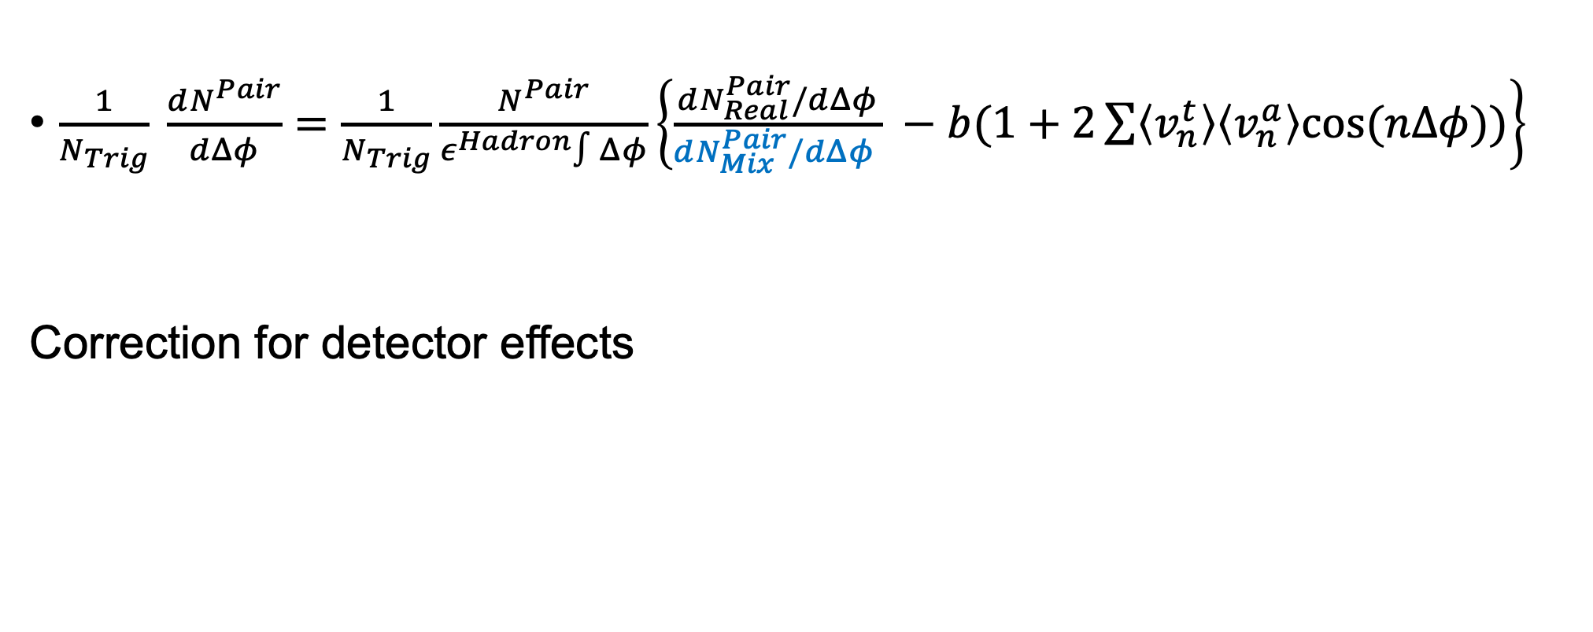
Two-Particle Correlation Anatomy
$\frac{1}{N_{Trig}} \frac{dN^{Pair}}{dΔφ}=\frac{1}{N_{Trig}}\frac{N^{Pair}}{ε^{Hadron}∫Δφ}\left\{\frac{dN_{Real}^{Pair}/dΔφ}{dN_{Mix}^{Pair}/dΔφ } −b(1+2\sum{\left\langle v_{n}^{t}\right\rangle \left\langle v_{n}^{a}\right\rangle cos⁡(nΔφ))}\right\}$
Correction for detector effects

Slide 20
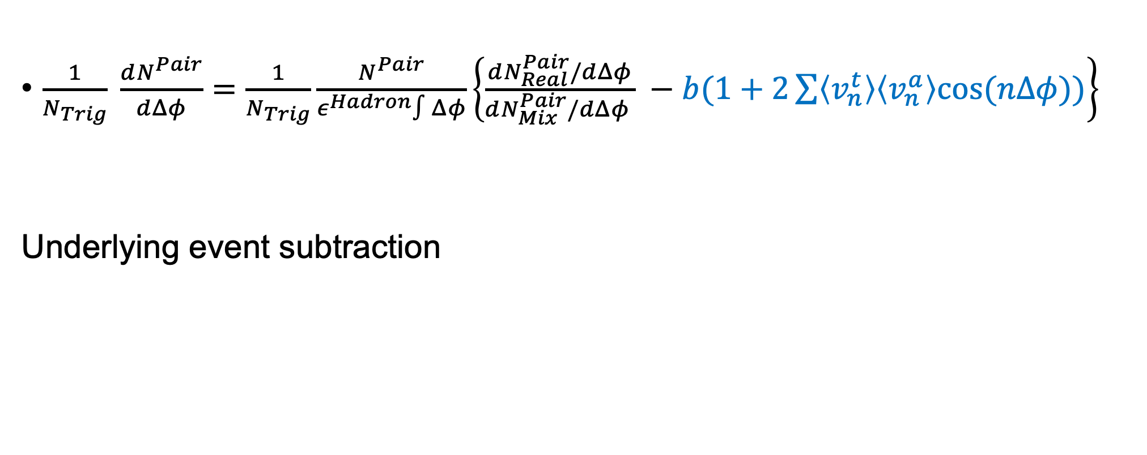
Two-Particle Correlation Anatomy
$\frac{1}{N_{Trig}} \frac{dN^{Pair}}{dΔφ}=\frac{1}{N_{Trig}}\frac{N^{Pair}}{ε^{Hadron}∫Δφ}\left\{\frac{dN_{Real}^{Pair}/dΔφ}{dN_{Mix}^{Pair}/dΔφ } −b(1+2\sum{\left\langle v_{n}^{t}\right\rangle \left\langle v_{n}^{a}\right\rangle cos⁡(nΔφ))}\right\}$
Underlying event subtraction

Slide 21
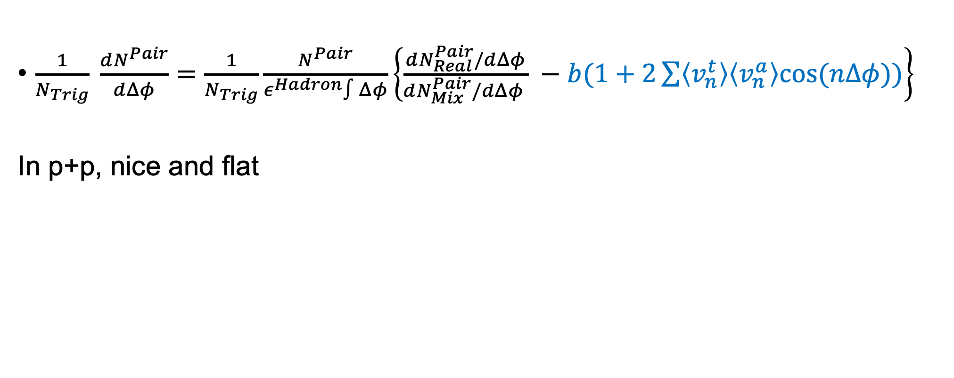
Two-Particle Correlation Anatomy
$\frac{1}{N_{Trig}} \frac{dN^{Pair}}{dΔφ}=\frac{1}{N_{Trig}}\frac{N^{Pair}}{ε^{Hadron}∫Δφ}\left\{\frac{dN_{Real}^{Pair}/dΔφ}{dN_{Mix}^{Pair}/dΔφ } −b(1+2\sum{\left\langle v_{n}^{t}\right\rangle \left\langle v_{n}^{a}\right\rangle cos⁡(nΔφ))}\right\}$
In p+p, nice and flat

Slide 22
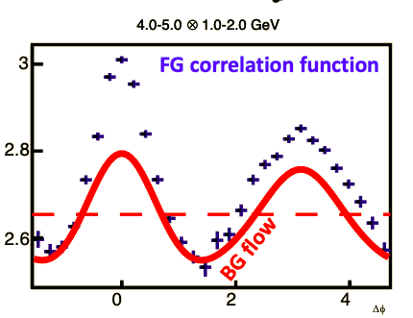
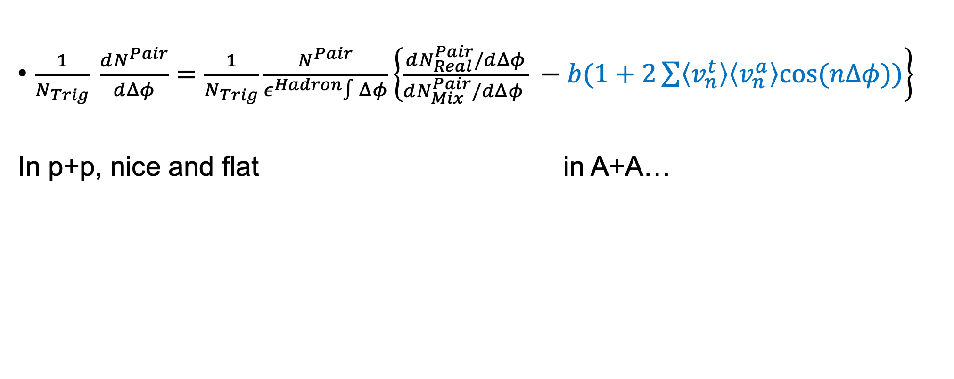
Two-Particle Correlation Anatomy
$\frac{1}{N_{Trig}} \frac{dN^{Pair}}{dΔφ}=\frac{1}{N_{Trig}}\frac{N^{Pair}}{ε^{Hadron}∫Δφ}\left\{\frac{dN_{Real}^{Pair}/dΔφ}{dN_{Mix}^{Pair}/dΔφ } −b(1+2\sum{\left\langle v_{n}^{t}\right\rangle \left\langle v_{n}^{a}\right\rangle cos⁡(nΔφ))}\right\}$
In p+p, nice and flat in A+A…

Slide 23
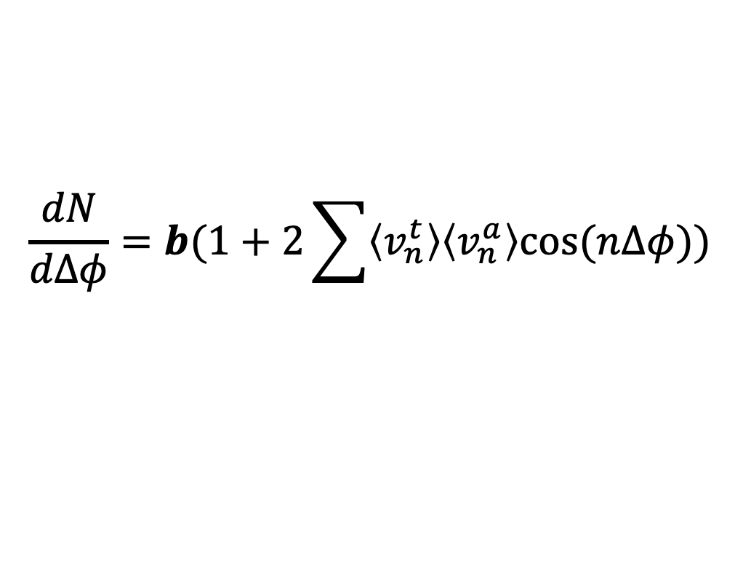

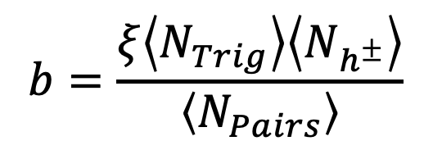
Underlying Event Subtraction
$$\frac{dN}{dΔφ}=b(1+2\sum{\left\langle v_{n}^{t}\right\rangle \left\langle v_{n}^{a}\right\rangle cos⁡(nΔφ))}$$
$$b=\frac{ξ\left\langle N_{Trig}\right\rangle \left\langle N_{h^{±}}\right\rangle }{\left\langle N_{Pairs}\right\rangle }$$
Amplitude given by Absolute Background Subtraction method for $p_{T}^{Hadron}>1$GeV/c
  Phys. Rev. C 81, 014908
Notes:
And then once we have these coefficients and we determine the amplitude of the flow signal, we can subtract the the underlying event correlation, which leaves us with

Slide 24
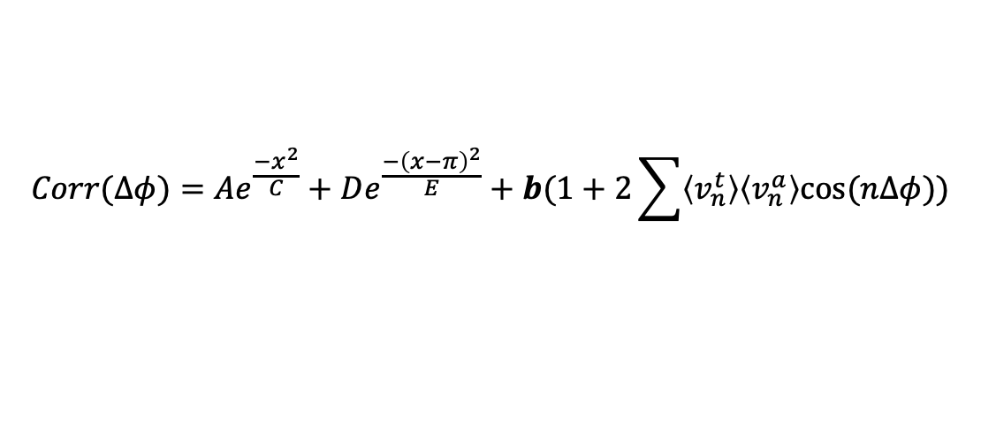
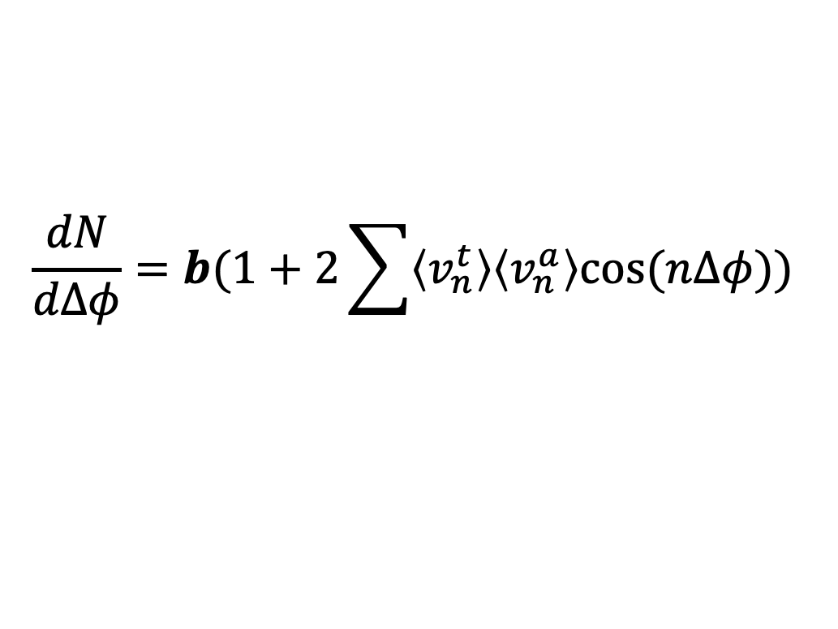



Underlying Event Subtraction
$$\frac{dN}{dΔφ}=b(1+2\sum{\left\langle v_{n}^{t}\right\rangle \left\langle v_{n}^{a}\right\rangle cos⁡(nΔφ))}$$
Correlation Function
Fit
-1
0
1
2
3
4
$$Δφ$$
$$Δφ$$
$$Corr(Δφ)=Ae^{\frac{−x^{2}}{C}}+De^{\frac{−{\left(x−π\right)}^{2}}{E}}+b(1+2\sum{\left\langle v_{n}^{t}\right\rangle \left\langle v_{n}^{a}\right\rangle cos⁡(nΔφ))}$$
$b$ from ZYAM (Zero Yield At Minimum) for $p_{T}^{Hadron}<1$GeV/c to account for over-subtraction
Notes:
And then once we have these coefficients and we determine the amplitude of the flow signal, we can subtract the the underlying event correlation, which leaves us with

Slide 25
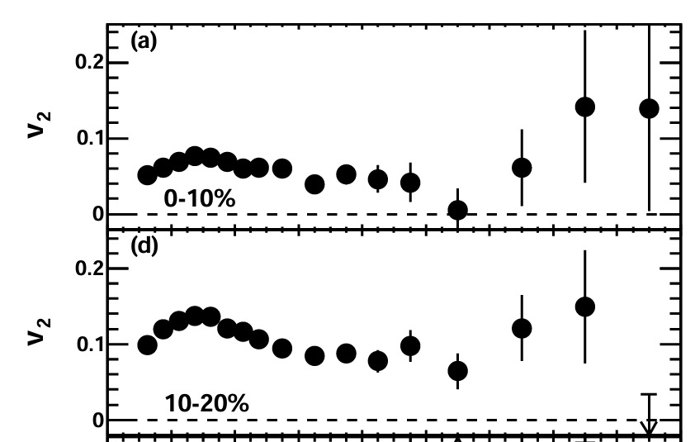

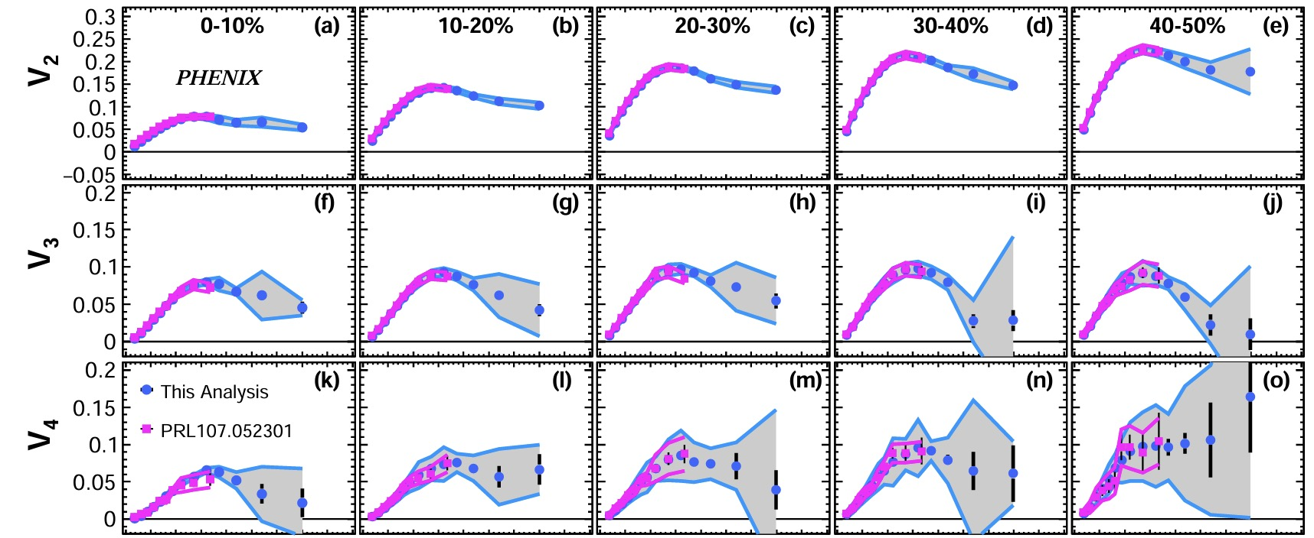
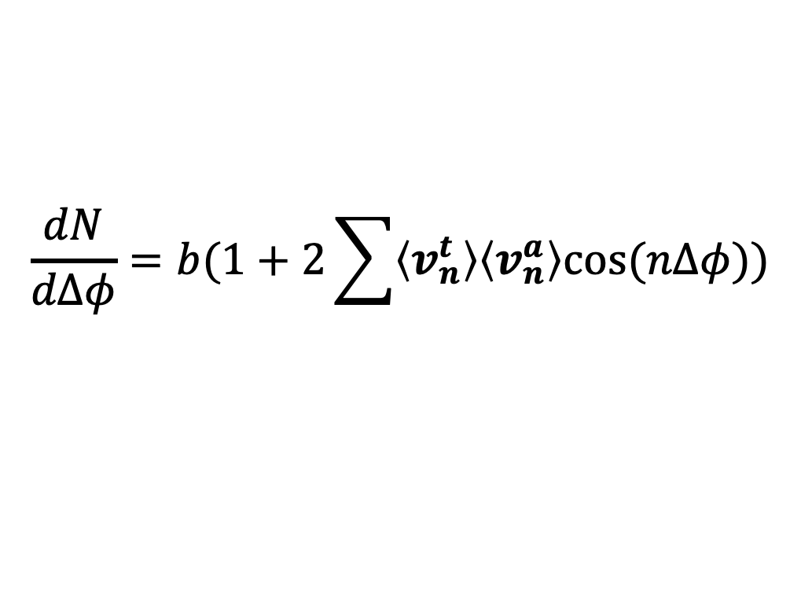

Underlying Event – Flow
Phys. Rev. Lett. 105, 142301
$$\frac{dN}{dΔφ}=b(1+2\sum{\left\langle v_{n}^{t}\right\rangle \left\langle v_{n}^{a}\right\rangle cos⁡(nΔφ))}$$
$v_{n}$ terms quantify background shape, come from previous PHENIX analyses
Phys. Rev. C 99, 054903
Notes:
, and these vn values which quantify the relative strength of each of the harmonics. There’s a v_n here for the trigger species and the associate hadrons as a whole. Taking these v_n values as high as they go is very important to characterizing the shape of the background in phi space, which is where our measurement is, so we care a lot about these coefficients

Slide 26
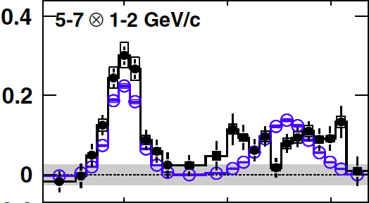
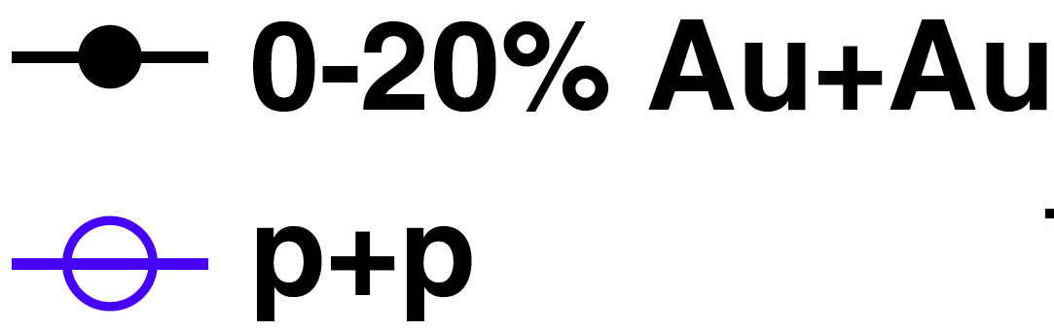
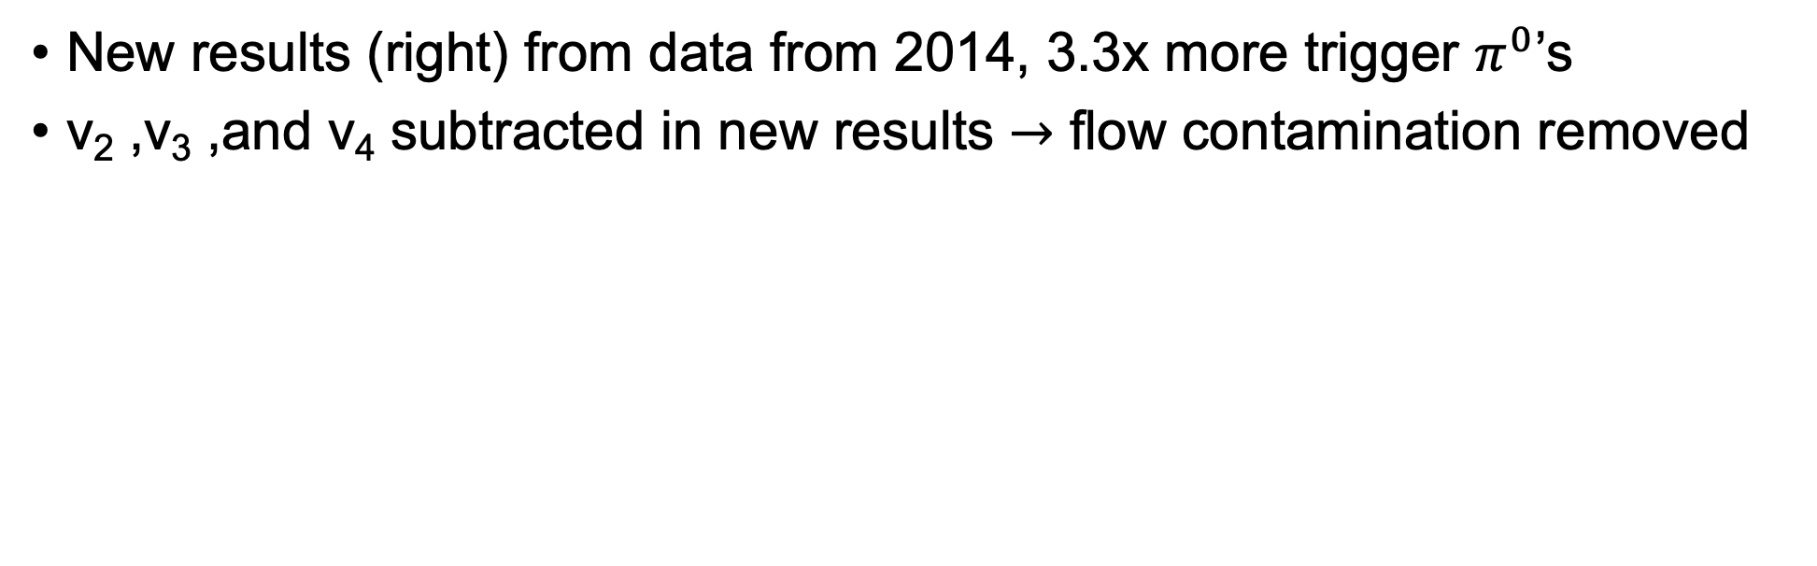
Improved Background Subtraction
Previous
New
PRL 104 252301 (2010)
New results (right) from data from 2014, 3.3x more trigger $π^{0}$’s
v₂ ,v₃ ,and v₄ subtracted in new results $→$ flow contamination removed

Slide 27

Jet Modification: $I_{AA}(p_{T})$
Notes:
And remember, because we’re looking at particle correlated to a jet proxy, what we’re really teasing out here is modification to the jet fragmentation function

Slide 28

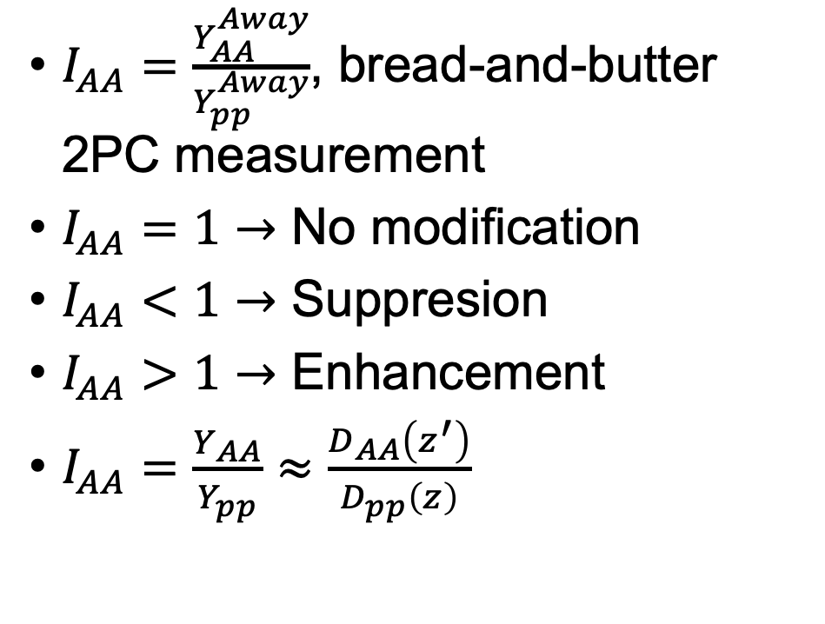
Jet Modification: $I_{AA}(p_{T})$
$I_{AA}=\frac{Y_{AA}^{Away}}{Y_{pp}^{Away}}$, bread-and-butter 2PC measurement
$I_{AA}=1→$ No modification
$I_{AA}<1→$ Suppresion
$I_{AA}>1→$ Enhancement
$I_{AA}=\frac{Y_{AA}}{Y_{pp}}≈\frac{D_{AA}\left(z^{′}\right)}{D_{pp}\left(z\right)}$
$Y_{AA}^{Away}$
Notes:
And remember, because we’re looking at particle correlated to a jet proxy, what we’re really teasing out here is modification to the jet fragmentation function

Slide 29
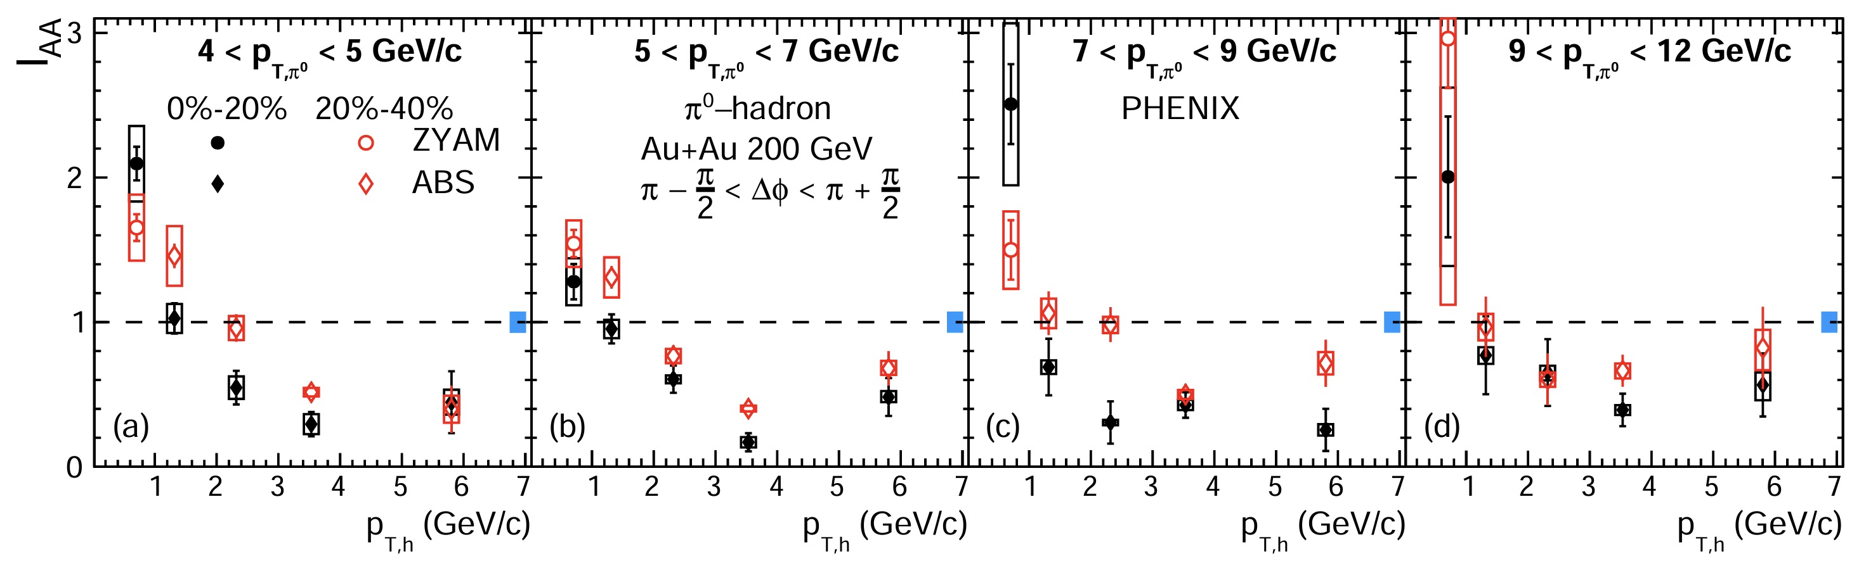
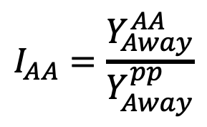
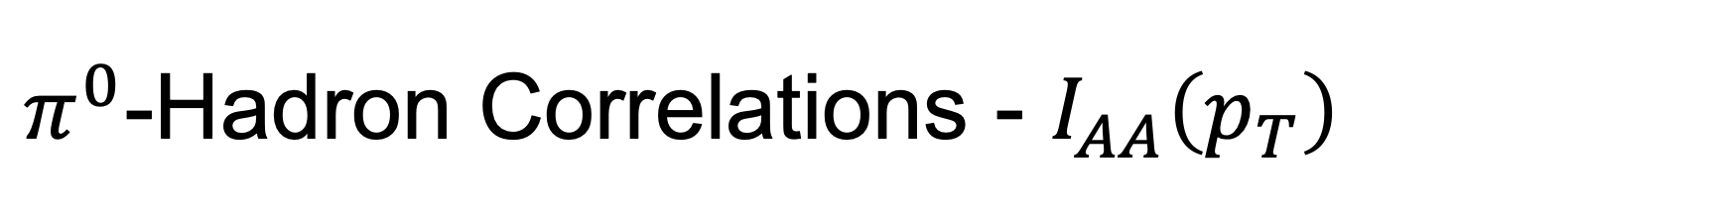
$π^{0}$-Hadron Correlations - $I_{AA}\left(p_{T}\right)$
Phys. Rev. C 110, 044901 (2024)
$$I_{AA}=\frac{Y_{Away}^{AA}}{Y_{Away}^{pp}}$$
Newly Published!
Enhancement of yield (I_{AA} > 1) at low associate particle momentum
Depletion (I_{AA} < 1) at high associate particle momentum
0-20%
20-40%

Slide 30
$π^{0}$-Hadron Correlations - $I_{AA}\left(p_{T}\right)$
Phys. Rev. C 110, 044901 (2024)
$$I_{AA}=\frac{Y_{Away}^{AA}}{Y_{Away}^{pp}}$$
Newly Published!
Suppression phenomenon is consistently more severe in most central collisions (black points)
0-20%
20-40%

Slide 31

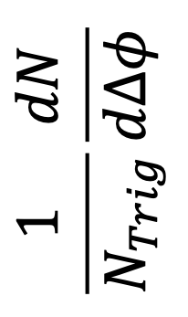
Jet Structure Modification: $Δ_{AA}$ vs. $Δφ$
Phys. Rev. C 110, 044901 (2024)
Can we look at modification “inside” the jet?
Can take difference between differential yields rather than integrated
How is the actual distribution of particles changed within a jet?
$$\frac{1}{N_{Trig}}\frac{dN}{dΔφ}$$
Notes:
And we can look at changes in the differential yields as well

Slide 32
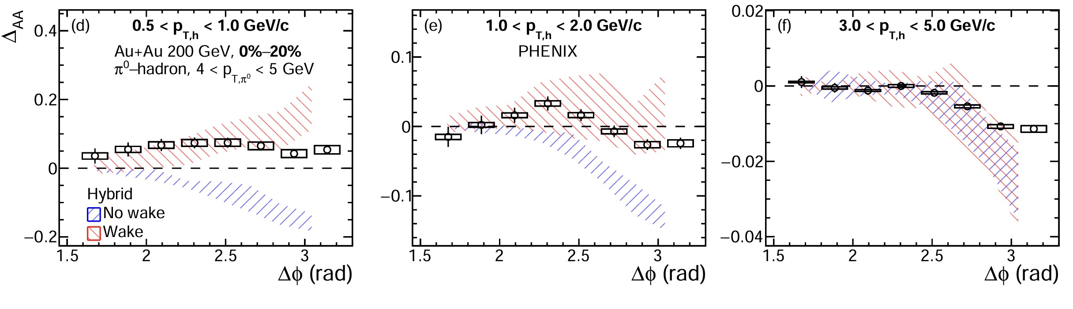
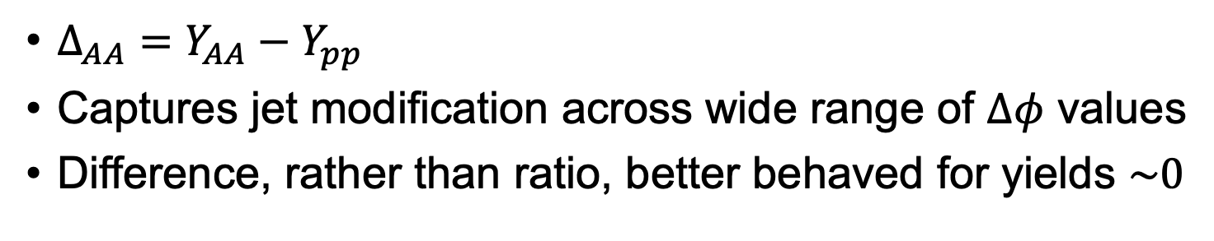
Jet Structure Modification: $Δ_{AA}$ vs. $Δφ$
$Δ_{AA}=Y_{AA}−Y_{pp}$
Captures jet modification across wide range of $Δφ$ values
Difference, rather than ratio, better behaved for yields $\sim 0$
Phys. Rev. C 110, 044901 (2024)
Notes:
Similarly, we can look at high momentum associate hadrons, and we see a suppression in their yield, and we see that this suppression is most intense about the jet core, very close to pi. And so this is all very cool and such, but in a broader sense, what do we want from this measurement?

Slide 33

Jet Structure Modification: $Δ_{AA}$ vs. $Δφ$
For high $p_{T}$ constituents, can see suppression ($Δ_{AA}<0$)
Suppression is most severe at jet core ($Δφ\sim π$)
Phys. Rev. C 110, 044901 (2024)
Notes:
Similarly, we can look at high momentum associate hadrons, and we see a suppression in their yield, and we see that this suppression is most intense about the jet core, very close to pi. And so this is all very cool and such, but in a broader sense, what do we want from this measurement?

Slide 34
Jet Structure Modification: $Δ_{AA}$ vs. $Δφ$
Enhancement of soft particles seen at wide angles
For softest jets, this enhancement even appears at the core
Phys. Rev. C 110, 044901 (2024)
Notes:
But there’s a relatively simple fix to that, and that’s to measure the D_AA, which is merely the difference between the two jet functions. The primary difference is that now our reference point is zero rather than 1. A positive DAA is an enhancement, and a negative DAA is a suppression. So here we’re looking again at low momentum associate hadrons, and like with the iaa, we see a marked enhancement in the away-side yield, but we can actually track how far this enhancement occurs, and it appears to go out as far as pi/2, the valley between the two jet peaks.

Slide 35
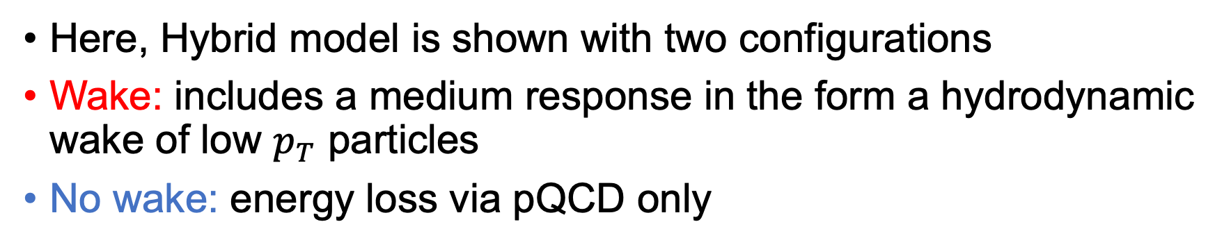
Model Comparisons
Here, Hybrid model is shown with two configurations
Wake: includes a medium response in the form a hydrodynamic wake of low $p_{T}$ particles
No wake: energy loss via pQCD only
Phys. Rev. C 110, 044901 (2024)

Slide 36
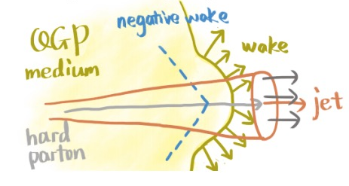
The Importance of Medium Response
Jet modification is an interplay between energy loss and the medium’s response to that energy
Phys. Rev. C 110, 044901 (2024)
Image credit:
Jing Wang (artist)
Hannah Bossi (presenter)

Slide 37
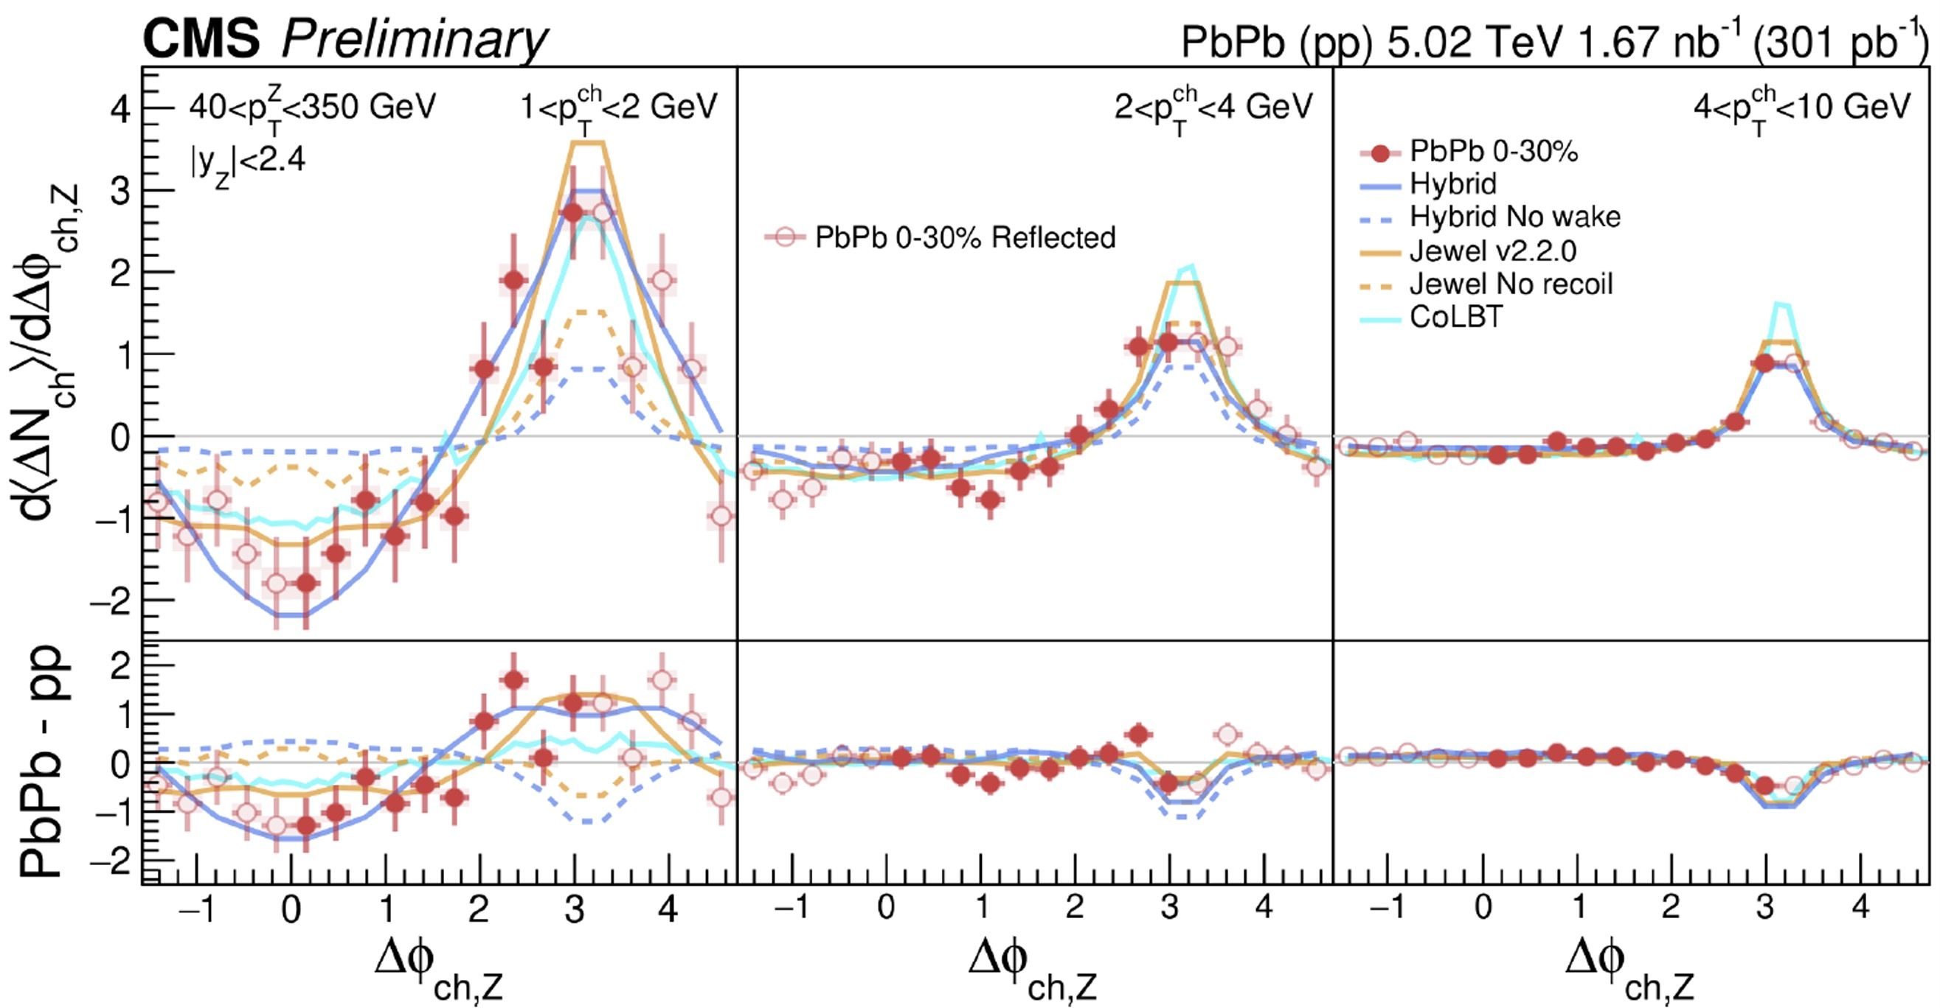




Turning 180$°$: The Diffusion Wake
CMS-PAS-HIN-23-006
In addition to enhancement wake, recent studies have also sought a corresponding depletion wake near $Δφ\sim 0$
arXiv:2408.08599
Yeonju Go, Hard Probes 2024
Apple
Medium
Yen-Jie Lee, Hard Probes 2024

Slide 38



Future PHENIX Results
Phys. Rev. C 102, 054910 (2020)
$Δ_{AA}$ extracted from previously published results
Familiar depletion signal for low $ξ$ (high $p_{T}$) bins
High $ξ$ (low $p_{T}$) bins will benefit from larger Run 14 dataset in ongoing analysis
High $ξ→$ low $p_{T}$
Low $ξ→$ high $p_{T}$
$$ξ=log(1/z_{t})$$

Slide 39

Summary and Conclusion
New two-particle correlation results from PHENIX probe modification to the structure of recoil jets
The yield of high $p_{T}$ hadrons associated with jets is found to be suppressed, especially at the jet core
The yield of low $p_{T}$ hadrons is enhanced, with this enhancement appearing as far as $\frac{π}{2}$ [rad] away from the jet peak
Enhancement phenomenon is captured well by HYBRID model, where it is owed to a hydrodynamic wake of low $p_{T}$ particles
Future PHENIX measurements will employ the large-statistics Run 14 dataset to probe jet modification via prompt photon-hadron correlations

Slide 40
Thank You! Questions?

Slide 41
Back-Up

Slide 42


Future Jet-Medium Studies at RHIC
sPHENIX completed reference $p+p$ run in 2024 exceeding luminosity projections by 200%
$Au+Au$ run in a matter of months!
Exciting era of jet-medium interactions awaits!

Slide 43





Flow Subtraction – Acoustic Scaling
$$g_{3}=$$
$$g_{4}=$$
$$g_{n}=\frac{v_{n}}{{\left(v_{2}\right)}^{n/2}}$$
arXiv:1105.3782v2
Have charged hadron $v_{n}^{a}$ for $(n=2,3,4)$ from PHENIX results
No $π^{0}$ $v_{3}$ or $v_{4}$ measured at RHIC energies
$v_{n}$ harmonics can be scaled to one another via value $g_{n}$
Notes:
So we have

Slide 44


Flow Subtraction – Acoustic Scaling
arXiv:1105.3782v2
$$g_{3}=$$
$$g_{4}=$$
arXiv:1105.3782v2
$$v_{n}^{π^{0}}={g_{n}^{h}\left(v_{2}^{π^{0}}\right)}^{n/2}$$
Can calculate $π^{0} v_{3}, v_{4}$ by scaling $π^{0} v_{2}$ with charged hadron $g_{n}$

Slide 45
Jets in Heavy Ion Collisions
Inside the medium…
Heavy Ion Collision
Notes:
And how does this modification occur at the partonic level? Well there are two primary mechanisms. One is interaction with the large internal color field that causes our partons to lose energy via soft gluon production like QED brehmstrahlung. And the other is via smaller scatterings withing the medium. That is to say our partons are simply bumping around and hitting other medium constituents.

